Slide 1
FV3GFS SST Concerns
6 September MEG Briefing
Logan Dawson
EMC Model Evaluation Group

Slide 2
Topic
Cold FV3GFS SSTs in some shallow waters
Alaska Region was aware of extremely cold FV3GFS water temps in Cook Inlet and expressed concerns about whether the cold waters were causing a cold 2-m T bias at Anchorage

Slide 3
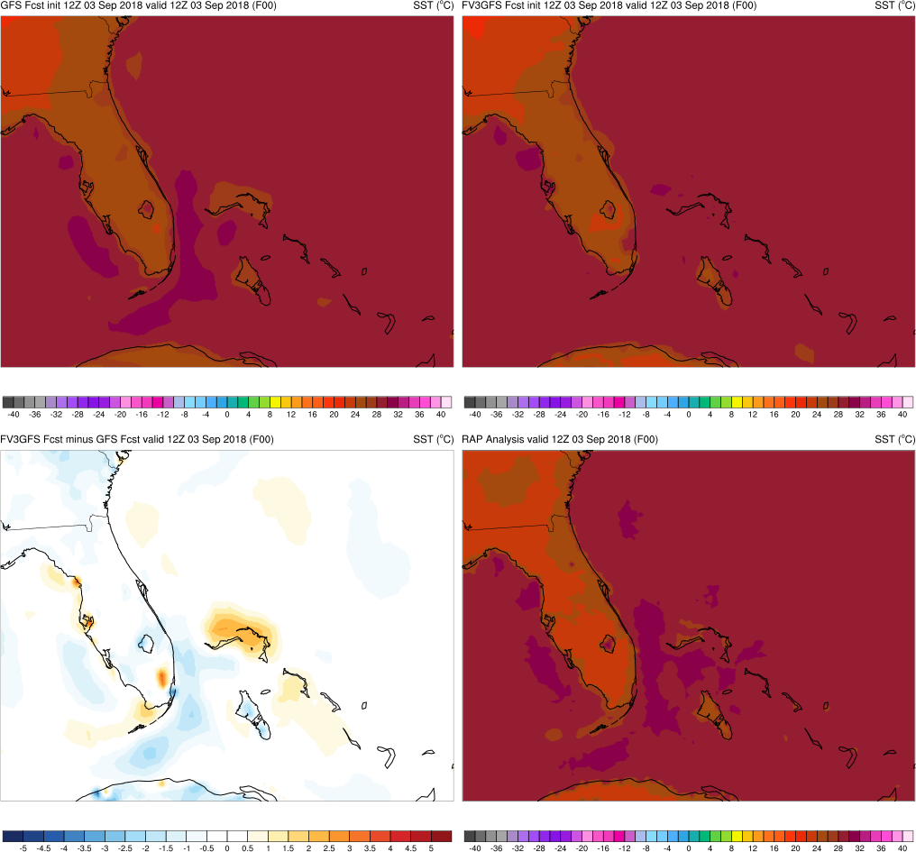
SST Analysis Comparison Format
GFS
FV3GFS
FV3GFS−GFS
GFS or RAP Analysis

Slide 4
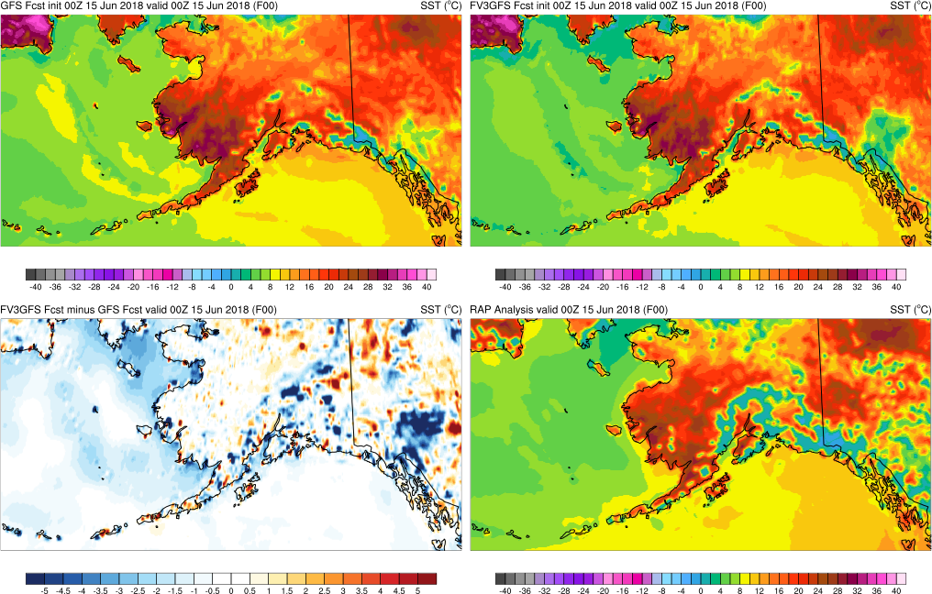
FV3GFS SSTs Much Colder in Cook Inlet and in Bering Sea
Analyses at 00Z 15 June 2018

Slide 5
FV3GFS SSTs Much Colder in Cook Inlet and in Bering Sea
Analyses at 00Z 15 July 2018

Slide 6
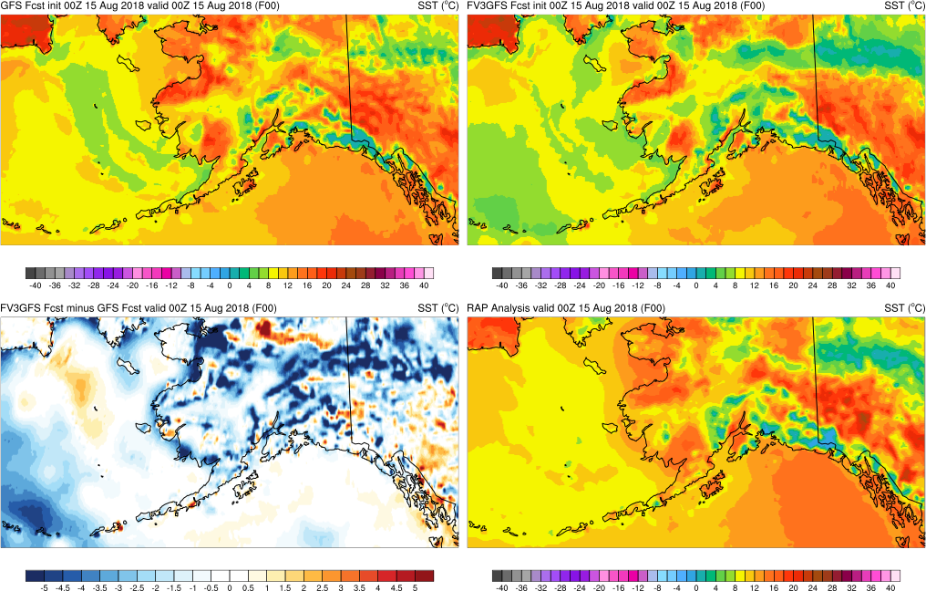
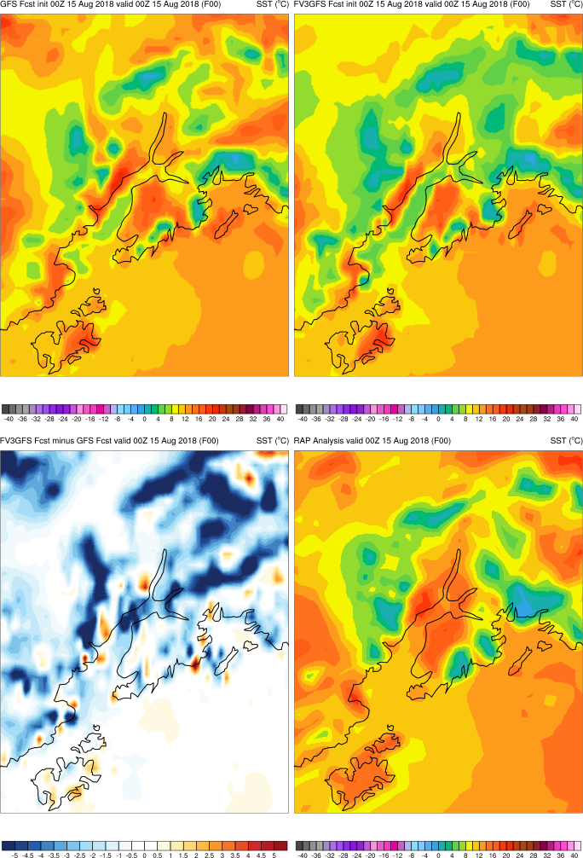
FV3GFS SSTs Much Colder in Cook Inlet and in Bering Sea
Analyses at 00Z 15 August 2018

Slide 7
Apparent in other areas…

Slide 8
FV3GFS SSTs Cooler in Florida Straits
Analyses at 12Z 3 September 2018

Slide 9
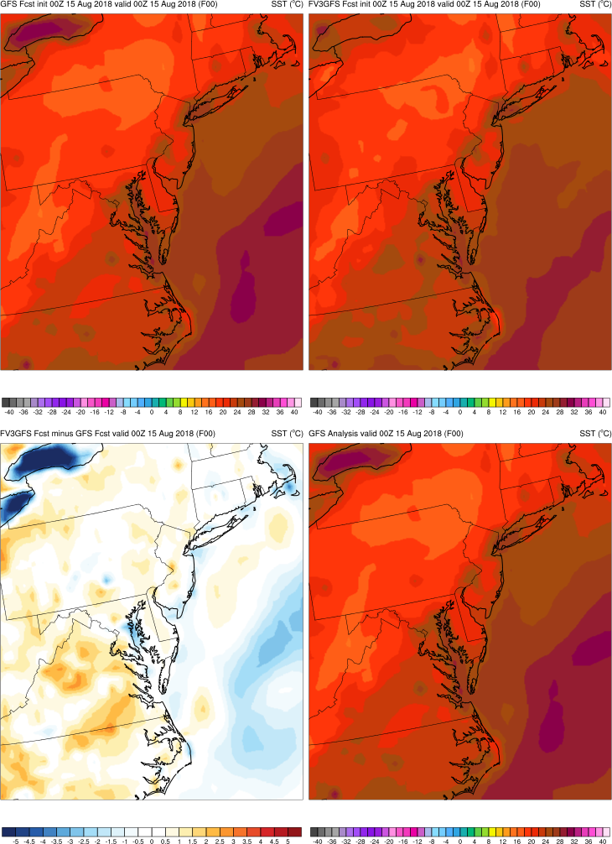
FV3GFS SSTs Cooler around Cape Cod & in Chesapeake/Delaware Bays
Analyses at 00Z 15 August 2018

Slide 10
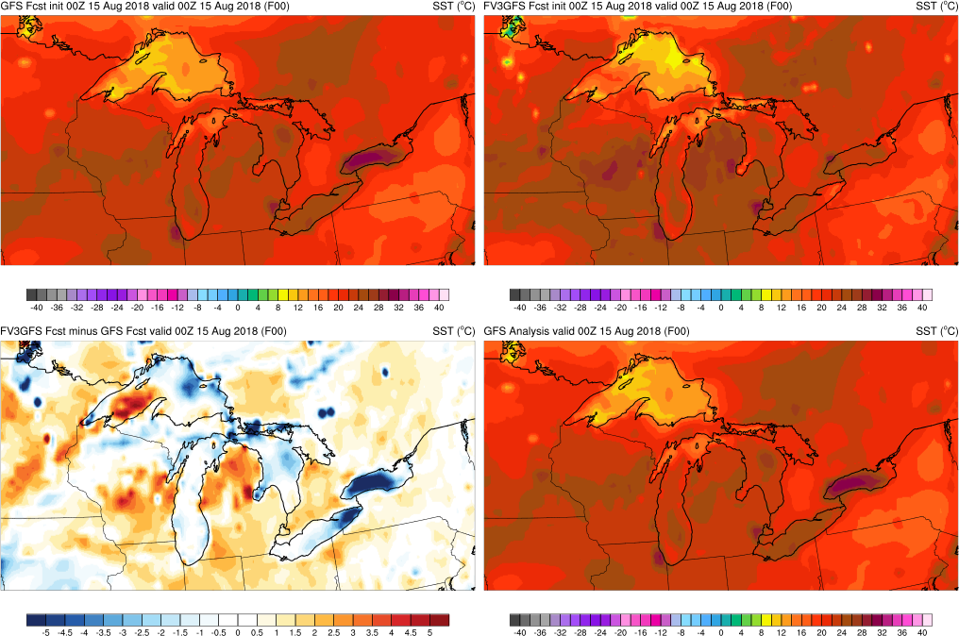
FV3GFS SSTs Much Colder in Portions of Erie & Ontario.
Colder/Warmer in Portions of Superior
Analyses at 00Z 15 August 2018

Slide 11
One issue is changes to the land/sea mask

Slide 12
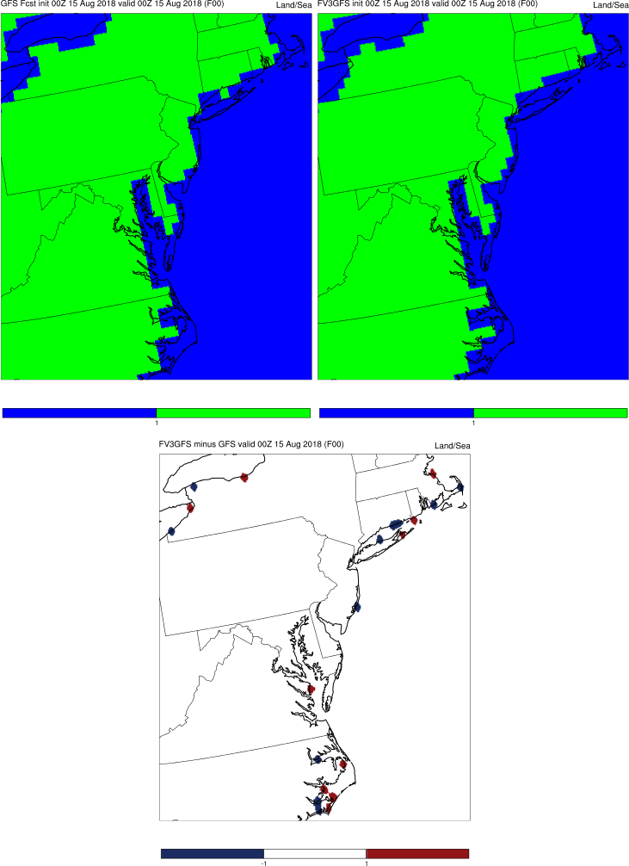
Changes to Land/Sea Mask
KEY:
Blue = GFS land point changed to FV3GFS water point
Red = GFS water point changed to FV3GFS land point
Changing water and land points causes the heat capacity of the surfaces to change as well
Causes localized, large differences along some coastline areas
FV3GFS is more updated, higher resolution terrain data

Slide 13
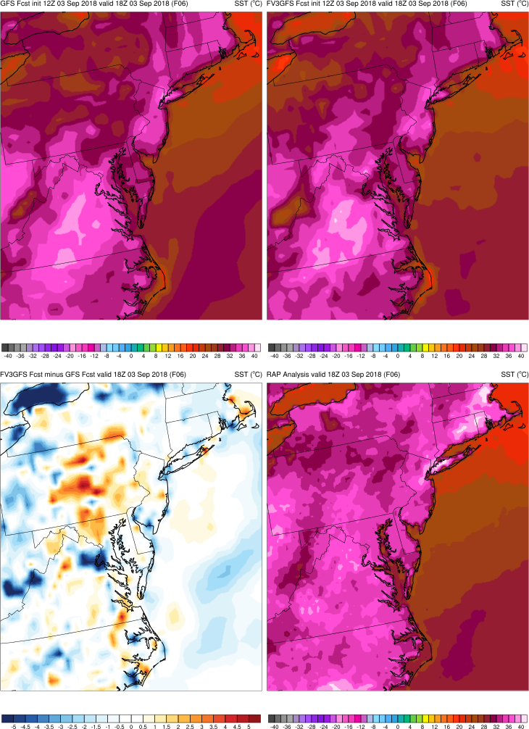
Changes to Land/Sea Mask
KEY:
Blue = GFS temp > FV3GFS temp
Red = GFS temp < FV3GFS temp
Changing water and land points causes the heat capacity of the surfaces to change as well
Causes localized, large differences along some coastline areas

Slide 14
Changes to Land/Sea Mask

Slide 15
Are the large FV3GFS – GFS differences a sign of improved SSTs in the parallel?

Slide 16
Notes…
Buoy observations were limited. Even fewer buoys reported water temperatures.
Makes validating model analyses/forecasts challenging
Likely makes analyzing SSTs even more challenging
GFS and FV3GFS analysis/forecast SST values pulled from nearest gridpoint (0.25 degree grid). BUFR data would provide more exact values

Slide 17
Cook Inlet

Slide 18
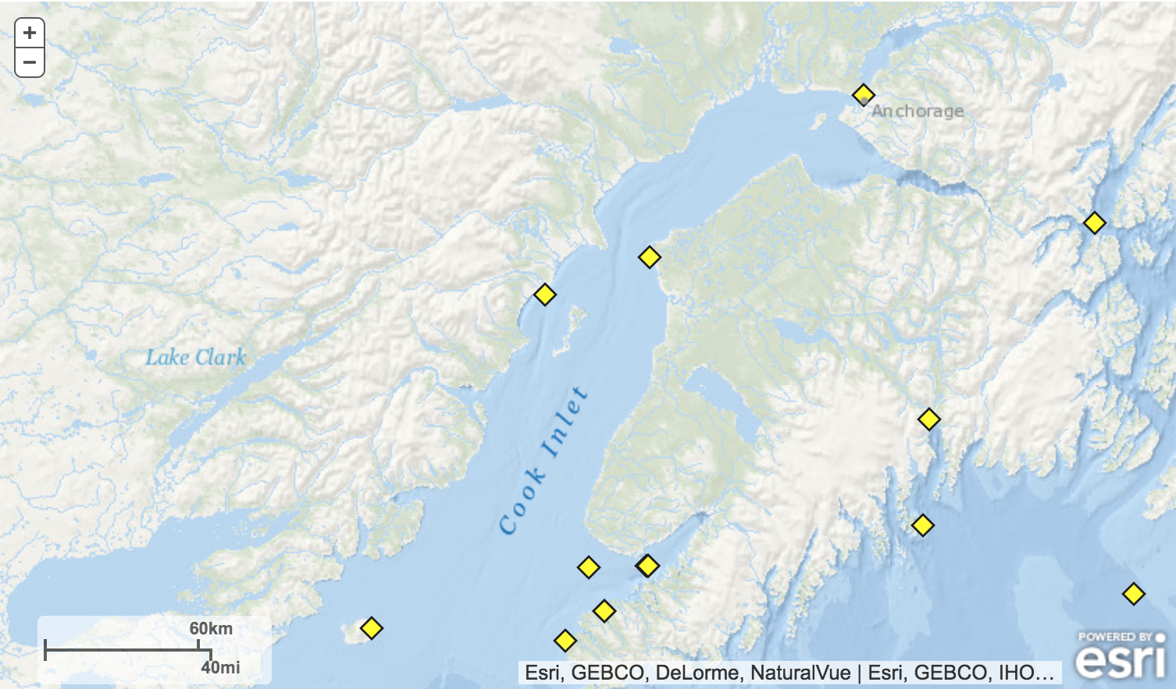
Cook Inlet Buoys
ANTA2
NKTA2
46108
FV3GFS is clearly colder than the GFS (and RAP analysis) near ANTA2 and NKTA2

Slide 19
Cook Inlet Buoys
ANTA2 – Cook Inlet near Anchorage
 | GFS | FV3GFS | Obs
00Z 8/15 | 12.8 | 6.5 | 13.3
00Z 9/4 | 15.4 | 11.7 | 12.7
NKTA2 – Cook Inlet near Kenai
 | GFS | FV3GFS | Obs
00Z 8/15 | 7.3 | 4.5 | 14.3
00Z 9/4 | 9.3 | 5.2 | 13.5
46108 – Lower Cook Inlet
 | GFS | FV3GFS | Obs
00Z 8/15 | 10.2 | 10.1 | 10.2
00Z 9/4 | 12.6 | 11.7 | 11.3
For these three buoys, where FV3GFS-GFS differences were large, FV3GFS was clearly more incorrect
FV3GFS is too cold at ANTA2 and NKTA2

Slide 20
Great Lakes

Slide 21
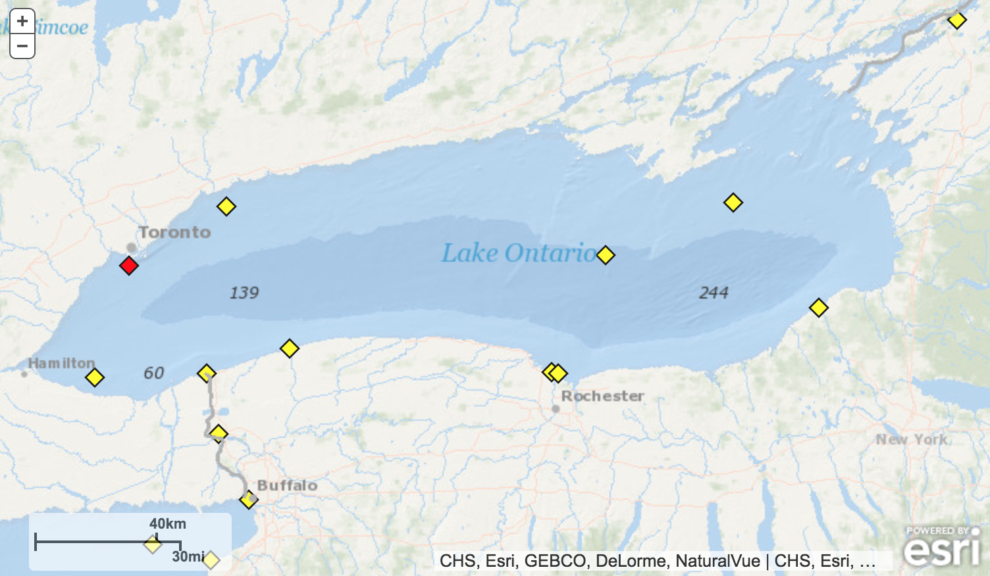
Lake Ontario Buoys
45159
45135
45012
45159 and 45012 are in areas where large FV3GFS-GFS differences show up

Slide 22
Lake Ontario Buoys
45159 – northwest near Toronto
 | GFS | FV3GFS | Obs
00Z 8/15 | 29.9 | 24.2 | 23.6
00Z 9/4 | 29.2 | 22.6 | 22.8
45012 – central & deeper waters
 | GFS | FV3GFS | Obs
00Z 8/15 | 29.6 | 23.6 | 24.5
00Z 9/4 | 28.8 | 22.5 | 23.9
45135 – eastern end & shallower waters
 | GFS | FV3GFS | Obs
00Z 8/15 | 23.3 | 23.1 | 24.3
00Z 9/4 | 23.0 | 22.6 | 23.1
GFS was too warm at 45159 and 45012 (where large differences were on the previous slide)
FV3GFS had reasonable temps at all three buoys

Slide 23
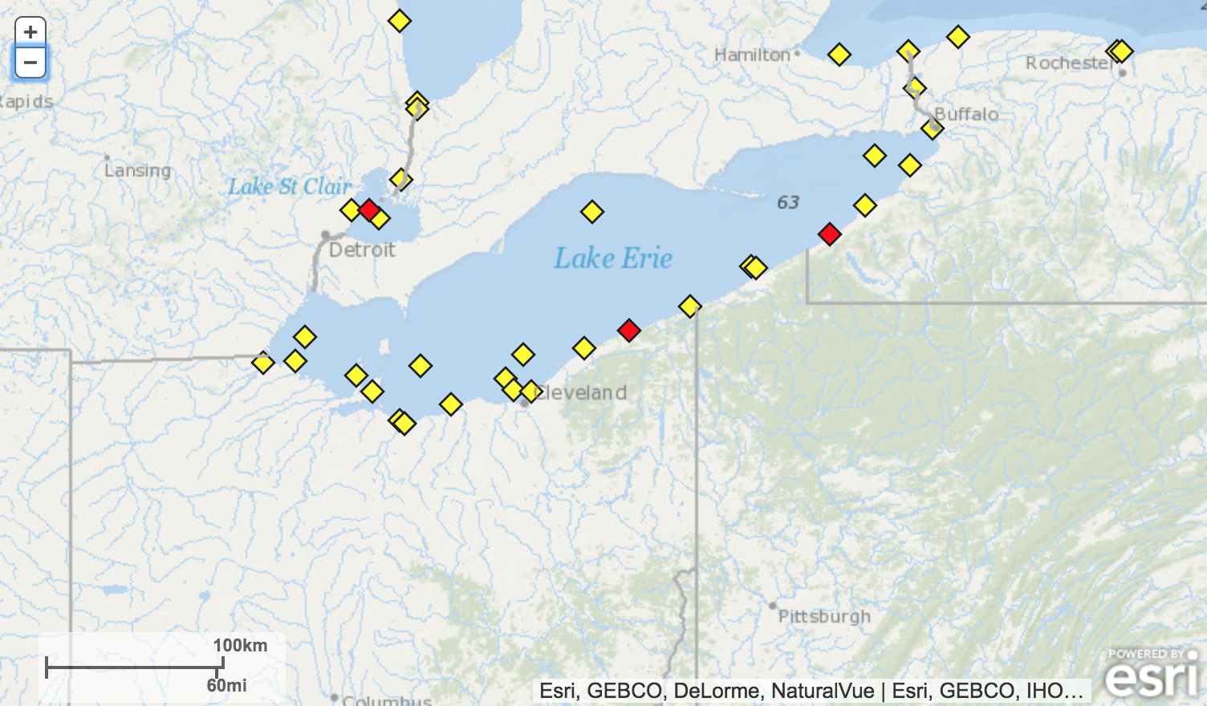
Lake Erie Buoys
45132
45142
45005
45167
45142 and 45167 are in areas where larger FV3GFS-GFS differences show up
Differences are smaller at 45132 and 45005

Slide 24
Lake Erie Buoys
45142 – eastern end & shallower waters
 | GFS | FV3GFS | Obs
00Z 8/15 | 24.1 | 17.3 | 23.9
00Z 9/4 | 23.6 | 17.5 | 23.8
45167 – near Erie, Pa
 | GFS | FV3GFS | Obs
00Z 8/15 | 24.2 | 21.4 | 25.0
00Z 9/4 | 23.7 | 23.6 | 24.6
45132 – north/central
 | GFS | FV3GFS | Obs
00Z 8/15 | 24.9 | 24.8 | 25
00Z 9/4 | 24.1 | 23.7 | 23.5
45005 – southwest
 | GFS | FV3GFS | Obs
00Z 8/15 | 25.8 | 25.5 | 26
00Z 9/4 | 25.0 | 25.9 | 25.2
FV3GFS is too cold near large differences at 45142 and 45167
Where differences are small, FV3GFS (and GFS) match obs well

Slide 25
Lake of the Woods

Slide 26
Lake of the Woods – Buoy 45148
FV3GFS appears to better match the RAP analysis at Lake of the Woods, but extremely cold water temperatures in small lakes is a known issue with the RAP

Slide 27
Lake of the Woods – Buoy 45148
Buoy 45158
 | GFS | FV3GFS | Obs*
00Z 8/15 | 9.2 | 1.3 | 22
00Z 9/4 | 11.4 | 3.1 | 19.7
*inexact grid point
GFS is likely much too cold, but near freezing water temperature in mid-August is clearly incorrect

Slide 28
Are the large cold FV3GFS SSTs influencing 2-m temps at coastal METARs?

Slide 29
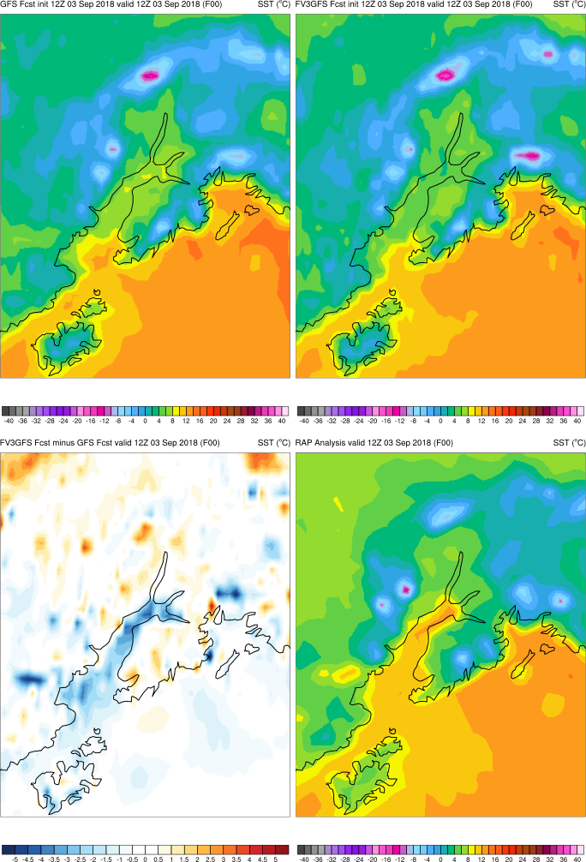
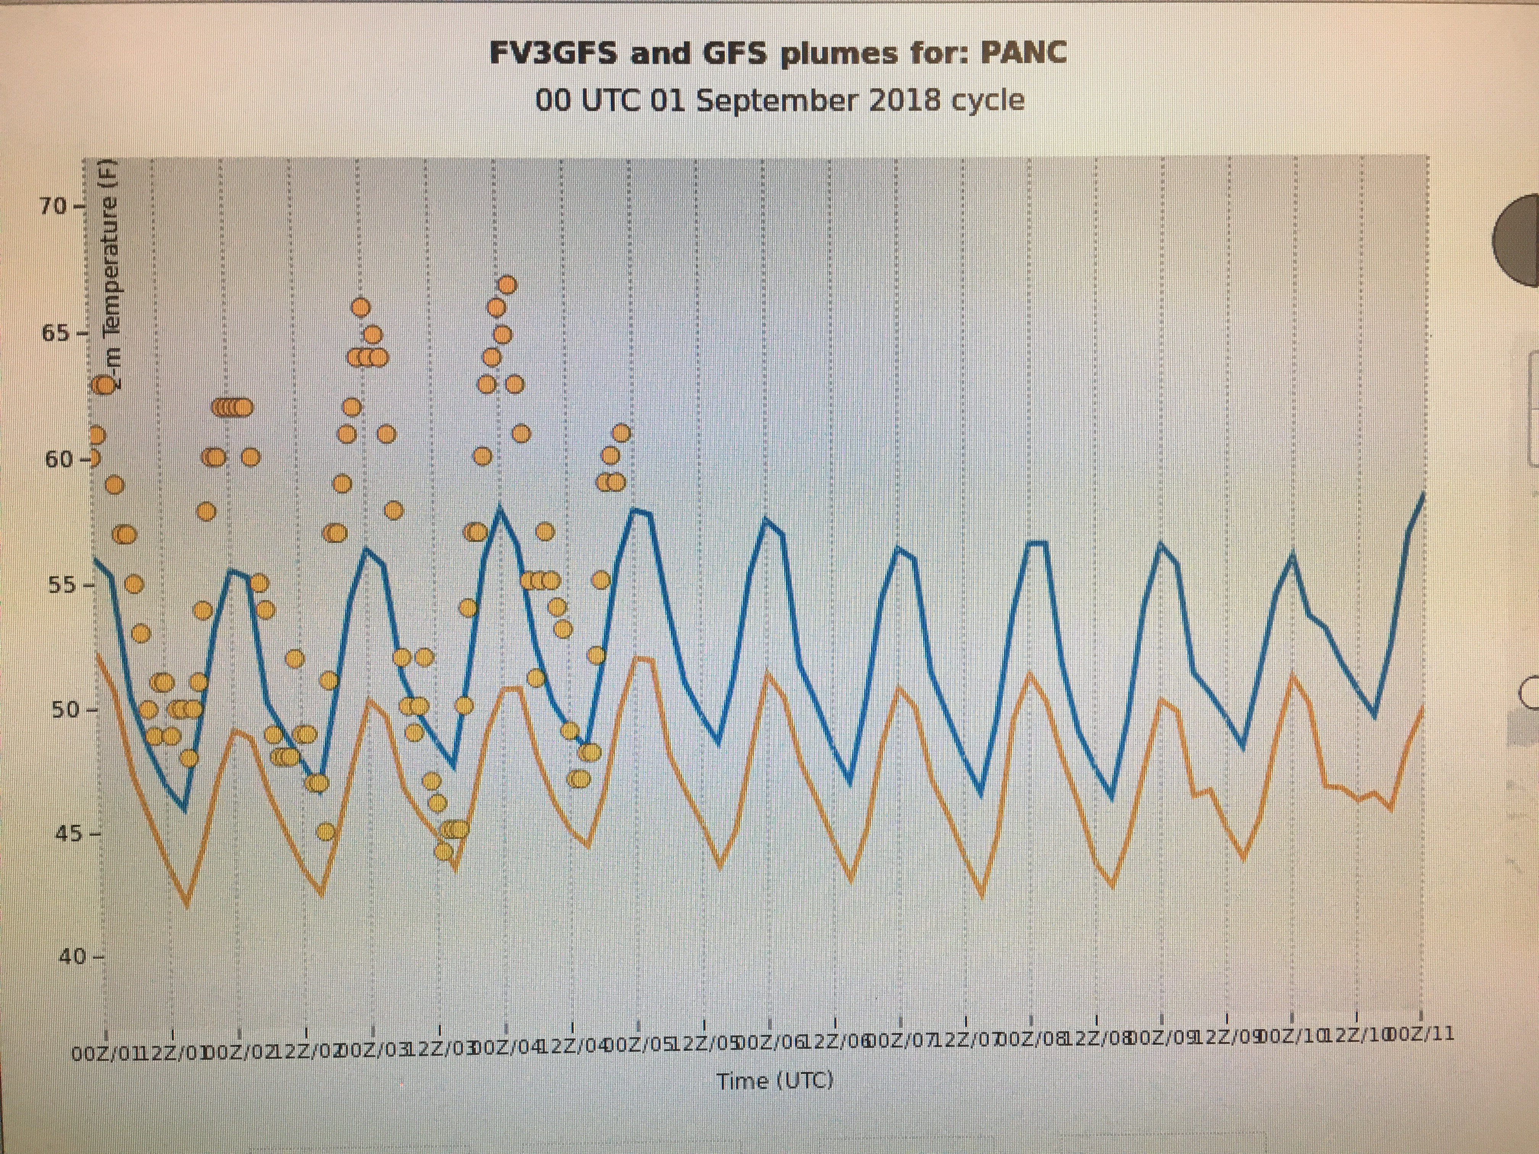
FV3GFS SSTs Have Been Running Too Cold in Upper Cook Inlet
*
*
FVGFS in orange
GFS in blue
At Anchorage, clear low bias (compared to obs and GFS) in FV3GFS 2-m temperatures

Slide 30
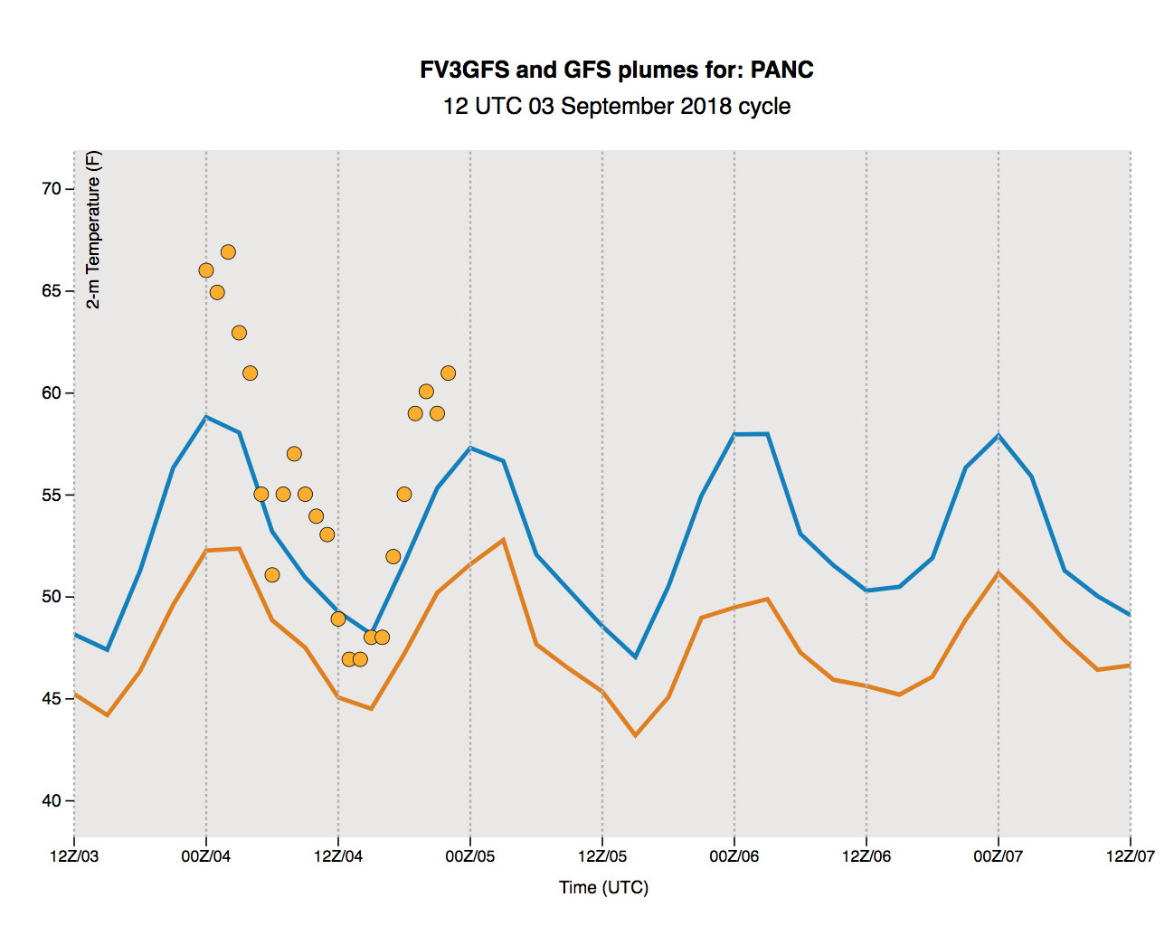
FV3GFS SSTs Have Been Running Too Cold in Upper Cook Inlet
*
*
FVGFS in orange
GFS in blue
At Anchorage, clear low bias (compared to obs and GFS) in FV3GFS 2-m temperatures

Slide 31
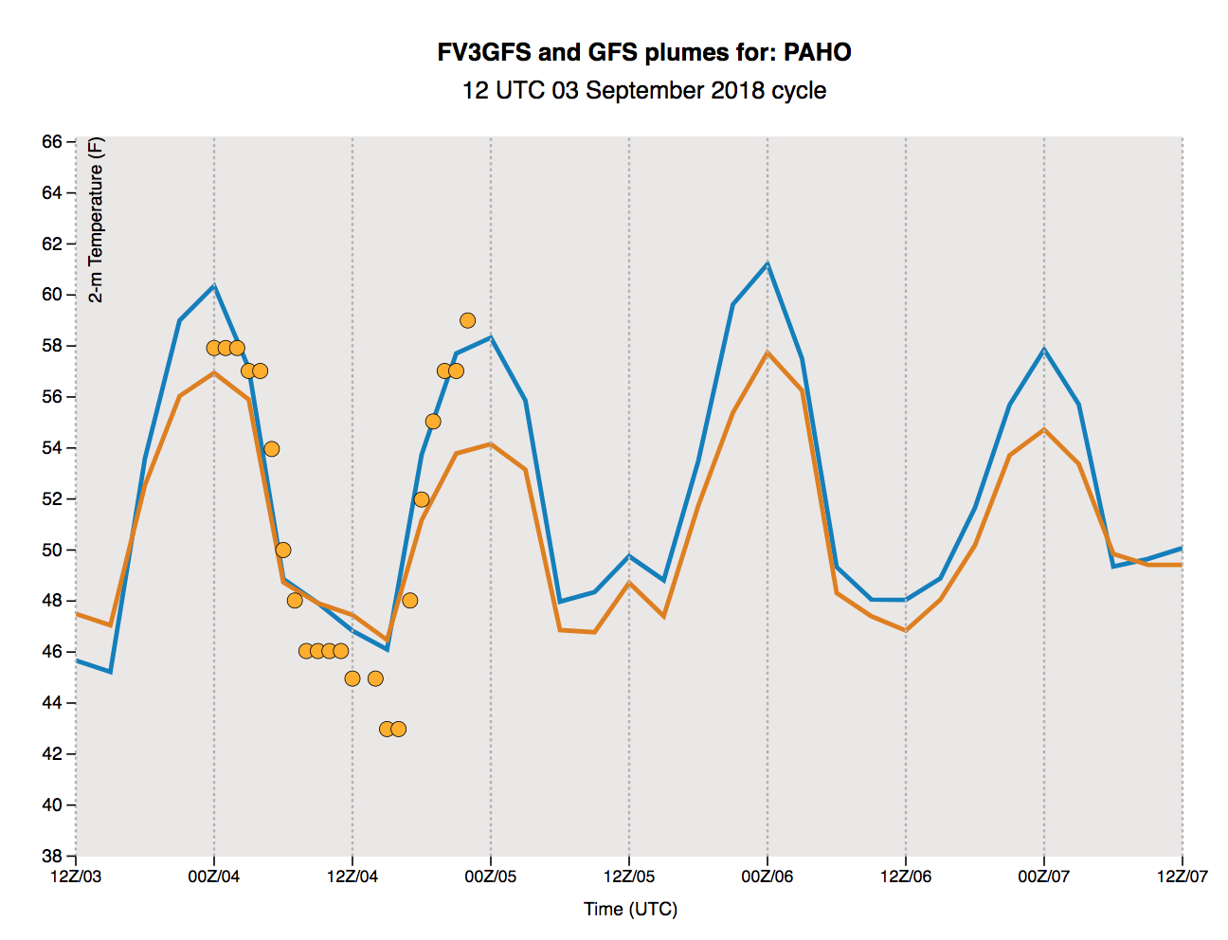
FV3GFS SSTs Don’t Seem as Cold in Lower Cook Inlet
*
*
FVGFS in orange
GFS in blue
At PAHO, FV3GFS 2-m temperatures compare more favorably to GFS and obs

Slide 32
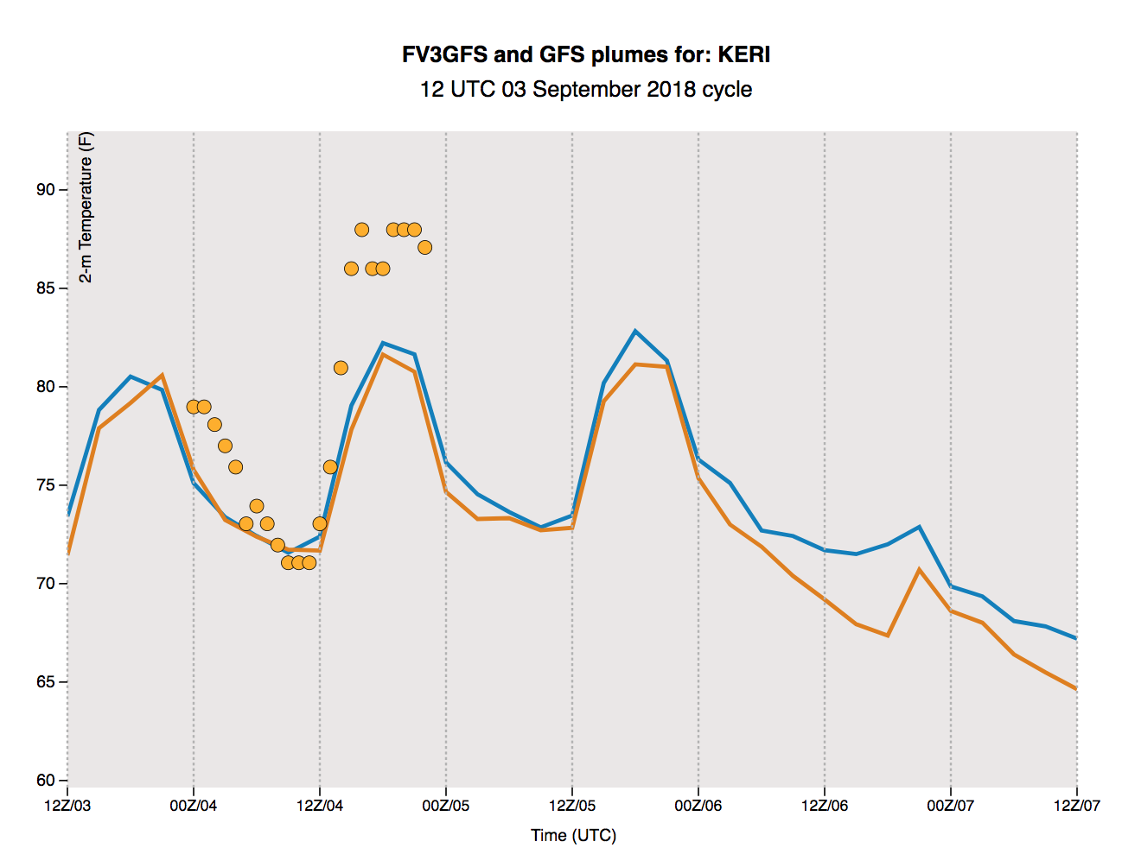
FV3GFS 2-m T Running Colder than GFS and Obs Isn’t Clear at Erie, PA
At KERI, FV3GFS 2-m temperatures compare more favorably to GFS and obs
SST differences in Lake Erie are reduced here (12Z 9/3) compared to 00Z 8/15
FVGFS in orange
GFS in blue

Slide 33
Summary
Alaska Region expressed concerns about cold FV3GFS SSTs potentially causing a cold 2-m T bias at Anchorage
FV3GFS SSTs appear to be running too cold in the Bering Sea, Cook Inlet, and portions of Lake Erie
FV3GFS SSTs are colder than GFS SSTs in Lake Ontario, but the GFS is running to warm there
More investigation is need to determine the 1) cause of these cold SSTs in the FV3GFS and 2) whether these cold SSTs are affecting air temperatures in the FV3GFS

