Slide 1
FV3GFS Alaska Retro Cases
Tracey Dorian
IMSG at NOAA/NCEP/EMC
September 6, 2018

Slide 2
Case #1
Alaskan Cyclone December 2016

Slide 3
00z 12/2/16 cycle F144
GFS
FV3GFS
FV3GFS is again slightly too progressive at longer time ranges

Slide 4
00z 12/3/16 cycle F132
GFS
FV3GFS
FV3GFS very similar to GFS at day 5 with erroneously strong storm approaching
southeast AK

Slide 5
00z 12/3/16 cycle F132
GFS
FV3GFS
Both models show major impacts that didn’t occur

Slide 6
Case #2
Alaskan Cyclone September 2017
Link to the case

Slide 7
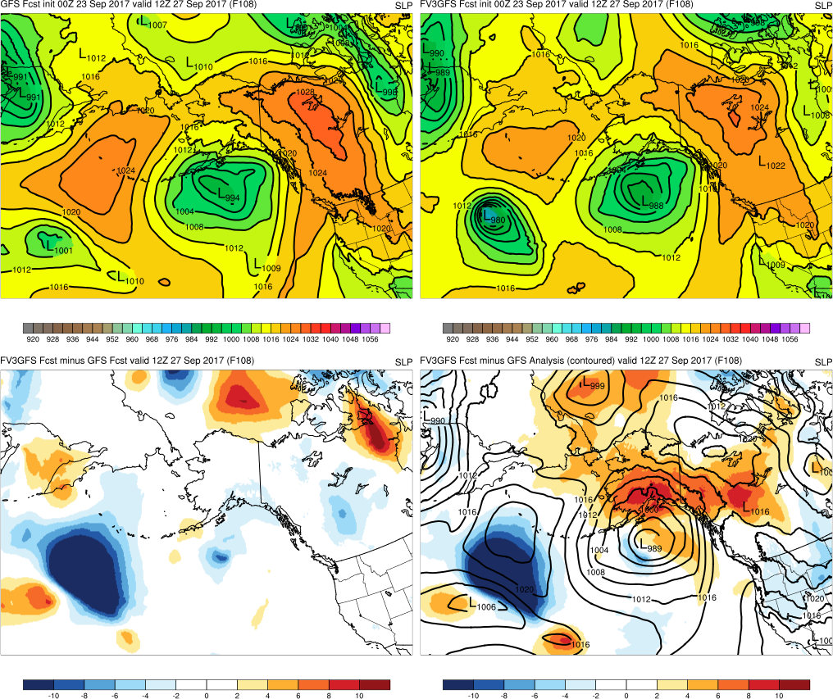
f108
GFS handles the Pacific ridge better
GFS
FV3GFS
FV3GFS-GFS
FV3GFS-GFS Anl

Slide 8
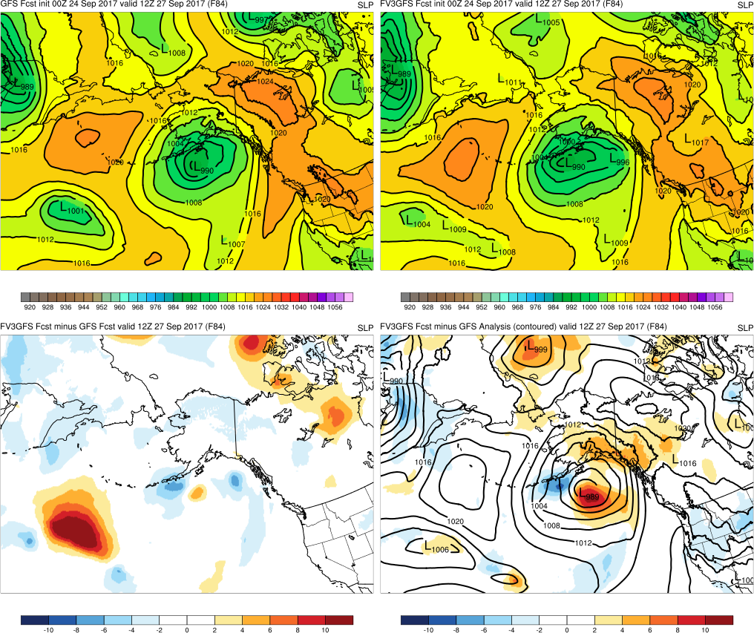
f84
GFS
FV3GFS
FV3GFS-GFS
FV3GFS-GFS Anl

Slide 9
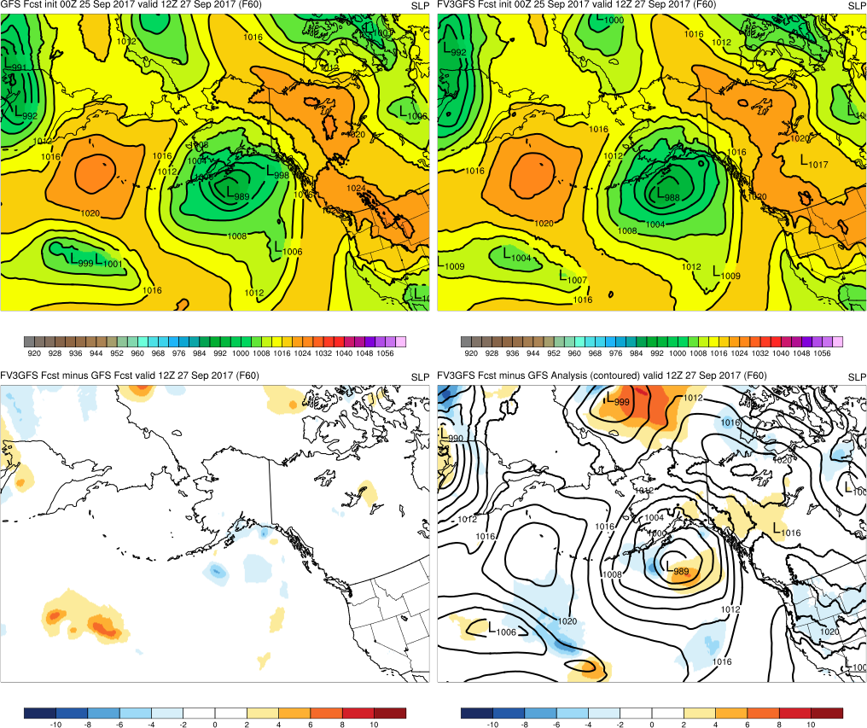
f60
GFS
FV3GFS
FV3GFS-GFS
FV3GFS-GFS Anl

Slide 10
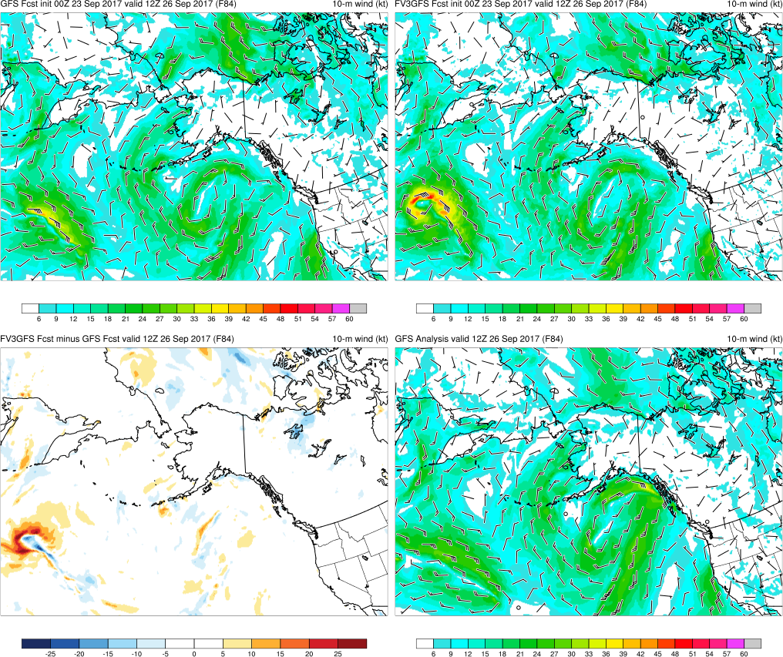
f84
South displacement
GFS
FV3GFS
FV3GFS-GFS
GFS Anl

Slide 11
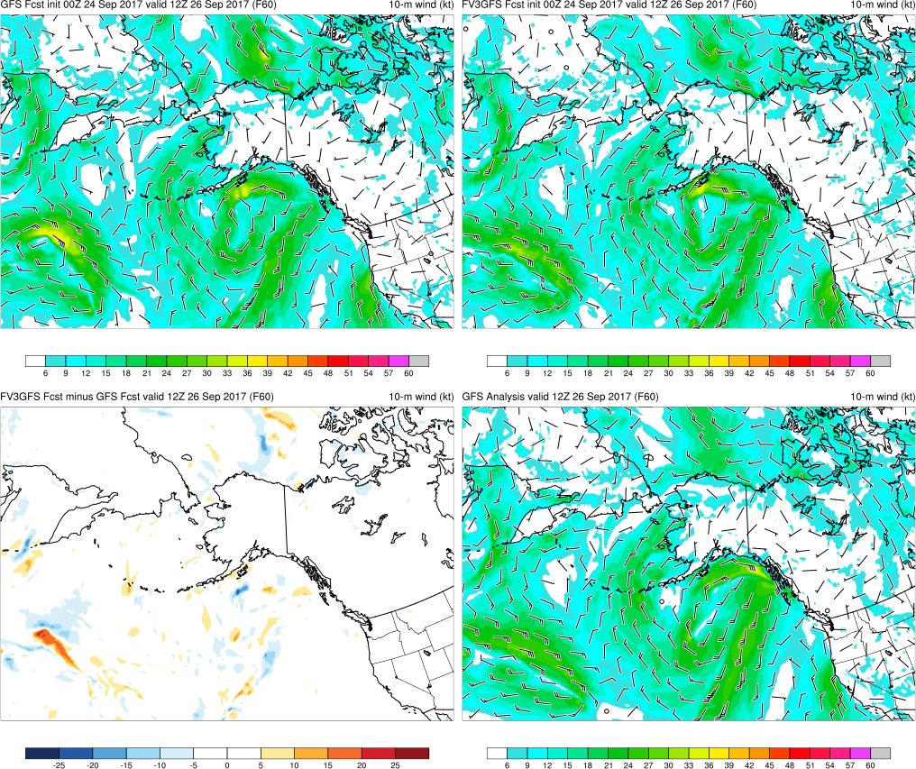
f60
GFS
FV3GFS
FV3GFS-GFS
GFS Anl

Slide 12
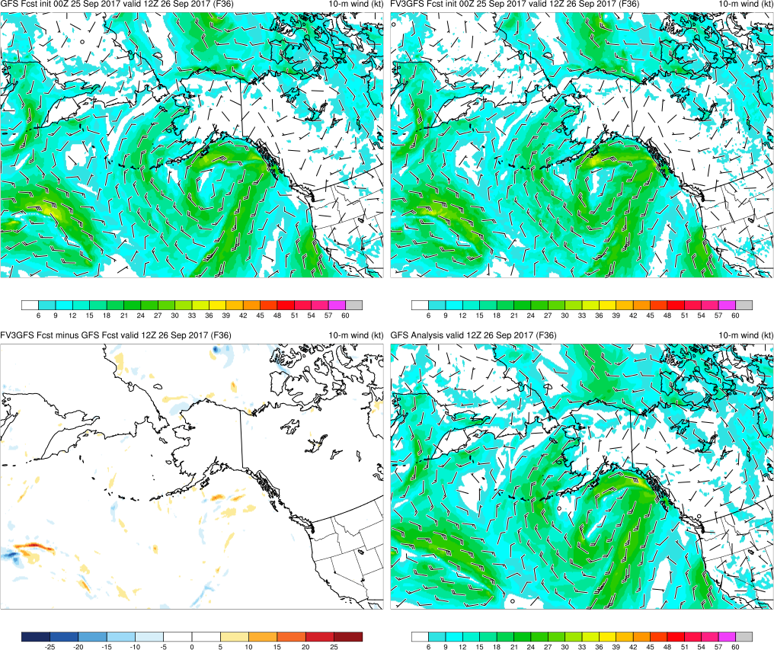
f36
GFS
FV3GFS
FV3GFS-GFS
GFS Anl

Slide 13
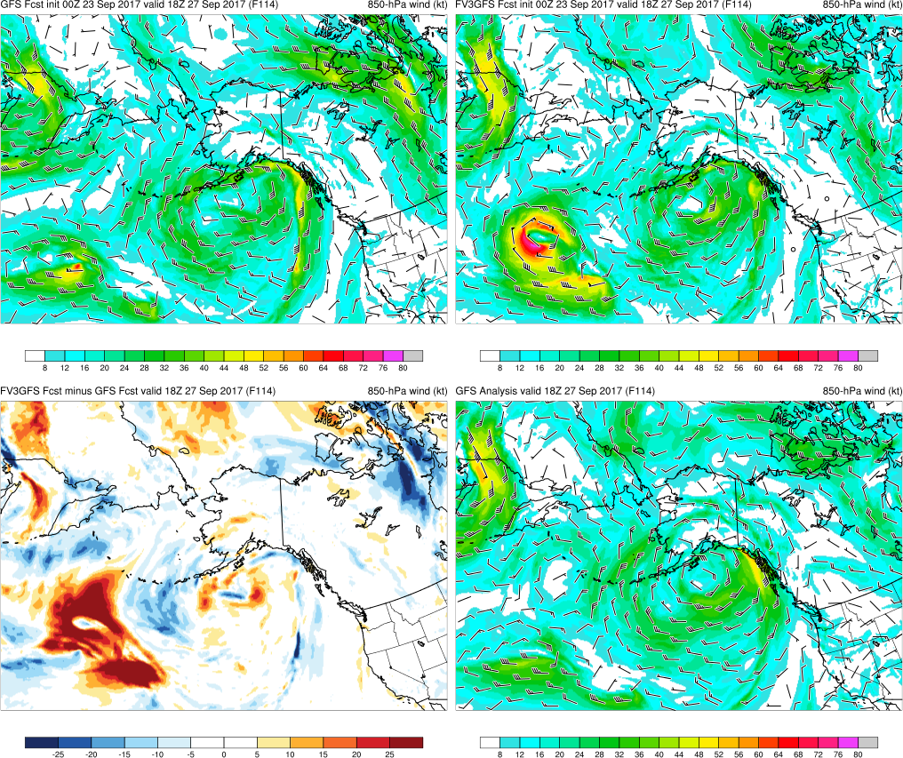
f114
GFS
FV3GFS
FV3GFS-GFS
GFS Anl

Slide 14
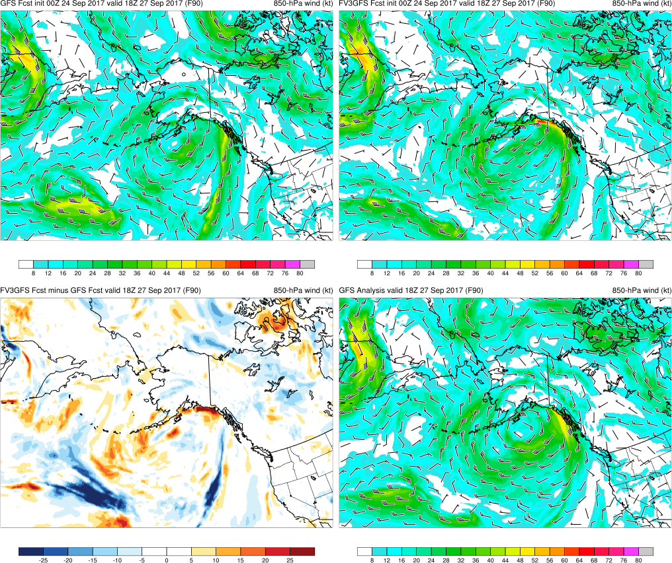
f90
GFS
FV3GFS
FV3GFS-GFS
GFS Anl

Slide 15
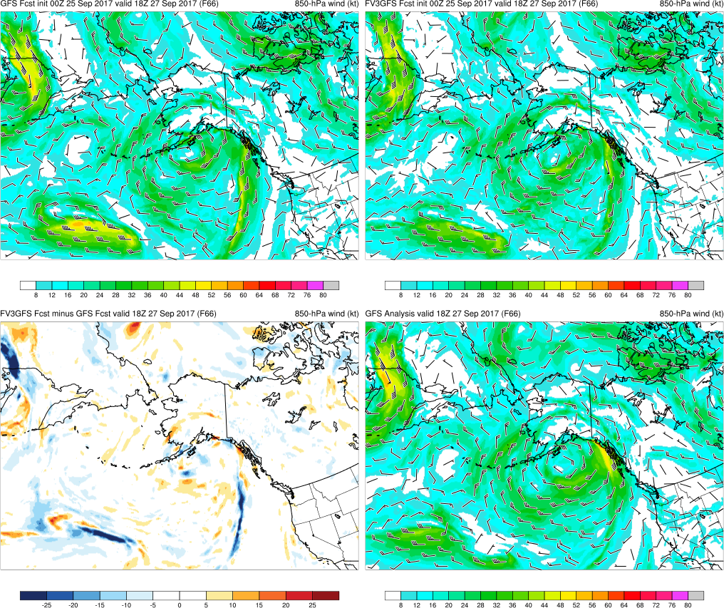
f66
GFS winds too strong
GFS
FV3GFS
FV3GFS-GFS
GFS Anl

Slide 16
LONG-RANGE FORECAST
00z 9/23/17 cycle F144
GFS
FV3GFS
FV3GFS is slightly too progressive but captures the split flow better

Slide 17
Findings
FV3GFS too strong with the trailing cyclone
The leading cyclone SLP forecasts were similar between the GFS and the FV3GFS
Both the FV3GFS and the GFS were initially too far south with the leading cyclone
Some evidence that the FV3GFS was too progressive in the medium-range

Slide 18
Case #3
Alaskan Cyclone April 2018
Link to the case

Slide 19
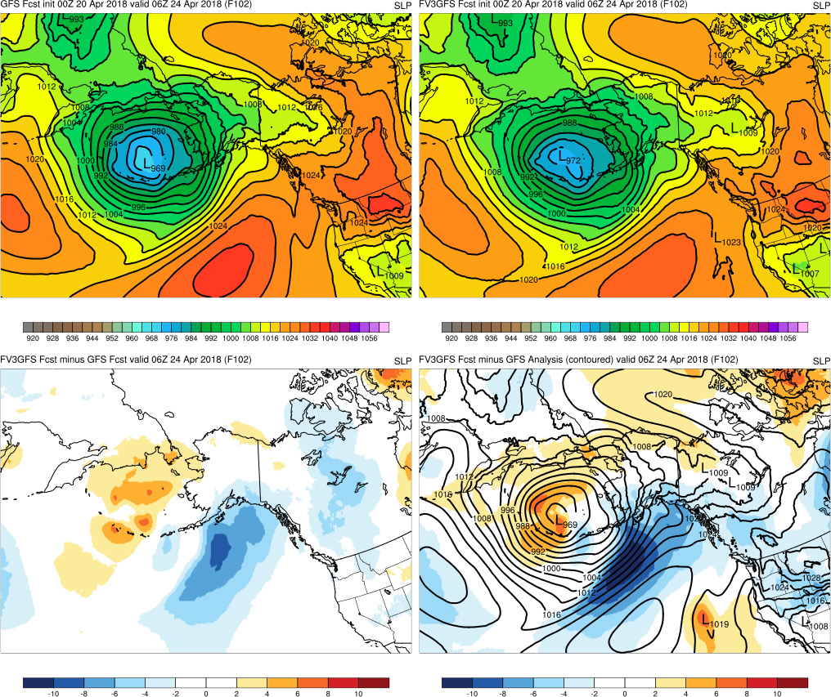
f102
GFS has stronger ridge, displaced north
GFS
FV3GFS
FV3GFS-GFS
FV3GFS-GFS Anl

Slide 20
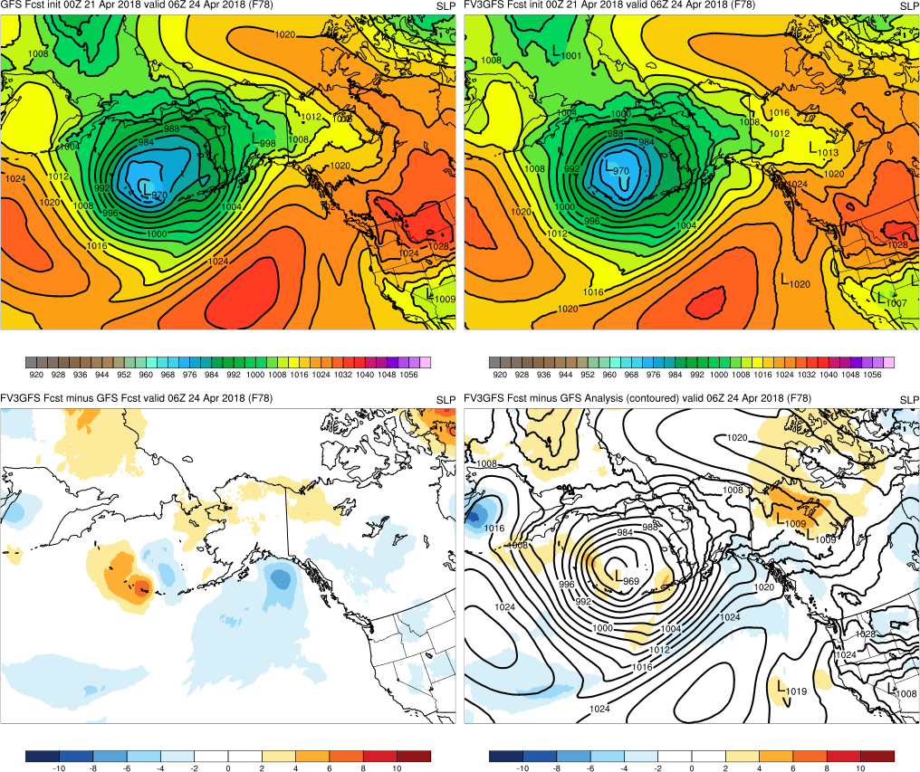
f78
GFS
FV3GFS
FV3GFS-GFS
FV3GFS-GFS Anl

Slide 21
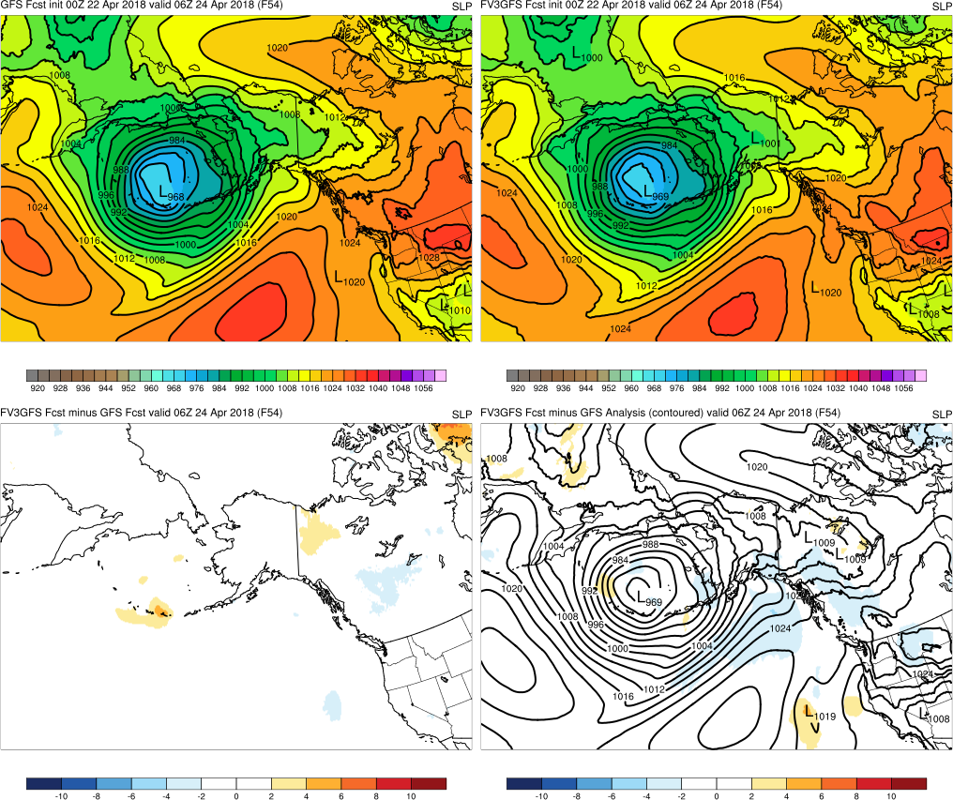
f54
GFS
FV3GFS
FV3GFS-GFS
FV3GFS-GFS Anl

Slide 22
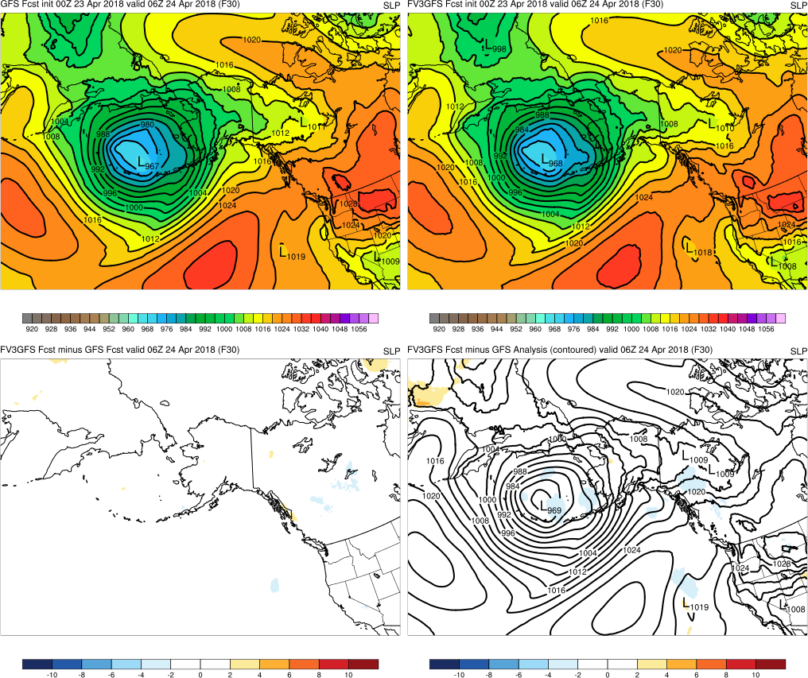
f30
GFS
FV3GFS
FV3GFS-GFS
FV3GFS-GFS Anl

Slide 23
00z 4/20 cycle F102 and F132
GFS
FV3GFS
GFS and FV3GFS look similar at f102 w deep Bering Sea low
GFS
FV3GFS
By f132, GFS correctly maintains a single, strong low, while the FV3GFS
has an elongated, weaker system that’s slightly too far south

Slide 24
00z 4/20 cycle F144
GFS
FV3GFS
FV3GFS remains too far south at f144
GFS
FV3GFS
But impact on the QPF field is minor

Slide 25
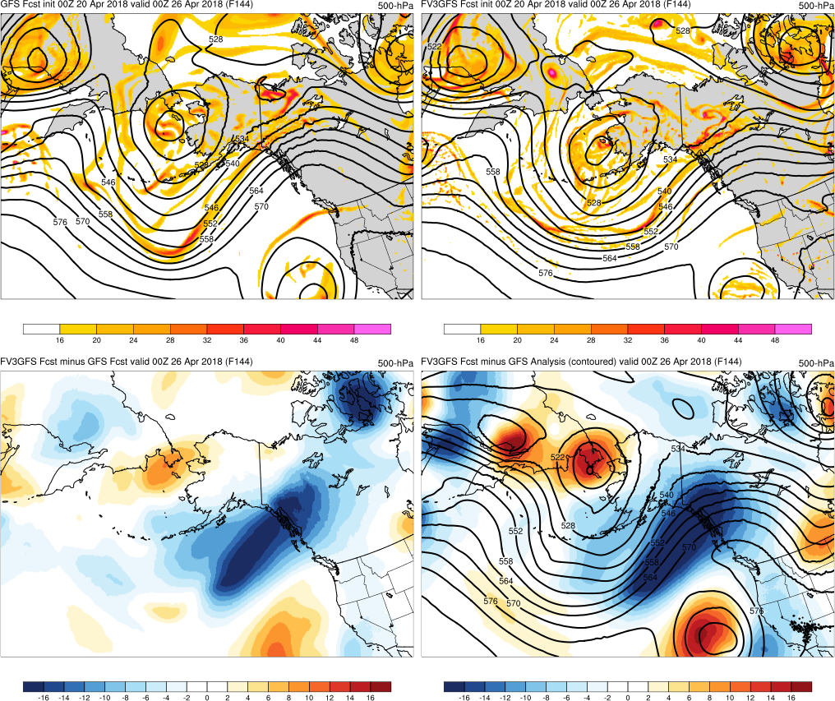
00z 4/20 cycle F144
GFS
FV3GFS
The cause of the sfc low position errors is a too progressive 500 mb evolution

Slide 26
00z 4/23 cycle F120
GFS
FV3GFS
FV3GFS seemingly better at day 5 with trailing system, with a
better hint of multiple low centers, while GFS has a consolidated too deep low

Slide 27
Findings
The SLP forecasts were generally comparable between the GFS and the FV3GFS
The GFS correctly started off with a stronger ridge, the FV3GFS trended stronger
These three cases demonstrate that the FV3GFS matches GFS performance for Alaskan high-impact cases

