Slide 1
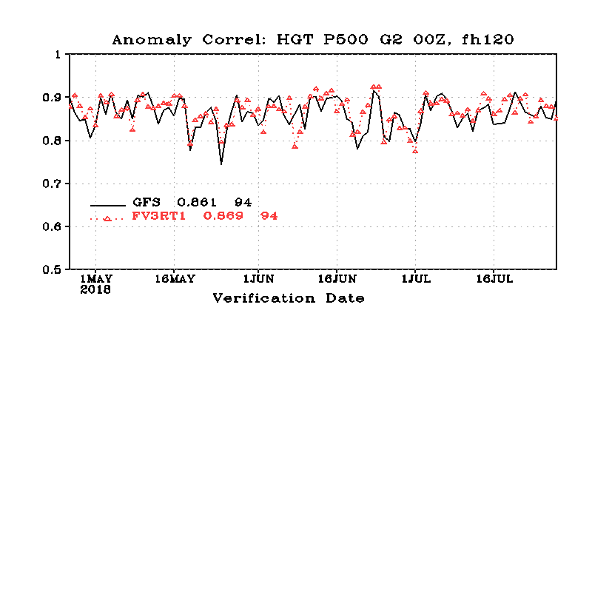
FV3GFS Statistical Update
Anomaly Correlation
Verification Date
Alicia Bentley
NCEP/EMC Model Evaluation Group
9 August 2018

Slide 2
Statistical Topics
500-hPa geo. height Anomaly Correlation (AC) scores
2-m temp. Root Mean Square Error (RMSE) and bias
10-m wind Root Mean Square Error (RMSE) and bias
CONUS QPF Equitable Threat Score (ETS) and bias
Vertical profile comparisons (1000–10-hPa)
Images provided by: EMC FV3GFS Parallel Execution Group and Ying Lin (EMC)

Slide 3
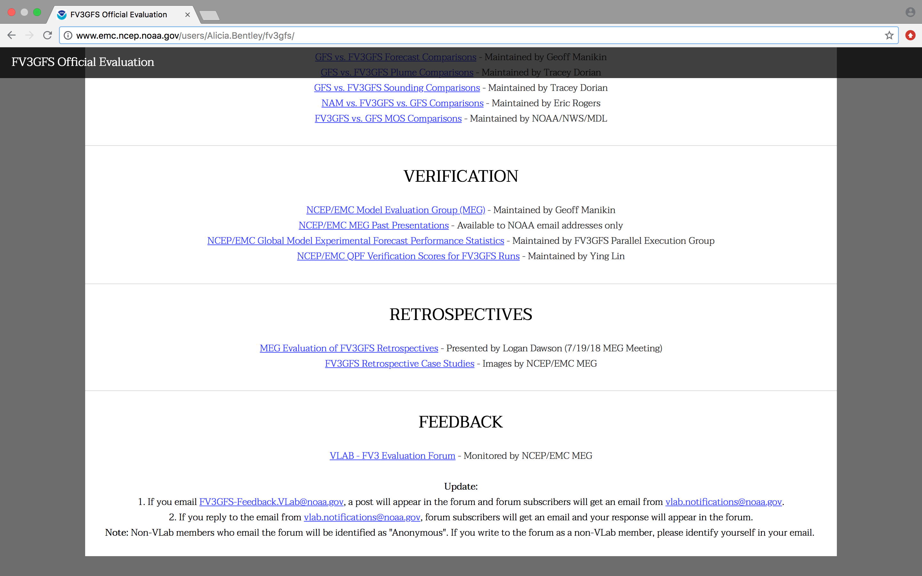
http://www.emc.ncep.noaa.gov/users/Alicia.Bentley/fv3gfs/

Slide 4
500-hPa Anomaly Correlation (AC) Scores

Slide 5
500-hPa Anomaly Correlation (AC) Scores [Day 5]
Anomaly Correlation
GFS = 0.861
FV3GFS = 0.869
Global
Verification Date
FV3GFS AC score is comparable to and slightly better than GFS AC score during late April–late July 2018

Slide 6
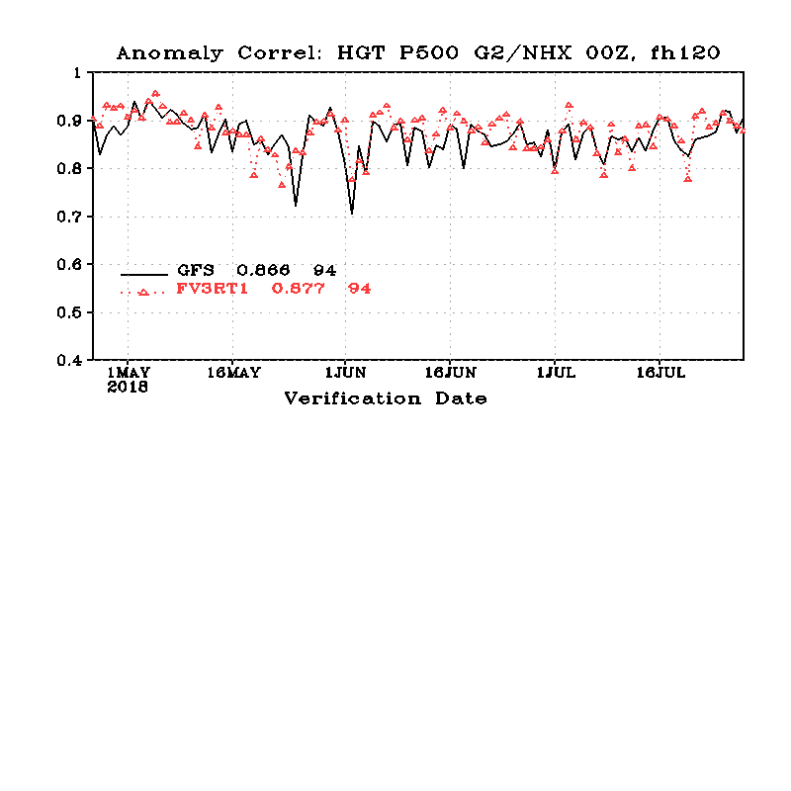
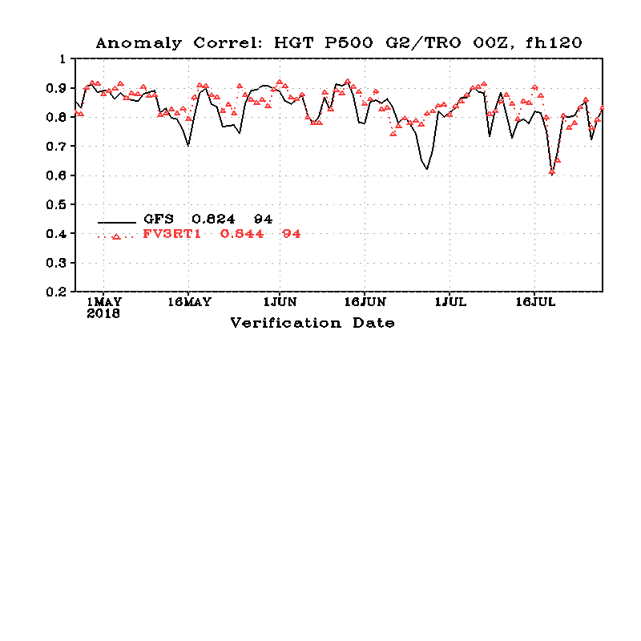
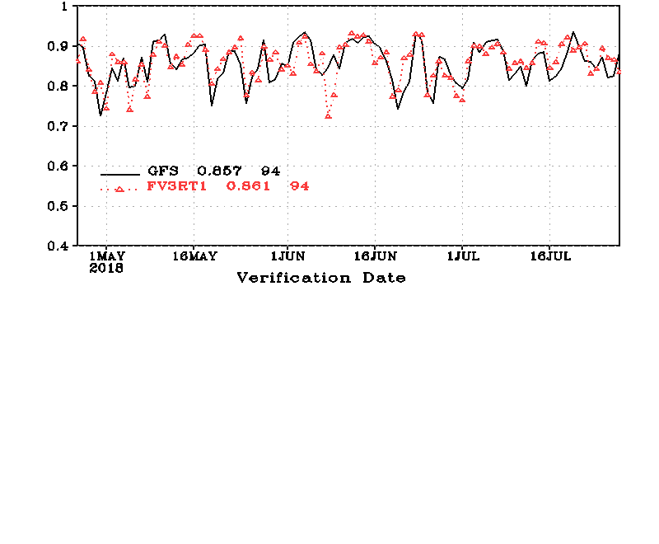
500-hPa Anomaly Correlation (AC) Scores [Day 5]
GFS = 0.866
FV3GFS = 0.877
NH
Anomaly Correlation
Anomaly Correlation
GFS = 0.824
FV3GFS = 0.844
Tropics
GFS = 0.857
Verification Date
FV3GFS = 0.861
SH
Verification Date
FV3GFS AC scores for NH, SH, and tropics are comparable to and slightly better than GFS during late April–late July 2018
Largest FV3GFS AC score improvement relative to GFS in tropics

Slide 7
500-hPa Anomaly Correlation (AC) Scores [Dieoff Curve]
Global
Tropics
GFS
FV3GFS
FV3GFS AC scores are statistically significantly better than GFS AC scores at days 1–5 (globally and in tropics)
FV3GFS and GFS AC scores are comparable at days >5

Slide 8
500-hPa Anomaly Correlation (AC) Scores [Dieoff Curve]
NH
SH
GFS
FV3GFS
FV3GFS AC scores are statistically significantly better than GFS AC scores at days 2–5 (NH) and at days 1–3 (SH)
FV3GFS AC scores statistically signif. worse at days 11–13 (NH)

Slide 9
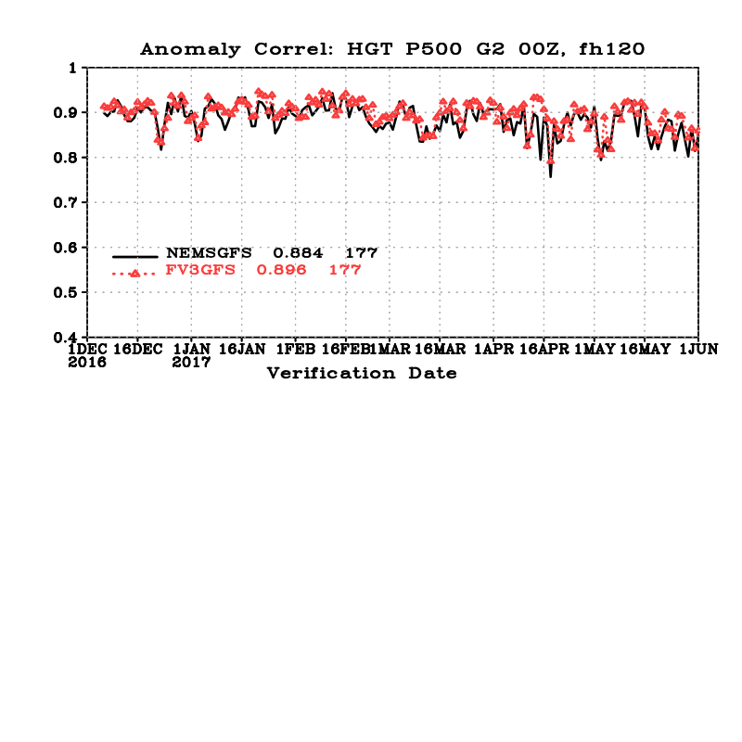
500-hPa Anomaly Correlation (AC) Scores [Day 5]
Anomaly Correlation
GFS = 0.884
FV3GFS = 0.896
Global
(Retros)
Verification Date
FV3GFS AC score is comparable to and slightly better than the GFS AC score during early December 2016–early May 2017 (Retros)

Slide 10
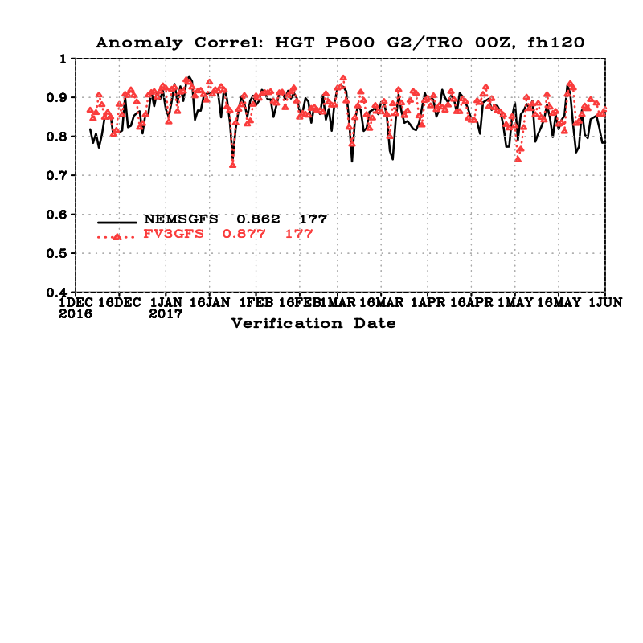
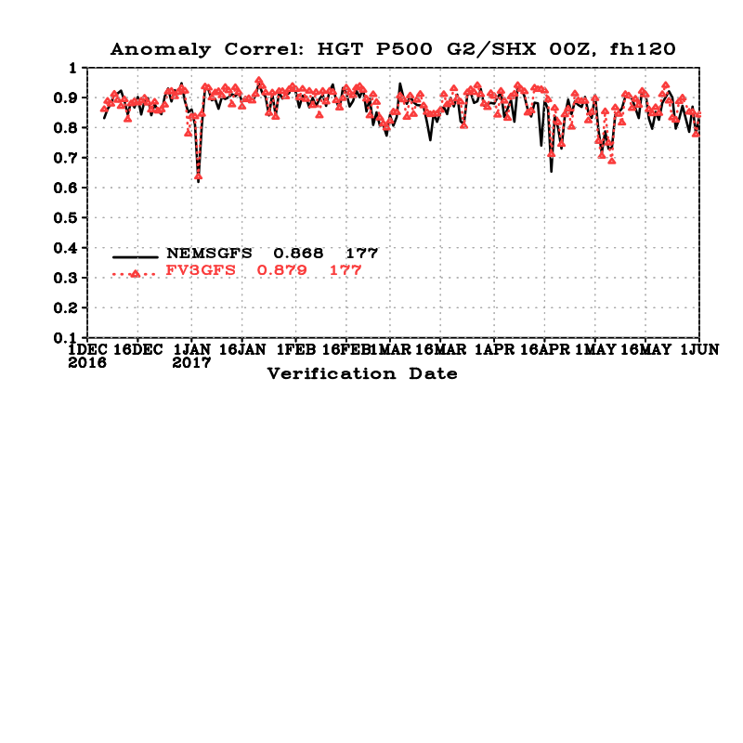
500-hPa Anomaly Correlation (AC) Scores [Day 5]
GFS = 0.899
FV3GFS = 0.911
NH
Anomaly Correlation
Anomaly Correlation
GFS = 0.862
FV3GFS = 0.877
Tropics
GFS = 0.868
Verification Date
FV3GFS = 0.879
SH
Verification Date
FV3GFS AC scores for NH, SH, and tropics are comparable to and slightly better than GFS AC scores during early December 2016–early May 2017 (Retros)

Slide 11
500-hPa Anomaly Correlation (AC) Scores [Dieoff Curve]
Global
NH
GFS
FV3GFS
FV3GFS AC scores are statistically significantly better than GFS AC scores at days 2–10 (globally and over the NH) during early December 2016–early May 2017 (Retros)

Slide 12
2-m Temperatures

Slide 13
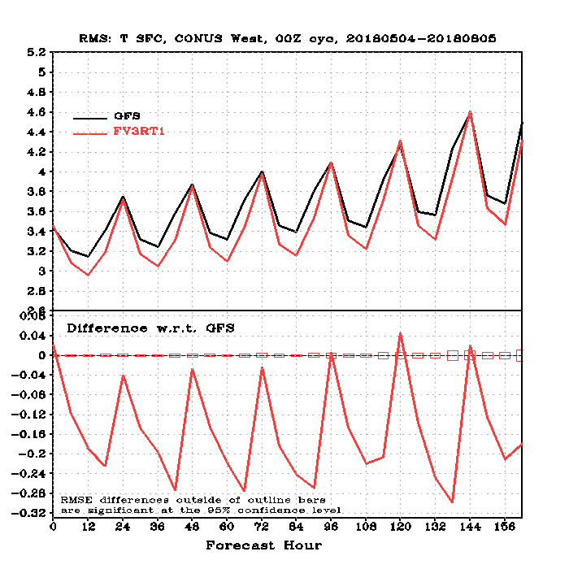
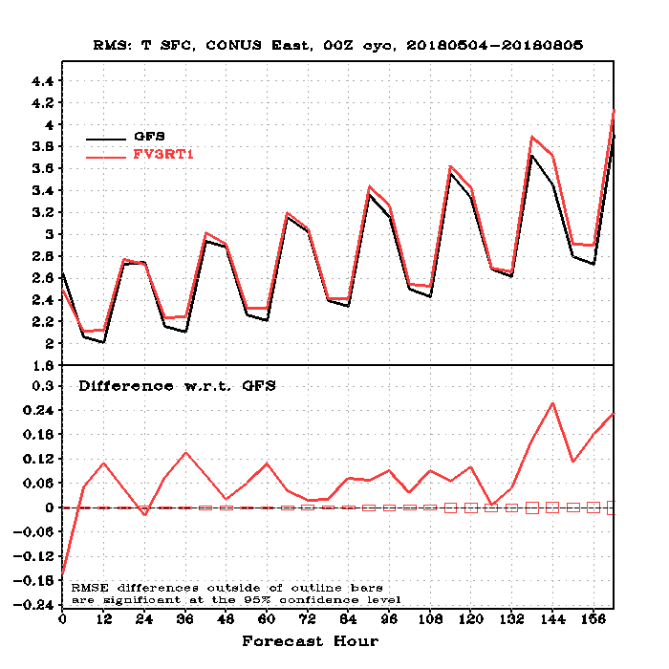
2-m Temperatures (RMSE/Diff.)
WEST
EAST
GFS
GFS
FV3GFS
FV3GFS
FV3GFS RMSE is better than GFS RMSE over western CONUS
FV3GFS RMSE is comparable to GFS RMSE over eastern CONUS, with the largest differences occurring in the early morning

Slide 14
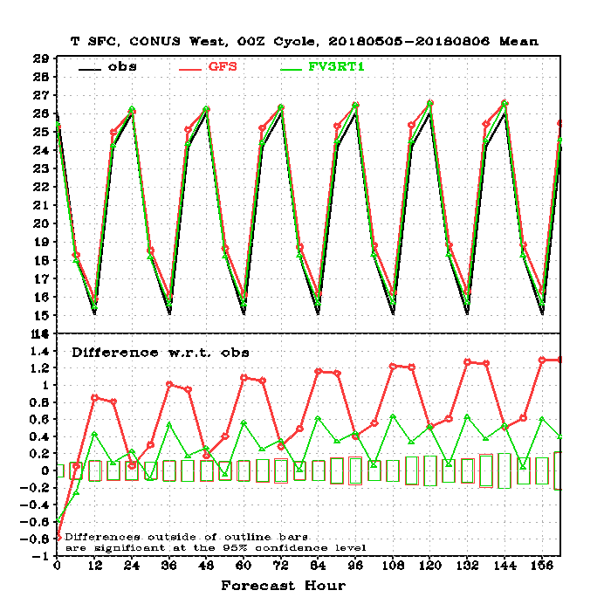
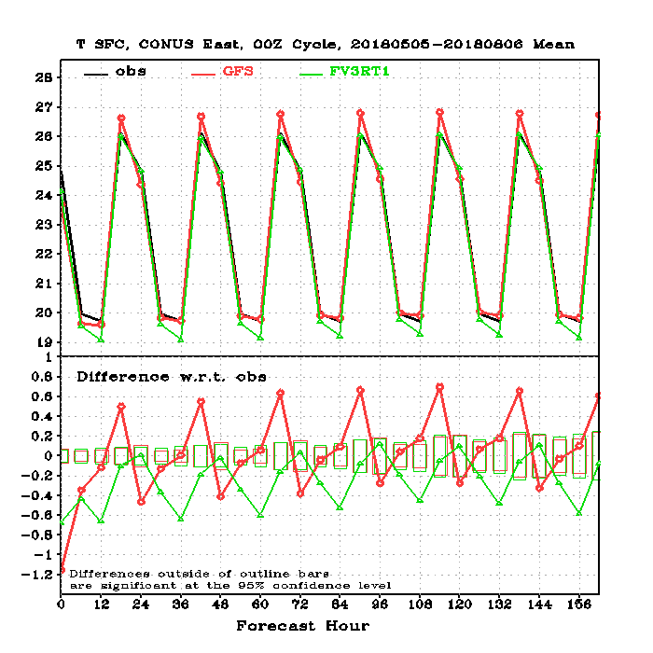
2-m Temperatures (vs. Obs)
WEST
EAST
OBS
GFS
FV3GFS
FV3GFS more in line with observations than GFS over west CONUS
FV3GFS better with daytime highs over east CONUS, but worse with overnight low 2-m temperatures

Slide 15
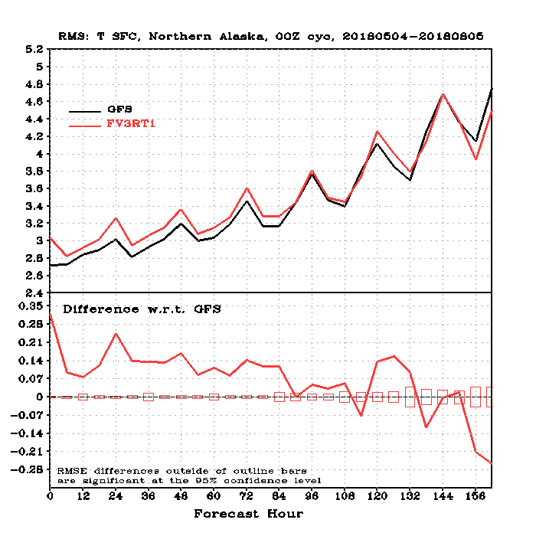
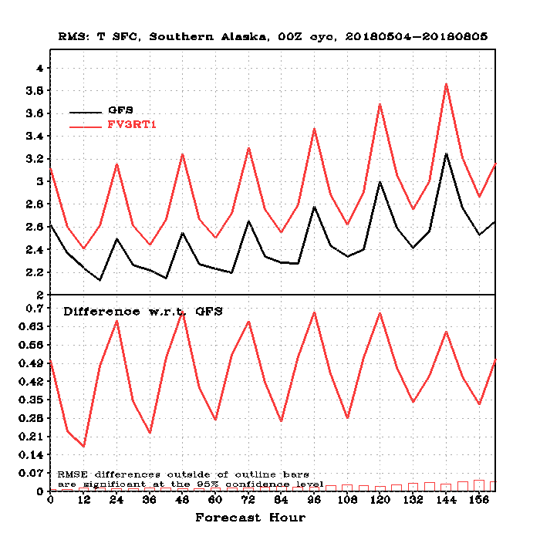
2-m Temperatures (RMSE/Diff.)
N. AK
S. AK
GFS
GFS
FV3GFS
FV3GFS
FV3GFS RMSE is slightly worse than GFS RMSE over N. AK
FV3GFS RMSE is noticeably worse than GFS RMSE over S. AK at all forecast hours

Slide 16
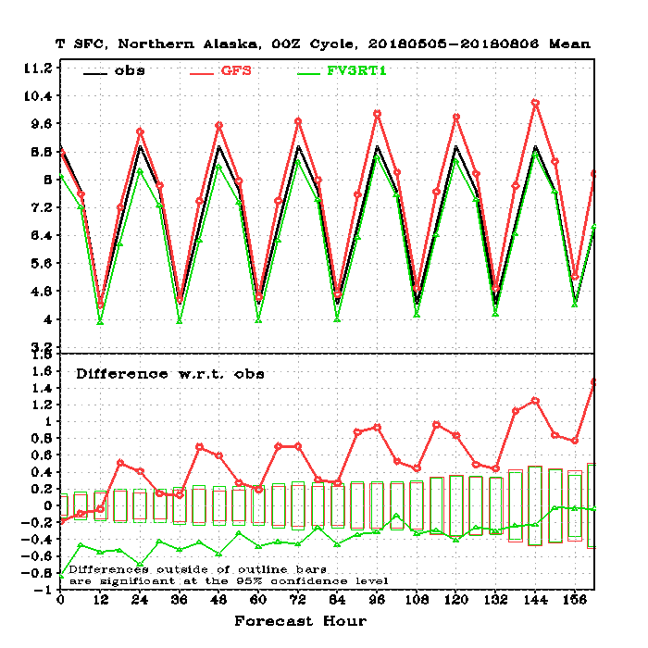
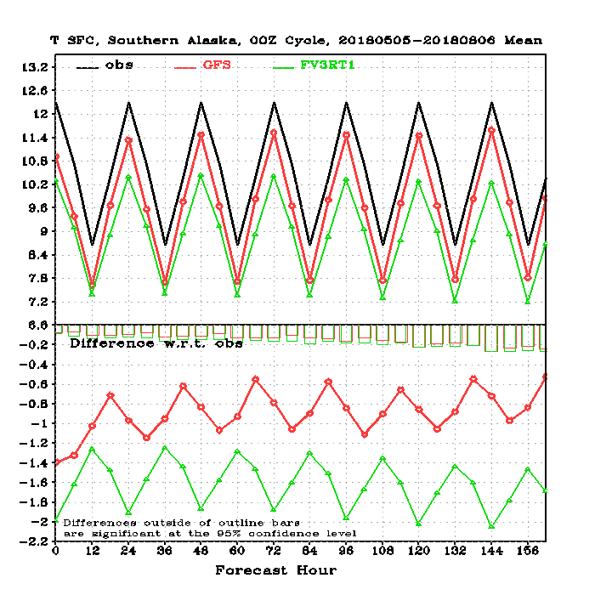
2-m Temperatures (vs. Obs)
N. AK
S. AK
OBS
GFS
FV3GFS
FV3GFS slightly colder than observations at all times over N. AK
FV3GFS noticeably colder than both observations and GFS at all times over S. AK

Slide 17
10-m Winds

Slide 18
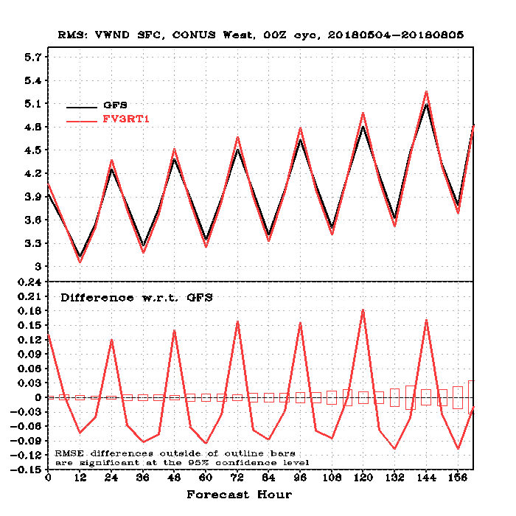
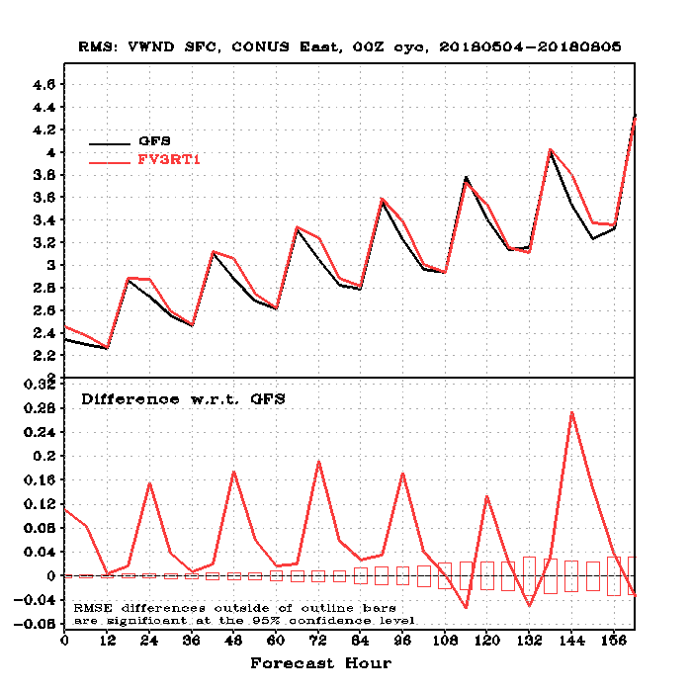
10-m Winds (RMSE and Diff.)
WEST
EAST
GFS
GFS
FV3GFS
FV3GFS
FV3GFS RMSE is comparable to GFS RMSE over western CONUS
FV3GFS RMSE is comparable to GFS RMSE over eastern CONUS, with the largest differences occurring just during peak heating

Slide 19
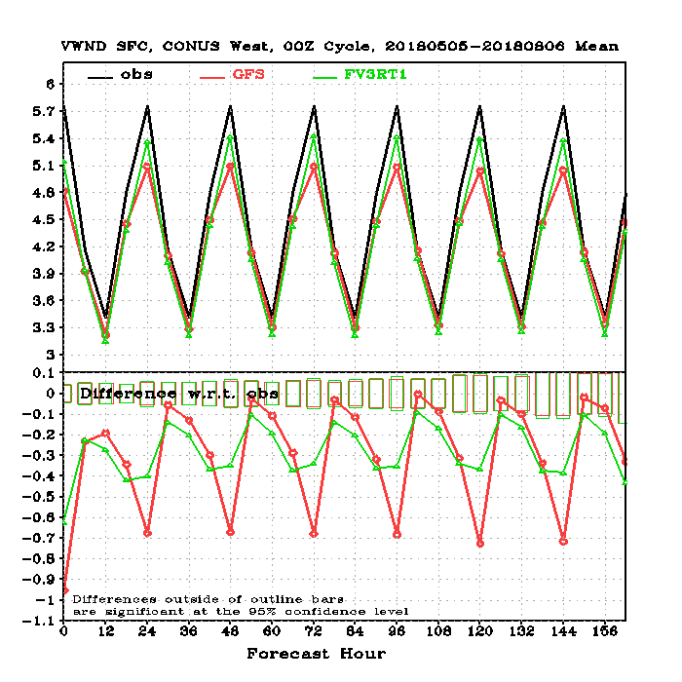
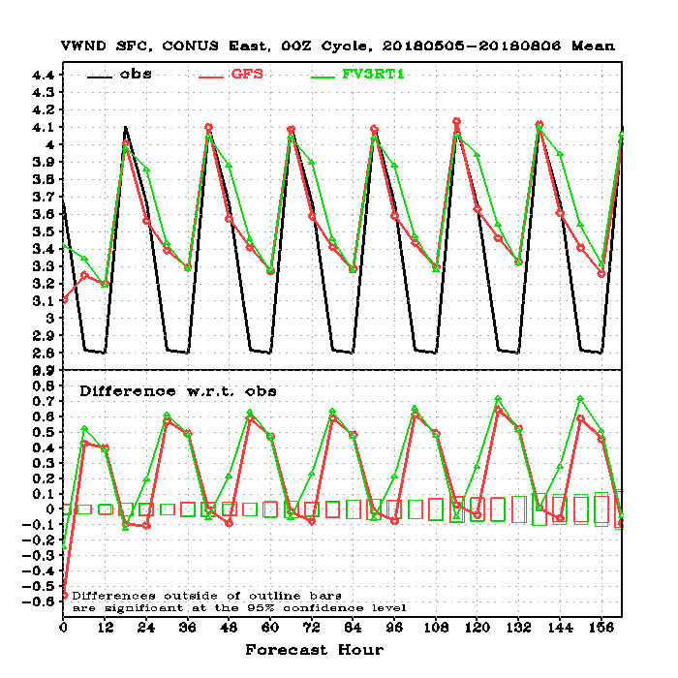
10-m Winds (vs. Obs)
WEST
EAST
OBS
GFS
FV3GFS
FV3GFS more in line with observations than GFS over west CONUS
FV3GFS does not show improvement vs. GFS over east CONUS

Slide 20
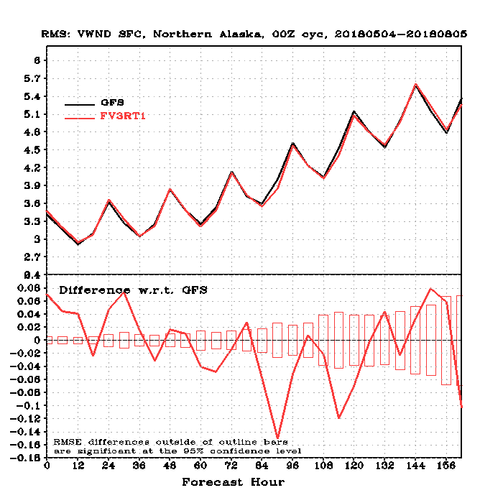
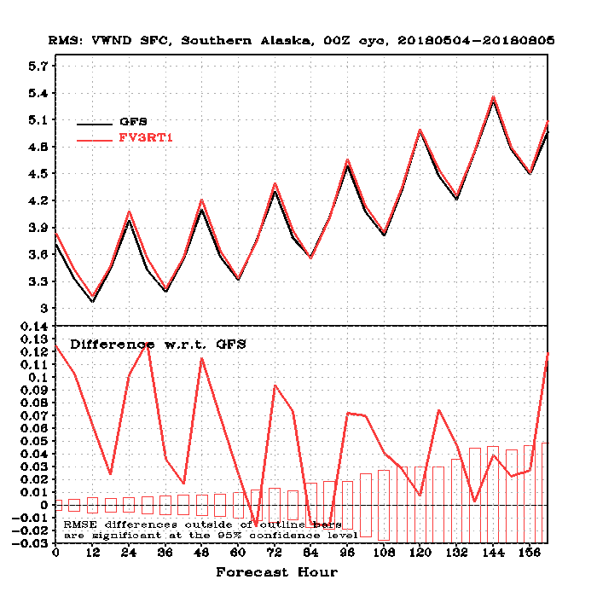
10-m Winds (RMSE and Diff.)
N. AK
S. AK
GFS
GFS
FV3GFS
FV3GFS
FV3GFS RMSE is comparable to GFS RMSE over Northern Alaska and Southern Alaska

Slide 21
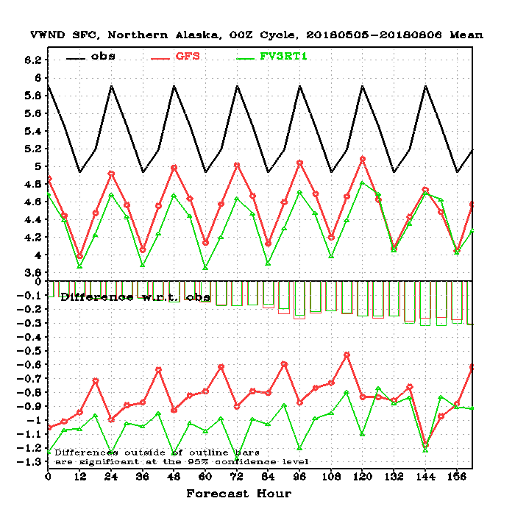
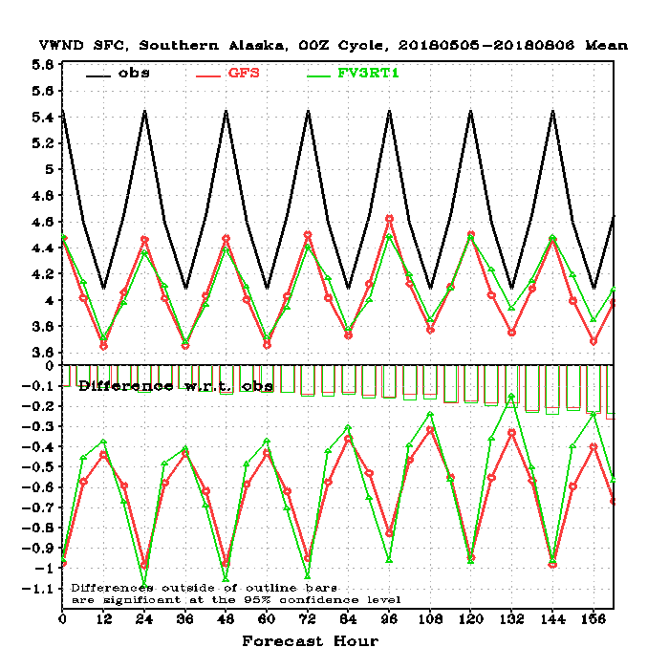
10-m Winds (vs. Obs)
N. AK
S. AK
OBS
GFS
FV3GFS
FV3GFS is worse than GFS 10-m winds over Northern Alaska
FV3GFS is comparable to GFS 10-m winds over Southern Alaska

Slide 22
CONUS QPF Statistics

Slide 23
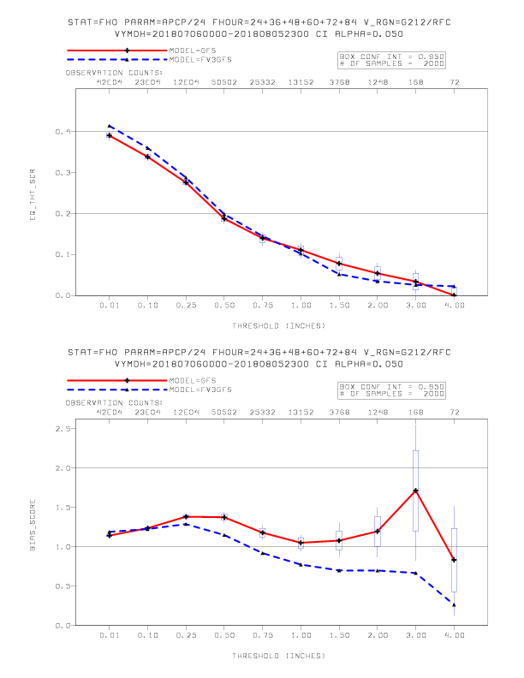
CONUS QPF Statistics (24-h Forecasts from 0–84 h)
FV3GFS Equitable Threat Score is statistically signif. better than GFS for smaller thresholds
FV3GFS has statistically signif. less overall bias than GFS at thresholds 0.25”–0.75”
FV3GFS has a low bias at thresholds ≥0.75” that is statistically significantly different from current GFS high bias
Equitable Threat Score
GFS
FV3GFS
Threshold (inches)
Bias
GFS
FV3GFS
Threshold (inches)

Slide 24
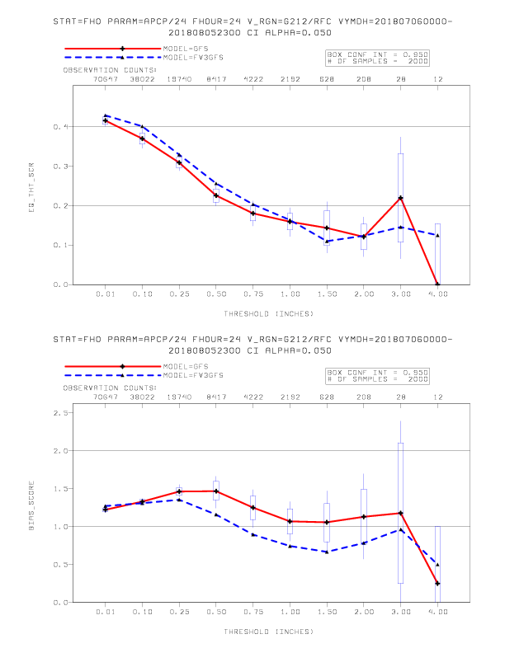
CONUS QPF Statistics (24-h Forecasts from 0–24 h)
FV3GFS Equitable Threat Score is better than GFS for thresholds 0.01”–1.00”, but not statistically significantly different
FV3GFS has a low bias at thresholds ≥0.75” that is statistically significantly less than GFS high bias
Equitable Threat Score
GFS
FV3GFS
Threshold (inches)
Bias
GFS
FV3GFS
Threshold (inches)

Slide 25
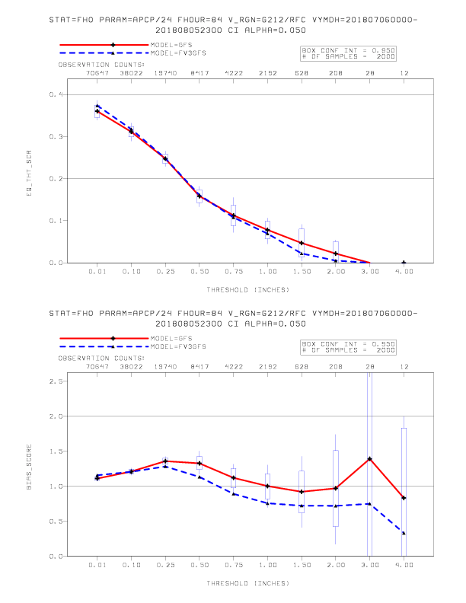
CONUS QPF Statistics (24-h Forecasts from 60–84 h)
FV3GFS Equitable Threat Score is not statistically significantly different from GFS across all thresholds
FV3GFS bias is not statistically significantly different from GFS across all thresholds
Equitable Threat Score
GFS
FV3GFS
Threshold (inches)
Bias
GFS
FV3GFS
Threshold (inches)

Slide 26
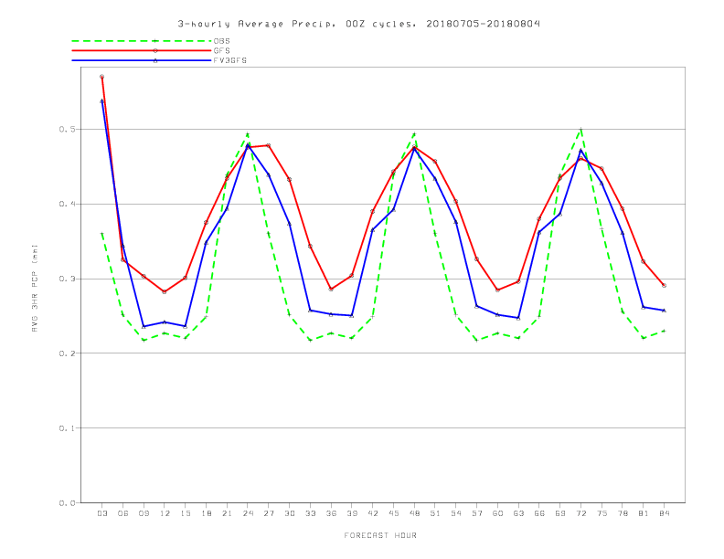
CONUS QPF Statistics (Diurnal Cycle Comparison)
7/5/18–8/4/18
Average 3-h Precipitation (mm)
OBS
GFS
00Z Cycles
FV3GFS
Forecast Hour

Slide 27
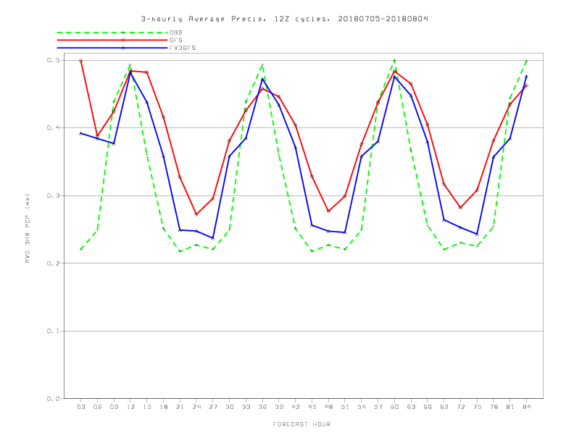
CONUS QPF Statistics (Diurnal Cycle Comparison)
7/5/18–8/4/18
Average 3-h Precipitation (mm)
OBS
GFS
12Z Cycles
FV3GFS
Forecast Hour

Slide 28
Vertical Profile Comparisons

Slide 29
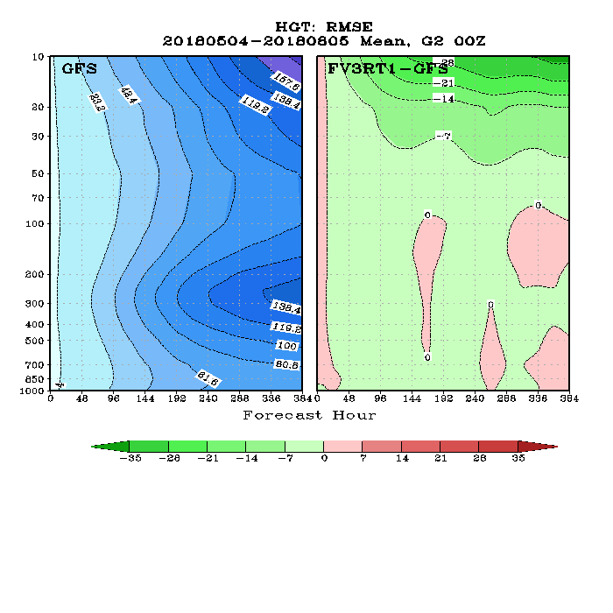
Vertical Profiles Comparisons (Global Geo. Height)
GFS RMSE
FV3−GFS
Forecast Hour
Better
Worse

Slide 30
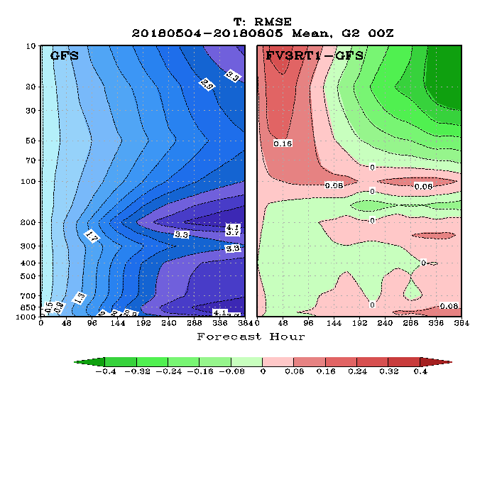
Vertical Profiles Comparisons (Global Temperature)
GFS RMSE
FV3−GFS
Forecast Hour
Better
Worse

Slide 31
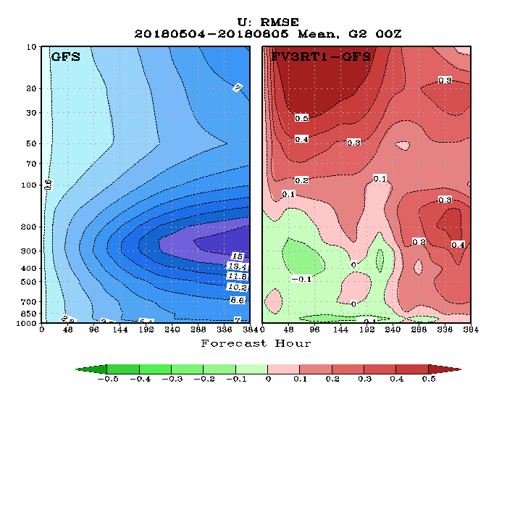
Vertical Profiles Comparisons (Global Zonal Wind)
GFS RMSE
FV3−GFS
Forecast Hour
Better
Worse

Slide 32
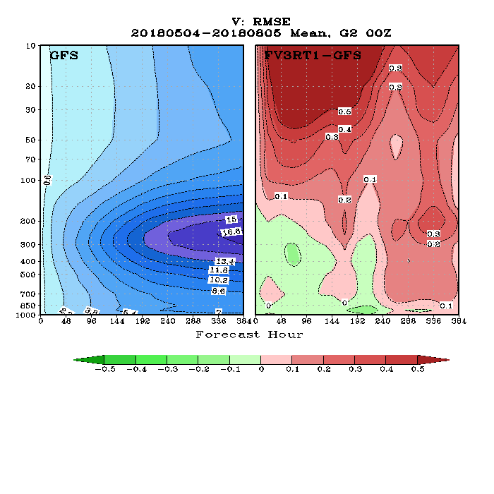
Vertical Profiles Comparisons (Global Meridional Wind)
GFS RMSE
FV3−GFS
Forecast Hour
Better
Worse

Slide 33
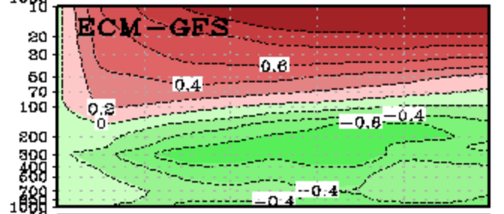
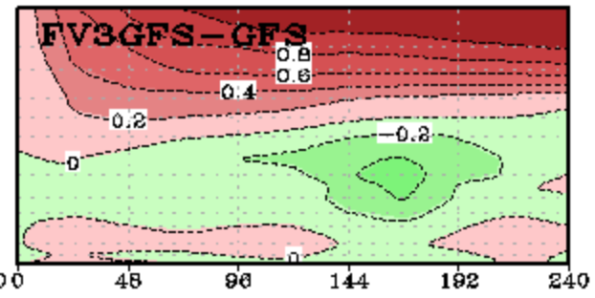
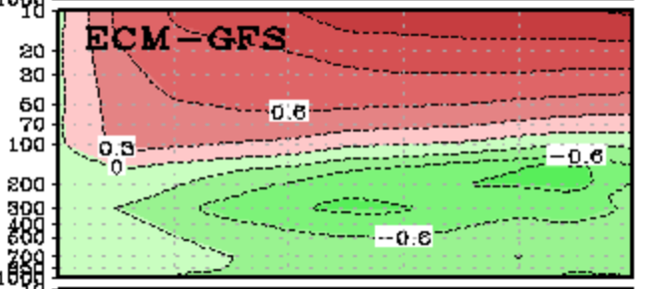
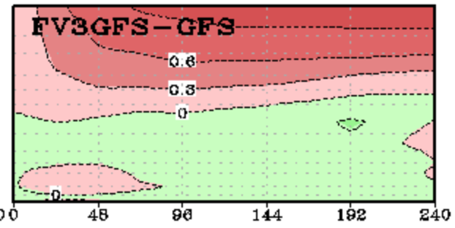
Vertical Profiles Comparisons (ECMWF vs. FV3GFS)
U WIND
V WIND

Slide 34
Summary
FV3GFS AC scores are statistically significantly better than GFS AC scores at days 1–5 (globally and in tropics) currently
FV3GFS AC scores are statistically significantly better than GFS AC scores at days 2–10 (globally and NH) in winter retro

Slide 35
Summary
FV3GFS AC scores are statistically significantly better than GFS AC scores at days 1–5 (globally and in tropics) currently
FV3GFS AC scores are statistically significantly better than GFS AC scores at days 2–10 (globally and NH) in winter retro
FV3GFS Equitable Threat Score is statistically significantly better than GFS ETS at smaller 24-h QPF thresholds (0.01”–0.25”)
FV3GFS has a low bias at 24-h QPF thresholds ≥0.75” that is statistically significantly different from current GFS high bias

Slide 36
Summary
FV3GFS AC scores are statistically significantly better than GFS AC scores at days 1–5 (globally and in tropics) currently
FV3GFS AC scores are statistically significantly better than GFS AC scores at days 2–10 (globally and NH) in winter retro
FV3GFS Equitable Threat Score is statistically significantly better than GFS ETS at smaller 24-h QPF thresholds (0.01”–0.25”)
FV3GFS has a low bias at 24-h QPF thresholds ≥0.75” that is statistically significantly different from current GFS high bias
FV3GFS improves the diurnal cycle of averaged 3-h precipitation
Temperature and geopotential height are improved in stratosphere in FV3GFS, but zonal and meridional wind are worse

Slide 37
http://www.emc.ncep.noaa.gov/users/Alicia.Bentley/fv3gfs/

Slide 38
http://www.emc.ncep.noaa.gov/users/Alicia.Bentley/fv3gfs/

Slide 39
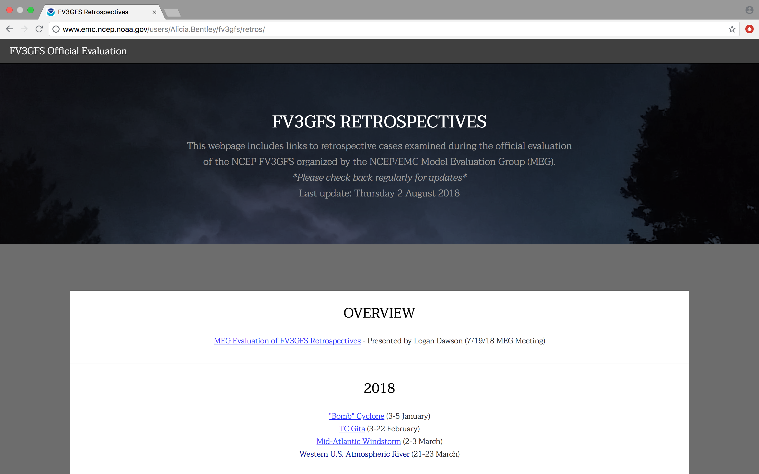
http://www.emc.ncep.noaa.gov/users/Alicia.Bentley/fv3gfs/retros/

Slide 40
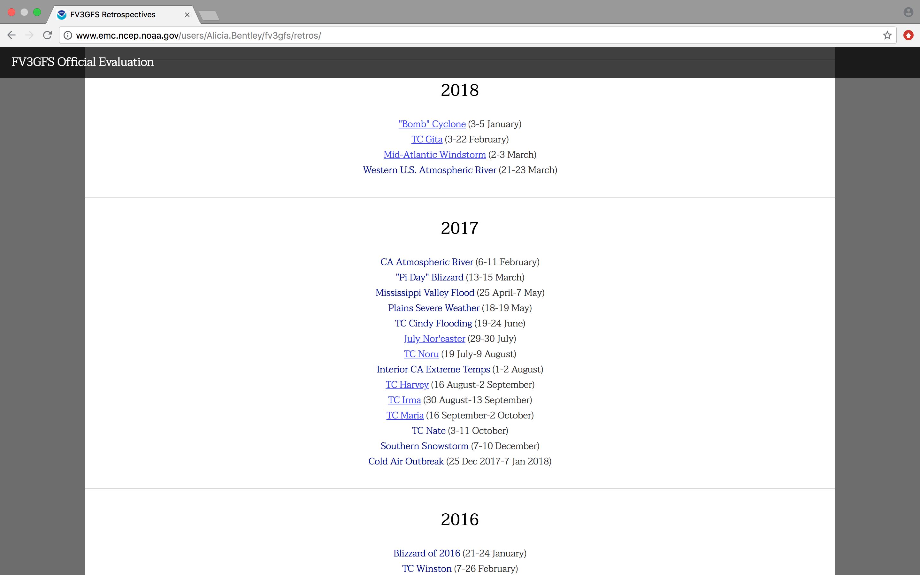
http://www.emc.ncep.noaa.gov/users/Alicia.Bentley/fv3gfs/retros/

Slide 41
http://www.emc.ncep.noaa.gov/users/Alicia.Bentley/fv3gfs/retros/

Slide 42
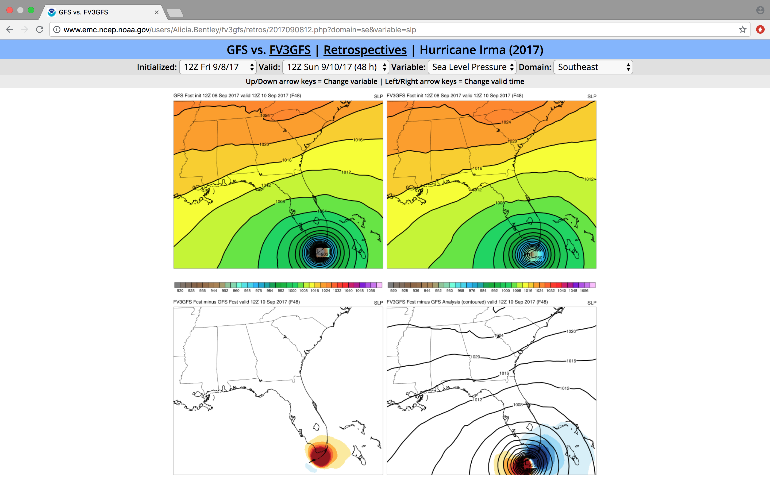
http://www.emc.ncep.noaa.gov/users/Alicia.Bentley/fv3gfs/retros/

