Slide 1
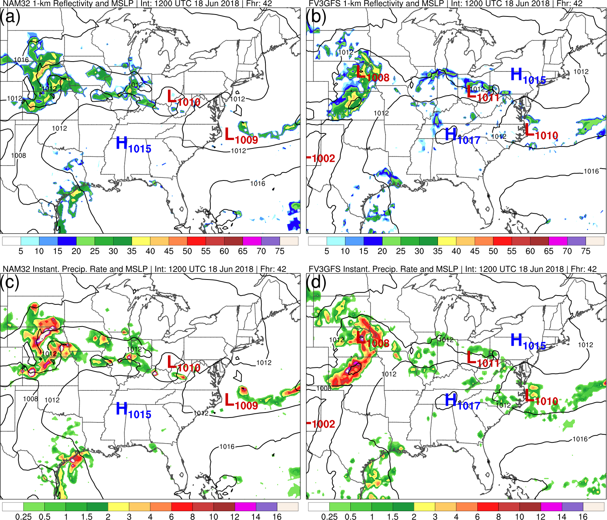
FV3 Update: Instantaneous Precipitation Rate,
1-km Reflectivity, Visibility, and VLAB
NAM
FV3GFS
Alicia Bentley, Logan Dawson,
Tracey Dorian, Geoff Manikin
NCEP/EMC Model Evaluation Group
28 June 2018

Slide 2
Recap: 5/31/2018 MEG Meeting
MEG and FV3GFS users noticed considerably less
instantaneous precipitation rate and 1-km reflectivity coverage in FV3GFS compared to NAM and RAP
At the time the issues were identified, we weren’t sure if one issue was causing a loss of coverage in both output parameters or if this was caused by two separate issues

Slide 3
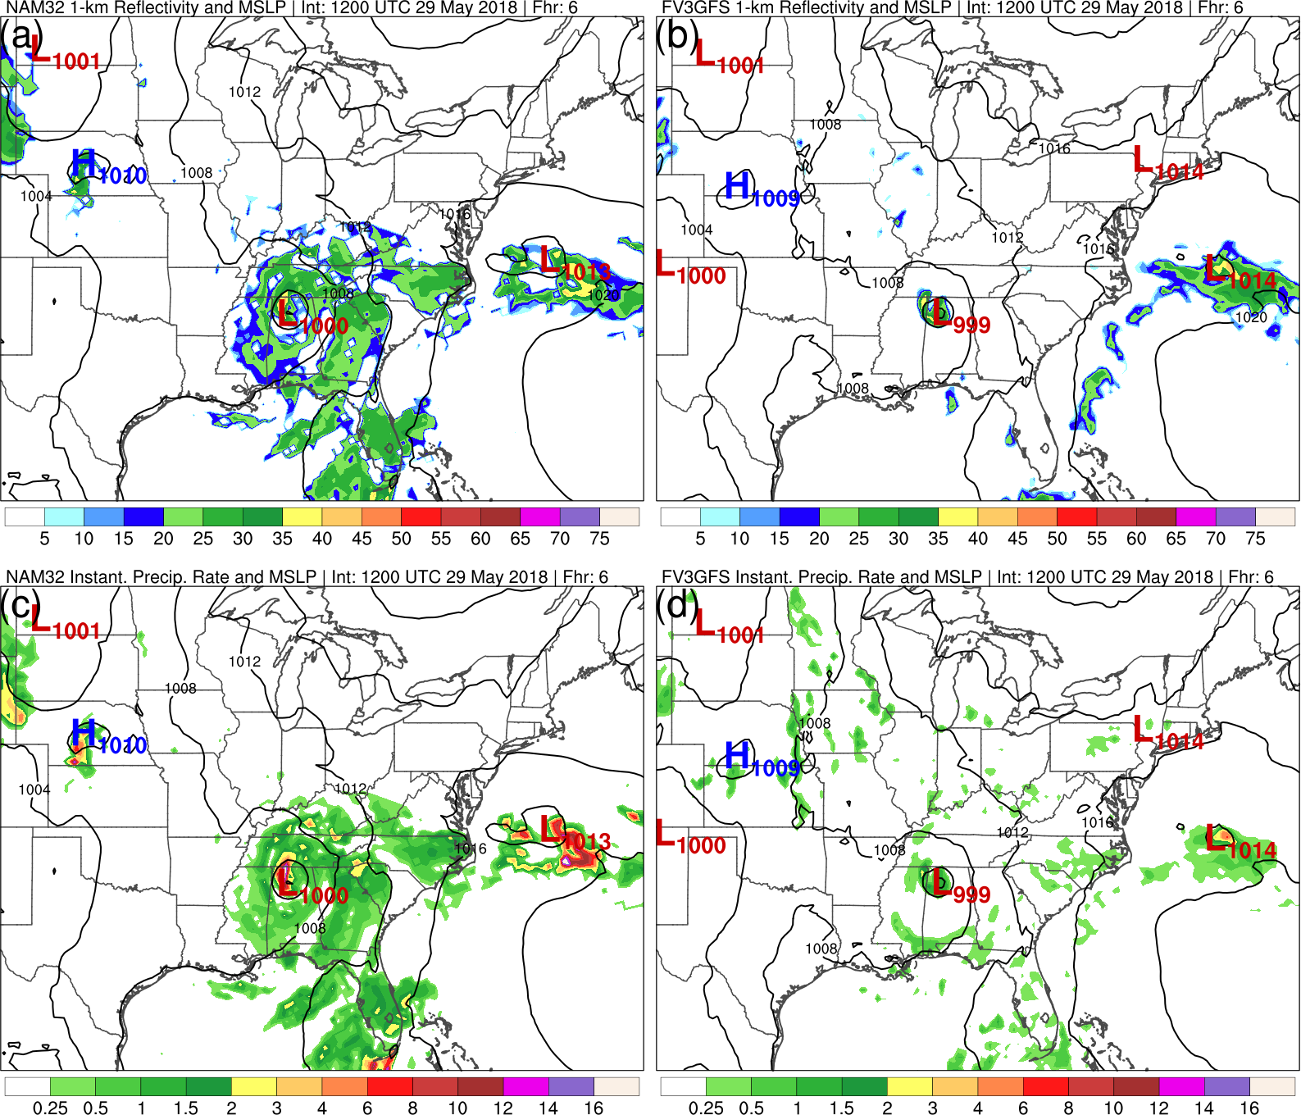
Initialized: 1200 UTC 29 May 2018 | Fhr: 006
NAM
FV3GFS
Reflectivity is
underdone
NAM
FV3GFS
PRATE is
located over strange regions

Slide 4
Initialized: 1200 UTC 29 May 2018 | Fhr: 006
NAM
FV3GFS
Reflectivity is
underdone
NAM
FV3GFS
PRATE is
located over strange regions

Slide 5
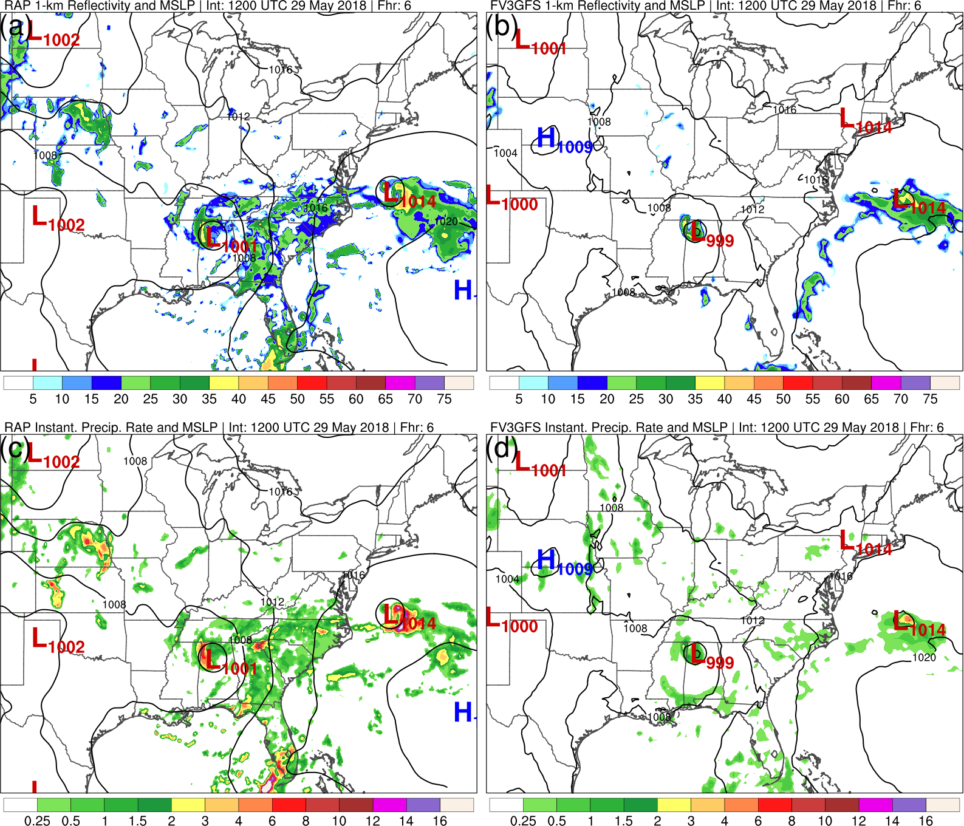
Initialized: 1200 UTC 29 May 2018 | Fhr: 006
RAP
FV3GFS
Reflectivity is
underdone
RAP
FV3GFS
PRATE is
located over strange regions

Slide 6
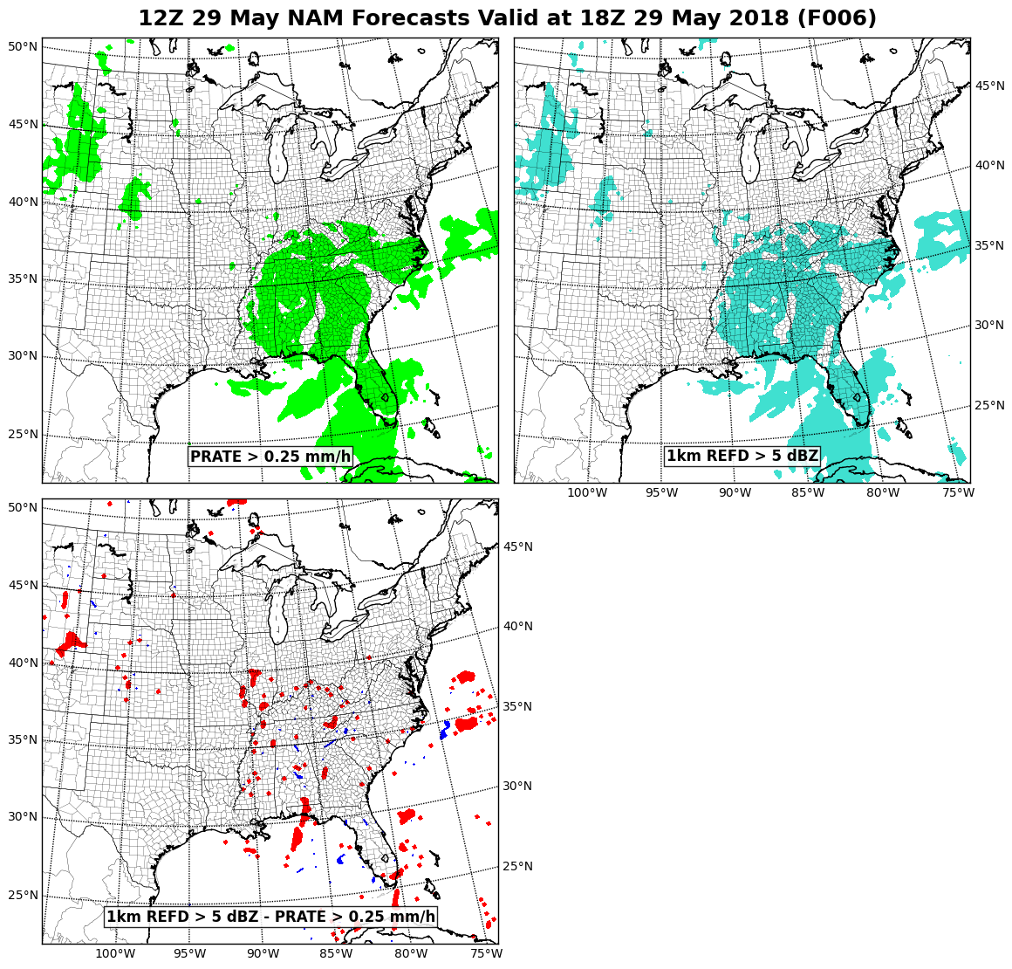
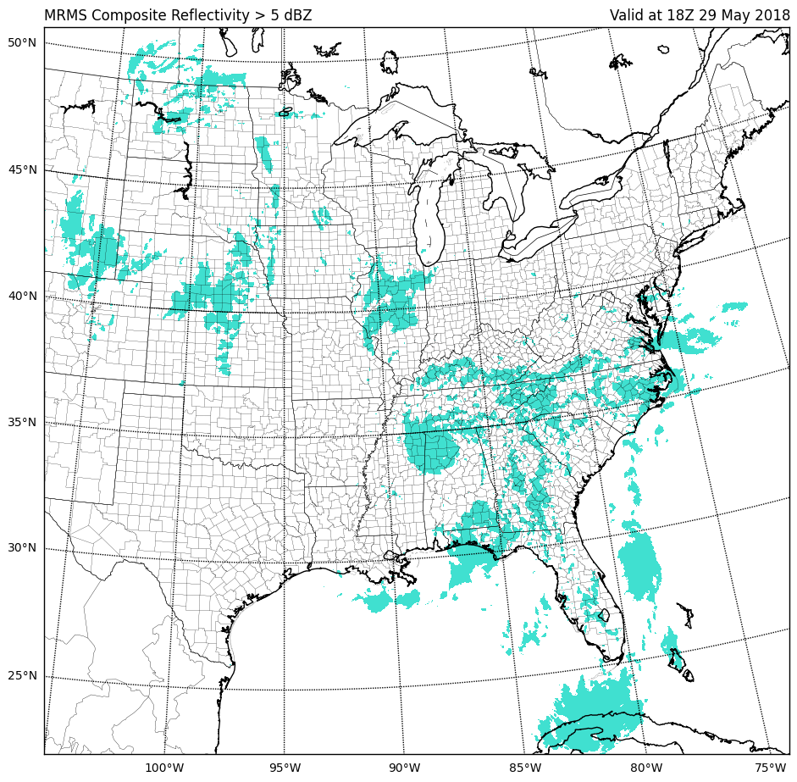
NAM
NAM
NAM Diff.
MRMS*
Reflectivity has slightly more spatial coverage
*Composite reflectivity thresholded for MRMS

Slide 7
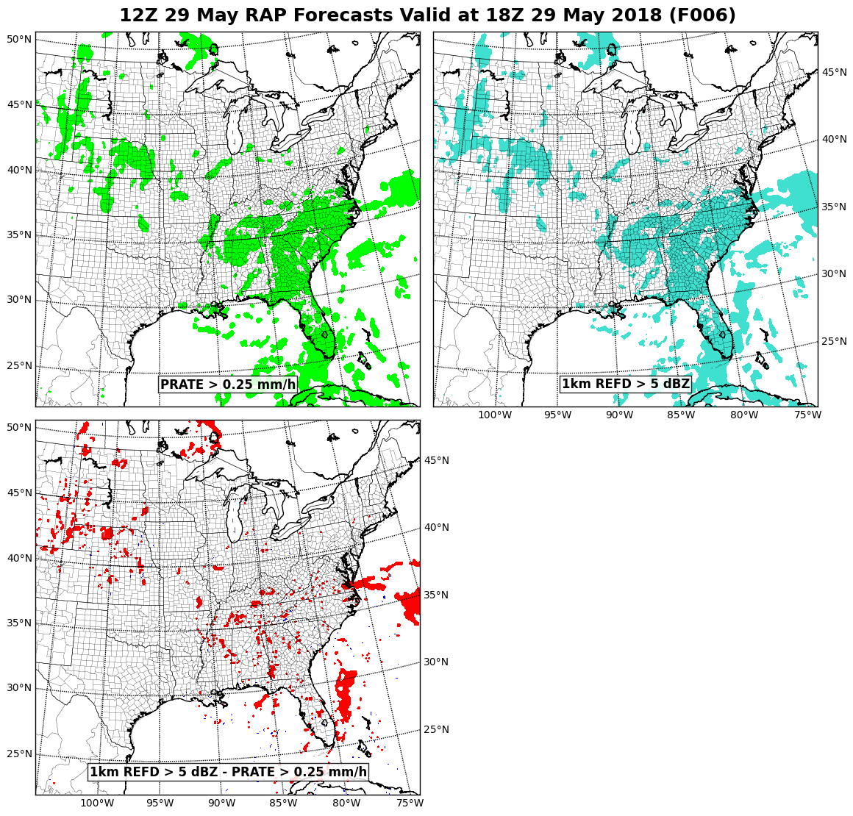
RAP
RAP
RAP Diff.
MRMS*
Reflectivity has slightly more spatial coverage
*Composite reflectivity thresholded for MRMS

Slide 8
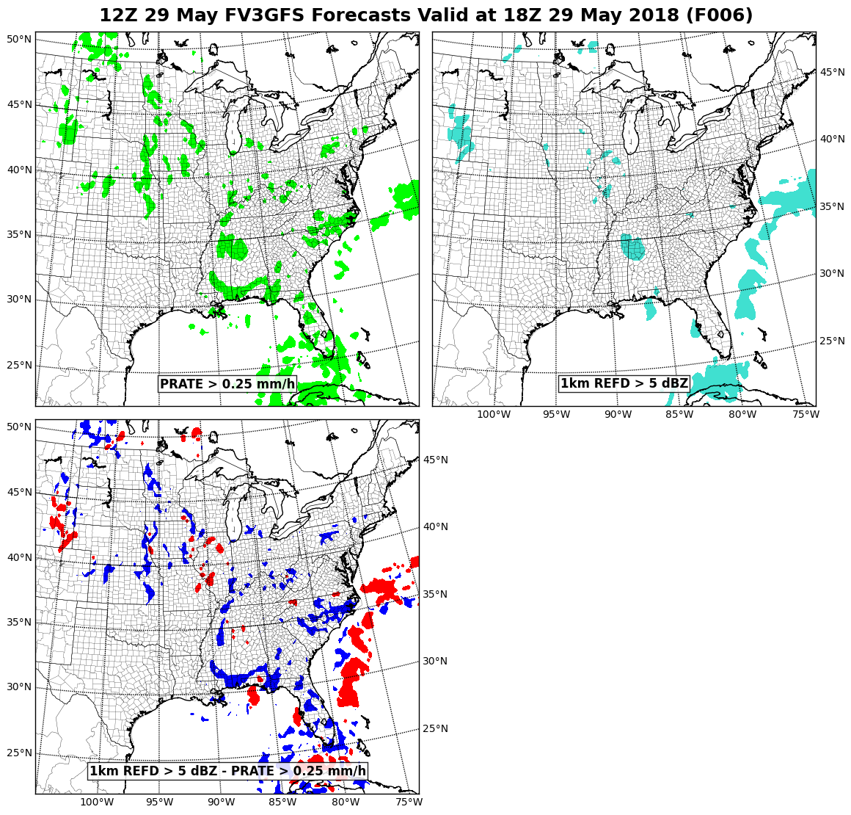
FV3GFS
FV3GFS
FV3GFS Diff.
MRMS*
Reflectivity has less spatial coverage and PRATE is over strange locations
*Composite reflectivity thresholded for MRMS

Slide 9
Updates
Instantaneous Precipitation Rate
  Previously: Using the incorrect units
  Now: Using units of (kg/m²)/s, where kg/m² = mm
1-km Reflectivity
  Previously: Using the instantaneous precip. rate with incorrect units
  Now: Using the instantaneous convective precip. rate

Slide 10
Updates
Instantaneous Precipitation Rate
  Previously: Using the incorrect units
  Now: Using units of (kg/m²)/s, where kg/m² = mm
1-km Reflectivity
  Previously: Using the instantaneous precip. rate with incorrect units
  Now: Using the instantaneous convective precip. rate
Updates were included in the parallel FV3GFS
by 1200 UTC 18 June 2018

Slide 11
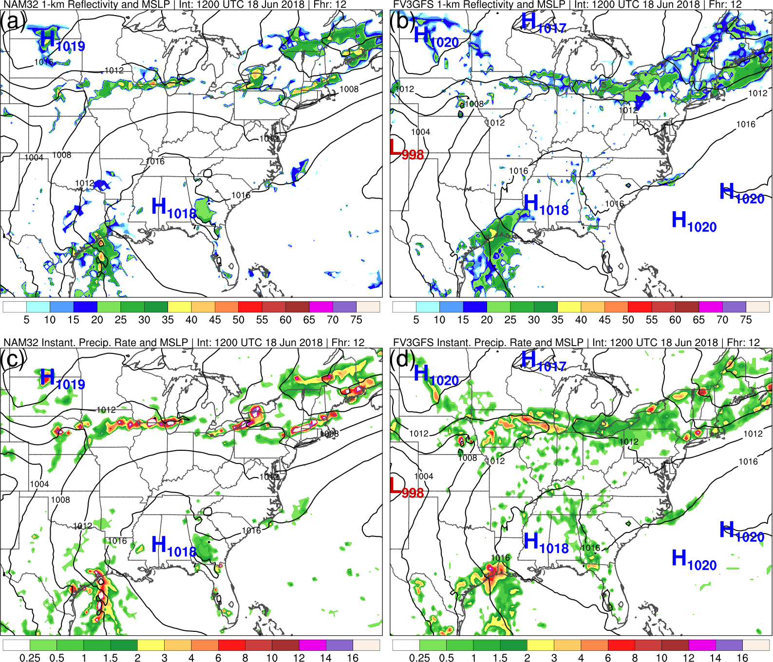
Initialized: 1200 UTC 18 June 2018 | Fhr: 012
NAM
FV3GFS
NAM
FV3GFS

Slide 12
Initialized: 1200 UTC 18 June 2018 | Fhr: 012
NAM
FV3GFS
NAM
FV3GFS

Slide 13
Initialized: 1200 UTC 18 June 2018 | Fhr: 042
NAM
FV3GFS
NAM
FV3GFS

Slide 14
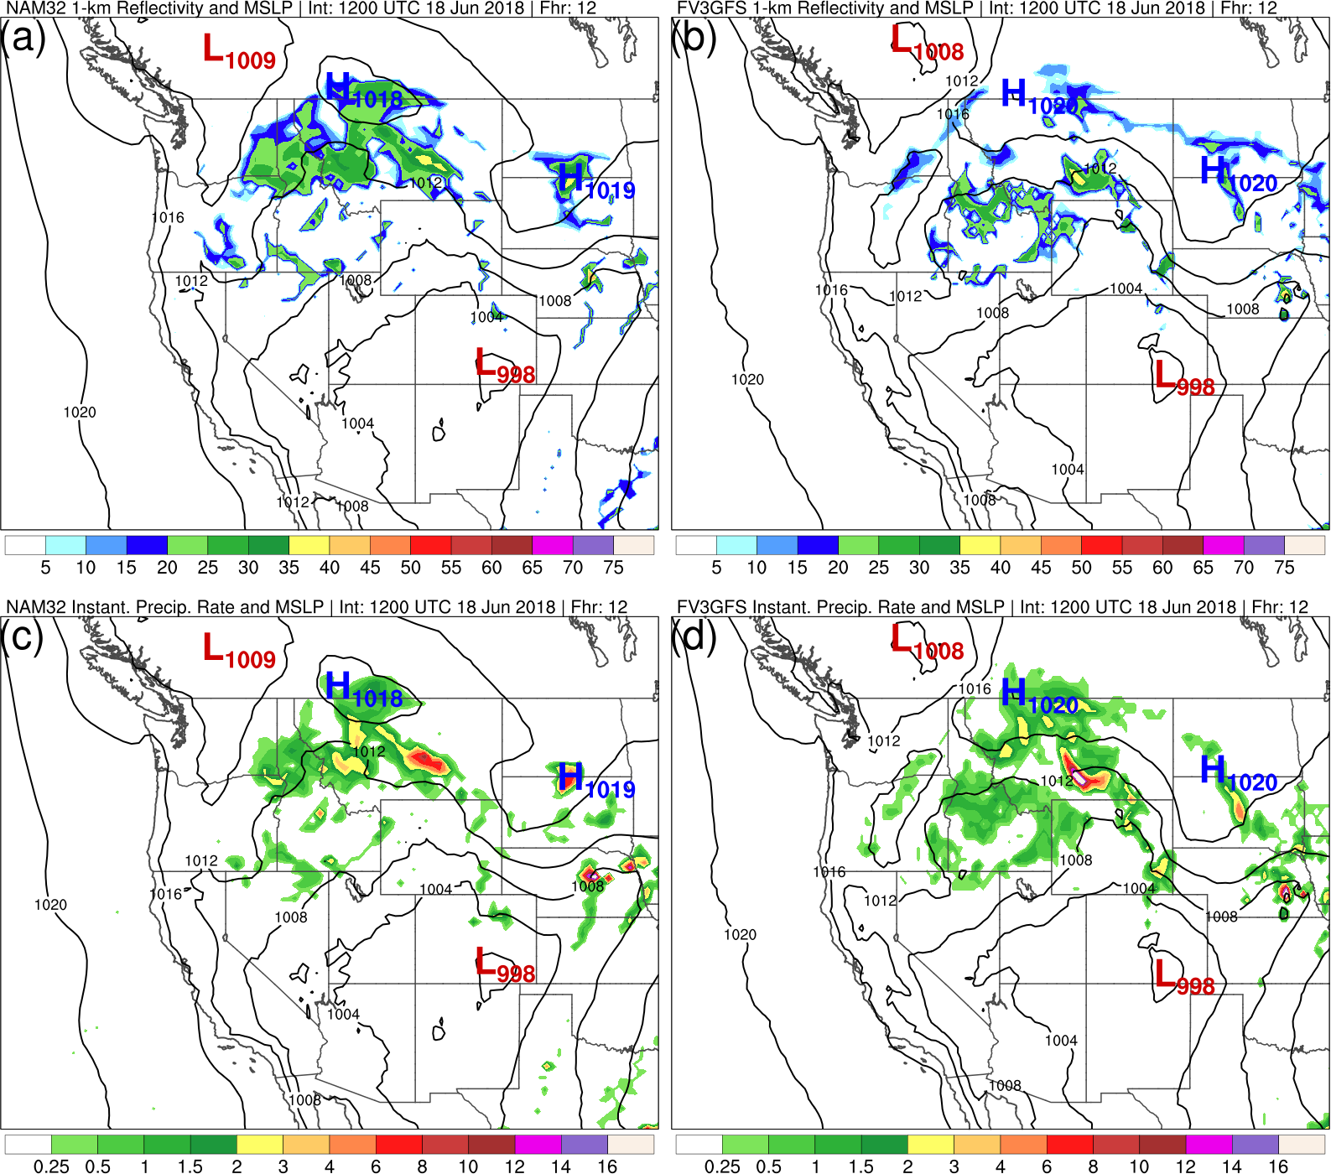
Initialized: 1200 UTC 18 June 2018 | Fhr: 012
NAM
FV3GFS
Reflectivity is
still underdone
NAM
FV3GFS
PRATE is
primarily non-
convective here

Slide 15
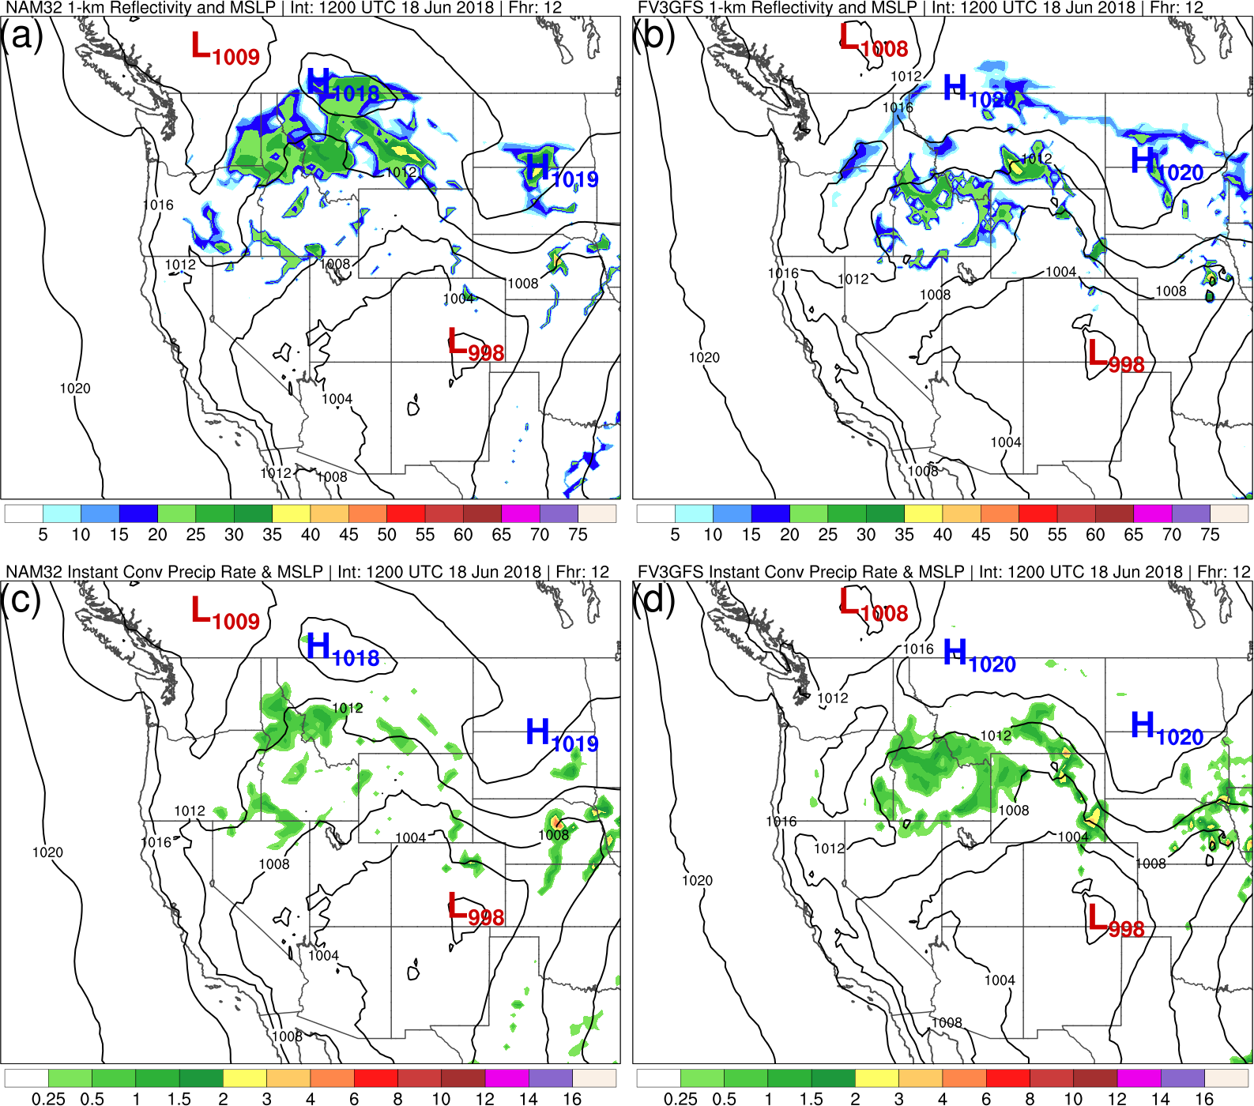
Initialized: 1200 UTC 18 June 2018 | Fhr: 012
NAM
FV3GFS
Reflectivity is
still underdone
NAM
FV3GFS
PRATE is
primarily non-
convective here

Slide 16
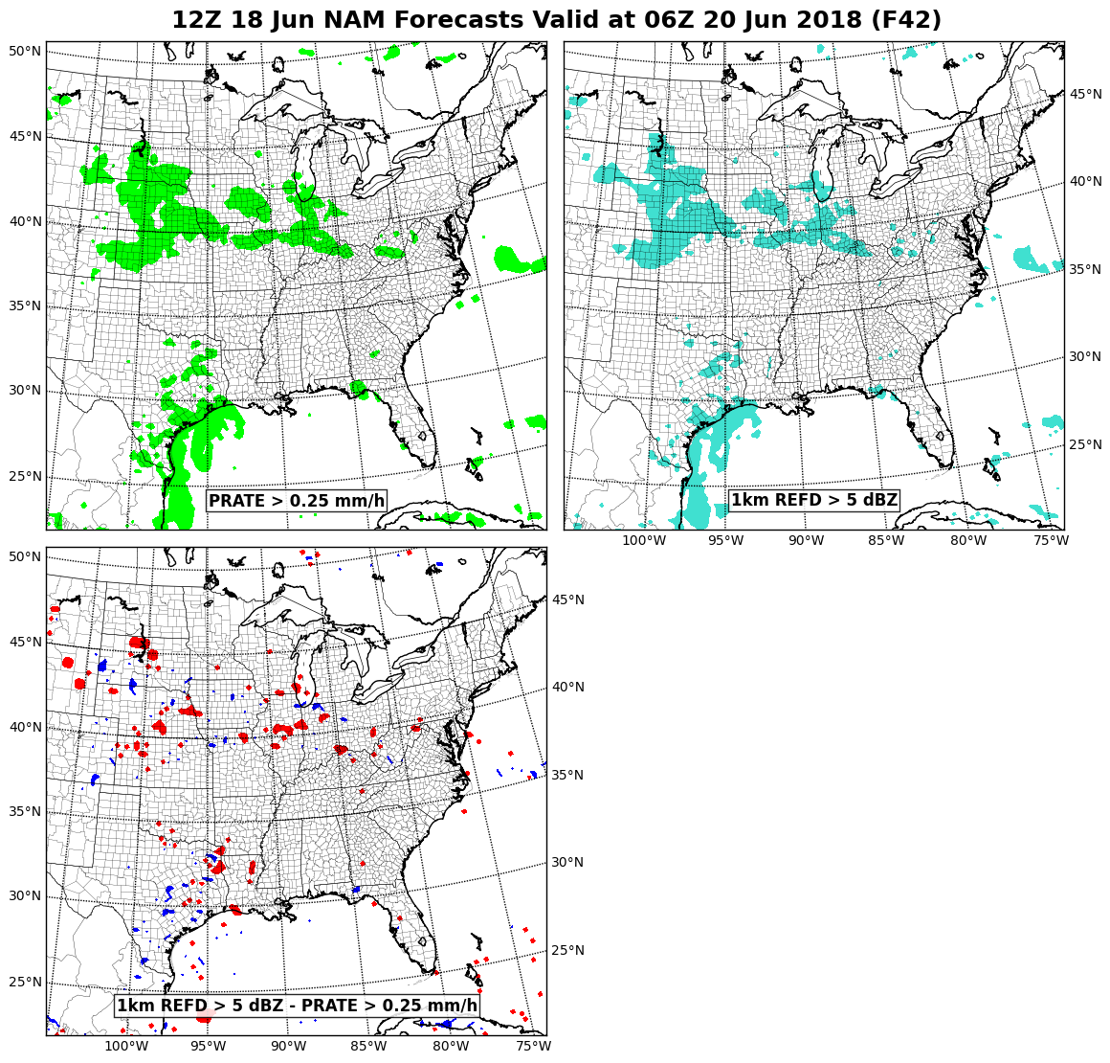
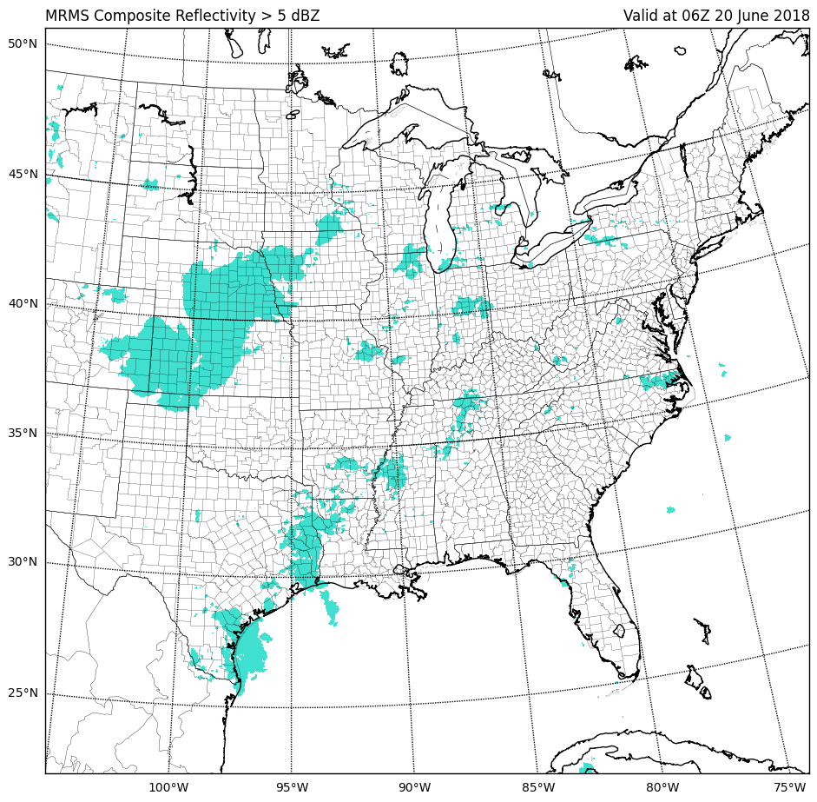
NAM
NAM
NAM Diff.
MRMS*
*Composite reflectivity thresholded for MRMS

Slide 17
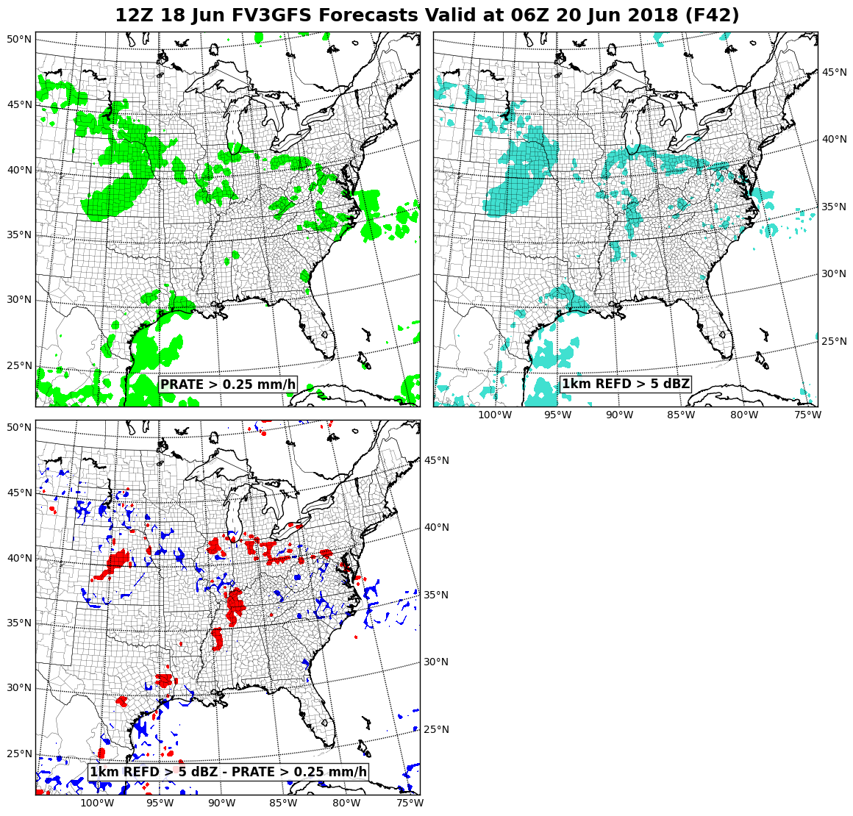
FV3GFS
FV3GFS
FV3GFS Diff.
MRMS*
PRATE improved!
Reflectivity is better in primarily
convective regions.
*Composite reflectivity thresholded for MRMS

Slide 18
Remaining Issues
Reflectivity coverage is too low (and sometimes nonexistent) in areas of primarily stratiform precipitation
Reflectivity values still appear too low in some areas of higher precipitation rates
The MEG and EMC’s Physics and Post teams are continuing to work on resolving these issues

Slide 19
FV3GFS Visibility

Slide 20
Recap: 5/31/2018 MEG Meeting
Considerably less coverage of reduced visibilities was
noted in the FV3GFS compared to the ops GFS
Error with instantaneous precipitation rate was suggested as a possible contributing factor for this visibility issue

Slide 21
OBS
Images from Geoff Manikin
Low coverage in FV3GFS

Slide 22
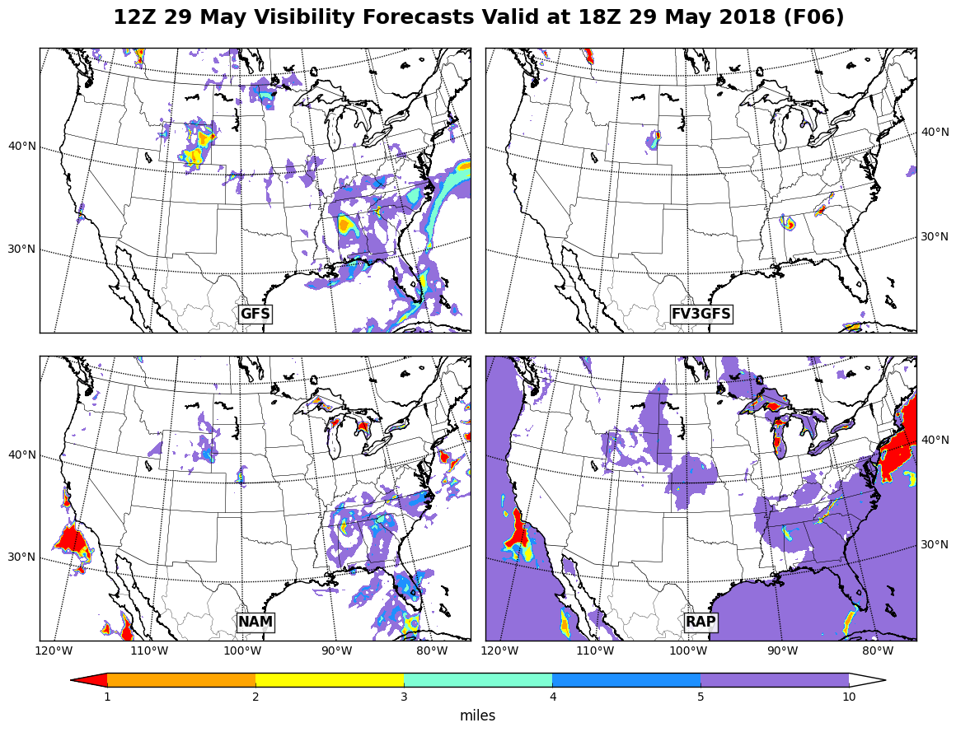
Initialized: 1200 UTC 29 May 2018 | Fhr: 006
GFS
FV3GFS
NAM
RAP
FV3GFS had limited visibility reductions.

Slide 23
Initialized: 0600 UTC 30 May 2018 | Fhr: 048
Before Instantaneous Precip. Rate Fix
GFS
FV3GFS
Images from Matt Pyle

Slide 24
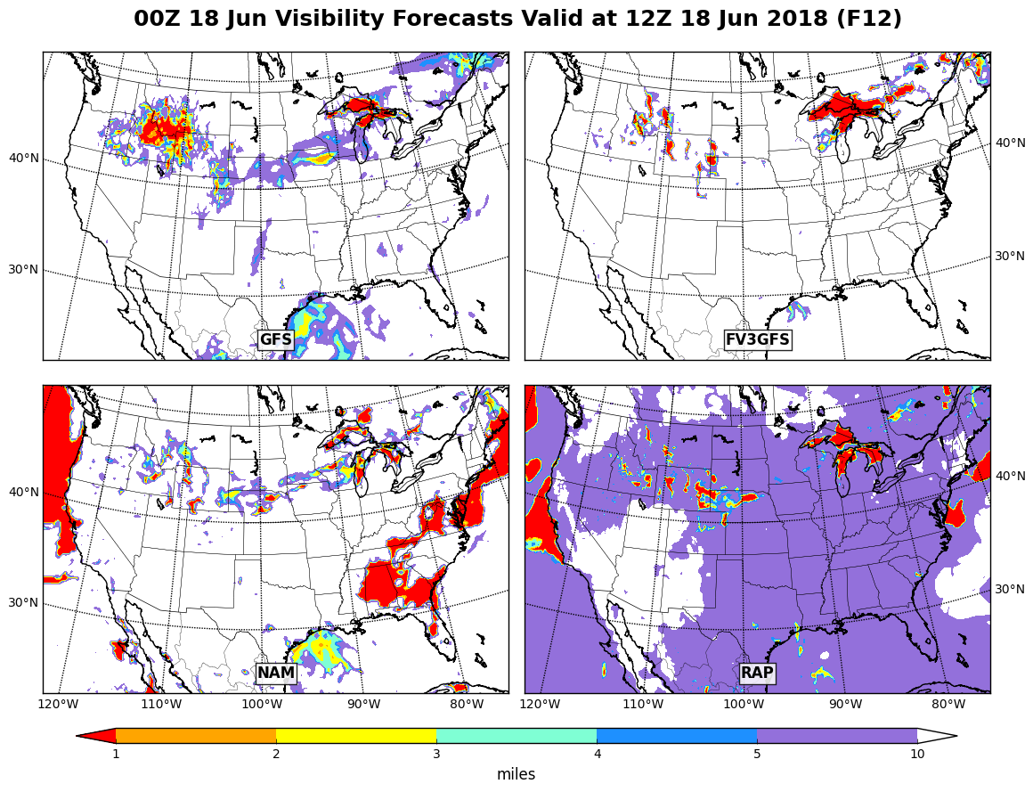
Initialized: 0000 UTC 18 June 2018 | Fhr: 012
GFS
FV3GFS
NAM
RAP
After instantaneous prate fix, FV3GFS still had limited visibility reductions.

Slide 25
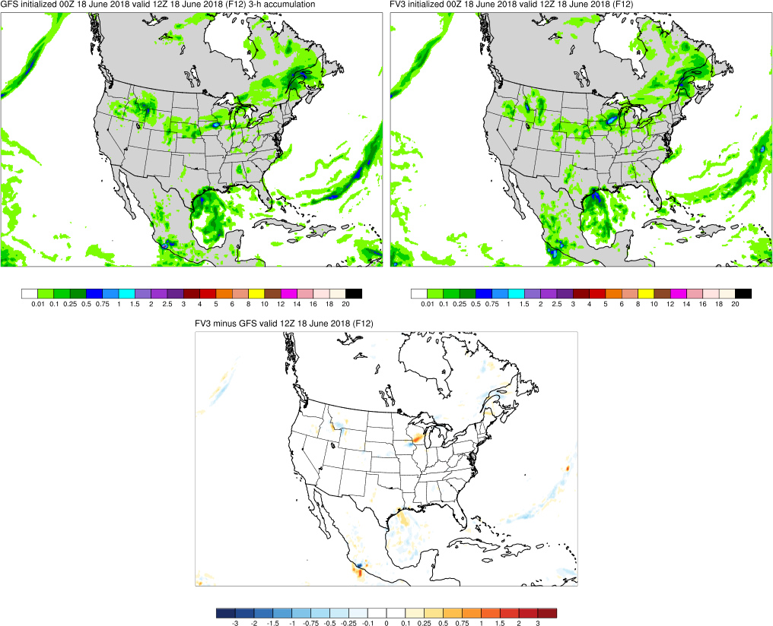
Initialized: 0000 UTC 18 June 2018 | Fhr: 012
GFS and FV3GFS were producing similar precipitation forecasts at this time.

Slide 26
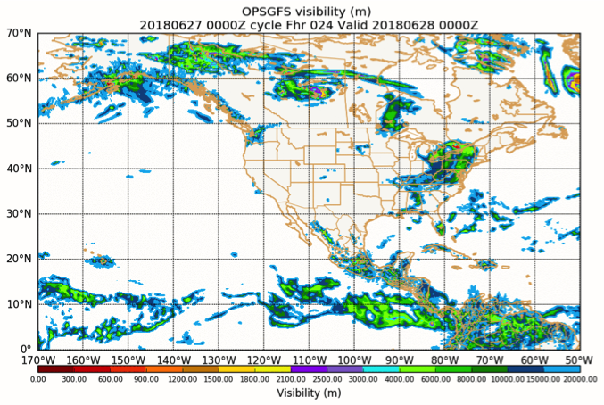
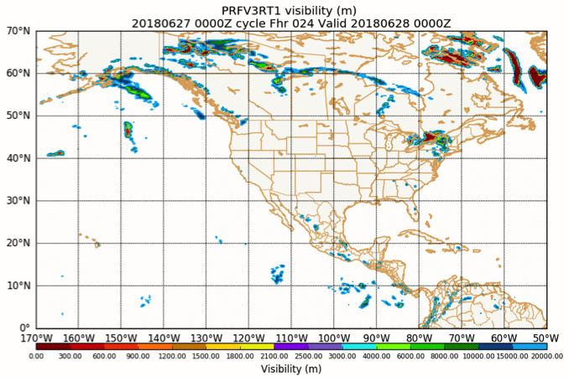
Initialized: 0600 UTC 30 May 2018 | Fhr: 048
After Instantaneous Precip. Rate Fix
GFS
FV3GFS
Some of the most noticeable differences are along the ITCZ.
Images from Matt Pyle

Slide 27
Other Potential Contributing Factors
FV3GFS visibility calculation uses instantaneous precip. rate while ops GFS uses a 6-h averaged precip. rate
Handling of hydrometeors may need to be reconsidered with the change from Zhao-Carr to GFDL microphysics
Other NCEP models, like the NMMB, include a contribution from convective precip. when calculating visibility. This may be the reason why the ITCZ doesn’t show up in the FV3GFS visibility product.
EMC’s Post team has been notified and will address soon
Thanks to Matt Pyle and Jacob Carley for the feedback on this issue

Slide 28
FV3GFS Feedback

Slide 29
VLAB Forum Update
FV3GFS-Feedback.VLab@noaa.gov account is ready
If you send an email to FV3GFS-Feedback.VLab@noaa.gov, the
email will appear as a post in the FV3GFS Evaluation Forum, and all forum subscribers will get an email from vlab.notifications@noaa.gov
If you reply to a message from vlab.notifications@noaa.gov, forum subscribers will get an email, and the post will appear in the thread
on the forum
NOTE: Non-VLab members who email to the forum will be identified as “Anonymous” on VLab and in the subscription email. If writing to the forum in this manner, please identify yourself in the text of your email.

Slide 30
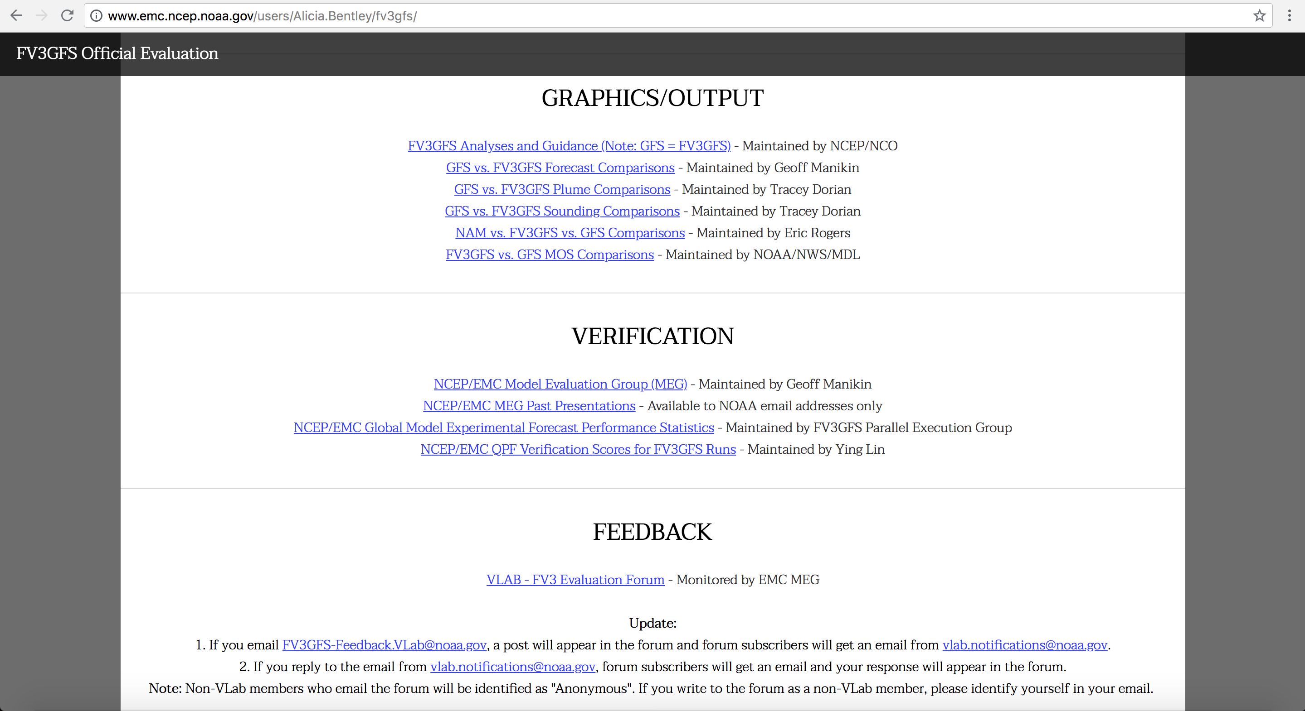
VLAB Forum Update
http://www.emc.ncep.noaa.gov/users/Alicia.Bentley/fv3gfs/

