Slide 1
14 June 2018 MEG Briefing Recent FV3GFS Stats
Logan Dawson
logan.dawson@noaa.gov
EMC Model Evaluation Group

Slide 2
Topic
Discussion of recent FV3GFS stats
Update on VLab Forum functionality
500 mb Anomaly Correlation scores from EMC FV3GFS Parallel Execution Group
CONUS QPF stats from Ying Lin (EMC)
Temperature stats from EMC FV3GFS Parallel Execution Group

Slide 3
VLab Forum Update
The FV3GFS-Feedback.VLab@noaa.gov account is ready
If you send an email to FV3GFS-Feedback.VLab@noaa.gov, the email will appear as a post in the FV3GFS Evaluation Forum, and all forum subscribers will get an email from vlab.notifications@noaa.gov
If you reply to a message from vlab.notifications@noaa.gov, forum subscribers will get an email, and the post will appear in the thread on the forum
NOTE: Non-VLab members who email to the forum will be identified as “Anonymous” on VLab and in the subscription email. If writing to the forum in this manner, please identify yourself in the text of your email.

Slide 4
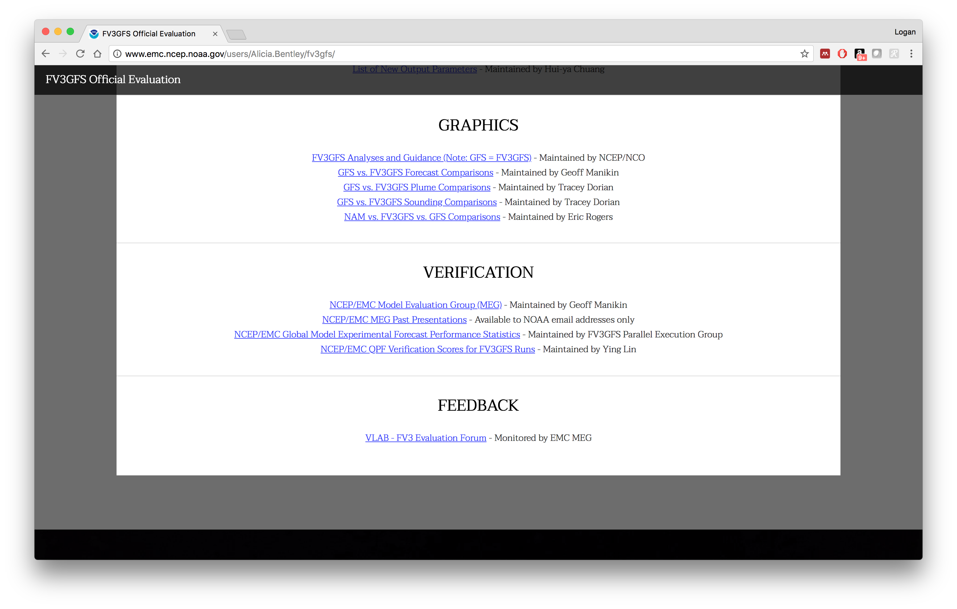
Links for VLab Forum and Recent Stats Are Publicly Available
on FV3GFS Official Evaluation Website

Slide 5
500 mb Anomaly Correlation

Slide 6
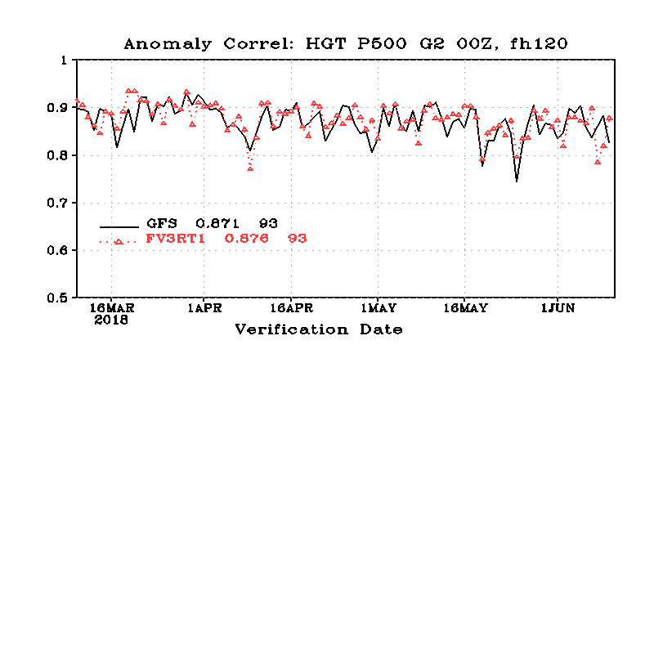
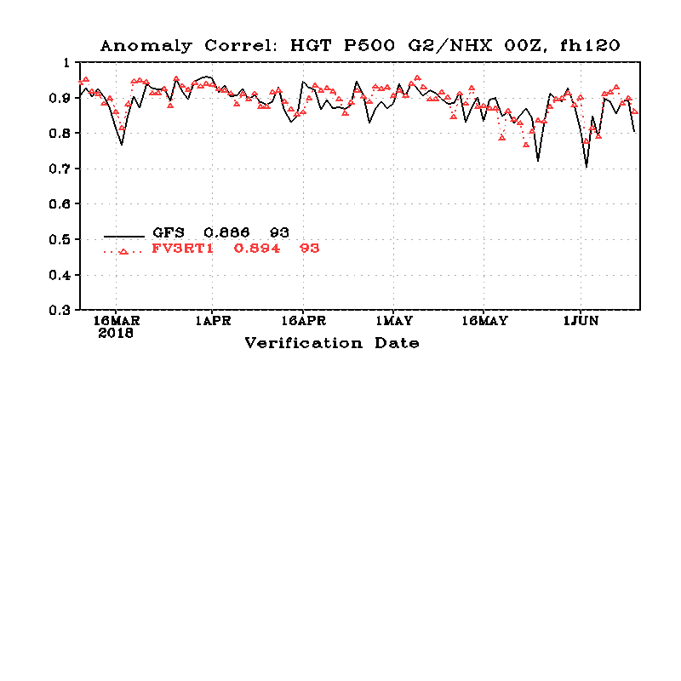
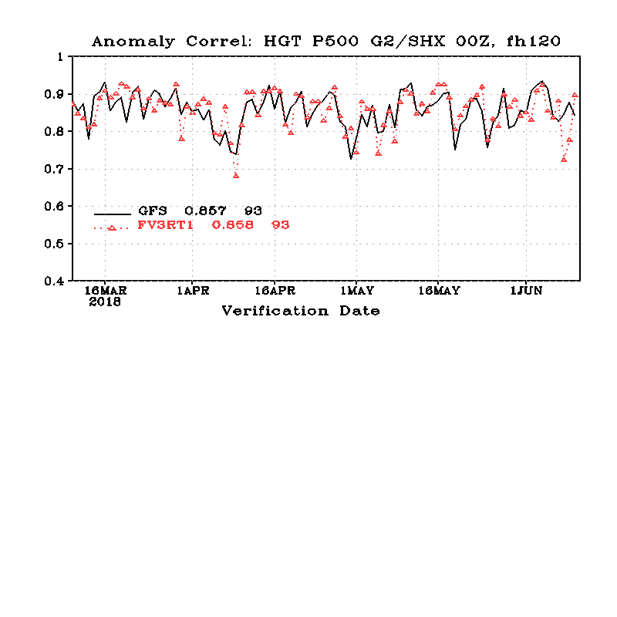
DAY 5 500 mb Anomaly Correlation Scores
GFS: 0.871
FV3GFS: 0.876
Globe
N. Hemisphere
S. Hemisphere
GFS: 0.886
FV3GFS: 0.894
GFS: 0.857
FV3GFS: 0.858

Slide 7
FV3GFS ACs Were Nominally Lower from Day 7-12 in S. Hemisphere

Slide 8
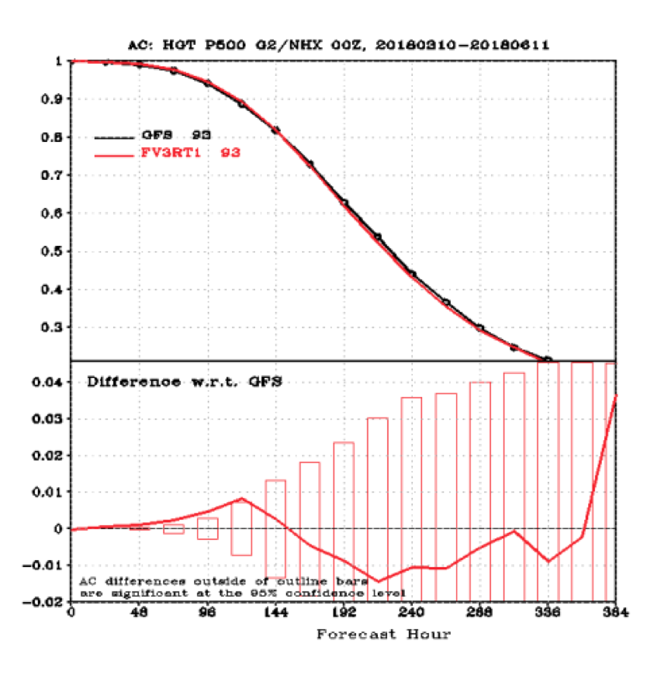
FV3GFS ACs Were Higher through Day 6 in N. Hemisphere

Slide 9
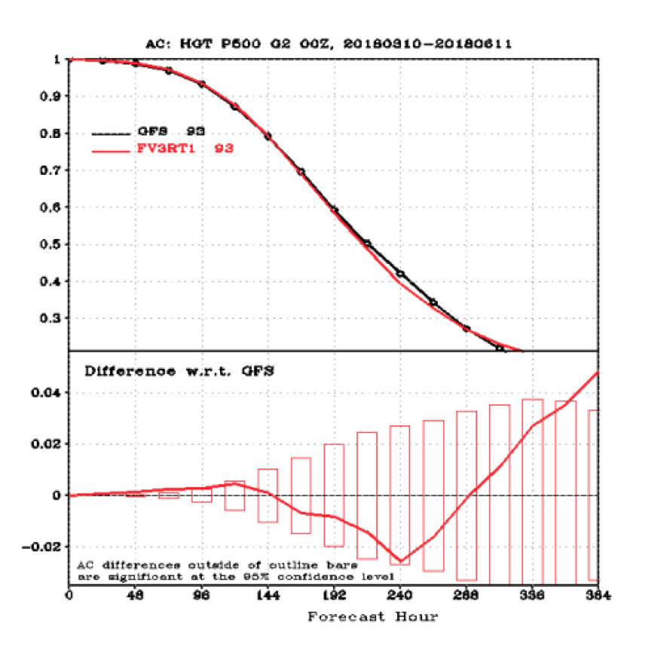
Pattern Averages for Globe, Where FV3GFS May Have Been Slightly Better in First Few Days of Forecast

Slide 10
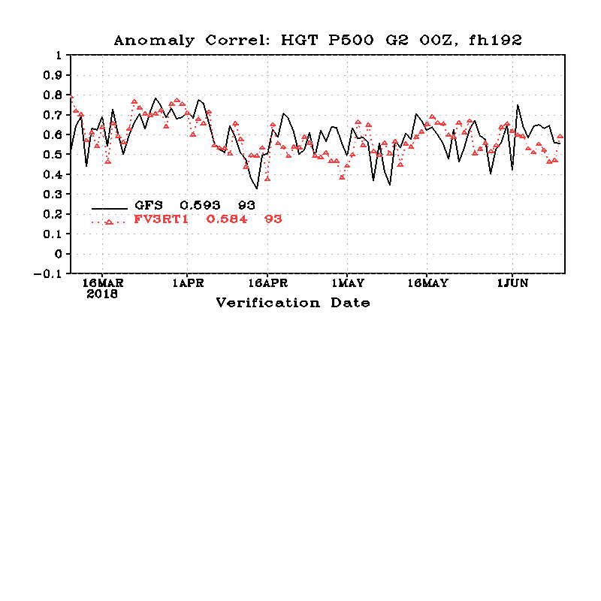
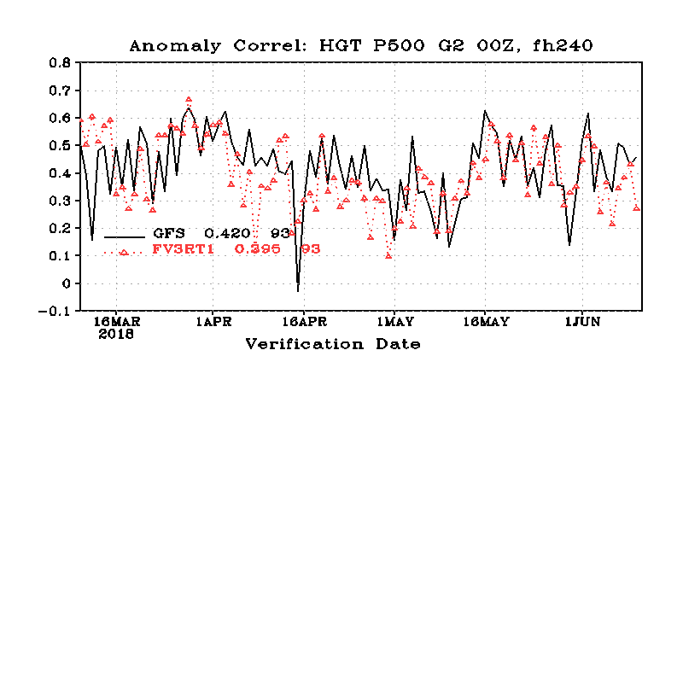
With Medium-Range Forecasts, ACs Decreased More Rapidly
for FV3GFS than for GFS
GFS: 0.871
FV3GFS: 0.876
*FV3GFS is lower at Day 8 and Day 10 , but not statistically significant
Day 5
Day 8
Day 10
GFS: 0.593
FV3GFS: 0.584
GFS: 0.420
FV3GFS: 0.395

Slide 11
QPF Stats

Slide 12
On Following Slides…
GFS is shown with red lines
FV3GFS is shown with blue lines
CCPA observations (if shown) are in green lines

Slide 13
Caveats
Precipitation stats shown on next two slides are for a roughly 6-week period from early May through early June
This period includes the time frame when the FV3GFS SST issue was at its worst.
Thus, QPF stats were to some degree contaminated by spurious convection that was forming in the FV3GFS.

Slide 14
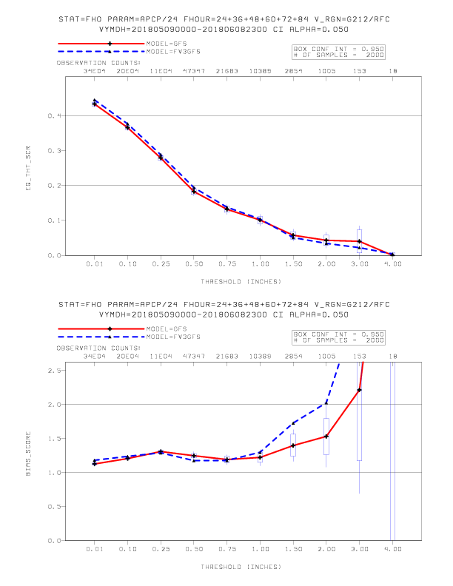
GFS and FV3GFS ETS and Bias for 24-h Precipitation Forecasts
Stats for all forecasts through F84
GFS and FV3GFS equitable threat scores were quite similar
Both had slightly high bias at all thresholds <= 1”
Higher bias at higher thresholds, especially for FV3GFS
ETS
Bias

Slide 15
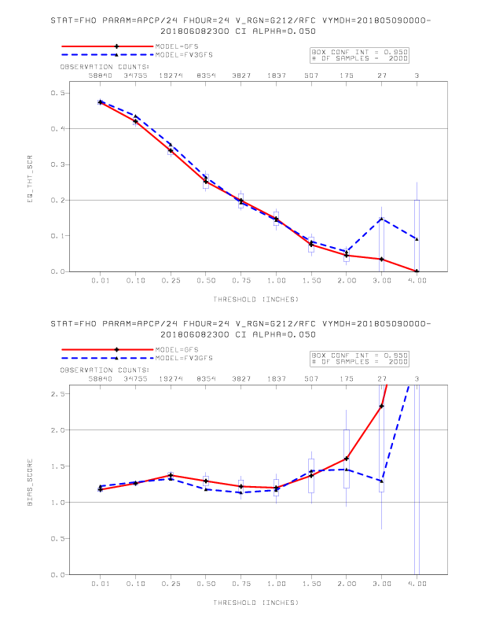
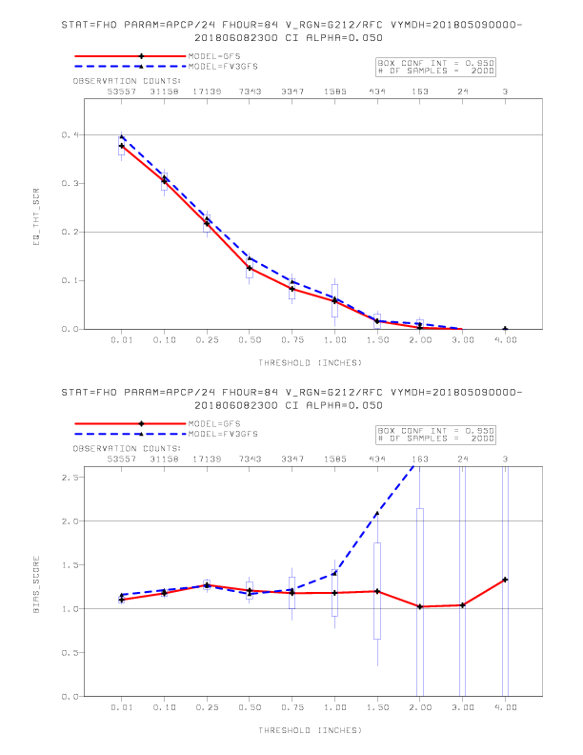
GFS (FV3GFS) Bias Was Lower at Longer (Shorter) Forecast Leads
ETS
F00-F24
ETS
F60-F84
Bias
F00-F24
Bias
F60-F84

Slide 16
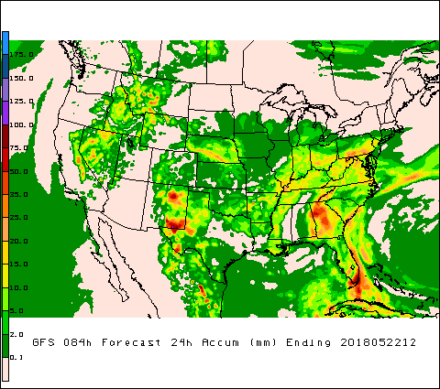
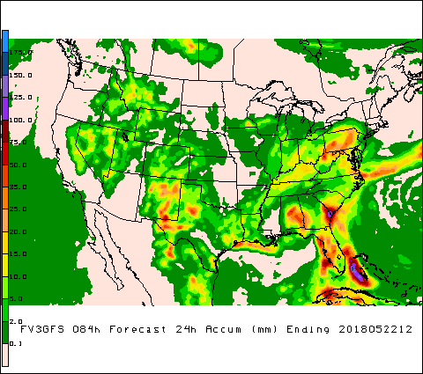
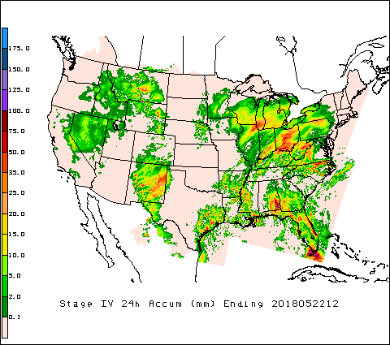
FV3GFS Bias Was Higher at Longer Forecast Leads
GFS
F60-F84
FV3GFS
F60-F84
FV3GFS high QPF maxes far and away overdid precipitation amounts along SE coast
Stage IV

Slide 17
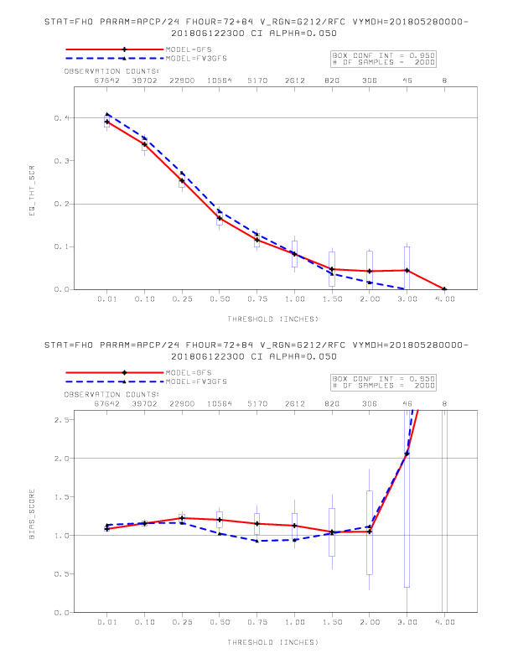
Similar Bias for FV3GFS and GFS After SST Fix
9 May – 8 June
28 May – 12 June
ETS (top) and Bias (bottom) for F60-F84

Slide 18
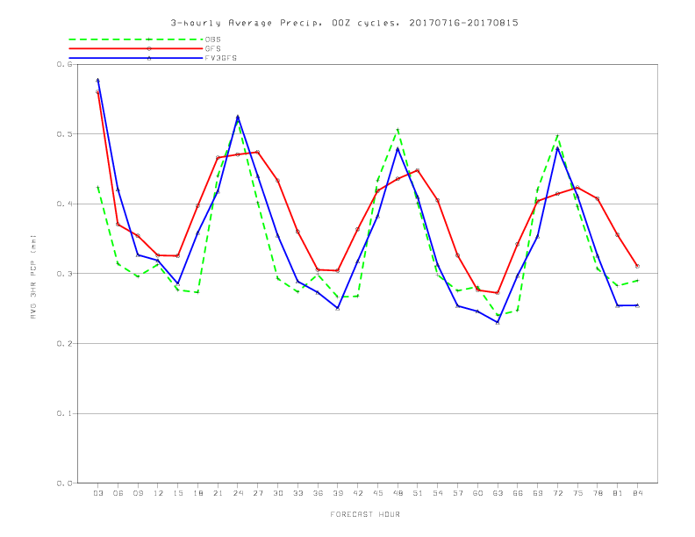
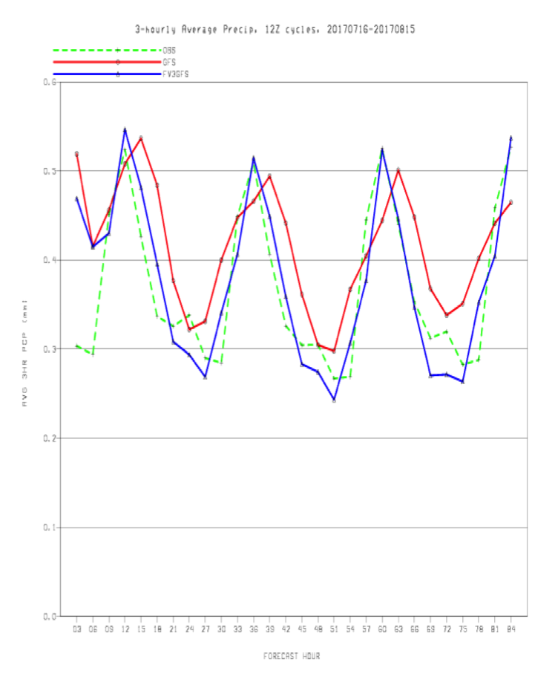
Previous FV3GFS Stats Suggested Significant Improvement in Diurnal Cycle
From February MEG Presentation by Glenn White
FV3GFS used GFS ICs and Zhao-Carr MP during this time
00Z Cycles
12Z Cycles
CONUS averaged 3-hourly precipitation (mm) by forecast hour
16 July 2017 – 15 August 2017

Slide 19
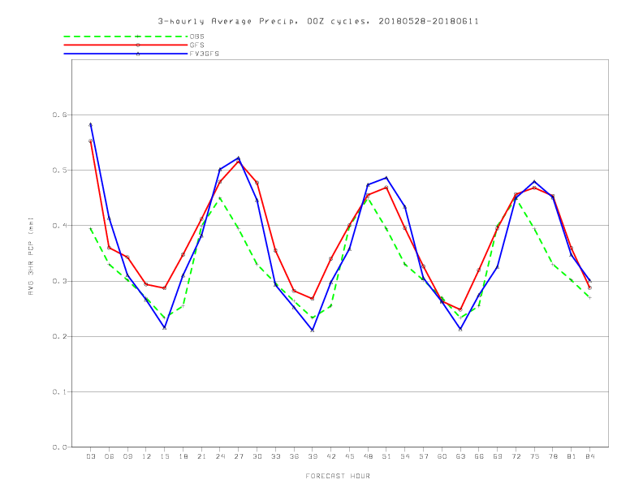
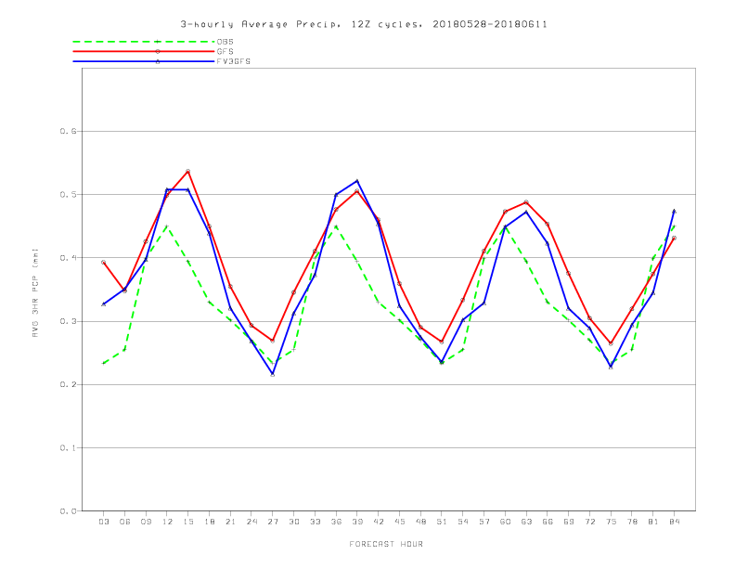
Diurnal Cycle Improvement May Have Been Lost? – Will Have to Watch
00Z Cycles
12Z Cycles
CONUS averaged 3-hourly precipitation (mm) by forecast hour
28 May 2018 – 11 June 2018
Compared to previous slides:
FV3GFS still closely matched the bottom of the diurnal cycle
But, like the GFS, the FV3GFS diurnal cycle peak lagged CCPA observations by 3 hours (compare to slide 18)

Slide 20
Temperature Stats

Slide 21
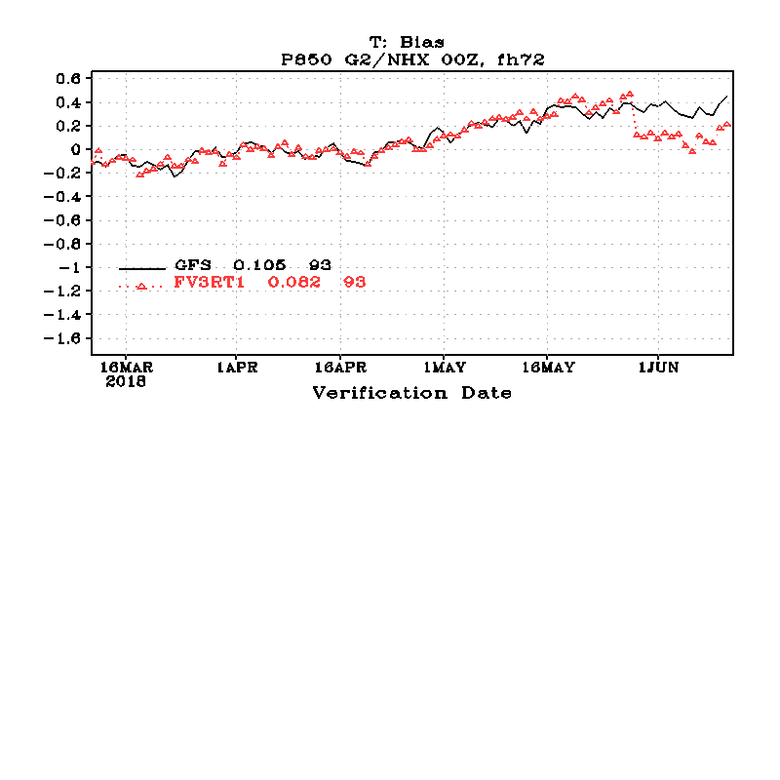
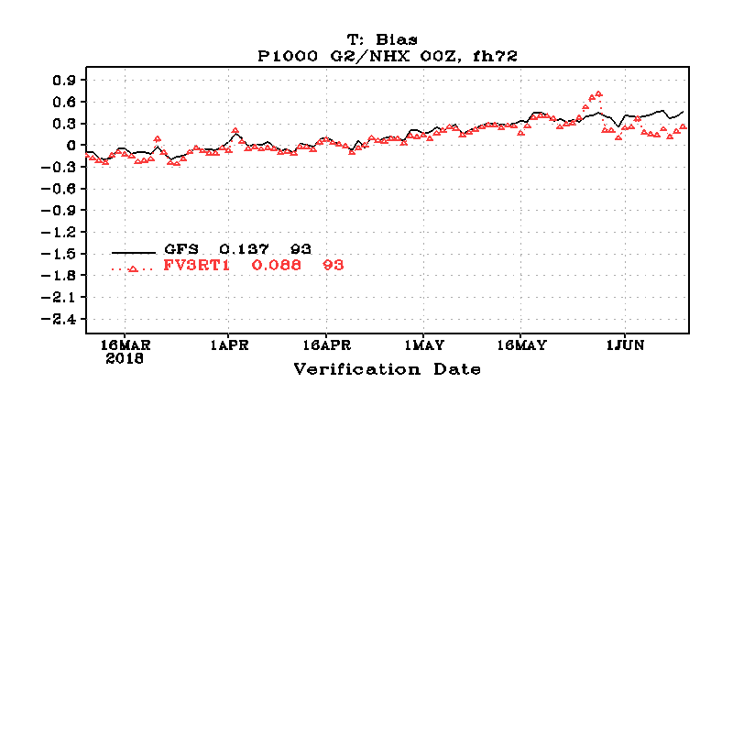
FV3GFS 1000 mb and 850 mb Temp Biases Noticeably Lower after SST Fix*
*Reminder: Immediate impact of SST fix was due to introducing GFS background state into the FV3GFS parallel

Slide 22
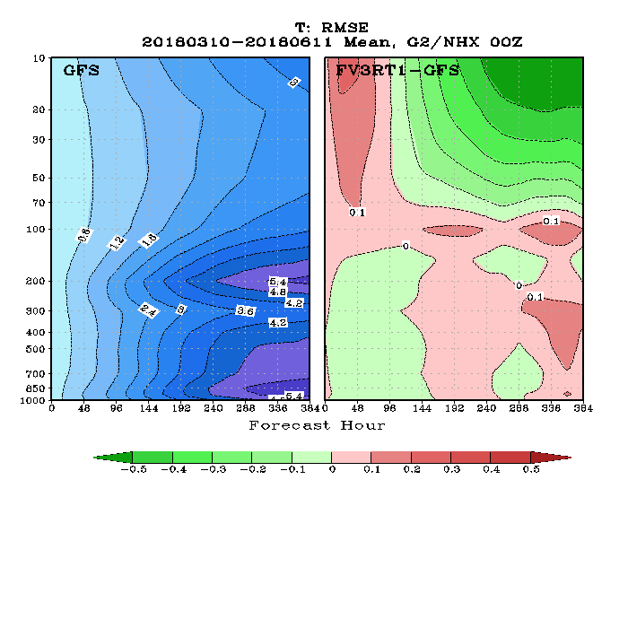
Near Model Top, FV3GFS RMSEs Are Initially Higher than GFS,
Then Improve at Longer Forecast Leads
Focus on right panel…
After ~Day 4, FV3GFS RMSEs are lower (shown in green) than that of the GFS
Considerable improvement above 20 hPa after Day 10

Slide 23
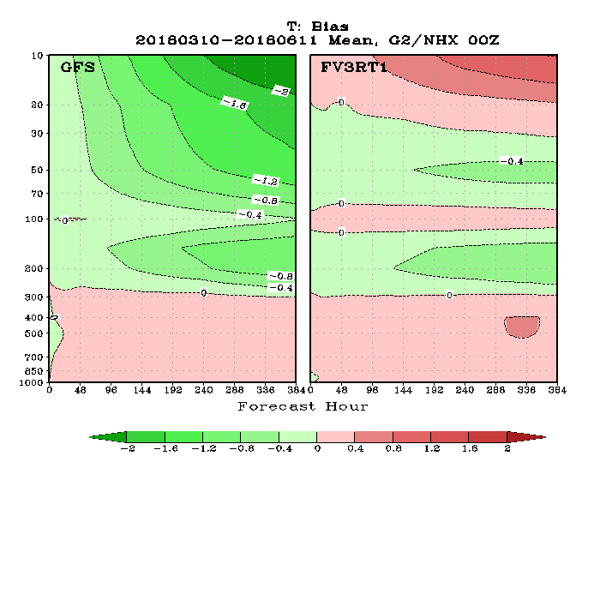
FV3GFS Generally Has a Warm Bias in the Stratosphere,
Though GFS’s Cold Bias Has a Higher Magnitude
Both GFS and FV3GFS have cold bias around the tropopause level, but FV3GFS bias is slightly less at longer forecast leads.
Above 20 hPa, FV3GFS has a warm bias that increases with forecast range, but the magnitude of the GFS cold bias increases more rapidly

Slide 24
Summary
Day 5 500 mb anomaly correlations from FV3GFS are comparable to those of the GFS
FV3GFS QPF statistics were affected to some degree by SST bug. QPF stats after bug fix closely follow GFS stats.
GFS cold bias in stratosphere addressed in FV3GFS parallel, but temperatures are slightly warm now, especially at extended forecast times.
Please continue to send us your feedback via the evaluation VLab forum/email. It’s critical and extremely beneficial to this process!

