Slide 1
MEG DISCUSSION 5/24/18
PROBLEMS with the FV3GFS SST
Geoff Manikin
geoffrey.manikin@noaa.gov

Slide 2
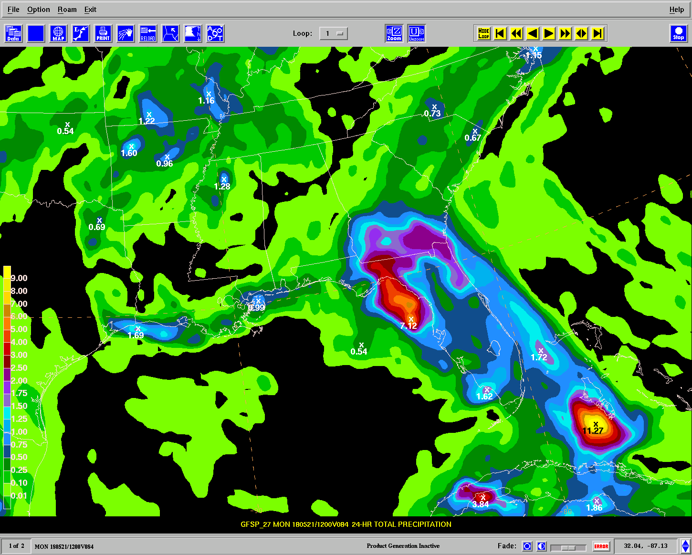
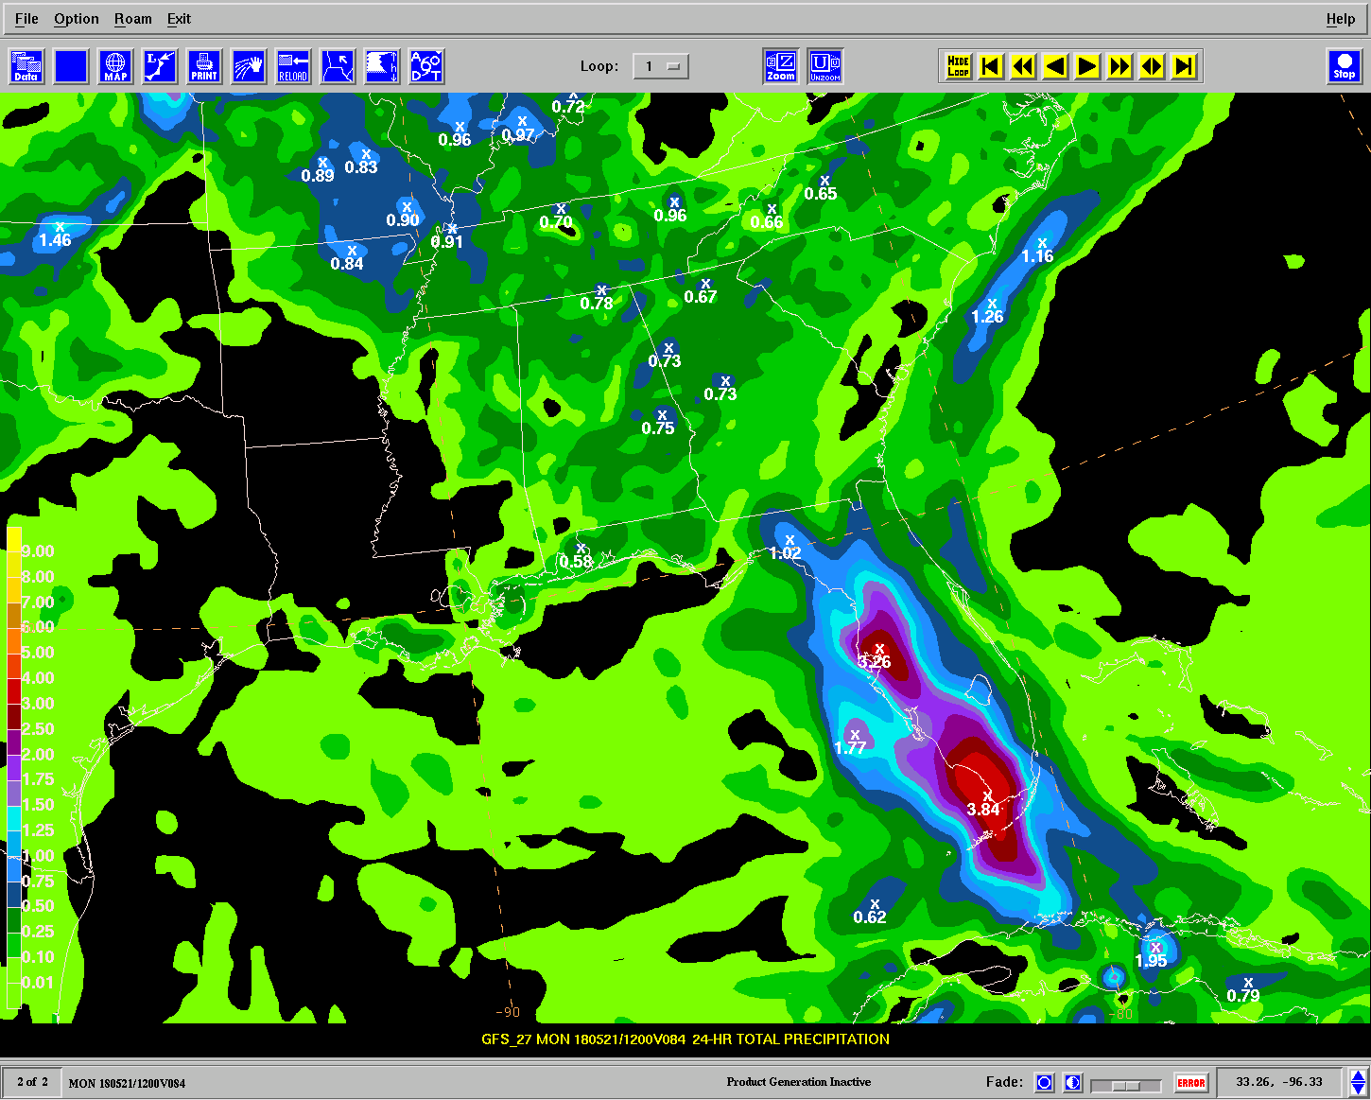
Initial discovery of odd convection in the FV3GFS by Mark Klein (WPC)
Another example - 84-hour forecast - 24hr QPF valid 12Z 5/21
FV3
GFS

Slide 3
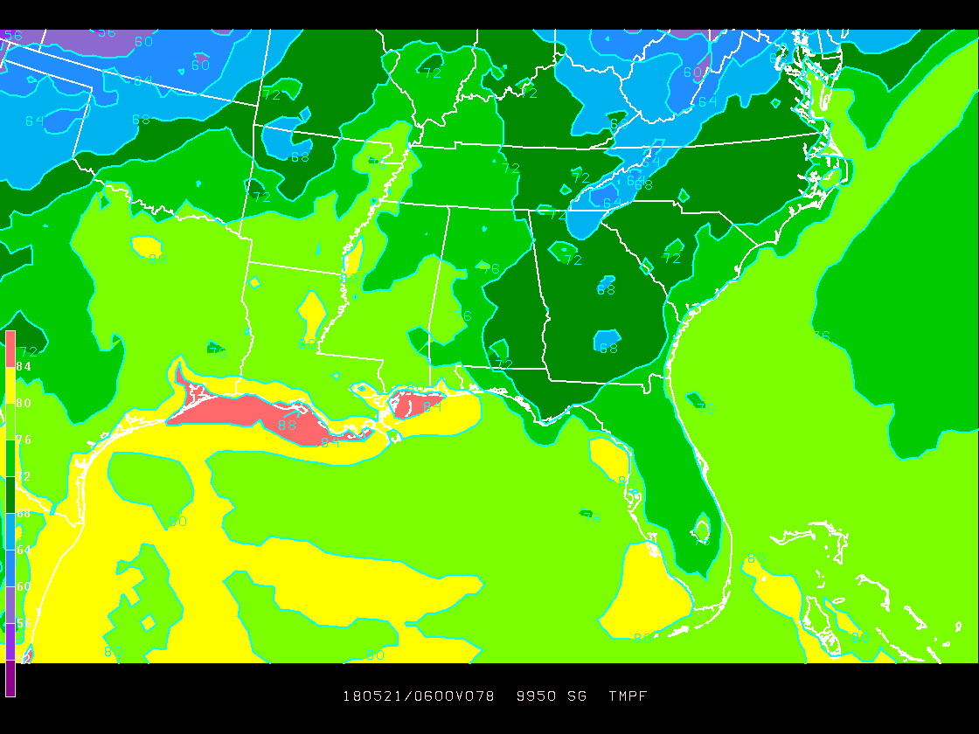
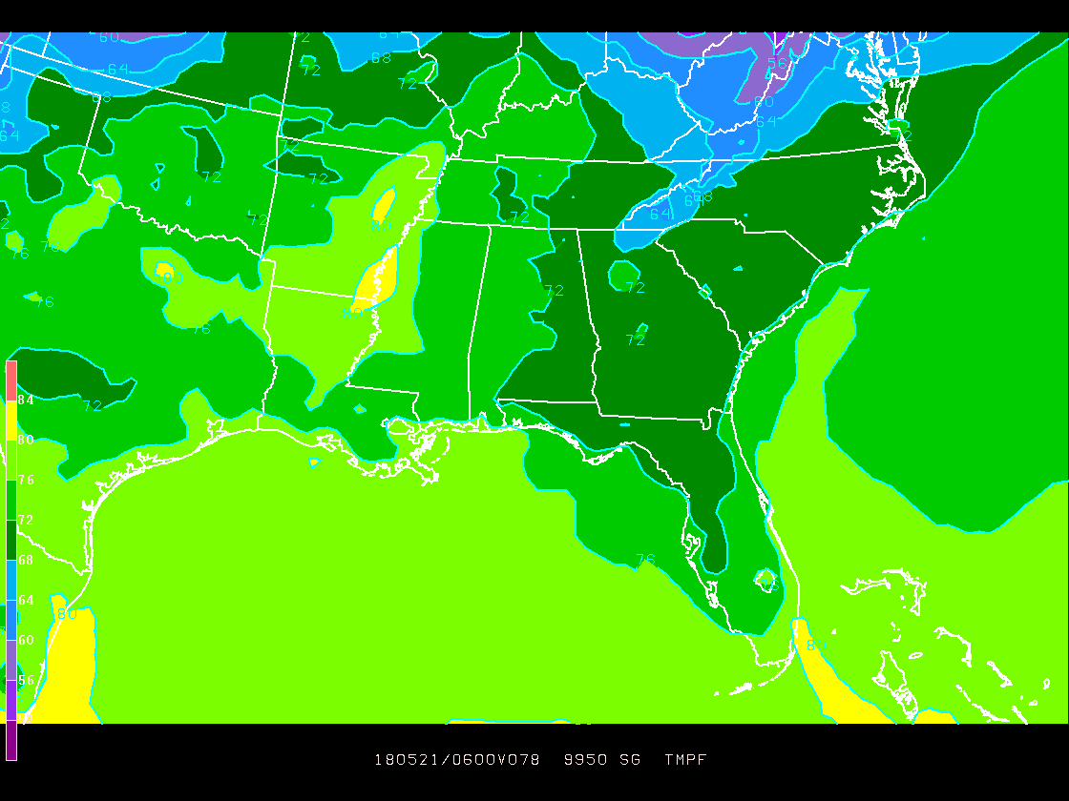
78-hour forecast - Boundary layer temperatures
FV3
GFS

Slide 4
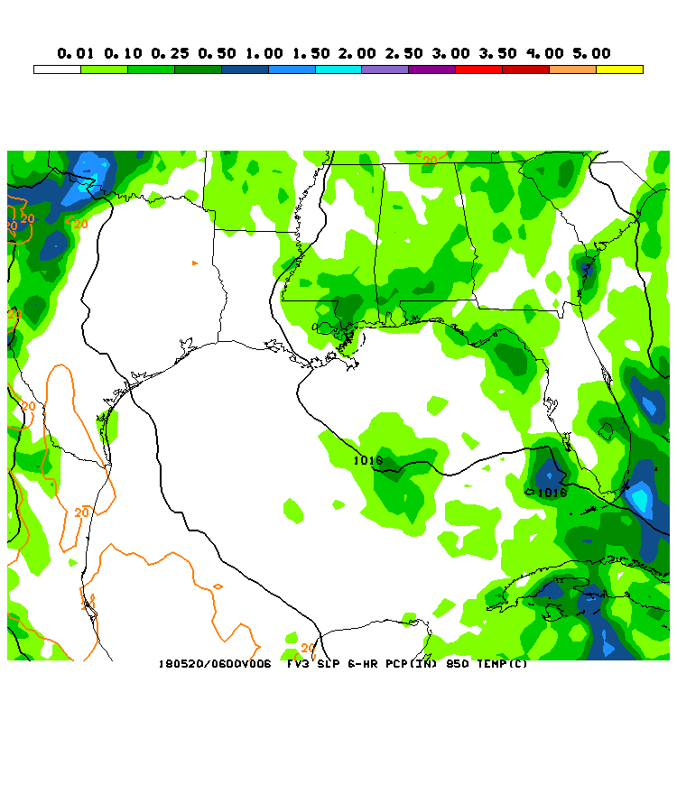

Slide 6
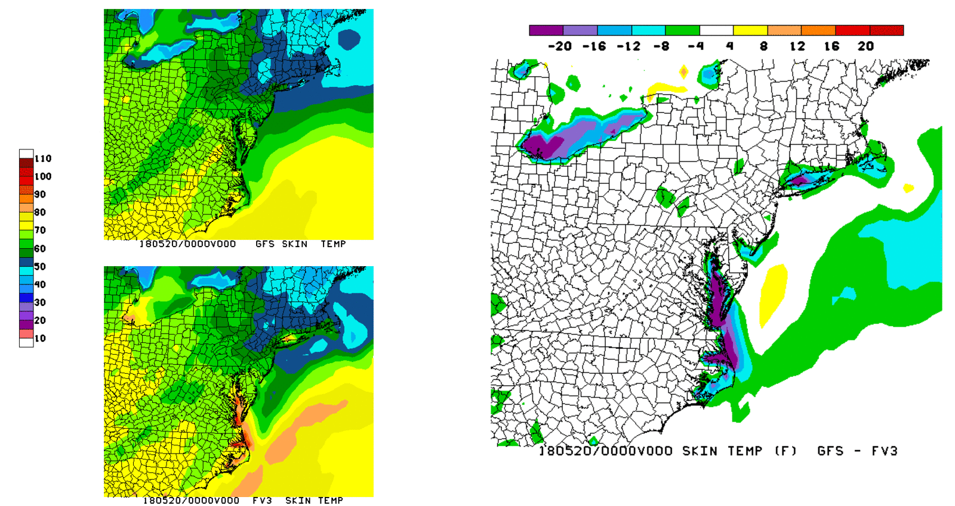

Slide 7
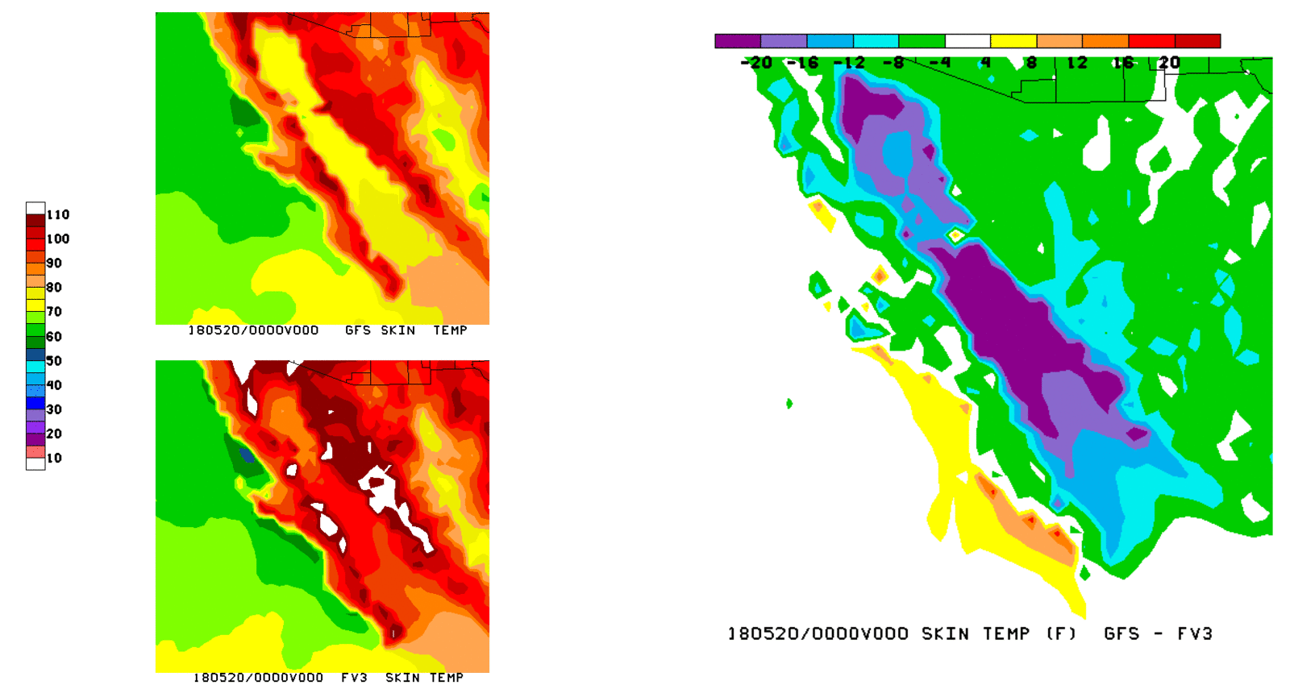

Slide 8
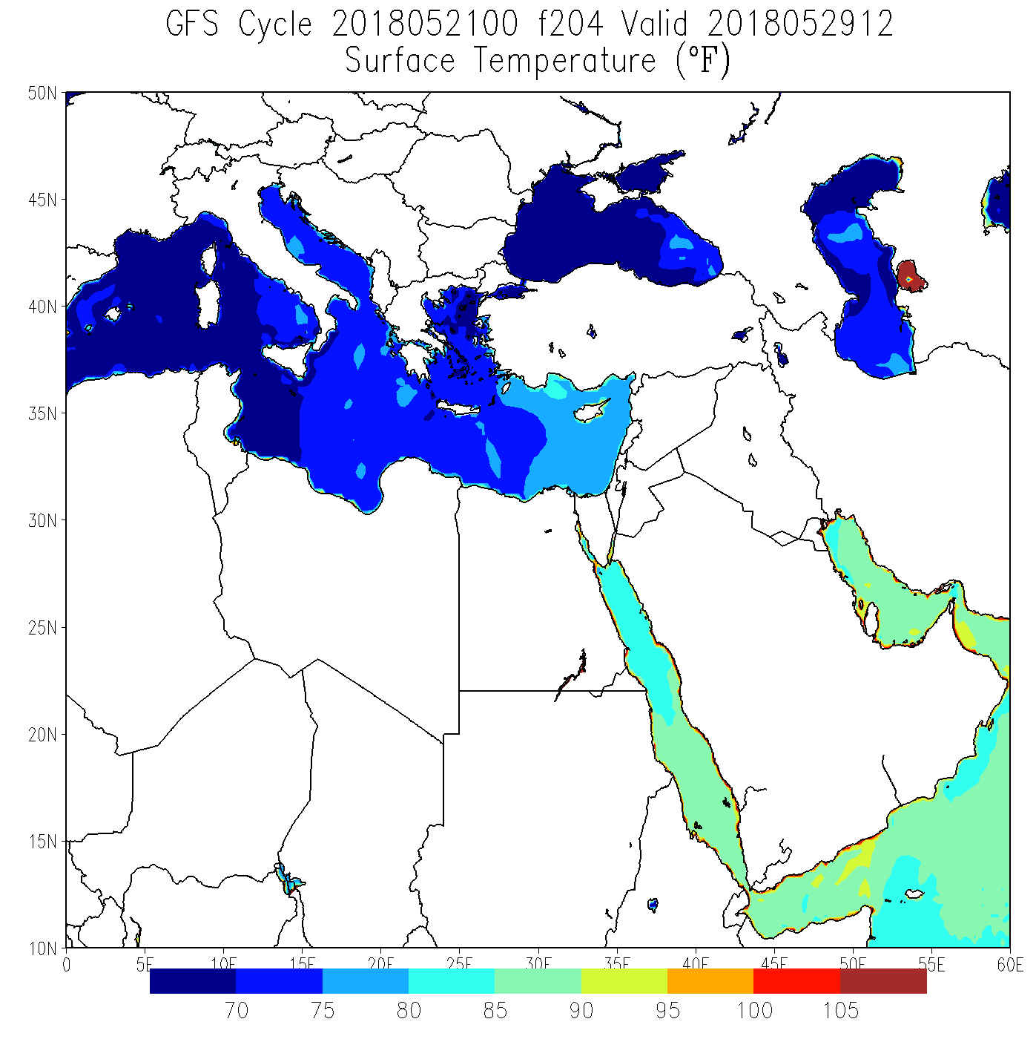
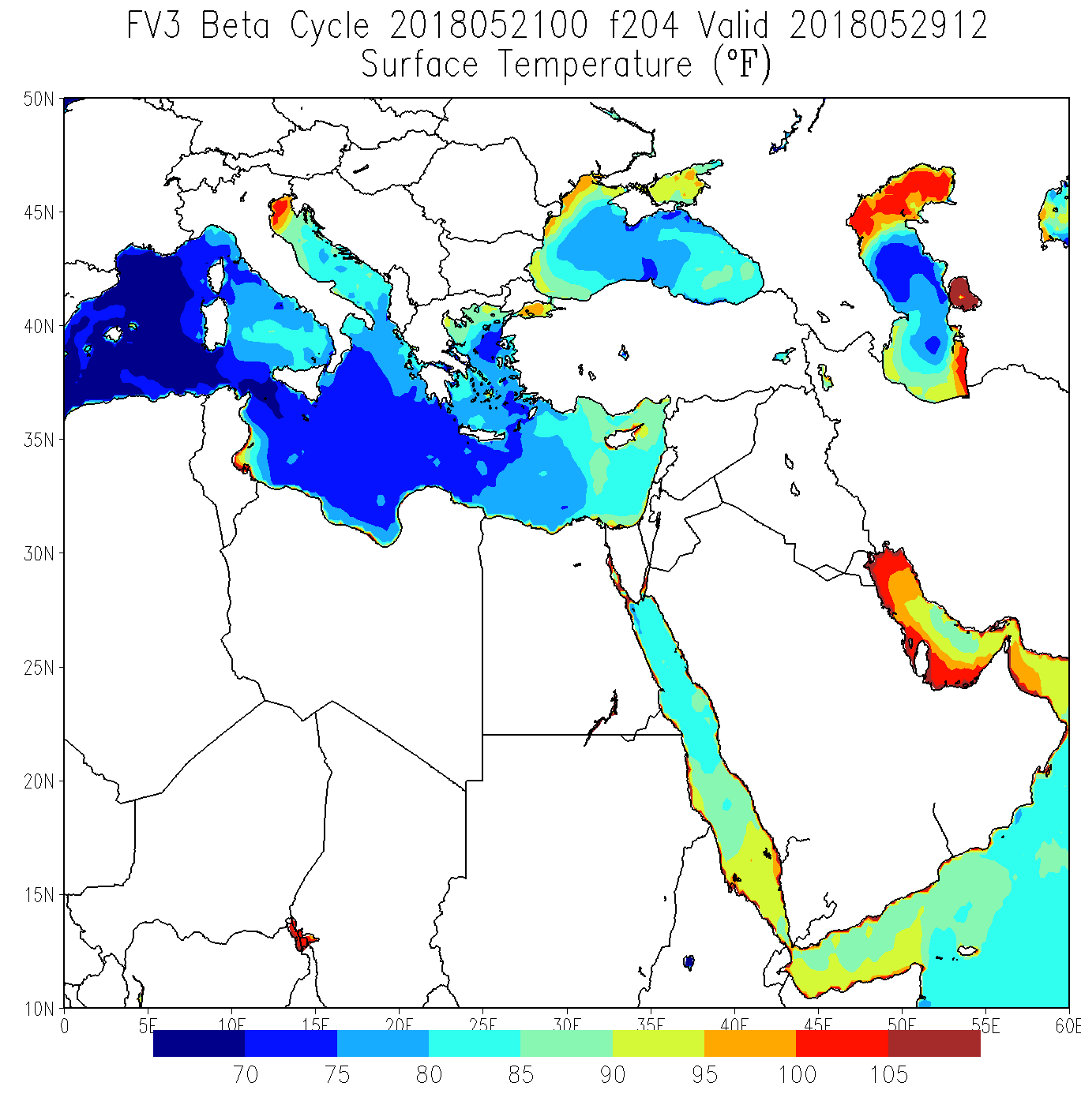
From Tracey Dorian

Slide 9
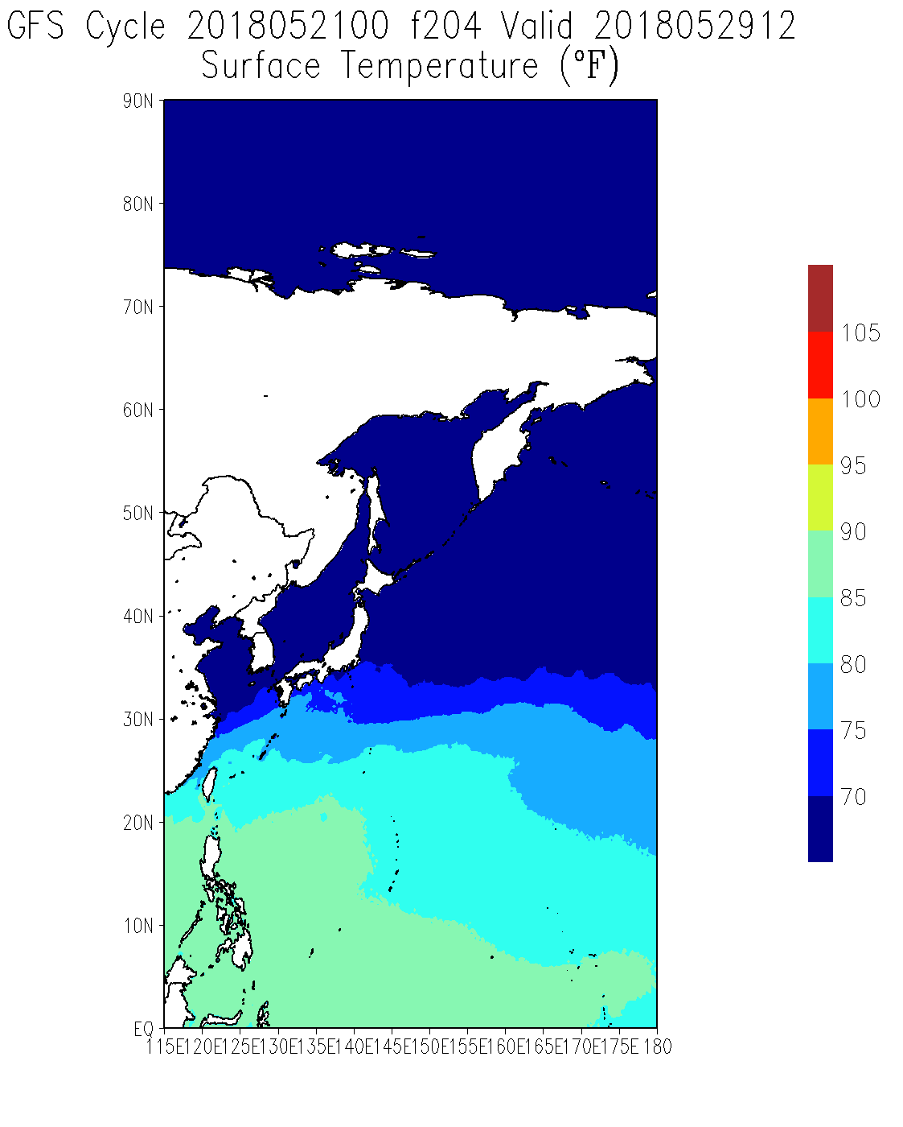
From Tracey Dorian

Slide 10
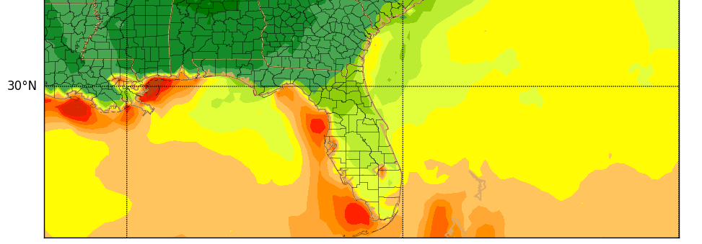
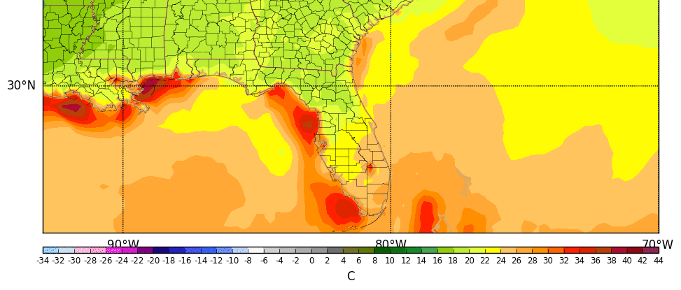
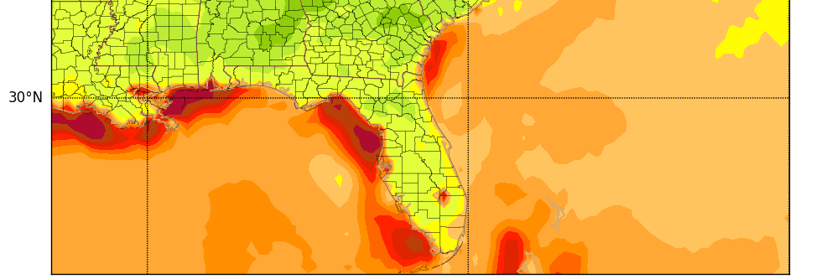
Effect has been cumulative
4/25
5/5
From Matthew Pyle
5/21

Slide 11
NSST (Near-Surface Sea Temperature) Definition
NSST is a T-Profile just below the sea surface.
Here, only the vertical thermal structure due to diurnal thermocline layer warming
and thermal skin layer cooling is resolved
Diurnal Warming Profile
T
Mixed Layer
Thermocline
z
Deeper
Ocean
Skin Layer Cooling Profile
z
z
11
from Xu Li, John Derber, Shrinivas Moorthi
12

Slide 12
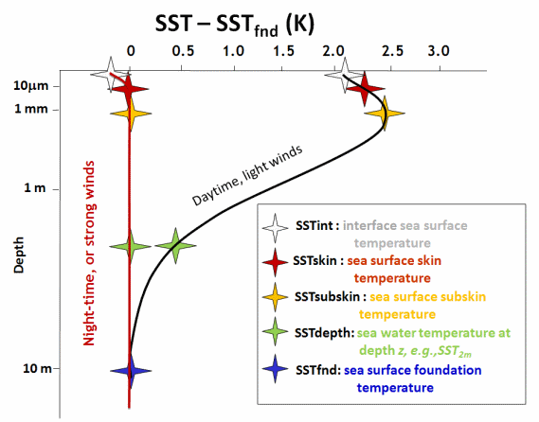
Foundation temperature definition (GHRSST)
IR: $15 μm$
MW: $1 −30 mm$
In situ :
20$cm −3+ m$
Hypothetical vertical profiles of temperature for the upper 10m of the ocean surface
in high wind speed conditions or during the night (red) and for low wind speed during the day (black).
Comments:
The 5 defined SSTs are just characteristic temperatures of a T-Profile $T\left(z\right)$: NSST
$SST=T\left(z=0\right): {SST}_{int}$
Foundation Temperature ${ T}_{f} ({SST}_{fnd})≈$ Mixed layer temperature $≈$ Bulk temperature
SST is not observed directly

Slide 13
12z
18z
GFS
FV3
GFS

Slide 14
What Happened
The order in which the physics and dynamics are called differs in the FV3GFS compared to the GFS
There is a check on whether to modify the foundation SST with climatological tendencies in the code
It’s not invoked in the GFS, but due to the changed order of operations in the FV3GFS, the tendencies were applied to that model
So there was a gradual accumulation of warmth in some areas of water, with the largest increments applied to shallow water

Slide 15
FIXING THE PROBLEM
the fix is in the final stages of testing
should be placed into the EMC FV3GFS parallel by the end of the week
retrospective runs will be redone

Slide 16
PROPOSED Revised Schedule for NGGPS/FV3GFS Version 1 (GFS v15.0) Implementation
3/7/18: code freeze of FV3GFS-V1 (GFS V15.0)
3/30/18: Public release of FV3GFS-V1 code
4/1 - 12/11/18: real-time EMC parallels
5/15 - 9/30/18:
retrospectives and case studies (May 2015 – March 2018: 3 summers and three winters)
develop and validate downstream products
prepare downstream NPS models
science evaluation
NCEP Centers and Field engagement
10/3/18 Field Recommendations Due
10/13/18: Brief NCEP Director
10/17/18: code handoff and public release of operational code
1/3/19: commence NCO 30-day parallel
2/13/19: GFS V15.0 operational

Slide 17
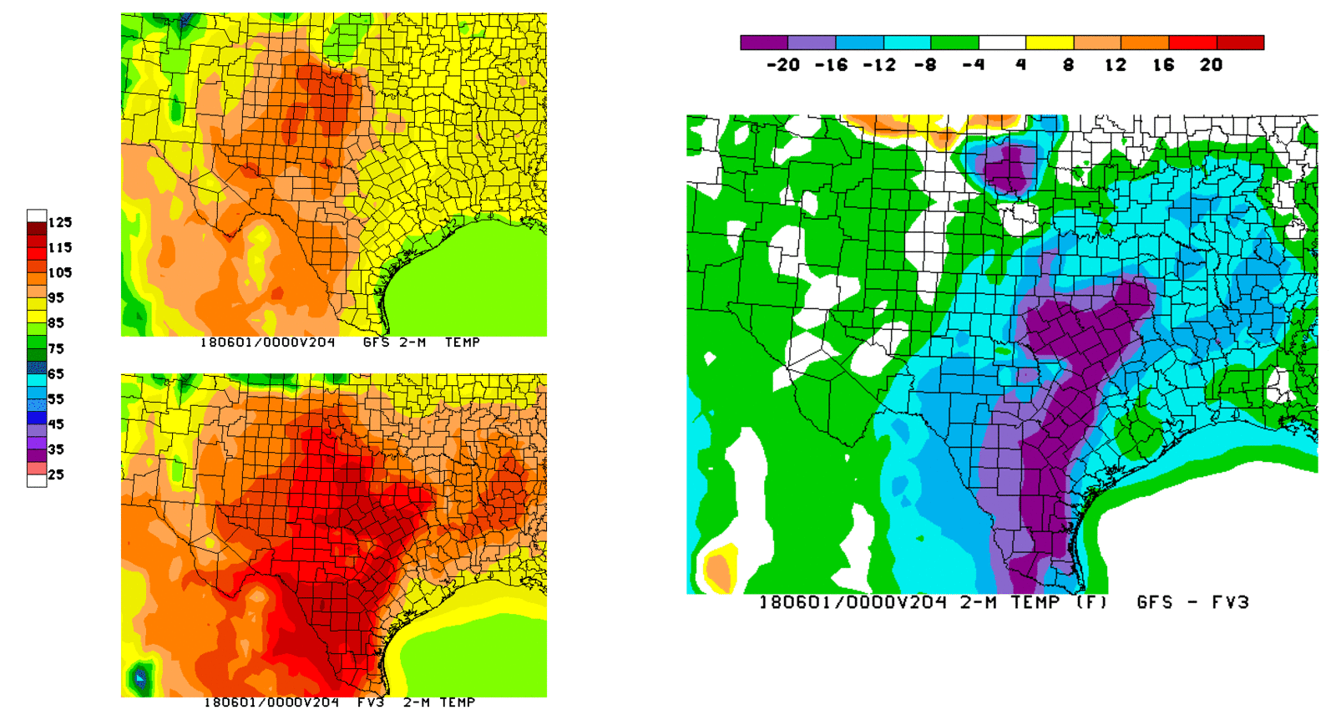
ANOTHER CONCERN
very hot in south/central TX in the long range

