Slide 1
Status Update on Addressing Excessive Snowfall and
the Lower Tropospheric Cold Bias in the FV3GFS
7 March 2019 MEG Briefing
Logan Dawson and Geoff Manikin
Contributions from Fanglin Yang, Brian Gross, Ivanka Stajner, Vijay Tallapragada,
Jack Kain, Jason Levit, Russ Treadon, Daryl Kleist, Weizhong Zheng, Jun Wang,
Helin Wei, Ruiyu Sun, Alicia Bentley, and Tracey Dorian

Slide 2
Current Status
GFSv15 implementation is currently on hold due to issues related to excessive and erroneous snowfall amounts.
EMC is aware of and working on understanding/addressing two issues:
  Unrealistically large accumulation of snow under marginal conditions
  Exacerbated cold bias in the lower atmosphere
EMC has determined at least one cause of the excessive snow and two causes of some of the exaggerated cold bias in the lower troposphere.
EMC management has briefed the acting NCEP Director and the NWS Executive Council on these issues and possible solutions.

Slide 3
Key Facts and Findings So Far
The snow depth and water-equivalent of snow depth at the surface have unrealistically large values when precipitation occurs in environments with low-level temperature profiles close to freezing.
Algorithms that use either of these variables for deriving snowfall from the real-time parallel will exhibit excessive snowfall values.
A July 2018 bug fix to address erroneous snow in the tropics inadvertently caused the excessive snow issue. A fix to ameliorate (but not completely prevent) excessive snow is straightforward.

Slide 4
Key Facts and Findings So Far
The real-time parallel forecasts exhibit an increased cold bias in the lower atmosphere that became more pronounced after late September 2018.
A September 2018 bug fix to address erroneous solar zenith angle in the radiation scheme inadvertently exaggerated the cold bias. We’ve identified a remedy that reduces the cold bias.
Arctic temperatures in the analysis are also excessively cold.
We have a proposed adjustment for a supersaturation constraint in the data assimilation to address cold polar temperatures, and it may also help reduce the cold bias.

Slide 5

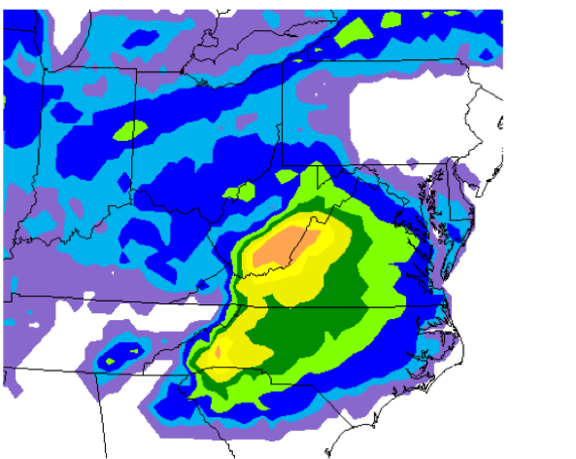
Issue #1: Excessive Snowfall in FV3GFS
FV3GFS predicted widespread snowfall over NC, KY, northern SC, and northern GA. This was inconsistent with other guidance.
Prior to July 2018, if there was more liquid precipitation than frozen, the land surface model (LSM) would ignore any frozen precipitation on the ground, even in warm environments
A fix was added in July 2018 so that when any frozen precip is present, the LSM treats all precip as frozen
In warm environments, the LSM melts the precip
In cold environments, the LSM overestimates snow depth
One cause: Snow depth calculation in the model
(Recall that snow accumulations represent snow + sleet)
FV3GFS 24-h snow accumulation
96-120hr Fcst valid 12Z 19 Feb to 12Z 20 Feb 2019

Slide 6
Issue #1: Excessive Snowfall in FV3GFS
How snow depth and snow water equivalent are currently computed inside the FV3GFS
The cloud model (GFDL MP) predicts rain, snow, graupel, and ice falling on the ground
Total precipitation (rain + snow + graupel + ice + crain), where crain is the convective precipitation
A flag (srflag) is set to 1 if (snow + ice + graupel) > 0 at the lowest model level
srflag is set to 0 if there are no frozen hydrometeors at the lowest model level
For snow depth inside the LSM…
Total precipitation and the srflag are fed into the LSM
If srflag=1, then all precipitation is treated as snowfall.
If srflag=0, but the ground temperature is below 0C, then all precipitation is treated as freezing rain.
For snow water equivalent from the MP…
Snow water equivalent = total precipitation x srflag

Slide 7
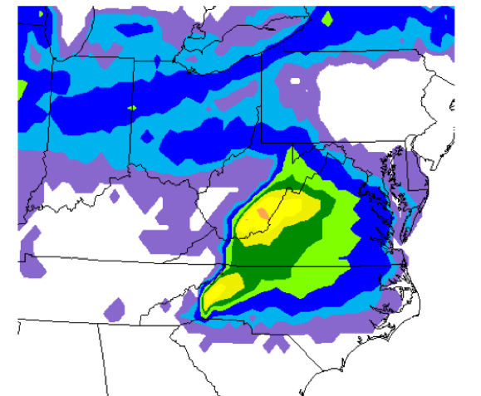
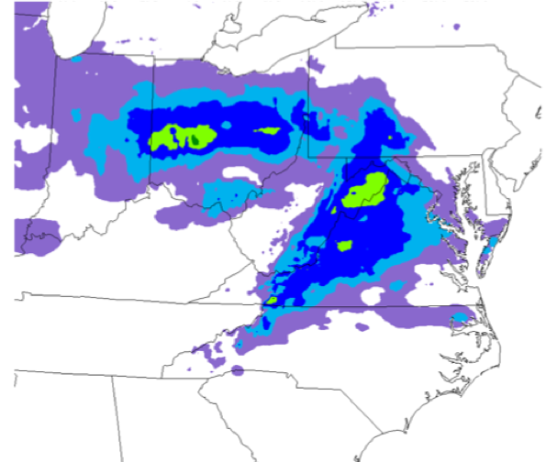
Issue #1: Excessive Snowfall in FV3GFS
Remedy: Only use the frozen part of precip falling on the ground to compute snow depth inside the LSM
i.e., srflag = (snow + ice + graupel)/total precip
24-h snow accumulation valid from 12Z 19 February to 12Z 20 February 2019
Real-Time Parallel
96-120hr Fcst
Fractional srflag Experiment
96-120hr Fcst
24-h NOHRSC Analysis
Excessive snow amounts are reduced in the experiment (middle image), but it still overpredicts snowfall
Overprediction in the experiment is potentially linked to cold bias in lower troposphere (see Issue #2)

Slide 8
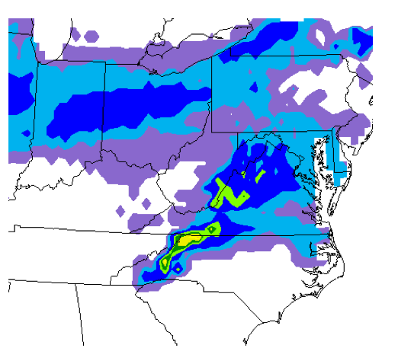
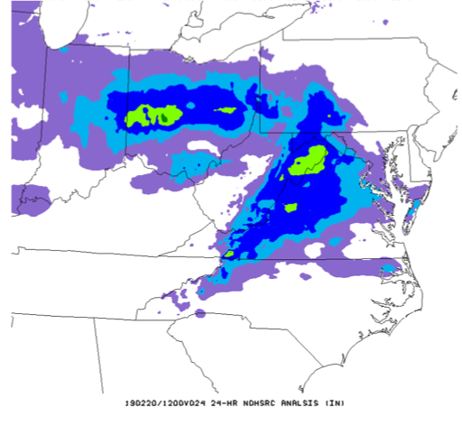
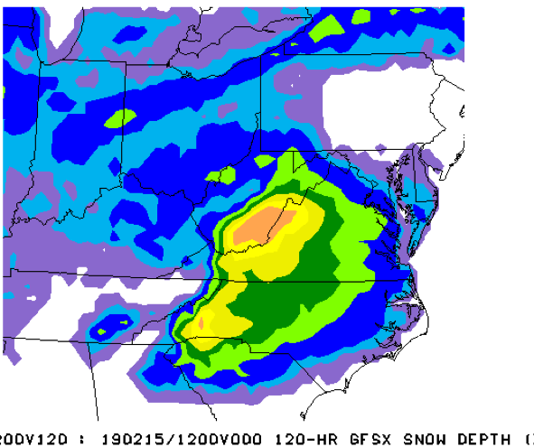
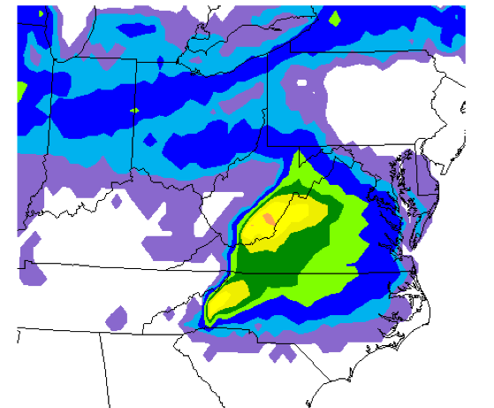
Issue #1: Excessive Snowfall in FV3GFS
24-h Snow Depth Forecasts
and NOHRSC Analysis
Forecasts initialized at 12Z 15 Feb 2019
Valid 12Z 19 to 12Z 20 Feb 2019 (F96-F120)
Excessive snow amounts are reduced in the experiment (bottom right), but it still overpredicts snowfall
Ops GFS provided much more reasonable guidance compared to NOHRSC analysis (upper right)
Overprediction in the experiment is potentially linked to cold bias in lower troposphere (see Issue #2)
GFS
ANL
FV3GFS
FV3GFS w/ srflag test

Slide 9
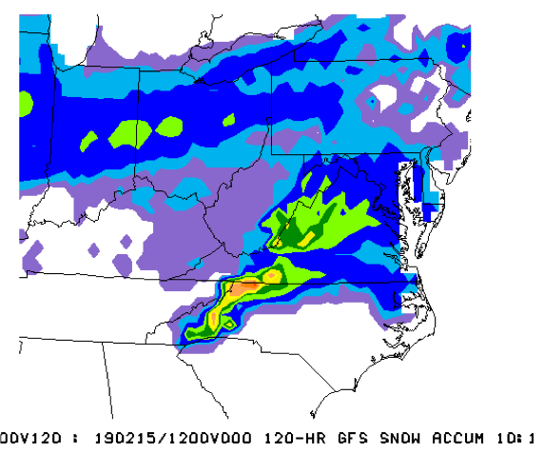
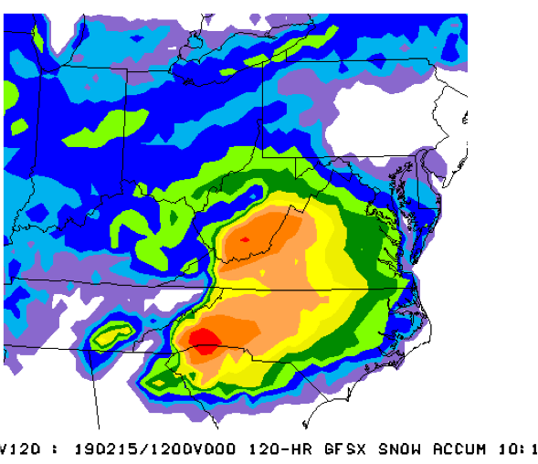
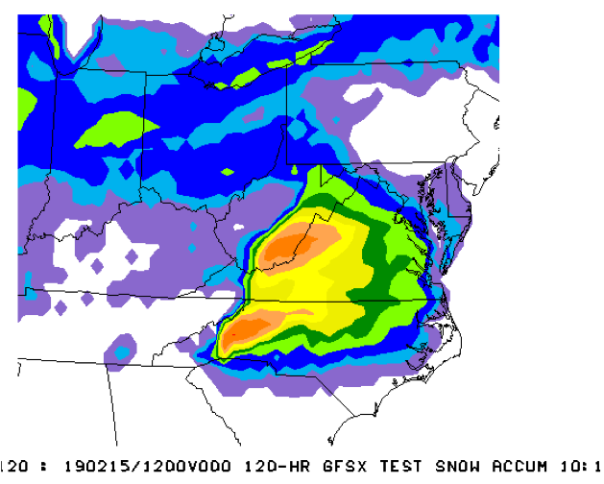
Issue #1: Excessive Snowfall in FV3GFS
24-h 10:1 Snow Water Equiv. Forecasts
and NOHRSC Analysis
Forecasts initialized at 12Z 15 Feb 2019
Valid 12Z 19 to 12Z 20 Feb 2019 (F96-F120)
Overprediction of snowfall in both FV3GFS forecasts appears even more egregious when 10:1 ratios are applied to the snow water equivalent
The MEG encourages users to examine accumulated snow depth in addition to the common 10:1 maps (See G. Manikin’s 20 Feb 2019 MEG presentation)
GFS
ANL
FV3GFS
FV3GFS w/ srflag test

Slide 10
Surface Observations Valid at 02Z 20 February 2019
There were a few sleet reports in NC during the onset of the precip
However, the FV3GFS was too cold in the lower levels (likely due to the lower tropospheric cold bias)
Caused an overproduction of sleet in the model

Slide 11
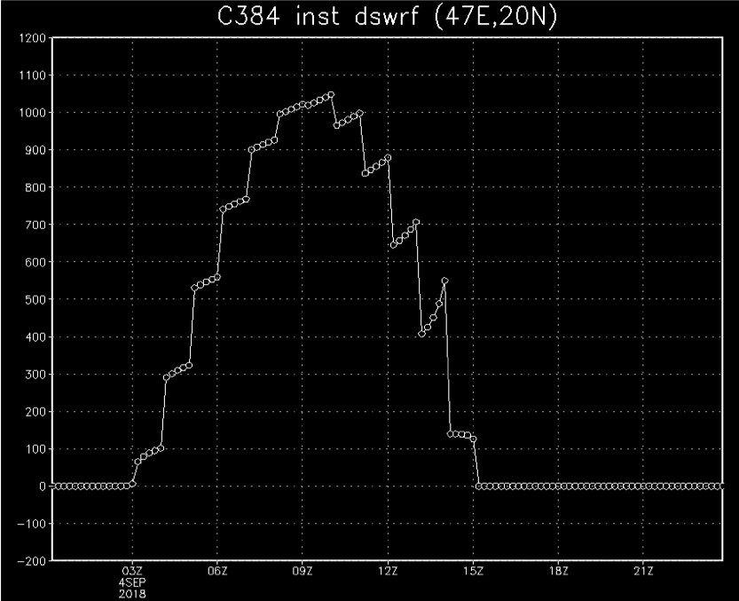
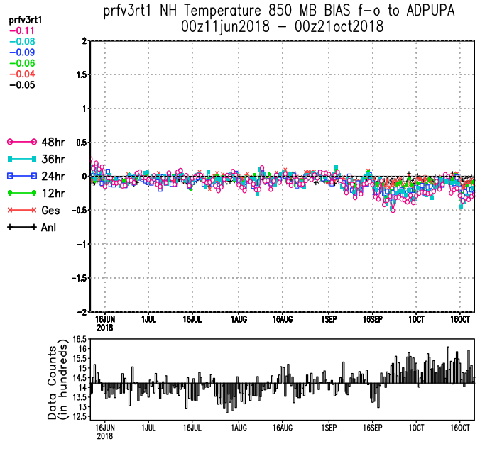
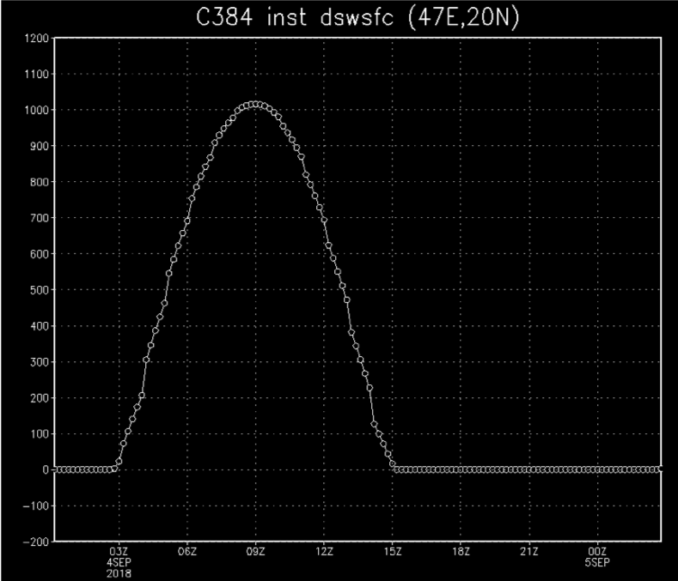
Issue #2: Exacerbated Cold Bias in the Lower Troposphere
Cause #1: Bug fix for erroneous Solar Zenith Angle computation in the radiation scheme
Hourly surface downward
shortwave radiation
NH 850 mb Temperature Fit-to-Obs at Various Forecast Leads
BUG
09/17/2018 Fix
Wrong diurnal cycle
Excessive solar energy
FIX
The bug fix was introduced into the real-time parallel on 17 Sept 2018
Coincides with signs of increased cold bias in the lower troposphere
Correct diurnal cycle
Less available solar energy

Slide 12
Issue #2: Exacerbated Cold Bias in the Lower Troposphere
Mid-level height bias and low-level temp. bias grew more negative with forecast length
during the full set of retrospective runs
FV3GFS
GFS
850 mb
Temp Bias
500 mb
Height Bias
-5 m
-0.24C
From the September MEG official evaluation of the FV3GFS

Slide 13
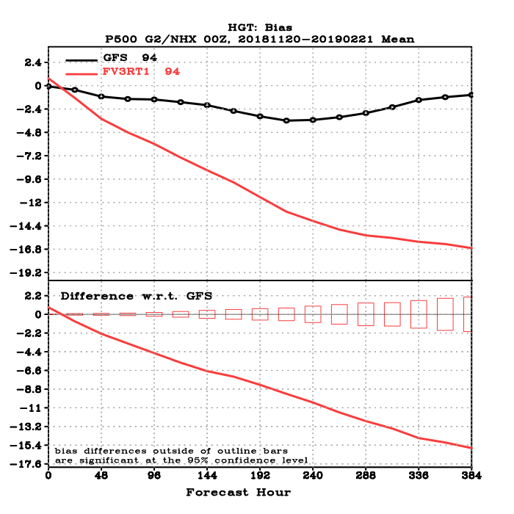
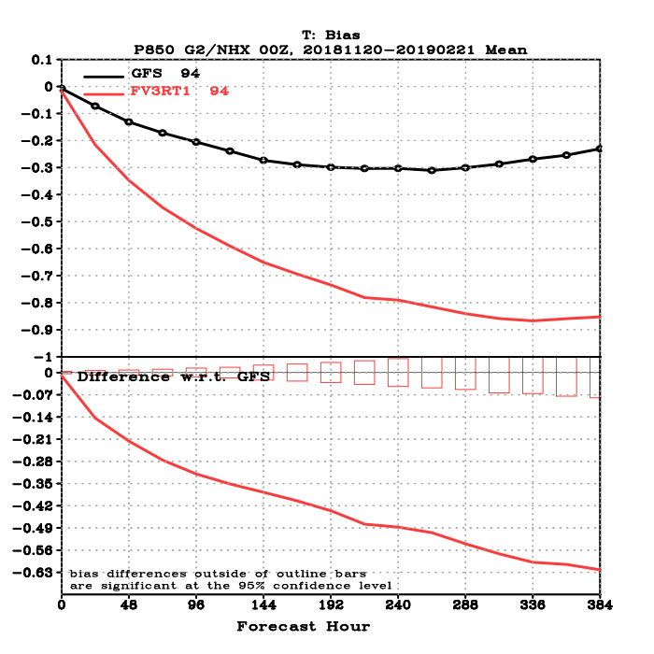
Issue #2: Exacerbated Cold Bias in the Lower Troposphere
Issue is much more pronounced this winter
FV3GFS
GFS
850 mb
Temp Bias
500 mb
Height Bias
-17 m
-0.85C

Slide 14
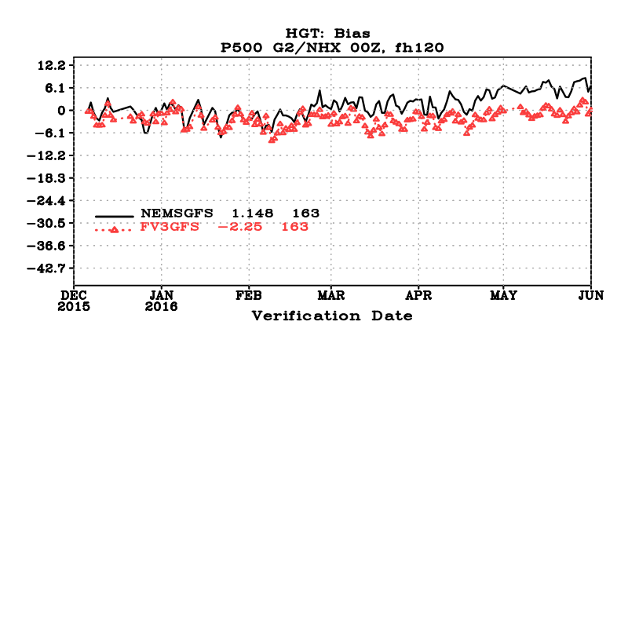
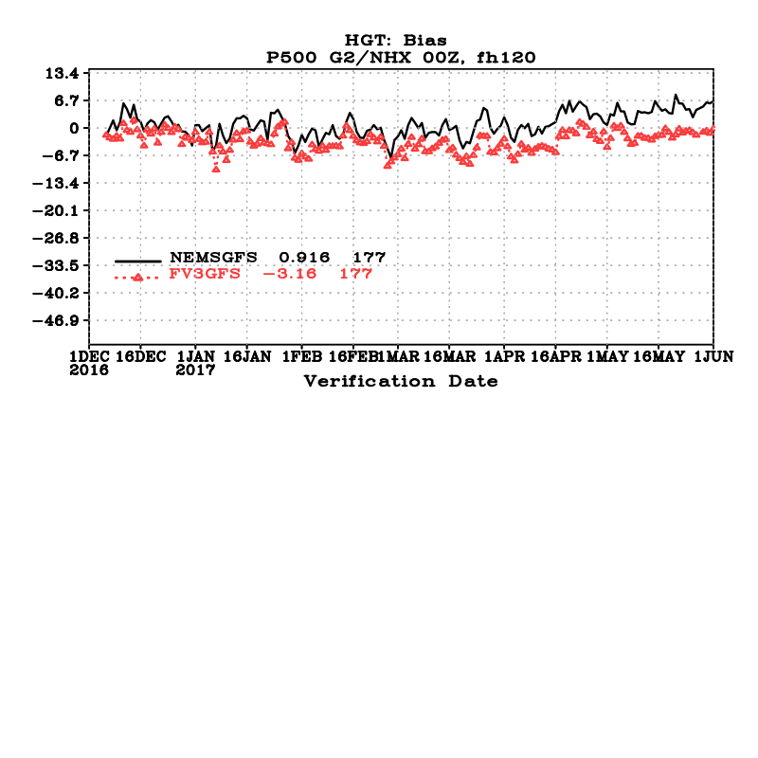
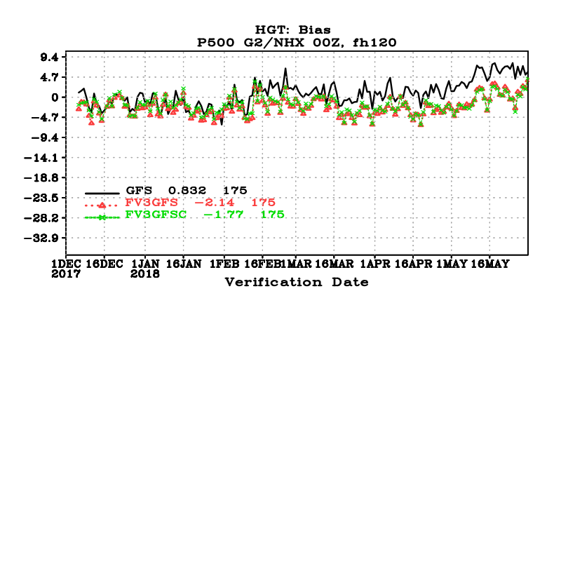
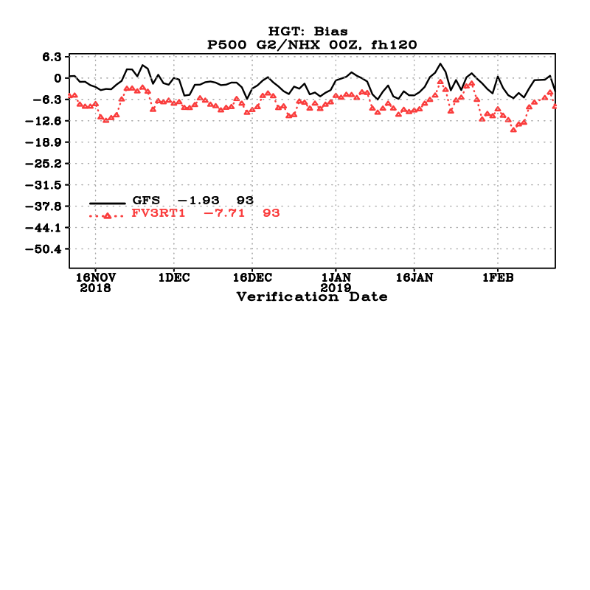
Issue #2: Exacerbated Cold Bias in the Lower Troposphere
Issue is much more pronounced this winter
Winter 2015-16
Winter 2016-17
GFS
FV3GFS
Winter 2017-18
Winter 2018-19
14

Slide 15
Issue #2: Exacerbated Cold Bias in the Lower Troposphere
Issue is much more pronounced this winter
Day-10 850-hPa temperature bias
(2015–2016) -0.27°C
(2016–2017) -0.35°C
(2017–2018) -0.23°C
(2018–2019) -0.77°C
Day-10 500-hPa geopotential height bias
(2015–2016) -4.5 m
(2016–2017) -5.0 m
(2017–2018) -3.2 m
(2018–2019) -14.4 m
Full retro &
real-time
period
Current
real-time
period

Slide 16
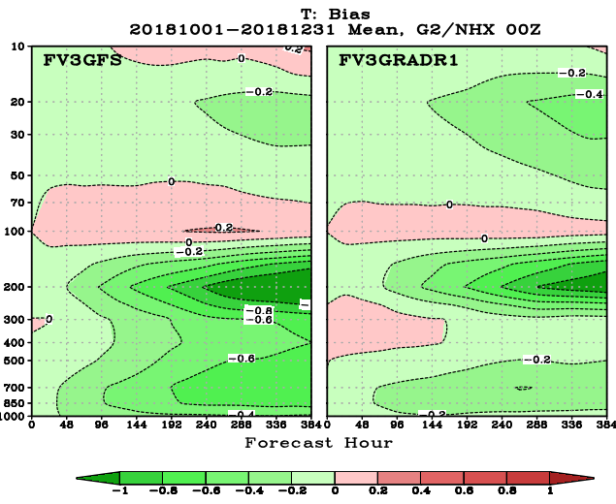
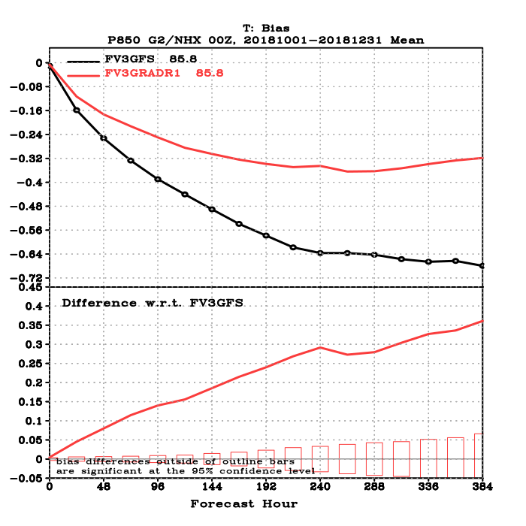
Issue #2: Exacerbated Cold Bias in the Lower Troposphere
Remedy #1: More consistent cloud-radiation interactions
Modify the model physics so the radiation can directly interact with each hydrometeor species from the cloud microphysics. This is expected to warm the lower atmosphere.
This improves representation of cloud-radiation interactions but is not directly related to the solar zenith angle bug fix.
NH Temperature Bias
NH 850 mb Temperature Bias
Cold bias at 850 mb reduced by ~50%
in prior experiment (FV3GRAD1) with more sophisticated cloud-radiation interactions

Slide 17
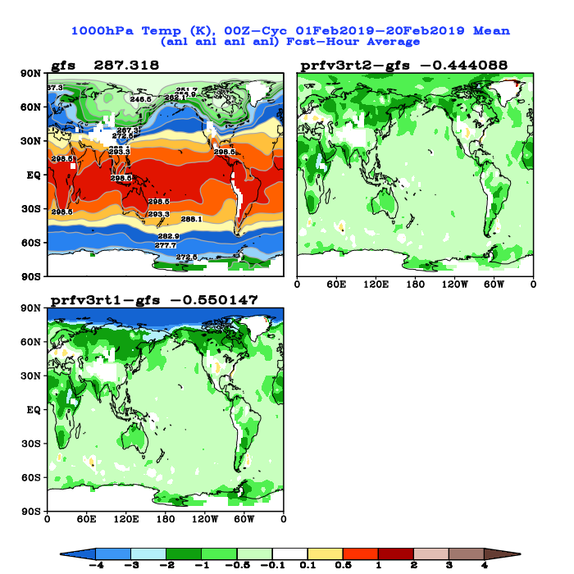
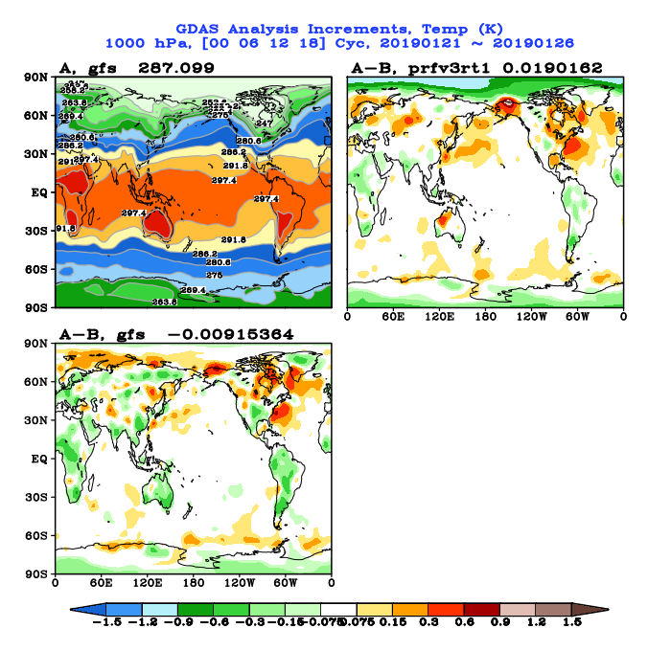
Issue #2: Exacerbated Cold Bias in the Lower Troposphere
Cause #2: FV3GFS analysis has a stronger constraint on supersaturation than GFS at very low levels near the pole in cold season (combination of more grid points & physics changes)
FV3GFS – GFS temperature
analysis @ 1000 hPa
FV3GFS temperature analysis
increment @ 1000 hPa
FV3GFS analysis much colder than GFS (and ECMWF)
Large negative analysis increment
Analysis has a weak constraint on the amount of supersaturation allowed. The impact of the constraint depends on the density of gridpoints.
The GFS and FV3GFS have different gridpoint densities near the poles, so the constraint should be weighted differently. Right now, it is not.

Slide 18
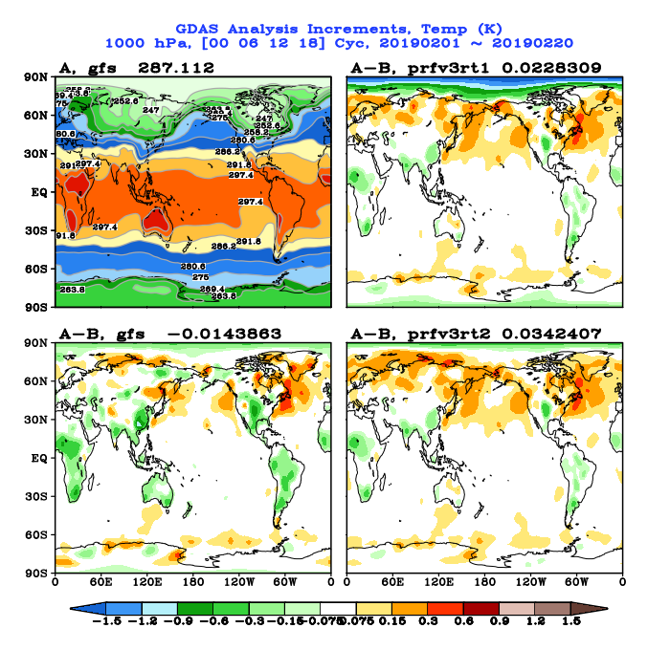
Issue #2: Exacerbated Cold Bias in the Lower Troposphere
Remedy #2: Reduce weighting factor for supersaturation constraint
in the data assimilation for the FV3GFS
FV3GFS – GFS temperature
analysis @ 1000 hPa
FV3GFS temperature analysis
increment @ 1000 hPa
Reduce FV3GFS cold bias with respect to GFS
Negative analysis increment largely removed
Reduced cold temperature bias over the Arctic region

Slide 19
New Experiments
Individually, each fix has a positive impact
All three fixes/updates have been included in a new model tag, nemsfv3gfs_beta_v1.0.16
  Fractional snow/ice/graupel flag
  Cloud-radiation interaction
  Supersaturation adjustment in the DA
One parallel for winter with cycled DA (12/15/2018 – realtime)
https://www.emc.ncep.noaa.gov/gmb/emc.glopara/vsdb/prfv3rt3/
One parallel for summer (hurricane) with cycled DA (8/26/18 – 10/31/18)
https://www.emc.ncep.noaa.gov/gmb/emc.glopara/vsdb/prfv3rt3s/
We estimate the winter parallel will catch up with real-time by March 25th

Slide 20
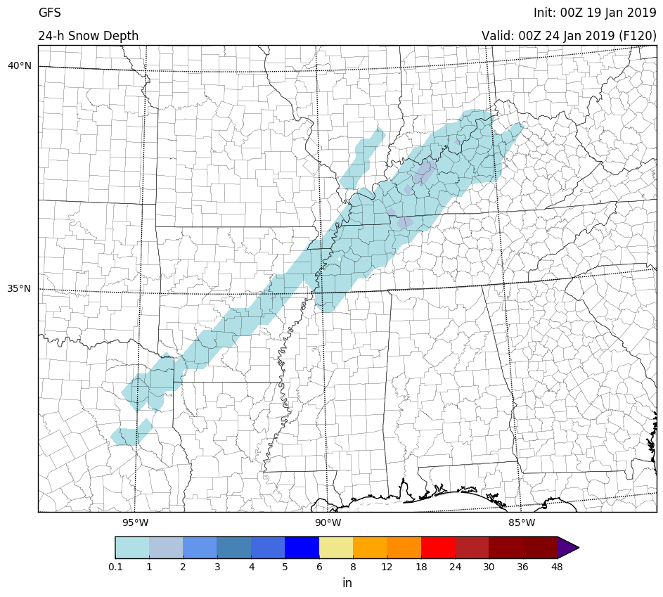
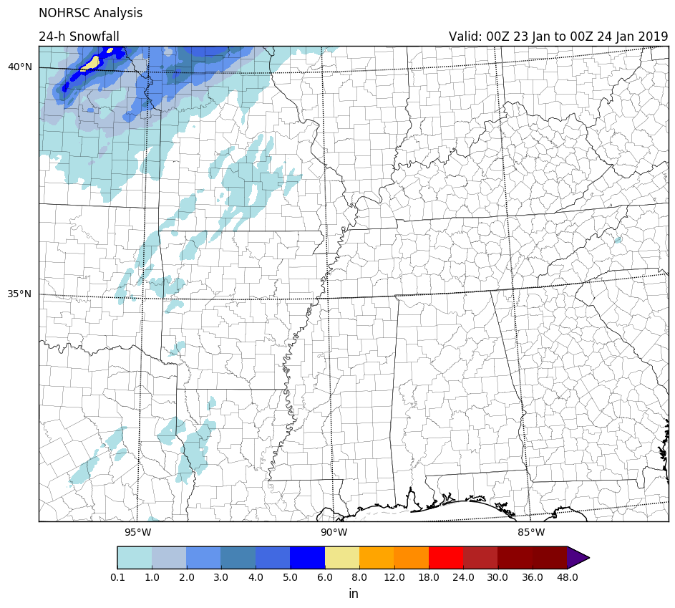
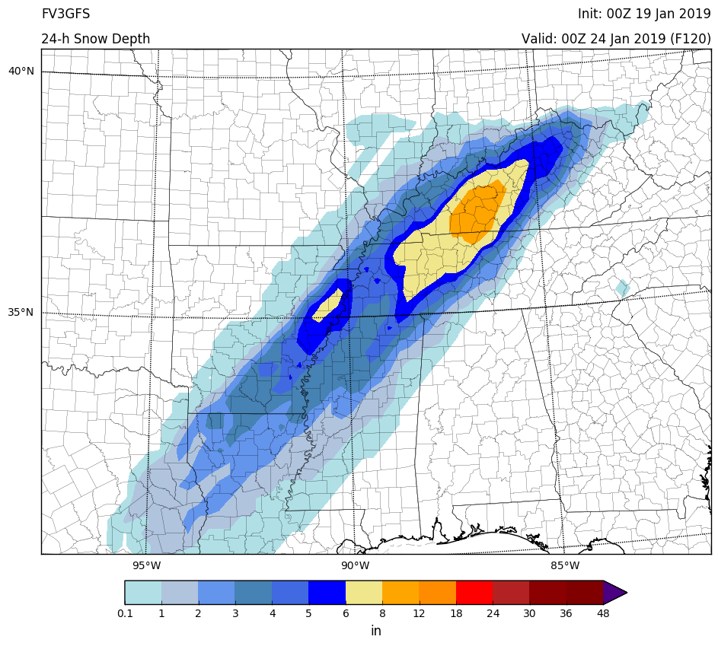
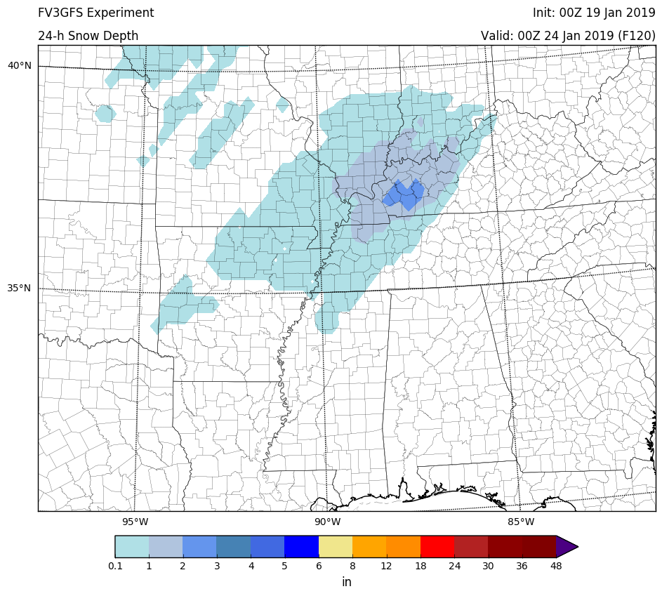
Preliminary Results from the “Winter” Run with All Three Changes Included
https://www.emc.ncep.noaa.gov/gmb/emc.glopara/vsdb/prfv3rt3/
Issue #1 mitigated – New snow depth amounts are more reasonable
24-h Snow Depth Forecasts
and NOHRSC Analysis
Forecasts initialized at 00Z 19 Jan 2019
Valid 00Z 23 to 00Z 24 Jan 2018 (F96-F120)
Excessive snow amounts are reduced in example forecast from new “winter” parallel (bottom right)
Will confirm improvement in the SC/NC snow event (shown on slides 5-9) once the parallel reaches the 12Z 15 Feb 2019 cycle
GFS
ANL
FV3GFS
Experiment
FV3GFS

Slide 21
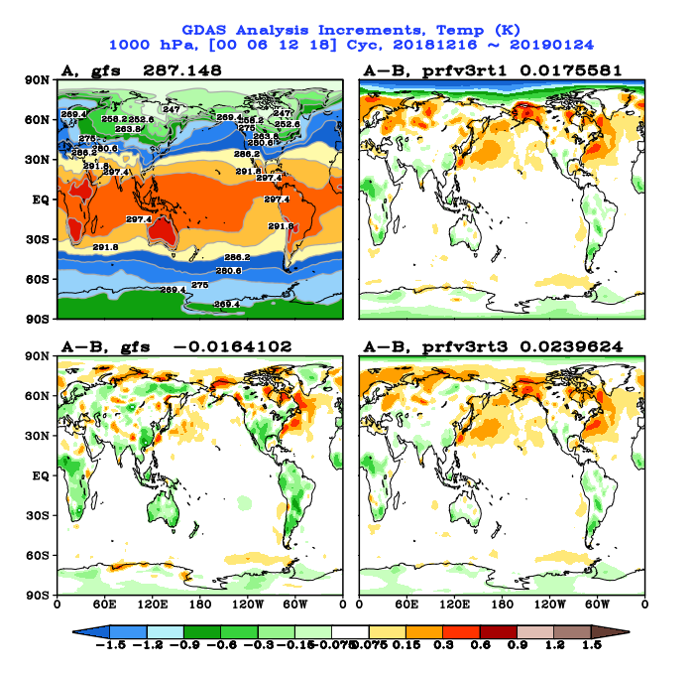
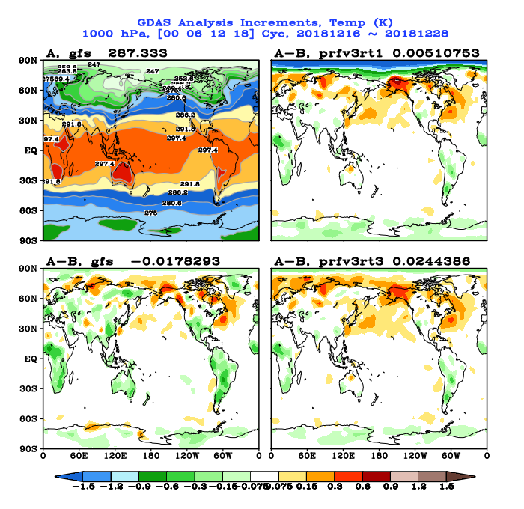
Preliminary Results from the “Winter” Run with All Three Changes Included
https://www.emc.ncep.noaa.gov/gmb/emc.glopara/vsdb/prfv3rt3/
Issue #2 mitigated – Large negative temperature analysis increments
over the winter polar region are removed
Real-time parallel
Experiment

Slide 22
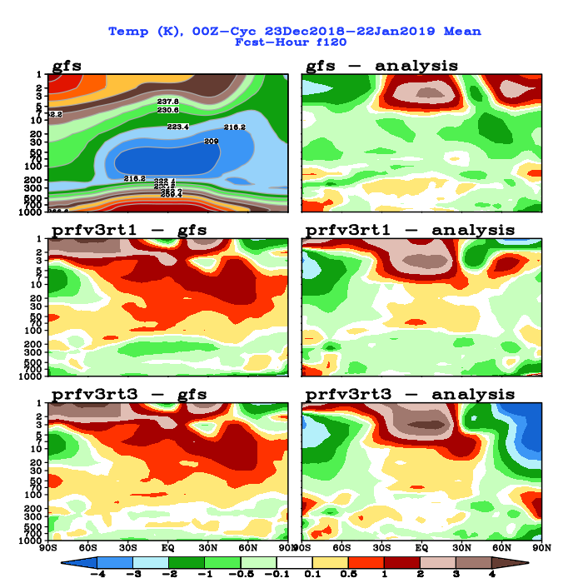
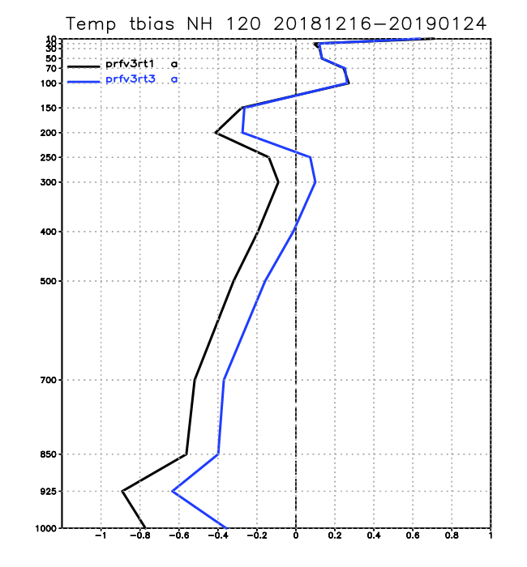
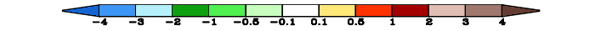
Preliminary Results from the “Winter” Run with All Three Changes Included
https://www.emc.ncep.noaa.gov/gmb/emc.glopara/vsdb/prfv3rt3/
Issue #2 mitigated – Cold tropospheric temperature bias is reduced
Expecting further reduction in bias as more cycles are completed
Zonal Mean Temp, 120hr Fcst
NH Temp Bias Fit-to-RAOBS, 120hr Fcst
Real-time parallel
Experiment

Slide 23
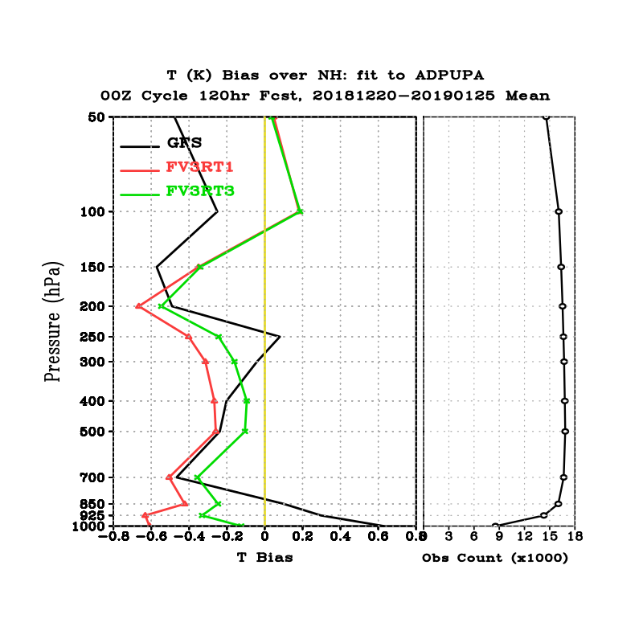
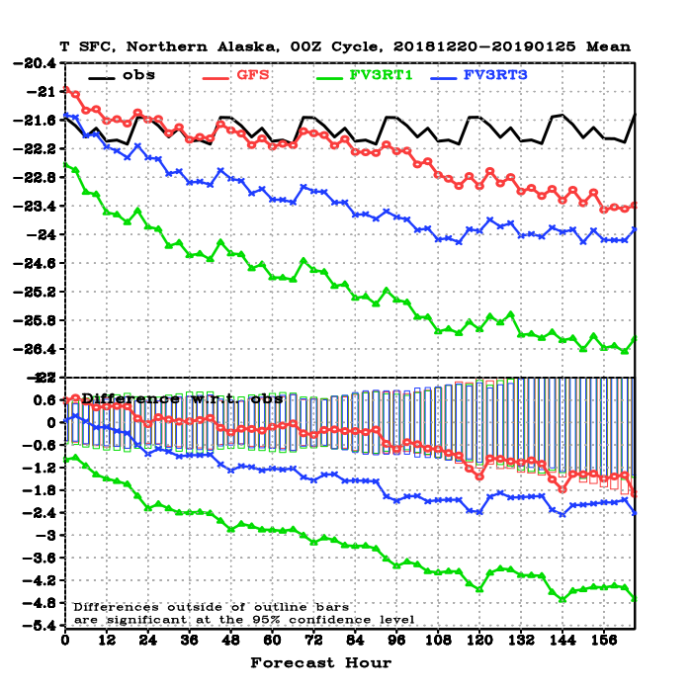
Preliminary Results from the “Winter” Run with All Three Changes Included
https://www.emc.ncep.noaa.gov/gmb/emc.glopara/vsdb/prfv3rt3/
Issue #2 mitigated – Cold tropospheric temperature bias is reduced
Expecting further reduction in bias as more cycles are completed
NH Temp Bias Fit-to-RAOBS, 120hr Fcst
Fit to Sfc Obs in Northern AK
GFS
FV3GFS
FV3GFS Exp.
GFS
FV3GFS
FV3GFS Exp.

Slide 24
Preliminary Results from the “Winter” Run with All Three Changes Included
https://www.emc.ncep.noaa.gov/gmb/emc.glopara/vsdb/prfv3rt3/
Issue #2 mitigated – 2-m temp forecasts for January Arctic outbreak are improved
GFS
From 2/7/19 MEG examining the Arctic outbreak of late January 2019
GFS – FV3GFS
FV3GFS was much colder than the GFS
FV3GFS

Slide 25
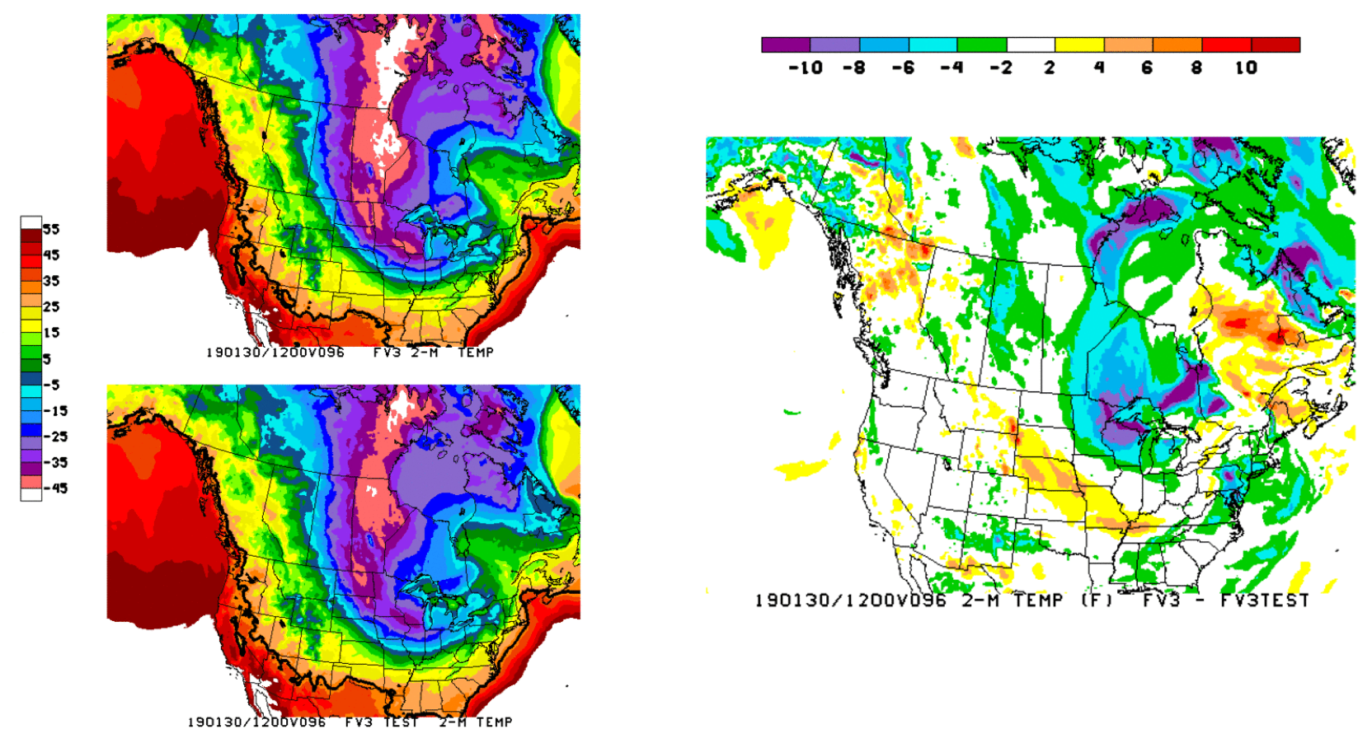
Preliminary Results from the “Winter” Run with All Three Changes Included
https://www.emc.ncep.noaa.gov/gmb/emc.glopara/vsdb/prfv3rt3/
Issue #2 mitigated – 2-m temp forecasts for January Arctic outbreak are improved
FV3GFS
FV3GFS –
FV3GFS Exp.
FV3GFS
Exp.
FV3GFS “winter” run is clearly warmer than the real-time parallel

Slide 26
Preliminary Results from the “Winter” Run with All Three Changes Included
https://www.emc.ncep.noaa.gov/gmb/emc.glopara/vsdb/prfv3rt3/
Issue #2 mitigated – 2-m temp forecasts for January Arctic outbreak are improved
2-m Temperature Forecasts
and RTMA Analysis
Fcsts initialized at 12Z 26 Jan 2019
Valid at 12Z 30 Jan 2019 (F096)
Experimental “winter” run is still too cold, but there is clear improvement upon the real-time run
GFS
ANL
FV3GFS
Exp.
FV3GFS

Slide 27
Moving Forward
EMC has determined at least one cause of excessive snowfall and two causes of some of the exaggerated cold bias in the lower atmosphere
EMC will return to the acting NCEP Director and NWS Executive Council in two weeks to provide implementation options with pros and cons
In the interim, we will continue the two new parallels (one tropical, one winter) to confirm mitigation of the issues and to check for other side effects
Pending additional results from these two parallels and senior leadership decisions, an evaluation period may be required to more thoroughly assess the merit of the updated model

