Slide 1


Modeling Regional & Global Tropospheric Ozone: Gas Phase Chemical Mechanisms & Respiratory Health Impacts
Presented by: Emily Saunders, PhD.
Date: February 5, 2018

Slide 2
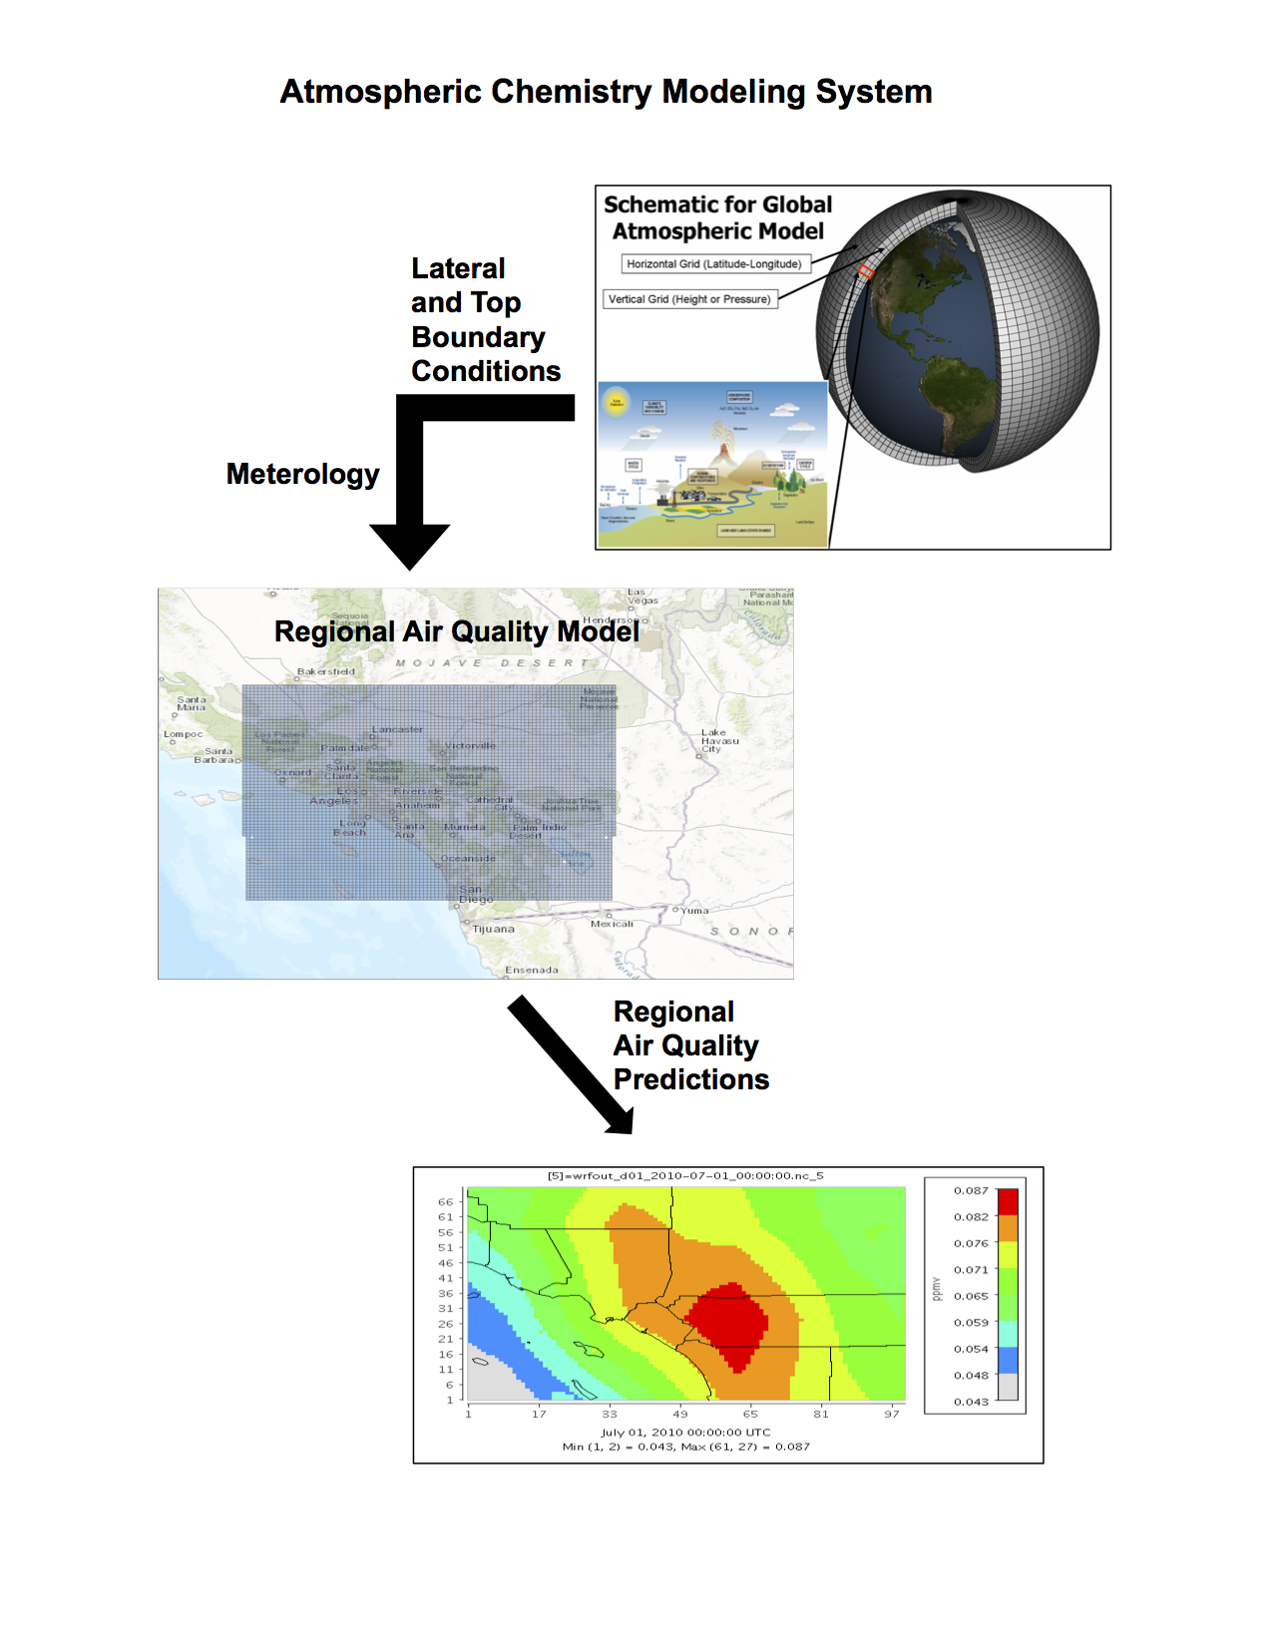
Air Quality Models are essential to predicting the concentrations of pollutant species
Stockwell, et. al., 2002
Notes:
Essential tools for evaluating control strategies for the reduction of ozone in order to meet air quality goals, many agencies These models are important to our air quality management system because they are widely used by agencies tasked with controlling air pollution to both identify source contributions to air quality problems and assist in the design of effective strategies to reduce harmful air pollutants. For example, air quality models can be used during the permitting process to verify that a new source will not exceed ambient air quality standards or, if necessary, determine appropriate additional control requirements. In addition, air quality models can also be used to predict future pollutant concentrations from multiple sources after the implementation of a new regulatory program, in order to estimate the effectiveness of the program in reducing harmful exposures to humans and the environment.
Regional air quality models may use boundary conditions provided from global models, which is essential to the regional model producing reasonable air quality predictions.
This observation shows that further improvement in regional model predictions will require efforts to reduce the uncertainty in the global model BCs

Slide 3
Significance of the Global Atmospheric Chemistry Mechanism (GACM)
Initial and Boundary Conditions on a Global Scale
Additional chemistry for marine environments
Maintain computational efficiency (Reduced VOC (volatile organic compounds) Chemistry)
VOC chemistry compatibility to RACM2 (Regional Atmospheric Chemistry Mechanism, Version 2)
Notes:
A: The mechanism must be an accurate representation of particular region of the atmosphere to be modeled (marine, urban, background, stratosphere, etc...) or some combination;
B: the mechanism must be compact enough so that it does not require unreasonable computational resources when combines with meteorological, transport, etc. calculations. There are many, many grid cells;
C: GACM needs to represent marine (halogens, reduced sulfur compounds, etc.) while not becoming to complex.
D: For a modeling system composed of a global air quality model and a regional model it is very desirable that the regional model mechanism (RADM2) and the global mechanism (GACM) be as comparable as possible; therefore if they perform very similarly for the West Coast, such as the SoCAB, then the goal of compatibility has been achieved.
GACM’s chemistry of volatile organic compounds (VOC) is highly compatible with the VOC chemistry in RACM2. This compatibility in VOC should reduce error when a model with GACM is used to provide boundary conditions for a model with RACM2. The global gas-phase chemical mechanism will help predict the atmospheric oxidants produced within the atmosphere in both a local and global regions. The GACM-RACM2 system of mechanisms will hopefully yield more accurate forecasts over the ocean and land. The implementation of GACM initial conditions into a current regional air quality models will show how global gas phase chemical mechanisms can help produce better air quality model forecasts for the regional scale.
Chemistry was removed because the globe covers a much wider area (lower resolution and larger grid slice). The mechanism should have a more simple mechanism, not as detailed as regional model. Added species the were more marine chemistry friendly because RACM2 was created for the highly polluted continental United States.
GACM includes additional chemistry for marine environments while reducing its treatment of the chemistry needed for highly polluted urban regions. The overall reduction in GACM’s size will allow it to be used efficiently in global models.

Slide 4
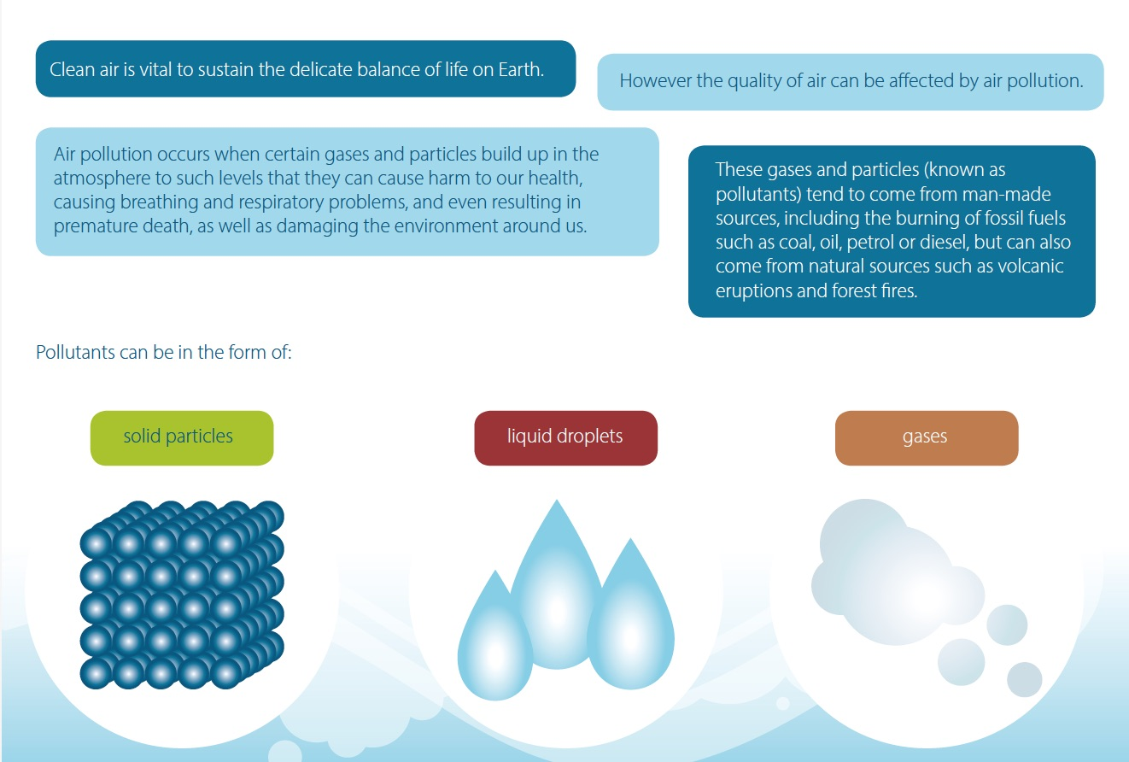
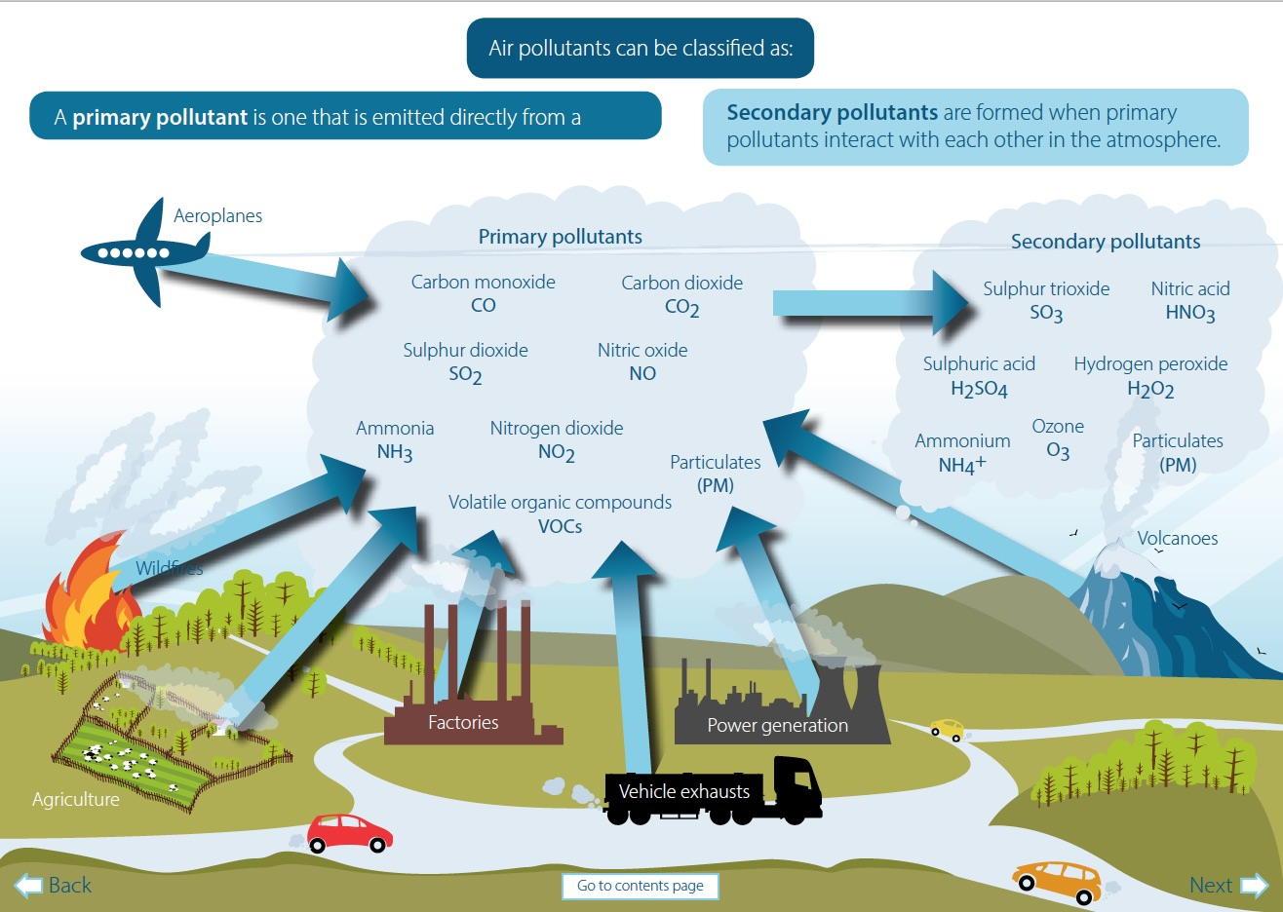
Air Quality & Air Pollution
Air pollutants can be classified as:
A primary pollutant is one that is emitted directly from a
Secondary pollutants are formed when primary
pollutants interact with each other in the atmosphere.
Primary Pollutants
Secondary Pollutants
Ozone
O₃
solid particles
liquid droplets
gases
Scottish Environment Protection Agency (SEPA), 2014
Notes:
Pollution in large populations is usually caused by gas exhaust from cars, burning of garbage, and the air pollution emissions from cars. The man-made causes of air pollutants produce volatile species (i.e. VOCs, NO_{x}, and O₃) within the troposphere, which is one of the reasons large populations are more susceptible to being effected by air pollution.

Slide 5
Tropospheric Ozone Chemistry
Tropospheric ozone formation occurs when nitrogen oxides (NOx), carbon monoxide (CO) and volatile organic compounds (VOC), react in the atmosphere in the presence of sunlight. NOx, CO, and VOCs are referred to ozone precursors.
Hydroxyl radical (HO) initiated oxidation of CO is represented by
Equations 1 – 5
(Calvert et al., 2015)
HO. + CO HO₂ + CO₂ (+ O₂) (1)
HO₂. + NO HO. + NO₂ (2)
NO₂ + h𝛎 (𝛌 < 420 nm) NO + O(³P) (3)
O(³P) + O₂ + M O₃ + M (4)
Net: CO + 2O₂ CO₂ + O₃ (5)
Notes:
CO is a major primary air pollutant
HO radicals play an enoromously important role in initiating the atmospheric oxidation of organic and inorganic air pollutants. These peroxy radicals can undergo reaction with NO leading to the formation of NO₂ which then can undergo photolysis to generate oxygen atoms and hence ozone. (Calvert et al., 2015)

Slide 6
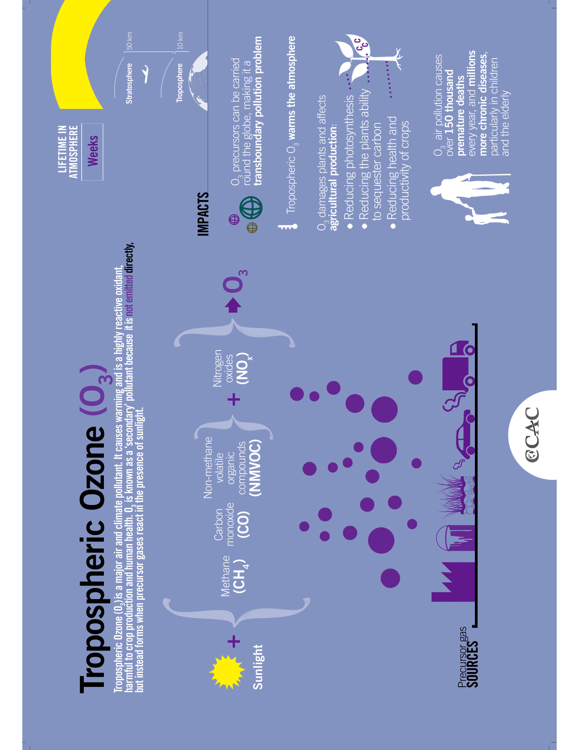
Tropospheric O₃ (Sources and Impacts)
Tropospheric Ozone (O₃)
LIFETIME IN ATMOSPHERE
Weeks
Tropospheric Ozone (O₃) is a major air and climate pollutant. It causes warming and is a highly reactive oxidant,
harmful to crop production and human health. O₃ is known as a ‘secondary’ pollutant because it is not emitted directly, but instead forms when precursor gases react in the presence of sunlight.
50km
Stratosphere
Troposphere
10km
CH₄
CO
VOCs
NO_{x}
O₃
O₃ precursors can be carried
around the globe, making it a
trans-boundary pollution problem
Sunlight
Tropospheric O₃ warms the atmosphere
O₃ damages plants and affects
agricultural production:
Reducing photosynthesis
Reducing the plants ability to sequester carbon
Reducing health and productivity of crops
Precursor gas
SOURCES
O₃ air pollution causes
over 150 thousand
Premature deaths
every year, and millions
more chronic diseases,
particularly in children
and the elderly
GRID-Arendal, 2014

Slide 7
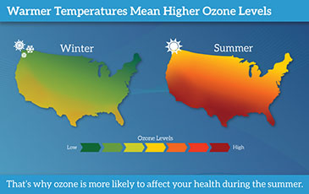
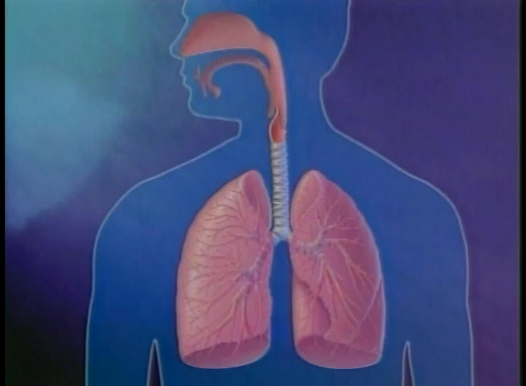
Respiratory Health Effects
Warmer Temperatures Mean Higher Ozone Levels
Winter
Summer
Ozone Levels
Low
High
That’s why ozone is more likely to affect your health during the summer.
Center for Disease Control, 2016
American Lung Association, 2016
Notes:
Tropospheric ozone reaches its highest level during the afternoon and early evening hours.
High levels occur most often during the summer months. It is a strong irritant that can cause constriction of the airways, forcing the respiratory system to work harder in order to provide oxygen.
It can also cause other health problems:
Reduce lung function
Inflame and damage the lining of the lung
Aggravates respiratory diseases such as emphysema, bronchitis and asthma
Lung Function: When scientists refer to “lung function,” they mean the volume of air that you draw in when you
take a full breath and the speed at which you are able to blow it out.
Ozone may make it more difficult for you to breathe as deeply and vigorously as you normally
would. When this happens, you might notice that breathing starts to feel uncomfortable. If you are
exercising or working outdoors, you may notice that you are taking more rapid and shallow breaths
than normal. Reduced lung function can be a particular problem for outdoor workers, competitive
athletes and others who exercise outdoors
Damage Lining of Lungs: Some scientists have compared ozone-caused lung damage to a sunburn. Ozone damages the cells that line the air spaces in the lung. Within a few days, the damaged cells are replaced and the old
cells are shed – much in the way skin peels after a sunburn. If this kind of damage occurs
repeatedly, it may lead to permanent damage to your lungs that could cause a lower quality of life.
Cause other problems: Ozone may aggravate chronic lung diseases, such as emphysema and bronchitis. Studies in
animals suggest that ozone also may reduce the immune system’s ability to fight off bacterial infections
in the respiratory system.
Scientists are concerned that repeated short-term damage from ozone exposure may permanently injure
the lung. For example, repeated ozone damage to the developing lungs of children may reduce
their lung function when they are adults. In addition, ozone exposure may speed up the decline in
lung function that occurs as a natural result of aging.

Slide 8
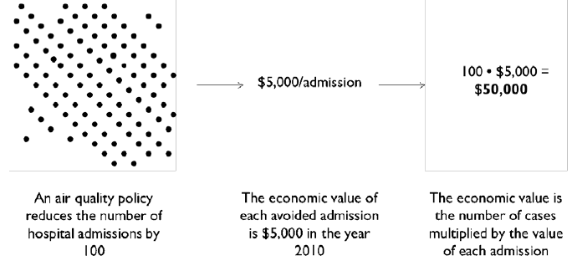
Economic Impacts from Ozone Air Pollution
According to the CDC there have been more than 10 million lost school days, 14 million work days loss, and nearly 2 million emergency room visits a year.
BenMAP User’s Manual, 2015
Notes:
Employers lose every year when asthma keeps adults out of the workplace.
Respiratory illnesses are also responsible for.
which has sidelined many children from physical activity.
estimate the economic value by multiplying the reduction of the health effect by an estimate of the economic value per case (see Figure 1-2):
Economic Value = Health Effect * Value of Health Effect
There are several different ways of calculating the value of the health effect. For example, the value of an avoided premature mortality is generally calculated using the Value of Statistical Life (VSL). The value of a statistical life is the monetary value that a group of people are willing to pay to slightly reduce the risk of premature death in the population. For other health effects, the medical costs of the illness may be the only valuation data available. The BenMAP-CE database includes several different functions for VSL and valuation functions for other health effects for you to choose, or you can rely on U.S. EPA's preloaded selections.

Slide 9
California’s South Coast Air Basin
South Coast Air Quality Management District, 2016
Notes:
California’s South Coast Air Basin (SoCAB) has historically experienced the most severe ground-level ozone (O₃) pollution in the United States. The basin encompasses 10,743 square miles and is home to over 17.8 million people (2010 U.S. Census).
High concentrations of ozone in the SoCAB result from the combination of high mountains that contain air pollutants (Fujita et al., 2015)
The SoCAB (California’s South Coast Air Basin) region has historically experienced the most severe ground level ozone pollution in the United States.
Southern California’s air remains home to some of the worst air in the United States, the American Lung Association said Tuesday in its annual State of the Air report.
and adverse meteorology that results in low mixing layers and conditions that limit atmospheric dispersion.
All of California is divided into air basins, which means air pollution tends to stagnate within these air basins due to natural barriers, such as mountains, unless prevailing winds are strong enough to disperse into other areas.
The basin includes portions of Los Angeles, Riverside, and San Bernardino counties and all of Orange County.

Slide 10
Gas Phase Chemical Mechanisms (RACM2 & GACM)
The Regional Atmospheric Chemistry Mechanism (RACM2) is a gas-phase chemical mechanism that is widely used for the modeling of regional atmospheric chemistry (Stockwell, et. al., 2013). It is able to simulate chemistry from the earth’s surface to the upper troposphere.
The global atmospheric chemistry mechanism (GACM) is the global version of RACM2 used to run simulations around the globe (or wider domain) and produce output of pollutant species within the atmosphere in regional and global communities.
Notes:
Gas phase mechanisms play a vital role in air quality models because the mechanisms are incorporated into the modules that are use to calculate the concentrations of chemical sources, sinks of ozone, and the precursors of particulates.
GACM includes additional chemistry for marine environments while reducing its treatment of the chemistry needed for highly polluted urban regions. The overall reduction in GACM’s size will allow it to be used efficiently in global models.
** RACM2 would be better than the Carbon Bond mechanisms that they use now. Secondary organic aerosol formation depends strongly on the number carbon atoms in a VOC. RACM2 provides more information on the size of VOC that carbon bond.**
RACM2:
The gas phase chemistry of the polluted atmosphere helps determine the effect of emissions on the production of ozone and other air pollutants produced within the lower atmosphere. These chemical mechanisms consist of chemical species, reactions, rate constants and photochemical data (used to calculate the photolysis frequencies). Aggregated species are placed in the mechanism to represent a group of organic species within the atmosphere.
It includes 17 stable inorganic species, 4 inorganic intermediates, 55 stable organic species (3 of these are primarily of biogenic origin) and 43 organic intermediates includes 363 reactions. The gas phase chemistry of the polluted atmosphere helps determine the effect of emissions on the production of ozone and other air pollutants produced within the lower atmosphere. These chemical mechanisms consist of chemical species, reactions, rate constants and photochemical data (used to calculate the photolysis frequencies). Aggregated species are placed in the mechanism to represent a group of organic species within the atmosphere.
Lumped model species that represent reactions of a large number of species with similar reaction rates and mechanisms, The lumped-structure approach for condensing organic chemical mechanisms is attractive, since it yields fewer species and reactions and reduces computational costs
RACM2 includes various VOCs species because there are several different species and chemical reactions currently in the atmosphere that has an effect on the amount of ozone produced in the troposphere.

Slide 11
GACM Species List
GACM Species (Abbreviation) | GACM Species (Chemical Name)
Removed Species
PER2 | Peroxy intermediate formed from TOL
XYLP | Peroxy radicals formed from XYL
XYL1 | Peroxy radicals formed from XYL
XY2 | Peroxy radicals formed from XYL
XYO2 | Peroxy radicals formed from XYO
XYOP | Peroxy radicals formed from XYO
BALP | Peroxy radicals formed from BALD
BAL1 | Peroxy radicals formed from BALD
BENP | Peroxy radicals formed from BEN
MCTO | Phenoxy radical from Methyl Catechol
MCTP | Peroxy radicals formed from MCTO + O3
PPN | Peroxypropionyl nitrate and higher
PAA | Peroxyacetic acid and higher analogs
PHEN | Phenol
MCT | Methyl Catechol
BEN | Benzene
GACM Species (Abbreviation) | GACM Species (Chemical Name)
Halogen Species
CL | Chlorine
CL2 | Chlorine (gas)
CLO | Chlorine monoxide
CLN
HCL | Hydrochloric acid
HOCL | Hypochlorous acid
BR | Bromine
BR2 | Bromine (gas)
BRO | Bromine monoxide
I | Iodine
I2 | Iodine (gas)
IO | Iodine oxide
HOI | Hypoiodous acid
Reduced Sulfur Species
H2S | Hydrogen sulfide
DMS | Dimethyl Sulfide
GACM Species (Abbreviation) | GACM Species (Chemical Name)
Lumped Species
OLE (OLI + OLT) | Terminal / Internal alkenes
OLEP (OLIP + OLTP) | Peroxy radicals formed from OLE
TOL | Toluene and less reactive aromatics (represents the majority of aromatic in the mechanism)
ACD (ACD + ALD) | Acetaldehyde & ≥C3 aldehydes
Notes:
Removing the methyl catechol (MCT) scheme and recombining phenol (PHEN) and cresol (CSL) into one species (CSL). Since methyl catechol, phenol and cresol aren't routinely measured, this won't hurt the initial conditions.
Recombining acetaldehyde (ACD) and the higher aldehydes (ALD) since the higher aldehydes aren't routinely measured either (and acetaldehyde is the dominant aldehyde in the atmosphere).
Chemistry was removed because the globe covers a much wider area (lower resolution and larger grid slice). The mechanism should have a more simple mechanism, not as detailed as regional model. Added species the were more marine chemistry friendly because RACM2 was created for the highly polluted continental United States. The reduction of chemistry contributes to the compatability to RACM2 and how GACM performs in a global model.

Slide 12
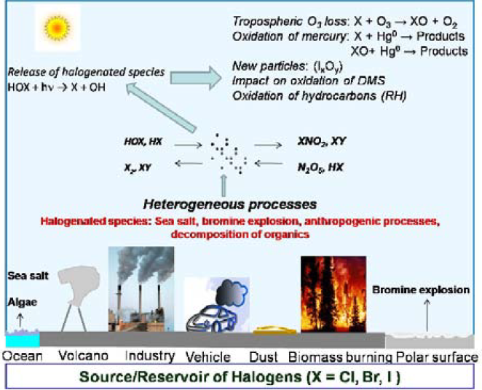
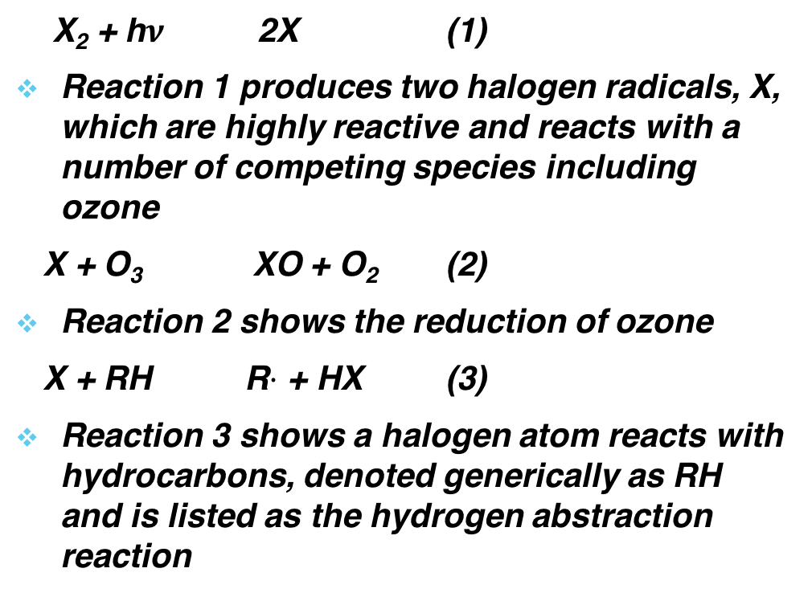
Gas Phase Chemical Mechanisms II (GACM) : Halogen Chemistry-Importance & Sources
X₂ + h$ν$ 2X (1)
Reaction 1 produces two halogen radicals, X, which are highly reactive and reacts with a number of competing species including ozone
X + O₃ XO + O₂ (2)
Reaction 2 shows the reduction of ozone
X + RH R$·$ + HX (3)
Reaction 3 shows a halogen atom reacts with hydrocarbons, denoted generically as RH and is listed as the hydrogen abstraction reaction
Tropospheric O₃ loss: X + O₃ → XO + O₂
Oxidation of mercury: X + Hgº → Products
XO + Hgº → Products
Release of halogenated species
HOX + h𝛎 → X + HO
New Particles: (I_{x}O_{y})
Impact on oxidation of DMS
Oxidation of hydrocarbons (RH)
HOX, HX
X₂, XY
XNO₂, XY
N₂O₅, HX
Heterogeneous processes
Heterogeneous species: Sea salt, bromine explosion, anthropogenic processes,
Decomposition organics
Sea salt
Algae
Bromine explosion
Ocean Volcano Industry Vehicle Dust Biomass Burning Polar Surface
Source/Reservoir of Halogens (X = Cl, Br, and I
Sahu L. K., 2013
Notes:
Halogen radicals take part in complex chemical cycles involving gas phase reactions in the troposphere. One of the most important roles of halogen chemistry is the catalytic destruction of ozone in the lower troposphere. Halogen radicals formed by the photo-dissociation of X₂, XY, HOX, etc., where X represents Cl, Br, and I, react with ozone.
Anthropogenic and natural sources for reactive halogen species in the troposphere
Emissions from oceanic sources: sea salt and decomposition of algae
Emissions from polar surface: fresh sea ice
Emissions from continental sources: volcanoes, biomass burning, decay of terrestrial vegetation, use of fossil fuels, vehicular exhaust, dust plume, cooling towers, swimming pools, salt lakes, etc.
Autocatalytic mechanism releasing bromine in the gas phase is also known as the bromine explosion
[HOBr + Br⁻_{aq} + H⁺ → Br₂ + H₂O; Br₂ + h$ν$ →Br + Br ($λ$ < 600 nm)].
Chlorine atoms can initiate Ozone production in the polluted atmosphere just like HO does
Global ocean covers about 2/3 of the earth’s surface and are the important source of halogens particularly those of chloride and bromine ions. Therefore, halogen chemistry plays a major role in the MBL chemistry.
One of the most important sources of chlorine is sea salt spray from interaction of wind at the ocean surface.
Sea spray is produced by bubble burst mechanism producing film and jet drops.
HCl is released from sea salt particles by an acid displacement reaction [H₂SO₄ + 2NaCl_{aq} -> 2HCl_{g} + Na₂SO₄]. Oxidants (HOx = HO, HO₂) can convert I⁻, Br⁻, and Cl⁻ ions to Br₂, BrCl, ICl, or IBr through a gas phase reaction HCl + HO -> Cl + H₂O].
Oxidized nitrogen compounds can react with sea halide ions to release HCl, HBr, and other species like ClNO₂ and BrNO₂[N₂O₅ + NaCl_{aq} -> NaNO_{3, aq} + XNO₂]. The mechanism of bromine release in volcanic plumes is similar to bromine explosion.
Halogens are mainly emitted as halogen halides (HX, where X = Cl, Br, or I) in volcanoes.
The first step is the uptake of bromine occurs from gaseous HOBr and HBr into the particles followed by the acid catalyzed reaction in the aqueous phase and then release of Br₂ back to the gas phase.
Global biomass burning accounts for about 20% of CH₃Cl, chlorine content is about 0.1 % weight in coal, emissions from coal combustion and incineration of plants are among the major anthropogenic sources of HCl
The HCl bond strength is similar to that of organic CH bonds, allowing chlorine atoms to react with hydrocarbons including abundant methane, giving it a reactivity similar to or larger than that of OH, but with different patterns of relative reactivity. Therefore, for chlorine, the hydrocarbon path outcompetes the ozone depleting pathway. Bromine is less reactive to hydrocarbons and, most often, reacts with ozone or the less abundant aldehydes (e.g., formaldehyde), increasing its role in tropospheric ozone depletion. Iodine atoms are even less reactive and react primarily with ozone, leading to the formation of higher iodine oxides. Reactions 2 and 3 are both radical propagation reactions, where the number of radical species is unchanged. Tracking halogens, we see that reaction 2 maintains the radical within the halogens and their oxides, while reaction 3 converts the radical to the organic species.
Bromine and iodine, the halogen oxides (XO) photo-dissociate rapidly (typically on the order of minute to second time scale), which recreates X and ozone in a “ null” cycle. This null cycle has no net effect on ozone destruction or production, but as these are often the fastest loss of XO, they, therefore, strongly affect the partitioning between X and XO. For typical ozone levels in the tens of picomole per mole range, the oxides dominate the atomic radical form, an eff ect that extends the effective lifetime of the XOx = X + XO family because the oxides are typically less reactive than the atomic form. The low reactivity of I is similar to that of IO, often making their ratio approximately unity. Chlorine monoxide, ClO, has a much longer photolytic lifetime,23 so this “ null cycle” does not apply to chlorine. The halogen oxides can react with each other with a variety of fates, which generally destroy ozone and either conserve radicals or produce dihalogens that then photolyze (in daytime) via reaction 1.
XO + XO → X2 + O2 (4)
XO + XO → X + X + O2 (5)
XO + XO → OXO + X (6)

Slide 13
Research Objective & Goal
The main objective of this project was to use both simple and complex air quality models coupled with the regional and global atmospheric chemistry mechanisms (RACM2 & GACM) to simulate the maximum concentrations of tropospheric ozone and its precursors to help estimate the resulting respiratory health impacts and economic value of those health impacts formed in California’s South Coast Air Basin (i.e. the SoCAB region).
The main goal of this research project was to create a global gas phase mechanism to help in the improvement of air quality model forecasting by supply improved initial and boundary conditions in a regional air quality model, which allows regional mechanism to simulate maximum concentrations of ozone and its precursors (i.e. nitric oxides); where the model output would be used predict the extent of respiratory health impacts and the cost of the resulting health impacts from changes in air quality in the SoCAB region.

Slide 14
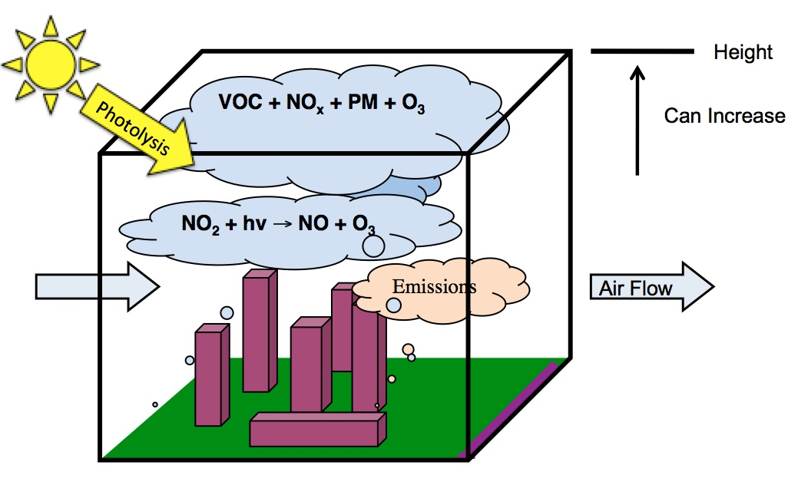
Methods: The S-BOX Model-Model Description
Stockwell et. al., 2002
Notes:
S – Box Model: The box model used to run simulations with the regional atmospheric chemistry mechanism is based on the concept behind the Eulerian box model. The Eulerian box encloses on a region in the atmosphere, which is assumed to have a height equal to the mixing layer height. The mixing layer height can vary at times to simulate the atmospheric condition state. The model is based upon the mass conservation of a species inside the Eulerian box of volume. Measures/calculates chemistry at a particular point.
Box Model w/ RACM2: The chemical compiler reads the rate constants from the reactions and sets up the differential equations and reads them into Fortran code or any other mathematical language that can read the data output. Basically it creates the subroutines that are called has a numerical solver.

Slide 15
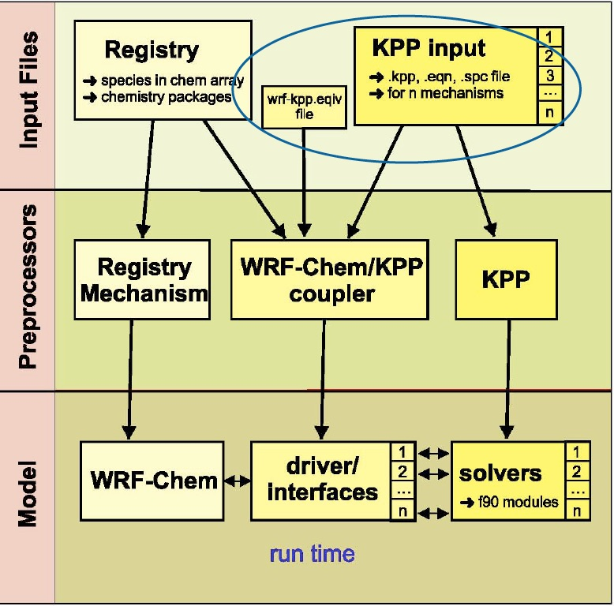
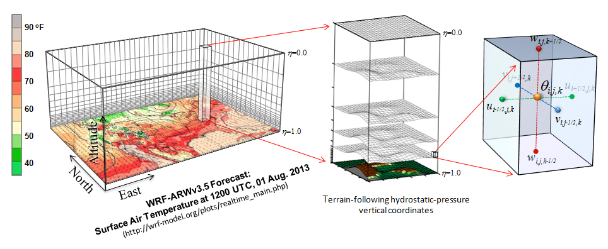
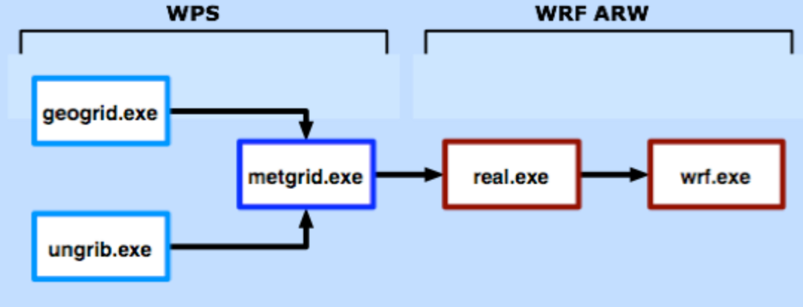
Methods: WRF-Chem (Weather Research & Forecasting Model coupled with Chemistry)-Model Description
WRF-Chem Version 3.7 User’s Guide, 2015
WRF-ARW Version 3.7 User’s Guide, 2015
Notes:
WRF is a numerical weather prediction system designed to serve both atmospheric research and operational weather predication needs. The WRF modeling system has Eulerian mass dynamic cores with terrain-following hydrostatic-pressure vertical coordinates.
KPP software tool used to read the chemical reactions and rate constants from the mechanism (ASCII) input files and automatically generates code for chemistry integration using the Rosenbrok solver (more efficient, less time consuming, less errors, numerically efficient, and flexibility in updating the mechanism with additional species and equations).
WRF-Chem/KPP Coupler writes the f90 interfaces between WRF-Chem and KPP generated code, minimum modifications to WRF-Chem, almost everything in one directory and also minimum changes in KPP, script to automatically compile/run KPP during WRF compile time
Add changes to the registry and KPP input (adding new reactions with rate constants to .eqn file, add new species to the .spc, add new defined functions to the .def file). After add all new species to the registry.chem file (if not already there). Compile new WRF-Chem source code. Update subroutines (i.e. chem_driver.F is adding new emissions. Be sure to add new emissions and chemical to emission and chem. package.
Model Run:
The purpose of GEOGRID is to define the simulation domain(s), and interpolate various terrestrial data sets to the model grids.
The purpose of UNGRIB is to unpack GRIB (GRIB1 and GRIB2) meteorological data and pack it into an intermediate file format.
The purpose of METGRID is to horizontally interpolate the meteorological data onto your model domain(edit namelist.wps)
real.exe: This program vertically interpolates the met_em* files (generated by metgrid.exe), creates boundary and initial condition files, and does some consistency checks.
wrf.exe:Generates the model forecast. (edit namelist.input run real then run wrf)

Slide 16
Methods: WRF-Chem-Model Domain & Input Options
Domain Options | Values
dx & dy (resolution of the grid in x/y axis) | 4000 (m)
Start Date | 2010-07-01_00:00:00
End Date | 2010-07-15_00:00:00
WRF-Chem model runs used RACM-based chemistry, Fast TUV photolysis, and included anthropogenic and biogenic emissions
Two WRF-Chem model cases were performed with RACM2 & GACM when the following emission options (biomass burning, dust, sea salt, and DMS (di-methyl sulfide)) were turned on or off during the simulation run
ArcGIS Online, 2016

Slide 17
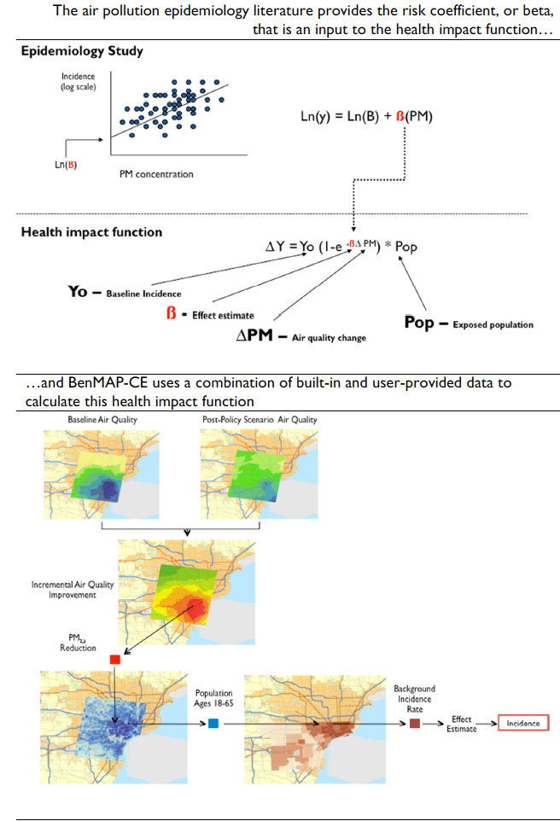

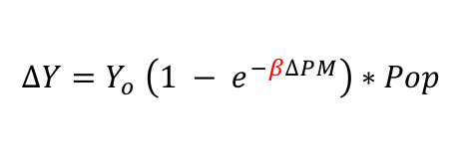
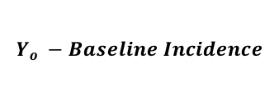
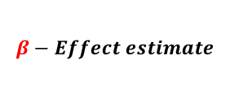





Methods: EPA BenMAP-CE-Program Description
The air pollution epidemiology literature provides the risk coefficient, or beta, that is an input to the health impact function…
Epidemiology Study
Incidence
(log scale)
Ln(y) = Ln(B) + $β(PM)$
Ln($β)$
PM concentration
Health Impact Function
$$∆Y=Y_{o} \left(1 − e^{−β∆PM}\right)∗Pop$$
$$Y_{o} −Baseline Incidence$$
$$β−Effect estimate$$
$$Pop−Exposed population$$
$$∆PM−Air Quality Change$$
…and BenMAP-CE uses a combination of built-in and user-provided data to calculate this health impact function
Baseline Air Quality
Post Policy Scenario Air Quality
Incremental Air Quality
Improvements
$${PM}_{2.5}$$
Reduction
Population
Ages 18 - 64
Baseline Incidence Rate
Effect
Estimate
Incidence
BenMAP User’s Manual, 2015
Notes:
The BenMAP-CE program estimates the human health impacts and economic value of air quality changes.
First, BenMAP-CE determines the change in ambient air pollution using user-specified air quality data.
Next, BenMAP-CE applies the relationship between the pollution and certain health effects.
BenMAP-CE applies that relationship to the exposed population to calculate health impacts. (Health Effect = Air Quality Change * Health Effect Estimate * Exposed Population * Health Baseline Incidence)
(This relationship is often referred to as the health impact function or the concentration-response (C-R) function, which is derived from epidemiology studies as shown in image to the right)
A C-R function estimates the relationship between adverse health effects and ambient air pollution, and is used to derive health impact functions
Epidemiological Study: The study of factors affecting the health and illness of populations. Epidemiological studies cannot prove that a specific risk factor actually causes the disease being studied but can only show that a risk factor is associated (correlated) with a higher incidence of disease in the population exposed to that risk factor.
Health Impact Function: A health impact function calculates the change in adverse health effects associated with a change in exposure to air pollution. Based on a C-R function, a typical health impact function has inputs specifying the air quality metric and pollutant; the age, race and ethnicity of the population affected; and the incidence rate of the adverse health effect.

Slide 18
Results & Discussion I (S-Box Model) :RACM2 Vs. GACM [Initial Conditions]
Initial Conditions | Value
Temperature | 290 K
Pressure | 760 mbar
Start Time | 300 mins
End Time | 1440 mins
Initial Conditions | Value
NO – Nitric oxide | 0.22 ppb
NO₂ - Nitrogen dioxide | 0.78 ppb
O₃ - Ozone | 40.00 ppb
CO – Carbon Monoxide | 110 ppb
TOL – Toluene | 2.5859 ppb
ACD - Acetaldehyde | 0.500 ppb
OLE – Terminal & Internal Alkenes | 0.634 ppb
Cl-Chlorine | 0.005 ppb
Cl₂ – Chlorine gas | 0.002 ppb
Br - Bromine | 2.46 x 10⁻⁰⁷ ppb
Br₂ – Bromine gas | 1.480 ppb
I – Iodine | 4.30 x 10⁻⁰⁷ ppb
I₂ – Iodine gas | 1.00 x 10⁻⁰⁷ ppb
Notes:
Initial concentrations of species used in the box model.
Where: (a) corresponds to typical concentrations in the marine
boundary layer and, (b) to values taken from the 3rd PORG report
initialised with background organic and inorganic
content representative of fresh emissions leaving a continental
landmass
The model was initialised with background organic and inorganic content representative of fresh emissions leaving a continental landmass

Slide 19
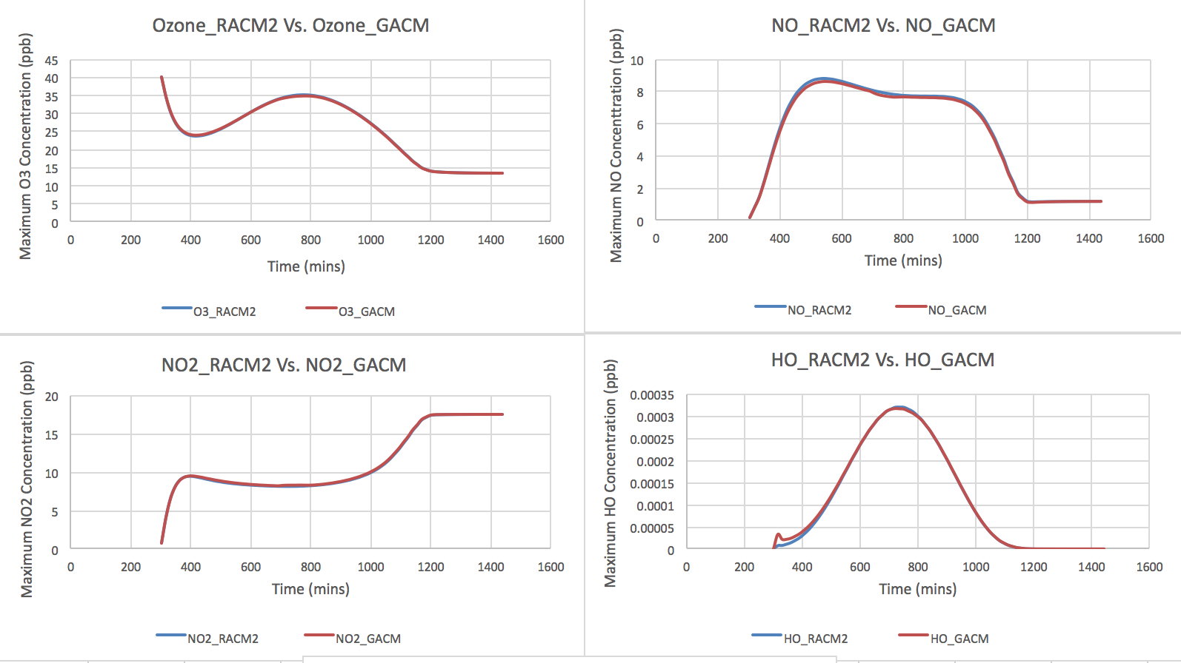
Results & Discussion I (S-Box Model) :RACM2 Vs. GACM [O₃ & its precursors]

Slide 20
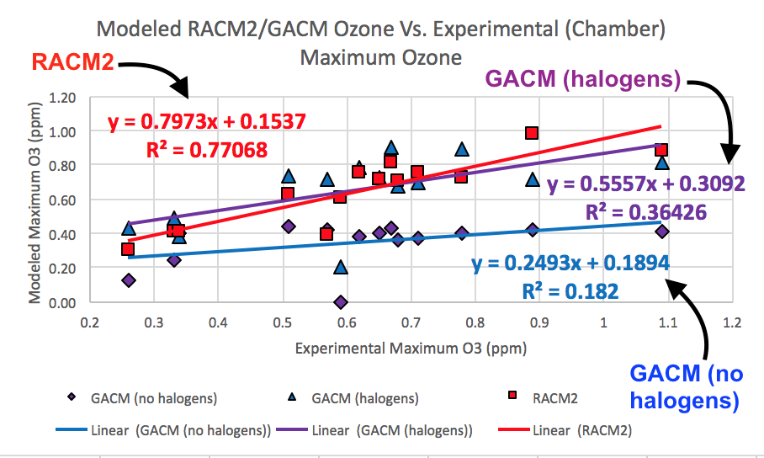
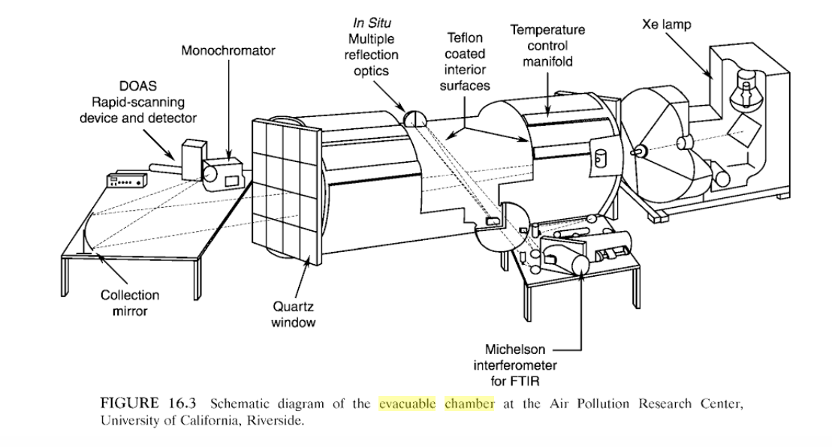
Results & Discussion I (S-Box Model) :RACM2 Vs. GACM [Experimental vs. Chamber]
Schematic diagram of the evacuable chamber at the Air Pollution Research Center, University of California, Riverside.
Finlayson-Pitts & Pitts, 1999
Notes:
Perhaps the most direct experimental means of examining the relationship between emissions and air quality is to simulate atmospheric conditions using large chambers. Measured concentrations of the primary pollutants are injected into these environmental (or smog) chambers, as they are called. These are then irradiated with sunlight or lamps used to mimic the sun, and the time-concentration profiles of the primary pollutants as well as the resulting secondary pollutants are measured. The primary pollutant concentrations as well as temperature, relative humidity, and so on can be systematically varied to establish the relationship between emissions and air quality, free from the complexities of continuously injected pollutant emissions and meteorology, both of which complicate the interpretation of ambient air data.
Figure 16.3 is constructed with an aluminum alloy and the walls are coated with FEP Teflon. The end windows through which the mixture is irradiated are UV grade quartz to allow transmission of the actinic UV. The radiation cutoff and spectral distribution in the 290 to 350 nm region can be varied using filters between the irradiation source and chamber windows. The pumping system used to evacuate the system is hydrocarbon free; back-diffusion of organics from the concentrations that by themselves exceed the VOC air quality standard. The pumping system consists of a liquid ring roughing pump (the fluid is water) with an air injection pump, cryosorption roughing pumps, a diffusion pump, and mechanical pump. (Both the diffusion and mechanical pumps use unreactive perflourinated oils rather than hydrocarbons as the working fluid.) Ports are included in the chamber for the air and pollutant injection, for sampling (e.g. GC or GC-MS analysis), and for in situ analysis using optical absorption spectroscopy.
This type of chamber satisfies most design criteria in that both pressure and temperature can be varied, the intensity and spectrum of the irradiation can be altered, and the surface can be coated with a relatively inert material to minimize heterogeneous reactions and pollutant adsorption and off gassing.

Slide 21
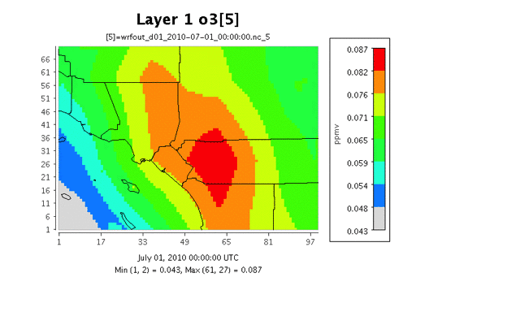

Results & Discussion II (WRF-Chem) -RACM2 & GACM Vs. SoCAB Site Data [Fast Tile Plots]
RACM2
Maximum Ozone Production in the SoCAB Region for July 1-July 14 Simulation Run
GACM
Maximum Ozone Production in the SoCAB Region for July 1-July 14 Simulation Run
VERDI, 2014

Slide 22
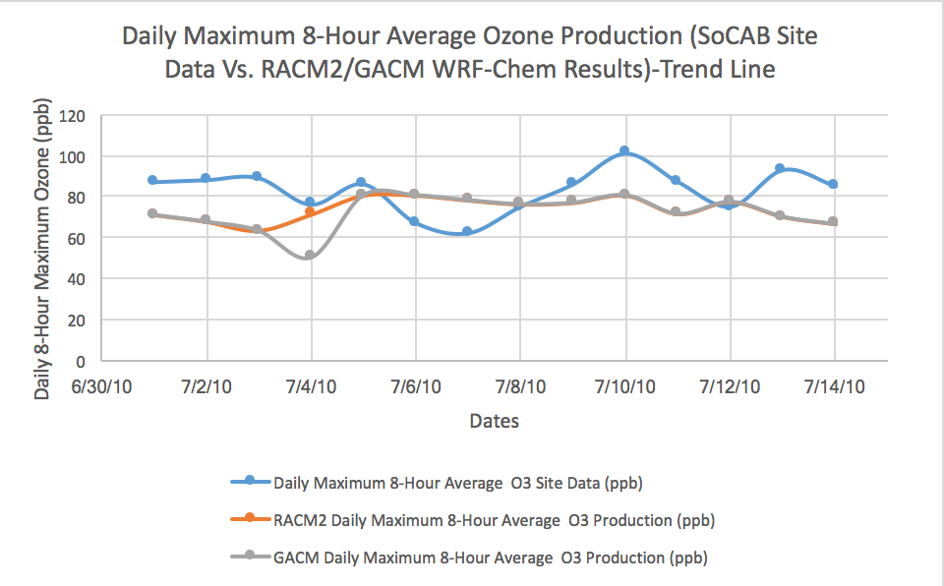
Results & Discussion II (WRF-Chem) -RACM2 Vs. GACM Vs. SoCAB Site Data
*The Clean Air Act requires the Environmental Protection Agency (EPA) to set national ambient air quality standards for six "criteria" air pollutants, including ground-level ozone (O3) and O₃ is measured as the daily 8-hour average.

Slide 23
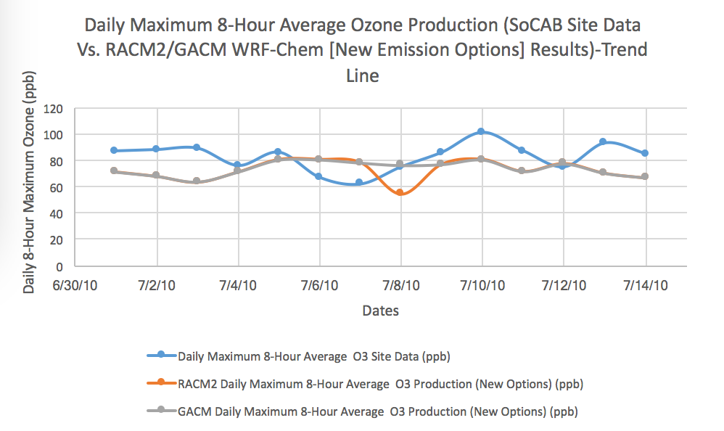
Results & Discussion II (WRF-Chem)-RACM2 Vs. GACM w/ new emission options Vs. SoCAB Site Data
*The Clean Air Act requires the Environmental Protection Agency (EPA) to set national ambient air quality standards for six "criteria" air pollutants, including ground-level ozone (O3) and O₃ is measured as the daily 8-hour average.

Slide 24
Results & Discussion II (WRF-Chem) -RACM2 & GACM Vs. SoCAB Site Data [Statistical Values]
Mechanism Run (Daily Maximum 8-hr Average Values) | Mean Bias (ppb) | Normalized Mean Bias (%) | Normalized Mean Error (%) | Root Mean Square (ppb) | Pair Mean Normalized Bias (%) | Pair Mean Normalized Gross Error (%)
RACM2 (Same Options Model Run) | -8.91 | -10.78 | 16.55 | 15.63 | -13.04 | 19.08
GACM (Same Options Model Run) | -10.39 | -12.58 | 18.34 | 17.01 | -16.18 | 22.22
RACM2 (New Emission Options Model Run) | -10.46 | -12.66 | 18.21 | 16.55 | -15.84 | 21.64
GACM (New Emission Options Model Run) | -8.91 | -10.79 | 16.55 | 15.63 | -13.05 | 19.09

Slide 25
Results & Discussion III (EPA BenMAP-CE) -RACM2 & GACM Health Impact Results: Chart
Health Endpoint | Metric | Age Range (years) | Location | Reference | Notes
Acute Respiratory Symptoms-Minor Restricitve Acttvity Days | D-8 Hour Max | 18 to 64 | Nationwide | Ostro and Rothschild, 1989 | All year, 8-hour max from 1-hour max
Emergency Room Visits, Asthma | D-8 Hour Max | 0 to 99 | Atlanta, GA | Peel et al., 2005 | All year, 8-hour max from 1-hour max
Emergency Room Visits, Asthma | D-8 Hour Max | 0 to 99 | Portland, ME | Wilson et al., 2005 | All year, 8-hour max from 1-hour max
Hospital Admissions, All Respiratory | D-8 Hour Max | 65 to 99 | New Haven, CT | Schwartz, 1995 | Warm season. 8-hour max from 24-hour mean
Hospital Admissions, Chronic Lung Disease (less Asthma) | D-8 Hour Max | 65 to 99 | Detroit, MI | Schwartz, 1995 | All year, 8-hour max from 1-hour max
Hospital Admissions, Chronic Lung Disease | D-8 Hour Max | 65 to 99 | Minneapolis, MN | Moolgavkar et al., 1997 | All year, 8-hour max from 1-hour max
Mortality, Respiratory | Annual | 30 to 99 | Southern California | Jerrett et al., 2009 | All year, 8-hour max from 1-hour max
School Loss Days, All Cause | D-8 Hour Max | 5 to 17 | Washoe Co, NV | Chen et al., 2000 | All year, 8-hour max from 1-hour max
School Loss Days, All Cause | D-8 Hour Max | 5 to 17 | Southern California | Gilliland et al., 2001 | All year, 8-hour max from 1-hour max

Slide 26
Results & Discussion III (EPA BenMAP-CE)-RACM2 & GACM Health Impact Results: Chart
Ozone Incidence | RACM2 Health Impact Point Estimates (95% CI) | GACM Health Impact Point Estimates (95% CI)
Acute Respiratory Symptoms-Minor Restricted Activity Days (Ostro & Rothschild, 1989) | 6,600,600 (2,800,000, 10,000,000) | 6,600,100 (2,800,600, 10,000,300)
School Loss Days, All Cause (Chen et al., 2000) | 4,400,100 (-700,700, 7,400,100) | 4,400,900 (-700,100, 7,400,100)
Emergency Room Visits, Asthma (Wilson et al. 2005) | 6,400 (2,300, 10,000) | 6,300 (2,300, 10,000)
Hospital Admissions, All Respiratory (Schwartz, 1995) | 3,800 (-100, 7,200) | 3,700 (-100, 7,200)
Mortality, Respiratory (Jerrett et al., 2009) | 3,300 (1,200, 5,000) | 3,200 (1,200, 5,000)
Notes:
American Lung Association Fact Sheet, 2004
School Loss Days C 190,000; 600,000 ;1,100,000
Hospital and ER Visits 2,600; 6,700; 11,000
Minor Restricted Activity Days 1,000,000; 2,600,000; 4,500,000
According to the California Air Resources Board the annual health impacts of exceeding state
health-based standards for ozone and particulate matter include:
♣ 6,500 premature deaths
♣ 4,000 hospital admissions for respiratory disease
♣ 3,000 hospital admissions for cardiovascular disease
♣ 350,000 asthma attacks
♣ 2,000 asthma-related emergency room visits
♣ Elevated school absences due to respiratory conditions, including asthma
♣ Reduced lung function growth rate in children
Sensitive groups, including seniors, people with heart or lung disease, children and infants are
the most vulnerable to the harmful effects of air pollution. Low-income communities and
communities of color are also especially vulnerable to pollution-related health impacts due to the
multiple pollution sources located in these communities and their often limited access to health
care.

Slide 27
Results & Discussion III (EPA BenMAP-CE)-RACM2 & GACM Valuation Results: Chart
Ozone Incidence | RACM2 Valuation Point Estimates (95% CI) | GACM Valuation Point Estimates (95% CI)
Acute Respiratory Symptoms-Minor Restricted Activity Days (Ostro & Rothschild, 1989) | $400,900,800.90 ($200,400,400.80, $800,900,900.10) | $400,500,600.40 ($200,200,400.20, $800,300,600.30)
School Loss Days, All Cause (Chen et al., 2000) | $200,400,000.80 ($90,000,500.60, $400,300,200.10) | $200,300,200.10 ($80,900,700.30, $400,000,900.20)
Emergency Room Visits, Asthma (Wilson et al. 2005) | $2,500,700.90 ($900,400.20, $3,800,500.70) | $2,500,500.70 ($900,600.40, $3,800,300.00)
Hospital Admissions, All Respiratory (Schwartz, 1995) | $40,900,700.40 ($11,900,500.60, $70,500,200.40) | $100,700,400.90 (-$4,400,800.90, $200,800,600.30)
Mortality, Respiratory (Jerrett et al., 2009) | $30,300,900,100.00 ($2,200,300,900.50, $80,800,800,700.50) | $30,300,900,100.00 ($2,200,600,200.20, $80,800,300,500.30)

Slide 28
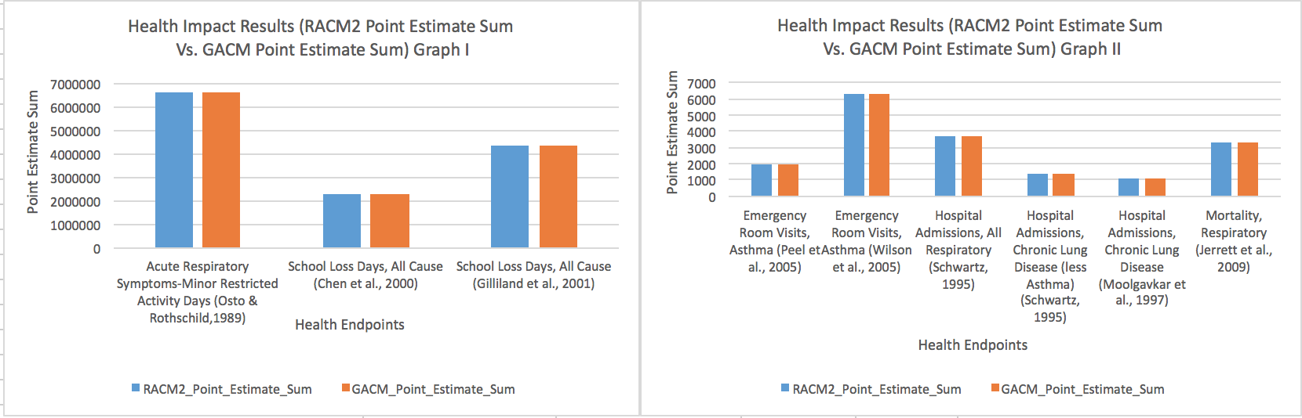
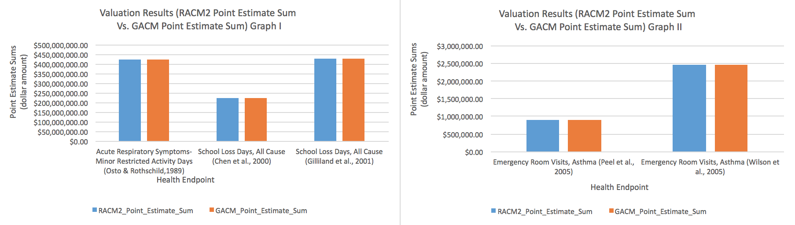
Results & Discussion III (EPA BenMAP-CE)-RACM2 & GACM Health Impact and Valuation Graphs

Slide 29
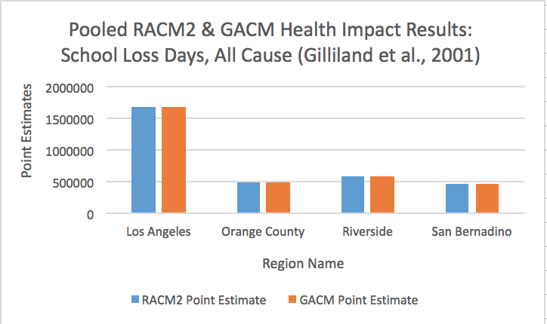
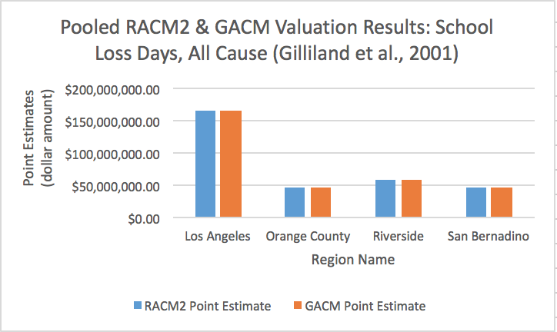
Results & Discussion III (EPA BenMAP-CE)-RACM2 & GACM Health Impact and Valuation Graphs: Pooled Counties
Region Name | Endpoint | RACM2 Point Estimate (Health Impact Results) | GACM Point Estimate (Health Impact Results) | RACM2 Point Estimate (Valuation Results) | GACM Point Estimate (Valuation Results)
Los Angeles | School Loss Days, All Cause (Gilliland et al., 2001) | 1,687,683 | 1,685,303 | $165,713,872.00 | $165,480,240.00
Orange County | School Loss Days, All Cause (Gilliland et al., 2001) | 486,803 | 486,701 | $47,799,280.00 | $47,789,256.00
Riverside | School Loss Days, All Cause (Gilliland et al., 2001) | 593,572 | 593,387 | $58,282,984.00 | $58,264,792.00
San Bernardino | School Loss Days, All Cause (Gilliland et al., 2001) | 478,705 | 478,486 | $47,004,160.00 | $46,982,680.00

Slide 30
Conclusions
GACM and RACM2 O₃ concentrations from the S-Box model runs showed the compatibility of the VOC chemistry within both mechanisms.
The successful testing of GACM against the environmental chamber data revealed how well GACM chemistry compares against actual concentrations of chemical species found in the troposphere.
WRF-Chem GACM and RACM2 results showed how well both mechanisms simulate O₃ under real-world conditions.
The amount of tropospheric O₃ in the SoCAB area leads to an increased amount of respiratory-related health impact and cost incurred from those results.
GACM & RACM2 will work well in global-regional modeling system based upon the compatibility from model results.
Notes:
compatibility of both mechanisms and how that relates to boundary conditions
in the month of July based upon the emission sources and initial/boundary conditions provided by the model.

Slide 31
Future Studies
Implement GACM into a current global model (i.e. GEOS-Chem or MOZART) to see how those boundary conditions work in a regional model.
Explore the model discrepancies between the WRF-Chem model and observed data when using RACM2 & GACM.
Research into the use of different emission inventories used to create the emissions of all species for a model run, so the O₃ results are not under predicted by the model due to the high NO_{x} emissions (Travis et al., 2016) .
Implementation of reactive halogen species (i.e. Br, Cl, & I) into WRF-Chem should be done to analyze how O₃ concentrations change for a GACM model run and to understand how various halogen processes in the troposphere impacts the destruction/production of O₃ in the atmosphere.
Notes:
RACM2 and GACM when used in WRF-Chem produced concentrations O₃ that were under predicted by the model (at least a 30% difference from the collected SoCAB site data)
Travis et al., study found that the NEI from the US EPA is too high by 30-60%, which is why simulated O3 concentrations are under-predicted by models by a 15ppb model bias.

Slide 32
Acknowledgments
I would like to acknowledge all of my collaborators on this project Alma Hodzic, Ph.D, John Orlando, Ph.D, and Sasha Madronich, Ph.D at NCAR (National Center of Atmospheric Research), Wendy Goliff, PhD. at U.C. Riverside (University of California at Riverside), and Dr. Vernon Morris at Howard University
Thank you to the Department of Chemistry and NCAS (NOAA Center for Atmospheric Research at Howard University), for there continued professional and financial support throughout my graduate career.
Lastly, I would like to especially acknowledge my PhD. Dissertation advisor Dr. William Stockwell without whose constant support and advocacy on my behalf has helped me become the research scientist I am today.

Slide 33


Any Questions ?????

Slide 34
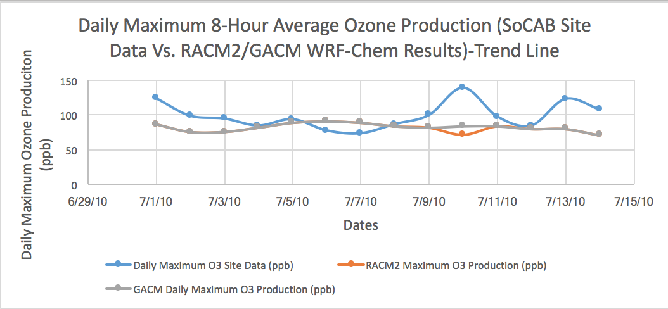
Results & Discussion II (WRF-Chem) -RACM2 Vs. GACM Vs. SoCAB Site Data

Slide 35
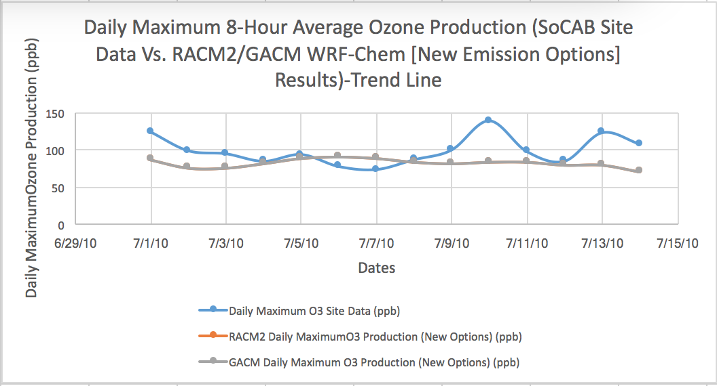
Results & Discussion II (WRF-Chem)-RACM2 Vs. GACM w/ new emission options Vs. SoCAB Site Data

Slide 36
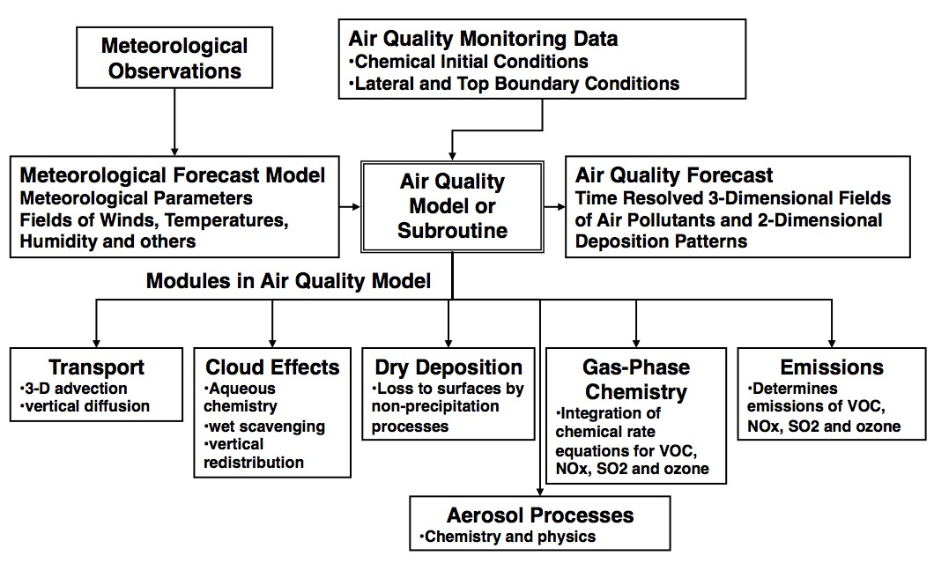
Air Quality Models
Stockwell, et. al., 2002
Notes:
In the past air quality predictions have had to rely on the use of climatological, and often fixed, BCs. As global model predictions have become available, regional air quality models are beginning to use BCs from the global models.
The most important advantage of using global model BCs is that these BCs can bring time-varied external signals to the regional domain, and reflect certain event information, such as biomass burning, stratospheric intrusion, and Asian air mass inflow. These results suggest that the use of global model BCs can improve regional air quality predictions. These results also point out that further improvement in regional model predictions will require efforts to reduce the uncertainty in the global model BCs.
Air Quality Modeling-is the mathematical prediction of ambient concentrations of air pollution, based on measured inputs.
The major components of the air quality model starts off with the meteorological observations(which means making analysis of past meteorological events) Then the simulations are made by the met. models(i.e. WRF-Chem). The observations that are processed by the meteorological models are used to generate future event. The way to generate the background (i.e. chemical measurements) is to run the met. model for sometime then discard the initial data (which is called a spin up) and keep the rest of the run to generate the chemistry for the model. The chemistry produced is also called chemical climatological data and this produces met. data that is self consistent. Use the air quality initial conditions to produce the air quality forecast. The individual models are used to bring together all of the modules to run air quality simulations.
Data Output- within the modeling system there is a main program that uses all of the separate modules to produce the final result.
Essential tools for evaluating control strategies for the reduction of ozone in order to meet air quality goals, many agencies These models are important to our air quality management system because they are widely used by agencies tasked with controlling air pollution to both identify source contributions to air quality problems and assist in the design of effective strategies to reduce harmful air pollutants. For example, air quality models can be used during the permitting process to verify that a new source will not exceed ambient air quality standards or, if necessary, determine appropriate additional control requirements. In addition, air quality models can also be used to predict future pollutant concentrations from multiple sources after the implementation of a new regulatory program, in order to estimate the effectiveness of the program in reducing harmful exposures to humans and the environment.

Slide 37
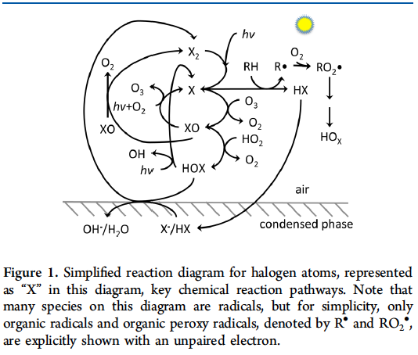
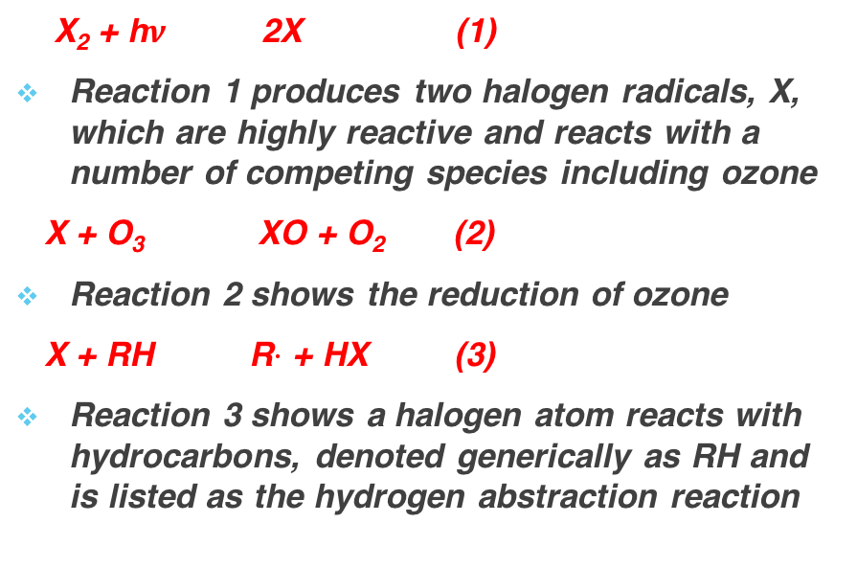
Gas Phase Chemical Mechanisms II (GACM) : Halogen Chemistry (Importance)
X₂ + h$ν$ 2X (1)
Reaction 1 produces two halogen radicals, X, which are highly reactive and reacts with a number of competing species including ozone
X + O₃ XO + O₂ (2)
Reaction 2 shows the reduction of ozone
X + RH R$·$ + HX (3)
Reaction 3 shows a halogen atom reacts with hydrocarbons, denoted generically as RH and is listed as the hydrogen abstraction reaction
Halogen radicals take part in complex chemical cycles involving gas phase reactions in the troposphere. One of the most important roles of halogen chemistry is the catalytic destruction of ozone in the lower troposphere. Halogen radicals formed by the photo-dissociation of X₂, XY, HOX, etc., where X represents Cl, Br, and I, react with ozone.
Simpson et al., 2015
Notes:
The HCl bond strength is similar to that of organic CH bonds, allowing chlorine atoms to react with hydrocarbons including abundant methane, giving it a reactivity similar to or larger than that of OH, but with different patterns of relative reactivity. Therefore, for chlorine, the hydrocarbon path outcompetes the ozone depleting pathway. Bromine is less reactive to hydrocarbons and, most often, reacts with ozone or the less abundant aldehydes (e.g., formaldehyde), increasing its role in tropospheric ozone depletion. Iodine atoms are even less reactive and react primarily with ozone, leading to the formation of higher iodine oxides. Reactions 2 and 3 are both radical propagation reactions, where the number of radical species is unchanged. Tracking halogens, we see that reaction 2 maintains the radical within the halogens and their oxides, while reaction 3 converts the radical to the organic species.
Bromine and iodine, the halogen oxides (XO) photo-dissociate rapidly (typically on the order of minute to second time scale), which recreates X and ozone in a “ null” cycle. This null cycle has no net effect on ozone destruction or production, but as these are often the fastest loss of XO, they, therefore, strongly affect the partitioning between X and XO. For typical ozone levels in the tens of picomole per mole range, the oxides dominate the atomic radical form, an eff ect that extends the effective lifetime of the XOx = X + XO family because the oxides are typically less reactive than the atomic form. The low reactivity of I is similar to that of IO, often making their ratio approximately unity. Chlorine monoxide, ClO, has a much longer photolytic lifetime,23 so this “ null cycle” does not apply to chlorine. The halogen oxides can react with each other with a variety of fates, which generally destroy ozone and either conserve radicals or produce dihalogens that then photolyze (in daytime) via reaction 1.
XO + XO → X2 + O2 (4)
XO + XO → X + X + O2 (5)
XO + XO → OXO + X (6)

Slide 38
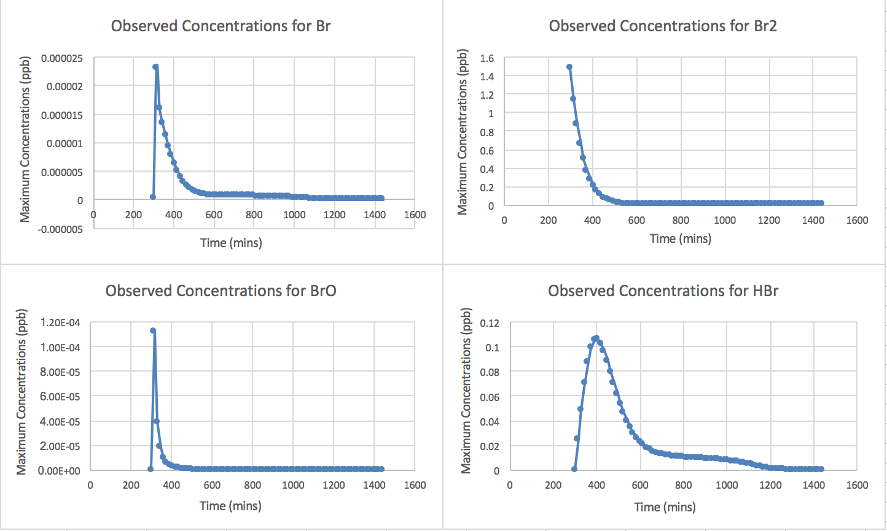
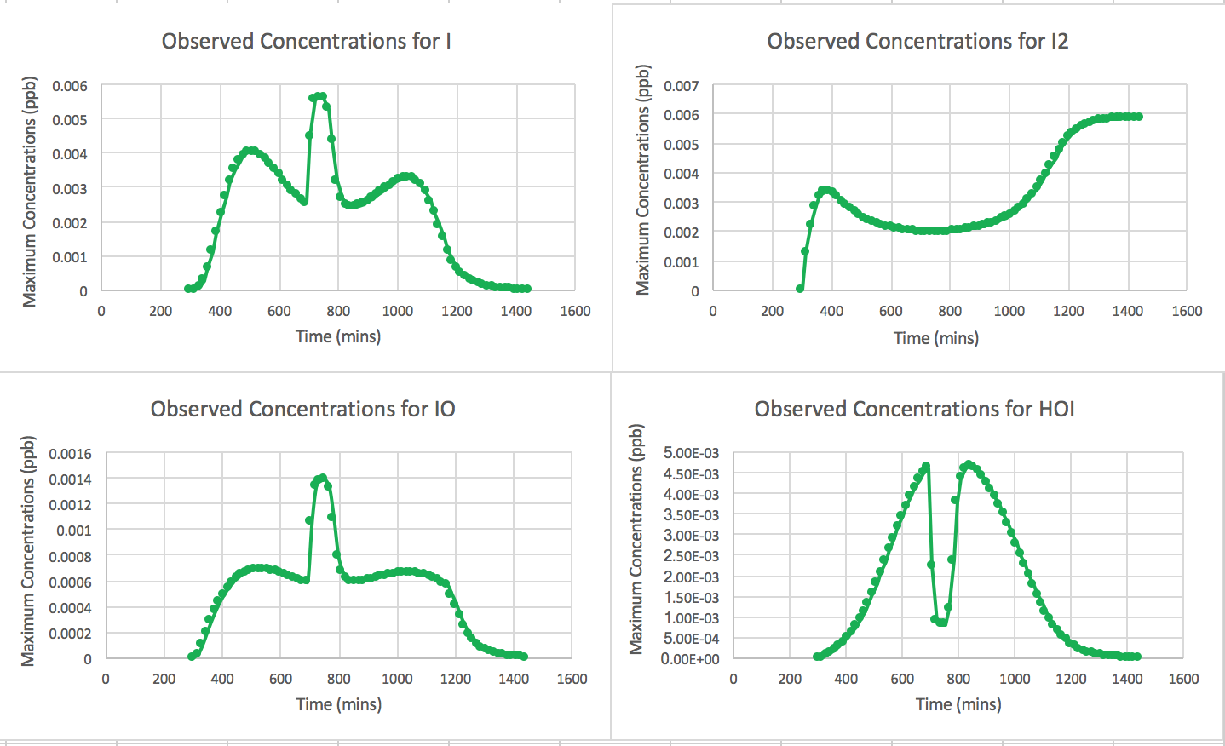
Results & Discussion I (S-Box Model) :GACM [Halogen Chemistry I]

Slide 39
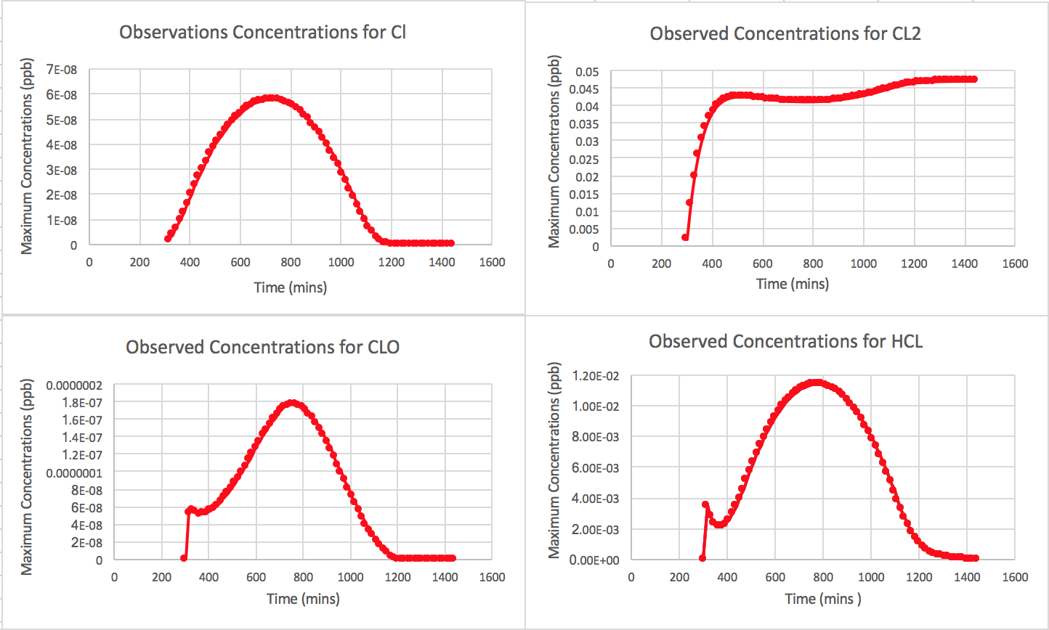
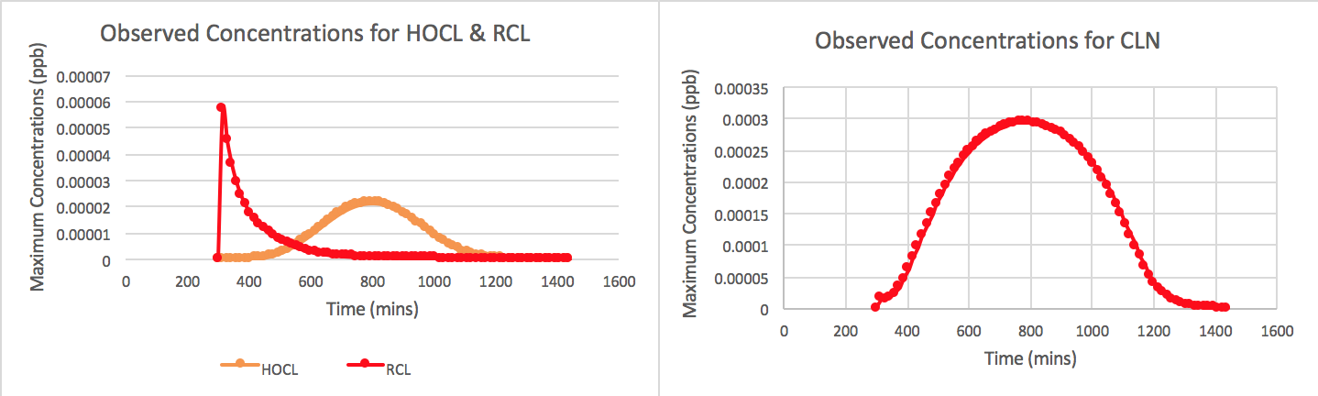
Results & Discussion I (S-Box Model) :GACM [Halogen Chemistry II]

Slide 40
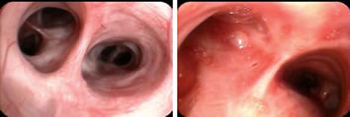
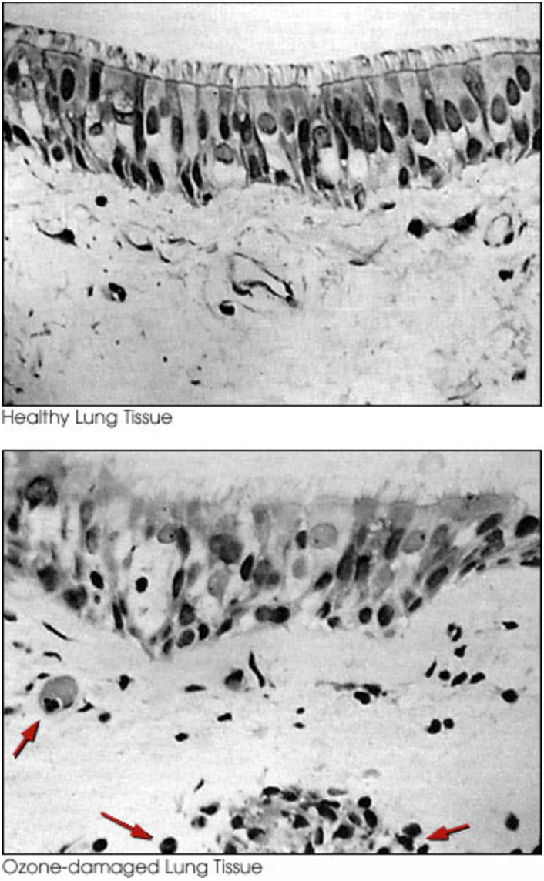
Respiratory Health Effects (Images)
Healthy Lung Tissue
These photos show a healthy lung airway (left) and an inflamed lung airway (right).Photos courtesy of PENTAX Medical Company
Ozone Damaged Lung Tissue
In the control image (upper) from the lung of a person exposed only to air, the tiny cilia that clear the lungs of mucus appear along the top of the image in a neat and regular row. (Allen, 2002)
Notes:
Image 1: Evidence for airway inflammation following ozone exposure includes visible redness of the airway seen during bronchoscopy
Image 2: Microscopic views of human lung tissue (epithelium, or lining) show damage resulting from exposure to relatively low levels of ozone. In the lung exposed to 20 ppb of ozone added to the air for four hours during moderate exercise, many cilia appear missing and others appear misshapen. Arrows point to tiny bodies called neutrophils in the ozone-exposed subject. The presence of neutrophils indicates inflammation. Magnification: x400. (Micrographs courtesy of the American Thoracic Society, from American Review of Respiratory Diseases, Vol. 148, 1993, Robert Aris et al., pp. 1368-1369.)

Slide 41
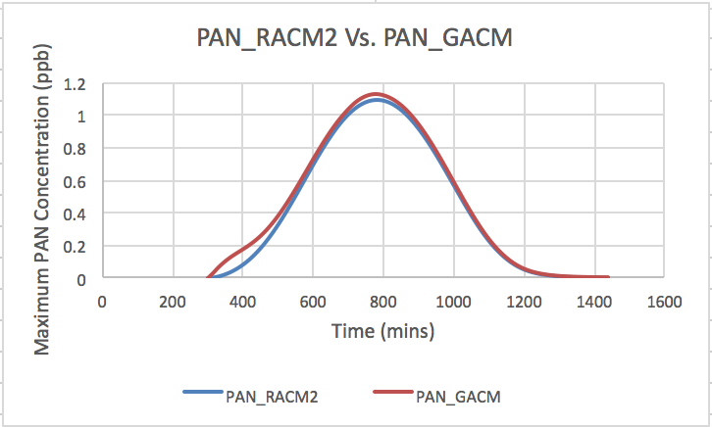
PAN Results

Slide 42
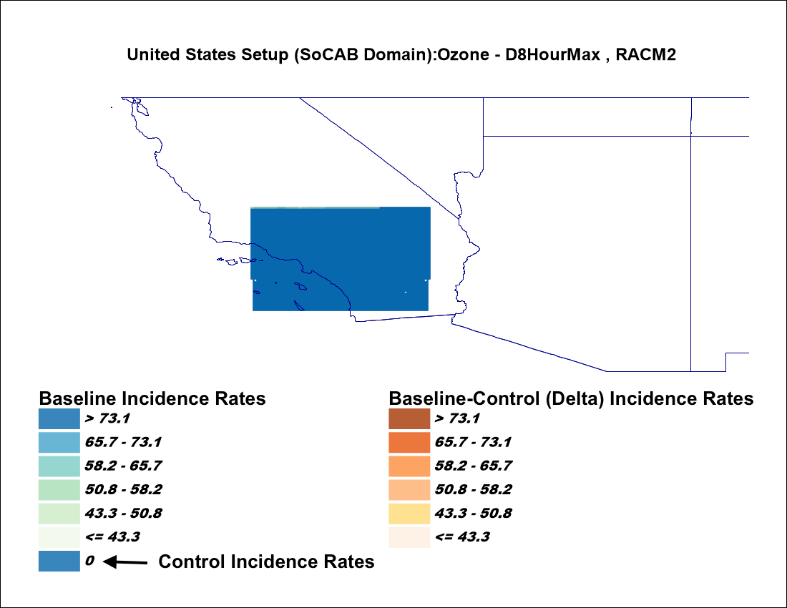
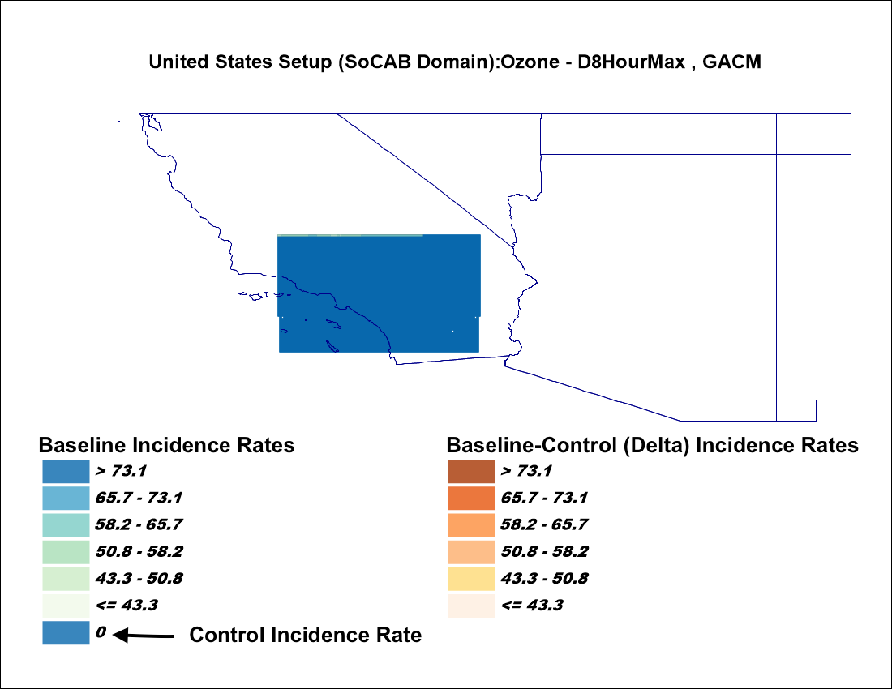
Results & Discussion III (EPA BenMAP-CE) (RACM2 & GACM Health Impact and Valuation Results: Map)

Slide 43
Results & Discussion III (EPA BenMAP-CE) (RACM2 & GACM Health Impact and Valuation Graphs)

Slide 44
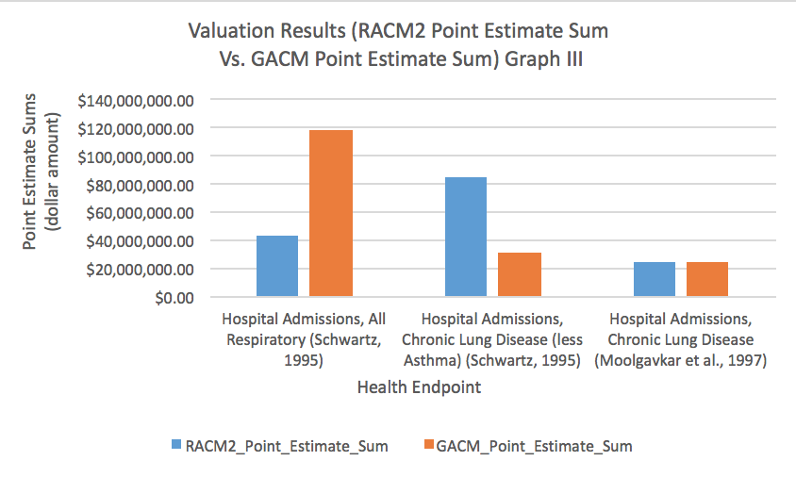
Results & Discussion III (EPA BenMAP-CE) (RACM2 & GACM Health Impact and Valuation Graphs)

Slide 45
Results & Discussion I (S-Box Model) :RACM2 Vs. GACM [Experimental vs. Chamber]
Chamber Reactions | Principal Organic Compounds | VOC/NOx Ratio | O3 (ppm) | GACM (NH) [ppm] | GACM (H) [ppm] | % Difference (GACM (NH) Vs. Chamber O3) | % Difference (GACM (H) Vs. Chamber O3) | RACM2 (ppm) | % Difference (GACM (NH) Vs. RACM2) | % Difference (GACM (H)Vs. RACM2)
ec231 | Mixture | 27.9 | 0.62 | 0.38 | 0.79 | 48.80% | -23.96% | 0.75 | 66.25% | -5.04%
ec233 | Mixture | 96.8 | 0.33 | 0.24 | 0.49 | 30.67% | -38.41% | 0.41 | 51.44% | -17.14%
ec237 | Mixture | 22.5 | 0.65 | 0.40 | 0.72 | 47.92% | -10.68% | 0.72 | 57.44% | -0.47%
ec238 | Mixture | 11 | 0.67 | 0.43 | 0.90 | 43.19% | -29.40% | 0.81 | 60.87% | -10.63%
ec246 | Mixture | 17.6 | 0.57 | 0.42 | 0.72 | 29.52% | -22.63% | 0.39 | -8.21% | -58.88%
ec331 | Toluene + n-butane | 47.4 | 0.51 | 0.44 | 0.74 | 13.84% | -36.45% | 0.63 | 34.65% | -15.70%
ec340 | Toluene | 9.2 | 0.34 | 0.40 | 0.38 | -15.58% | -11.12% | 0.41 | 3.11% | 7.58%

Slide 46
WRF-Chem Chemistry Options
Chemistry options | Value | Description
chem_opt (chemistry option) | 108 | racm_soa_vbs_kpp (NOAA/ESRL RACM Chemistry and MADE/VBS (volatility basis set) aerosols using KPP library. VBS is used for SOA’s)
photo_opt (photolysis option) | 3 | Madronich F-TUV photolysis
emis_opt (emission option) | 3 | RADM2/MADE/SORGAM anthropogenic emissions
bio_emiss_opt (biogenic emissions option) | 3 | Includes MEGAN biogenic emissions online based upon the weather, land use data.
biomass_burn_opt (biomass burning emissions option) | 0; 1 | no biomass burning emissions; includes biomass burning emissions and plume rise calculation
dust_opt (dust emissions option) | 0; 2 | no GOCART dust emissions included; MOSAIC and MADE/SOGRAM dust emissions
seas_opt (sea salt emissions option) | 0; 2 | no GOCART sea salt emissions included; MOSAIC or MADE/SOGRAM sea salt emissions
dmsemis_opt (dms emissions option) | 0; 1 | no GOCART dms (di-methyl sulfide) from sea surface; includes GOCART dms (di-methyl sulfide) from sea surface

Slide 47
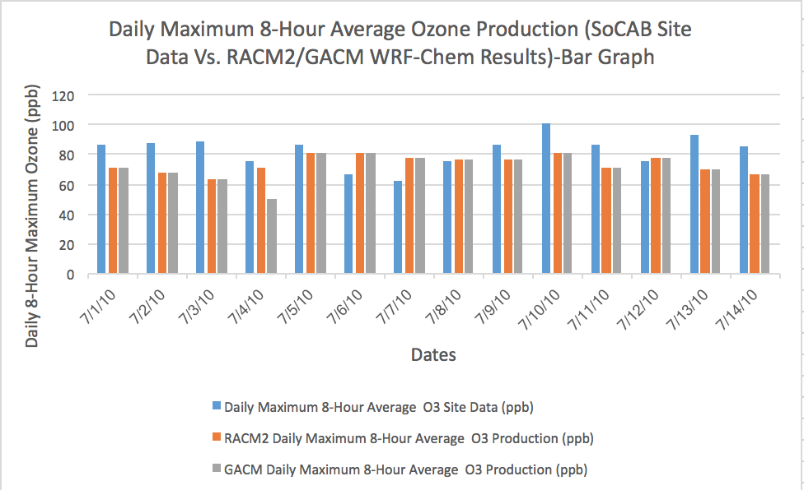
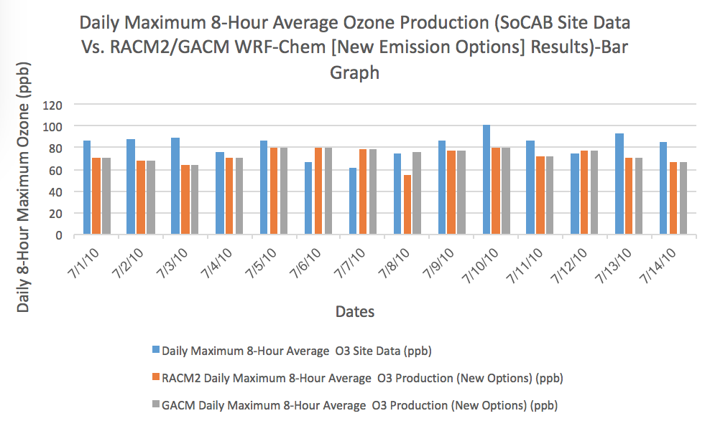
WRF-Chem Results- Bar Graphs

Slide 48
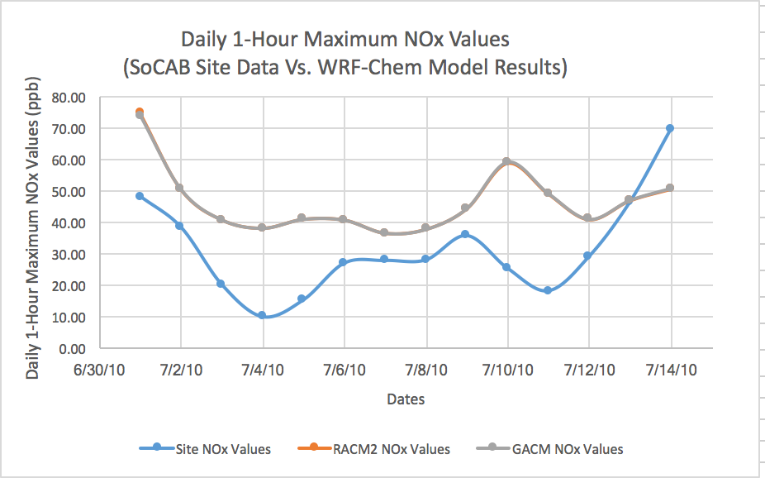
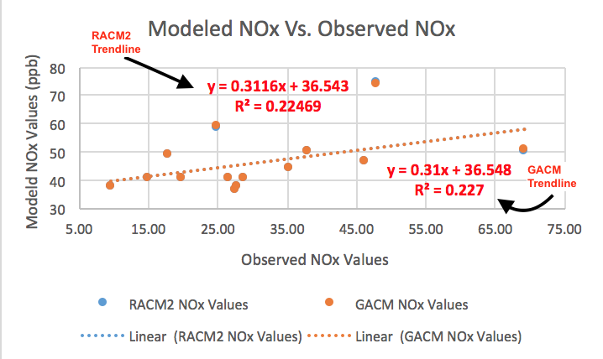
NOx WRF-Chem Results

Slide 49
CalNex Study

Slide 50
CalNex 2010 Study

Slide 51
CalNex Study-Instruments
Notes:
The NOAA P-3 was instrumented to measure a wide variety of trace gases; aerosol particle composition; microphysics;cloud nucleating and optical properties; hydrometeor concentration, size, and morphology; solar actinic fluxes; and solar irradiance
The NOAA Twin Otter was equipped with the TOPAZ differential absorption lidar (DIAL) to measure vertically resolved O3 and aerosol backscatter nadir profiles, a scanning Doppler lidar to measure nadir wind fields, and an airborne multi-axis differential optical absorption spectrometer (AMAX-DOAS) to measure aerosol extinction and variety of trace gas column densities, among them nitrogen dioxide (NO2 ), formaldehyde (HCHO), glyoxal (CHOCHO), and nitrous acid (HONO)
Fifty-one NOAA Twin Otter research flights during CalNex, totaling 207 h, took place between 19 May and 19 July 2010. Of these, 33 flights were based in Ontario, California, and 15 were based in Sacramento, California, in coordination with the DOE CARES program; three were transit flights to and from California. These flights were supported by CARB and the NOAA Air
Quality Program. Its deployment and flight plans were focused on providing data to better understand the emissions sources of NOx to the atmosphere; the three-dimensional distribution of O3 , NO2 , CHOCHO, and particulate matter in different regions of California; and the key transport processes affecting spatial and temporal distributions of these pollutants.

Slide 52
GACM-RACM2 System
GACM
GACM Initial / Boundary Conditions
RACM2
Air Quality Forecast (Regional/Global)
GACM is intended for use in global scale atmospheric chemistry models to provide chemical boundary conditions for regional scale simulations by models such as CMAQ.
The GACM-RACM2 system of mechanisms should yield more accurate forecasts by regional air quality models such as CMAQ.
The implementation of GACM initial conditions into a current regional air quality models will show how global gas phase chemical mechanisms can help produce better air quality model forecasts for the regional scale.

Slide 53
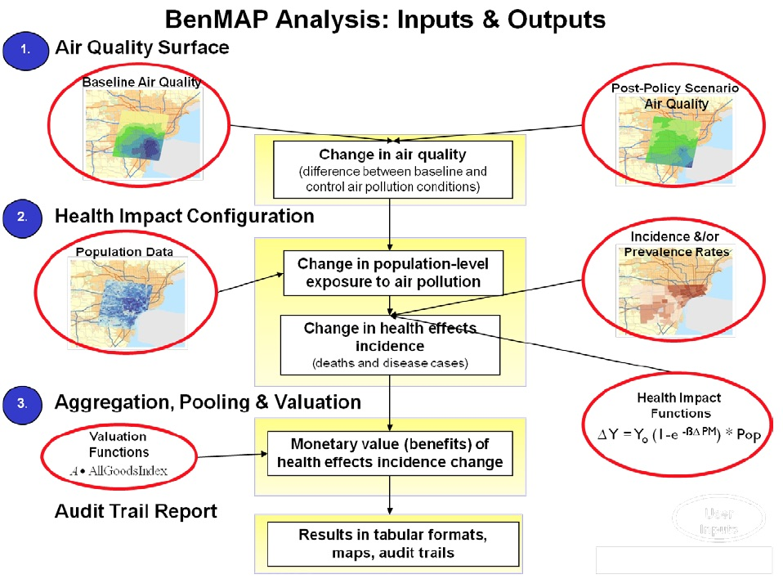
BenMAP Analysis
EPA BenMAP-CE User Manual , 2015
Notes:
Analysts can use BenMAP-CE to:
Create maps illustrating the population/community level ambient pollution levels;
Compare benefits associated with various regulatory programs;
Characterize the distribution of health impacts among population sub-groups;
Estimate health impacts and economic values of existing air pollution concentrations;
Estimate the health benefits of alternative ambient air quality standards; and
Perform sensitivity analyses of health or valuation functions, or of other inputs.
C-R function Y_{o}-Baseline Incidence, B-Health effect estimate, PM-Air quality change, Pop-exposed population
Health Effect = Air Quality Change * Health Effect Estimate * Exposed Population * Health Baseline Incidence
Air Quality Change. The air quality change is the difference between the starting air pollution level (i.e., the baseline) and the air pollution level after some change, such as a new regulation (i.e., the control).
Health Effect Estimate. The health effect estimate is an estimate of the percentage change in the risk of an adverse health effect due to a one unit change in ambient air pollution.
Exposed Population. The exposed population is the number of people affected by the air pollution reduction. The government Census office is a good source for this information.
Health Baseline Incidence. The health incidence rate is an estimate of the average number of people who die (or suffer from some adverse health effect) in a given population over a given period of time.
BenMAP-CE also calculates the economic value of avoided health effects. After calculating the health changes, you can estimate the economic value by multiplying the reduction of the health effect by an estimate of the economic value per case:
Economic Value = Health Effect * Value of Health Effect

Slide 54
Halogen Chemistry
Halogen Chemistry Importance
Ozone destruction at polar sunrise
Ozone destruction in the marine boundary layer
Ozone production in polluted atmospheres
Conversion of elemental mercury to reactive mercury.
Removal of Methane.
Detection Techniques
Tandem mass spectroscopy (e.g., Spicer et al. 1998).
  H₃O⁺ generated and it reacts with Cl₂
Chemical ionization Mass Spec (CIMS)
Mist chamber
DOAS
Resonance fluorescence

Slide 55
Halogen Chemistry
Halogen atoms can destroy ozone in the unpolluted trop.
X + O₃ → XO + O₂
XO + hv + (O₂) → X + O₃
-----------------------------------------------------
Do nothing
X + O₃ → XO + O₂
XO + HO₂ → HOX + O₂
HOX + hv → X + OH
OH + CO (+O₂) → CO₂ + OH
----------------------------------------------------------
O₃ + CO → CO₂ + O₂ net
Where X represents Cl, Br, or I, but not F.
F + H₂O → HF + OH
And HF is stable.
Destruction can also proceed through a halogen dimer.
2(X + O₃ → XO + O₂)
XO + XO → 2X + O₂
→ X₂ + O₂
X₂ + hv → 2X
----------------------------------------------------------
2O₃ → 3O₂ net
This cycle proceeds in the Arctic where X represents Br, and BrO concentrations are high.
It can also proceed with one Br and one Cl.

Slide 56
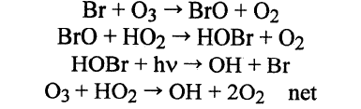
Halogen Chemistry
Chlorine atoms can initiate ozone production in the polluted trop. as OH does.
R-H + Cl → HCl + R●
R● + O₂ + M → RO₂ + M
RO₂ + NO → NO₂
Etc.
HCl is pretty much dead in the troposphere. It is lost by dry & wet deposition.
Bromine atoms, in contrast, do not react with hydrocarbons. They do react with aldehydes though.
Bromine atoms destroy ozone
in the absence of NOx
Barrie et al. (1988) Used these reactions to explain rap[id ozone loss in the Arctic spring (polar sunrise).
Keene et al. (1990) and Vogt et al. (1996) proposed this mechanism as a path to ozone destruction in the marine boundary layer

Slide 57

Sea salt aerosol production.

