Slide 1
Exploring Using Artificial Intelligence (AI) for NowCasting and NWP
S. Boukabara*, E. Maddy⁺, A. Neiss⁺, K. Garrett*, E. Jones⁺, K. Ide~, N. Shahroudi ⁺ and K. Kumar⁺
*NOAA/NESDIS Center for Satellite Applications and Research (STAR) , College park, MD, USA
⁺ Riverside Technology Inc. (RTI) @ NOAA/STAR, College park, MD, USA
~ University of Maryland (UMD), College Park, MD, USA
NOAA/NWS/NCEP?EMC Seminar, College Park, MD, April 24th 2018

Slide 2
Agenda
1
Why Artificial Intelligence (AI) ? Background and Motivations
2
Methodology & Description
3
AI for Remote Sensing and Data Assimilation/Fusion/NowCasting
4
Conclusions

Slide 3
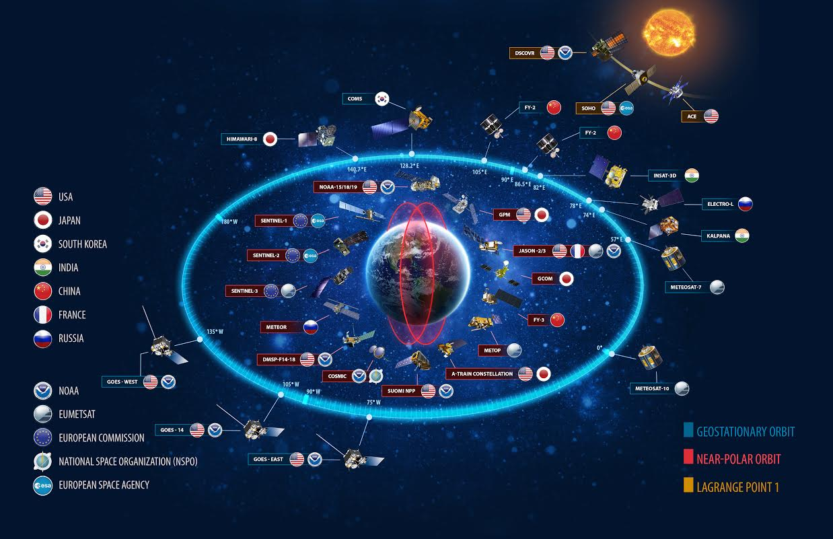
Trends in Global Earth Observation Systems
GOS Trends:
  New Players in GOS (international, commercial, etc)
  New Sensors (higher resolutions, etc)
  New technologies (small sats, etc)
  Emergence of New GOS (IoT, etc)
  Significant Increase in volume and diversity of data
Parallel Trends
  Budget, HPC Constraints
  Higher societal impact and expectations
  Higher users expectations
  Demand for Increase in quantity of data assimilated (5% currently assimilated)

Slide 4
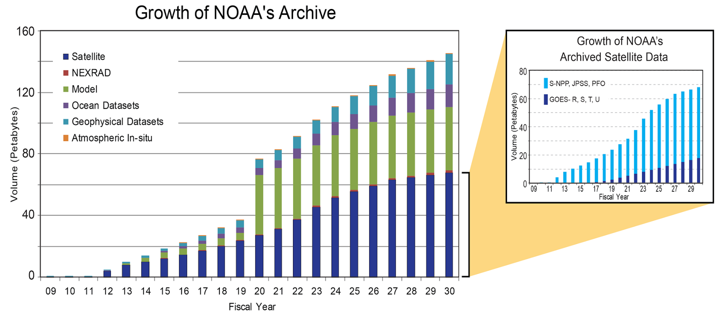
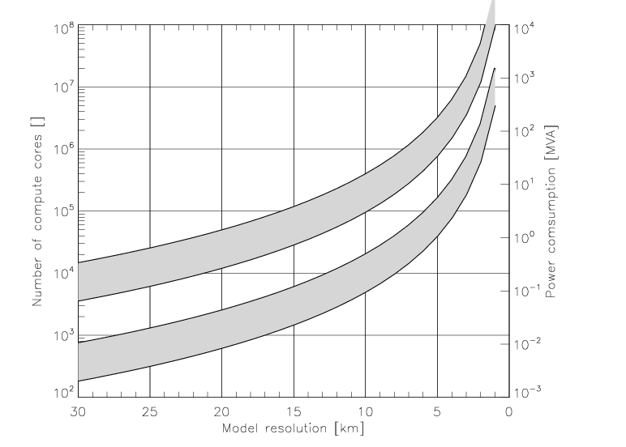
Expected Increase in HPC requirements and Data Volume
(for ECMWF NWP center: using currently 5-10% of satellite data)
Ensemble
Single
160 PB
affordable power limit
2010
2020
2030
scalability range
scalability range
2015/6
2025
NOAA Data Volume graph, Courtesy Steve Del Greco & Ken Casey, NOAA/ NCEI (via Jeff de La Beaujardiere)
[ECMWF, Bauer et al. 2015]

Slide 5
Why AI?
AI applied successfully in fields with similar traits as Environmental data & NWP/SA: (1) # obs. systems to analyze/assimilate/fuse and (2) predict behavior
  Medical field (Watson Project): Scan Image Analysis, Cancer detection, heart Sound analysis
  In finance: Algorithmic Trading, market data analysis, portfolio management
  In Music: Composing any style by learning from huge database & analyzing unique combinations.
  Self-Driving Transportation Devices: Fusion of Multiple Observing Systems for situational awareness
  …..
We believe Environmental data exploitation (remote sensing, data assimilation and perhaps forecasting), presents a viable candidate for AI application.
This presentation is meant to present a few examples to convey that the potential is significant.

Slide 6
Neural Networks versus Deep Learning (AI)
Neural Network vs Deep Learning (AI)
Schematic of a traditional feed forward Neural Network (top), and Deep Network (bottom).
Advances in computer power, optimization algorithms, highly non-linear activation function (e.g., ReLU), enabled learning via multiple deep layers of abstraction as compared to traditional NNs.
Google’s open source TensorFlow™ API (library for numerical computation using data flow graphs) is used to perform deep learning training and testing of deep networks.
Most networks described in following use between 3 and 5 hidden layers of roughly 20 to 40 hidden units with ReLU activation.

Slide 7
Exploring AI for Remote Sensing, NWP & Situational Awareness (SA). Status
Secure Data Ingest
Calibration
Bias Correction
Intelligent Thinning
Pre-processing & Inversion
Quality Control (QC)
Radiative Transfer
Data Assimilation
NowCasting
Data Fusion
AI has also a potential impact on OSSE & OSE Applications for observing Systems Impact assessments
Value Chain of Observing Systems Data
Post-Forecast Correction
Short-term Forecasting
Post-Forecast Correction
NWP Forecasting
Not Tested. Unknown level of confidence | Not tested. Reasonable level of confidence | Tested or not: Moderate level of confidence | Tested. High level of confidence

Slide 8
Methodology and Description
(baby steps)
Training & Verification:
Sets: ECMWF Analyses, G5NR fields, GDAS Analyses
Noise addition: uncorrelated, Gaussian distributed noise with spread of (instrument noise*2) is added to simulations
Sampling: Training data is randomly selected from a fixed set of ~5% of a days worth of data in each training epoch
Simple training (sample over a day generally
Independent sets used for verification, but still the same period
Scope of the effort: Nowcasting/RS and Forecasting Adjustment
  focus on satellite-based analyses (RS), focusing on an enterprise algorithm used for inversion and assimilation pre-processing
  but also assess capability of short term forecast correction
  focus on atmosphere (T, Q, Wind) but highlight surface parameters and hydrometeors capability as well
Tools: Google TensorFlow
Real data
  Focus on SNPP/ATMS and SNPP/CrIS

Slide 9
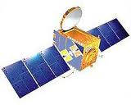
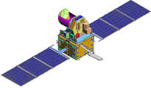
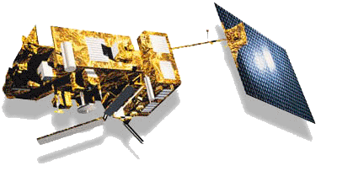
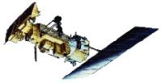
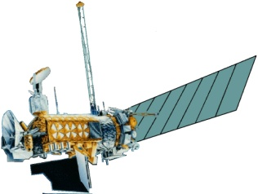
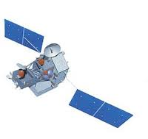
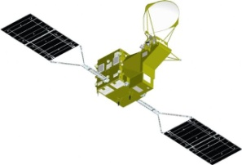
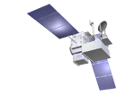
Example Pilot Project:
MIIDAPS Enterprise Algorithm
Multi-Instrument Inversion and Data Assimilation Preprocessing System
Motivation: Universal retrieval and Data Assimilation preprocessor for IR and MW satellite observations
Megha-Tropiques
SAPHIR
S-NPP& JPSS ATMS/CrIS
MetOp-A AMSU/MHS/IASI
MetOp-B AMSU/MHS/IASI
Major Challenge(s) with MIIDAPS
Computer time (1DVAR approach).
70% of time is used for RT (forward operator) for radiances and Jacobians
MIIDAPS
(upgrade version of MiRS)
NOAA-18 AMSU/MHS/AVHRR
NOAA-19 AMSU/MHS/AVHRR
DMSP F16 SSMI/S
DMSP F17 SSMI/S
DMSP F18 SSMI/S
TRMM TMI
Inversion Process
Inversion/algorithm consistent across all sensors (MW and IR)
All parameters included in state vector
Uses CRTM for forward and Jacobian operators
Valid over all surfaces/all-sky conditions
Use forecast, fast regression or climatology as first guess/background
GPM GMI
GCOM-W1 AMSR2
Benefits
Consistent Quality Control, error characteristics
Modular design, scalable
Use of MPI for HPC
Highly tunable retrieval
**MIIDAPS also applicable to GOES-15/16 Sounder, Meteosat SEVIRI, AHI, ABI, MODIS, AIRS, etc

Slide 10
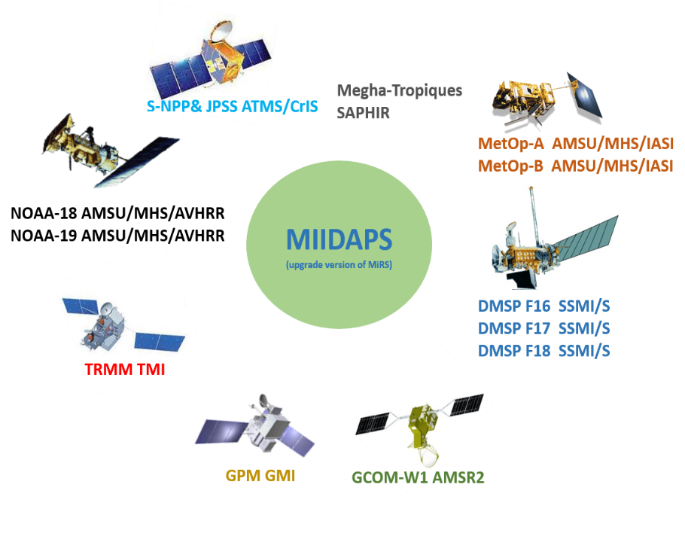
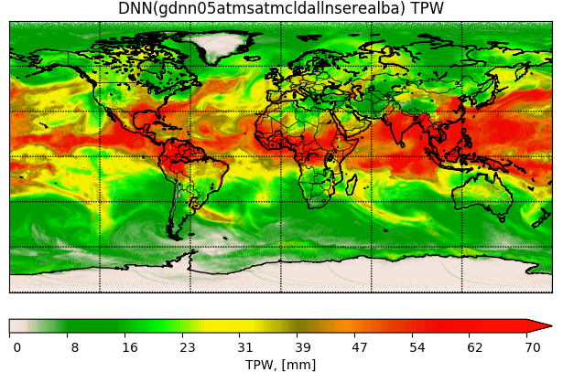
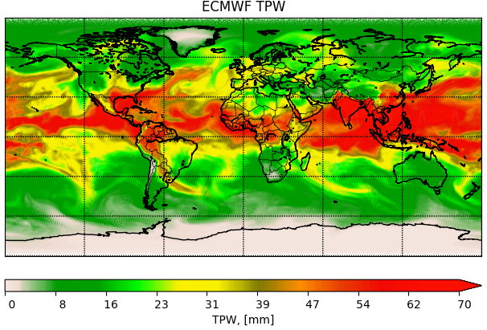
Pilot Project: MIIDAPS-AI:
Multi-Instrument Inversion and Data Assimilation Preprocessing System
Exploring Artificial Intelligence for Remote Sensing/Data Assimilation/Fusion Applications
Google TensorFlow Tool used for MIIDAPS-AI
MIIDAPS-AI outputs (TPW) Using SNPP/ATMS Real Data
Reference source of TPW: ECMWF Analysis
How to assess that AI-based output (Satellite Analysis) is valid?
Assessing quality by comparing against independent analyses
Assessing Radiometric Fitting of Analysis
Assessing analysis spatial coherence
Assessing inter-parameters correlations
MIIDAPS-AI
ECMWF
 | MIIDAPS-AI | MIIDAPS
Processing Time for a full day data. A single sensor (ATMS). Excluding I/O | ~5 seconds | ~ 2 hours
10

Slide 11
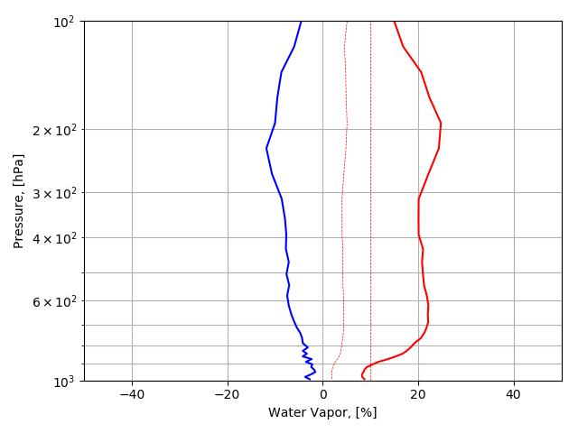
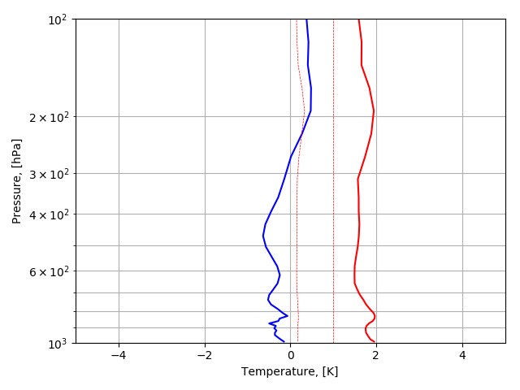
(1) Performance Assessment (T, Q)
ECMWF used as independent reference set. Clear and cloudy points. All surfaces included.

Slide 12
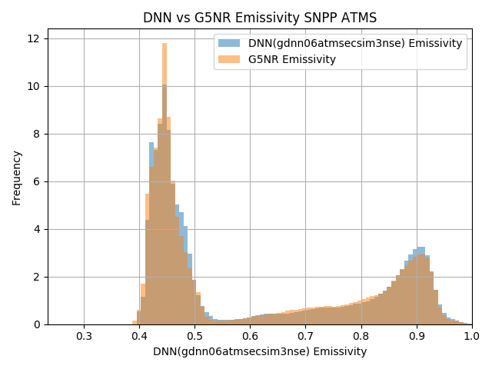
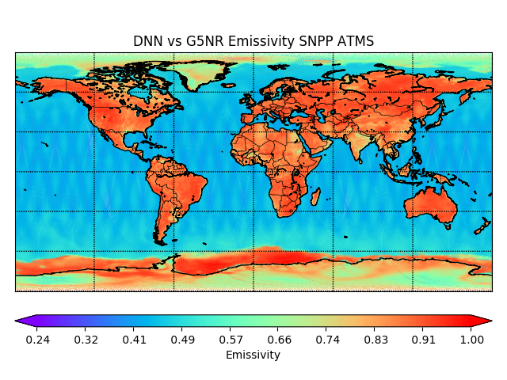

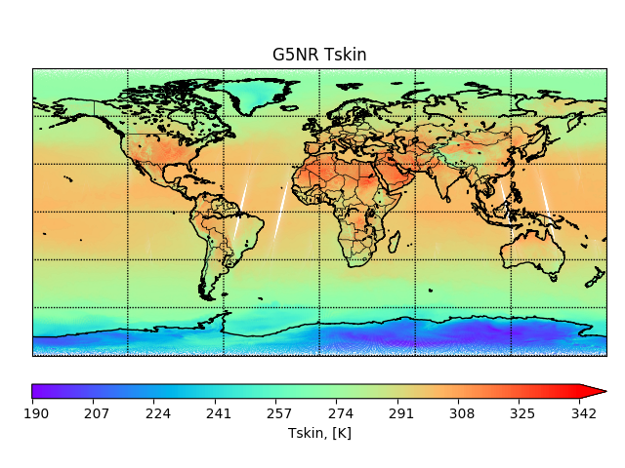
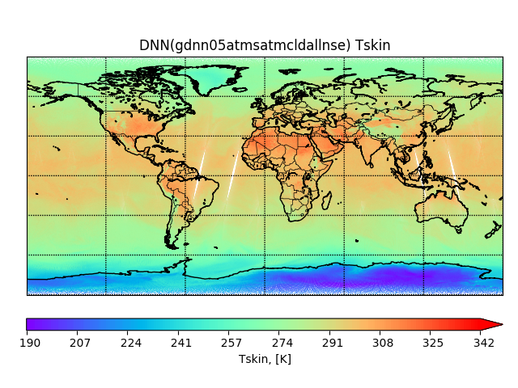
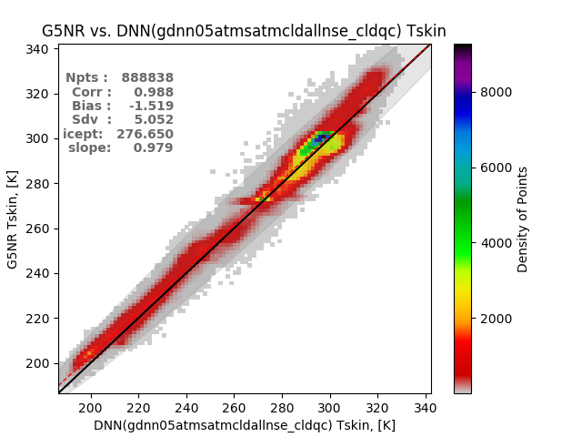
(1bis) Performance Assessment (Tskin, Emiss)
DNN and Analytic-Emissivity Histograms
Analytic Emissivity (ATMS Channel #1)
AI Based on real ATMS Data
Channel 1 emissivity
DNN and G5NR Tskin
Skin Temperature

Slide 13
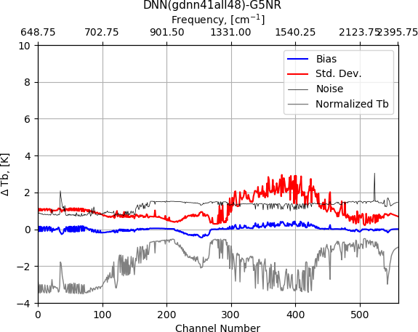
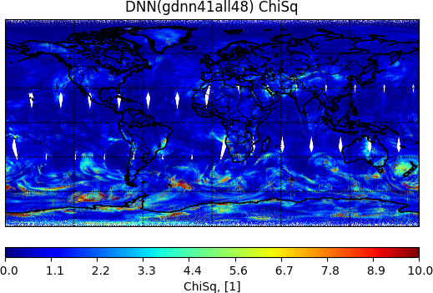
(2) Convergence Assessment (CrIS Case)
AI-based analysis is fed to CRTM and then simulation is compared to CrIS radiances

Slide 14
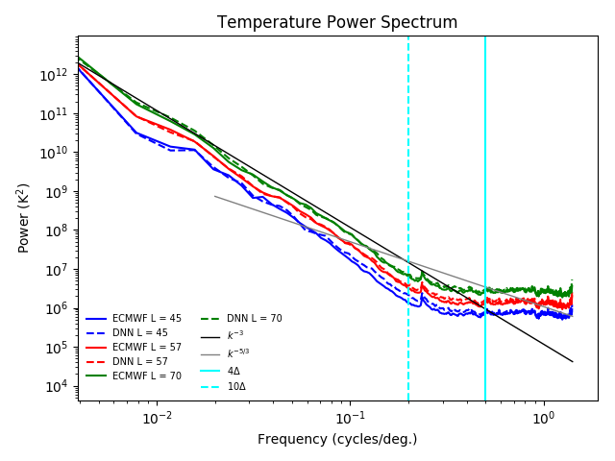
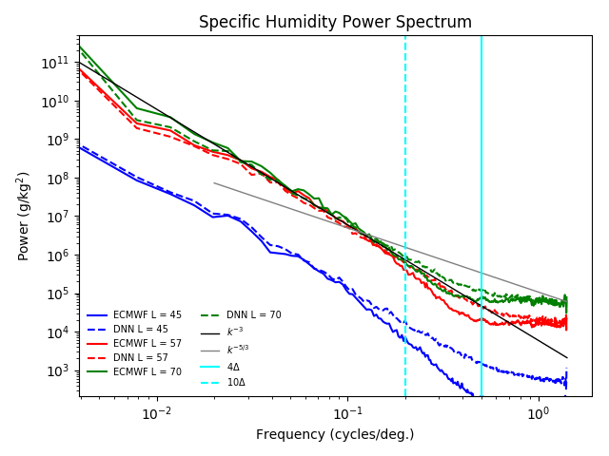
Spatial coherence – Global Temperature and Water Vapor 1D power spectrum from ATMS and ECMWF
(3) Spatial Coherence Assessment
Temperature
Water Vapor
Water vapor fields and Temperature fields generated by AI (and satellite data) are consistent with those from ECMWF, except for high variability scales (as expected)

Slide 15
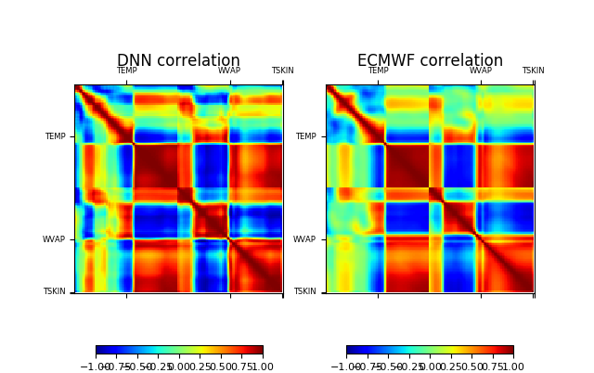
(4) Inter-Parameters Correlation Assessment
AI-Based Algorithm vs ECMWF – ocean
Water vapor, temperature and Skin temperature generated by AI applied to ATMS are correlated with each other in a similar way than those same parameters obtained from an NWP analysis, are.

Slide 16
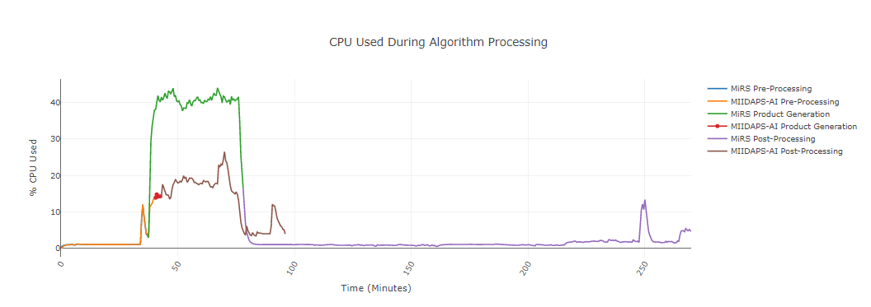
Timing Profile (1/2)
Comparison between MIIDAPS-AI timing and Regular 1DVAR-based MIRS system. For preprocessing, product generation, and post-processing

Slide 17
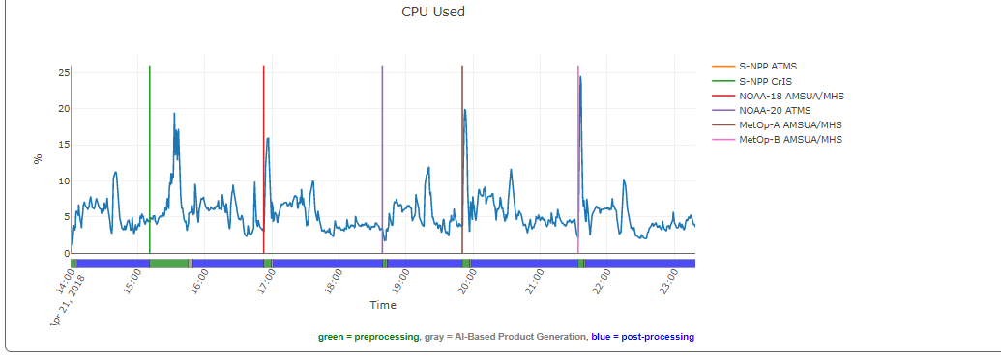
Timing Profile (2/2)
Comparison of timings using MIIDAPS-AI for multiple sensors (ATMS, CrIS, AMSU/MHS, etc

Slide 18
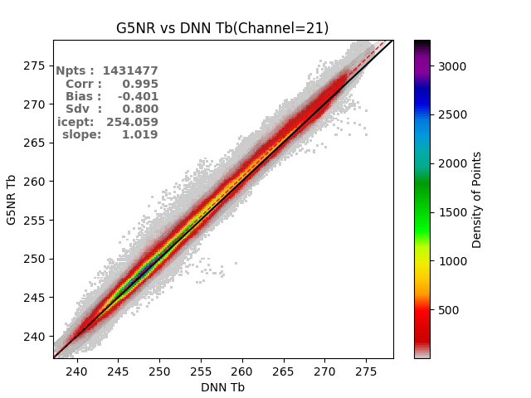
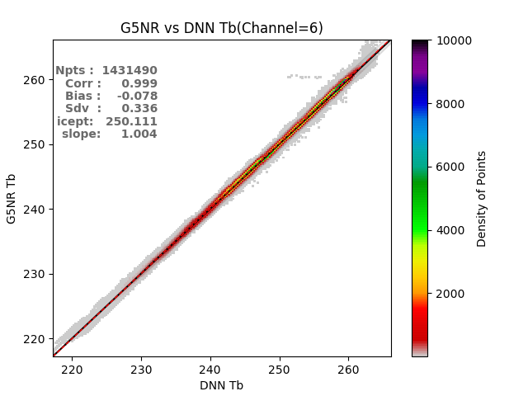
Can AI Be Used as Forward Operator?
Variational N-dVAR
Measured Radiances
Comparison: Fit
Within Noise Level ?
Yes
Solution
Reached
Simulated Radiances
AI vs CRTM
No
~1000 faster
Update
State Vector
AI-Based
ForWard
Operator
Chan21
Initial State Vector
New State Vector
Chan6
As an alternative to using AI for Inversion, DA, etc. What about if we simply change the forward operator using the AI tool (and keep the variational approach the same it is now)

Slide 19
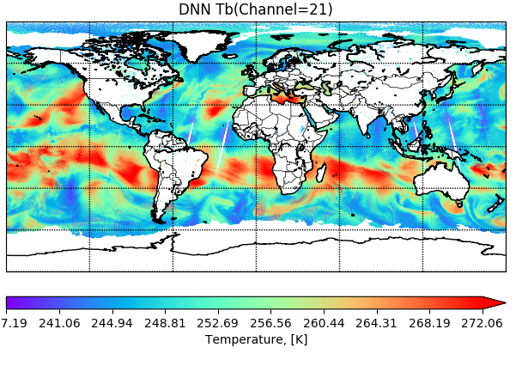

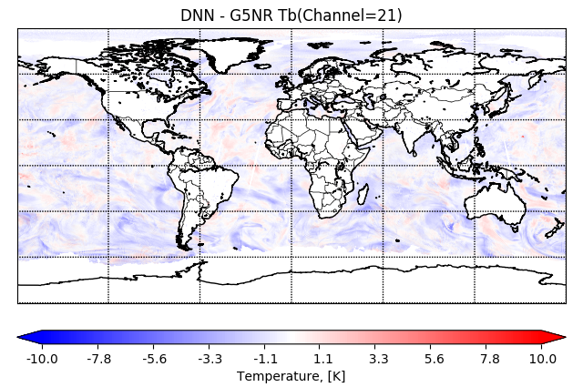
Can AI Be Used as Forward Operator?
CRTM/AI-Chan21
Status:
EOF of Geoph Data Used as Inputs
Only clear sky was tested
Only surface-blind channel tested
ATMS tested. All channels together
~million points used: training/testing
Jacobians need to be trained (TBD)
Quick test: CRTM used as training
Potential Advantages:
Multiple Orders of magnitude faster
Allows using this in a Variational setting (inversion, DA/DF)
Is just an extension of the faster implementation of true RT models (Line-By-Line Models)
Does not Replace LBL: Uses them for training just like CRTM, RTTOV, etc
Next Steps:
Use LBL as training
Assess in variational setting
Extend (cloudy, surface, IR, Jacob., etc)
CRTM- Chan21
CRTM-CRTM/AI-Chan 21
AI vs CRTM
Chan21
Chan6
 | CRTM-AI | CRTM
Processing Time for a full day data. A single sensor channel(ATMS). Excluding I/O | <1 second | ~ 1.3 hours

Slide 20
Does AI Have Predictive Applications?
Timestep T=-1 (past)
Timestep T=0 (present)
Timestep T=1 (future)
Water
Cloud
Temper.
This simple model has potential to:
Compute AMV from tracers ( at t=0) based on spatial AND vertical tracing
Correcting short-term forecast to adjust systematic errors and displacements (t=1 or 2, 3,…)
NWP (t=N)
Wind
U
V
Questions:
Can we predict AMV center of box at T=0 timestep using the ~ 100 inputs parameters?
Can we improve prediction at Time step 1 if we set a target to match?
3x3x3x2xN box of parameters:
Vertical x Spatial x Temporal dimensions x Nparameters

Slide 21
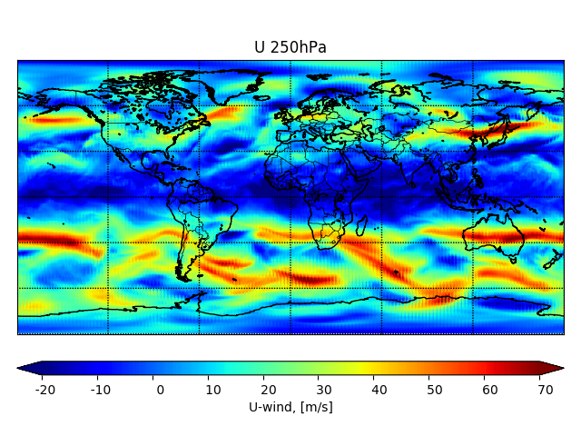
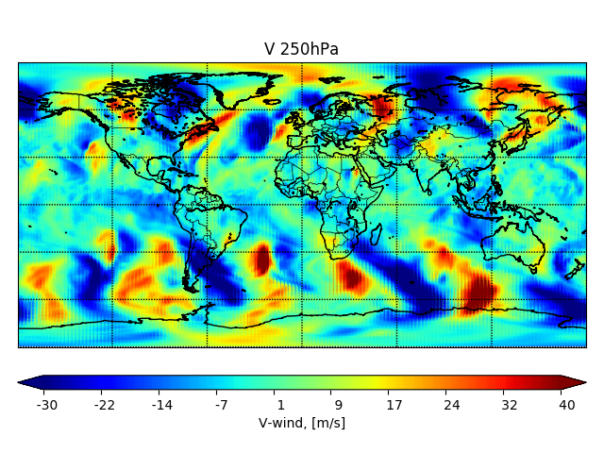
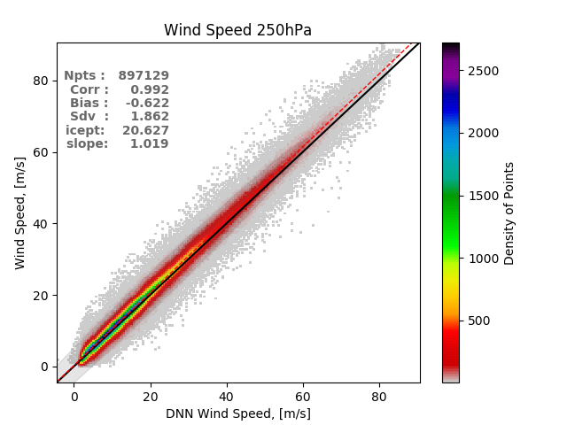
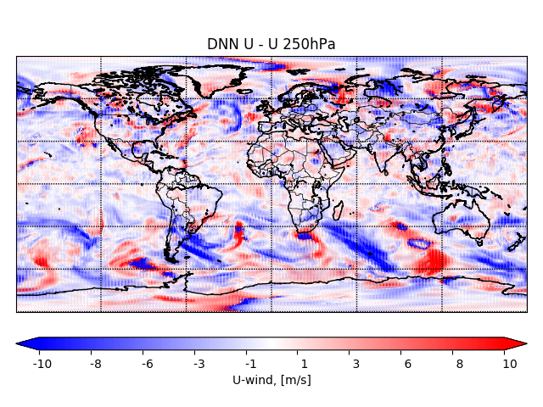
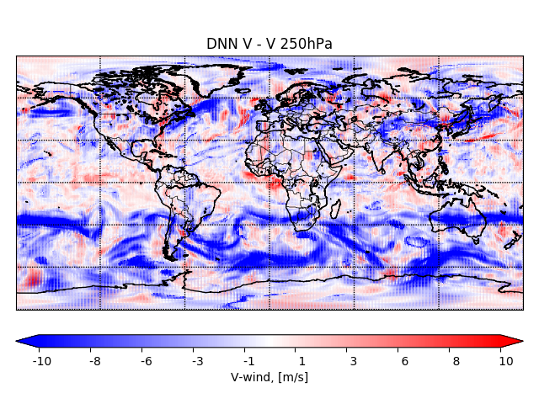
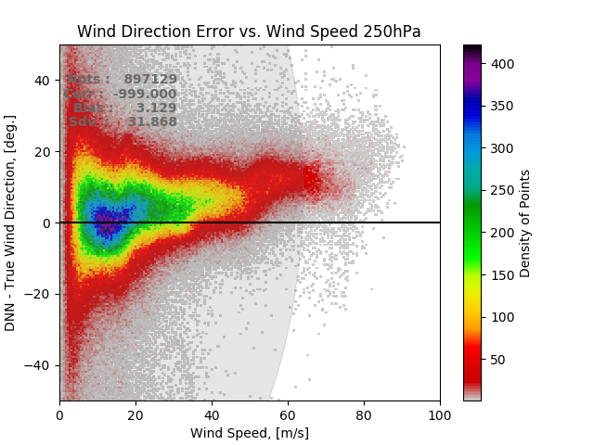
Using AI to estimate 250hPa wind speed and direction from 1 hour water vapor gradients
Predicting AMV From WV Field Using AI?
AMV wind speeds agree well with true values, but there is a large degree of ambiguity at low wind speeds and around 0, 360 degrees.
AMV training was done with ECMWF and operational GFS. Both at 0.25 deg resolution.

Slide 22
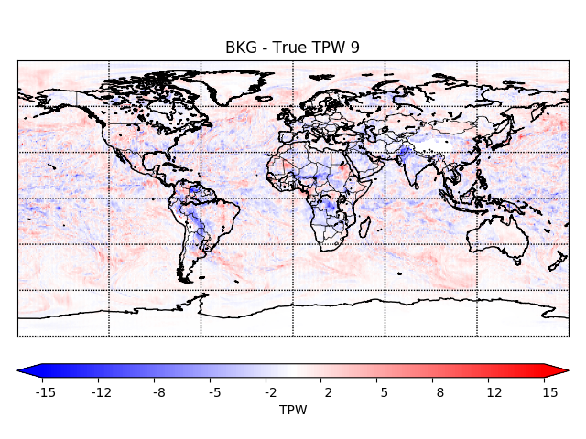

AI based TPW forecast correction using ECMWF as Target
Correcting TPW Forecasting with AI?
GFS 6 hour forecast at center of 3x3 box
AI corrected forecast based on ECMWF training
1 day of GFS analysis and 6 hour forecast are used as inputs to AI algorithm to predict ECMWF analyses at 00z, 06z, 12z, 18z.
Inputs include TPW and lower tropospheric column averaged wind fields
AI forecast correction removes some global TPW biases (high latitudes); however, the impact is difficult to discern because the GFS 6 hour background is pretty good to begin with.

Slide 23
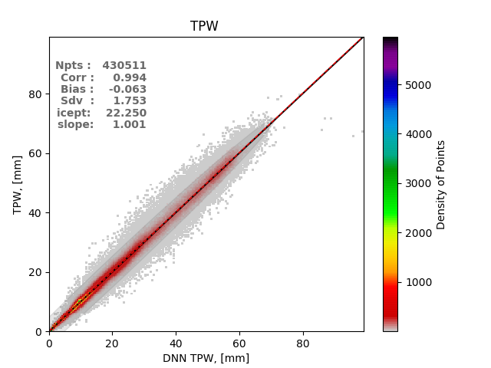
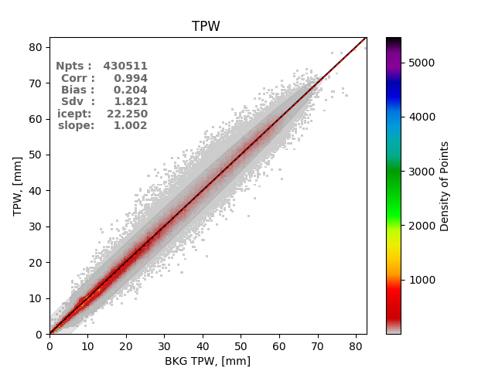
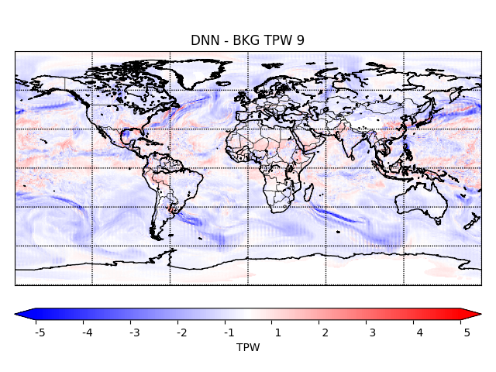
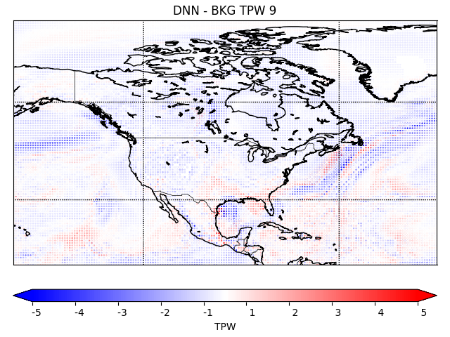
Correcting TPW Forecasting with AI?
ECMWF vs AI-corrected 6h fcst valid @ECMWF analysis time
ECMWF vs 6 hr frcst valid @ECMWF analysis time.
AI Increment
AI Increment – N. America
One day - all 4 cycles concatenated together.
AI increment shows some dipoles indicating that the correction is adjusting the position of some features – Most notably the position of Harvey (Texas) and off the Eastern coast of N.America

Slide 24
Conclusions
Increase in number, diversity and sources of global observing systems (GOS) including private sector. This presents unprecedented (and welcome) added resiliency and quality of the GOS. However this presents challenges: Cost and infrastructure to leverage/exploit them.
Computing constraints, perhaps require us to explore new approaches for the future (not so distant). AI-Based Analyses (satellite-exlusive) are found to be radiometrically, spatially and geophysically consistent with traditional analyses.
Goal of this study is not to show AI can do better, but that it can provide at least similar quality, much faster. It appears to be doing that.
Different components can benefit from AI (Inversion, Data Assimilation, RT, QC, Data Fusion,.. ) for NWP and Situational Awareness SA.
Encouraging results so far were found when assessing derivation of AMV using AI (not shown) and when assessing the feasibility of correcting GFS forecasts (using ECMWF as a target). Pointing to the potential for using AI for actual forecasting (at least short-term).
Training is key for AI. Nature Run Datasets presents a good source for this.
Pursuing AI applications, we believe, will allow us to :
  (1) Reduce pressure on Infrastructure (ground systems), HPC and cost
  (2) benefit from new environmental data (and face increased volume), including satellite data from all partners, including IoT
  (3) Improve Latency
  (4) Reduce cost of running legacy systems (remote sensing and data assimilation/fusion systems)
  (5) Increase percentage of satellite data being assimilated (improved thinning, QC-ing, faster processing, etc)
  (6) Reduce time to run OSE/OSSE and in general data assimilation/fusion systems, for decision making purposes
  (7) Perhaps Improve forecast as a result of above and because AI can be exploited for forecast improvement

