Slide 1
The CAPS implemented physics schemes and their performance in FV3
Chunxi Zhang and Timothy Supinie
HWT team: Ming Xue, Fanyou Kong, Kevin Thomas, Gang Zhao, Timothy Supinie, Keith Brewster, Chunxi Zhang, Nathan Snook

Slide 2
Physics schemes we implemented in FV3
Microphysics Scheme: Thompson
PBL Schemes: YSU, Shinhong, MYJ, MYNN and E-epsilon (still in testing) - all PBL schemes share the same surface layer scheme
Cumulus Scheme: New Tiedtke

Slide 3
May 16-17 dry line case

Slide 4
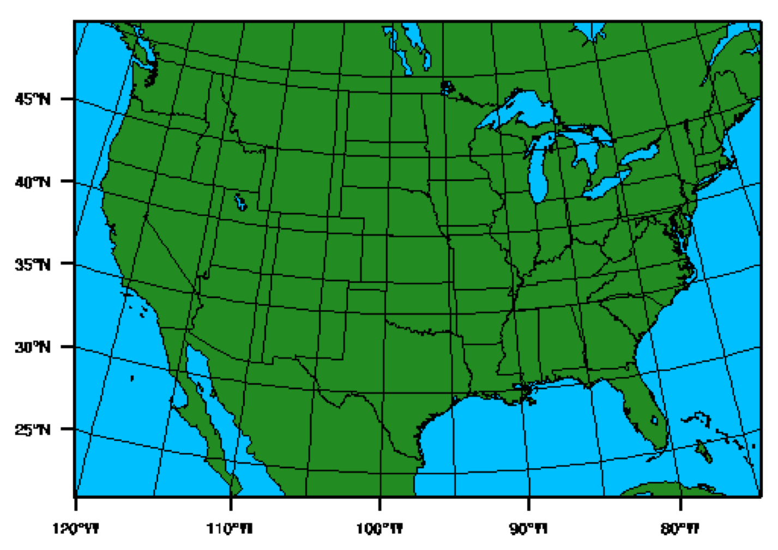
CAPS HWT WRF-ARW ensemble members
-
Different combination of
Initial conditions and lateral boundary conditions (ICBCs) + physics schemes
Resolution: 3 km
Model initial Time: 00 UTC 16 May 2017
The following analyses are at time 00 UTC 17 May
(e.g. 24 hours forecast)

Slide 5
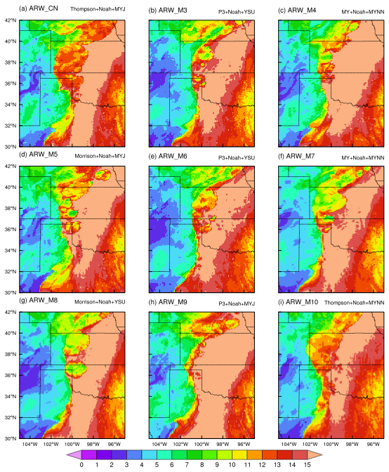
Specific Humidity
at 2 m height
g/kg

Slide 6
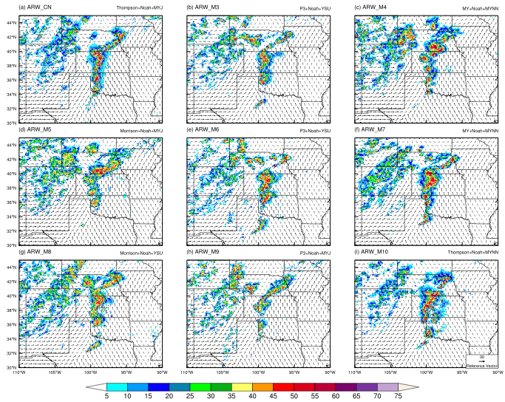
Composite
Reflectivity
&
Surface wind
Vector
dbz

Slide 7
CAPS HWT FV3
Thompson microphysics + Noah Land Surface + different PBL schemes
(the default PBL scheme is MRF-like scheme)
Nested domain: ~3 km horizontal resolution

Slide 8
g/kg

Slide 9
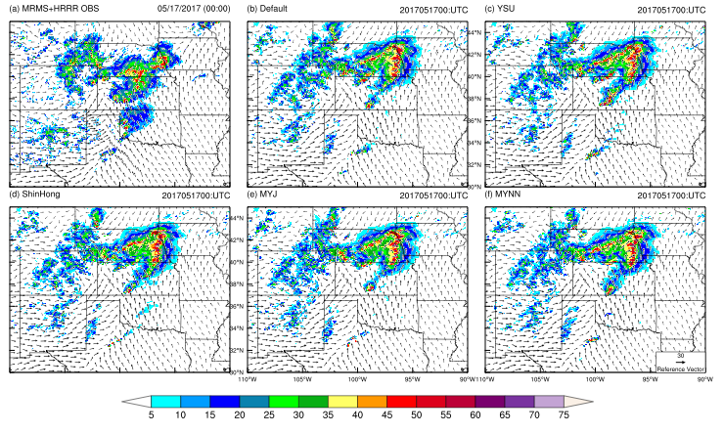
dbz

Slide 10
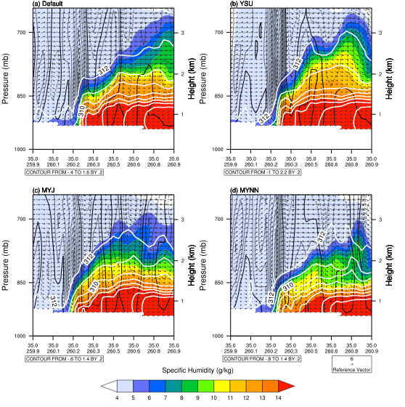
00 UTC 17 May
(7 pm Local Time)
Black contour:
Vertical velocity (m/s)
White contour:
Virtual potential
temperature (K)
Vector (U;W, m/s)
Shading:
Specific humidity

Slide 11
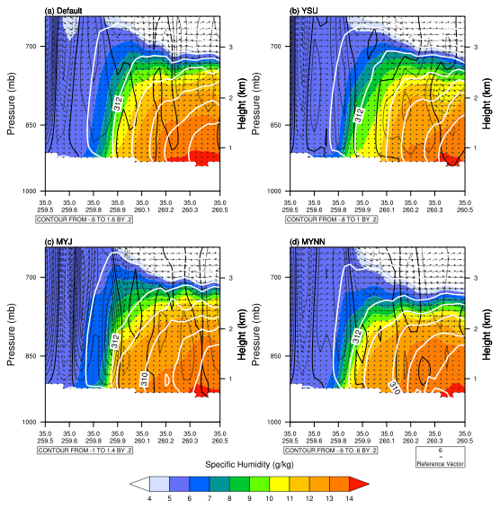
21 UTC 16 May
(4 pm Local Time)
Black contour:
Vertical velocity (m/s)
White contour:
Virtual potential
temperature (K)
Vector (U;W, m/s)
Shading:
Specific humidity

Slide 12
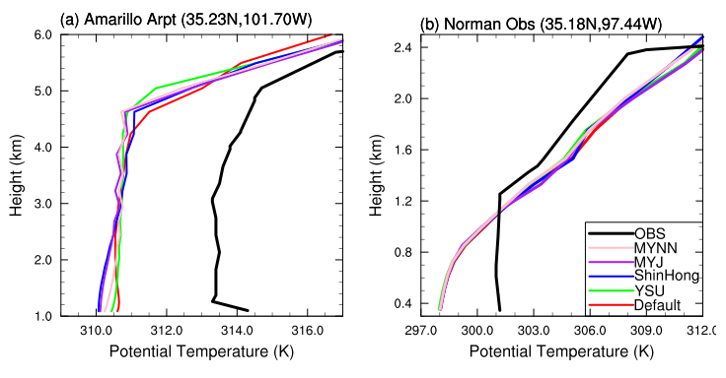
Amarillo
Norman
dry line

Slide 13
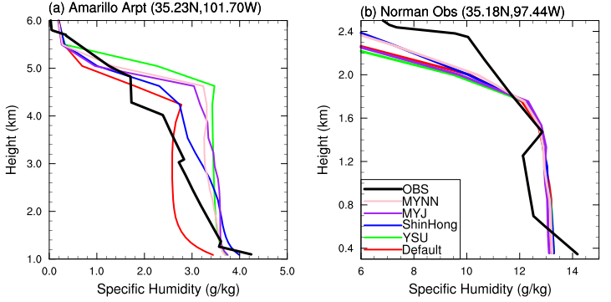

Slide 14
Summary
HWT WRF-ARW simulated better Dry lines than HWT FV3 in terms of dry line locations.
The locations of dry lines and the initial development of severe storms are not very sensitive to the choices of ICBCs and the combination of physics schemes in WRF-ARW. They are also not sensitive to the choices of PBL schemes in FV3.
The vertical mixing of heat and moisture over dry side of dry line is good among the different PBL schemes, while it is too weak over wet side of dry line for all PBL schemes.
Questions: Does vertical mixing cause the biases of dry line? Or probably dynamical core? Or cumulus scheme infected by two-way nesting.

Slide 15
Precipitation and Clouds
in 13 km FV3 global domain
FV3 version 1.3 (Mid September 2017)
Default physics schemes include:
Hybrid eddy-diffusivity mass-flux PBL scheme
Scale-awareness NSAS cumulus scheme for both deep and shallow cumulus
GFDL microphysics scheme
Noah Land surface model

Slide 16
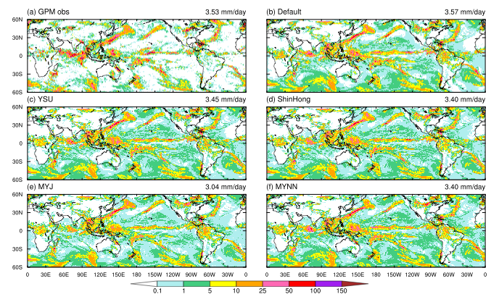
Model initialized at 00 UTC 16 May 2017. This is the precipitation forecast (24-48 hrs)

Slide 18
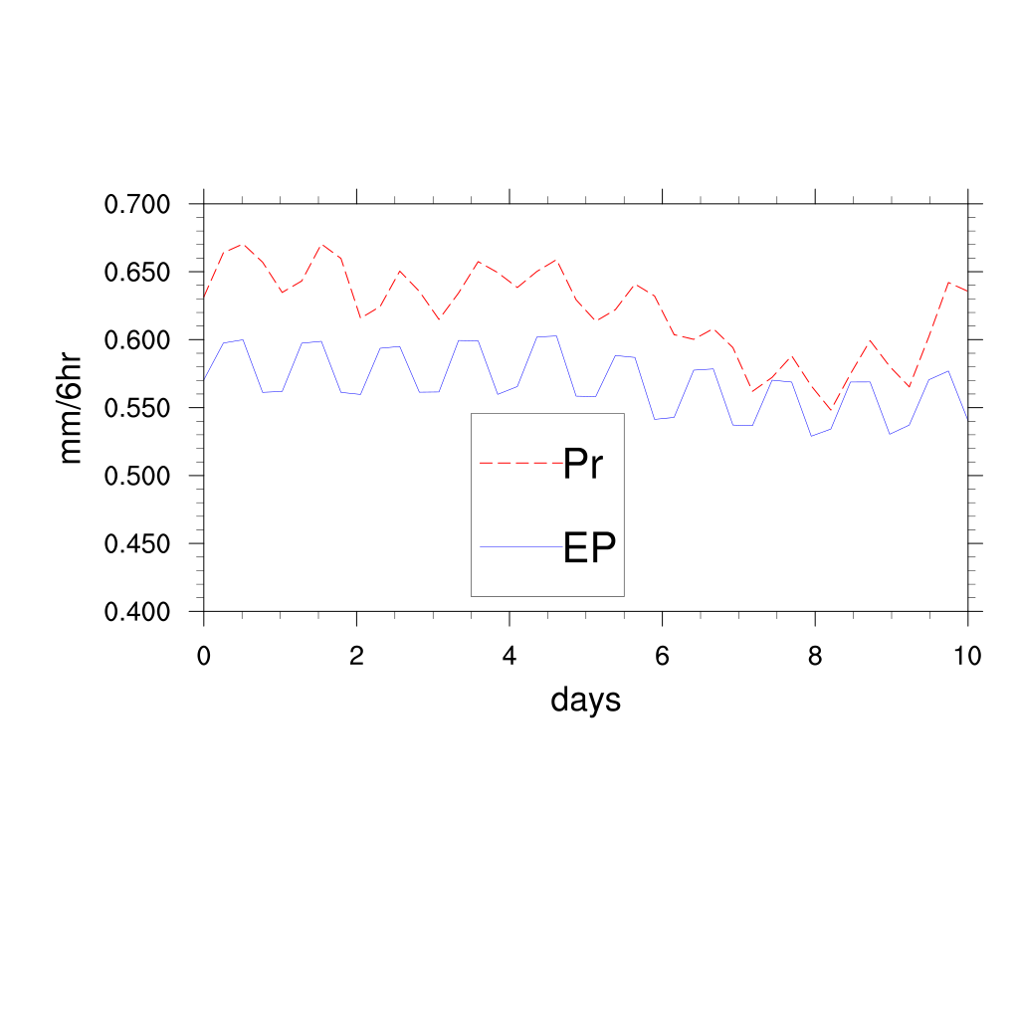
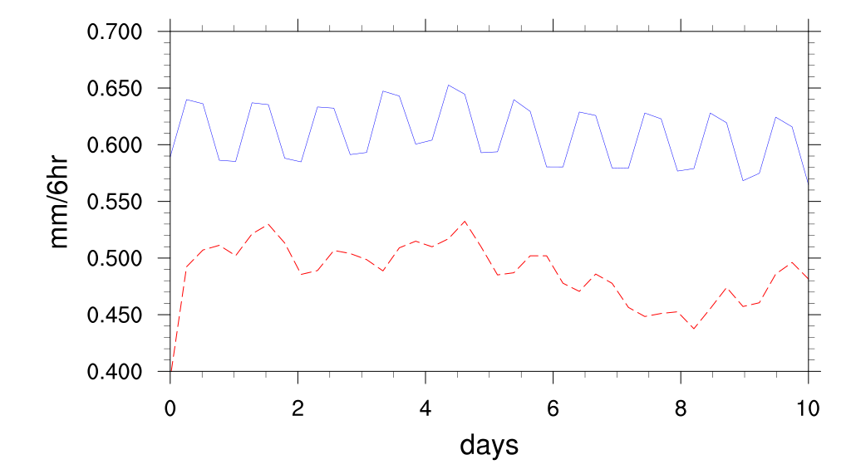
NSAS
TDK

Slide 19
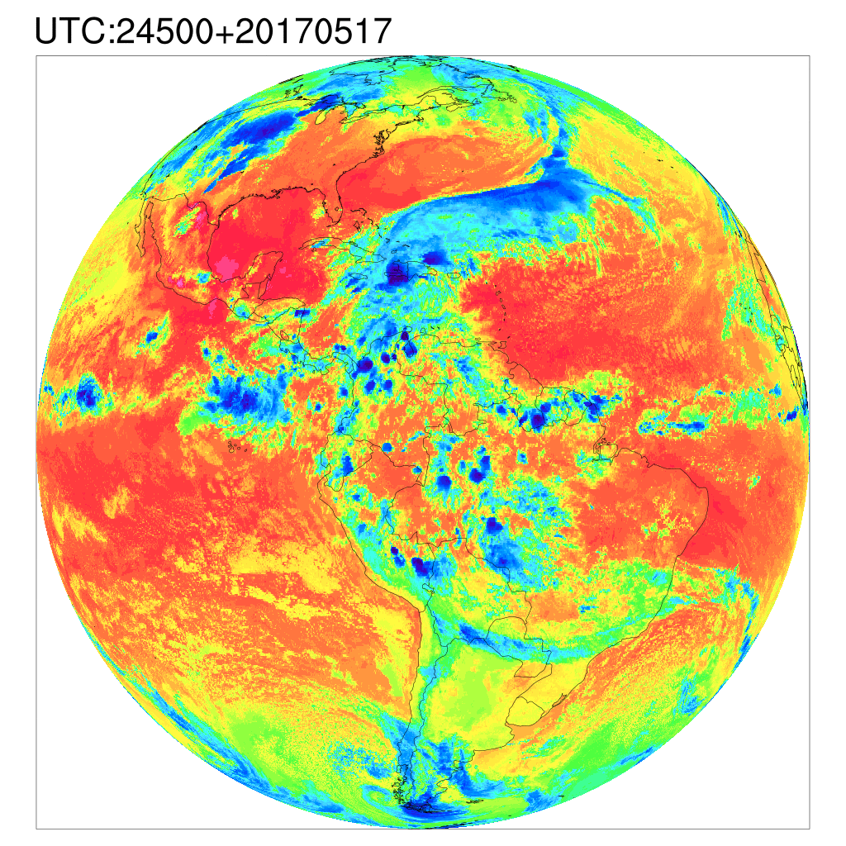
Infrared

Slide 20
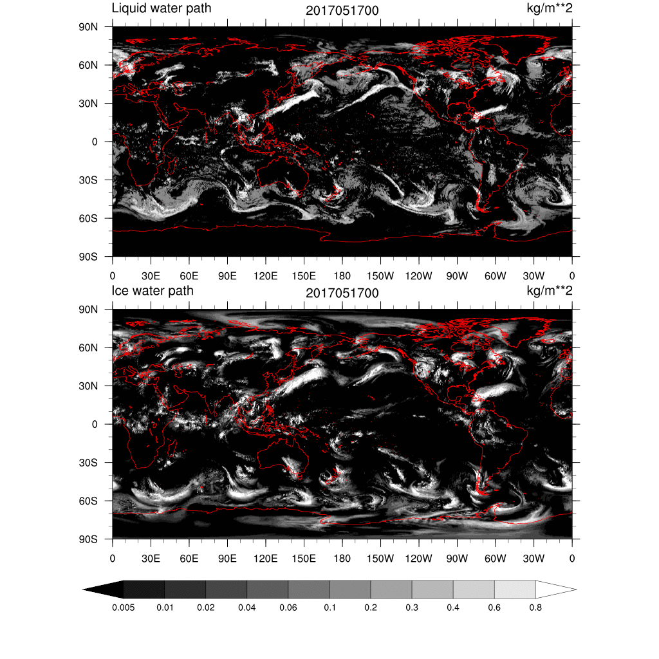
NSAS

Slide 21
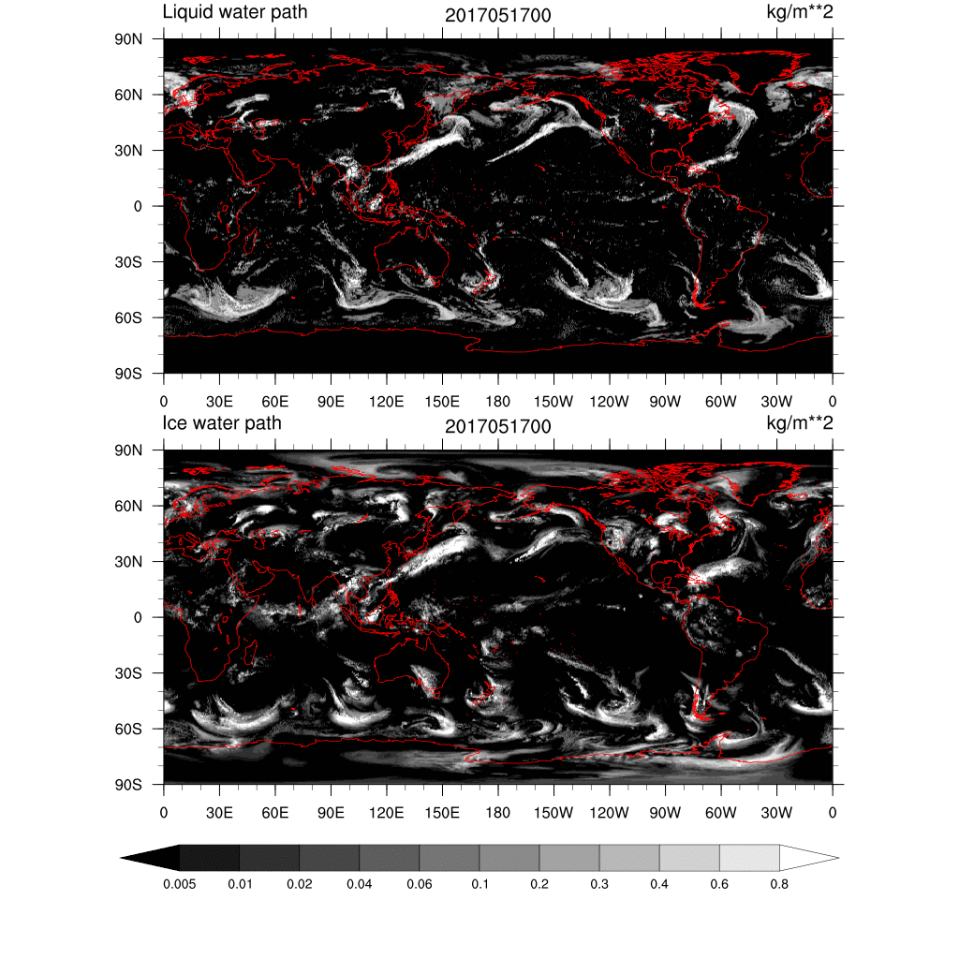
TDK

Slide 22
Testing and improving the physics schemes are ongoing
Thanks!

