Slide 1
Tools for applying adaptive mesh refinement and automated tuning to wave model simulations
Richard Gorman¹, Jose-Henrique Alves², Hilary Oliver¹
¹National Institute of Water and Atmospheric Research, New Zealand
²SRG/EMC/NCEP/NOAA, NOAA Center for Weather and Climate Prediction, College Park, MD, USA
NCEP, 30 November 2017

Slide 2
Wavewatch on an adaptive grid
Richard Gorman

Slide 3
2010: Gerris (Stephane Popinet)
Adaptive mesh refinement
Quadtree grid in 2D (octree in 3D)
Applied to various flow problems, e.g. Navier-Stokes equations

Slide 4
Why adaptive mesh refinement for waves?
Wave models are computationally expensive, and computing resources aren’t infinite,
We can’t afford to have very high resolution everywhere
We need to cover full ocean basins
We can used nested rectangular grids or unstructured meshes to give higher resolution where we know in advance it is needed
With tropical cyclones, we need high spatial resolution, but don’t know in advance where it will be needed

Slide 5
Gerris + Wavewatch
Gerris
Wavewatch subroutine calls

Slide 6
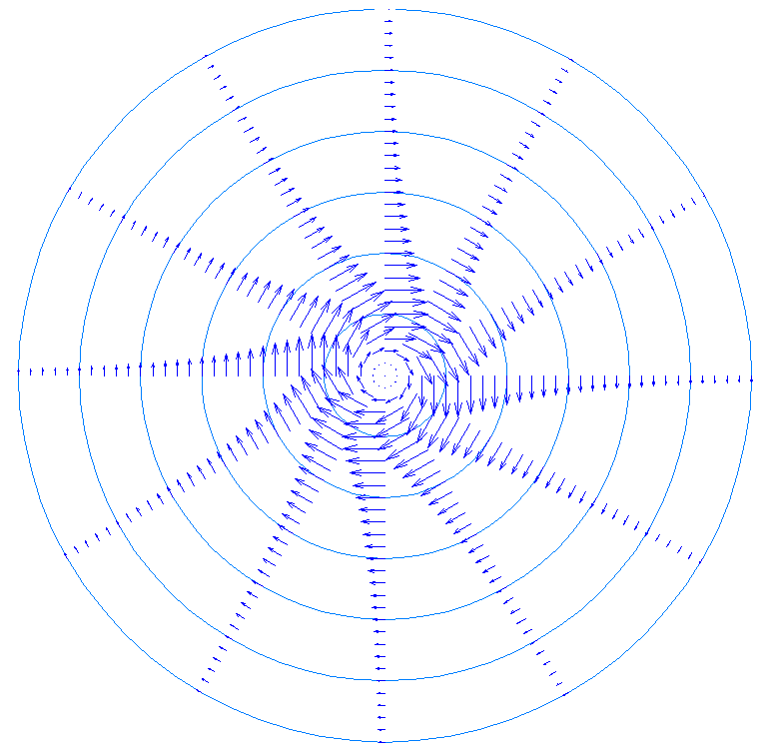
Simulating an artificial “cyclone”
R_{max} = 100 km
V_{max} = ramps up from 0 to 50 m/s after 25 hours, then constant
Centre moving southward at 555 km/day.
No background wind field

Slide 7
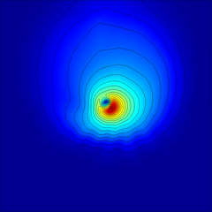
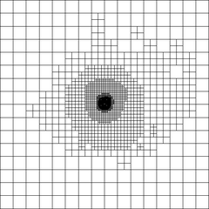
Adaptive mesh (48 hours)
Spatial resolution
208 km
104 km
52 km
26 km
13 km
6.5 km
The mesh is refined according to the estimated truncation error in the significant wave height field

Slide 8
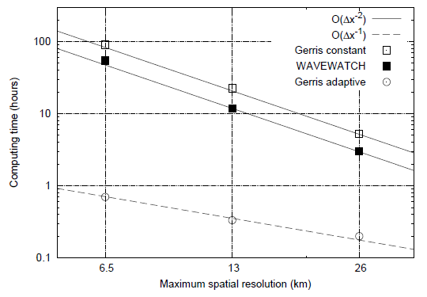
Artificial “cyclone” simulations
Computing time (hours)
100
10
gerris constant
Wavewatch
1
gerris adaptive
0.1
6.5
13
26
Maximum spatial resolution (km)

Slide 9
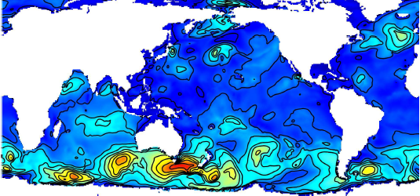
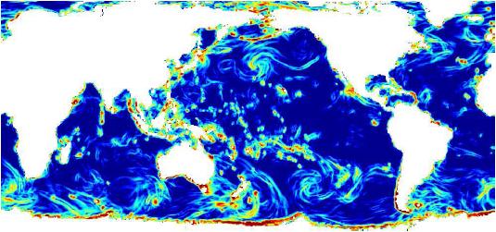
Estimated efficiency in global models
Sample global significant wave height field (1/9/2009 00Z NCEP Analysis)
the corresponding truncation error ε for a 0.352° rectangular mesh. Logarithmic scale, ranging from ε < 1mm (dark blue) to ε > 5cm (dark red).

Slide 10
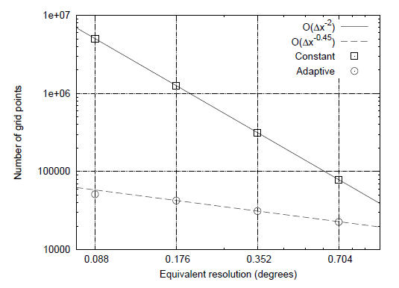
Number of cells needed in adaptive and constant grids
Starting with the sample wave height field, we apply the refinement algorithm to meet given truncation error targets
Compare the number of grid cells in the resulting adaptive grid with the corresponding constant-resolution grid
Number of grid cells
1x10⁷
constant
1x10⁶
adaptive
1x10⁵
1x10⁴
0.088
0.176
0.352
0.704
Equivalent resolution (degrees)

Slide 11
Limitations of Gerris-WW3
Gerris-WW3:
uses WW3 v2.22 source terms,
has limited I/O,
has no handling of ice, subgrid obstruction, reflection, …
Need to bring these features in, and keep up with other developments
Who might use/develop it?
Answer?: build adaptivity into Wavewatch

Slide 12
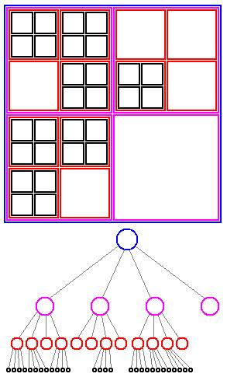
Quadtree structures
A “quad” is a square divided into four “child” quadrants
Each of these “children” can itself be a “quad”, and further subdivided, or a “leaf” cell, for which model data are computed.
A standard rectangular grid is a special case
Leaf cells correspond to WW3 seapoint index ISEA

Slide 13
Inputs on a quadtree grid
Refinement level of the the wave model may be controlled by inputs
Bathymetry
Wind, currents, water level
Handle inputs on independent quadtree structures
Inputs may be defined at multiple refinement levels

Slide 14
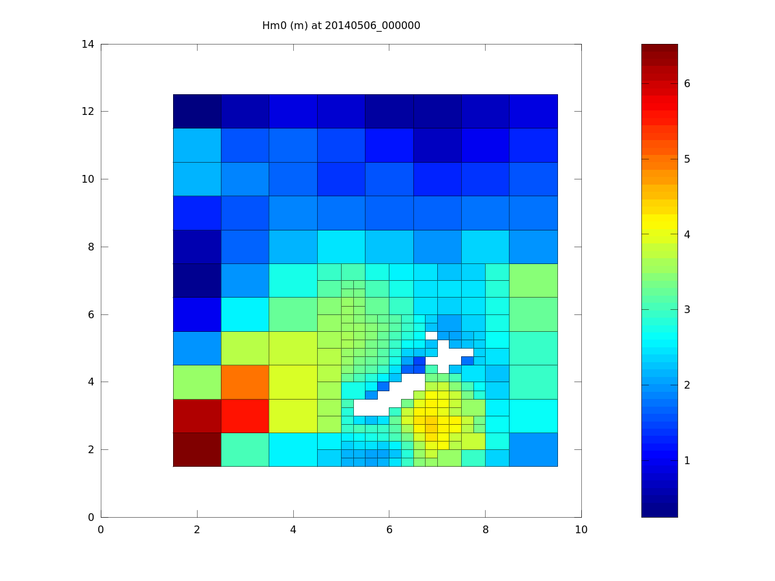
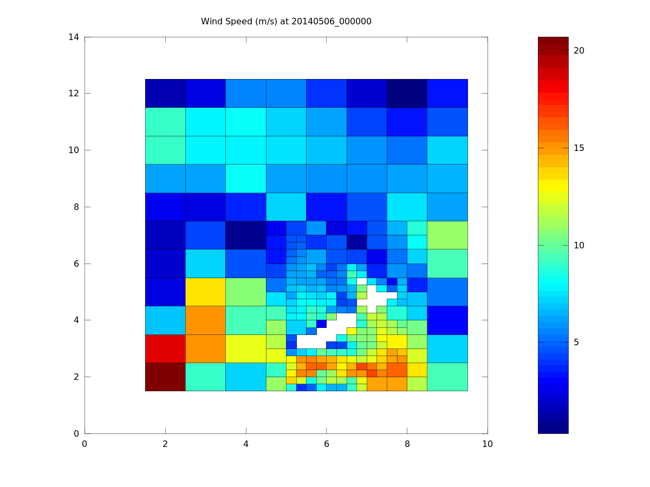
Test simulation : 1st order propagation, adaptive grid
Wind speed
Significant wave height

Slide 15
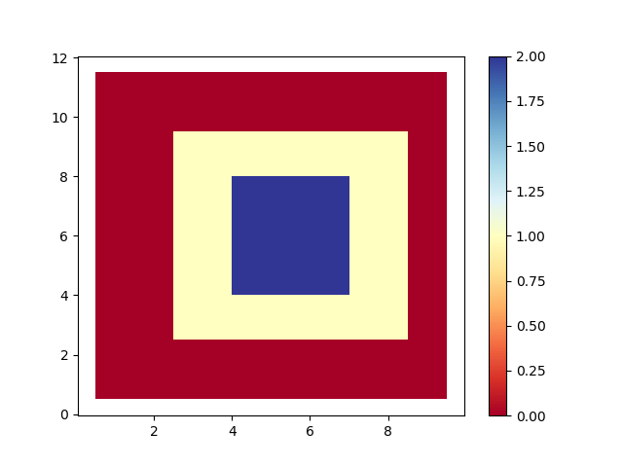
Quadtree mesh 1 – refinement level

Slide 16
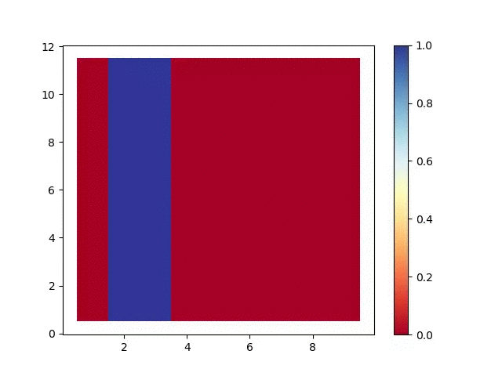
Quadtree mesh 1 – UNO2 propagation test

Slide 17
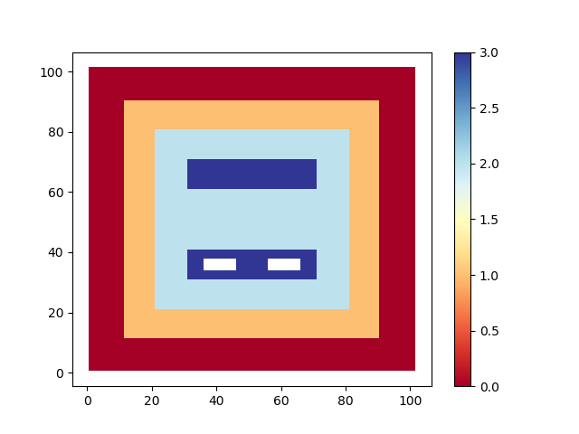
Quadtree mesh 2 – refinement level

Slide 18
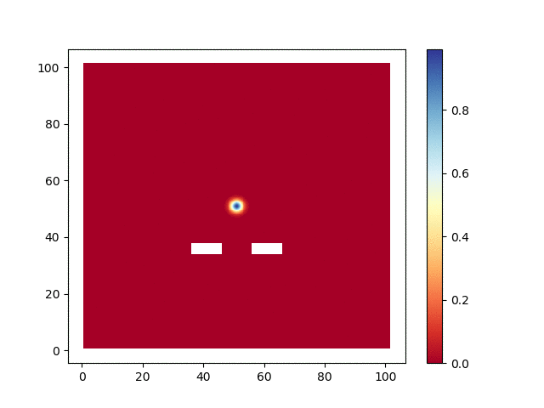
Quadtree mesh 2 – UNO2 propagation test

Slide 19
Status:
Code version
Code development brought into a new branch from the EMC_ww3 trunk
Quadtree adaptive processes
Modules for quadtree operations
I/O:
Bathymetry & obstructions from multiple regular grids
Wind, currents, levels, ice ( ← binary ← netcdf)
Restart files
Gridded outputs ( → binary → netcdf)
Point & track outputs
Input boundary conditions
Output boundary conditions

Slide 20
Status
MPI: coded, but needs testing
Physics:
First order spatial propagation
Higher order propagation (UNO2, UQ)
Subgrid obstructions, including “old” ice physics
Spectral propagation
Local source terms
Reflections
Bottom scattering
Mud interactions
New ice physics

