Slide 1
Convective-Scale Ensemble Prediction Experiments over the Yangtze-Huaihe River Basin
Huiling Yuan
Key Laboratory of Mesoscale Severe Weather/Ministry of Education and School of Atmospheric Sciences, Nanjing University, Nanjing
Contributors: Xi Chen, Ming Xue, Min Sun, Xiaoman Jiang
January 23, 2018

Slide 2
Outline
Verification of ensemble forecasts
Convective-scale ensemble prediction experiments
Results of convective-scale ensembles

Slide 3
Background
Scales of ensemble prediction systems (EPS)（WMO; 2012）
Global EPS
10-15 d
32km-70km
Regional EPS
2-5.5 d
7km-33km
Convective-scale EPS
0-24 h
1km-4km
Operational or quasi-operational：
MOGREPS-UK 2.2 km (Tennant, 2015)
AROME-EPS 2.5 km (Bouttier et al., 2012, 2016)
COSMO-DE-EPS 2.8 km (Harnisch and Keil, 2015)
NCAR EPS experiments 4 km (Schwartz et al., 2015)

Slide 4
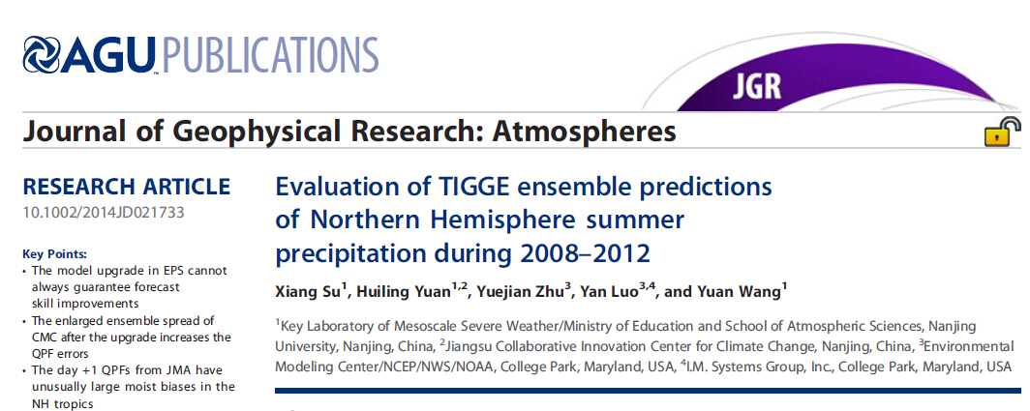

Slide 5
Configurations of six TIGGE EPSs
Center | Base time (UTC) | members | Horizontal resolution archived | Fcst length (day) | Initial perturb method | Model uncertainty | Major EPS upgrade time
CMA (China) | 00/12 | 14+1 | 0.56º×0.56º | 0-10 | BVs | - | -
CMC (Canada) | 00/12 | 20+1 | 1.0º×1.0º | 0-16 | EnKF | PTP + SKEB multi-physics | 17 Aug 2011
ECMWF | 00/12 | 50+1 | N320 (~0.28º) N160 (~0.56º) | 0-10 10-15 | EDA-SVINI | SPPT + SPBS | 9 Nov 2010
JMA | 12 | 50+1 | 1.25º×1.25º | 0-9 | SVs | SPPT | 17 Dec 2010
NCEP | 00/06/12/18 | 20+1 | 1.0º×1.0º | 0-16 | BV-ETR | STTP | 23 Feb 2010
UKMO | 00/12 | 23+1 | 0.83º×0.56º | 0-15 | ETKF | RP + SKEB | 9 Mar 2010
1. The CMC EPS was upgraded to version 2.0.2 on 17 August 2011.
2. The ECMWF EPS used a horizontal resolution of N200 (~0.45º) for 0-10 day forecasts
and N128 (~0.7º) for 10-15 day forecasts before 26 January 2010.
EVO-SVINI was used as the initial perturbation method before 24 Jun 2010.
The SPBS method has been added on 9 November 2010.
3. The JMA EPS began to use the SPPT method on 17 December 2010.
4. The NCEP EPS was upgraded to version 8.0 and began to use the STTP method on 23 February 2010.
In 14 February 2012, the NCEP EPS was upgraded to version 9.0.
5. The UKMO EPS used a horizontal resolution of 1.25º×0.83º before 9 March 2010.
Referenced to the CMA EPS (frozen), the impacts of major model upgrades on the forecast performance are examined for other five EPSs.

Slide 6
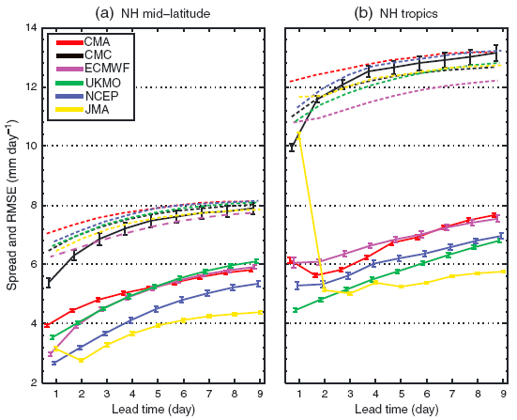
Spread-skill relationship
The day +1 ensemble spread of JMA is the largest in the NH tropics
CMC has the largest spread and it grows with the lead time:
NH midlatitude: level with the ensemble mean error
NH tropics: slightly overdispersive
Spread: dash (- - -), RMSE: solid (——)

Slide 7
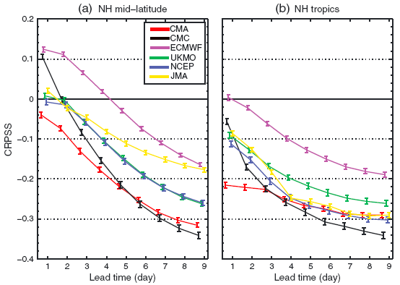
PQPF error: CRPSS
ECMWF best
In the NH tropics, the day +1 CMA is even poorer than the day +9 ECMWF
Skill of CMC rapidly drops from day +2

Slide 8
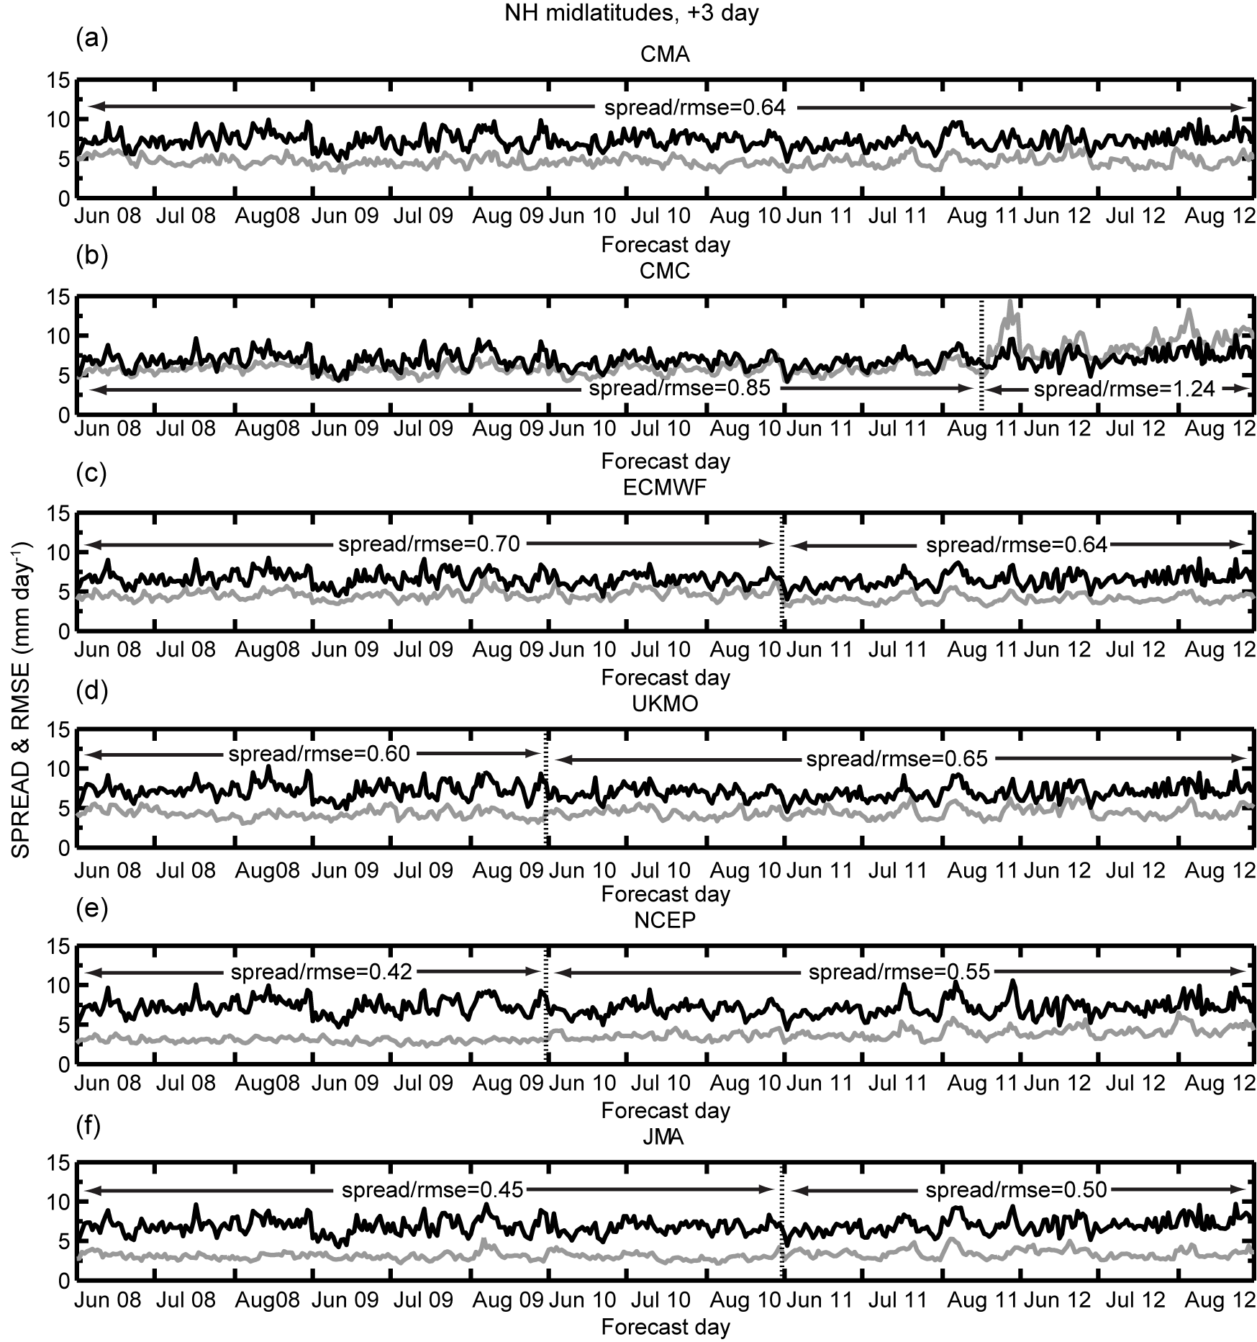
Performance changes due to major EPS upgrade
Changes of spread, Spread/RMSE ratio are significant for CMC and ECMWF
Change of RMSE is only significant for CMC (increase)
Spread: grey, RMSE: black

Slide 9
Performance changes due to major EPS upgrade
Changes of spread, Spread/RMSE ratio are significant for UKMO, NCEP, JMA
Change of RMSE is only significant for UKMO (decrease)
Spread: grey, RMSE: black

Slide 10
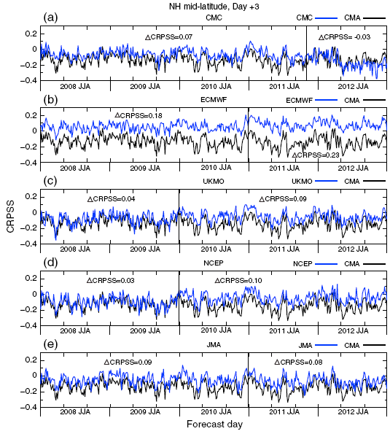
Skill changes
After EPS major upgrade:
CMC: decreased skill
ECMWF, UKMO, NCEP: improved
JMA: no significant change

Slide 11
Verification of convective-scale ensembles
The spread-skill relationship is a crucial verification metrics for ensemble prediction systems（EPSs).
For a convection-allowing EPS, conventional spread-skill metrics of precipitation forecasts suffer from serious double penalty and disregard scale information, so the new spatial verification methods of spread-skill relationship are needed.
The spatial spread-skill relationship for precipitation forecasts is varied with weather regimes.

Slide 12
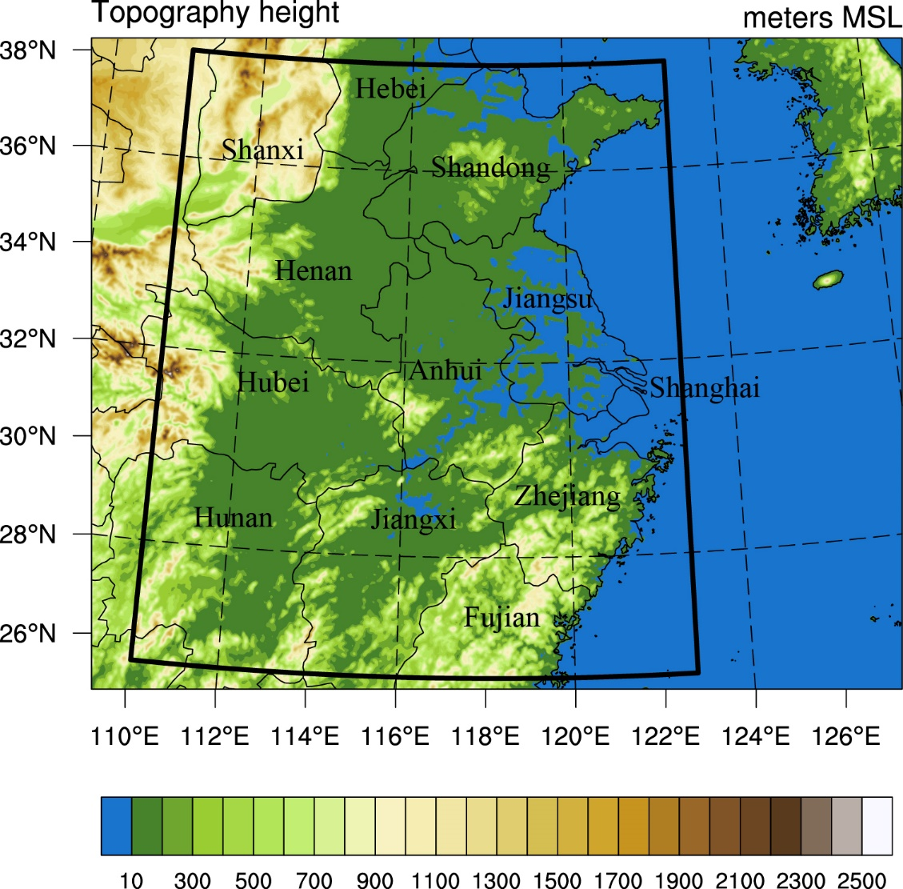
Model configurations
Model:
WRF V3.5.1
Model domain:
620*498, 3 km
50 vertical model levels
Verification domain:
25.55-38.25 ºN, 110.05-122.75 ºE

Slide 13
EPS configurations
Members: 1 control and 14 perturbed forecasts
ICs and BCs: Randomly selected from GEFS (1 degree) without nesting
Initialized at 0000 UTC, 0-36 h forecasts, 3 h interval (except hourly rainfall for the control run)
Verification: 30 cases from one month (23 June-22 July 2013), Meiyu season, 3-27 h lead times

Slide 14
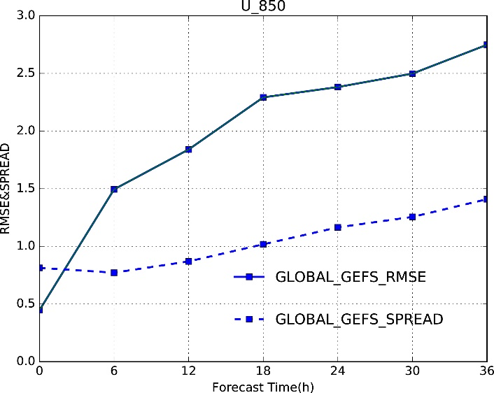
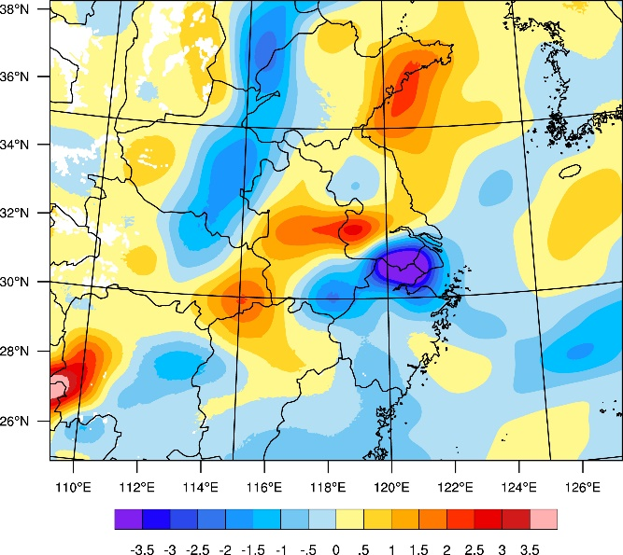
EPS forcing data
GEFS
Spread-skill relationship over the Yangtze-Huaihe River Basin
GEFS initial perturbation
Notes:
其次，这里介绍下本文的集合预报系统配置，为了考虑物理过程不确定性，本文再进行了诸多试验和参考了美国春季试验的集合预报配置后，为每个预报成员选取了不同的物理参数化组合方案，如表所示。本文中使用的驱动数据为NCEP的全球集合预报系统GEFS，本文中的集合预报系统都包括一个控制预报和14个扰动预报，本文检验的是2013年6月23日到7月22日的30天梅雨期降水，预报从每天的00UTC起报，预报36h

Slide 15
Convective-Scale Ensemble Prediction Experiments over the Yangtze-Huaihe River Basin
4 multi-physics EPSs
Perturbation EPS | Physics | IC | BC
WRF_GEFS downscaling | √ | GEFS | GEFS
WRF_GEFS_INF Inflated BC | √ | GEFS | GEFS_INF
WRF_BGM Small-scale | √ | BGM | GEFS_INF
WRF_BLEND Multi-scale blending | √ | BLEND | GEFS_INF
Notes:
针对初始和侧边界扰动，本文共设计了4套集合预报系统，它们分别是降尺度初始和侧边界扰动的WRF_GEFS；在WRF_GEFS基础上增大了侧边界扰动的WRF_GEFS_INF；将WRF_GEFS_INF的初始扰动换成了增长模繁殖法扰动的WRF_BGM;以及融合了WRF_GEFS_INF和WRF_BGM初始扰动，形成多尺度混合初始扰动的WRF_BLEND

Slide 16
Convective-Scale Ensemble Prediction Experiments over the Yangtze-Huaihe River Basin
WRF_GEFS
Inflated BC
WRF_GEFS_INF
WRF_BGM
Large-scale IC
Small-scale IC
WRF_BLEND
Notes:
本文的研究路线分成四步，第一步，我们首先检验WRF_GEFS，来进行降尺度扰动可行性与空间检验方法研究；第二步，对比WRF_GEFS和WRF_GEFS_INF，来进行侧边界扰动的研究；第三步，对比WRF_BGM和WRF_GEFS_INF，来进行小尺度与降尺度初始扰动对比研究；最后一步，通过对比WRF_GEFS_INF，WRF_BGM和WRF_BLEND，来进行多尺度融合初始扰动研究

Slide 17
Classification of weather regimes
Verification data:
CMORPH-CMA: The NOAA CPC CMORPH merged with the rain gauge observations in China (1 h, 0.1 degree)
Classification of weather regimes:
Both the median and mean values of hourly precipitation fractional coverage of observations for one case during the 24 h period (3-27 h forecasts)
< 0.1: Small coverage
≥ 0.1: Large coverage
Surcel et al. (2016)

Slide 18
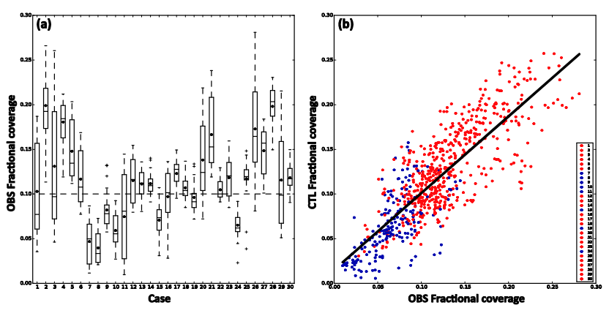
Classification of weather regimes
r=0.86
LC: 22 cases
SC: 8 cases
(b) The scatterplot of hourly precipitation coverage of observations vs the control forecasts of EPS
(a) The boxplot of hourly precipitation coverage of observations for 30 cases.

Slide 19

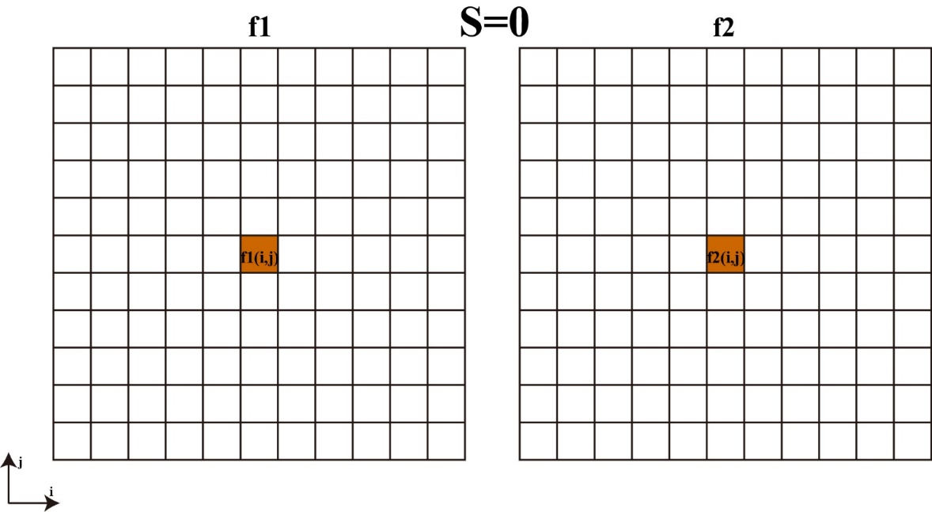
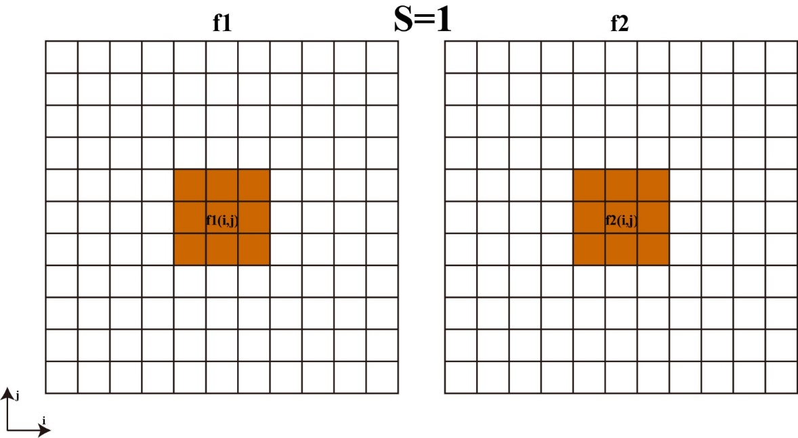
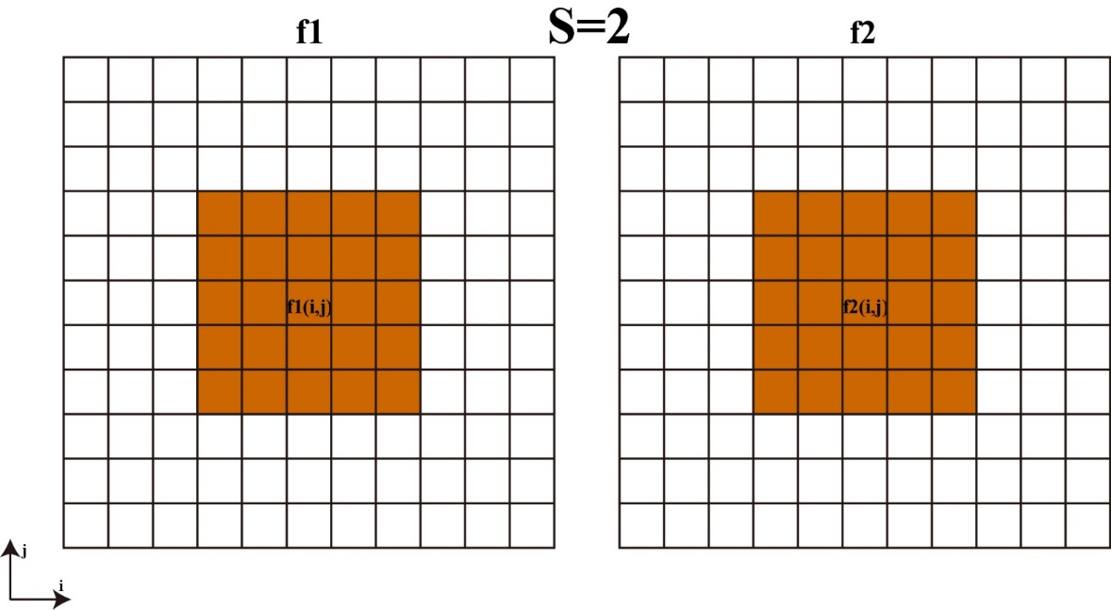
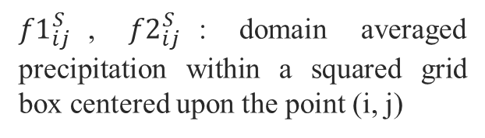
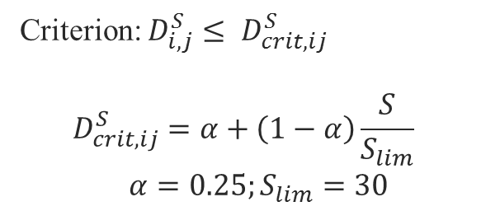
Location-dependent agreement scales
${f1}_{ij}^{S}$, ${f2}_{ij}^{S}$: domain averaged precipitation within a squared grid box centered upon the point (i, j)
Criterion: $D_{i,j}^{S}≤ D_{crit,ij}^{S}$
$$D_{crit,ij}^{S}=α+\left(1−α\right)\frac{S}{S_{lim}}$$
$α=0.25;S_{lim}=30$
Neighbourhood-based method
Dey et al. (2016)

Slide 20
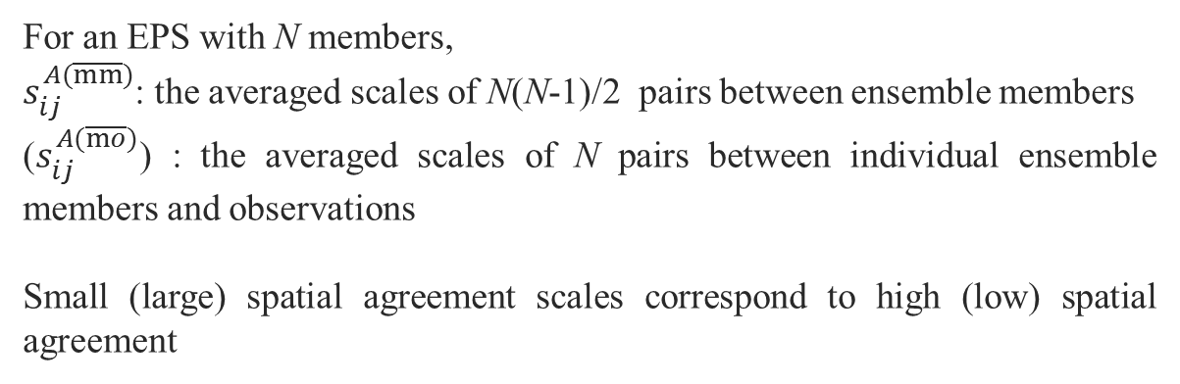
Location-dependent agreement scales
Statistics of average scales:
For an EPS with N members,
$s_{ij}^{A(\overline{mm})}$: the averaged scales of N(N-1)/2 pairs between ensemble members
($s_{ij}^{A(\overline{mo})}$) : the averaged scales of N pairs between individual ensemble members and observations
Small (large) spatial agreement scales correspond to high (low) spatial agreement

Slide 21
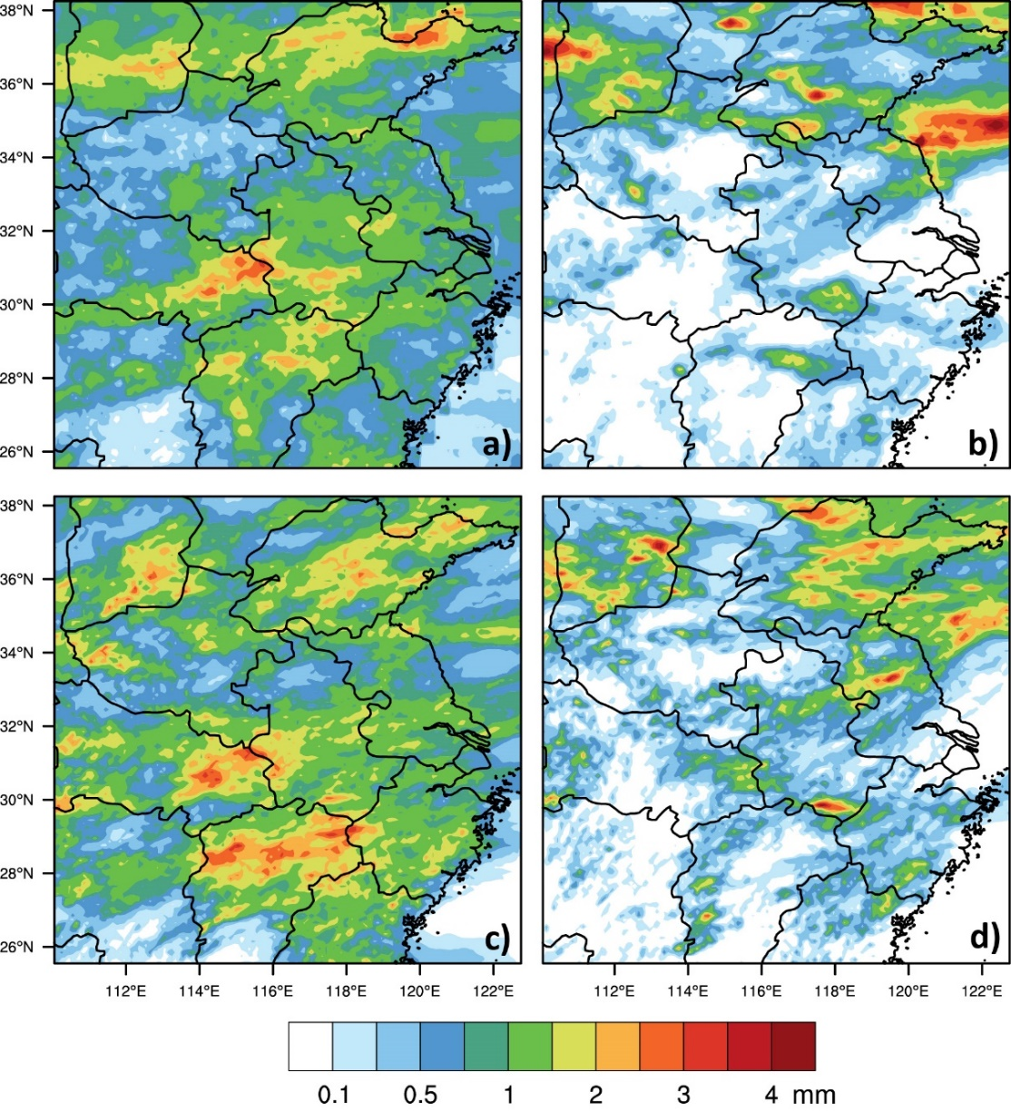
Spatial distributions of 3h accumulated precipitation
Large Coverage Small Coverage
OBS
LC:
Widely spread, east-west or northeast-southwest
SC:
Localized, higher extremes
Control
forecasts

Slide 22
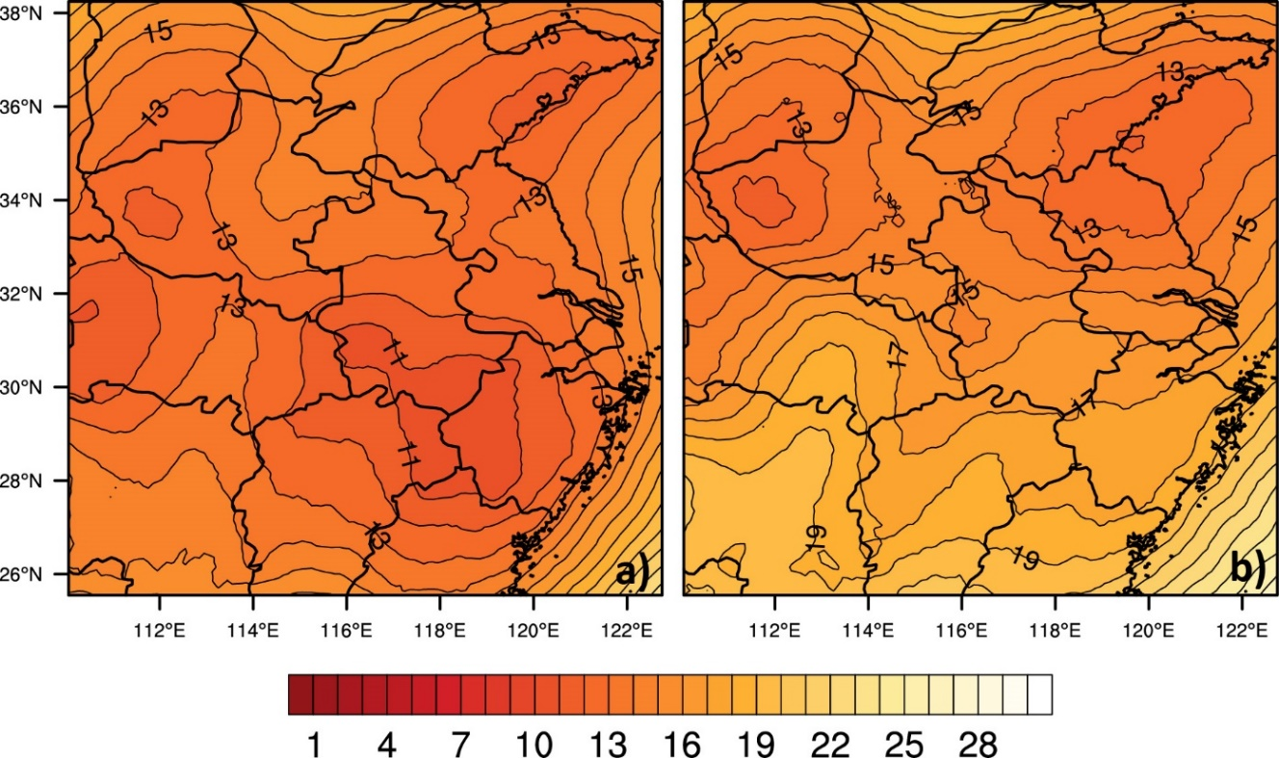
Spatial agreement scales
Large Coverage Small Coverage
Lowest agreement scales locate close to the rainfall centers
Lower agreement scales under the strong regime
Minimum agreement scales: ~10 grids (~210 km) under LC
~12 grids (~250 km) under SC

Slide 23
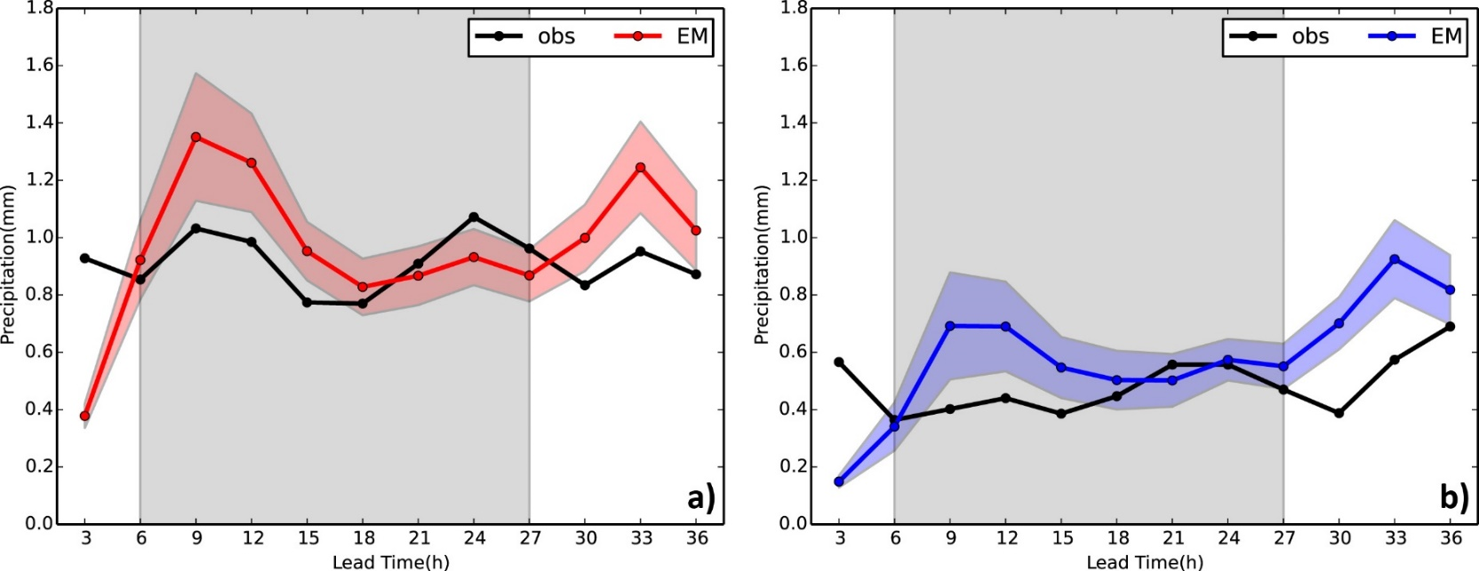
Diurnal variations of domain averaged precipitation
Large Coverage Small Coverage
LC:
Overestimate the first rainfall peak and underestimate the second peak
SC:
Generate a spurious peak and a time lag for the real peak

Slide 24
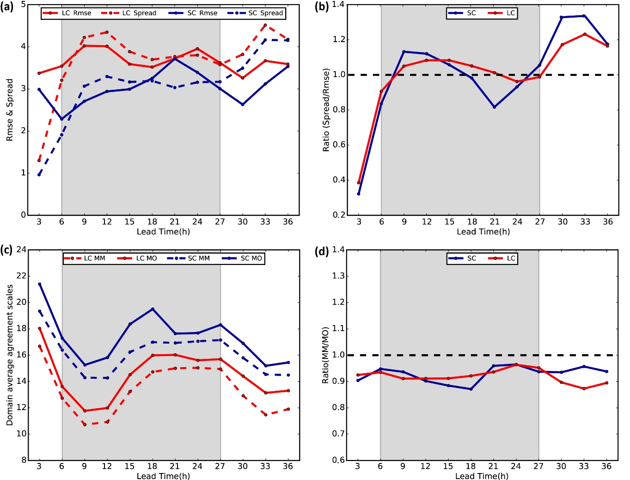
Diurnal variations of spread-skill relationship
RMSE&spread spread/RMSE
Domain averaged precipitation amounts negatively correlate with agreement scales.
The weak regime shows higher domain averaged agreement scales.
Underdispersion (ratio < 1): the lowest at the 18 h lead time under the weak regime.
Averaged Agreement scales the ratios of $S_{ij}^{A(\overline{mm})}$ and $S_{ij}^{A(\overline{mo})}$

Slide 25
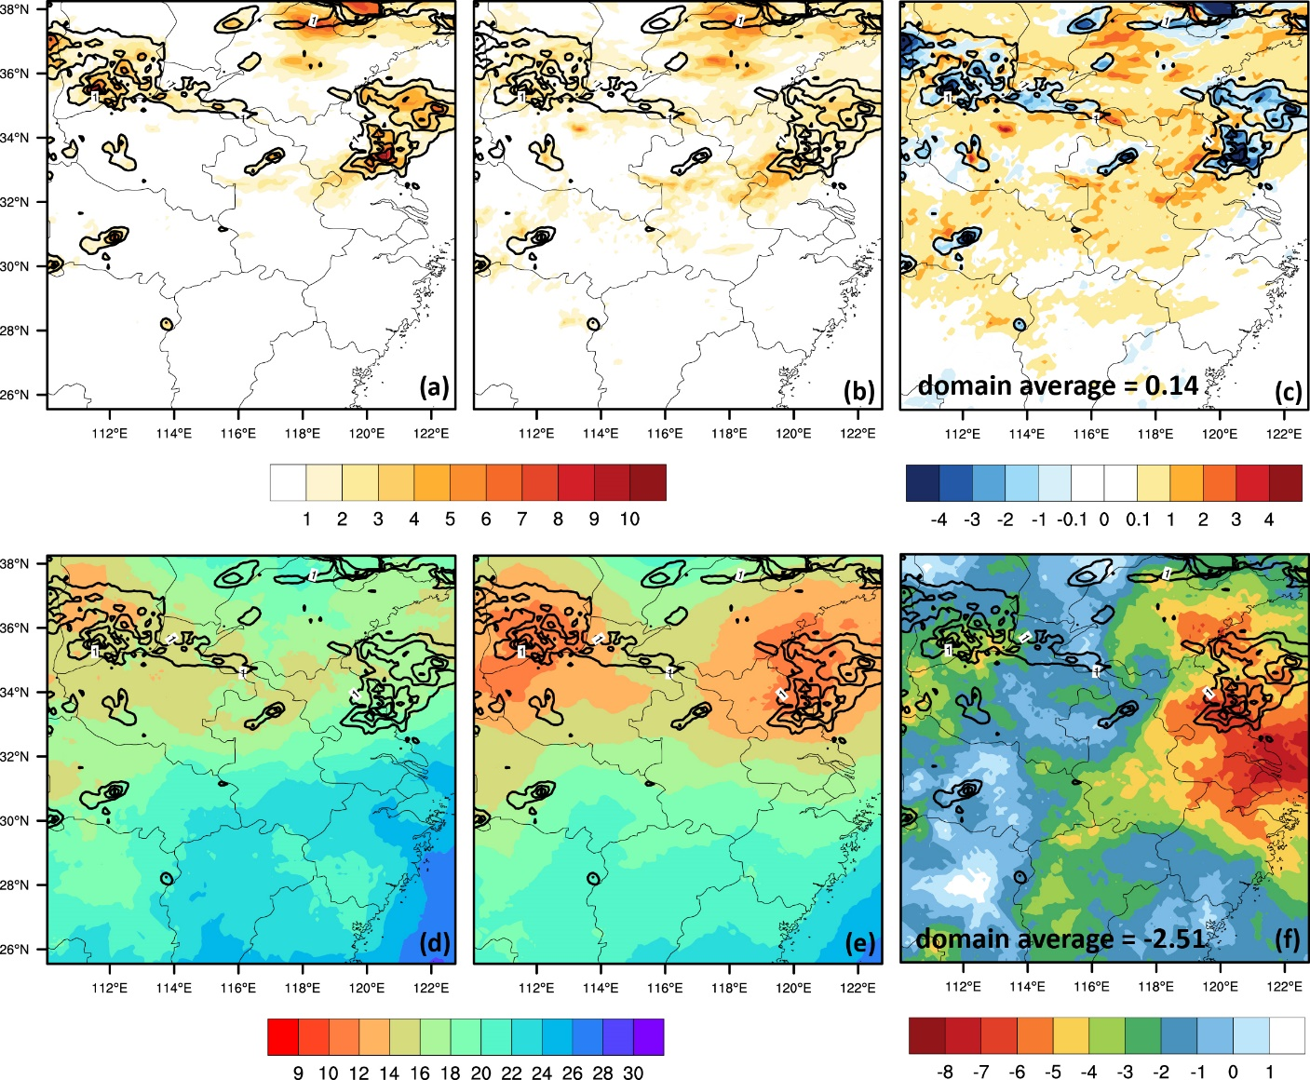



Comparison between the traditional
and spatial spread-skill relationship
RMSE
spread
Spread-RMSE
The forecasts for heavier precipitation amounts show larger forecast errors increased spread, and smaller agreement scales
The EPS is underdispersive in the precipitation areas from both of the relationships
The traditional one provides spurious perfect spread-skill relationship in statistics, while the spatial spread-skill relationship is capable of reflecting the correct spatial scale information and obtaining consistent total statistics
$$S_{ij}^{A(\overline{mo})}$$
$$S_{ij}^{A(\overline{mm})}$$
$$S_{ij}^{A(\overline{mm})}−S_{ij}^{A(\overline{mo})}$$

Slide 26
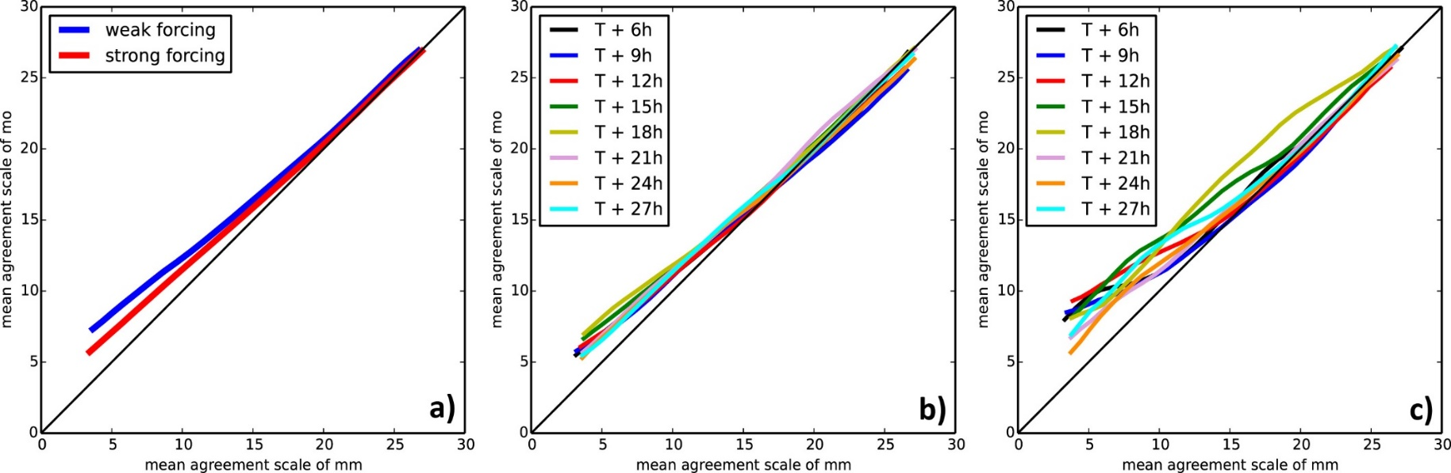
Spatial Spread-skill relationship
(a) 3-27 h averages (b) large coverage (c) small coverage
Underdispersive spread-skill relationship
SC shows much larger diurnal variations (worst at the 18 h lead time)

Slide 27
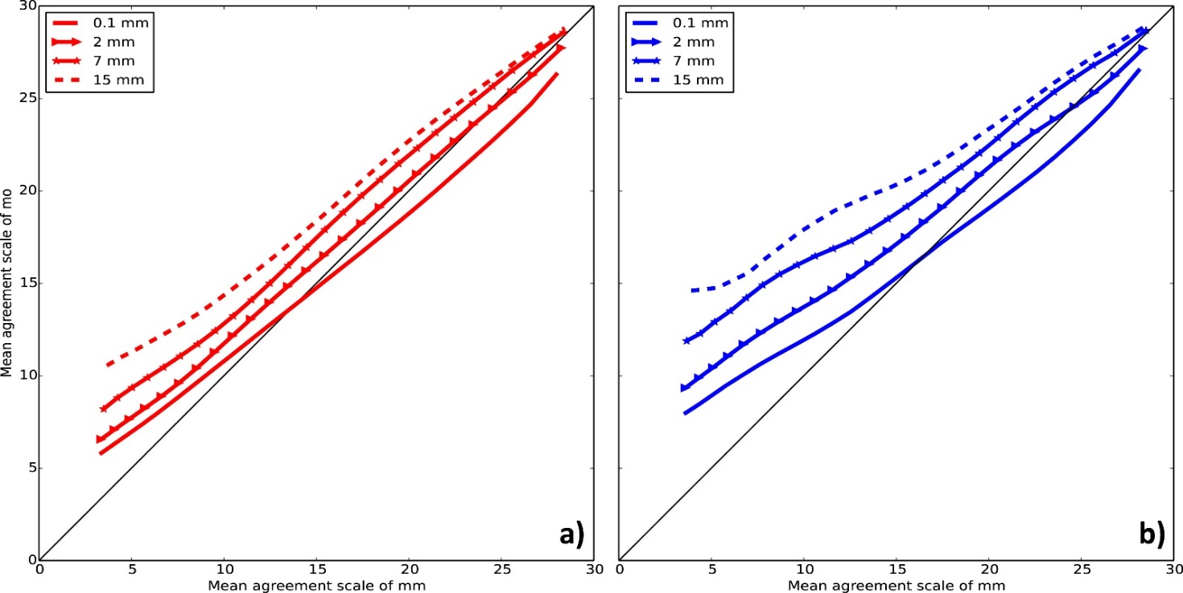
Spatial Spread-skill relationship
Large Coverage Small Coverage
Better spread-skill under LC
More insufficient spread for higher precipitation intensities

Slide 28
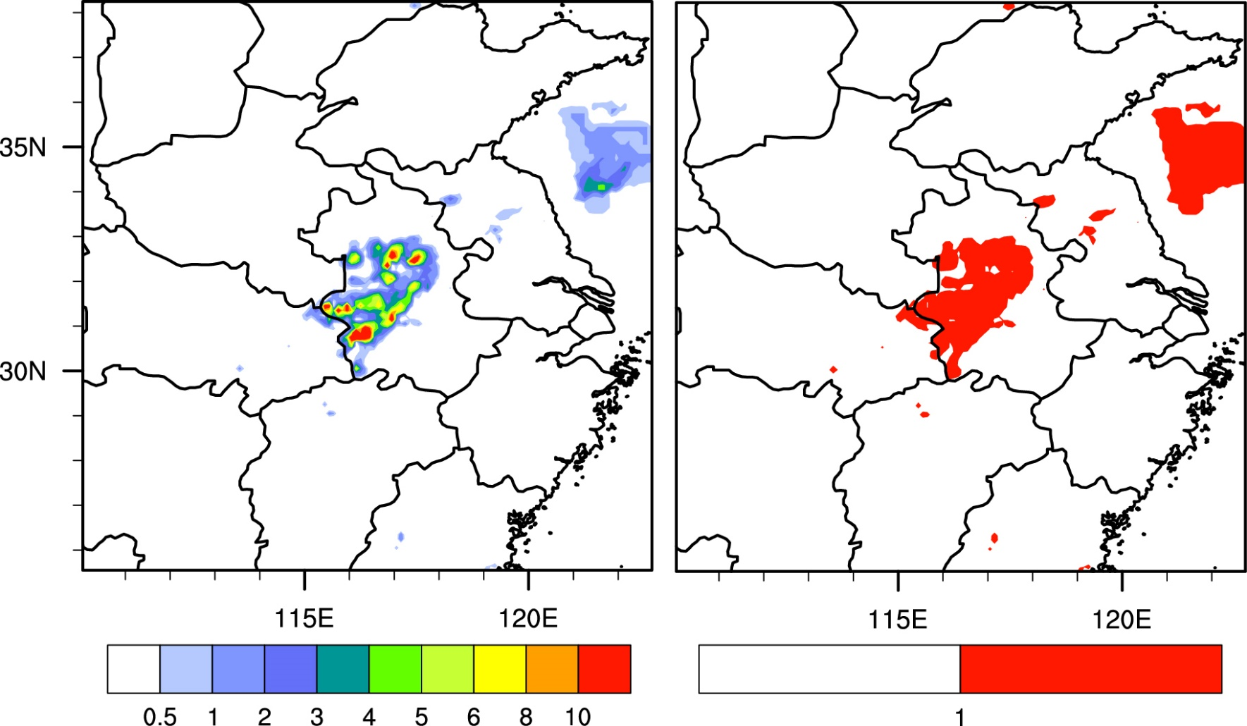
Relative impacts of intensity and placement on the spread-skill relationship
Raw
Binary
Notes:
除了上述的检验外，本文还对降水一致性尺度法进行了扩展研究。Dey在他的工作中指出，在降水区内，空间集合离散度误差关系由降水强度和落区决定，但他没有比较两者的相对重要性；本文在他的基础上对一致性尺度方法进行了扩展，使得此方法可以用来比较降水强度落区的相对重要性；我们在计算降水一致性尺度之前，对降水场进行了两种不同的处理，第一种，选择降水阈值后，小于阈值的降水量值变为0，大于阈值的降水量值保持不变，我们将这种降水场叫做原始阈值场；第二种，小于阈值的降水值仍变为0，而大于阈值的降水值变为1，我们将这种降水场称为二分阈值场。从图中可以看出，两种降水场的唯一区别就在于大于阈值的降水强度。原始阈值场保留了强度误差，而二分阈值场忽略了强度误差

Slide 29
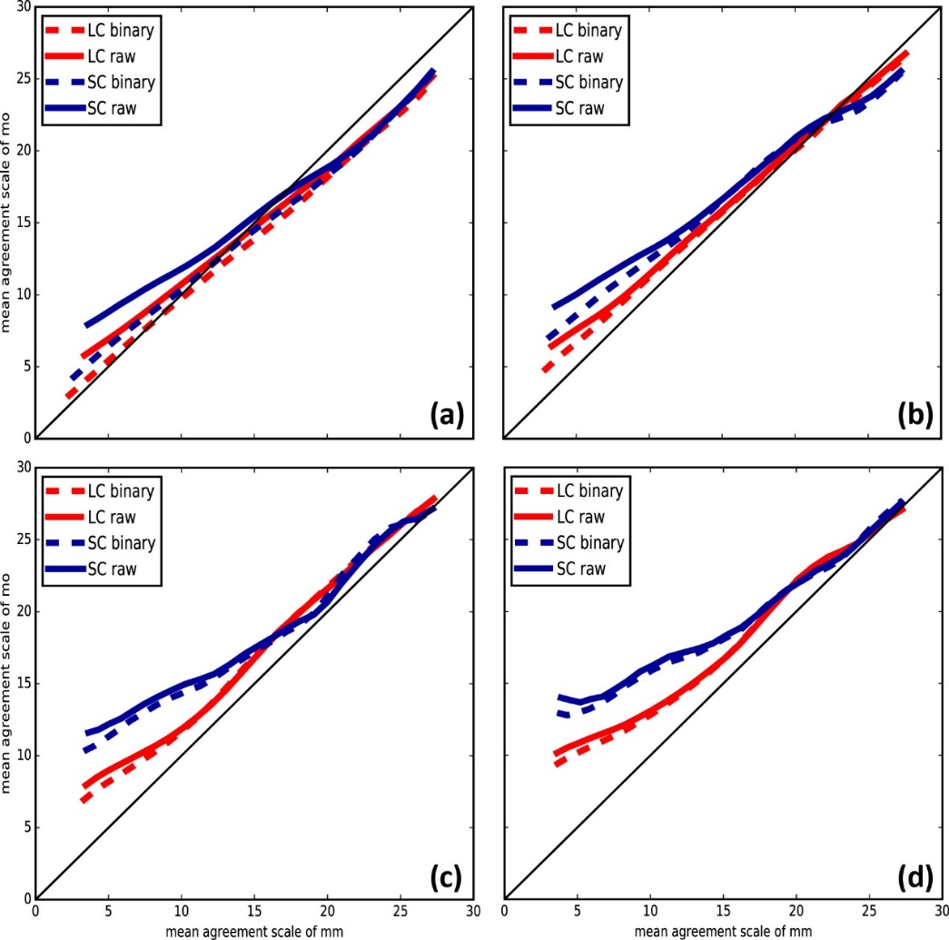

Impacts of intensity and placement on spread-skill
Scatterplots of $S_{ij}^{A(\overline{mm})}$ and $S_{ij}^{A(\overline{mo})}$
Higher spread-skills under LC
Higher skills for threshold binary precipitation fields
With the increasing threshold, the skill differences between the fields reduce
0.1 mm/3h
2 mm/3h
7 mm/3h
15 mm/3h

Slide 30
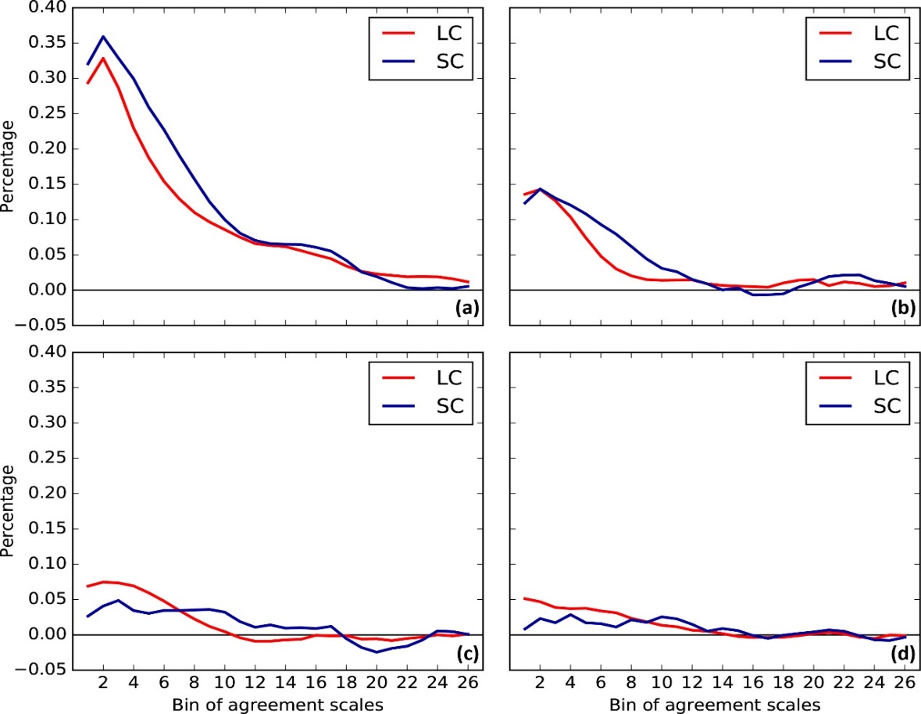

Impacts of intensity and placement on spread-skill
The relative difference percentages of precipitation intensity on the spatial spread-skill relationship
$$s^{i}=\frac{s_{b}^{i}−s_{r}^{i}}{s_{r}^{i}}$$
0.1 mm/3h
2 mm/3h
7 mm/3h
15 mm/3h
Impacts of precipitation intensity on the spatial spread-skill decrease with the increasing threshold and agreement scales, while the precipitation placement becomes more dominant to influence the spatial spread-skill relationship for heavy precipitation events

Slide 31
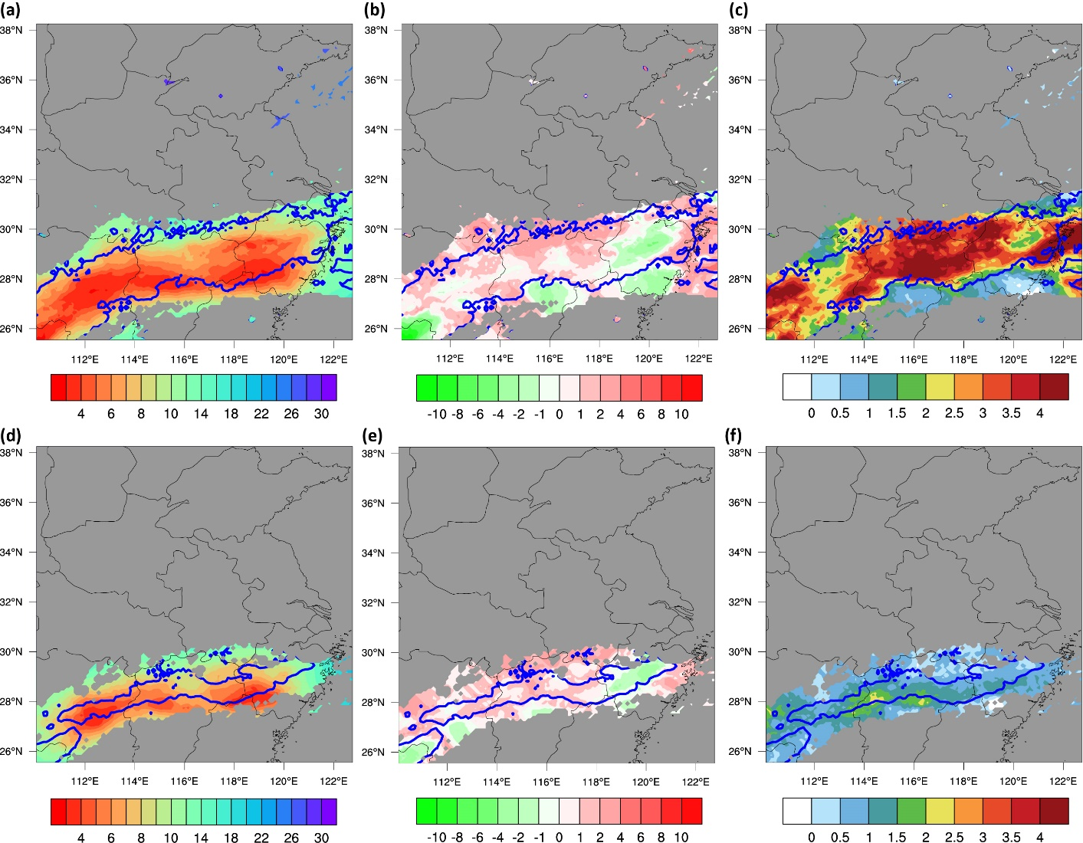


The case under LC
threshold raw – binary fields
$S_{ij}^{A(\overline{mm})}$ of threshold raw
$S_{ij}^{A(\overline{mm})}$-$S_{ij}^{A(\overline{mo})}$
Case 1: June 27, 2013
Gray areas: no precipitation
Blue contours: Observed thresholds
0.1
mm/3h
the influence of precipitation intensity on agreement scales decrease with the increasing precipitation threshold
7
mm/3h

Slide 32
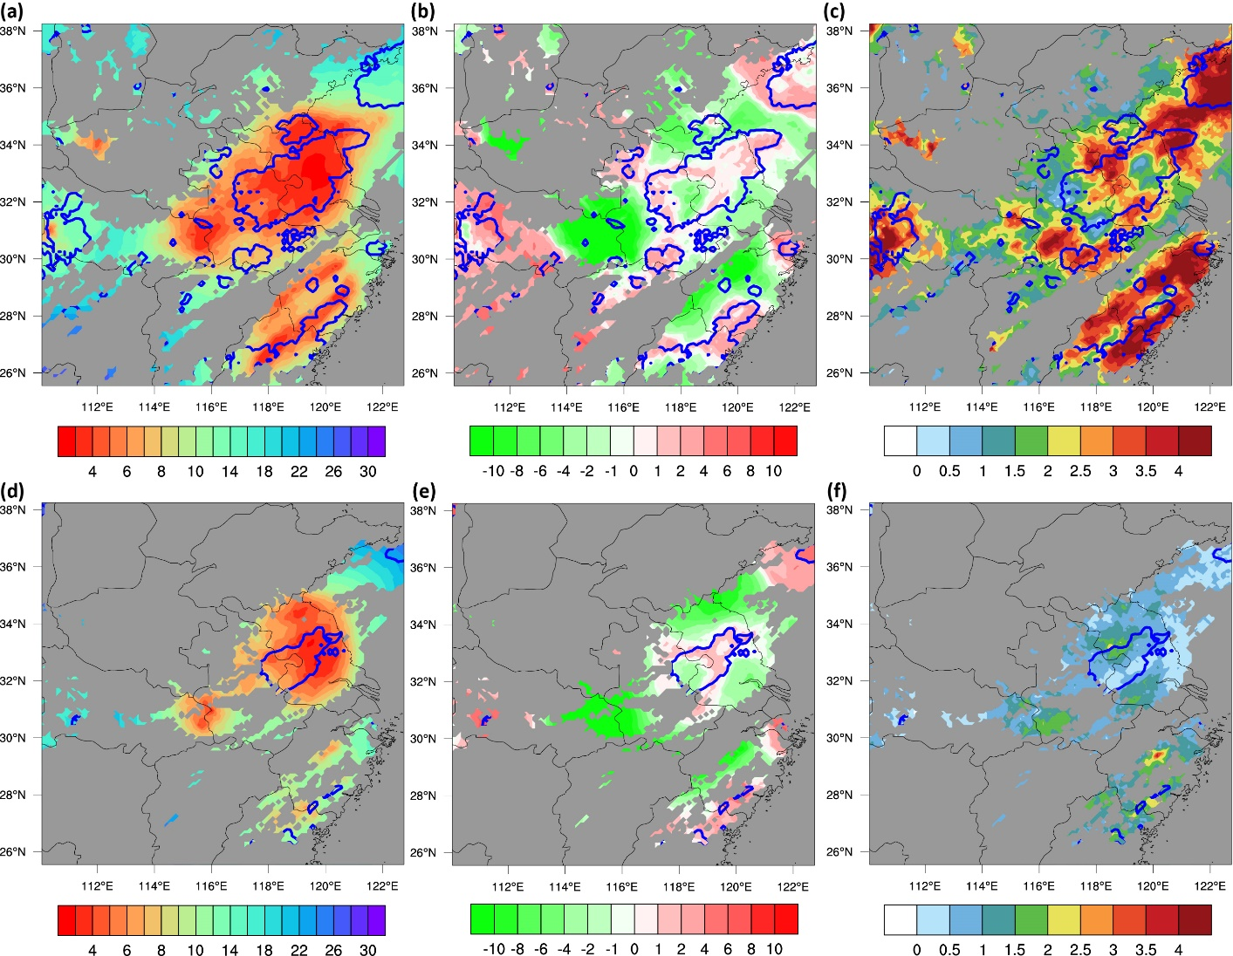
The case under SC
threshold raw – binary fields
$S_{ij}^{A(\overline{mm})}$ of threshold raw
$S_{ij}^{A(\overline{mm})}$-$S_{ij}^{A(\overline{mo})}$
Case 2: July 7, 2013
0.1
mm/3h
Displacement for case 2 is more severe than case 1, especially for the heavier precipitation threshold
the underdispersion of the spatial spread-skill relationship for the SC case is more serious than that for the LC one
7
mm/3h
The two cases results further suggest that the spatial spread-skill relationship under SC is poorer than that under LC and the precipitation placement gradually become a dominant factor to affect the spatial spread-skill relationship at higher precipitation thresholds for both regimes.

Slide 33
Summary and discussions (1)
Compared to the cases under LC, the spatial spread-skill relationship for precipitation forecasts under SC is poorer and shows more diurnal variations.
With the increasing precipitation threshold and agreement scales, the relative impact of precipitation intensity gradually decreases, and the influence of precipitation placement on the spatial spread-skill relationship becomes dominant.
The CMORPH-CMA observation dataset is still coarse for the exquisite verification of this EPS because of the information loss below 10 km.
In the next-generation EPS, small-scale initial perturbations will be implemented and the spread-skills need to be evaluated to assess the benefit of the initial perturbations in the future.
  Chen, X., H. Yuan, and M. Xue, 2017: Spatial Spread-Skill Relationship in Terms of Agreement Scales for Precipitation Forecasts in a Convection-Allowing Ensemble., Q. J. Royal Meteo. Soc. DOI: 10.1002/qj.3186

Slide 34
Convective-Scale Ensemble Prediction Experiments over the Yangtze-Huaihe River Basin
WRF_GEFS
Inflated BC
WRF_GEFS_INF
WRF_BGM
Large-scale IC
Small-scale IC
WRF_BLEND
Notes:
本文的研究路线分成四步，第一步，我们首先检验WRF_GEFS，来进行降尺度扰动可行性与空间检验方法研究；第二步，对比WRF_GEFS和WRF_GEFS_INF，来进行侧边界扰动的研究；第三步，对比WRF_BGM和WRF_GEFS_INF，来进行小尺度与降尺度初始扰动对比研究；最后一步，通过对比WRF_GEFS_INF，WRF_BGM和WRF_BLEND，来进行多尺度融合初始扰动研究

Slide 35
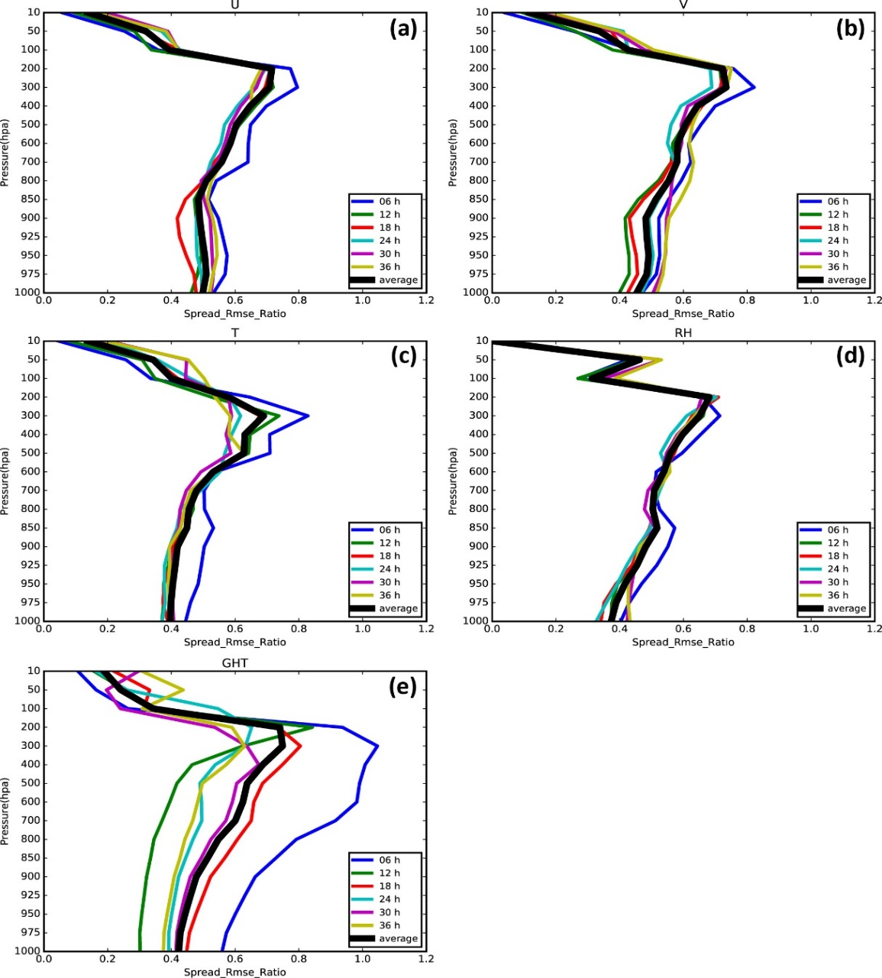
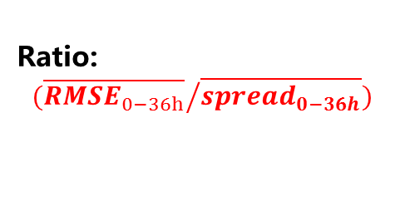
Boundary condition perturbation
GEFS（spread/RMSE）
Ratio:
$${(\overline{{RMSE}_{0−36h}}}/{\overline{{spread}_{0−36h}})}$$
U
V
T
RH
GHT
Notes:
本文首先研究了GEFS在江淮流域内各个预报时效的集合离散度误差关系，我们使用集合离散度误差比值来表征此关系，比值越接近于1，说明集合离散度误差关系越好，小于1则说明预报存在欠离散现象。从图中各个变量的spread与RMSE的比值来看，对于大多数变量而言，GEFS预报在6到36h内都存在欠离散现象。从图中我们还可以发现，除了位势高度外的其他变量，这种欠离散程度对垂直层敏感，但对预报时效不敏感。因此，本文针对不同层次的不同变量，使用其在6-36h内的平均误差与离散度比值对侧边界扰动进行放大

Slide 36
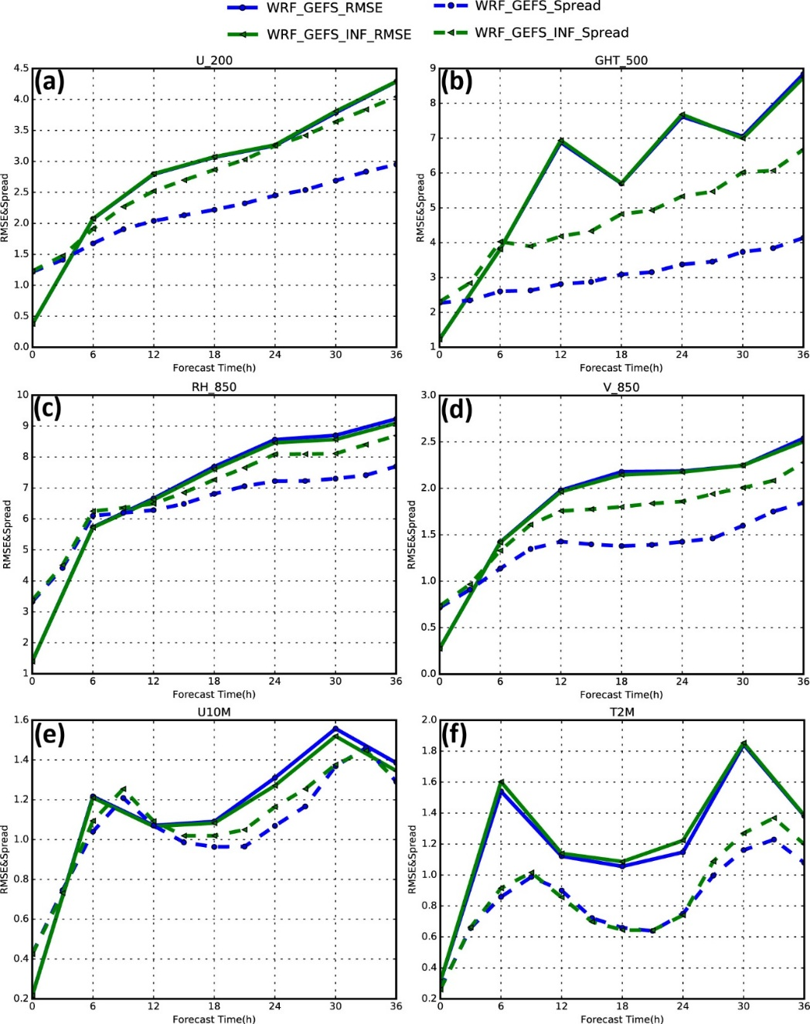
Boundary condition perturbation
OBS: GFS analysis（>200km）

Slide 37
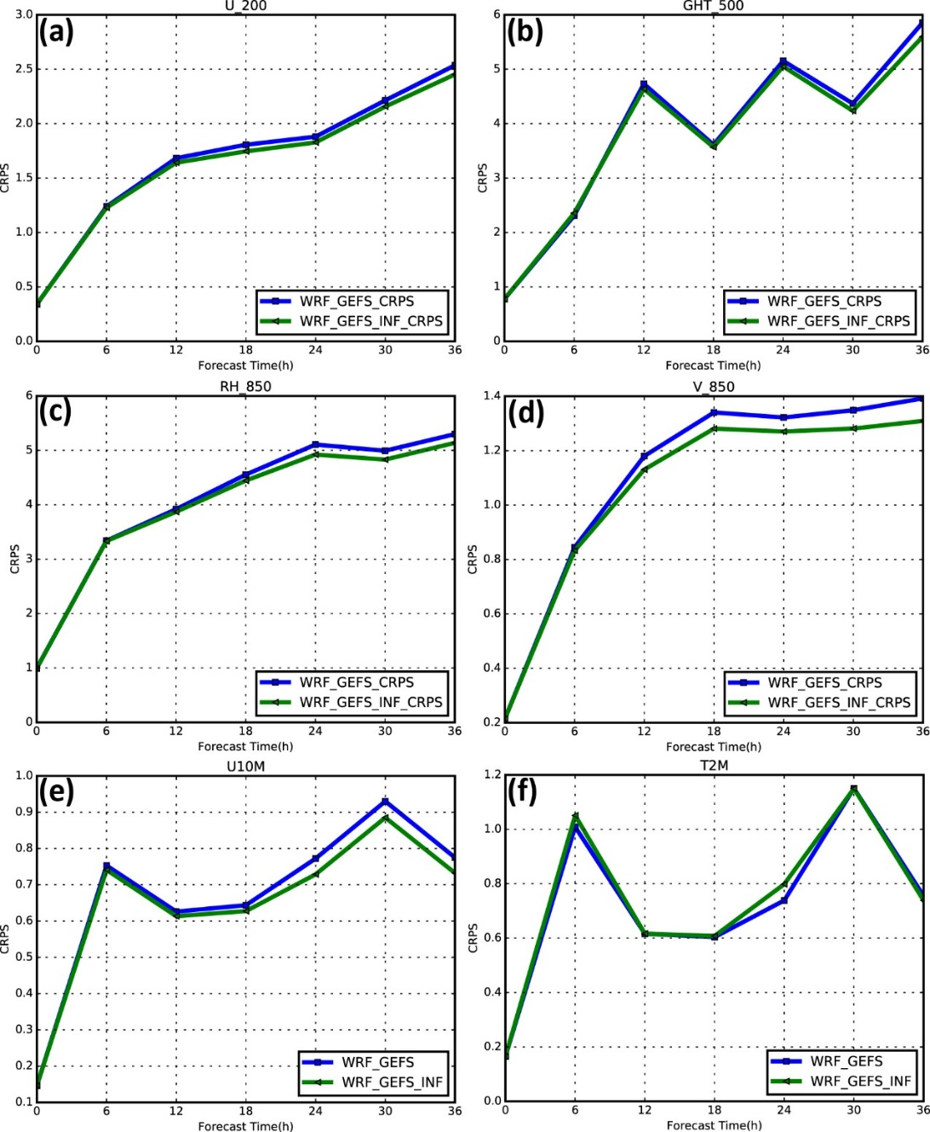
Boundary condition perturbation
WRF_GEFS vs. WRF_GEFS_INF, CRPS

Slide 38
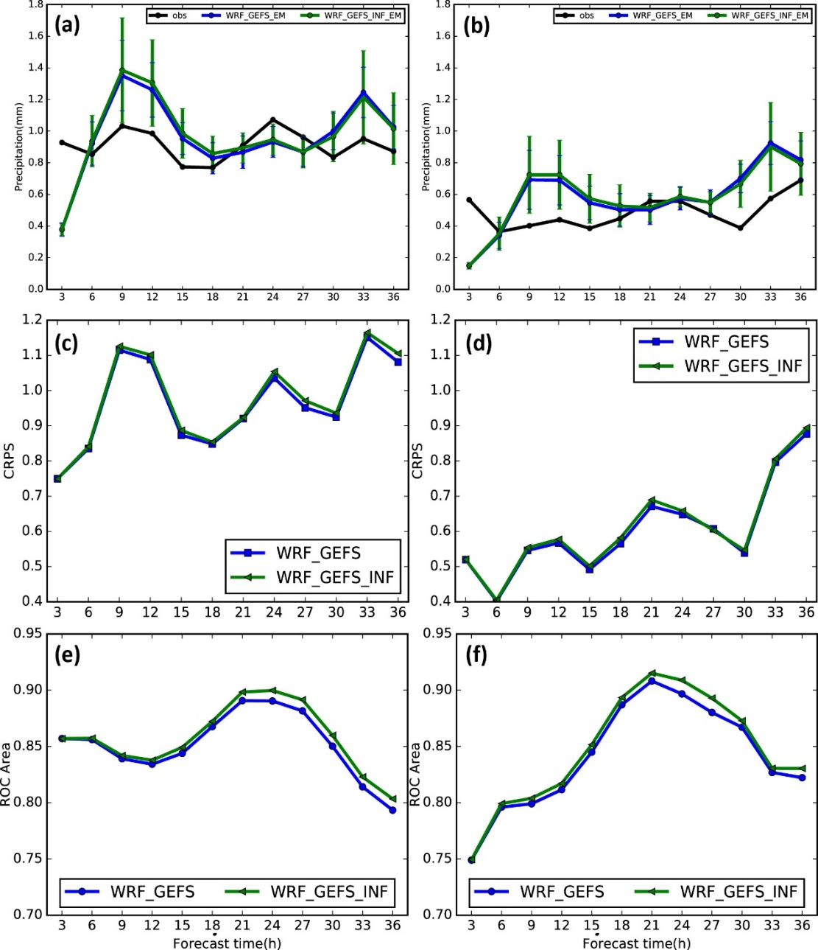
Boundary condition perturbation
WRF_GEFS vs. WRF_GEFS_INF, 3h precipitation
ROC area 0.1mm/3h
LC
CRPS
QPF
SC

Slide 39
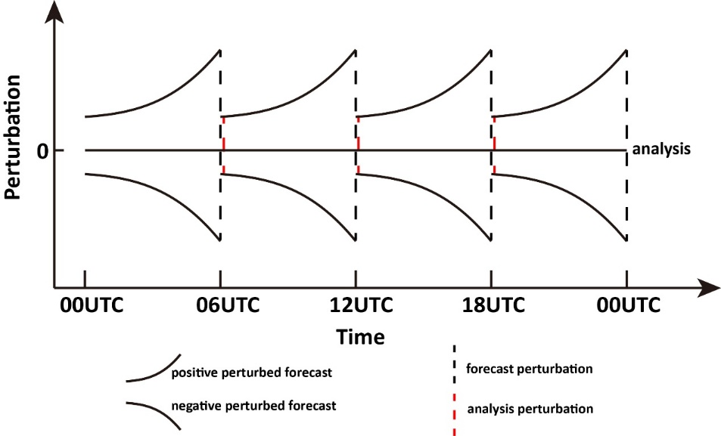
Downscaling vs. BGM perturbations
BGM方法介绍

Slide 40
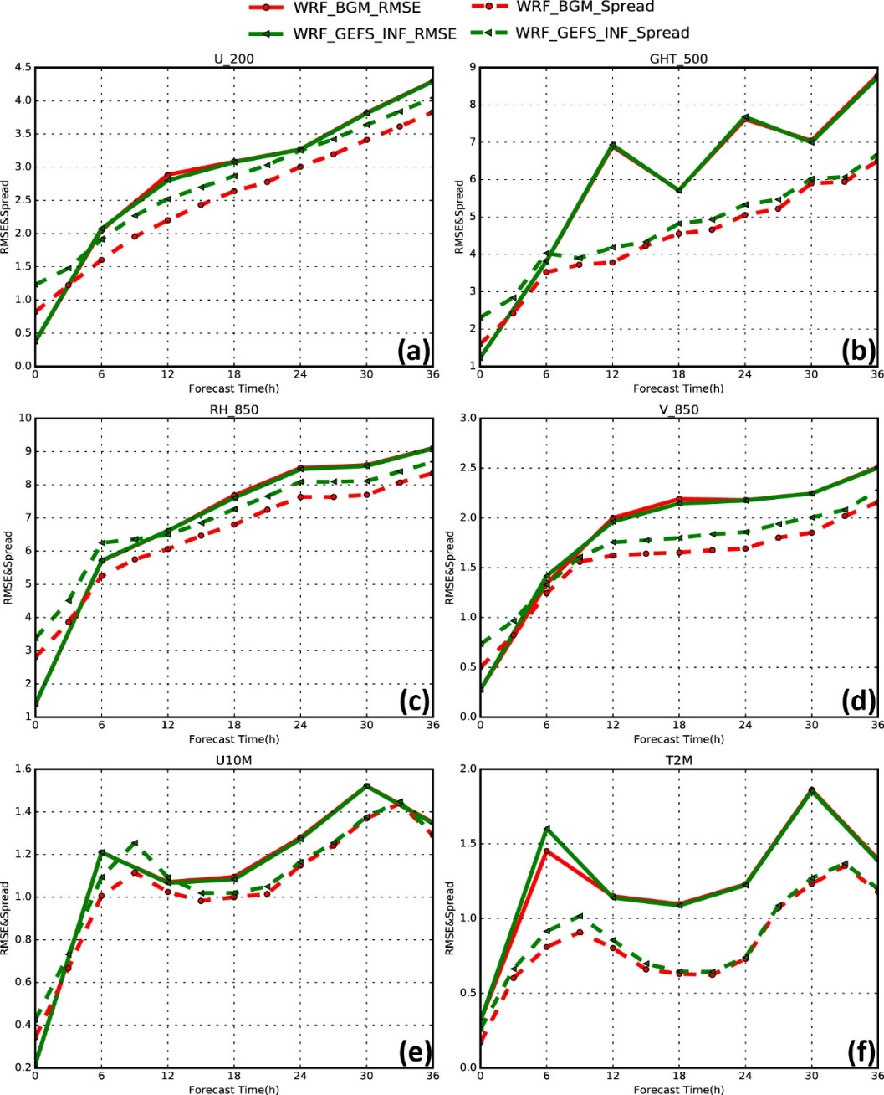
Downscaling vs. BGM perturbations

Slide 41
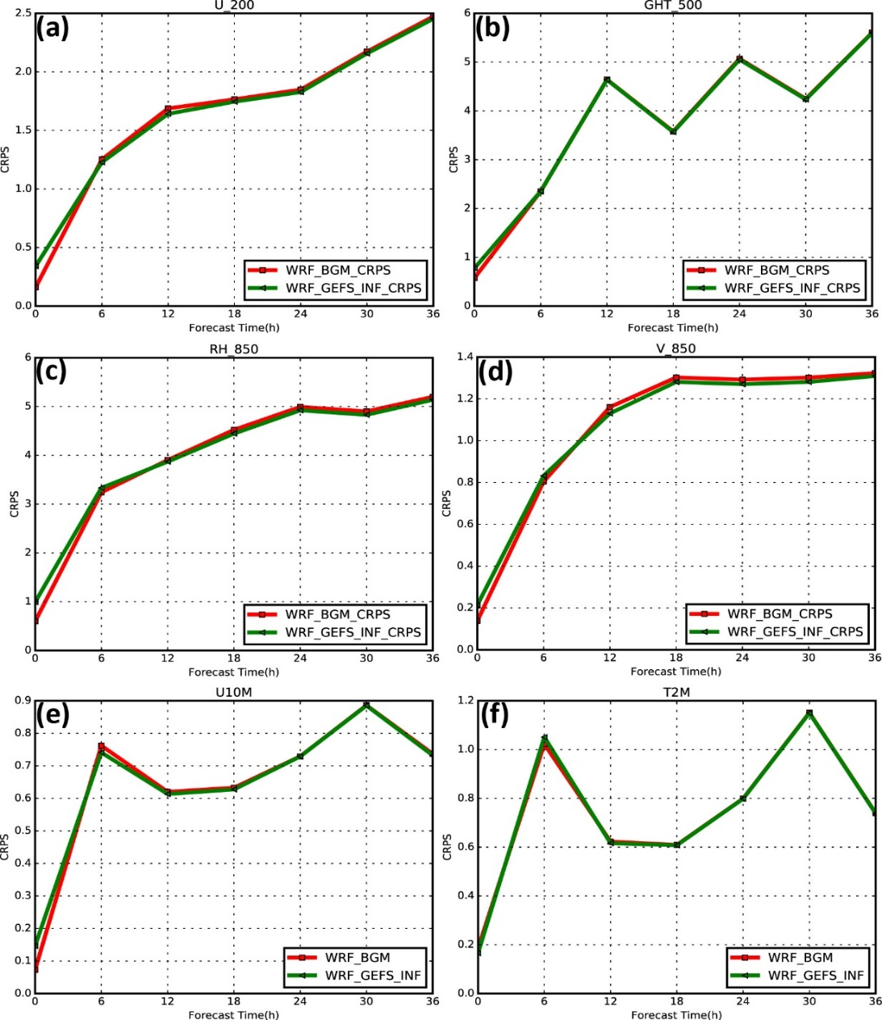
Downscaling vs. BGM perturbations
WRF_BGM vs. WRF_GEFS_INF, CRPS

Slide 42
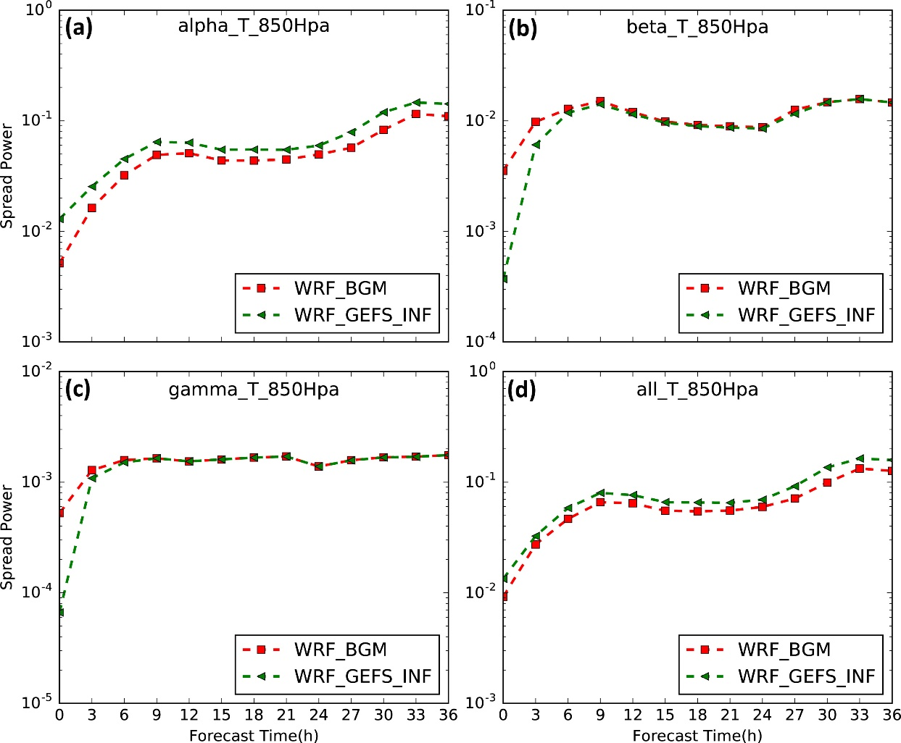
Downscaling vs. BGM perturbations
Meso-α
Meso-β
WRF_BGM vs. WRF_GEFS_INF
Spectral power
Meso-γ
total

Slide 43
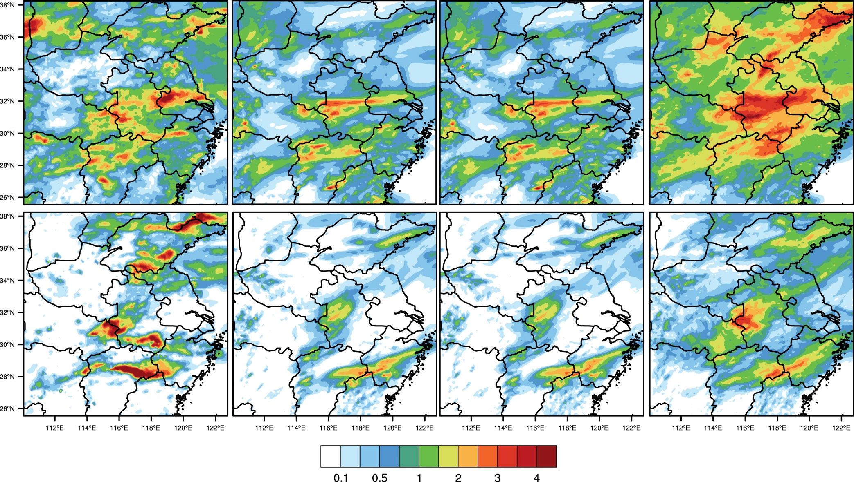
Precipitation（0-6h）
OBS WRF_GEFS WRF_GEFS_INF WRF_BGM
LC
SC
Notes:
为了更为直观地对比两套集合预报系统（0-6h）降水预报差异，图中给出了WRF_BGM和WRF_GEFS_INF在0到6h内降水平均空间分布对比情况，从图中可以看出LC：WRF_GEFS_INF为干偏差，WRF_BGM存在湿偏差；SC: WRF_GEFS_INF为干偏差，WRF_BGM与观测较为接近

Slide 44
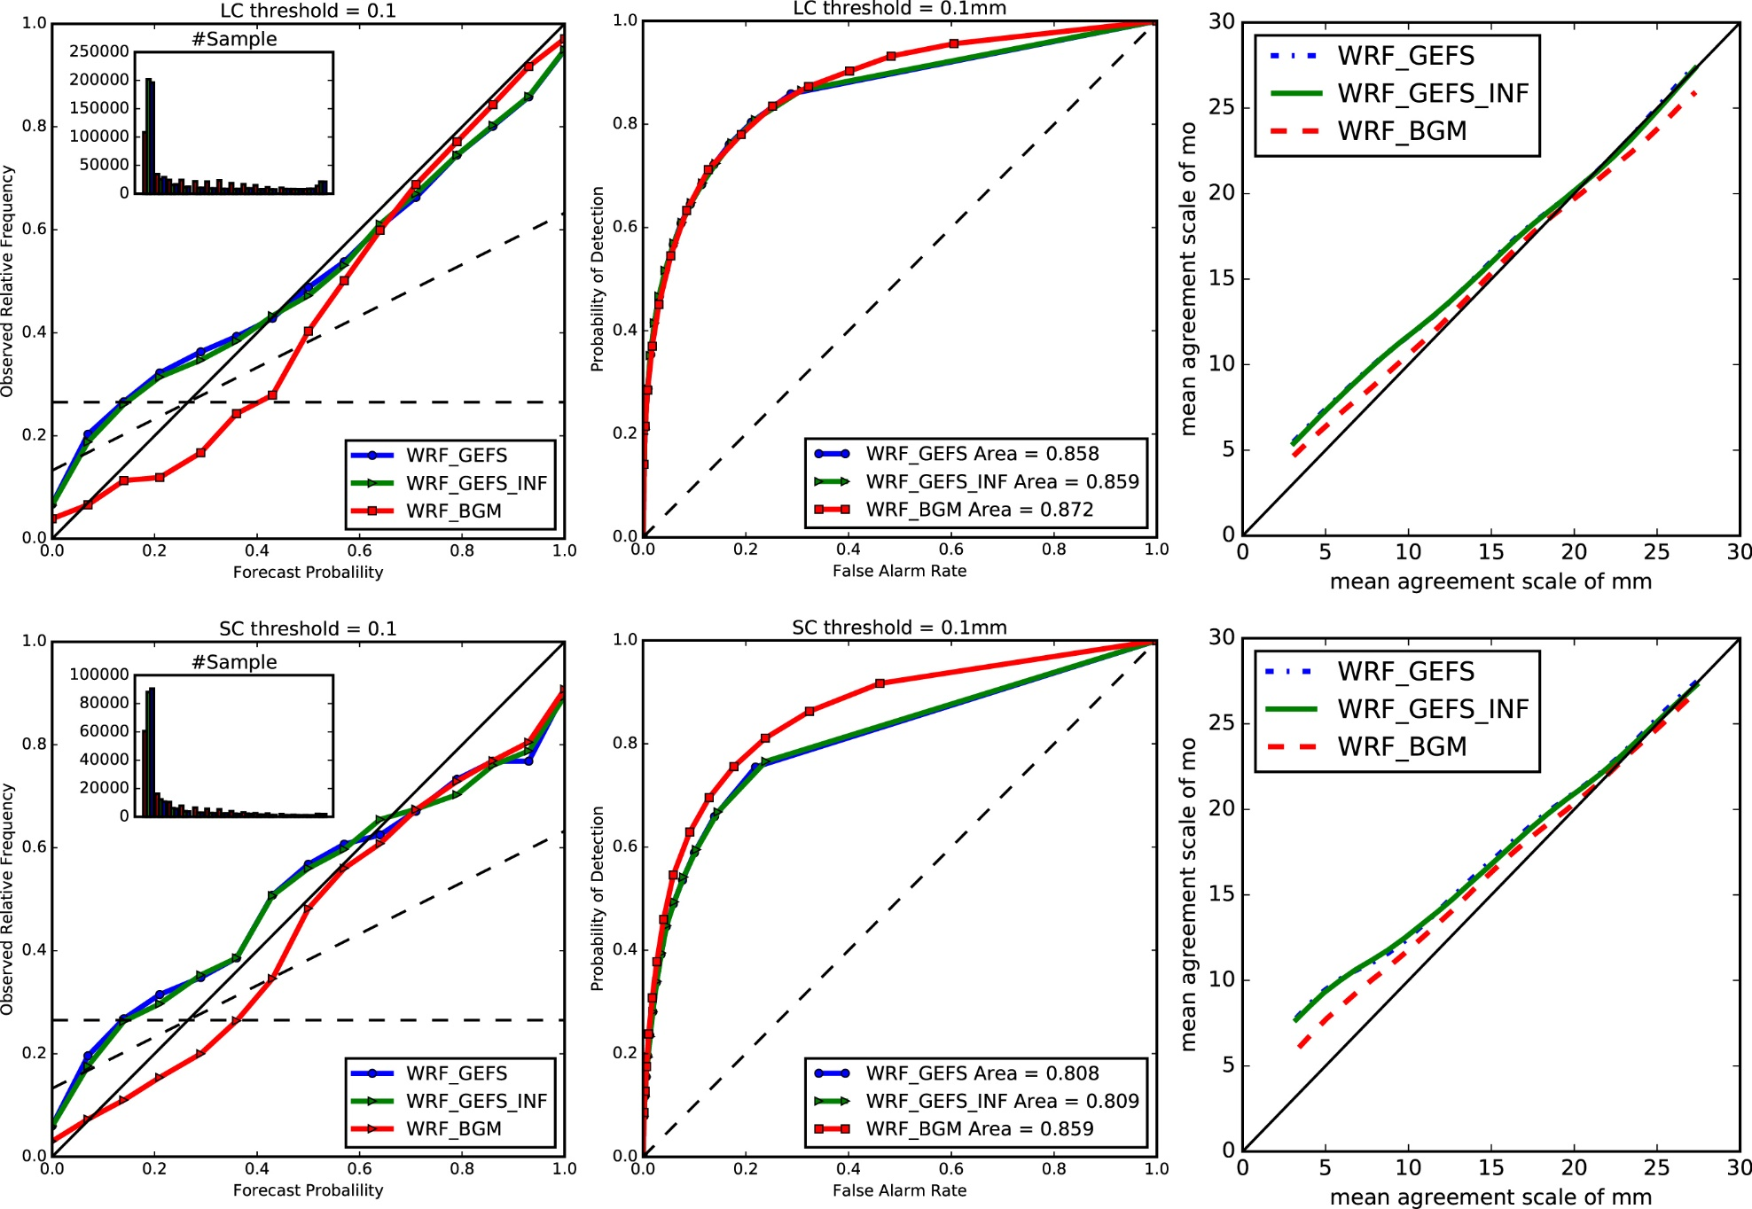
Forecast skill（0-6h）
LC
ROC
SC
Notes:
这里我们进一步对比了0到6h内WRF_BGM和WRF_GEFS_INF的集合降水预报技巧进行全面的对比；从图中可以看出，在两种降水形势下，WRF_BGM的可靠性，分辨率和空间集合离散度误差关系均优于WRF_GEFS_INF，不过，在LC形势下，大的降水一致性尺度上，WRF_BGM存在过离散现象，这主要是由预报存在湿偏差引起；相比于LC形势而言，WRF_BGM对SC形势下的预报技巧改进更为明显

Slide 45
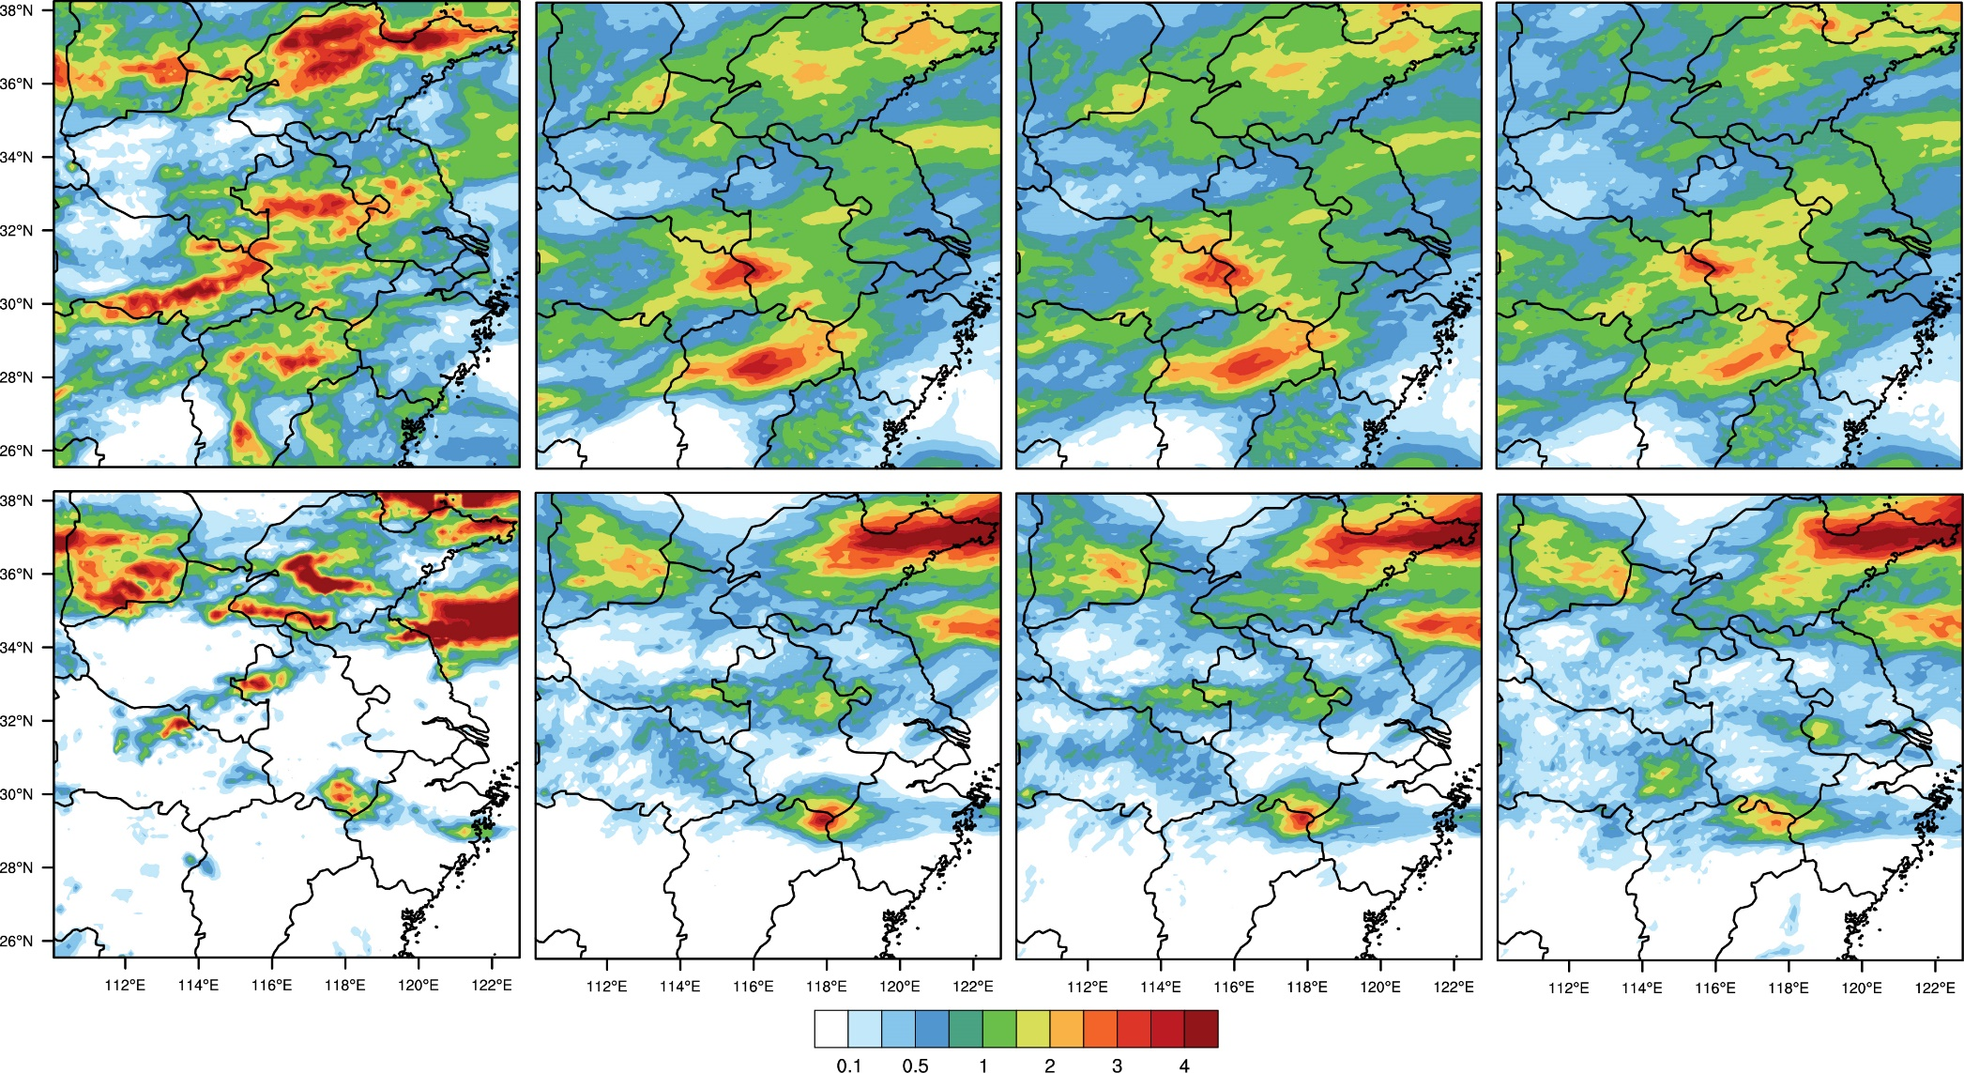
Precipitation（18-24h）
OBS WRF_GEFS WRF_GEFS_INF WRF_BGM
LC
SC
Notes:
为了更为直观地对比两套集合预报系统（0-6h）降水预报差异，图中给出了WRF_BGM和WRF_GEFS_INF在0到6h内降水平均空间分布对比情况，从图中可以看出LC：WRF_GEFS_INF为干偏差，WRF_BGM存在湿偏差；SC: WRF_GEFS_INF为干偏差，WRF_BGM与观测较为接近

Slide 46
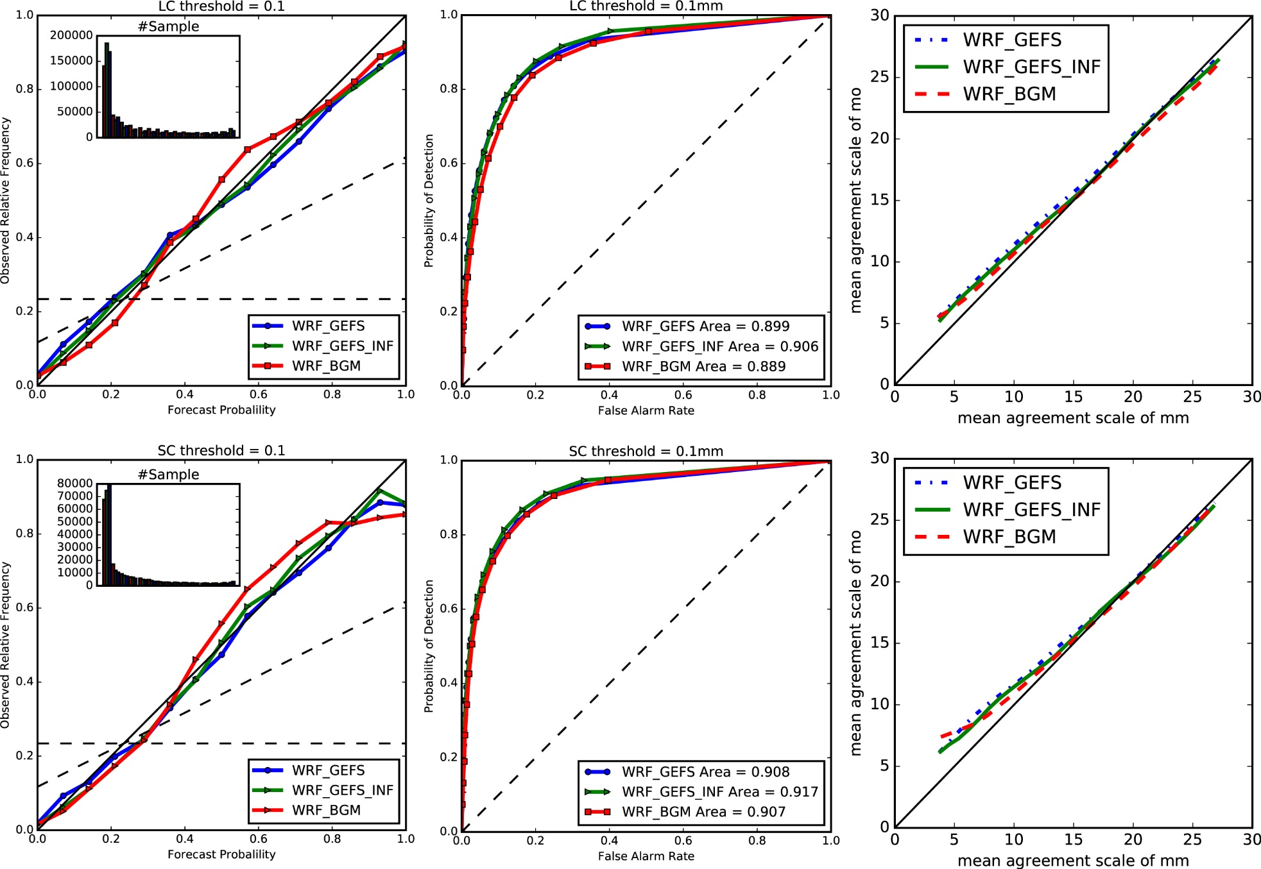
Forecast skill（18-24h）
观测与预报间一致性尺度
命中率
LC
SC
Notes:
因此，我们以SC形势为例，对两套集合预报系统在不同预报时段的集合降水预报技巧进行了全面的对比。我们比较了可靠性曲线，ROC曲线和空间集合离散度误差关系。可靠性曲线比较的是不同概率阈值下预报概率和观测频率的一致性，这条线越接近于对角线越好，说明集合预报越可靠。ROC曲线比较的是不同概率阈值下，假警率和命中率的对比，这条线越接近于左上角越好，说明集合分辨率越高。从图中我们可以发现，在3-15h内，WRF_GEFS和WRF_GEFS_INF的可靠性曲线，ROC曲线和空间集合离散度误差关系几乎重合。而随着预报时效的增大，到了15-27h时段内，WRF_GEFS_INF的可靠性，分辨率和空间集合离散度误差关系均有少许提升。

Slide 47
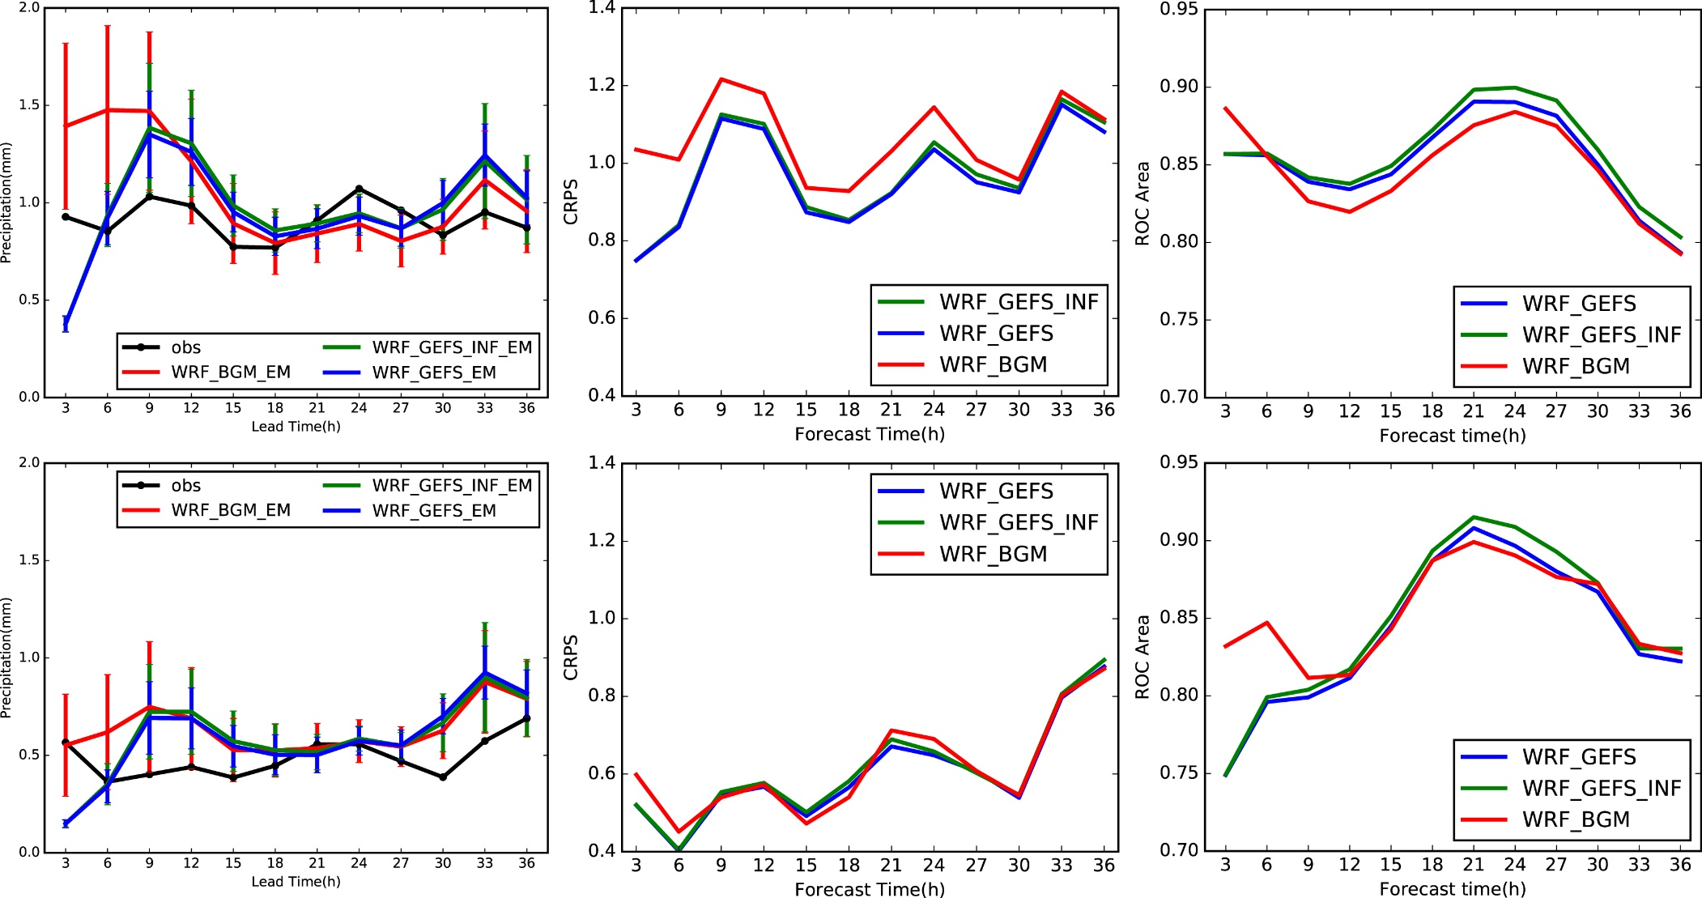
Forecast skill
WRF_GEFS, WRF_GEFS_INF, WRF_BGM, 3h rain
Areal rain
CRPS
ROC area, 0.1mm/3h
LC
SC
Notes:
我们又进一步比较了两套对流尺度集合预报系统的降水预报情况，从它们在两种降水形势下面雨量，crps评分和ROC面积评分的对比图可以发现，两套集合预报系统的面雨量预报，和crps评分差异非常小，只是ROC面积评分有些许差异，ROC面积评分评估的是预报区分不同事件的能力，也就是分辨率，值越大越接近于1，说明集合预报系统的分辨率越高。从对比图可以看出，总体而言，放大侧边界扰动对两种降水类型下的集合降水预报影响很小，但随着预报时效的增加，集合预报分辨率略有提升；

Slide 48
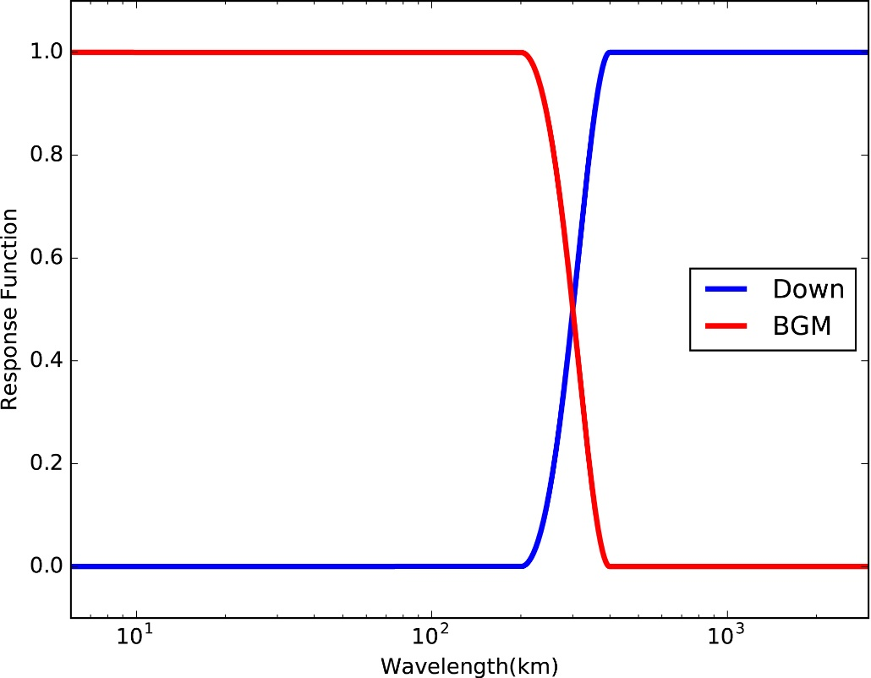
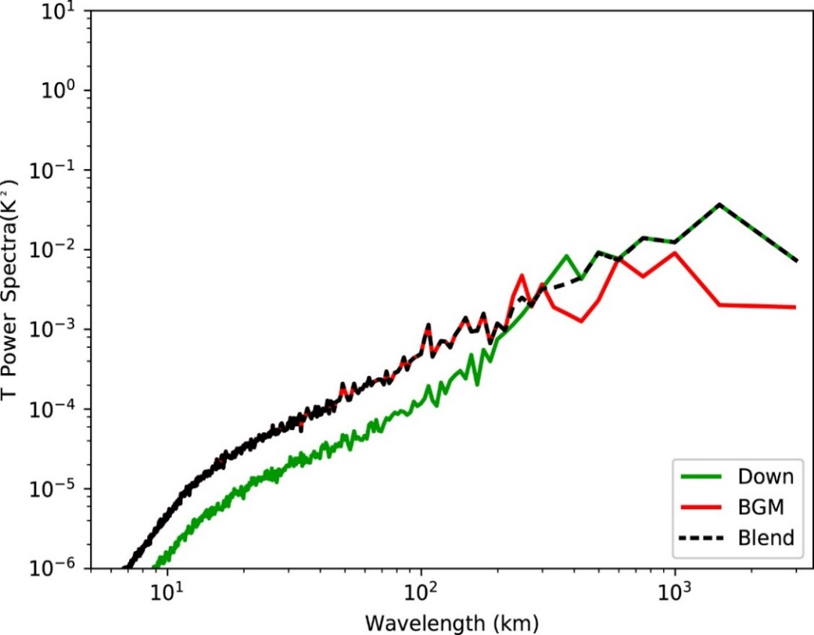


Blending perturbation
Blending
850hPa T
$$1−\cos^{2}\left(\frac{π}{2}∗\frac{ω−400}{200−400}\right)$$
$$\cos^{2}\left(\frac{π}{2}∗\frac{ω−400}{200−400}\right)$$
r≤200km BGM
200<r<400km BGM, Downscaling
r≥400km Downscaling
Blending
Notes:
如图所示，我们给出了本文中的融合方法与融合结果。我们使用如左图所示的滤波函数，对降尺度扰动和小尺度扰动进行融合。此函数，会完全保留降尺度扰动400km以上的信息，完全保留小尺度扰动200km以下的信息，而在200到400km之间，未进行一个平缓的过渡，两种初始扰动都包括。从融合结果上看，多尺度融合初始扰动拥有最好的扰动能量谱分布；下面我们使用两个个例对多尺度融合初始扰动进行研究

Slide 49
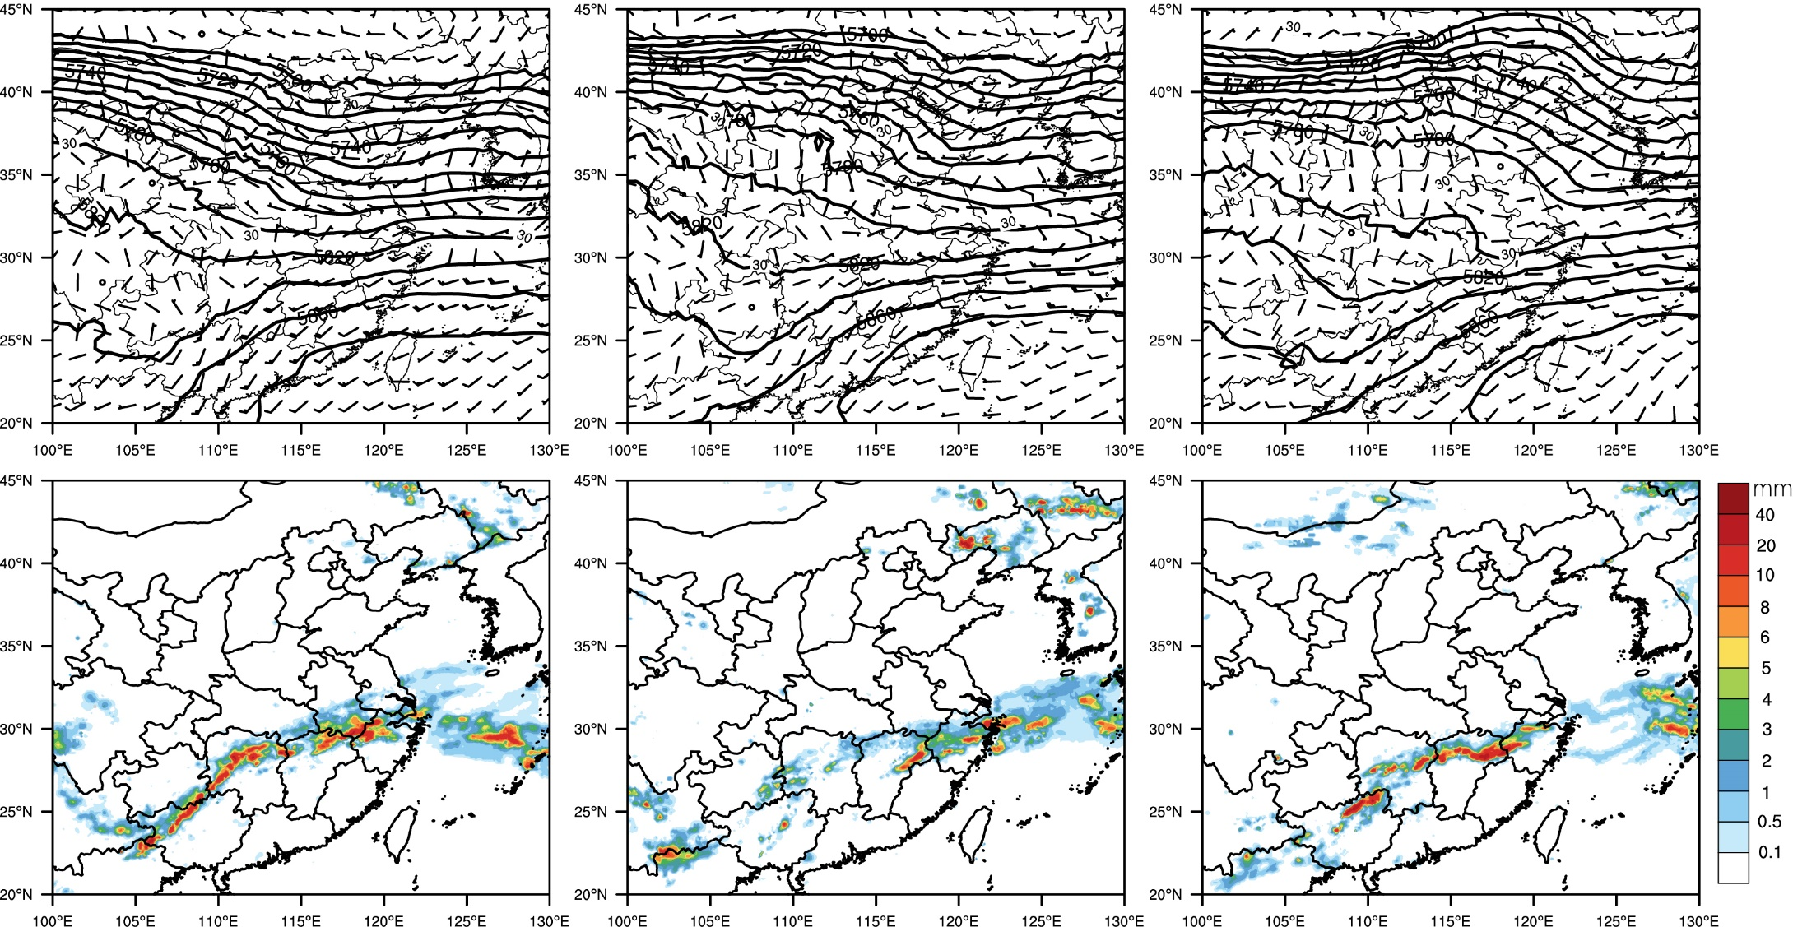
LC case（20130627）
27日00UTC
27日12UTC
28日00UTC
850hPa wind, 500hPa height, CMORPH precipitation
Notes:
首先，我们简单介绍下第一个个例--LC个例。从这个个例的大尺度形势场和降水分布图可以发现，这是一此典型的梅雨锋降水。江淮流域内850hPa上存在风切变，且位于500hpa的槽前和200hpa的高空急流下方，大尺度环境场有利于大面积强降水的发生

Slide 50
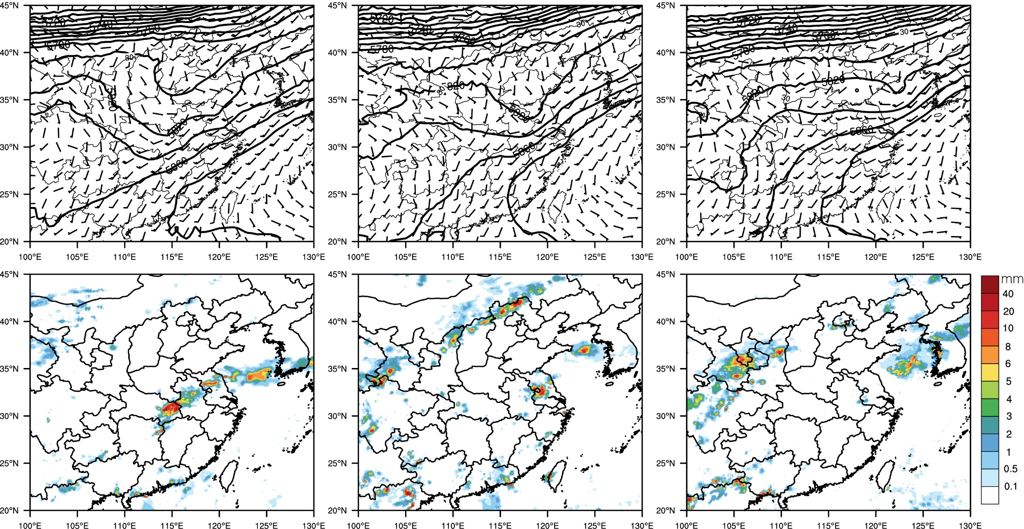
SC case（20130707）
7日00UTC
7日12UTC
8日00UTC
850hPa wind, 500hPa height, CMORPH precipitation
Notes:
接着，我们来看一下第二个个例的概况--SC个例。从形势场上可以看出，江淮流域上，850hpa表现为较强的西南风，无明显的切变线存在，只有一个较弱的气旋存在，此气旋位于500hpa短波槽前，随槽从西南向东北方向移动，而200hpa，江淮流域上空无急流存在。这个个例，大尺度环境场不利于大面积强降水的发生，降水较为局地；此图中我们想要强调一个位置，7日00UTC时，弱气旋在安徽湖北和河南三省交界处，这个位置我们后面会重点介绍。

Slide 51
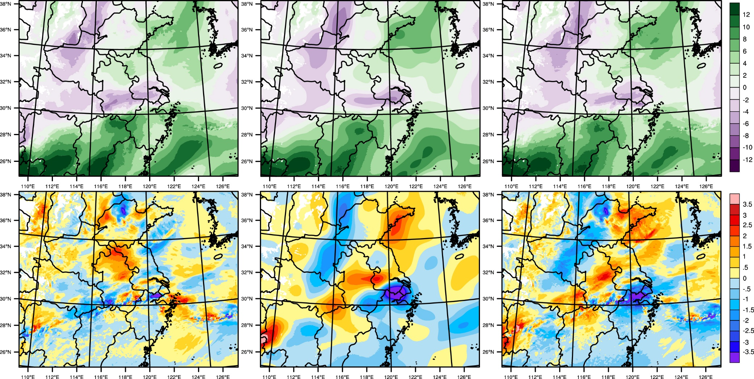
LC case, IC and perturbation（V850hPa）
BGM
Down
Blend
IC
Perturb
Notes:
接着我们以其中一个成员的850hpa经向风为例，对比下三种初始扰动方案的初始场和扰动场。首先我们来看一下LC个例。从初始场可以看出，三种初始扰动方案比较一致，在江淮流域内都可以看到明显经向风辐合；而扰动也主要分布在这条符合线上。从图中可以看出，BGM扰动，小尺度扰动丰富，Down扰动较为平滑，在辐合线上呈现一个正负扰动对，而Blend扰动，在保留了这个正负扰动对的同时，增加了不少小尺度扰动，具有最全面的扰动尺度信息

Slide 52
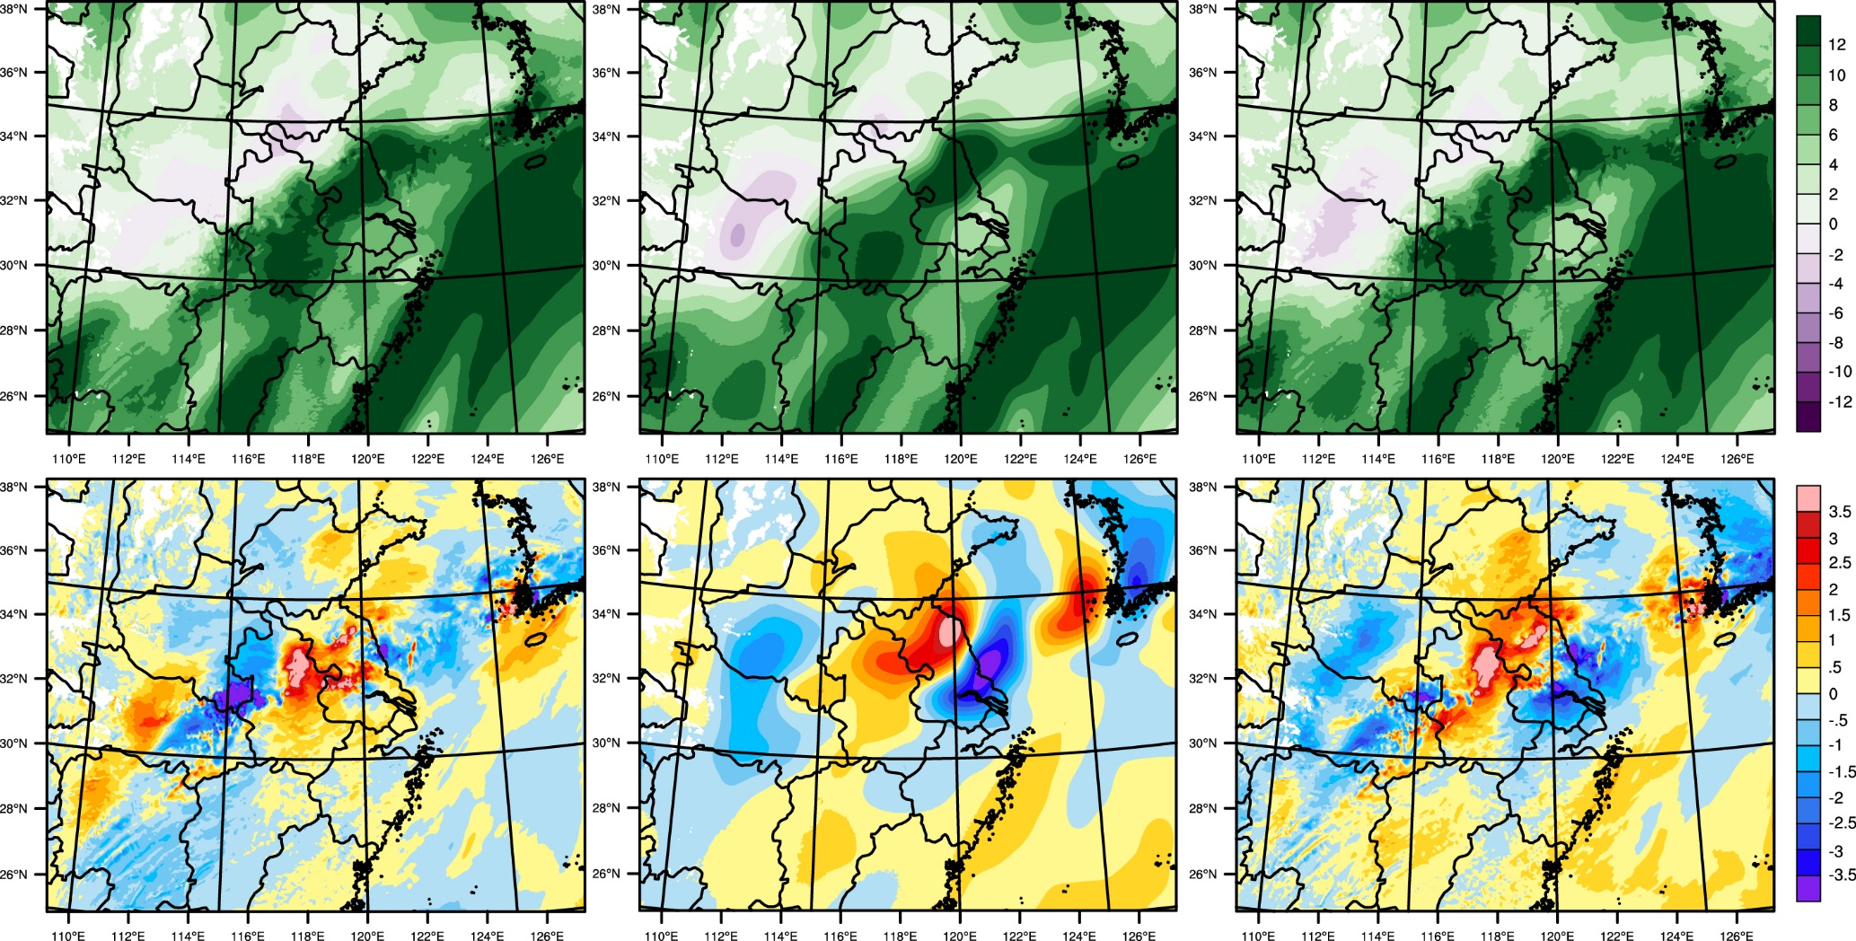
SC case, IC and perturbation（V850hPa）
BGM
Down
Blend
IC
Perturb
Notes:
接着，我们看下SC个例的初始和扰动场。从图中可以看出，江淮流域主要受西南风控制，无明显的辐合线存在。而从扰动场上可以看出，三种初始扰动有明显区别。在之前提到的三省交界处，弱气旋存在的地方，BMG扰动以复扰动为主，Down扰动以正的我ie住，而Blend扰动，则是正负扰动相结合，且这样一个扰动是可以使得气旋强度更大的

Slide 53
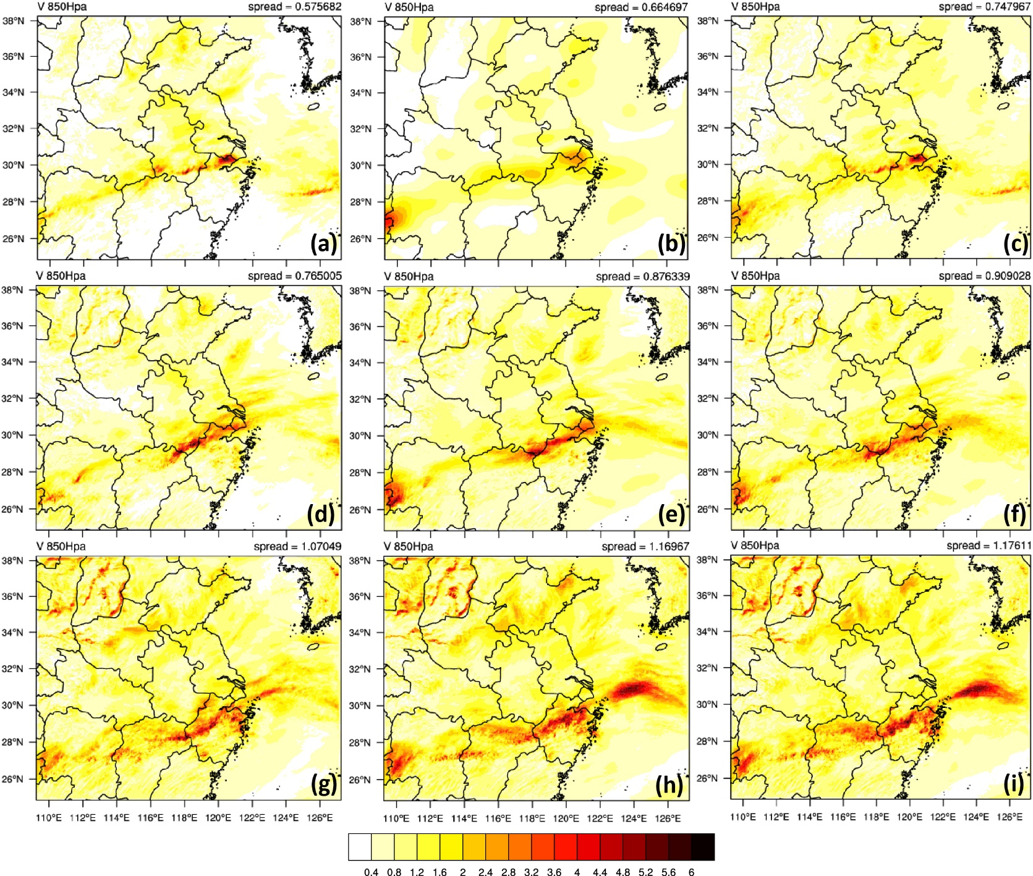
LC case spread（V850hPa）
BGM
Down
Blend
0.58
0.66
0.75
0h
0.77
0.88
0.91
3h
1.07
1.17
1.18
6h
Notes:
初始时刻比较完了，接着我们比较下三种扰动方案的扰动发展情况。图中给出的是LC个例850hpa经向风的离散度发展情况。从图中可以看出，扰动在辐合线附近发展，BGM扰动的发展受到了抑制，一直是三种扰动方案中扰动最小的一个；Down扰动则是扰动发展最快的一个；而Blend扰动是三者中扰动最大的一个，不过它的扰动强度逐渐被Down扰动追赶上，且和Down扰动的扰动分布十分相近

Slide 54
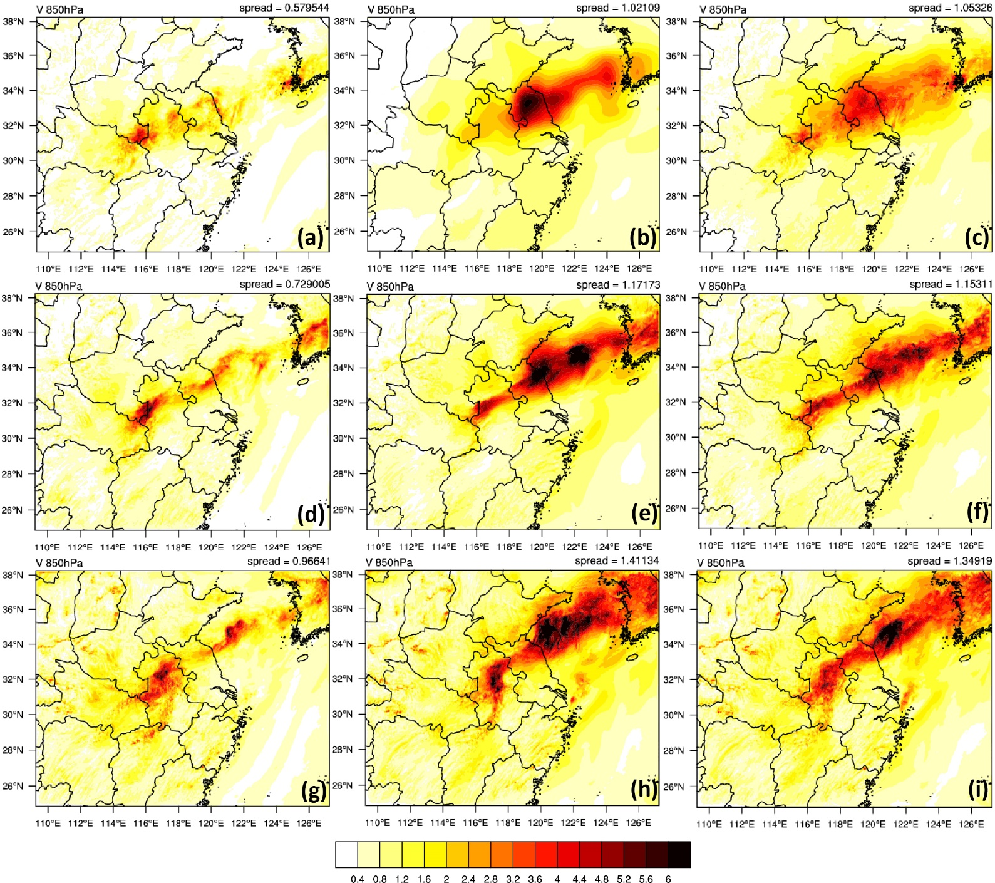
SC spread（V850hPa）
BGM
Down
Blend
0.58
1.02
1.05
0h
0.73
1.17
1.15
3h
0.97
1.41
1.35
6h
Notes:
接着，我们比较下SC个例的扰动增长情况。从图中我们可以看到一些和LC个例相同的扰动增长情况，如BGM始终是三者中扰动最小的一个，Down扰动发展也是最快的一个，Blend扰动也和Down扰动越来越相似；不过我们可以发现一个有趣的地方，就是三省交界处，弱气旋存在的地方。我们可以发现，在初始时刻，BGM和Blend初始涡旋的扰动较大，而Down扰动则较小，在非降水区却较大。随着预报时效的增加，BGM和Blend涡旋扰动迅速增加，这时Down扰动发现自己错了，赶紧增加气旋扰动，并在6h时刻追赶了上来。从以上两个个例的扰动特征可以看出，Blend扰动确实能将BGM扰动和Down扰动的特征相结合，至于结合后，预报效果会不会提升呢，下面我们接着对比下三种方案的集合降水预报技巧

Slide 55
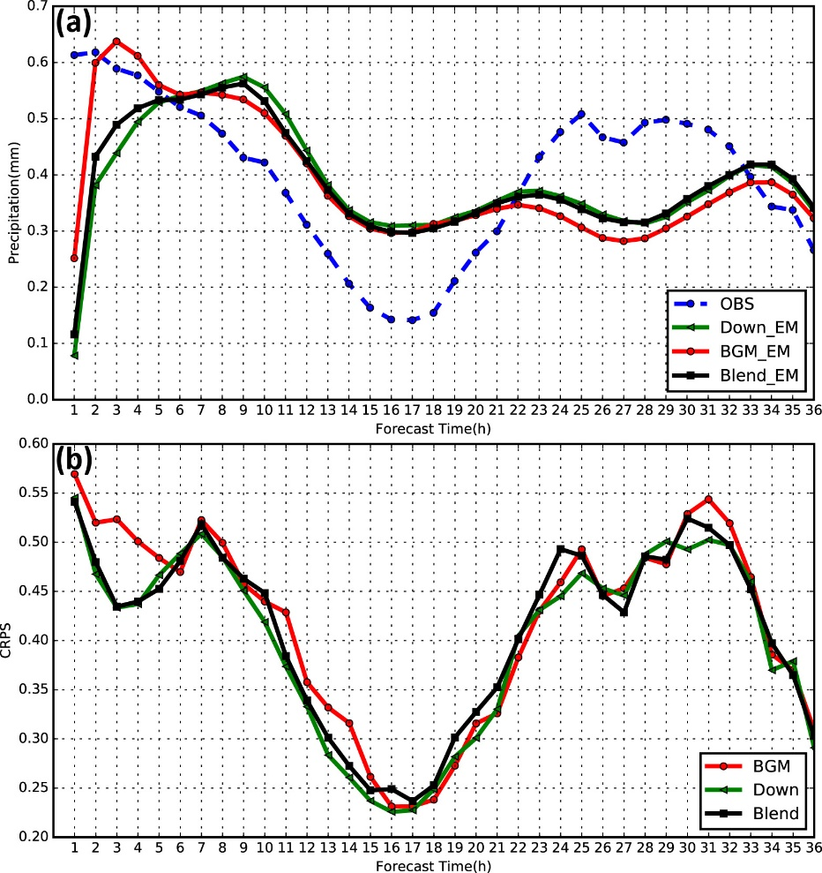

Forecast skill
LC
SC
QPF
CRPS
Notes:
从两个个例的逐小时降水面雨量和CRPS评分可以看出，三套方案最显著的区别在预报前期6h左右的时段内；从CRPS评分可以看到，两个个例中，Blend扰动方案的概率预报准确性都是最高的（黑线都是最小的）；不过两个个例体现出了截然不同的降水预报结果，在LC个例中，Blend扰动方案和Down扰动方案的表现十分相近（黑线和绿线接近），而在SC个例中Blend扰动方案则和BGM扰动方案接近（黑线和红线接近）。从这样的现象，我们可以推断出，在LC形势下，大尺度扰动影响更大，而在SC形势下，小尺度扰动影响更大

Slide 56

Spread-skill（0-6h）
LC SC
Notes:
我们进一步比较了三种扰动方案的集合降水预报技巧，为了增大样本量，我们比较了0-12h内的降水，而非0-6h；从图中的比较可以发现，在LC个例中，Blend的表现和Down几乎完全相同，这说明，在LC形势下，在大尺度扰动上增加小尺度扰动，对降水预报没有影响，融合多尺度初始扰动并不适合于LC形势下的降水预报；而在SC个例中，Blend的表现是最好的，它拥有最好的可靠性，分辨率和空间集合离散度关系，这说明融合多尺度初始扰动更适用于SC形势下的降水预报

Slide 57

SC case
Spread-skill（0-6h）
0.1mm/h 2.5mm/h 5mm/h
Notes:
图中给出了两种降水场在不同降水阈值下的空间集合离散度误差关系对比图，虚线代表二分阈值场，实线代表原始阈值场，红线为LC降水，蓝线为SC降水。从图中可以发现，忽略了降水强度误差，空间集合离散度关系得到改善，但这种改善幅度随着阈值的增大逐渐减小，由于强度和落区这两个因子的影响是此消彼涨的关系，我们可以推断出，对于强降水而言，降水落区误差是影响空间集合离散度误差关系的最重要的因素

Slide 58



Relative skill
$$=\frac{{skill}_{binary}^{Down}−{skill}_{raw}^{Down}}{0−{skill}_{raw}^{Down}}$$
$$=\frac{{skill}_{binary}^{Blend}−{skill}_{binary}^{Down}}{0−{skill}_{binary}^{Down}}$$
Intensity impact Blend vs Down location

Slide 59

ROC（0-6h）
0.1mm/h 2.5mm/h 5mm/h

Slide 60

Probability（5-6h）
0.1mm/h 2.5mm/h 5mm/h
Blend
Down

Slide 61
Summary and discussions (2)
Small-scale (large-scale) initial perturbations are relatively important for SC (LC) cases.
With the inflated boundary condition perturbations, the forecasts of state variables are improved, but only slight improvements for long-term precipitation forecasts.
In general, multi-scale initial perturbations are the optimal scheme for convective-scale EPSs, which may improve the precipitation distribution of SC cases.

Slide 62

Ongoing research
WRF_ENS,(WRF3.9)EPS, 3 km
June 2015 WRF_ENS
cloud analysis

Slide 63

Ongoing research
Multi-model + cloud analysis

