Slide 1
Current development of JMA’s operational Ensemble Prediction Systems
September 20, 2016 Environmental Modeling Center, NCEP
Takuma Yoshida (University of Maryland, Japan Meteorological Agency)

Slide 2
Today’s talk
About Japan Meteorological Agency
JMA’s NWP systems
Updated coupled EPS (JMA/MRI-CPS2)
Ongoing development toward unified atmospheric EPS

Slide 3
Today’s talk
About Japan Meteorological Agency
JMA’s NWP systems
Updated coupled EPS (JMA/MRI-CPS2)
Ongoing development toward unified atmospheric EPS

Slide 4
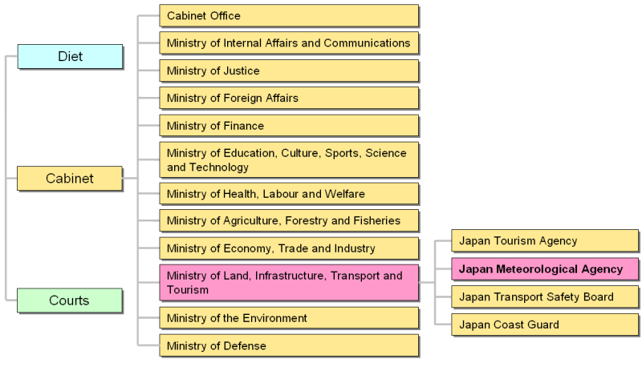
JMA in Government

Slide 5
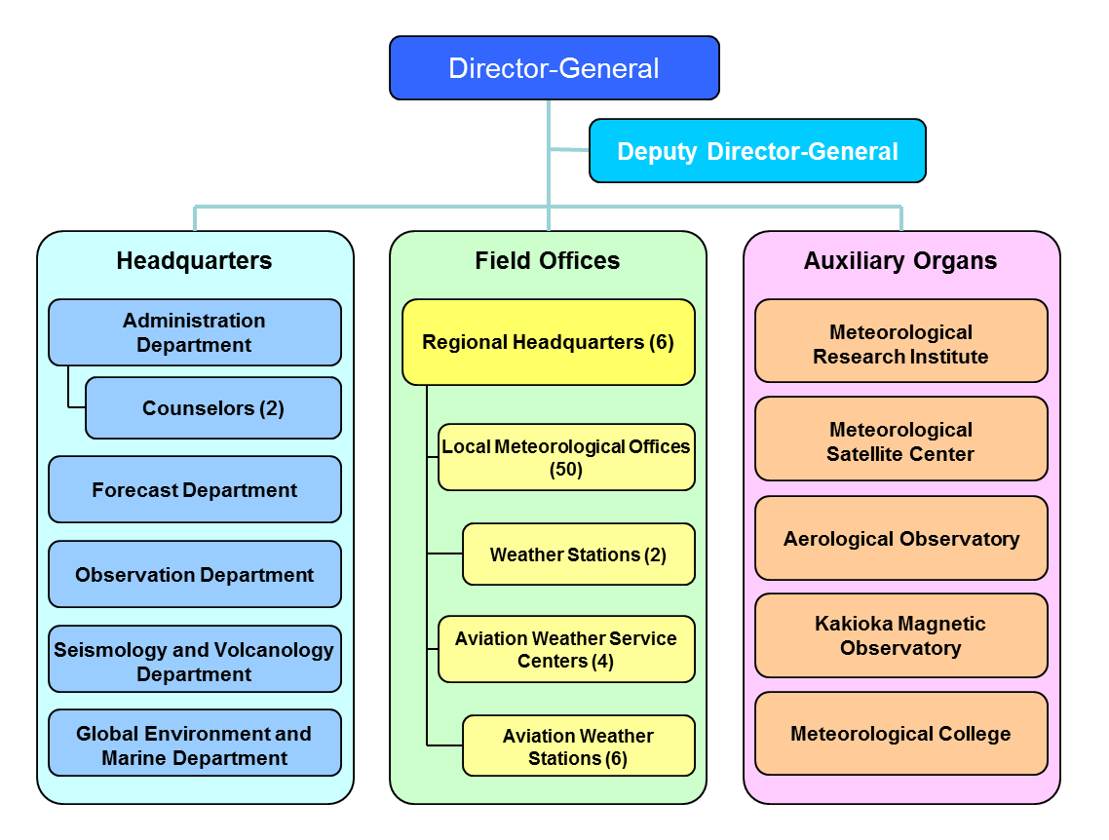
JMA organization structure
M. Sawada
Numerical Prediction Division (M. Nakagawa, Y. Ota, …)
Climate Prediction Division (Y. Sato, me)

Slide 6
JMA’s goals
By meteorological services (including volcanic and seismological),
Improve public welfare
Prevention and mitigation of natural disasters
Safety of transportation
Development and prosperity of industry
Offer international cooperation in meteorological services

Slide 7
Climate Prediction Division (CPD)
Operation Issuing climate information on
climate monitoring (analysis and interpretation)
forecast (2nd week forecast ~ seasonal outlook)
ENSO outlook
Global Warming
Development
One-month EPS
Coupled Prediction System (JMA/MRI-CPS2)
JRA-55 reanalysis
Joint team with NPD to develop unified EPS

Slide 8
Today’s talk
About Japan Meteorological Agency
JMA’s NWP systems
Updated coupled EPS (JMA/MRI-CPS2)
Ongoing development toward unified atmospheric EPS

Slide 9
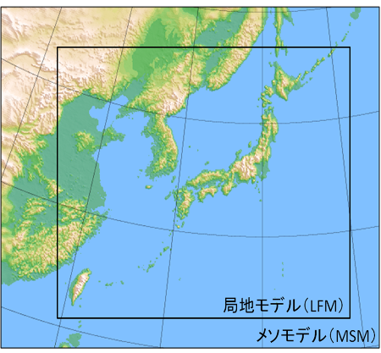
Deterministic models at JMA/NPD
GSM: Global Spectral Model
short- and medium-range forecast
TL959(0.1875deg.) / 100 Layers up to 0.01hPa
84-hours forecast at 00, 06, 18UTC,
264-hours forecast at 12UTC
MSM: MesoScale Model
Disaster reduction, short-range forecast
5km / 50 Layers up to 22km
39-hours forecast at 00,03,06,09,12,15,18,21UTC
LFM: Local Forecast Model
Disaster prevention, Aviation forecast
2km / 60 Layers up to 20km
9-hours forecast every hour

Slide 10
Ensemble Prediction Systems
 | Typhoon EPS | One-week EPS | One-month EPS | JMA/MRI-CPS2
Main targets | Typhoon forecast | One-week forecast | Two-week to one-month forecast | Seasonal outlook Enso outlook
Atmospheric Initial Condition | Global Analysis |  |  | JRA-55
Frequency | 4 times a day (at maximum) | 2 times a day | Sat., Sun. and Tue., Wed. | Once a month
Forecast range | 5.5 days | 11 days | 18 days(Sat., Sun.) 34 days(Tue., Wed.) | 7 months
Ensemble size | 25 | 27 | 50 (25x2 with LAF) | 51 (13x4 with LAF)
Resolution | TL479L60 (Model top: 0.1hPa) |  | TL319L60 (0.1hPa) | TL159L60 (0.1hPa)
Initial Perturbations | SV (NW Pacific, TC areas) | SV (NH, TR and SH) | BGM (NH and TR) | BGM
Model ensemble | Stochastically Perturbed Physics Tendency (SPPT)
Ocean | Assume constant SST anomaly (MGDSST, ICE) |  |  | Dynamical model coupled (1 x 0.3-0.5 deg, 52L+BBL)

Slide 11
Current DA systems at JMA
Global Analysis (4DVAR): every 6 hours
Model resolution: Outer: TL959 / Inner: TL319, L100
Data cut off time
for Early Analysis: +2h20m
for Cycle Analysis: +11h50m(00,12), 7h50m(06,18)
Assimilation Window: -3h to +3h
Mesoscale Analysis (4DVAR): every 3 hours
Model resolution: Outer: 5km / Inner: 15km, L50
Data cut off time: +50min.
Assimilation Window: -3h to Analysis time
Local Analysis (3DVAR):
every hours
Resolution: 2km, L60
Data cut off time: +30min
Climate Analysis (JRA-55) (4DVAR): every 6 hours
Model resolution:
Outer: TL319 / Inner: T106, L60
Consistent analysis with reanalysis

Slide 12
Today’s talk
About Japan Meteorological Agency
JMA’s NWP systems
Updated coupled EPS (JMA/MRI-CPS2)
Ongoing development toward unified atmospheric EPS

Slide 13
System components of JMA/MRI-CPS2
JMA/MRI-CPS2（Coupled Prediction System 2）
Upgraded in June 2015
Atmospheric Reanalysis
（JRA-55）
Coupled model (JMA/MRI-CGCM2)
JMA Global Spectral Model （TL159L60: 110km）
Kobayashi et al. 2015 JMSJ
Atm. I.C.
Initial Perturbation
Trop.&NH Breeding Method
(BGM method)
JMA 2013
Coupler (SCUP)
Yoshimura and Yukimoto 2008
Chikamoto et al. 2007 GRL
Ocean Model (MRI.COM v3)
1.0°×(0.3°-0.5°) , L52+BBL
Sea Ice Model
CICE type, 5-categories
Ocn. I.C.
Ocean Data
Assimilation （MOVE/MRI.COM-G2）
Tsujino et al. 2010
Toyoda et al. 2013
Theor. Appl. Mech. Jpn.

Slide 14
History of Coupled Models at JMA
1999- for ENSO forecast
2010- for ENSO/Seasonal forecast
1999
JMA-CGCM01
Atmosphere: T42 (~250 km) L21 (~10hPa)
Ocean: 2.5x2-0.5(10N-10S) L20
2003
JMA-CGCM02
Atmosphere: T63 (~180 km, 1.875 deg.) L40 (~0.4hPa)
Ocean: 2.5x2-0.5(10N-10S) L20 (top: ~10 m)
2008
JMA/MRI-CGCM
Atmosphere: T_{L}95 (~180 km, 1.875 deg.) L40 (~0.4hPa)
Ocean: 1x1-0.3 (30N-30S) L51 (top: ~1m)
2015
JMA/MRI-CGCM2 Atmosphere: T_{L}159 (~110 km, 1.125 deg.) L60 (~0.1hPa) Ocean: 1x0.5-0.3 L52+BBL

Slide 15
Configuration of JMA’s seasonal EPS
 | JMA/MRI-CPS1 ( Previous ) | JMA/MRI-CPS2 ( since June 2015 )
Atmosphere (JMA-AGCM) | TL95L40, ~180km, Up to 0.4hPa | TL159L60 , ~110km, up to 0.1hPa Stochastic tendency perturbation GHG forcing from RCP4.5 scenario
Ocean (MRI.COM) (Tsujino et al 2010) | 1.0゜ (lon) x 0.3-1゜ (lat) L50 75゜S-75゜N Ocean Sea-ice climatology | 1.0゜ (lon) x 0.3-0.5゜ (lat) L52+BBL Global ocean with tri-polar grid Sea-ice model
Coupler (Scup) (Yoshimura and Yukimoto 2008) | 1-hour coupling interval Momentum and heat flux adjustments | 1-hour coupling interval No flux adjustment
Initial Condition | Atmosphere: JRA-25 Land: Climatology with ERA-15 forcing Ocean: MOVE/MRI.COM-G T, S&SSH (Usui et al. 2006) Sea-ice climatology | Atmosphere: JRA-55 Land: JRA-55 land analysis Ocean: MOVE/MRI.COM-G2 T, S & SSH Sea-ice model
Ensemble Size | 51 (9 BGMs, 6 days with 5-day LAF) 10 for reforecast (5 BGMs, 2 days with LAF) | 51 (13 BGMs, 4 days with 5-day LAF) 10 for reforecast (5 BGMs, 2 days with LAF)

Slide 16
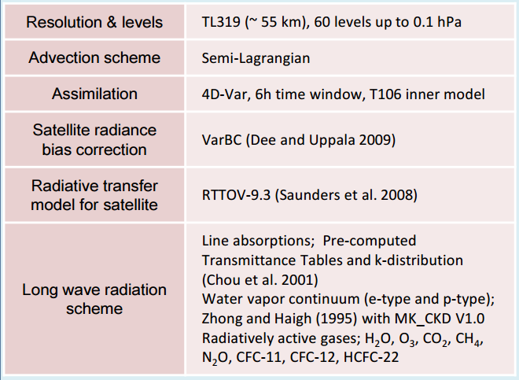
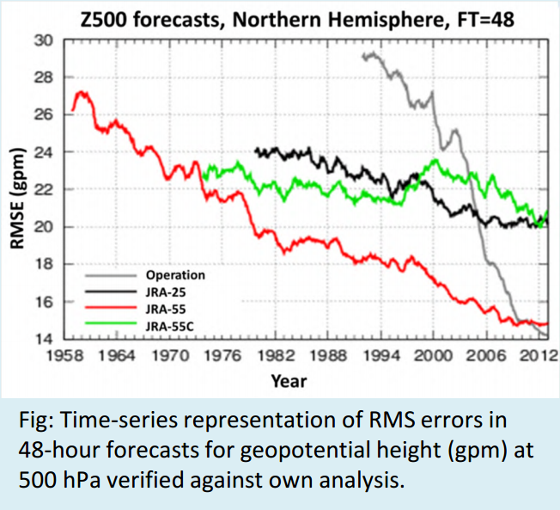
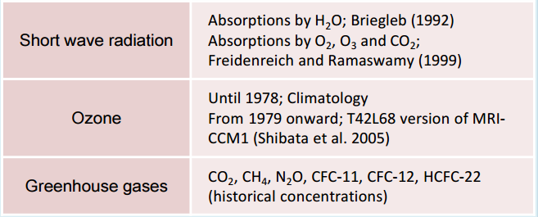
JRA-55 reanalysis
JRA-55 Kobayashi et al. (2015)

Slide 17
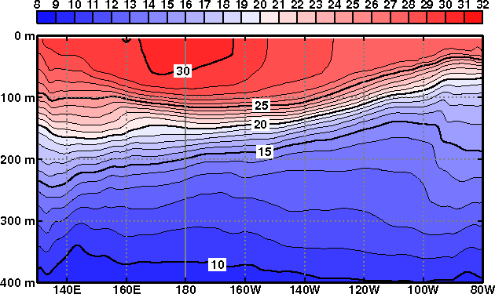
Ocean data assimilation for ENSO monitoring and coupled forecast
MOVE/MRI.COM-G2 Toyoda et al. (2013), Fujii and Kamachi (2003)
Ocean General Circulation Model
(MRI.COM v3) Prediction
Past
Future
First guess
IAU (Incremental Analysis Update)
Climatology
Observations
Temperature
Salinity
Altimetry
Objective Analysis
(3-D Variational Method)

Slide 18
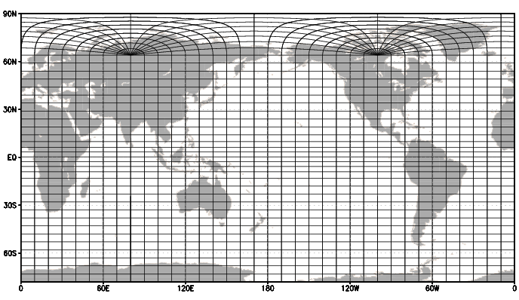
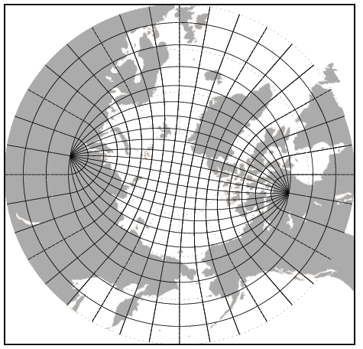
Global ocean with tri-polar grid
Horizontal resolution
Longitude direction: 1°(approximately 100km)
Latitude direction: 0.3-0.5°(approximately 30-50km)
with finer resolution near the equator
Vertical level: 52 and BBL(bottom boundary layer)
Global ocean with tri-polar grid

Slide 19
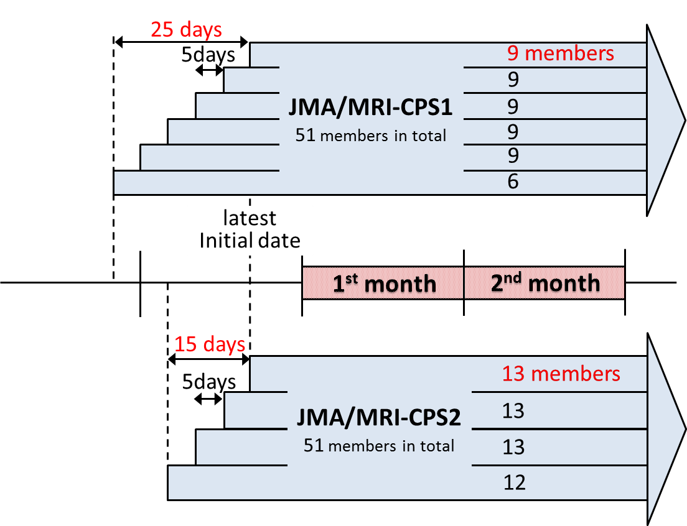
Operational ensemble method
Previous system
(JMA/MRI-CPS1)
New operational system
(JMA/MRI-CPS2)
The number of ensembles per initial date has been increased from 9 to 13.
Production of combined 51-member ensemble predictions starting from later initial dates compared to the previous system
➔ The forecast lead time is shortened.

Slide 20
Newly introduced sources of predictability
Dynamical sea ice simulation
Land initialization with JRA-55
Fully covered stratosphere (Top: 0.1 hPa)
Global ocean domain
Realistic concentration of GHGs (6 gases prescribed with RCP4.5 scenario)
The new system is capable of
incorporating a full range of
potential sources of the
predictability.
Atmo-sphere
Strato-sphere
Sea Ice
Ocean
Land

Slide 21
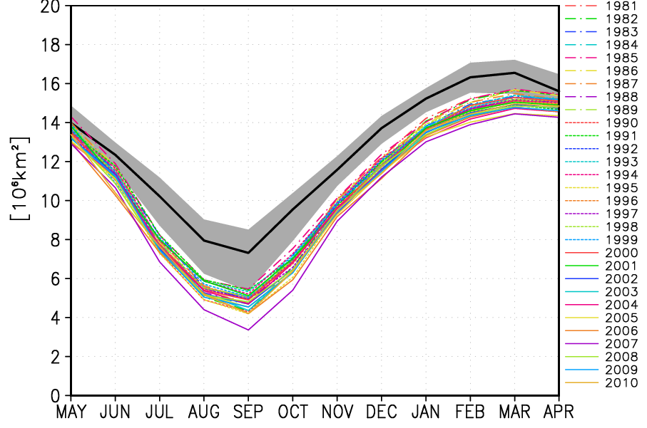
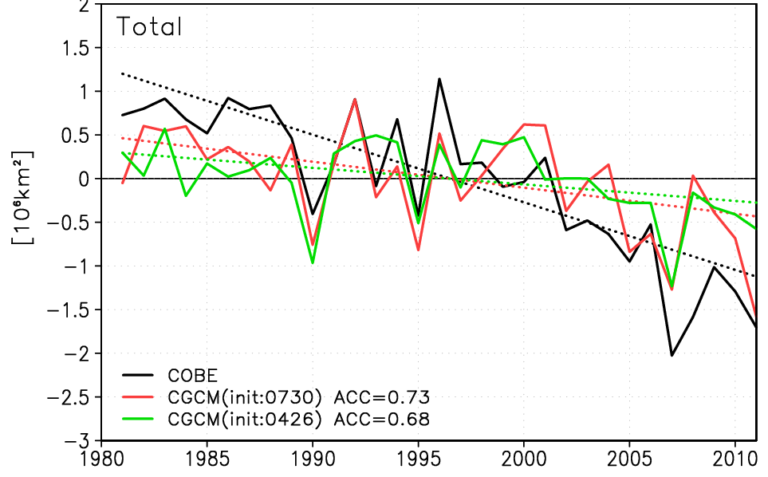
Sea-ice model
Interactive sea-ice model
Thermodynamic model (sea-ice production / melting)
Dynamic model (momentum equation)
Arctic sea-ice extent from May
Arctic sea-ice extent in September
Observation (COBE-ICE)
Lead time of 2 months ACC=0.73
Lead time of 5 months ACC=0.68
Color: Individual forecast
Black and Grey: Observed climatology (COBE-ICE) (Grey) minimum and maximum
Sea-ice simulation represents:
Seasonal variation of Arctic sea ice.
Interannual variability and reduction trend of Arctic sea-ice extent.

Slide 22
2-m temperature over Arctic
Anomaly Correlation of 2-m Temperature over the Arctic region (60N-90N)
Lead time: 1 month
Target: 3-month mean
Prediction skill of 2-m temperature over the Arctic area is improved in almost all initial month.
It is suggested that sea-ice model contributes to improvement of 2-m temperature.

Slide 23
Impact of land initialization
JMA/MRI-CPS1 Climatology with ERA-15 forcing
JMA/MRI-CPS2 JRA-55 land analysis : Land A
Additional experiment: Climatology (1981-2010) of JRA-55 land analysis (Land C)
Anomaly Correlation of 2-m Temperature over land (Lead Time: 0 month)
Global
Northern Hemisphere
Eurasia
90S-90N,0E-360E
20N-90N,0E-360E
20N-90N,0E-180E
Anomaly Correlation
Initial Month
Initial Month
Initial Month

Slide 24
Improvement of GHG forcing
JMA/MRI-CPS1 CO₂ trend
JMA/MRI-CPS2 6 GHGs in RCP 4.5 scenario
2-m temperature Trend over Land (JJA) (Initial: May)
VarCO₂
- JMA/MRI-CPS1
- CO₂ Trend
VarGHG
- JMA/MRI-CPS2
- CO₂, CH₄, N₂O, CHC-11, CHF-12, HCFC-22 (GHGs) Trend
(RCP 4.5 scenario)
ConstGHG
(Additional experiment)
- JMA/MRI-CPS2
- Constant GHGs
VarCO₂
ConstGHG
VarGHG
JRA-55
Linear trend: JMA/MRI-CPS1 < ConstGHG < VarGHG < JRA-55 (anl)

Slide 25
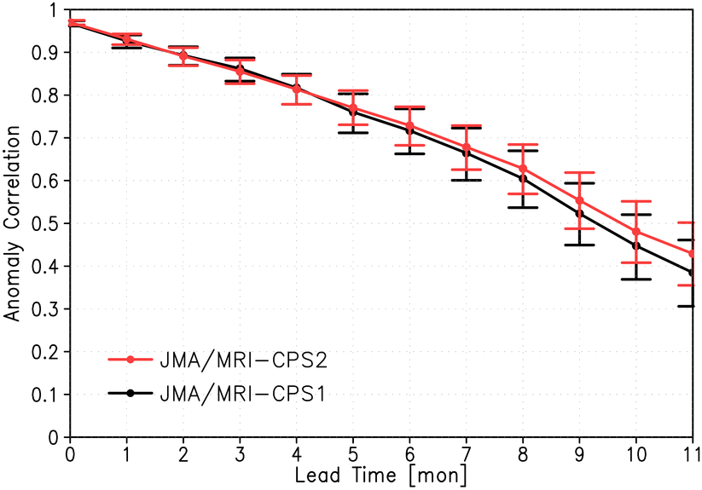
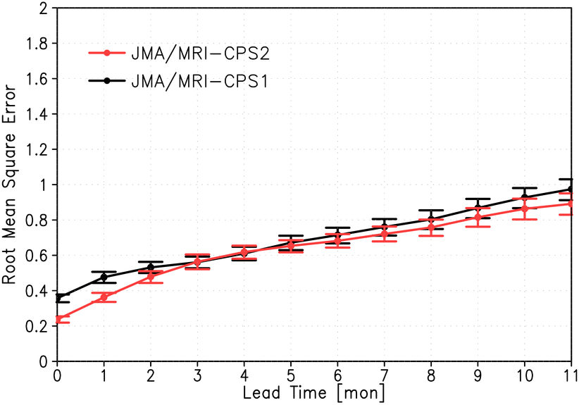
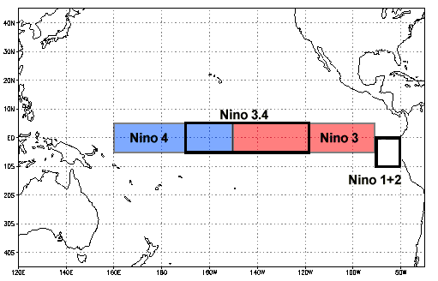
NINO.3 SST prediction skill
Anomaly Correlation
RMSE
Improvement of ACC in longer lead time
Improvement of ACC over the spring barrier (not shown)
NINO.3 : 150W-90W, 5S-5N
(figure from NOAA website)

Slide 26
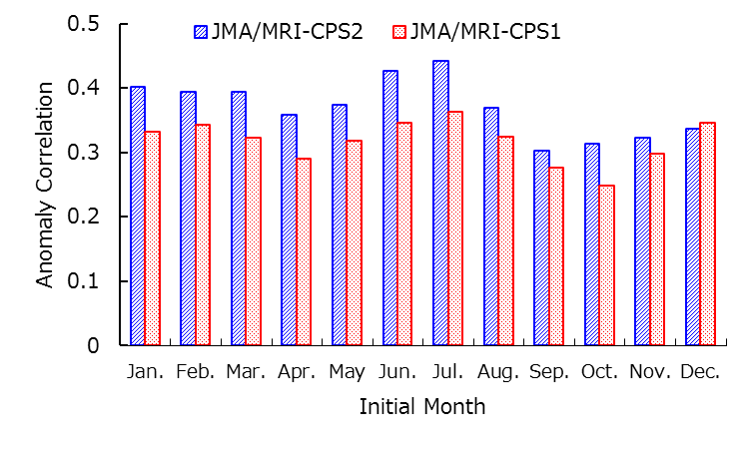
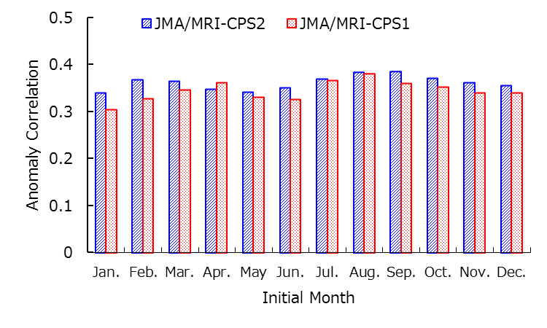
Improved ACC for 3-month forecast
NH: 20N-90N,0E-360E
TRP: 20S-20N,0E-360E
2-m Temperature averaged in NH
Precipitation averaged in TRP
For 3-month forecast, anomaly correlation coefficient of 2m temperature (NH) and precipitation (TRP) is greater than the previous system in almost all initial months.

Slide 27
Improved Madden-Julian Oscillation
Initial: Nov-Apr
Ensemble Member: 10
Period: 30 years (1981-2010)
Analysis:
Index: RMM1, RMM2
Correlation
JMA/MRI CGCM2
JMA/MRI CGCM
JMA 1-month EPS (AGCM)
[day]
larger amplitude
Amplitude Error
smaller amplitude
The verification of Wheeler-Hendon indices indicates that:
the forecast time of 0.5 correlation extends roughly 2 days with model update.
too small MJO amplitude is improved.

Slide 28
Today’s talk
About Japan Meteorological Agency
JMA’s NWP systems
Updated coupled EPS (JMA/MRI-CPS2)
Ongoing development toward unified atmospheric EPS

Slide 29
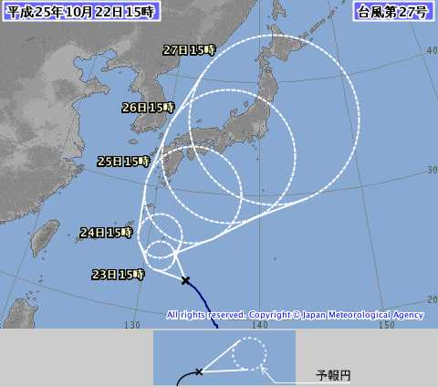
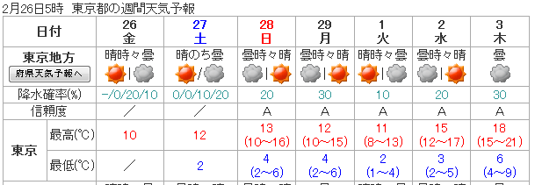
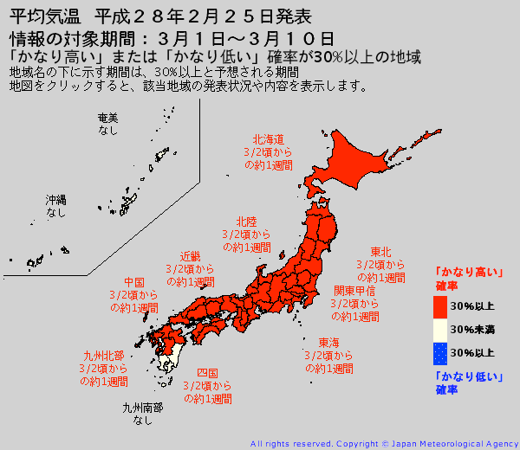
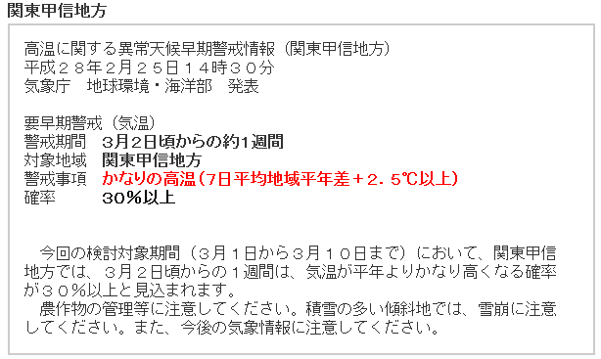
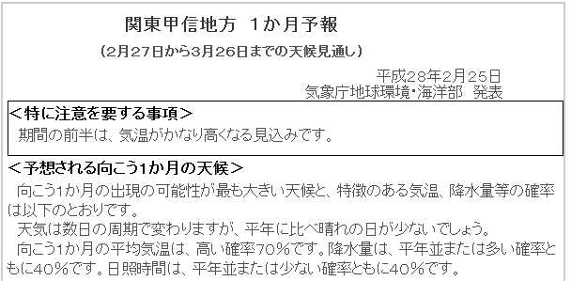
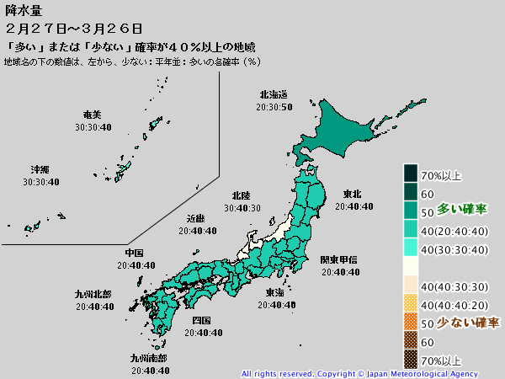
Unifying atmospheric EPSs
Current
Planned
Typhoon forecast
Typhoon
EPS
Mid-range forecast
One-week EPS
Global
EPS
2nd week forecast
One-month EPS
One-month forecast
Common NWP, Consistent forecast

Slide 30
Operational global EPSs in JMA
 | Typhoon EPS | One-week EPS | One-month EPS
Main targets | Typhoon forecast | One-week forecast | Two-week to one-month forecast
Frequency | 4 times a day (at maximum) | 2 times a day | Sat., Sun. and Tue., Wed.
Forecast range | 5.5 days | 11 days | 18 days(Sat., Sun.) 34 days(Tue., Wed.)
Ensemble size | 25 | 27 | 50 (25x2 with LAF)
Model and Resolution | GSM1304* TL479L60 (Model top: 0.1hPa) |  | GSM1304* TL319L60 (0.1hPa)
Initial Perturbations | SV (NW Pacific, TC areas) | SV (NH, TR and SH) | BGM (NH and TR)
Model ensemble | Stochastically Perturbed Physics Tendency (SPPT)
Boundary Perturbations | None
Different configurations for each EPS depending on the main target
Significant costs on developments and maintenance of multiple EPSs → Plans to unify three existing EPSs to one global EPS
* Some minor features differ

Slide 31
Plan of new global EPS
 | Global EPS
Main targets | Typhoon forecast, One-week to One-month forecast
Frequency | 4 times a day when TC exists, 2 times a day otherwise
Forecast range | 5.5 days (06,18UTC), 18 days (00,12UTC) 34 days (00,12UTC on Tue. and Wed.)
Ensemble size | 27 up to 11 days, 13 afterwards
Model and Resolution | GSM1603 + extra features TL479L100 (Model top: 0.01hPa) up to 18 days, TL319L100 afterwards
Initial Perturbations | SV (NH, TR and SH) + LETKF
Model ensemble | Stochastically Perturbed Physics Tendency (SPPT) Modified amplitude
Boundary Perturbations | Perturbations on SST
New Global EPS will cover from Typhoon forecast to One-month prediction
Plans to implement with the latest version of the GSM with extra features
Target on 2017 spring implementation

Slide 32
New perturbation strategy
LETKF as initial perturbation
Better representation of analysis error compared to (initial + evolved) SV
However, spread will be insufficient
Must consider uncertainties else than analysis error
Model error：larger Stochastic Physics
Boundary condition：SST perturbation
Plus, combine initial SV with LETKF

Slide 33
LETKF + Initial SVs
EMC seminar May 20, 2016
Yoichiro Ota
Initial perturbations from LETKF are supposed to approximate analysis error covariance. → Use LETKF perturbations instead of evolved SVs
Use initial SVs as a temporal solution to mitigate the underdispersiveness on medium-range forecast.
Based on above ideas, LETKF and initial SVs are combined for global EPS experiment.
Decide initial amplitudes
Amplitude of initial SVs is set almost equal to that of the operational one-week EPS.
Minimal adjustments to the amplitude of the LETKF perturbations for adding initial SVs

Slide 34
Representing analysis uncertainty
EMC seminar May 20, 2016
Yoichiro Ota
Analysis uncertainty is represented with sampling like “NMC-method”.
Where ΔSST_{ini} represents analysis uncertainty of the SST.
In conclusion, SST perturbations are derived as following:
α and ΔT are parameters to be determined from the statistics of the past SST analysis and set 1.0 and 1 day respectively.

Slide 35
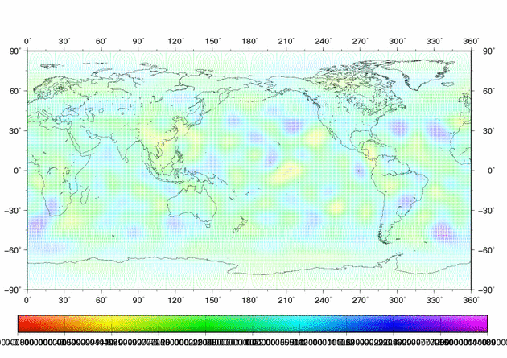
Stochastically Perturbed Physics Tendencies
Non-perturbed Forecast
Perturbed phys. tendency
Ｐ：Tendency from physical processes
Probabilistic term with zero mean
λ：latitude φ：longitude
Represents uncertainty in parameterization
Gaussian distribution with variance 0.16 -> 0.25
6h time correlation, ~700km spatial correlation (wavenumber<=20)
R. BUIZZA,M.MILLER and T.N.PALMER (1999)
L. MARTIN et al. (2009)

Slide 36
Upgrades on GSM
Recent major upgrades to GSM will be applied to EPSs
March 2014
Enhance the number of vertical layers from 60 to 100
raise model top from 0.1hPa to 0.01hPa
improvements on the parametrizations
March 2016
Significant upgrades to the parametrizations
Additional improvements towards next version of GSM
Land and cloud parameterization modified to reduce excessive shortwave radiation in summer
Daily climatology of SST and Sea Ice Concentration

Slide 37
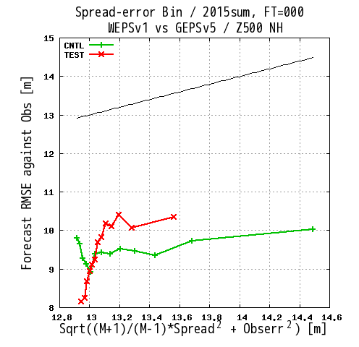
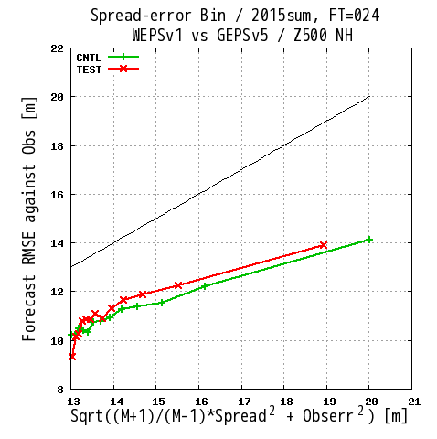
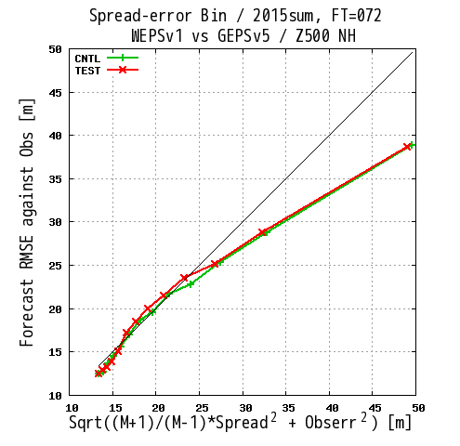
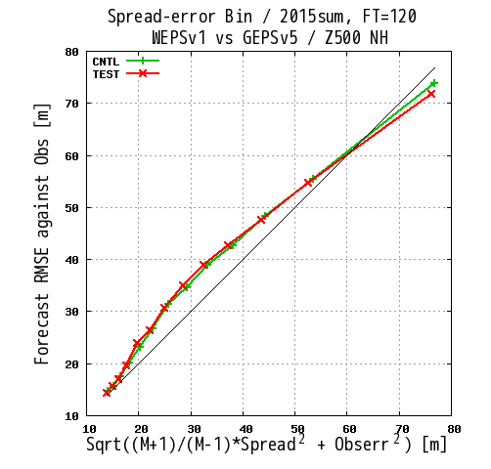
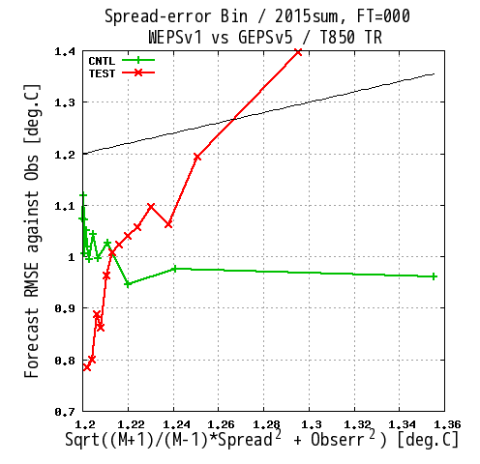
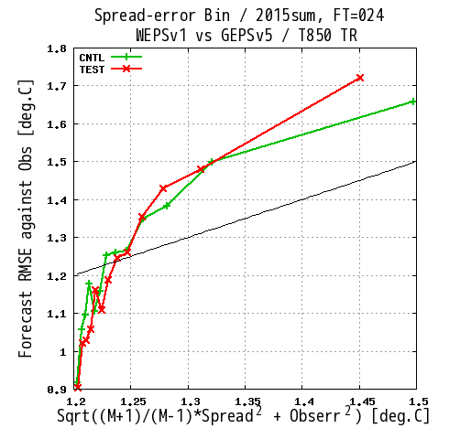
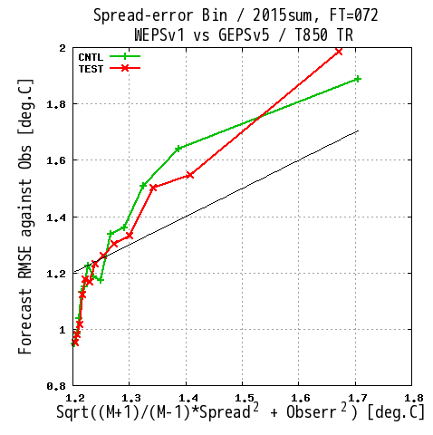
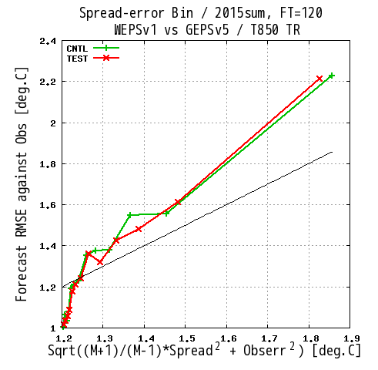
RMSE-Spread relationship
0 h
24 h
72 h
120 h
Z500-NH
T850-Trp
With LETKF perturbation, RMSE-Spread relationship became more obvious in shorter lead time
Boreal summer exp. (6/22-10/11, 2015), 12UTC, verified by radiosonde
CNTL(GSM1603 + old ptb)
TEST(GSM1603 + new ptb)

Slide 38
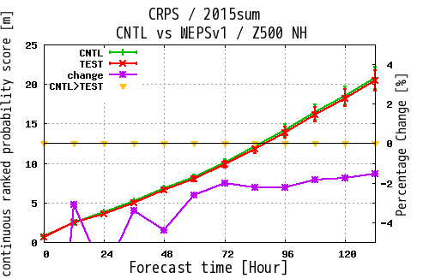
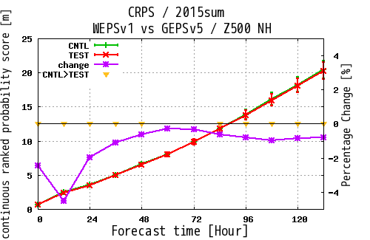
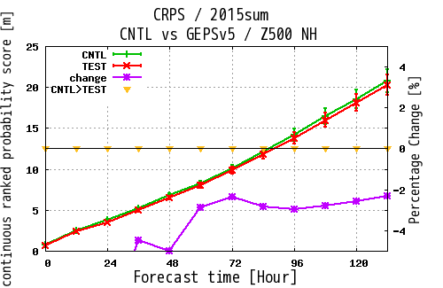
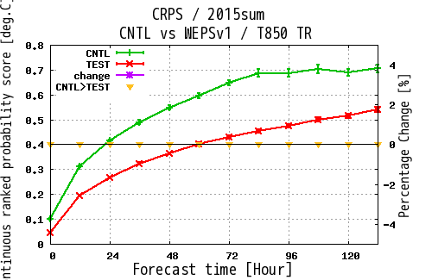
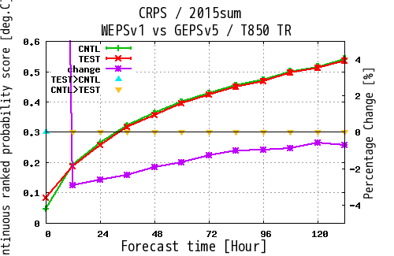
Ensemble mean field CRPS
+
Perturbation update (vs One-week EPS)
=
Model and perturbation
Model update
Z500-NH
T850-Tro
TEST
CTRL
relative improvement (better ↓)
Model update shows improvement in Z500-NH, T850-Tro. (Z500-SH (winter) is depreciated by model update; not shown)
New perturbation shows improvement in almost all lead time and area
Boreal summer exp. (6/22-10/11, 2015), 12UTC, verified by radiosonde

Slide 39
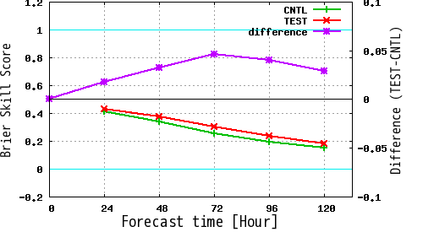
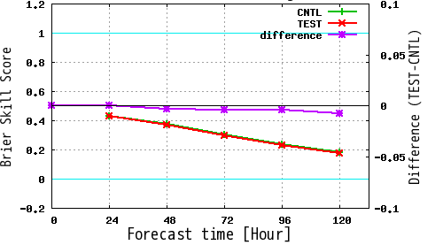
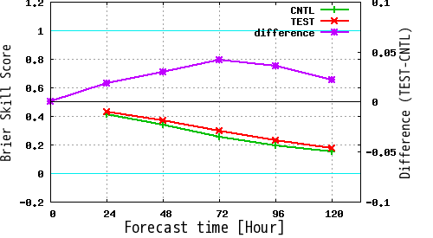
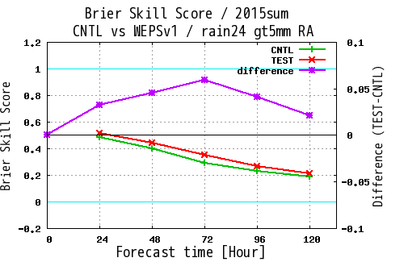
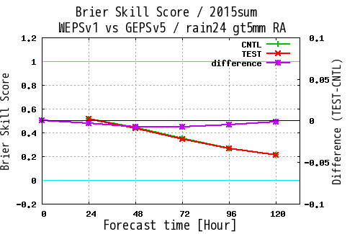
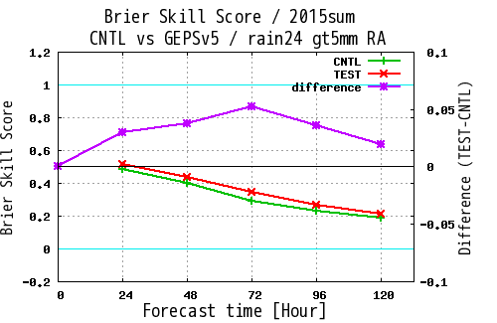
precipitation probability (Brier Skill Score)
+
Perturbation update (vs One-week EPS)
=
Model and perturbation
Model update
1mm/24h
5mm/24h
TEST
CTRL
relative improvement (better ↑)
- Precipitation over Japan. Verified with gauge-corrected radar.
Model update has significant improvement on precipitation forecast
Perturbation update has slight negative effect on precipitation
Boreal summer exp. (6/22-10/11, 2015), 12UTC

Slide 40
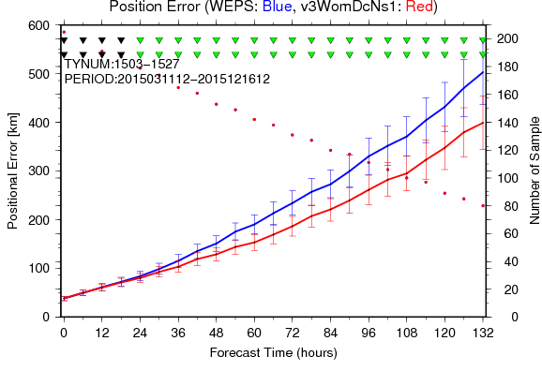
Typhoon position error (w/o ptb)
vs One-week EPS non-ptb
TL479 vs TL959
TEST
CTRL
TL479
TL959
Significant improvement from old model (100km less at 132 h)
Even in a lower resolution, almost as accurate as deterministic (TL959)
Experiments for typhoons in 2015 (TL959 does not include early 2015)

Slide 41
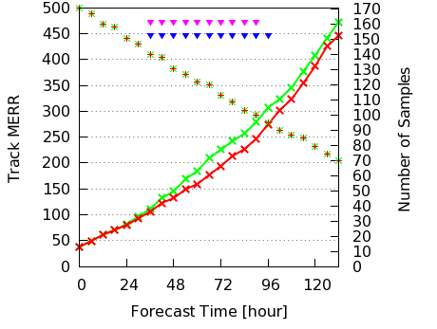
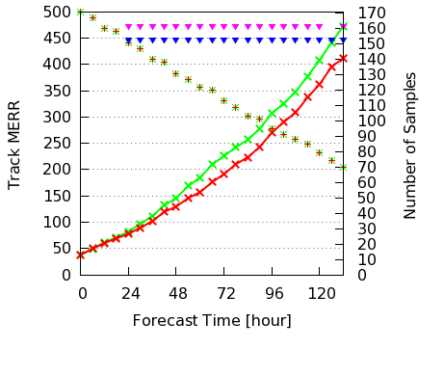
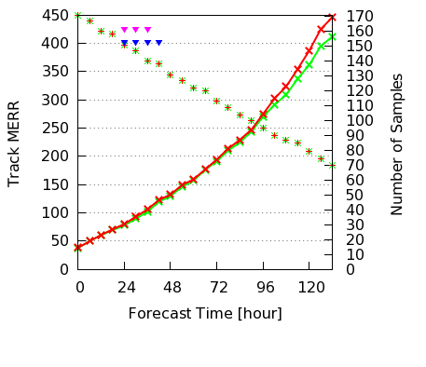
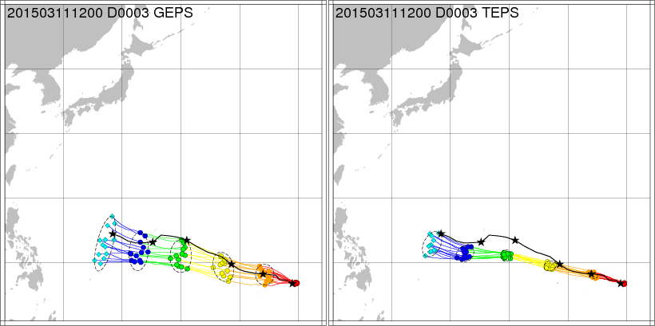
Typhoon track error (ensemble mean)
+
=
Model and perturbation
Model update
(vs typhoon EPS)
Perturbation update (vs typhoon EPS)
TEST
CTRL
New model
Old PTB
New model New PTB
New perturbation is slightly less accurate in mean typhoon track compared to typhoon-specific perturbation
Modify under-dispersive typhoon EPS
Experiments for typhoons in 2015
Forecast from 12Z, 3/11, 2016

Slide 42
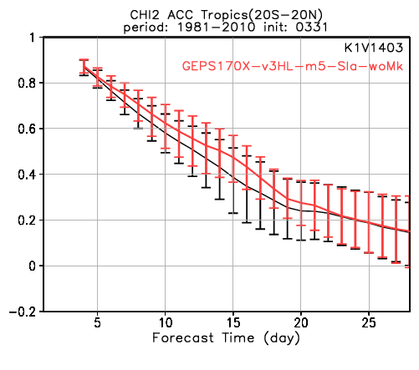
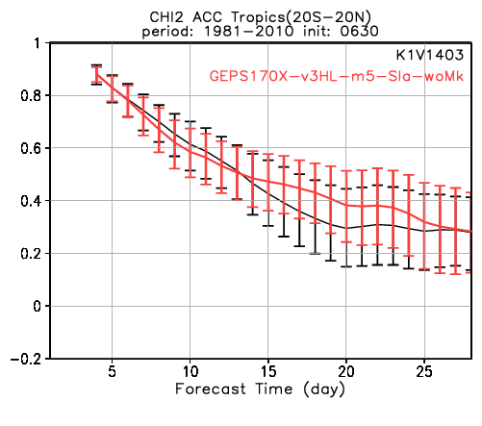
One-month reforecast (1981-2010)
TEST (new model + SV)
CNTL (One-month EPS)
Tropics CHI200, bias-corrected ACC for 7day mean
03/31
06/30
09/30
12/31
Northern Hemisphere Z500, bias-corrected ACC for 7day mean
03/31
06/30
09/30
12/31
Overall improvement except for tropics CHI200 in some initial date
It will be verified with 36 initial date (this is preliminary result with smaller sample)
JRA-55 init, 5-mem, initial + evolved SV. Verified to JRA-55

Slide 43
Thank you!
About Japan Meteorological Agency
JMA’s NWP systems
Updated coupled EPS (JMA/MRI-CPS2)
Ongoing development toward unified atmospheric EPS

