Slide 1
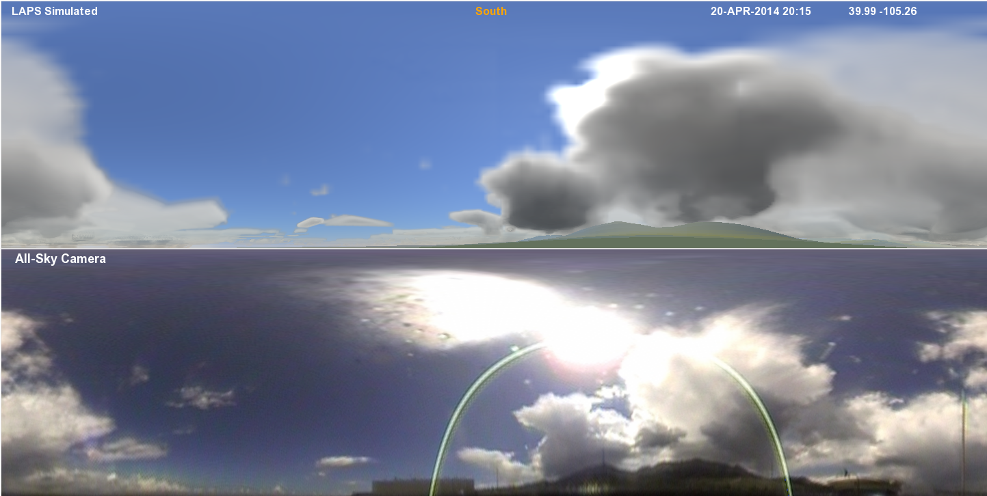
Observations, Ray-Tracing, and Data Assimilation in Aerosol Assessment
Steve Albers, Yuanfu Xie, Zoltan Toth (NOAA/ESRL/GSD & CIRA)
Updated 6/23/2016

Slide 2
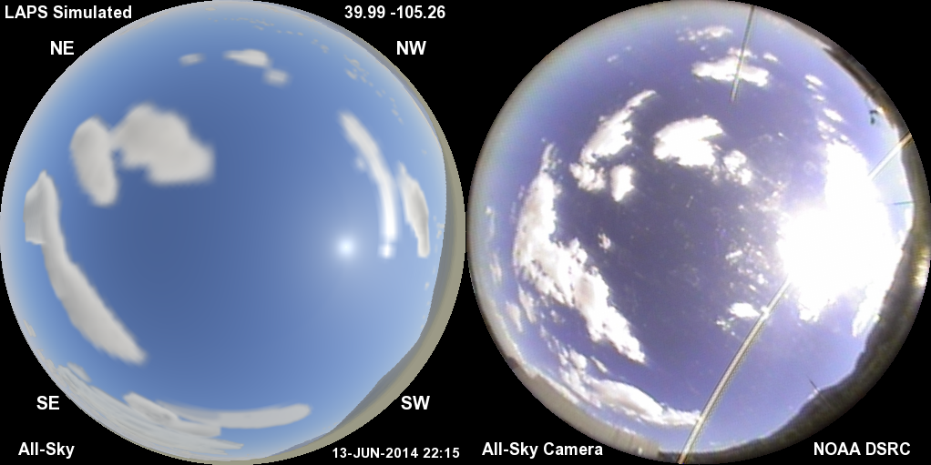
Model Simulated All-Sky Image (left)
Compared with All-Sky Camera (right)
A way to peer into the model analysis (or forecast)

Slide 3
Simulated Weather Imagery Purpose
Helps communicate capabilities of high-resolution real-time model, literally “peering inside”
  Real-time Analyses
  Forecasts
Visually / physically realistic display conveys lots of information
  Clouds, Precipitation, Aerosols, Land Surface
Display output for scientific and lay audiences
  Connect weather phenomena with what can be seen in the sky (bringing science and art together)
Helps guide improvements in cloud, etc. analyses and model initialization
  Sensitive independent validation of both model fields and visualization package
Potential use as an input for model data assimilation
  Variational forward model (e.g. GSI or vLAPS)
3

Slide 4
Sky & Weather Simulation Ingredients
3-D cloud / hydrometeor analyses (or forecasts)
  Cloud liquid / ice, rain, snow, graupel
  LAPS / HRRR systems developed at ESRL/GSD (e.g.)
  Typical grid resolution = 500m – 3km
Land Surface (3-color spectral reflectance - including snow cover)
Aerosol parameters
  Optical depth (~.03-.30)
  Scale height (~750-3000m)
  Size distribution
Locations of sun, moon, planets, stars
Nighttime city lights (via VIIRS), airglow
Specify vantage point – easily movable
  Latitude, longitude, elevation / altitude (surface to lunar distance)
  Viewing window up to full 360º sphere (virtual reality)
4

Slide 5
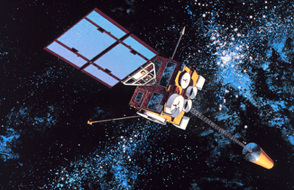

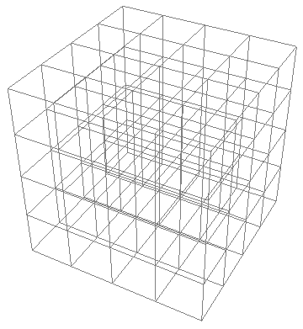
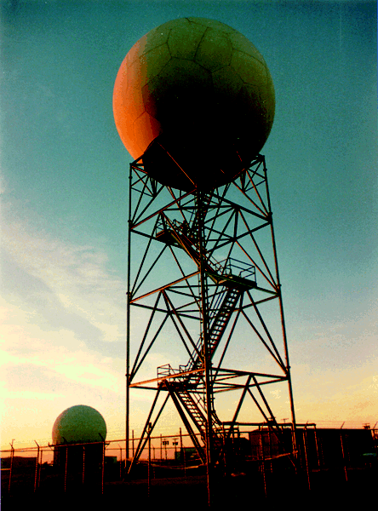
Cloud analysis
(e.g. from LAPS)
11um,VIS,3.9um
First Guess →
METAR
METAR
METAR
(Albers et. al. 1996)
5

Slide 6
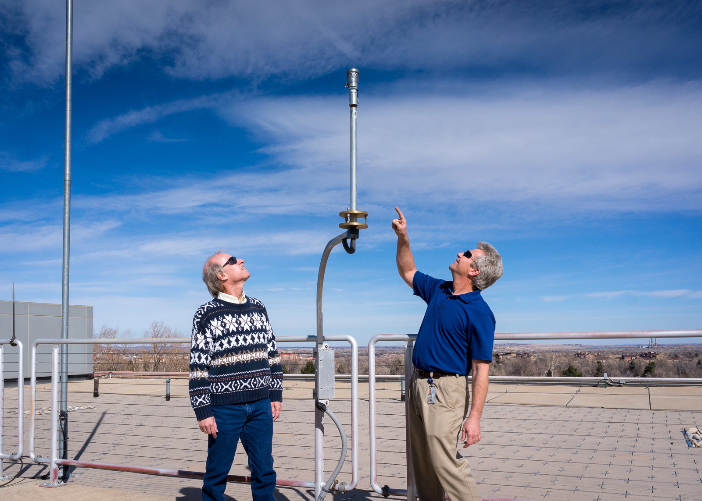
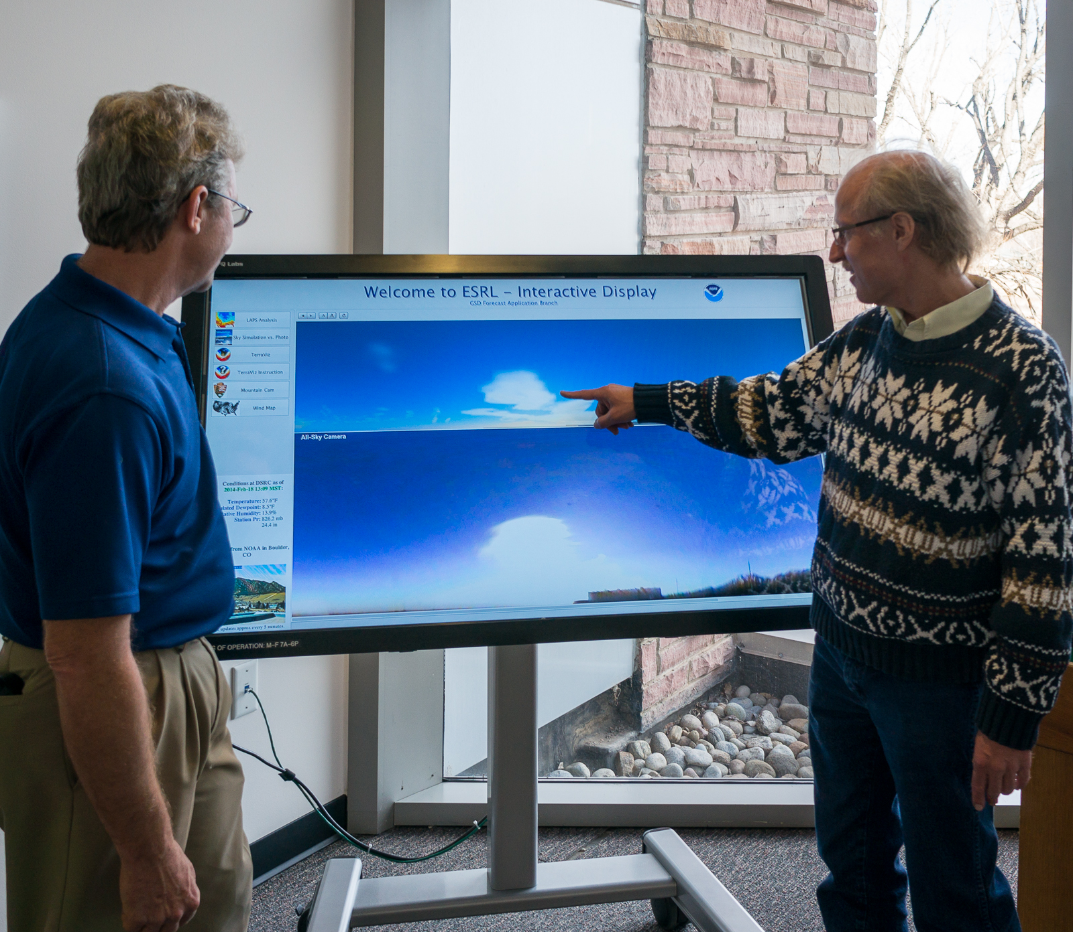
DSRC Rooftop
“Moonglow” Camera
Acknowledgement to Kirk Holub
(GSD) as camera engineer
Other cameras:
Mt. Evans webcam
(Meyer-Womble Observatory
Univ. of Denver)
Longmont Astronomical Society
300m BAO Tower (Erie, CO)

Slide 7

Ray Tracing Techniques
3D Short Wave
θ
θ = scattering angle
7

Slide 8
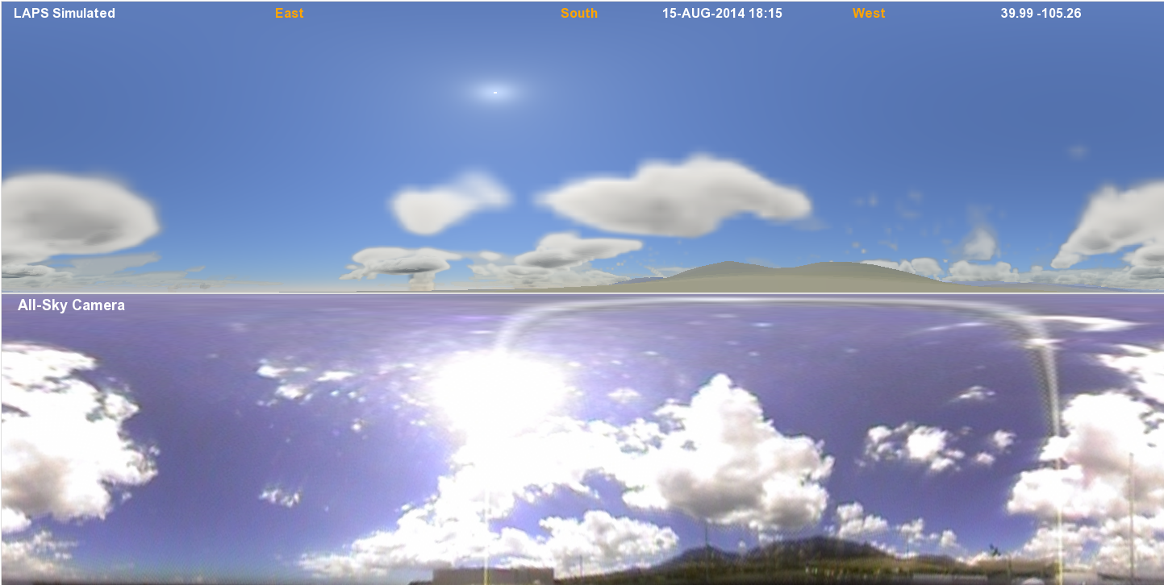
Cylindrical Panorama Comparison
(1/4 degree resolution)
Top: simulated sky via LAPS analysis (independent of camera)
Bottom: observed sky (“Moonglow” camera atop ESRL)

Slide 9
Ray Tracing Techniques
      Determine 3-D short wave radiation field
      Light scattering by hydrometeors, aerosols, gases
  Cloud liquid / ice, rain, snow, graupel
  Determine optical thickness along light ray paths
  Rayleigh and Mie scattering
  Single / Multiple scattering phase functions
  Calculated using 3 colors
  Shadowing effects and terrain
  Light scattering by land / water / snow surface
  Spectral albedo and reflectance (BRDF) used
  Spectral Solar Irradiance fields (GHI, DNI) – Renewable Energy Link
  Terrain slope considered

Slide 10
Initial ray-trace from sun through 3-D grid
Determines 3-D short wave radiation field
  Efficient simplified approach
Uses model 3-D hydrometeor analysis or forecast
Specified in 3 colors to work with sun near the horizon
  luminance (nL) and solar relative units presently used
  can be converted to spectral radiance
Moon can be light source at night

Slide 11
Scattering of Sunlight by Clouds & Precip
(initial gridded ray trace from sun)
Calculate fraction of incident sunlight scattered up & down
  Based on optical depth and backscatter fraction
Backscatter fraction (for a single scattering event)
  Ratio of backscattering coefficient to extinction coefficient
  .063 for liquid, .14 for cloud ice or snow, 0.3 for graupel
  Low values explain why clouds can look opaque yet still darker gray even when lit in full sunlight from behind the observer
  Remainder of light continues downward (through cloud) via forward scattering

Slide 12
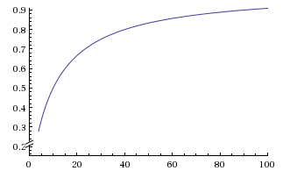
Cloud / Precip Multiple Scattering
(initial gridded ray trace from sun)
a
b ~ 0.1
τ
Determine cloud albedo (a) using optical depth (τ) and backscatter fraction (b)
  a = bτ / (1 + bτ)
  Asymptotically approaches 1 for high τ
  Reproduces figure in Mishchenko et. al. (1996) within a few % (for non-absorbing clouds)
  Works with cloud liquid and cloud ice (random fractal crystals)
  Reduces to expected relationship a = bτ for small values of τ
Light not reflected (back-scattered) is assumed to be transmitted (directly and via forward scattering), thus transmittance = (1. – a)
Absorption by clouds is small and is presently neglected

Slide 13
2nd Ray-Tracing Step (from observer)
Trace from viewer into sky using ¼º x ¼º cylindrical grid
Ray path travels through clear air, aerosols, clouds, and may hit terrain
First estimate is clear sky value (modified as follows)
  Scattered by clouds (can show up either bright or dark)depends on optical depth of cloud and elongation from sun (scattering angle), as well as pre-computed cloud illumination (3-D shortwave radiation field)
  Phase function varies with single/multiple scattering
Cloud/Aerosol scattering can obscure distant terrain

Slide 14
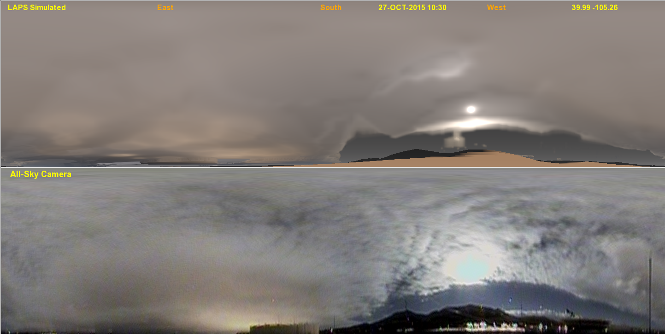
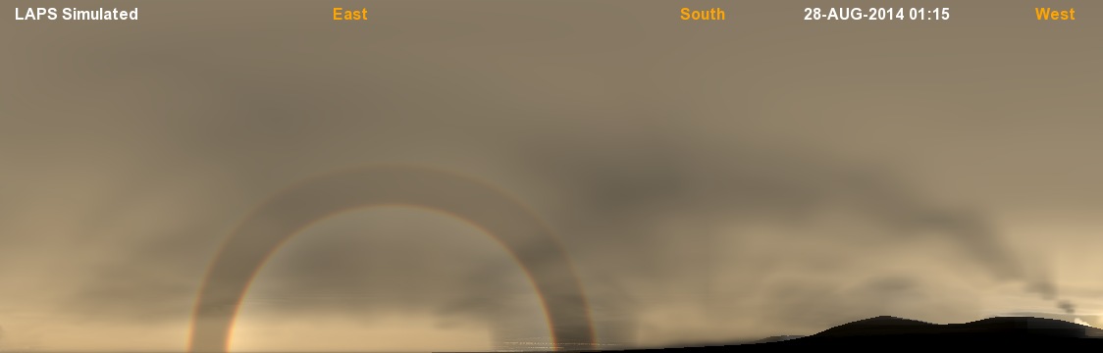
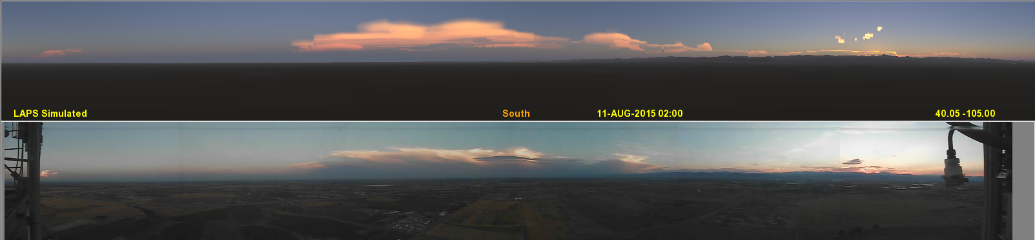
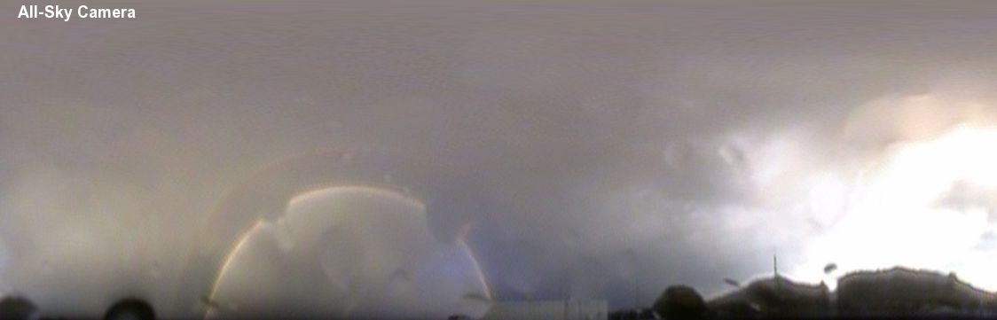
FOUR SIMULATED vs OBSERVED COMPARISONS
Daytime clouds
Nighttime clouds
SIMULATED
OBSERVED
Rainbow
SIMULATED
Sunset colors
OBSERVED

Slide 15
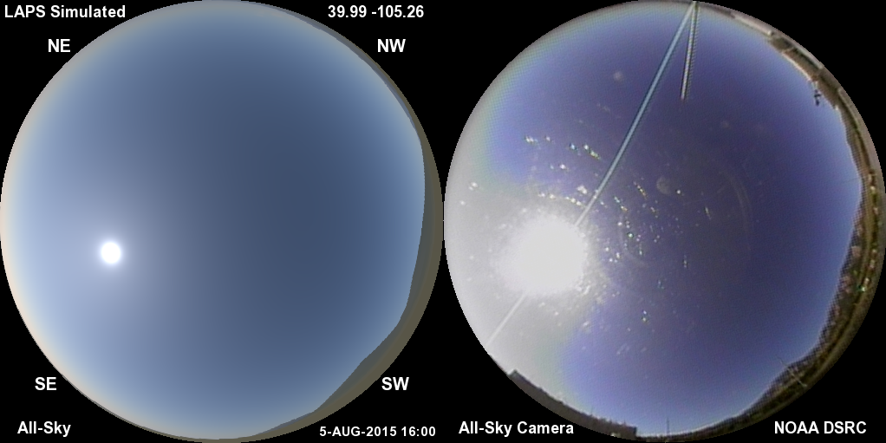
Daylight Clear Sky
Low aerosol content (τ~.05) with aureole around the sun
Bimodal aerosol size distribution contributes to condensed aureole
Standard gamma brightness function to match camera image
Image brightness proportional to actual scene enhances realism

Slide 16
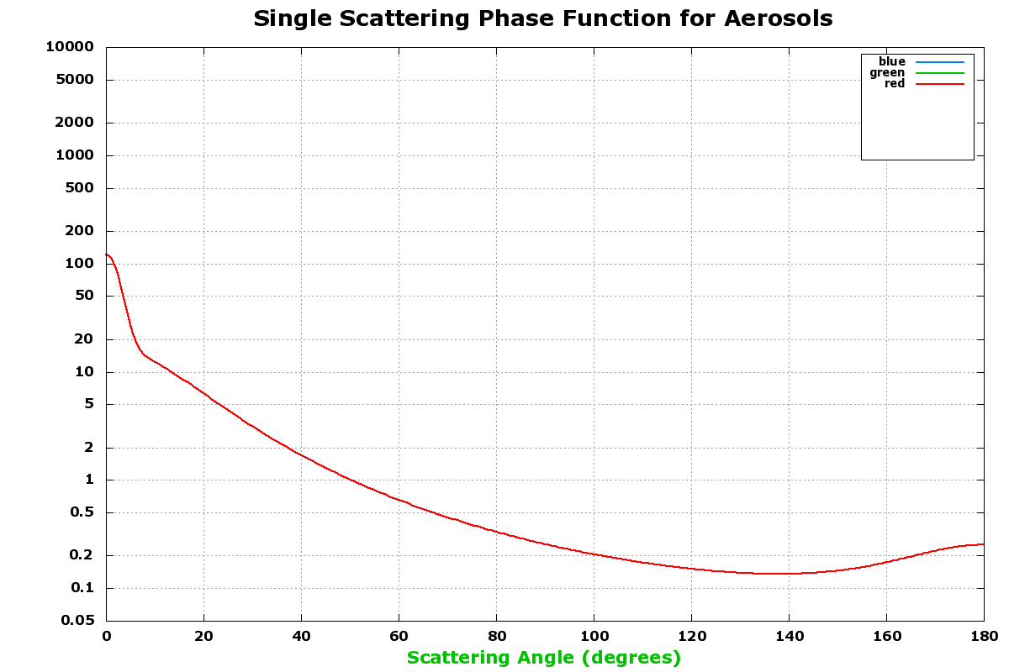
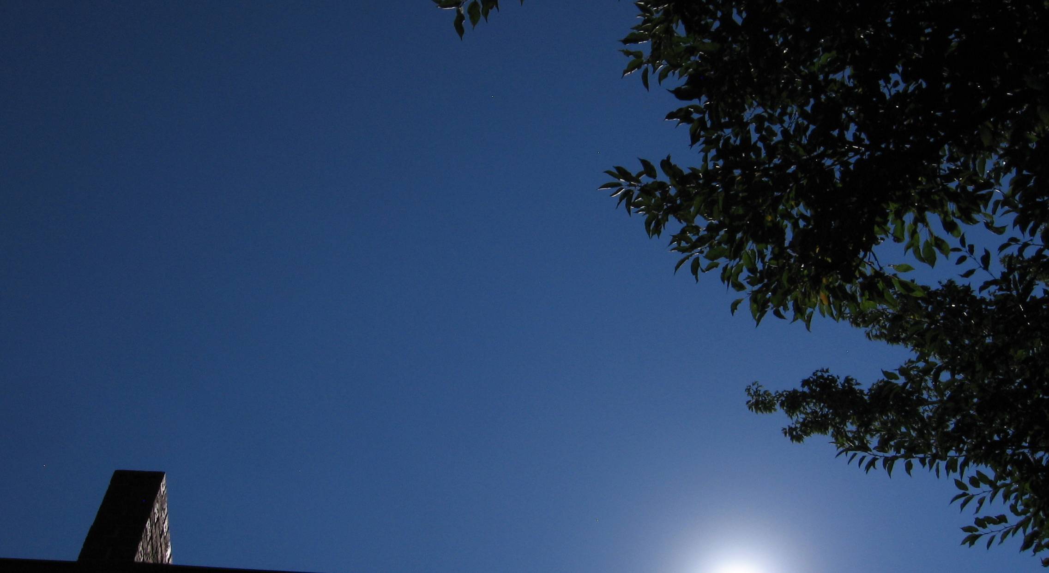
Closeup of Solar Aureole
Aureole (glow around sun)
Aerosols modeled with vertical extinction coefficient profile and scattering phase function. Phase function and Angstrom exponent depend on size distribution

Slide 17
Aerosol Scattering Phase Function
Multi-parameter phase function
  Terms use Henyey-Greenstein and related functions
  Approximates Mie scattering for non-spherical aerosols with bi-modal size distribution
  Agrees with recent AERONET aerosol phase function measurements in Boulder area
  Central peak is adjustable (higher with more large aerosols)
Used with Aerosol Optical Depth & Single Scattering Albedo
Wavelength dependent phase function?
  Plus Angstrom exponent (wavelength dependence for τ)
Consider size distribution of aerosols from chemistry model?
  Connect to aerosol phase function database?

Slide 18
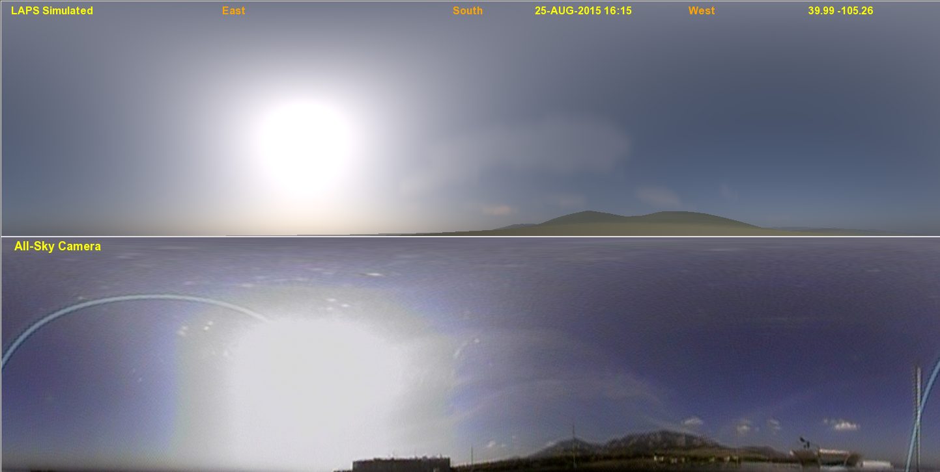
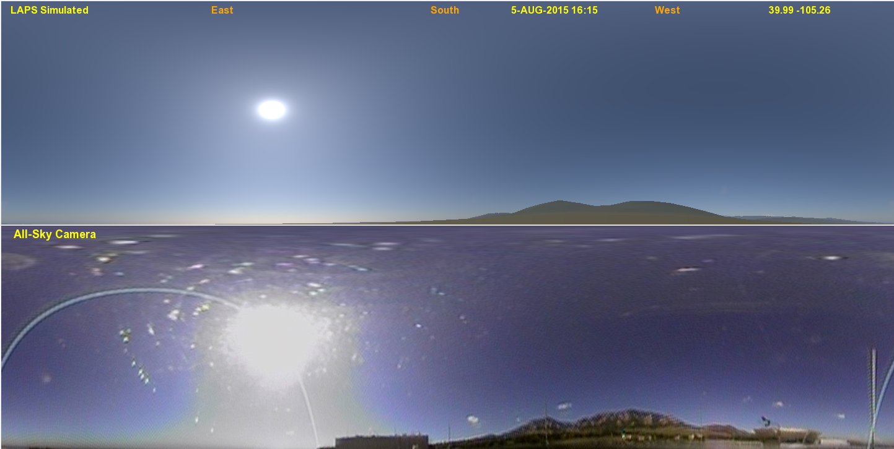
Smoke Event Comparison - 1
SIMULATED
AOD ~ 0.23
OBSERVED
SIMULATED
AOD ~ 0.05
OBSERVED

Slide 19
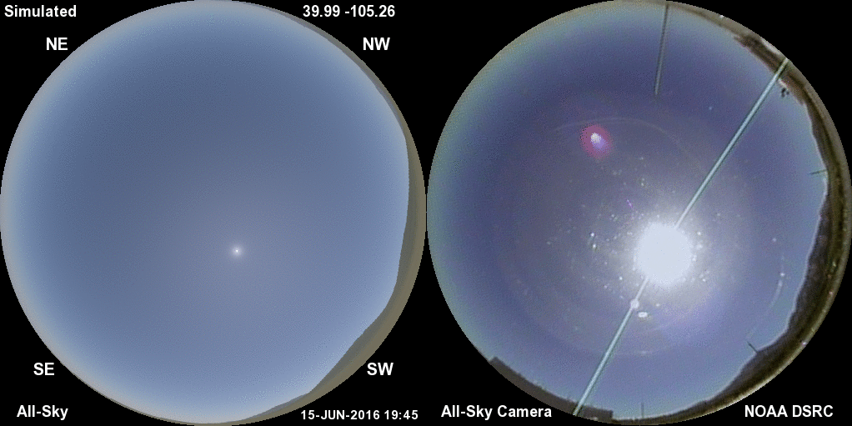
Smoke Event Comparison - 2
SIMULATED
OBSERVED
AOD ~ 0.045 – 0.09

Slide 20
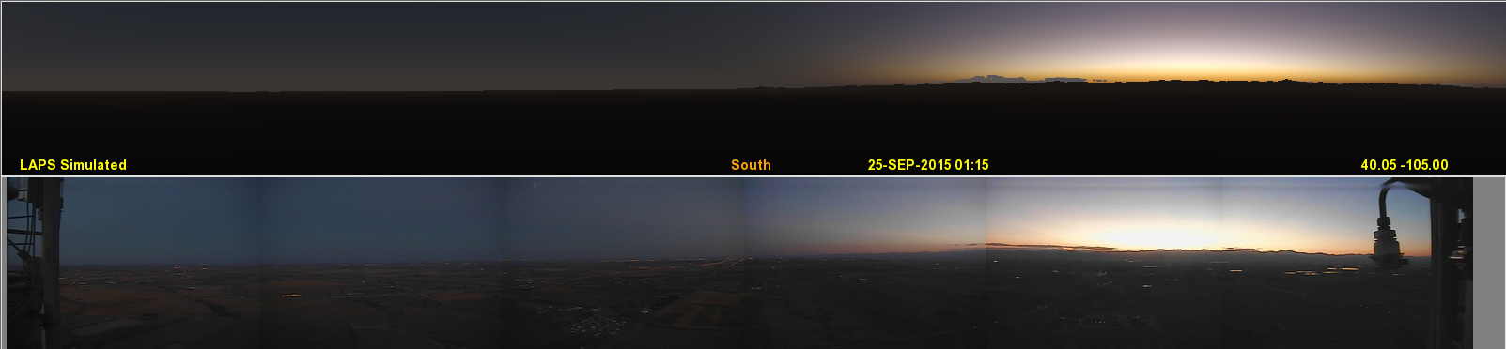
Twilight Comparison – BAO Tower
SIMULATED
Colors relate to handling of multiple scattering & ozone absorption
Stratospheric (and tropospheric) aerosols can affect twilight appearance
OBSERVED

Slide 21
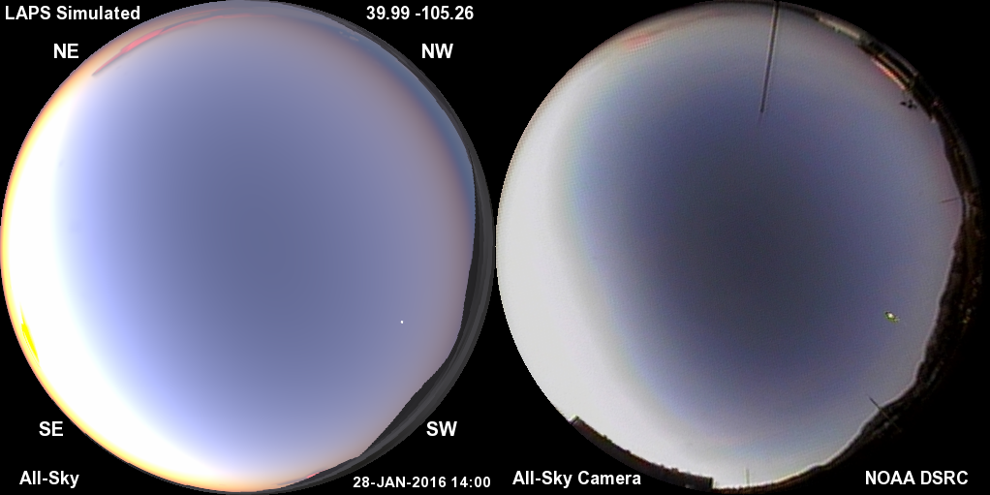
Twilight Comparison – Fisheye View
Colors relate to handling of multiple scattering & ozone absorption
Stratospheric (and tropospheric) aerosols can affect twilight brightness

Slide 22
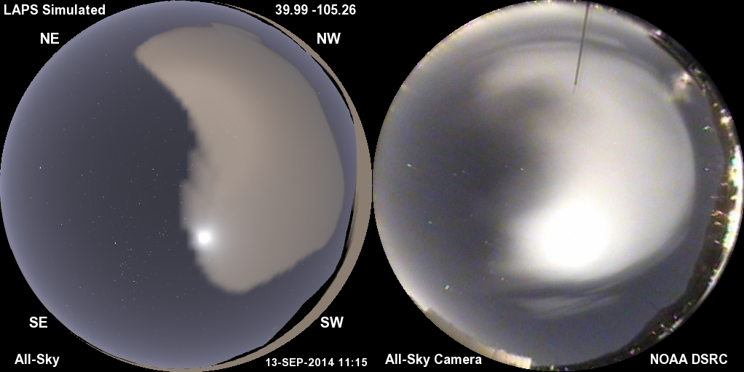
Nighttime Clouds (and stars)
Illumination by moonlight and artificial surface lighting

Slide 23
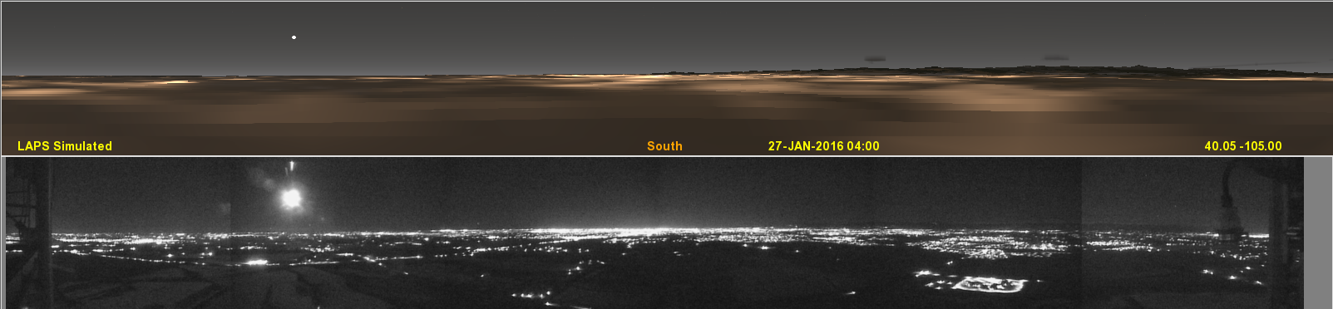
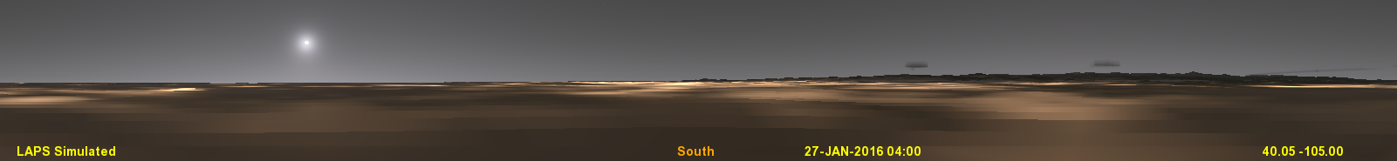
Nighttime Comparison atop 300m BAO Tower in Erie, CO
SIMULATED
OBSERVED
Lunar aureole is bright in this example
VIIRS stable nightlights used in simulation
Good alignment of city lights on larger scales
City lights show aerosol scattering localized over Denver (observed)

Slide 24
Aerosol Observation Platforms
Camera
  Scattered light intensity & phase function
Nephelometer
  In-situ spectral measurement of extinction coefficient (AirPhoton)
Aeronet
  Spectrophotometry yields spectral phase function
  Provides AOD, Angstrom exponent, size distribution
Other Spectrophotometry
  Solar / Moon / Star extinction vs zenith angle
  Yields AOD and potentially vertical / horizontal distribution
  Airmass calculation is non-linear vs sec(z) near the horizon from Earth curvature and aerosol scale height
  Direct / Diffuse irradiance comparisons, such as MultiFilter Rotating Shadowband Radiometer (MFRSR) at NOAA/GMD.

Slide 25
Aerosol Observation Platforms (cont)
Small Telescope
  Concurrent star extinction measurements throughout sky
Balloon / Glider
  Miniaturized Aeronet like package – experimental at ESRL/CSD
LIDAR
Satellite
  Radiance Measurements (in conjunction with RTM)
  Retrievals (e.g. GASP from GOES satellite)

Slide 26
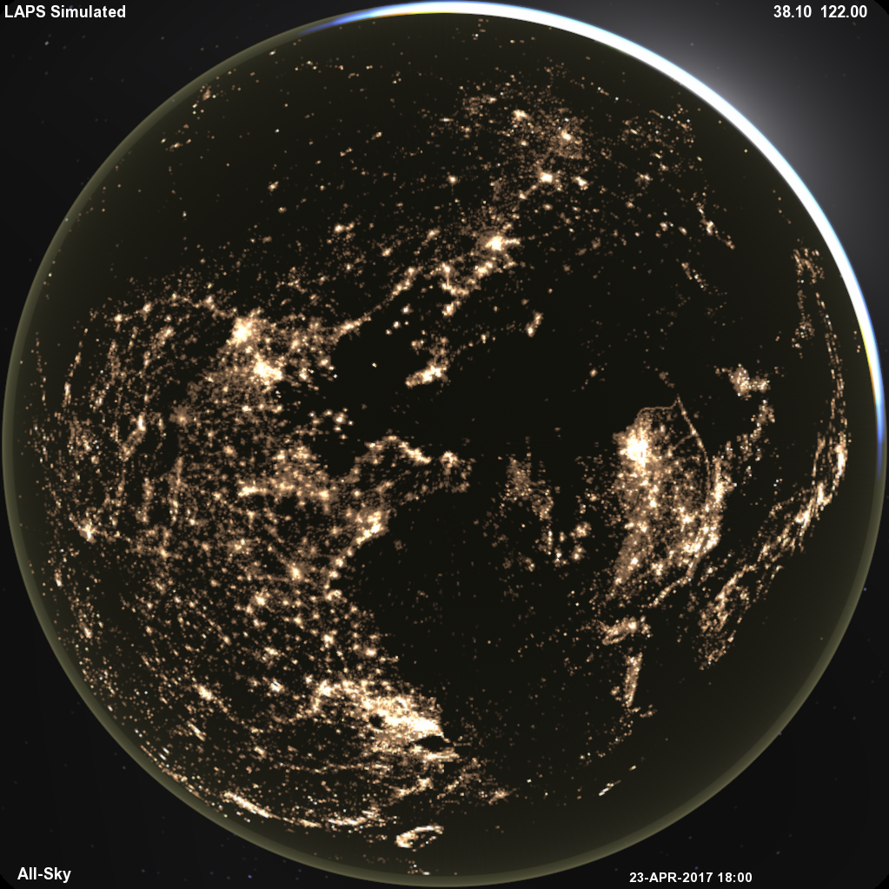
Nighttime View
Twilight / Airglow 790km up
+ City Lights, Zodiacal Light, Galactic Glow

Slide 27
Scattering of City Lights by Aerosols
Extinction is fairly straightforward
Scattering presently under development
  Determine upward irradiance field within aerosol volume
  Can be approximated by calculating aerosol irradiance at one or more layers, then interpolate in height
  Consider “dominant” scattering angle
  Show light domes on horizon as seen from observer
Similar procedure for clouds

Slide 28
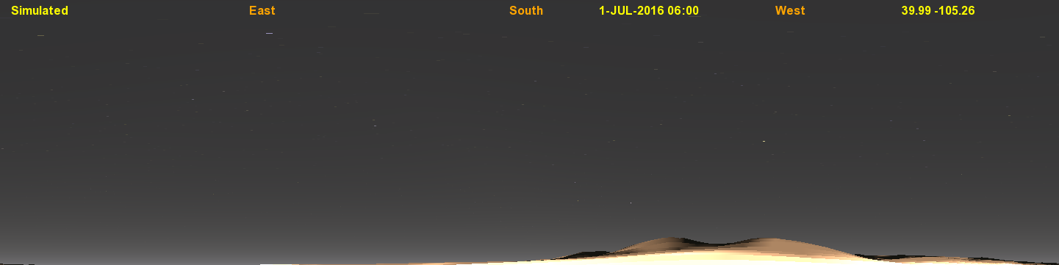
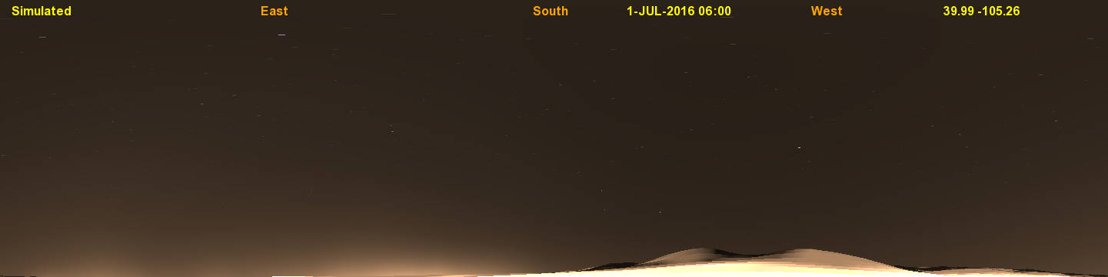
City Lights Atmospheric Scattering
Location in Boulder, CO
Altitude variation only
Azimuthal variation added

Slide 29
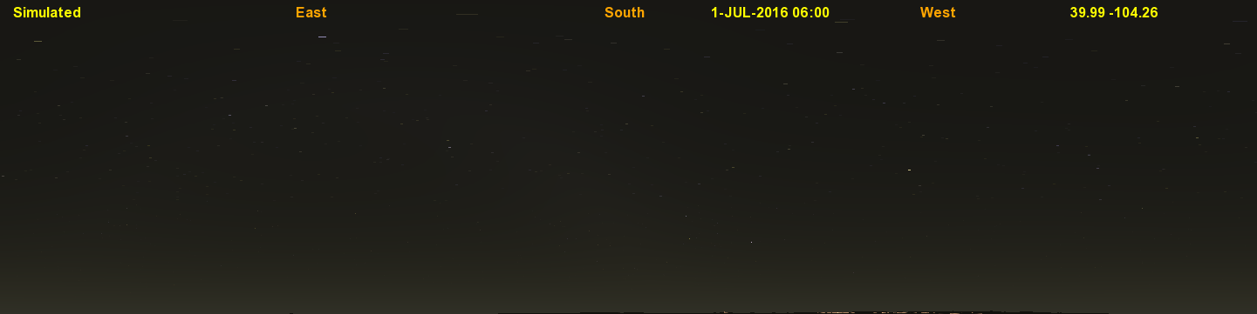
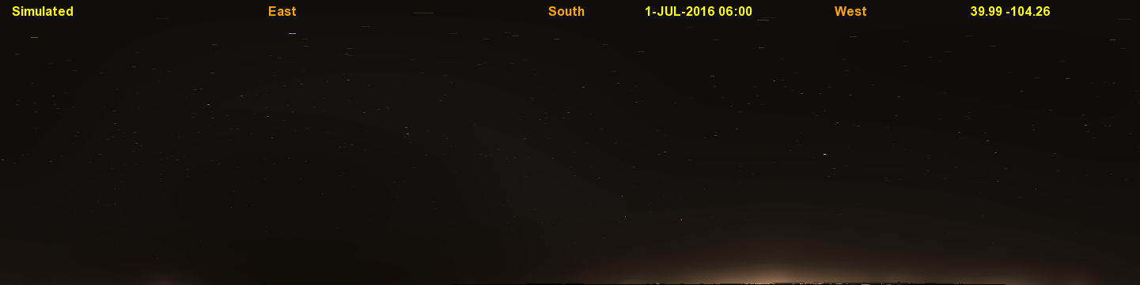
City Lights Atmospheric Scattering
Location 110km East of Boulder, CO
Altitude variation only
Azimuthal variation added

Slide 30
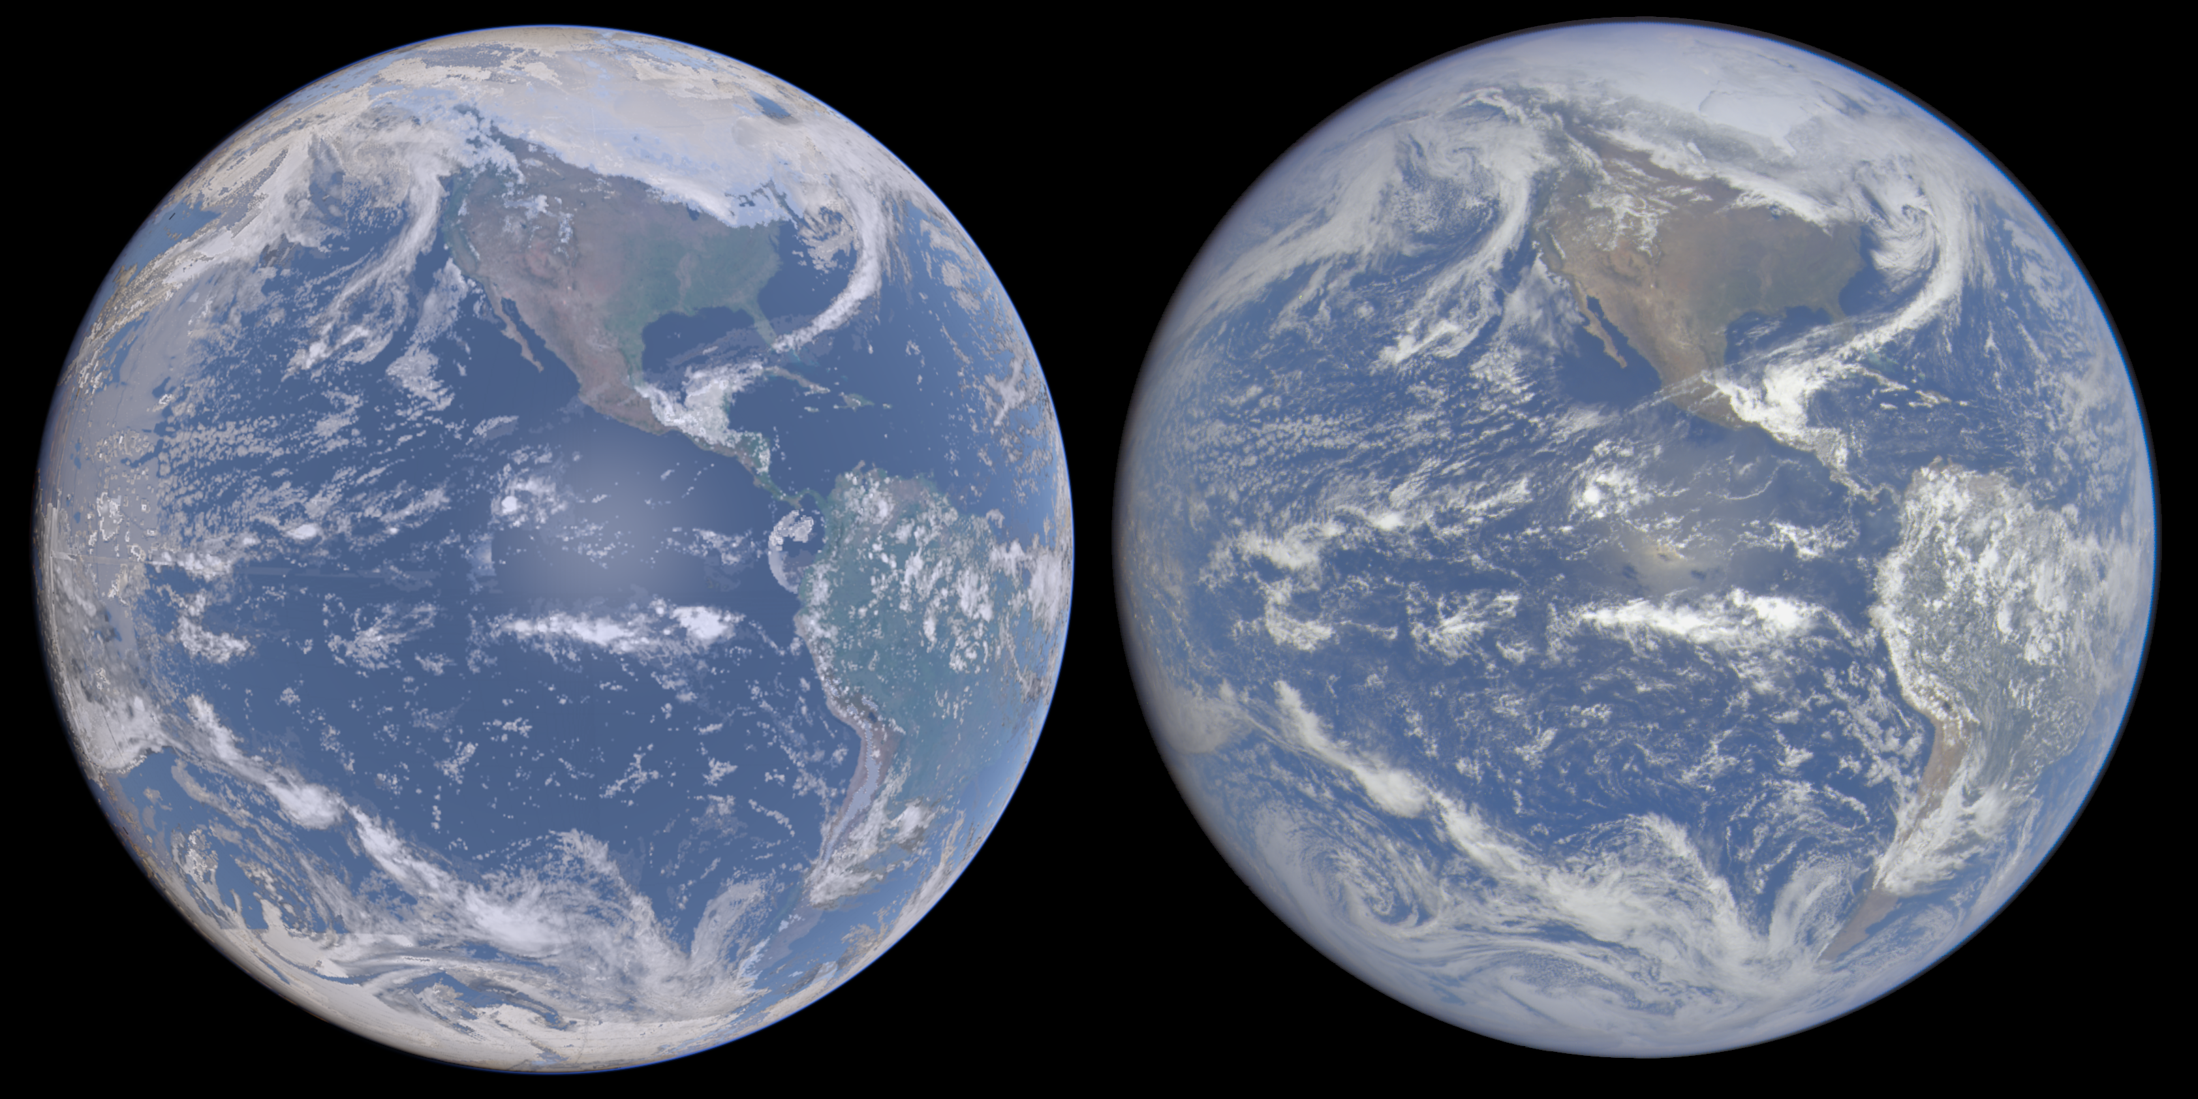
Full Disk Earth View
SIMULATED
OBSERVED (DSCOVR)
Earth global view
Compare with
DSCOVR or Himawari

Slide 31
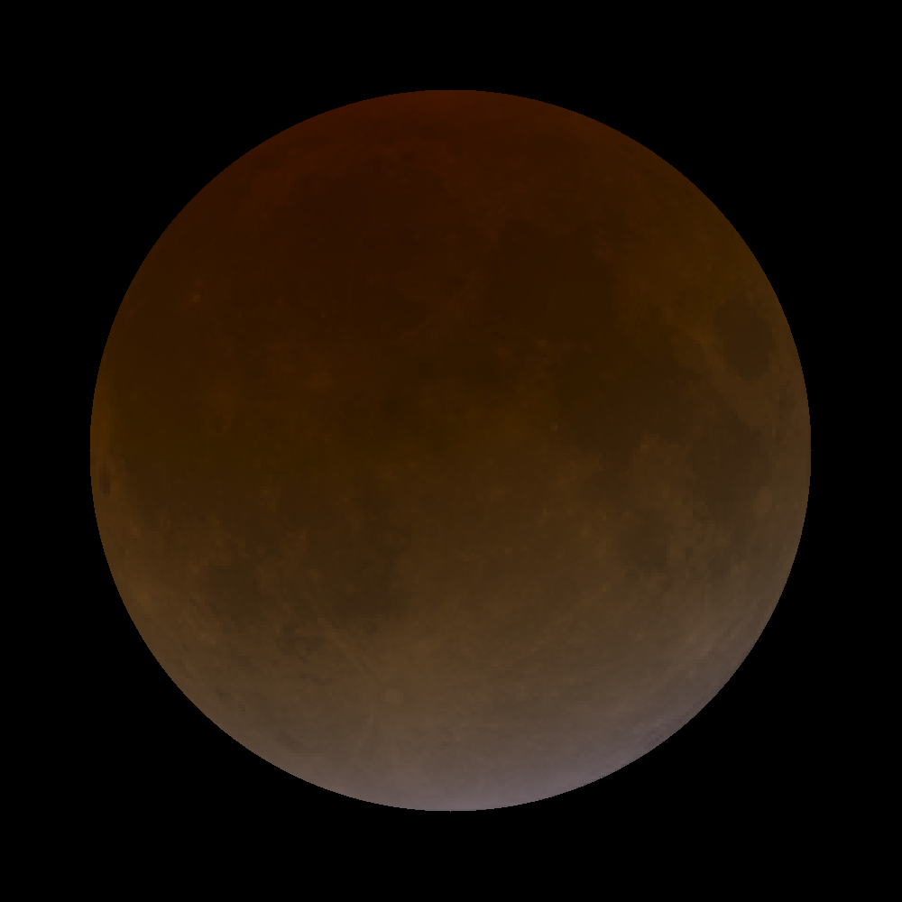

Miscellaneous Simulations
Lunar Eclipse
Sensitive to stratospheric aerosols, ozone, clouds
Martian Sky – Mainly Dust

Slide 32
Future Directions
Improve ray-tracing techniques
  Monte Carlo methods (in parallel using GPU)?
Improve scattering phase functions
Connect with microphysics packages and chemistry models
  Details on hydrometeor & aerosol species
  FIM-Chem global model and WRF-Chem

Slide 33
Variational Cloud / Aerosol Analysis
Variational cloud analysis currently under development
  based on existing LAPS and GSI cloud analyses
Simultaneous solution with all types of data + constraints
Use satellite radiance (e.g. CRTM) or algorithm products (e.g. CWP, AOD)
  radiances may blend more naturally with other types of data
Radars used for precipitating hydrometeors
Appropriate forward models and constraints
  constraints between state variables and hydrometeor fields
Will use all-sky cameras + all aerosol obs as input data

Slide 34
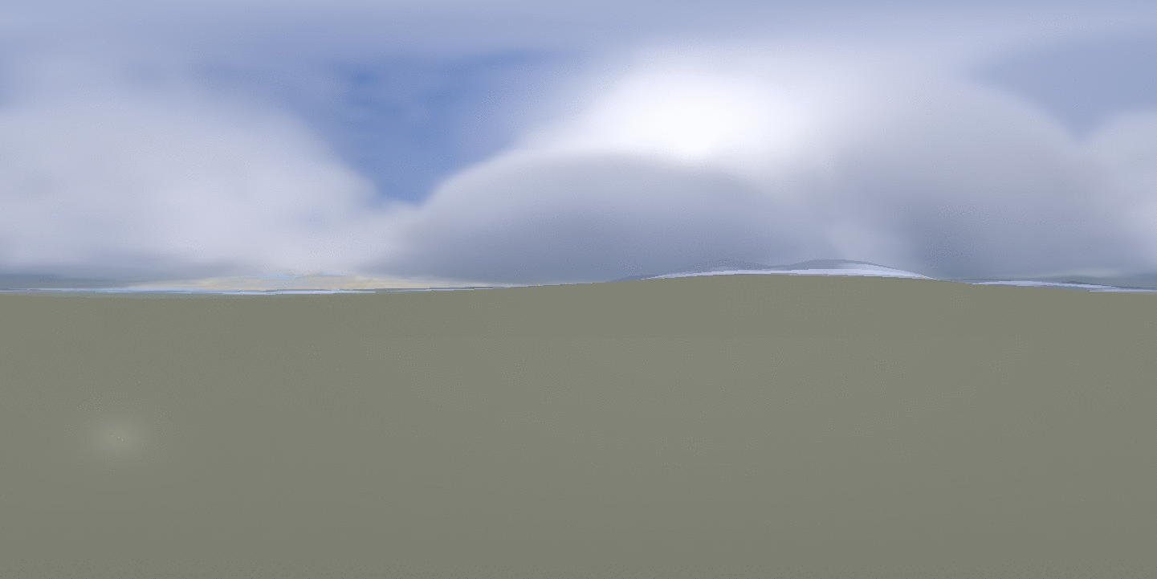
  The sky is the limit!
“Launch” into the stratosphere (40km up), 360º spherical view
  More at laps.noaa.gov/allsky/allsky.cgi OR steve.albers@noaa.gov

Slide 35
Backup Slides

Slide 36
Future Directions - II
More cameras, via NOAA’s observing systems?
  Add to ASOS?
  FAA camera networks (e.g. Alaska)
  Airborne cameras?
  CSTAR / AWIPS
Data assimilation with variational cloud and GSI analysis
  Efforts underway to use GSI cloud/hydrometeor analysis (used in HRRR/RAP) with all-sky forward model for nowcasting.
  Use derived METAR, cloud mask, image correlation, or spectral radiances
  Check applicabilty of available RTMs

