Slide 1
Ensemble Assimilation of Ocean Data
into the GEOS-5 Coupled GCM
Christian Keppenne^{1,2,*}, Guillaume Vernieres^{1,2}, Michele Rienecker¹,
Robin Kovach^{1,2}, Jossy Jacob^{1,2} and Atanas Trayanov^{1,2}
¹NASA GMAO
²SAIC
Outline:
NASA GMAO coupled model
Coupled ensemble assimilation with GMAO ODAS-2
Atmospheric analysis “replay” procedure
Augmented ocean ensemble Kalman filter
Adaptive observation errors
Adaptive background-error covariance localization and inflation/deflation
Hybrid particle filter
Online bias correction
System validation
Assimilation of sea level height
Online bias correction
Multivariate projection method
Assimilation of in situ T and/or S
Outlook
June 15, 2010
*contact: christian.keppenne@nasa.gov

Slide 2
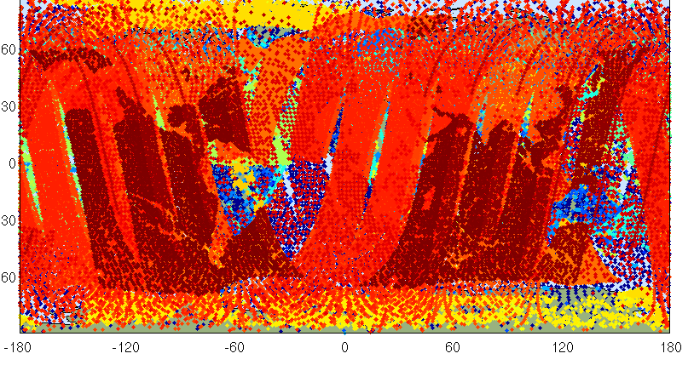
Atmospheric Observing System
GEOS-5 ADAS 14 May 2008 00UTC
1,557,926 observations – 90% from satellites
The atmospheric observing system today…
a 6-hr snapshot (courtesy of Ron Gelaro, GMAO)

Slide 3
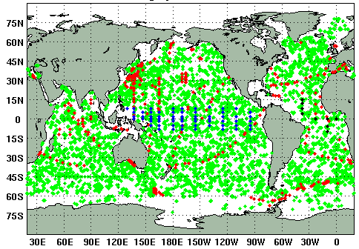
Ocean Observing System
In situ data: 1 month (Jan. 2010)
ODAS-2 data
Topex/Jason SSH anomalies
Argo in situ T and S profiles
In situ T from TAO, XBT, Pirata and Rama
Reynolds SST
Levitus surface salinity while waiting for Aquarius
Argo: 291 profiles/day XBT: 31 profiles/day
TAO: 64 profiles PIRATA: 9 profiles
Historical availability of in situ data
Jason altimeter track: 1 day - ~2500 obs./day
The density and vertical coverage of in situ data has increased tremendously but the ocean is still poorly observed vs. the atmosphere. Hence, assimilating surface measurements from remote sensing is a must.

Slide 4
ODAS-1
CGCM forecast
OGCM
ODAS-1
LSM-AGCM-OGCM coupling
Ocean-only runs
OGCM: Poseidon 4
Analysis algorithms
EnKF
MvOI (EnKF analysis with steady-state fixed ensemble)
UOI (functional univariate background covariances)
ODAS-2
CGCM forecast
CGCM
ODAS-2
ADAS replay
GEOS-5 Coupled Model:
OGCM: MOM-4 (0.5°X 0.167-0.5°X 40L) or any other ESMF-ready model
AGCM: GEOS-5 AGCM (1.25°X 1°X 72L)
Analysis algorithms
Atmosphere: “replay” of GMAO atmospheric analysis
Ocean: “Augmented” hybrid EnKF/lagged EnKF/particle filter approach
ODAS implemented as ESMF gridded-component -> model independent

Slide 5
GEOS-5 coupled model and
coupled ensemble system
ESMF
MAPL
misc.libraries
GEOS-5 CAP
GEOSGCS
GEOSGCM1
GEOSANA
AGCM
OGCM
AANA
ODAS-2
GEOSGCM2
GEOSGCM3
GEOSGCM4
GEOSGCM current configuration:
OGCM: MOM4p1 720x410x40 grid
AGCM: GEOS5 AGCM 288x181x72 grid
(Each subsystem implemented as ESMF gridded component)
Etc…
GEOSGCM
AGCM
OGCM
physics
dynamics
sea ice
Ocean radiation
biogeochemistry
guest ocean
chemistry,
radiation,
moisture,
turbulence,
etc…
FV dycore,
topography,
etc…
MOM4, Poseidon 5 or Other ESMF-ready OGCM

Slide 6
Atmospheric analysis replay
2: read atm. analysis (A)
3: calculate atm. increment (A-F)
time
03z
06z
09z
1: AGCM forecast (F)
4: rewind AGCM
5: incremental analysis update (IAU)
ocean analysis
ocean analysis
ocean IAU
2: read atm. analysis (A)
3: calculate atm. increment (A-F)
2: read atm. analysis (A)
3: calculate atm. increment (A-F)
2: read atm. analysis (A)
3: calculate atm. increment (A-F)
2: read atm. analysis (A)
3: calculate atm. increment (A-F)
03z
06z
09z
12z
15z
18z
21z
00z
03z
1: AGCM forecast (F)
1: AGCM forecast (F)
1: AGCM forecast (F)
1: AGCM forecast (F)
4: rewind AGCM
4: rewind AGCM
4: rewind AGCM
4: rewind AGCM
5: incremental analysis update (IAU)
5: incremental analysis update (IAU)
5: incremental analysis update (IAU)
5: incremental analysis update (IAU)

Slide 7
Augmented EnKF
The data assimilation problem
model state vector
Objective: Find the best possible estimate of x_{t} given x, y and their error distributions
unknown true state
measurements
The Kalman Filter (Kalman 1960)

Slide 8
The ensemble Kalman Filter
Evensen (1994, 1996)
Replace background-covariance evolution with ensemble integration
d
x
=
+
−
−
=
i
M
(
x
,
f
)
q
E
((
x
x
)
T
(
x
x
)
)
P
dt
i
i
t
t
≈
1
∑
−
−
T
P
(
x
x
)
(
x
x
)
n
−
i
i
1
i
given
the update for ensemble member x_{i} is computed as
(from right to left -> only matrix-vector products):
Error-Covariance Localization and Filtering
Hadamard (Schur) product

Slide 9
ODAS-2 Augmented EnKF
3 Sources of background-error covariance information
P_{dyn}: State-dependent error-covariance basis vectors from ensemble integration
Current state of each ensemble member minus low pass filter
Past states of each ensemble member minus a low pass filter
time
Ensemble member
Low pass filter
P_{stat}: Static ensemble of time-independent “error EOFs”
Error EOFs calculated from a time series of differences between a coupled model run constrained by replaying the GMAO atmospheric analysis and unconstrained short-term forecasts
P_{func}: Pseudo-Gaussian univariate covariance term
time
t1
t1+δ
t1+2δ
t1+3δ
t1+4δ

Slide 10
ODAS-1 Error-Covariance Localization
Static, not flow adaptive 3D localization along (x, y, z) space dimensions
Also apply Gaussian filter to deviations from ensemble mean
Marginal Kalman gain: T obs @(0n,156E,150m) on 12/31/01
horizontal section through <T’,T’> covariances
EnKF-9
0.36
0.46
0.67
EnKF-17
0.51
0.58
0.75
EnKF-33
0.63
0.70
0.77
EnKF-65
Unfiltered,
not compactly supported
Unfiltered,
compactly supported
Filtered,
compactly supported

Slide 11
ODAS-2 flow-adaptive and observation-adaptive analysis
Flow adaptive error-covariance localization following neutral density [(x, y, z, ρ) dimensions]
Adaptive optimization of error-covariance localization scales (x, y, z) used with each observation
Adaptive estimation of representation error associated with each observation
Adaptive background-error covariance inflation/deflation
Adaptive rescaling of analysis increments
Particle pre-filter

Slide 12
ODAS-2 adaptive error covariance localization: successive stages
1. Traditional approach (as in ODAS-1)
C(δx, δy, δz, δt) is an approximately Gaussian compactly supported correlation function
2. Tried hierarchical ensemble filter (Anderson 2007)
Observations must be processed serially (α_{kl} P_{kl} is not a covariance)
Bishop’s (2007) flow adaptive moderation of spurious covariances
Some long-range spurious features are amplified.
Assimilation performance (OMFA statistics) worse than case 1
Back to approach 1 with localization in (x, y, z, t, neutral density) space
Respects flow-dependent gradients such as thermocline and fronts
Adaptive optimization of localization scales involved in processing each observation
Assimilation performance better than case 1

Slide 13
ODAS-2 flow-dependent error-covariance localization along neutral density surfaces
Covariance localization is the most numerically intensive part of the ensemble assimilation system
C₀ is a compactly supported analytical covariance function (Gaspari and Cohn 1985)
ODAS-1: l_{x}(y) and l_{y}(y) proportional to Rossby radius of deformation
ODAS-2: l_{x}(x,y,z,t), l_{y}(x,y,z,t), l_{z}(x,y,z,t) & l_{ρ}(x,y,z,t) optimized iteratively for each datum

Slide 14
ODAS-2 flow-dependent error covariances
Marginal Kalman gain:
unit T innovation at 95m
Marginal Kalman gain:
unit SSH innovation along equator

Slide 15
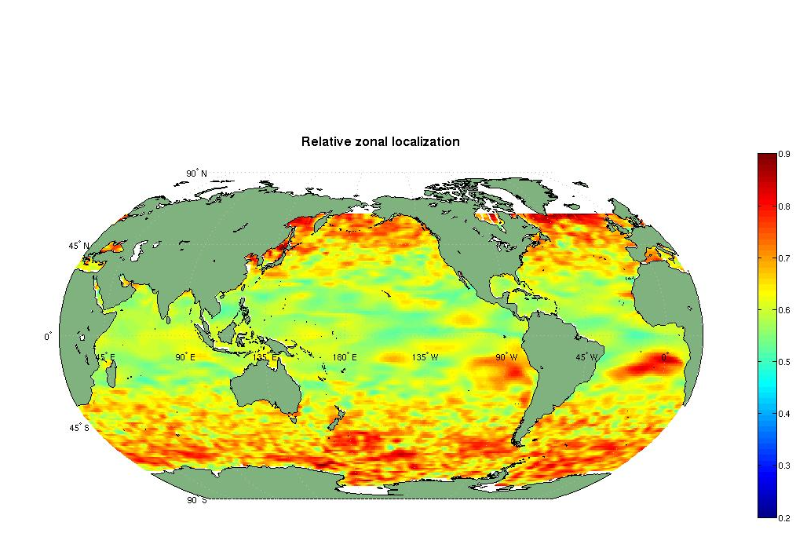
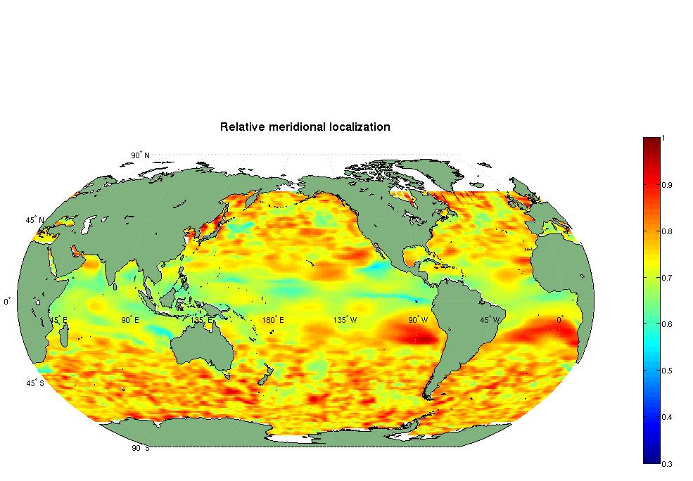
ODAS-2 adaptive error-covariance localization
For each observation y₀, process neighboring observations as though they were perfect (R=0) and optimize the localization by iteratively solving for the l_{x}, l_{y} & l_{z} that minimize
: an observation
: set of neighboring observations of same variable excluding y₀
: maps the state vector to y_{n}
: maps the state vector to y₀
Example:
optimized l_{x} and l_{y} localization scales for Reynolds SST data on Jan. 1 2007 expressed as a fraction of the default Rossyby-radius dependent localization

Slide 16
ODAS-2 adaptive representation-error estimation
For each individual observation, after optimization of the covariance localization parameters l_{x}, l_{y} & l_{z}, the representation error is estimated as
Estimated representation error
for Reynolds SST data
Jan. 1 2007
Difference in SST increment :
adaptive (errors + localization + covariance inflation) – standard assimilation (adaptive inflation only)

Slide 17
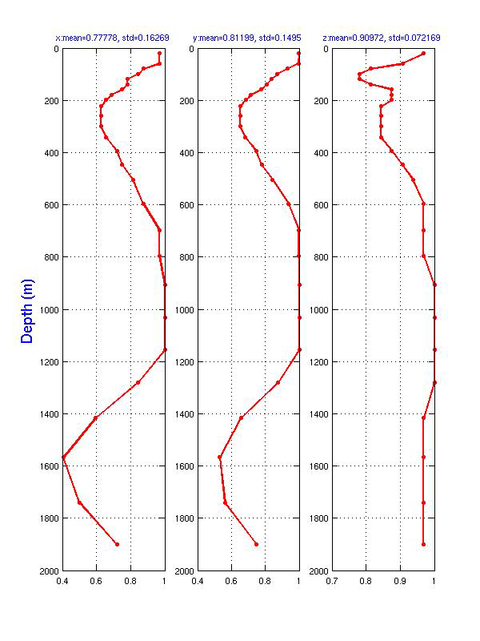
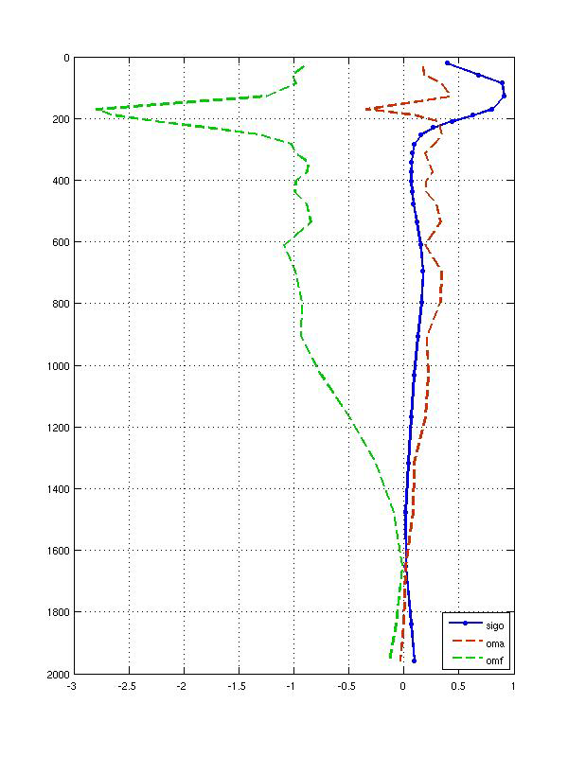
ODAS-2 adaptive localization and representation-error estimation
Relative x loc. scale
Relative y loc. scale
Relative z loc. scale
Example for one ARGO T profile
at (16S, 0W) on Jan. 1, 2007
OMF
OMA
σ_{obs}
Optimal horizontal scales: ~60% of Rossby-radius dependent scales @250m, larger @1000m
Optimal vertical localization scales: minimum in thermocline. Default (250m) is too short near 1000m
Representation error estimate (σ_{obs}): maximum in thermocline, very small below 1000m

Slide 18
ODAS-2 adaptive error-covariance inflation
Following Desroziers et al. we have:
Iteratively iterate until global convergence is satisfied:
Not prohibitively expensive because does not require calculation of C°HPH^{T}
: observation operator (e.g., interpolation) for observation i (scalar)
Assimilation increment rescaling
Parallel algorithm involves each CPU minimizing RMS analysis error variance for a subset of all the observations (all the observations that influence state variables pertaining to that CPU). The increment, Δ, is then optimized globally by rescaling it (Δ →γΔ) such as to globally minimize

Slide 19
ODAS-2 particle pre-filter
Motivation: ensemble mean is not necessarily a realizable state. Hence we want to improve upon this state by shifting the ensemble mean to the ensemble member that is closest to the observations (a realizable state).
Find ensemble member x_{p} that is closest to the data in terms of RMS OMF
Displace the whole ensemble by an increment Δ_{p} = x_{p} - x_{m} where x_{m} is the ensemble mean
Thereafter, apply the ensemble Kalman filter analysis
x_{p}
x_{p}
Δ_{p}
Y
x_{m}
x_{m}
Y

Slide 20
ODAS-2 particle pre-filter example:
assimilate in situ ARGO T data. Validate against ARGO S data
CGCM
Data
Daily assimilation of ARGO T profiles 04/01/06 – 05/31/06 (active data set)
ARGO S profiles used for validation (passive data set)
Initial condition
03/01/06 coupled model restart from single coupled model run with atm. Anal. Replay
Ensemble initialization (03/01/06 – 04/01/06)
initial perturbation from linear combinations of model signal EOFs
daily perturbations with 1% of initial perturbation amplitude
Assimilation (04/01/06-05/31/06)
CE-16: 16-member control ensemble – no assimilation
EnKF-16x11: 16 streams (model integrations) and 10 past instances in each stream (lag = 1 day)
HPEnKF-16x11: reordering particle pre-filter HPF-16 used prior to each EnKF-16x11 analysis

Slide 21
ODAS-2 particle pre-filter example: assimilate in situ ARGO T data. Validate against ARGO S data
CE-16 RMS OMF – ENKF-16x11 RMS OMF: z<200m
Salinity improvement over control ensemble
Warm (resp. cold) colors denote areas where the analysis is closer to (resp. further away from) the passive S ARGO data than the control ensemble in May 2006 (last month of exp).
EnKF 16x11 better
CE-16 better
CE-16 RMS OMF – HPENKF-16x11 RMS OMF: z<200m
HPEnKF 16x11 better
CE-16
RMS OMF=0.51
CE-16 better
Global salt
OMFA statistics:
mean OMF
RMS OMF
mean OMA
RMS OMA
CE-16 RMS OMF – ENKF-16x11 RMS OMF: z>200m
better than control below 200m
EnKF 16x11 better
EnKF 16x11
RMS OMF=0.50
CE-16 better
CE-16 RMS OMF – HPENKF-16x11 RMS OMF: z>200m
HPEnKF 16x11 better
better overall
HPEnKF 16x11
RMS OMF=0.37
CE-16 better

Slide 22
Online bias correction and assimilation of SSH anomalies
Challenge 1: model bias changes as the data are assimilated
Challenge 2: must derive T(z), S(z) u(z) and v(z) from scalar η measurements
a) Standard assimilation
true climate
after Dee and Dasilva (1998)
Total error
bias
model climate
y – H(x): total innovation
y – H(x - b): unbiased innovation
b) Assimilation with online bias estimation (OBE)
SSH bias estimate snapshot 04/01/2006
Bias estimate
true climate
model climate
Side by side estimation of
bias
unbiased error component

Slide 23
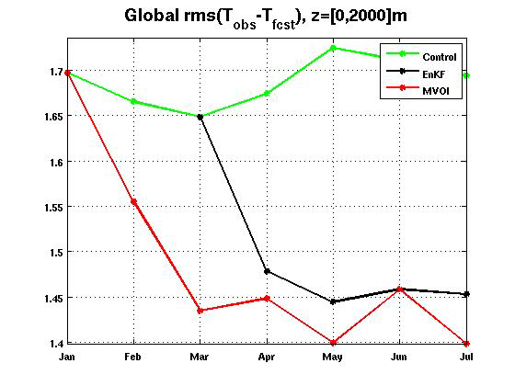
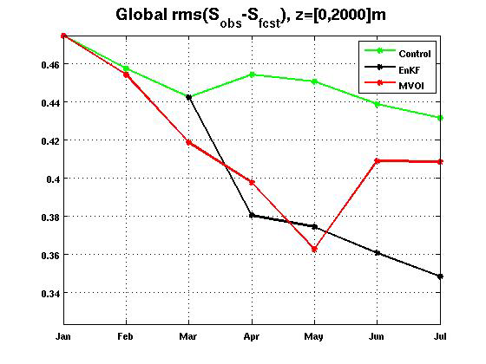
Online bias correction and assimilation of SSH anomalies
Experiment duration 01-07 2007
RMS T OMFA statistics at TAO moorings
TAO T data are passive
SLA is active
Control
RMS T OMF = 1.76C
MVOI (static ensemble)
RMS T OMF = 1.48C
EnKF-8x1
RMS T OMF = 1.3C
Note: ensemble initialization during first two months of EnKF run
RMS T OMFA statistics at TAO
mooring locations (April-July 2007)

Slide 24
T improvement over control: control RMS T OMF – ODAS RMS T OMF
Validation of surface data assimilation using passive (not assimilated) sub-surface Argo data
RMS T OMF diff. 0-300m
Experiment
is better
Control
is better
RMS T OMF diff. 300-2000m
Experiment
is better
Control
is better
SST + SSS assimilation
SLA assimilation
SST + SSS + SLA assimilation
Assimilation of SST + SSS alone does not improve the subsurface T much (vs. control)
SLA assimilation with online bias correction improves upon control, but not in Nino-4 area (0-300m)
Assimilating SST + SSS + SLA mostly corrects the 0-300m Nino-4 area deficiencies

Slide 25
S improvement over control: control RMS S OMF – ODAS RMS S OMF
Validation of surface data assimilation using passive (not assimilated) sub-surface Argo data
RMS S OMF diff. 0-300m
Exp.
better
Control
better
RMS S OMF diff. 300-2000m
Exp.
better
Control
better
SST + SSS assimilation
SLA assimilation
SST + SSS + SLA assimilation
SLA assimilation alone very effective is improving S over the control
Best results for S seen when assimilating SST + SSS + SLA

Slide 26
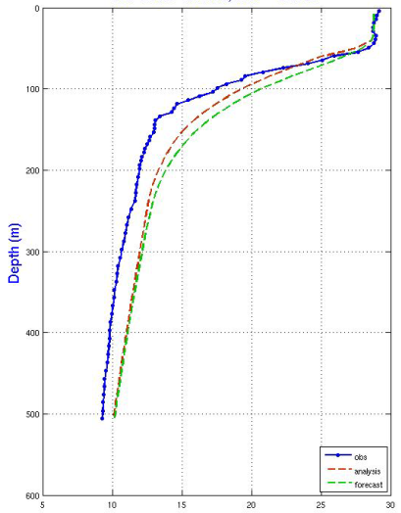
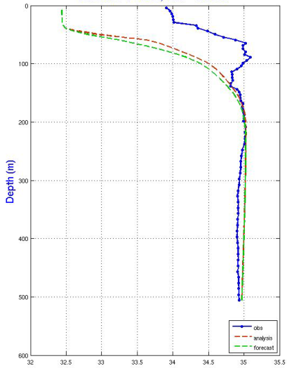
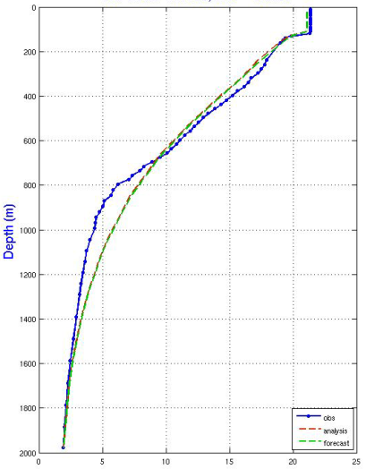
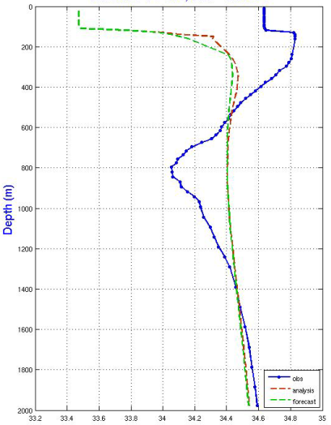
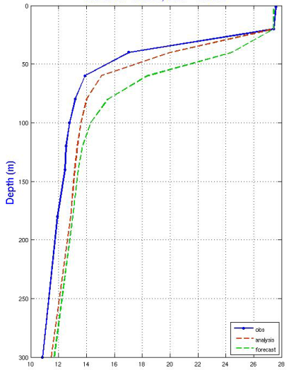
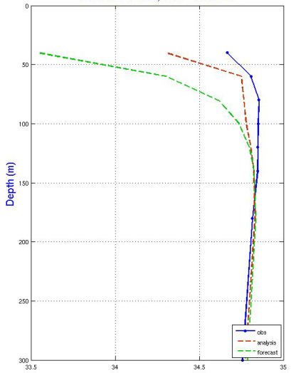
Online bias correction and assimilation of SSH anomalies
1
1
ARGO T
Analysis
forecast
ARGO S
Analysis
forecast
1
2
3
2
2
ARGO T
Analysis
forecast
T and S forecast and analysis compared to some un-assimilated in situ profiles near the altimeter track at the time of the first assimilation
ARGO S
Analysis
forecast
3
3
TAO T
Analysis
forecast
TAO synthetic S
Analysis
forecast

Slide 27
Summary
Ocean data assimilation into GMAO CGCM with “replay” of the GMAO atmospheric analysis
Combining static and dynamic ensembles (including lagged ensemble) gives best performance
Multivariate background covariances effective in improving unobserved model variables
SLA assimilation improves subsurface T & S, but best results with SST + SSS + SLA assim.
Ensemble data assimilation system ready for production runs
Started 1950-present retrospective analysis
Outlook
Moving towards fully coupled data assimilation system through data assimilation into the skin layer
(building upon NCEP GSI work)
Ready for new data types, starting with Aquarius
GMAO ODAS webpage: http://gmao.gsfc.nasa.gov/research/oceanassim

