Slide 1
South Asian Regional Reanalysis (SARR)
Ashish Routray
National Centre for Medium Range Weather Forecasting (NCMRWF)
Ministry of Earth Sciences
Government of India

Slide 2

Motivation for South Asian Regional Reanalysis
Due to the direct societal impacts, interest in Regional Hydroclimate (precipitation, surface temperature, soil moisture, stream flow, drought indices, etc.) is intense and growing.
National Action Plan on Climate Change
Government of India
Prime Minister’s Council on Climate Change
3.8.2 ……. Regional data reanalysis projects should be encouraged. ……..

Slide 3


South Asian Regional Reanalysis (SARR)
A Collaborative Project between
Ministry of Earth Sciences,
Government of India
and
National Oceanic and Atmospheric Administration,
Department of Commerce,
United States of America

Slide 4
Specific SARR Goals
Refinement in methods of precipitation and radiances assimilation.
Conduct a 5-year pilot-phase reanalysis
(to test and optimize data stream organization and the geographic domain and assimilating model choices)
Develop high-resolution SST analysis for the Indian ocean from satellite and in-situ observations, including moorings, drifters and Argo floats
Design techniques for assimilation of aerosols
Generate a high spatio-temporal resolution (≤25 Km, ≤3 hours) climate data set for the 1979-2009 period over the South Asian land-ocean region.

Slide 5
The SARR Project is being carried out with an objective that the SARR Products shall be useful for
Climate Diagnostics,
Climate Variability,
Climate Change,
Model Verification/Tuning
It is expected that
The SARR project will provide an Atmosphere-Land-Ocean surface state description where consistency between circulation and hydroclimate components is assured.
To achieve the goal, assimilation of rainfall, radiance, and aerosol observations in numerical weather prediction models shall be carried out

Slide 6
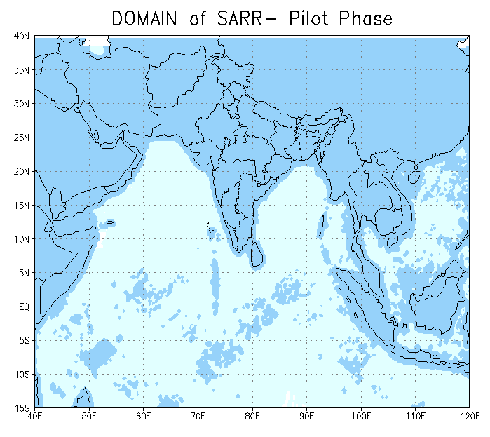
Domain chosen for SARR
Lat: 15⁰S-45⁰N (286 pts)
Lon: 40⁰E-120⁰E (332 pts)
Res.: 25 km (pilot phase)
18 km (final SARR)
Cen-lat: 17.5⁰N
Cen-lon: 80.0⁰E

Slide 7
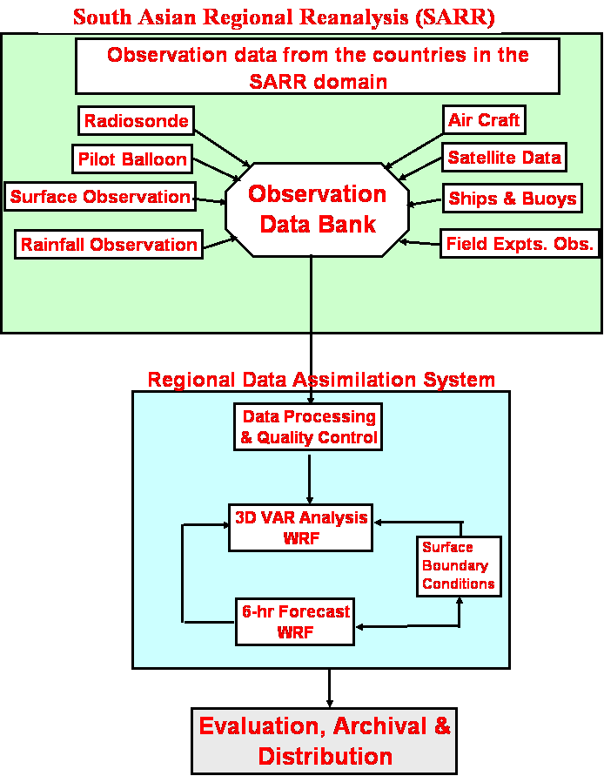

Slide 8




NCEP
SARR
OBSERVATION
DATA BANK
IMD
NCMRWF
Countries in
SARR domain
INCOIS
ISRO
Field
Experiments

Slide 9
SARR Pilot Phase Experiments (1999-2003)
Analysis Scheme & Model for SARR Pilot Phase
WRF 3.1 and WRF-VAR (3.1) has been chosen for SARR Pilot phase experiments
Several modeling and assimilation experiments have been carried out using past data.
Most of the experiments are for July 1999 using NCEP & NCMRWF observation datasets

Slide 10
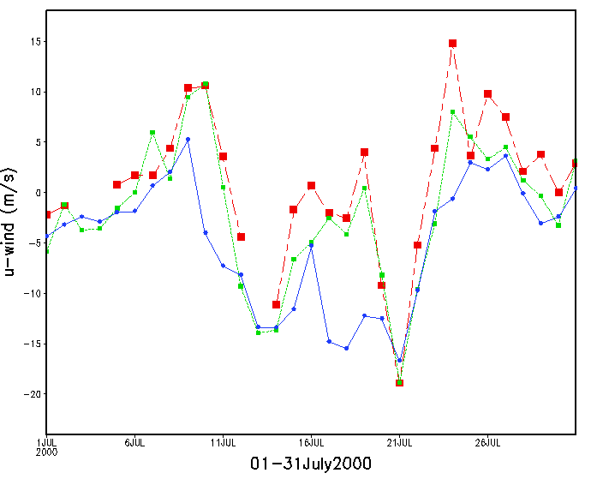
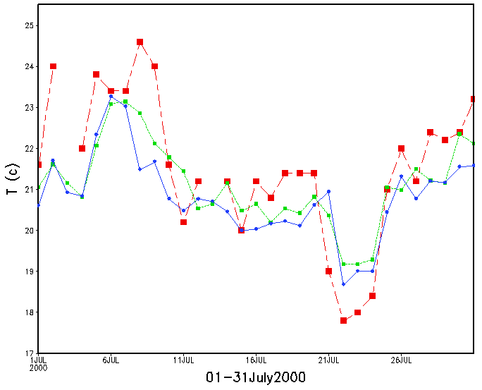
Comparison between CFSR, SARR and Observation
(1-31 July 2000)
OBS CFSR SARR

Slide 11
SARR Products
Archival and Distribution
Archival Format (Reanalysis):
IEEE (suitable for GrADS)
NetCDF
GRIB2
Archival Format (Observed data):
ASCII (GTS)
PrepBUFR
little-R
Original format of data
Archival online/nearline disk, Tapes
Available to Partner Organizations: Immediately

Slide 12
IMPACT of BACKGROUND ERRORS (BE) & ASSIMILATION

Slide 13
Numerical Experiments
The objective of the study is to evaluate the impact of the different back ground errors (Global and Regional) towards simulation of four Monsoon Depressions (MDs) over Indian region during SARR pilot phase period.
        27-29 July 1999 (Case-1)
        17-18 June 1999 (Case-2)
        11-12 June 1999 (Case-3)
        6-8 August 1999 (Case-4)
For this purpose three numerical experiments are carried with WRF-3DVAR as follows:
    CNTL: Without data assimilation using NCEP re- analyses as IC and BC.
    BG-3DV: Data assimilation using NCEP global Background Error (BE).
    3) BR-3DV: Data assimilation using own calculated BE over SARR region.
The additional observations viz. SYNOP, SHIP, TEMP, BUOYS, PILOT, GEOMV, AIREP etc. are used to improve the model initial condition derived from coarse resolution large scale global analysis.

Slide 14
a)
b)
c)
Mean RMSE from BR-3DV and BG-3DV of O-A for a) U (m/s), b) V (m/s) and c) T (K).

Slide 15
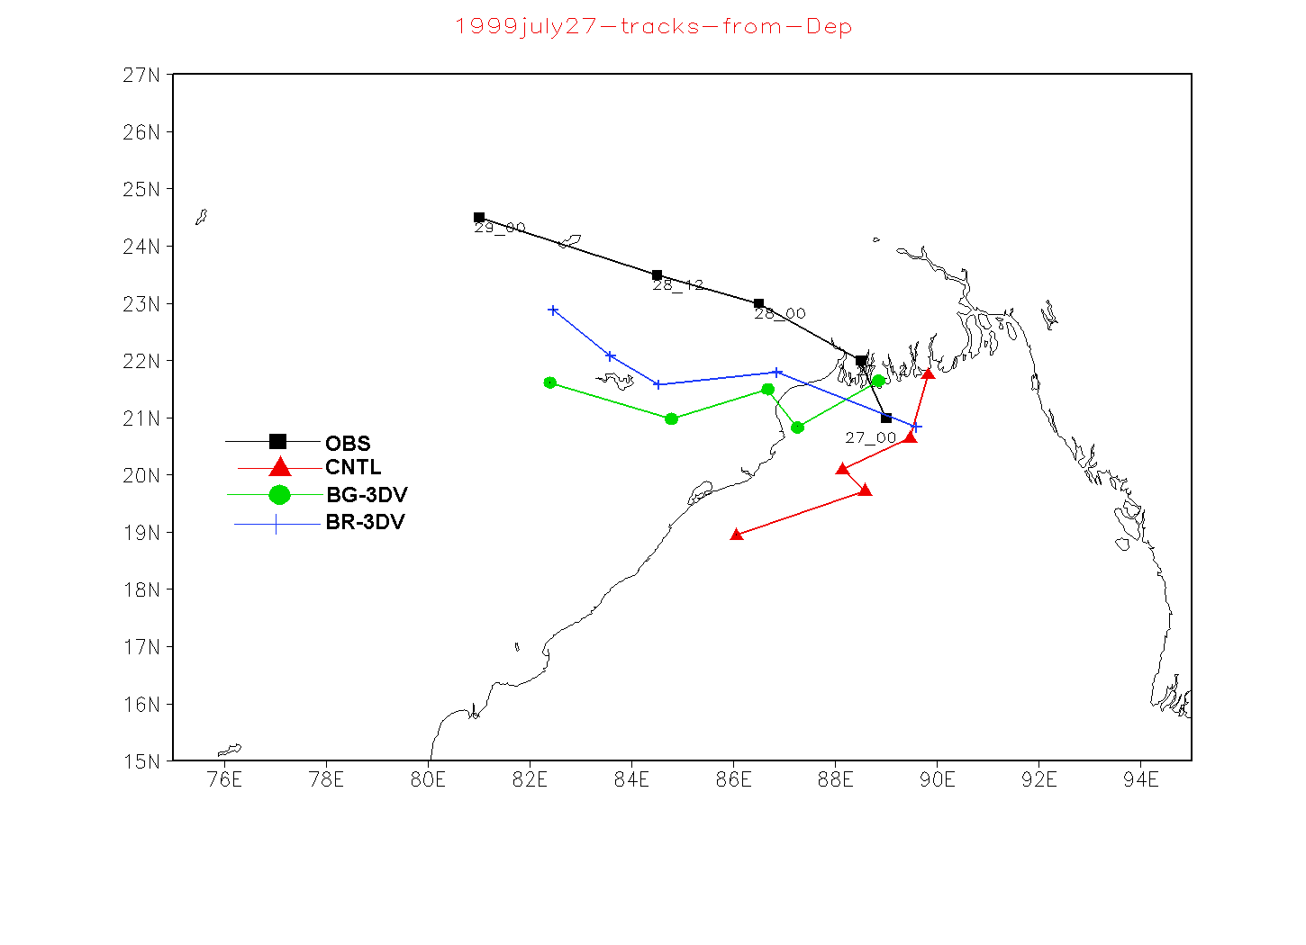
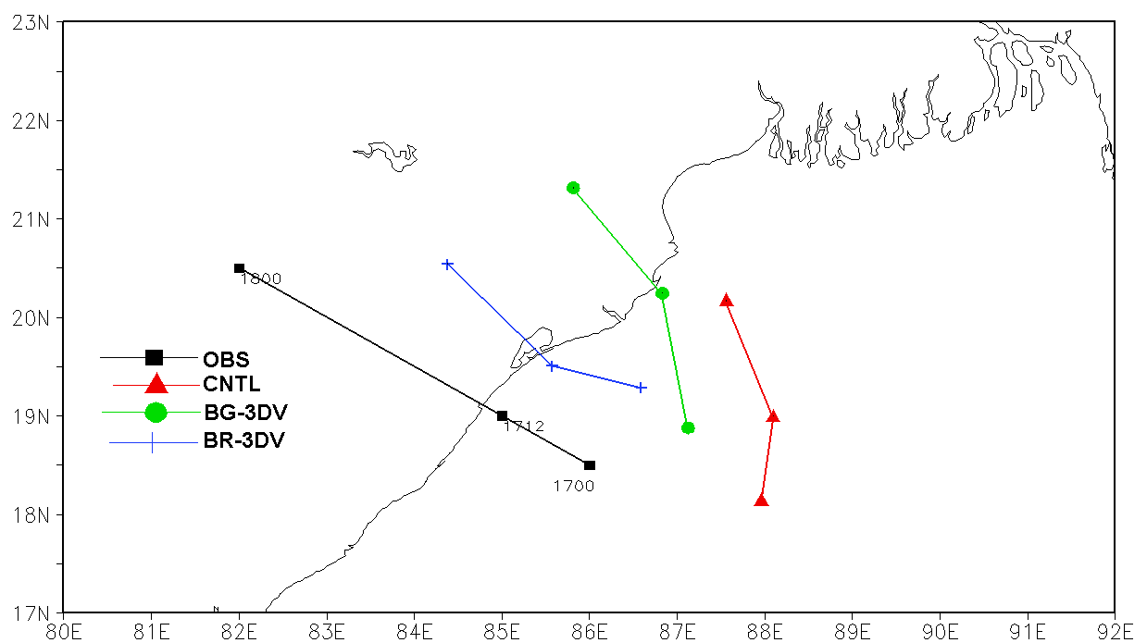
Case-1
Case-2

Slide 16
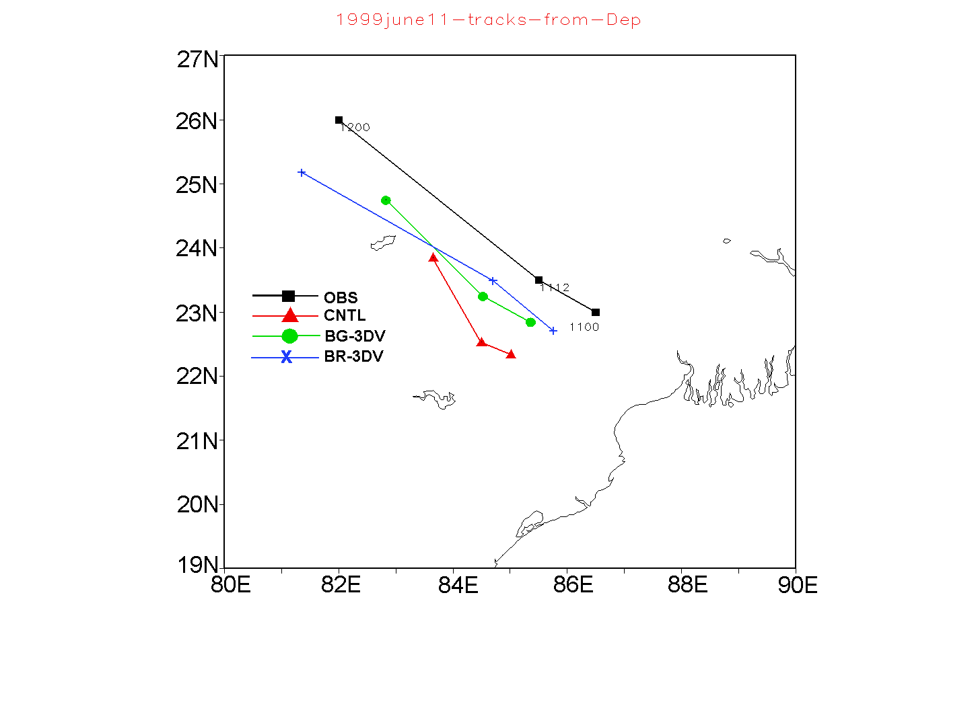
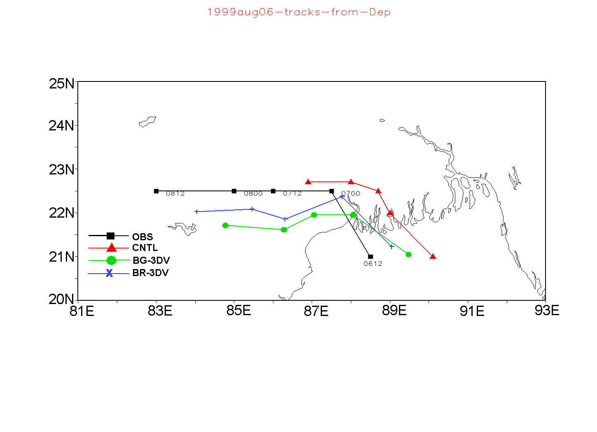
Case-3
Case-4

Slide 17
Spatial RMSE (mm) and Correlation Co-efficient (CC) of rainfall over the area (Lat=150-250N; Lon=750-900E) for all cases.
Cases | RMSE |  |  | CC
 | CNTL | BG-3DV | BR-3DV | CNTL | BG-3DV | BR-3DV
Case-1 (27-29 July 99) | 29. 62 | 26. 24 | 22.15 | 0.23 | 0.36 | 0.52
Case-2 (17-18 June 99) | 24. 32 | 22. 31 | 18. 38 | 0.21 | 0.33 | 0.46
Case-3 (11-12 Jun 99) | 26. 93 | 22. 54 | 18. 68 | 0.26 | 0.35 | 0.46
Case-4 (6-8 Aug 99) | 40. 59 | 34. 25 | 29. 41 | 0.33 | 0.46 | 0.52
Mean | 30. 37 | 26. 34 | 22. 16 | 0.26 | 0.38 | 0.49

Slide 18
Mean VDEs (km) and gain skill of experiments

