Slide 1
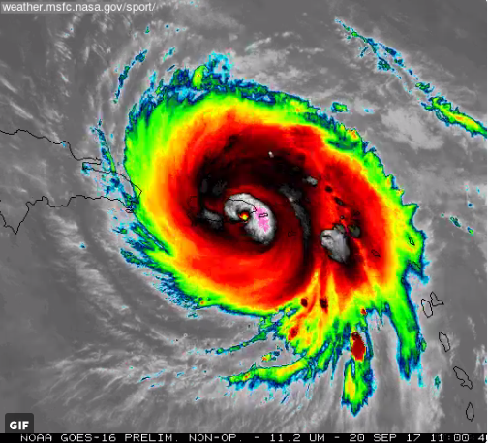
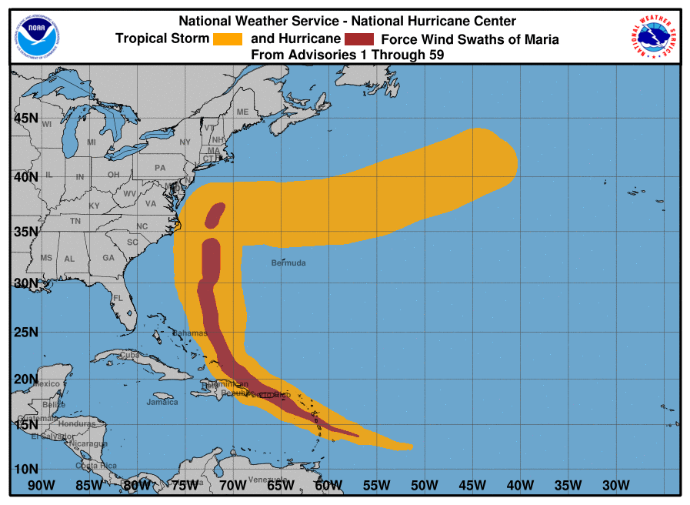
Recap of 9/14 MEG Briefing on Hurricane Maria (2017)
Logan Dawson, Tracey Dorian, Corey Guastini, and Geoff Manikin

Slide 2
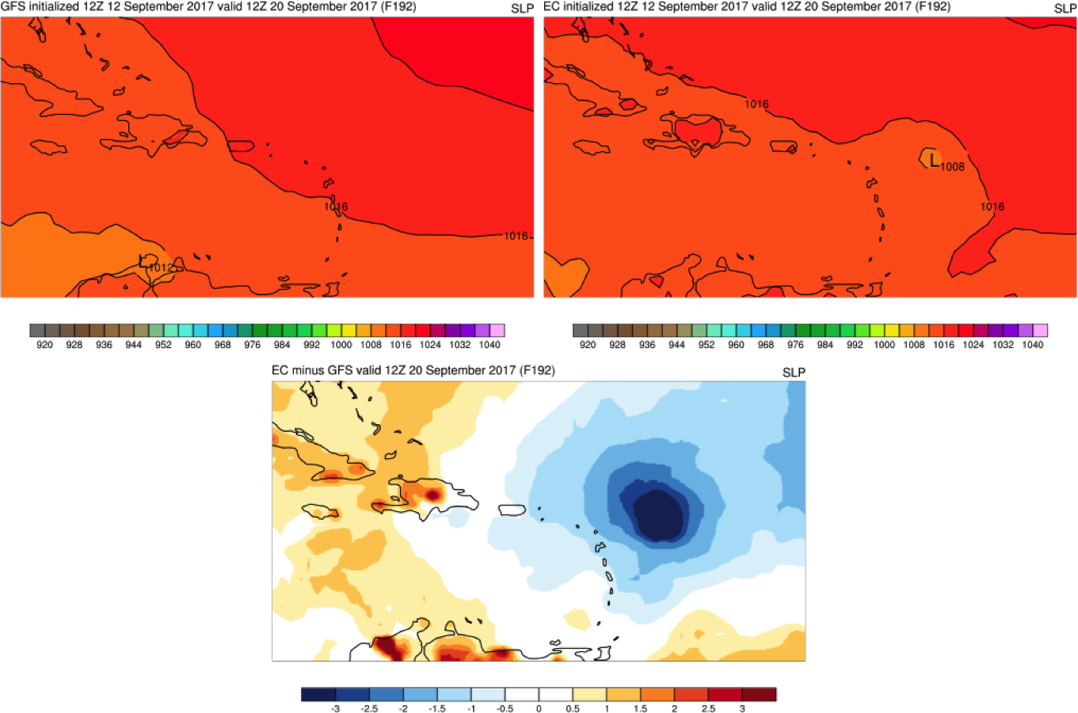
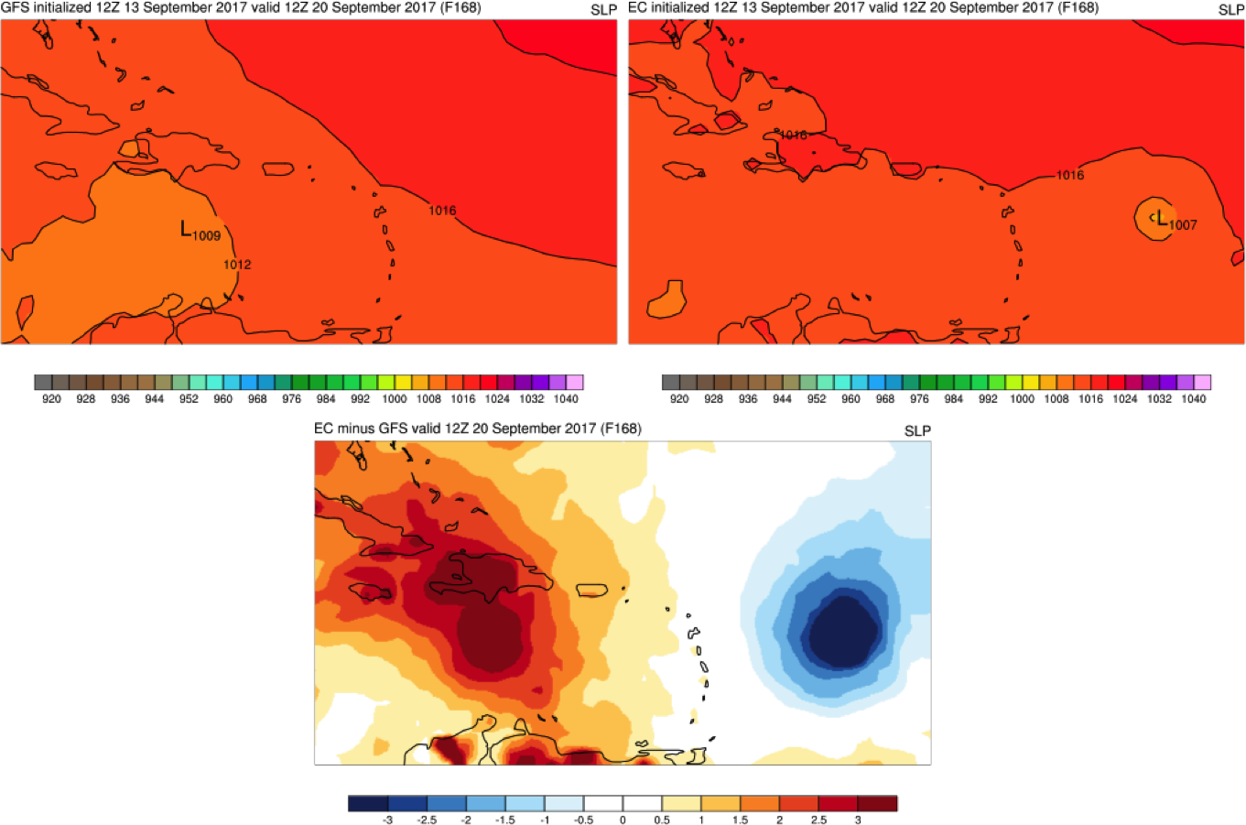
At Medium Ranges, EC and GFS Hinted at a Tropical Cyclone in Puerto Rico’s Vicinity
MSLP forecasts valid at 12Z Wednesday, 20 September, roughly the time of landfall in Puerto Rico
EC – GFS MSLP difference fields are also shown
During the 12Z 9/12 cycle, the EC showed a closed area of low pressure to the east of the Leeward Islands
The 12Z 9/13 EC continued to show a weak closed low in the same area
At this time, the 12Z 9/13 GFS showed a broad area of low pressure to the southwest of Puerto Rico in the Caribbean Sea
12Z 9/12 GFS – F192
Min Pressure: 1012 mb
12Z 9/12 EC – F192
Min Pressure: 1008 mb
EC - GFS
12Z 9/13 GFS – F168
Min Pressure: 1009 mb
12Z 9/13 EC – F168
Min Pressure: 1007 mb
EC - GFS

Slide 3
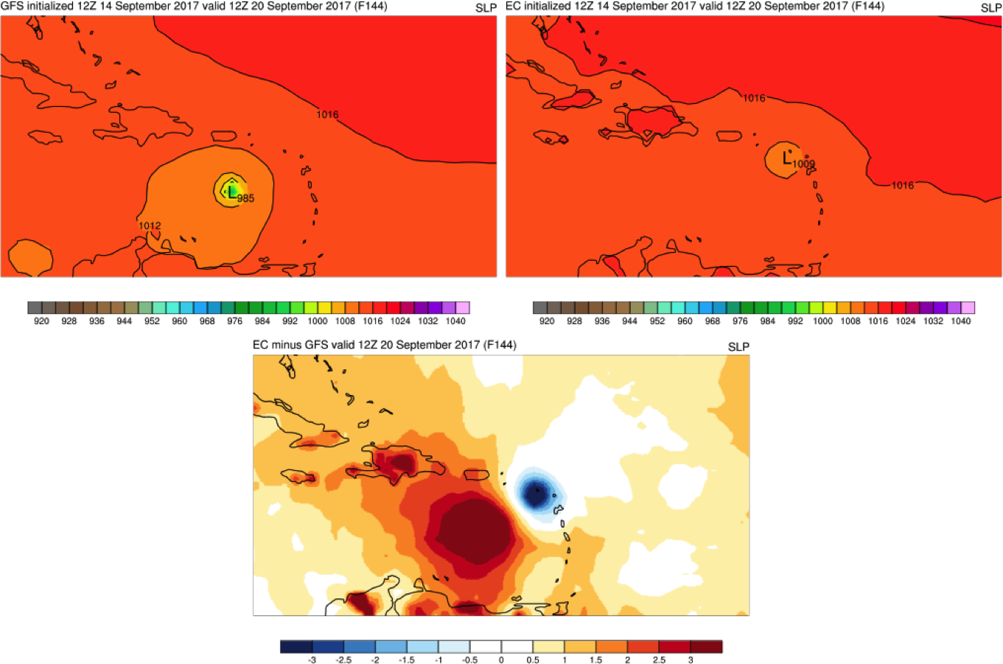
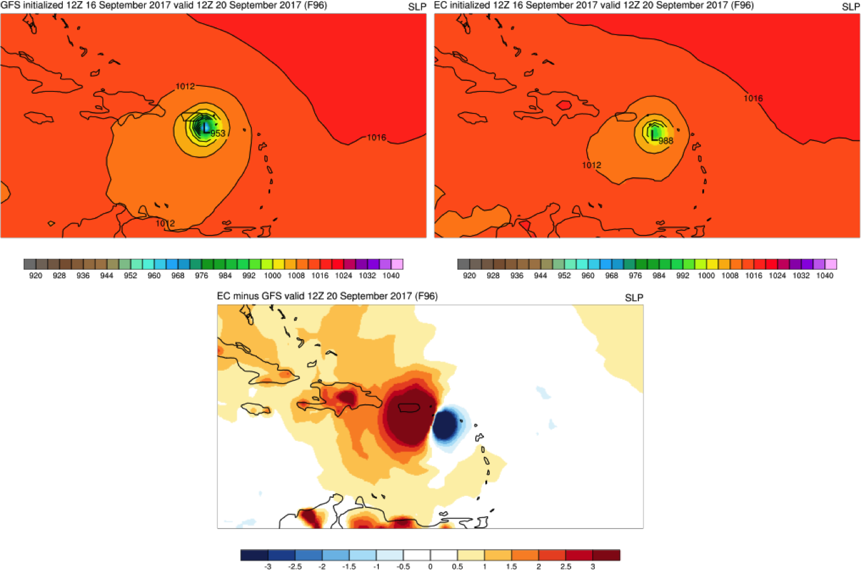
At Medium Ranges, EC and GFS Hinted at a Tropical Cyclone in Puerto Rico’s Vicinity
MSLP forecasts valid at 12Z Wednesday, 20 September, roughly the time of landfall in Puerto Rico
EC – GFS MSLP difference fields are also shown
The 12Z 9/14 GFS predicted a strong tropical cyclone centered to the south of Puerto Rico
The 12Z 9/14 EC showed a weaker storm impacting the Leeward Islands
By the 12Z 9/16 cycle, the GFS and EC showed a high potential for Maria to impact Puerto Rico
During the 12Z 9/16 cycle, the GFS had a better timing and intensity forecast than the EC
12Z 9/14 GFS – F144
Min Pressure: 985 mb
12Z 9/14 EC – F144
Min Pressure: 1009 mb
EC - GFS
12Z 9/16 GFS – F096
Min Pressure: 953 mb
12Z 9/16 EC – F096
Min Pressure: 988 mb
EC - GFS

Slide 4
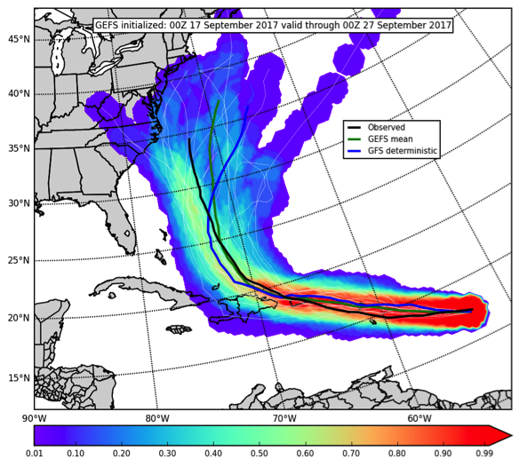
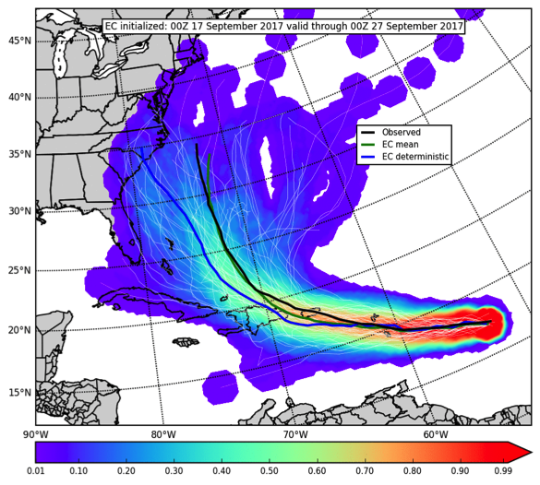
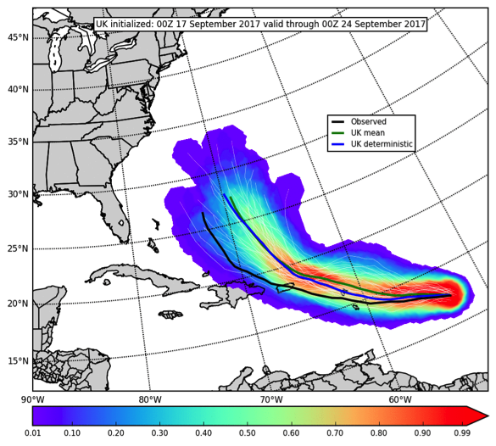
Medium-Range Ensemble Guidance from 00Z Sunday, 17 September 2017
GEFS
EC
UK
Three and a half days before Maria’s landfall in Puerto Rico, deterministic and ensemble global models were in good agreement that Maria would impact Puerto Rico
Despite a slight early poleward bias, GEFS members and the GFS deterministic indicated a high probability of a landfall in Puerto Rico
EC mean and EC deterministic showed an eventual bias to the left of the observed track, but EC members still indicated a relatively high track probability over Puerto Rico
UK mean and UK deterministic showed a strong poleward bias with the majority of UK members forecasting Maria to pass to the northeast of Puerto Rico

Slide 5
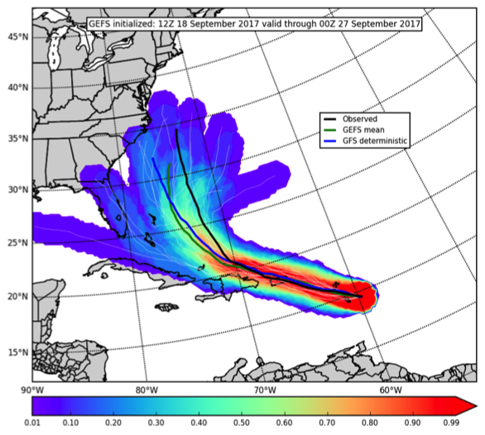
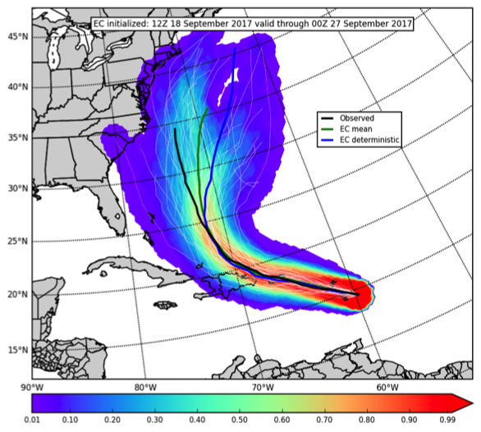
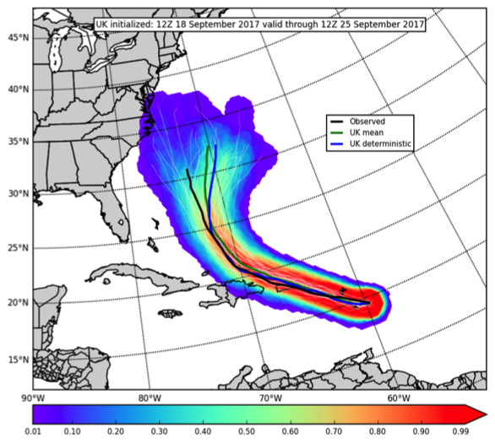
Medium-Range Ensemble Guidance from 12Z Monday, 18 September 2017
GEFS
EC
UK
Two days before Maria’s landfall in Puerto Rico, deterministic and ensemble global models showed high confidence in a direct hit to Puerto Rico
GEFS mean and the GFS deterministic extended high track probabilities and very closely predicted Maria’s observed track through 70° W
EC members, EC deterministic, UK members, and UK deterministic all adjusted and closely predicted Maria’s track with high track probabilities over Puerto Rico
Track errors and uncertainty for all systems increased once Maria turned north. GEFS/GFS were generally to the left of observed; EC and UK were generally to the right.

Slide 6
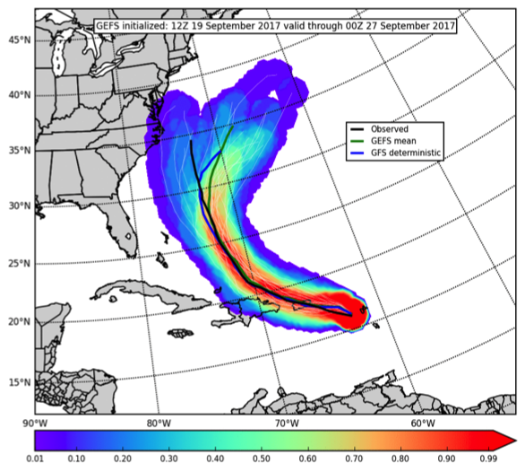
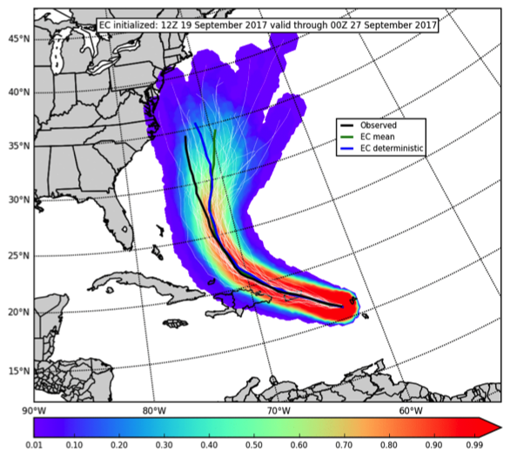
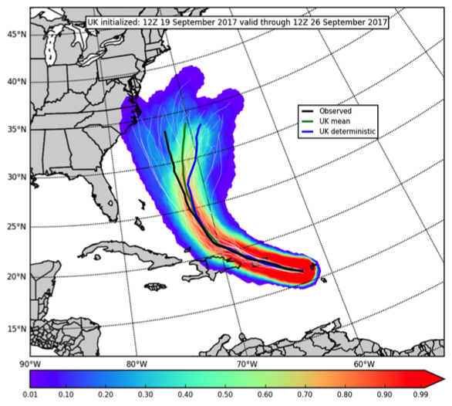
Medium-Range Ensemble Guidance from 12Z Tuesday, 19 September 2017
GEFS
EC
UK
One day before Maria’s landfall in Puerto Rico, deterministic and ensemble global models maintained high confidence in a direct hit to Puerto Rico
All systems maintained high confidence in Maria directly impacting Puerto Rico and eventually turning more northward as the storm passed Hispaniola
After the north turn, global ensembles showed uncertainty in whether Maria would impact the eastern seaboard of the CONUS before accelerating east across the Atlantic
Dynamic tropopause analyses suggested Maria’s track uncertainty in the midlatitudes was likely related to a complex upper level flow pattern over eastern North America

Slide 7
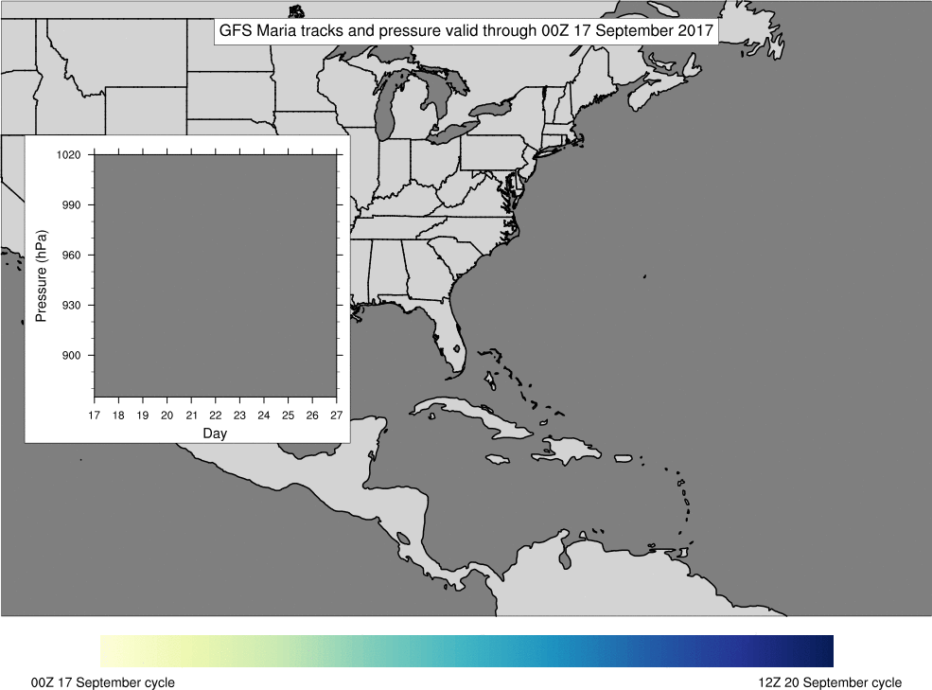
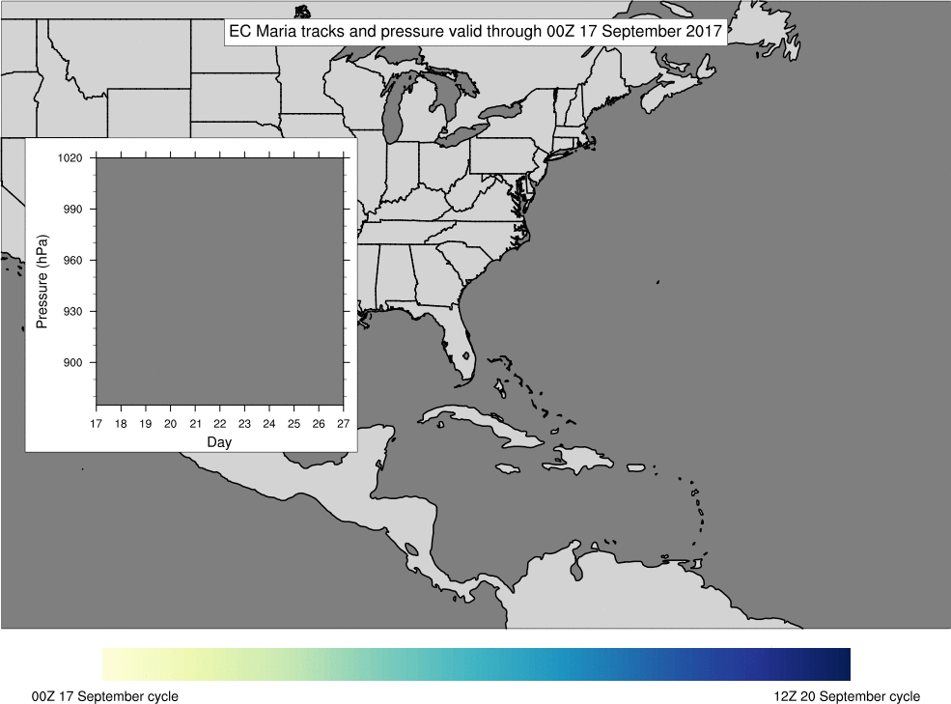
GFS and EC Tracks Were Tightly Clustered Until Maria Turned Northward
Before landfall in Puerto Rico, track errors were relatively low for GFS and EC forecasts
After landfall in Puerto Rico, track errors and uncertainty drastically increased, likely due to a complex flow pattern in the midlatitudes
GFS and EC both underpredicted the extent of deepening during the rapid intensification period early in Maria’s lifetime
After Maria made landfall in Puerto Rico, EC and even more so the GFS overpredicted Maria’s strength as the storm moved north into the midlatitudes

Slide 8
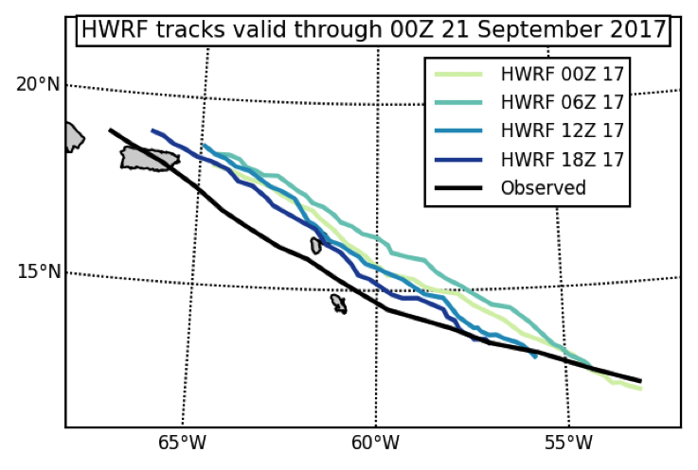
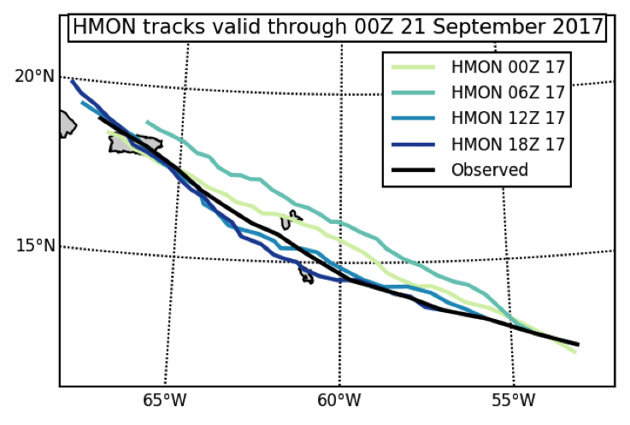
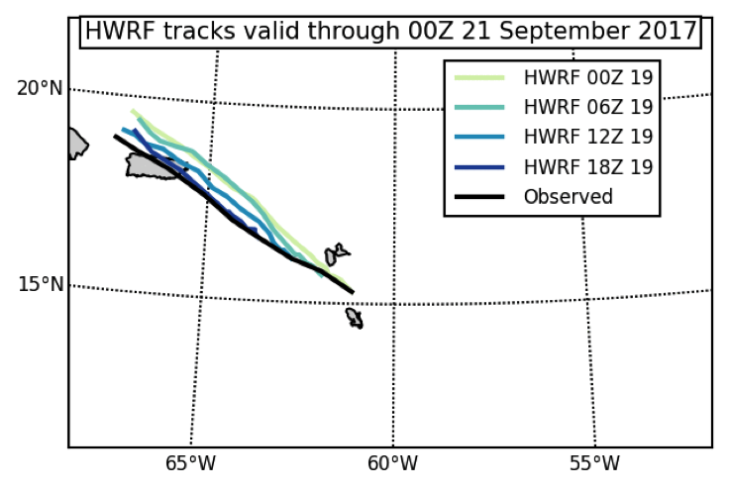
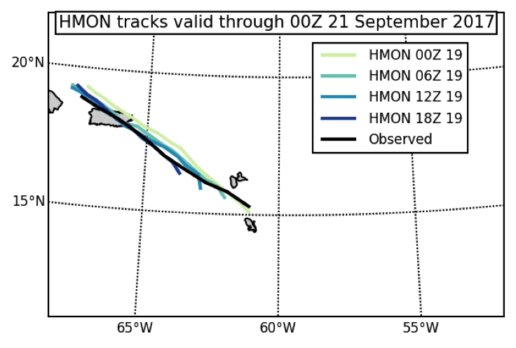
Poleward Bias in Early HWRF Forecasts Were Significant
(in the context of expected impacts to Puerto Rico)
Sunday, 9/17 HWRF Cycles
Sunday, 9/17 HMON Cycles
Tuesday, 9/19 HWRF Cycles
Tuesday, 9/19 HMON Cycles
Roughly two days prior to landfall, HWRF was indicating Puerto Rico would not take a direct hit from Maria. HMON, GFS, and ECMWF were all in consensus for a PR landfall
HWRF maintained this bias until approximately 24 h before landfall

Slide 9
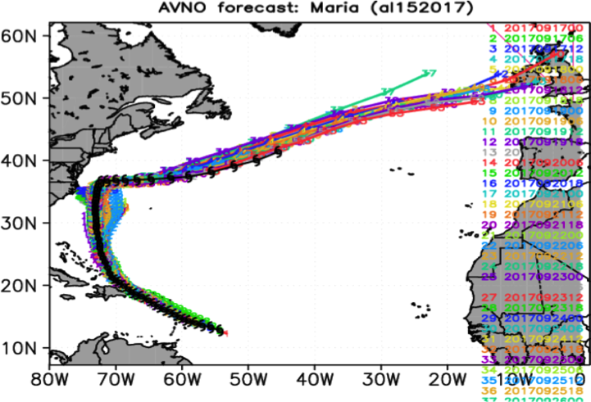
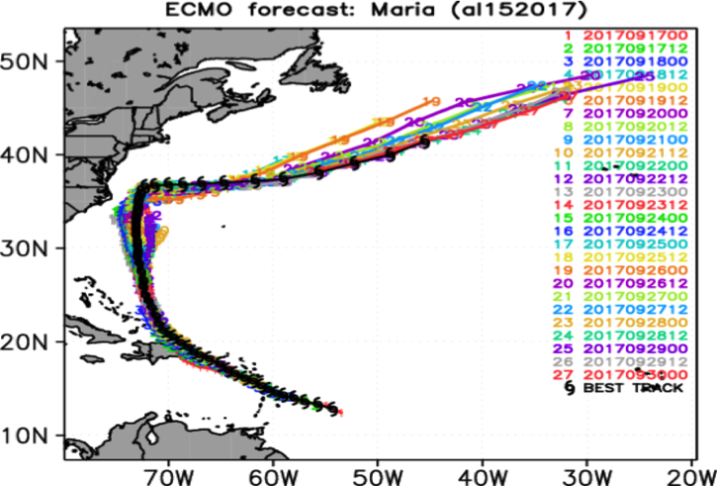
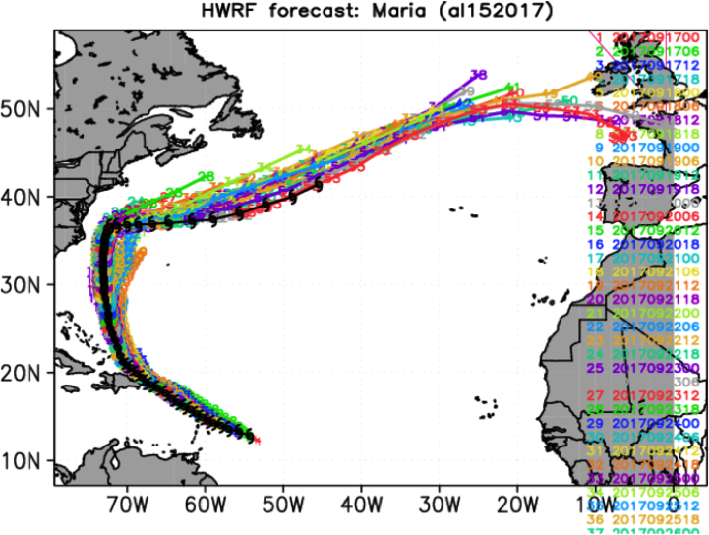
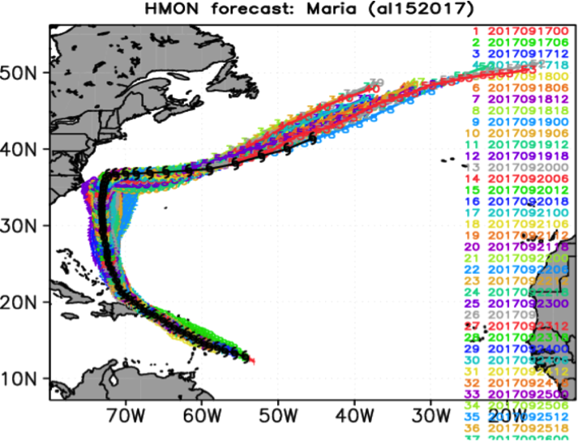
Plots courtesy of
Avichal Mehra
Composite Track Forecasts
GFS
EC
HWRF
HMON
Forecast track errors were quite low prior to Puerto Rico landfall and subsequently increased as Maria made a northward turn and moved into the midlatitudes.
Track errors further increased with uncertainty in 1) Maria’s proximity to the Outer Banks and 2) timing of right turn and acceleration eastward across the Atlantic Ocean
Complex upper level flow likely caused the increase in track errors in the midlatitudes

Slide 10
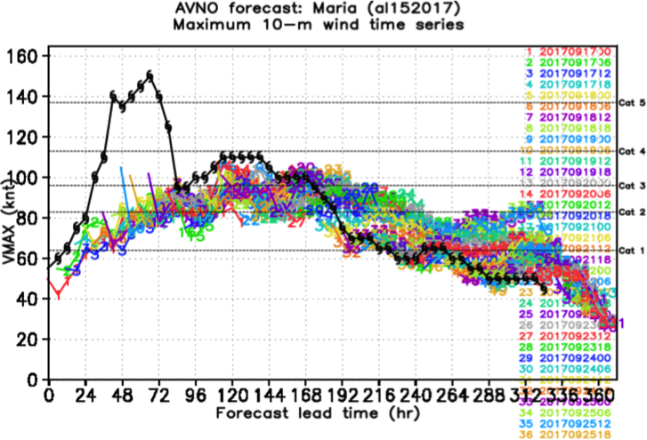
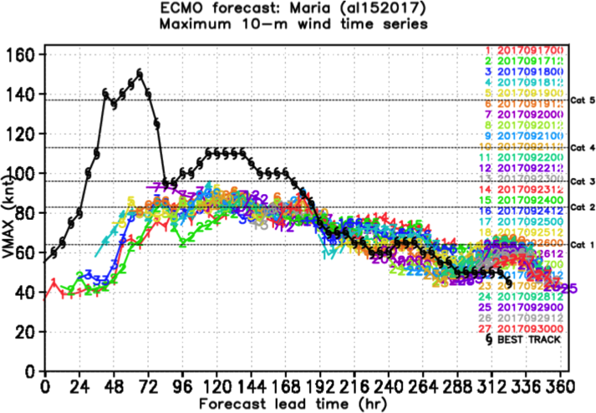
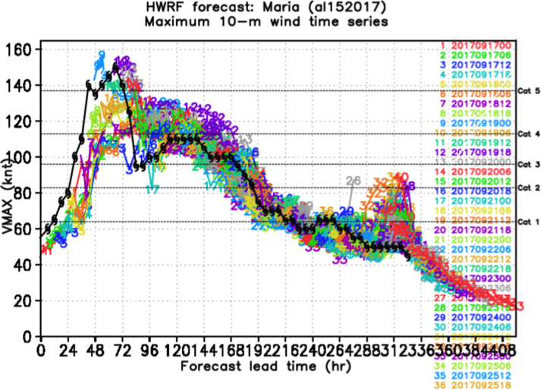
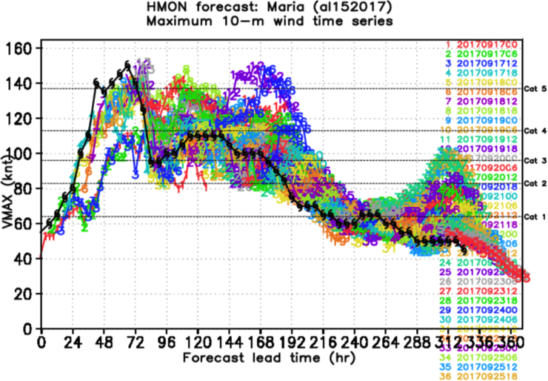
Plots courtesy of
Avichal Mehra
Composite Intensity Forecasts
GFS
EC
HMON
HWRF
GFS and EC did not hint at potential for rapid intensification prior to PR landfall. Intensity was well predicted by HWRF and HMON during this period.
HMON, HWRF, and GFS all tended to keep Maria too strong after PR landfall

Slide 11
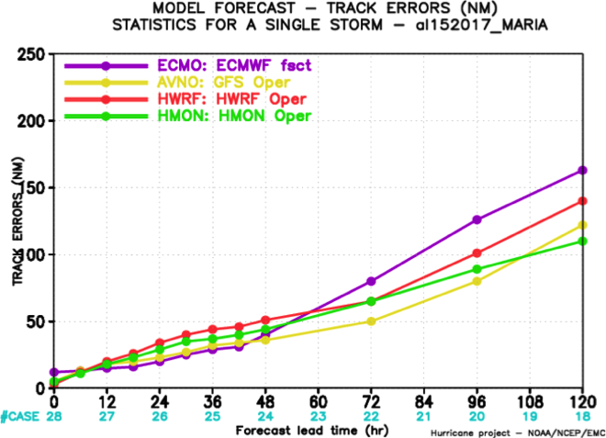
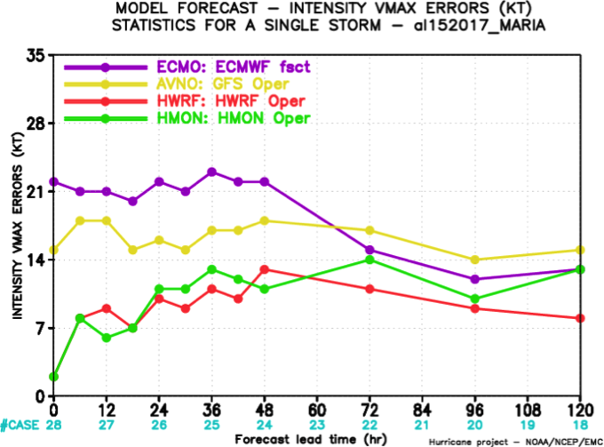
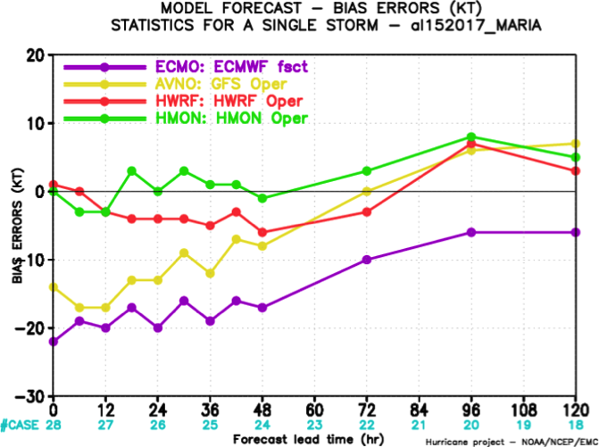
Track and Intensity Error Statistics
Track
Intensity
During the first two days:
GFS and EC tracks were more skillful than HMON and HWRF
HMON and HWRF intensity and bias were notably more skillful than GFS and EC
Beyond the first two days:
EC track forecasts generally showed the most error
There was less distinction between global and hurricane models for intensity/bias
High biases in HMON and HWRF caused increased intensity errors
Bias

Slide 12
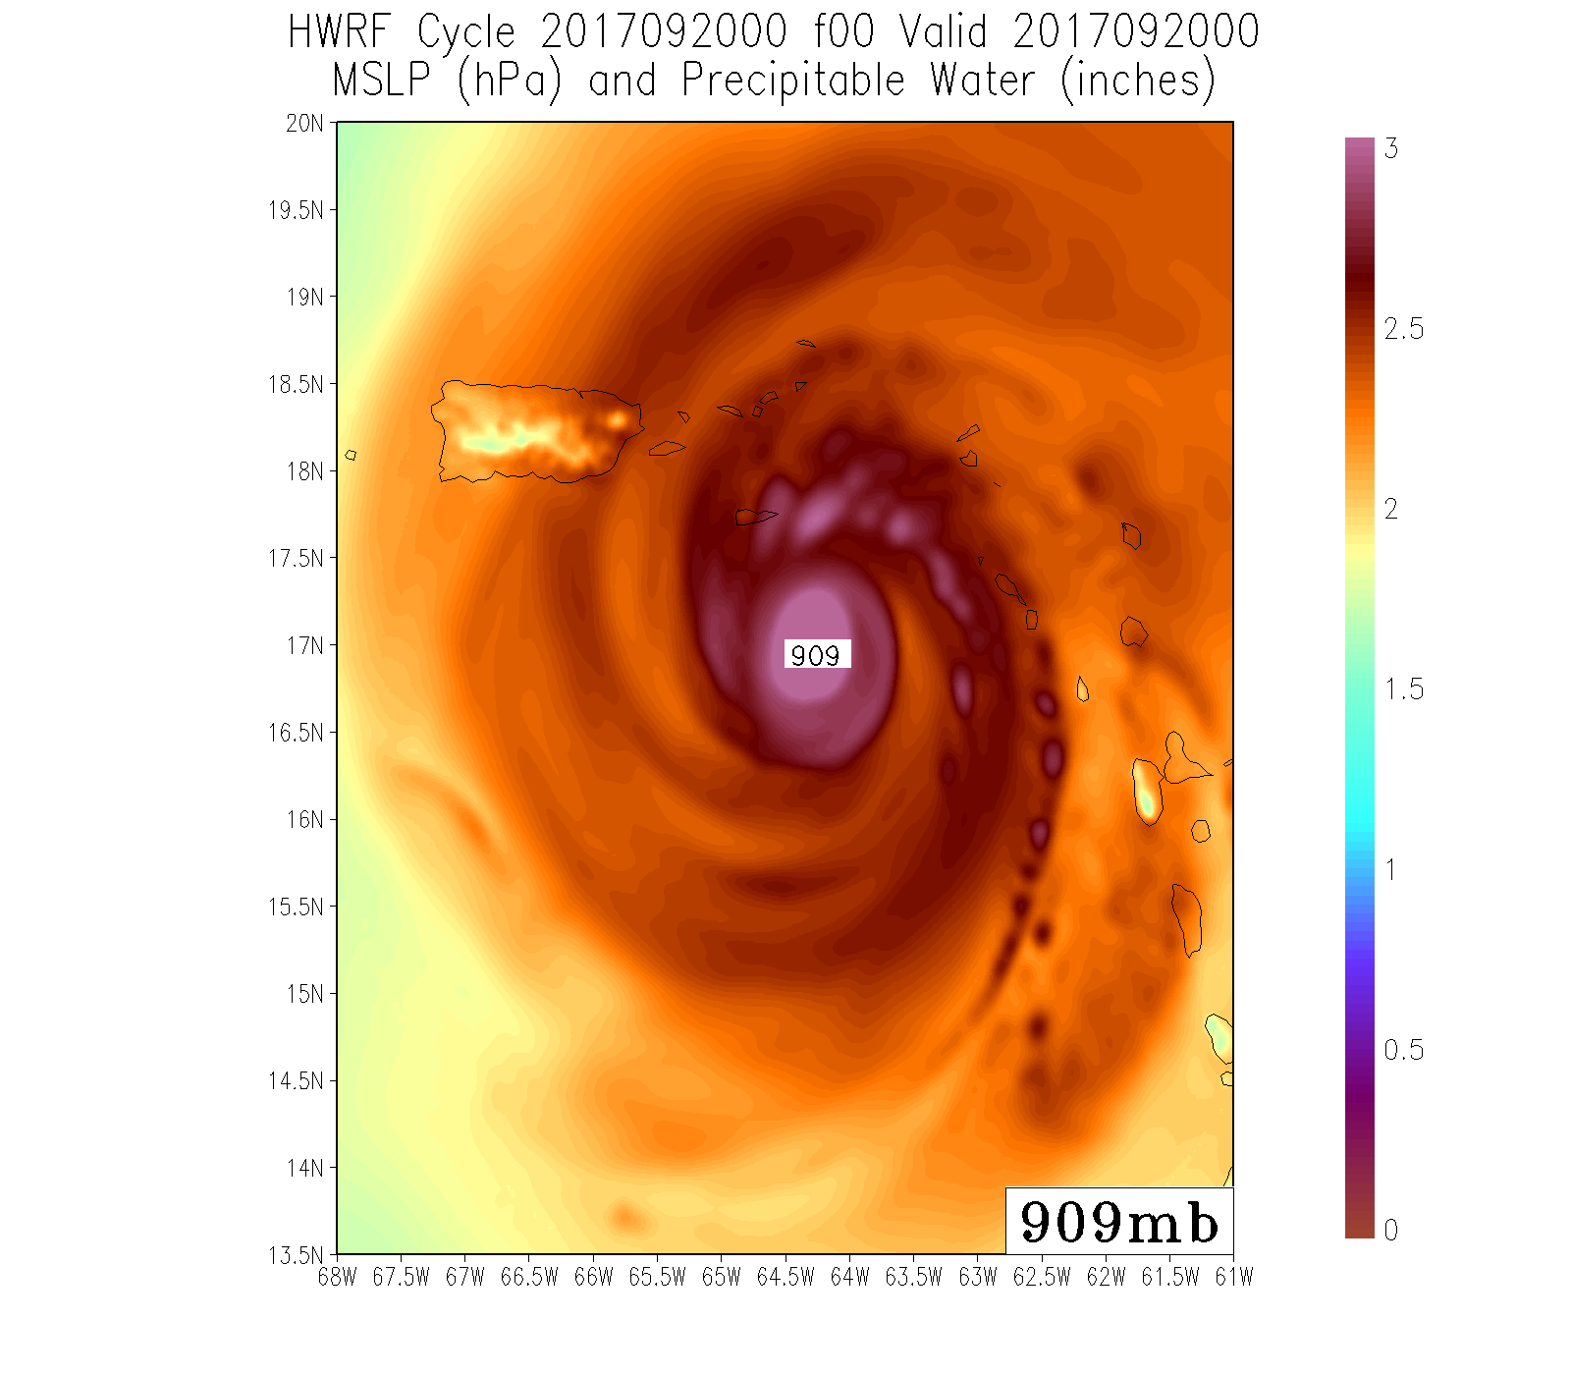
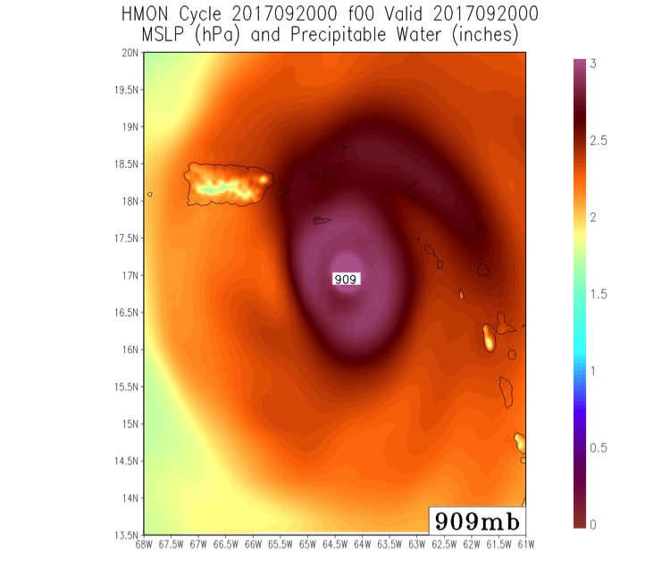
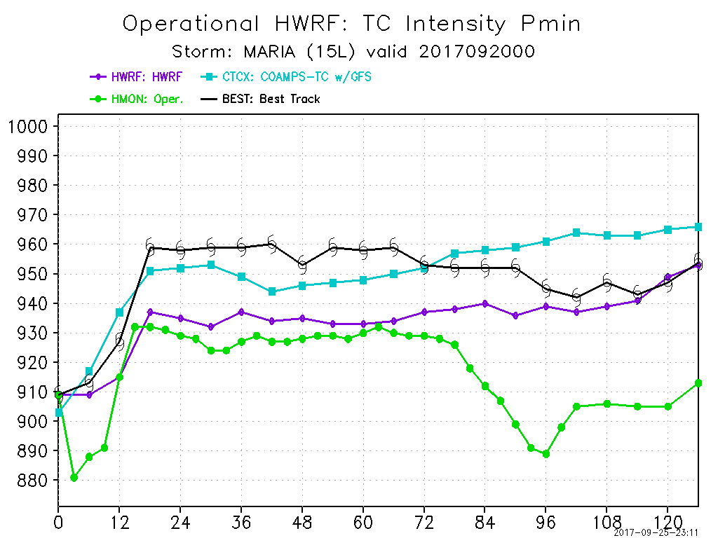
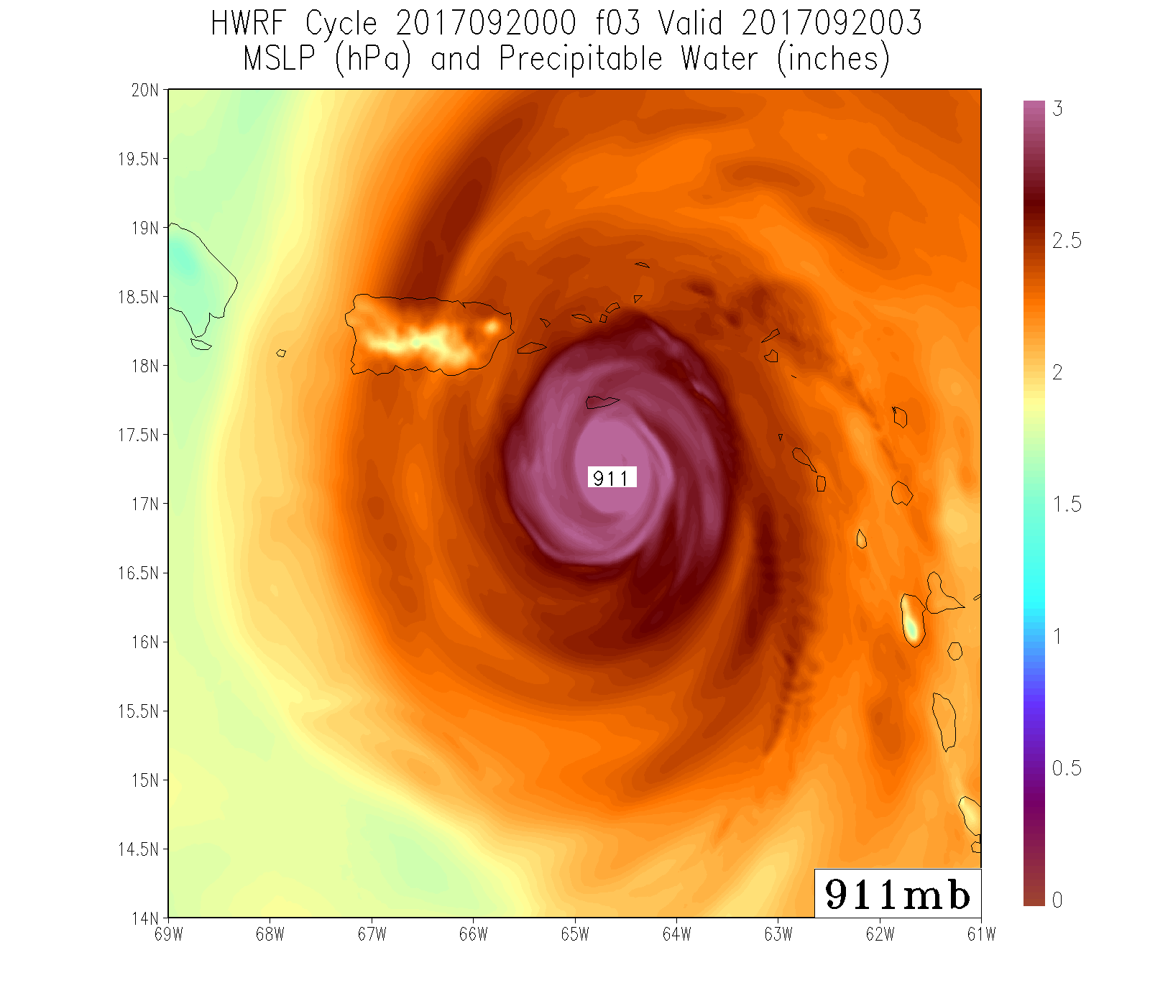
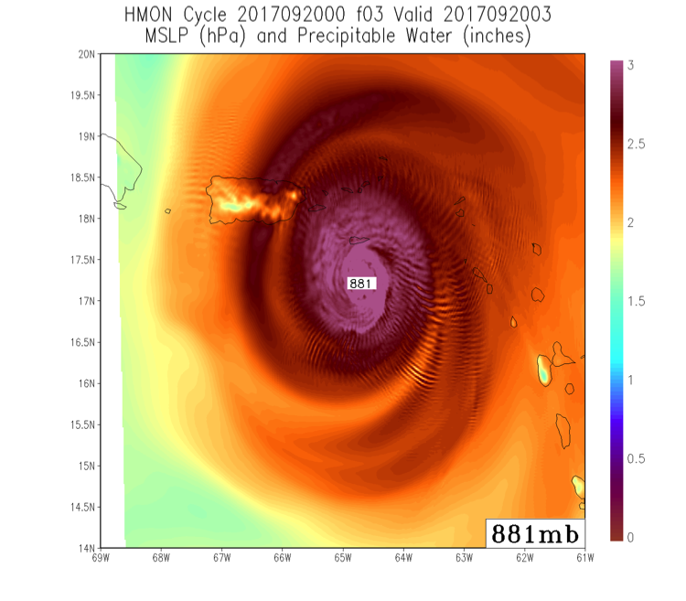
Potential Link Between HMON Initialization and Early Model Errors
00Z 9/20 HWRF – F000
Min Pressure: 909 mb
00Z 9/20 HMON – F000
Min Pressure: 909 mb
Though initial minimum pressures were the same, HMON initial fields were much smoother than HWRF fields
Ongoing work indicates noise in HMON at F003 is a result of HMON initialization procedures (currently no DA)
Will be improved for next year
00Z 9/20 HWRF – F003
Min Pressure: 911 mb
00Z 9/20 HMON – F003
Min Pressure: 881 mb
MSLP and PWAT forecasts initialized at 00Z 9/20

Slide 13
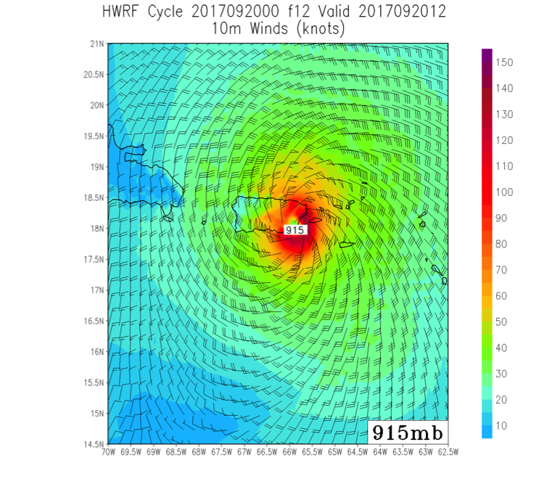
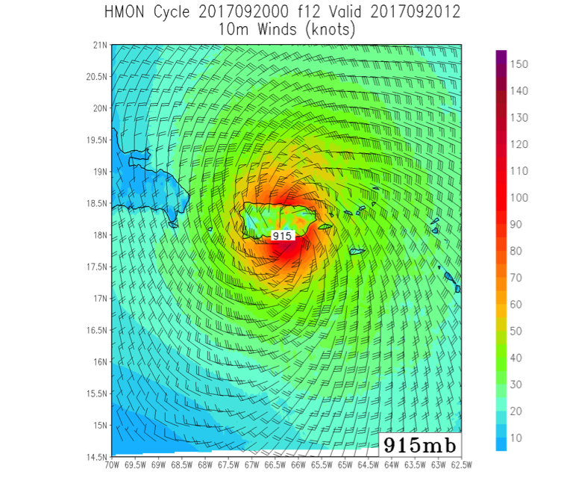
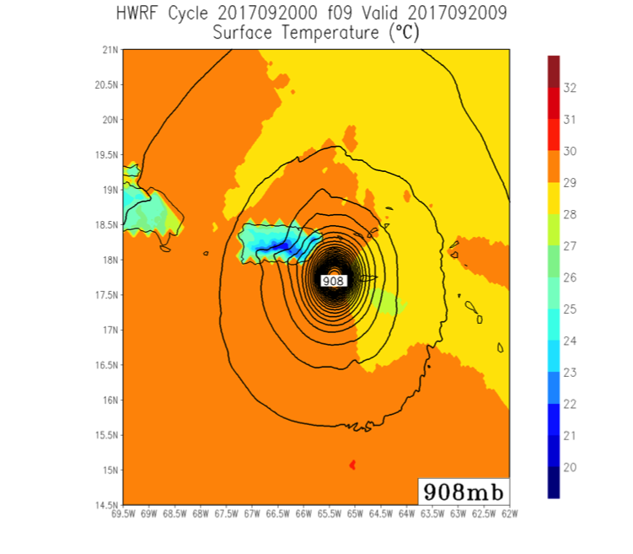
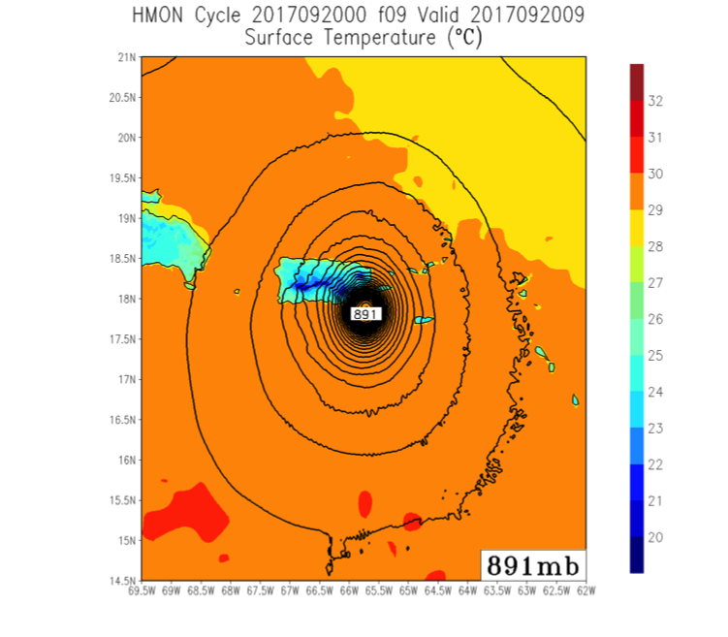
HMON Errors Noted in Forecasts for Irma Were Seen Again with Maria
12-h forecasts of 10-m wind
Though minimum pressures were the same, surface winds over Puerto Rico were much weaker in HMON than in HWRF
Underdone winds were also seen over smaller Leeward Islands
9-h forecasts of skin temperature
Lack of ocean coupling in HMON was clear. SSTs in Maria’s wake were not cooled as seen in HWRF
Extreme deepening at this time could be due to a combination of the high SSTs and suboptimal initialization
00Z 9/20 HWRF – F012
10-m Winds
00Z 9/20 HMON – F012
10-m Winds
00Z 9/20 HWRF – F009
Skin Temperature
00Z 9/20 HMON – F009
Skin Temperature
10-m wind and skin temperature forecasts initialized at 00Z 9/20

Slide 14
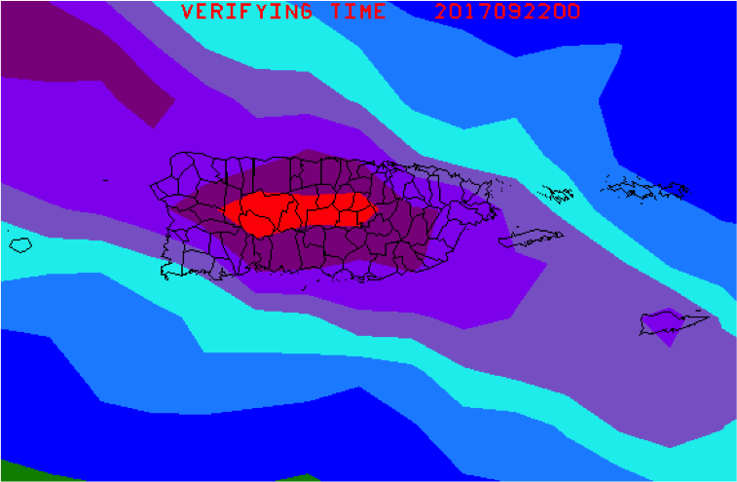
Precipitation Forecasts Generally Improved with Shorter Lead-Times
18Z 9/18 GFS
F078 – 48-h QPF
12Z 9/18 EC
F084 – 48-h QPF
12Z 9/18 NAM
F078 – 48-h QPF
18Z 9/18 NAM Nest
F060 – 60-h QPF
18Z 9/18 Hi-Res NMMB
F048 – 48-h QPF
18Z 9/18 Hi-Res ARW
F048 – 48-h QPF
QPF totals from forecasts initialized on Monday, 18 September
These 2-3 day forecasts generally showed the highest precipitation to the northeast of PR
Hi-res models showed influence of terrain in central and northeast portions of the island
In particular, the NAM nest predicted a maximum in excess of 40” in northeast PR
EC showed a broad precipitation maximum over the high terrain of central PR

Slide 15
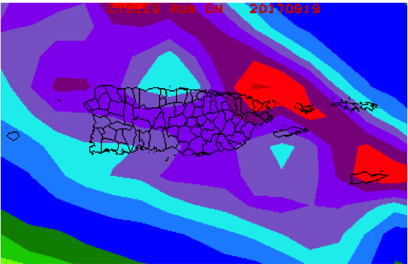
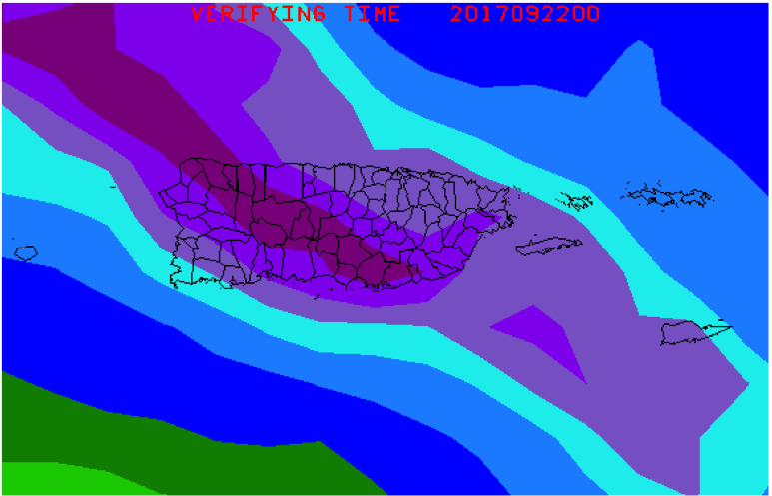
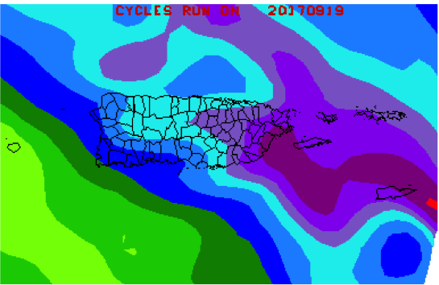
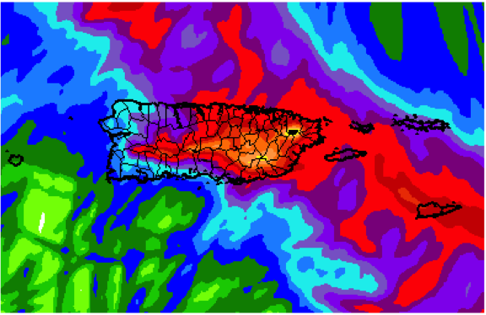
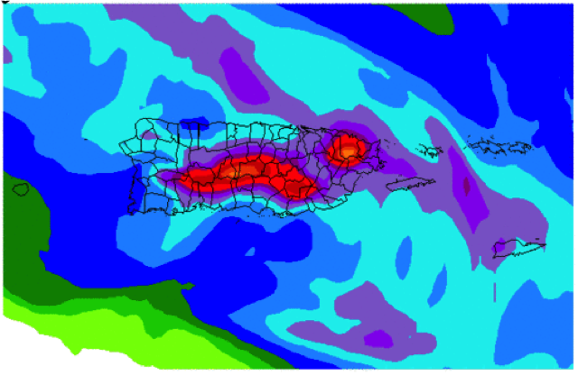
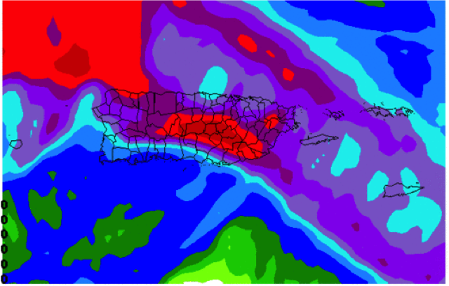
Precipitation Forecasts Generally Improved with Shorter Lead-Times
18Z 9/19 GFS
F054 – 48-h QPF
12Z 9/19 EC
F060 – 48-h QPF
12Z 9/19 NAM
F054 – 48-h QPF
18Z 9/19 NAM Nest
F060 – 60-h QPF
18Z 9/19 Hi-Res NMMB
F048 – 48-h QPF
18Z 9/19 Hi-Res ARW
F048 – 48-h QPF
QPF totals from forecasts initialized on Tuesday, 19 September
QPF was generally improved with better track forecasts, particularly for the hi-res models
Hi-res models further emphasized orographically enhanced precipitation
NAM PR nest maximum (45”+) in northeast PR appeared to match the Stage IV analysis (though there is uncertainty in the analysis due to destruction of Puerto Rico’s radars)

Slide 16
Resolution Was Key to Capturing Complex Terrain and Associated Orographic Precipitation Enhancement
12Z 9/19 NAM PR Nest
F060 – 60-h QPF
12Z 9/19 GFS
F060 – 48-h QPF
NAM Nest Surface Height
GFS Surface Height
NAM PR nest predicted high QPF amounts with totals enhanced in locations of higher terrain
From the corresponding GFS cycle, QPF was much more uniform across the island with no hint of orographic influences

Slide 17
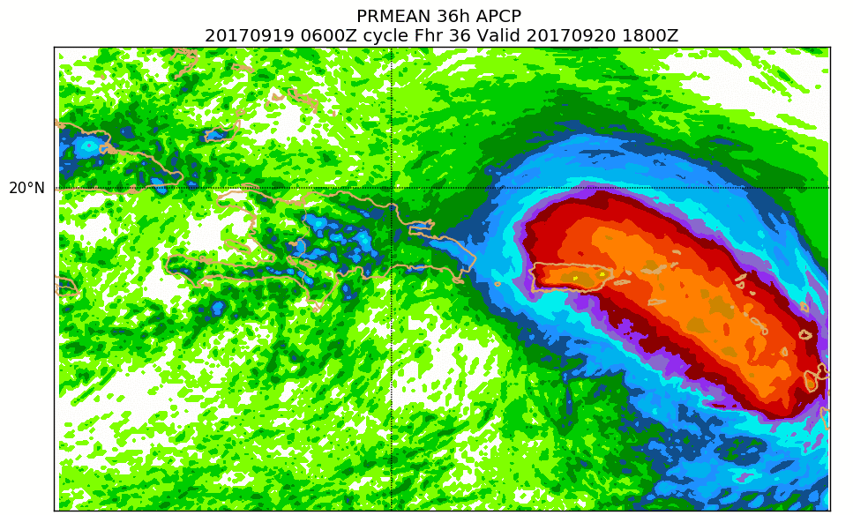
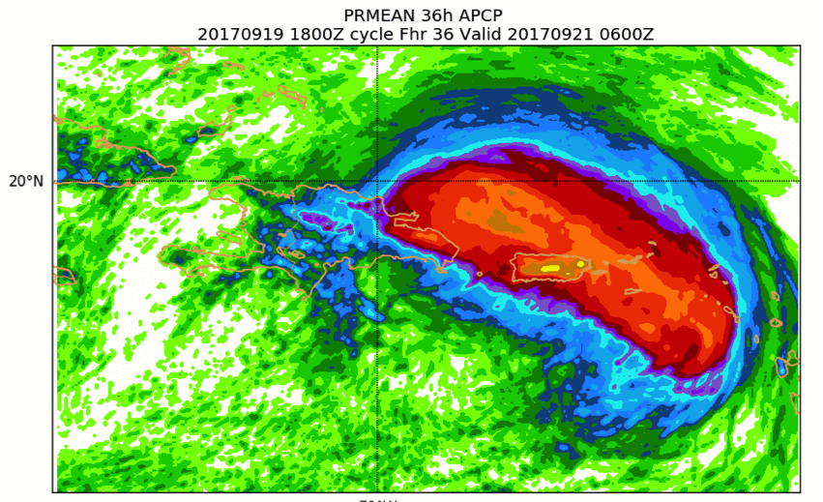
Benefit of Resolution Was Reflected in HREFv2
06Z 9/19 MEAN
F036 – 36-h QPF
18Z 9/19 MEAN
F036 – 36-h QPF
06Z 9/19 PROB-MATCHED MEAN
F036 – 36-h QPF
18Z 9/19 PROB-MATCHED MEAN
F036 – 36-h QPF
36-h QPF totals from HREFv2 cycles on Tuesday, 19 September
Benefit of resolution was reflected HREFv2 output, particularly the probability-matched mean precipitation

Slide 18
NAM PR Nest Is Not Optimally Configured to Handle Tropical Cyclones Approaching Puerto Rico from the East
Run-total QPF (left) and 10-m wind/MSLP forecasts (right) from the 06Z 9/19 (top row) and 12Z 9/19 (bottom row) cycles of NAM PR nest
The 06Z 9/19 cycle underdid PR’s QPF because Maria was predicted to pass to the northeast of Puerto Rico
Subsequently, the 12Z 9/19 cycle ramped up PR’s QPF because this cycle predicted a direct hit to Puerto Rico
Similar errors in track and intensity were also seen in the 06Z 9/19 hi-res windows
60-h QPF
F027
06Z 9/19 NAM PR Nest
60-h QPF
F021
12Z 9/19 NAM PR Nest

Slide 19
NAM PR Nest Is Not Optimally Configured to Handle Tropical Cyclones Approaching Puerto Rico from the East
NAM PR Nest
Initialization: 06Z 9/19
Initialization: 12Z 9/19
10-m wind and MSLP analyses for the NAM PR nest initialized at 06Z 9/19 (upper right) and 12Z 9/19 (lower right)
The 12Z 9/19 cycle was initialized with a stronger signal of a tropical cyclone moving into the domain
Likely aided in improving the the track forecast relative to the previous cycle
PR’s location in the eastern half of the nest limits predictability (of high-resolution guidance) when tropical cyclones are approaching from the east

Slide 20
Summary
Before landfall in Puerto Rico, global models produced better track forecasts than the hurricane models. Conversely, hurricane models produced better intensity forecasts during this period.
Track and intensity forecasts from the global and hurricane models were less skillful as Maria began moving north into the midlatitudes
HMON’s initialization procedure has been identified as a potential source of considerable model errors during the initial forecast hours (0-6 h)
High-resolution models were able to predict a reasonable pattern of precipitation accumulations because these models were capable of resolving Puerto Rico’s complex terrain
The NAM nest appeared to predict the most reasonable precipitation forecasts with maxima in excess of 40 inches in 2-3 day forecasts
Puerto Rico’s location in the high-resolution nests limits the lead time wherein tropical systems approaching from the east can be properly initialized

