Slide 1
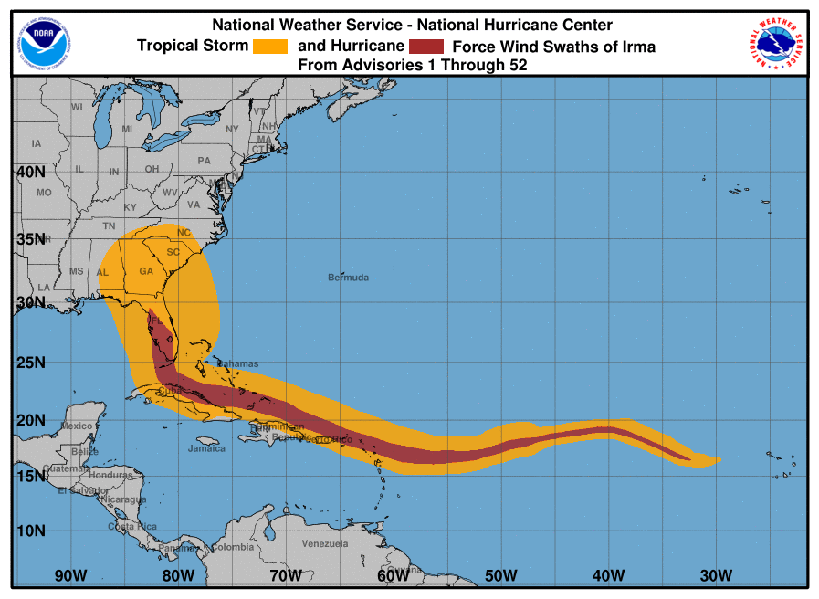
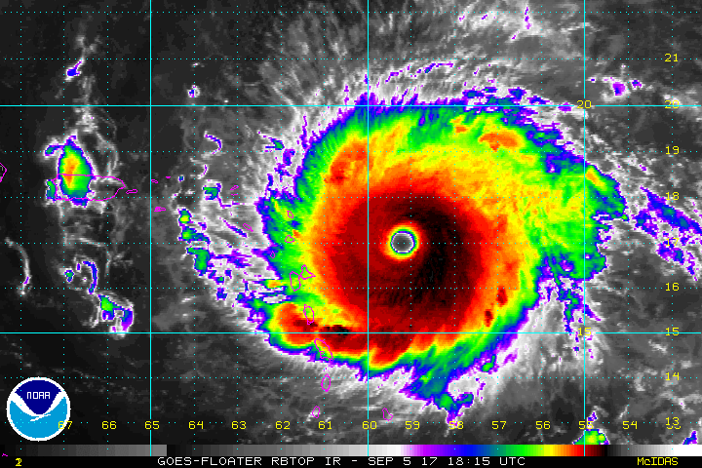
Recap of 9/14 MEG Discussion on Hurricane Irma (2017)
Logan Dawson, Tracey Dorian, Corey Guastini, and Geoff Manikin

Slide 2
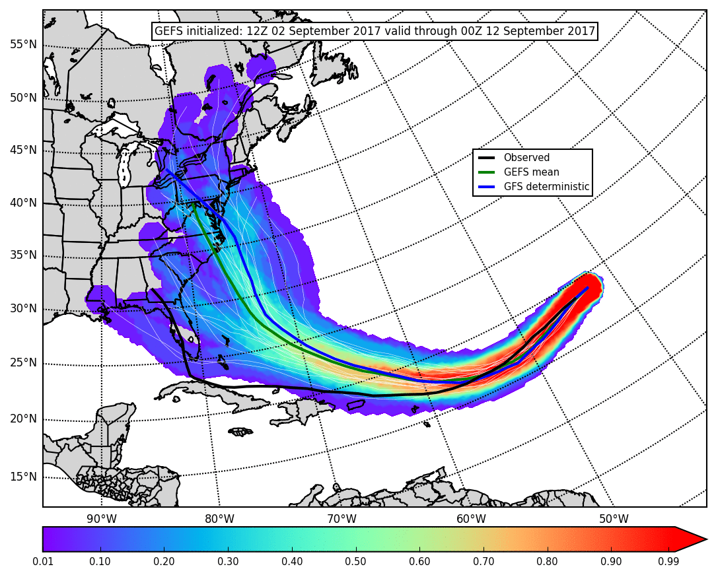
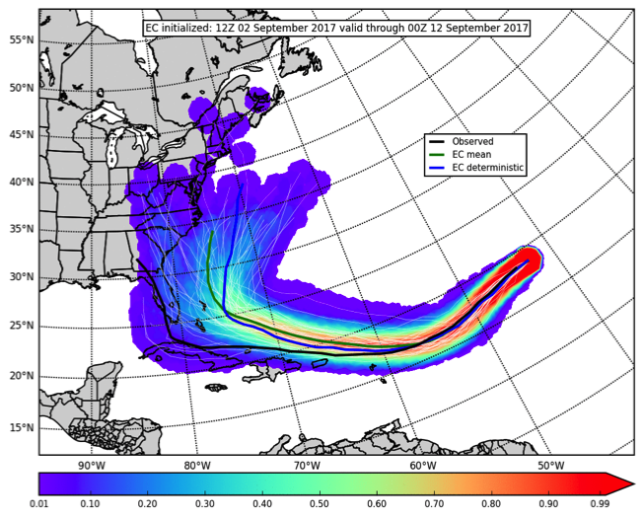
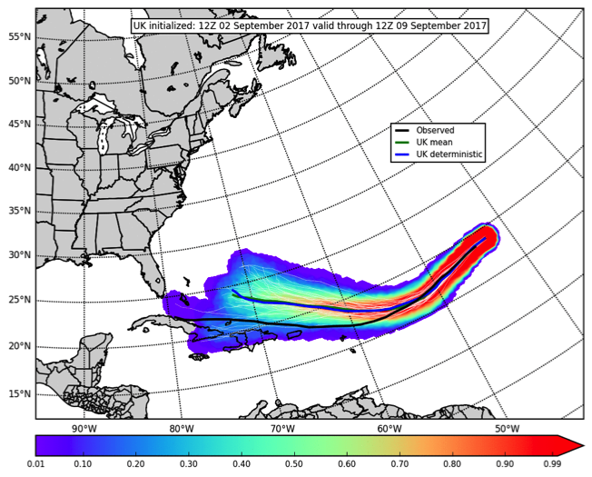
Medium-Range Ensemble Guidance from 12Z Saturday, 02 September 2017
Nine days before Florida landfall
Global ensemble guidance indicated Irma could pose a threat to the eastern seaboard of the United States
The GEFS and EC ensembles indicated landfall could occur anywhere between south Florida and the Mid-Atlantic
GEFS
EC
GEFS mean and GFS deterministic showed a likely threat to the Mid-Atlantic states
EC mean and deterministic suggested Irma recurving out to sea was a likely outcome
At this time, all ensembles clearly had a poleward bias in track with the EC having the lowest track errors at longer ranges
UK

Slide 3
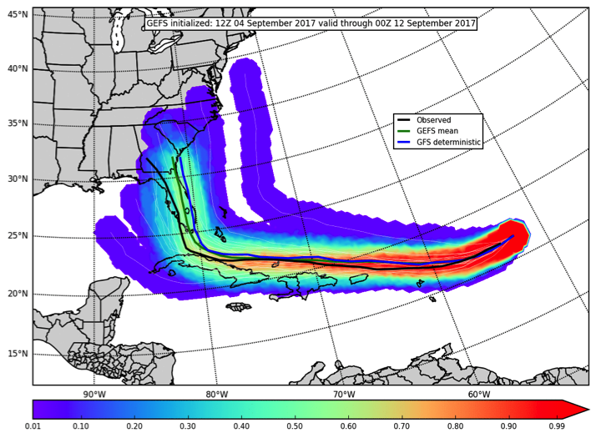
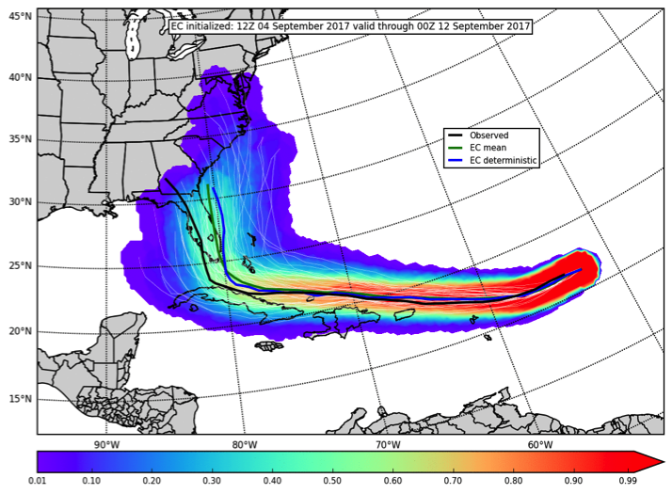
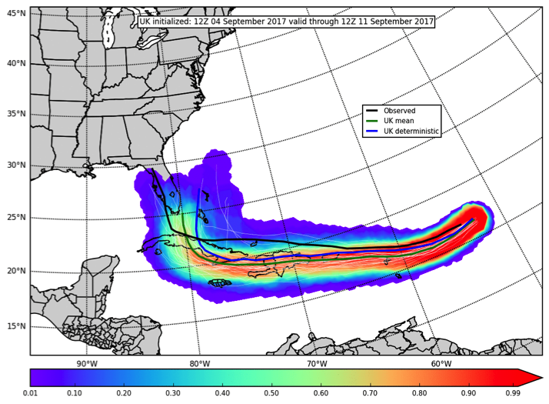
Medium-Range Ensemble Guidance from 12Z Monday, 04 September 2017
Six days before Florida landfall
Global ensembles were more focused on a likely threat to the Florida peninsula with potential tracks extending as far north as the Carolinas
At this time, all ensembles clearly suggested Irma would
GEFS
EC
make a strong right turn to the north once reaching a longitude near 80° W
After this right turn, ensemble means and deterministic runs generally showed a SE Florida landfall near Miami
GEFS mean had a slight poleward bias and UK mean had a stronger equatorward bias
EC mean and deterministic tracks were again closest to the observed track
UK

Slide 4
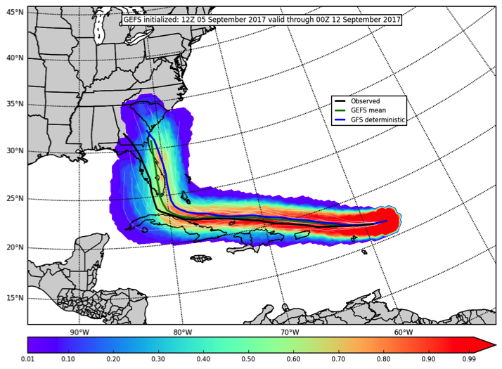
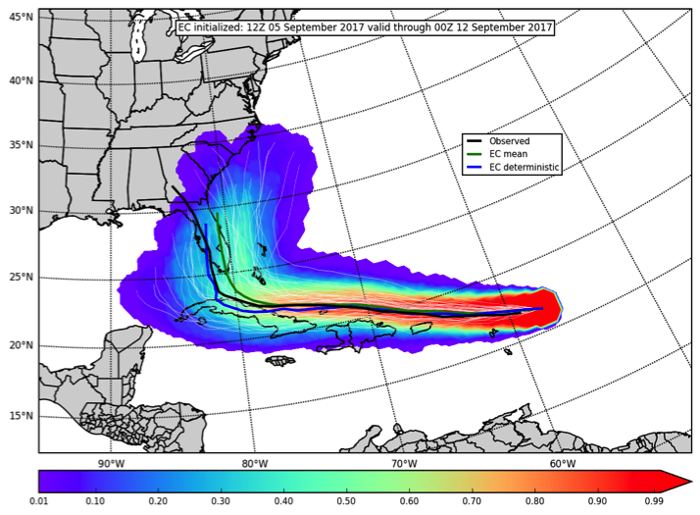
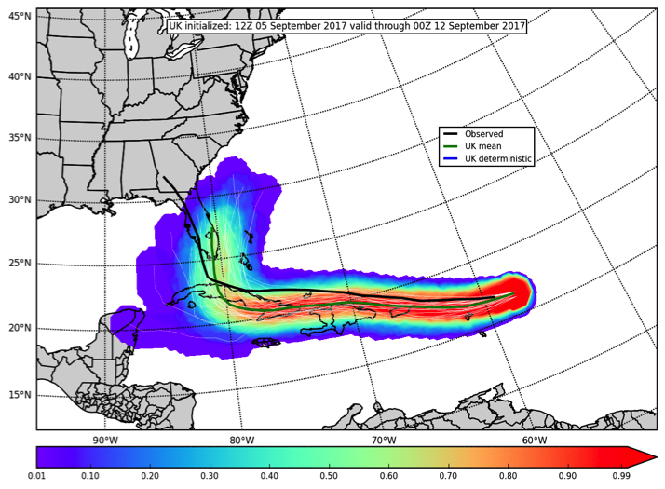
Medium-Range Ensemble Guidance from 12Z Tuesday, 05 September 2017
Five days before Florida landfall
GEFS ensemble extended higher track probabilities northward along the Atlantic coast of Florida
EC ensemble had lower probabilities over a larger area, but the EC mean and
GEFS
EC
GEFS mean tracks were quite similar
Again, GEFS mean had a slight poleward bias, UK mean had a stronger equatorward bias, and the EC mean and deterministic tracks were closest to the observed track
Comparison of ensembles showed that Irma’s forecast latitude was playing a role in determining when the right turn to the north would begin
UK

Slide 5
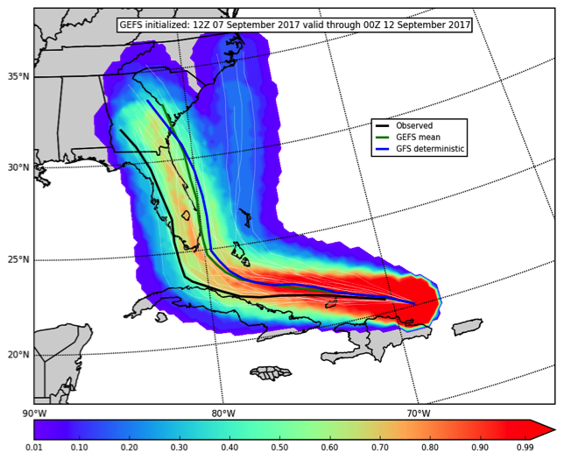
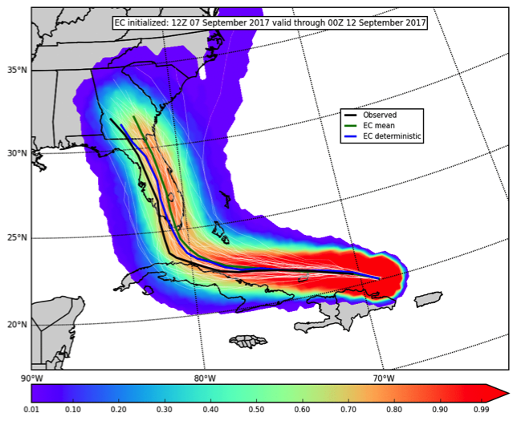
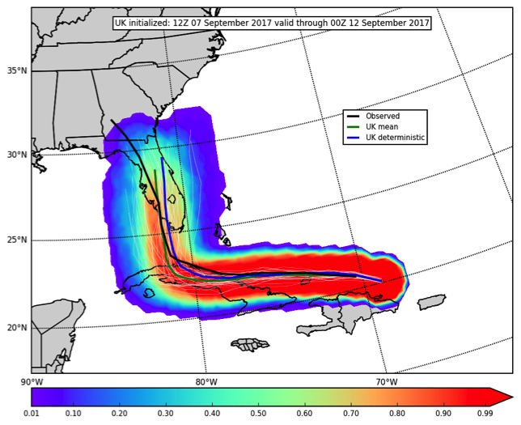
Medium-Range Ensemble Guidance from 12Z Thursday, 07 September 2017
Three days before Florida landfall
The highest GEFS ensemble probabilities were in central Florida, but the GEFS mean and GFS deterministic tracked Irma to the east of FL into GA
EC ensemble probabilities were highest in central
GEFS
EC
Florida, but the EC mean and deterministic tracked Irma into southwest Florida
UK mean and deterministic had an equatorward bias west of 80° W (with more Cuba interaction) but still made landfall in southwest Florida
GEFS ensemble’s poleward bias and early right turn is evident in comparison with the EC ensemble tracking further west (and closer to observed) before turning right
UK

Slide 6
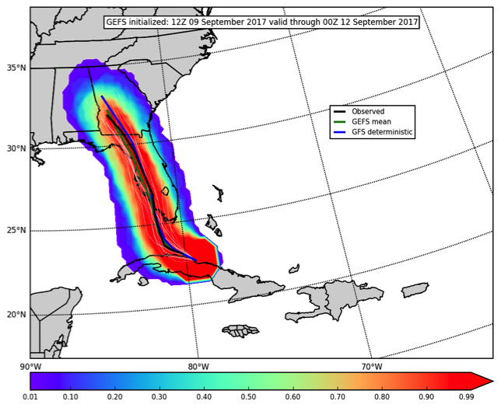
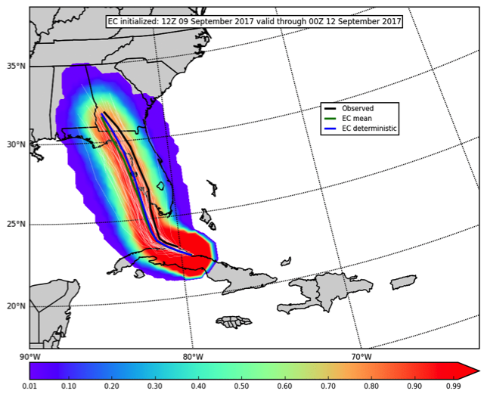
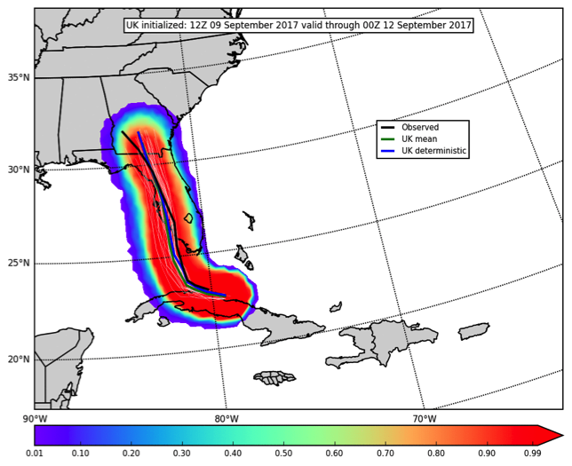
Medium-Range Ensemble Guidance from 12Z Saturday, 09 September 2017
One day before Florida landfall
All ensembles extended high track probabilities along the Gulf Coast of Florida into southwest Georgia
For each modeling center, the ensemble mean and deterministic run were in
GEFS
EC
good agreement by this time
GEFS mean and GFS deterministic most closely predicted the observed track in this cycle
EC mean and deterministic were slightly west of the observed track and suggested a potential delay in landfall until Irma reached the Florida panhandle
UK

Slide 7
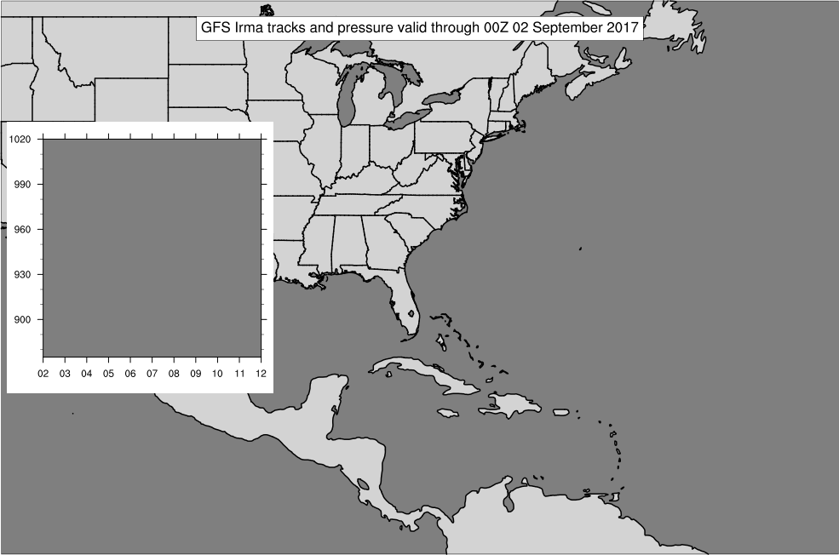
GFS and EC Forecast Tracks Shifted West Over Time
NWM v1.1 Experimental Guidance
Depicts Streams Forecast to Rise Above Bankfull
GFS
EC
Earlier cycle (00Z 9/2)
Later cycle (12Z 9/9)
A potential threat to the CONUS was clear with ~10 days lead time
GFS and EC cycles gradually shifted Irma’s predicted track to the west during this time
The EC indicated southwest Florida as the primary threat area before the GFS, but the EC eventually tracked Irma too far to the west of the observed track
For all cycles during this period, Irma’s central pressure was consistently too low in GFS forecasts after Irma reached the western Atlantic around 8 September

Slide 8
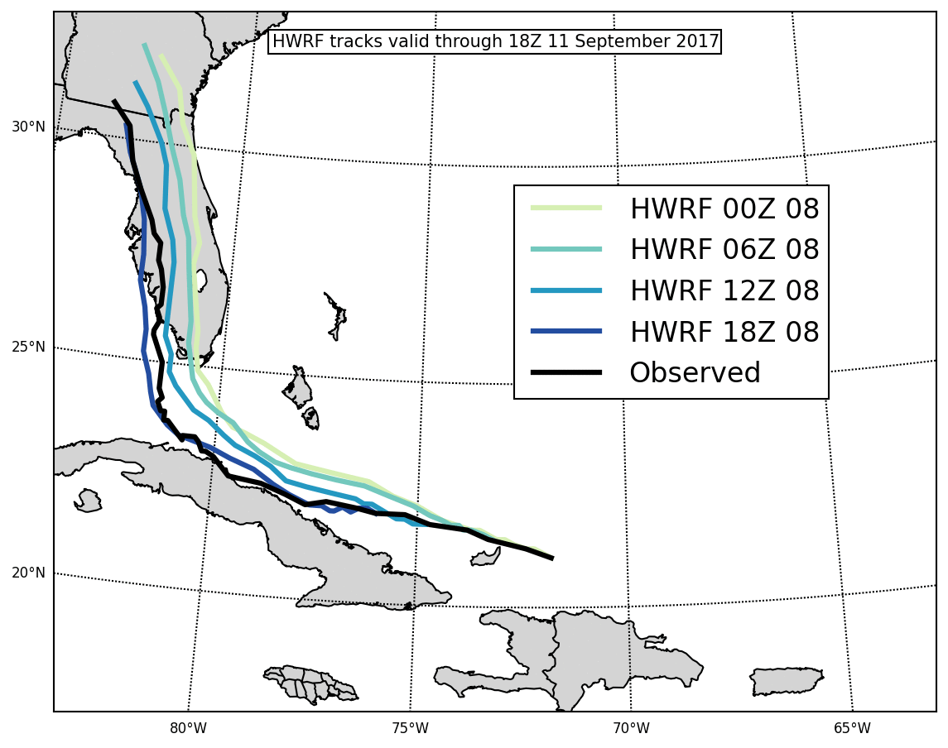
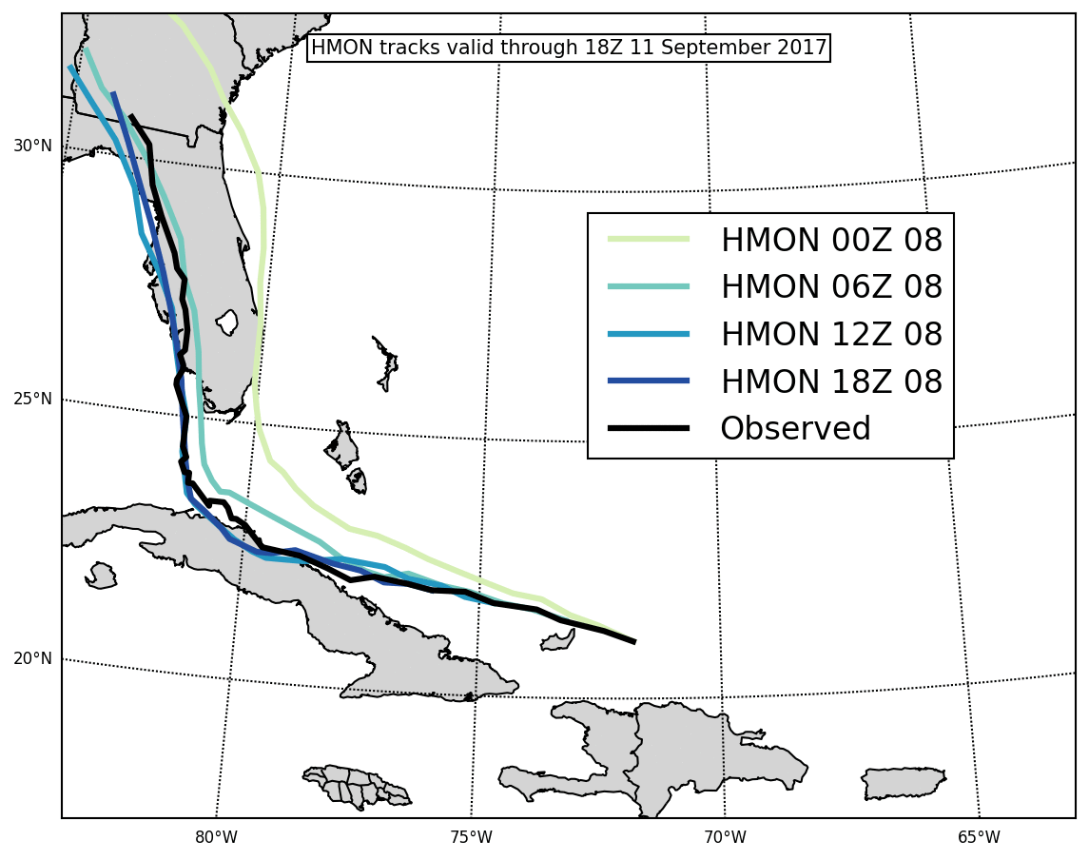
HWRF and HMON Forecast Tracks Also Shifted West Over Time
HWRF
HMON
Early cycles on HWRF and HMON on 9/4 suggested Irma could interact with Cuba
HWRF and HMON cycles on 9/6 and 9/7 primarily showed Irma being a threat to the Atlantic Coast from Florida to South Carolina
Successive cycles on 9/8 shifted Irma’s track to the west indicating landfall would be along Florida’s Gulf Coast (see above)
Subsequently, HWRF and HMON cycles on 9/9 and 9/10 skillfully continued to predict Irma’s path along the observed track

Slide 9
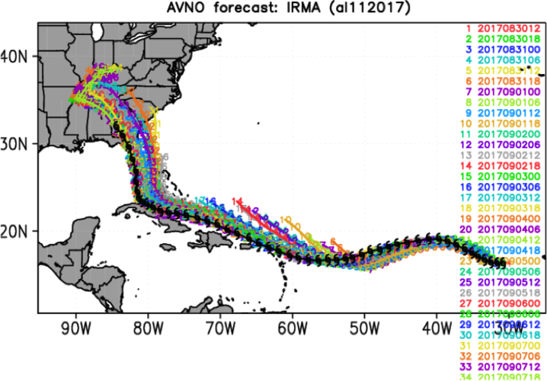
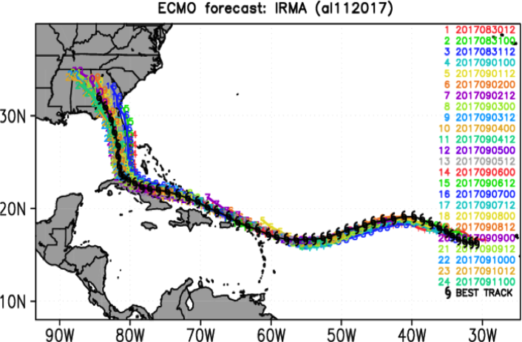
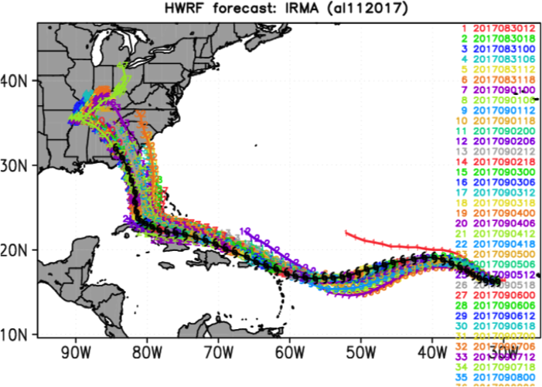
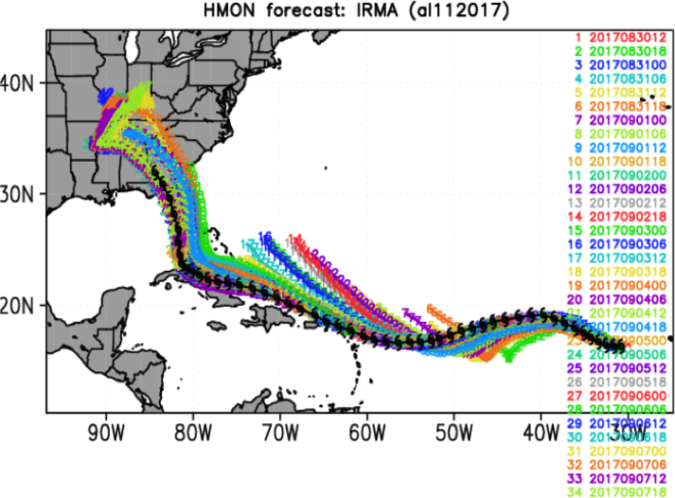
Plots courtesy of
Avichal Mehra
Composite Track Forecasts
GFS
EC
HWRF
HMON
As Irma neared the CONUS, successive cycles of all four models generally shifted Irma’s projected track to the west across the Florida peninsula
Cycles that kept Irma further south generally delayed the right turn to the north
This was possibly related to the strength of the Atlantic subtropical ridge, which kept Irma to the south and west (compared to tracks with a poleward bias)

Slide 10
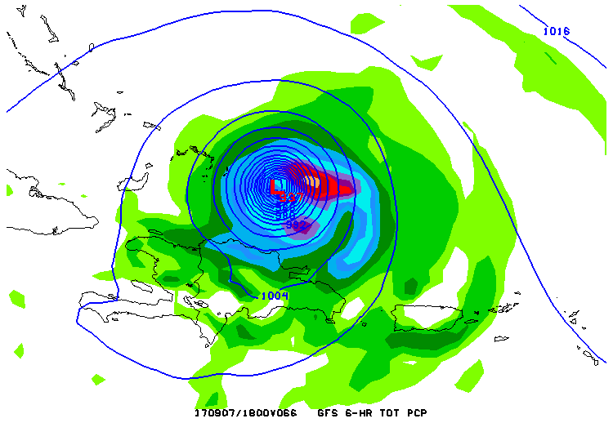
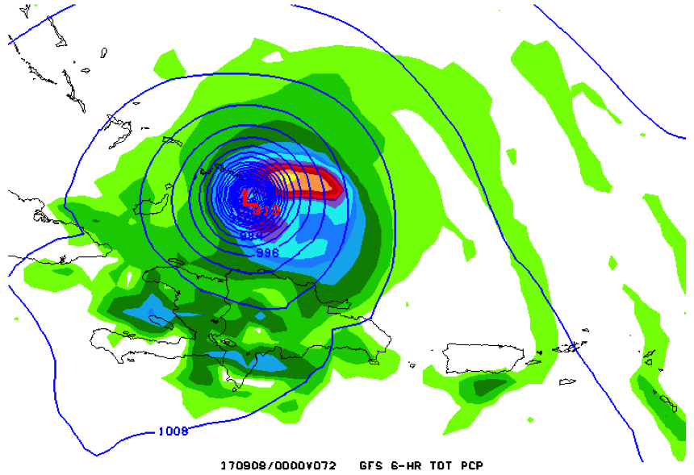
GFS Was Prone to Rapid Intensification and Overdeepening
00Z 9/5 GFS – F066
Central Pressure: 937 mb
00Z 9/5 GFS – F072
Central Pressure: 919 mb
6-h QPF and MSLP forecasts initialized at 00Z Tuesday, 5 September
Rapid intensification and overdeepening was seen in most GFS cycles during Irma’s lifetime. For example, Irma’s central pressure dropped 18 mb during a 6-h period in the 00Z 9/5 GFS cycle (see above)
Inspection of SSTs during this period did not suggest a relationship to the recently implemented NSSTs, which allows for some diurnal variation in SSTs
Inspection of convective and non-convective precipitation did not suggest an erroneous convective feedback loop

Slide 11
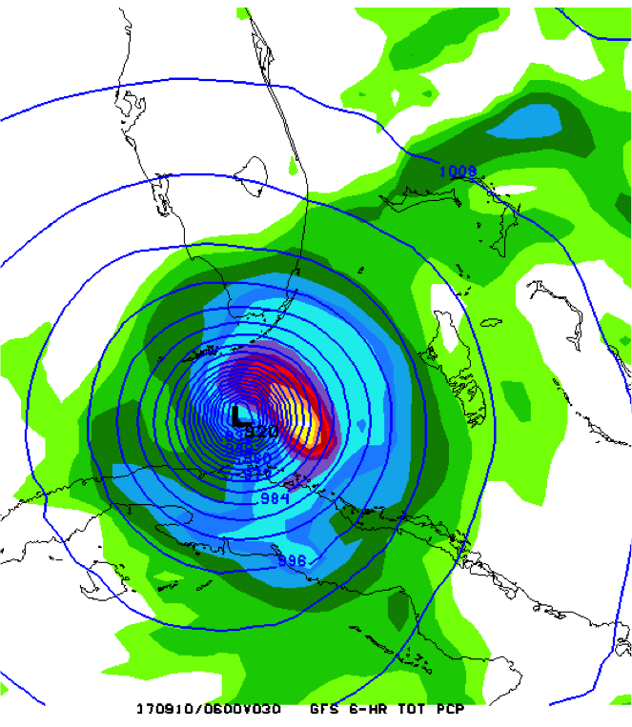
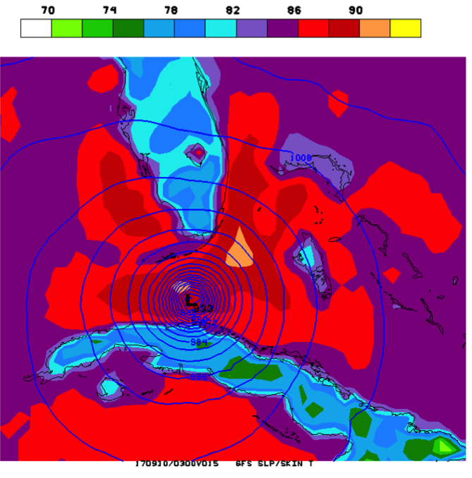
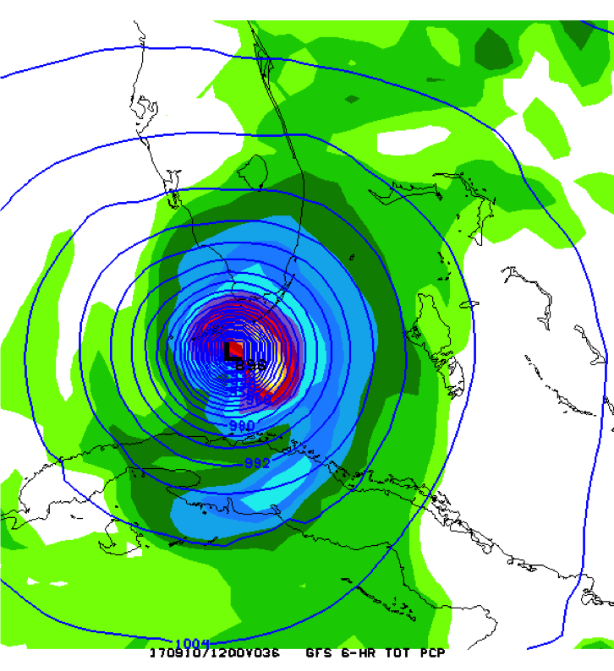
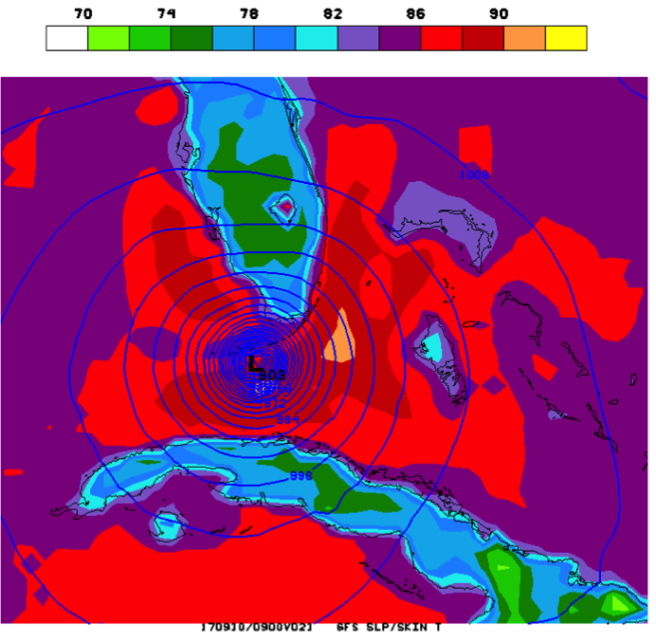
GFS Was Prone to Rapid Intensification and Overdeepening
6-h QPF and MSLP forecasts initialized at 00Z Saturday, 9 September (left)
Skin temperature and MSLP forecasts initialized at 12Z Saturday, 9 September (right)
Successive GFS cycles deepened Irma by 20-30 mb during a 6-h period when Irma crossed the Florida Straits
GFS SSTs in the Florida Straits were potentially too warm
However, GFS and NAM displayed similar patterns in latent heat flux and precipitation in this area
More investigation is needed
00Z 9/9 GFS – F030
Central Pressure: 920 mb
12Z 9/9 GFS – F015
Central Pressure: 933 mb
12Z 9/9 GFS – F021
Central Pressure: 903 mb
00Z 9/9 GFS – F036
Central Pressure: 896 mb

Slide 12
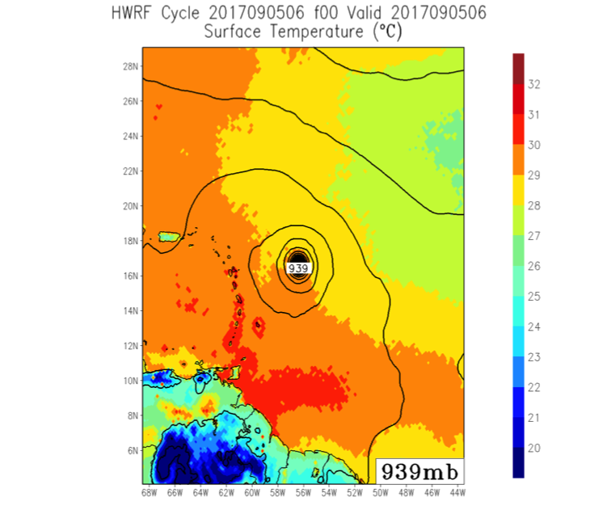
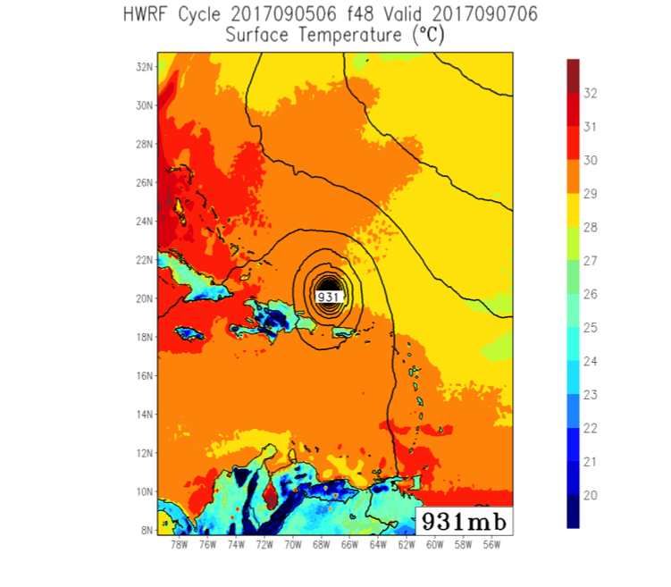
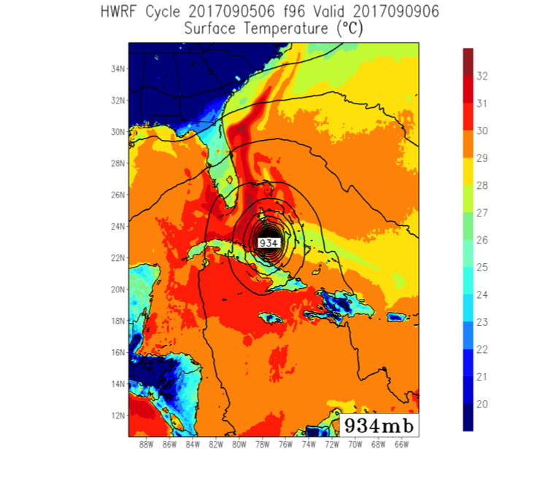
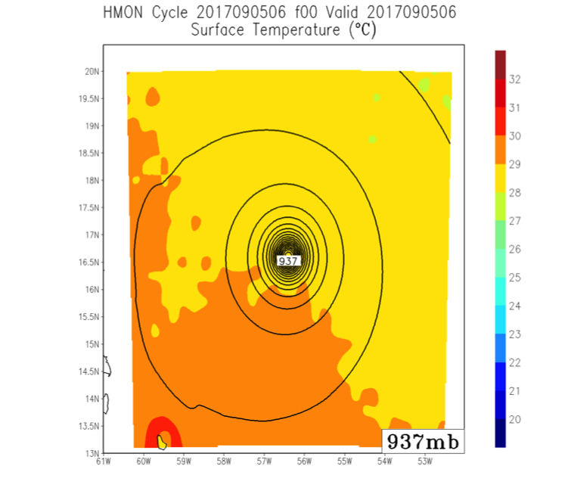
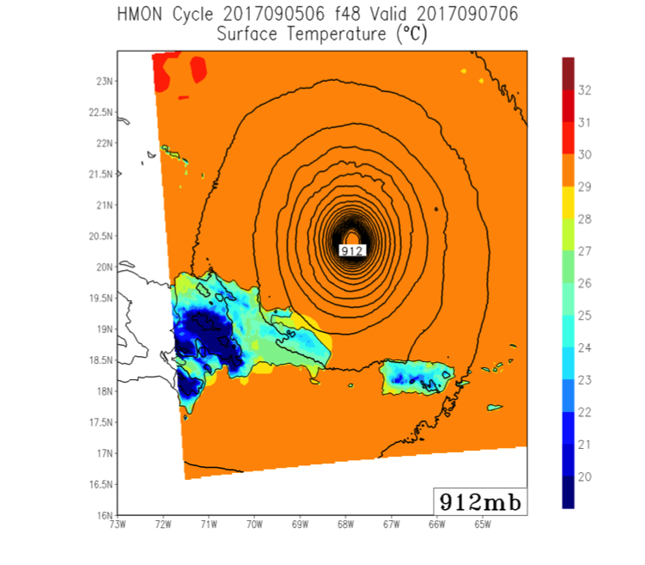
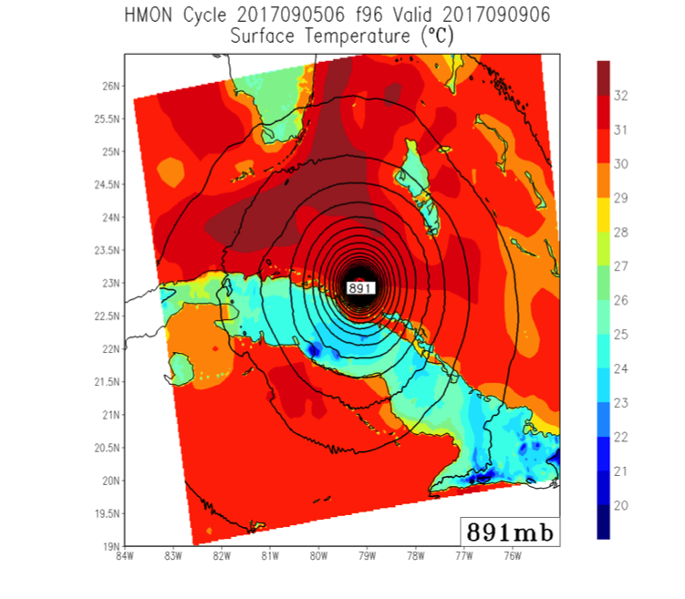
Overdeepening in HMON Possibly Due to Uncoupled Atmosphere–Ocean System
HWRF SSTs were cooled in Irma’s wake
06Z 9/5 HWRF – F000
Min Pressure: 939 mb
06Z 9/5 HWRF – F048
Min Pressure: 931 mb
06Z 9/5 HWRF – F096
Min Pressure: 934 mb
F000 Verification: 939 mb
F048 Verification: 921 mb
F096 Verification: 930 mb
HMON SSTs were not affected by Irma
06Z 9/5 HMON – F000
Min Pressure: 937 mb
06Z 9/5 HMON – F048
Min Pressure: 912 mb
06Z 9/5 HMON – F096
Min Pressure: 891 mb
Skin temperature and MSLP forecasts initialized at 06Z Tuesday, 5 September
HMON is not coupled with the Atlantic. Storm-induced SST cooling wasn’t present and caused erroneously low MSLP.

Slide 13
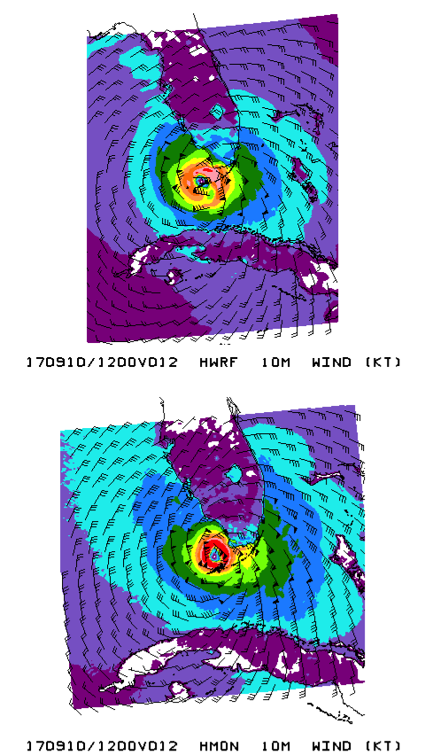
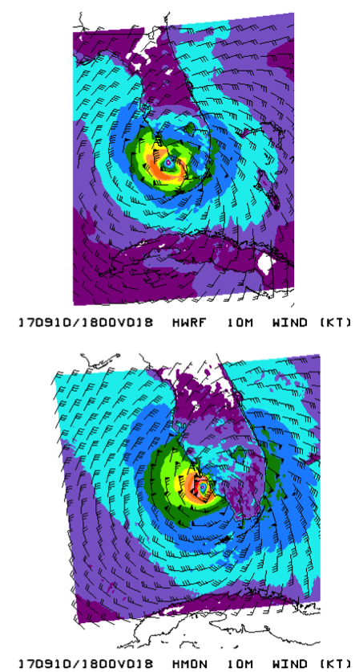
HMON 10-m Winds Were Extremely Weak Over Land
10-m wind forecasts from the 00Z Sunday, 10 September cycle of HWRF and HMON
Despite stronger winds prior to landfall, HMON weakened surface winds over land much more rapidly than HWRF
Eyewall winds in HMON were rapidly reduced from 100+ knots to less than 50 knots over land
Frictional slowing of winds over land is physical and expected, but such a rapid decrease does not appear correct
More investigation is needed to determine the cause
00Z 9/10 HWRF – F012
00Z 9/10 HWRF – F018
00Z 9/10 HMON – F012
00Z 9/10 HMON – F018

Slide 14
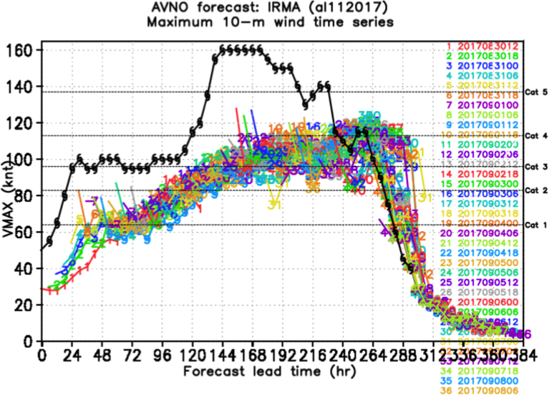
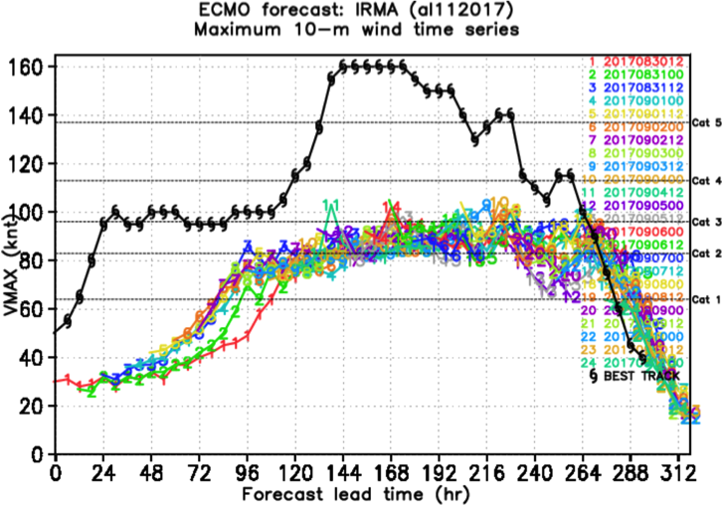
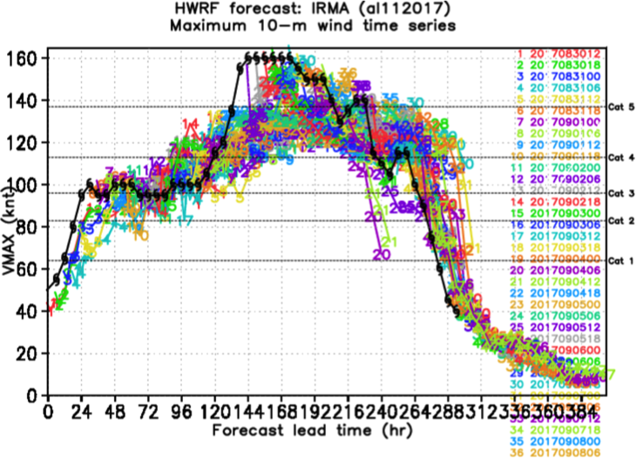
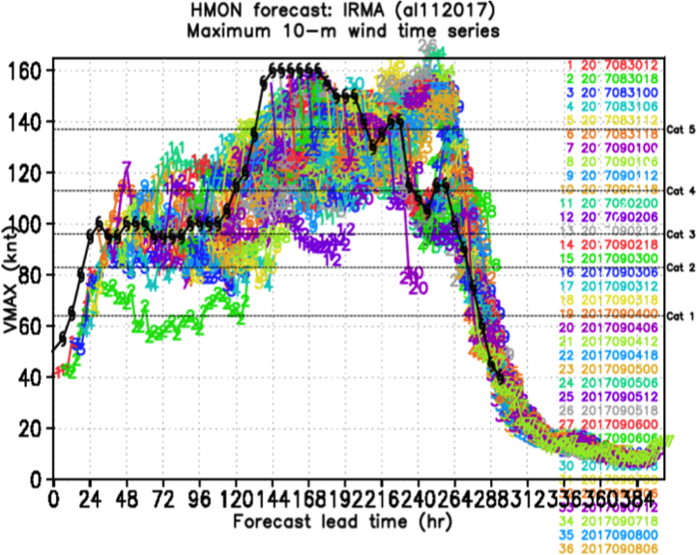
Plots courtesy of
Avichal Mehra
Composite Intensity Forecasts
GFS
EC
HWRF
HMON
Maximum 10-m winds in GFS and EC were too low throughout Irma’s early life cycle. This is in spite of the overdeepening seen in the GFS.
HWRF and HMON had better wind forecasts with more error seen in HMON.

Slide 15
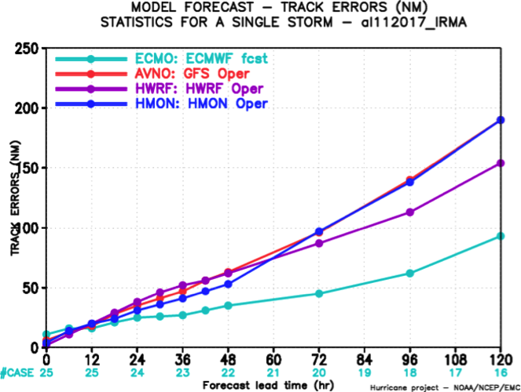
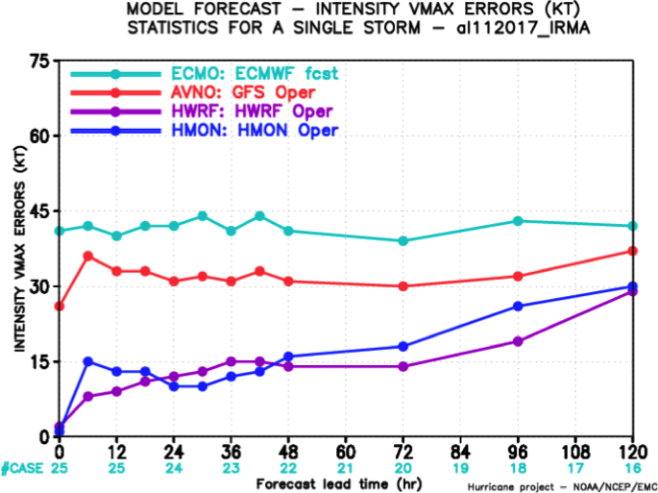
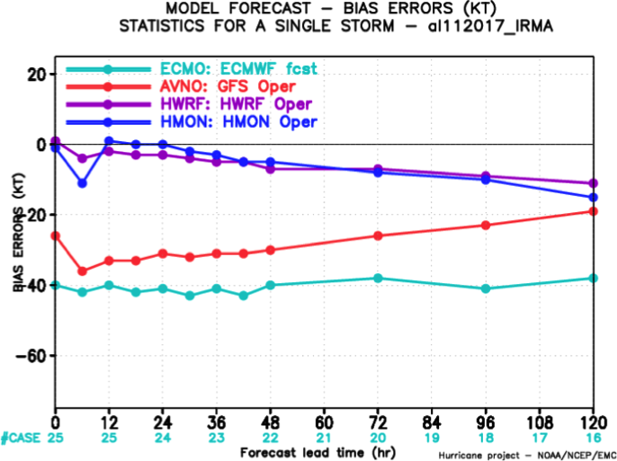
Track and Intensity Error Statistics
Track
Intensity
Overall, EC had the lowest track errors, particularly at lead times greater than two days
HWRF track errors were lower than GFS and HMON errors for 72+ h forecasts
Intensity and bias errors were comparable for HWRF and HMON
EC followed by GFS had the highest intensity errors with low biases in maximum wind speeds
Bias

Slide 16
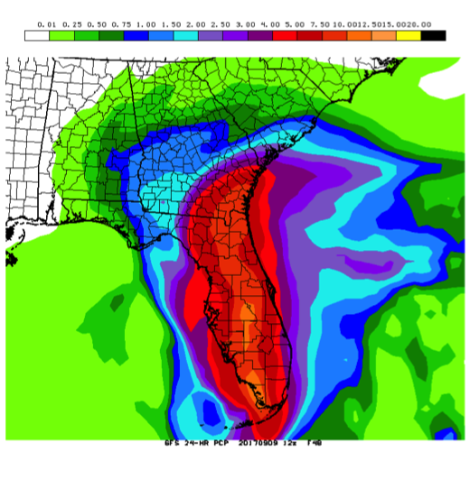
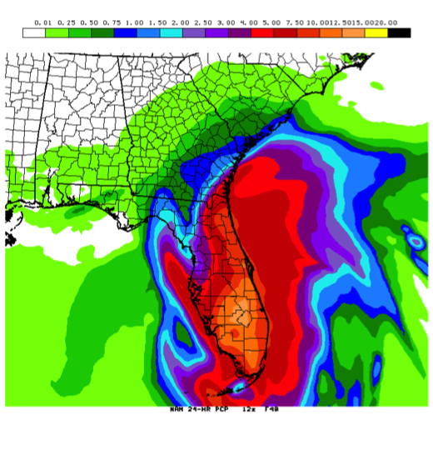
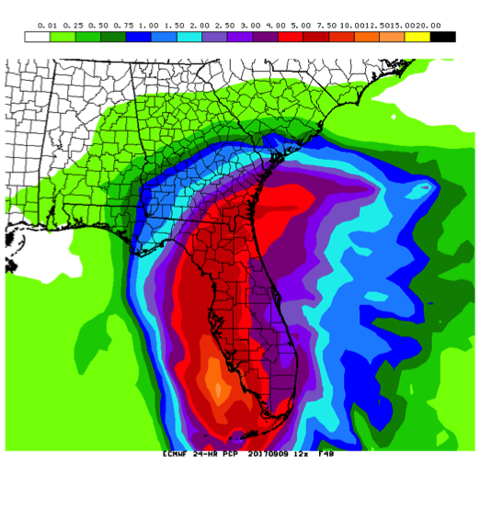
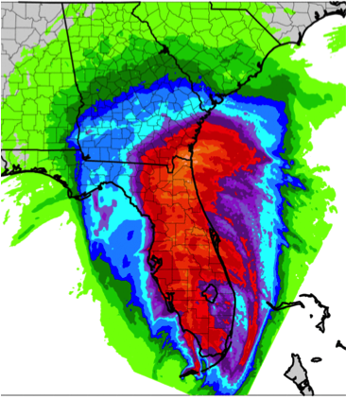
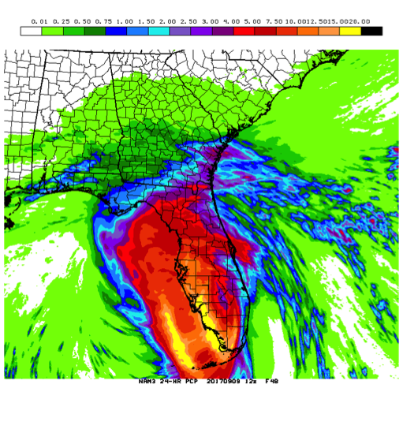
Precipitation Forecasts Improved in Response to Better Track Forecasts
GFS
Stage IV analysis
NAM
EC
NAM3
HIRESW
NMMB
HIRESW
ARW
24-h QPF totals from forecasts initialized at 12Z Saturday, 9 September (F048)
NAM3 and NMMB tracks were too far west. Thus, precipitation axis was shifted to the west.

Slide 17
Precipitation Forecasts Improved in Response to Better Track Forecasts
GFS
Stage IV analysis
NAM
EC
NAM3
HIRESW
NMMB
HIRESW
ARW
24-h QPF totals from forecasts initialized at 12Z Sunday, 10 September (F024)
NAM3 and NMMB tracks improved and so did QPF. Mesoscale details were still challenging.

Slide 18
Precipitation Forecasts Improved in Response to Better Track Forecasts
GFS
NAM
EC
Stage IV analysis
HIRESW
NMMB
HIRESW
ARW
NAM3
24-h QPF totals from forecasts initialized at 12Z Sunday, 10 September (F048)
QPF maxima were generally too broad and too far from the Atlantic coast.

Slide 19
Precipitation Forecasts Improved in Response to Better Track Forecasts
GFS
NAM
EC
Stage IV analysis
HIRESW
NMMB
HIRESW
ARW
NAM3
24-h QPF totals from forecasts initialized at 12Z Monday, 11 September (F024)
Location and size of QPF maxima were improved, but mesoscale details were still challenging.

Slide 20
Summary
Global ensembles and deterministic models indicated Irma could pose a significant threat to Florida with about 10 days lead time
In the week leading up to Irma’s landfall, forecast continually shifted from east to west across the Florida peninsula as the verification time neared
EC locked into correctly predicting Irma’s landfall in southwest Florida, and GFS and UK caught up to this solution with shorter lead time
Timing of Irma’s right turn seemed dependent on errors in forecast latitude. With a consistent poleward bias, GFS possibly underrepresented the strength of the Atlantic subtropical ridge
Overall, EC had the best track forecasts, and HWRF had the best intensity forecasts
GFS was consistently too deep with Irma’s central pressure in the western Atlantic, and more investigation is needed to determine the cause.
Rainfall predictions were more skillful as track forecasts improved with shorter lead times

