Slide 1
N
Evaluation of Potential NMMB CMAQ Configurations for the July 2011 Operational NAQFC Implementation
February 17, 2011

Slide 2
Implementation Options with NMMB Coupling
CMAQ with CB05 upgrades
Combo: bundled upgraded CB05 run
M-O similarity theory deposition velocity (exp1)
Improved canopy resistance (exp2)
Minimum PBL height (exp3)
GEOS-5 Chem dynamic LBCs (exp4)
Combo1 : combo + satellite derived canopy heights
Other (biogenics, additional deposition velocity changes…)
NMMB CB-IV Default
Gas phase Carbon Bond IV mechanism only
PM Predictions not available
Reduced Volatile Organic Compounds (VOC) speciation
-Using CB-IV based 2005 Emissions Inventory
Delay NMMB implementation

Slide 3
CMAQ CONUS Domain Tests for
Summer 2010
Simulation | CMAQ physics | CMAQ chem | Vertical Coupling | CMAQ mapping to USGS
NAM PROD | Default | CB-IV | Unified | USGS
NAM EXP | Default | CB05, AERO-IV | Unified | USGS
NAM combo1 | Vd PBLH LBCs | CB05, AERO-IV | Unified | USGS
NMMB combo1 | Vd PBLH LBCs | CB05, AERO-IV | Interpolated | From USGS
NMMB prod | Default | CB-IV | Interpolated | From USGS

Slide 4
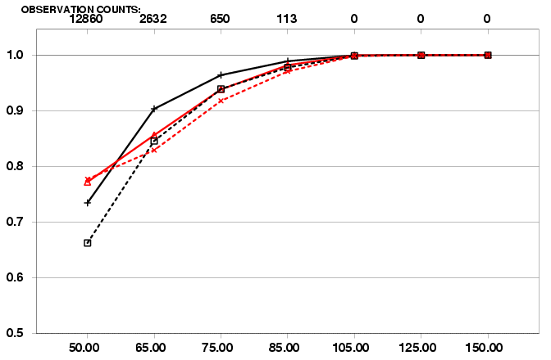
NCEP Air Quality Forecast 2010 Verification
Daily 8h Max O3 Threshold performance
NAM-Production(CB04) vs NCO-Para (CB05), East vs West
Bias
Equitable Threat Score
CSI
Fraction Correct
NCO/PARA CB05 run ETS is Improved over Western U.S .
BUT Skill reduced over East

Slide 5
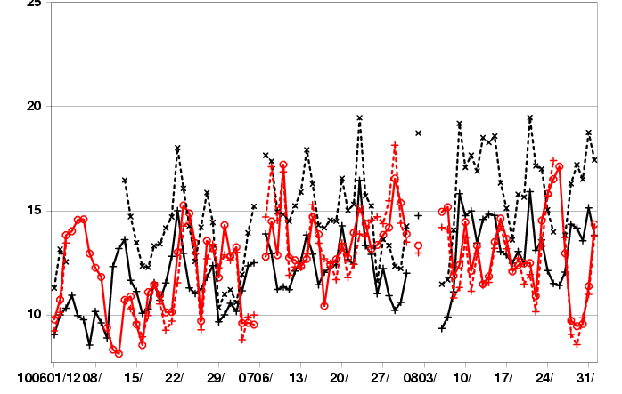
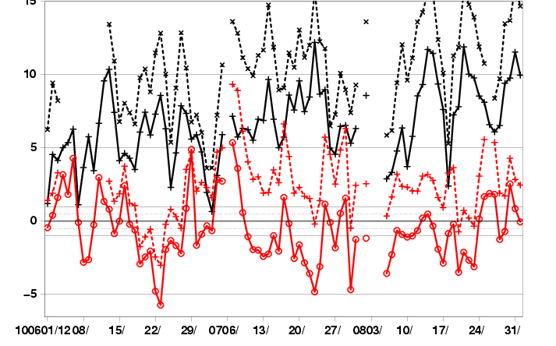
NCEP Air Quality Forecast
NAM-CMAQ OPS vs EXP
(8 hr Max Ozone East vs West U.S. for Day 2)
Aug. 1
Aug. 1
2010 RMSE
2010 BIAS
Current Exp/Para system (dashed line):
Increasing error as Summer progressed for Eastern U.S.

Slide 6
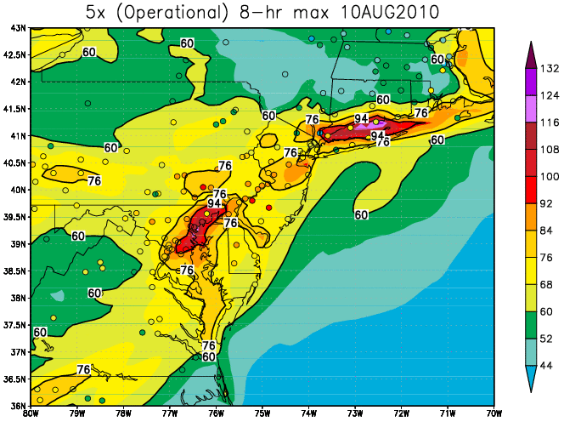
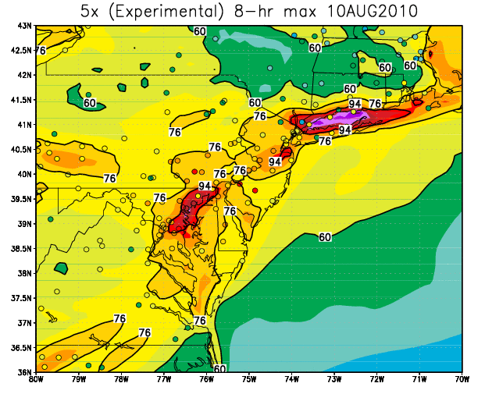
Operational vs Experimental Verification Day 2 Ozone 8h daily maximum August 10, 2010
Strong overprediction esp. along Long Island Sound and DC metro area

Slide 7
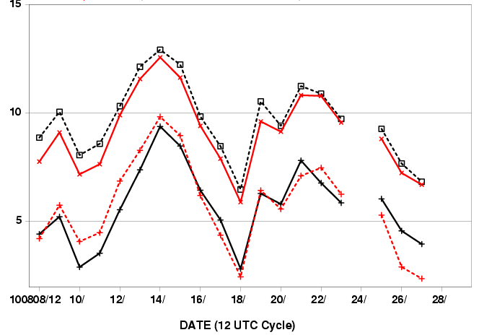
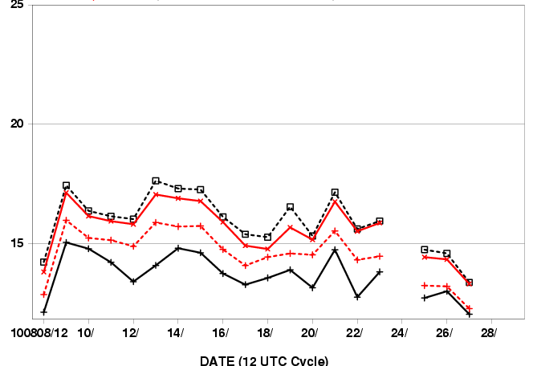
NCEP Air Quality NAM-Combo1 Experiments
(Daily 8 hr Max ozone CONUS Errors for Day 2)
BIAS
RMSE
Para/Ctl
Prod
NAM-CB-IV PROD
NAM-CB05 EXP/PARA
NAM-CB05 Control (same config as EXP/PARA)
NAM-CB05 Combo1
NAM –CB05- Combination1 run (dashed red) improved
compared to Experimental/Para CB05 (dashed black)
BUT combo1 run RMSE are still worse than NAM-CBIV Prod(solid black)

Slide 8
NEMS-NMMB Coupling Tasks
Vertical coupling: NMMB hybrid with CMAQ sigma
Tight (ARL)
Equivalent sigma (ARL)
Interpolated (Marina, Youhua)
MAP NEMS-NMMB IGBP land-use characteristics to CMAQ USGS
Land use categories.
Impacts:
Biogenic emissions
Chemical deposition processes
Couple NMMB with Production CMAQ CB-IV Configuration
August 2010 retrospective NMMB-CMAQ runs
Real-time NAM-B CMAQ EMC parallel runs

Slide 9
1. Loose coupling: equivalent sigma - Temperature
High terrain

Slide 10
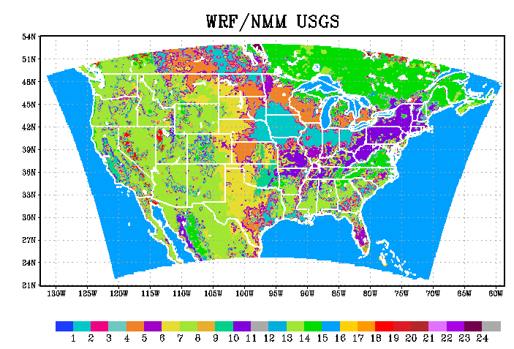
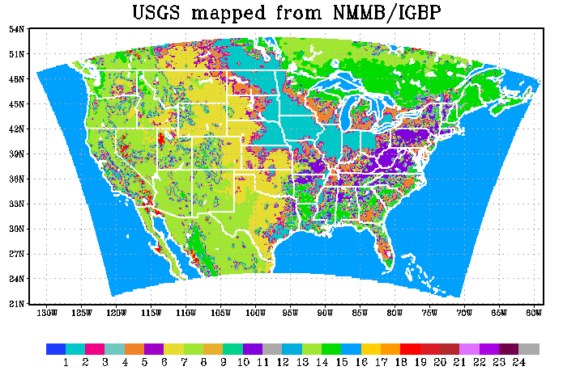
2. NMMB new IGBP Land Use
15: Mixed Forest
11: Deciduous Broadleaf Forest

Slide 11
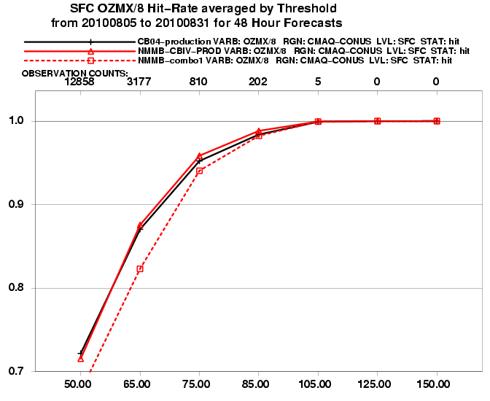
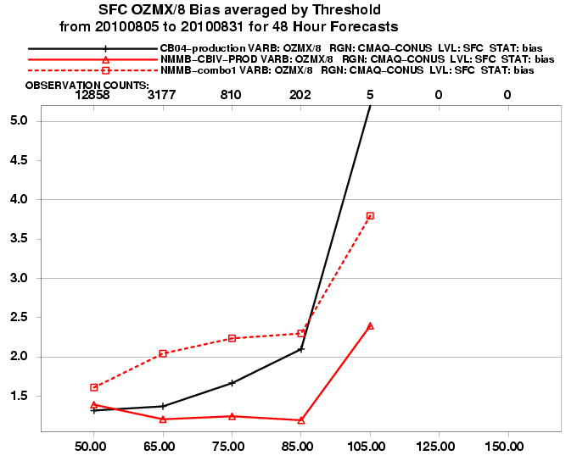
CMAQ driven by NAM vs NMMB
Daily 8h-max O₃ error by Threshold (ppb)
Black: NAM-CMAQ CB IV
Red: NMMB-CMAQ CB IV
Dashed: NMMB-CMAQ CB05 combo1
NMMB-CBIV system similar to NAM-CBIV Operational
NMMB-CBIV bias improved for >65 thru >85 thresholds

Slide 12
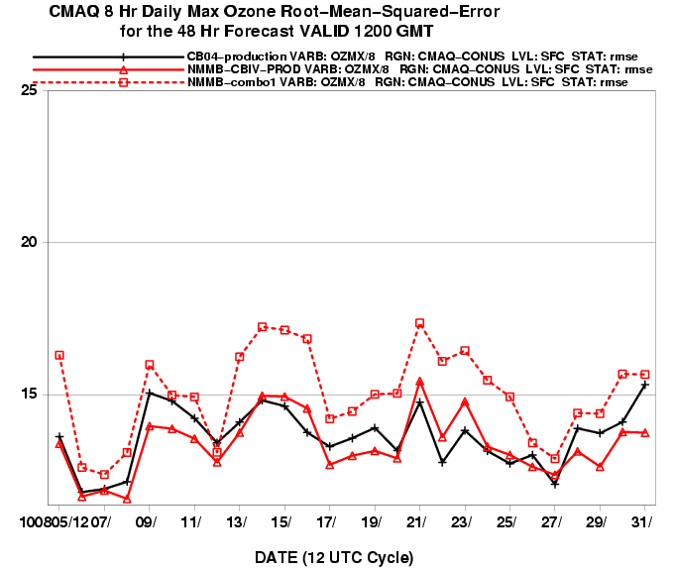
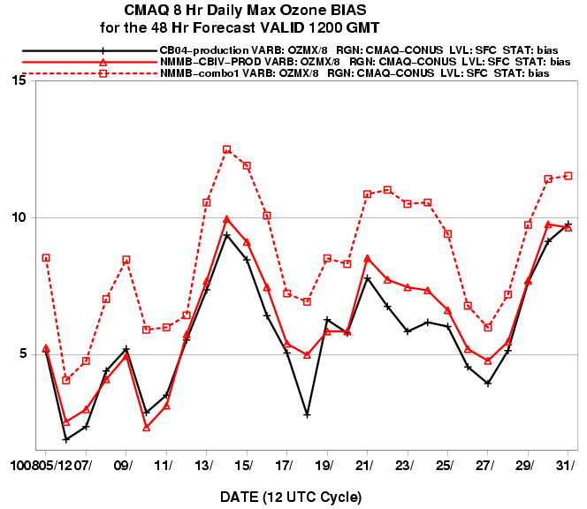
Daily RMSE & BIas CONUS 8h-max O₃
Black: NAM-CMAQ CB IV
Red: NMMB-CMAQ CB IV
Dashed: NMMB-CMAQ CB05 combo1
NMMB-CBIV system RMSE similar to NAM-Production
NMMB-CBIV bias worse esp. August 20-24th

Slide 13
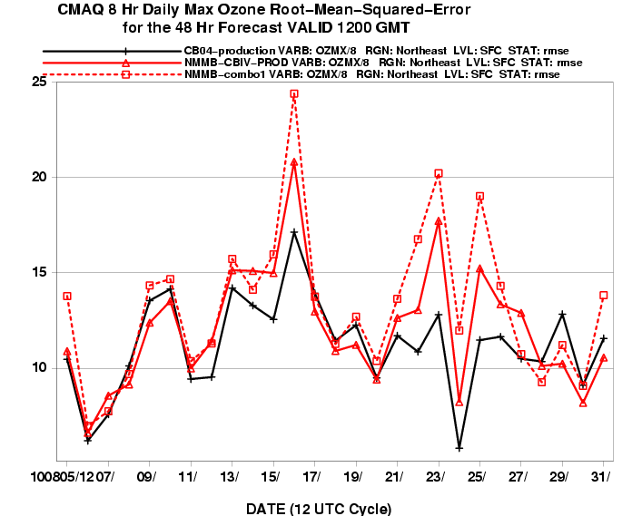
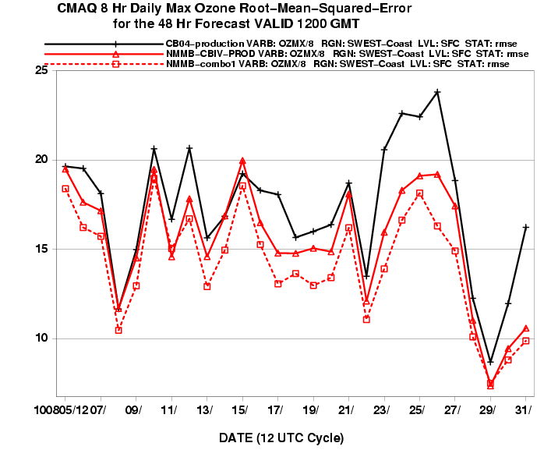
Daily RMSE & Sub-regions 8h-max O₃
Black: NAM-CMAQ CB IV
Red: NMMB-CMAQ CB IV
Dashed: NMMB-CMAQ CB05 combo1
Northeast RMSE
Southwest RMSE
NMMB-CBIV worse than Production over North East
NMMB-CBIV & CB05 better than Production over South West

Slide 14
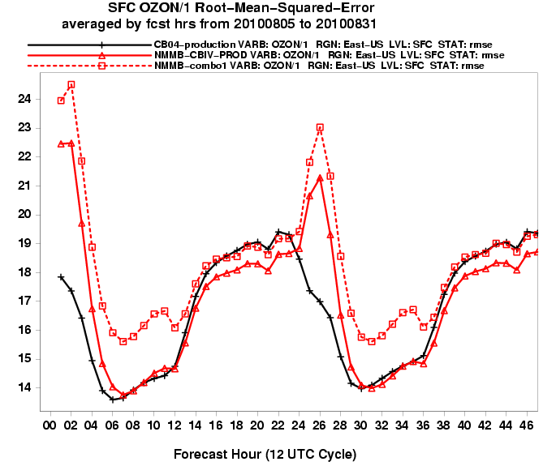
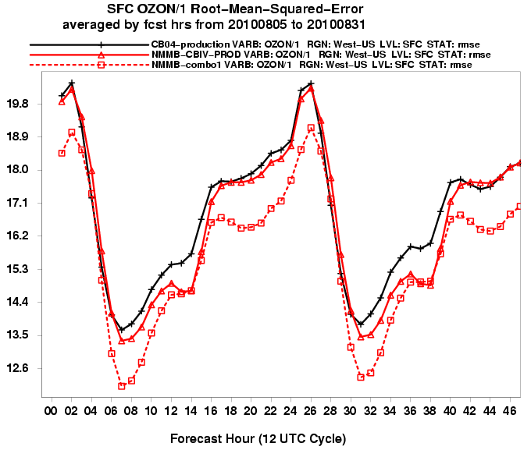
Diurnal Cycle RMSE East vs West 1h-avg O₃
Black: NAM-CMAQ CB IV
Red: NMMB-CMAQ CB IV
Dashed: NMMB-CMAQ CB05 combo1
Early morning error spike for only NMMB runs in East
Higher NMMB-CMAQ PBLH contributes to residual layer mixing
Early morning error spike for all runs in West

Slide 15
Summary
CMAQ CB05 Configuration Experiments
Combo1 configuration performs best
Further calibrations needed with NMMB (e.g: deposition velocity)
Changes are appropriate only for CB05 chemistry
NMMB Coupling
In general CB-IV configuration
performs best for threshold daily max statistics except over Southwest
RMSE are improved over East but worse over West
Early morning error spike more evident for NMMB runs in East
Deeper PBLH in NMMB mixes down residual pollutant airmass
Questions
Impact of higher Initial conditions with CB05 runs
CB05 performance degradation primarily in rural areas or lower ozone events
Impact of potential NMMB radiation change

Slide 16
FY11 NAQFC Plans (besides maintenance, verification, etc)
Para/Prod Upgrades
July 2011: PROD: NMMB-CMAQ loose vertical coupling + 2011EI
Aug 2011: PARA: NMMB CMAQ V4.7.1, tight vertical coupling
Oct 2011: Global Para: NEMS-GOCART In-line (Sarah Lu)
Developmental Testing (PM Improvements)
CMAQ V4.7.1
w/ Smoke & dust sources
On consistent NMMB grid (rotated lat-lon, RLL)
PBL mixing w/ NMMB eddy diffusivity
GSI AIRNOW PM2.5 Data Assimilation
Test optimized CMAQ system
DT&E 4 km NMMB met and CMAQ

Slide 17
ARL Progress/Plans

