Slide 1
CMAQ V5.0 Upgrade for ozone and Particulate Matter Predictions http://www.emc.ncep.noaa.gov/mmb/aq
Pius Lee, Li Pan, Daniel Tong –NOAA/ARL
Jeff McQueen, Jianping Huang, Ho-Chun Huang,
Perry Shafran, Geoff DiMego – NCEP/EMC
Jim Wilczak, Irina Djalalova, Dave Allerud – NOAA/ESRL/PSD
Ivanka Stajner, Sikchya Upadhaya – NWS/STI
Amanda Sleinkofer – Millersville University
February 24, 2017
Notes:
Remarkable amount of work considering this was both a transition to Cray and science upgrade that included a completely new CMAQ model

Slide 2
CMAQ weaknesses Identified
Overprediction of ozone in Eastern U.S. in Summer
  Especially along coastal cities (NYC, DC, Cleveland)
  →Update National Emission Inventory point sources to 2011 (project to 2016)
  → Evaluate NOx emissions based on OMI satellite trends (Deferred)
  → Evaluate Impact of NAM-X and reduced SW radiation under clouds
  → Update CMAQ gas and aerosol chemistry/biogenic emissions to EPA V5.0.2
Underprediction of particulate matter (PM) in Summer and near wild-fires
  → Update 9 year old USFS BlueSky smoke emission system
  → Introduce 24 h pre-analysis cycle to correct fire time mismatch with CMAQ initial time
Underprediction of Ozone and PM when strong fires are present outside CMAQ domain
  → Test NGAC full aerosol predictions for CMAQ lateral boundaries
Overprediction of PM during winter-time stagnation episodes (cold, stable)
→ update emissions/chemistry as in bullet 1
Notes:
Largest impact is better treatment of wild-fire smoke and reduction of summertime ozone overpredictions

Slide 3
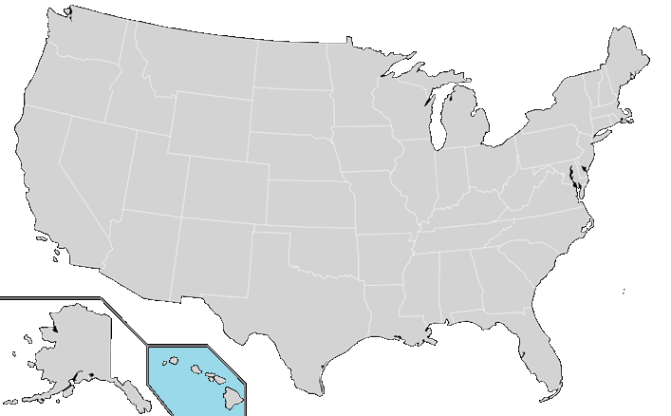
Proposed CMAQ FY2017
Chemical Transport Model:
CMAQ5.0.2 for CONUS
CB05 gas chemistry: increased
from current 105 to 155 species:
Improved heterogeneous, aqueous,
and winter-time reactions
From current aero4 to aero6 chemistry:
Improved SOA and coarse mode PM
LBC: Static from GEOS-CHEM +
Dynamic LBC for dust
derived from NGAC
Added a 24 h analysis PM field for
initialization adjustment
O₃, PM_{2.5} (CONUS)
For Wildfire Emission:
Adopt Bluesky HYSPLIT/SMOKE emission strength and duration for the aforementioned
24h analysis and 48h forecast;
New Bluesky version 3.5.1 from US Forest Service
Upgrade Bias correction to include temporal trends (Kalman Filter Analog technique, ESRL)
NEW OUTPUT to MDL NDGD web site: bias corrected hourly & daily 24 h avg M2.5
PM_{2.5} Performance (Exceedance w.r.t 35 μg/m³): EMC website mmb/aq
24 h averaged PM_{2.5} for the above domains: Bias, RMSE, and % Hit Rate

Slide 4
Emissions accompany CMAQ5.0.2
Point source: Baselined from NEI2011v1 & updated by 2014 CEM & 2016 DoE Energy Outlook
Canada: Environment Canada 2006 Inventory made available as part of US EPA NEI2011;
Mexico: Inventory (MI) 2012 v2.2 for six Northern bordering states & 2.1 other states
Area Sources
  US EPA 2011 NEIs;
  Canada 2006 Emission Inventories (in NEI2011 package);
  Mexico 2012 EI for six Northern bordering states (in NEI2011 package);
  US residential wood combustion and oil and gas sectors;
  Snow/Ice effect on fugitive dust emissions;
  Mobile Sources (on-road)
  NEI 2005 projected to 2011 using Cross-State Air Pollution Rule (CSAPR) projection for US sources and; Canada 2006 Emission Inventories; MI 2012;
Natural Sources
  Terrestrial biogenic emission: BEIS model v3.14;
  Sea-salt emission: CMAQ online Sea-salt emission model based on 10m wind;
  Fire emissions based on HMS fire detection and BlueSky V3.5.1 emission model
Windblown dust emission: FENGSHA model

Slide 5
Emissions IT Testing (ARL)
ARL ensures a robust and thorough quality check of emission files:
Monthly emission quality assurance (QA) check and test results will be posted in ARL website so that the scope of check is shared with EMC and focus group.
Annual emission delivery will happen in December and April. Testing should be conducted before both deliveries. Typically ARL mimics January 1st and June 1st 12 UTC cycle for the respective test. For leap years the December test should also include December 31st 12UTC cycle.
Extend emergency contact list: Add Li Pan to the current ARL list: Pius Lee and Daniel Tong

Slide 6
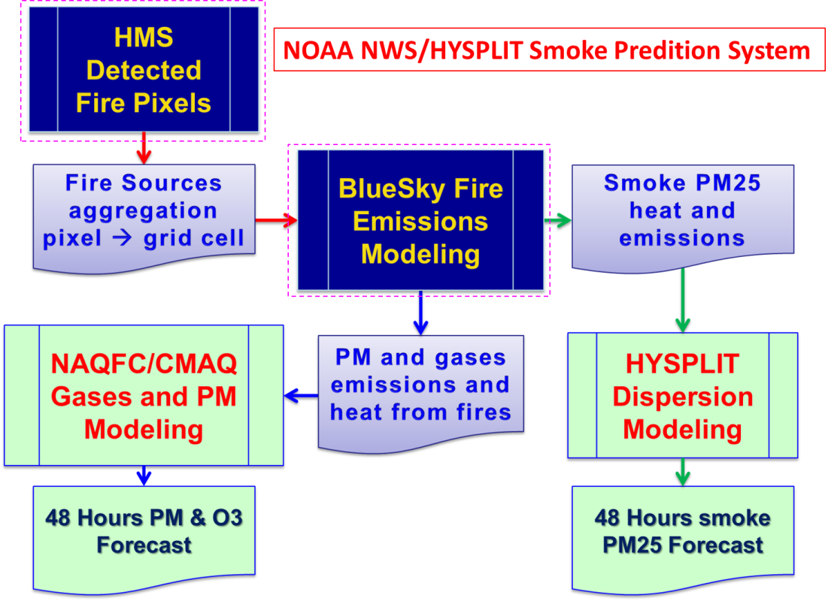
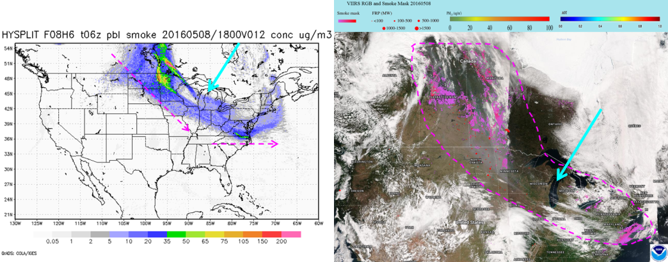
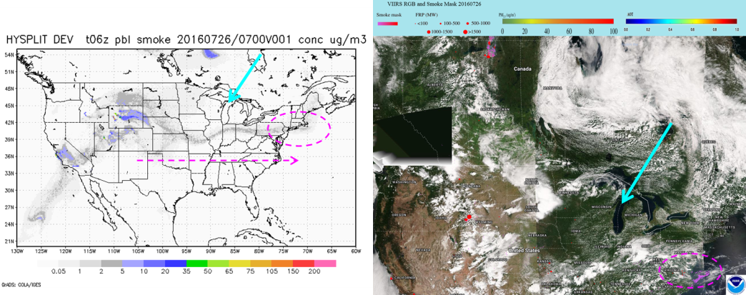
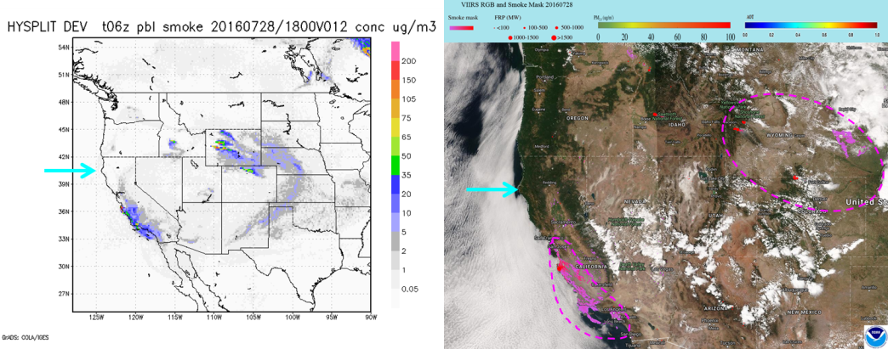
May 2016 Ft McMurry (Canada) Fires
July 2016 Northern Wyoming Fires
New Updated BlueSky:
The Fuel Characteristic Classification System version 2 (FCCS2) which includes a more detailed description of the fuel loadings with additional plant type categories.
Explicit fuel load map for Alaska
improved fuel consumption model and fire emission production system (FEPS).
July 2016 California Big Surf Fires
Courtesy Ho-Chun Huang, EMC
HYSPLIT/Smoke prediction
eIDEA Smoke Mask
Notes:
This is run as part of HYSPLIT processing so it does impact HYSPLIT predictions as well. Both CMAQ and HYSPLIT use the same smoke emissions system.
Includes a more detailed land use/fuel loading. Worked closely with USFS to transiition this code.

Slide 7

Analog Ensemble for PM_{2.5} Bias Correction
Analog metric is determined by (Monache et al. 2011)
where F_{t} is current NWP forecast valid at future time t, A_{t’} is analog at past time t’, N_{v} is the number of variables , $\tilde{t}$ is half the number of additional computation time, w_{i} weight, $_{f_{i}}$standard deviation
(Source: Djalalova et al., 2015)
Implementation in NAQFC
Variables for Analog search: PM_{2.5} , T₂, WS/WD
Ensemble members: 5
Training period: one year
Courtesy Jianping Huang, EMC
Notes:
Key here is how to compute the analog….using previous PM, 2m T, and Wind errors

Slide 8
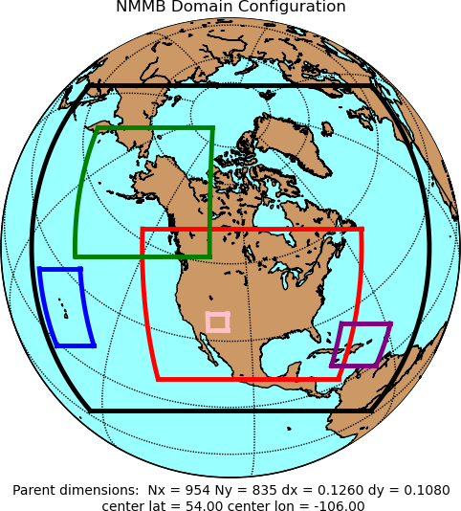
NAM Forecast System - Version 4 (Q3FY17)
Resolution Changes
  CONUS (4 km) and Alaska (6 km) nests → 3 km
  Sync AK and CONUS On-Demand Fire Weather nests → 1.5 km
Select Model Changes
  Updated microphysics → Improved stratiform precip., better anvil reflectivity, lower peak dBZs, smaller areas of light/noisy reflectivity (rain treated as drizzle), improved nest QPF bias in warm season, Reduce incoming SW Rad under clouds; reduce warm season 2-m T warm bias
  More frequent calls to physics → Physics/dynamics more in sync (e.g. improved upper air, improved nest QPF)
  Improve effect of frozen soil on transpiration and soil evaporation → Improve cold season 2-m T/Td biases
  Adjustment to convection in 12 km NAM → Improve QPF
  Modify latent heat flux treatment → Improve visibility along CA coast
Data Assimilation:
  DA cycles for 3 km CONUS and AK nests → Much less ‘spin-up’ time
  Use of Lightning and Radar Refectivity-derived temperature tendencies in initialization
    Improved short-term forecasts of storms at 3 km
    Improved 00-12 hr QPF
  New satellite radiances, satellite winds → Improved Inital Conditions
DA
3 km
1.5 km
12 km
DA
DA: Data Assimilation Cycle
Courtesy Eric Rogers, EMC
Notes:
Reducing incoming SW radiation under clouds probably the largest impact on ozone production as photolysis and overprediction would be reduced

Slide 9

CMAQ Version 5.0
Status as of 02/17/17
G
G
Project Information & Highlights
G
Schedule
Leads: Jeff McQueen & Jianping Huang (EMC), Steven Earle(NCO)
Scope: Upgrade CMAQ to Cray with improved aerosol chemistry and emissions with 2011 base year estimates; Update BlueSky smoke emission system; Include 24 h pre-analysis run for smoke initialization; Use NGAC dust aerosol lateral boundary conditions; Update PM bias correction.
Expected benefits: AQM is improved and unified through improved chemistry, emissions and physics. Improved smoke emissions.
Dependencies: Transition code from ARL; BlueSky outputs from Hysplit
Milestones & Deliverables | Date | Status
Freeze system code; deliver to NCO if applicable | 12/15/16 | Complete
Complete full retrospective/real time runs and evaluation | 2/13/17 | Complete
Conduct CCB | 2/17/17 | On track
Issue Technical Information Notice | 3/15/17 | On track
Complete 30-day evaluation and IT testing | 5/15/17 | On track
Operational Implementation | 5/30//17 | On track
G
Issues/Risks
G
Resources
EMC | NCO
Staff: 0.8 Fed FTEs + 2 contractor FTEs; including Dev
+ ARL 0.8 Fed FTEs + 1.9 contractors FTEs
Funding Source: STI/NAQFC
Compute: Dev: 120 nodes(+40);Para: 40 nodes (+15);
Ops: 24 nodes/cycle (+8)
Archive: Ops: 400 GB/day (+80 GB),
Issue: reproducity issue between Cray machines. Resolution: module versions differed (resolved, 2/15/17)
Risk: Not enough time remaining to test O-Conus updates;
Mitigation: do not upgrade O-Conus system: defer to FY18 (resolved)
Management Attention Required | Potential Management Attention Needed | On Target
R
Y
G
Notes:
Originally a Q1FY17 implementation. Will go into later why the delay.
Will require 480 tasks compared to 256 currently used given additional species in CMAQ V5.0.2

Slide 10
Summary of work performed
TASK | F | M | A | M | J | J | A | S | O | N | D | J
Evaluation of updated BlueSky for HYSPLIT/CMAQ Additional BlueSky emission processing for 6Z Completed installation on WCOSS Phase II Ho-Chun Huang & ARL
Coupling/testing ECCC smoke emissions w/HYSPLIT Evaluation of different default Canadian fuel classes Combined EC & CONUS BlueSky emissions (deferred) Ho-Chun Huang & ECCC |  |  |  | - Python extensions unavailable - Different python version used
Transition V5.0.2/Updated Emissions -- Transition to Cray Rewrite scripts to NCO stand job flow/env. variables Develop direct GRIB2 postprocessor NAM-X Grib2 input coupler Jianping Huang & ARL |  |  | Q1FY17→ Q3FY17 Code delay Redo Script merging w/ops codes PM LBC/array bounds error Slowdown on Cray Cray reproducibility Grib2/wgrib2 library issues O-Conus scripts
Transition KFAN Bias Correction -- experiments w/ # members/training period Jianping Huang & ESRL
Maintain operational/experimental graphics/verification (o3, pm, bias corr. pm) --- VIIRS AOD into op. data stream --- GOES Combined AOD product
Notes:
Major tasks for FY16 - upgrade/further calibration of BlueSky, transition of 2 versions of CMAQ
Text in orange time lines outline reasons for delay….

Slide 11
Evaluations Performed
Ozone and PM
ARL Preliminary: Aug. 2015/Feb. 2016
EMC Real-Time: July 2016→Present
EMC NAM-X Retrospectives : July 2016
EMC/ARL NOx emissions adjustments : Aug-Sept. 2016 retros
NWS/STI & AQ Focus Group: Aug. Retros + RT runs
  EMC maintains NRT comparison graphics and verification web sites
  EMC provides daily ascii text predictions at monitor sites to following state forecasters :
    AL, AZ, CA, CT, DE,GA, IA, MD, ME, NY, OH, PA,TN,VA
Notes:
The following graphics are from the EMC web sites. Graphics updated daily with observation overlays. Enables forecasters to do their own detailed evaluations for their areas of interest. This is a huge help for us as we do not have the particular expertise to understand key processes or important sites for their area.

Slide 12
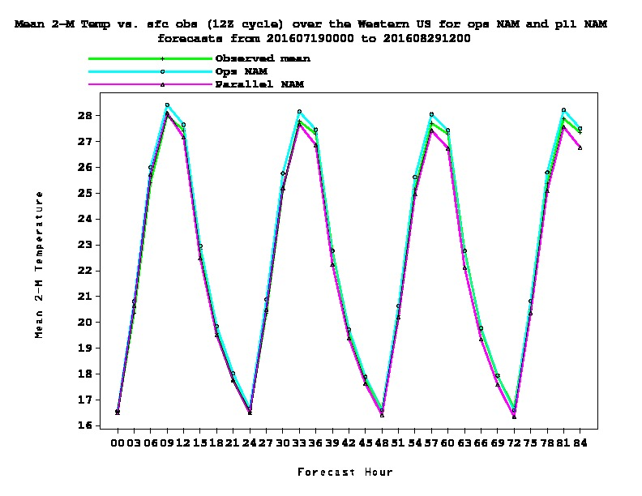
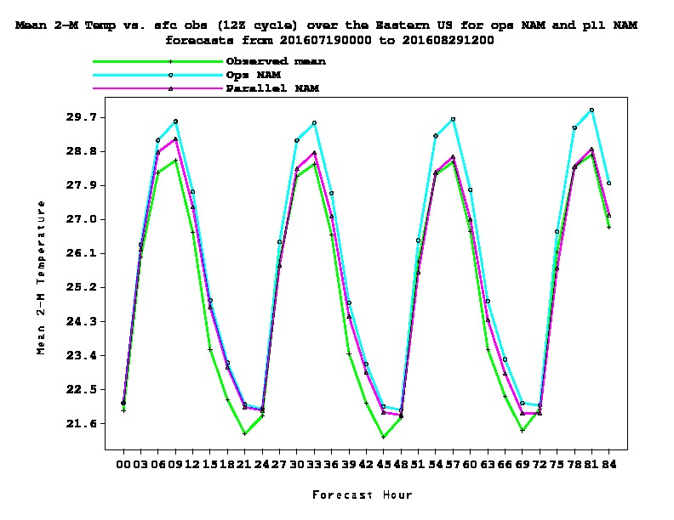
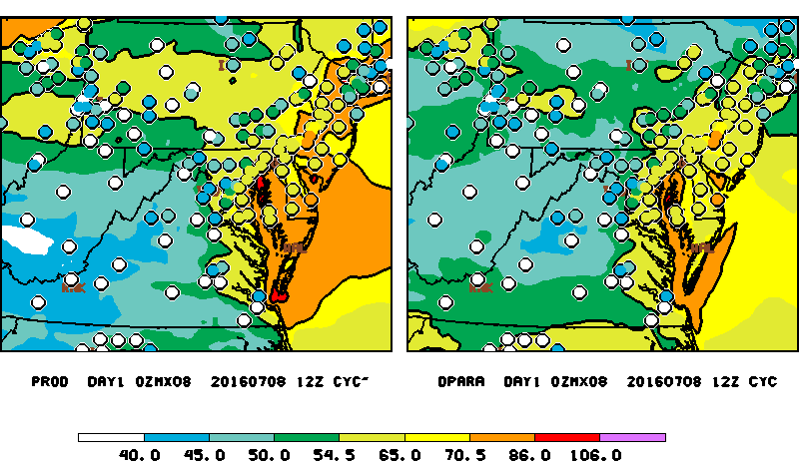
Upcoming NAM Q3FY17 Upgrade
WEST
EAST
2 m Temperature
NAM - CMAQ V4.7
NAM-X - CMAQ V4.7
Notes:
Green observed for the Eastern U.S. improved for both day and night time esp the first 24 hours or so. Reduced warm bias.
Note improvements in overpredictions from CMAQ just by using NAM-X alone.
Here observations are plotted in parts per billion, colored circles vs color filll contoured model predictions. Key threshold is code orange…greater than 70 ppb also colored in orange. Note the impact of NAM-X alone strongly improves the over predictions

Slide 13
July 2016 NRT CMAQ Prod vs V5.0.2
1 h avg Diurnal Ozone
WEST
EAST
CMAQ V5.0.2 NAM-X: improvement in ozone over-prediction over the East
West
CMAQ V5.0.2 NAM-X: Strongest underestimate over West
Meteorological impact nearly as large as CMAQ/Emissions upgrade
Notes:
July 2016 results Dashed red lines…updated CMAQ and NAMX shows good improvement compared to the observed black line. But more underprediction in the west (wild fire impact again ??)
Comparing solid rad to dashed red lines show the impact of Met alone. It is almost as large as comparing blue to red solid lines for instance (the impact of cmaq upgrade).

Slide 14
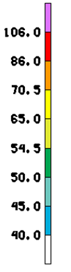
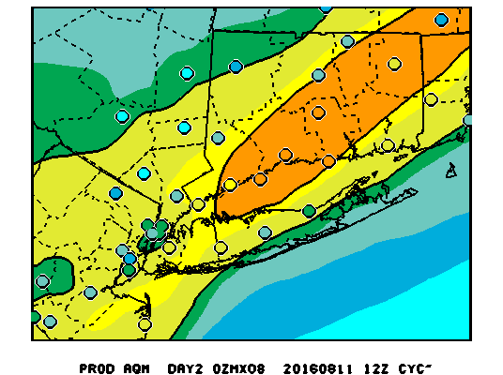
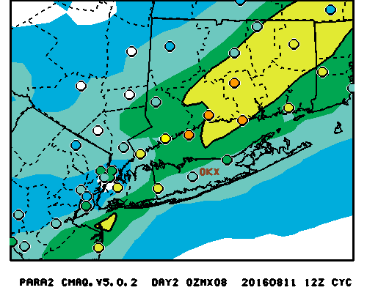
Day 2 8h O3 Daily Max
August 12, 2016
Operational
EMC Parallel w/ NOx Emissions reduced
CT/PA DEP Noted numerous mixed exceedences
with V5.0.2 Near Real-time parallels
Notes:
Again, these daily maximum ozone prediction maps were provided to AQ forecasters in near real-time for the Summer 2016 and continuing to today.
At the annual focus group meeting in Sept., CT and PA forecasters were concerned that the experimental run was missing some code orange exceedence events. These events bear the most weight on their forecast accuracy as the public advisories would go out. For this August case, the paralle had underpredicted the event by a lot or 20-30 ppb while the operational system captured the code orange regions albeit with an over-prediction bias . This was unacceptable

Slide 15
Experiments to address missed exceedences
No NOx Adjustment for Mobile Emissions (green line) NAMX
Cross State Air Pollution Rule (CSAPR) 2011 Mobile Emission
Should result in increased ozone product
Gridded NOx Mobile emission adjustment (red line) NAMX
Adjustment factor also considers fine-scale features by taking into account the12 x 12 km grid-by-grid satellite-observed NOx to NAQFC forecasted NOx ratio
V5.0.2 Para : State wide NOx adjustment using NAM
Notes:
So went back to ARL and decided to experiment further by revisiting the adjustment of important NOx emissions. Statistical time series to follow will show the runs for August 2016 with No Nox adjustment, while the dashed red line is the run with gridpoint NOX adjustment both with NAM-X . The solid redi line represents the original parallel run configuration with state wide NOX adjustments using OMI satellite data.

Slide 16
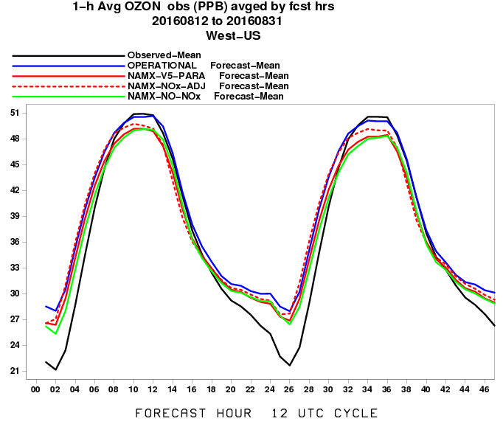
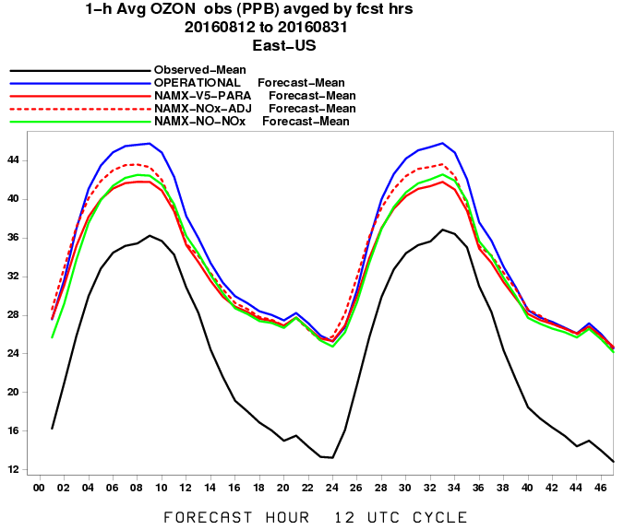
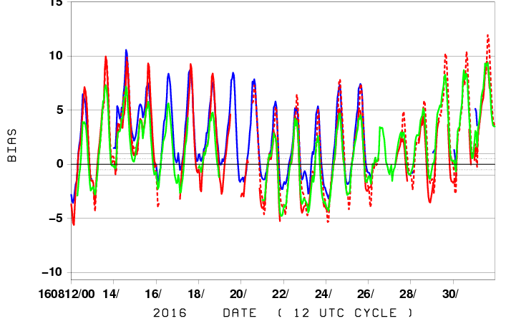
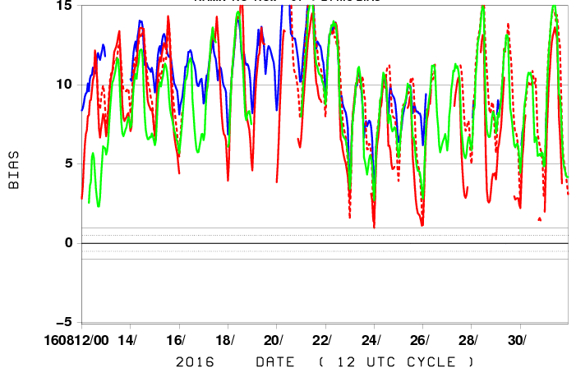
August 2016
East vs West Ozone
WEST
EAST
DIURNAL
Daily
Bias
No-NOX: Slight improvement during day over East
Slightly better over West late August
Notes:
Black line is observations Blue Line is operational model ,compare the red lines (nox adj) to green line (no nox adj)

Slide 17
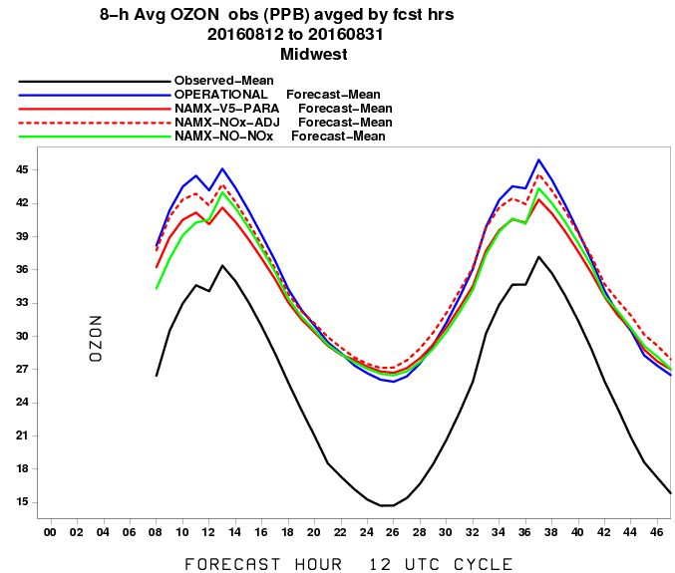
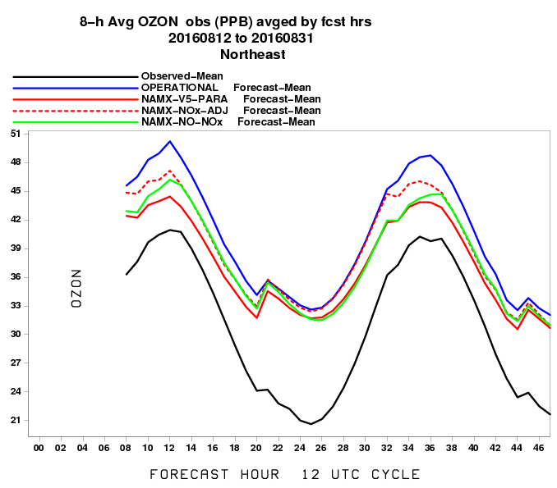
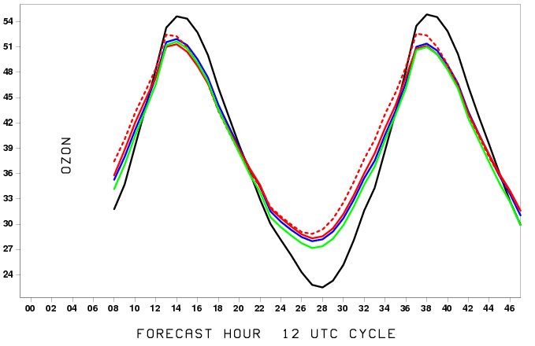
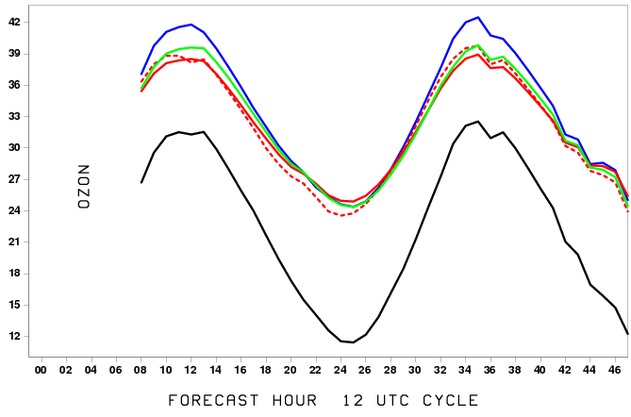
August 2016
Sub-region Ozone Diurnal plot
Midwest
NE
SW
SE
No-NOX: slight improvement during day over NE/MW
Notes:
For sub-regions, we see an improvement with No-NOX adjustment compared to gridded Nox adjustment. So we are on the right trcak

Slide 18
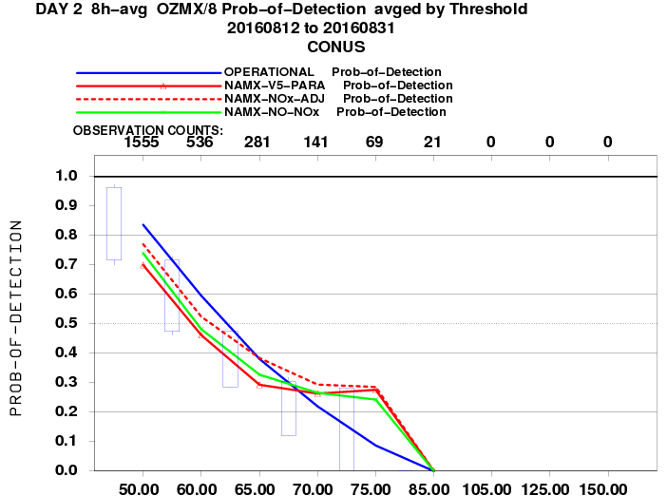
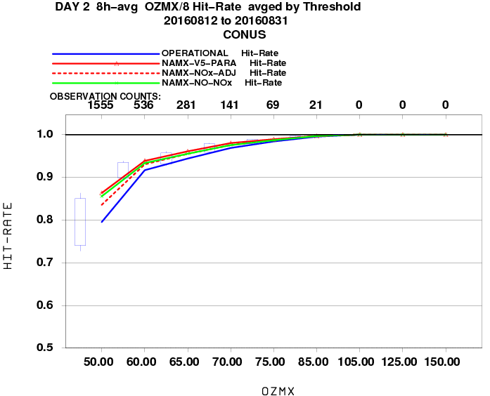
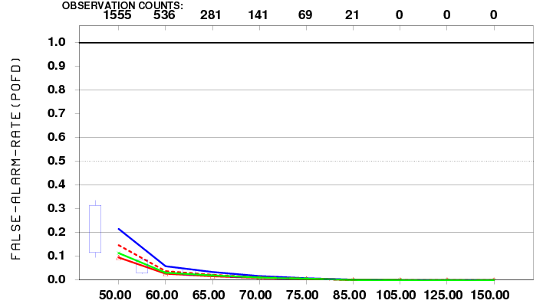
Skill Score statistics
CONUS Ozone August 2016
POD
Fraction Correct
NOX-Adj & Oper runs highest POD but
also highest FAR
FAR
Notes:
Not enough cases above 65-70 ppb threshold
Significance box plot compares operational to para run. Overall little difference

Slide 19
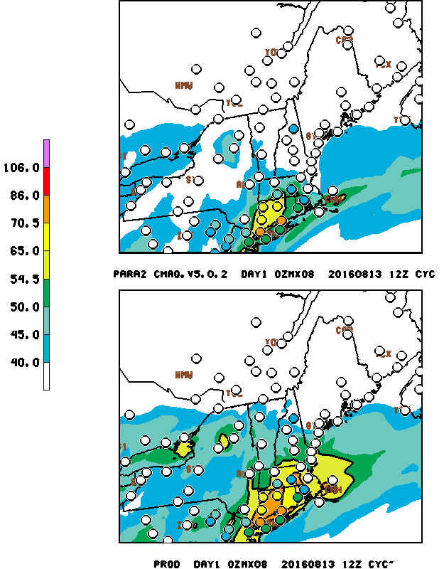
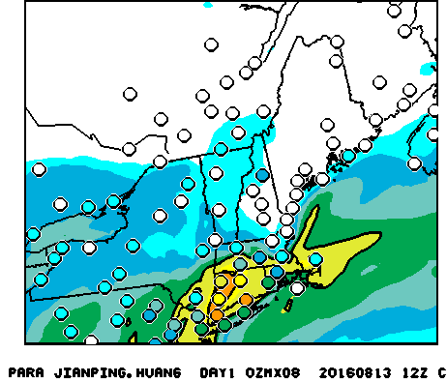
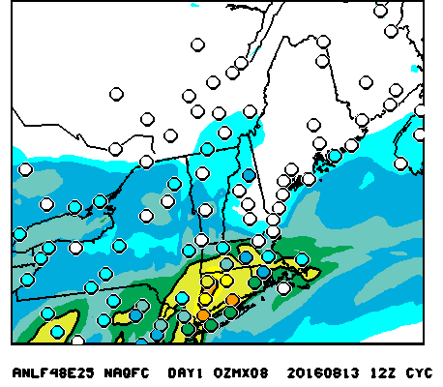
August 13, 2016 Day 1
NE Ozone exceedences
NOx State ADJ
No NOx Adj
Production
NOx Grid ADJ
Prod: Overprediction; NOx State Adj: Misses event
NOX Grid Adj: Misses coastal CT exceedence
Notes:
Looking at case studies will yeild more light on performance. Aug. 13 case, original parallel, upper left missed the code orange event. NO-NOx indicates code orange in CT but shifted inland from the coast. Difficult at 12 km to capture long island sound breeze.

Slide 20
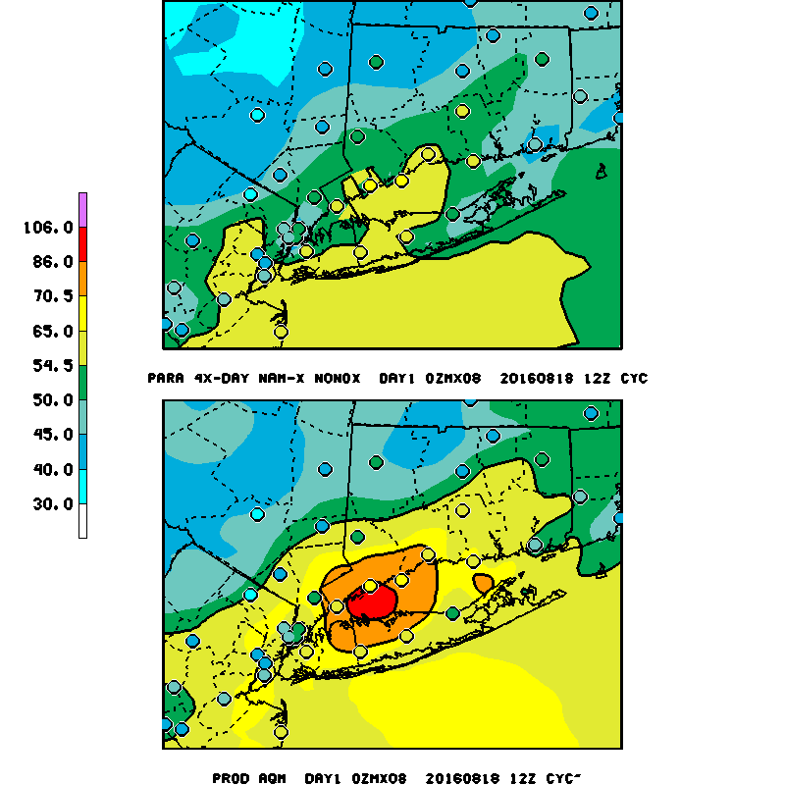
August 18, 2016 Day 1
NAMx showed a great improvement over PROD;
NAMx eliminated the four false alarms.
Courtesy Mike Geigart,
CT DEP
PARA NAMx No Nox Adj
PROD
Notes:
Advantage of having daily maps with comparisons, observation overlays….aids in user feedback

Slide 21
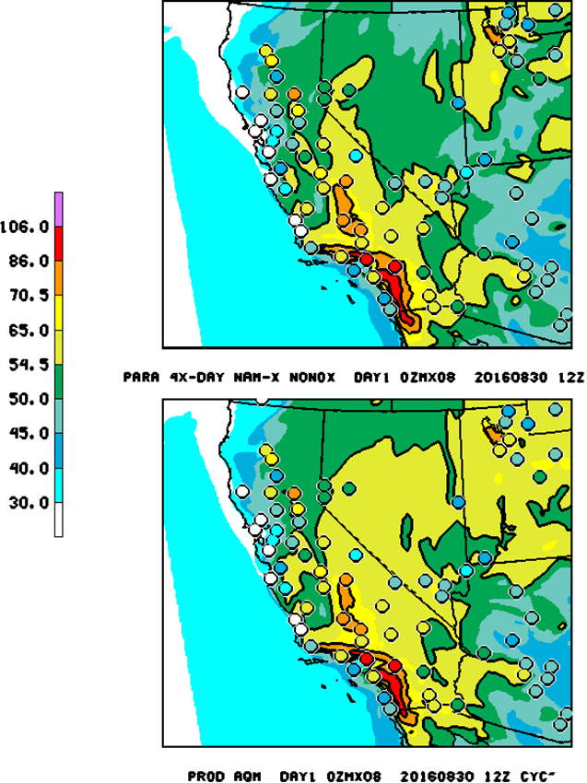
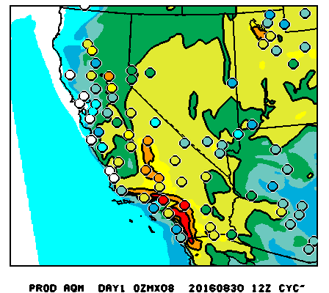
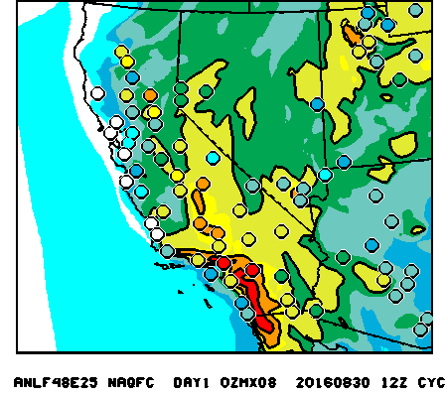
August 30, 2016 Day 1
California
No NOx Adj
Production
NOx ADJ
All similar→less ozone over Ut/NV with parallel runs
Notes:
No-NOX more ozone production over Sacramento Valley as compared to Nox adj run

Slide 22
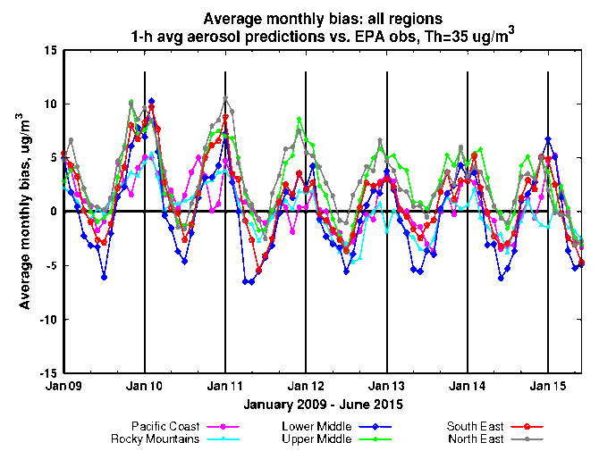
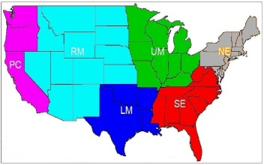
Current issues of PM_{2.5} predictions
Significant seasonal bias
over-prediction in winter
under-prediction in summer
Sources of the bias
Emissions ?
Met (PBLH) ?
CMAQ chemistry ?
LBCs?
Over-prediction in winter is improving and
Under-prediction in summer is unchanged

Slide 23
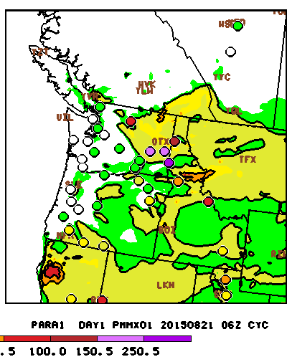
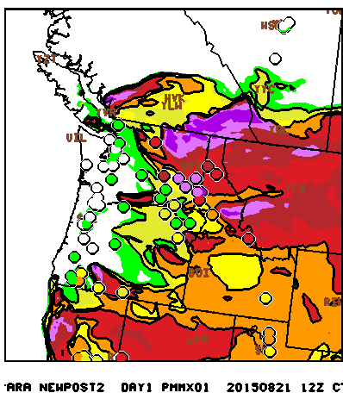
Western Fires
August 21, 2015 1hr PM2.5 Max
BlueSky v3.5.1 &
Current day locations
Operational V4.7
Operational runs: Most sites impacted by fire smoke are severely under-predicted.
Experimental tests: Updated BlueSky and use of current day fire info
Notes:
Much better fire smoke signature in the near field at least i

Slide 24
JULY 2016 PM Predictions
1 h avg PM
West
East
Underpredict PM over Western U.S.
Slight overprediction over Eastern U.S.
Bias Correction strong improvement
Notes:
Note the parallel (red ) line follows observed diurnal pattern better

Slide 25
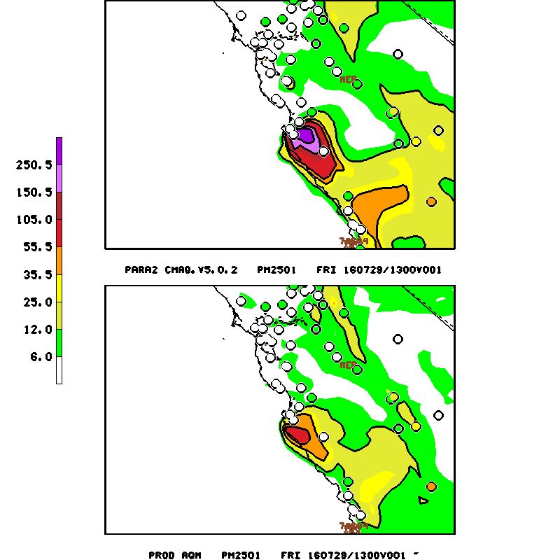
July 29, 2016 Big Sur Fire forecast and comparison to PM measurements
Smoke Emissions
- Location
Magnitude
Ejection height
Diurnal evolution
Notes:
Too much emitted in the morning

Slide 26
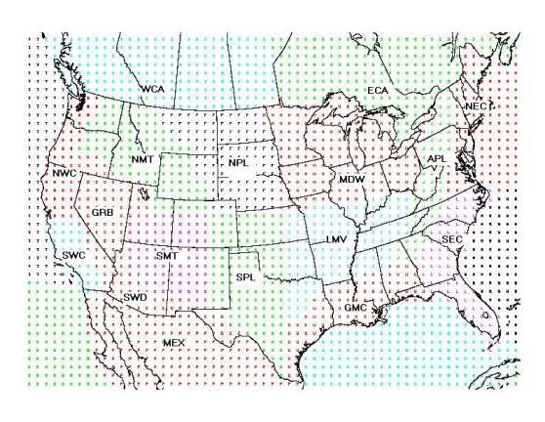
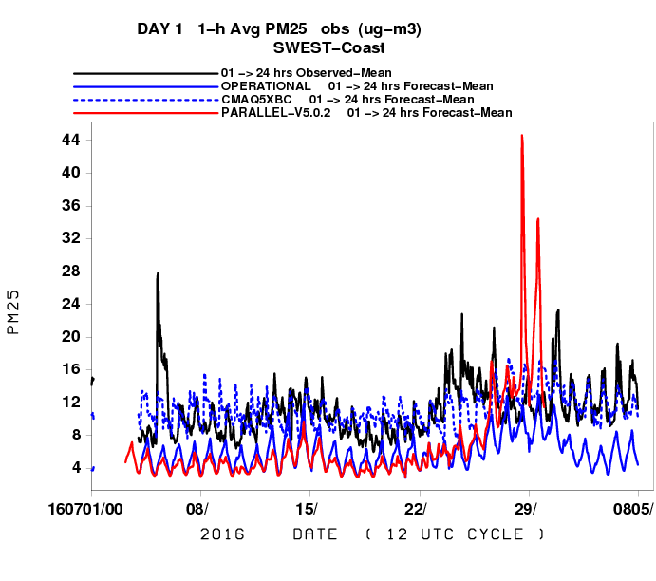
JULY 2016 PM Predictions
1 h avg PM : South West U.S. Fires
South West Coast
Underprediction (except Bias corr) in general BUT :
Overprediction of wild fire smoke events in morning
  No diurnal emissions profile used
Notes:
The overprediction primarily in the early morning when dumping too much smoke into a shallow boundary layer

Slide 27
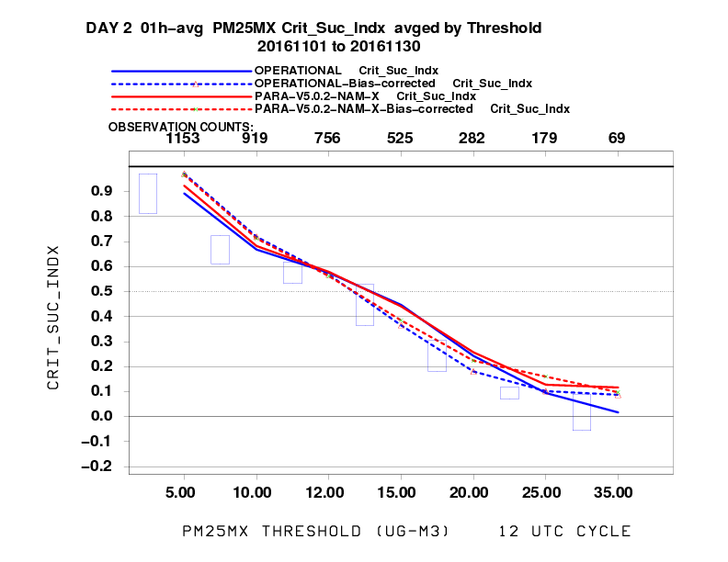
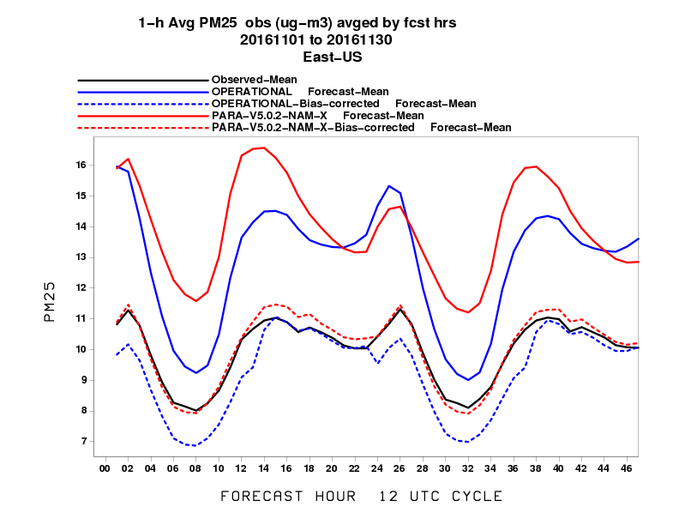
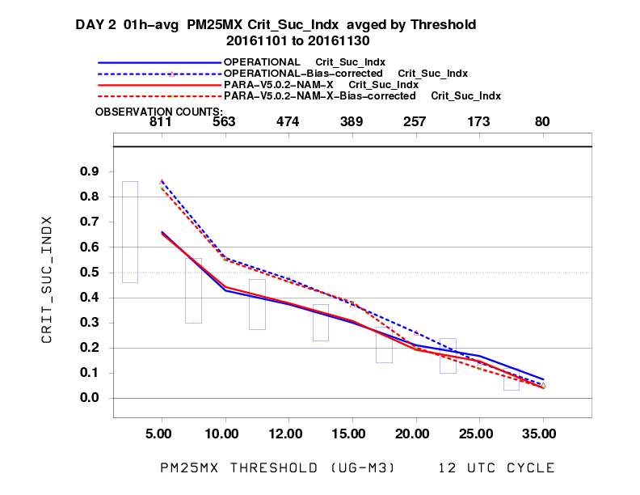
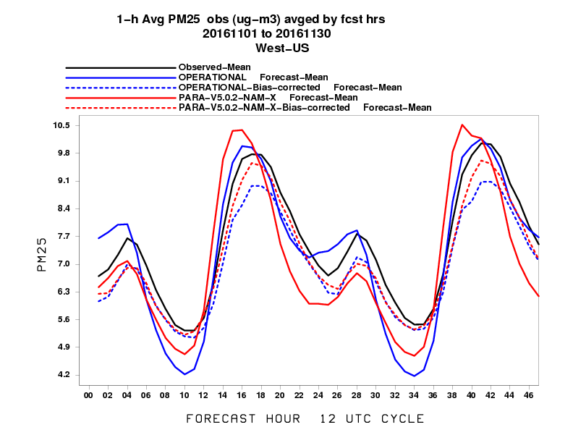
November 2016
East vs West PM and Bias Corrected PM
EAST
WEST
V5.0.2 – KFAN BC follows diurnal profile closely
Notes:
PARA-KFAN follows Diurnal observations closely in East
Improved over operational AN in E/W from diurnal plots, CSI highest in West for BC (dashed lines)

Slide 28
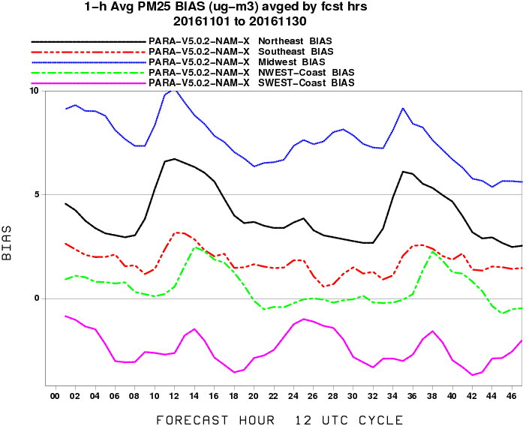
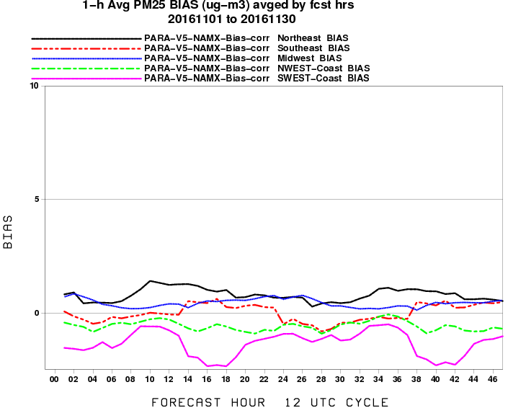
November 2016
Parallel Run PM BIAS by Region
RAW
KFAN BIAS CORRECTED
Overprediction for NE and MW improved compared to Raw
Notes:
Midwest and NE Bias nicely reduced.
SE bias over corrected
SW coast improvement is minimal
Underprediction in BC at night for SE Coast is improved as compared to AN BC

Slide 29
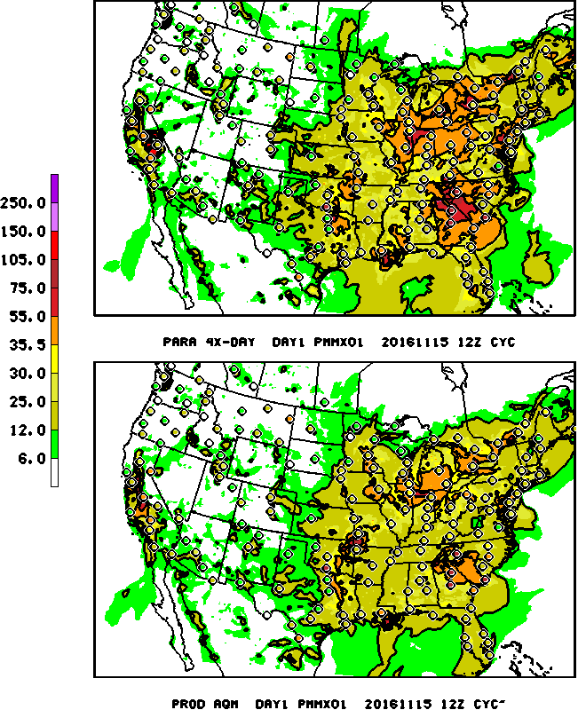
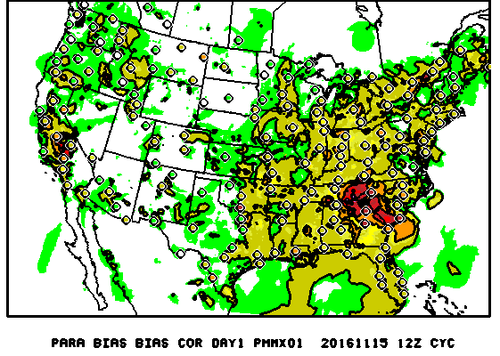
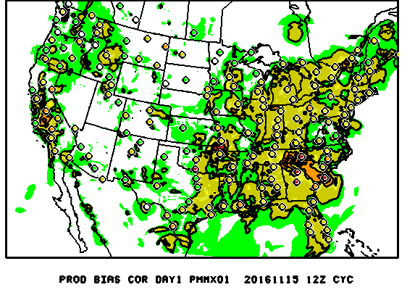
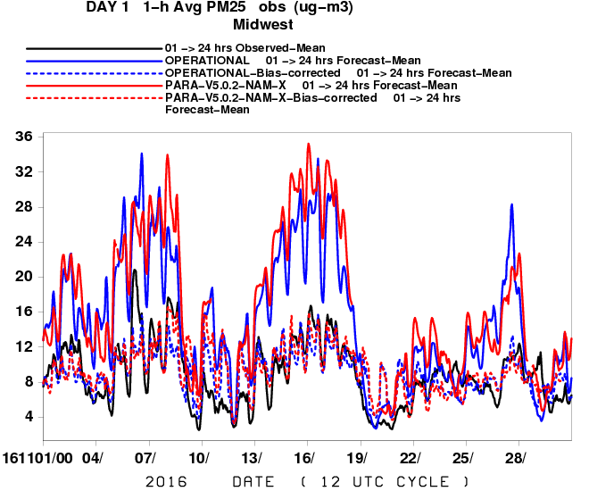
November 15, 2016
South East U.S. Fires: Midwest impact
Prod BC
Para BC
Prod
Para
Is smoke from fires moving too far downwind (Midwest)
BC does good job for correcting in prod & para runs
Notes:
NRT PM Evaluation : Oper and v5.0.2 para strong underprediction esp in late afternoon early evening. Dashed blue line bias correction has good agreement overally but bcan miss exceptional events. The overprediction primarily in the early morning when dumping too much smoke into a shallow boundary layer

Slide 30
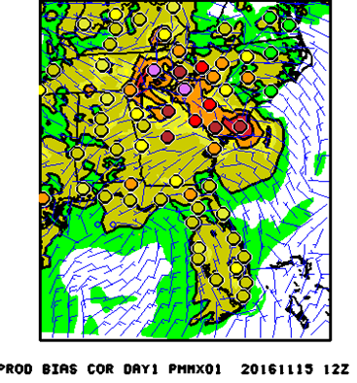
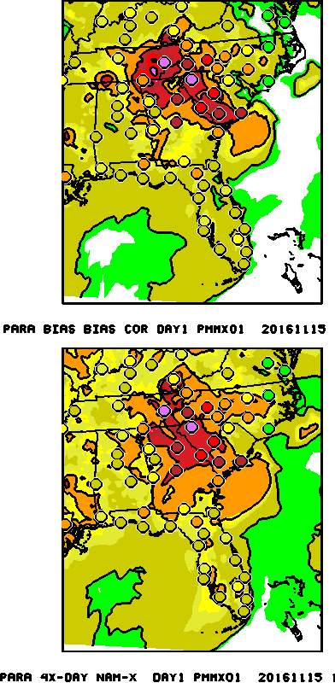

November 15, 2016
1 h Daily Max PM : South East U.S. Fires
BC underpredicts fire events, but still closer than other runs
Prod BC
Para BC
Prod
Para
Notes:
NRT PM Evaluation : Oper and v5.0.2 para strong underprediction esp in late afternoon early evening. Dashed blue line bias correction has good agreement overall but can miss exceptional events. The overprediction primarily in the early morning when dumping too much smoke into a shallow boundary layer

Slide 31




HYSPLIT Blue Sky Evaluation
MAY 2016
Prod
SEPT. 2016
Dev: New BlueSky
Notes:
Improved skill scores in May from large Ft. McMurray fires. Similar skill from smaller fires in September

Slide 32
Summary
  V5.0.2 Ozone w/ NAM-X
    Improvement correcting over-prediction esp along coasts
      Long Island Sound (CT DEP analysis)
        7 False Alarms compared to 17 from production for NYC area
      Lake Erie/Michigan and Ohio Coastline
    Much improved for Southwest and marginal or non-events
    Missed exceedences in NE corrected after removing NOx adjustments
  PM
    Large positive impact near forest fires :
      Updated BlueSky and24 h pre analysis run
      Underprediction when external sources (Saharan dust, Canadian fires) are impacting CONUS
      Emission timing and ejection height uncertainties
    Continued overprediction in Winter from raw predictions
  Updated NAM alone strongly improves ozone forecast
    Amount of incoming radiation under clouds critical

Slide 33
Future Emphasis
  Extend to 72 hours, update emissions to 2014 base
  Near real-time fire locations, strength, emissions
    Canadian, Mexican & external source impacts
    Top down (satellite) vs Bottom up (BlueSky) approaches
    Improved temporal profiles and plume rise algorithms
  NGAC full aerosol boundaries
  Unification of AQ systems
    HYSPLIT smoke/dust → NGAC Aerosol
    CMAQ ozone & total PM
    HRRR-smoke
  Extend Kalman Filter bias correction to ozone
  Improved Evaluations
    Use of VIIRS/GOES-R/AERONET AOD, CALIPSO aerosols
    Evaluate Operational models for field experiments (ESRL FireX 2018, FASMEE)
USWRP ESRL/EPA FV3-CMAQ
- Inline allows for
High Resolution
Notes:
NGGPS project to support unification

Slide 34
BACKUPS

Slide 35
Web pages
CMAQ V5.0.2
Real-time parallel runs (July 2016-Present
  http://www.emc.ncep.noaa.gov/mmb/aq/cmaq/web/html/max.html
No NOx adj/NAM-X/4x-day cycling (Aug. 7-Sept 10)
  http://www.emc.ncep.noaa.gov/mmb/aq/cmaqnox11/web/html/max.html
Gridpoint NOx adj/NAM-X/1x-day cycling (Aug. 1-Sept 10)
  http://www.emc.ncep.noaa.gov/mmb/aq/cmaqnox/web/html/max.html
Verification statistics (prod,para, cmaqnox11, cmaqnox)
  http://www.emc.ncep.noaa.gov/mmb/aq/fvs/web/html/regular.html

Slide 36




NAM PROD (left panel) and updated NAM Parallel (right panels)
20160717 06Z at FCST HR 36 and 48
Impact of Experimental NAM on smoke
(a)
Quite different between NAM Prod and NAM Para on
Circulation pattern
Stability -> plume rise -> emission release height
(b)
Notes:
Experimental run for this case produces somewhat more smoke…difference met of course impacts the transport plus the injection heights.
Just started quantitative verification of NAM-X run

Slide 37
Winter Time PM
Southern CA, Jan. 17, 2017
Mid Atlantic, Jan. 21,2017
Improved out west, but overprediction sometimes worsened over East
Notes:
NRT Evaluation : Oper and v5.0.2 para

