Slide 1
Global Aerosol Modeling at NCEP:
A new capability by transitioning NASA research to operations
Sarah Lu
Atmospheric Sciences Research Center
University at Albany, State University of New York

Slide 2
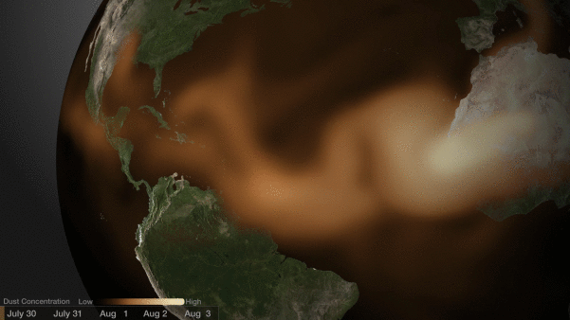
Trans-Atlantic Sahara dust
Nightly News | July 31, 2013
Massive dust storm sweeps over Atlantic
The Saharan Air Layer, a burst of dust, could possibly suppress this year’s hurricane season. NBC’s Brian Williams reports.
WKRG (CBS at Mobile, AL) : Saharan dust moves across the Atlantic (Aug 8)
KSAT (San Antonio, TX): Saharan dust cloud over San Antonio irritates residents (Aug 9)
While the impact of dust on hurricane is yet to be determined, the long range dust transport and its impact on air quality and public health is clearly shown.

Slide 3
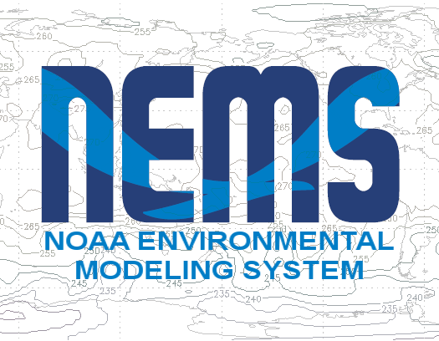
Global aerosol prediction at NCEP
NEMS GFS Aerosol Component (NGAC)
Successful example of transitioning NASA research to NCEP, supported by NASA Applied Sciences Program
NCEP’s global in-line aerosol forecast system
Build upon NOAA Environmental Modeling System (NEMS), a common modeling framework using Earth System Modeling Framework (ESMF)
Provide 5-day dust-only forecast since 2012
Model Configuration:
Resolution: T126 (~ 1°x1°) L64
AGCM: NCEP’s NEMS GFS
Aerosol: GSFC’s GOCART

Slide 4
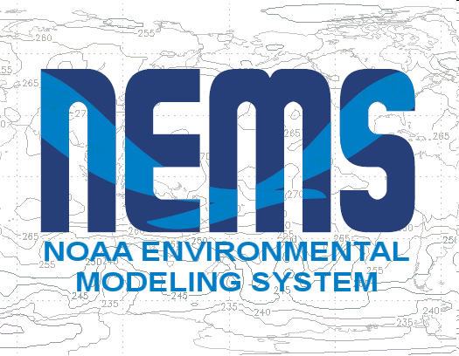
Multi-agency collaborations toward developing global aerosol forecasting system at NCEP
NCEP EMC team
Jun Wang (aerosol modeling, project POC)
Mark Iredell (NEMS team lead)
Shrinivas Moorthi (physics)
Yu-Tai Hou (radiation-aerosols)
Henry Juang (dynamics)
Hui-Ya Chuang (post-processing)
Weiyu Yang (ESMF infrstructure)
Perry Shafran (verification)
Downstream applications (Jeff McQueen)
NCEP Collaborators
NASA/GSFC: Arlindo da Silva, Mian Chin, Peter Colarco, Anton Darmenov, Donifan Barahona
NESDIS/STAR: Shobha Kondragunta
Universities: Sarah Lu, Qilong Min, Sheng-Po Chen (University at Albany, SUNY)
Xiaoyang Zhang (South Dakota State University)

Slide 5
Why include aerosols in the predictive systems?
Improve weather forecasts and climate predictions by taking into account of aerosol effects on radiation and clouds
Improve assimilation of satellite observations by properly accounting for aerosol effects
Provide aerosol (lateral and upper) boundary conditions for regional air quality predictions
Produce quality aerosol information that address societal needs and stakeholder requirements, e.g., UV index, air quality, ocean productivity, visibility, and sea surface temperature retrievals.

Slide 6
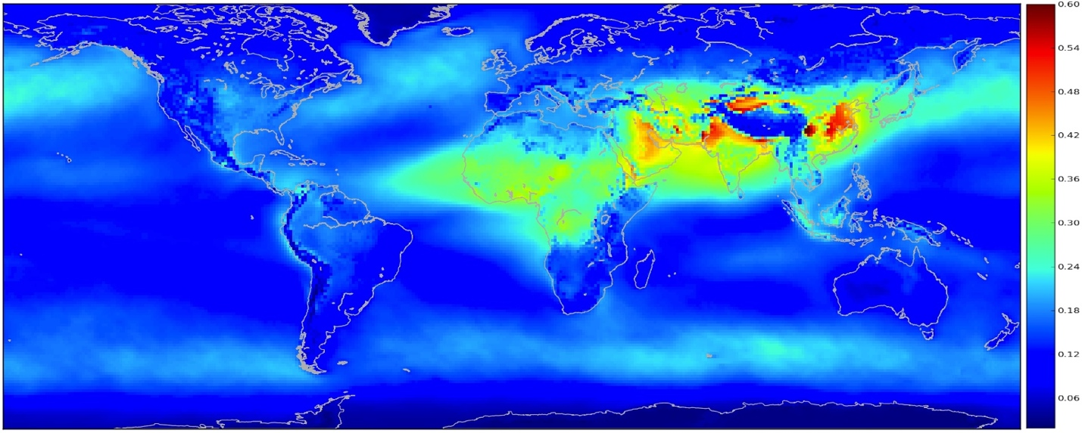
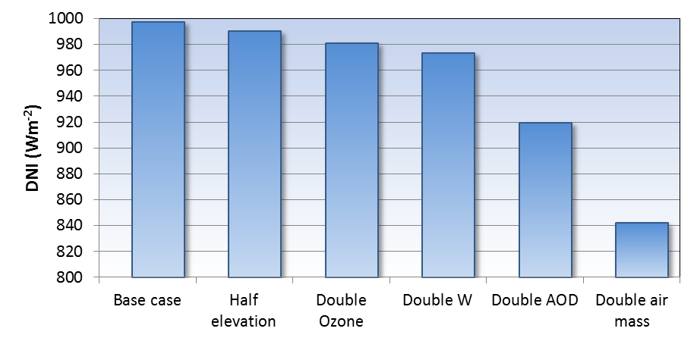
Semi-empirical satellite model for solar power
Radiative transfer model (quasi physical) + cloud modulation (largely empirical)
Solar power product: 10 km hourly (standard); 1km ½ hourly (enhanced)
0.4
AOD
0.3
0.2
0.1
W Preciptable water
O₃ Ozone
H Altitude
Richard Perez (SUNYA) and Tom Hoff (Clean Power Research)

Slide 7
Global aerosol prediction at NWP centers
Aerosol modeling, traditionally serving regional air quality and climate communities, has seen rapid development at several operational NWP centers over the last few years
Operational aerosol forecasts are now available from several operational and research NWP centers
Aerosol prediction systems are built upon modeling/assimilation methodologies already in place for the meteorological systems.
NRL: NAAPS, driven by NOGAPS
ECMWF: MACC, IFS coupled with LMD
UKMO: MetUM with the Hadley Centre dust scheme
GMAO: GEOS-5, GEOS-5 AGCM coupled with GOCART
NCEP: NGAC, NEMS GSM coupled with GOCART
GOCART in different AGCMs: NCEP-GSFC collaborative R2O project

Slide 8
GOCART Module
In-line chemistry advantage
Consistency: no spatial-temporal interpolation, same physics parameterization
Efficiency: lower overall CPU costs and easier data management
Interaction: Allows for feedback to meteorology
GOCART diagram provided by Peter Colarco (GSFC)

Slide 9
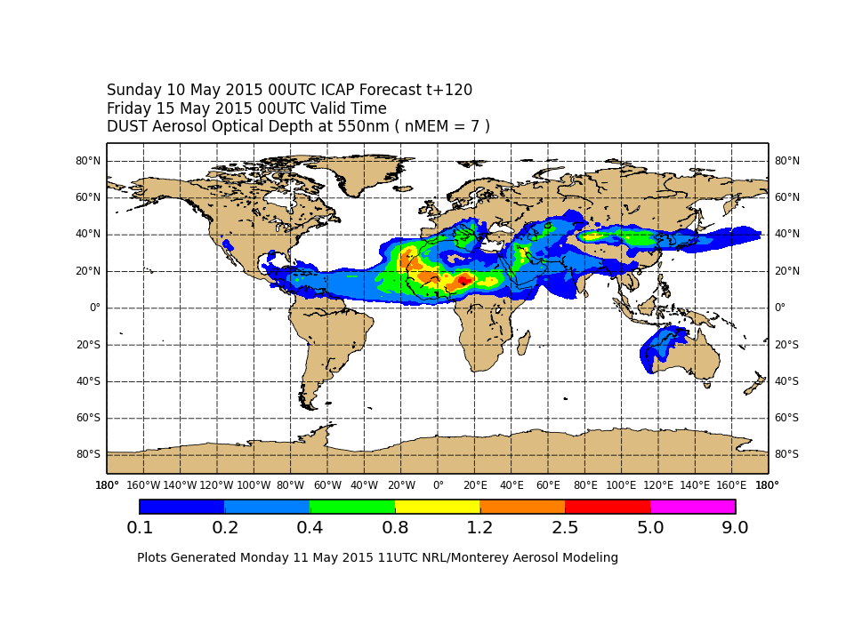
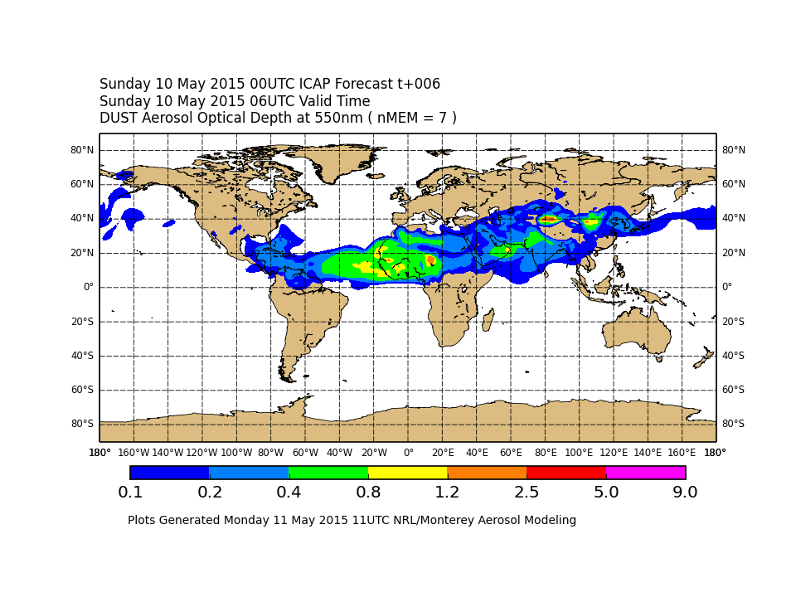
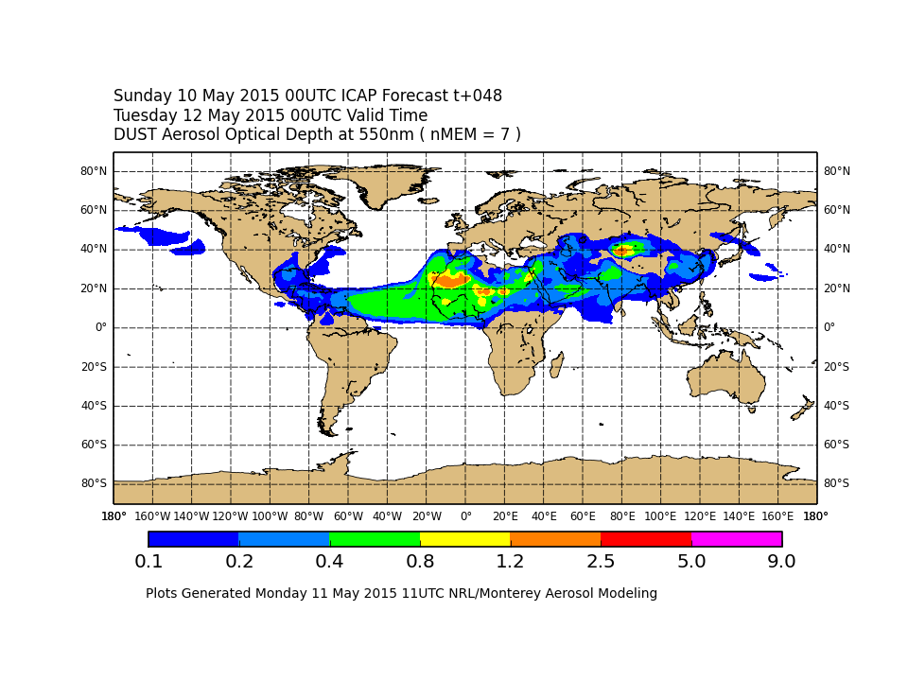
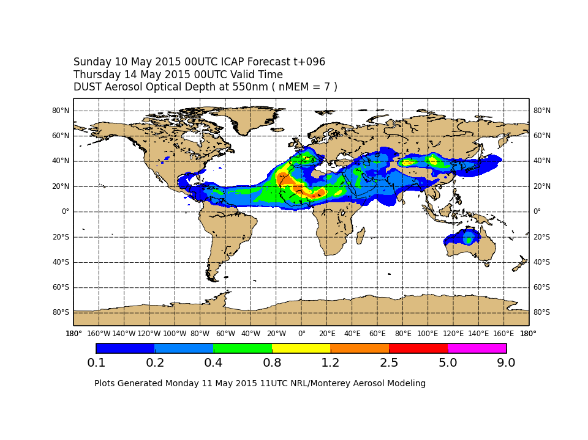
Multi-Model Aerosol Ensemble
International Cooperative for Aerosol Prediction (ICAP) multi-model ensemble. Dust AOD from 7 members (BSC, ECMWF, GMAO, NCEP, NRL, JMA, and UKMO)
ICAP is a global aerosol forecasting working group for aerosol forecast centers and data providers. NCEP leverages collaborations with other recognized world experts in operational aerosol forecasting

Slide 10
Looking forward …..
Ongoing aerosol modeling activities | Program facilitating R2O
Enable global short-range multi-species aerosol prediction (Q1Y16) | Joint Center for Satellite Data Assimilation (JCSDA)
Provides a first step toward an operational aerosol data assimilation capability at NOAA | JCSDA
Allows aerosol impacts on medium range weather forecasts to be considered | NWS Next-Generation Global Prediction System (NGGPS) R2O
Allows NOAA to explore aerosol-cloud-radiation interaction in the Climate Forecast System (CFS) | CPO MAPP-Climate Test Bed (CTB)
Provides lateral aerosol boundary conditions for regional air quality system (Q4FY15) | NWS National Air Quality Forecast Capability (NAQFC)

Slide 11
JSDI Project: Global Aerosol Forecasting at NCEP using Satellite-based Smoke Emissions
NESDIS/STAR: Shobha Kondragunta, Xiaoyang Zhang#
NCEP/EMC: Sarah Lu*, Jun Wang, Jeff McQueen
GSFC/GMAO: Arlindo da Silva
ARL: Hyun Kim
Multi-agency collaborative efforts to develop the near-real-time smoke emissions (GBBEPx), funded by JCSDA Science and Development Implementation (JSDI)
The implementation of GBBEPx by NESDIS enables NCEP to upgrade NGAC for multi-species forecast (Q1FY16)
The multi-species prognostic capability provides a first step toward aerosol data assimilation and aerosol reanalysis
Efforts are underway to develop the DA capability at NCEP (a NCEP-STAR-GSFC-SUNYA collaborative project funded by JCSDA)
*: now at SUNYA
#: now at SDSU

Slide 12
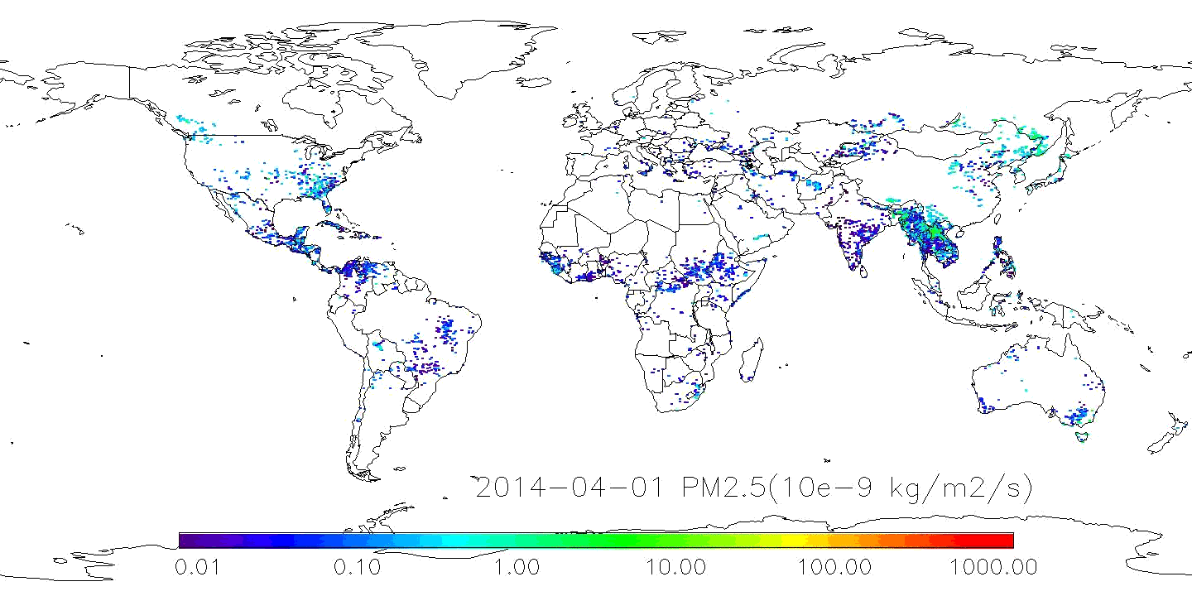
Temporal and Spatial Variation in Fire Emissions from GBBEPx
GBBEPx: Global Biomass Burning Emissions Product from Geo (NESDIS’s GBBEP) and Polar (GMAO’s QFED)
Shobha Kondragunta (NESDIS/STAR)

Slide 13
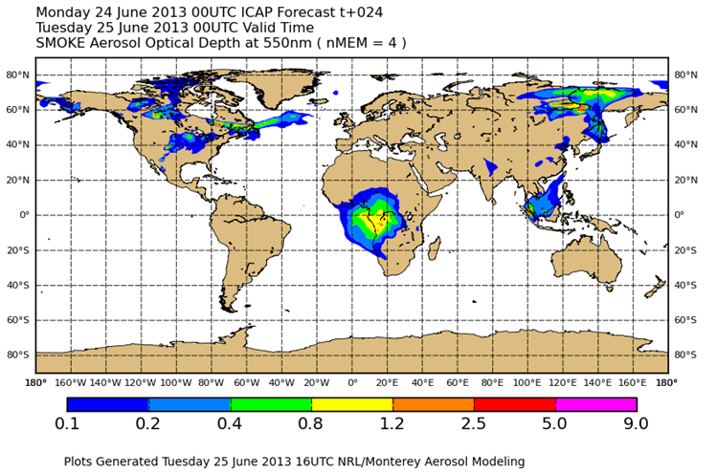
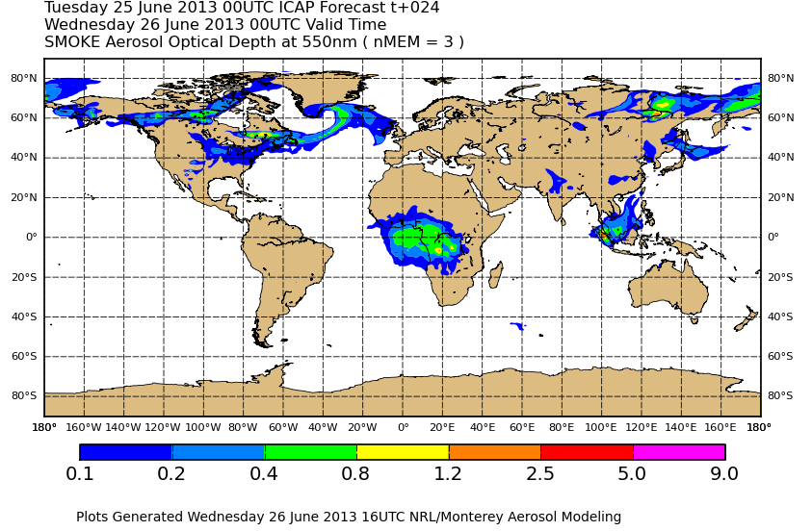
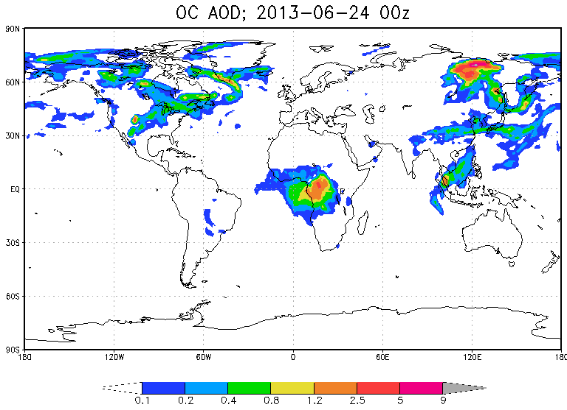
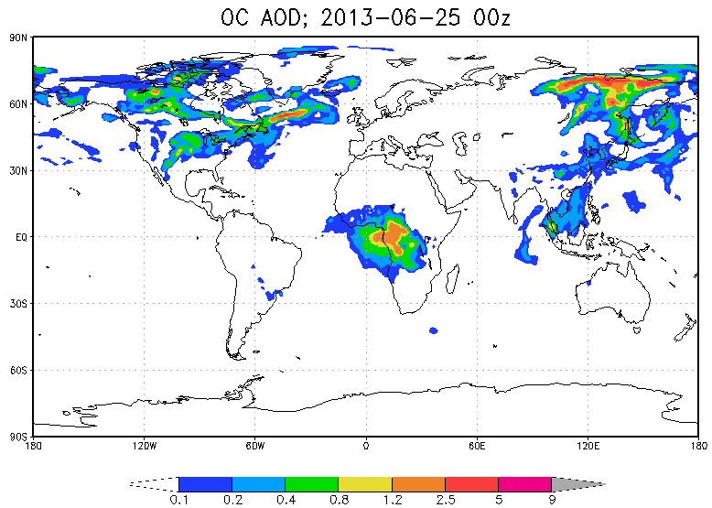
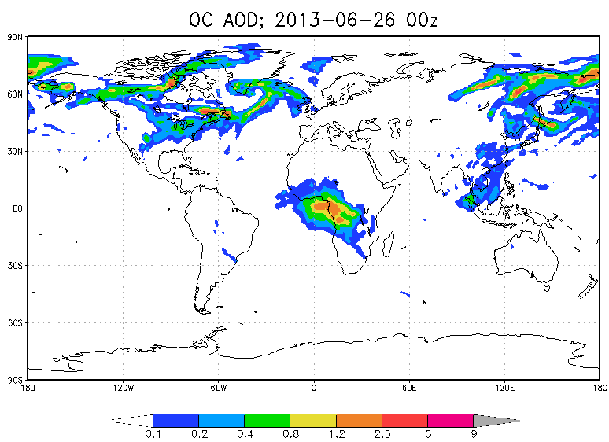
NGAC simulations using GBBEPx
ICAP global ensemble from NRL, ECMWF, GMAO, and JMA
NGAC OC 24hr forecast for Jun 24-26 2013

Slide 14
MAPP-CTB Project: Improving Cloud Microphysics and Their Interactions with Aerosols in the NCEP Global Models
SUNYA: Sarah Lu, Qilong Min, Sheng-Po Chen
GSFC/GMAO: Arlindo da Silva, Anton Darmenov, Donifan Barahona
NCEP/EMC: Yu-Tai Hou, Shrinivas Moorthi, Fanglin Yang, Jun Wang
Multi-agency collaborative efforts to improve the representation of aerosol processes, cloud microphysics, and aerosol-cloud-radiation interaction in NCEP global models
Proposed physics upgrade: adapting GSFC’s physically-based aerosol and cloud microphysics package (which in turn is based on NCAR CAM5)
This project contributes toward the development of advanced physical parameterization suite in NEMS, and is closely aligned with the NWS R2O Initiative

Slide 15
Adopting GEOS-5 aerosol-cloud package
GSM_Moist
Convective parameterization
Coupling of Macrophysics and Microphysics
Two-moment MG cloud microphysics
RAS V2
PDF-based cloud scheme (SHOC)
Large scale and convective condensation, precipitation, evaporation, and sublimation
Detrained mass fluxes,
Unsaturated downdrafts,
Very simple bulk microphysics
MGMICRO
Microphysical processes for Stratus and Anvil clouds
AER_CLOUD
Cloud droplet activation and Ice nucleation
Aerosol Activation
This CTB project will adopt MAM, MG, and AER_Cloud from GSFC and coordinate with EMC/CPT teams on coupling cloud micro and macro physics
Aerosol Transport (GOCART, MAM-7)

Slide 16
Concluding Remarks
The global aerosol modeling capability at NCEP has been established through close collaborations among NCEP, NASA GSFC, NESDIS STAR, and universities
The research-to-operation is accomplished by:
Concurrent code management via version control: code development are committed to NCEP code repository and all tests are based on NCEP parallel infrastructure
Utilization of Earth System Modeling Framework (ESMF) in NEMS
Operational requirements and constraints clearly defined by NCEP
Continued engagement to ensure close communication and coordination between R and O throughout the transition (Not just R handoff to O)
Multi-agency partnership arrangements are needed to ensure sustainable system development at NCEP.
The transition of research capabilities to operational implementation has been facilitated by applications oriented programs (e.g., NASA ASP, JCSDA, and MAPP-CTB)

Slide 17
Thanks.
Questions and Comments?

