Slide 1
Preliminary Report on the MYJ PBL Experiment with the Operational HWRF: Comparisons with the GFS PBL Scheme
The NOAA HWRF TEAM
The EMC Internal HWRF Meeting
6 September 2012

Slide 2
Outline
Brief overview of the MYJ PBL scheme and its major differences with the GFS scheme
Statistics of individual 2012 high impact cases and Isaac (2012).
Example of track and structural comparisons for Isaac (2012).
Summary

Slide 3
How to Couple the MYJ PBL Scheme with a Surface Flux Module
The MYJ PBL scheme takes the surface physical properties as the lower boundary condition, instead of the vertical fluxes of the properties.
When coupling with Janjić’s two-layer surface scheme (default in NMM):
MYJSFC is called to calculate surface fluxes, obtain K_{M} and K_{C} at the lowest
model level corresponding to the surface fluxes, and diagnose the PBL depth.
When coupling with the GFDL model (new option for the HWRF model):
GFDLSFC is called to calculate surface fluxes. Then, a modified GFDLSFC is
called to obtain K_{M} and K_{C} at the lowest model level corresponding to the GFDL
surface fluxes, and to diagnose the PBL depth.

Slide 4
Comparison of the MYJ and the GFS Schemes
Parameterization | “Major Tunable Parameters” | Order and Type of Closure
The GFS Scheme (K-profile) | PBL depth, magnitude and profile of Km and Kh | 1st order non-local
The MYJ Scheme (TKE-closure) | Mixing length | 1.5th order local
Other important tunable factors?
Coupling with the land-surface model?
Coupling with the cloud physics?

Slide 5
Property Summary of the Two Schemes
The GFS scheme assumes that there is a well defined layer h in which the vertical distribution of diffusivities follows a special cubic polynomial function x(1-x)², where x = z/h.
The MYJ scheme naturally links the PBL depth to the sub-grid TKE distribution, though it does require a specification of the mixing length. Also, the non-singularity requirement leads to small TKE above the PBL.
3. The magnitude of the diffusivities from the GFS scheme is determined by the PBL depth, while in the MYJ scheme it is determined by the mixing length.

Slide 6
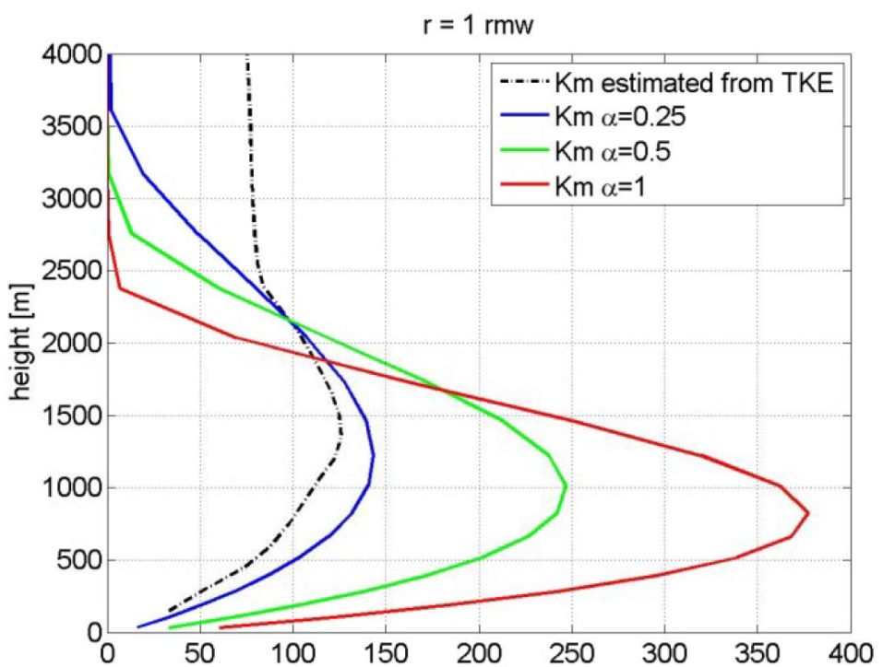
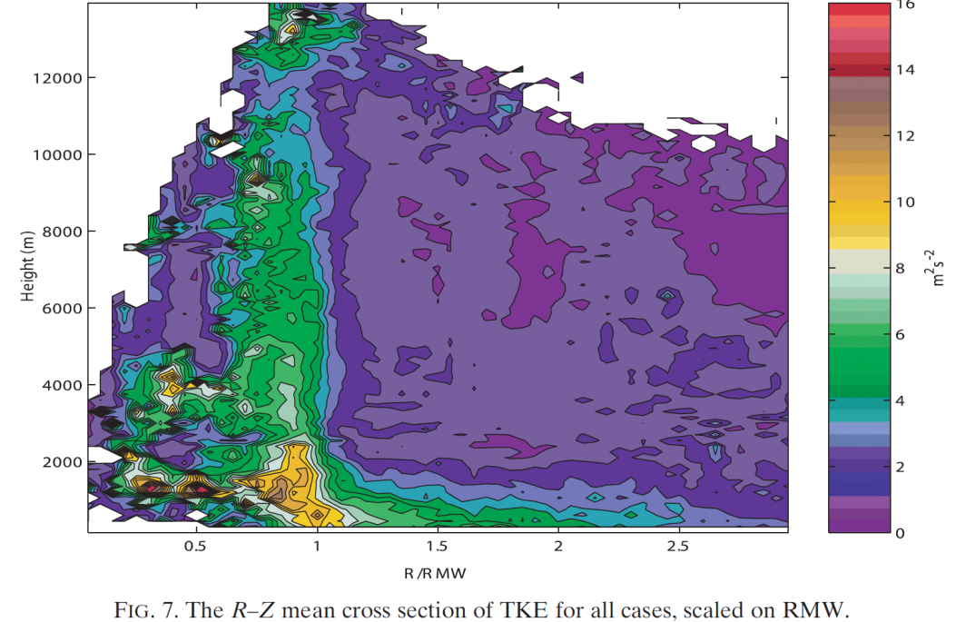
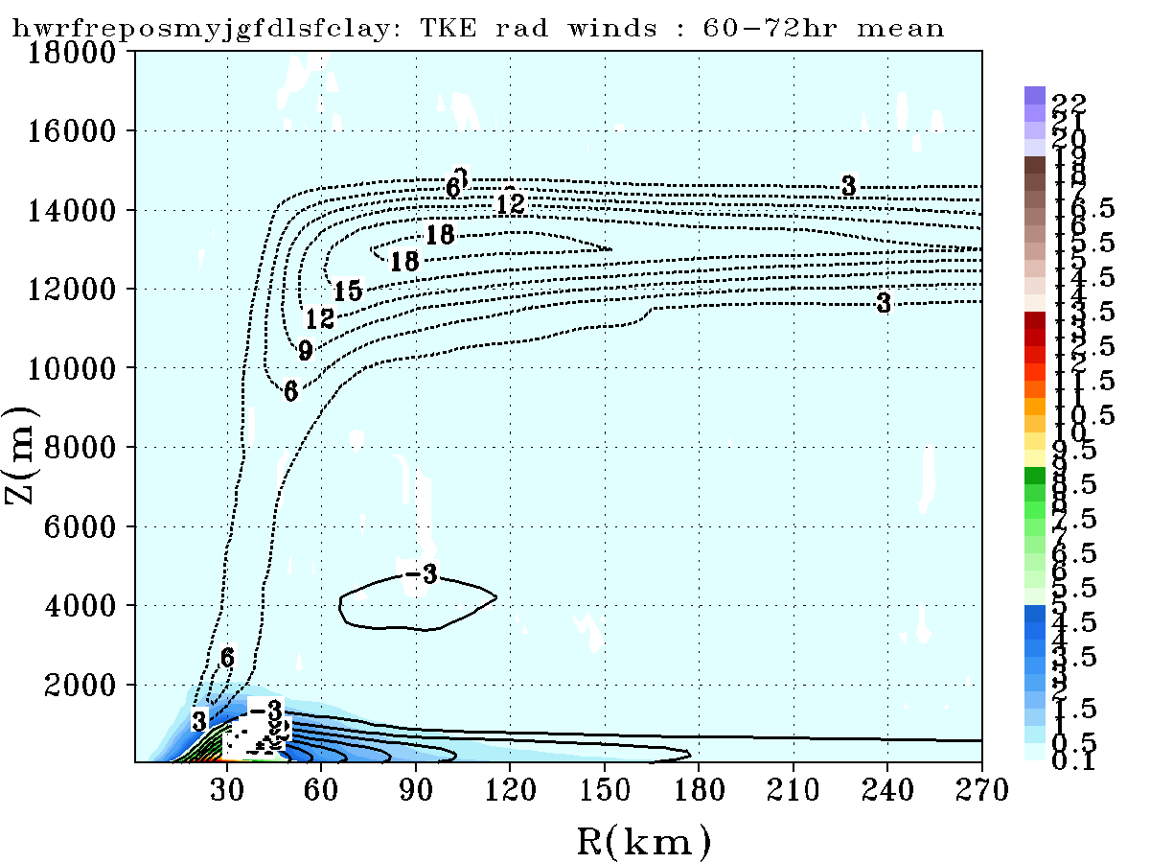
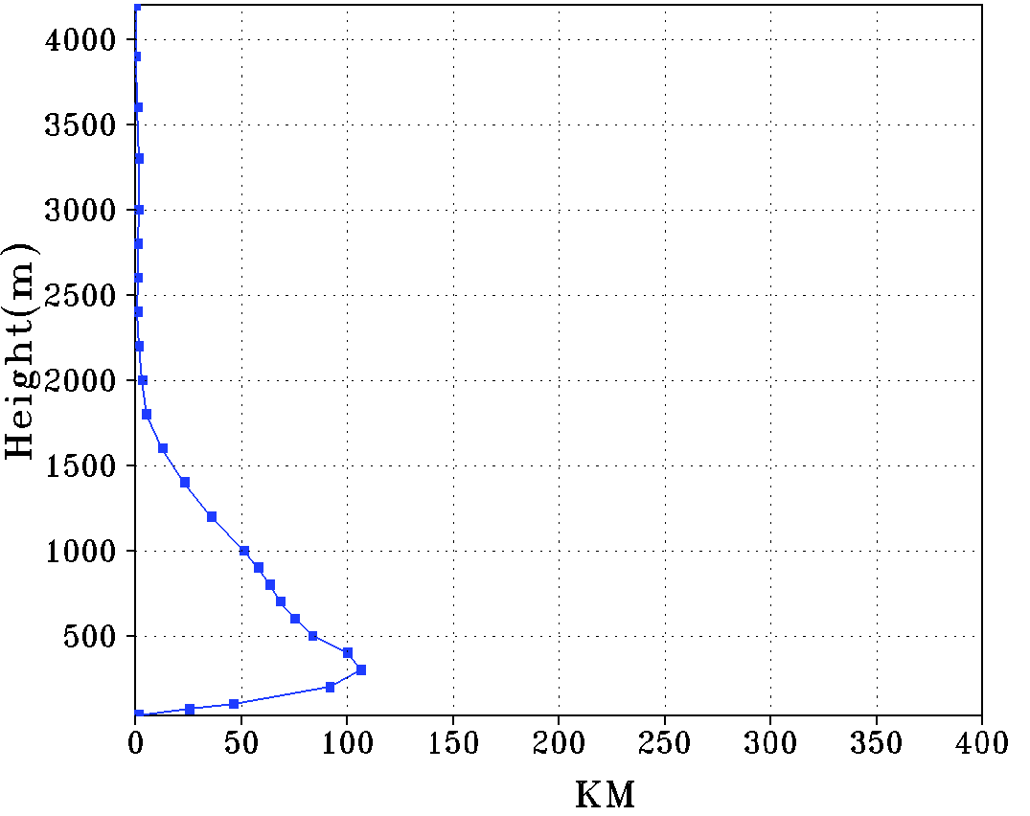
Measured TKE
Idealized HWRF GFS Km and observational estimate at r = 1
Zhang et al. 2012
Lorsolo et al. 2010
Lorsolo et al. 2010, MWR
Idealized HWRF2012 MYJ TKE (shaded colors) and radial wind (contours)
Idealized HWRF2012 MYJ Km at r = 1
Azimuthal average
Azimuthal average

Slide 7
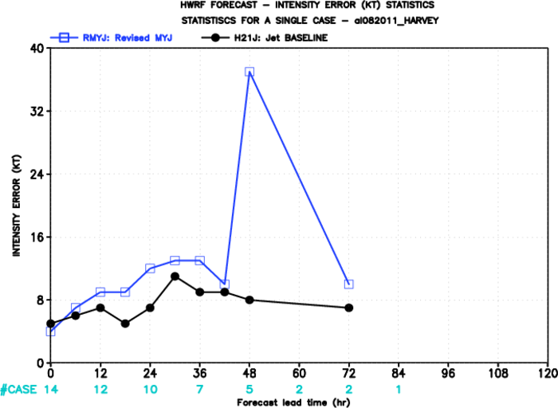
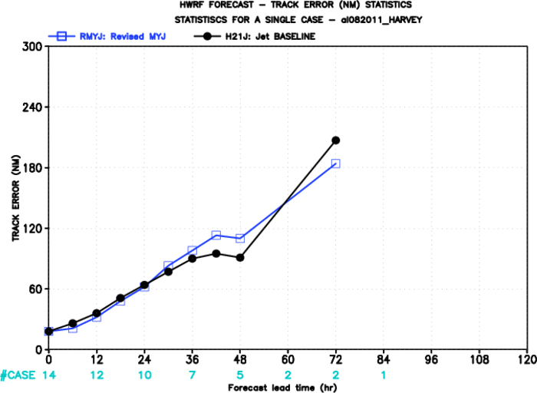
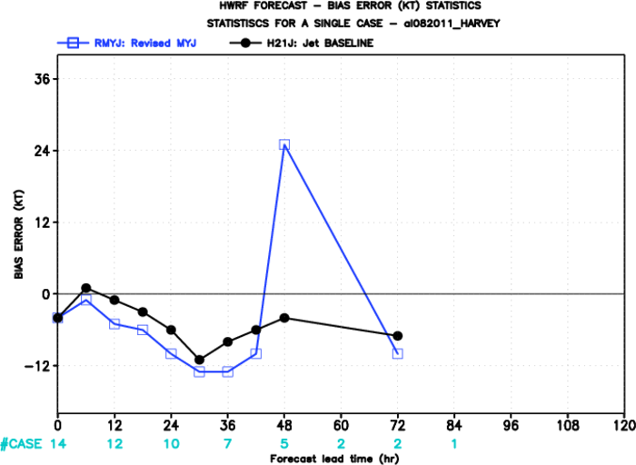
HARVEY (2011)

Slide 8
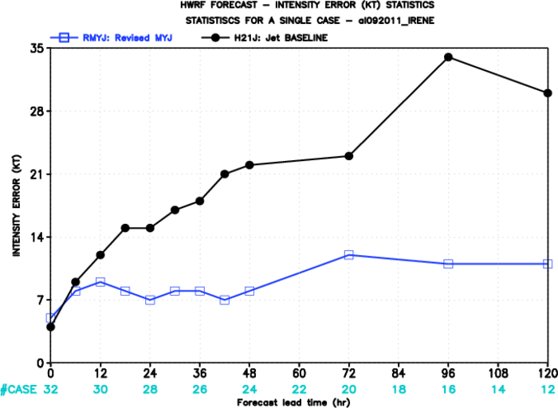
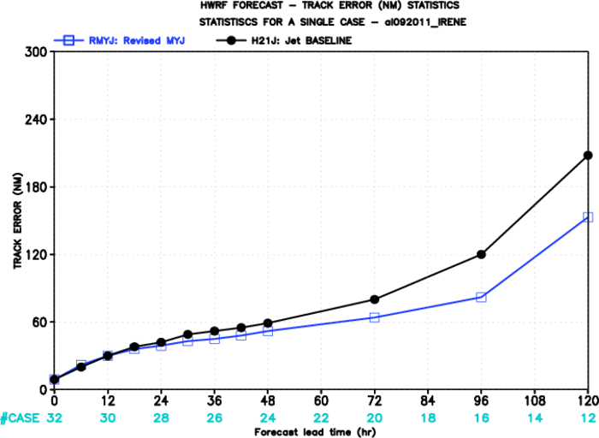
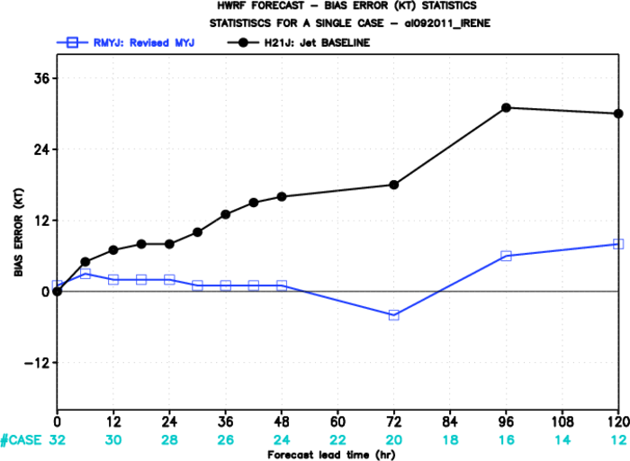
IRENE (2011)

Slide 9
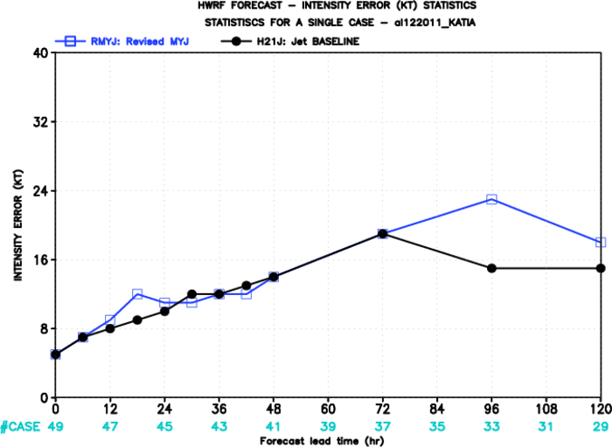
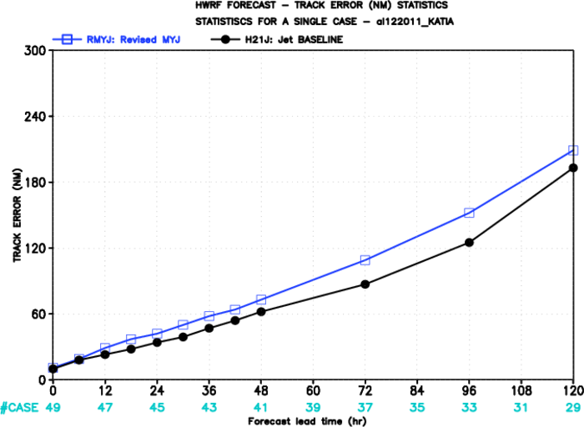
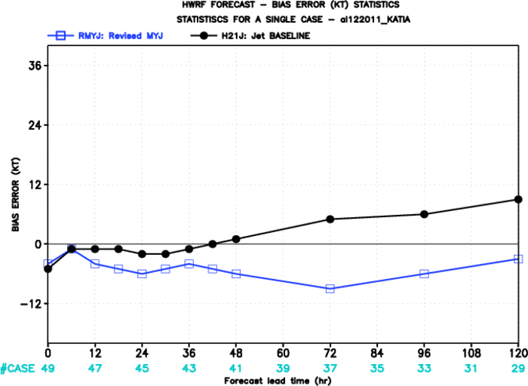
KATIA (2011)

Slide 10
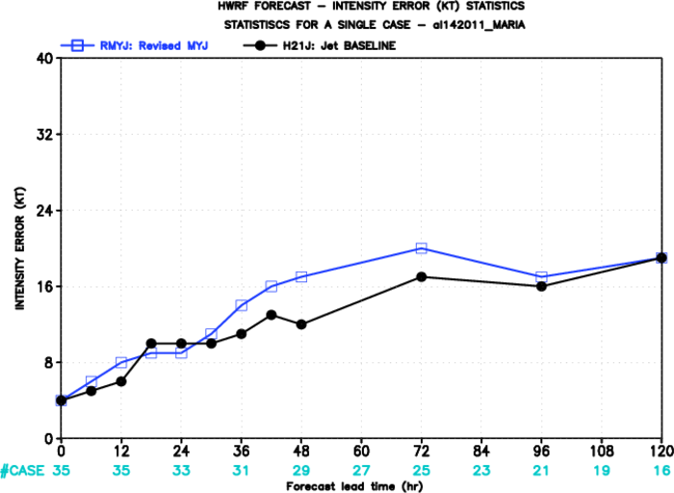
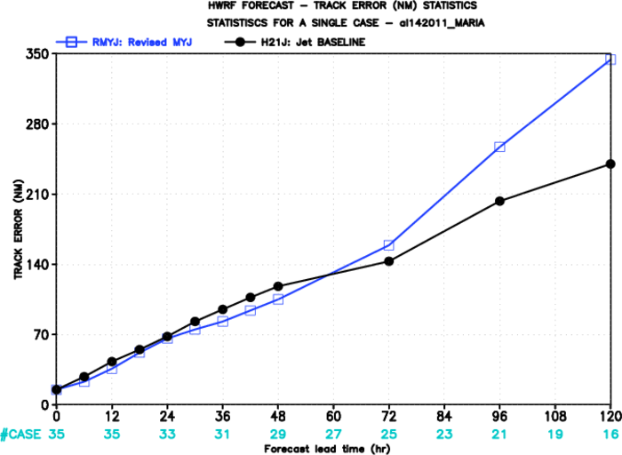
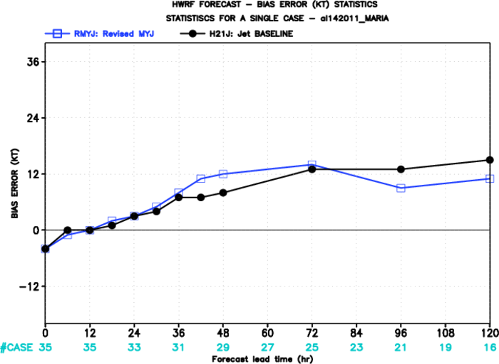
MARIA (2011)

Slide 11
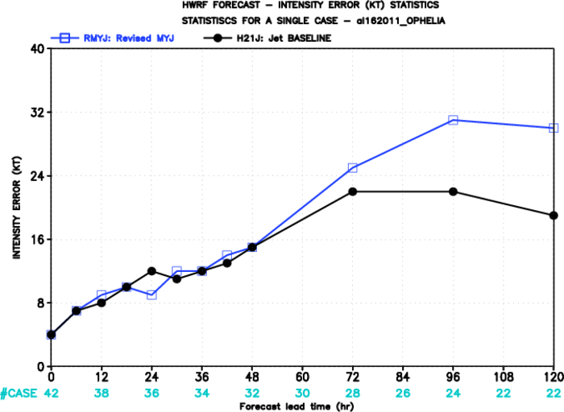
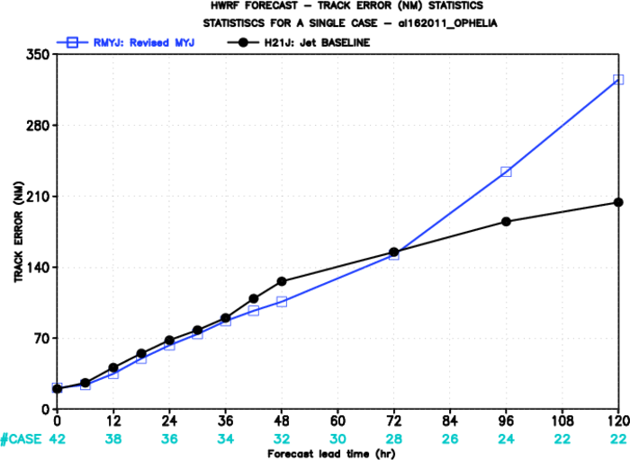
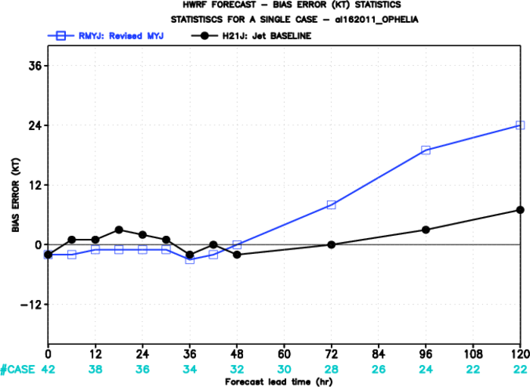
OPHELIA (2011)

Slide 12
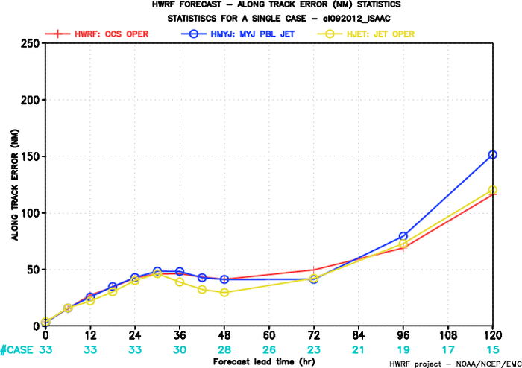
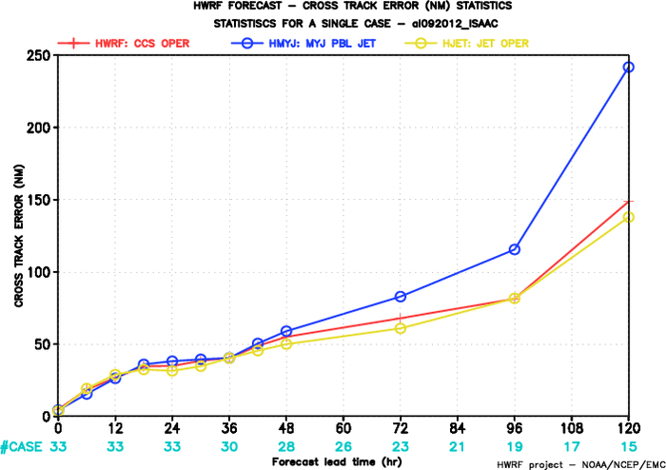
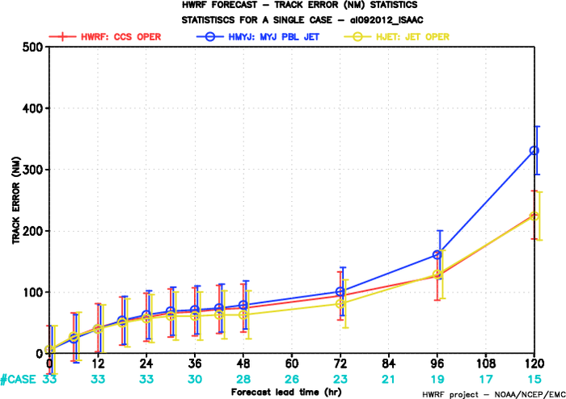
ISAAC (2012)

Slide 13
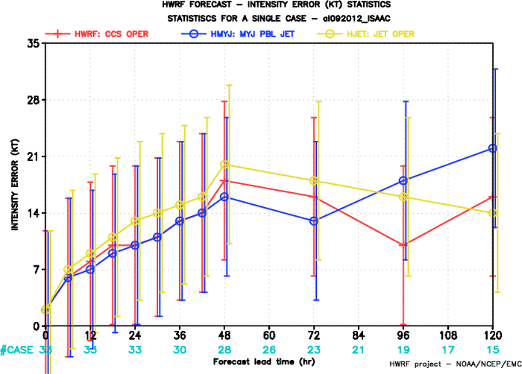
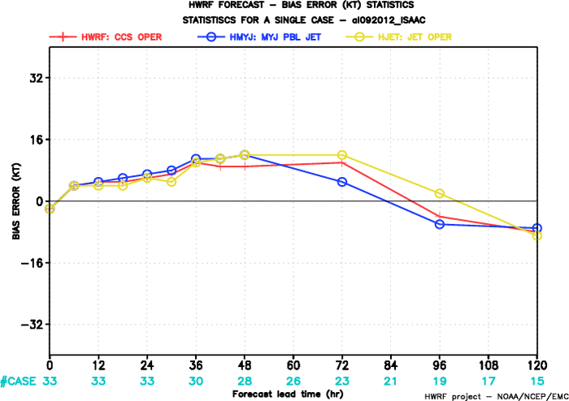
ISAAC (2012)

Slide 14
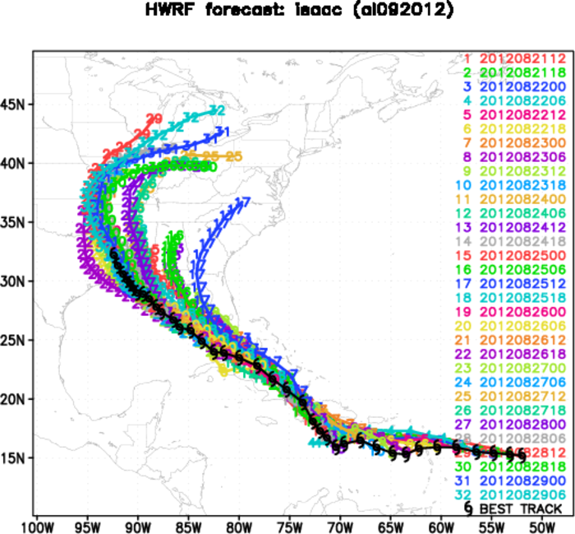
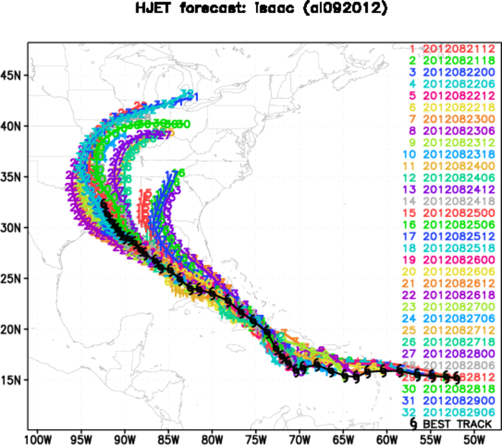
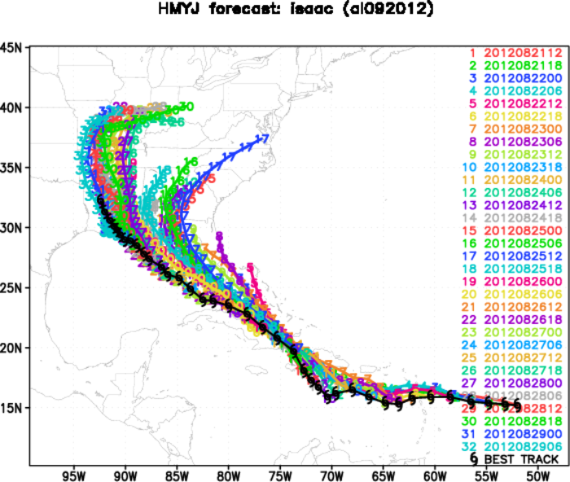
ISAAC (2012)

Slide 15
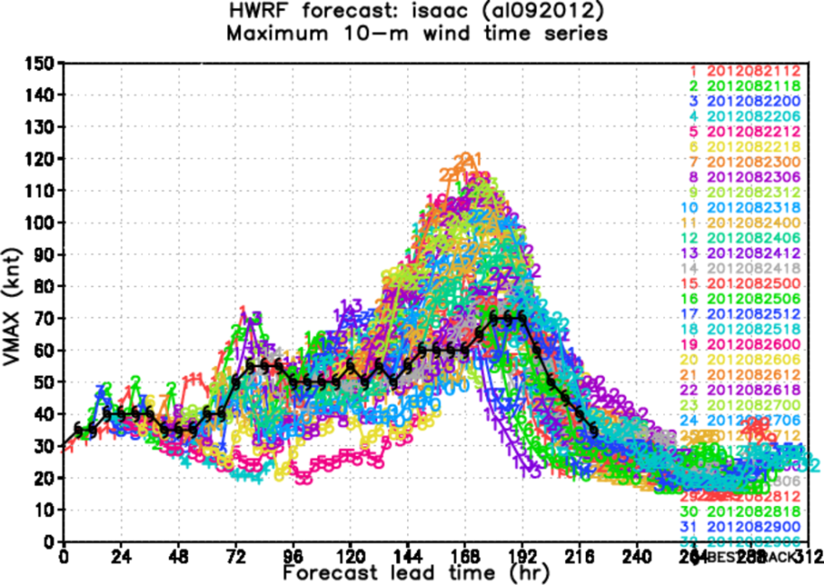
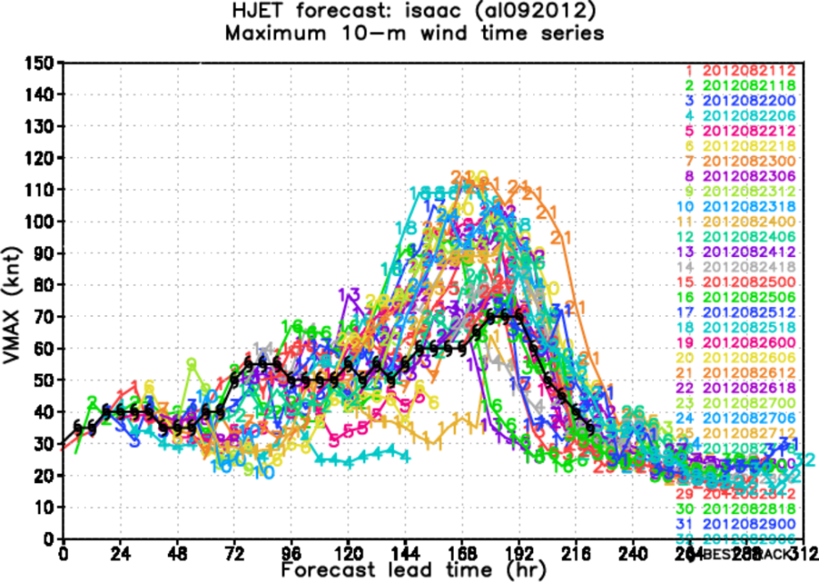
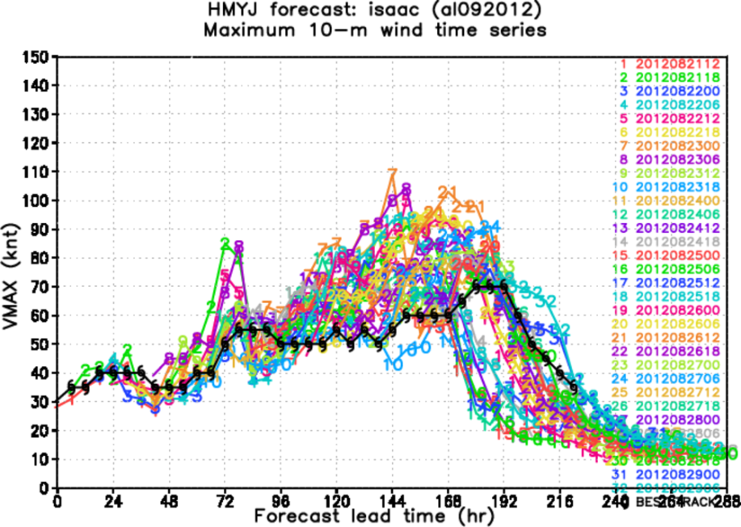
ISAAC (2012)

Slide 16
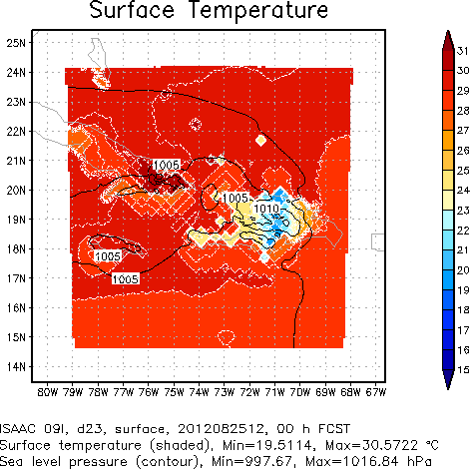
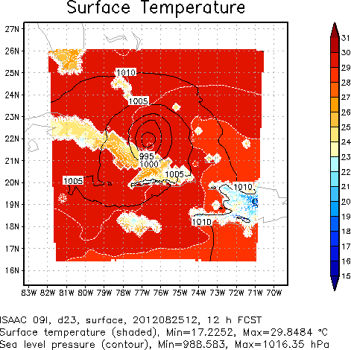
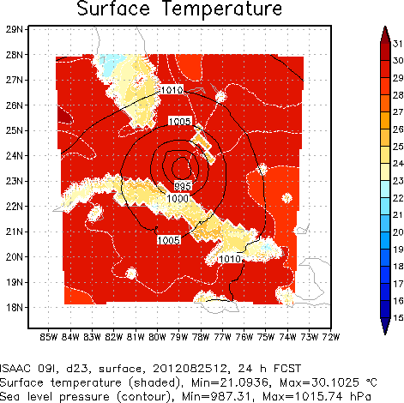
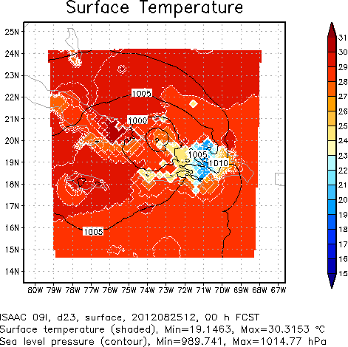
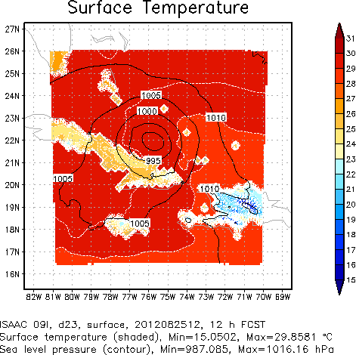
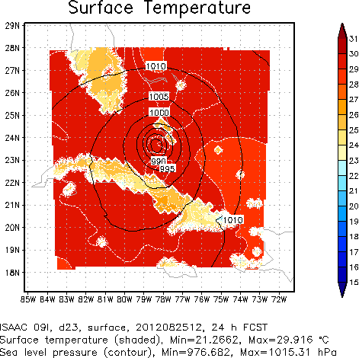
GFS GFDL
MYJ GFDL

Slide 17
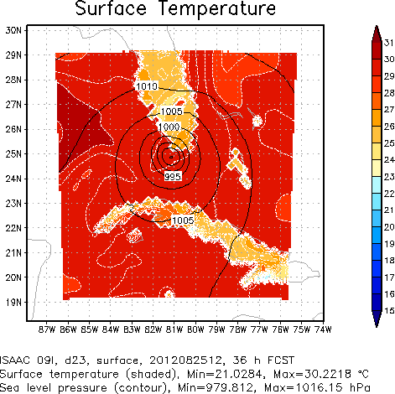
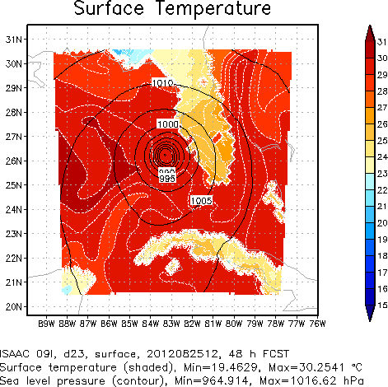
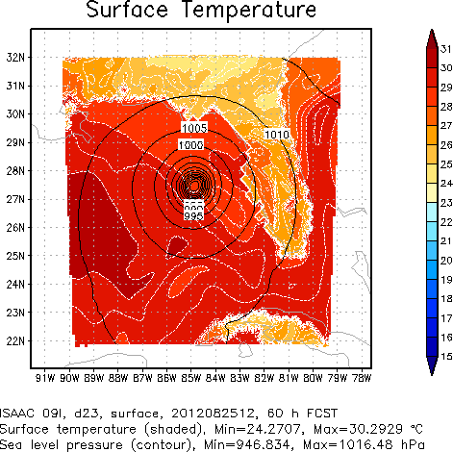
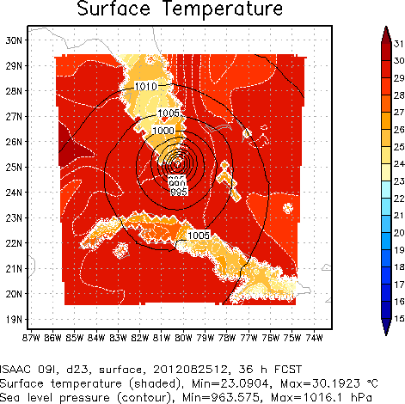
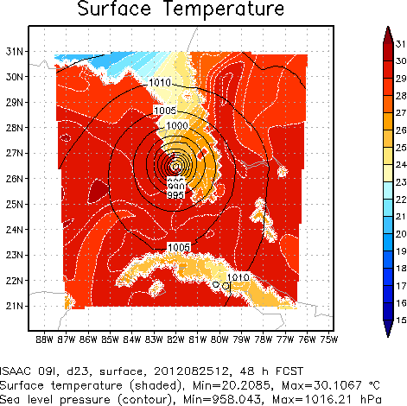
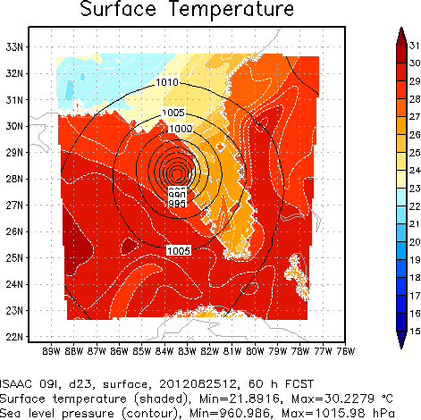
GFS GFDL
MYJ GFDL

Slide 18
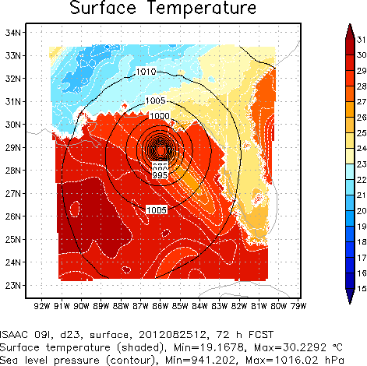
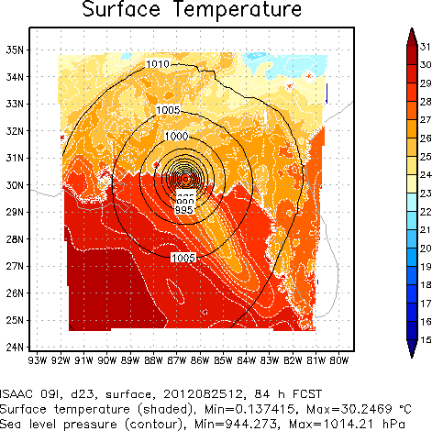
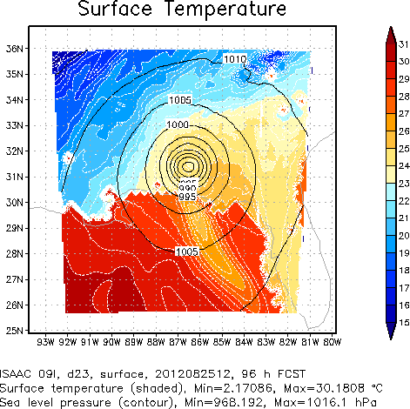
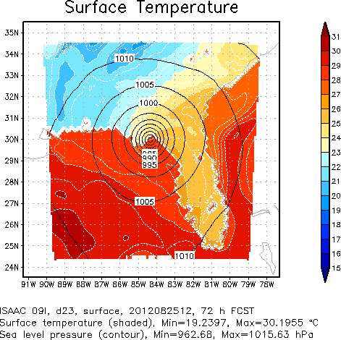
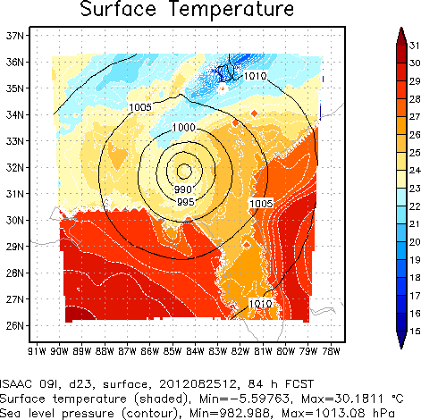
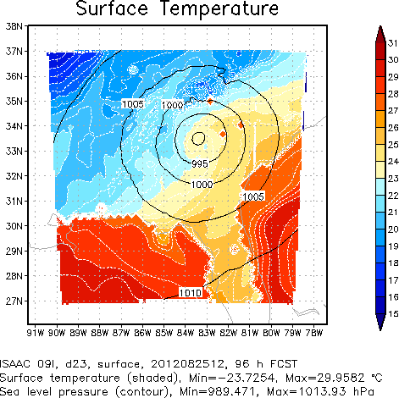
GFS GFDL
MYJ GFDL

Slide 19
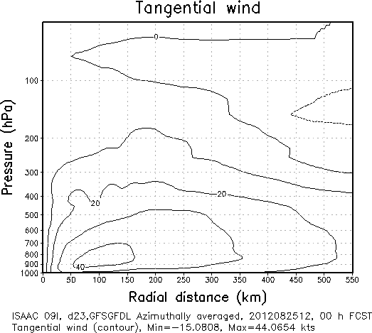
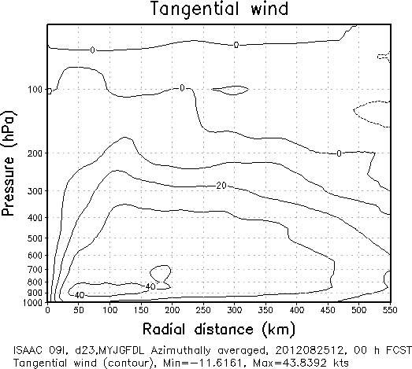

Slide 28
Summary
The preliminary results from these comparisons suggest that adjustments of the MYJ scheme need to be done in order to make its performance on par with the GFS scheme.
We need to examine adjusting other physics components (particularly, the land-surface model and the cloud physics).
We need, additionally, to consider exploring whether other implementations of the MY scheme, even the more general 3-D TKE sub-grid mixing scheme, would perform better than the MYJ scheme.
Notes:
The results are not very surprising to me, given the fact that we perturbed the model physics by simply replacing the GFS PBL scheme with the MYJ scheme. We are demonstrating a likely consequence when anyone simply replaces a component of the physics in a model without a lot of testing and adjustment.

