Slide 1
Performance of NCEP Operational HWRF (9 km) and HWRF Parallels for Hurricane Irene
 | Operational HWRF | HFIP Stream 1.5 HWRF (H3GP)*
Framework | HWRFV3.2 | HWRFV3.2
Resolution | 27/9 | 27/9/3
Initialization | Relocation, Vortex Init., Cycling, GSI | Same as Oper. HWRF for 27/9. 3 km domain is downscaled from 9 km
IC/BC | prep hybrid | prep hybrid
Ocean | POM | POM (SSTs interpolated to 3 km)
Physics | Oper. HWRF 2011 | Oper. HWRF 2011; no CP at 3km. For 9 and 3, Km in PBL reduced to 25%, COAC set to 5.0
Platform | NCEP IBM CCS | HFIP tJet Linux Cluster
Real-time products | http://www.emc.ncep.noaa.gov/gc_wmb/vxt | http://storm.aoml.noaa.gov/realtime
 | TDRP | HLSM
 | HWRFV3.2 | HWRFV3.2
 | 27/9 | 27/9
 | Use TDRP when available. Vort init and GSI modified | Same as Oper. HWRF
 | prep hybrid | prep hybrid
 | POM | POM
 | Oper. HWRF 2011 | Oper. HWRF 2011; NOAH LSM
 | NCEP IBM CCS | NCEP IBM CCS
 | http://www.emc.ncep.noaa.gov/gc_wmb/vxt/PARA/TDRP
*Stream 1.5 HWRF (H3GP) is a collaborative effort between EMC and AOML

Slide 2
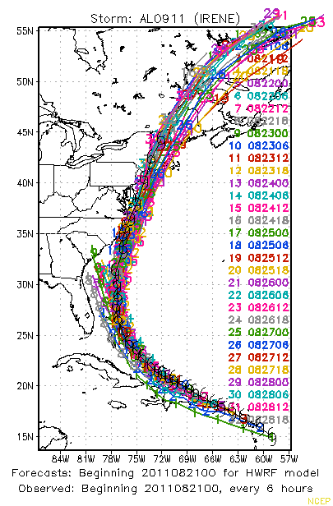
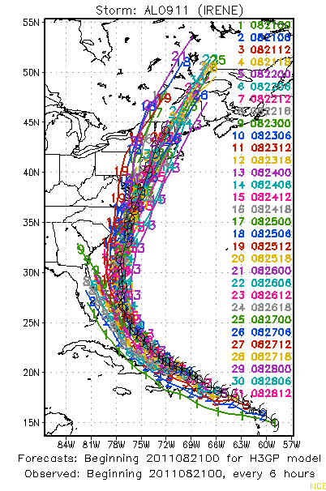
Track Forecasts for Hurricane Irene
More consistent track forecasts from operational HWRF
Very little “west” bias compared to H3GP forecasts.
Operational HWRF
HFIP Stream 1.5 HWRF (H3GP)

Slide 3
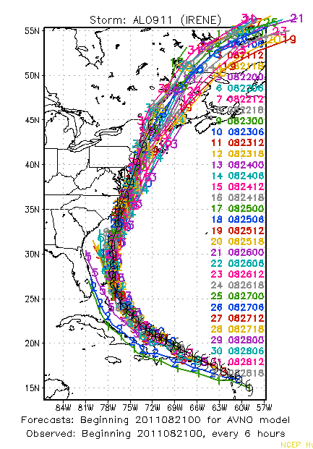
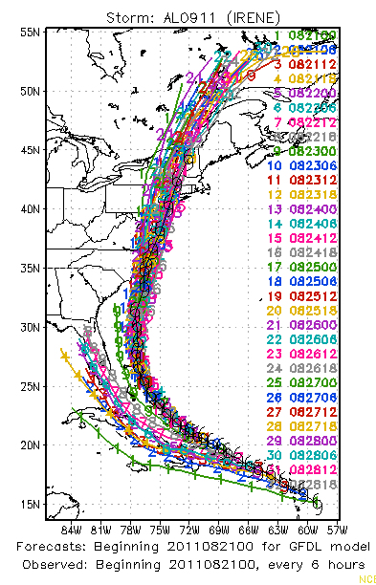
Track Forecasts for Hurricane Irene
Operational HWRF track forecasts are quite similar to GFS forecasts
GFDL had significant west bias in the early forecast cycles
GFS
GFDL

Slide 4
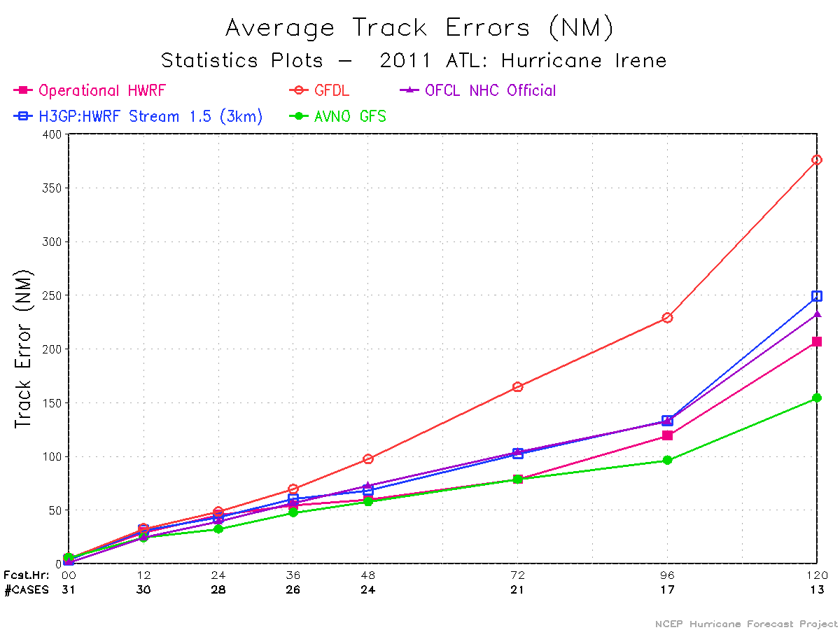
Mean Track Errors for Hurricane Irene: GFS did very well for tracks - operational HWRF is as good as GFS except at 96hr and 120hr (mostly larger along track errors). H3GP is the real-time HFIP Stream 1.5 3km version of HWRF, which also was very competitive.

Slide 5
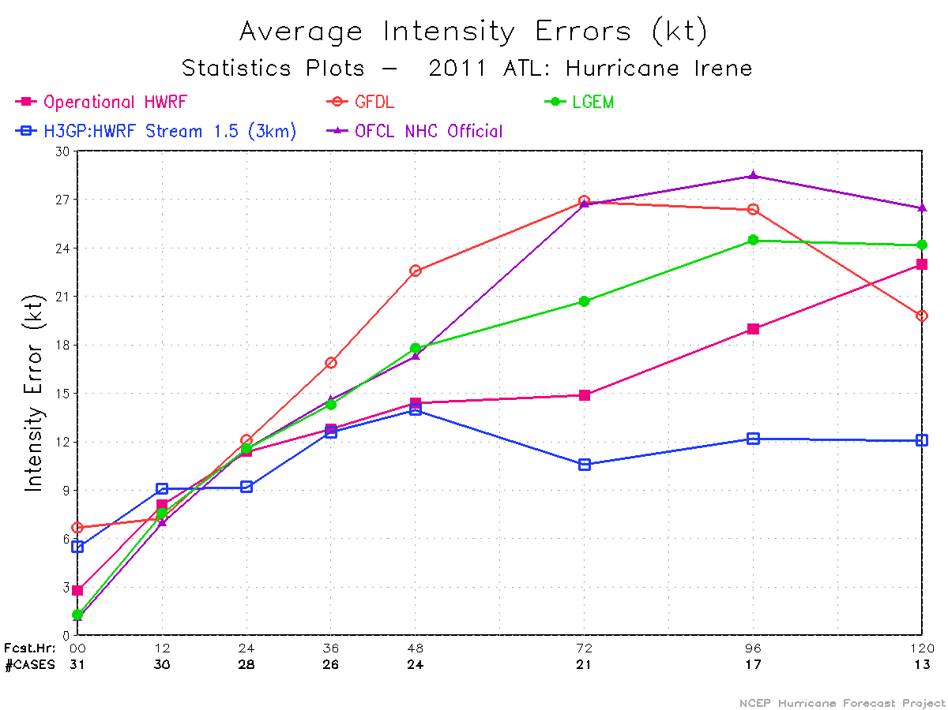
Mean Intensity Errors for Hurricane Irene: H3GP (real-time HFIP Stream 1.5 3km version of HWRF) H3GP have been extremely impressive, with skill improvements of the order of 30 – 50% over the operational HWRF at 72 hr and beyond.

Slide 6
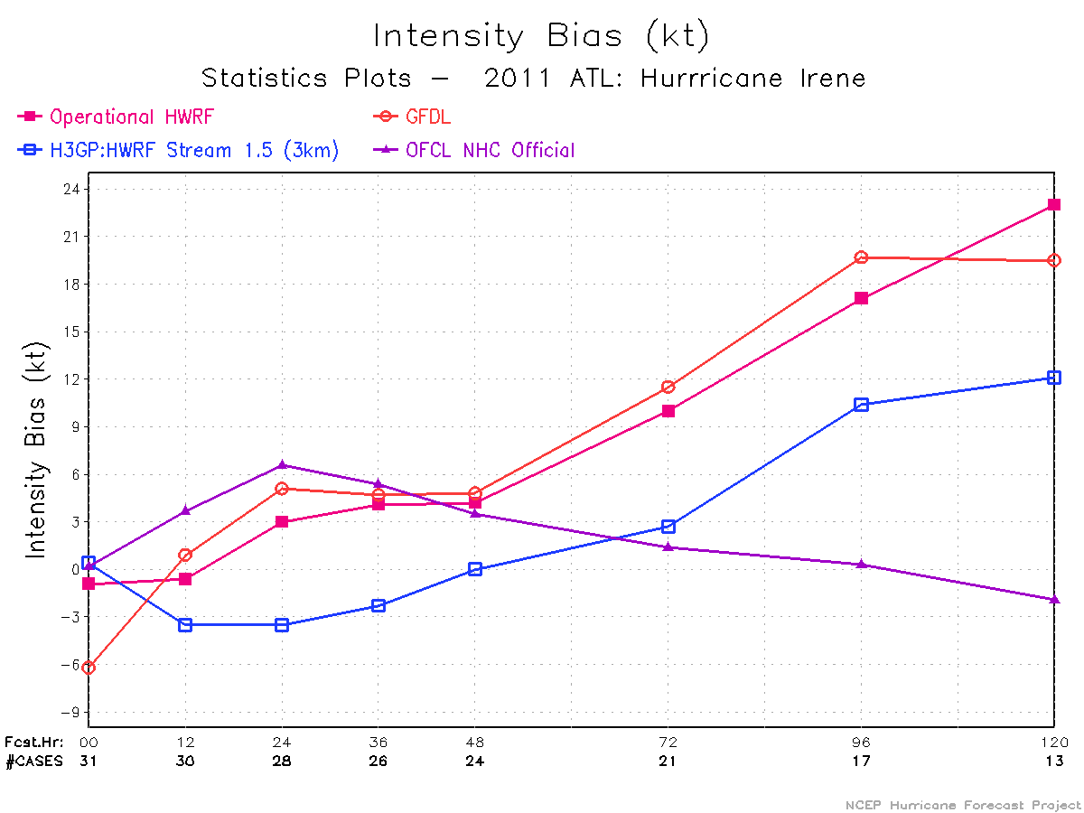
Mean Intensity Bias for Hurricane Irene: More positive intensity bias for operational HWRF compared to H3GP

Slide 7
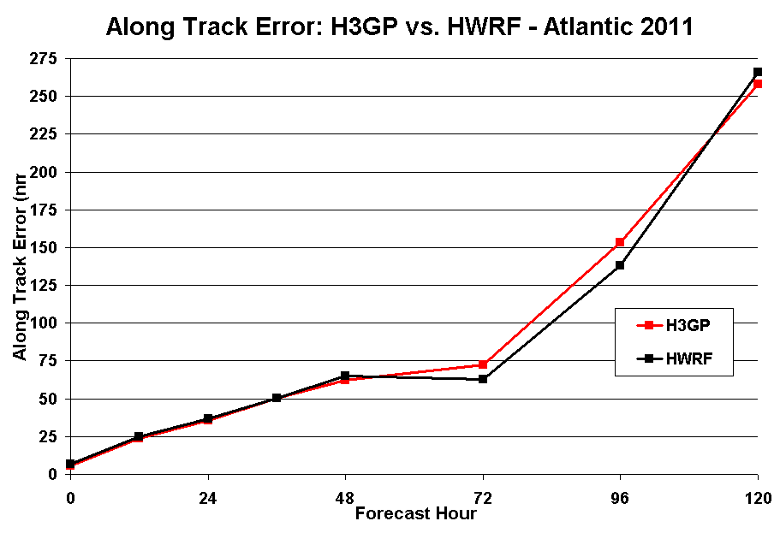
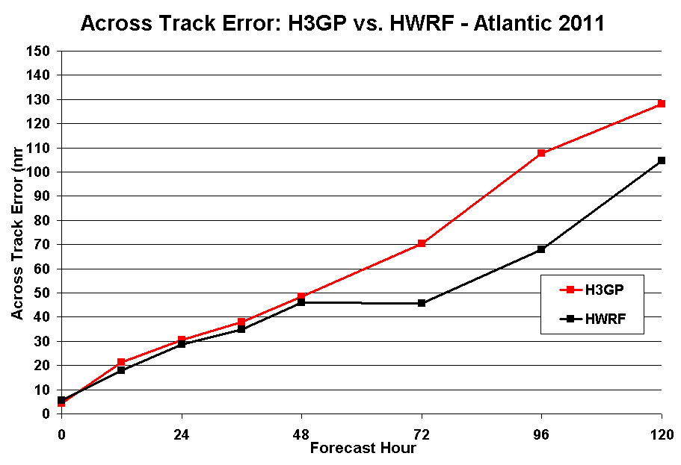

Slide 8
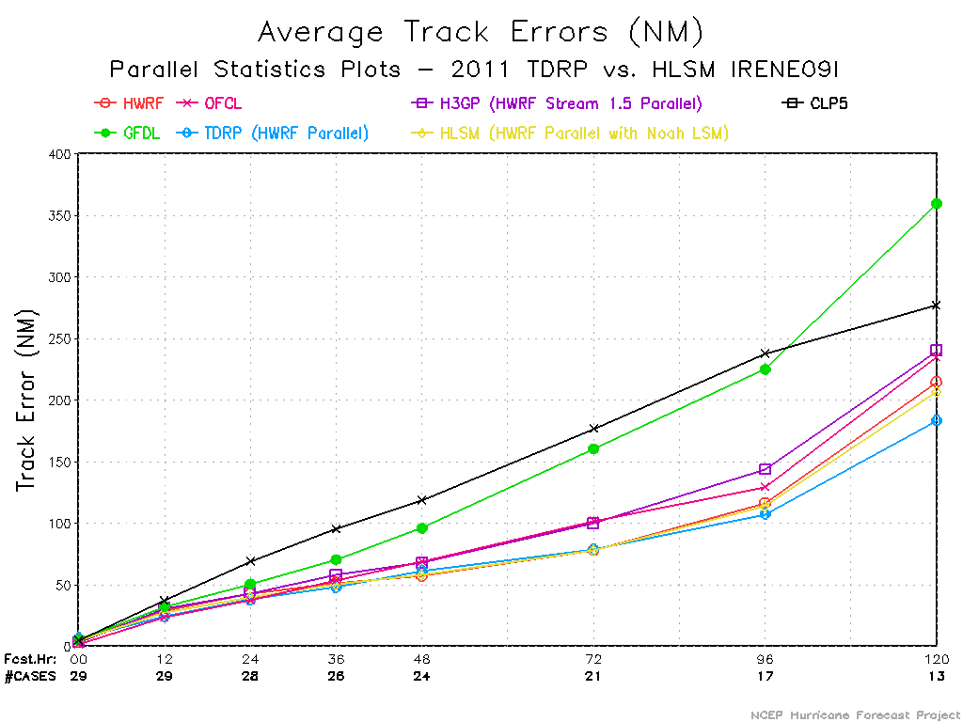
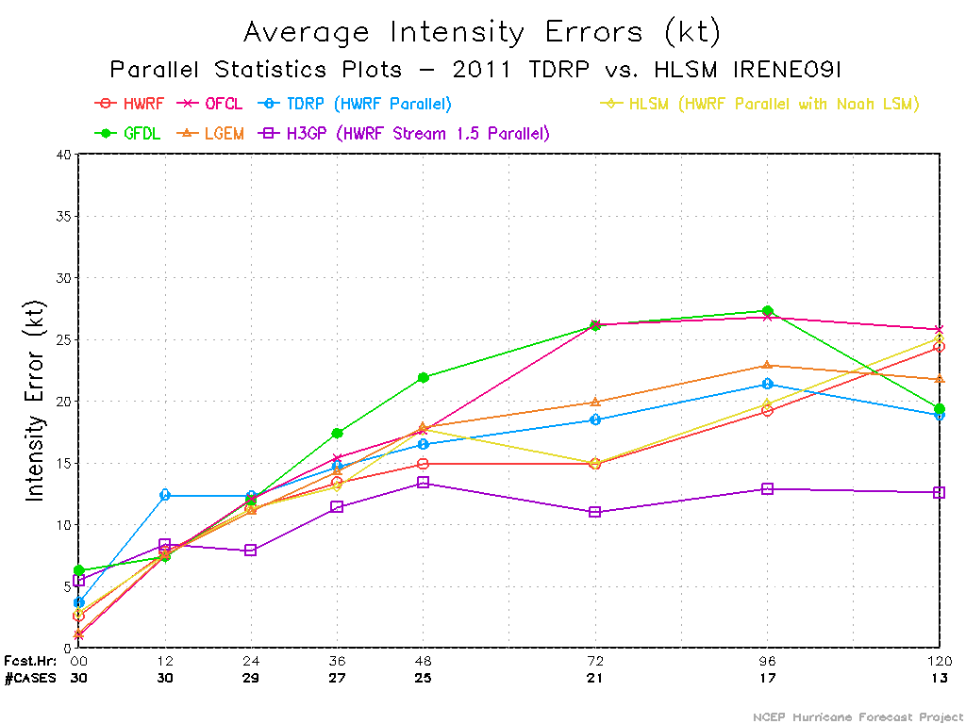
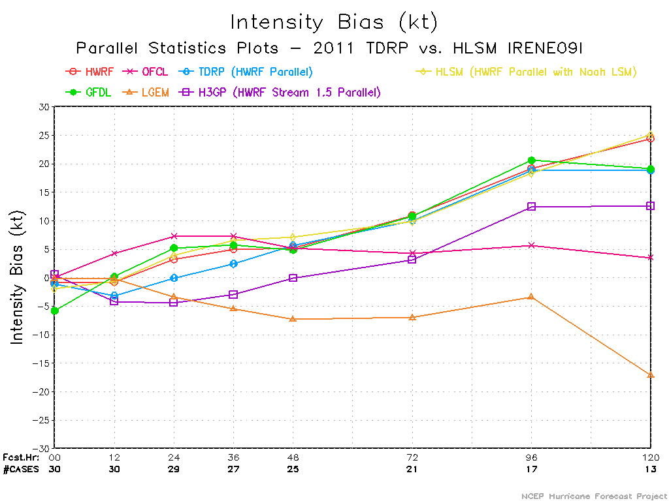
Performance of Parallel HWRF runs for Hurricane Irene
Track errors from HWRF parallels are comparable to the operational HWRF, TDRP and HLSM did better at 120hr fcst
HLSM and HWRF are on top of each other, TDRP slightly worse except at 120hr

Slide 9
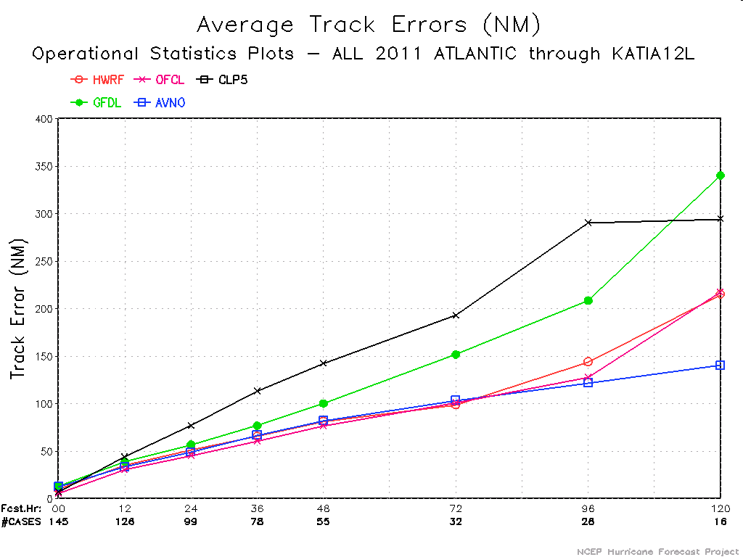
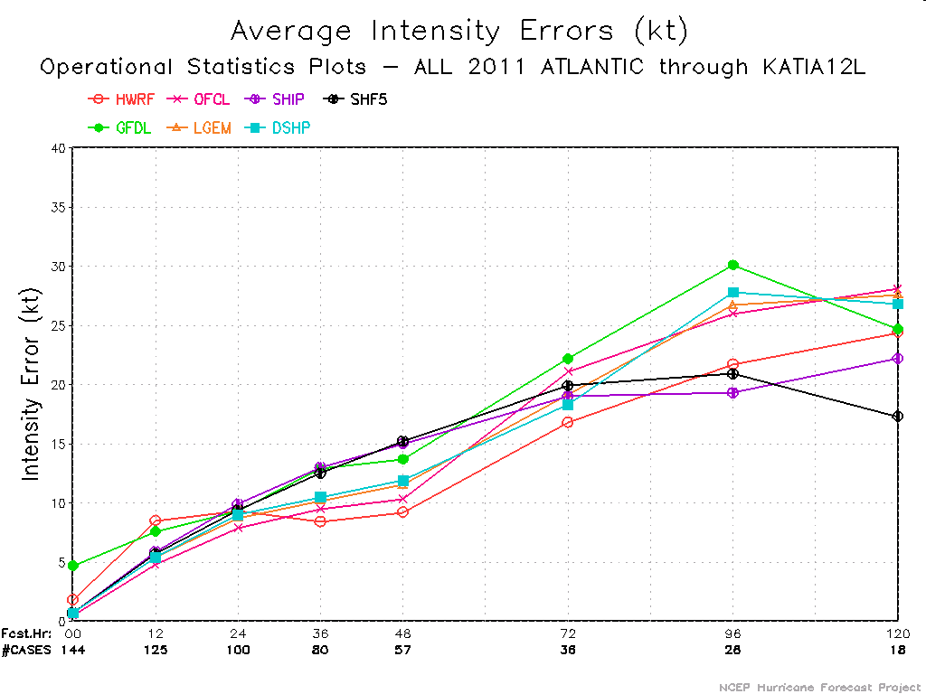
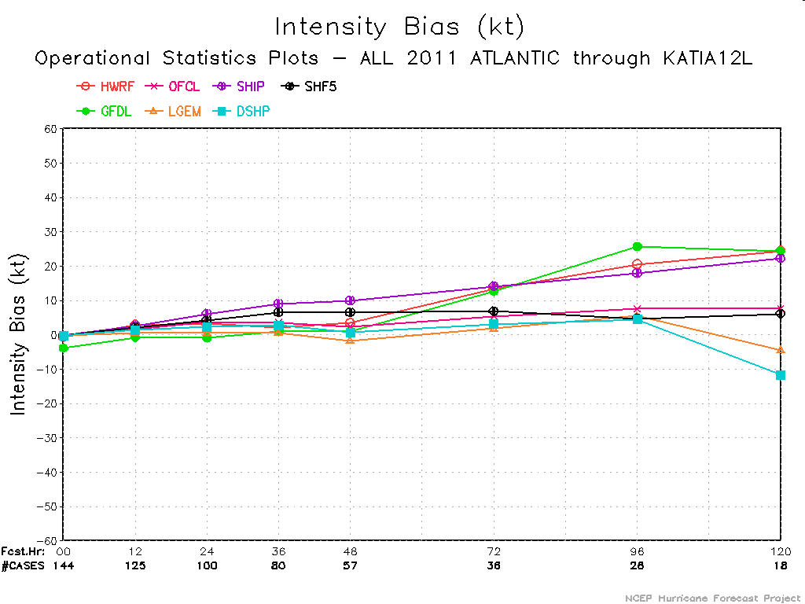
Performance of Operational HWRF till date (Atlantic Basin)
HWRF Track errors comparable to or better than GFS through 96hr fcst
HWRF Intensity errors are generally lower than other model guidance

