Slide 1
A pseudo-ensemble hybrid data assimilation system for tropical cyclone initialization in HWRF: TC Library
Xuyang Ge
UCAR
Acknowledgements: Fuqing Zhang, Yonghui Weng (PSU)
Vijay Tallapragada, Mingjing Tong (EMC)

Slide 2
Motivations
EnKF has a great promise in initializing the hurricane forecasts
(Weng and Zhang 2011, Torn and Hakim 2009; Li and Liu 2009; Hamill et al. 2010).
Merits: EnKF with a flow-dependent ensemble covariance is more appropriate than that using a static covariance to spread the observational information to correct the background forecast.
However, the computational cost for running a concurrent convection-permitting ensemble forecast required for the EnKF remains impractical for current operational implementations.

Slide 3
Motivations (cont.)
Poterjoy and Zhang (2011): Wavenumber 0 storm structures have the largest influence on both ground- and storm-relative forecast uncertainty for TCs with category 1 or higher intensity.

Slide 4
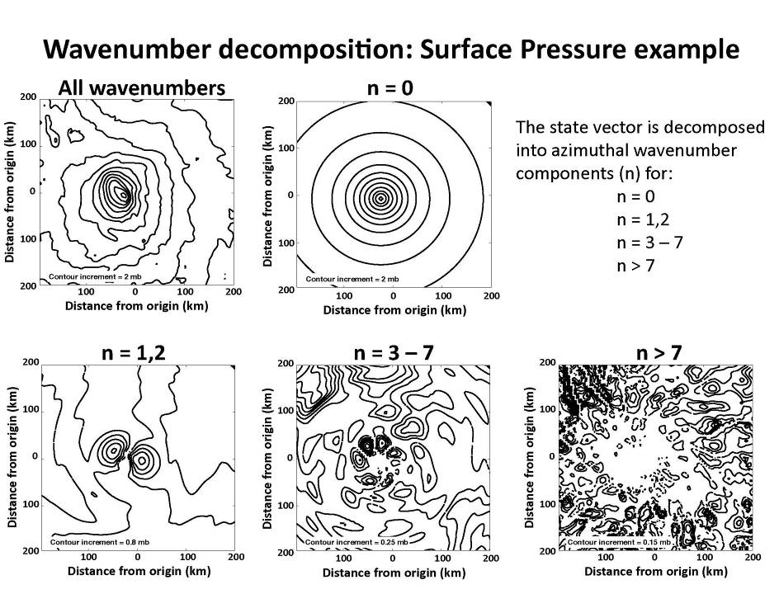

Slide 5
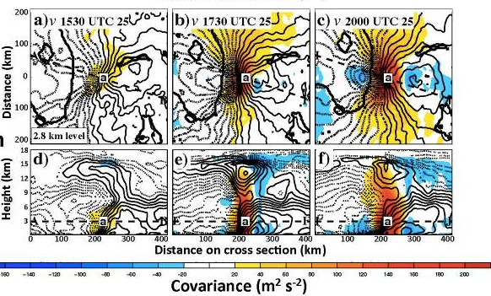
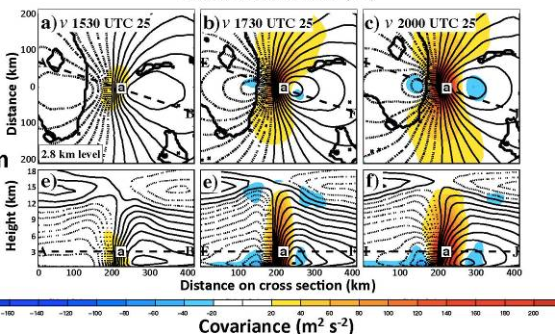

Slide 6
Proposal:
Flow-dependent forecast covariance can be approximated from a sample of near-axisymmetric TC vortices;
Ensemble perturbations randomly sampled from a pre-constructed library of idealized TC vortices are hybridized into 3DVar system via extended control variables (Lorenc 2003) to assimilate inner-core wind observations.

Slide 7
Pseudo-ensemble hybrid data assimilation system (PEDA) for TC initialization
First guess: GFS analysis
Ensemble perturbations
Replace TC vortex perturbations
TC Vortex Library
Pseudo-ensemble members
Flow-dependent multivariate
B for inner core (thorough alpha control)
3Dvar

Slide 8
Establish a TC Vortex Library
Methods:
idealized simulations
Problems: environmental influences are excluded.
thousands of real-case TC vortex from HFIP
Problems: resolution; storm size and intensity correlation

Slide 9
Model Configuration
1) HWRF model with triply nested domains (27, 9, 3km)
each domain has 300×300 grid points
43 vertical levels same as the operational system
2) in a quiescence environmental flow and on a water planet
3) 6-hourly outputs (innermost domain only) are saved.
60 simulations with over 1000 vortices are generated.

Slide 10
To create TC vortices with sufficient spreads:
1) varied Vmax (10-20m/s)/size/Rmax (75-150km)
2) perturb sounding profile (i.e., moisture field)
3) latitude effect (dynamic constrain;vortex outer size/strength)
4) physics options (cumulus,microphysics,boundary layer schemes)
5) SST (27.5-29C)

Slide 11
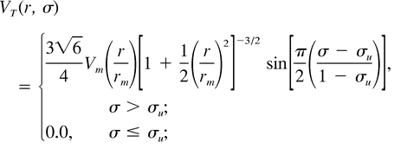
Initial vortex specification
Bogussing vortex technique ( Wang 1995)
environmental sounding: Jordan sounding
Initial vortex types:
1) Rankine vortex: change shape factor α (0.5;0.65;0.75)
2) Vortex used in TCM3

Slide 12
Steps for creating idealized initial conditions
1) WRF_NMM: WPS
gfs→ met_nmm.d01.yyyy-mm-dd-hh_mm:00:00.nc
…….
2) Bogussing vortex created by TCM
Sigma-level→ P-coordinate
Horizontal interpolation to match HWRF model grids
3) Variables replacement
met_nmm.d01.yyyy-mm-dd-hh_mm:00:00.nc
U, V, T, PSFC, GHT, SST, F, Landuse, Landmask, SST, Topography height, Albedo;…
4) Real_nmm.exe
wrfinput_d01 & wrfbdy_d01

Slide 13
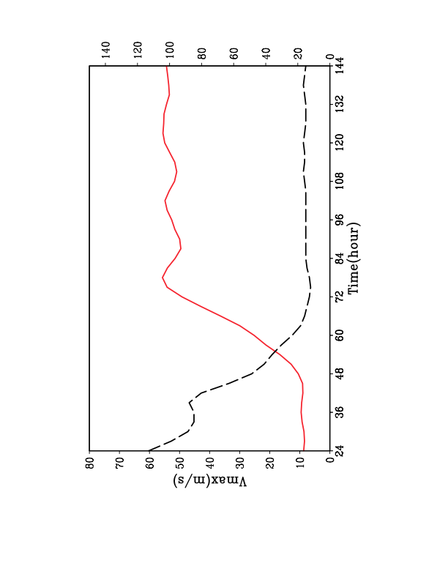
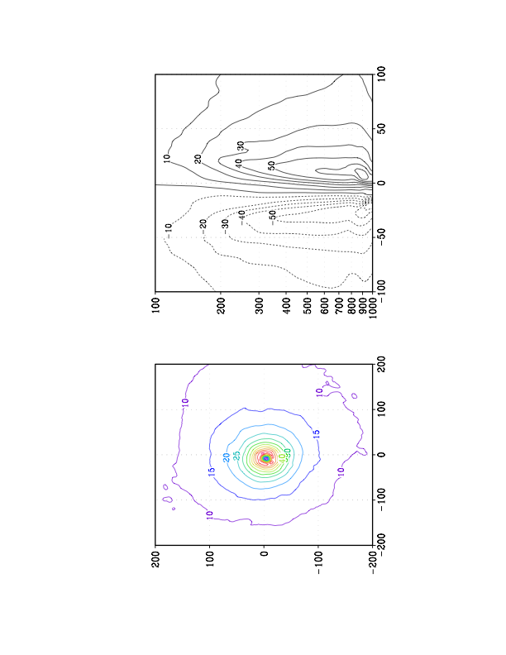
Example of idealized TC
Vmax
Rmax(km)
Rmax

Slide 14
TC Vortices at different output times are binned according to Vmax
(more binning criteria to be added: size, …)
Group | V15 | V20 | V25 | V30 | V35 | V40 | V45 | V50 | V55 | V60
Number | 149 | 102 | 101 | 143 | 170 | 211 | 182 | 190 | 183 | 150
V15: 12.5m/s≤ <17.5m/s
V20: 17.5m/s≤ <22.5m/s
V25: 22.5m/s≤ <27.5m/s
….

Slide 15

V50_001.info : text file includes some TC inforantion
V50_001.wrfout : original output saved with NETCDF format
V50_002.info
V50_002.wrfout
……
V50_150.info
V50_150.wrfout
V50_001.info:
148.2 152.0 934.1 50.8 24.0
grid in (X, Y); Pmin(hPa); Vmax(m/s); Rmax(km)

Slide 16
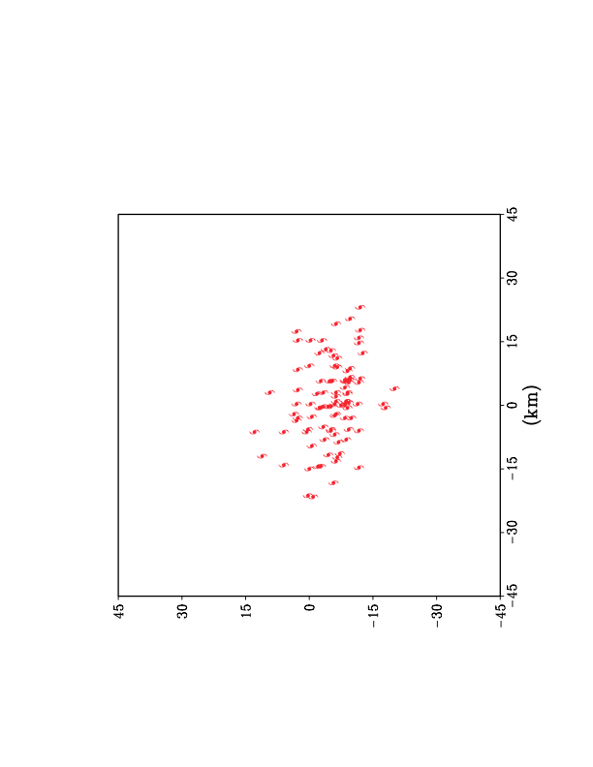
Vortex center positions
V40
Standard Deviation: Pmin (11hPa); Position (10km); Vmax(2m/s)

Slide 17
To save diskspace:
Only the necessary variables are extracted, and saved and plotted with GrADS
…………..
allocate( varname (varnum) )
varname = (/'U ', 'V ', &
'T ', 'Q ', &
‘PSFC '/)
!----------------------------------------------------------------
call open_file( wrffile, nf_nowrite, fid )
call get_var_ij (wrffile, 'T ', ii, jj, kk )
……..

Slide 18
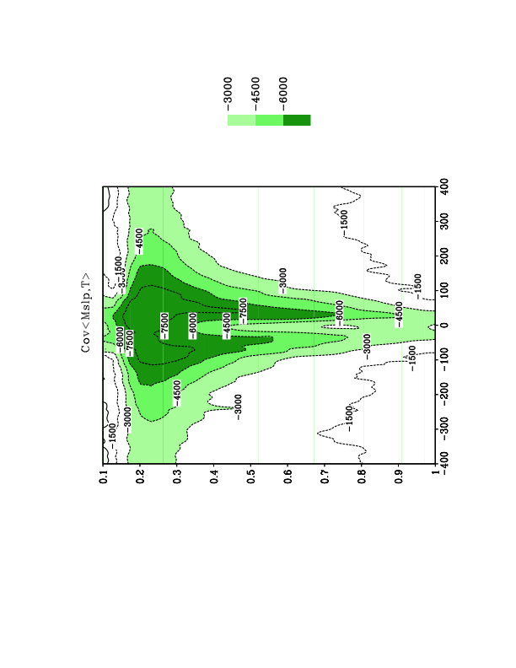
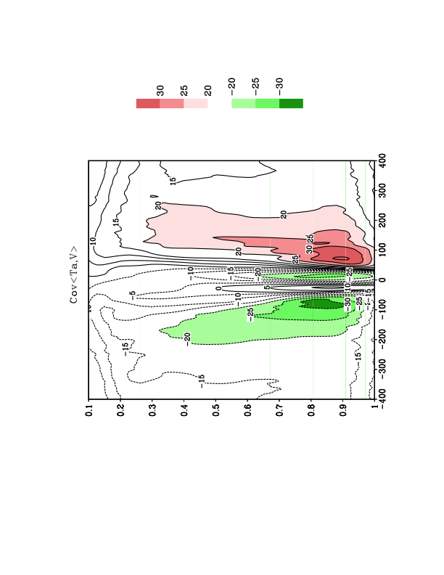
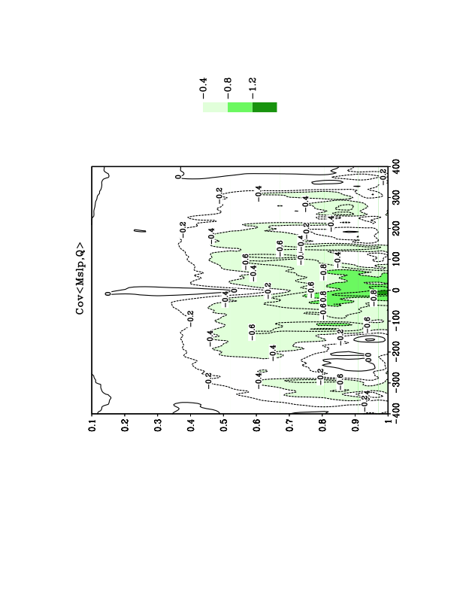
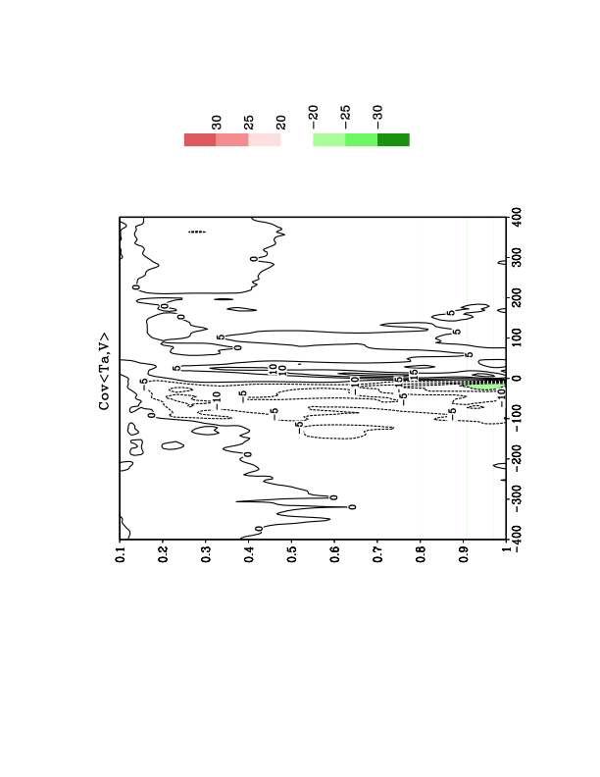
Dynamics and Structure of Error Covariance
V40
a
V15

Slide 19
Ongoing works
Generate pseudo-ensemble members
Create TC Library with environmental flows
Learn Hybrid 3Dvar assimilation system for HWRF
Conduct test runs and evaluate its performances

Slide 20
Performance of PEDA on Hurricane IRENE (2011)
WRF_ARW version ( triply nested domains: 40.5;13.5;4.5km)
Observation: MTCSWA
http://satepsanone.nesdis.noaa.gov/pub/MTCSWA/AL092011/

Slide 23
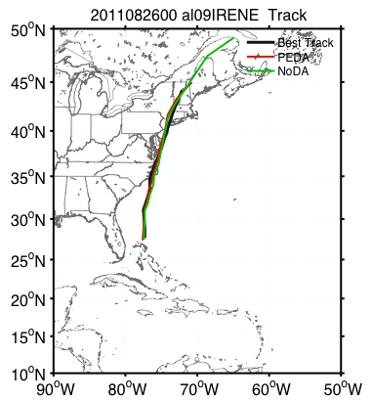
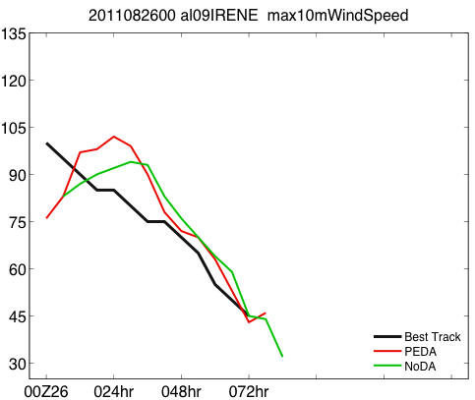

Slide 24
“poor” case

Slide 26
Thanks

Slide 27
Exploration of other hurricane inner-core observations
Multi-platform Tropical Cyclone Surface Wind Analysis (MTCSWA) provides 10-m winds in polar coordinates with 4.5 km radial and 10º azimuthal resolutions, and can resolve the very strong winds with 200 km or so of the TC center.

Slide 28
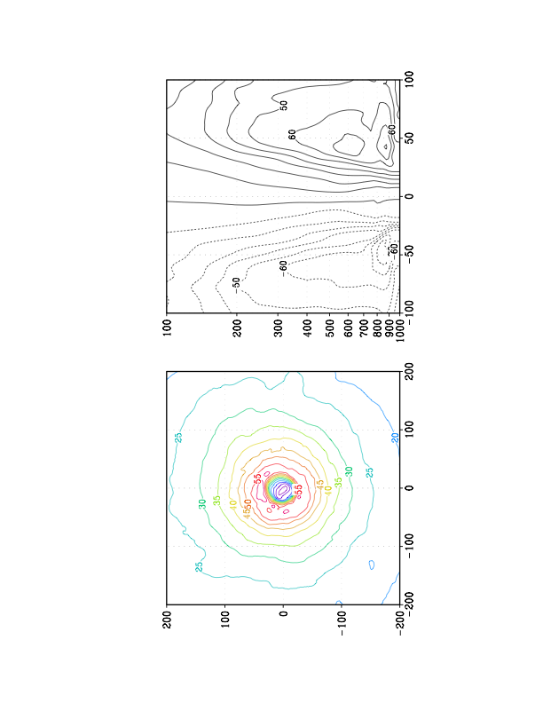
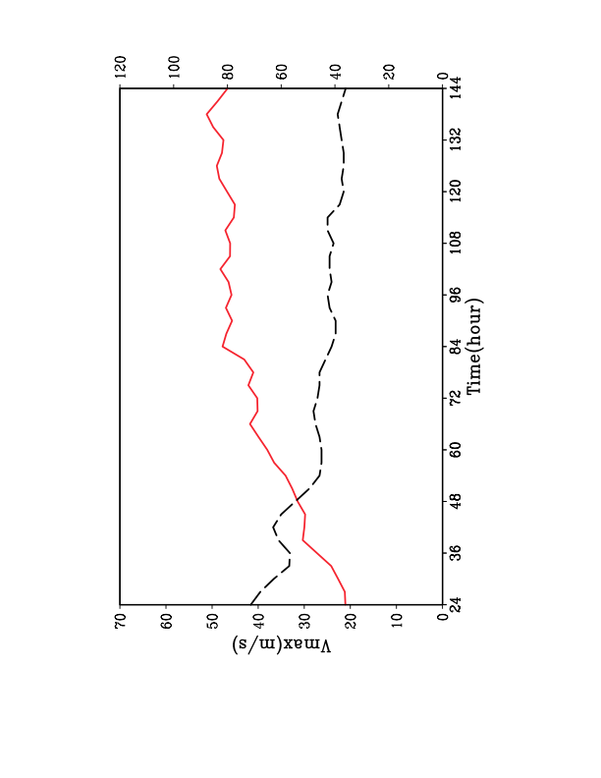
Examples of idealized TCs (II):
Rmax(km)

Slide 29
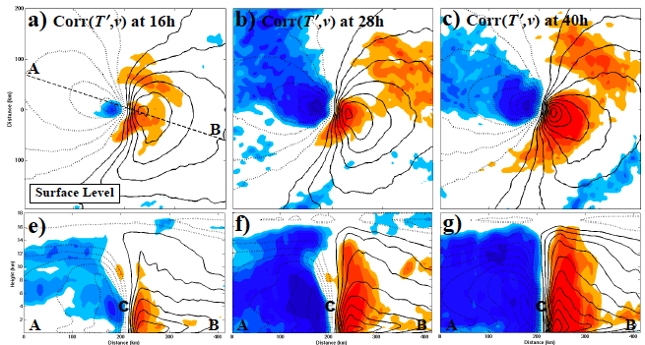
Dynamics and Structure of Error Covariances
Cross-spatial correlation of 4-km T at point C with v
(Poterjoy and Zhang 2011 JAS)

Slide 32
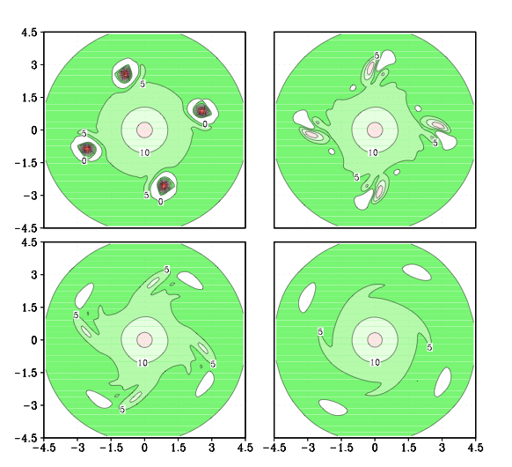
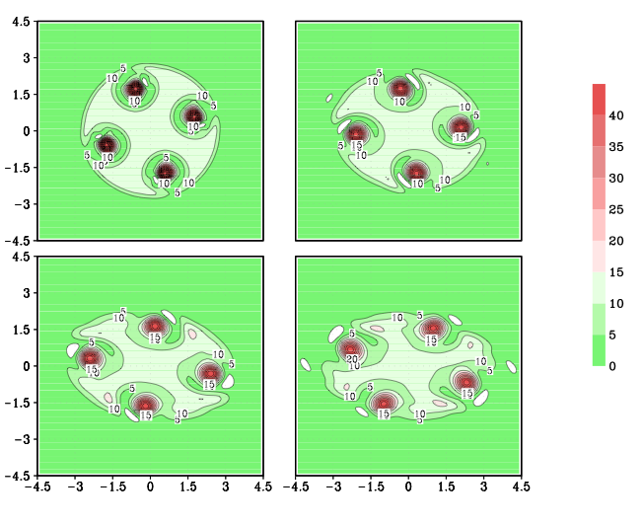
Every 12hrs
Rankine-type vortex
(100km)
(100km)

