Slide 1
Tropical Cyclone diagnostic Tool
In-Hyuk Kwon
SEP 29 2011

Slide 2
Purpose
Plotting Tropical cyclone structure and environment from the HWRF output in vertical pressure coordinate
Useful to diagnose the hurricane motion and intensity change
Location
/global/save/hurpara/Tcdiagnosis/
diagnose_total/
data/
archive/
diagnose_d01/
archive/
diagnose_d02/
archive/

Slide 3
Plotting the nest domain
How to use
Create a directory as the experiment name in diagnose_total/data/
Copy hwrf output files into that directory
( *.trak.hwrf.atcfunix and *.hwrfprs_n.grbf* )
Run diagnose_d02/tc_diagnosis.sh
Figures are stored in diagnose_d02/archive/$EXPT/
Usage: sh tc_diagnose.sh STORM stormid date EXPT [hBegin] [hEnd]
Example: sh tc_diagnose.sh ADRIAN 01e 2011060912 HNEW 12 48

Slide 4
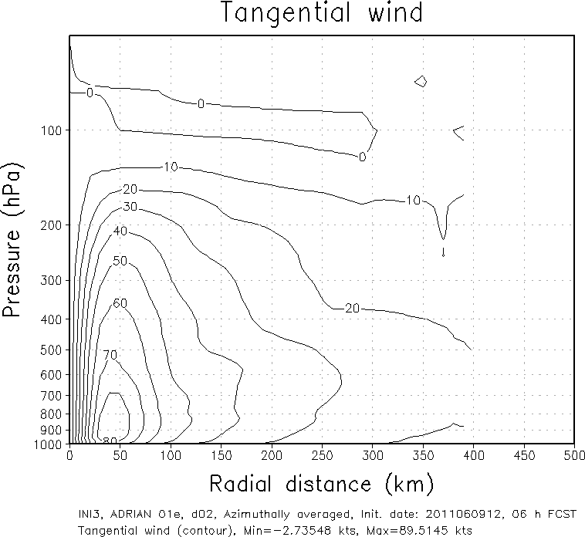
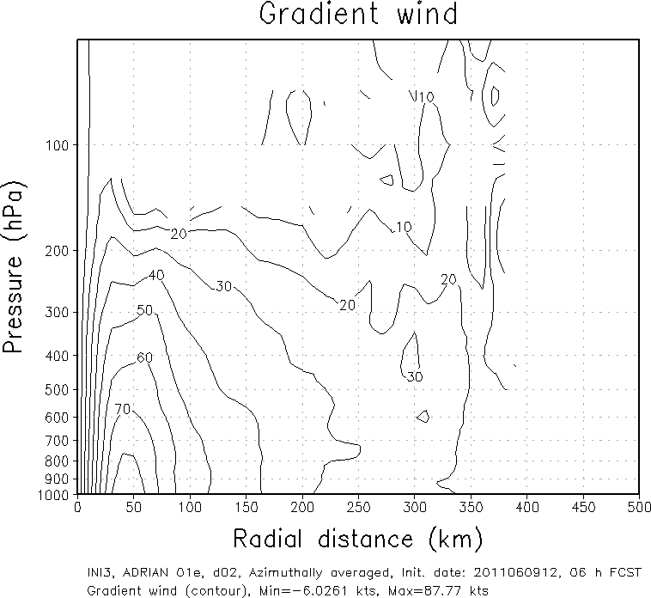
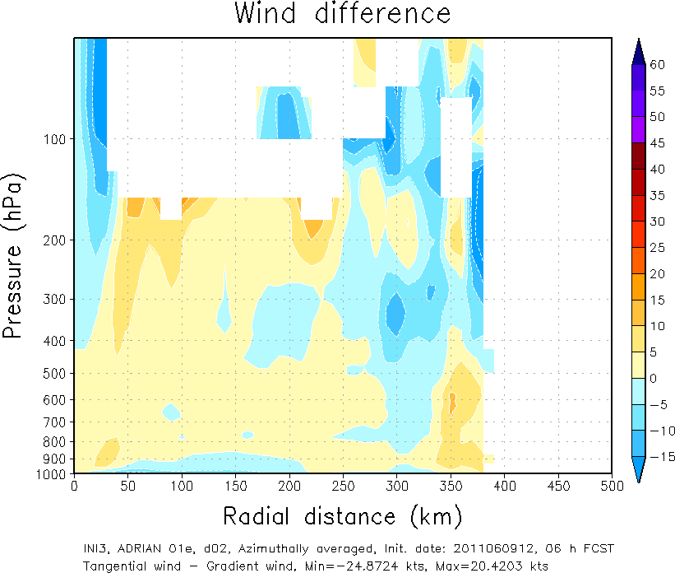
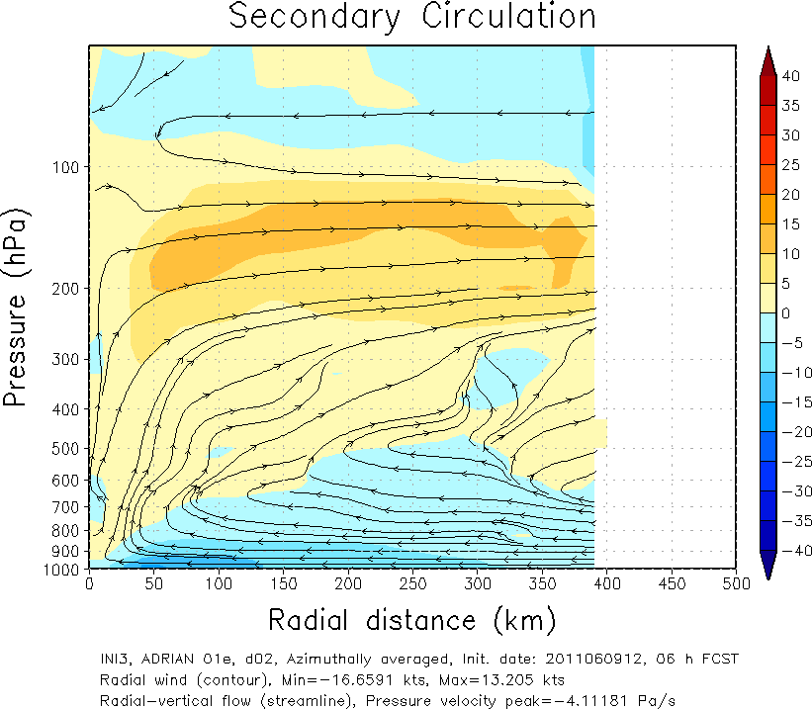
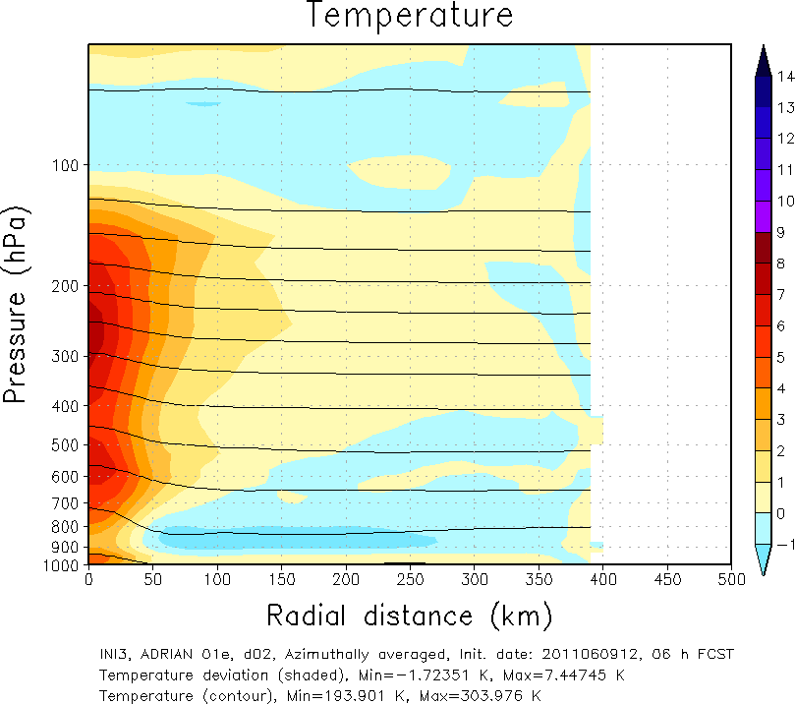
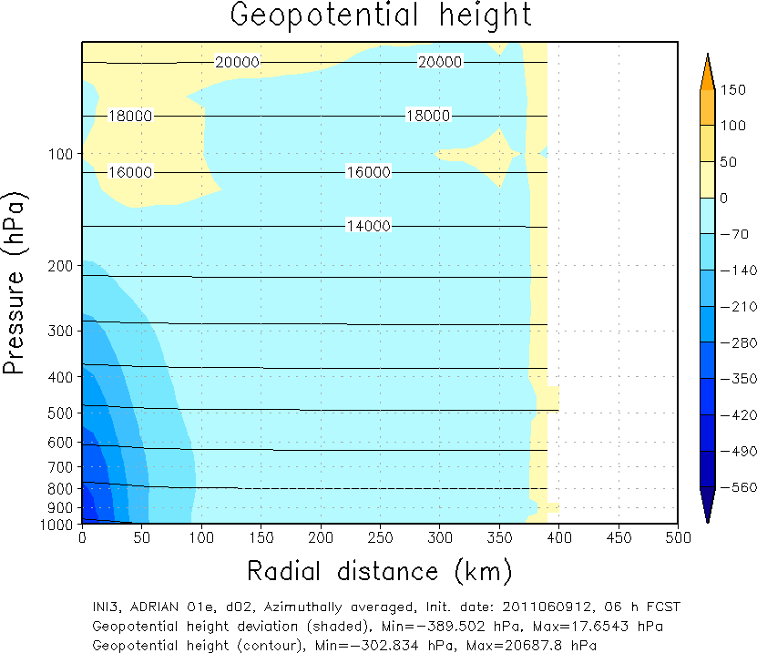
Azimuthal averaged structure
Adrian 2011060912 06h forecast

Slide 5
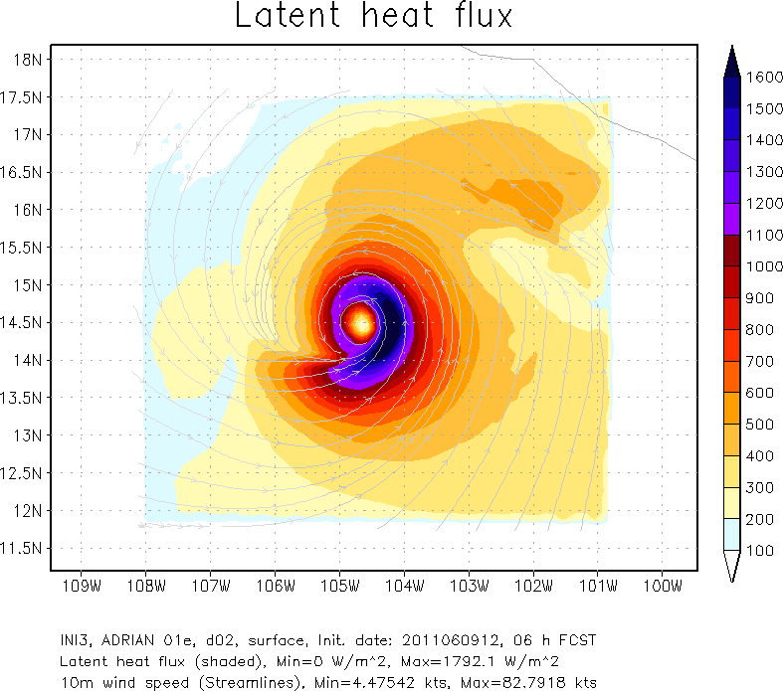
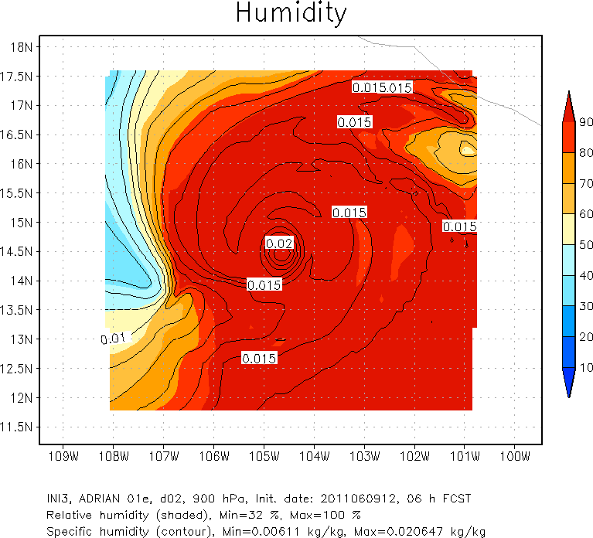
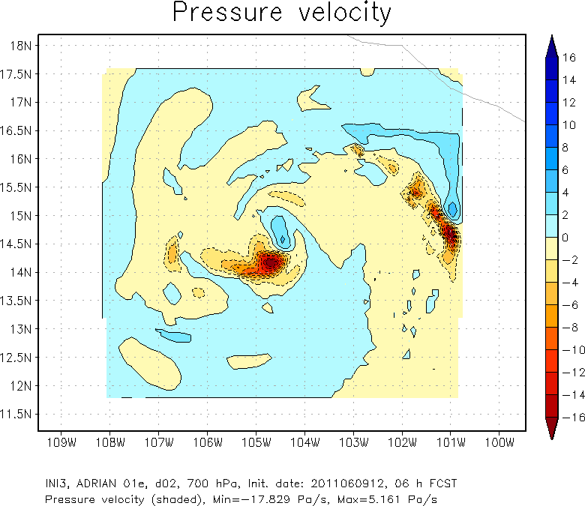
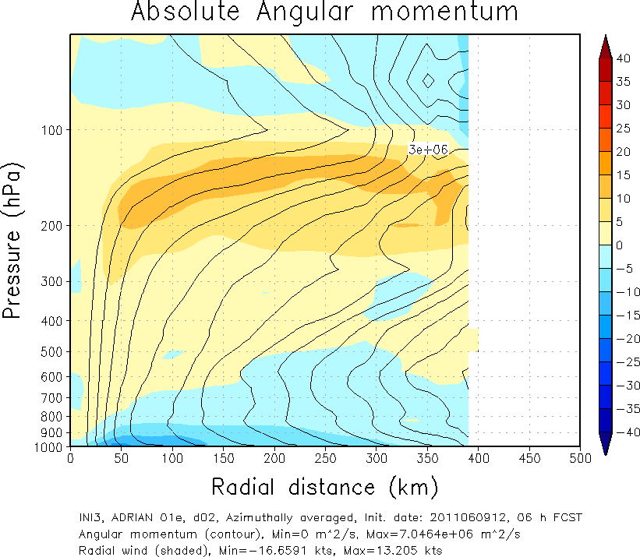
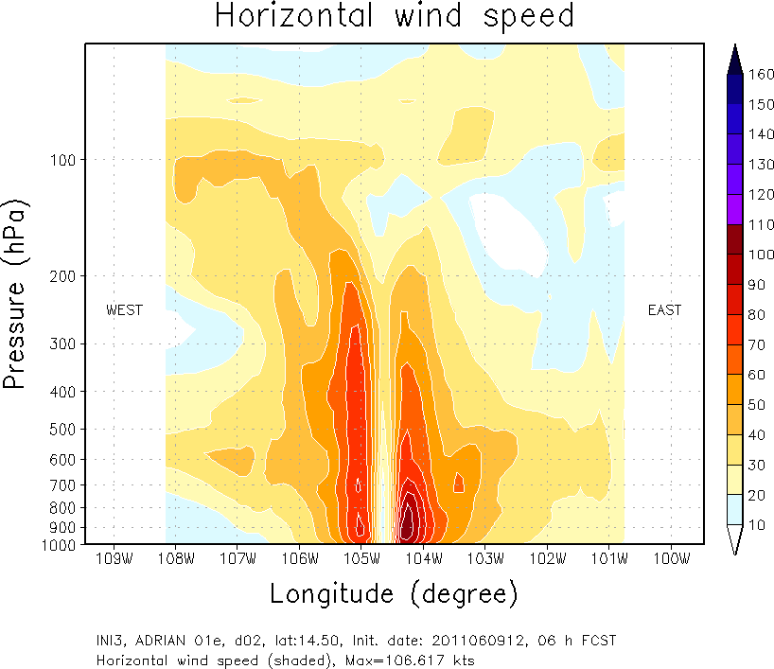
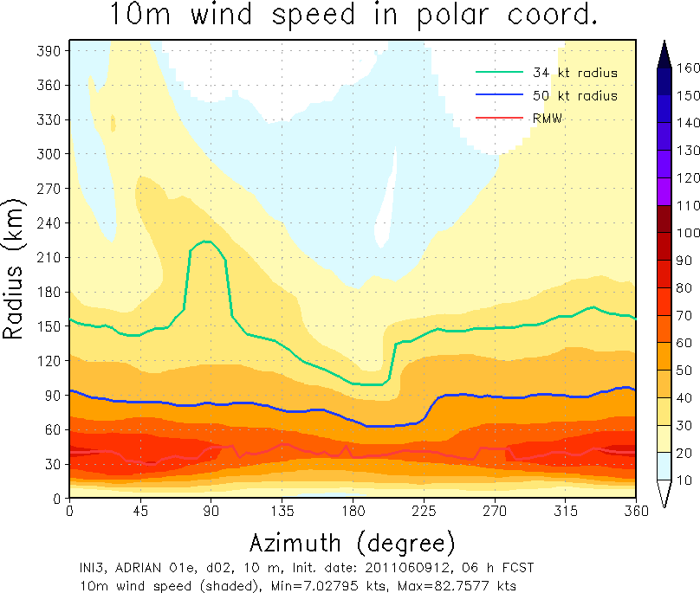
Horizontal structure
ETC.

Slide 6
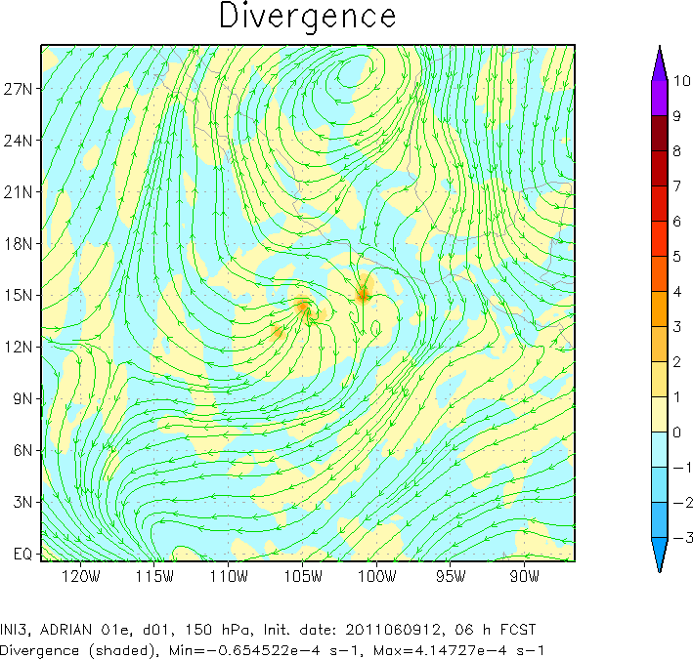
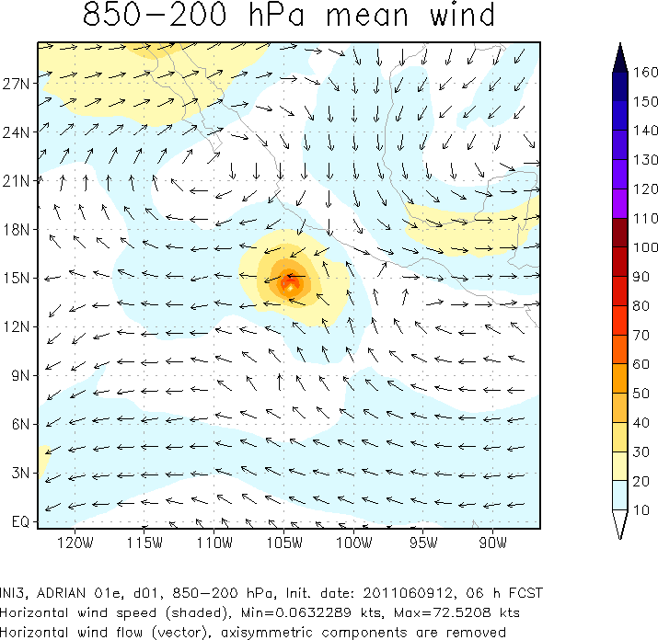
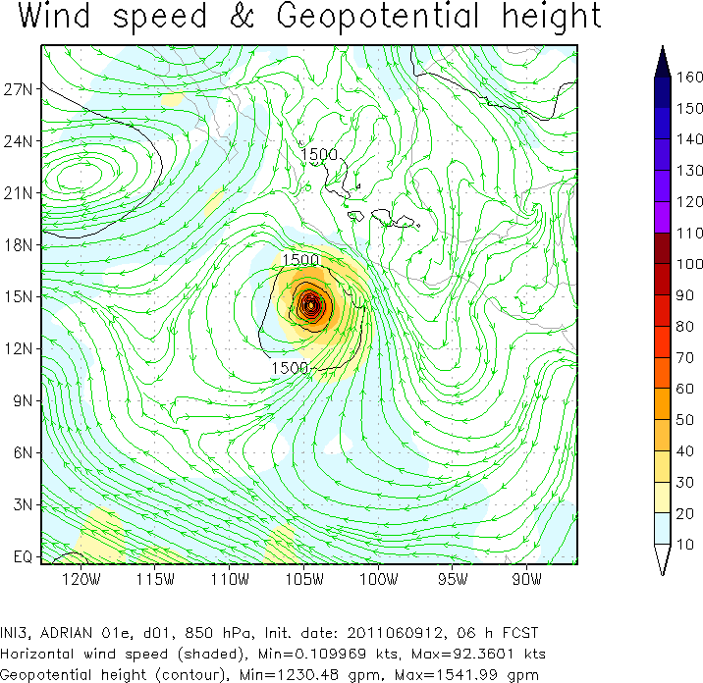
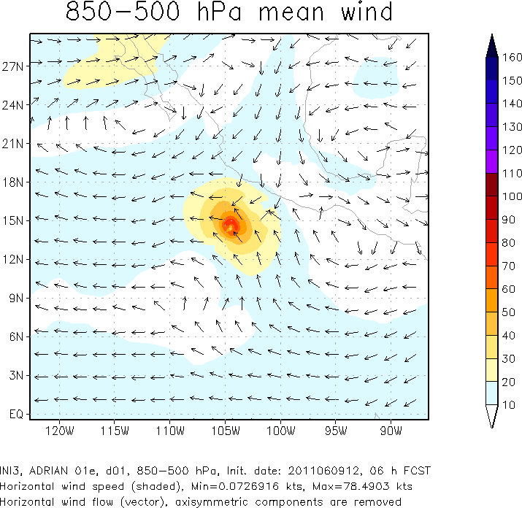
Plotting the parent domain

Slide 7
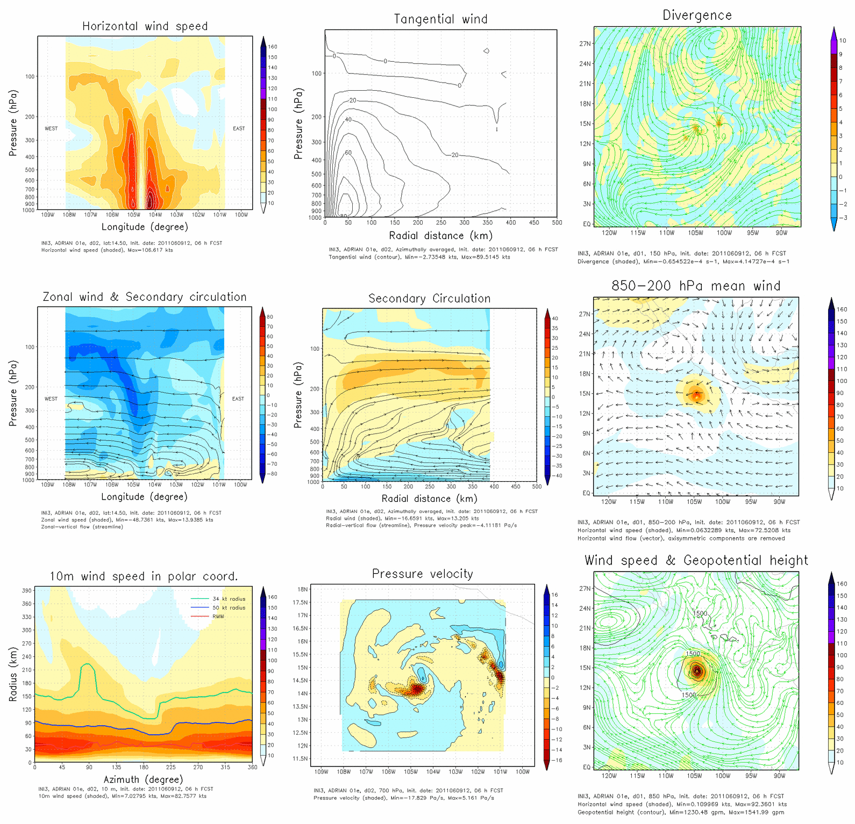
Total figure #1

Slide 8
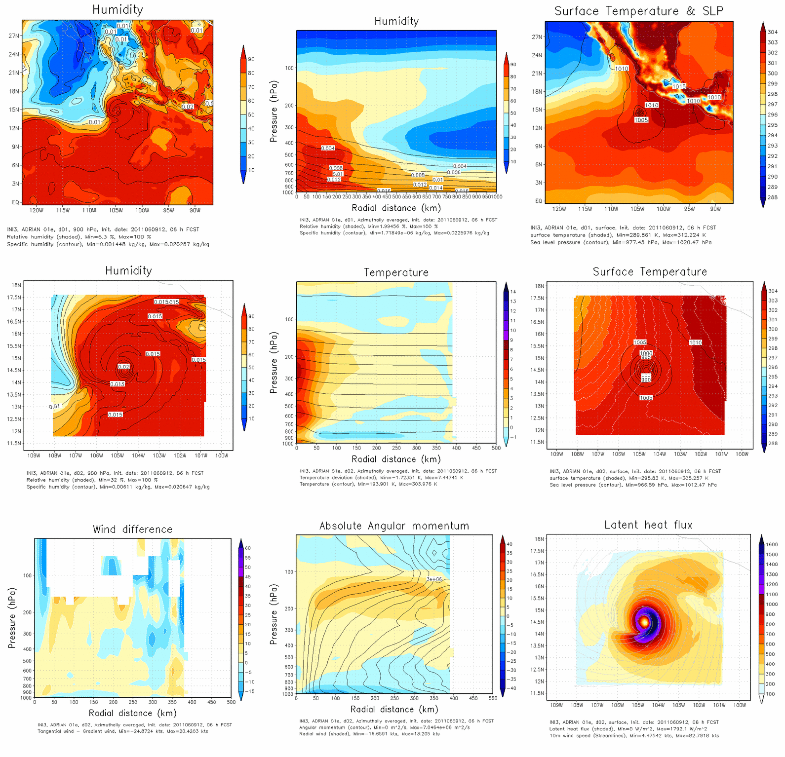
Total figure #2

Slide 9
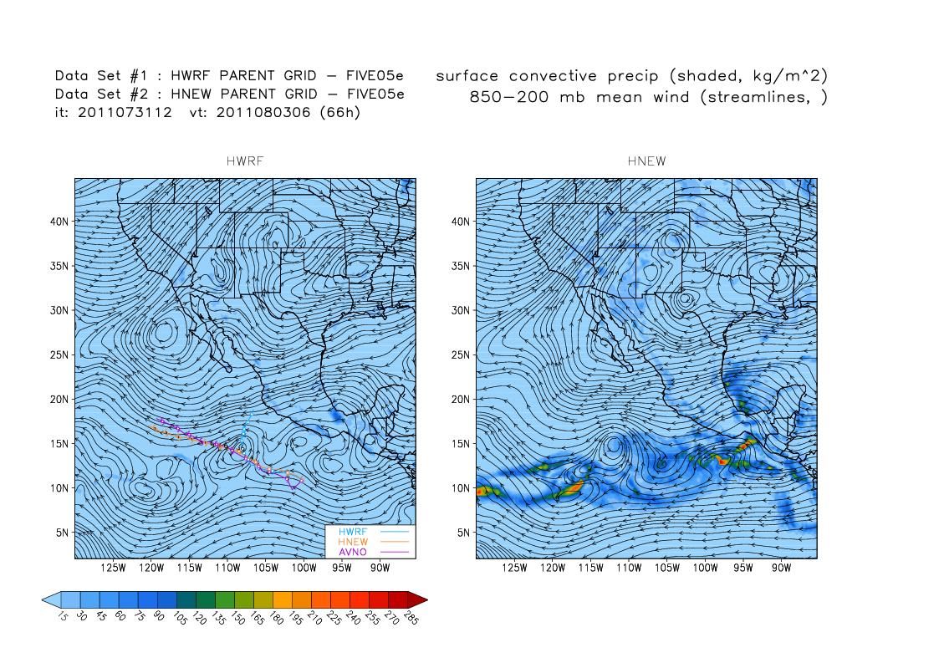
Hurricane Motion Diagnosis
From Vijay’s presentation ( 04 AUG 2011)

Slide 10
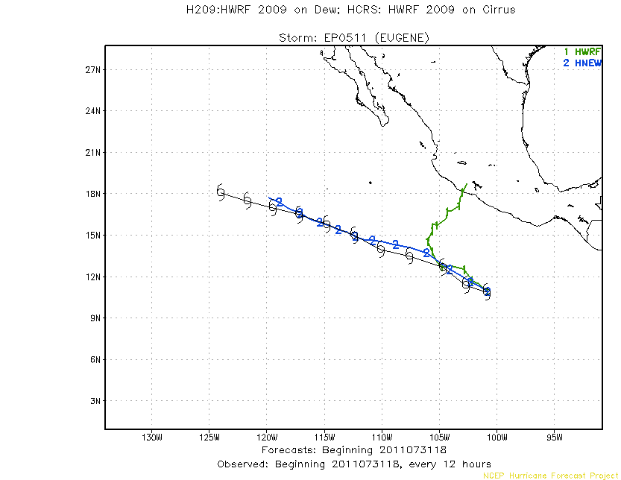
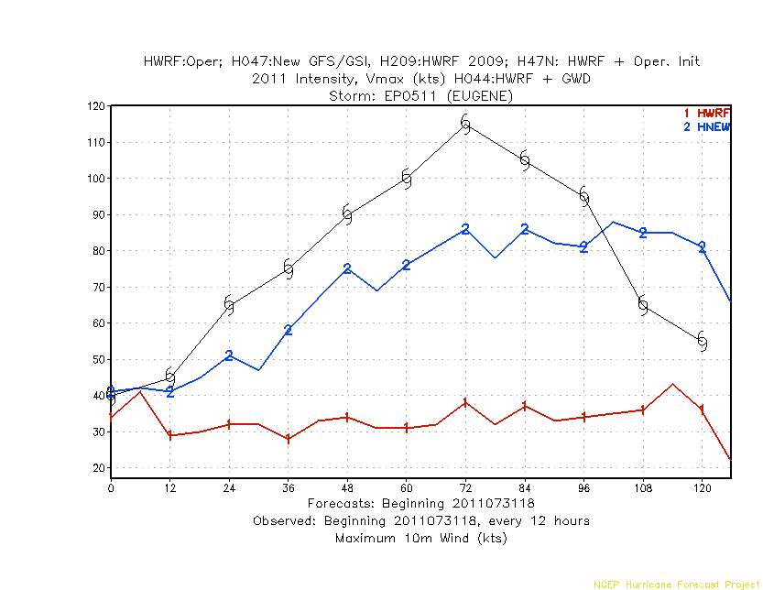
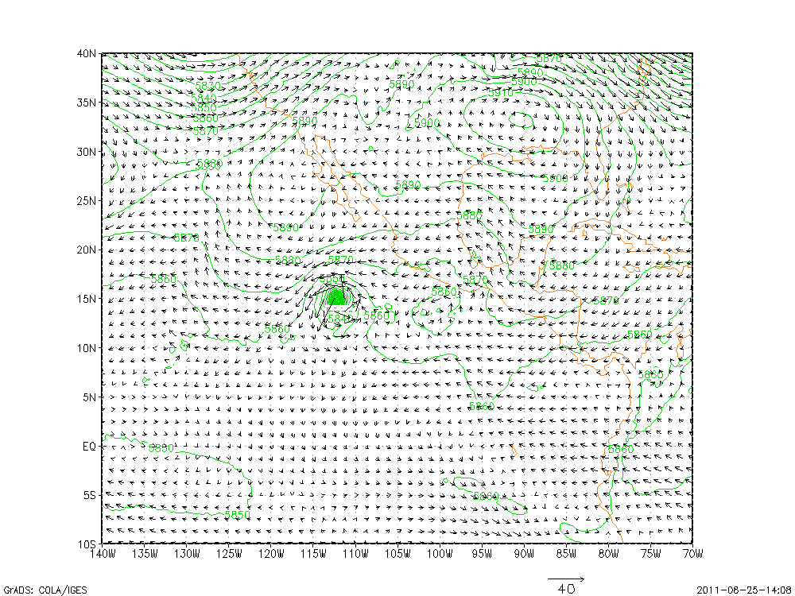
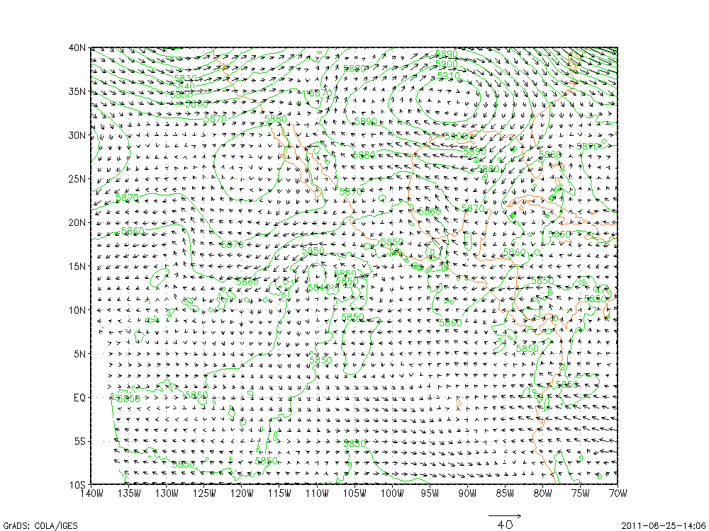
Hurricane Motion Diagnosis
72h
72h
HNEW 72h fcst
HWRF 72h fcst
500 hPa Wind & Height
500 hPa Wind & Height
Notes:
Huge track difference between HWRF and HNEW(bug-fixed HWRF).
HNEW large scale flows is not much different from HWRF

Slide 11
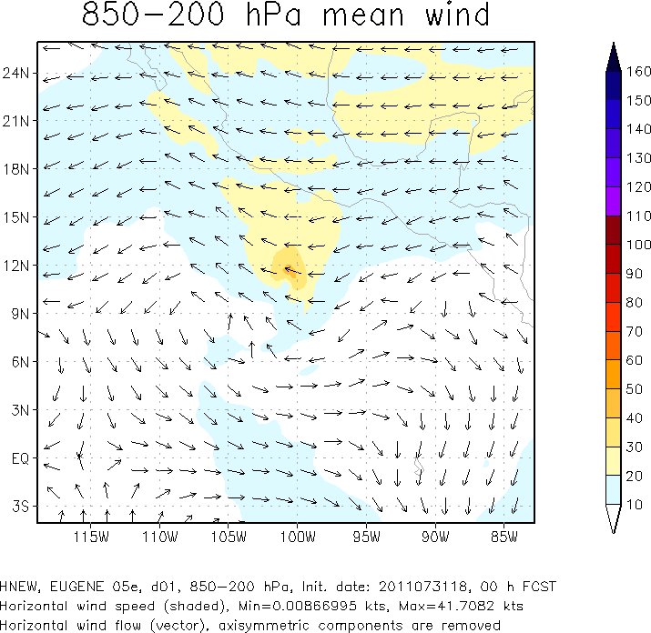
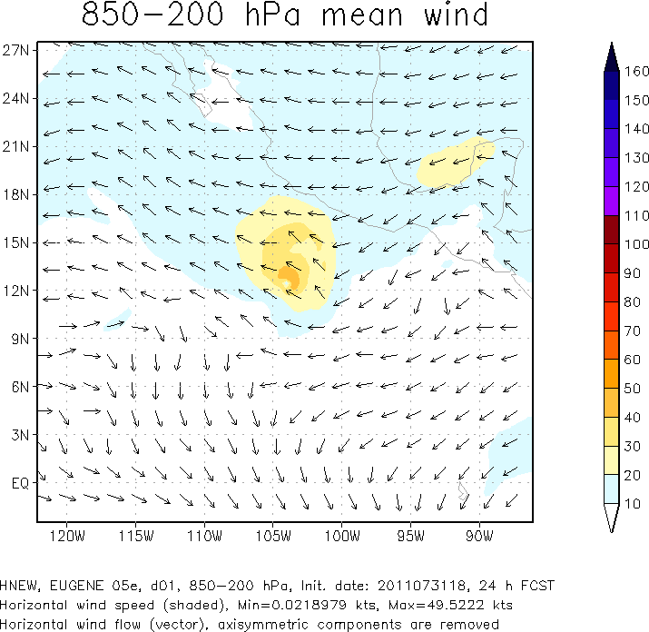
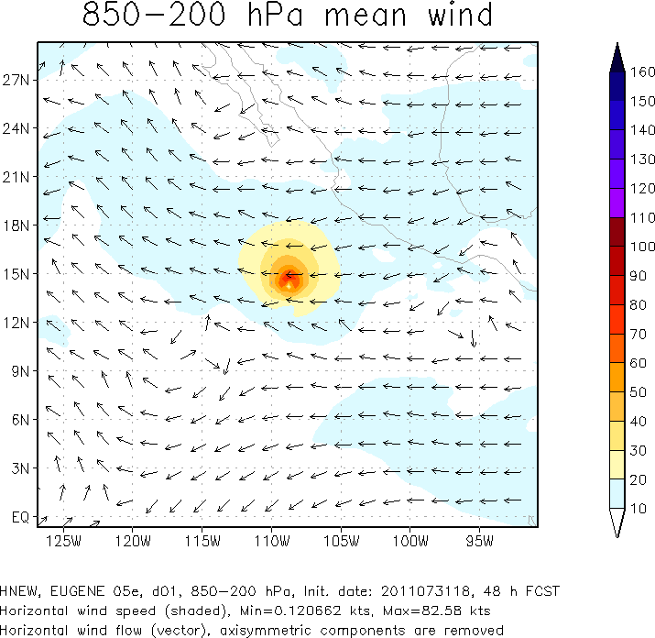
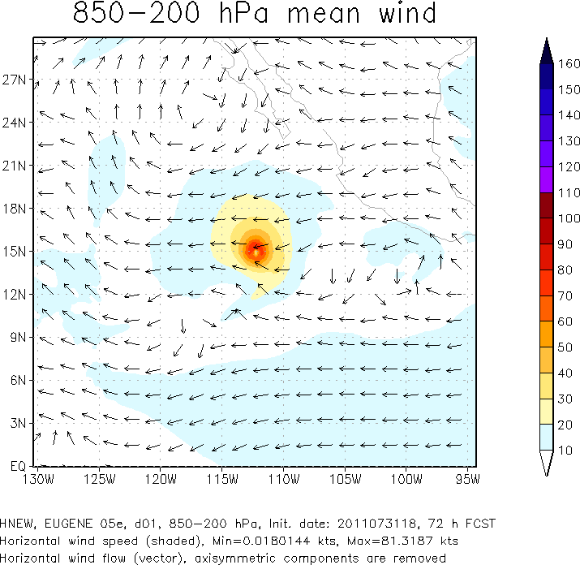
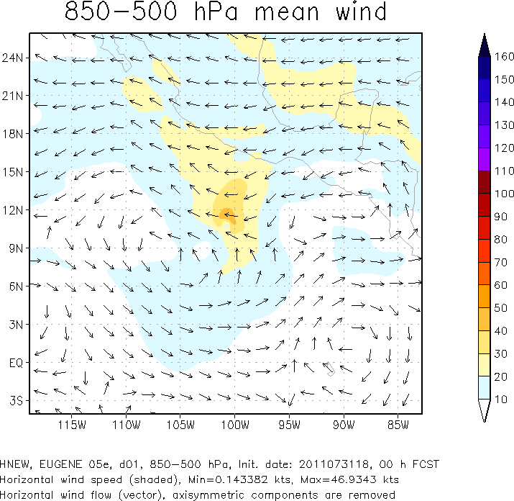
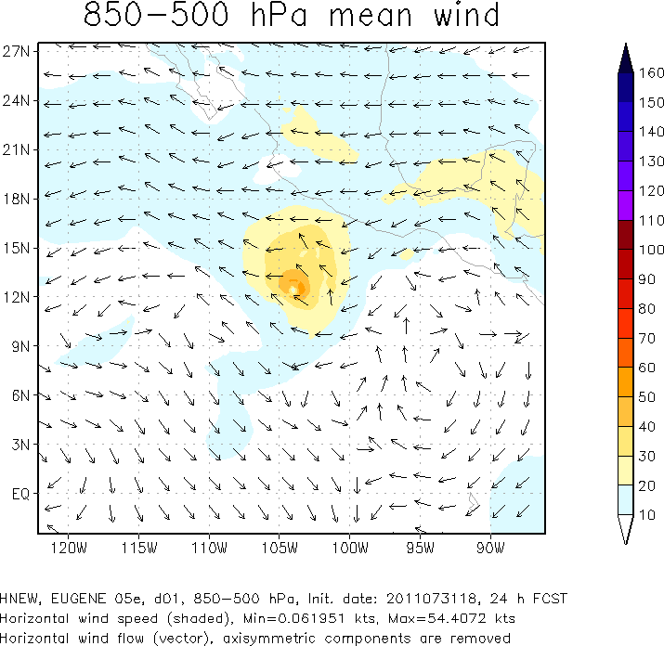
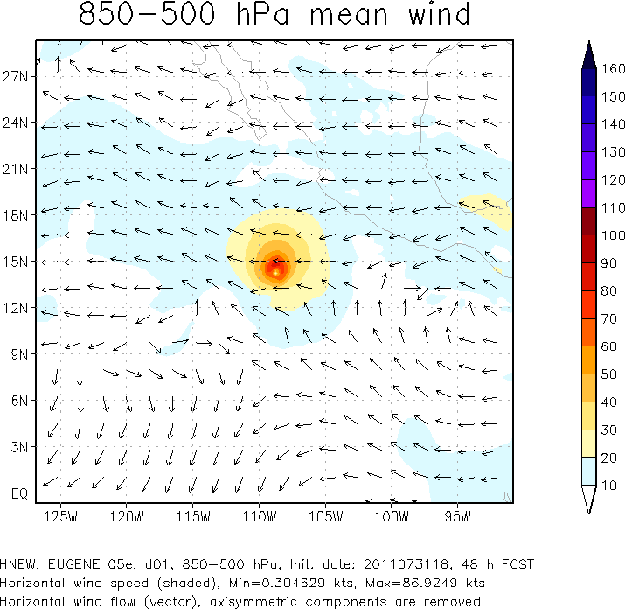
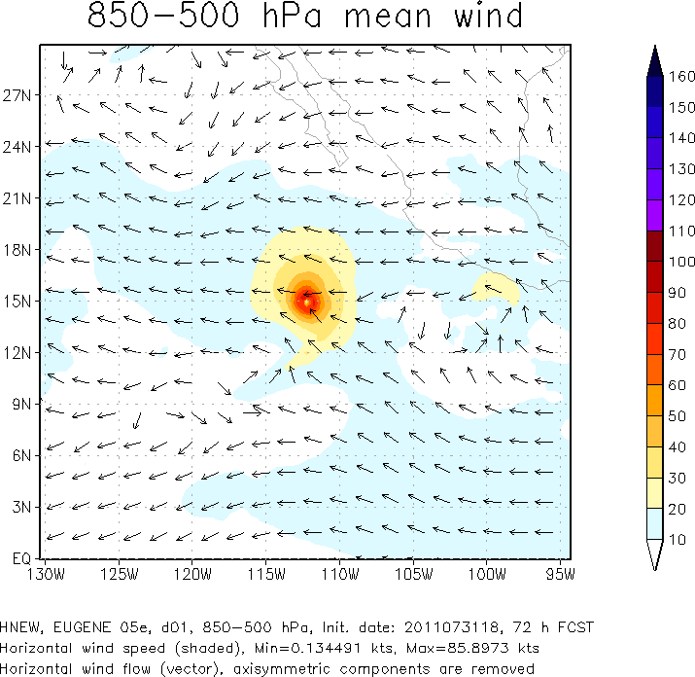
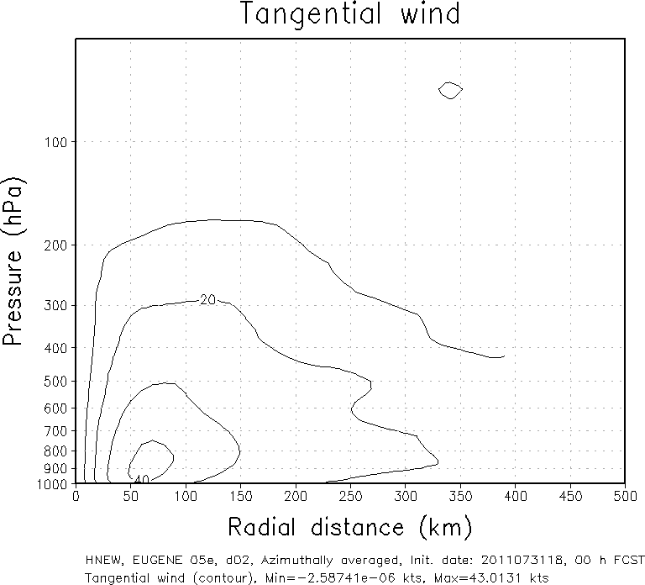
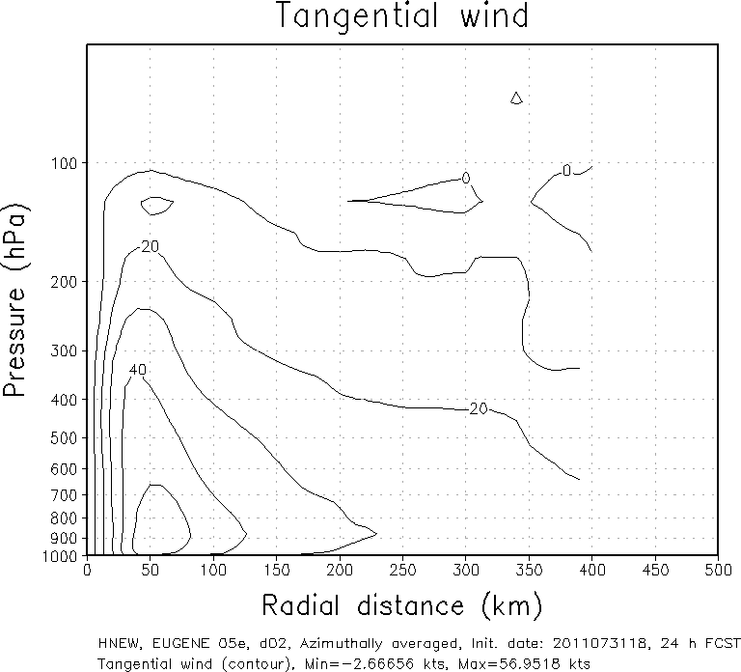
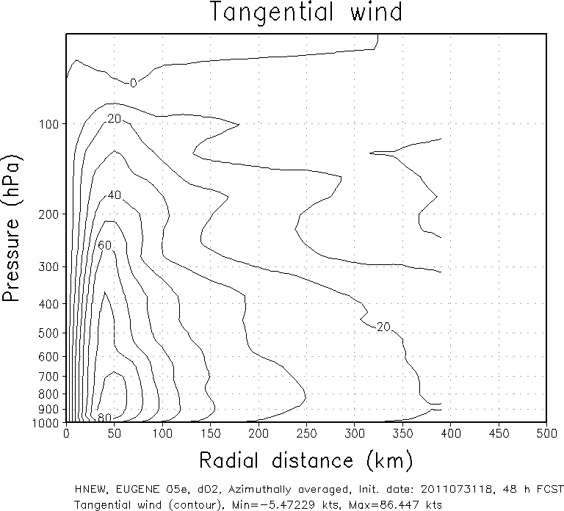
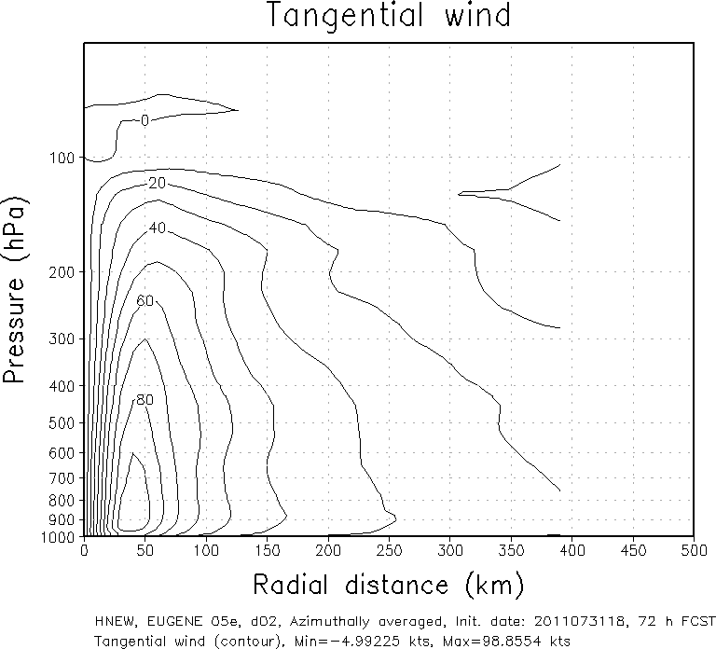
00h
24h
48h
72h
HNEW
11

Slide 12
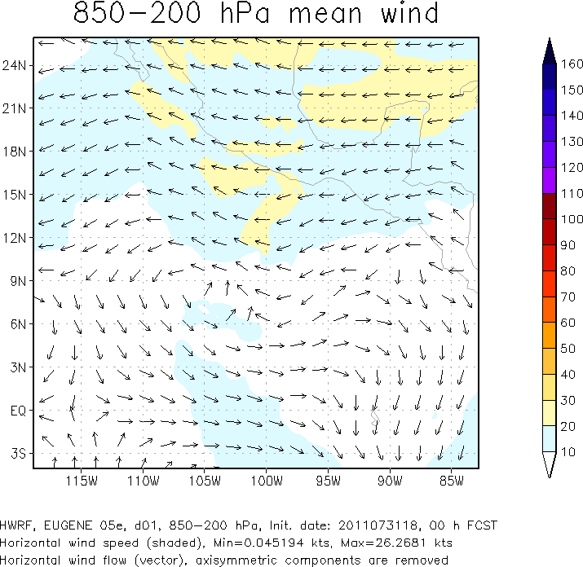
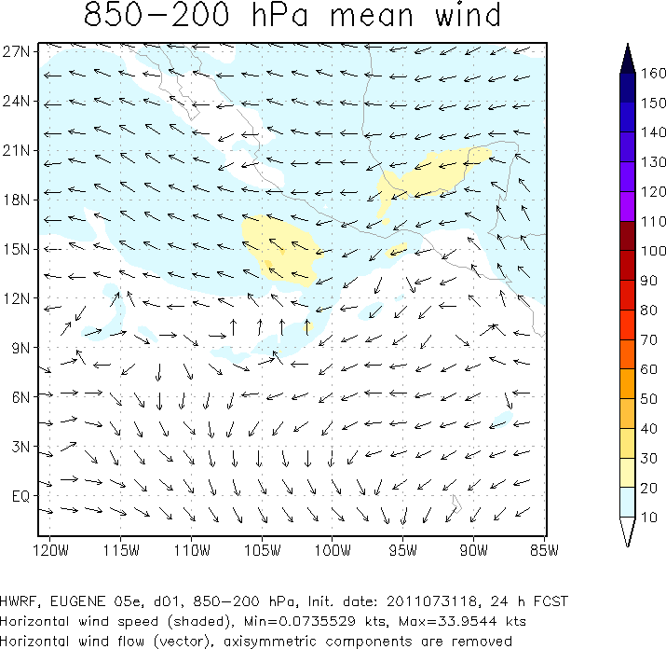
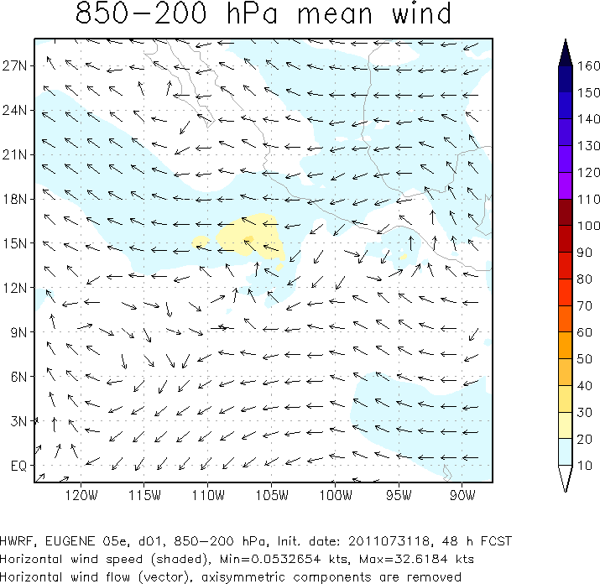
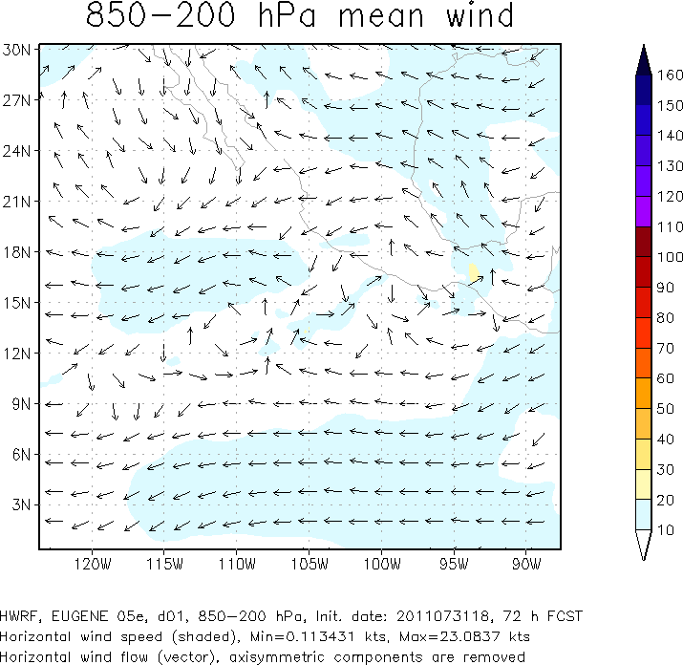
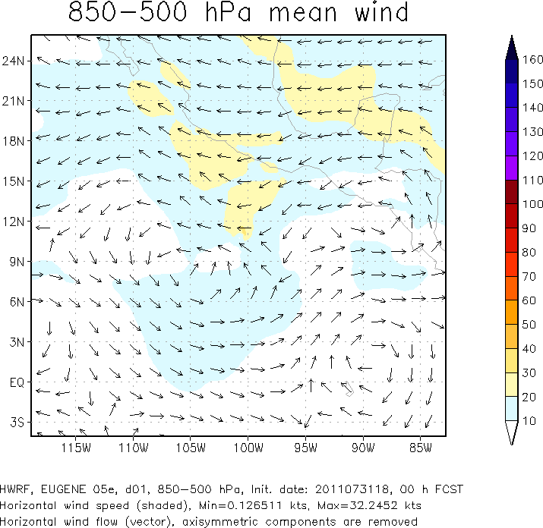
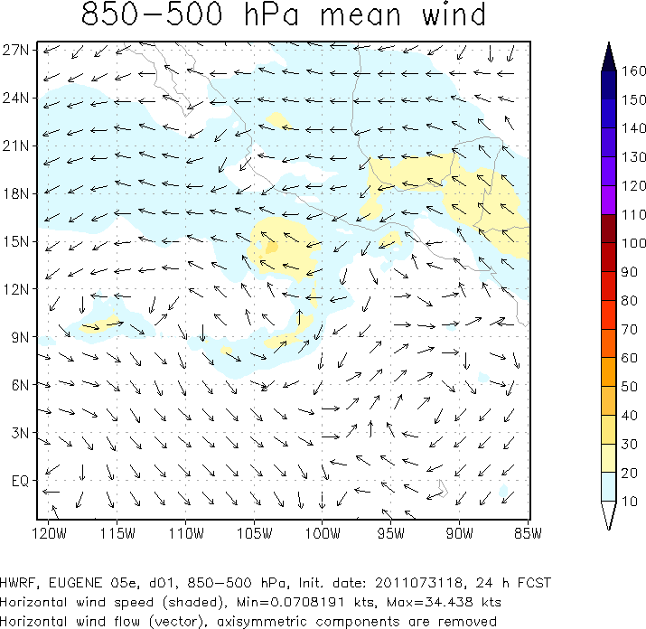
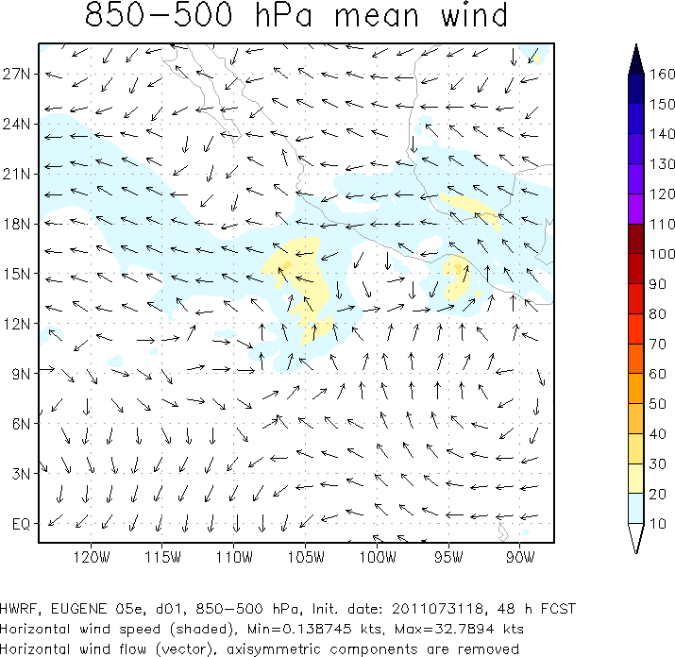
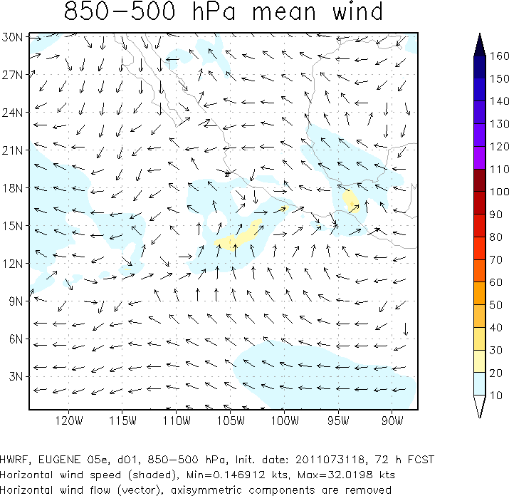
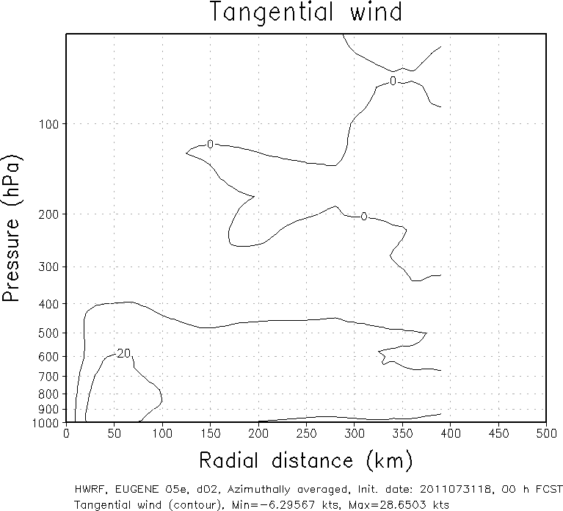
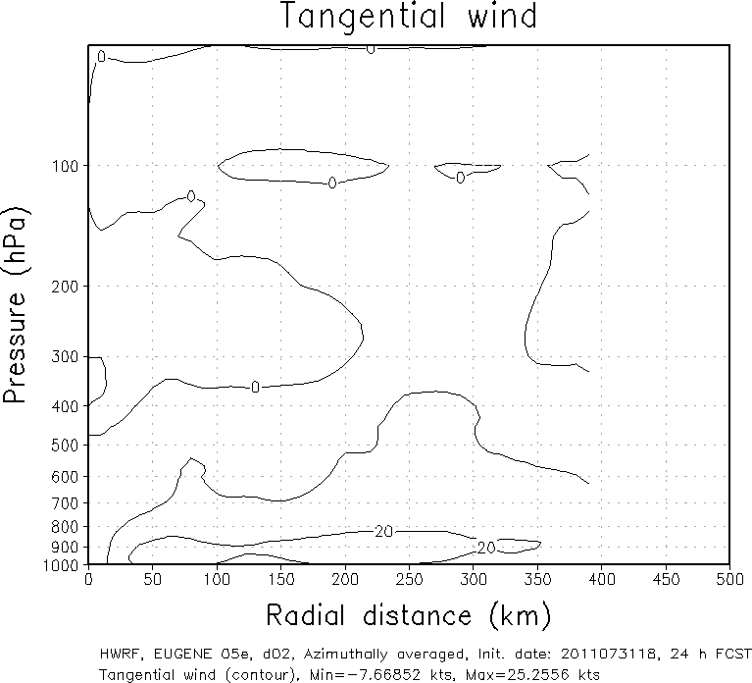
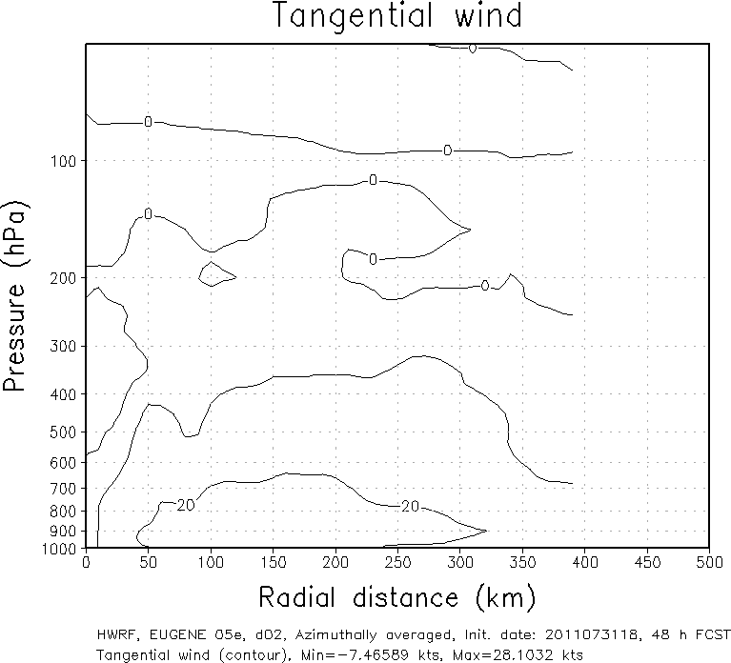
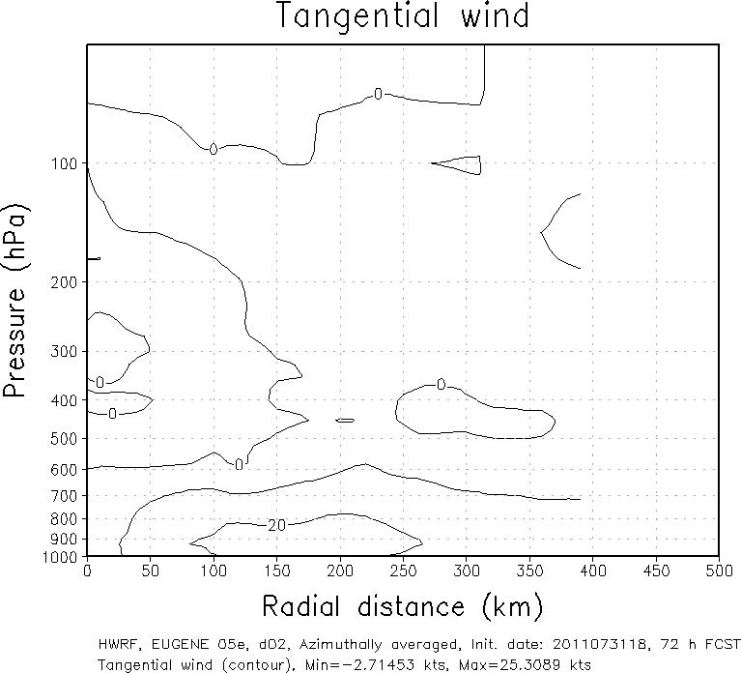
00h
24h
48h
72h
HWRF

