Slide 1
Extending Operational HWRF Initialization to Triple-nest HWRF System
Qingfu Liu (EMC), Xuejin Zhang (HRD) and Samuel Trahan (EMC)
Contributors: Vijay Tallapragada, Kevin Yeh (HRD),
Zhan Zhang, Young Kwon, Mingjing Tong, Robert Tuleya (ODU), Janna O’Connor and
Sundararaman Gopalakrishnan (HRD)

Slide 2
1. HWRF initialization for 9km operational model
1) Overview
HWRF initialization is separated into Step1 and Step2 (then GSI analysis and domain data merge).
Step1: run before GFS analysis is completed.
Step2: run after GFS analysis is completed.
Step1 includes,
Create 40x40 degree² 9km resolution domain by interpolating data from HWRF 6h forecast parent domain (d01) and inner nest (d02).
Split the 40x40 degree² 9km fields into HWRF environment and HWRF vortex
Compute axisymmetric storm and define the radius of outermost closed isobar

Slide 3
Step2 includes,
Interpolate GFS analysis data onto the same 40x40 degree² 9km resolution domain
Split the 40x40 fields into GFS environment and GFS vortex
Combine GFS environment and modified HWRF vortex
Interpolate the combined data onto outer nest and the ghost domain
After Step2, we run GSI on the outer nest and ghost domain. The outer nest data and the ghost domain data then are combined to create initial fields for outer nest and inner nest.

Slide 4
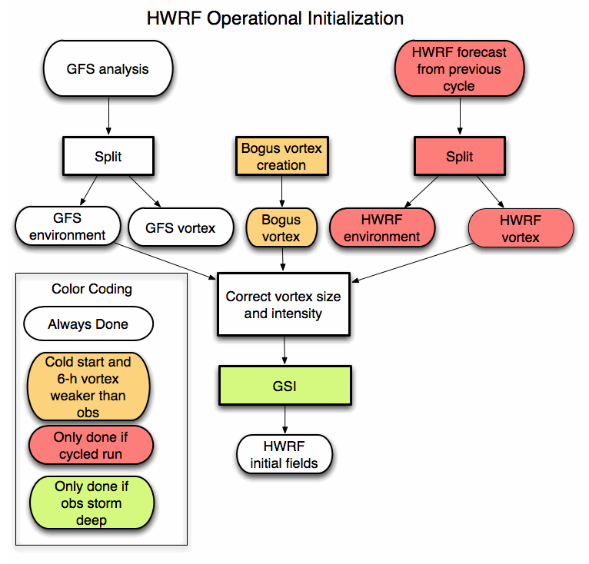
1/11/2010
( Flow chart drawn by Ligia Bernardet)
4

Slide 5
2) Create the 40x40 degree² 9km resolution data
Generate horizontal e-grid (standard procedure) and construct vertical pressure grid for the 40x40 degree² 9km domain
Vertical pressure grid generation:
Interpolate MSLP (Mean Sea Level Pressure) from old model grid d01 and d02 (for example, previous 6h forecast data) onto new 40x40 degree² 9km grid
Convert MSLP to surface pressure and calculate
PD (I,J)=PS(I,J,1)-PDTOP-PT
New vertical pressure grid:
P(I,J,K)=PT+PDTOP*ETA1(K)+PD(I,J)*ETA2(K)
These pressure grid is terrain following and closely match the pressure grid of the original model grid for domains d01 and d02
Data interpolation
Localized vertical interpolation
Horizontal E-grid to E-grid interpolation.

Slide 6
Sigma-Pressure Hybrid Coordinate
Credit: Zavisa Janjic WRF-NMM Tutorial

Slide 7
Localized vertical interpolation
Consider a new grid point Q with pressure P (target point)
Find the surrounding 4 grid points A,B,C and D (source points)
Vertically interpolate data (U, V, T, r) at grid points A,B,C and D onto constant pressure P level (the same pressure level as target point Q)
Horizontally interpolate the new data at level P from A,B,C and D to the target grid point Q (E-grid to E-grid interpolation)
This kind of data interpolation, though complex, carrying accurate information from old grids to new grids.
Why use the localized vertical interpolation?
Suppose we use 43 constant vertical pressure levels:
At 900mb (center pressure for strong hurricanes), the vertical distance between the first grid and the second grid is over 200m, whereas the first grid of U,V,T and r are roughly located at 35m (half grid points) above ocean surface.
At 700mb (high mountains), the vertical distance between the first grid and the second grid is over 400m, whereas the first grid of U,V,T and r are roughly located at 20m at high mountains.

Slide 8
inside merge K,T5,Q5,U5,V5,Z5,P5=
K Temp r U(m/s) V(m/s) Z (m) P (Pascal)
1 300.12 0.02 7.88 0.32 0.00 101344.46
2 299.37 0.02 8.79 0.10 68.11 100570.72
3 298.57 0.02 9.35 -0.19 146.82 99681.37
4 297.68 0.02 9.78 -0.53 237.65 98661.93
5 296.68 0.02 10.15 -0.91 342.36 97496.02
6 295.57 0.02 10.49 -1.34 462.88 96166.34
7 294.34 0.02 10.80 -1.82 601.05 94658.38
8 293.02 0.02 11.05 -2.34 759.12 92954.83
9 291.76 0.01 11.07 -2.82 939.41 91040.24
10 290.79 0.01 10.37 -2.79 1144.39 88901.16
11 289.74 0.01 9.29 -2.39 1377.04 86525.05
12 288.61 0.01 7.20 -1.95 1639.77 83907.09
13 287.32 0.01 4.33 -1.19 1935.41 81043.41
14 285.63 0.01 1.20 -0.33 2266.36 77937.90
15 284.10 0.01 -1.68 -0.79 2634.39 74602.08
16 281.86 0.01 -1.42 -4.24 3041.65 71055.24
17 278.65 0.01 -1.77 -7.55 3489.06 67322.43
18 274.96 0.01 -2.40 -10.40 3975.82 63439.29
19 271.82 0.01 0.78 -8.74 4501.40 59445.37
20 269.22 0.00 0.95 -3.23 5066.16 55387.84

Slide 9
3) Separate the vortex from its environment
The code are modified from GFDL model code, the procedures are the same as those used in GFDL. However, the program is relatively old and has not been updated for the last 10 years. The data smoothing is done on 1 degree grid resolution. The vortex separation procedure is described as follows,
Interpolate data onto 1 degree resolution grids
Separate vortex from its environment on 1 degree resolution grids
Interpolate the environment field to the original 40x40 degrees 9km data only for the grids inside the filter domain
Subtract the new 40x40 degrees data from its original data to obtain the high resolution vortex
Problem in this code:
-- noise at high mountain area (need temperature adjustment since the topography data is different between the 100km and 9km grid resolution)
-- hurricane component is stored at 85 constant pressure level (this vertical resolution may not be good enough for strong hurricanes).

Slide 10
4) Storm relocation and storm size and intensity correction
Once we have the high resolution HWRF vortex and GFS environment on the same 40x40 degrees 9km grids, we can do the storm relocation, storm size and storm intensity correction.
Storm relocation and storm size correction:
HLAT2(I,J)=(HLAT2(I,J)-CLAT_FCST)*fact+CLAT_OBS
HLON2(I,J)=(HLON2(I,J)-CLON_FCST)*fact+CLON_OBS
VLAT2(I,J)=(VLAT2(I,J)-CLAT_FCST)*fact+CLAT_OBS
VLON2(I,J)=(VLON2(I,J)-CLON_FCST)*fact+CLON_OBS
Storm Intensity correction:
vobs=vobs*log(delt_z1/z0)/log(10./z0)
(not good for 3km resolution)
Storm relocation, storm size correction and storm intensity correction are described in detail in DTC scientific document and the DTC tutorial document.
5) GSI analysis and Data merge

Slide 11
2. Operational HWRF initialization to triple-nest HWRF model initialization
HWRF initialization for 3km grid resolution is basically the same as that used in 9km initialization (the 40x40 degrees domain is replaced by 30x30 degrees domain). We add two programs, and retired two old programs, which make the total number of programs the same as before. There are some bug fixes. Major changes include:
1) New subroutine for the E-grid to E-grid interpolation
Horizontal E-grid to E-grid interpolation subroutine for 9km resolution has large errors when applied to 3km resolution. The problem is that the subroutine can’t find the correct surrounding grid points.
2) Changes in surface wind calculation
The max surface wind calculation from the 9km grid resolution does not work well for the 3km grid resolution. We have tried different methods in the 3km grid resolution, still has some problem, but not serious (post-process reduce initial intensity slightly). More accurate method requires that we calculate the 10m wind exactly the same way as that in the model.
In the new version, we are using:
U10_new(I,J)=min(1.0,U10(I,J)/U(I,J,1))*U_new(I,J,1)

Slide 12
Horizontal Interpolation Procedure
Obtain new storm center from TCVITAL
Create new domain and rotated latitude-longitude grid
Calculate regular latitudes and longitudes of new grid
Obtain 6-hr forecast fields and grid attributes at -6h
Define bi-linear weight coefficients and index in -6h rotated latitude-longitude grid
Adjust local vertical profile according to new terrain
Obtain new fields on new rotated latitude-longitude grid

Slide 13
Horizontal Interpolation Scheme
l
l
l
l
l
l
4
3
l
l
l
l
l
l
l
l
l
l
l
l
l
l
l
l
l
l
D
l
l
l
l
l
l
l
l
l
5
l
l
l
l
l
l
l
l
l
Q
l
l
l
l
l
l
l
l
l
l
1
2
A
B
l
l
l
l
l
l
C

Slide 14
Vertical Mass Adjustment
50 hPa
50 hPa
50 hPa
100 hPa
420 hPa
Downscale
420 hPa
500 hPa
Feedback
850 hPa
Earth’s Surface
1000 hPa
Earth’s Surface
Coarse Grid
Reference Surface
Fine Grid
Pressure NOT directly interpolated from source hybrid to target hybrid (sigmas don’t match!)
The height, temperature and moisture fields from the source domain are vertically interpolated onto pressure surfaces (not necessary standard pressure level).
The above meteorological fields from the source grid are further interpolated horizontally onto target grid on the same pressure surface.

Slide 15
3. Preliminary results
The test version of HWRF 27/9/3km has different model physics compared to 1.5 stream 27/9/3km tests Sam is running. Based on Sam’s e-mail:
The version on CCS is HR44 on Jet. The HR43 is what Sam is running now. The differences are: 1. SAS bug fix in HR44 2. pgcon=0.2 in HR44 3. pressure-based RH cutoff in HR44 4. the "dudhia-style" f_* fraction correction loop in module_mp_HWRF
All the following track and intensity plots are from Zhan Zhang
HWF3: Sam’s 1.5 stream run
HEXP: New tests

Slide 16
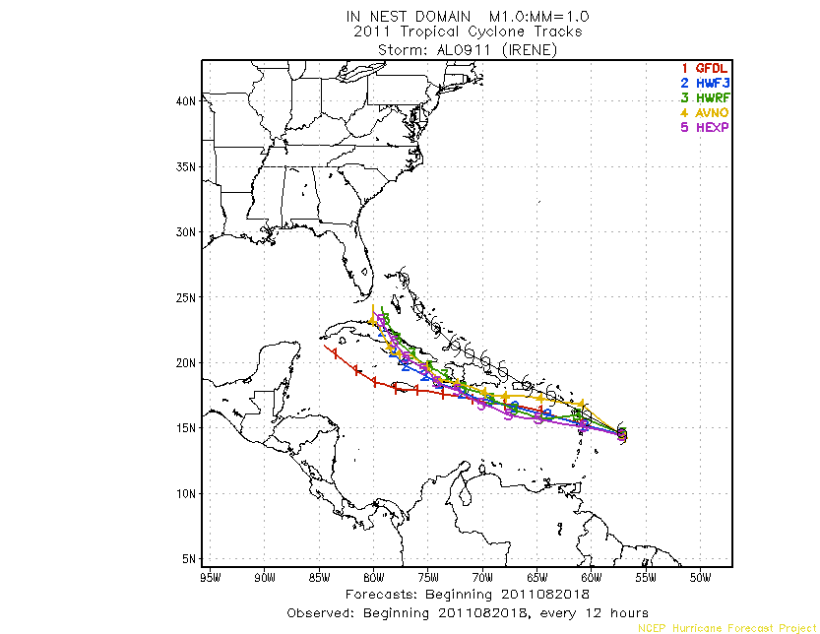

Slide 17
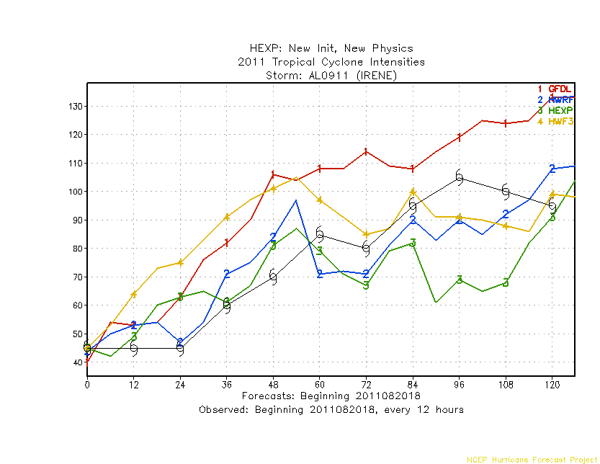

Slide 18
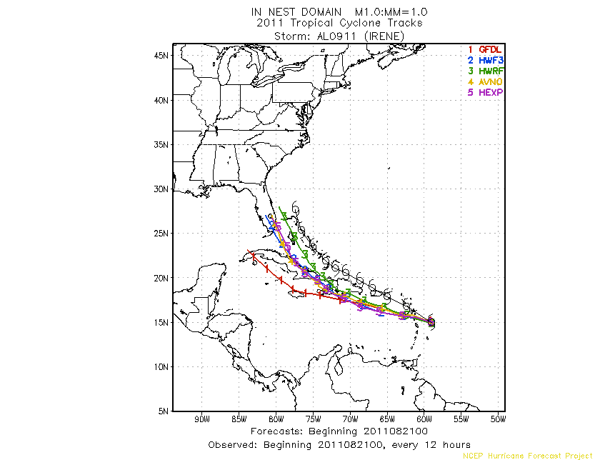

Slide 19
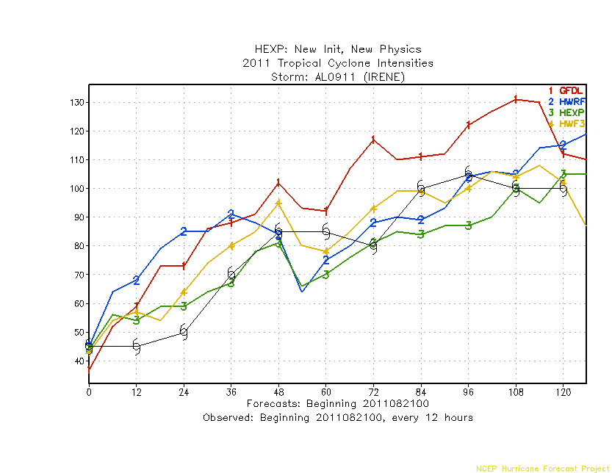

Slide 20
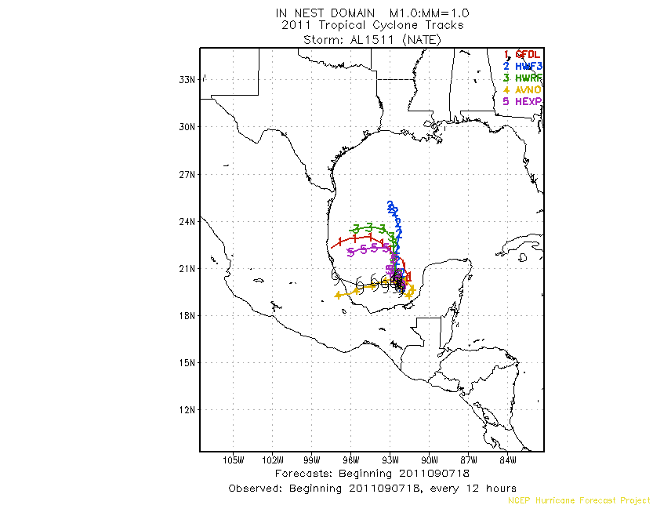

Slide 21
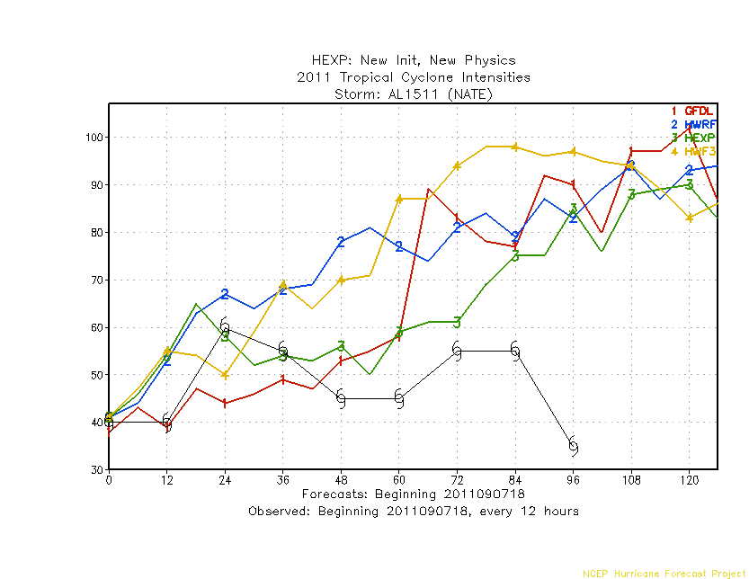

Slide 22
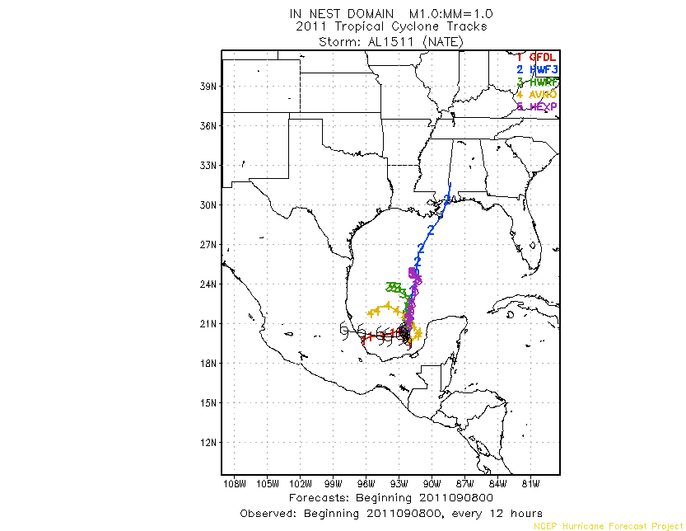

Slide 23
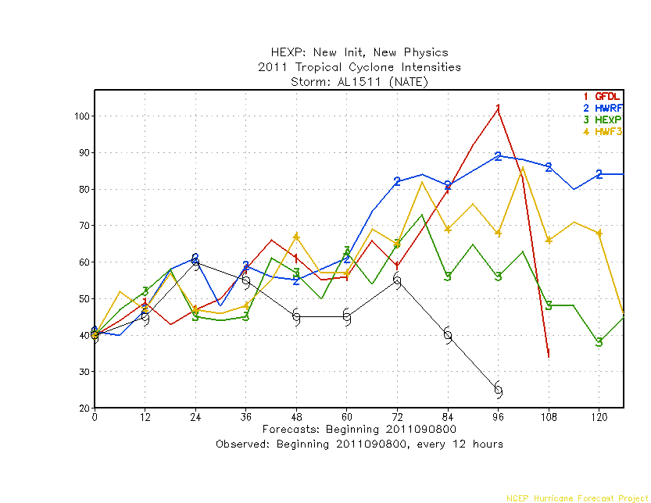

Slide 24
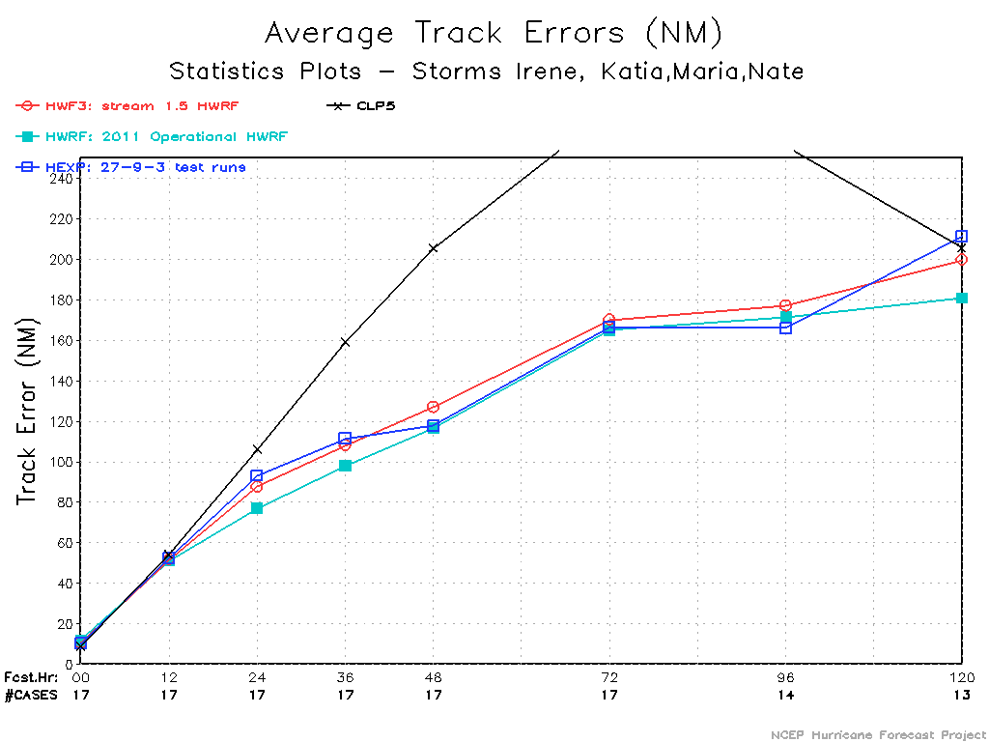

Slide 25
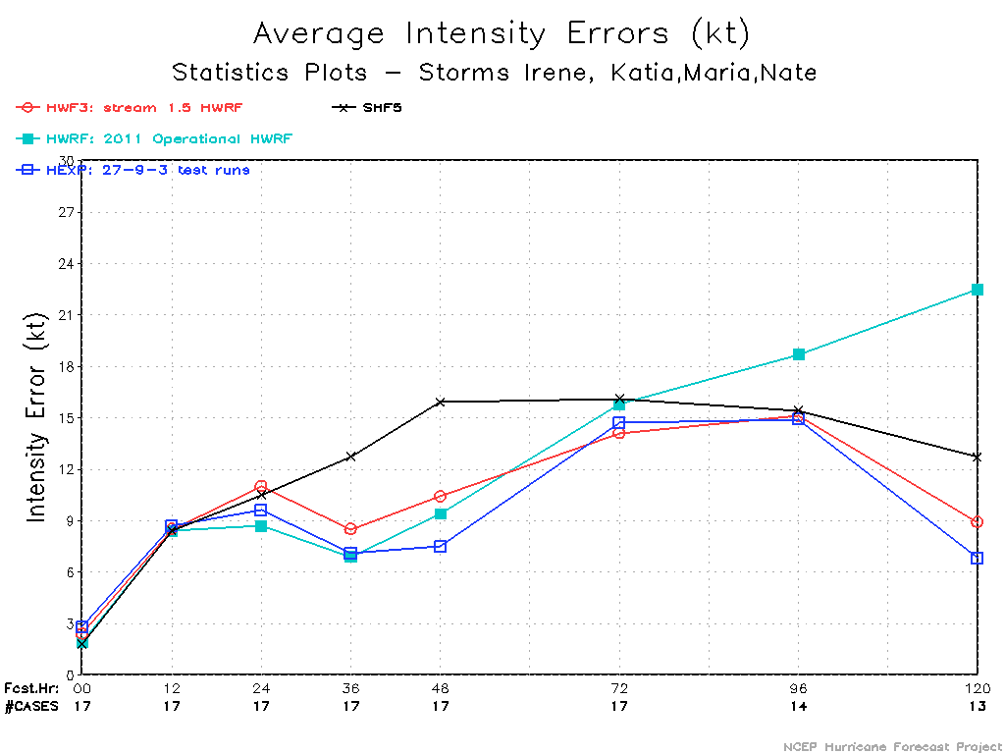

Slide 26
