Slide 1
Preliminary HWRF Diagnostics for Tropical Storm Erika 2009
Informal Presentation
HWRF Meeting, Sept 24, 2009
Mark DeMaria and Brian McNoldy

Slide 2
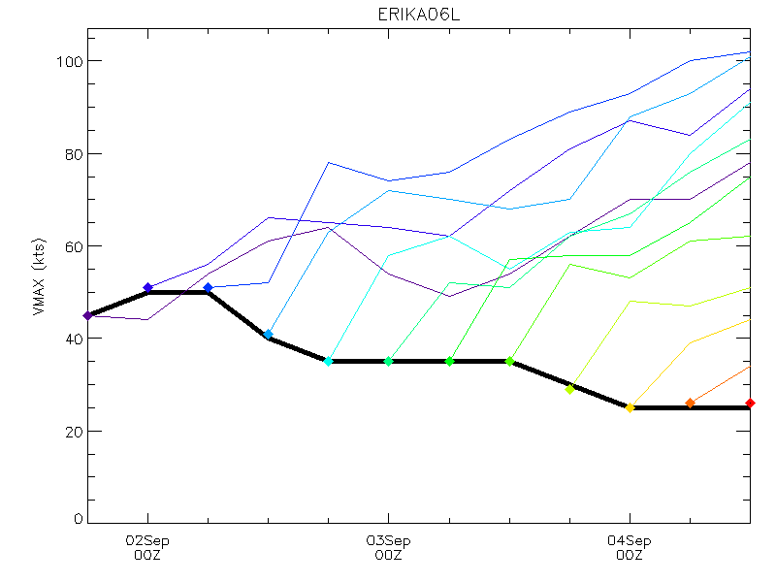
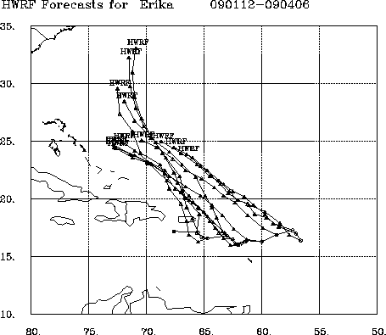
Systematic Intensity and Track Errors
HWRF Intensity Forecasts HWRF Track Forecasts

Slide 3
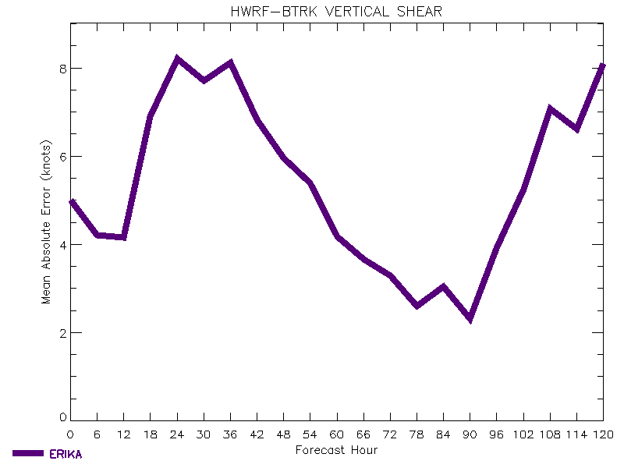
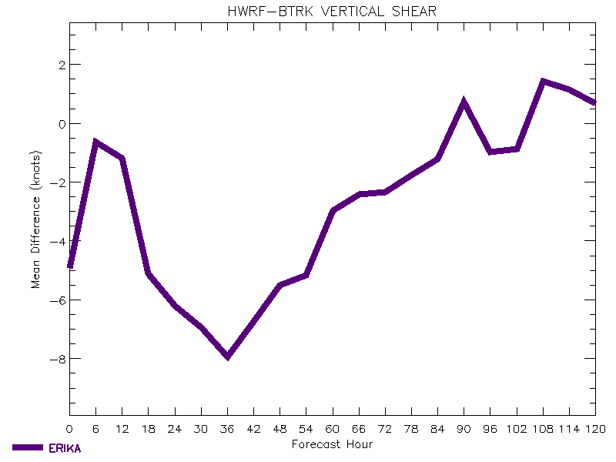
Average Shear Error and Bias
Mean Absolute Error Bias
Shear from GFS analyses along observed track used as ground truth

Slide 4
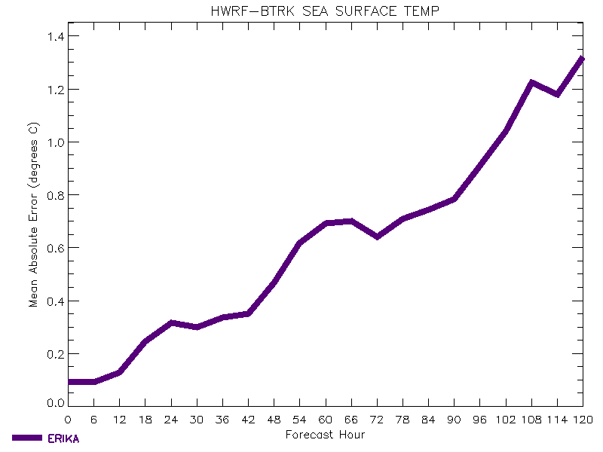
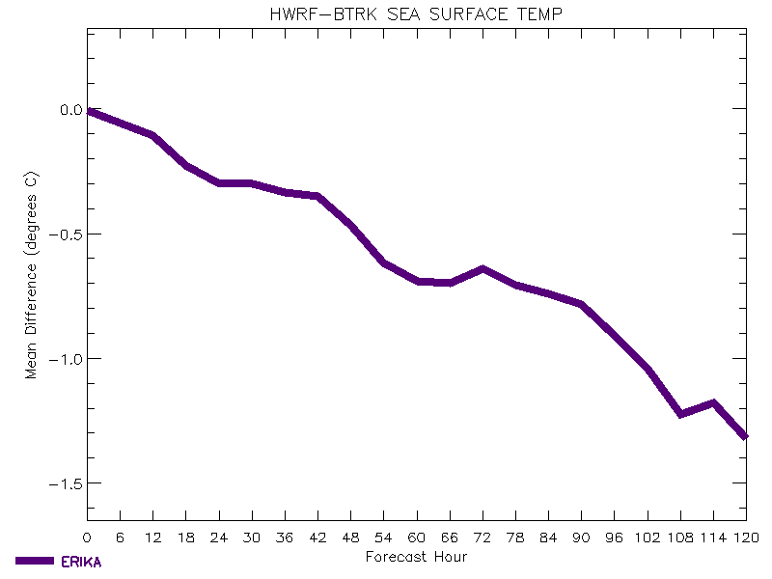
Average SST Error and Bias

Slide 5
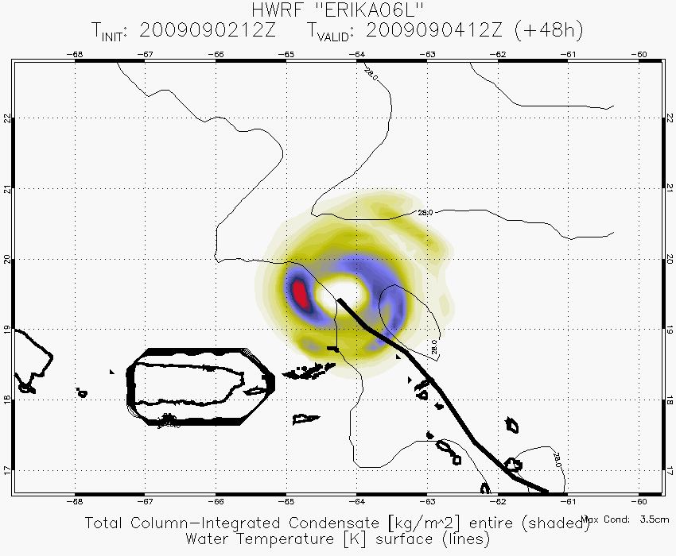
Forecast and Observed Moisture Structure
X
48 hr HWRF Forecast Condensate
Valid 090412
6 hr Accumulated Precipitation
From Microwave Satellite Imagery

Slide 6
Next Steps
Compare model and satellite precip estimates early in forecast periods
Compare time evolution of model and observed IR cloud top temperatures
Apply steering layer analysis to compare model and observed storm structure
Variational method for determining optimal vertical weights for storm motion
Weights related to vortex vertical structure
Apply to HWRF model and GFS analyses

