Slide 1
Real-Time HWRF Forecasts for Super Cyclone* Phailin 02B
126-hr HWRF Forecast Guidance for all cycles of Phailin 02B Provided to JTWC and IMD⁺ at 6-hr interval
This is the first time extending real-time forecast guidance support to JTWC for the Indian Ocean basin using the West-Pac HWRF experiments run on HFIP Jet machines
*IMD did not declare Phailin as Super Cyclone, however, JTWC estimates called for a Cat.5 hurricane strength for Phailin for a brief period 24 hrs before landfall. This could be due to difference in standards adopted for intensity estimates (10min sustained wind, WMO criteria for IMD vs. 1min sustained wind, NHC/JTWC criteria)
+IMD runs it’s own version of HWRF (9km, 2010 version of operational HWRF) at 12-hr interval, without vortex cycling. NCEP HWRF is latest 2013 operational configuration. Both are uncoupled. IMD scientist Mr. Das is currently visiting EMC to adopt the latest version of HWRF for implementation at IMD.

Slide 2
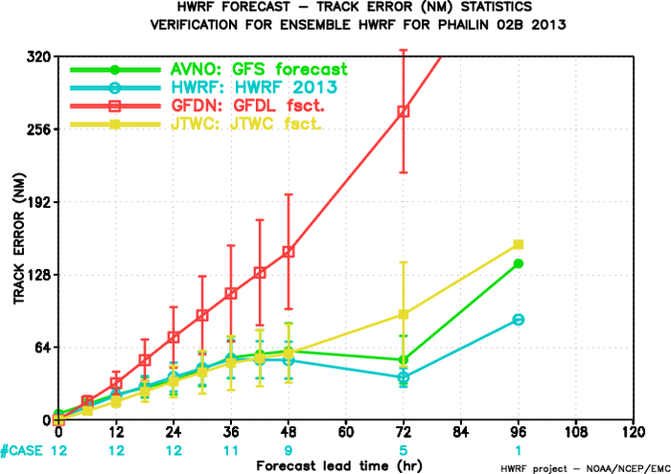
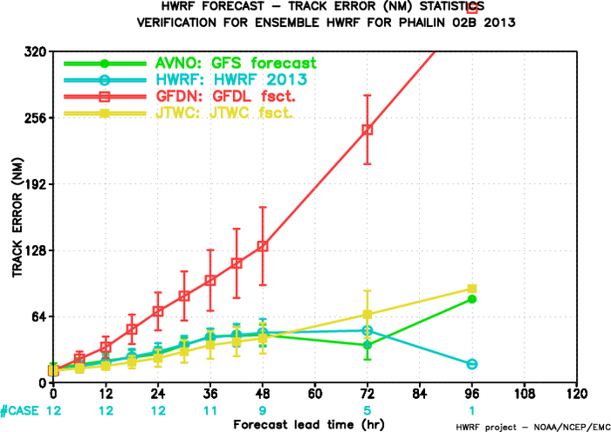
Track Forecast Verification, Tropical Cyclone Phailin 2013
Against JTWC
Against IMD
HWRF had lowest track forecast errors compared to other NCEP/Navy models, better than JTWC official forecasts
Similar track forecast error between JTWC and IMD. There is almost no cross-track diff between JTWC and IMD, but IMD track is slower than JTWC’s track.

Slide 3
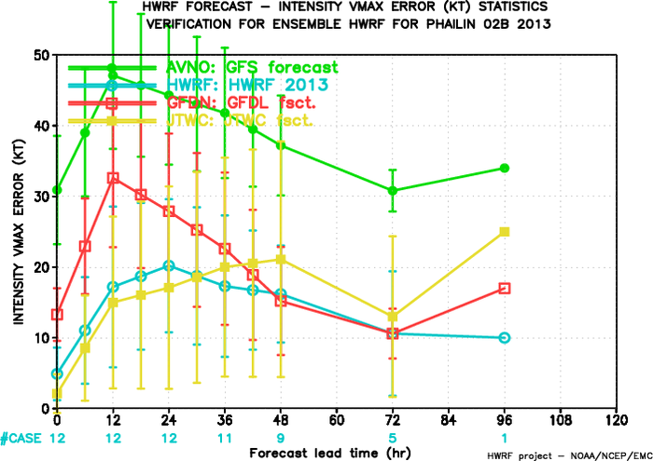
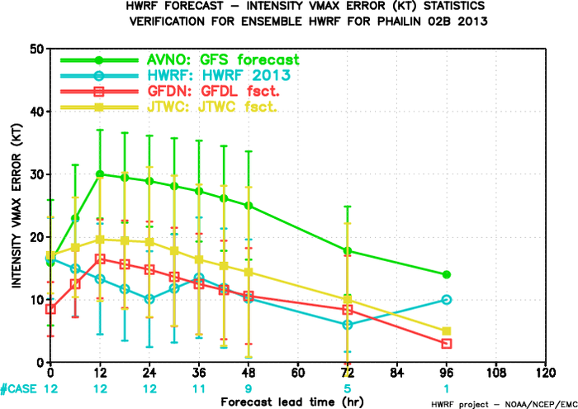
Intensity Forecast Verification, Tropical Cyclone Phailin 2013
Against JTWC
Against IMD
Intensity from IMD best track estimate is weaker than that from JTWC, about 10-25kt weaker

Slide 4
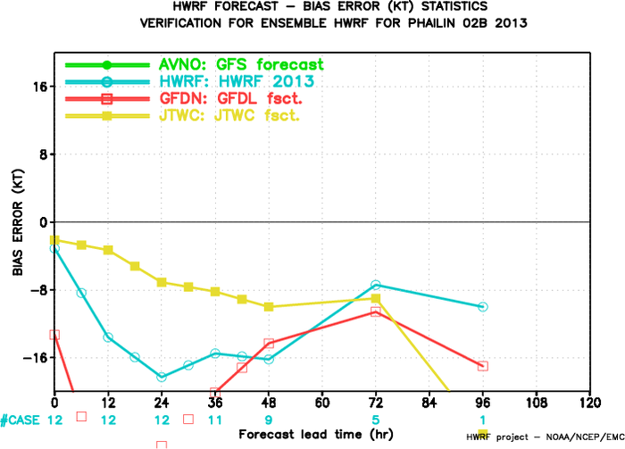
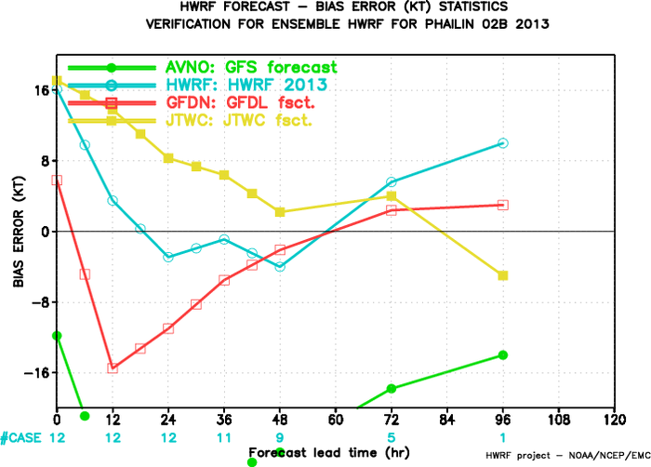
Verification for Intensity Bias, Tropical Cyclone Phailin 2013
Against JTWC
Against IMD
Negative bias against JTWC best track intensity;
Positive bias before 30h against IMD bias, small negative bias between 30h-60h, positive bias after 60h.

Slide 5
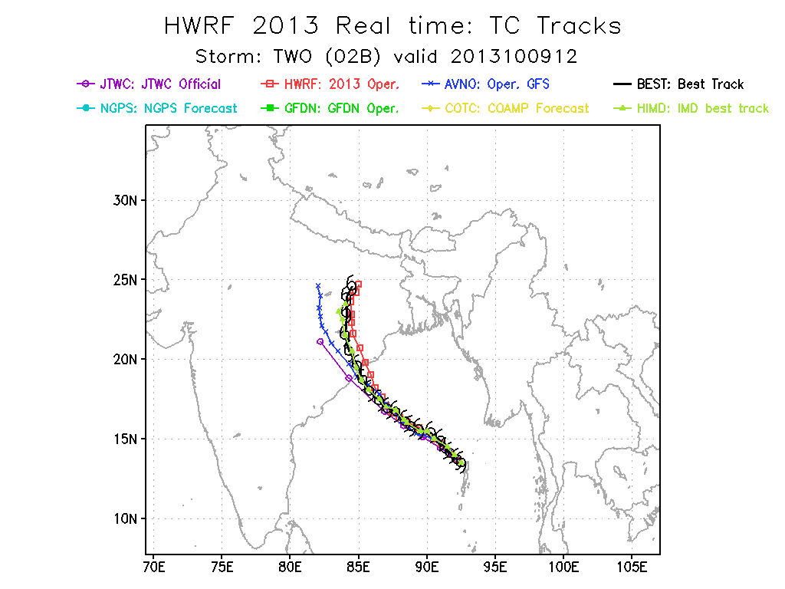
IMD best track is slower than JTWC track

Slide 6
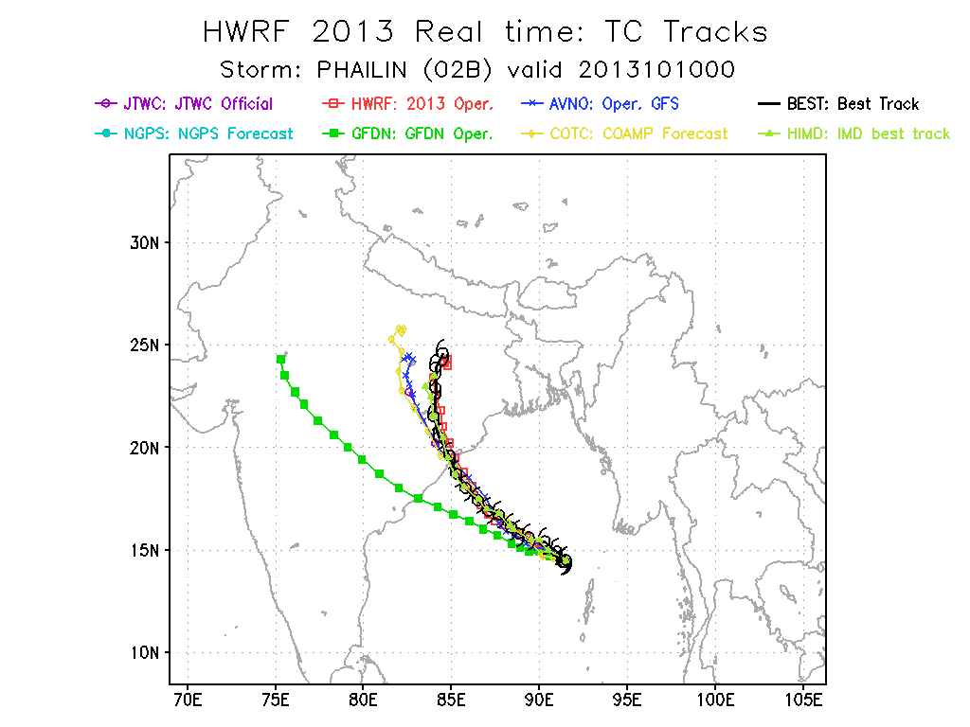
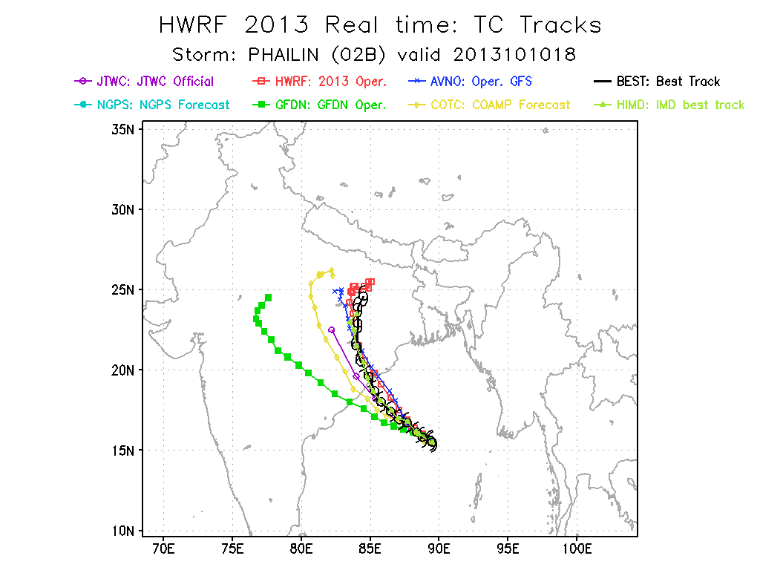
Consistently accurate forecast tracks from HWRF.
Navy models struggled to get the right timing and track

Slide 7
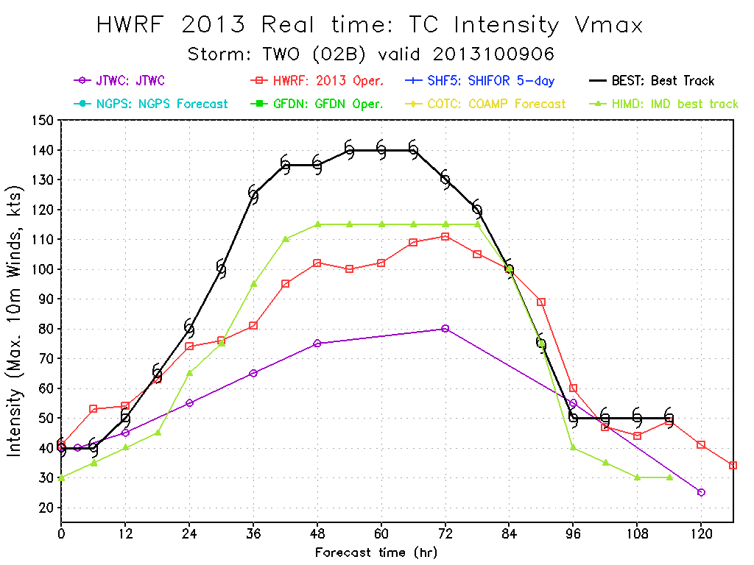
HWRF underestimated the maximum winds, better match with the IMD best track intensity! There is ~25kts diff between IMD and JTWC.

Slide 8
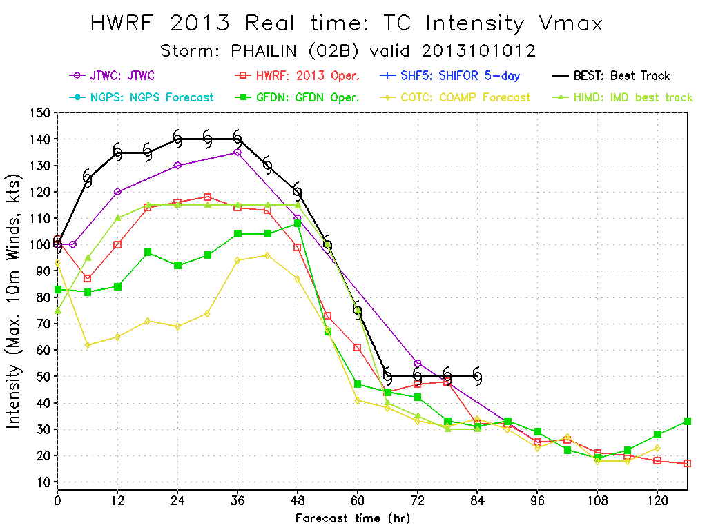
HWRF underestimated the maximum winds, better match with the IMD best track intensity!

Slide 9
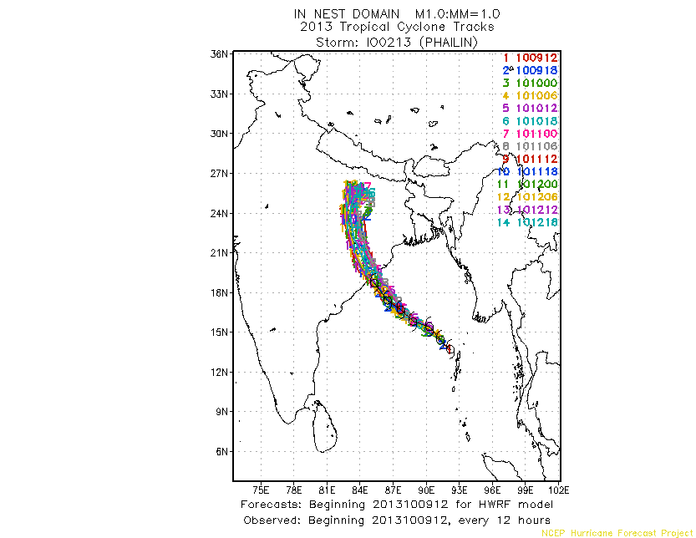
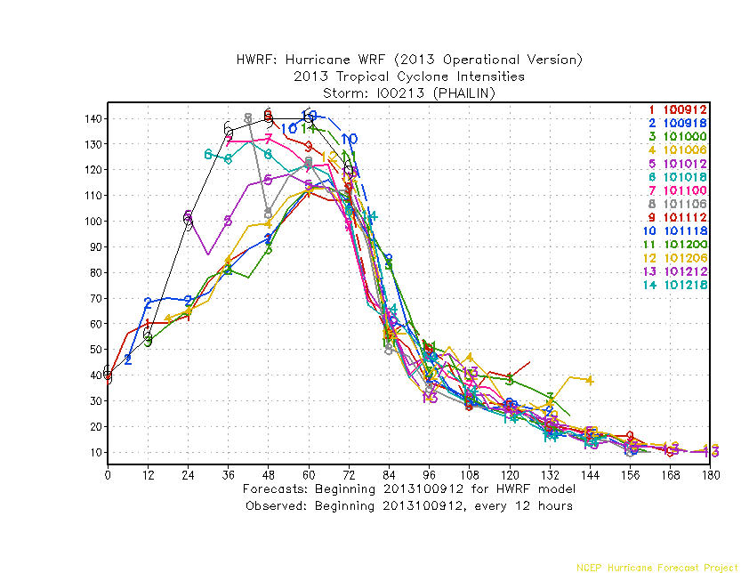
HWRF track and Intensity Forecasts at various starting time
Phailin, 2013
Consistent track forecasts, under-predicted intensity (compared to JTWC)

