Slide 1
HFIP Annual Meeting De-Brief
Nov. 17, 2011

Slide 2
Presentations
Presentation on “High-Resolution Hurricane Model Development and Evaluation at NCEP/EMC – the Operational HWRF Model” from 1.30 to 2.30 PM, Nov. 7, 2011. Covered a variety of topics including (a) overview of current operational HWRF system; (b) evolution of HWRF; (c) HWRF in FY11 and operational challenges; (d) hurricane model evaluation and diagnostics; (e) HWRF in 2012 and (f) future developments.
Second session of HFIP Annual Meeting on Nov. 8th - gave two presentations on “FY2011 HFIP Stream 1 Advancements at NCEP/EMC - Performance of Operational Models” followed by “NCEP/EMC Modeling Systems: FY12-FY13 Prioritized Stream 1.0 needs”. Emphasized on the following topics: (a) Performance of NCEP operational models in FY2011; (b) Status of activities in support of HFIP; (c) Ongoing developments and proposed changes in FY2012 and (d) Prioritized Stream 1.0 activities for FY2012 and FY2013. Highlighted a two-year approach to address Stream 1 priorities at EMC and NHC, with a proposal for additional man power, computational resources and a senior scientist visiting program to assist with further advancements to the HWRF modeling system.

Slide 3
Presentations
Co-hosted a community diagnostics workshop on Tuesday, Nov. 8th from 4.00 to 5.30 PM with special emphasis on coordinated efforts to evaluate model performance using available observations. Presented HWRF team efforts aimed at a specific case study of operational model performance for Hurricane Maria forecasts.
Participated and co-chaired the Hybrid DA workshop on Thursday, Nov. 10th. Gave a presentation on “Design and Development of Regional EnKF-3DVAR Hybrid DA System for Operational HWRF Model” with emphasis on operational requirements and pathway for R2O activities.

Slide 4
Impact of upgraded vortex initialization scheme in 2011 HWRF (EMC-HRD)
06hour forecast wind speed bias (y axis) vs initial wind speed (x axis)
Spin-up problem for weak storms and spin down problems of strong storms are much improved in 2011 season
* Modified initialization significantly improve the intensity skill of HWRF model (especially 0-48hr)

Slide 5
Code Optimization of Triple Nested HWRF System
Triple nested HWRF system (27-9-3) has been running parallel for 2011 hurricane season ;
The system is stable and produces comparable or better track/intensity forecasts with current operational HWRF;
The bottleneck for the system to be implemented into operation is the run time: it costs about 2 hours and 20 minutes for 126 hours forecast;
Several possible ways to further reduce the model run time, including:
- IO Servers configuration (identical results);
- Reducing HALO width (identical results);
- Increasing model time steps and physics calling frequencies;
- Adding one more node; Reducing model print statements;
- Reducing model domain; Loadleveler environment configuration;
3 dedicated nodes – thanks to vapor helpdesk.
End Result: Triple Nested HWRF system can run in 75 minutes with four nodes

Slide 6
HWRF T&E for 2012 Implementation
HR12 | H061 | H062 | H063 | HWRFV6.0.0
New Baseline (Control) | GFS Shallow convection and new PBL | Tuning of Microphysics parameters (NCW, NLImax, fall speed and so on) | Q3FY12 GFS (Hybrid GSI, prd12q3k) | H061+ H062+H063
Triple nested HWRF (27-9-3km) | Uses GFS shallow convection and PBL scheme implemented in July 2010 | Tune some microphysics parameters suggested by Eric and Brad | Create another baseline with proposed Q3FY12 Hybrid GSI/GFS | Combination of shallow convection, PBL and Microphysics and Q3FY12 GSI/GFS
Test cases: All 2011 cases in ALT and EP (about 600 cases) | Priority cases | Priority cases | All 2011 cases in ALT and EP (about 600 cases) | All 2011 cases in ALT and EP (about 600 cases)
Dec. 15, 2011 | Jan. 31, 2012 | Jan. 31, 2012 | Feb. 28, 2012 | Feb. 28, 2012

Slide 7
Status of FY11 Stream 1.0 Tasks Supported by HFIP (1)
Task | Status | Remarks
Improved initialization procedure | Completed, Implemented in FY11 | Further modifications for 2012 implementation
GFS Physics upgrades in HWRF and GFDL (EMC+GFDL) | Deep Convection implemented in FY11 | Shallow and PBL schemes for 2012 implementation
HWRF Model Diagnostics: (EMC+NHC+CIRA) | Most of the tasks completed, used in 2011 forecast evaluation | Community diagnostics effort for more focused diagnostics (Special Session at HFIP Annual Meeting on Nov. 8th)
Modified nest motion algorithm & 3rd nest development (EMC/AOML) | Completed, tested in 2011 real-time demo | Possible operational implementation in 2012
Initialization for third nest (EMC+AOML) | Development completed Oct. 2011 | Possible operational implementation in 2012
Coupler for third nest (EMC) | Completed, tested in 2011 real-time demo | Possible operational implementation in 2012
Optimization of 3-km HWRF (EMC, DTC) | Not listed in FY11 tasks. Completed, Oct. 2011 | Essential for 2012 implementation

Slide 8
Status of FY11 Stream 1.0 Tasks Supported by HFIP (2)
Task | Status | Remarks
Multi-center, multi-model global ensemble tracks and probabilistic products; GFDL tracker for SREF; storm calibration using ensemble bias corrections (EMC+GFDL) | Completed, tested in 2011 real-time demo | Possible operational implementation in 2012
Improve ocean model SST forecast accuracy through continued evaluation and validation of HYCOM and POM in the HWRF and GFDL operational models. (EMC+URI+AOML) | HYCOM Coupling withdrawn from 2011 implementation. Extended POM domain implemented for GFDL | Modified work plan for HWRF-HYCOM coupled system based on Global RTOFS
Physics Development for HWRF: (EMC+ESRL+AOML+DTC+URI+GFDL) | Work in progress. Conducted HFIP Physics Workshop at EMC in August 2011 | Operational implementation in FY12-FY13 time frame
Evaluation of impacts of lateral boundary conditions on HWRF forecasts. (EMC+ESRL) | Not started yet | Re-visit this task in FY12-FY13 time frame
Assimilation of real-time aircraft radar data in GSI framework. (EMC+AOC+AOML) | Work in progress, tested in 2011 real-time demo | Continue real-time tests in parallel

Slide 9
Annual Regional Hurricane Model Implementation Schedule at EMC/NCO
May-Nov
Implementation for current season
Operational Support, real-time parallels, model diagnostics
Oct-Dec
Identify potential upgrades for next season
T&E of individual upgrades, identify potential configuration (combined upgrades) for next year implementation
Dec-March
Final T&E, possible association with GSI/GFS upgrades, NHC evaluation and EMC CCB, Code Freeze
Prepare and submit RFCs to NCO
March-May
NCO Parallel Testing and Operational Implementation
Infrastructure improvement
Scientific development
Resource manipulation
R2O coordination
Extensive T&E requirements
Performance metrics
Inclusion of R2O activities require longer-term planning
Tight implementation schedules make it difficult to include all possible upgrades
Availability of resources (computational and personnel) add to the complexity

Slide 10
FY2012 HWRF Priorities
Implementation of a very high resolution triple-nested ocean-coupled hurricane model operating at 3 km horizontal resolution - a major step towards improving intensity forecast skill and rapid intensity changes

Slide 11
FY2012-2013 HWRF Priorities (1)
Task | Status
Model development: Triple-nesting and new nest movement algorithm HWRF Code optimization, Code Management and community support (EMC/DTC/HRD) | Tripled nested system tested in real-time (Stream 1.5). Optimization work started in August and completed in October. Code management is ongoing process
Physics Improvements: HWRF Physics upgrades to include new GFS PBL, Shallow Convection, modified Ferrier Microphysics and Surface Physics (EMC/GFDL/ESRL/HRD) (high priority for NHC) | Work in progress
Vortex Initialization and GSI: HWRF Vortex Initialization for high-resolution grids (EMC/HRD), Upgrade GSI to V3.0 (EMC/DTC) | Vortex initialization work started in March and completed in October . Continuous evaluation required. GSI upgrades work in progress.

Slide 12
FY2012-2013 HWRF Priorities (2)
Task | Status
HWRF Ocean Upgrades: (EMC/URI) | Work in progress
HWRF post-processing and tracker upgrades (EMC/NHC/GFDL), Very high-temporal-resolution (every time step) track and intensity forecast data as per NHC's specified format (EMC) (high priority for NHC) | Post-processing work in progress, tracker upgraded in October. High-frequency output generation completed.
Operational configuration (EMC) and pre-implementation T&E (EMC/NHC) | Work in progress
Advanced inner-core diagnostics (EMC/HRD) | Work in progress
Improved use of inner-core observations through GSI (very high priority for NHC) | Work in progress
Regional Hybrid-EnKF-3DVAR GSI for HWRF (high priority for NHC) | Workshop planned for Nov. 10, 2011

Slide 13
FY2012-2013 HWRF Priorities (3)
Task | Status
HWRF ensembles and product generation (EMC/ESRL/GFDL) | Work in progress
Optimal physics configurations (alternate physics suites) (EMC/ESRL/URI/GFDL/DTC) | Work in progress
Improved ocean-wave coupling and air-sea physics (EMC/URI) | Work in progress
Advanced downstream applications for storm surge, inundation, rainfall, and inland flooding (EMC/ODU) | Work in progress
Basin scale HWRF model with multiple moving nests and transition to NEMS (EMC/HRD) | Future work

Slide 14
NHC* Model Diagnostics Wish List
*This is my personal wish list, based on my work at NHC
David Zelinsky

Slide 15
Simulated Satellite
Using a uniform RTM:
GOES-13 and GOES-11
Channel 2,3,4,6
Microwave
37 GHz Vertical and Horizontal Polarization
85 GHz Vertical and Horizontal Polarization
Useful for:
Microphysics Comparisons and Structure Analysis
Included in operational HWRF product line

Slide 16
High Temporal Resolution Data
ATCF style text output every time step (or smallest time step possible):
Minimum Sea Level Pressure and location of Pmin
Maximum 10-m Wind and location of Vmax
Storm (or inner-nest) Center Gridpoint
Wind Radii
Useful for:
Analyzing initial spin-up/spin-down
Comparing relative variability of standard variables
Will be provided in real-time from operational HWRF (except wind radii)

Slide 17
FY2012 HWRF Issues
5th Storm Capability could be jeopardized
High-Resolution HWRF requires one additional node to fit in the operational window, and hence only 4 storms to run in operations
5th storm can still be run in delayed mode (about 2 hours delay)
Run time increased by 15-20 minutes
Still can meet the cut-off time of t+6
Post-processing and tracker to be run in parallel to the forecast job
Current operational GFDL delivers products about 15 minutes later than current operational HWRF – we are going to use that window
NHC's concurrence is required to proceed with these plans
Major limitation of T&E on NCEP CCS.
Proposing to use t-Jet resources for majority of pre-implementation T&E. Requires allocation of dedicated resources of about 3000 cores for a period of 3 months.

Slide 18
Computational Resource Requirements for implementation in FY2012 and beyond
Existing resources on IBM CCS developmental machine (about 1/3rd of the machine) are being diverted to run high-priority Q2/Q3FY12 GEFS, Hybrid-GSI/GFS and SREF implementation parallels.
Proposed FY2012 T&E plans for HWRF and GFDL implementations require dedicated resources on t-Jet machine.
For HWRF, six different high-resolution configurations to be tested (about 4000 retrospective runs) before finding optimal combination of model/physics/initialization upgrades.
We propose to have dedicated resources of 3600 cores on t-Jet for a period of 3 months from December 1, 2011 to February 28, 2011.
We expect to continue dependence on external computational resources for further model improvements and evaluation.

Slide 19
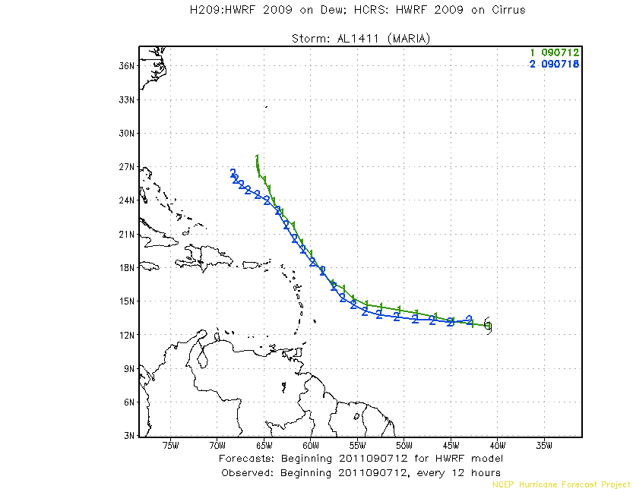
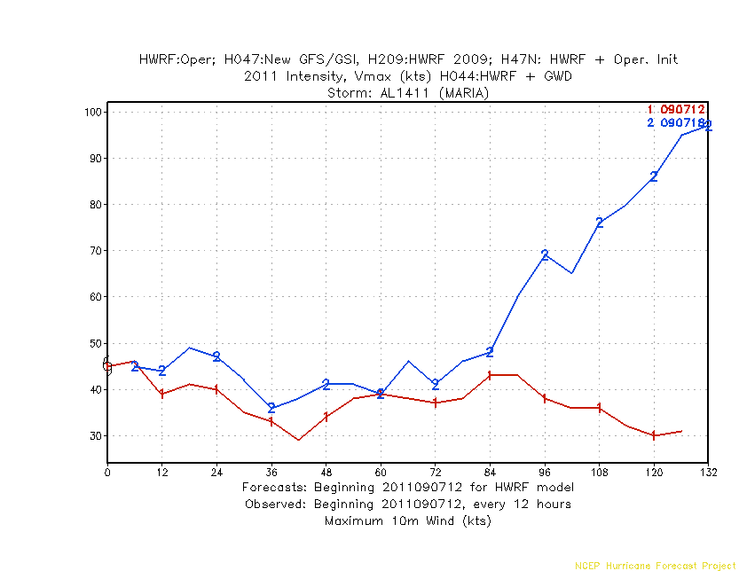
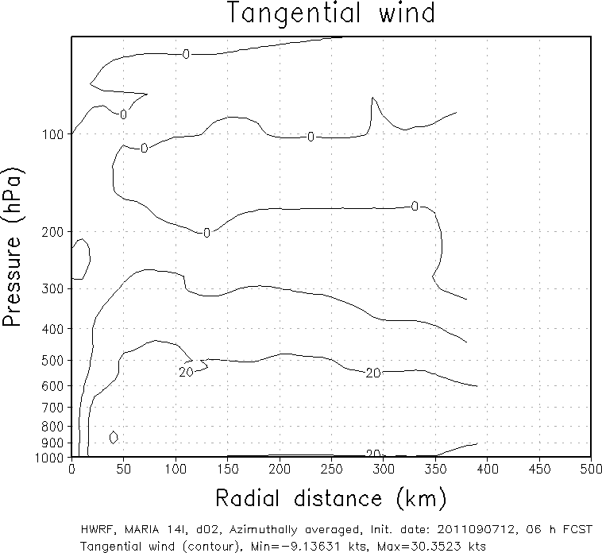
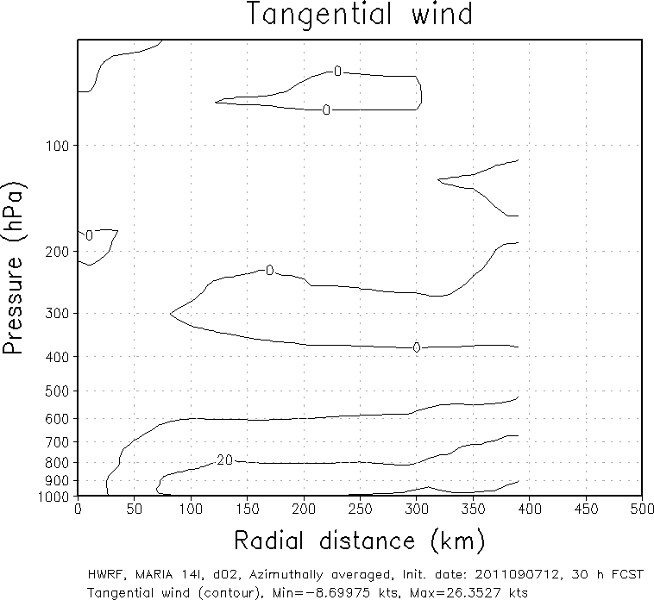
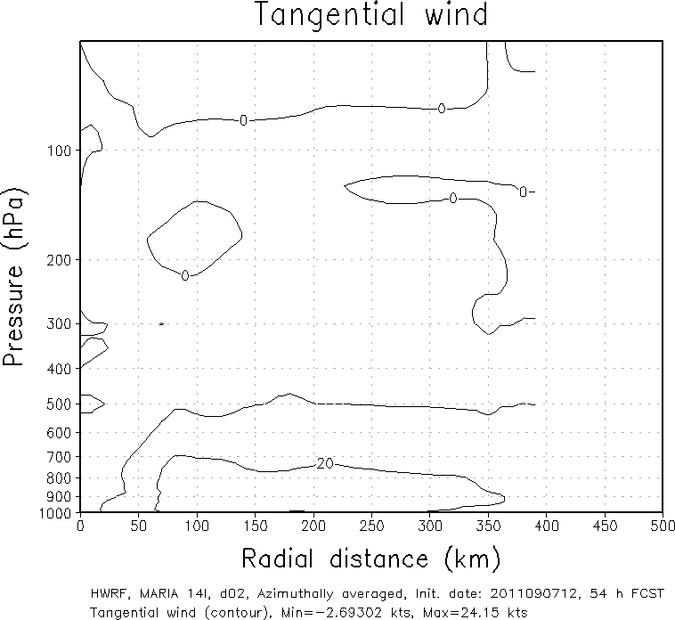
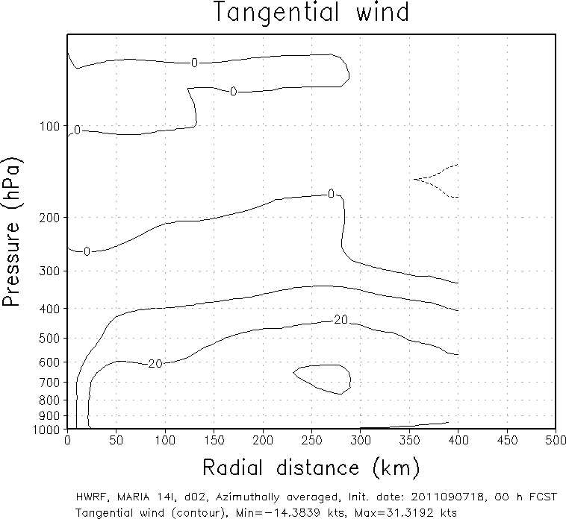
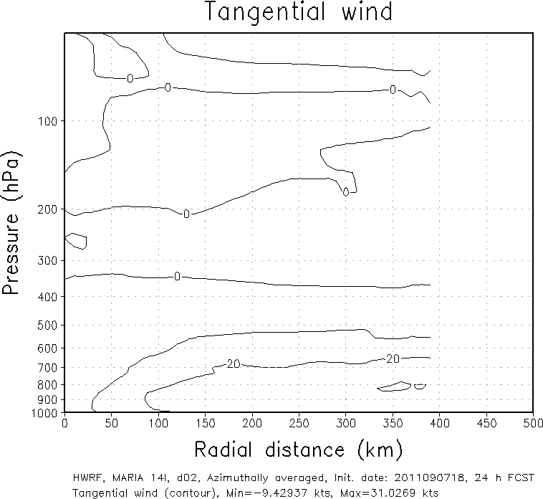
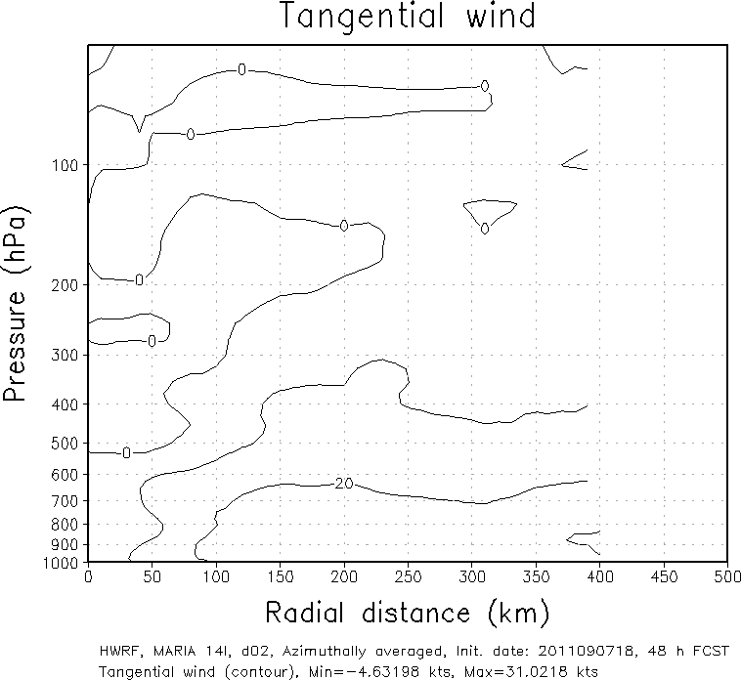
HWRF forecast results (from 07 SEP 12 UTC and 18 UTC)
Developing
Non
Developing
Initial time: 07 SEP 12 UTC (non developing)
Initial time: 07 SEP 18 UTC (developing)
Developing system has the bigger storm size at initial.
It keeps the bigger size during the whole forecast period
Initially bigger storm size
bigger storm size
bigger storm size
2011090718
2011090818
2011090918

Slide 20
Schematic of the unified hybrid system
HWRF
Preprocessing:
LBC- from GFS
HWRF
Post-processing
HWRF
Forecast
Ensemble member
HWRF
Preprocessing:
IC - regional
Observations:
Conventional , satellite and inner-core
HWRF
GSI
Global and Regional Shared EnKF/hybrid DA solvers
GFS deterministic/ensemble analysis and forecast system
Data flow in the current HWRF system
In GREEN : Current HWRF system, cycling with GSI DA
In PINK : Shared between HWRF and GFS systems
Data flow in the unified system

Slide 21
Operational Requirements for regional hybrid system
Regional Modeling Framework
Triple nested (27/9/3) high-resolution HWRF
Unified Ensemble generation method (EnKF):
Perturbations for large-scale (outer domain)
Perturbations for vortex-scale (9km and 3km domains)
Observational operators:
Should be supported by operational GSI
Meet the requirements
Development and T&E
Integrated Global-Regional system with support from DTC
Collaborators working on the unified system through shared repository
EMC will provide guidance on test cases and evaluation metrics for hurricane applications

Slide 22
Timelines
Concept
Agree upon the common approach for Global-Regional Unified Hybrid System
Design
Identify “methodologies” and “tools” required for regional applications (e.g., how to handle moving nests)
Experimentation
Have a prototype system ready for retrospective testing (Stream 1.5)
Real-time Demo
Participate in Real-Time Demo during 2012 hurricane season

Slide 23
Hybrid ensemble-variational data assimilation for HWRF - ongoing efforts and plan
Mingjing Tong¹
Collaborators: David Parrish ², Daryl Kleist², Russ Treadon², Wan-Shu Wu², John Derber²
Xuyang Ge¹, Fuqing Zhang⁴
Zhan Zhang³, Vijay Tallapragada²
¹UCAR (NCEP/EMC), ²NOAA/NWS/NCEP/EMC, ³IMSG (NCEP/EMC), ⁴PSU

Slide 24
Hybrid Ensemble-3DVAR System for HWRF
Current HWRF hybrid ensemble-3DVAR DA system is one way coupled system
Ensemble perturbations can be either from global EnKF-3DVAR hybrid system ensemble forecasts or independent HWRF ensemble forecasts
Ensemble perturbations in vortex area can come from a TC vortex library (Pseudo ensemble hybrid method, more later)
Ensemble covariance is incorporated as part of the background error covariance though extended control variable method (Lorenc 2003; Buehner 2005; Wang et al. 2007)

Slide 25
Global hybrid EnKF-3DVAR ensemble forecast member 1
observation
Global hybrid EnKF-3DVAR ensemble forecast member 2
Data assimilation
Global hybrid EnKF-3DVAR ensemble forecast member N
GSI
HWRF vortex initialization
Data thinning, quality control
global forecast vortex
Iterative minimization
GDAS forecast
global forecast environment
126 hr forecast
first guess
HWRF modified vortex
Relocation, size correction, intensity correction, adjust mass fields
HWRF 6 hr forecast
HWRF environment
HWRF Initialization

Slide 26
Ongoing effort
Testing and tuning the one way coupled hybrid system using global ensemble
Testing and improving the pseudo-ensemble hybrid data assimilation

Slide 27
Plans
The one way coupled hybrid system has the potential to be implemented within the current operational environment.
No much more computational cost is added by using PEDA. No need to worry about moving nests.
More hybrid test and comparison will be done for interested storms.
Will test new options in GSI hybrid code, e.g. using vertical integrated ensemble control variable α for Ps, spatially varying weighting parameter β₁⁻¹.
.

Slide 28
Plans
Improve the TC library for PEDA, e.g. including size variability in the TC library.
Will soon move on to higher resolution HWRF (27-9-3 km). Future PEDA test will be mostly done on higher resolution HWRF.
Plan to run real-time one way coupled hybrid parallel next hurricane season
Will start to build the two way coupled hybrid system for HWRF

Slide 29
Two way coupled HWRF hybrid system
EnKF
HWRF ensemble forecast member 1
analysis member 1
HWRF ensemble forecast member 1
Recentered analyses
HWRF ensemble forecast member 2
analysis member 2
HWRF ensemble forecast member 2
HWRF ensemble forecast member N
analysis member N
HWRF ensemble forecast member N
HWRF vortex initialization
global forecast environment
first guess
GSI hybrid analysis
Control forecast
Modified HWRF control 6hr forecast vortex
(optional)

Slide 30
Observations
Global models continue outperform regional models in track forecasts
High-Res global models started showing some skill in intensity forecasts
COAMPS-TC had better intensity forecast skill but with poor track forecasts
3km HWRF performed reasonably well, better intensity skill compared to operational HWRF
SHIFOR had better skill than any Statistical/dynamical and regional models for 2011.
Regional models suffered from high intensity bias – performed better for strong storms compared to weak storms
Model diagnostics and use of vortex-scale observations gained more attention with emphasis is on interactions between vortex and environment.

Slide 31
Observations
Stream 1.5 timelines advanced by about 2-4 months – heavily impact developmental efforts.
NHC’s definition of Stream 1.5 differs from what was originally thought of. “Operational pathway” is not a necessary condition!
Unification of regional hybrid may not happen until 2013.
Future of HFIP beyond 2013 is uncertain.
Delay in HFIP AO announcement of awards could affect and impact developmental efforts at EMC.
HWRF started gaining some respect, attention and big support from NHC.
Implementation plans of 3km HWRF into operations in FY2012 are well received.
NHC does not care how we provide intensity forecasts from regional models – they still believe that track and intensity errors are separable (from forecast perspective), may not be applicable for model improvements.
We need to revisit how we represent vmax in our models compared to best track data (representativeness, spatial and temporal scales, high-frequency oscillations, off-setting for late models etc.)

