Slide 1
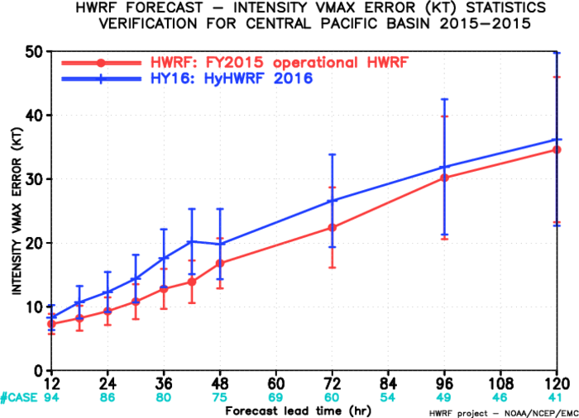
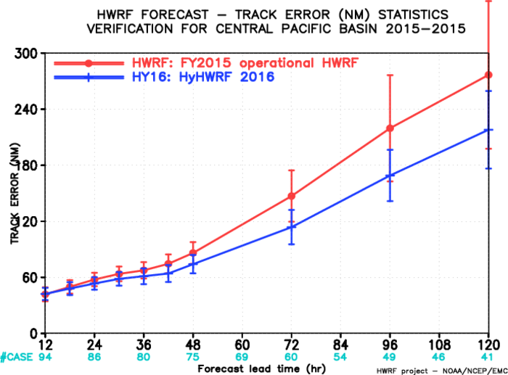
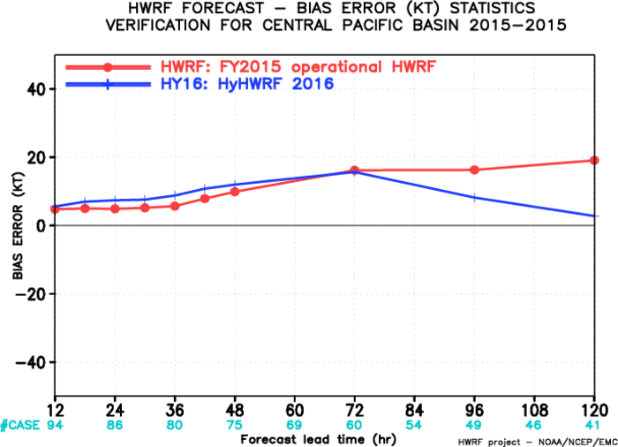
Central North Pacific
HY16 vs. HWRF
94 cases
Vmax MAE
Track MAE
Vmax bias

Slide 2
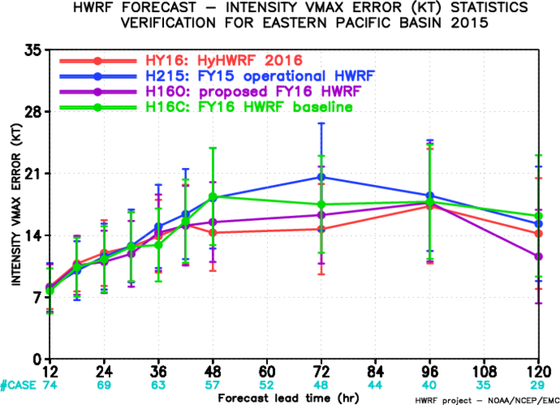
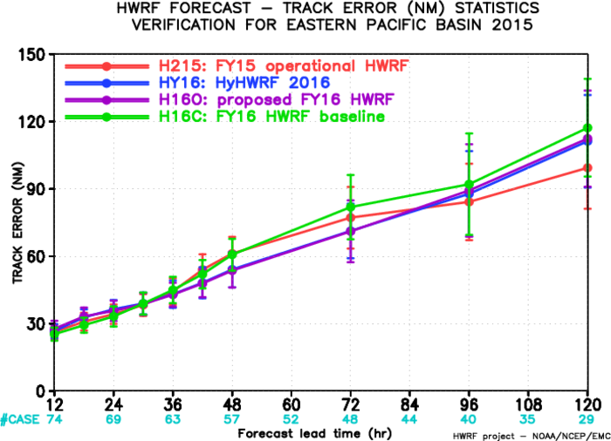
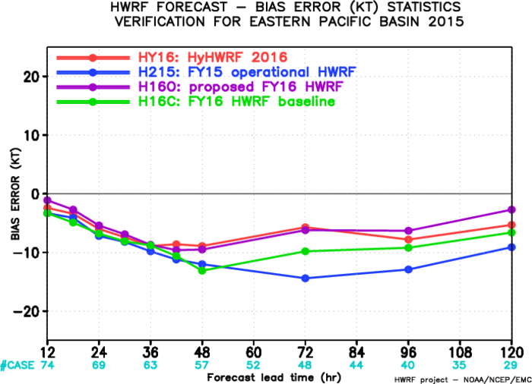
Eastern North Pacific
HY16
74 cases
Vmax MAE
Vmax bias
Track MAE

Slide 3
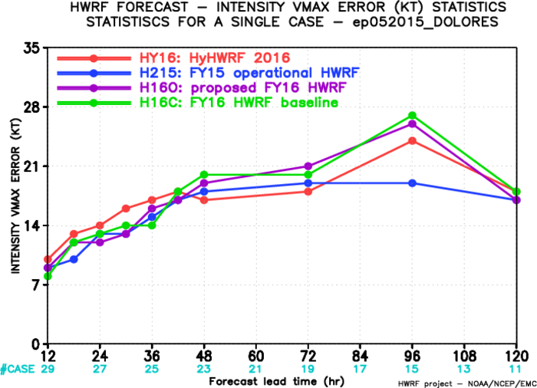
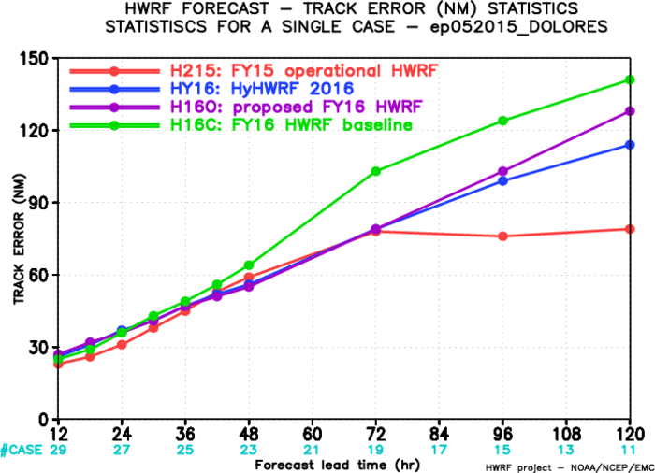
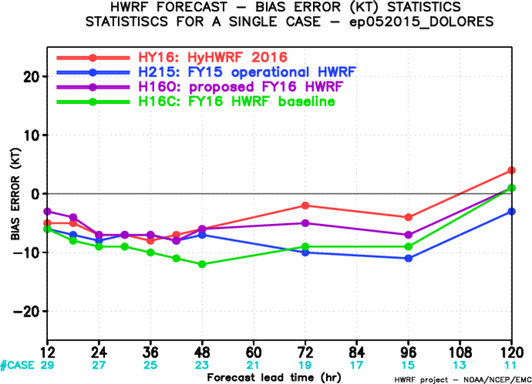
Eastern North Pacific: Dolores (05E)
HY16
29 cases
Vmax MAE
Vmax bias
Track MAE

Slide 4
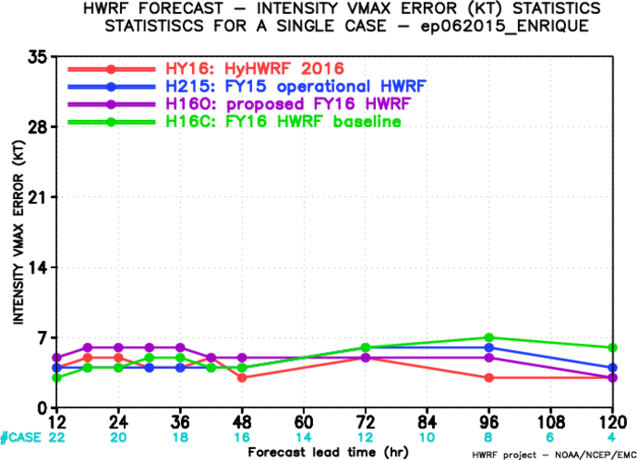
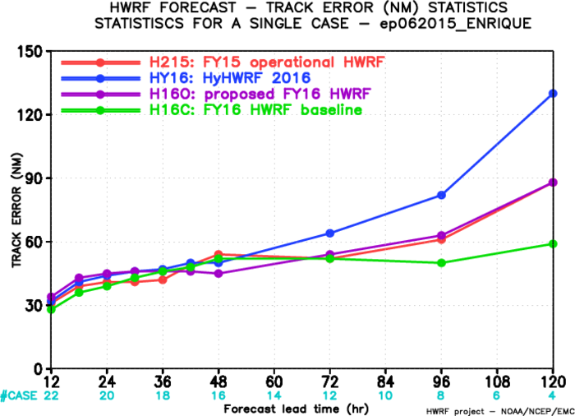
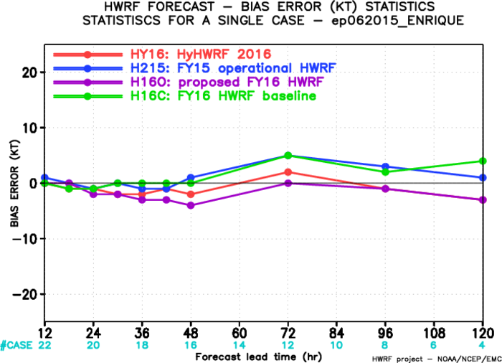
Eastern North Pacific: Enrique (06E)
HY16
22 cases
Vmax MAE
Track MAE
Vmax bias

