Slide 1
Meeting Agenda
Status report on final retrospective runs
H216 HYCOM update (Hyun-Sook)
Update on RTOFS initialization for EP storms

Slide 2
Difference between H216 and H16O
Impact on Al storms:
New tracker vs. old tracker;
Two more vertical levels (L61 vs L63) and stratosphere dw/dt damping;
Additional impact on EP storms:
RTOFS ocean initialization for EP storms;
DA for all EP storms;
No Impact:
One-way coupling to Wave;
Post process, New grib2 output;
AWIPS output;

Slide 3
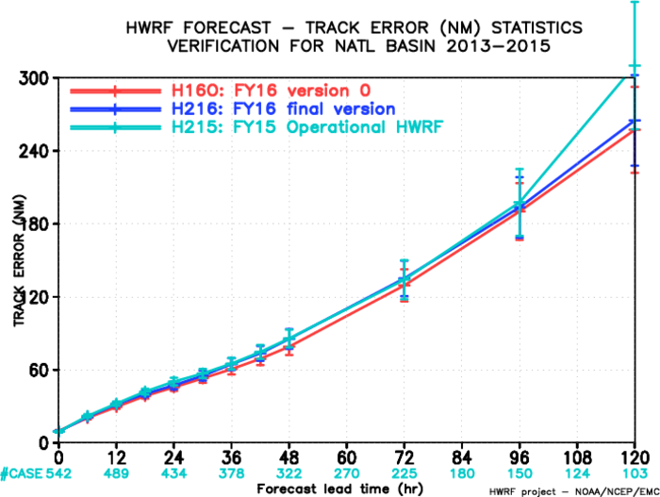
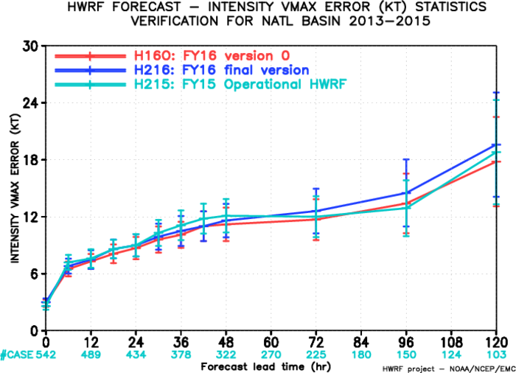
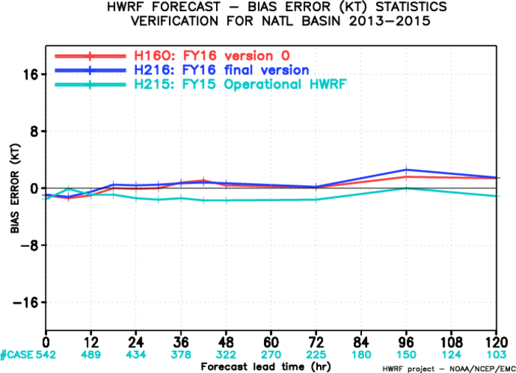
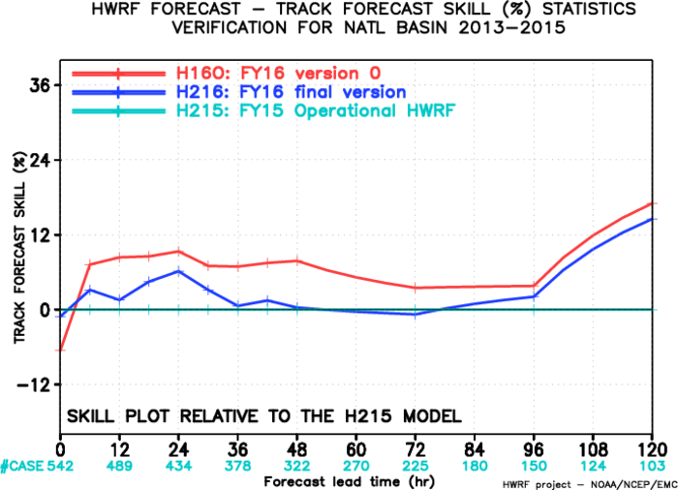
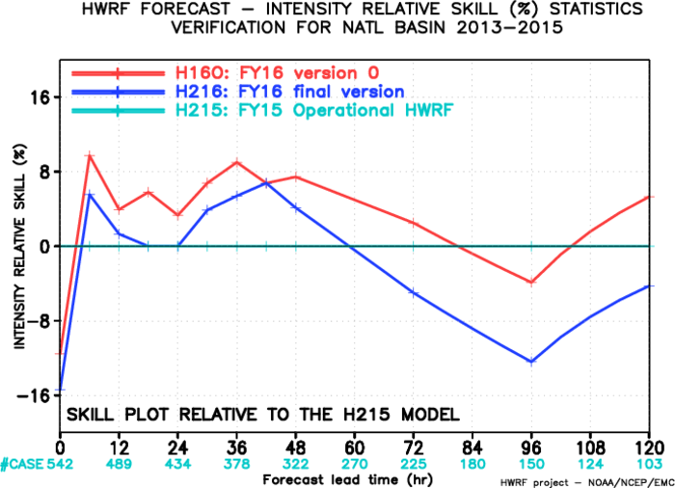
H16O vs H216, AL

Slide 4
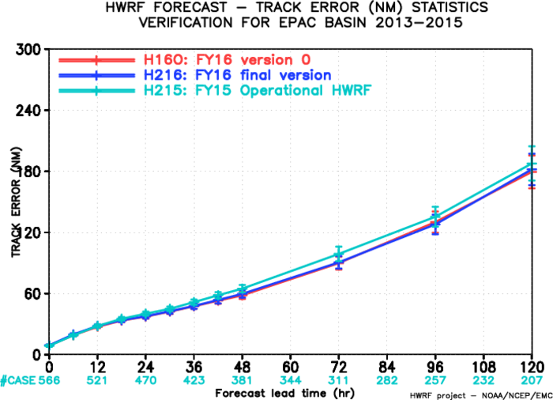
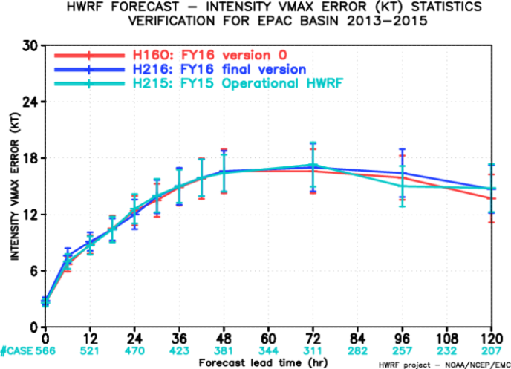
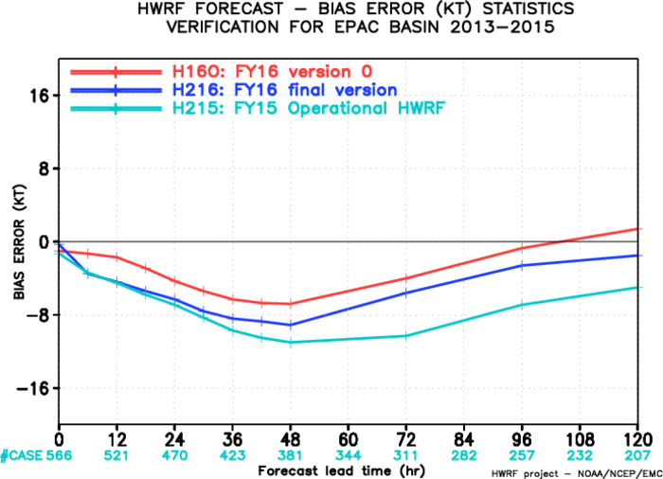
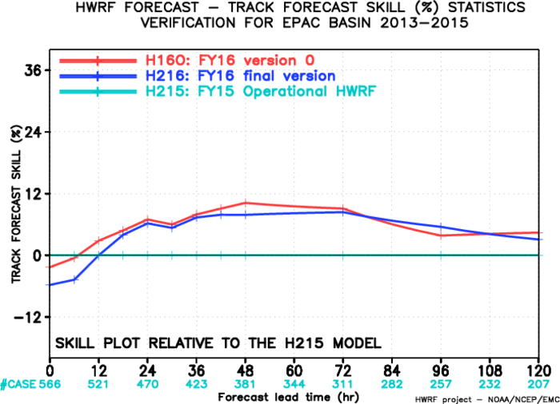
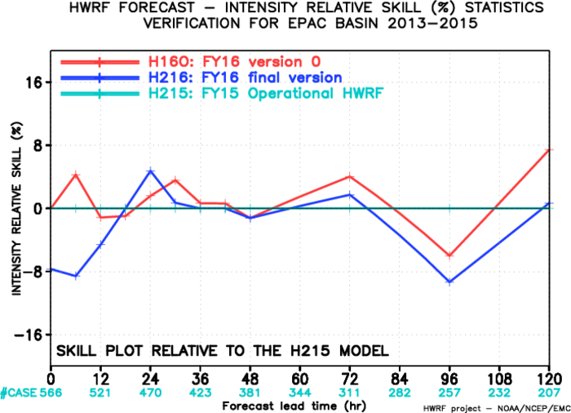
H16O vs H216, EP

Slide 5
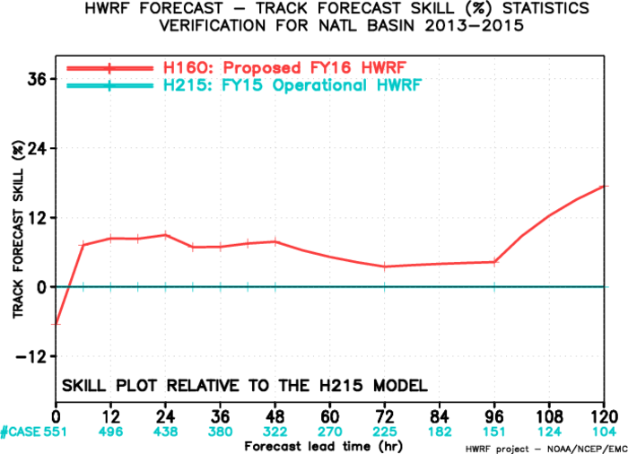
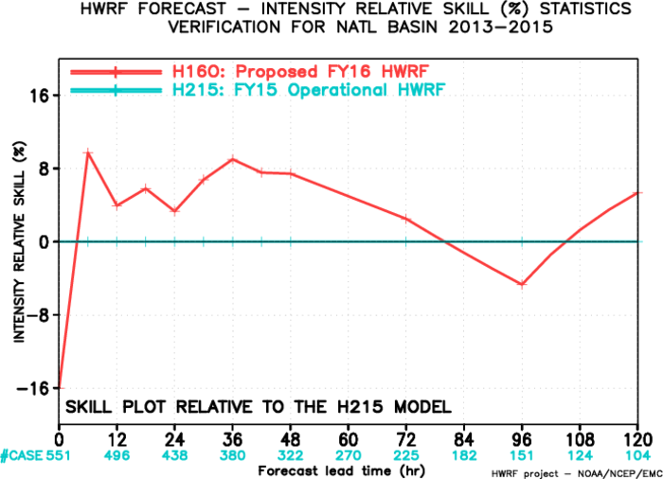
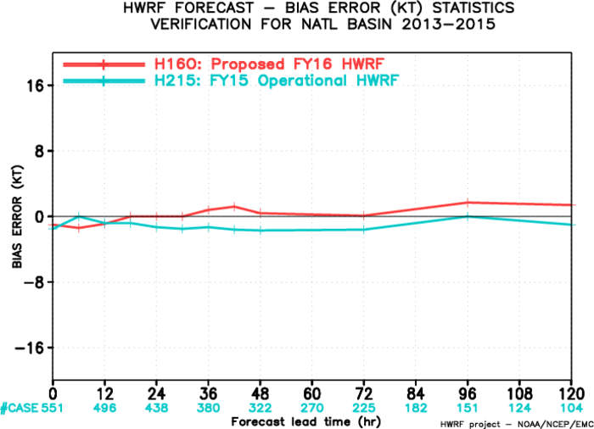
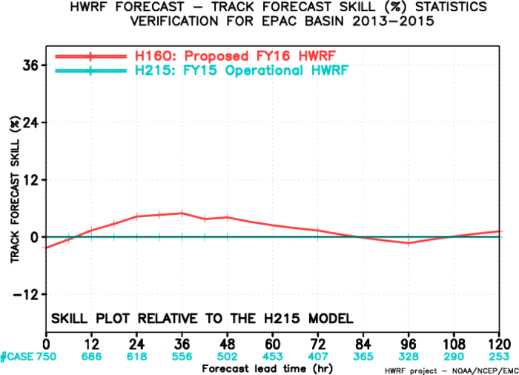
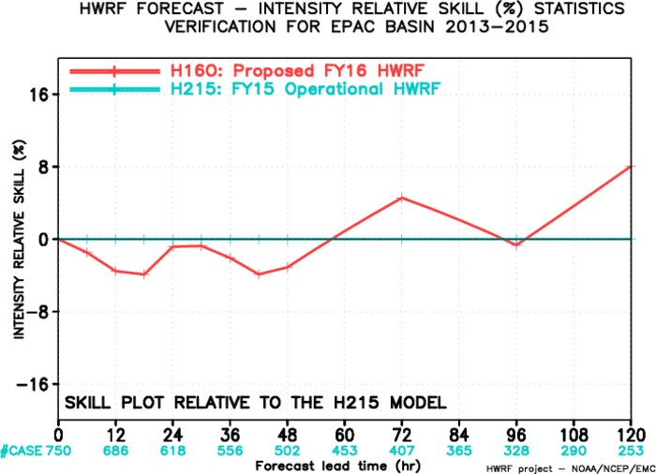
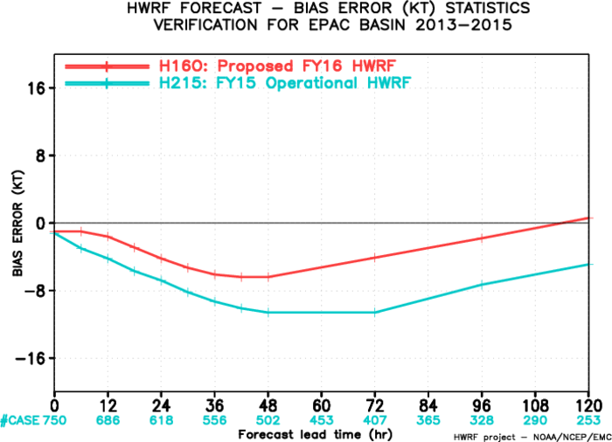
Verification of Proposed FY16 HWRF Implementation
Retrospective Runs for 2013-2015 AL/EP Storms
Atlantic Basin
Track skill improvement/degradation
Intensity skill improvement/degradation
Intensity bias improvement/degradation
East Pacific Basin
Track skill improvement/degradation
Intensity skill improvement/degradation
Intensity bias improvement/degradation

Slide 6
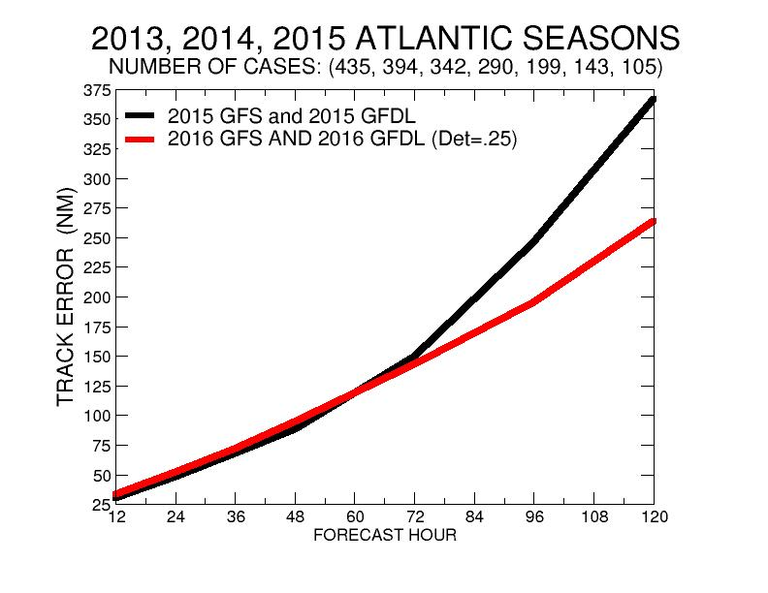
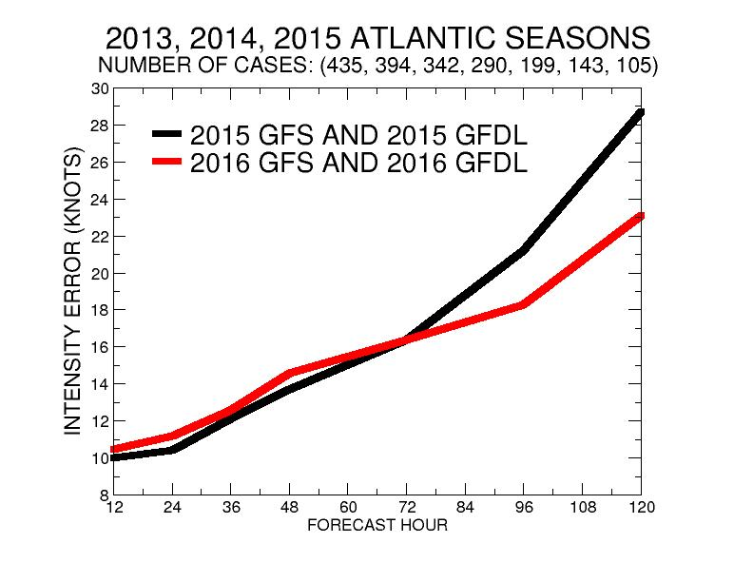
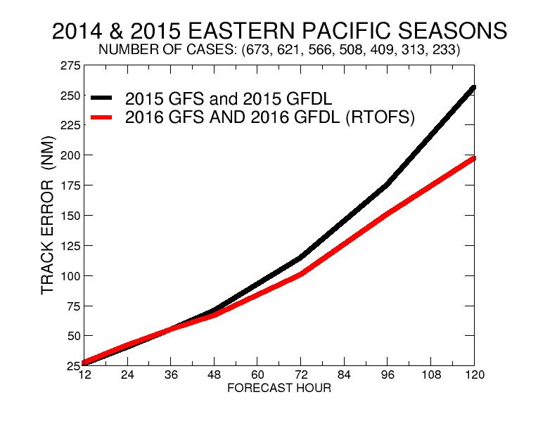
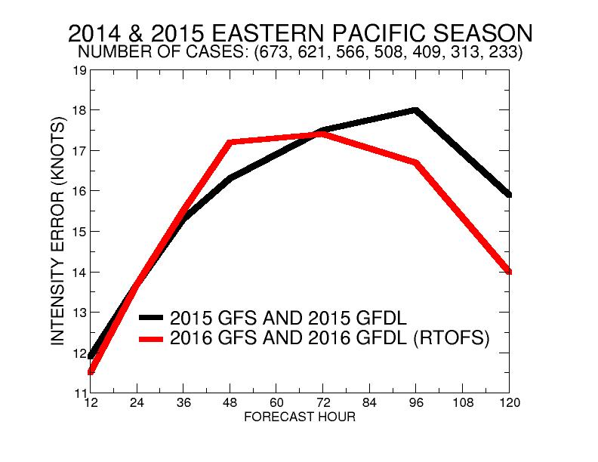
GFDL FY15 vs FY16 Verification

