Slide 1
Testing the MYJ Mixing Scheme Coupled with the GFDL Flux Scheme in the HWRF Model
The NOAA HWRF TEAM
Presented at
The EMC Internal HWRF Meeting
3 May 2012

Slide 2
What does the ABL Mixing scheme do?
Sub-grid turbulence transports temperature, moisture and
momentum (+ tracers).
Attempts to integrate effects of sub-grid scale turbulent
motion on prognostic variables at grid resolution.
Operational measure for success: correct model output on the grid-resolved scales everywhere in the model domain.
Scientific measure for success?
Challenge: The simulated turbulent mixing is quite dependent on the definition of the ABL depth and the parameterized description of the intensity
of the sub-grid turbulence!

Slide 3
The MYJ ABL Mixing Scheme
K-theory, 1.5-oder turbulent kinetic energy (T.K.E.)
prognostic equation with non-singular realization
where E = T.K.E. from the following prognostic equation:
Pressure correlation
Local
change
Shear production
Buoyancy
Turbulent
transport
Dissipation

Slide 4
How to Couple the MYJ Mixing Scheme with a Surface Flux Module
The MYJ ABL mixing scheme takes the surface physical properties as the lower boundary condition, instead of the vertical fluxes of the properties.
When coupling with Janjić’s two-layer surface scheme (default in NMM):
MYJSFC is called to calculate surface fluxes, obtain K_{M} and K_{C} at the lowest
model level corresponding to the surface fluxes, and diagnose the ABL depth.
When coupling with the GFDL model (new option for the HWRF model):
GFDLSFC is called to calculate surface fluxes. Then, a GFDL flux wrapper is
called to obtain K_{M} and K_{C} at the lowest model level corresponding to the GFDL
surface fluxes, and to diagnose the ABL depth.

Slide 5
Comparison of K_{M}: the MYJ Scheme vs the GFS Scheme

Slide 6
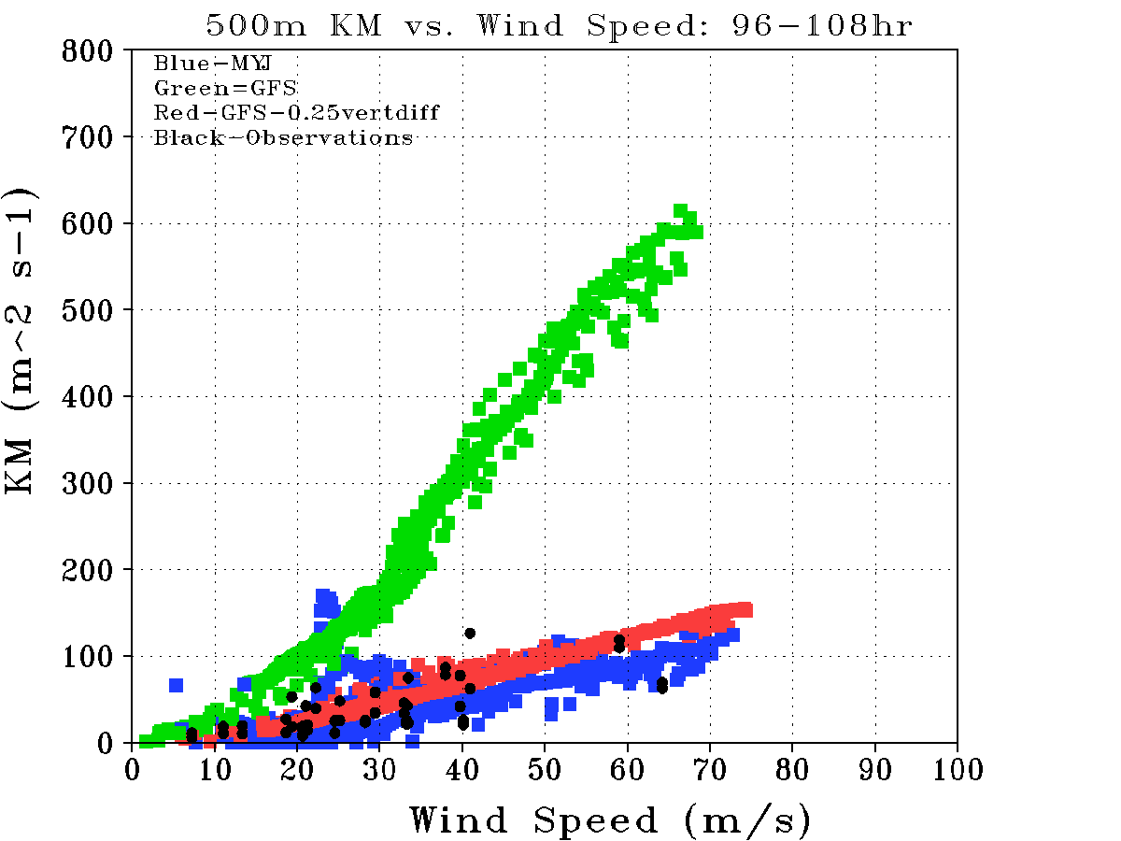
Comparisons of vertical eddy diffusivities
with observational estimate at 500 m AMSL

Slide 7
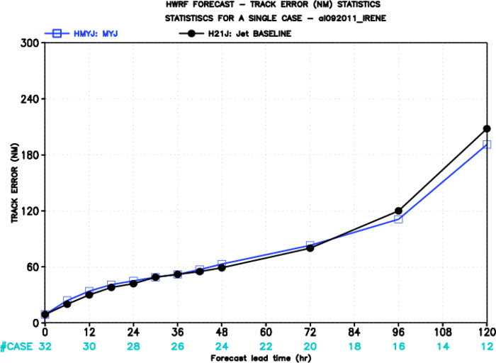
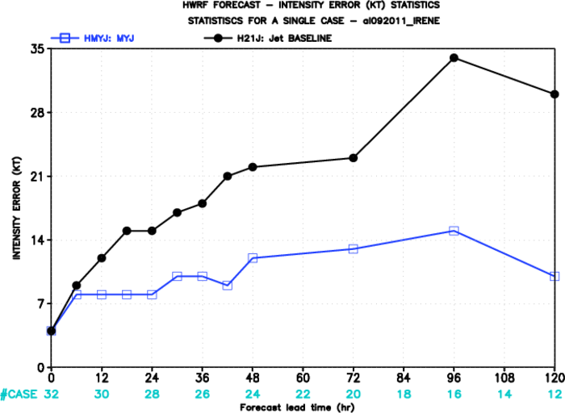
IRENE (2011)

Slide 8
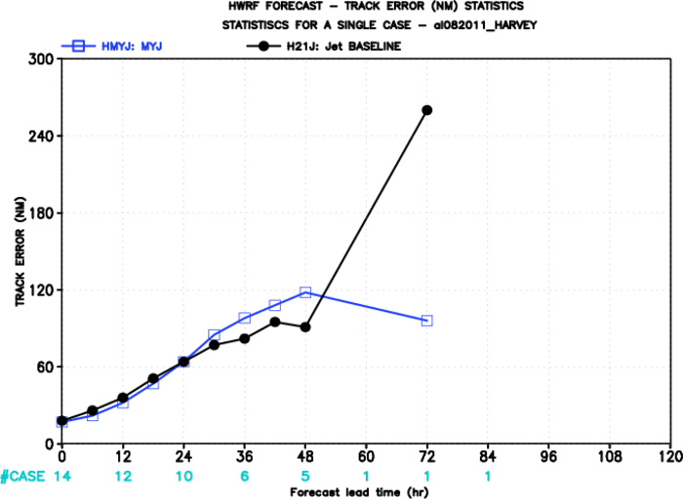
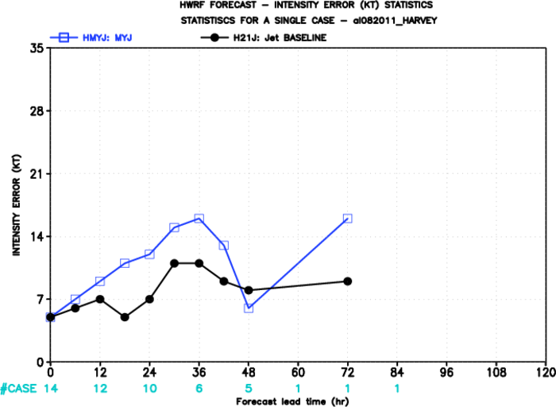
HARVEY (2011)

Slide 9
Future Work
Finish up the testing runs for all the priority cases
Refine the code to have a distinct option of MYJ ABL + GFDL SL in the namelist file
Evaluate the diffusivities from the MYJ mixing scheme using observational estimates
Evaluate the average R-Z structure of the simulated TCs by comparing to observations
Possible adjustment of the surface scheme to improve the overall performance of the MYJ ABL + GFDL SL package in terms of the intensity statistics

