Slide 1
Planned HWRF Physics upgrades in 2016

Slide 2
Module | Highlights | Improvements
Surface Layer | Use 10m wind to cal cd/ch Remove empirical correction Update Cd, Ch for V >20m/s | independent of z grid Better low level wind Closer to observations
PBL | Replace old GFSPBL with latest GFS-edmf PBL Add obs-based K adjustment Improve (2), remove discontinuity of K profile | Better representation of CBL/SBL Better low level wind Better simulation of storm intensification
Convection | Scale-aware deep/shallow convection scheme | Represent multi-scale convection
Horizontal diffusion | Reduce horizontal length scale ~ 2/3 of that in 3-km HWRF. | Consistent with higher resolution
Microphysics 1 adv Ferrier_hires 2 Thompson MP | Advect individual hydrometers good Ice physics | Tech issue, next year tests not yet done

Slide 3
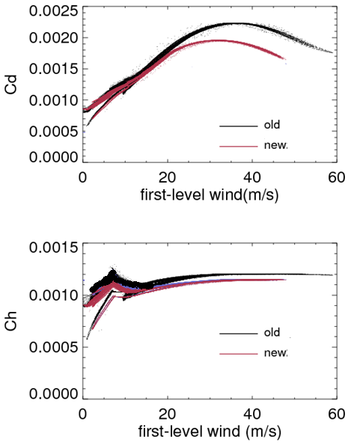
Surface-layer
Cd and Ch
Reduce Cd for wind > 20 m/s
Ch is reduced by 5%
More consistent with Obs-derived Cd, Ch.
Modify current z0 ~ wind function; Use the standard 10m wind to compute Cd, Ch through z0.

Slide 4


GFS PBL EDMF
Latest version GFS PBL
HWRF2015
Counter-gradient method
to represent nonlocal flux
HWRF2016
Also, TKE-based dissipation heating
Local Eddy Mass Flux

Slide 5
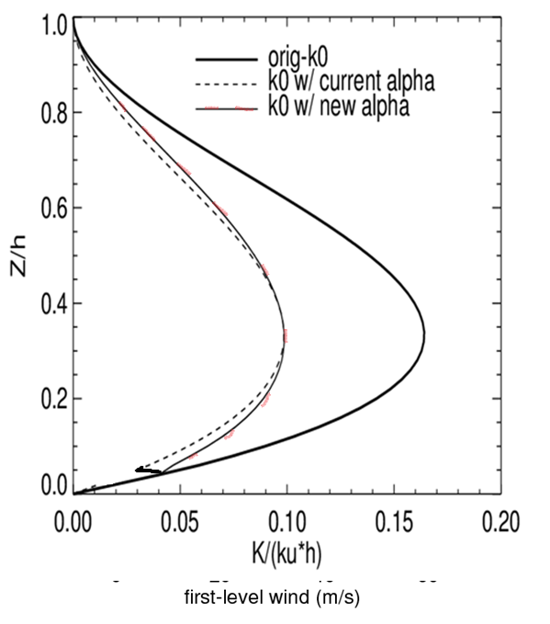
K adjustment
Obs-based
Constant (with z) adjustment, simply multiply K by a coefficient, discontinuous K, big impact on low-level wind.
Fix: height-dependent adjustment so that K is continuous.

Slide 6
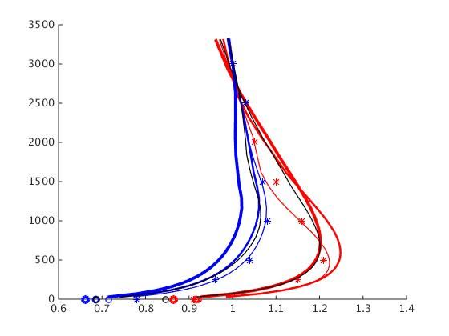
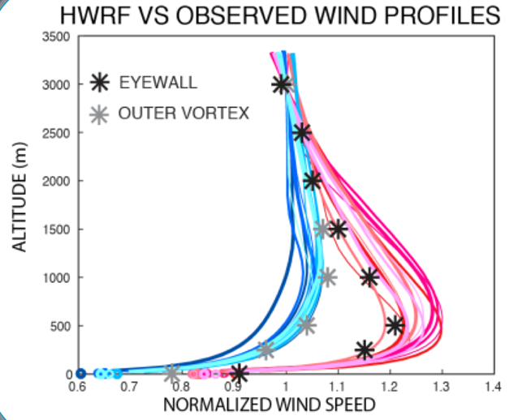
OLD NEW
Upgraded HWRF generates more physically sensible structure.

Slide 7
Scale-aware
convection scheme
For cumulus convection, a scale-aware parameterization will be necessary for the grid sizes of 500m ~ 10 km where the strong updrafts are partially resolved.
Scale function
Based on Arakawa & Wu (2013):
σ_{u}: updraft area fraction (0~1.0)
original cloud base mass flux from AS quasi-equilibrium closure
updated cloud base mass flux with a finite σ_{u}

