Slide 1
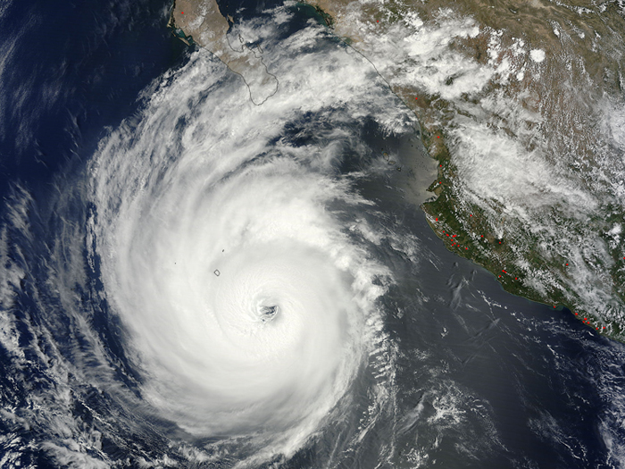
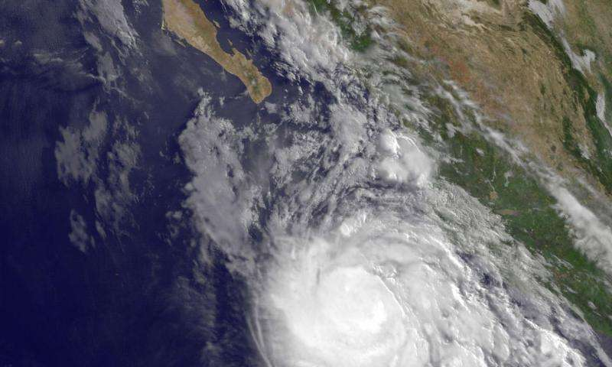
RTOFS impact in GFDL Model for Hurricanes Blanca and Dolores

Slide 2
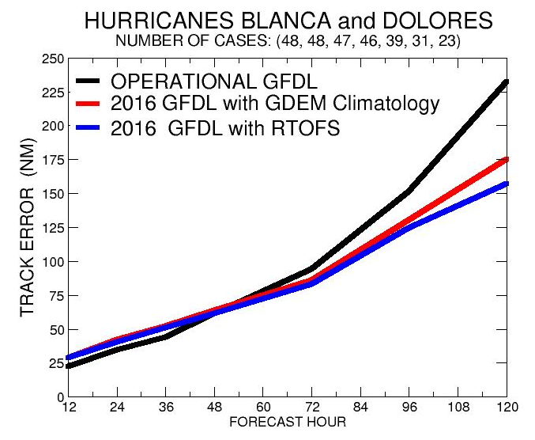
Summary of Impact on Track

Slide 3
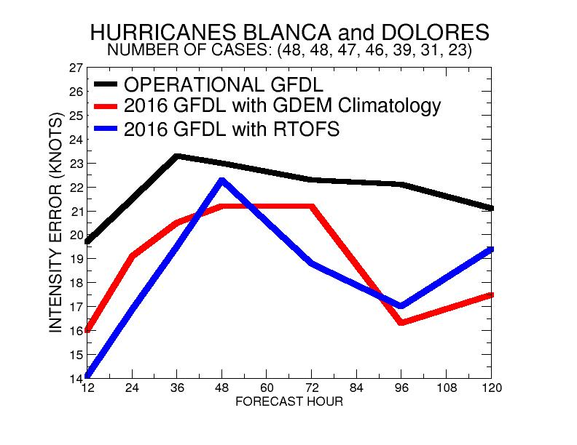
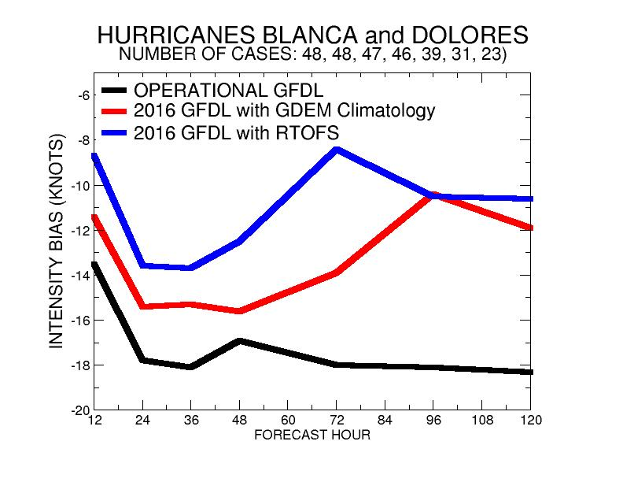
Impact on Intensity Errors and Bias
Much Reduced Negative Bias with
2016 GFDL Run with RTOFS Analysis !!!

Slide 4
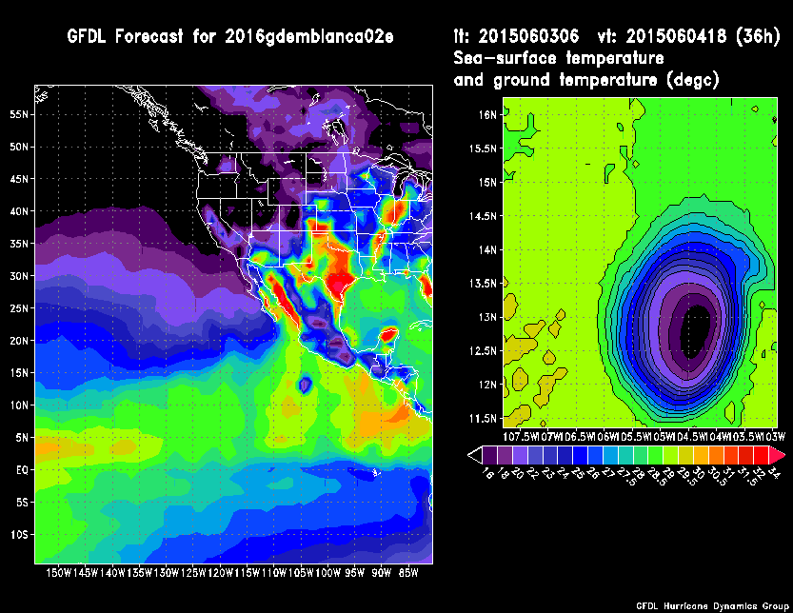
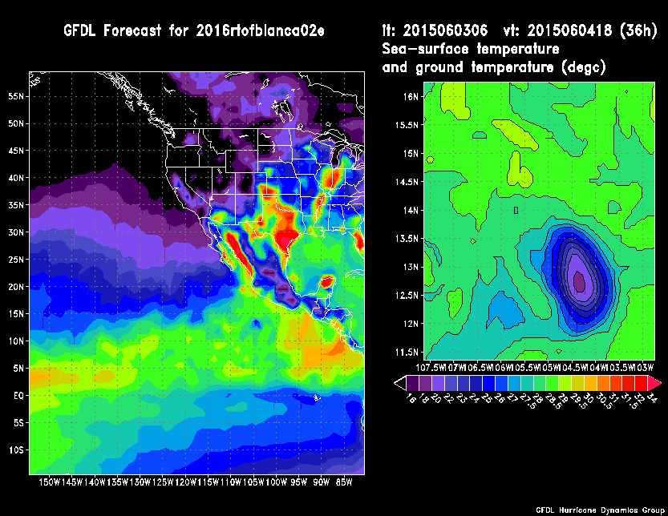
Hurricane Blanca (June 3rd, 6z)
Nest 3 SSTs
GDEM Climatology
RTOFS ANALYSIS
Forecast Hour 36
Forecast Hour 36

Slide 5
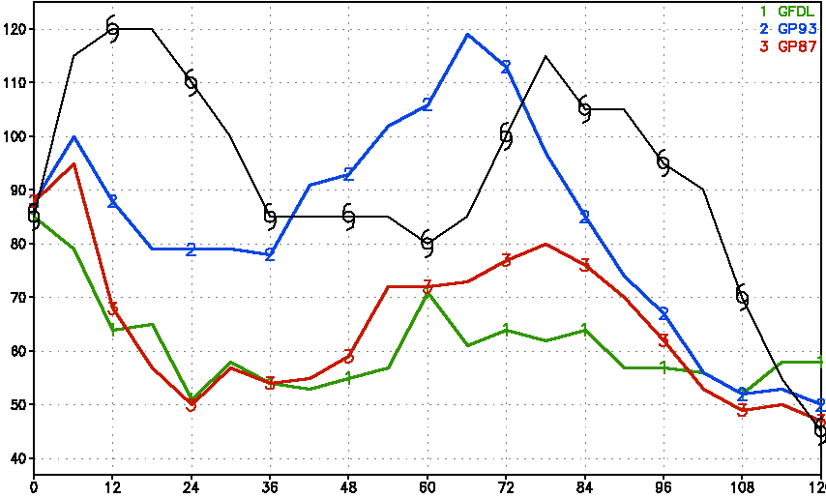
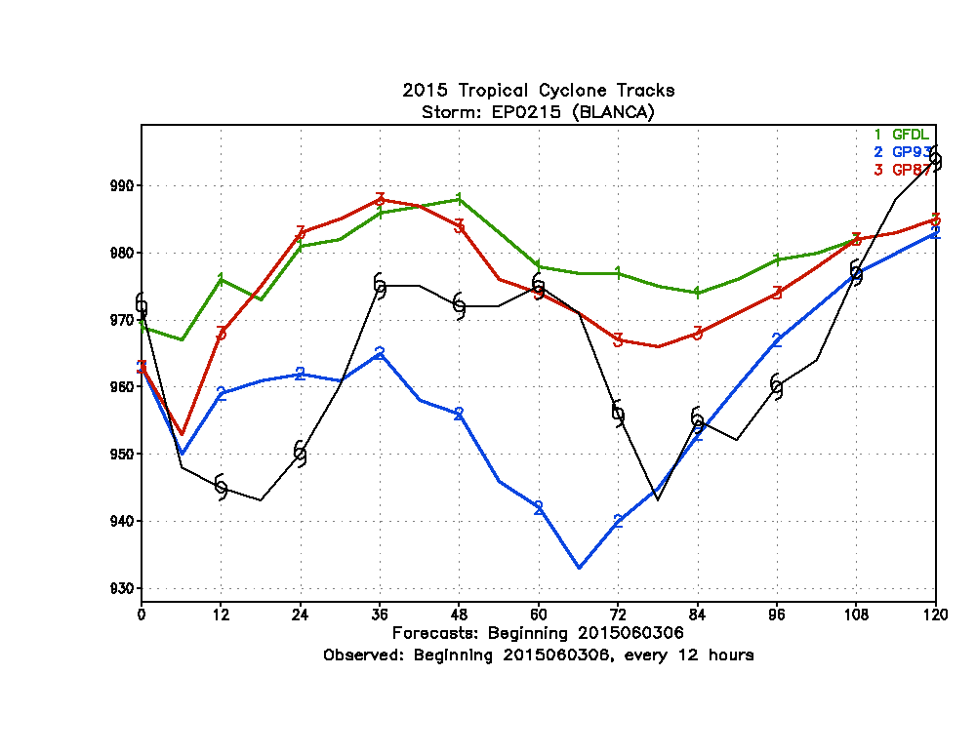
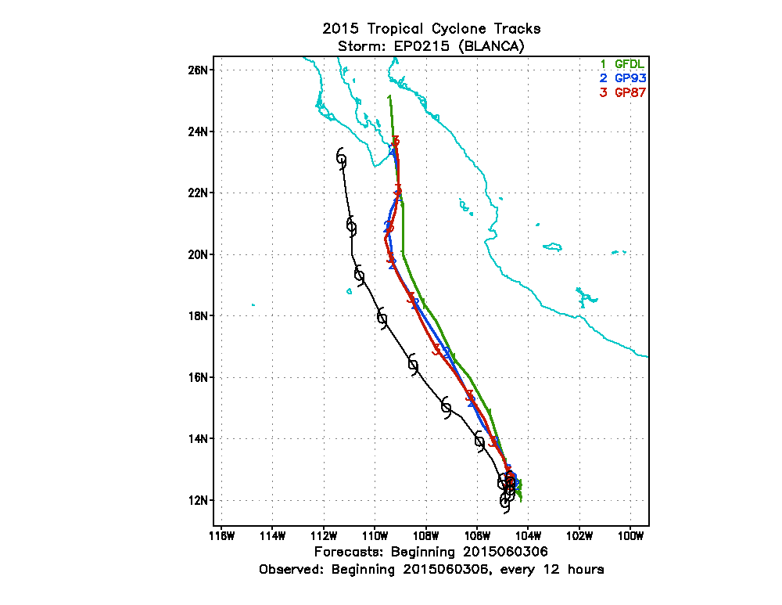
Hurricane Blanca (June 3rd, 6z)
2016
RTOFS
2015
GFDL
2016
GDEM
2016
GDEM
2015
GFDL
2016
RTOFS
Maximum Surface Winds (Knots)
Central Pressure (hPa)

Slide 6
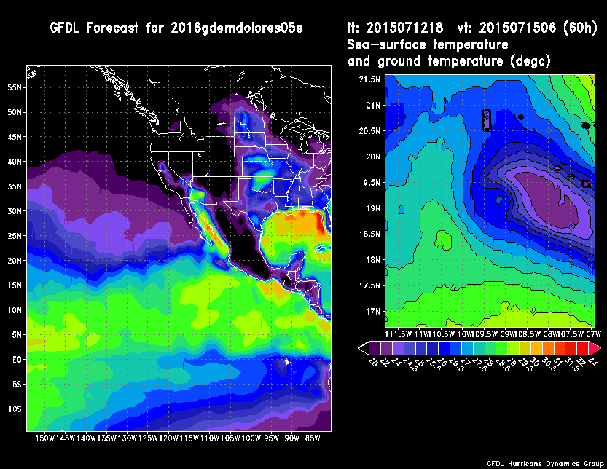
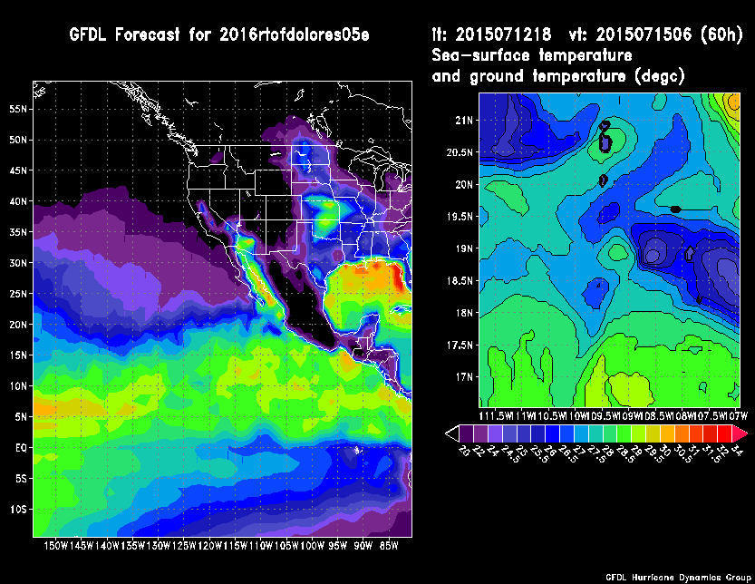
Hurricane Dolores (July 12th, 18z)
Nest 3 SSTs
GDEM Climatology
RTOFS ANALYSIS
Forecast Hour 60
Forecast Hour 60

Slide 7
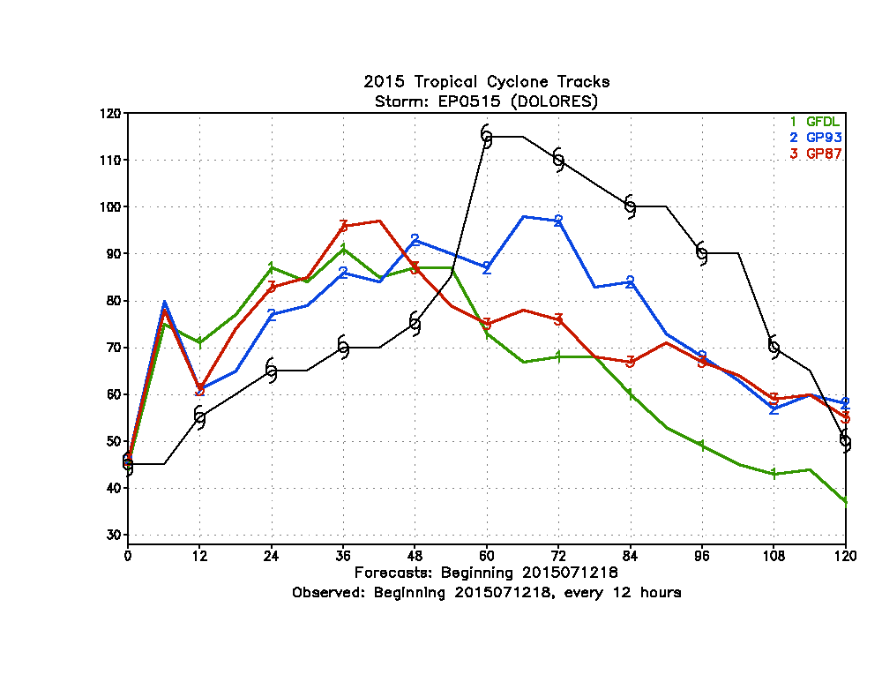
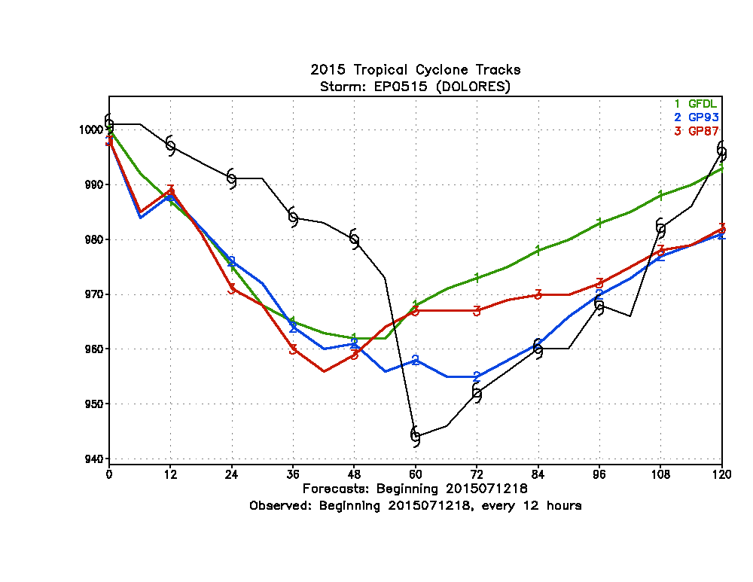
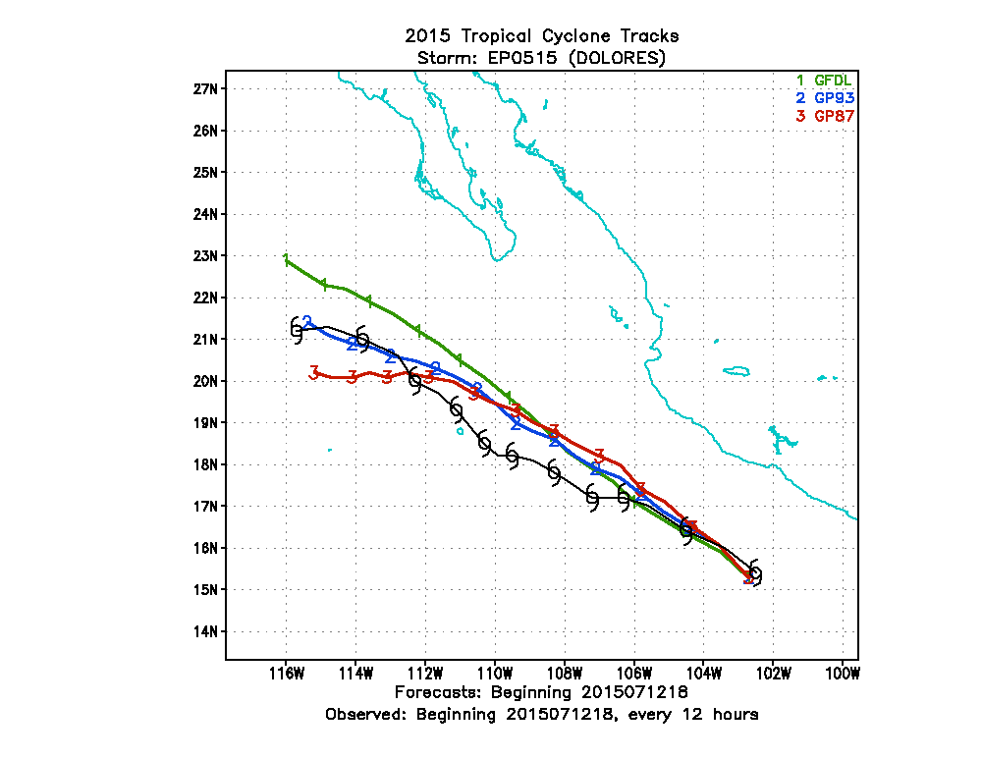
Hurricane Dolores (July 12th, 18z)
2016
GDEM
2016
RTOFS
2015
GFDL
2015
GFDL
2016
GDEM
2016
RTOFS
Maximum Surface Winds (Knots)
Central Pressure (hPa)
2016
RTOFS

