Slide 1
Meeting Agenda
FY16 baseline (H16C) update and combined physics upgrade;
Summary of FY16 GSI upgrades;
Summary of FY16 physics upgrades;
HWRF RTOFS ocean initialization update.
Other issues?

Slide 2
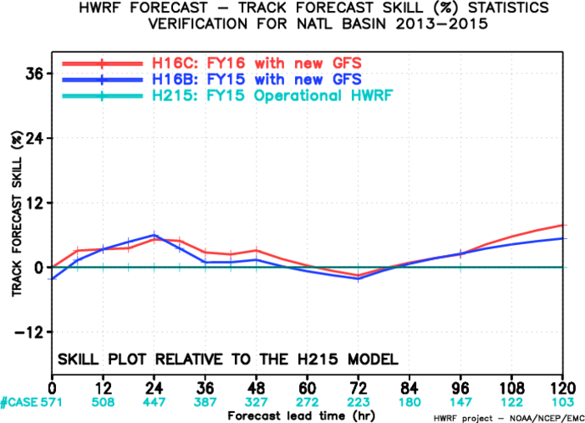
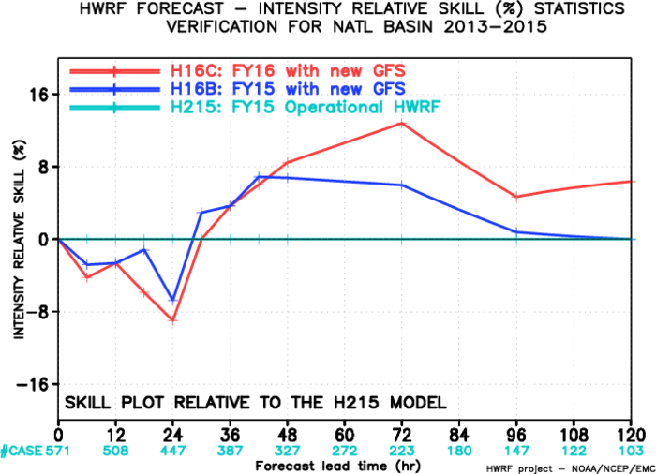
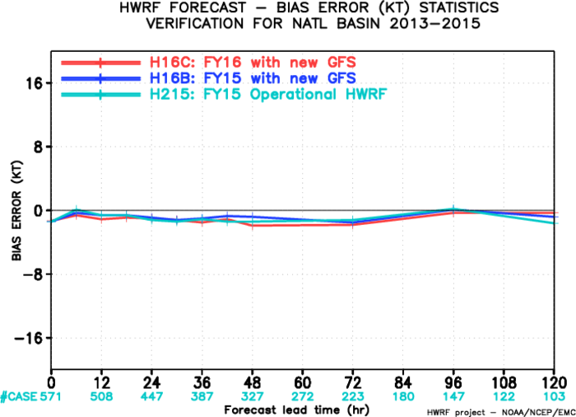
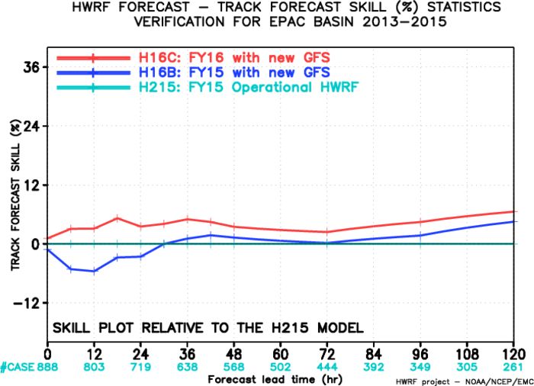
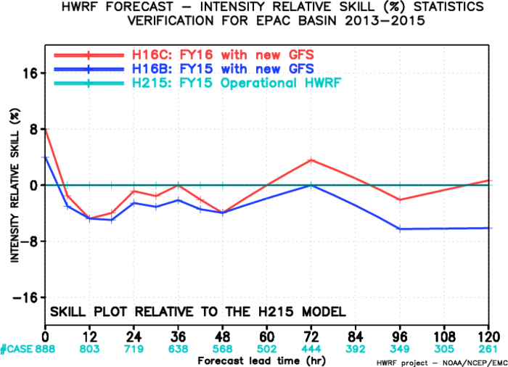
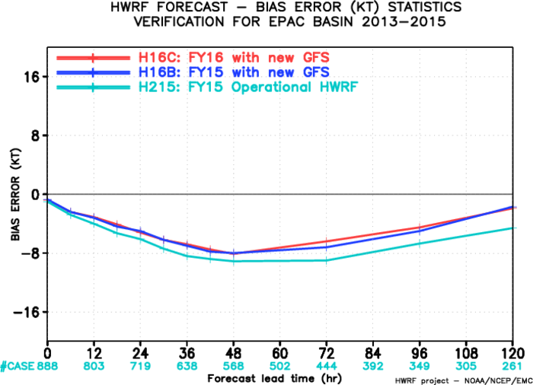
FY16 Baseline, AL/EP
AL-track- skill
AL-intensity- skill
AL-intensity- bias
EP-intensity- skill
EP-track- skill
EP-intensity- bias

Slide 3
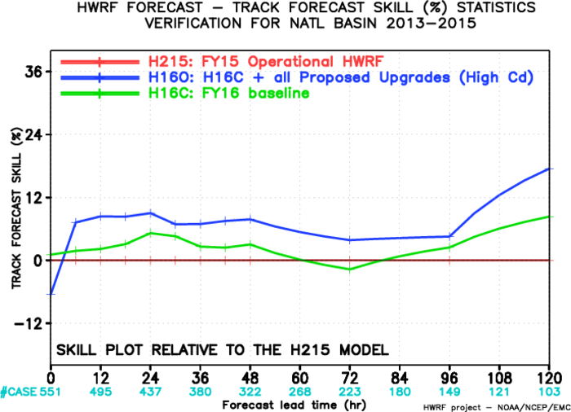
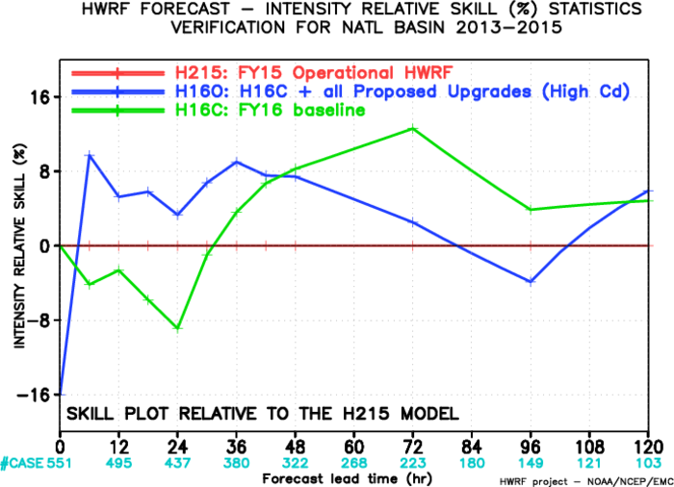
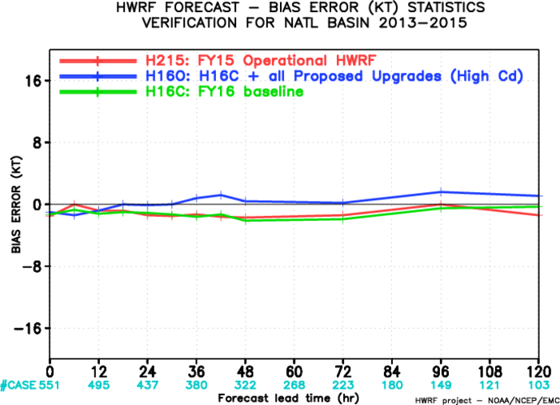
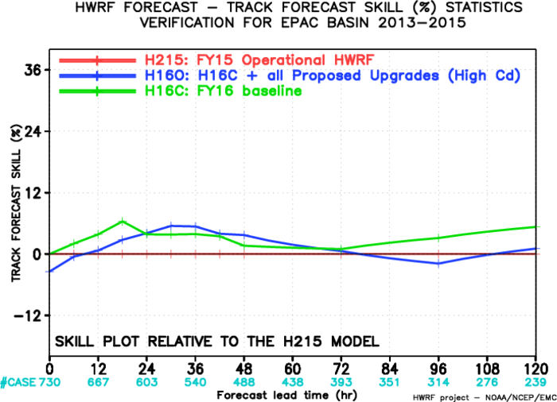
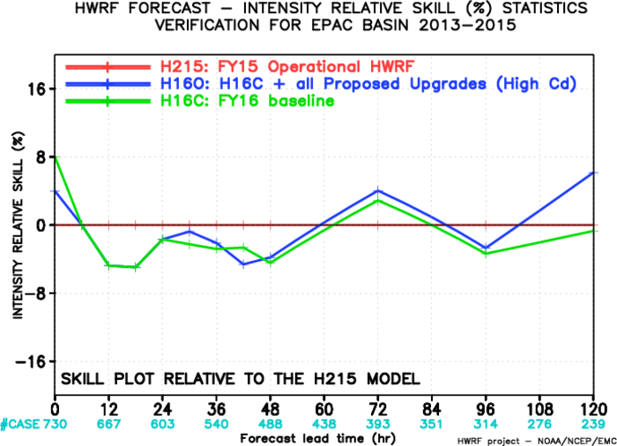
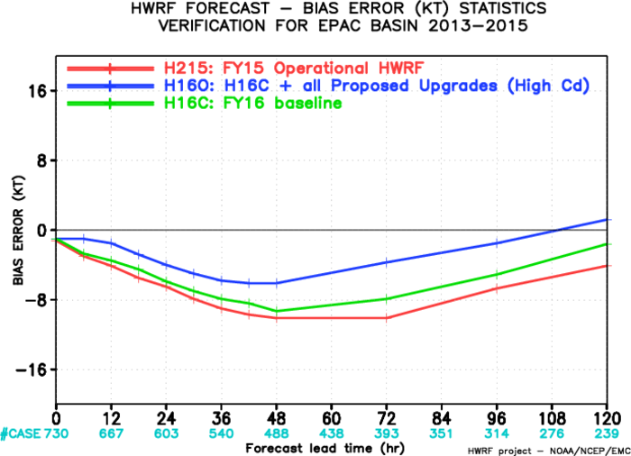
FY16 Physics Upgrade, AL/EP
AL-track- skill
AL-intensity- skill
AL-intensity- bias
EP-track- skill
EP-intensity- skill
EP-intensity- bias

Slide 4
Difference between final version H216 and H16O
Upgraded tracker;
Two more vertical levels (L61 vs L63) and stratosphere dw/dt damping;
RTOFS ocean initialization for EP storms;
DA for all EP storms;
One-way coupling to Wave;
New grib2 output;
AWIPS output;

