Slide 1
FY16 Data Assimilation Upgrades

Slide 2
DA scheme - same ensemble based hybrid DA as 2015
- When TDR data are available, use HWRF ensemble, otherwise use global ensemble
Turn off blending of vortex initialization and GSI analysis for weak storms (Vmax < 50 kts)
Turn on satellite DA on ghost d03
Satellite data usage changes:
a). Adding assimilation of CRIS, SSMIS, Metop-b AMSUA, Metop-b MHS, Metop-b IASI
b). Change from assimilation to monitor: NOAA 19 AMSUA Channel 7; NOAA 18 AMSUB Channel 5, 8; NOAA 19 HIRS4; NOAA 19 MHS channel 3; GOES sounder; SEVIRI Meteosat-10
c). Modified channels used for cloud detection: NOAA 15 AMSUA; Metop-a AMSUA; NOAA 18 AMSUB; HIRS/3; HIRS/4; AQUA AMSUA; ATMS; GOES sounder; IASI
Turn on VarQC in the second minimization loop

Slide 3
Planned/tested
(not implement in 2016)
Turn on DA in EP
IAU
- Need more test
- IAU source code need to pass the WRF code committee review and be committed to the trunk
Cycled HWRF ensemble hybrid DA
- Development close to finish. Will start to test soon
- DA real-time parallel experiment in 2016

Slide 4
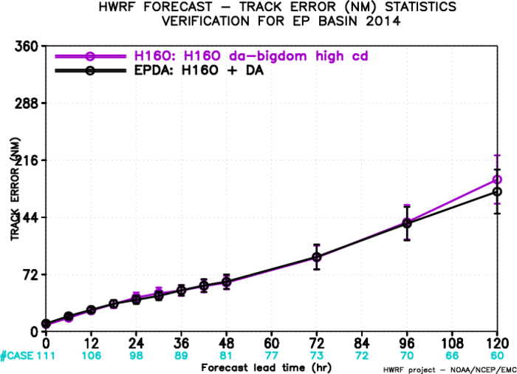
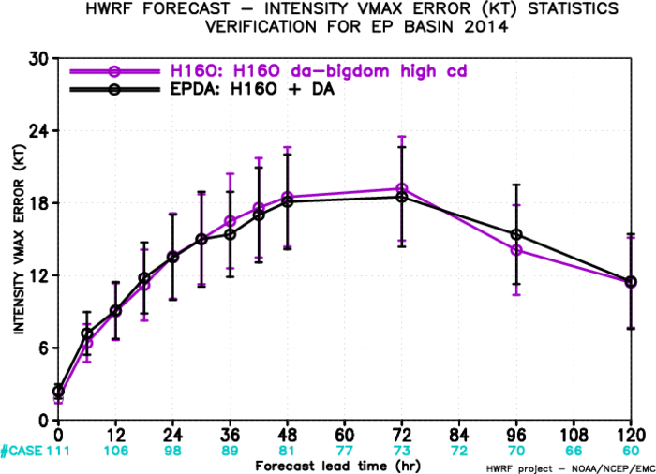
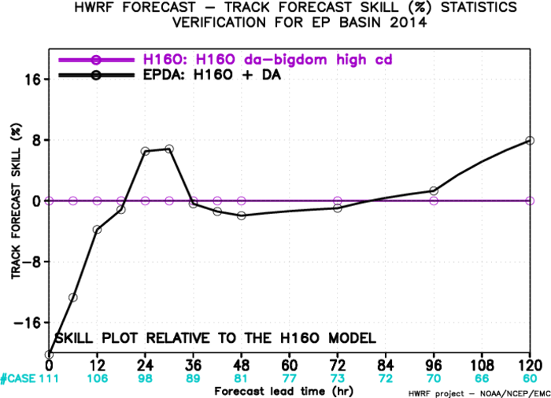
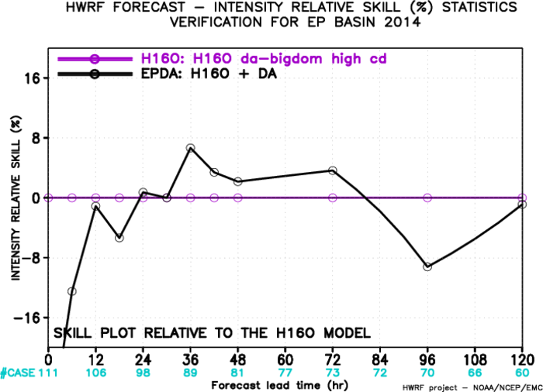

Slide 5
