Slide 1
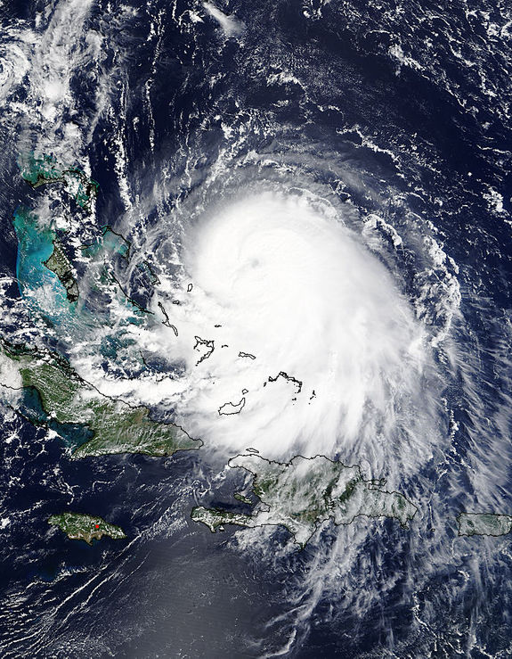
Upgrades to the 2016 GFDL Hurricane Model Morris Bender, Timothy Marchok and Matthew Morin GFDL/NOAA, Princeton, NJ

Slide 2
Results to be shown using Proposed 2016 GFDL model with 2016 GFS
Changes from the 2015 GFDL model:
Several bug fixes in SAS (Simplified Arakawa-Schubert) convection Scheme.
5 minute relaxation time in tendencies of temperature and moisture in Simplified Arakawa-Schubert (SAS) Convective scheme
Reduction in detrainment of cloud water and ice from SAS to Ferrier microphysics scheme
Improved representation of the initial wind profiles
Bug fix in soil moisture input to wetness
Replacement of QDEM climatology with RTOFS in Eastern Pacific ??

Slide 3
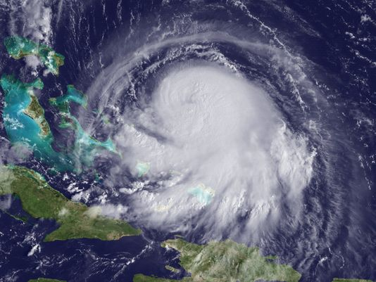
TRACK PERFORMANCE OF 2015 vs. 2016 GFDL MODELS
HURRICANE JOAQUIN
2015 GFDL
1200 UTC
28 September
HWRF
0000 UTC
29 September
HWRF
2015 GFDL
GFS
NEW
2016 GFDL
NEW
2016 GFDL
GFS
ECMWF
ECMWF

Slide 4
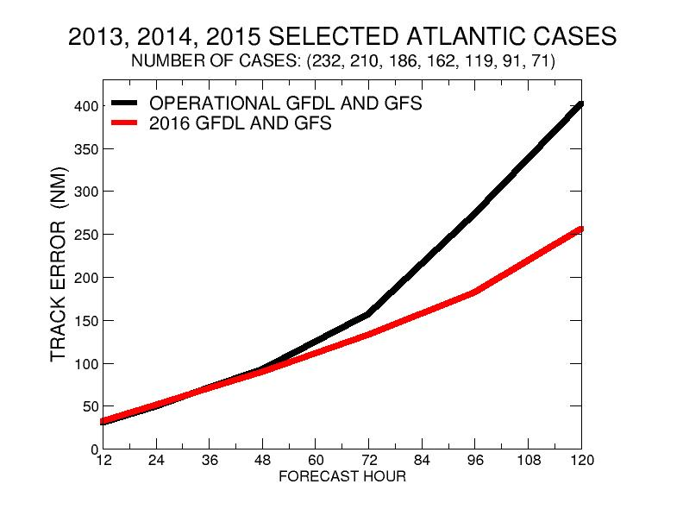
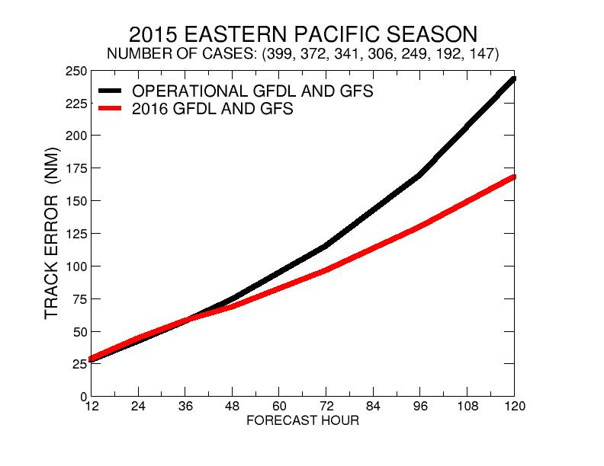
Comparison of 2015 vs. 2016 GFDL Track Errors
Atlantic
Eastern Pacific

Slide 5
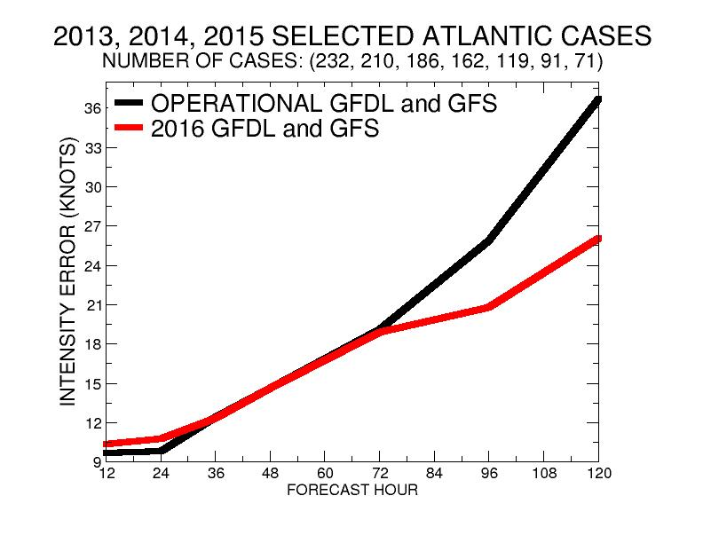
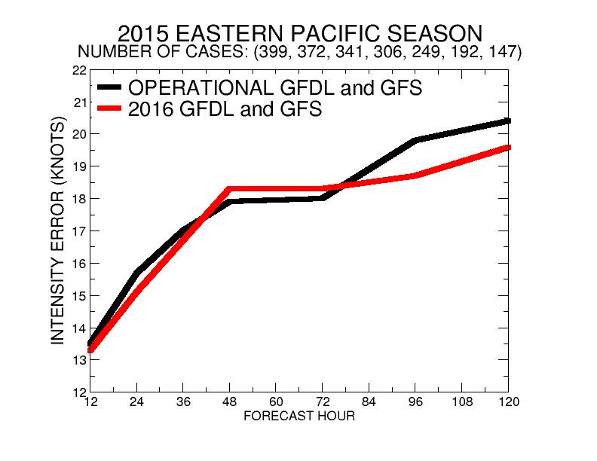
Comparison of 2015 vs. 2016 GFDL Intensity Errors
Atlantic
Eastern Pacific

Slide 6
Hurricane Dolores Reduction in North bias off Mexican Coast
July 11th, 18z
July 12th, 6z
2015 GFDL
2015 GFDL
2016 GFDL
2015 GFS
2016 GFDL
2015 GFS
2016 GFDL
2016 GFS
2016 GFDL
2016 GFS

