Slide 1
FY2012 Implementation Briefing for High-Resolution 3km Triple-Nested HWRFV6.0.0
Vijay Tallapragada & HWRF Team
Environmental Modeling Center,
NCEP/NOAA/NWS, Camp Springs, MD 20746.
EMC CCB Meeting, March 27, 2012
Notes:
1
1

Slide 2
Priorities for the FY12 HWRF Implementation
WRF NMM core and infrastructure:
Upgrade NMM Core for HWRF from V3.2 to V3.4+
Upgrade WPS , GSI and HWRF-POST to corresponding community versions
Vertical Structure Implementation of HWRFV6.0.0
Focus areas for FY12 Implementation:
a) Increase model resolution to 3 km near the hurricane core
Introduction of storm following third nest in 27/9/3 framework
Reduce time step from 54/18/6 to 45/15/5 sec.
Increase the computational efficiency to fit into operational window
Re-design Vortex Initialization Procedure (applicable for 3km resolution)
Improved interpolation algorithms, composite storm structure and initial storm size
b) Improve track, intensity and structure forecast skills and w-p relationship
Explicit convection in 3km domain
New GFS Shallow Convection
Surface fluxes based on 2010 HWRF implementation (based on observations)
Modified GFS PBL with observations based vertical diffusivity coefficients
1-D POM coupling for the Eastern Pacific basin
Improved Microphysics and SAS
Conduct scientific testing and evaluation of all 2010 and 2011 ATL and EP storms
Use of FY2012 Hybrid GSI/GFS retrospectives for 2011 hurricane season (including reruns)

Slide 3
Highlights of the 2012 HWRF upgrades
For the first time, a high-resolution hurricane model operating at cloud-permitting 3km resolution is being implemented into NCEP operational system
This upgrade is a result of multi-agency efforts
EMC: Computational efficiency, nest motion algorithm, physics improvements, 3km initialization and pre-implementation T&E
HRD/AOML: nest motion algorithm, multiple moving nests, PBL upgrades, interpolation routines for initialization, Stream 1.5 and diagnostics.
DTC/NCAR: code management and subversion based repository, MPI profiling
ESRL: Physics sensitivity tests and idealized capability
URI: 1D ocean coupling in Eastern Pacific basin
GFDL: Knowledge sharing, joint T&E
NHC: Diagnostics and evaluation of the HWRF pre-implementation tests
Three atmospheric telescoping nested domains:
27km outer domain 75x75 degree; 9km intermediate nest ~11x10 degree
3km inner-most nest ~6x5 degree
New centroid based nest motion algorithm, 1-D coupling in East-Pac, improved physics & vortex initialization
Upgraded tracker and new high-temporal resolution (every time step) track and intensity product (htcf) and new SSMI/S synthetic microwave imagery
Notes:
3

Slide 4
2012 HWRF Model Upgrades
Dynamics
modified several components of the model codes and add I/O servers and redirect the standard output through log-buffering to speedup model run time in order to fit within the operational time window (speedup factor of 3.2 in run time from ~265 min. to ~82 min.) and using 4 nodes (oper. HWRF uses 3 nodes)
Reduced Time step of model integration 45, 15, 5 sec (oper. HWRF uses 54,18 sec)
Fix a bug in mask inside the leading edge of a nest domain
Initialization and GSI
Build the vortex initialization at 3km resolution with more accurate interpolation algorithms and composite storm structure consistent with 3km HWRF
Upgrade GSI to version 3.5 which is the latest community version. Optimize (reduce) the impact of prepbufr data in a storm environment.
Ocean
Add one dimensional ocean coupling in Eastern Pacific basin
Bug fixes in ocean initialization for Atlantic basin
Physics
Add GFS shallow convection scheme with slight tuning (no precip. from SC when cloud is less than 50mbs thick and SC top is below PBL top)
Modify several microphysical parameters to more realistic values (NLImax, NCW and snow fall speed)
PBL: Change critical Richardson number from 0.5 to 0.25, and alpha=0.5 from 1
Use the constant Ch profile with wind speed consistent to the observation
Notes:
4

Slide 5
2012 Triple-Nested HWRF pre-implementation Test Plan
EXP | Description | Comments | Platform/# of cases
HBSE | Baseline: with the stripe bug fix (a=0.5, coac=0.75, 3.0, 4.0) | Unstable due to 54 sec. time step. Noise in several fields especially at higher latitudes. Not a viable configuration for operations. Operational GFS. | Jet, All 2010-11 ATL & EP, 1265
HPHY | HBSE + S.C. + MP tune (dt=45s, no sas in d03) | Revised HBSE configuration with 45 sec. time step. Numerically stable with no noticeable noise. Shallow convection and microphysics tuning included. Explicit convection in d03. Operational GFS. | Jet, All 2010-11 ATL & EP, 1265
HOCN | HPHY + new ocean | 1-D coupling for East-Pac storms, Operational GFS. | Jet, All 2010-11 EP, 418
HGSI | HPHY + GSI | Reduced impact of observations (prepbufr) in HWRF-GSI. Operational GFS. | CCS, Majority of 2010-11 ATL, 400
H12J | HPHY+HOCN+HGSIfor 2010, w/Hybrid GFS* for 2011 | For 2011 season, use hybrid GFS reruns (pre13r) for the period from Aug. 20 to Oct. 11, 2011. Use pre13h for rest of the season. Operational GFS for 2010 season. | Jet, All 2010-11 ATL & EP, 1265
H212 | HPHY+HOCN+HGSIfor 2010, w/Hybrid GFS* for 2011 | For 2011 season, use hybrid GFS reruns (pre13r) for the period from Aug. 20 to Oct. 11, 2011. Use pre13h for rest of the season. Operational GFS for 2010 season. | CCS, All 2010-11 ATL & EP, 1265
Not shown here: HSHAL (HBSE+Shallow Convection) – All 2010 ATL (Jet, 446), HBSE2 (Modified initialization): All 2011 ATL (Jet, 401), HPRD (Oper. HWRF w/new GFS): All 2011 ATL+EP (CCS, 664), H3GP: Stream 1.5, All 2011 ATL+EP (Jet, 800)
Unprecedented T&E of about 10 different configurations, more than 8000 simulations from 64 storms on Jet & CCS, thanks to support from HFIP PO for Jet usage, and from NCO for “devmax” usage on CCS

Slide 6
Performance of H212 compared to operational HWRF (HOPS)
(2010-2011* seasons)
*Final Retrospective runs for 2011 hurricane season are based on FY12 Hybrid GSI/GFS IC/BC (including reruns for the period from Aug.20-Oct.11 2011.

Slide 7
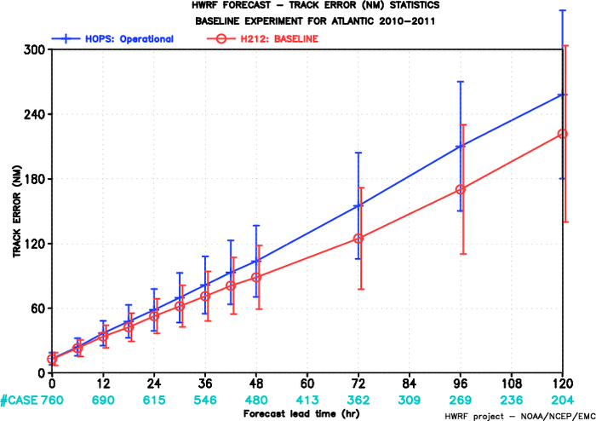
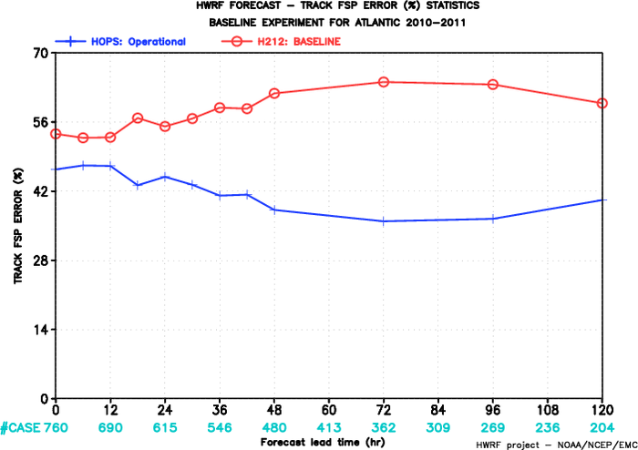
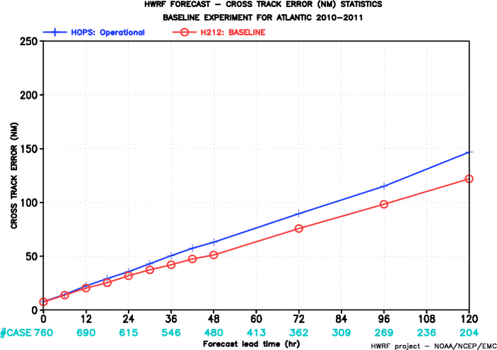
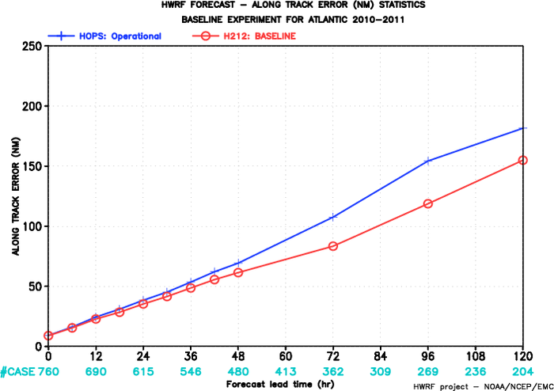
FY2012 HWRF
FY2012 HWRF
2010-2011 Atlantic Track Verification
~20% improvement
Track errors
Superior Track FSP
FY2012 HWRF
FY2012 HWRF
HOPS: operational HWRF
H212: 2012 HWRF
Improved Cross-Track errors
Improved Along-Track errors

Slide 8
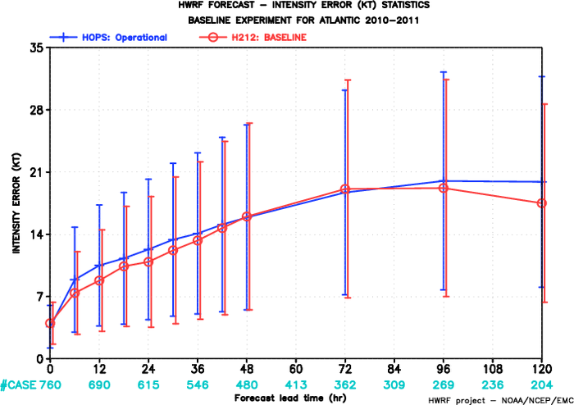
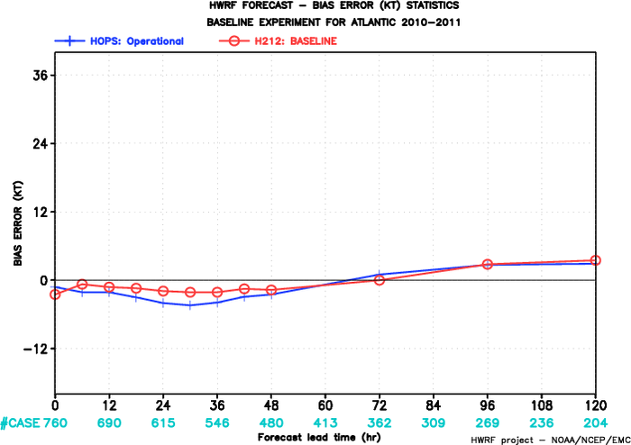
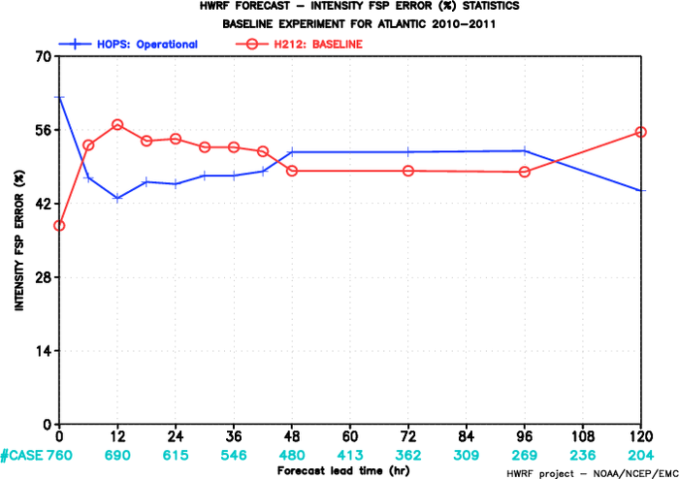
FY2012 HWRF
FY2012 HWRF
Intensity errors
HOPS: operational HWRF
H212: 2012 HWRF
~10% improvement
Improved Intensity Bias
FY2012 HWRF
2010-2011 Atlantic Intensity Verification
Intensity FSP

Slide 9
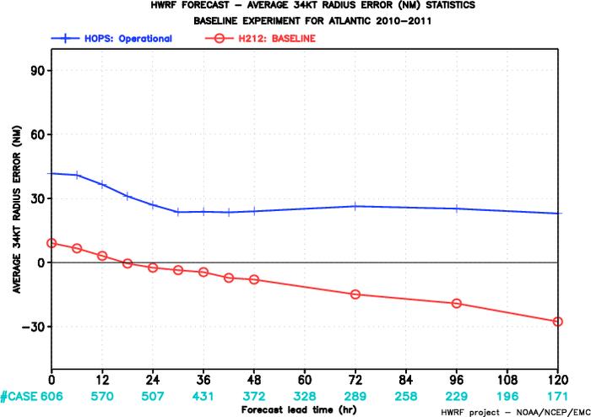
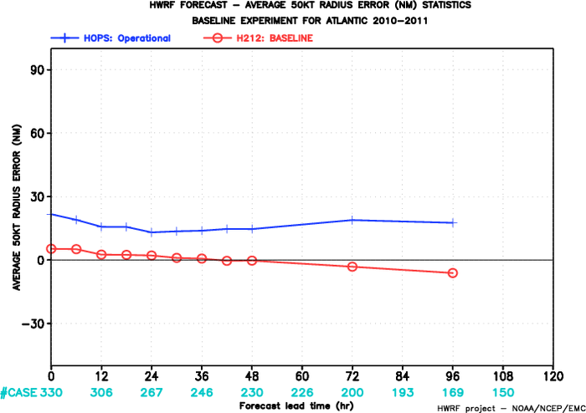
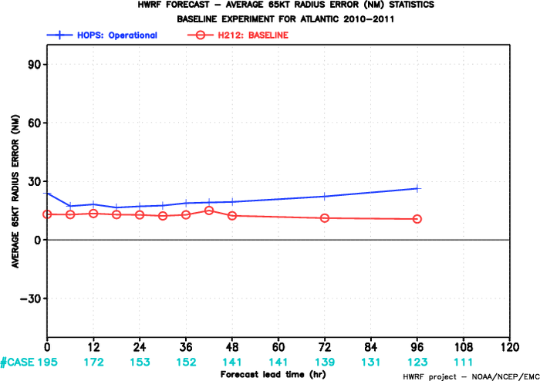
FY2012 HWRF
FY2012 HWRF
HOPS: operational HWRF
H212: 2012 HWRF
Mean 34-kt Radius Error
Mean 50-kt Radius Error
FY2012 HWRF
Mean 65-kt Radius Error
2010-2011 Atlantic
Radii Verification
Significant improvements in storm size and structure

Slide 10
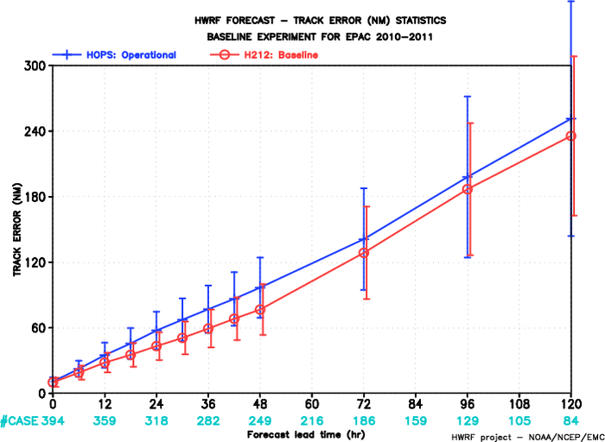
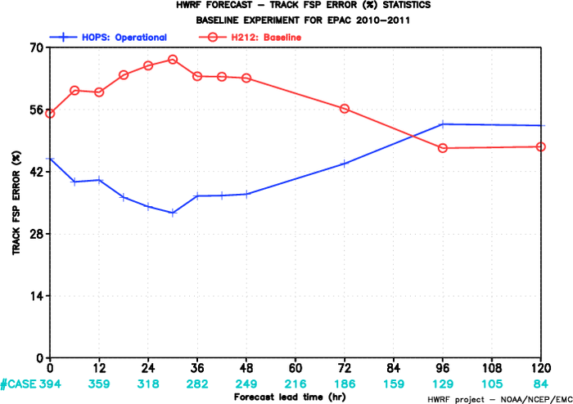
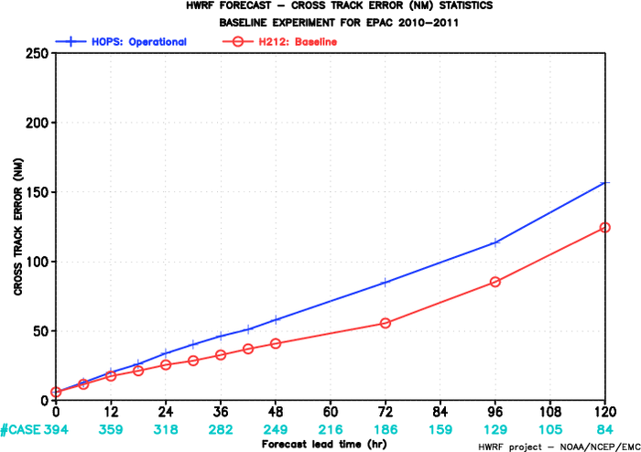
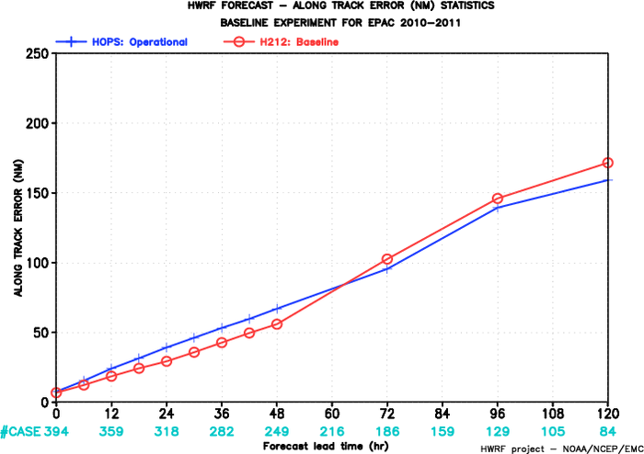
FY2012 HWRF
FY2012 HWRF
2010-2011 E-PAC
Track Verification
~20% improvement
Track errors
Improved Track FSP
FY2012 HWRF
FY2012 HWRF
HOPS: operational HWRF
H212: 2012 HWRF
Improved Cross-Track errors
Along-Track errors

Slide 11
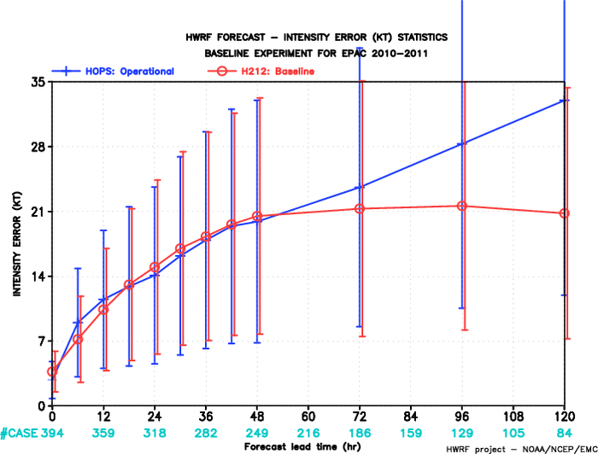
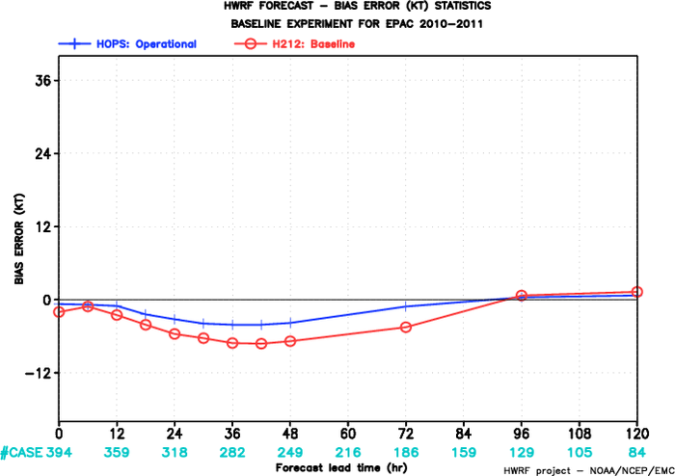
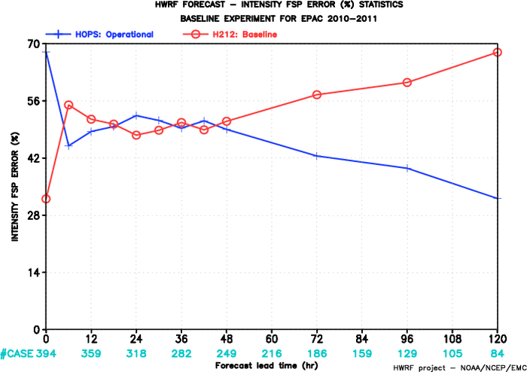
FY2012 HWRF
FY2012 HWRF
HOPS: operational HWRF
H212: 2012 HWRF
~35% improvement
Intensity errors
Intensity Bias
FY2012 HWRF
2010-2011 E-PAC Intensity Verification
Intensity FSP

Slide 12
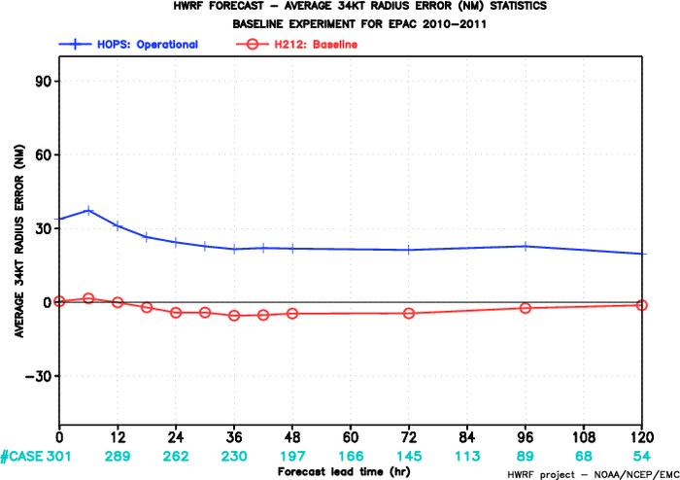
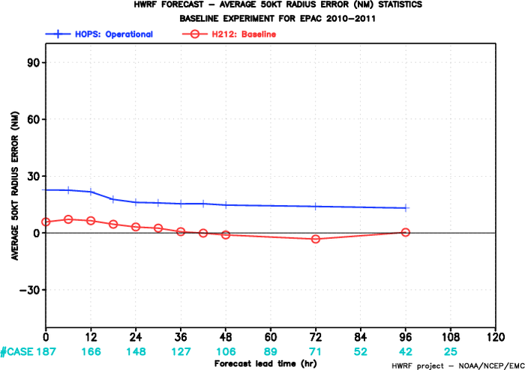
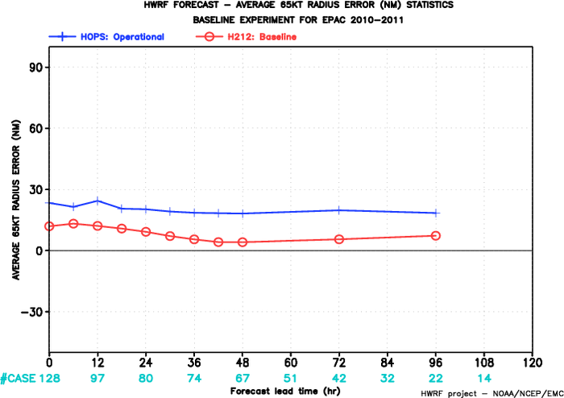
FY2012 HWRF
FY2012 HWRF
Mean 34-kt Radius Error
Mean 50-kt Radius Error
HOPS: operational HWRF
H212: 2012 HWRF
FY2012 HWRF
FY2012 HWRF
Mean 65-kt Radius Error
2010-2011 E-PAC
Radii Verification

Slide 13
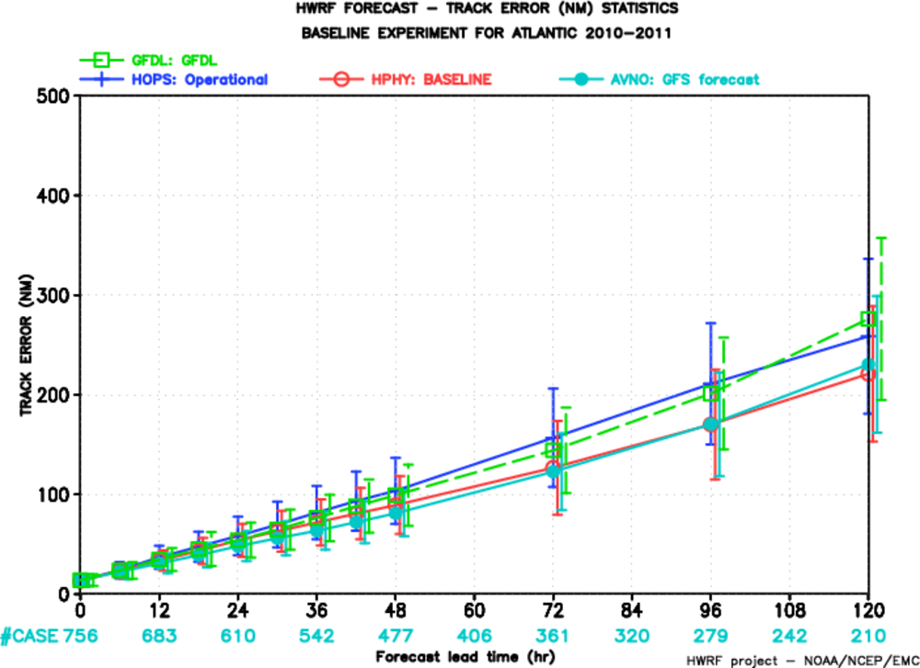
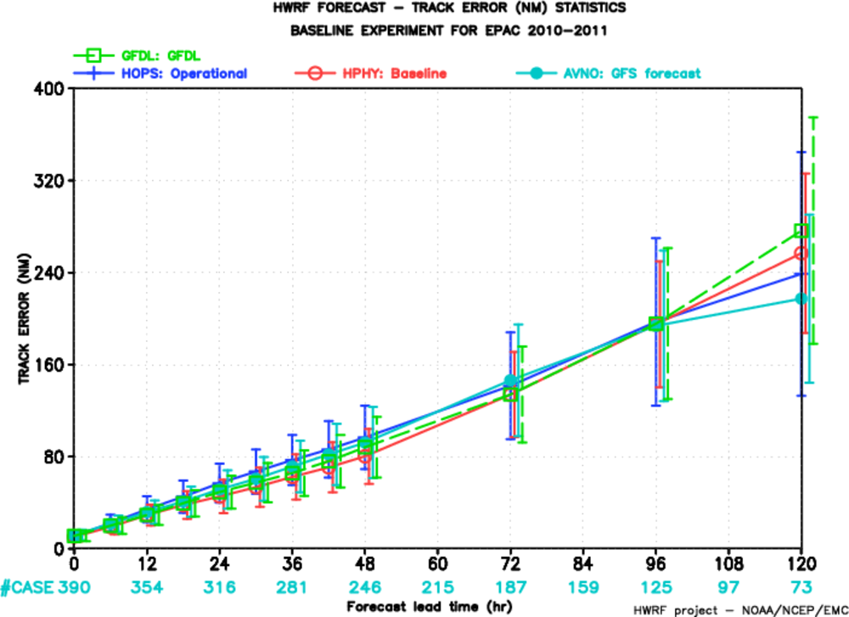
Atlantic basin
EPAC basin
FY2012 HWRF
FY2012 HWRF
Oper. HWRF
2012 HWRF
Oper. GFDL
Oper. GFS
3km HWRF Track Forecast Skill Comparable to Operational GFS for 2010-2011 seasons

Slide 14
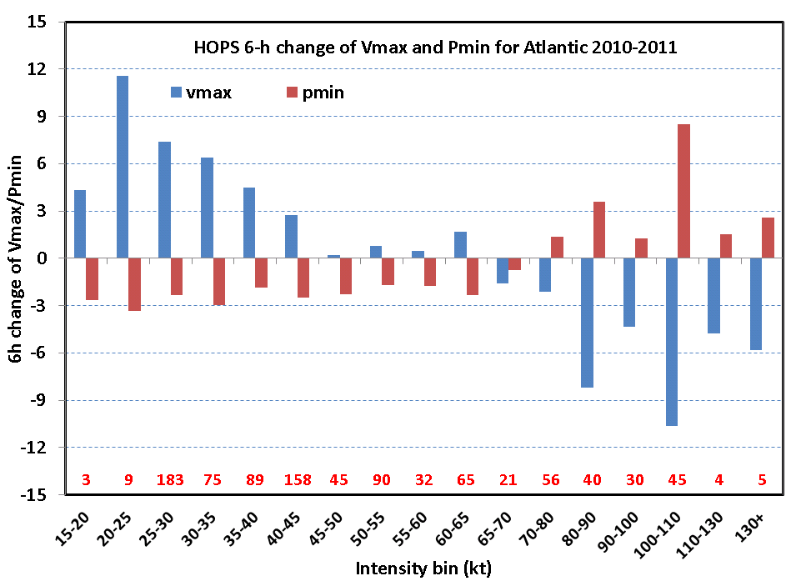
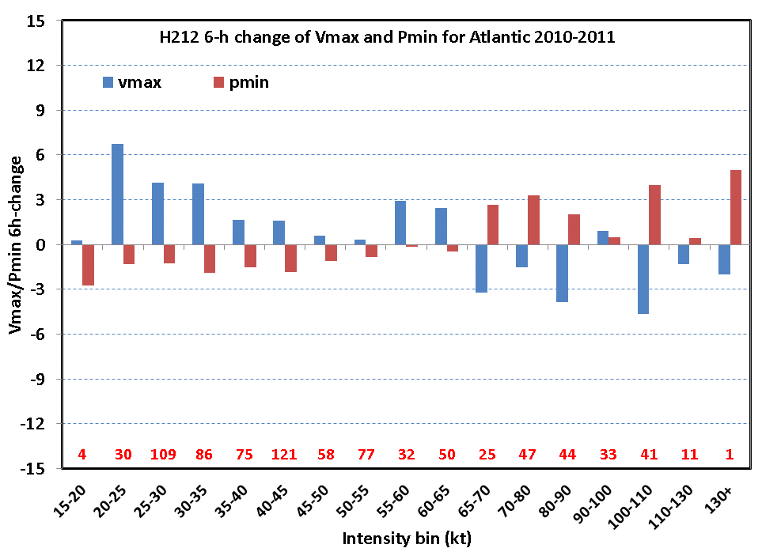
HOPS vs. H212 6-h intensity change for 2010-11 ATL
HOPS (H211)
H212

Slide 15
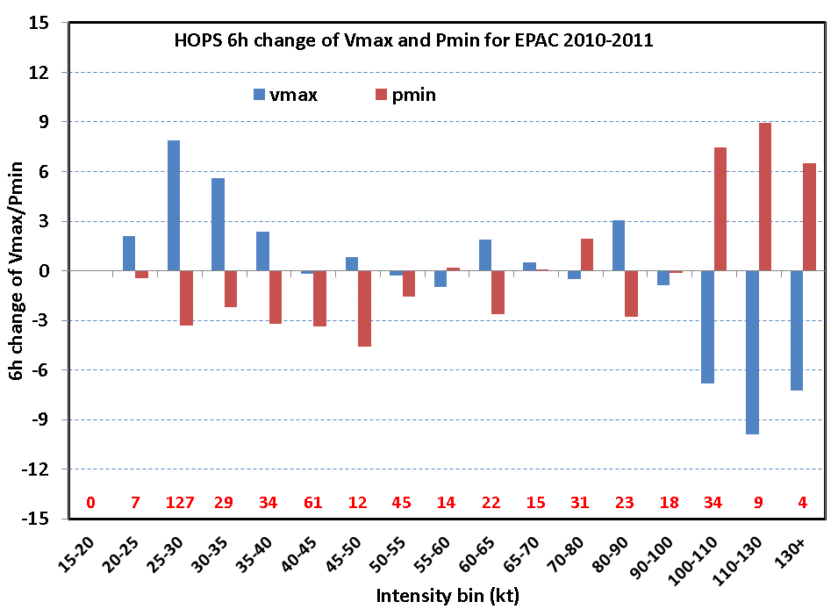
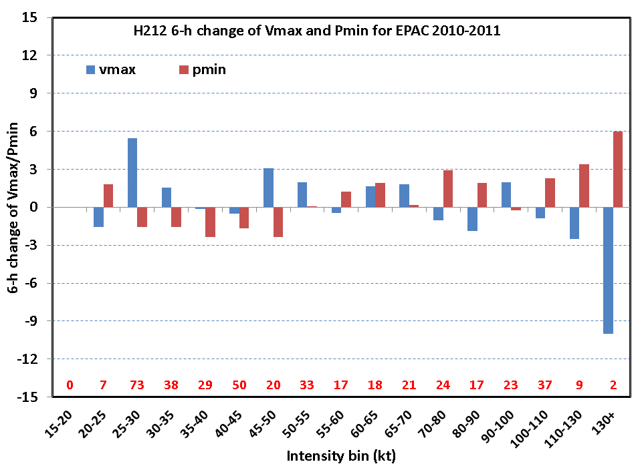
HOPS vs. H212 6-h intensity change for 2010-11 EPAC
HOPS (H211)
H212

Slide 16
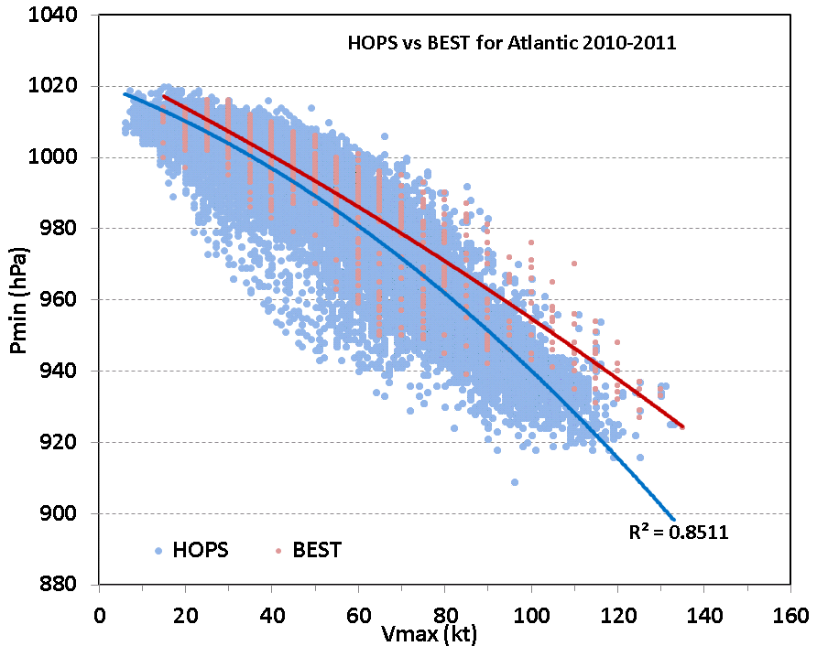
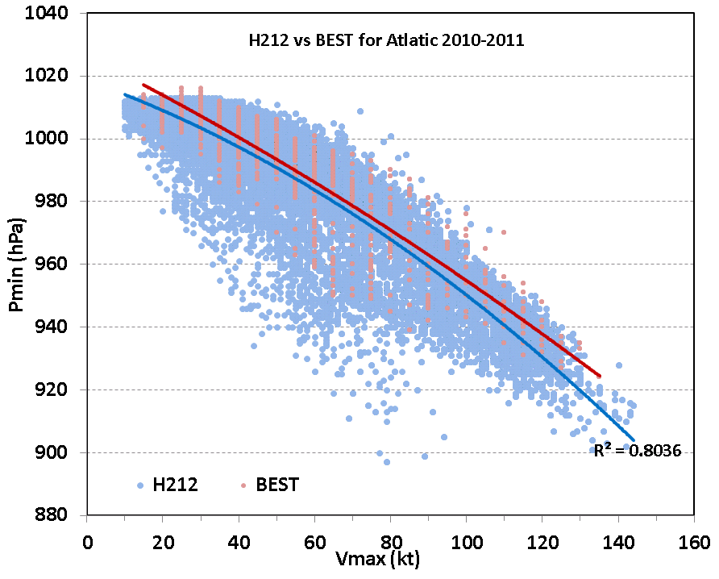
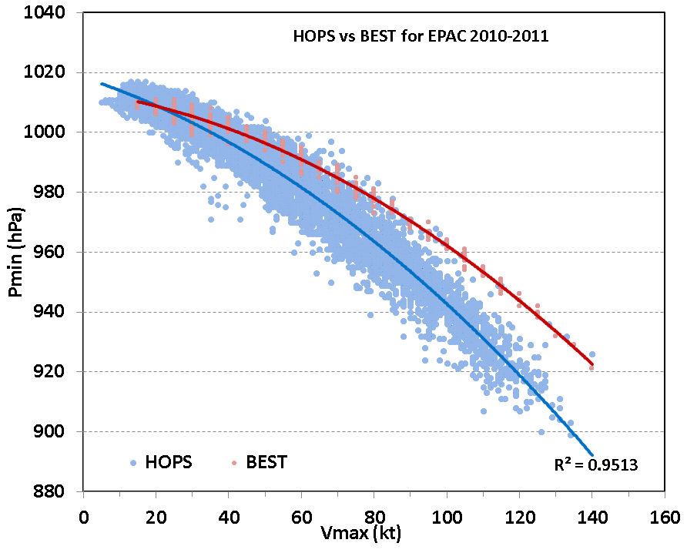
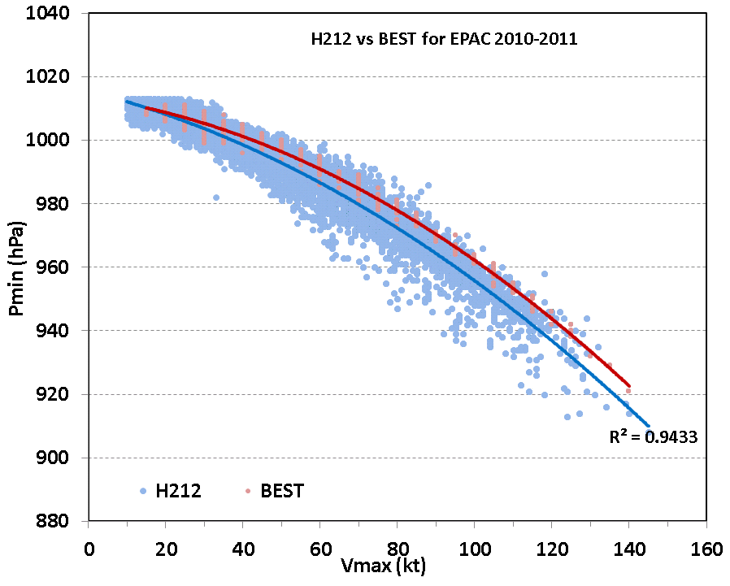
HOPS vs. H212 P-W relationship
ATLANTIC
E-PAC

Slide 17
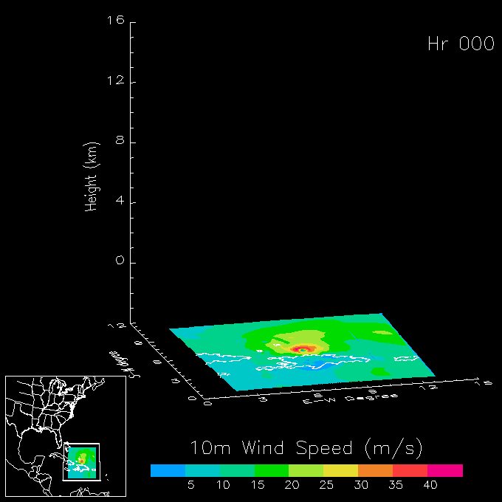
Impact of Physics and Resolution Upgrades
Surface of 10⁻⁵ kg/kg Total Condensate
Irene 2011082318

Slide 18
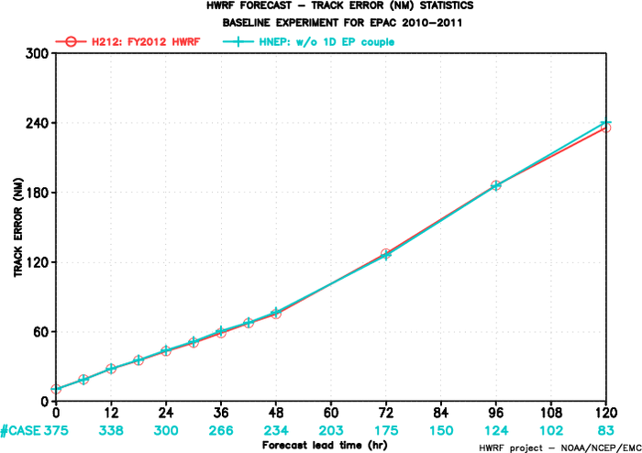
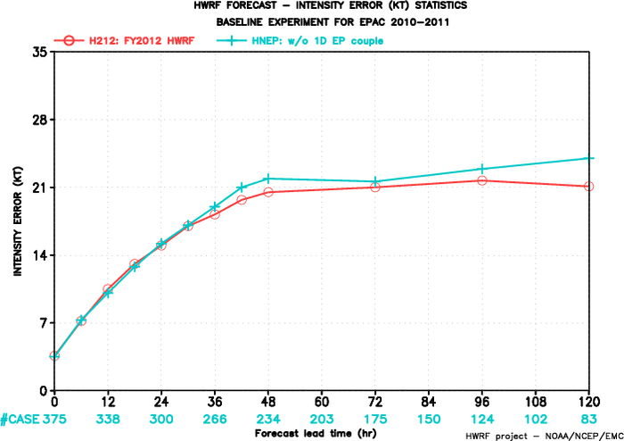
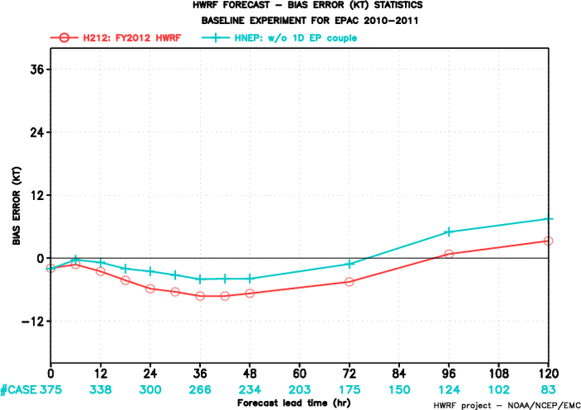
H212: 2012 HWRF w/ 1-D coupling
HNEP: 2012 HWRF w/o 1-D coupling
2.4%
6.4%
2.9%
5.4%
13.2%
Impact of 1-D Ocean Coupling
E-Pac Storms 2010-2011

Slide 19
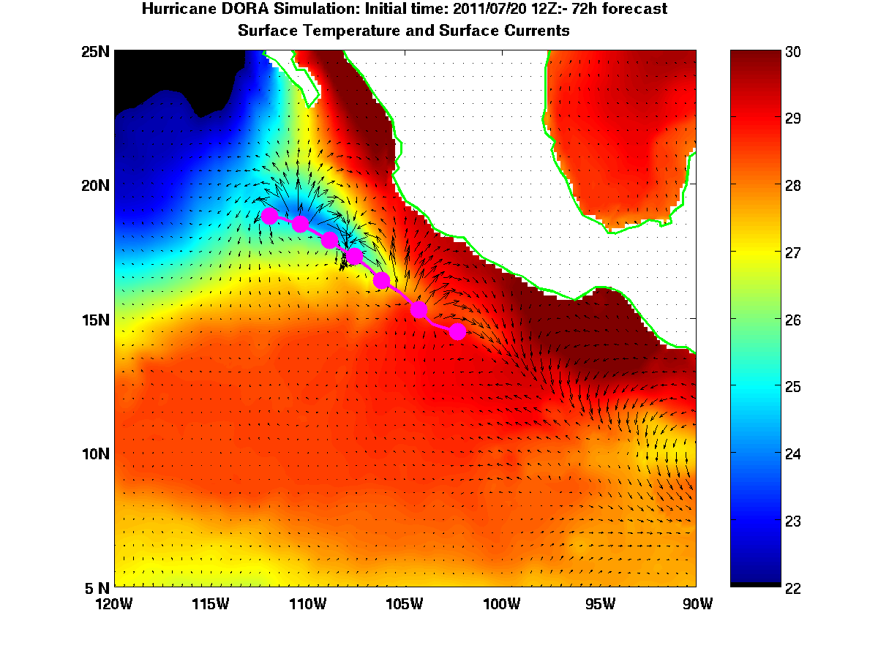
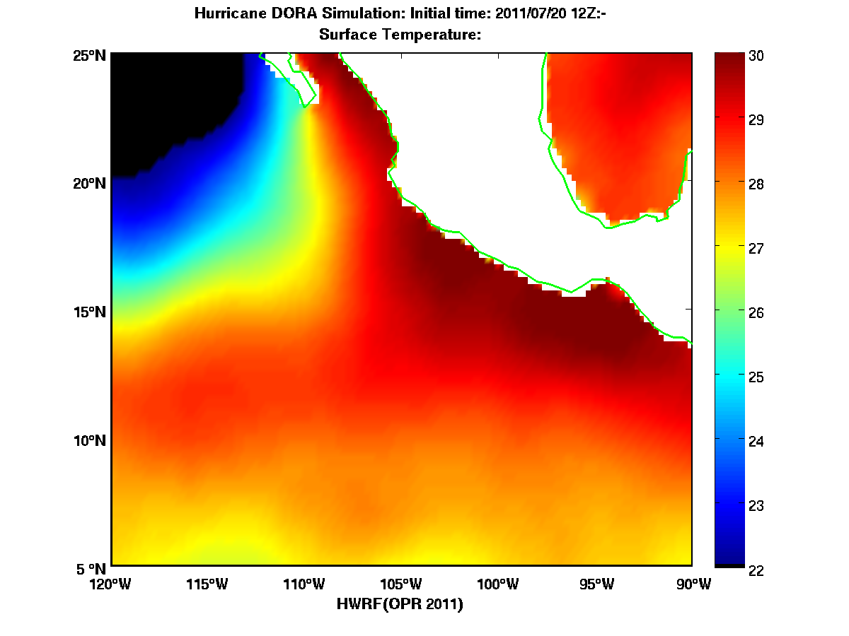
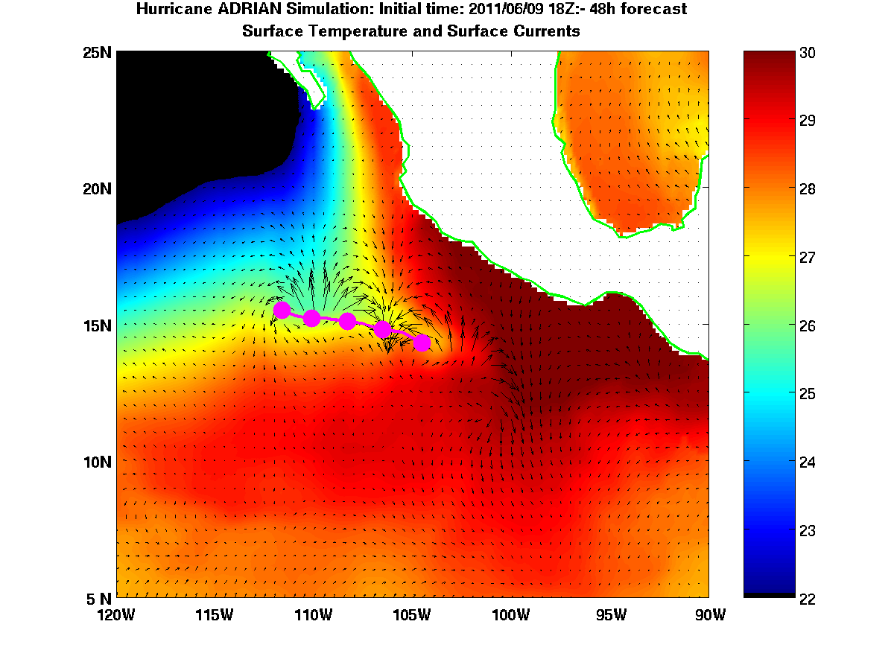
Impact of 1-D Ocean Coupling for E-Pac Storms
Hurricane Dora
H212
Oper. HWRF
Hurricane Adrian

Slide 20
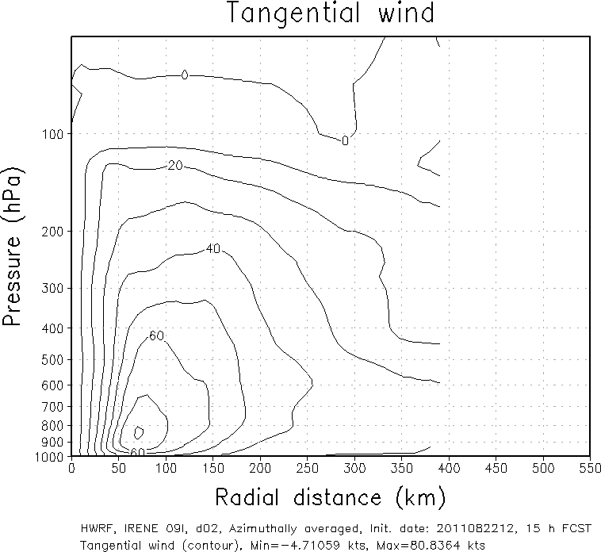
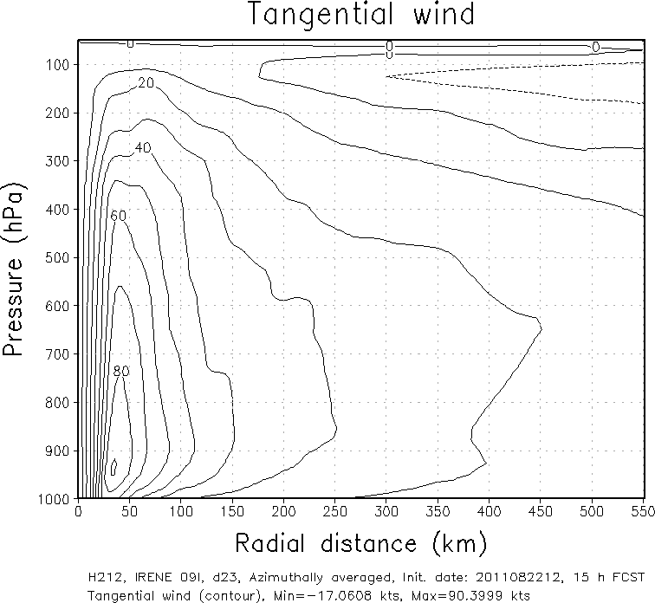
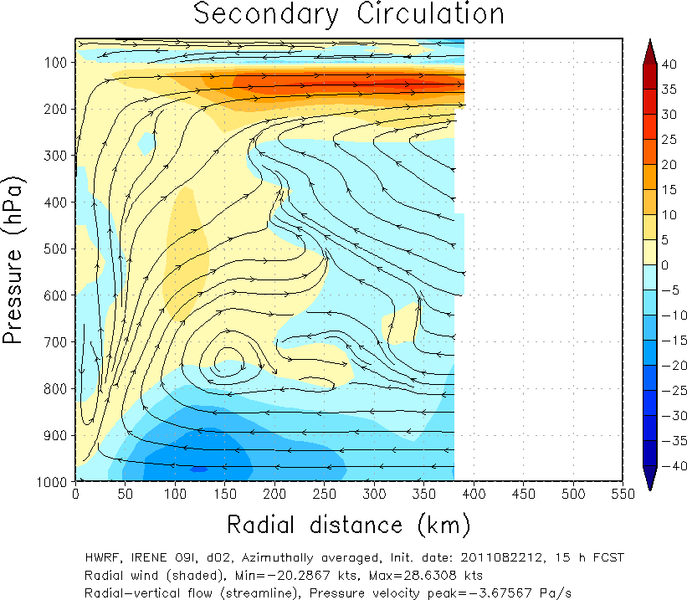
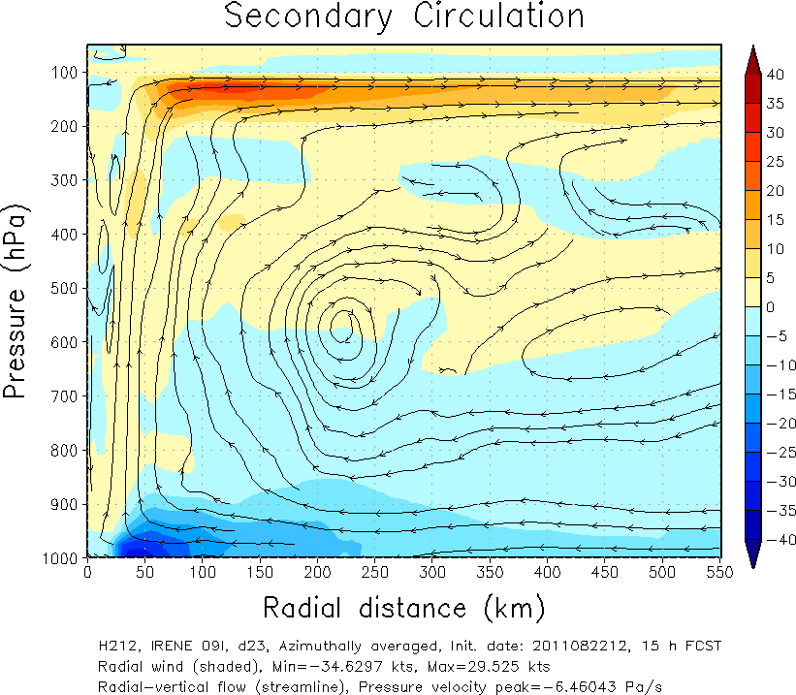
Advanced Vortex Scale Diagnostics
HOPS
H212
- Wind structure -
Smaller Size of vortex
Vertical structure comparison (Irene09L.2011082212 15h forecast)
Lower PBL height
- PBL height-

Slide 21
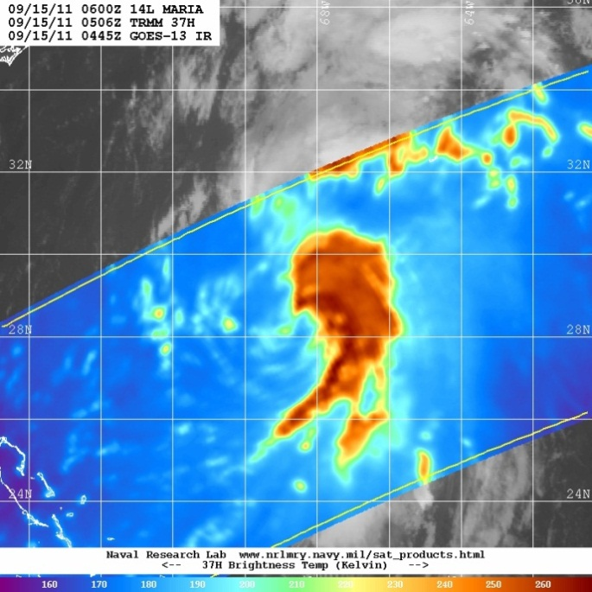
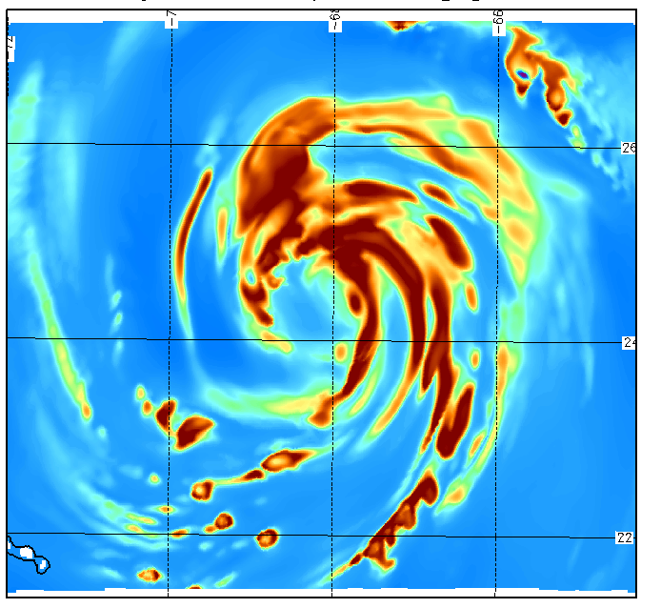
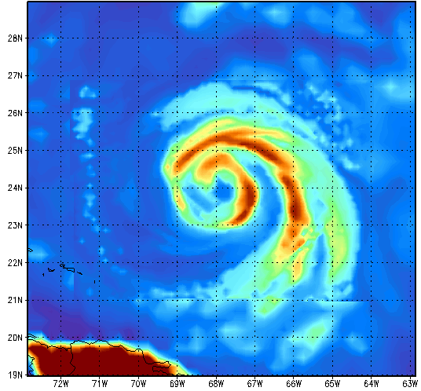
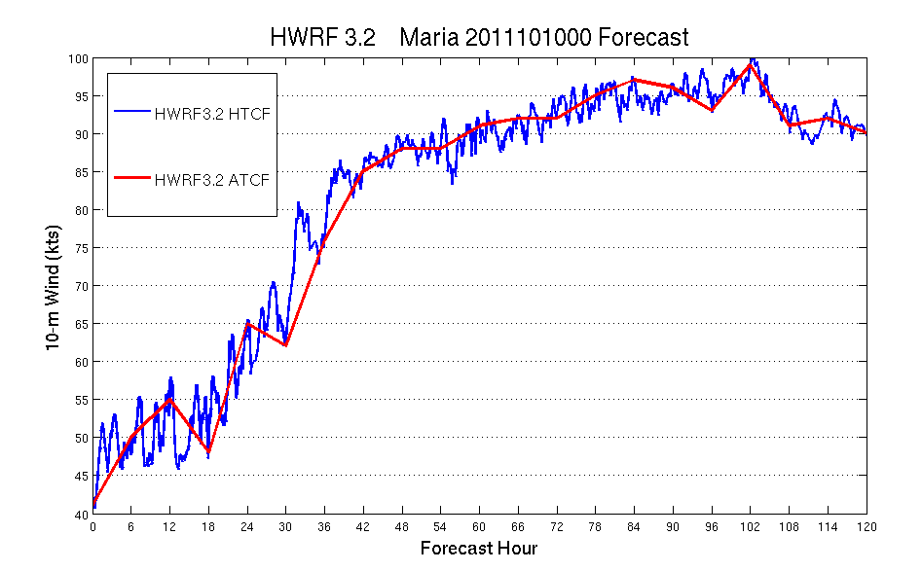
Simulated 3 km
New experimental products from operational HWRF
Synthetic satellite imagery using a uniform RTM:
GOES-13 and GOES-11 Channel 2,3,4,6
Microwave 37 GHz and 85 GHz Vertical and Horizontal Polarization (replace AMSRE with SSM/I F17/F18/F20)
Simulated 9 km operational
13/12 – 15/06
13/12 – 15/06
13/12 – 15/06
Valid: 2011091400
Valid: 2011091400
High Temporal Resolution HWRF ATCF-style output at every time step (5 seconds) at 3km resolution
Are 6-hr outputs representative of the actual model forecast?
What is happening during development and RI within the model?

Slide 22
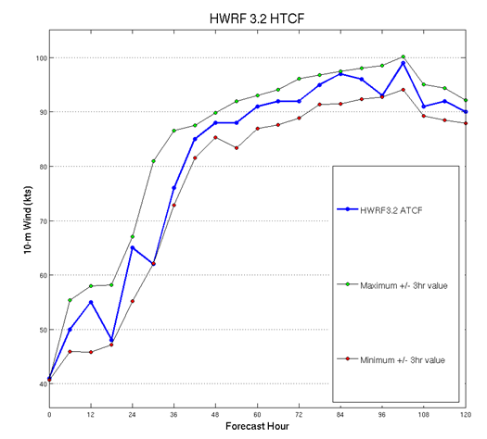
High Temporal Resolution Model Output
Intensity variability could impact verification statistics
Evaluation of High-resolution structure now possible

Slide 23
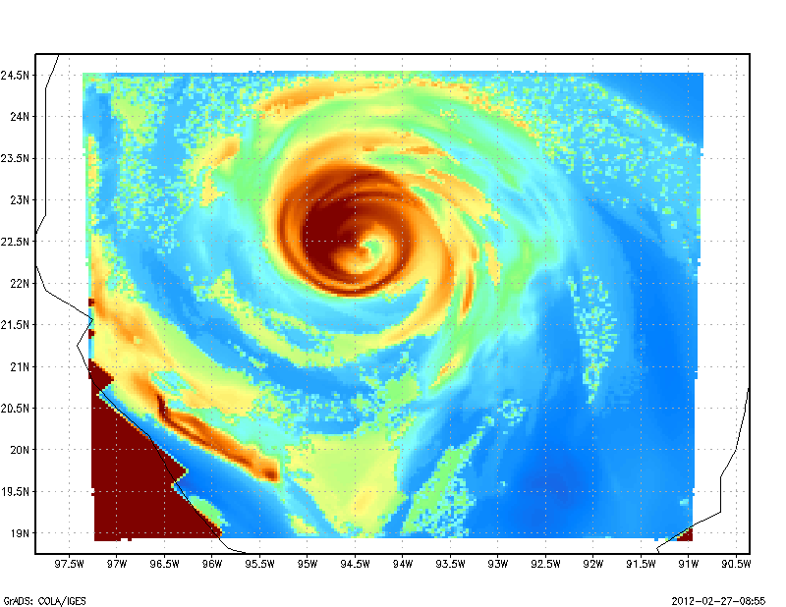
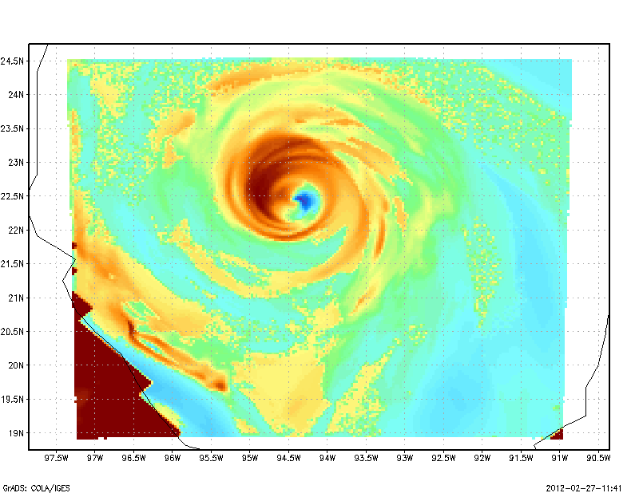
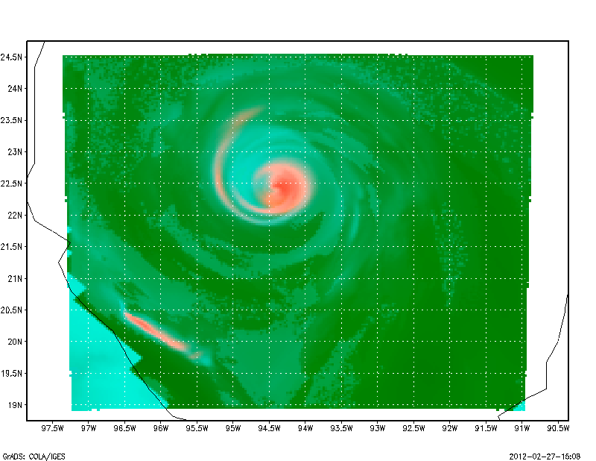
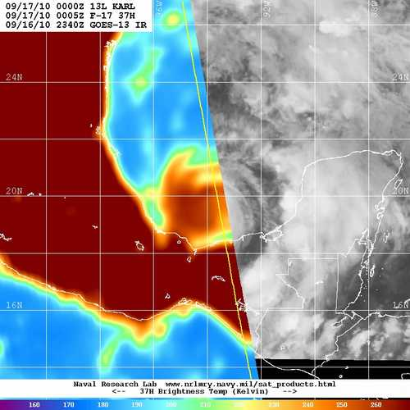
SSMI/S 37 GHz-H
SSMI/S 37 GHz-V
SSMI/S 37 GHz-Color Composite
HWRF Generated SSM/I S Microwave Imagery (new operational product)
-- Courtesy: Dave Zelinsky, NHC

Slide 24
Maximum wind PDF

Slide 25
Summary
Track forecast skills of H212 improved significantly over both 2011/2010 seasons on Atlantic basin with about 20-25% improvement against HOPS
Track forecast skills of H212 of Eastern Pacific basin also improved maximum 25% over the HOPS in 2011 season, but little degradation at day 4 and 5 in 2010 season mainly due to Hurricane Frank
Intensity forecast improvement is not as impressive as track improvement, but show overall improvement. The biggest improvement of intensity is 2011 EP basin with over 40% to HOPS. However, significant improvements in intensity bias is noted for both Atlantic and Eastern Pacific, for both 2010-2011 seasons.
On top of track and intensity skill, the storm size and structure of H212 improve as well, in terms of radii verification and evaluation of PBL height
The problem of wind-pressure relationship in high wind speed regime also significantly improved in H212
With high resolution and improved physics, we are laying foundation for improved intensity predictions through improved storm structure.

Slide 26
Evaluation and Recommendation from NHC
All HWRF FY2012 T&E was conducted in close collaboration with NHC with weekly updates.
Evaluation and Recommendation from Richard Pasch, Senior Hurricane Specialist at NHC:
The National Hurricane Center approves of the upgrades to the HWRF Model proposed for the 2012 hurricane season. A major accomplishment was the development of a third nest, at 3 km resolution, to cover the inner core and most of surrounding circulation of the storm. This would make the HWRF model the highest resolution hurricane model ever implemented for operations in the National Weather Service. Other changes to the model include a bug fix to the nesting scheme, the inclusion of ocean coupling in the eastern North Pacific, upgrades to models physics such as shallow convection and improvements to the planetary boundary layer formulation. Reruns of the model on a large number of tropical cyclone cases from the 2010 and 2011 Atlantic and east Pacific hurricane seasons generally show significant improvements to track and storm size forecasts. Some reductions in intensity forecast errors were noted, with a significant reduction of a high bias for weak storms.
Based on these results, we recommend implementation of this new version of the HWRF model for the 2012 season.
EMC HWRF Team recommends that EMC Director approve implementation of suggested upgrades/enhancements to operational HWRF system for the 2012 hurricane season

Slide 27
Supplemental Material
Composite Track Plots:
http://www.emc.ncep.noaa.gov/HWRF/weeklies/MAR12/h212_composite_tracks.pptx
Composite Intensity Plots:
http://www.emc.ncep.noaa.gov/HWRF/weeklies/MAR12/h212_composite_intensity.pptx
Stats for individual storms:
http://www.emc.ncep.noaa.gov/HWRF/weeklies/MAR12/h212_individual_stats.pptx
Graphics for each forecast cycle:
CCS Runs: http://www.emc.ncep.noaa.gov/gc_wmb/vxt/H212/
Jet Runs: http://www.emc.ncep.noaa.gov/gc_wmb/vxt/H12J/
Additional diagnostics:
Mark DeMaria/Janna O’Connor: SHIPS based diagnostics (large-scale) and GOES BT verification
Jonathan Vigh/Chanh Kieu: Environmental and vortex scale diagnostics based on VDMs
Stan Goldenberg/Young Kwon: Stratification of storms based on initial intensity
Dave Zelinsky/Wallace Hogsett: RI verification, Diagnostics of Microwave imagery

Slide 28
Next Steps
Briefing to NHC: March 20, 2012 ---- DONE
NHC Evaluation and Recommendations: March 23, 2012 ---- DONE
Briefing to EMC and CCB: March 27, 2012 ---- DONE
Submission of RFCs: March 30, 2012 ---- Ongoing
TIN for HWRF and GFDL: April 3, 2012 ---- DONE
NCO IT Testing and Code Freeze: April 10, 2012
Briefing to NCEP Director's Office: May 7, 2012
Implementation by NCO: May 15, 2012

Slide 29
Thanks for your attention
Real-time and pre-implementation T&E
HWRF products:
http://www.emc.ncep.noaa.gov/gc_wmb/vxt/index.html
Questions?
Acknowledgements:
HWRF team at EMC
EMC and HFIP Management
Collaborations with NHC, DTC, HRD, GFDL, URI, CIRA and other HFIP partners
Notes:
29

Slide 30
Atlantic basin 2007-2011: HWRF
Track
Intensity

Slide 31
Atlantic basin 2007-2011: H212
Track
Intensity

Slide 32
EPAC basin 2007-2011: HWRF
Track
Intensity

Slide 33
EPAC basin 2007-2011: H212
Track
Intensity

Slide 34
Performance of H212 for
Individual Hurricane Seasons

Slide 35
HOPS: operational HWRF
H212: 2012 HWRF
~20% improvement
Comparable
Track Errors
Intensity Errors
2011 Atlantic using FY2012 Hybrid GSI/GFS
Reduced
Intensity Bias

Slide 36
HOPS: operational HWRF
H212: 2012 HWRF
~25% improvement
15-40% improvement at days 3-5, degradation at days 1-2
Track Errors
Intensity Errors
2011 E-Pac using FY2012 Hybrid GSI/GFS
Reduced
Intensity Bias

Slide 37
HOPS: operational HWRF
H212: 2012 HWRF
~25% improvement
~10-20% improvement
Track Errors
Intensity Errors
2010 Atlantic using operational GFS
Improved
Intensity Bias

Slide 38
HOPS: operational HWRF
H212: 2012 HWRF
Track Errors
Day-4 and day-5 degradation due to Hurricane Frank
Improved
Intensity Errors
2010 E-Pac using operational GFS
Intensity Bias

