Slide 1
Tropical Cyclone Track and Genesis Prediction Through Multi-model Ensemble Forecasts
Jiayi Peng*, Yuejian Zhu and Richard Wobus*
*IMSG at Environmental Modeling Center
Environmental Modeling Center /NCEP/NOAA, Camp Springs, MD 20746
Presented by Vijay Tallapragada (EMC HWRF Team)
Acknowledgements:
EMC Ensemble Team, EMC HWRF Team
Geophysical Fluid Dynamics Laboratory (Tim Marchok)
Hurricane Forecast Improvement Project (HFIP)
30th Conference on Hurricanes and Tropical Meteorology , 15-20 April 2012, Florida

Slide 2
Outline
Models and data
TC track ensemble forecast
TC genesis ensemble forecast
Conclusions

Slide 3
Models | Resolution | Members | Daily Frequency | Forecast Length
NCEP ensemble | GFS T190L28 -70km | 20+1 | 00, 06, 12, 18 UTC | 16 days (384hrs)
CMC ensemble | GEM L40-66km (08/17/2011) | 20+1 | 00, 12 UTC | 16 days (384hrs)
ECMWF ensemble | IFS T639/319L62 -30/60km | 50+1 | 00, 12 UTC | 15 days (360hrs)
FNMOC ensemble | NOGAPS T159L42-80km (09/14/2011) | 20 | 00, 12 UTC | 16 days (384hrs)
UK MetOffice Ensemble | MOGREPS-G L70-60km | 23+1 | 00, 12 UTC | 15 days (360hrs)
NCEP deterministic | GFS T574L64 -27km | 1 | 00, 16, 12, 18 UTC | 192 /384hrs
CMC deterministic | GEM(0.45x0.3) L58-33km | 1 | 00, 12 UTC | 180/240 hrs (12/00z)
ECMWF deterministic | IFS T1279L91 -16km | 1 | 00, 12 UTC | 240 hrs
Data: 2010-2011 NCEP, CMC, FNMOC, ECMWF and UK MetOffice tropical cyclone genesis and tracks.
Our goal:
Improve tropical-cyclone track and genesis prediction by using NCEP, CMC , ECMWF, FNMOC and UK MetOffice global ensemble forecasts !

Slide 4
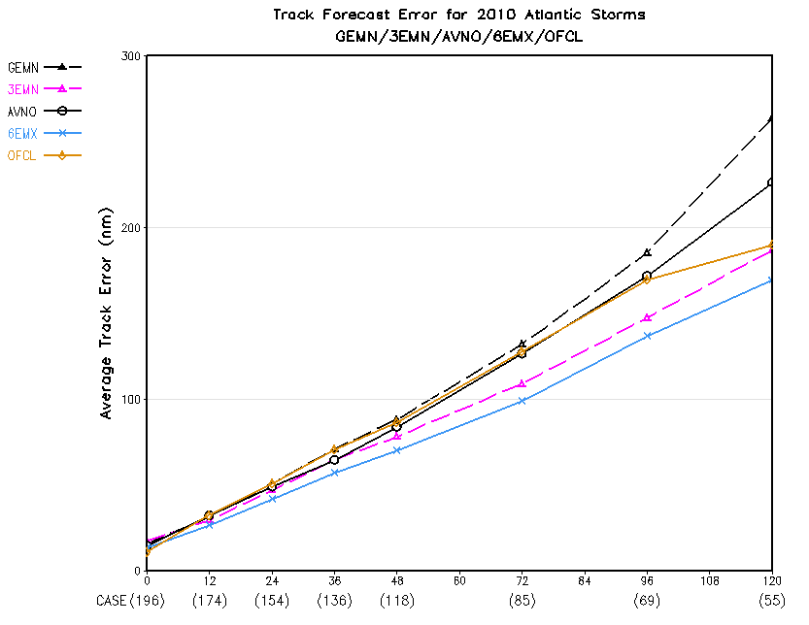
Multi-model ensemble TC track forecasts
2010 Atlantic, 21 TCs
Verification:
3EMN and 6EMX are better than OFCL.
Please note: Model guidance is usually delayed 06~12 hours which means model forecast is not fully comparable to official forecast. Here is for reference only.
AVNO (black solid)----NCEP (GFS) deterministic run (T574L64)
AEMN (black dashed)----NCEP (GEFS-T190) 20-member mean
3EMN---- NCEP(20)+CMC(20)+ECMWF(50) 90-member mean
6EMX---- three ensemble+ three deterministic runs weighted-mean OFCL----NHC official forecast

Slide 5
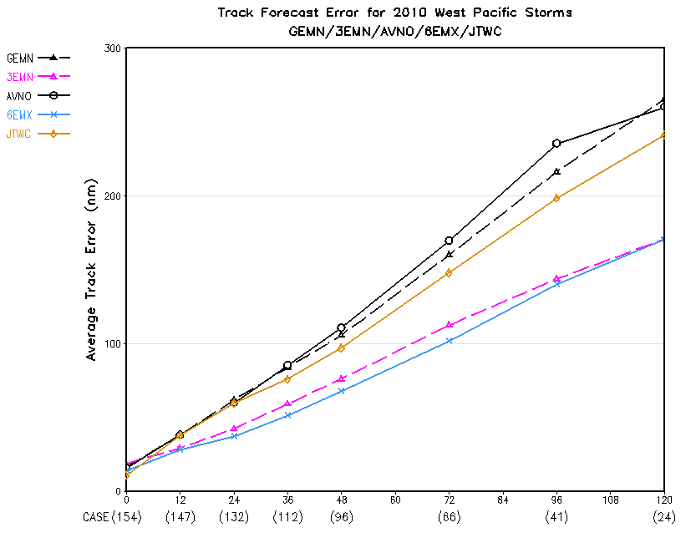
2010 West Pacific, 19 TCs
Verification:
3EMN and 6EMX are much better than JTWC.
Please note: Model guidance is usually delayed 06~12 hours which means model forecast is not fully comparable to official forecast. Here is for reference only.
AVNO (black solid)----NCEP (GFS) deterministic run (T574L64)
AEMN (black dashed)----NCEP (GEFS-T190) 20-member mean
3EMN---- NCEP(20)+CMC(20)+ECMWF(50) 90-member mean
6EMX---- three ensemble+ three deterministic runs weighted-mean JTWC----JTWC official forecast

Slide 6
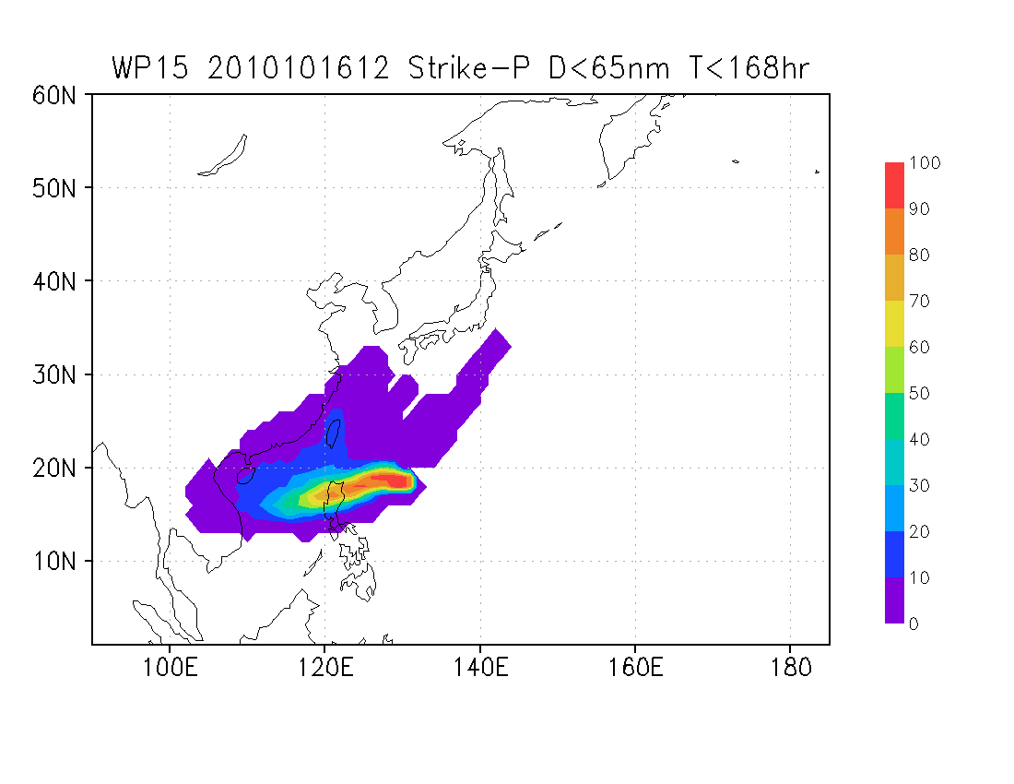
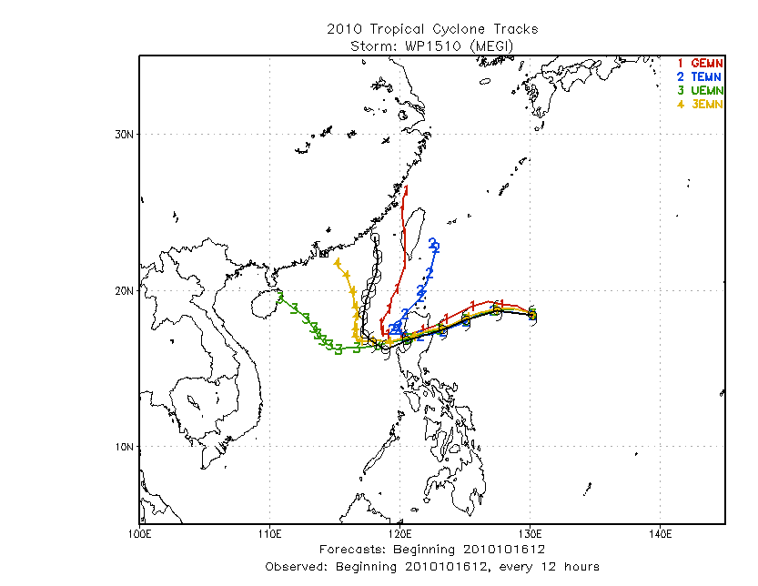
Strike probability
WP15: Megi (2010)
Ensemble mean track
AEMN
CEMN
EEMN
3EMN
AEMN----NCEP 20-member mean
CEMN----CMC 20-member mean
EEMN---- ECMWF 50-member mean
3EMN----NCEP+CMC+ECMWF 90-mean
Multi-model ensemble mean track predicted the best curve track for Typhoon Megi.

Slide 7
AL01-19, EP01-13, WP02-27 (04/01-12/31/2011)
Track error(NM)
#CASES 575 526 473 417 368 275 194 128
Forecast hours

Slide 8
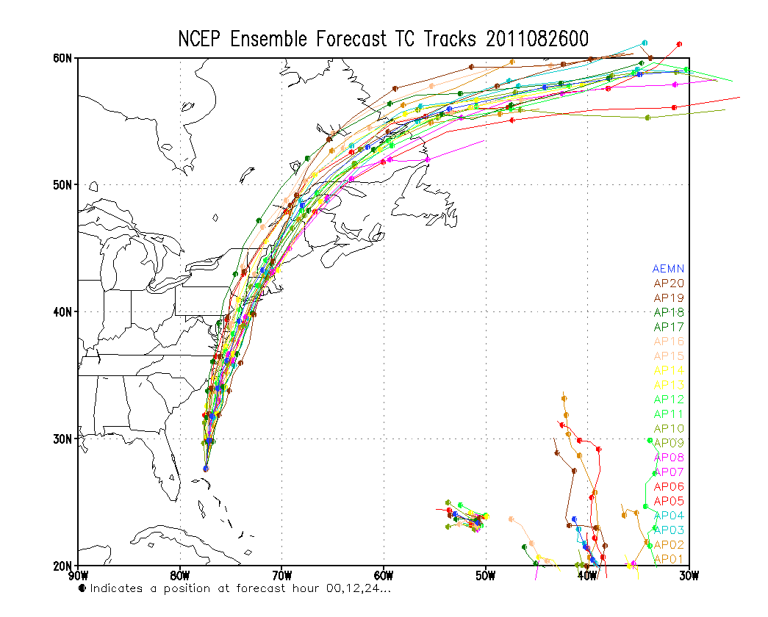
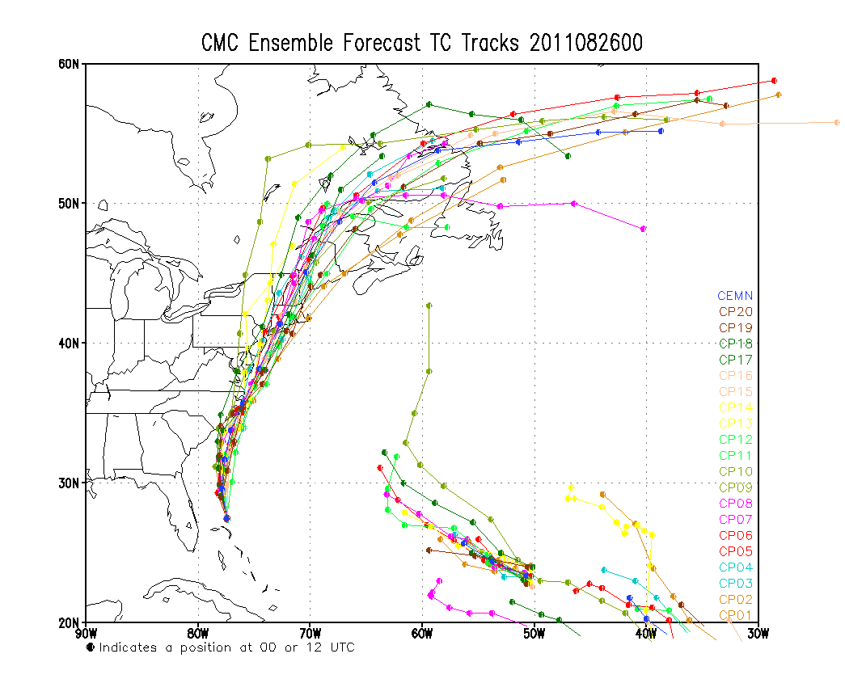
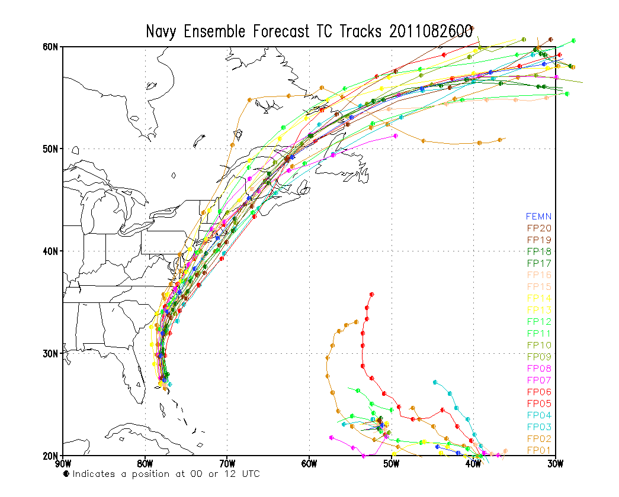
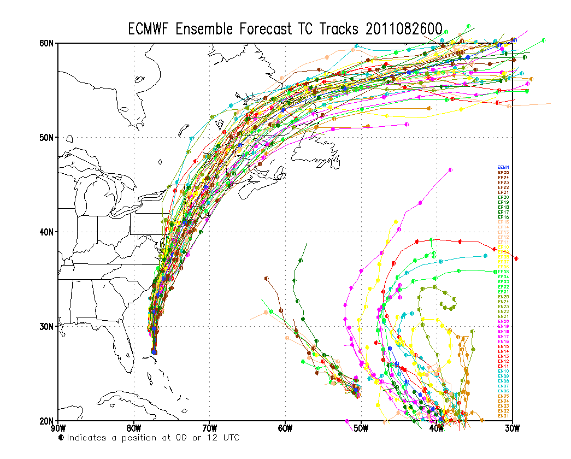
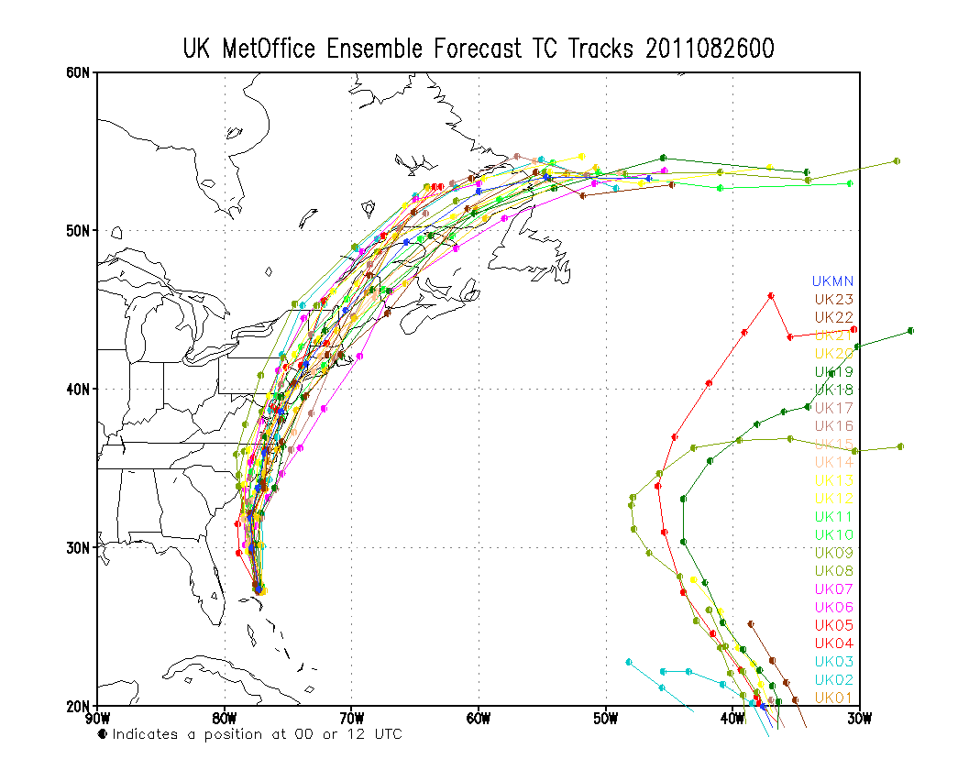
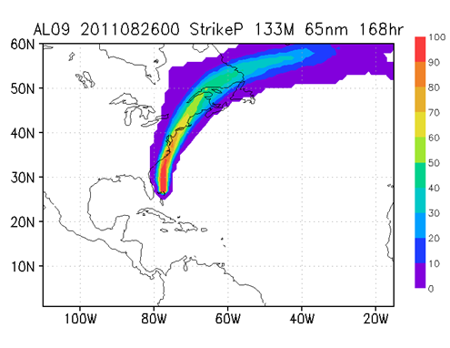
AL09: IRENE (08/26/2011 00Z) track probabilistic forecast

Slide 9
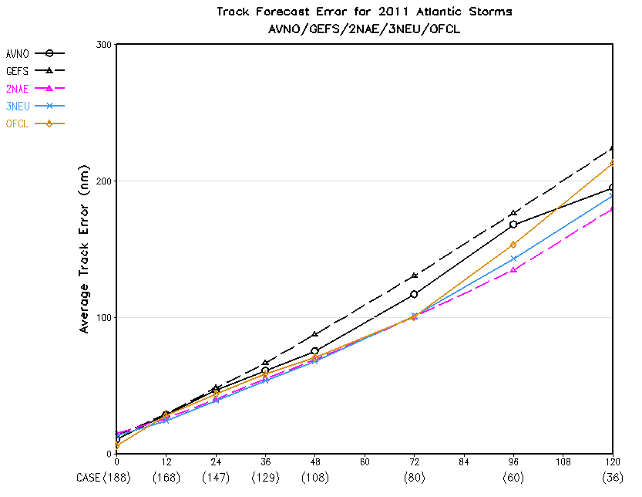
Multi-model ensemble TC-track forecasts. 19 TCs in Atlantic in 2011
Verification:
2NAE and 3NEU seems better than OFCL.
Please note: Model guidance is usually delayed 06~12 hours which means model forecast is not fully comparable to official forecast. Here is for reference only.
AVNO (black solid)----NCEP (GFS) deterministic run (T574L64)
AEMN (black dashed)----NCEP (GEFS-T190) 20-member mean
2NAE----NCEP(20)+ECMWF(50) 70-member mean
3NEU----NCEP(20)+ECMWF(50)+UK(23) 93-member mean
OFCL----NHC official forecast

Slide 10
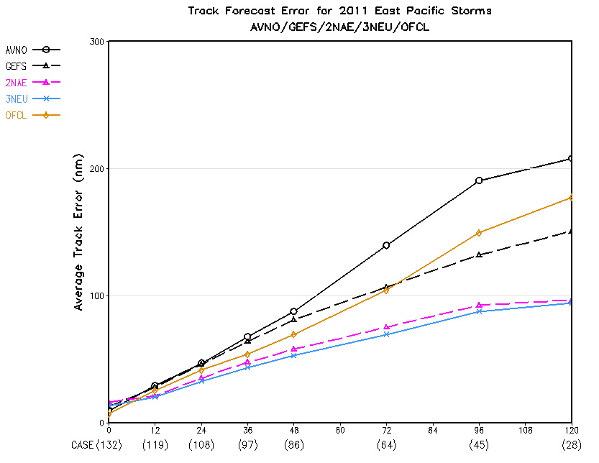
13 TCs in East Pacific in 2011
Verification:
2NAE and 3NEU are much better than OFCL.
Please note: Model guidance is usually delayed 06~12 hours which means model forecast is not fully comparable to official forecast. Here is for reference only.
AVNO (black solid)----NCEP (GFS) deterministic run (T574L64)
AEMN (black dashed)----NCEP (GEFS-T190) 20-member mean
2NAE----NCEP(20)+ECMWF(50) 70-member mean
3NEU----NCEP(20)+ECMWF(50)+UK(23) 93-member mean
OFCL----NHC official forecast

Slide 11
27 TCs in West Pacific in 2011
Verification:
2NAE and 3NEU are better than JTWC.
Please note: Model guidance is usually delayed 06~12 hours which means model forecast is not fully comparable to official forecast. Here is for reference only.
AVNO(black solid)----NCEP (GFS) deterministic run (T574L64)
AEMN(black dashed)----NCEP (GEFS-T190) 20-member mean
2NAE----NCEP(20)+ECMWF(50) 70-member mean
3NEU----NCEP(20)+ECMWF(50)+UK(23) 93-member mean
JTWC----JTWC official forecast

Slide 12
NCEP New GEFS-T254 (02/14/2012 in production)
Model and initialization
Using GFS V9.01 (current operational GFS) instead of GFS V8.00
Improved Ensemble Transform with Rescaling (ETR) initialization
Improved Stochastic Total Tendency Perturbation (STTP)
Configurations
T254 (55km) horizontal resolution for 0-192 hours (from T190 – 70km)
T190 (70km horizontal resolution for 192-384 hours (same as current opr)
L42 vertical levels for 0-384 hours (from L28)
Add Sunshine duration for TIGGE data exchange
Part of products will be delayed by approximately 20 minutes
Due to limit CCS resources
40-42 nodes for 70 minutes (start +4:35 end: +5:45)
Unchanged:
20+1 members per cycle, 4 cycles per day
pgrb file output at 1*1 degree every 6 hours
GEFS and NAEFS post process output data format
Why do we make this configurations?
Considering the limited resources
Resolution makes difference (example of T126 .vs T190)
What do we expect from this implementation?
Preliminary results (NH 500hPa and SH 500hPa height and tracks)

Slide 13
Atlantic, AL04-16 (08-09/2010); AL01-19(06-12/2011)
AEMN---GEFS T190 (operational run)
PARA---GEFS T254 (parallel run)
AVNO----GFS T574 (operational run)
Track error(NM)
#CASES 375 343 307 276 246 197 152 110 63 44
Forecast hours

Slide 14
Atlantic, AL01~19 (06/01~12/31/2011)
PARA runs once per day before Sep.
AEMN---GEFS T190 (operational run)
PARA---GEFS T254 (parallel run)
AVNO---GFS T574 (operational run)
11%
Improvement
20%
Track error(NM)
22%
12%
#CASES 309 279 251 227 202 162 125 88
Forecast hours

Slide 15
AL01~19 (06/01~12/31/2011)
2NAE---GEFS T190+ECMWF mean
2NEW---GEFS T254+ ECMWF mean
EEMN---ECMWF mean
AVNO---GFS T574 (operational run)
Track error(NM)
#CASES 474 438 395 357 316 251 195 137
Forecast hours

Slide 16
Algorithms for TC genesis probabilistic forecast
TC Genesis: maximum sustainable winds ≥25kts (12.9m/s)
Criteria (Gray,1968):
A positive relative vorticity in lower troposphere
Far away 5N/S from equator
Warm SST (≥79F or 26.1C for Atlantic)
Small vertical shear
Conditional instability in the lower to mid-troposphere
Large value of relative humidity in the middle troposphere
How to define NWP model TC genesis?
The prediction vortices in Global Ensemble Forecast Systems (GEFS) are very weak. (25kts ?)
We track every vortex by checking:
850/700hPa relative vorticity (max)
850/700hPa geopotential height (min)
Sea surface pressure (min)
850/700hPa wind speed (min)
SLP gradient (0.0015mb/km), Wind speed at 850hPa (≥ 1.5m/s)
We combine the above criteria and pick up the genesis vortex (Vmax≥15kts, SLPmin≤1015mb)
for each Global Ensemble System.

Slide 17
2011 Atlantic TC Genesis Forecast Reliability Diagram (GEFS-T190,15kts)
Verifying (%) or Distribution (%)
Forecast (%) N=289
Red line: perfect reliability
Blue line: the relationship between the forecast and verifying genesis probability
Green line: distribution of the forecast genesis probability
2011 GEFS-T190 Atlantic Hurricane Genesis Probability Forecasts within 48 Hours

Slide 18
2011 Atlantic TC Genesis Forecast Reliability Diagram (ECMWF ensemble, 15kts)
Verifying (%) or Distribution (%)
Forecast (%) N=165
Red line: perfect reliability
Blue line: the relationship between the forecast and verifying genesis probability
Green line: distribution of the forecast genesis probability
2011 Atlantic Hurricane Genesis Probability Forecasts within 48 Hours

Slide 19
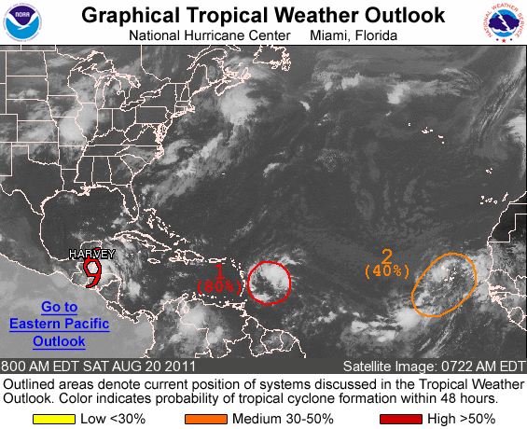
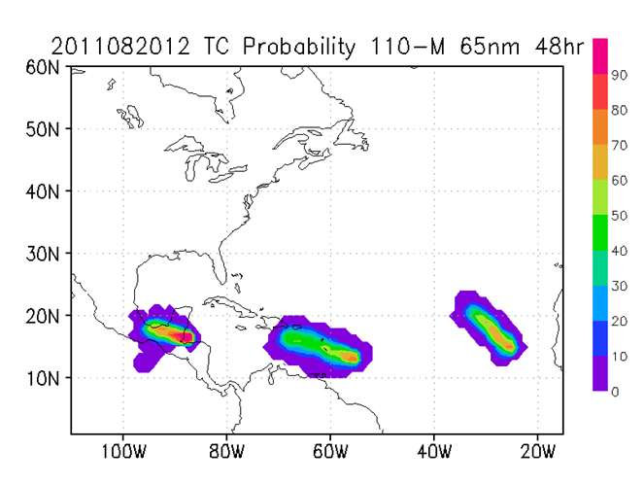
NHC Hurricane Genesis
Probability Forecasts
08/20/2011 12Z
NCEP+CMC+ECMWF+FNMOC
Multi-model TC genesis forecasts
AL08----HARVEY
AL97----IRENE genesis (true)
AL98----disappeared (false alarm)
AL08 AL97 AL98

Slide 20
Conclusions and Future Plans
The multiple model ensemble TC track prediction significantly reduced the 2010/2011 TC track forecast errors in Atlantic, East and West Pacific.
GEFS-T254 parallel runs for 2010/2011 hurricane seasons indicate a remarkable decrease of track error, which will be a good guidance for NHC 7-day hurricane forecast in 2012.
The global ensemble TC genesis probability predictions produce a lot of false alarms for TC genesis forecasts.
Future plans and ongoing works:
Investigate better TC genesis criteria for each ensemble forecast system.
Produce TC intensity probabilistic forecast.
GEFS bias-correction based on 30-year ensemble reforecast.
Please visit:
http://www.emc.ncep.noaa.gov/gmb/jpeng/TC_ens_V1.html
for 2012 real time TC track and genesis probabilistic forecasts.

Slide 21
2011 Atlantic TC Genesis Forecast Reliability Diagram (GEFS-T190, with TC,15kts)
Verifying (%) or Distribution (%)
Forecast (%) N=134
Red line: perfect reliability
Blue line: the relationship between the forecast and verifying genesis probability
Green line: distribution of the forecast genesis probability

Slide 22
2011 Atlantic TC Genesis Forecast Reliability Diagram (ECMWF, with TC, 15kts)
Verifying (%) or Distribution (%)
Forecast (%) N=77
Red line: perfect reliability
Blue line: the relationship between the forecast and verifying genesis probability
Green line: distribution of the forecast genesis probability

Slide 23
2011 Atlantic TC Genesis Forecast Reliability Diagram (NHC forecast)
Verifying (%) or Distribution (%)
Forecast (%) N=482
Red line: perfect reliability
Blue line: the relationship between the forecast and verifying genesis probability
Green line: distribution of the forecast genesis probability

Slide 24
2011 Atlantic TC Genesis Forecast Reliability Diagram (NHC, with TC)
Verifying (%) or Distribution (%)
Forecast (%) N=172
Red line: perfect reliability
Blue line: the relationship between the forecast and verifying genesis probability
Green line: distribution of the forecast genesis probability

Slide 25
Invest storm to TC genesis (06~11/2011)
MM | 06 | 07 | 07 | 07 | 07 | 08 | 08 | 08 | 08 | 08 | 08 | 08 | 08 | 09 | 09 | 09 | 09 | 10 | 11
IN | 95 | 98 | 99 | 90 | 91 | 95 | 94 | 93 | 97 | 90 | 91 | 92 | 93 | 95 | 96 | 99 | 90 | 96 | 98
AL | 01 | 02 | 03 | 04 | 05 | 06 | 07 | 08 | 09 | 10 | 11 | 12 | 13 | 14 | 15 | 16 | 17 | 18 | 19
MM----month IN----invest storm number AL----Atlantic storm number
The other invest storms:
June: 93L, 94L July:96L, 97L
August: 92L, 98L, 99L September:94L, 97L, 98L, 91L
October: 92L, 93L, 94L, 95L, 97L
November: 99L, 90L
June~November 2011, invest storms: 37 19 TC genesis (51%)

Slide 26
TC Genesis Criteria
Atlantic | NHC Best Track | GEFS-T190/254
Maximum Wind Speed | ≥25kts | ≥19kts
Minimum SLP | ≤1011mb | ≤1015mb
East Pacific | NHC Best Track | GEFS-T190/254
Maximum Wind Speed | ≥25kts | ≥13kts
Minimum SLP | ≤1009mb | ≤1010mb
West Pacific | JTWC Best Track | GEFS-T190/254
Maximum Wind Speed | ≥25kts | ≥15kts
Minimum SLP | ≤1006mb | ≤1008mb

Slide 27
2010 Atlantic: 3EMN/6EMN (3EMN/6EMN 0-hour delay)
Track error(NM)
#CASES 195 174 154 136 118 85 69 55
Forecast hours
3EMN---NCEP,CMC, ECMWF 90-member mean
6EMN---three ensemble means+three deterministic runs, 6-member mean

Slide 28
2010 Atlantic: 3EMI/6EMI (6-hour TC track interpolation, 3EMN/6EMN 6-hour delay)
Track error(NM)
#CASES 179 165 145 130 115 84 67 51
Forecast hours
3EMN---NCEP,CMC, ECMWF 90-member mean
6EMN---three ensemble means+three deterministic runs, 6-member mean

Slide 29
2010 Atlantic: 3EM2/6EM2 (12-hour TC track interpolation, 3EMN/6EMN 12-hour delay)
Track error(NM)
#CASES 173 155 137 122 104 79 62 48
Forecast hours
3EMN---NCEP,CMC, ECMWF 90-member mean
6EMN---three ensemble means+three deterministic runs, 6-member mean

Slide 30
2010 West Pacific: 3EMN/6EMN (3EMN/6EMN 0-hour delay)
Track error(NM)
#CASES 154 147 132 112 96 66 41 24
Forecast hours
3EMN---NCEP,CMC, ECMWF 90-member mean
6EMN---three ensemble means+three deterministic runs, 6-member mean

Slide 31
2010 West Pacific: 3EMI/6EMI (6-hour TC track interpolation, 3EMN/6EMN 6-hour delay)
Track error(NM)
#CASES 138 134 122 105 91 63 38 22
Forecast hours
3EMN---NCEP,CMC, ECMWF 90-member mean
6EMN---three ensemble means+three deterministic runs, 6-member mean

Slide 32
2010 West Pacific: 3EM2/6EM2 (12-hour TC track interpolation, 3EMN/6EMN 12-hour delay)
Track error(NM)
#CASES 133 126 114 99 84 57 32 21
Forecast hours
3EMN---NCEP,CMC, ECMWF 90-member mean
6EMN---three ensemble means+three deterministic runs, 6-member mean

