Slide 1
The Hurricane WRF model Satellite Simulator (HWSS)
Design and Applications
Tom Greenwald¹, Tomislava Vukicevic², and Jim Davies¹
¹University of Wisconsin/CIMSS, ²NOAA/AOML/HRD
Presentation at EMC, 7 June 2012

Slide 2
Contents
HWSS overview
Applications
Future capabilities
Transition to operations

Slide 3
HWSS Features
Modular design
Perl script controls separate f90/95 executables
Built around CRTM v2.0.4
Options set through keywords in text control file
One HWRF model output file (NetCDF) processed per control file
Multiple sensors (LEO and/or GEO) and individual channels can be processed
Instruments supported: GOES imager/sounder and conical-scanning microwave sensors: TMI, AMSR-E, SSM/I, SSMIS
Geometry specification (observation zenith/azimuth angles, GEO latitude); L1B file (NetCDF/HDF) needed to simulate swath for LEO sensors
Two hydrometeor size models available (fixed size or fixed number concentration)
3D CPR (W-band) reflectivity computed using modified QuickBeam package (improved ice scattering properties, etc.)
Presentation at EMC, 7 June 2012

Slide 4
HWSS Flow
Control File
Input HWRF data (NetCDF)
Sensor(s)/channel(s)
Satellite geometries
Radar or imager/sounder
Output file (NetCDF)
Configuration File
File paths
CRTM coeff files
HWSS.pl
HWRF Convert
Intermed
NetCDF
Slant path preprocessor
QuickBeam
Radar or Imgr/Snder?
HWRF CRTM
Imagery
NetCDF
Radar Z
NetCDF
Convolution
Smoothed Imagery
Presentation at EMC, 7 June 2012

Slide 5
HWRF Convert
Variables contained in intermediate file
Geometry assignment for LEO sensors
Fixed zenith angle
Control file
or
Multi-sensor zenith, multi-sensor azimuth
Control file + satellite lat/lon data
Fixed zenith angle
Missing
Time, P (layer), T(layer), w(layer), T_{s}, p_{s}, u₁₀, v₁₀, SST, land class,
lat, lon
HWRF model data
Subset of model variables
Fixed size
cloud(layer), ice(layer), rain(layer), hail(layer), graupel(layer), snow(layer), …
Control file;
HWRF model data
or
Fixed N, variable size

Slide 6
HWRF CRTM
Intermediate
File
Compute
geometry for GEO
and/or solar calcs
Output radiance
T_{b}
Reflectance file
CRTM
Control
file

Slide 7
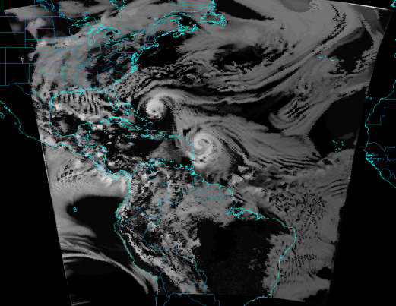
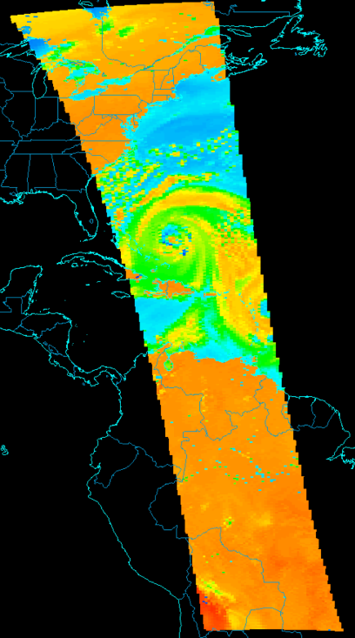
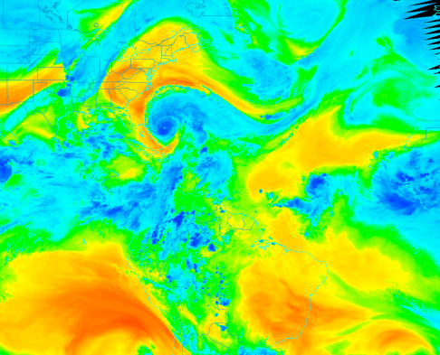
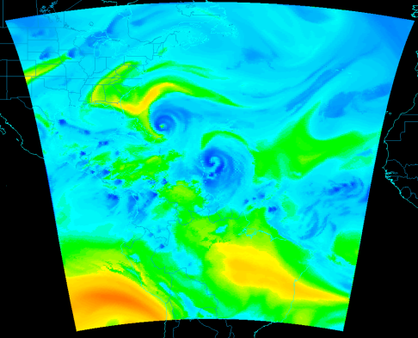
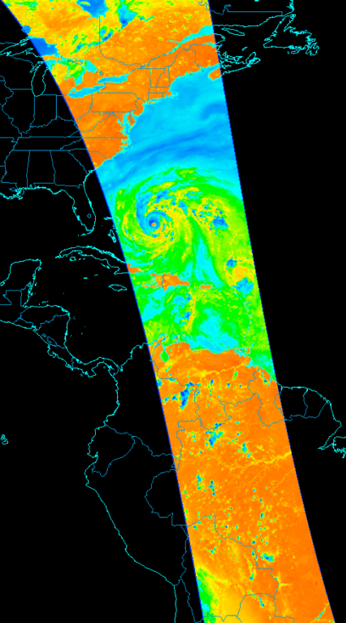
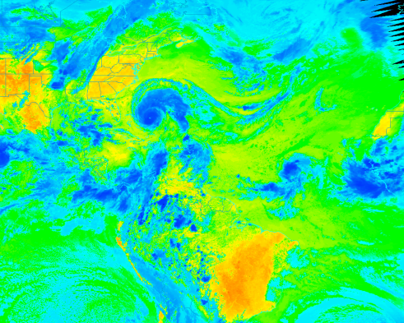
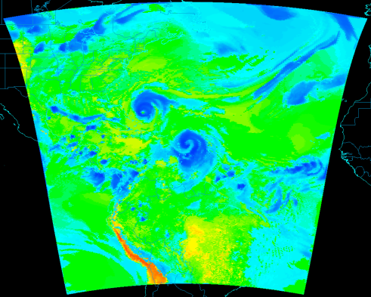
Sample Imagery
Hurricane Earl
1800 UTC 1 Sep 2010
GOES-13 Imager
AMSR-E
89H GHz
Visible
Water vapor
Simulated
Window IR
Observed
Observed
Simulated
Presentation at EMC, 7 June 2012

Slide 8
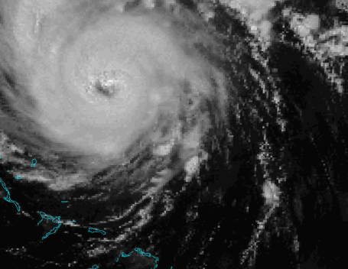
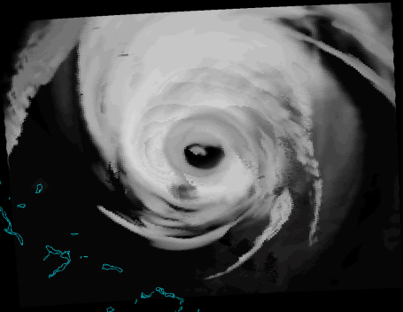
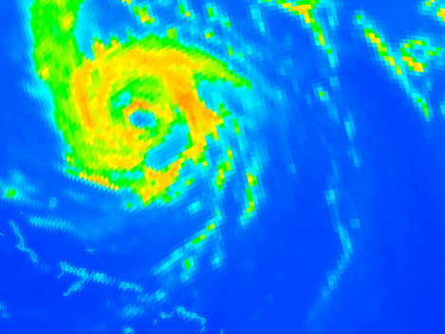
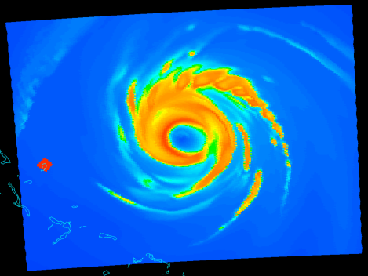
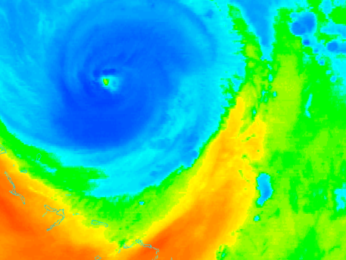
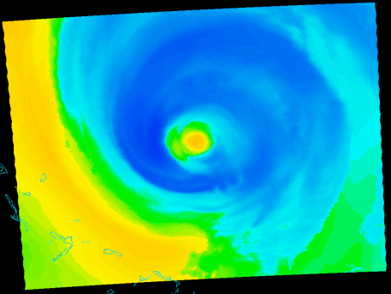
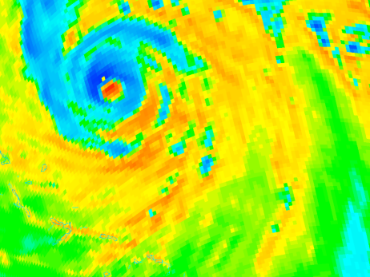
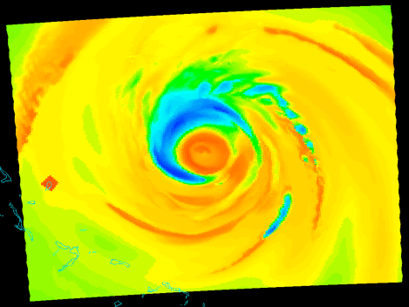
Sample Imagery Cont.
GOES-13
AMSR-E
Visible
37H GHz
0
Albedo
100%
155 K
T_{b}
295 K
Water vapor
89H GHz
195 K
T_{b}
265 K
160 K
T_{b}
300 K
Observed
Simulated
Observed
Simulated
Presentation at EMC, 7 June 2012

Slide 9
Applications: Verification
Joint PDFs
Warm core anomalies
CloudSat

Slide 10
Model Evaluation using Joint Pdfs
Analysis of hurricane Earl at 1800 UTC on 1 Sep 2010
Rain
Rain + ice
Storm relative using inner grid
Bi-spectral pdf gives information on vertical structure of storm
Polarization corrected temperature (PCT) used to reduce ambiguities for cold T_{b}s associated with ocean surface vs volume scattering
Observed
PCT₈₉ = 1.818 T_{89v} – 0.818 T_{89h}
Spencer et al. (1989)
Simulated
Presentation at EMC, 7 June 2012

Slide 11
Warm Core Anomalies at 54.4 GHz
Time series of hurricane Earl simulation vs. observations
Presentation at EMC, 7 June 2012

Slide 12
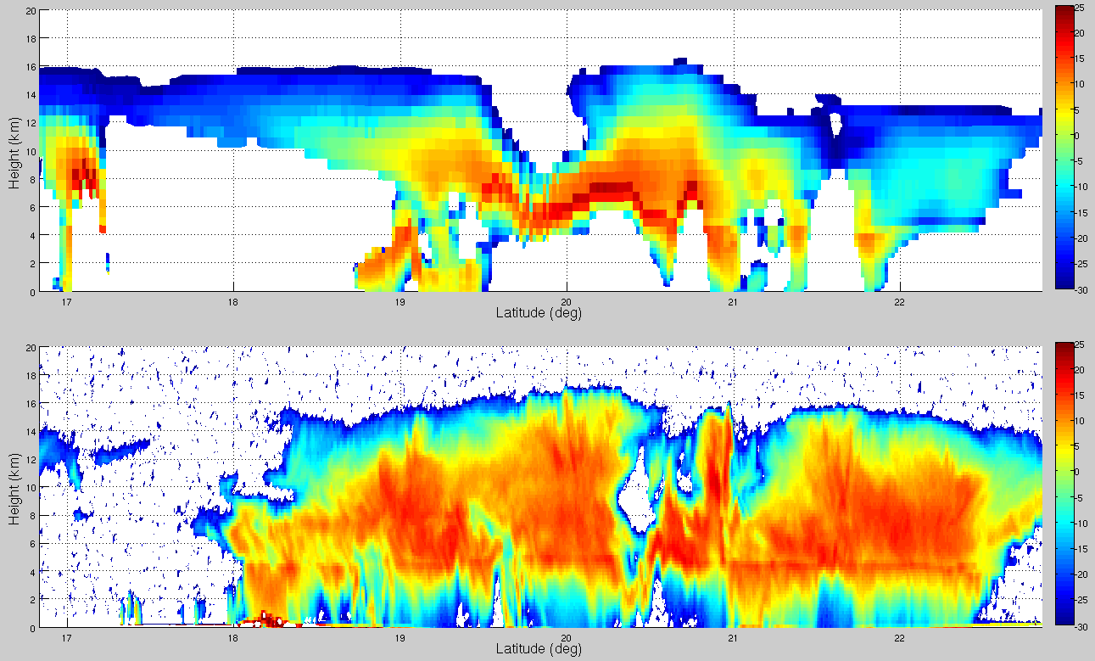
CloudSat Comparisons
Simulated (collocated)
Hurricane Earl 31 Aug 2010 0600 UTC
dBZ
Simulated (storm relative)
dBZ
Observed
dBZ
Presentation at EMC, 7 June 2012

Slide 13
Future HWSS Capabilities
Include cross-track scanning instruments: AMSU, ATMS, etc.
Import operational HWRF model data (native format?) and produce GRIB output files
Import satellite data in BUFR
Move to CRTM v2.1 when released
Convolve microwave data using antenna pattern
Slant path radiative transfer (important for higher microwave frequencies and high-resolution DA)
Presentation at EMC, 7 June 2012

Slide 14
Transition to Operations
Forecaster needs
Which satellite data are important? What about visible imagery? Any interest in AMSU/MHS and ATMS data?
Other thoughts?
UPP enhancement
Ability to simulate swath for conical and cross-track scanning instruments
Production of synthetic imagery using predicted LEO satellite track?
Convolution of synthetic microwave imagery should be relatively easy to implement
Is slant path RT too difficult to add?

