Slide 1
Test of scale-aware SAS in HWRF

Slide 2
Tests in both GFS and HWRF
1)
Arakawa & Wu (AW; 2013)
2)
Grell & Freitas (GF; 2014)
3)
Combination of AW & GF
4)
Modified Grell & Freitas (GFM)
Jongil Han

Slide 3
Modified parameterization of updraft fraction (σ_{u}) for scale-aware SAS
1) Arakawa & Wu, 2013:
Use of vertical velocities
at the cloud base
a₁=0.1
2) Grell & Freitas (2014):
3) Modified Grell & Freitas:
Actual entrainment rate at the cloud base is used to compute the cumulus radius rather than the constant value
Jongil Han

Slide 4
Experiments
Experiment | Description
No-scale | use scale-aware SAS, impose scale=1 on Domains 01 and 02. no SAS on domain 03. Mimic operational 2015 HWRF run, except using the latest SAS
AW | AW fractional updraft formulation
GF | GF fractional updraft formulation
AWGF | Combined AW+GF fractional updraft formulation
GFM | Modified GF
No-scale-all | Same as (1), except turning on SAS in all domains
OPER: | For reference. Same as (1), except using old SAS.
Runs:
: 09L 18L
: 09L
: 11L 20E

Slide 5
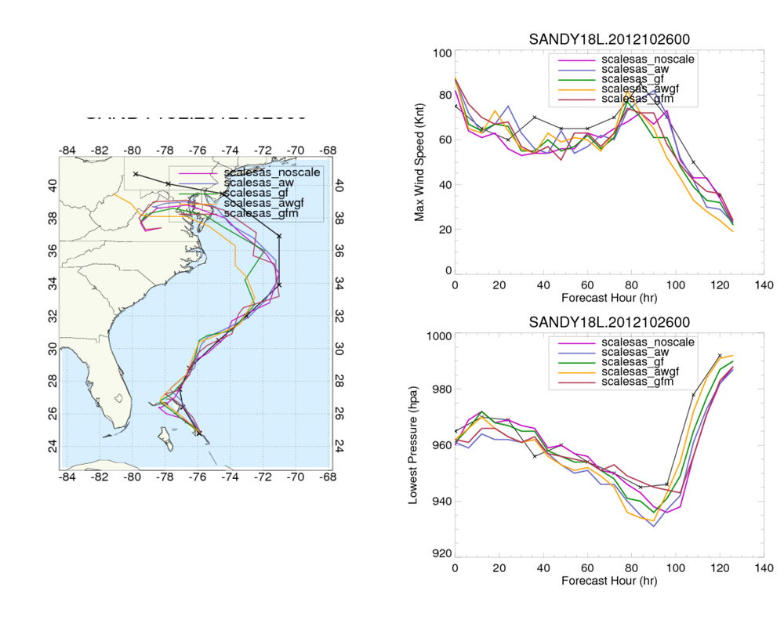

Slide 6
Scale function
updraft fractional area
accumulated precip
2012102600 cycle, at 6th hour
Kept nest domains “NO MOVE” to correctly display accumulated CU rain

Slide 7
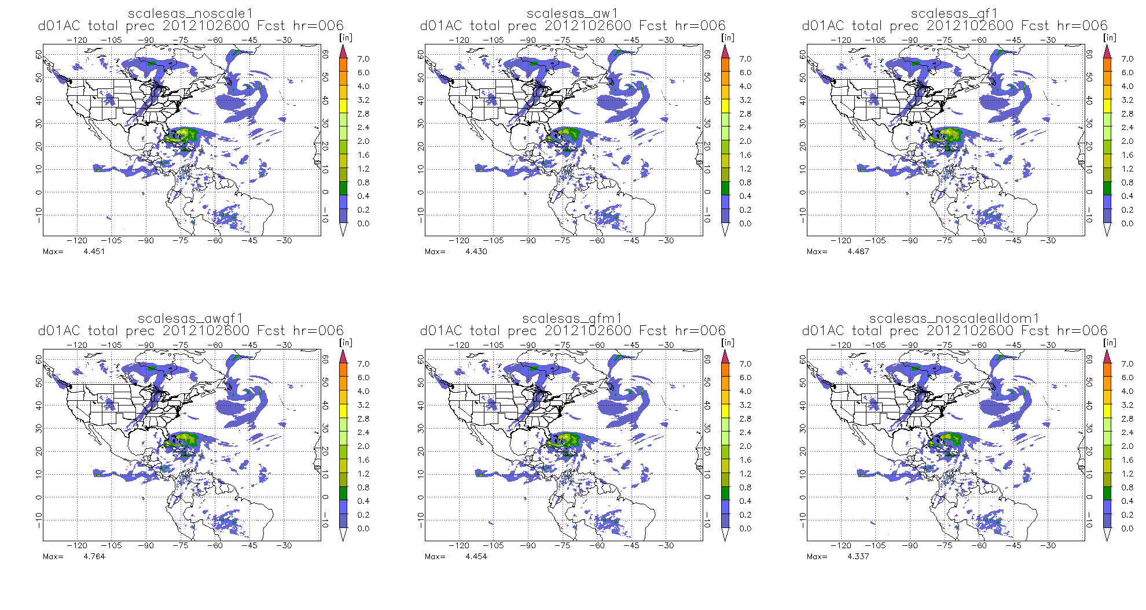
No scale
AW
GF
AWGF
GFM
No-scale-all domain
Accumulated Total Precip on D01

Slide 8
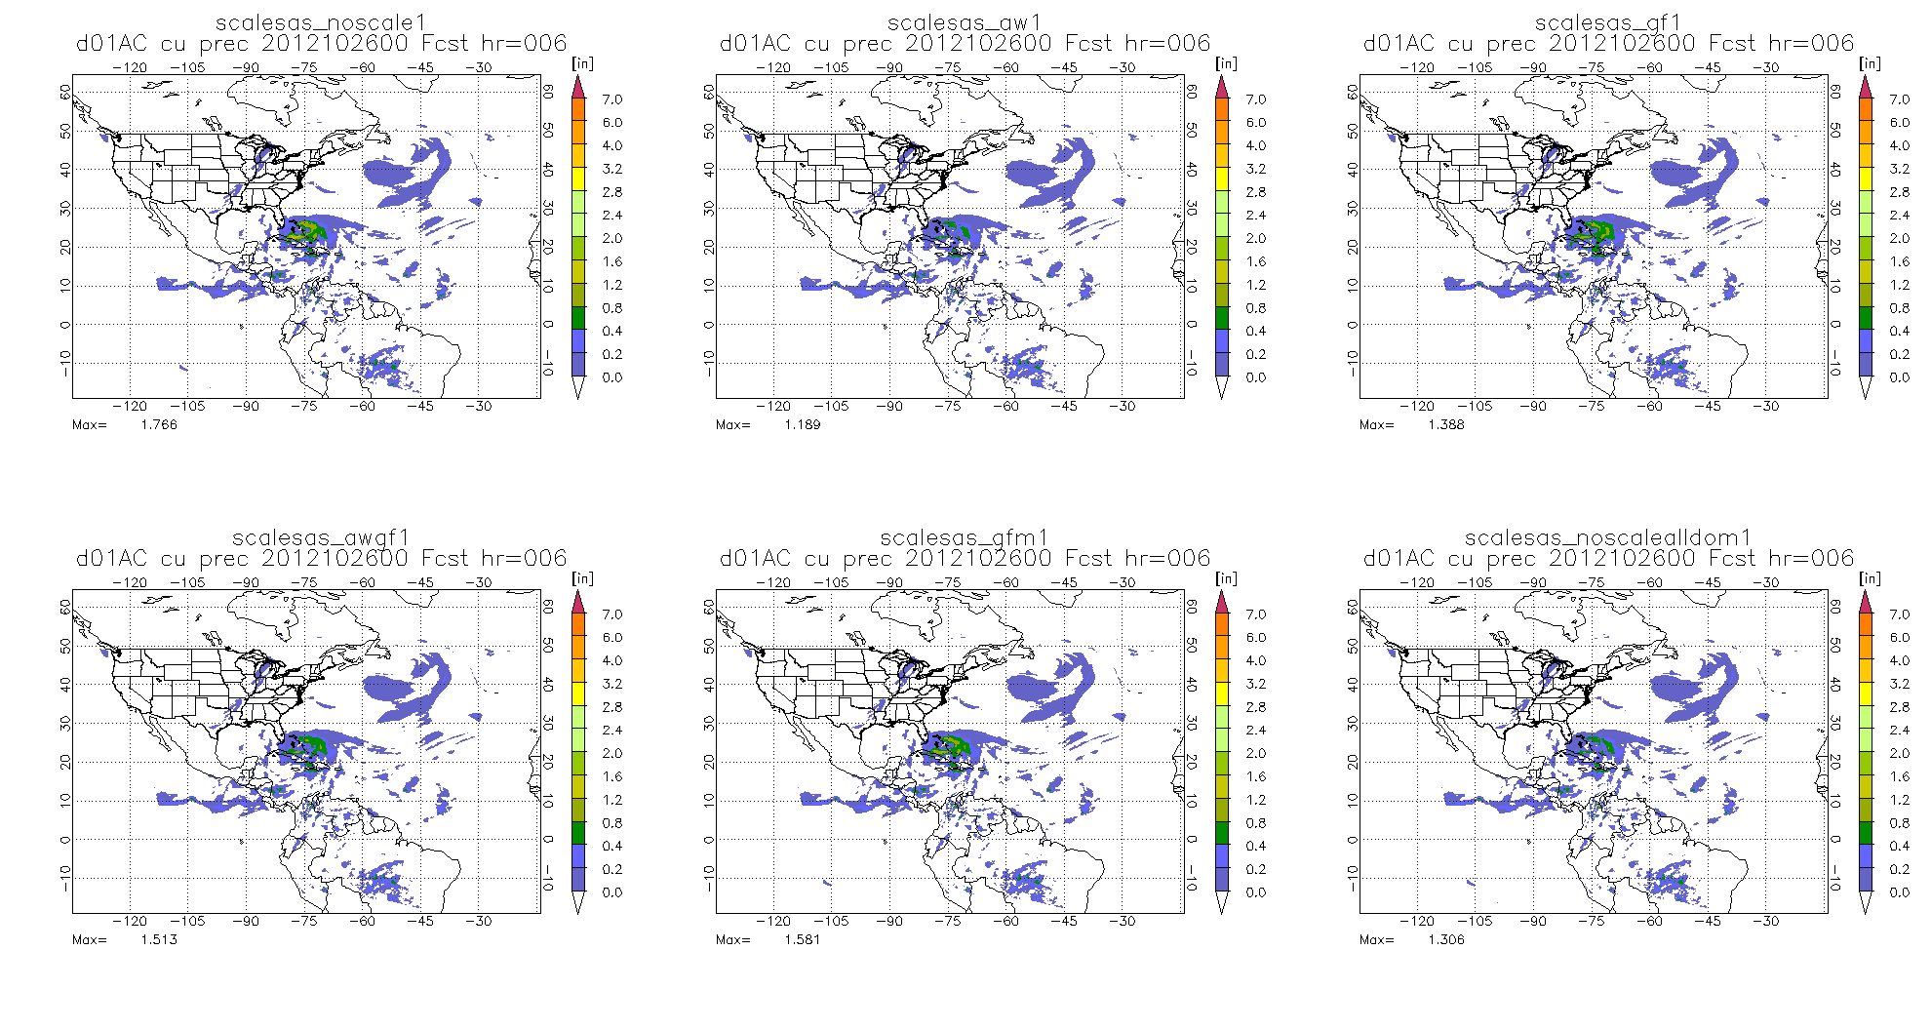
No scale
AW
GF
AWGF
GFM
No-scale-all domain
Accumulated CU Precip on D01

Slide 9
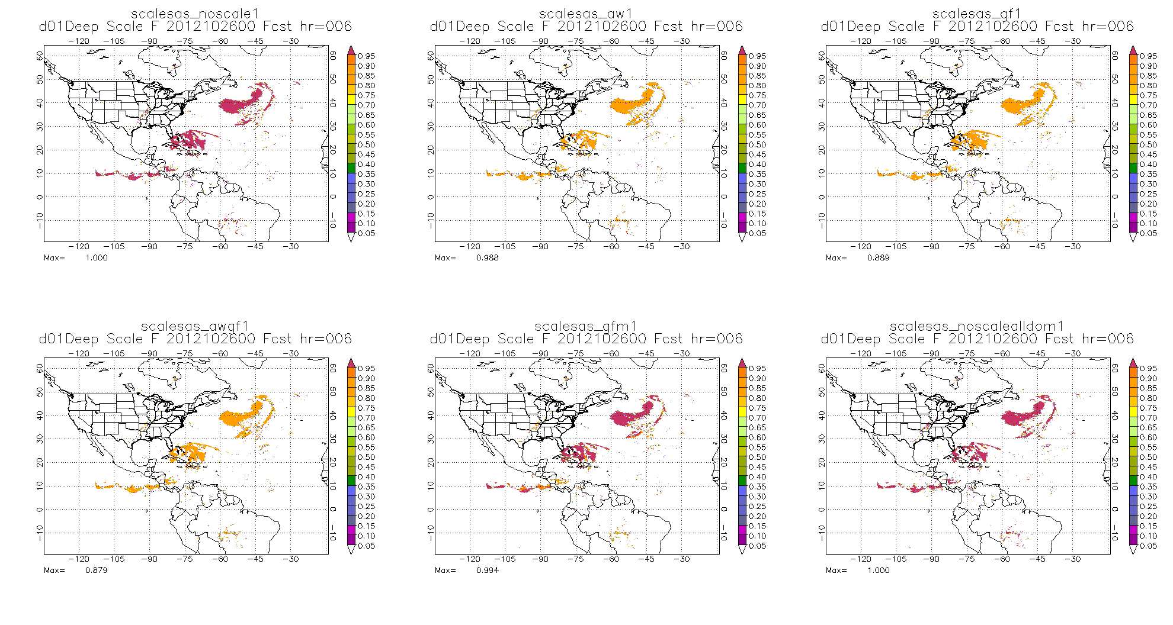
No scale
AW
GF
AWGF
GFM
No-scale-all domain
Deep: Scale function on D01

Slide 10
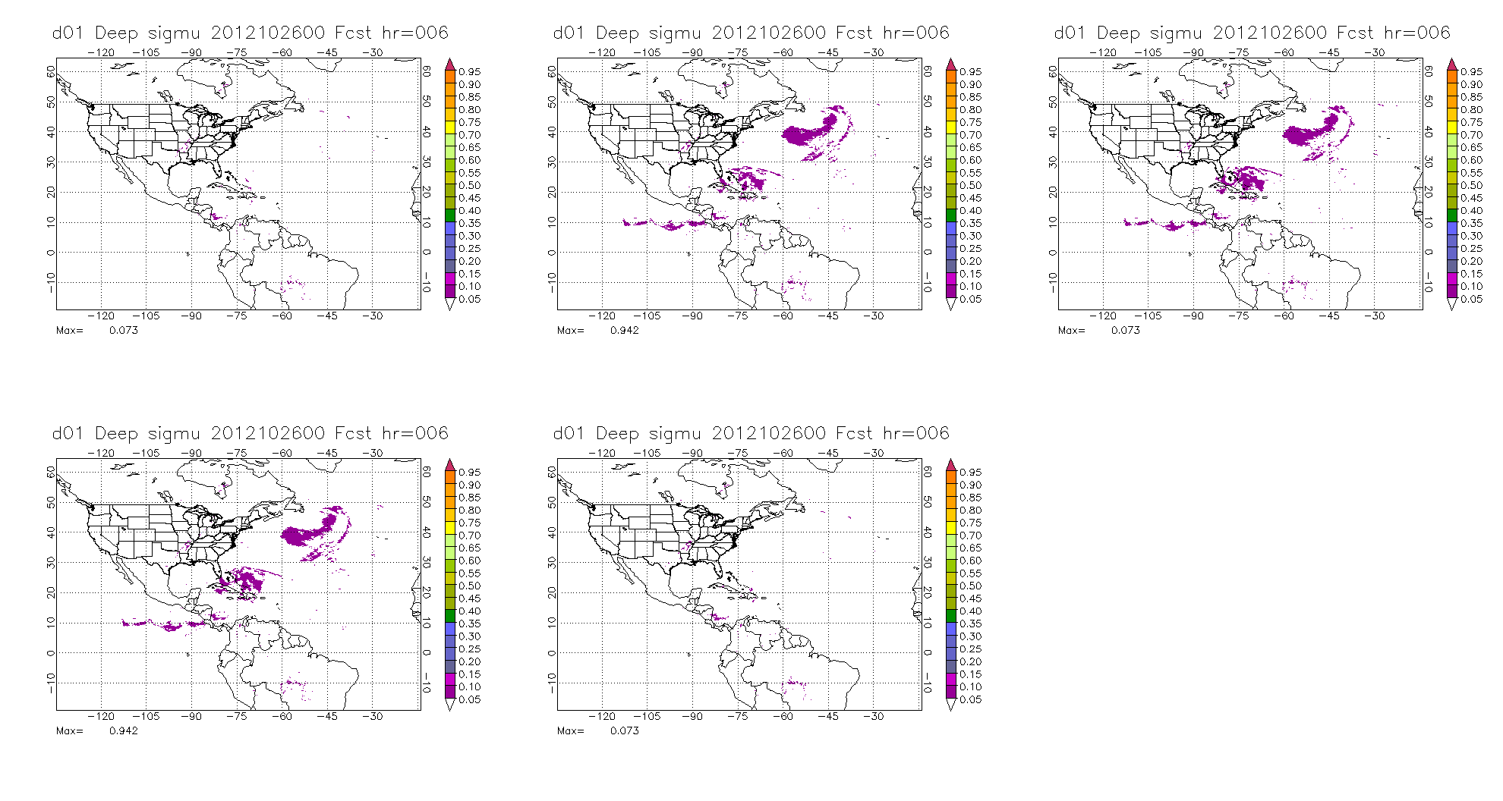
No scale
AW
GF
AWGF
GFM
Deep: Sigmu on D01

Slide 11
Domain 02

Slide 12
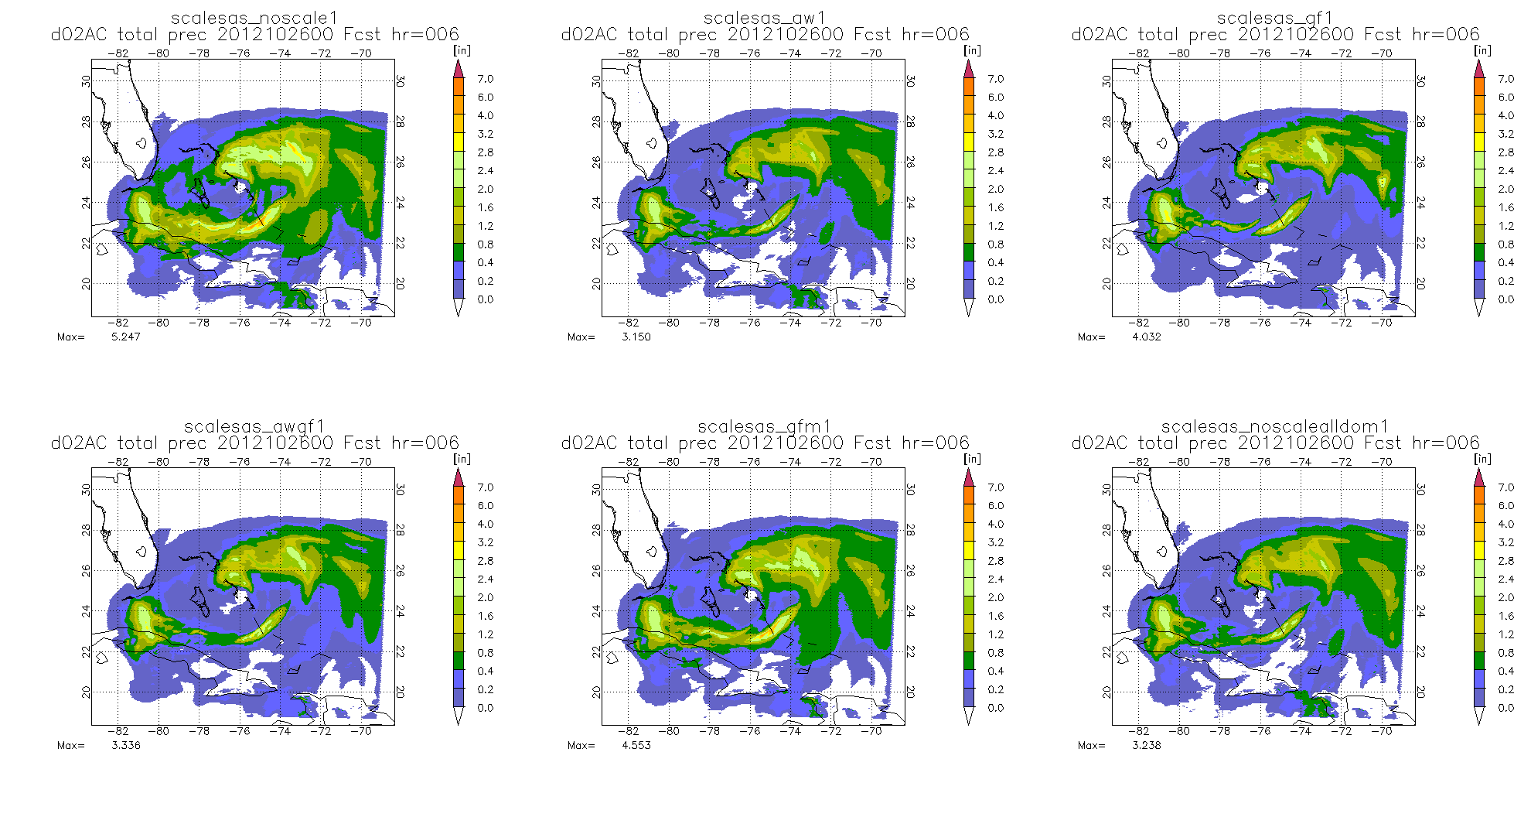
No scale
AW
GF
AWGF
GFM
No-scale-all domain
Accumulated Total Precip on D02

Slide 13
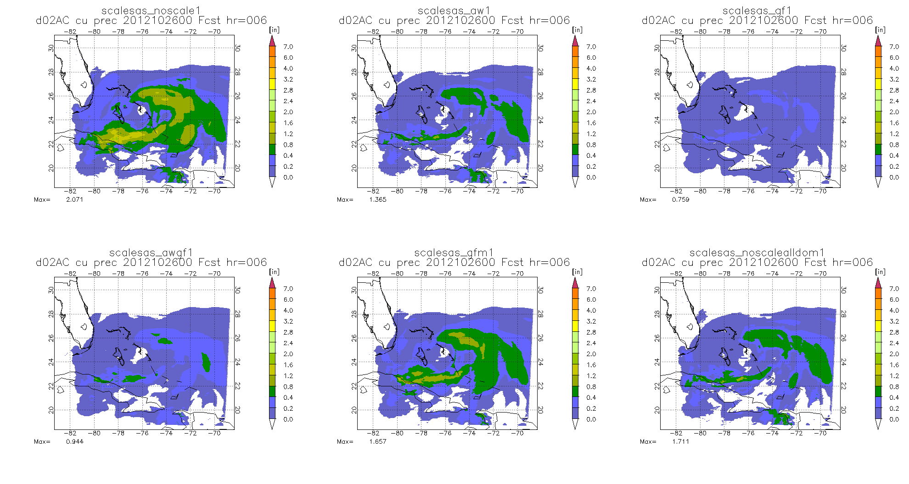
No scale
AW
GF
AWGF
GFM
No-scale-all domain
Accumulated CU Precip on D02

Slide 14
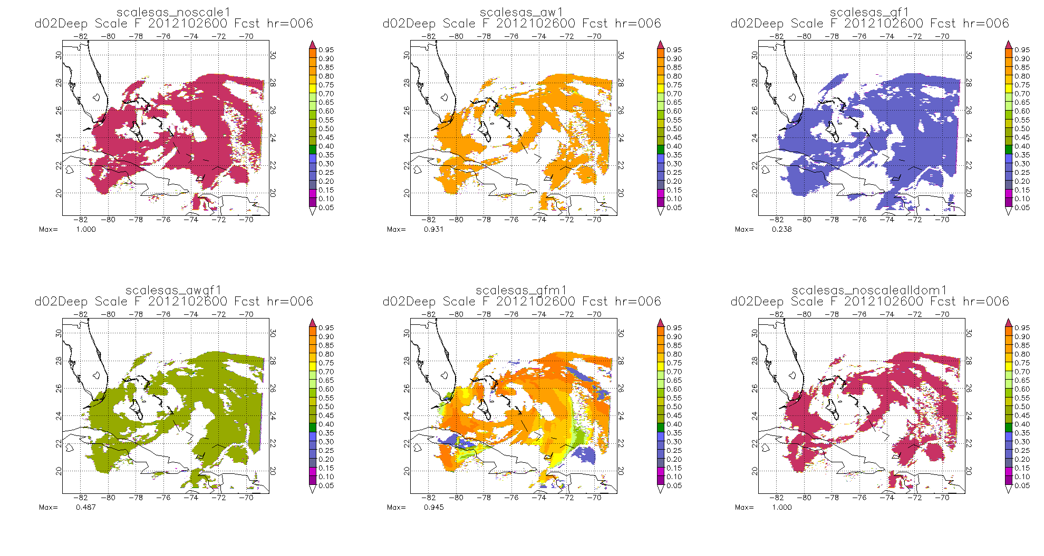
No scale
AW
GF
AWGF
GFM
No-scale-all domain
Deep: Scale function on D02

Slide 15
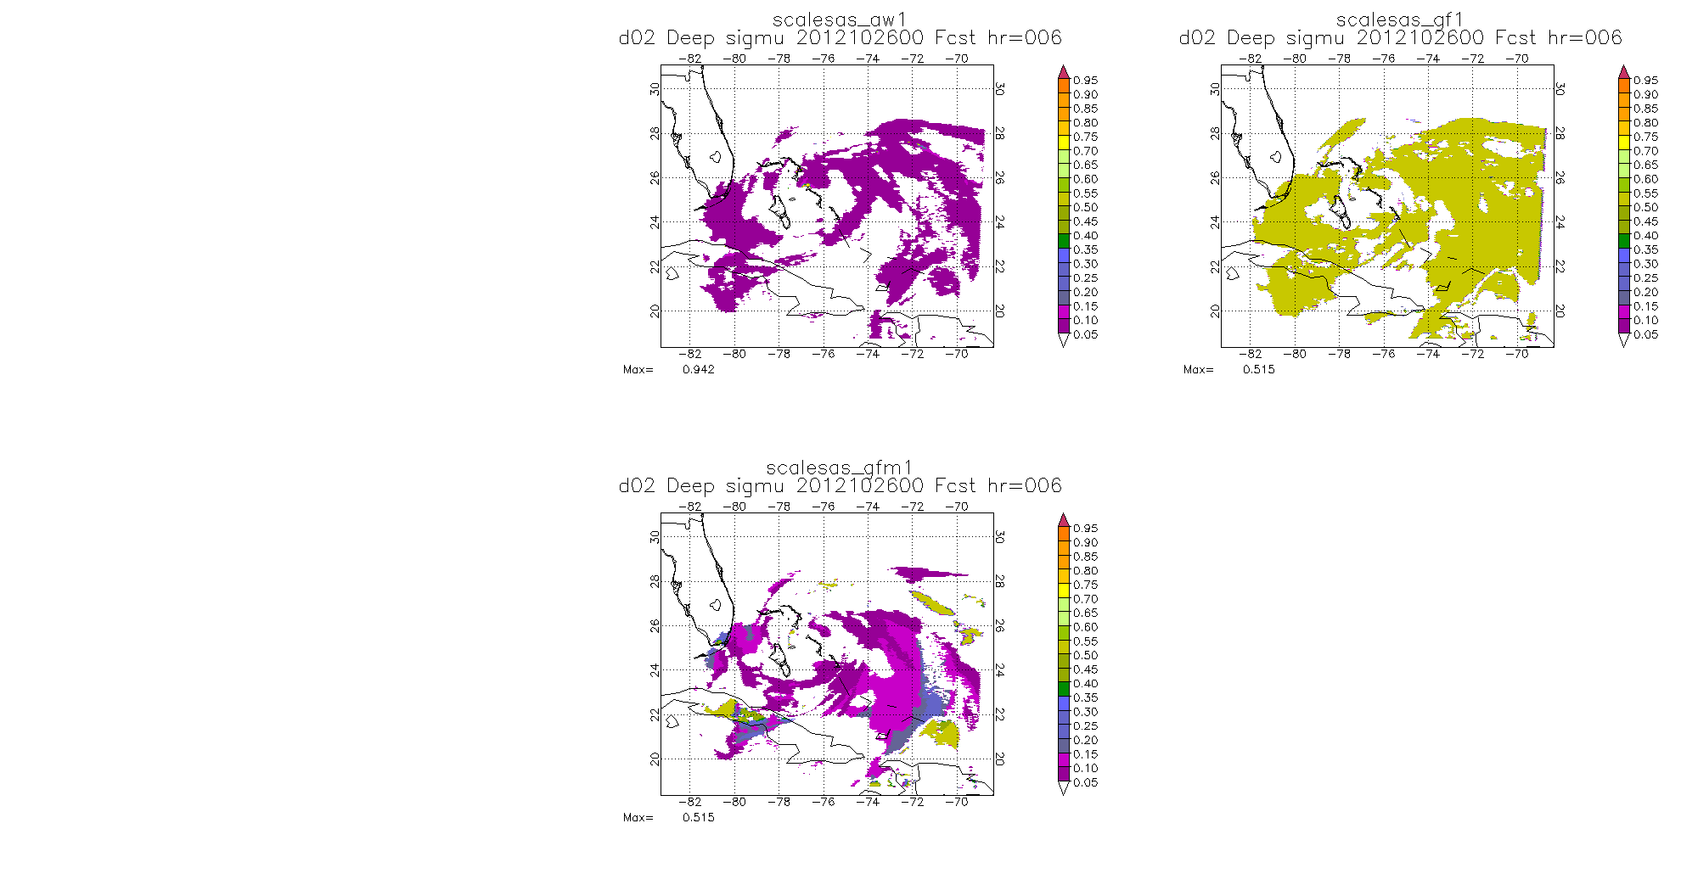
No scale
AW
GF
AWGF
GFM
Deep: SigmU on D02

Slide 16
Domain 03

Slide 17
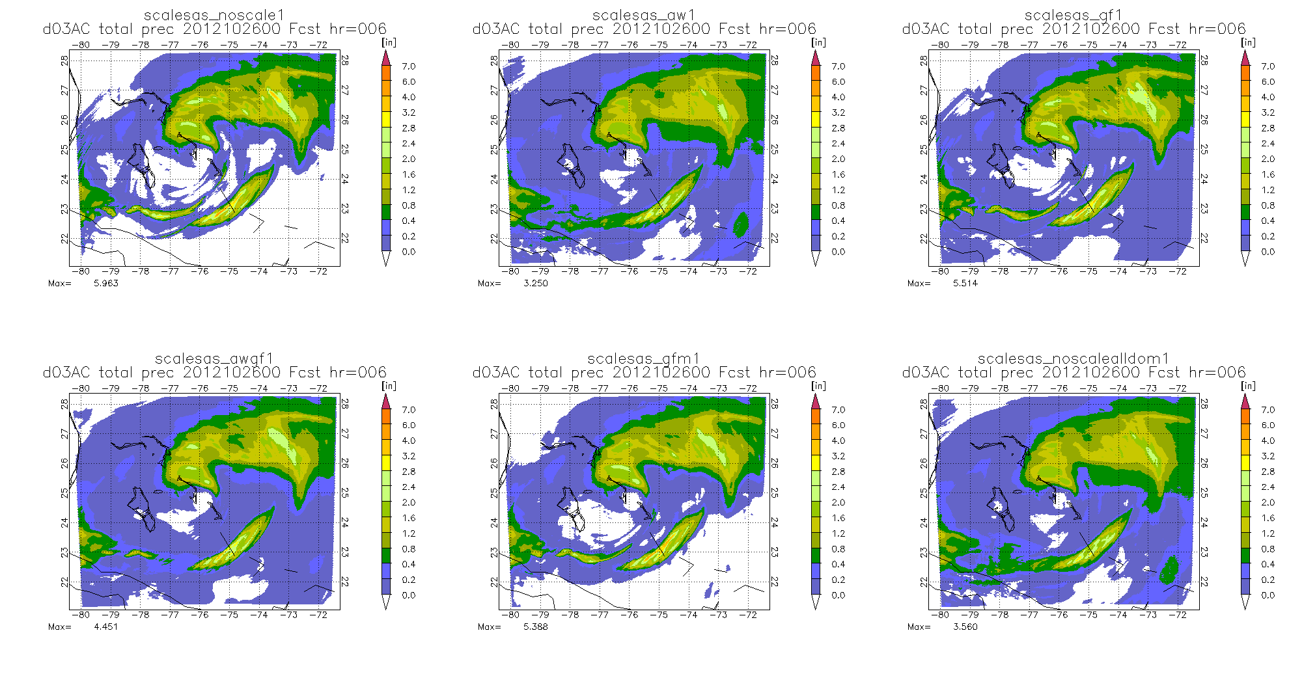
No scale
AW
GF
AWGF
GFM
No-scale-all domain
Accumulated Total Precip on D03

Slide 18
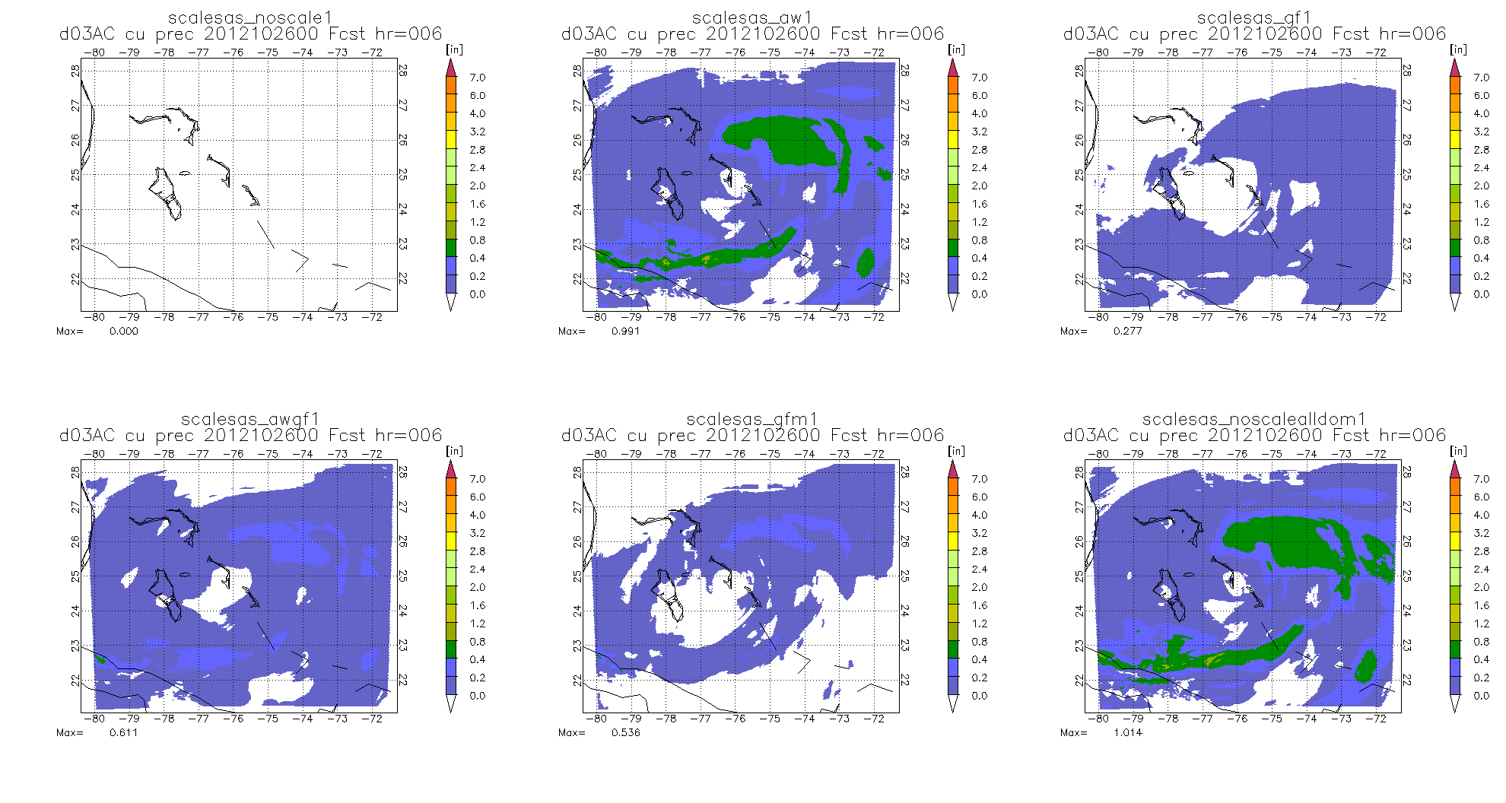
No scale
AW
GF
AWGF
GFM
No-scale-all domain
Accumulated CU Precip on D03

Slide 19
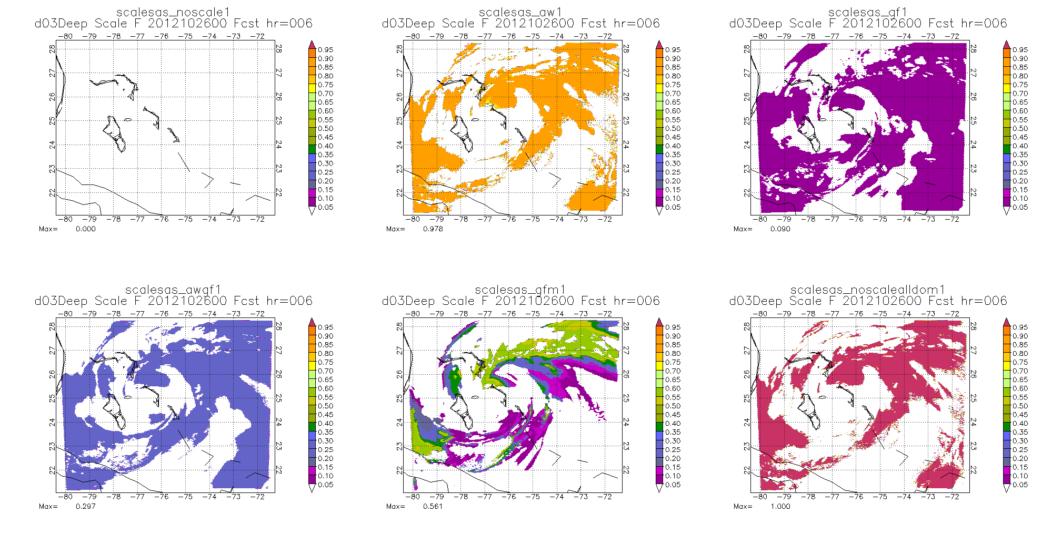
No scale
AW
GF
AWGF
GFM
No-scale-all domain
Deep: Scale function on D03

Slide 20
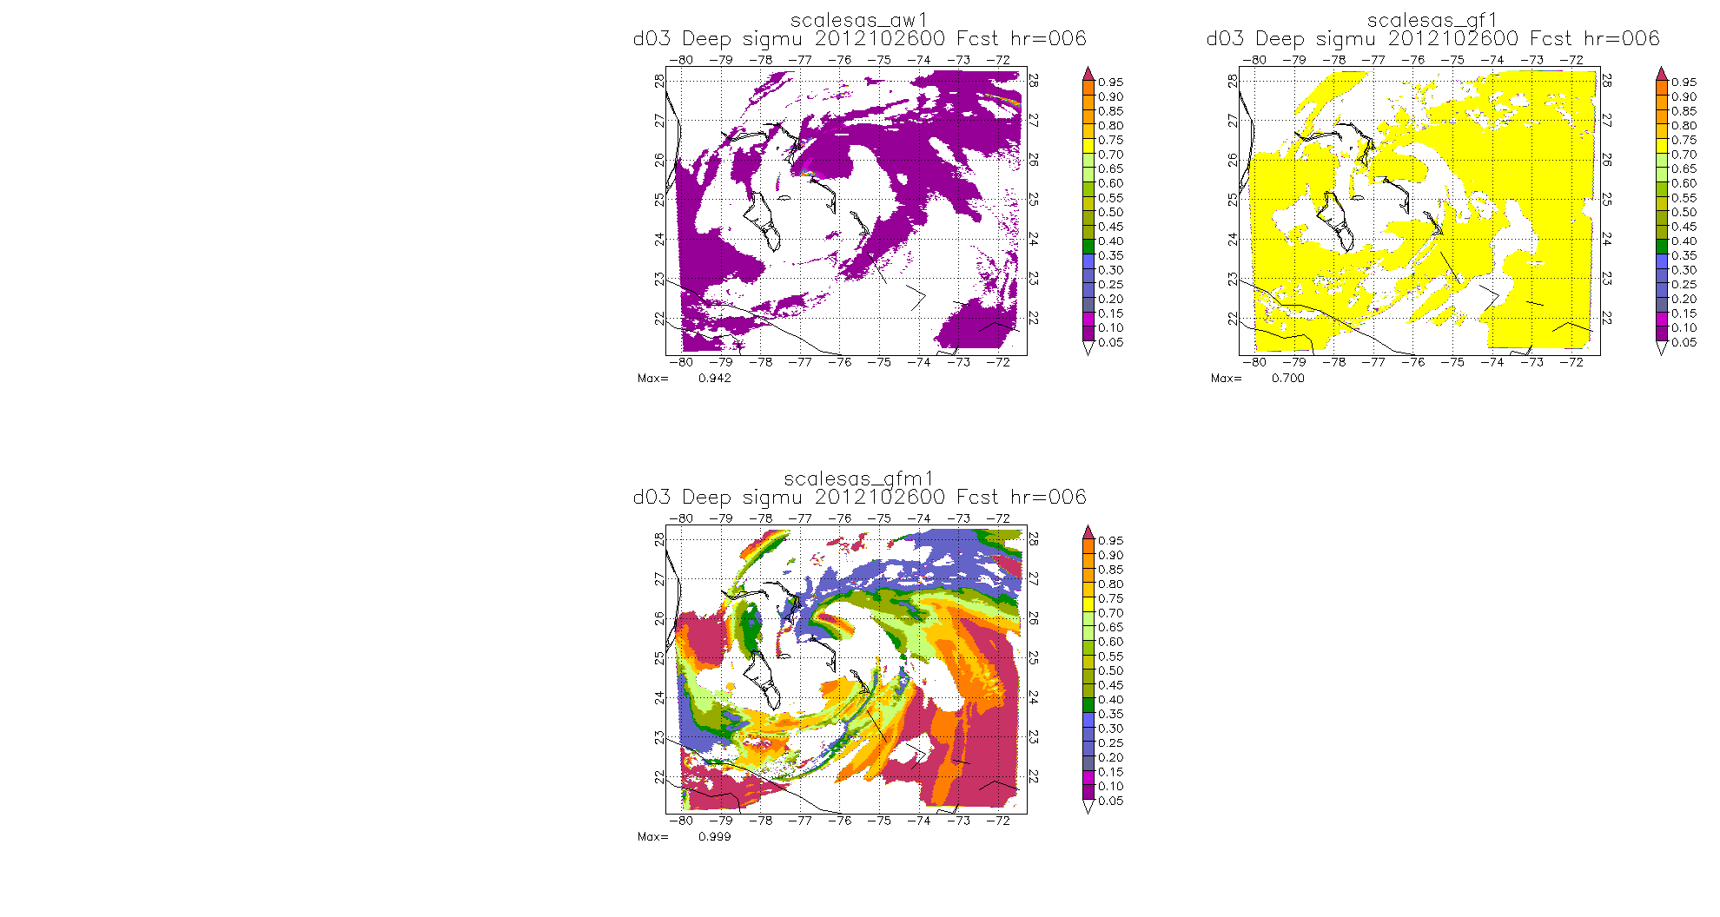
No scale
AW
GF
AWGF
GFM
Deep: SigmU on D03

Slide 21
new SAS vs Current SAS in HWRF

Slide 22
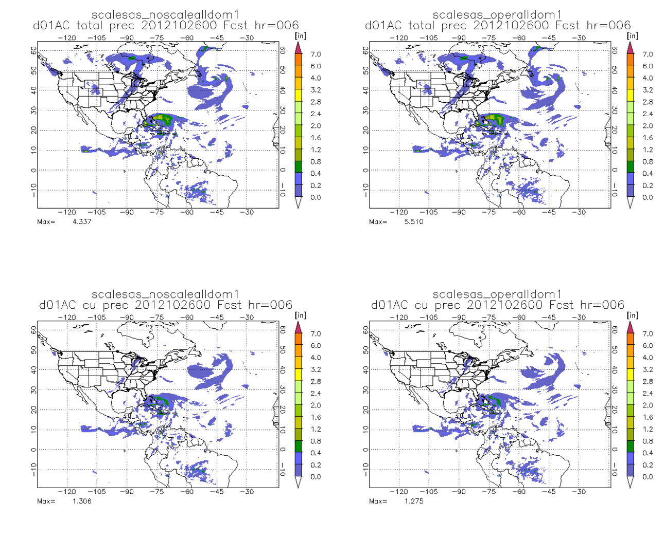
Total
CU
NEW SAS Current SAS in HWRF

Slide 23
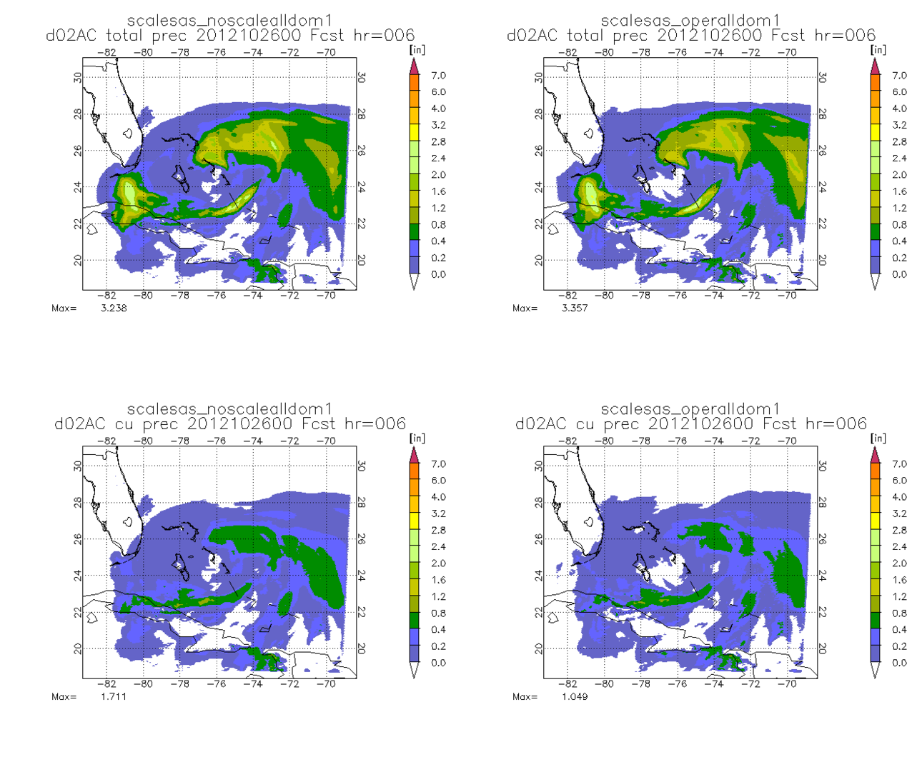
Total
CU
NEW SAS Current SAS in HWRF

Slide 24
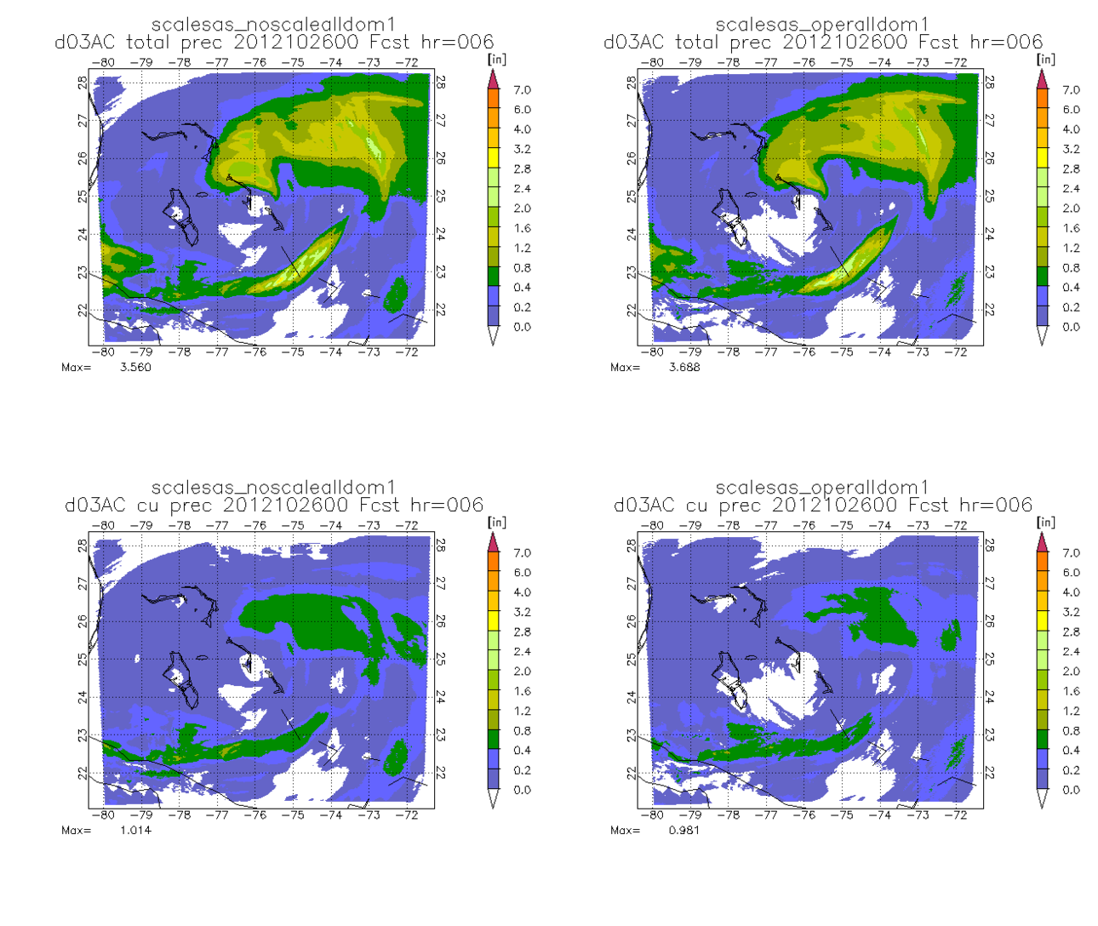
Total
CU
NEW SAS Current SAS in HWRF

