Slide 1
Meeting Agenda
FY16 baseline (H16C) update;
New GFS SAS (w/ or w/o Scale-aware) update, combined SAS/PBL update;
20160112, 12Z/18Z Operational failure investigation update;
Thompson MP sensitivity test update (DTC);
Global RTOFVS ocean initialization update (URI), and Wave coupling update(?)

Slide 2
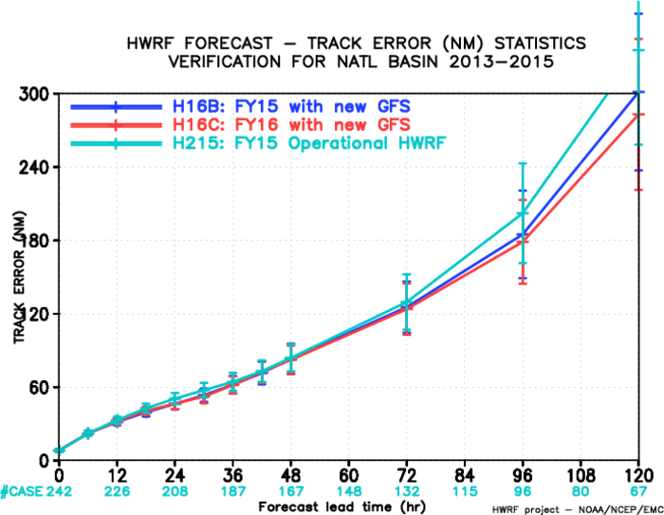
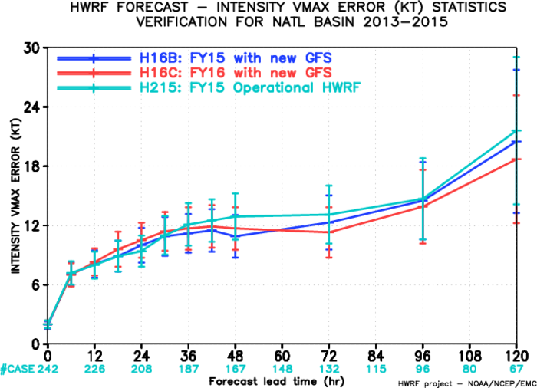
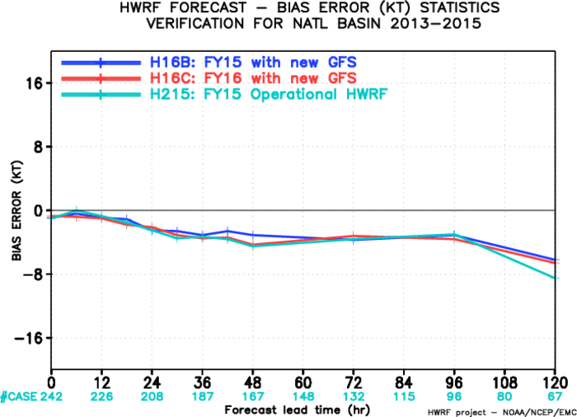
Comparison among Control Experiments, AL
H16A, FY16 HWRF, Current GFS
H16C, FY16 HWRF, new GFS
H215, FY15 HWRF, current GFS

Slide 3
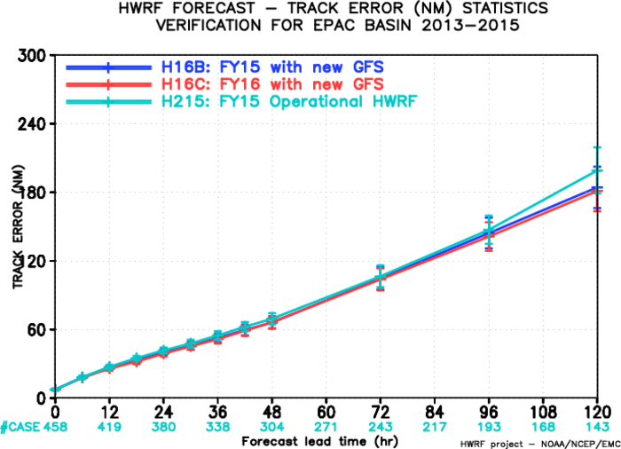
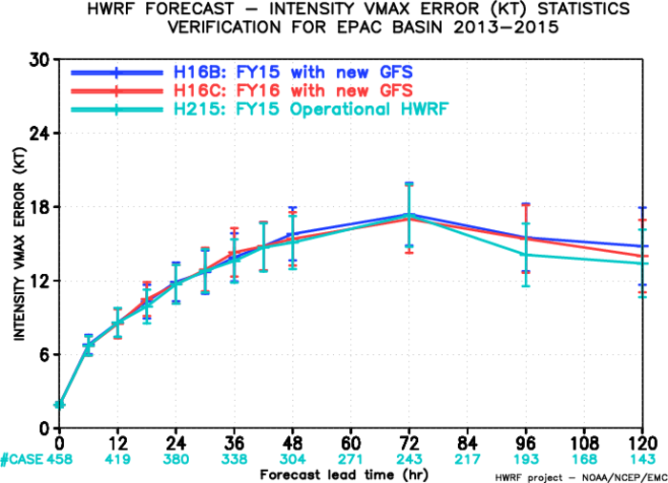
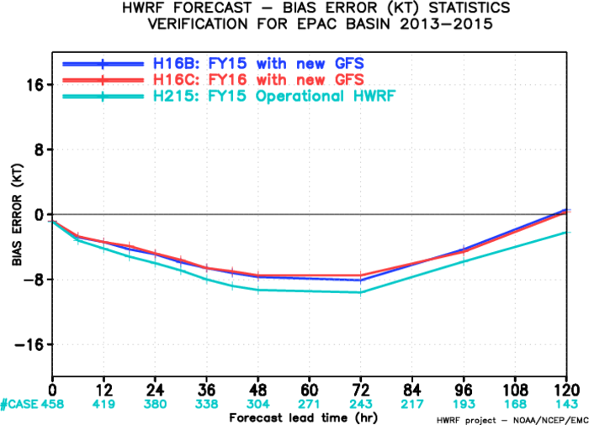
Comparison among Control Experiments, EP
H16A, FY16 HWRF, Current GFS
H16C, FY16 HWRF, new GFS
H215, FY15 HWRF, Current GFS

Slide 4
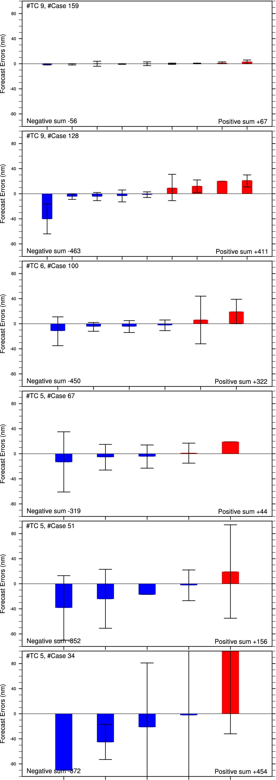
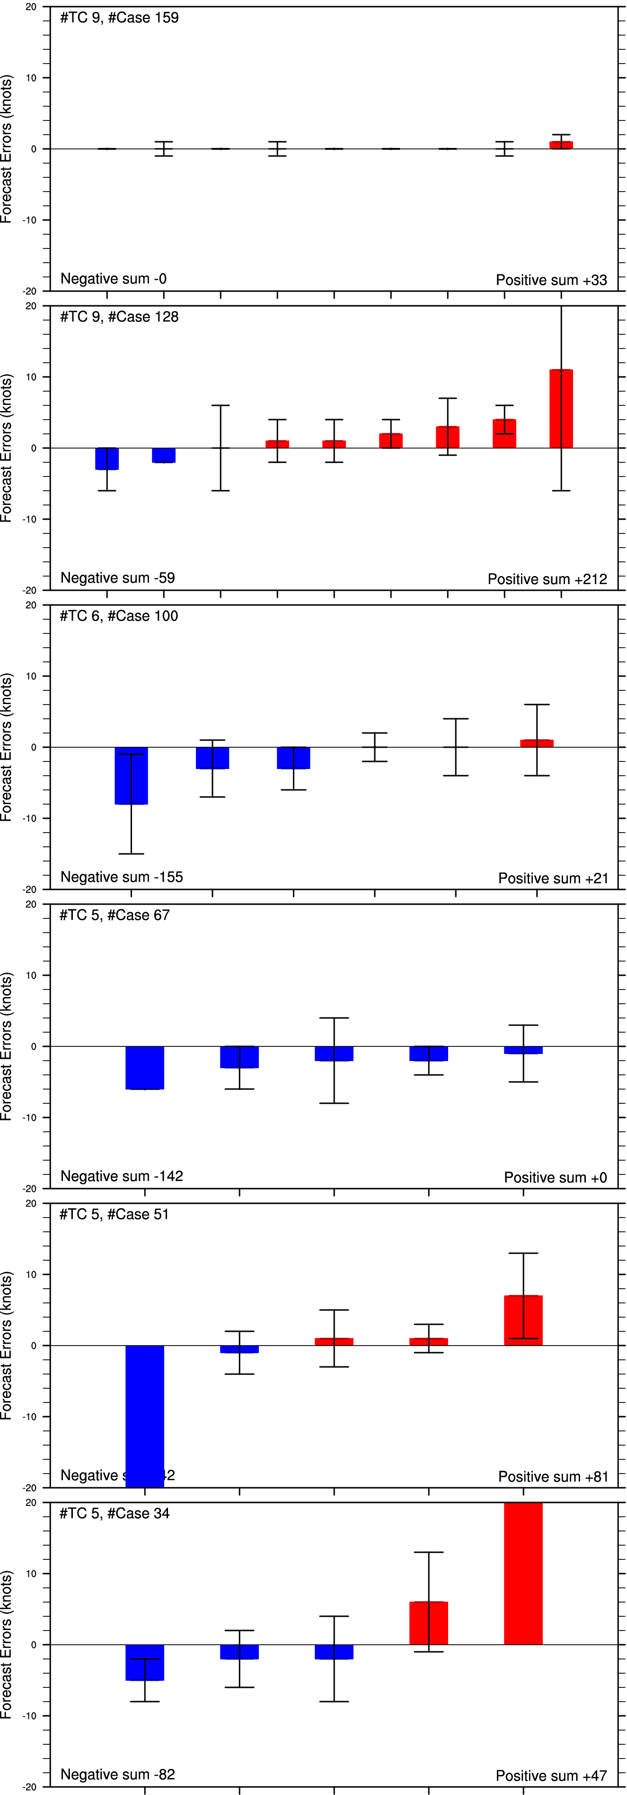
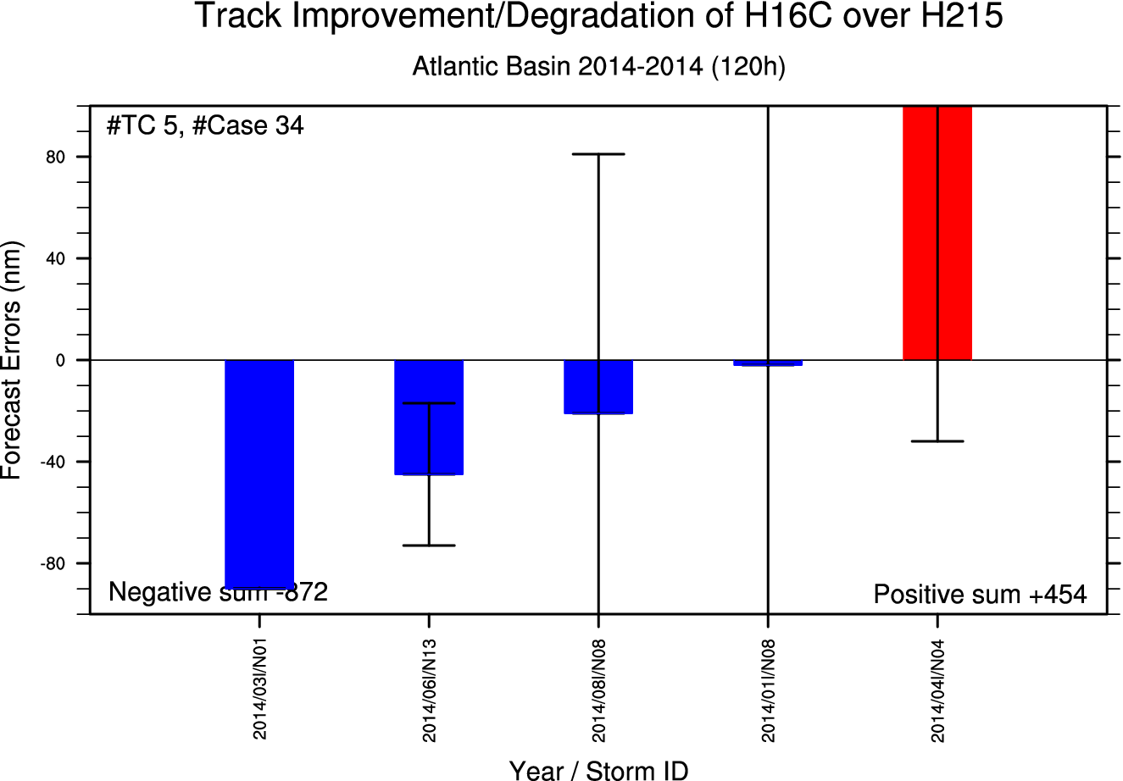
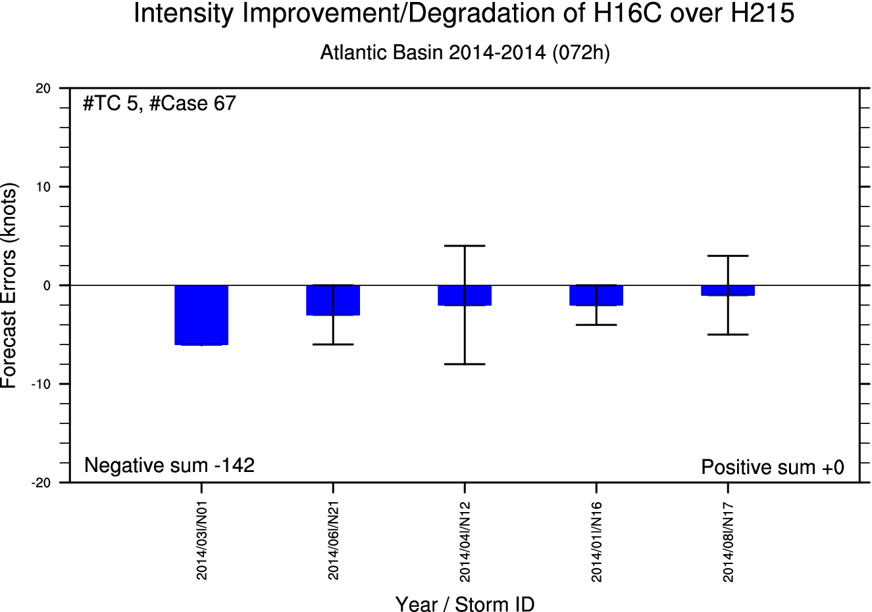
Improve/Degrade of H16C over H215: General
Track Improve/Degrade
Intensity Improve/Degrade
00h
00h
24h
24h
2014/05L
2014/08L*
2014/07L
2014/06L*
48h
48h
2014/03L
2014/06L*
72h
72h
96h
2014/08L*
96h
120h
2014/06L*
120h
Bold: significant improvement or degradation
*: main storm which led the performance

Slide 5
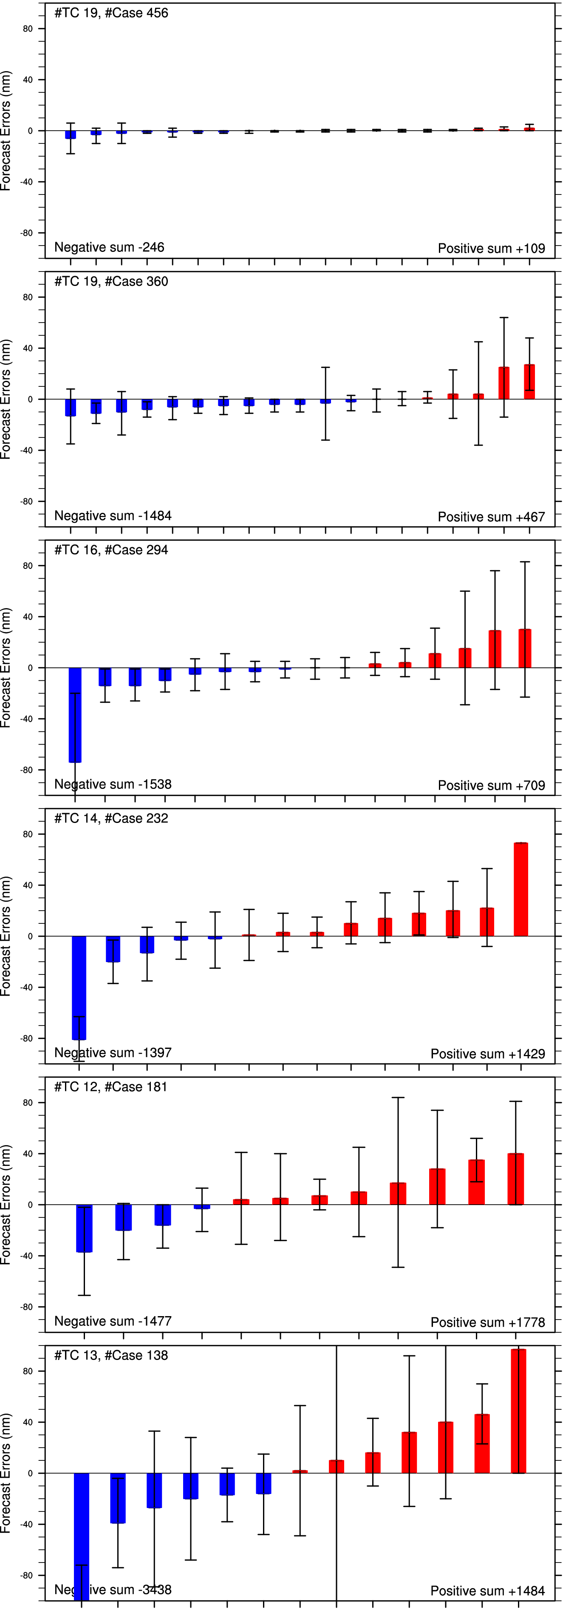
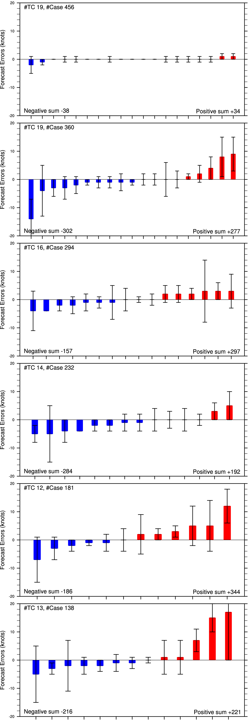
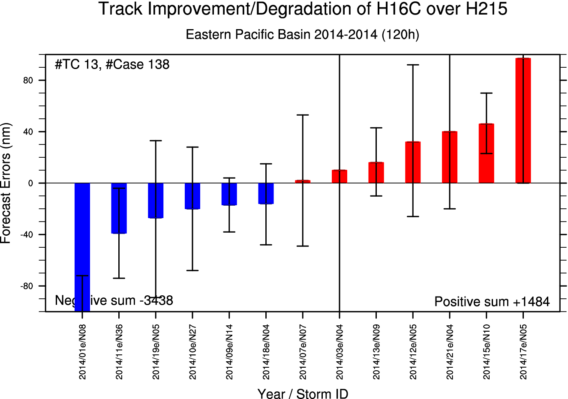
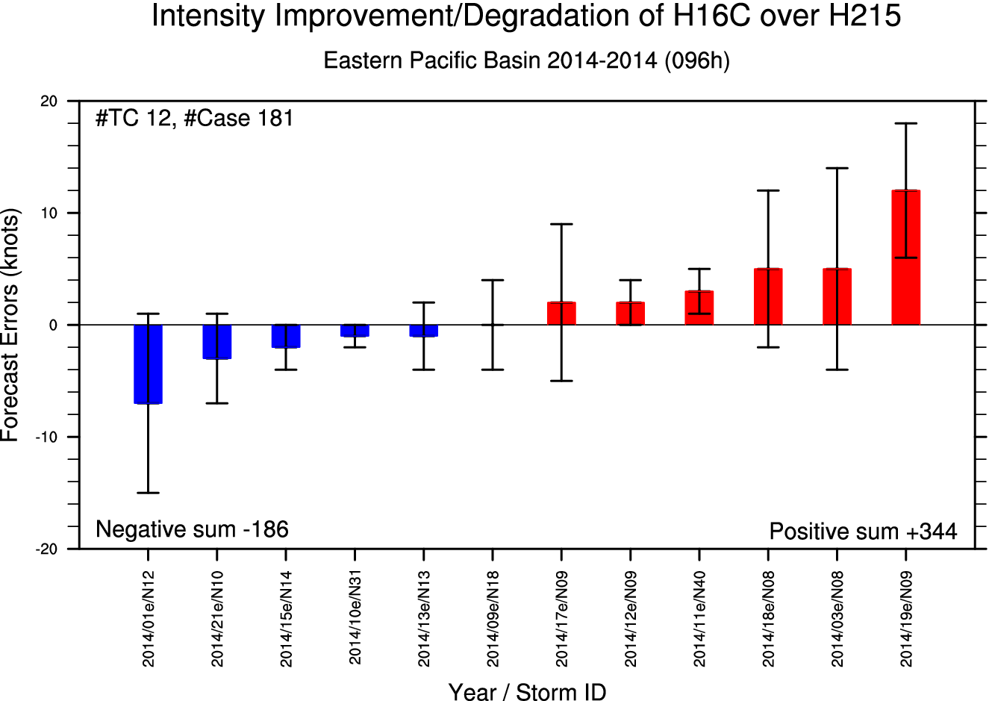
Improve/Degrade of H16C over H215: General
Track Improve/Degrade
Intensity Improve/Degrade
00h
00h
2014/05E
2014/19E*
24h
24h
2014/05E
2014/19E*
48h
48h
2014/09E
2014/11E*
2014/16E
2014/11E
72h
72h
2014/03E
2014/11E*
2014/01E*
2014/11E*
96h
96h
2014/03E
2014/19E*
2014/01E*
2014/11E*
120h
120h
2014/19E*
2014/17E
Bold: significant improvement or degradation
*: main storm which led the performance

Slide 6
PBL Wind Speed Profiles H16C, 60h forecast
Gonzalo 08L , 2014
Weaker Intensity
Hurricane Intensity
The nominal ratio of surface to 700-mb wind speeds in Franklin's paper is 0.91

