Slide 1
FY15 HWRF Baseline/Physics Verification

Slide 2
Acronym
H15B: FY15 HWRF baseline, 18/6/2km resolution, L61, input: T1534L64 GFS (Spectral file for both IC and BC)
H214: 2014 version of operational HWRF, 27/9/3km resolution, L61, input: T574 L64 GFS (Spectral files for both IC and BC);
H15Z: H214 driven by New GFS (Only 2011/2014 samples available, gradually adding more samples for 2012 and 2013 storms)
H15W: H15B + all physics upgrades (stopped due to strong positive intensity bias);
H15V: H15W but w/ rolled back Cd/Ch to FY14 HWRF;
H15U: H15W but w/ new Cd with old Ch;
H15T: H15B + upgraded Data Assimilation procedure.

Slide 3
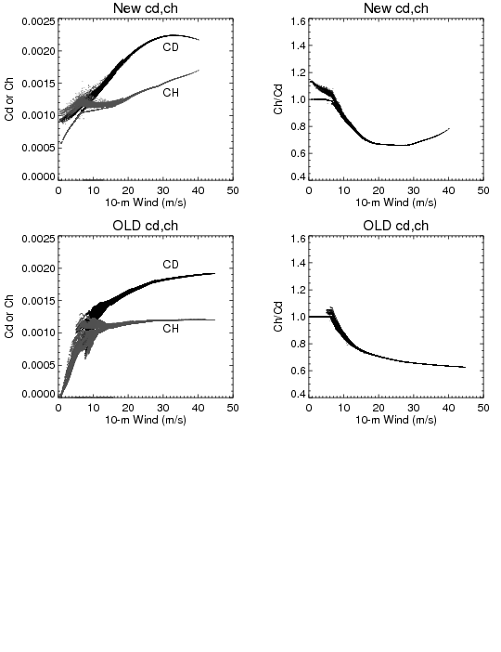
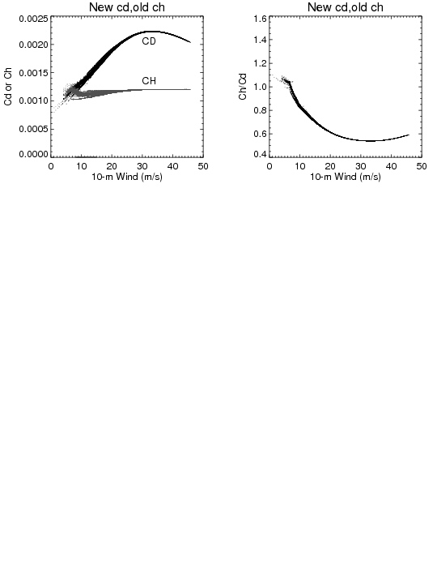
Configuration for Cd and Ch
H15W
H15V
H15U

Slide 4
Incremental Impact of Each Upgrade

Slide 5
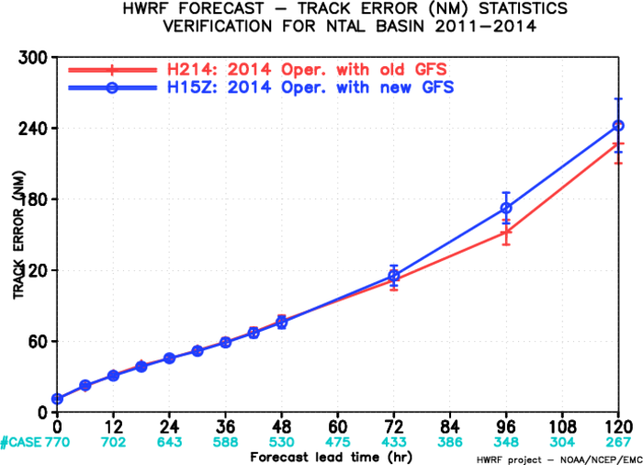
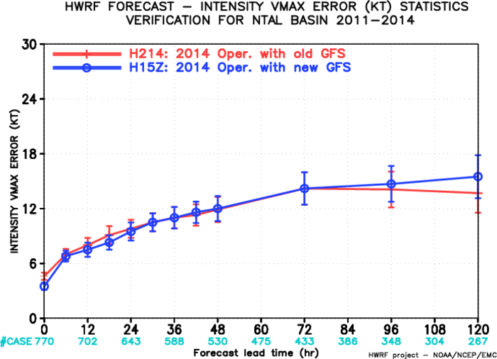
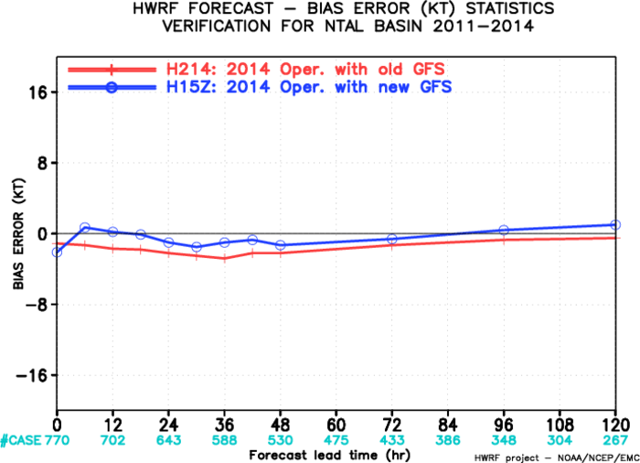
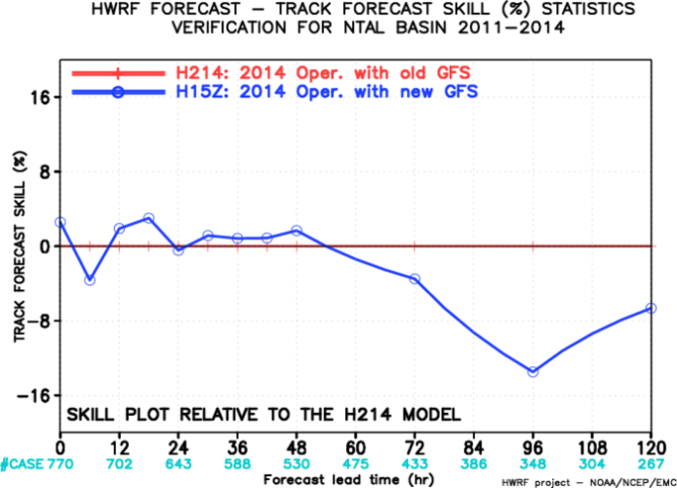
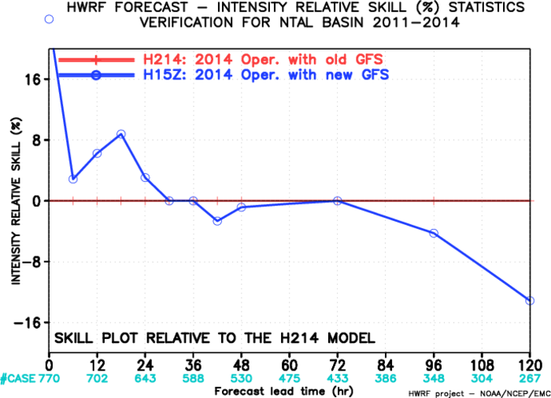
Impact of New GFS, AL
Track: degraded at later time;
Intensity: mixed;
Bias: slightly better bias
770 cases

Slide 6
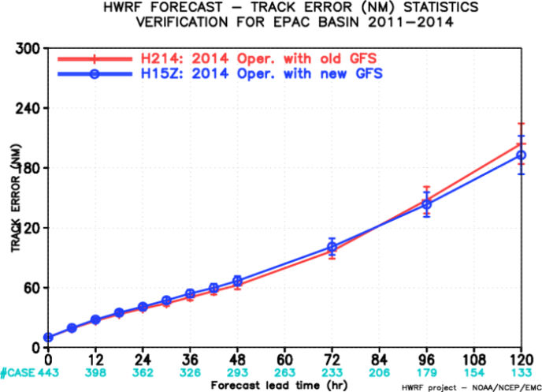
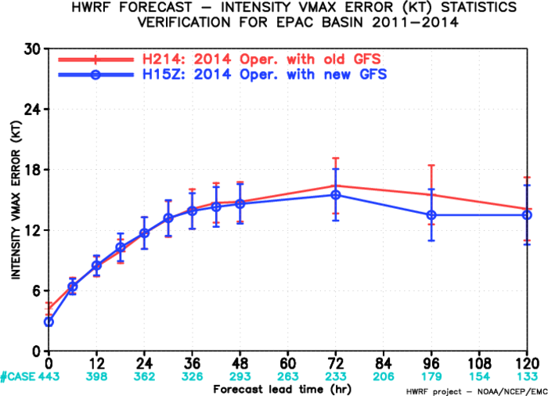
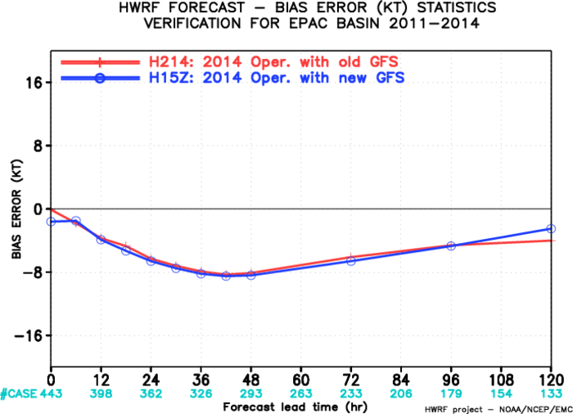
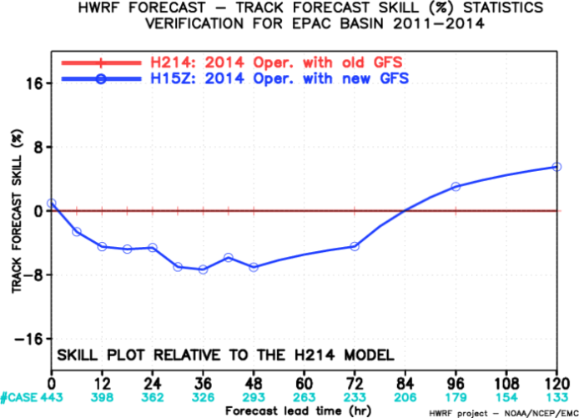
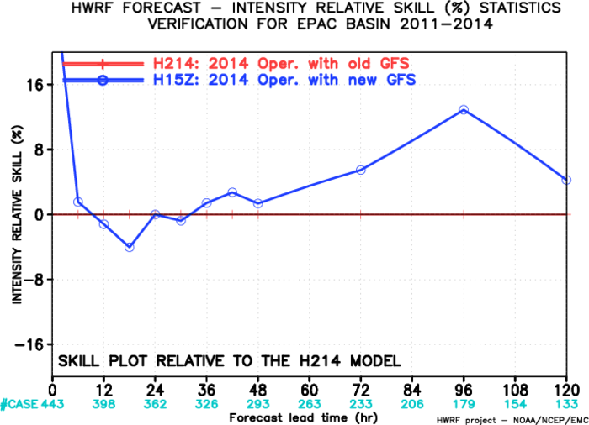
Impact of New GFS, EP
Track: degraded to neutral,
Intensity: neutral to improved at later times
Bias: neutral
443 cases

Slide 7
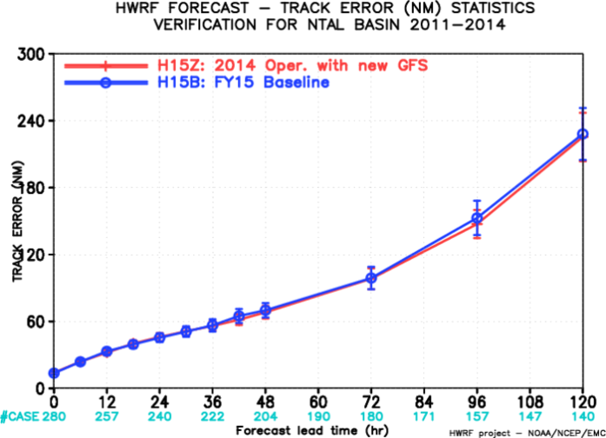
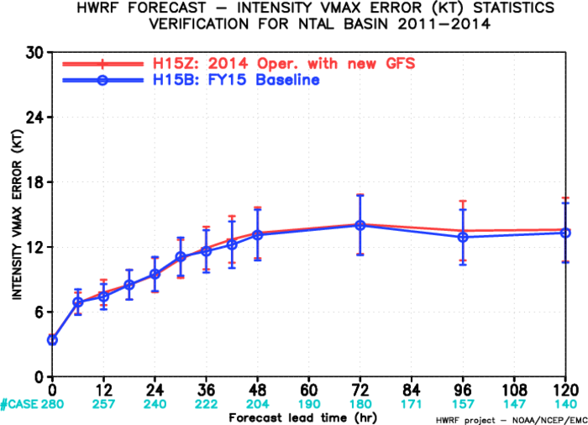
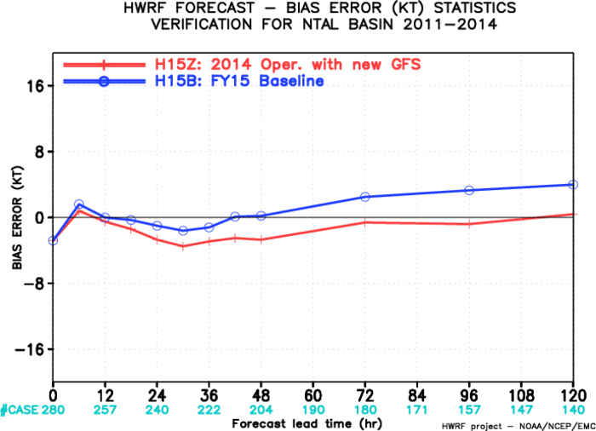
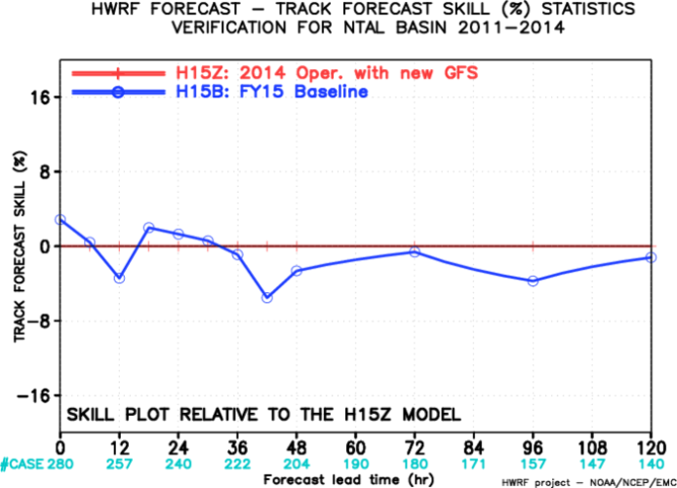
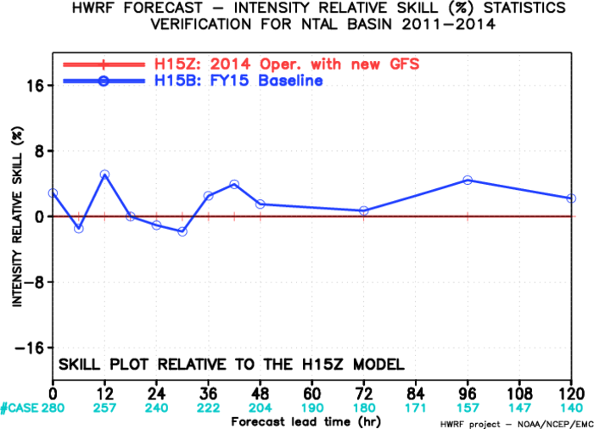
Impact of HWRF Resolution, AL
Track: neutral ;
Intensity: neutral
Bias: strong at later times

Slide 8
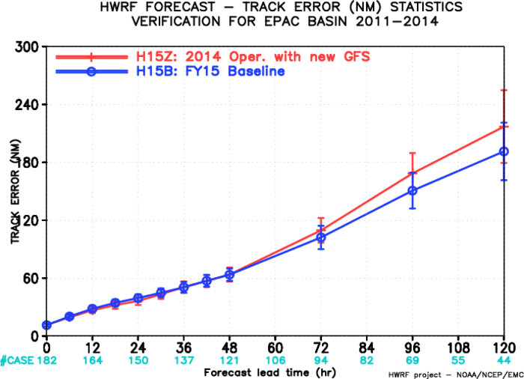
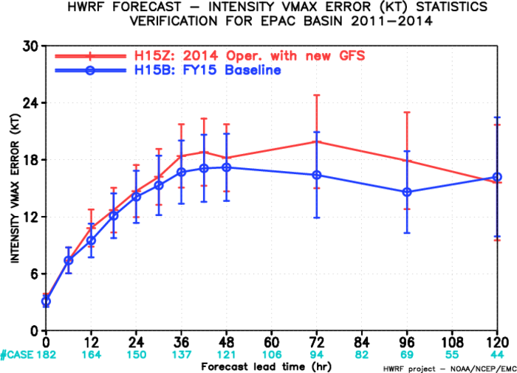
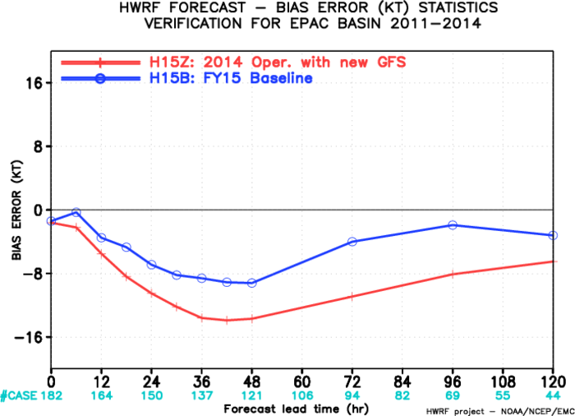
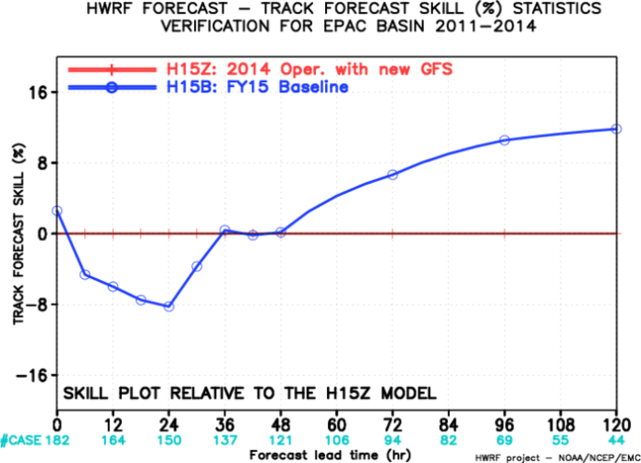
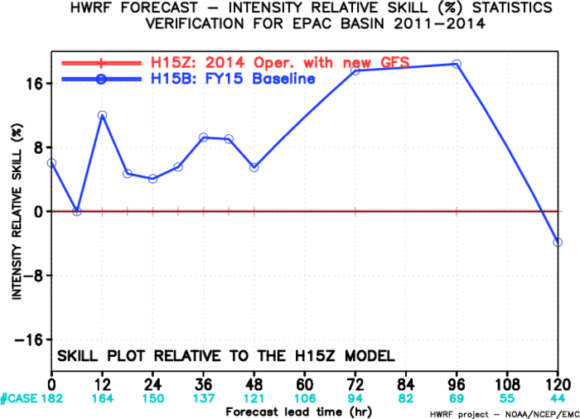
Impact of HWRF Resolution, EP
Track: improved at later times ,
Intensity: improved all times
Bias: Improved
Resolution upgrade H15B appears to offset degradation due to new GFS in both ATL and EP

Slide 9
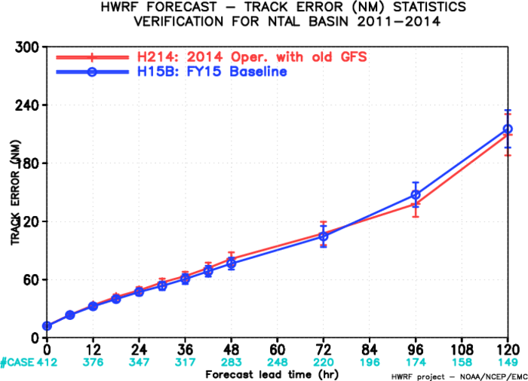
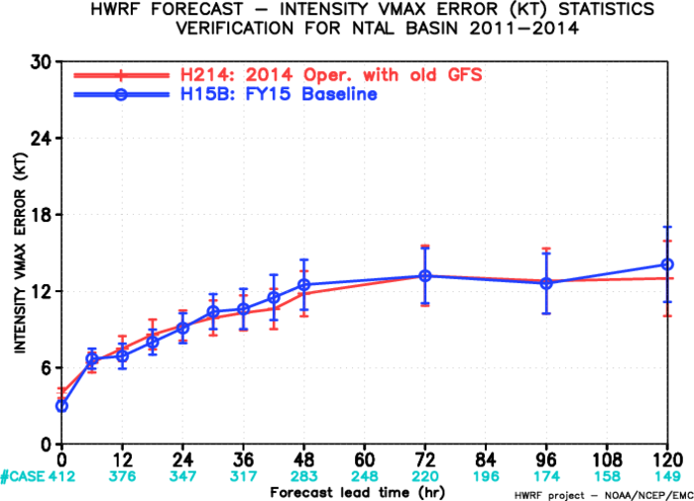
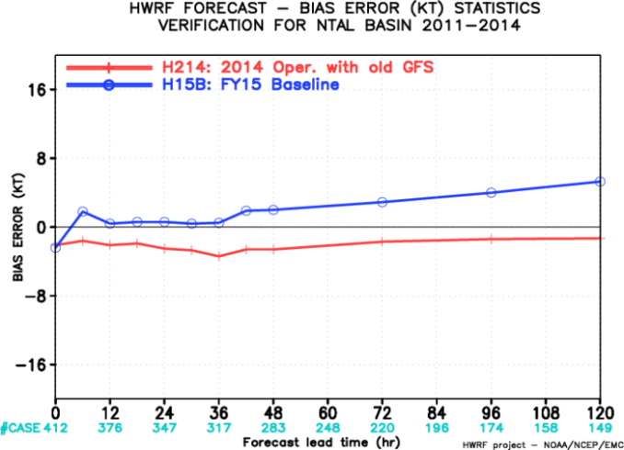
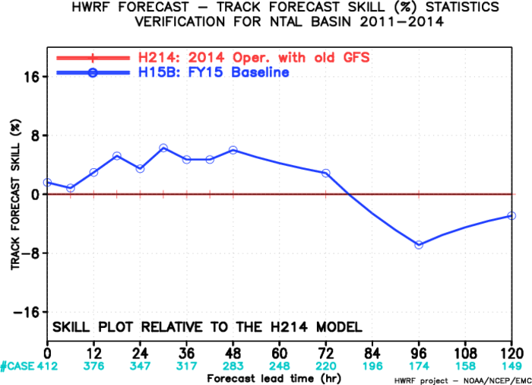
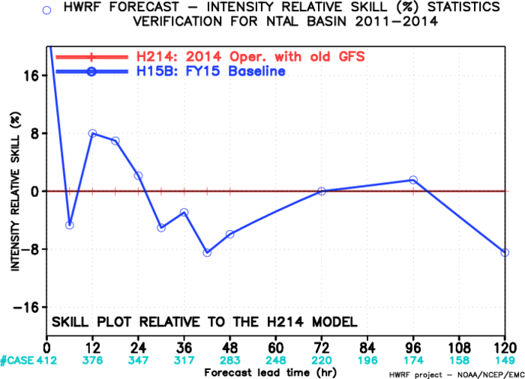
Impact of GFS/HWRF Resolution Increase, AL
Track: positive to neutral,
Intensity: neutral Bias: over-intensify at later hours

Slide 10
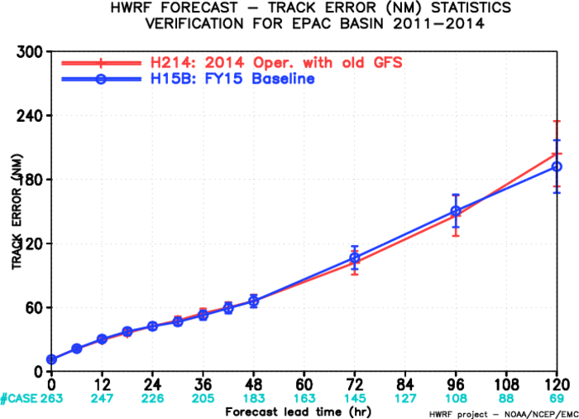
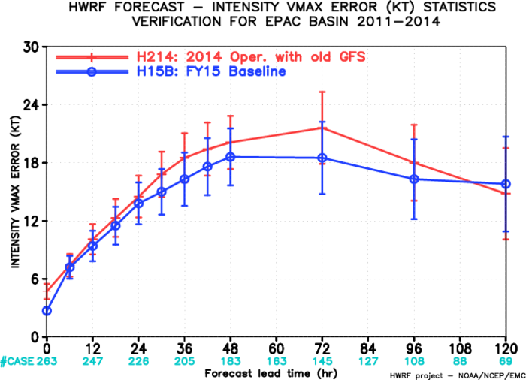
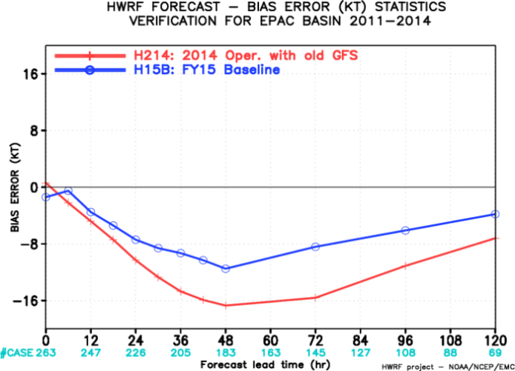
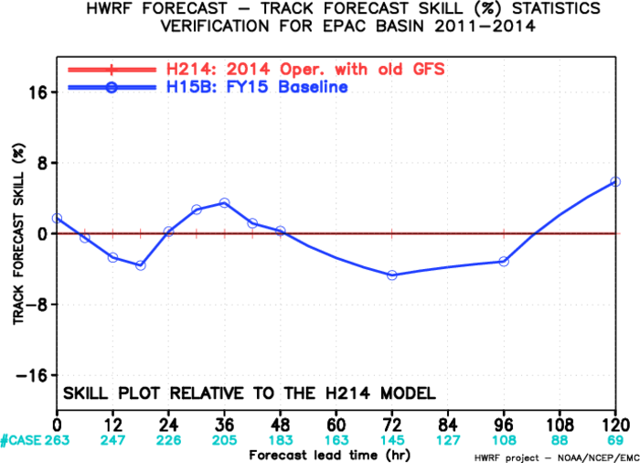
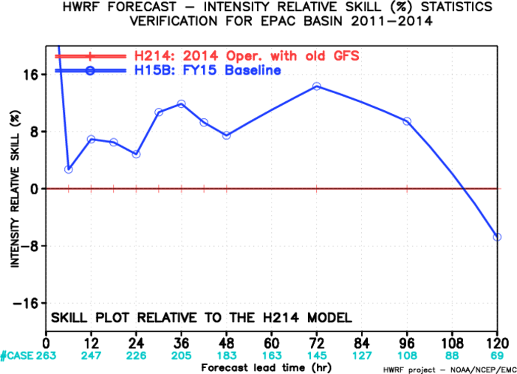
Impact of GFS/HWRF Resolution Increase, EP
Track: Neutral,
Intensity: improved all times
Bias: Improved significantly

Slide 11
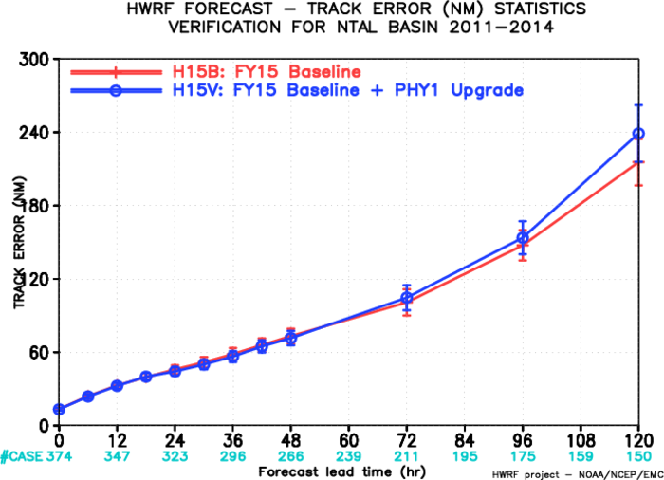
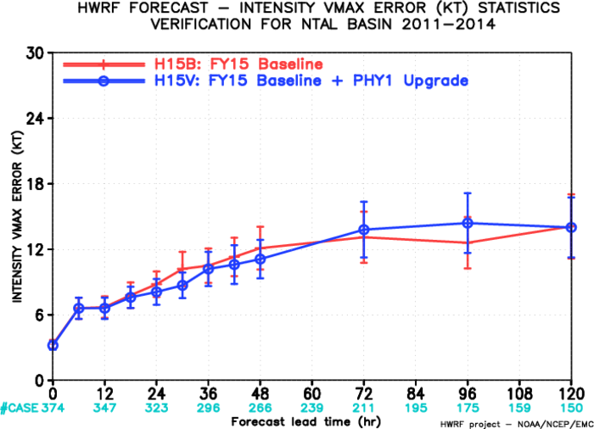
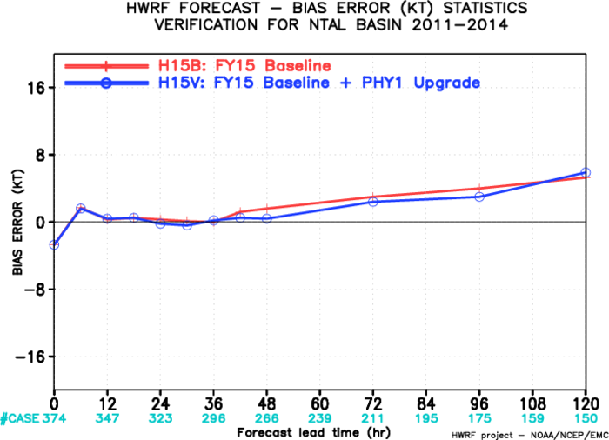
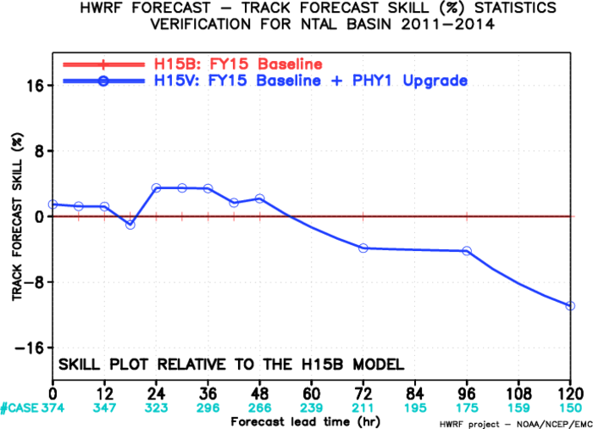
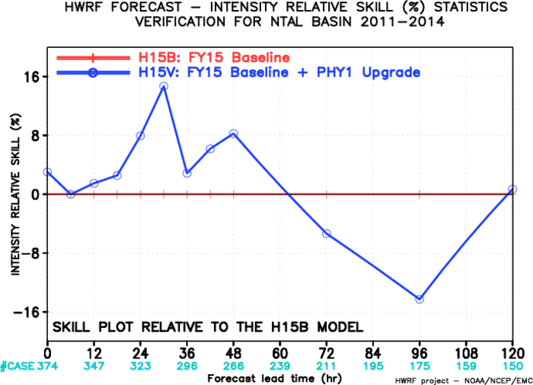
Impact of Physics Upgrades Test I, AL
Old Cd, Old Ch
H15W, new Cd/Ch, was stopped due to strong positive bias.
Track: neutral to worse at 120 hrs,
Intensity: Improved earlier, degraded at 96 hr
Bias: neutral, still too strong

Slide 12
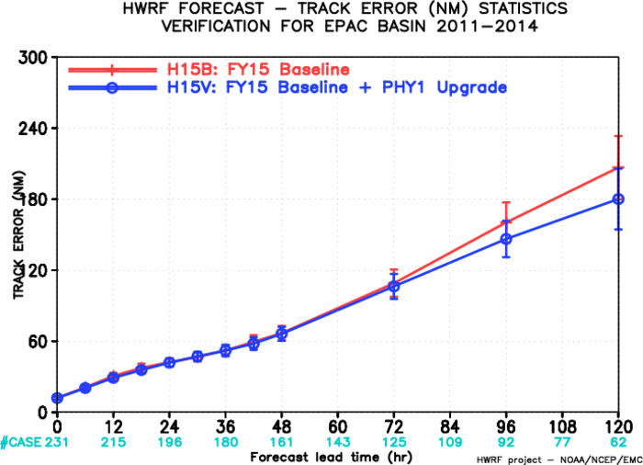
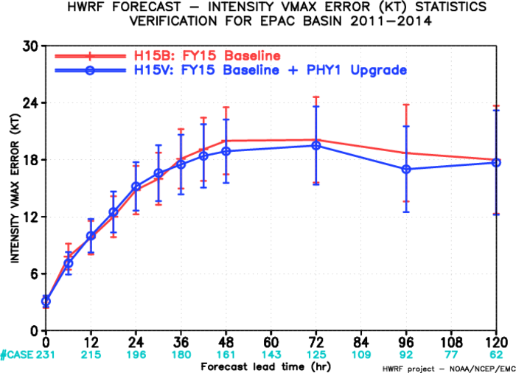
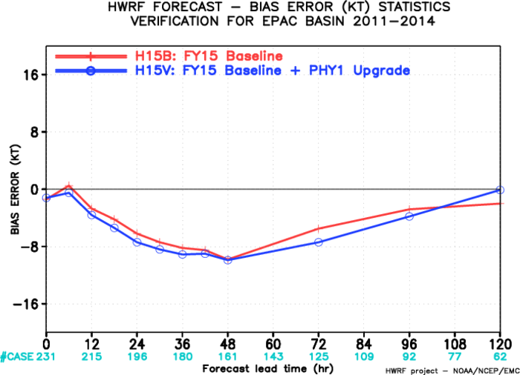
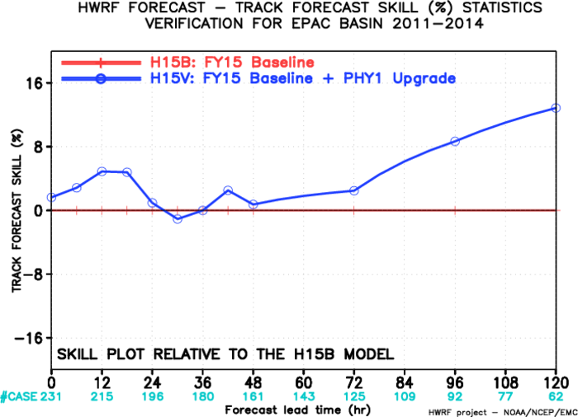
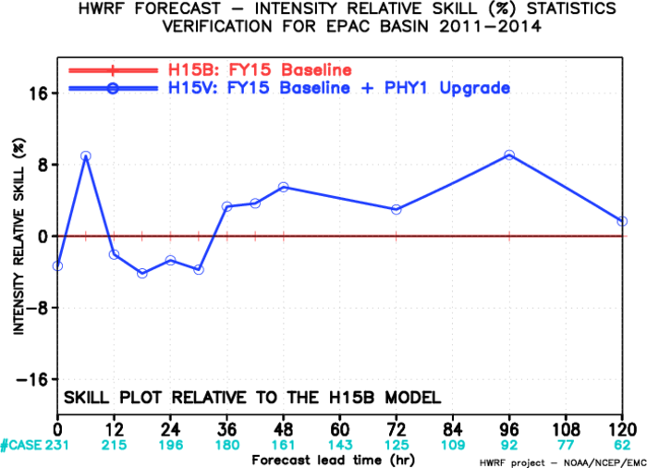
Impact of Physics Upgrades test I, EP
Old Cd, Old Ch
Track: greatly improved all times;
Intensity: neutral to improved beyond 36 hrs
Bias: neutral (still negative)

Slide 13
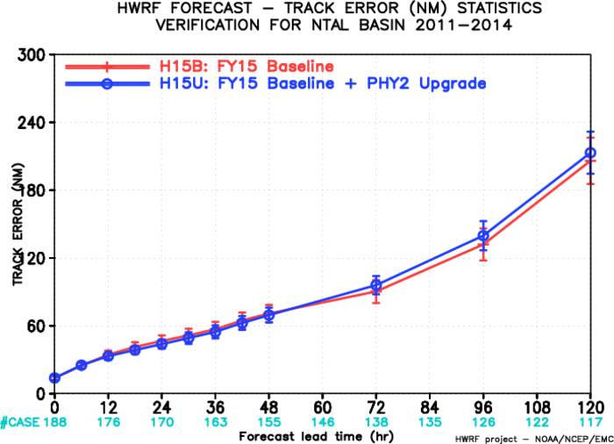
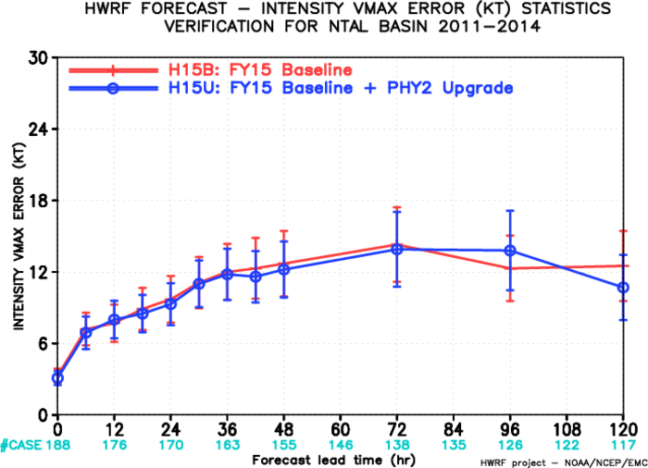
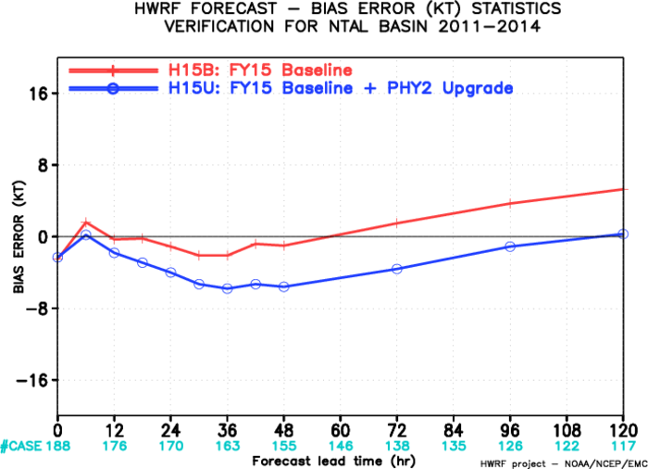
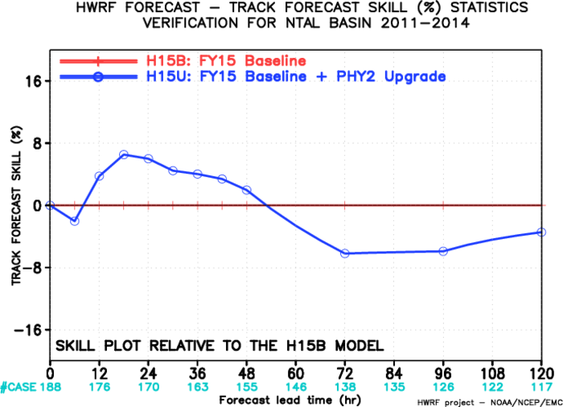
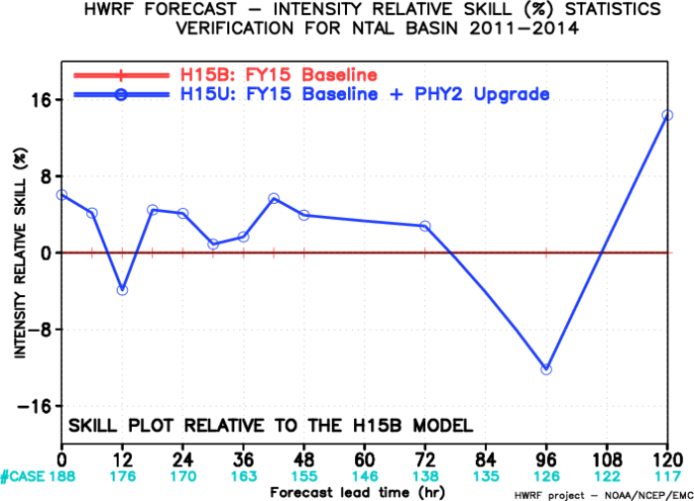
Impact of Physics Upgrades Test II, AL
New Cd, Old Ch
Track: neutral (± 5%),
Intensity: Neutral
Bias: reduced positive bias
Includes mostly worse performing storms. More samples being added to H15U
Not enough samples for EP

Slide 14
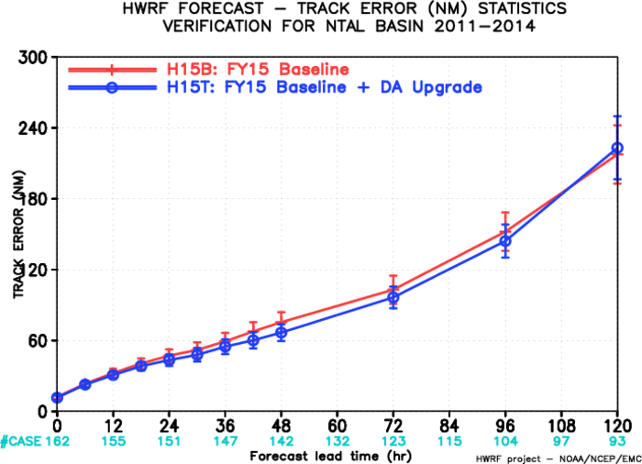
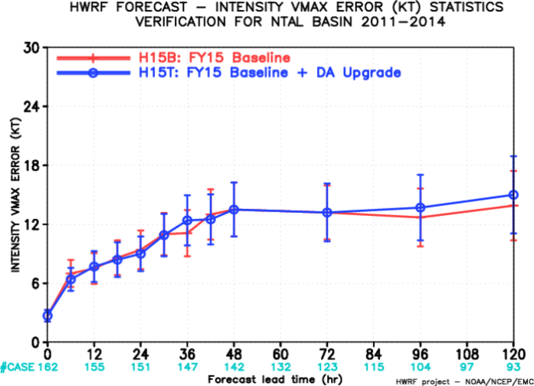
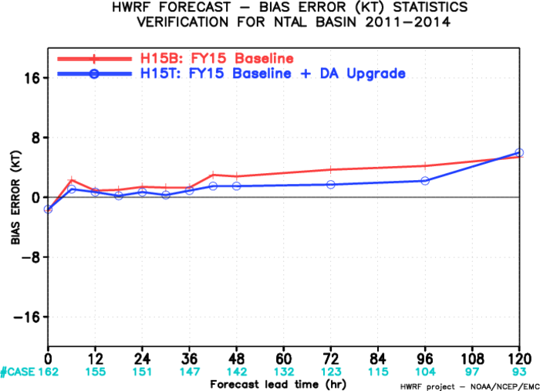
Impact of DA, AL
Track: Improved
Intensity: neutral
Bias: Improved

Slide 15
Impact of DA, EP
Track: neutral
Intensity: initial shock for one storm (Hilary), neutral at later times
Bias: neutral
Sample size too small.
Will address the problem with initializing small size storms
Caused by one small size storm: HILARY 09E

Slide 16
Two Physics Upgrades Comparison
New Cd old Ch vs Old Cd old Ch
H15V: Old Cd/Ch
H15U:New Cd, old Ch
H15U has the similar track forecast skills, but much better intensity fcst skills
Decided to retain new Cd and roll back Ch to operational HWRF formulation. All other physics changes are good!

Slide 17
Comparing H15U with Two Control Experiments (H214/H15Z)

Slide 18
H15U vs FY14 (H214) at AL
Track: Improved ~5-8% through 72 hrs, ~5% degraded at 96/120 hrs
Intensity: Improved all times ~5-8%
Bias: Neutral

Slide 19
H15U vs H15Z at AL

Slide 20
Storm Structure Verification for H15U
Storm structures are improved in H15U over H214/H15Z

Slide 21
H15U 72h Track Improved/Degraded over H214 (AL)
FSP ties between H15U and H214
Track Fcst Error Diff (H15U-H214)
Individual Storms

Slide 22
H15U 72h Intensity Improved/Degraded over H214 (AL)
All storms improved except ERNESTO 2012
Improved: <0
Degraded: >0
Track Fcst Error Diff (H15U-H214)
Individual Storms

Slide 23
Summary:
H15U performed better so far (with ~15 storms, ~207 cycles), compared H15V and H214 in AL;
Not enough samples to verify H15U performance for EP yet;
H15T performed better than H15B in AL/EP, 6h spin-up problem noted and is being investigated;
Continue to run three configurations: H15B, H15Z, H15U
Combine H15T with the final physics upgrade version: H215;
Use H214/H15Z as control runs to be compared to H215;
Anticipated completion of tests by March 31, 2015
Code optimization efforts are going on, no changes in product delivery times
Code delivery deadline is April 16, 2015 (CCB to be scheduled in early April)

