Slide 1
HURRICANE ENSEMBLE DATA ASSIMILATION WITH HWRF EXPERIMENTAL SYSTEM: SUCCESSES AND CHALLENGES
Tomislava Vukicevic
Altuğ Aksoy^{1,2}, Kathryn Sellwood^{1,2}, Sylvie Lorsolo^{1,2}, Gopal¹ , XueJin Zhang^{1,2} , Sim Aberson¹ and Frank Marks¹
¹NOAA/AOML Hurricane Research Division
²U. Miami/RSMAS Cooperative Institute for Marine & Atmospheric Studies
³Science Applications International Corporation

Slide 2
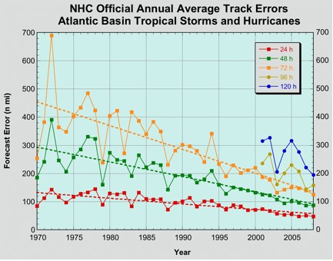
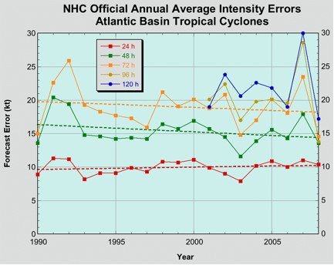
Motivation and Objective
There have been few advances in hurricane intensity
prediction in the past 20 years.
NOAA’s Hurricane Forecast Improvement Program (HFIP) goal is to reduce hurricane intensity and track forecasts by 20% by 2016 and 50% by 2021
In HRD/AOML research is conducted on assimilation of airborne and other observations into experimental version of HWRF model to reduce forecast errors due to poor representation of the initial conditions on TC scales
*Figure from www.nhc.noaa.gov

Slide 3
HRD’s experimental Hurricane Ensemble Data Assimilation System (HEDAS)
Forecast model:
HRD’s Experimental HWRF (HWRF-X)
2 nested domains (9/3 km horizontal resolution, 42 vert. levels)
Static inner nest to accommodate covariance computations
➔ Inner nest size: ~10x10 degrees
Explicit microphysics on inner nest
Data assimilation:
Square-root ensemble Kalman filter, EnKF (Whitaker and Hamill 2002) with covariance localization (Gaspari and Cohn 1999)
Assimilates inner-core aircraft data on the inner nest
➔ NOAA P-3, NOAA G-IV, USAF, PREDICT G-V
Ensemble system:
Initialized from semi-operational GFS-EnKF (NOAA/ESRL) ensemble
30 ensemble members

Slide 4
2010 HEDAS Semi-Real-Time Runs for HFIP: DA Cycling Workflow
Only ran when Doppler radar wind data was available from NOAA P-3 flights (➔ 19 cases)
Used 1452 processors on NOAA’s tJet cluster (supported by HFIP)
T – 6 h
T
T + 126 h
Ensemble
Spin-up
DA Cycling
with EnKF
Deterministic HWRF-X Forecast from Ens. Mean
1-hour Cycles
Ensemble
Initialization from T-6h GFS-EnKF
Real-Time
Observation
Pre-Processing
Mean of Final Analysis Assumed Valid for T

Slide 5
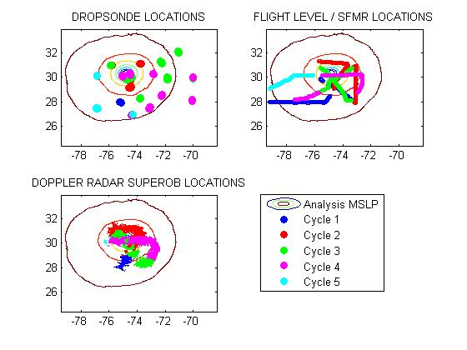
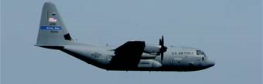
Observations
2 NOAA Orion P-3
Dropsonde + Flight level
+ Tail Doppler Radar
1 NOAA Gulfstream G-IV
Dropsonde
Data types
flight level: wind temperature and humidity + SFMR surface wind
GPS dropwindsonde: wind, temperature, humidity and pressure
Tail Doppler Radar: radial winds.
Approximate vertical location
Orion P3: ~ 3 km
G-IV : 1300 - 1400 km and
U.S. A.F. C-130’s: 10km maximum with a minimum 2000ft. vertical separation from the P3’s
Observation distribution
(9/02/2010 02Z analysis)
U.S.A.F WC-130J
Flight level + Dropsonde

Slide 6
2010 HEDAS Semi-Real-Time Runs for HFIP: Summary of Cases
A total of 19 cases were run (when NOAA P-3’s collected Doppler radar data)
Number of Observations Assimilated per Cycle
Number of Observations
Number of Cycles

Slide 7
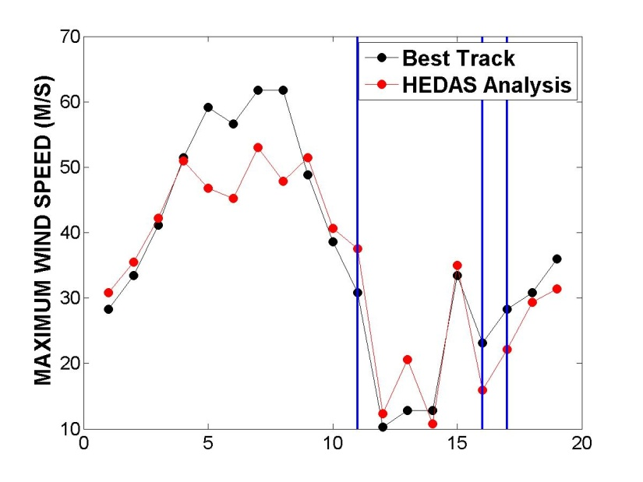
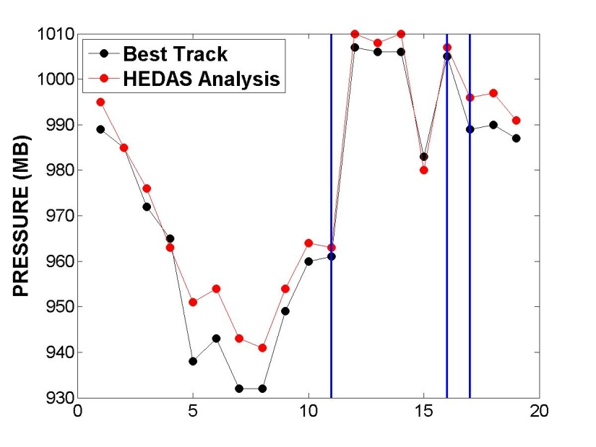
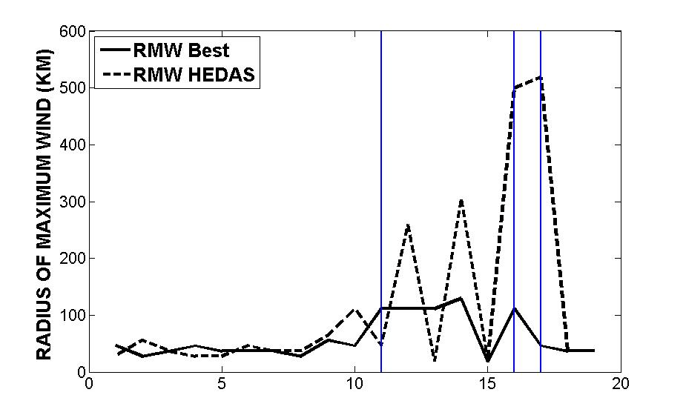
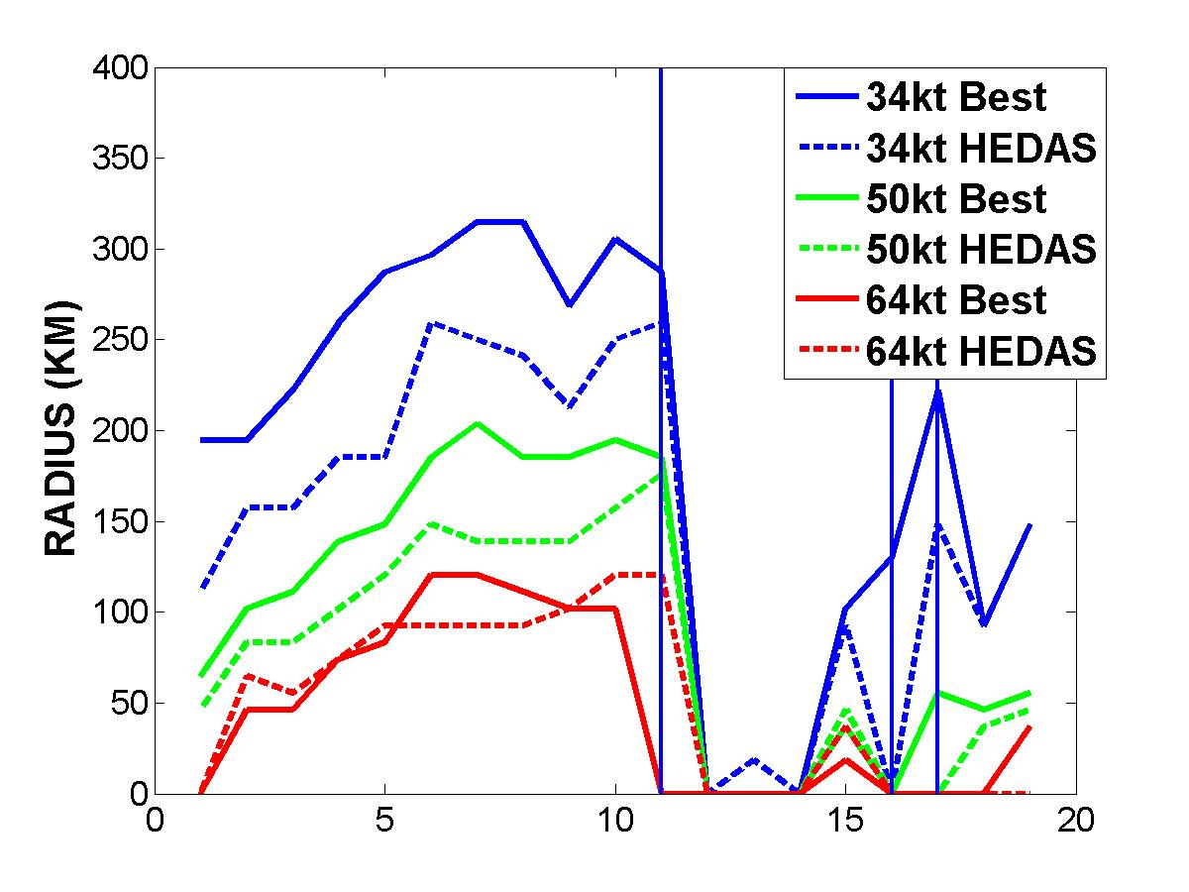
Storm size and Intensity in HEDAS Analyses
Earl
Karl
Richard
Tomas
Weak System

Slide 8
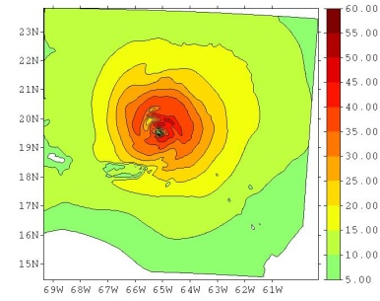
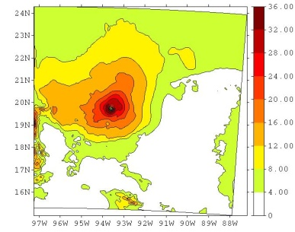
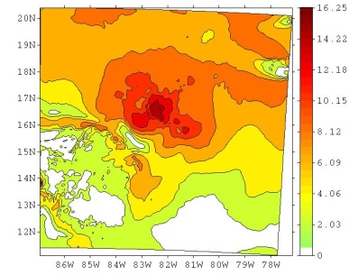
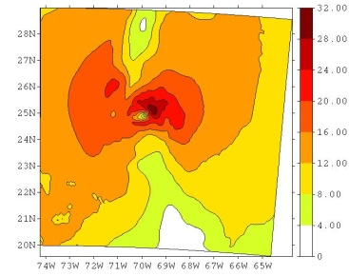
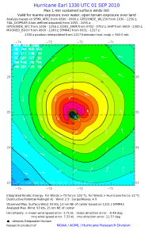
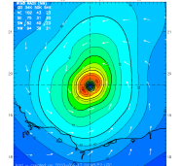
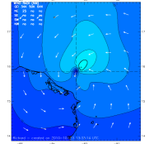
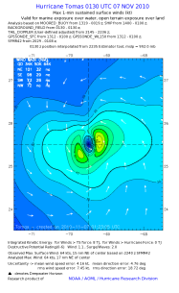
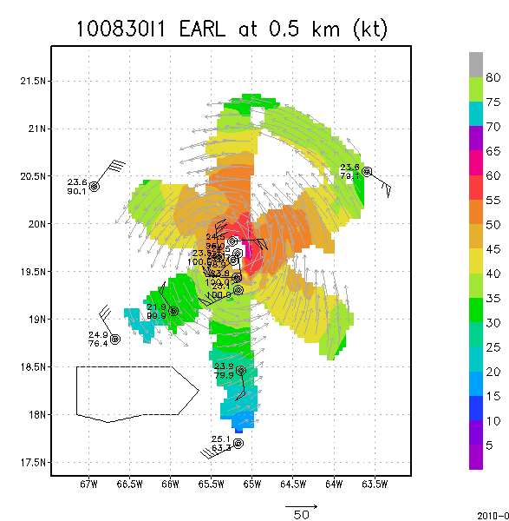
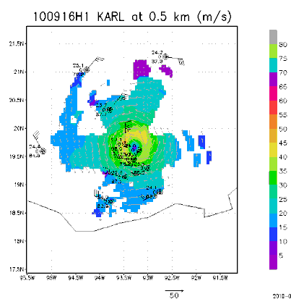
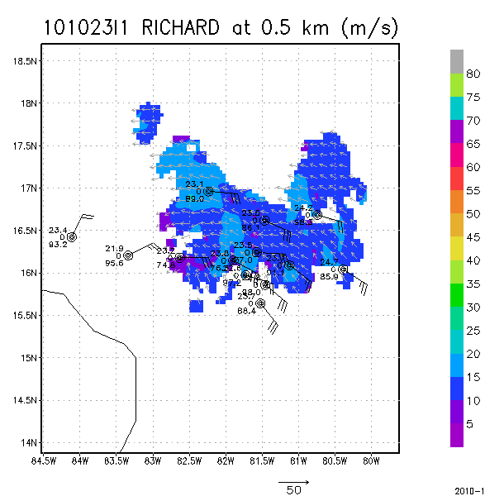
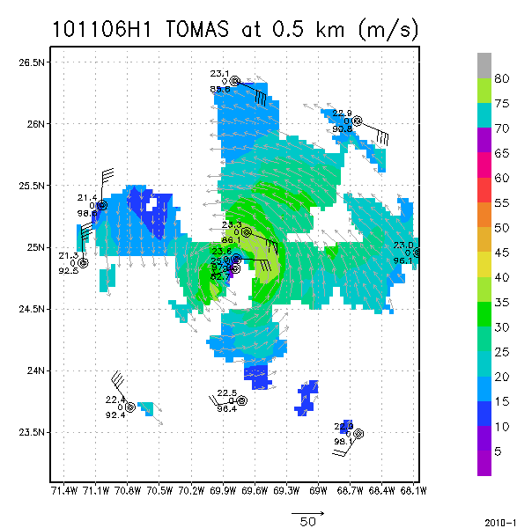
EARL KARL RICHARD TOMAS
Aug. 31 00Z Sep. 17 00Z Oct. 23 06Z Nov. 7 00Z
(11 cases) (4 cases) (1 case) (3 cases)
HEDAS
Analysis
H*Wind
Analysis
Radar
Dropsonde
Composite
MaxV = 46.7 m/s MaxV = 35.2 m/s MaxV = 16.2 m/s MaxV = 31.2 m/s
Max V = 58.1 m/s MaxV = 42.2 m/s MaxV = 19.5 m/s MaxV = 32.9 m/s
H*WIND (Powell et al. 1996) is an objective analysis of the wind speed distribution in hurricanes from a variety of observational platforms

Slide 9
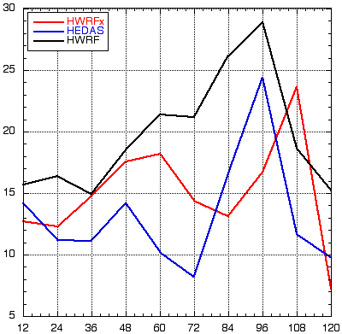
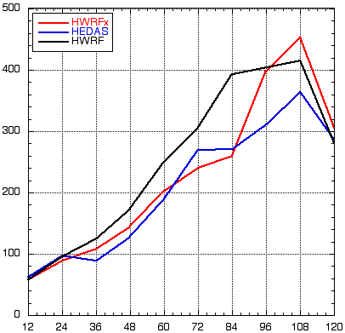
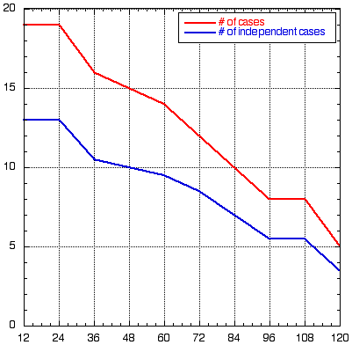
Overall Forecast Performance in 2010 from HEDAS Analyses
Intensity Error (kt)
Track Error (km)
Number of Cases
HEDAS (in blue) performs better in intensity and comparably in track (to HWRF and HWRFx)

Slide 10
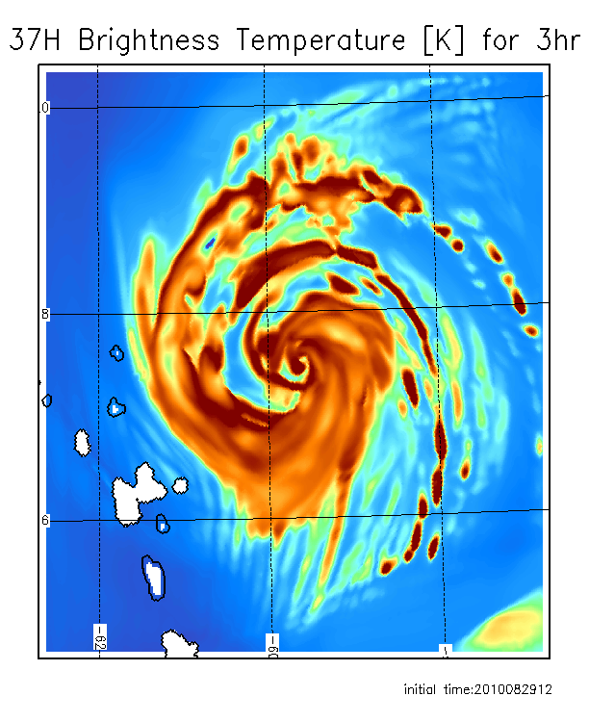
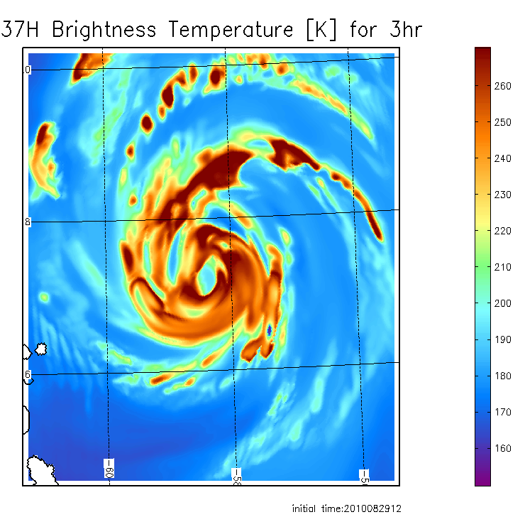
Comparison to satellite observations: observed and forecast images for hurricane Earl
36 GHz observed AQUA closest time within 1 h
3h 37 GHz forecast from HEDAS IC
3h 37 GHz forecast from HWRF IC
Forecast initial time 12:00Z, 08/29/2010

Slide 11
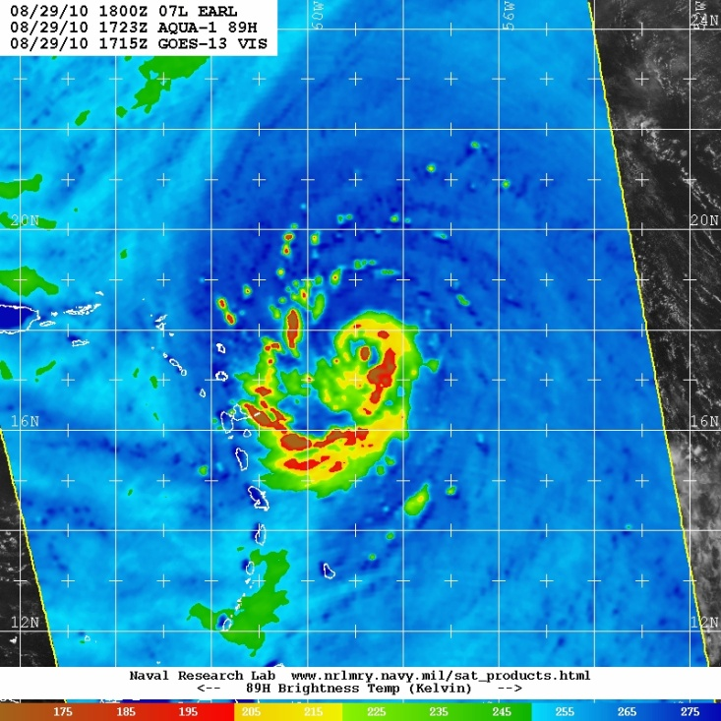
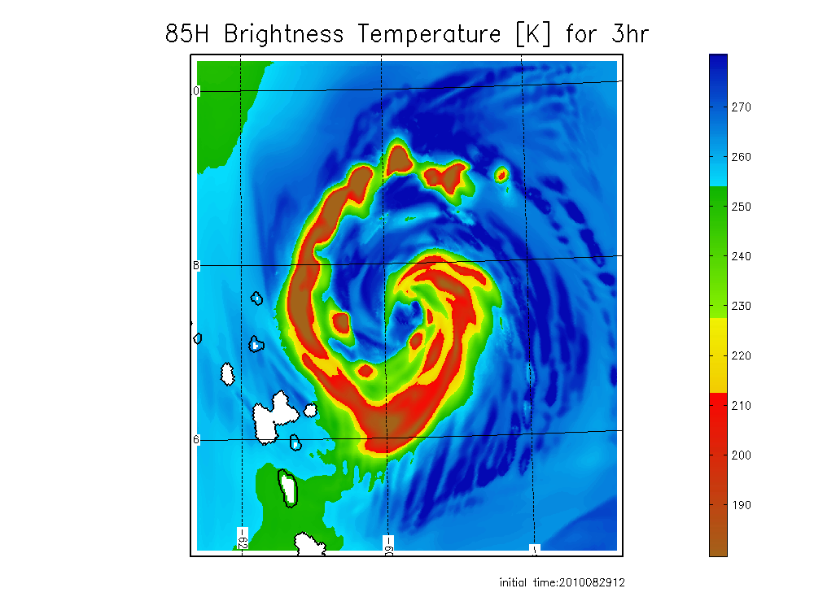
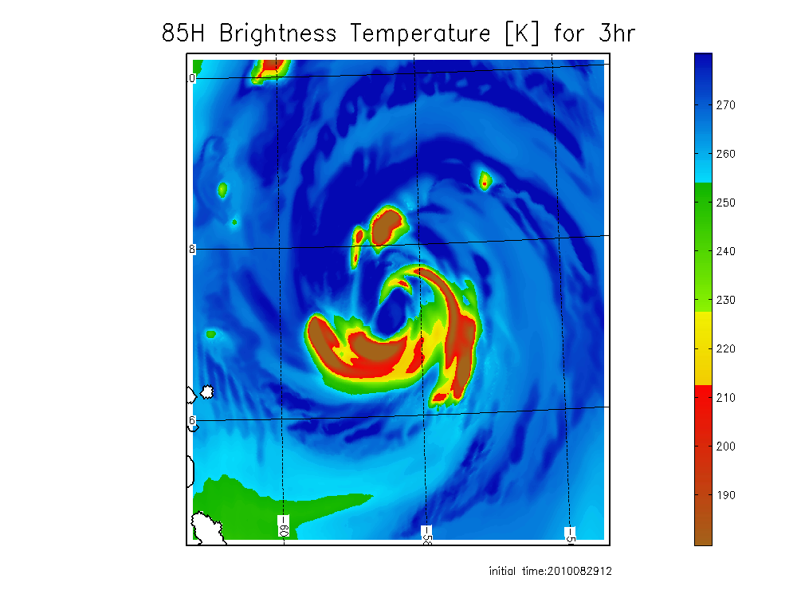
Comparison of observed and forecast images for hurricane Earl: 85GHz
89 GHz observed AQUA closest time within 1 h
3h 85GHz forecast from HEDAS IC
3 h 85 GHz forecast from HWRF IC
Forecast initial time 12:00Z, 08/29/2010

Slide 12
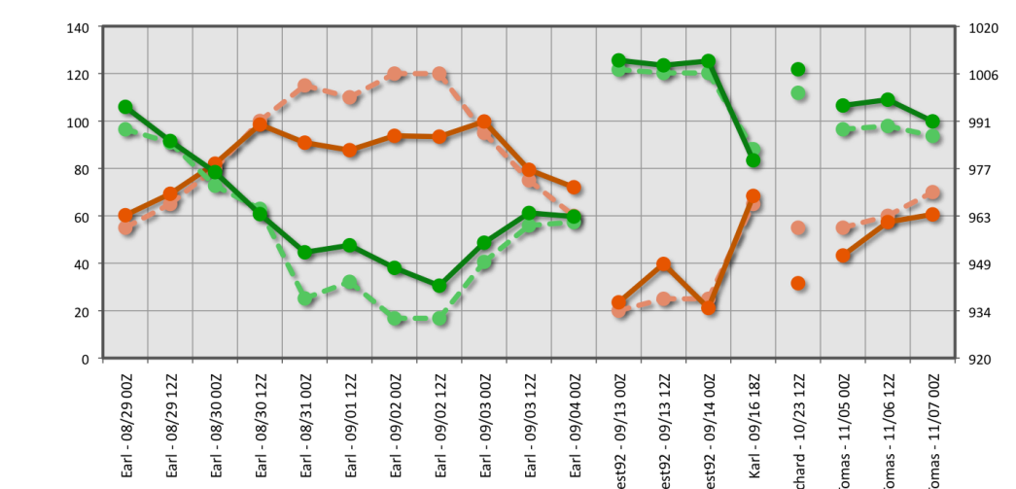
Problems identified
The analyzed maximum surface wind was significantly underestimated in HEDAS analysis during periods with strong and intensifying hurricane (the cases of hurricane Earl while category 3 and 4)
Analysis intensity error
Forecast intensity error HEDAS in blue
Similar to the results with other regional hurricane forecast systems, the short-term intensity forecast errors were large in average
Forecast Time (hour)
Notes:
These results indicate presence of a systematic dynamical adjustment to the initial condition in the short-term forecasts ; In this study we focus on the analysis of systematic intensity errors in the analysis

Slide 13
Diagnostic analysis : Evolution of mean state during the data assimilation
3-4 h background ensemble forecast
Cycle 1
1 h background ensemble forecast
Cycle 2
1 h background ensemble forecast
Cycle 3
EnKF update
Posterior/analysis
Cycle 1
EnKF update
Posterior/analysis
Cycle 2
…….
observations
observations
Diagnostic procedure
Cylindrical coordinates: The ensemble mean of background forecasts and the mean analysis from each cycle were transformed into cylindrical coordinates centered on the corresponding storm center
Azimuthal average was then computed for tangential, radial and vertical wind components, vorticity, surface pressure, temperature, specific humidity, …

Slide 14
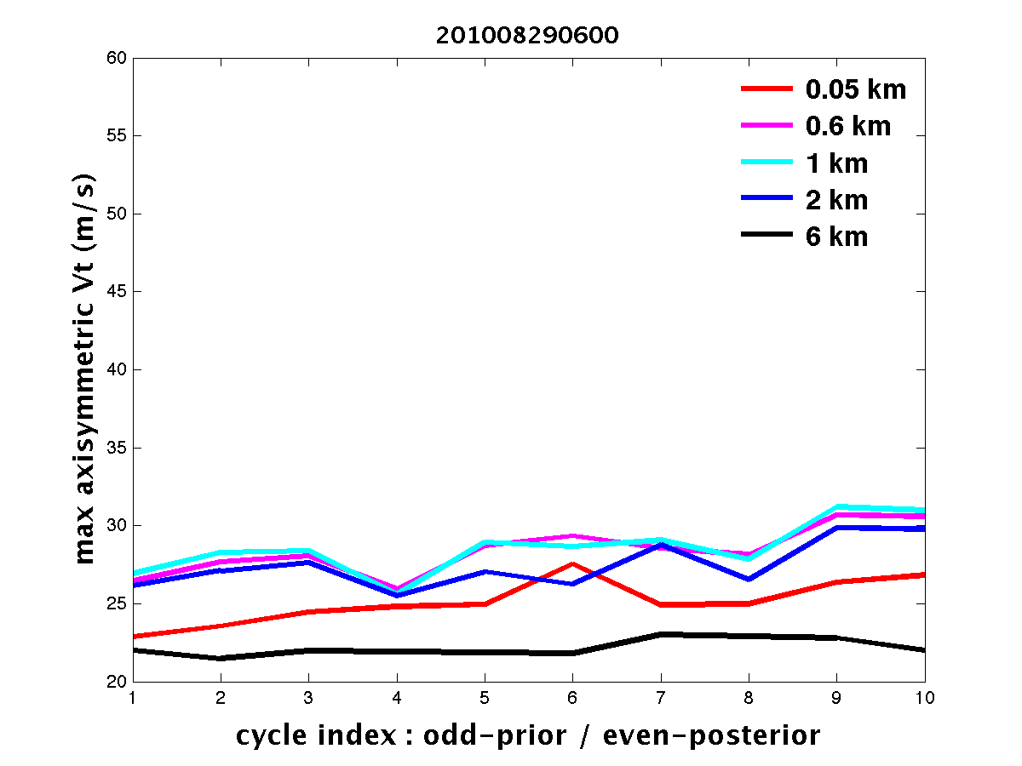
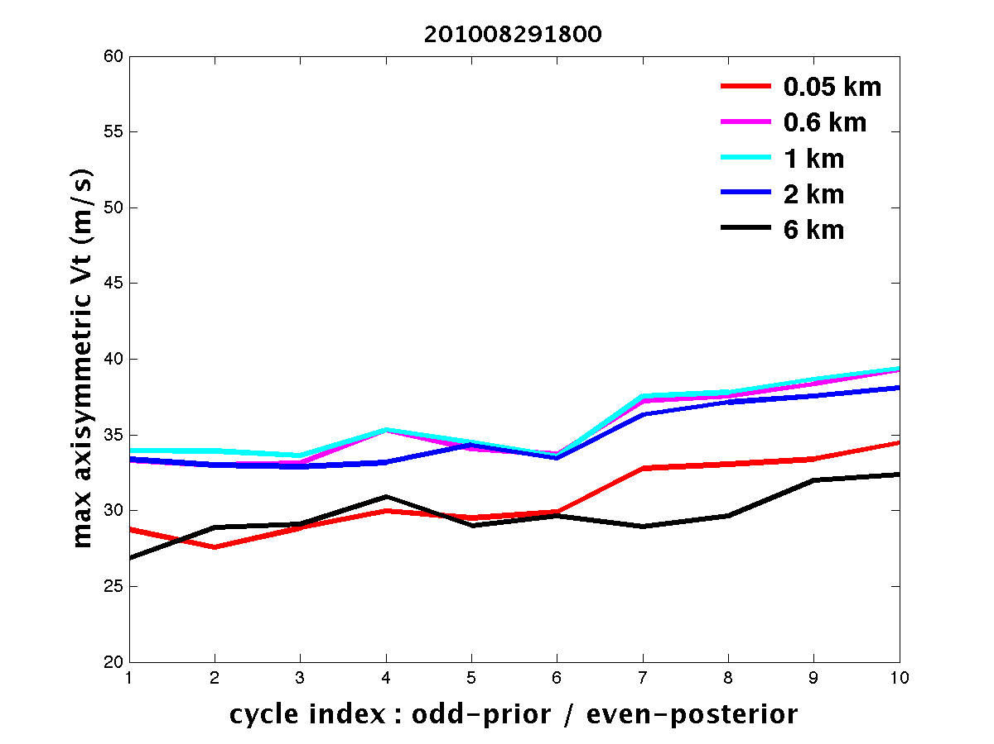
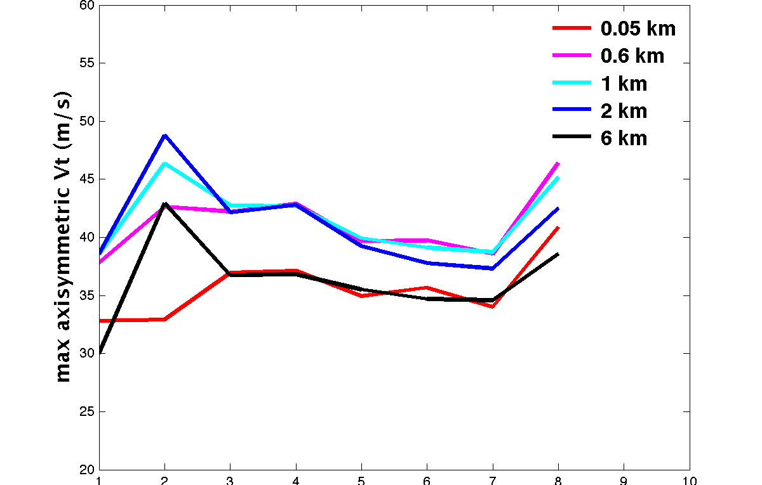
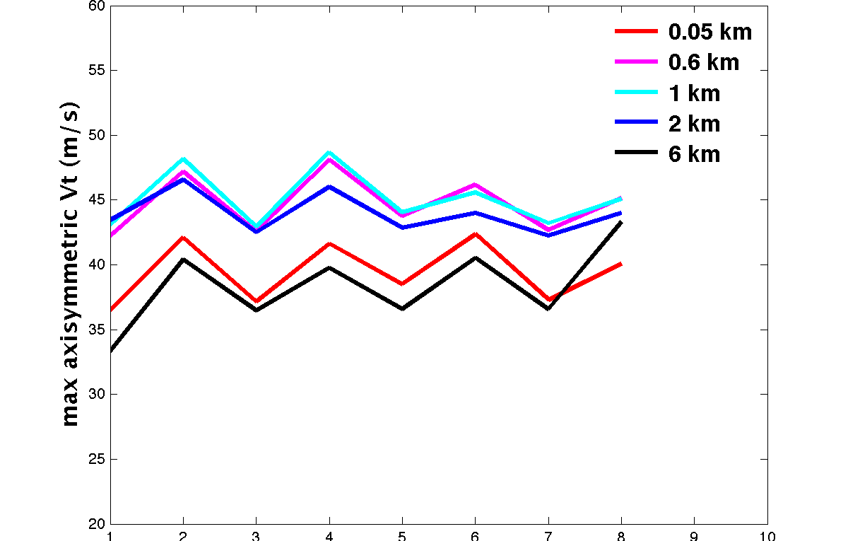
Evolution of maximum axisymmetric tangential velocity at different heights
TS
H1
Examples form
the hurricane Earl cases
H3
H4
F A F A F A F A
F A F A F A F A
The results show systematic reduction of the mean vortex strength in short-term forecast after the increase at the analysis update times for the periods when Earl was category 3-4
Such background forecast error leads to poor memory of the impact of observations on the vortex strength during EnKF cycling
Notes:
The results show presence of systematic dynamical adjustment at high intensity with negative trend in the short-term forecast

Slide 15
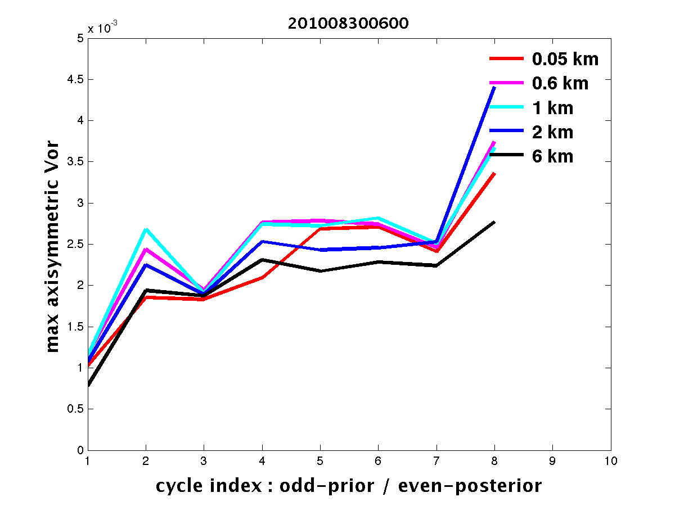
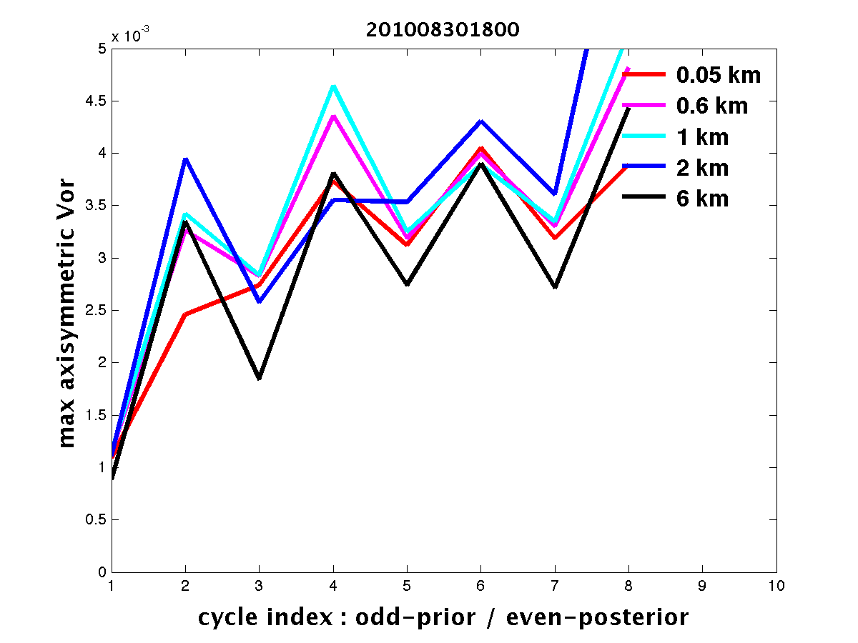
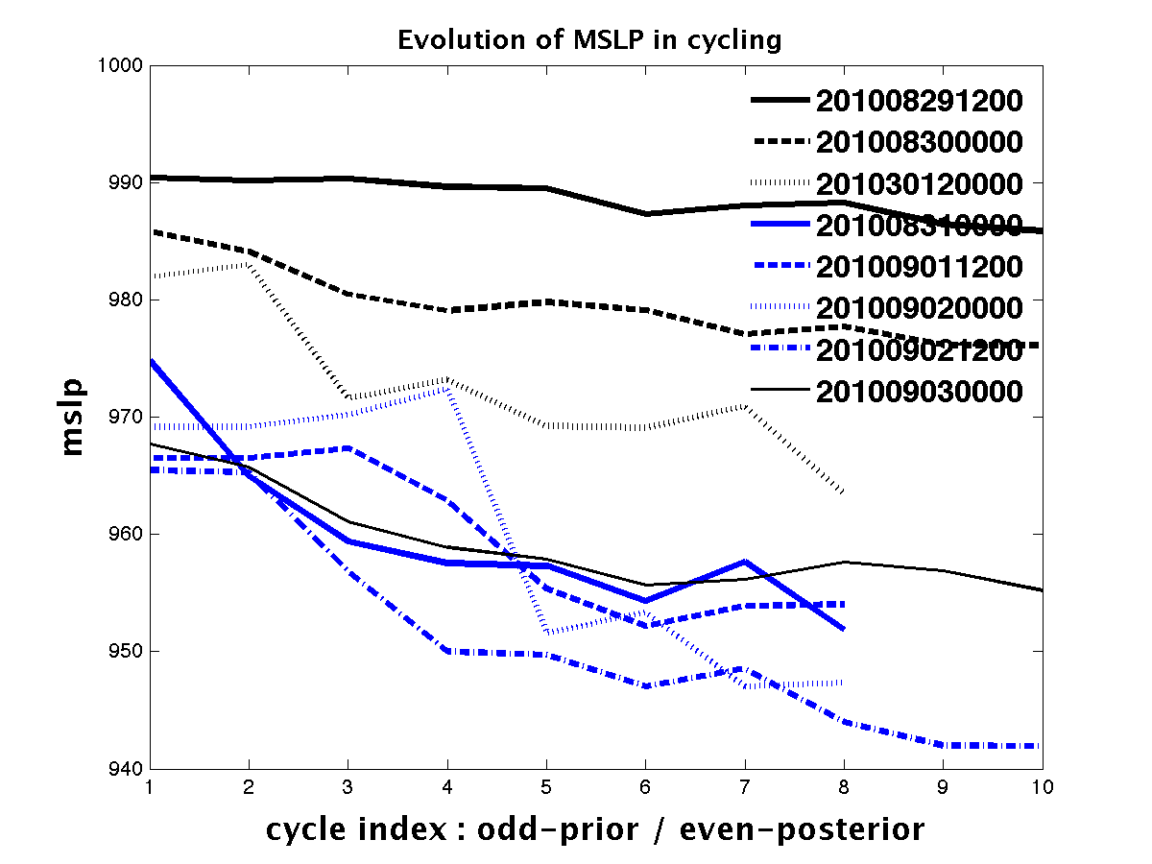
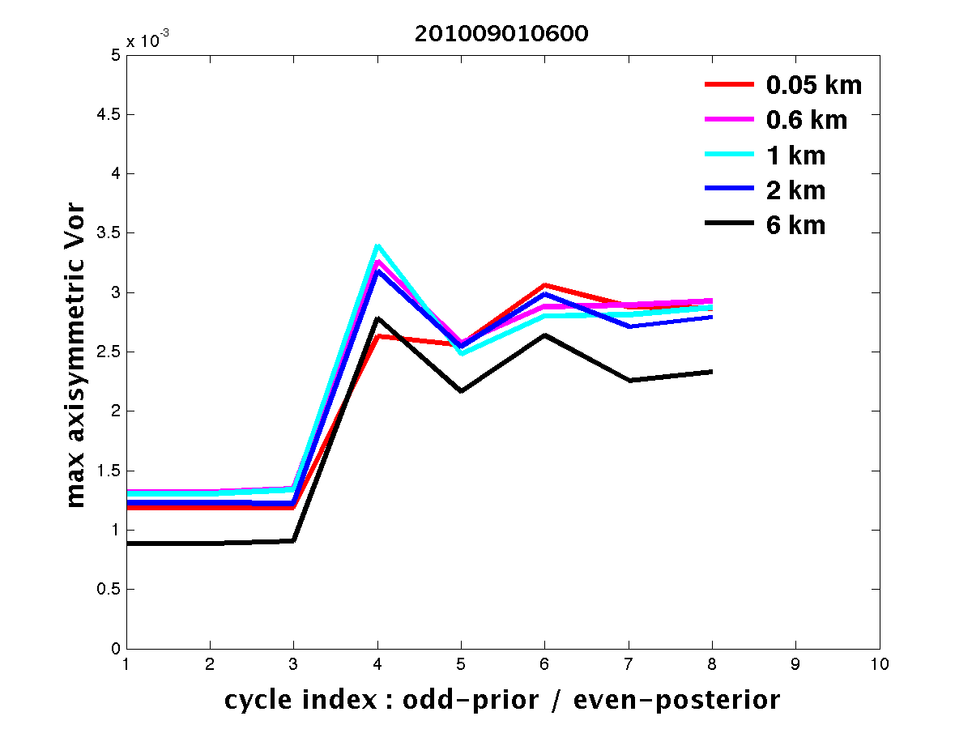
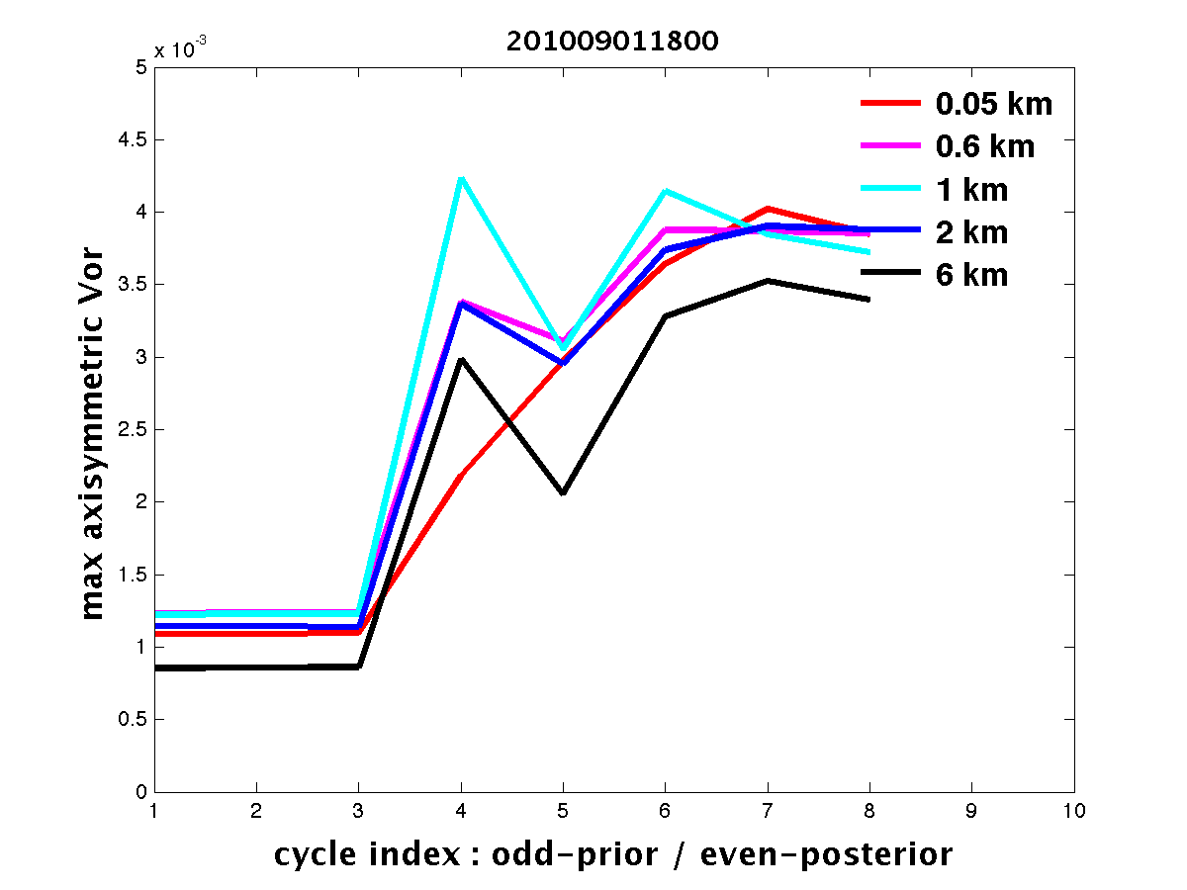
Evolution of maximum axisymmetric vorticity and MSLP
MSLP all Earl cases
VORTICITY examples
Hurricane Earl cases
MSLP decreases under the influence of observations during the EnKF cycling, coupled with oscillating but overall increasing maximum vorticity in the core
This result shows that the pressure dropping and vorticity spin-up in the vortex core are not balanced with the wind evolution during the data assimilation cycling

Slide 16
What is the problem?
Main properties
Dynamic adjustment of the wind
Systematically opposing tendency in short-term forecast, includes wind, temperature and humidity fields
Significant change of wind amplitude at analysis update
All this at the condition of high intensity vortex

Slide 17
Vortex structure in the analysis cycling
Prior
Earl 08/31 00Z - Final Cycle
Posterior
Significant phase discrepancy in the radial wind between prior and posterior state below 3 km indicates large disagreement between forecast and observations in PBL

Slide 18
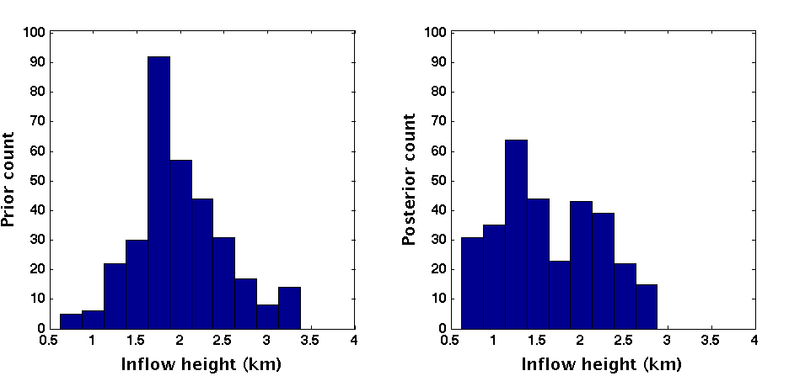
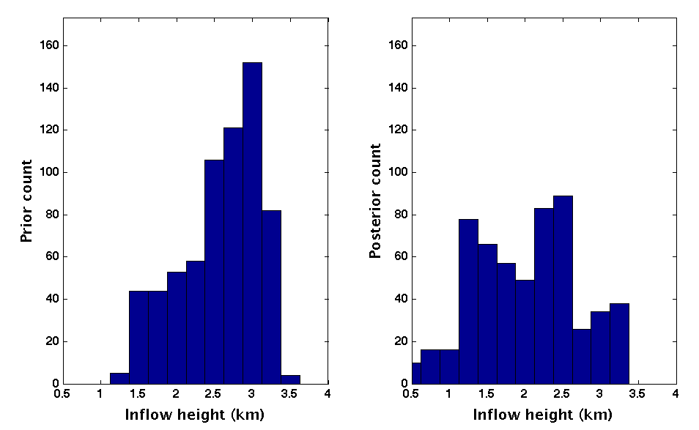
Systematic background forecast error
PBL structure: depth of inflow layer
Earl, cat 1-2
Earl, cat 3-4
prior
posterior
prior
posterior
A systematic shift to the lower inflow layer heights in the analysis relative to the background short-term forecast is clearly evident
This result together with the comparison of 3D wind structure shows that the forecast model has strong tendency to quickly develop erroneous PBL structure, which causes the systematic and large discrepancy between the observations and forecast at the analysis update in the cycling
Notes:
Comparison between prior and posterior distribution of heights of radial inflow layer within vortex core (1.5 < R < 2.1 RMW); PBL height systematically grows in the short-term forecast, while the wind is reduced

Slide 19
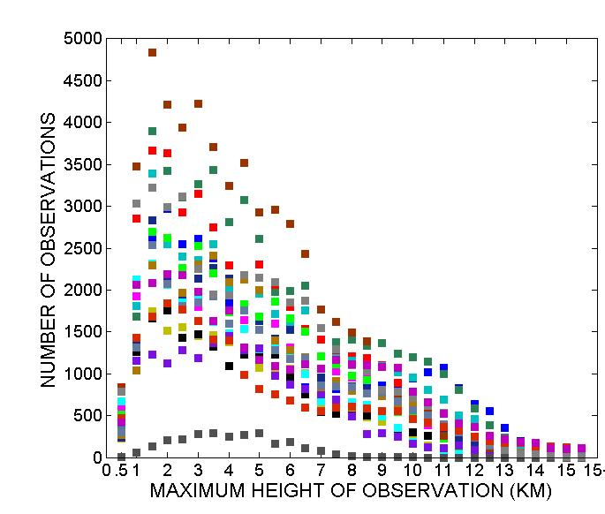
Background error correlations in PBL and wind observations
Background error correlations within model PBL
Number of Doppler radial wind observations
Very strong vertical coupling of background forecast errors causes wind updates that favor circulation at where there are most observations (above 1.5 km) and where the forecast is most in error both in the intensity and phase

Slide 20
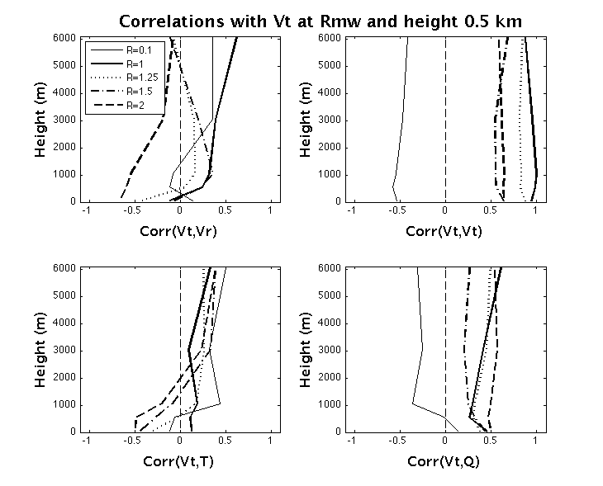
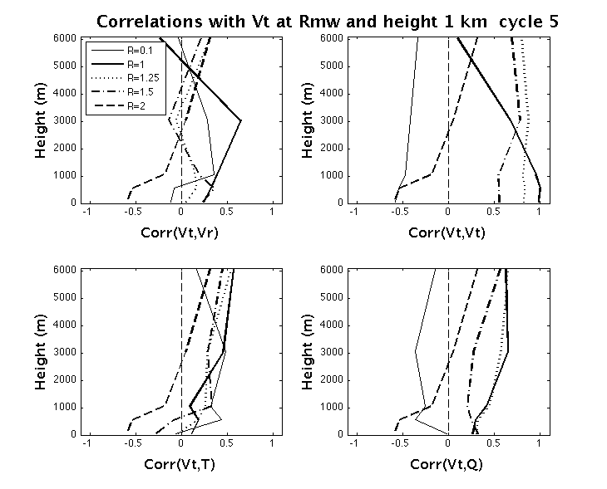
Dynamical modes of the background errors
Spin-down dynamical mode
Spin-up dynamical mode
Vr
Vt
Vr
Vt
Earl Aug 31
Earl Aug 29
T
Q
T
Q
The background error correlations differ between dynamical regime in the background forecast
When the assimilation is not effective in correcting the wind the dynamical-mode is opposing the observations (the spin-down mode), suggesting further impact of the model error on the analysis by the error correlations
Notes:
Do not try to interpret the correlations; Just say that they are different for different dynamical regimes which suggests hat the analysis increments project onto model error

Slide 21
Summary of the coupling between the model and analysis errors
Start up forecast
Model PBL errors cause significant discrepancy between the background forecast and observations of the wind at heights < 4 km in the core region
EnKF analysis
Update with the observations corrects the winds such that
Vt and Vr and rapid rotation with height, coupled with T and Q
Background error correlations
The ensemble error correlations are likely reinforcing the background forecast errors because of the preferred dynamical mode under the influence of the model error, while there is no-explicit representation of this error in the ensemble
Short forecast
In the subsequent 1 h forecast, friction and mixing, in conjunction with other meso processes reverse the effect of update of the wind, namely
Vt and Vr , also coupled with T and Q ,
while PBL height increases
Notes:
Start reading content of the boxes from the left, following blue arrows first then yellow

Slide 22
Summary and future work
The experience with HEDAS in 2010 shows that the EnKF data assimilation on vortex scale with HWRF model produces skilled 3D atmospheric mesoscle state analysis and has potential for making significant improvements to the deterministic forecast of intensity
Further research and development is needed to improve upon the demostrated potential

Slide 23
HRD’s plan for current and near future data assimilation R&D
Model error representation in the ensemble by physics perturbations with properties specific to HWRF model and TC dynamics
More observations: Continuous cycling of HWRF Ensemble DA using the satellite and other observations by way of EnKF/GSI system (collaboration with ESRL/PSD, UofU, CIMSS and NCEP/HWRF)
Developing the hybrid DA system for HWRF (collaboration with ESRL/PSD, OU, NCEP/HWRF)
Forecast diagnostics and verification with satellite observations
Notes:
The analyzed maximum surface wind was significantly underestimated in HEDAS analysis during periods with strong and intensifying hurricane (the cases of hurricane Earl while category 3 and 4)

Slide 25
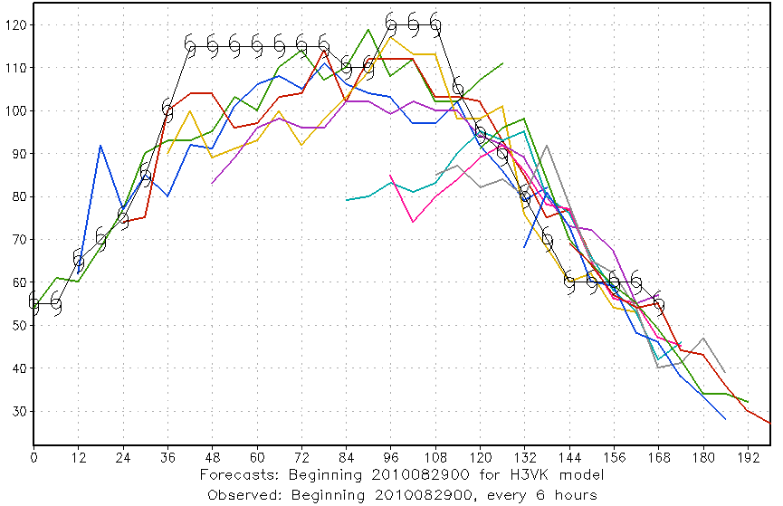
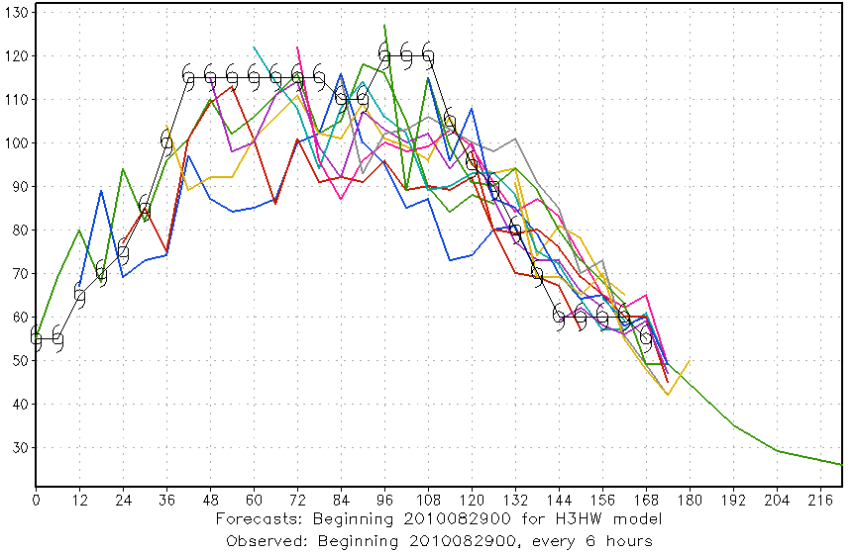
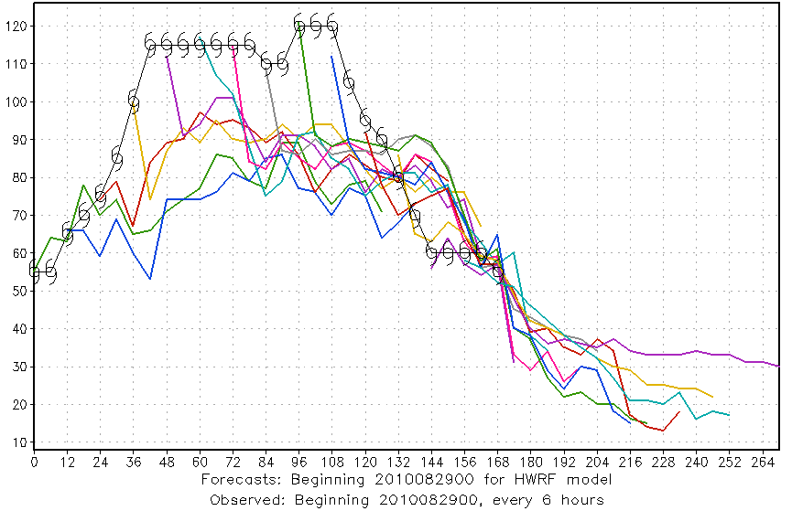
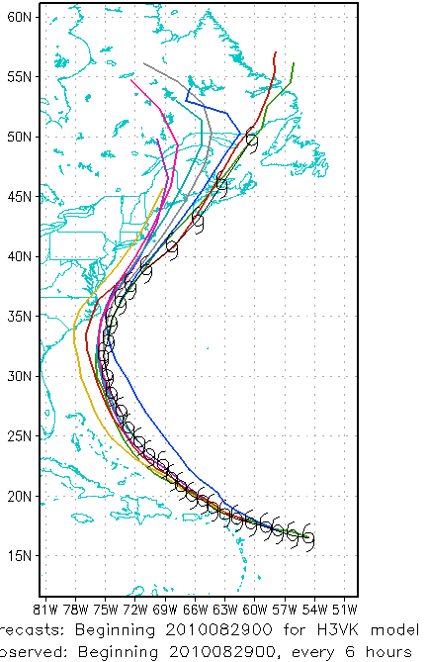
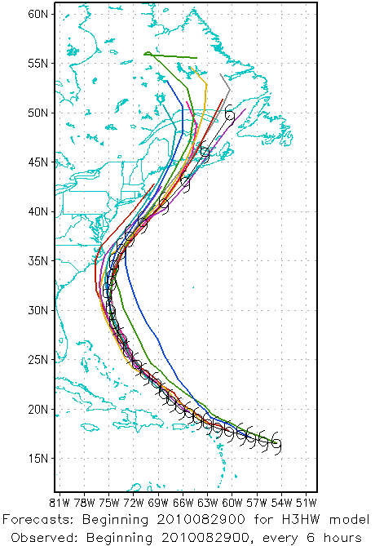
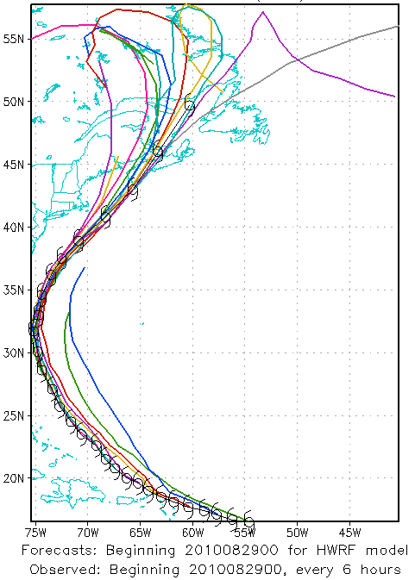
2010 HEDAS Semi-Real-Time Runs for HFIP: Forecast Results by Storm (Earl)
HEDAS
HWRFx
HWRF

