Slide 1
An update on verification tool for HWRF
Chanh Kieu, IMSG/EMC

Slide 2
Objective
Have as many different types of verifications as possible besides intensity and track errors (radii, along-track, cross-track, weak versus strong, land/ocean category….);

Slide 3
Requirements
All verifications have to be reliable and consistent with existing verification packages;
Have to be comparable with the current package at EMC.
Need to be simple and efficient for porting to different platforms.

Slide 4
NHC_verif package
The NHC verification program developed by James Franklin was selected, modified, and an interface based upon this NHC program has been developed
On vapor, go to: /gpfs/v2/home/wx24ck/programs
drwxr-xr-x 7 wx24ck g01 32768 Nov 22 15:13 .
drwxr-xr-x 5 wx24ck g01 32768 Nov 28 13:10 ..
drwxr-sr-x 8 wx24ck g01 32768 Nov 22 15:13 DTC_verif
drwxr-xr-x 5 wx24ck g01 32768 Nov 10 15:09 EMC_verif
drwxr-xr-x 7 wx24ck g01 32768 Nov 25 14:46 NHC_verif
drwxr-xr-x 4 wx24ck g01 32768 Nov 10 15:09 Statistics

Slide 5
NHC_verif package: compiling
Next go into: /gpfs/v2/home/wx24ck/programs/NHC_verif
total 832
drwxr-xr-x 7 wx24ck g01 32768 Nov 25 14:46 .
drwxr-xr-x 7 wx24ck g01 32768 Nov 22 15:13 ..
drwxr-sr-x 3 wx24ck g01 32768 Nov 25 14:29 arch
-rwxr-xr-x 1 wx24ck g01 594 Nov 25 14:29 clean
-rwxr-xr-x 1 wx24ck g01 496 Nov 25 14:29 compile
-rwxr-xr-x 1 wx24ck g01 829 Nov 25 14:29 configure
-rw-r--r-- 1 wx24ck g01 1299 Nov 25 14:34 configure.nhcvx
drwxr-sr-x 3 wx24ck g01 32768 Nov 25 14:35 exec
-rw-r--r-- 1 wx24ck g01 464 Nov 25 14:29 makefile
drwxr-xr-x 5 wx24ck g01 32768 Nov 29 15:58 run
drwxr-xr-x 3 wx24ck g01 32768 Nov 29 15:55 src
drwxr-xr-x 2 wx24ck g01 32768 Nov 28 15:34 utils
Type ./configure, choose an option for Fortran compiler (PGI or IBM), and run ./compile

Slide 6
NHC_verif package: running
Next go into: /gpfs/v2/home/wx24ck/programs/NHC_verif/run
total 832
drwxr-xr-x 4 wx24ck g01 32768 Nov 30 15:53 .
drwxr-xr-x 8 wx24ck g01 32768 Nov 30 15:41 ..
drwxr-xr-x 2 wx24ck g01 32768 Nov 30 15:52 data
lrwxrwxrwx 1 wx24ck g01 22 Nov 30 15:53 emc_driver.sh
lrwxrwxrwx 1 wx24ck g01 24 Nov 30 15:53 emc_gs_table.sh
lrwxrwxrwx 1 wx24ck g01 25 Nov 30 15:53 emc_namelist.txt
lrwxrwxrwx 1 wx24ck g01 24 Nov 30 15:53 emc_nhc2grads.exe
lrwxrwxrwx 1 wx24ck g01 26 Nov 30 15:53 emc_nhc2grads.f90
lrwxrwxrwx 1 wx24ck g01 29 Nov 30 15:53 emc_template_ctl.tbl
lrwxrwxrwx 1 wx24ck g01 28 Nov 30 15:53 emc_template_gs.tbl
drwxr-xr-x 2 wx24ck g01 32768 Nov 30 15:52 model_logs
lrwxrwxrwx 1 wx24ck g01 23 Nov 30 15:53 verify_model.exe
lrwxrwxrwx 1 wx24ck g01 25 Nov 30 15:53 verifym_ctrl.dat
1. Edit the home path in ./emc_driver.sh
2. Edit the namelist file ./emc_namelist.txt

Slide 7
NHC_verif package: running
edit some NHC input parameters in the emc_namelist.txt file:
#
# Input verification parameters
#
# verif - option of verification: intensity/track/radii/all
# ntype - option for NHC verification. Note that it can onlt take
# the entire year or mutil year format. Single case will
# be processes as though that year has 1 case. This saves
# a lot of formatting.
# ntime - number of verification lead time (by default = 21 for 5
# days forecast, output every 6h)
# title - experiment title for plotting
#
verif: all
ntime: 21
ntype: ALAL2011
title: ALL 2011 ATLANTIC THRU 18L

Slide 8
NHC_verif package: running
edit models to process and the adeck files :
#
# Note: model,mark,style,color,thick,
#
model: HWRF 1 1 2 9
model: GFDT 2 1 4 9
model: CLP5 3 1 9 9
model: SHF5 4 1 9 9
model: GFDL 5 1 3 9
model: H3GP 6 1 7 9
model: OFCL 1 1 1 9
#
# put the adeck files in the lines below. One line per adeck file
#
adeck: aal012011
adeck: aal022011
Then run: ./emc_driver.sh. All figures will be put in ./run/figures/

Slide 9
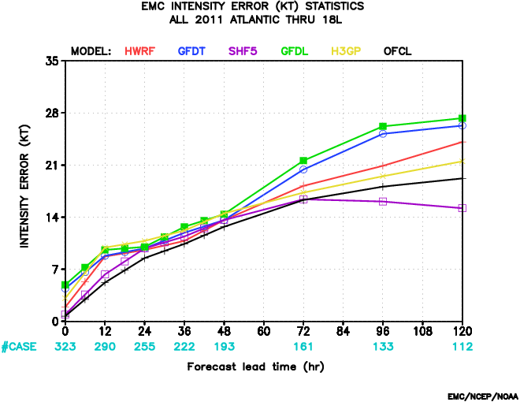
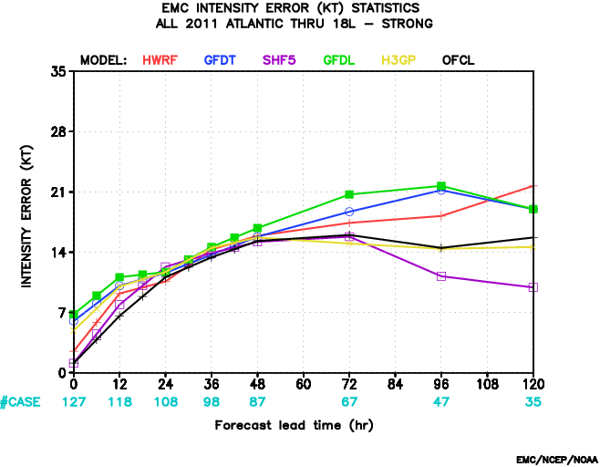
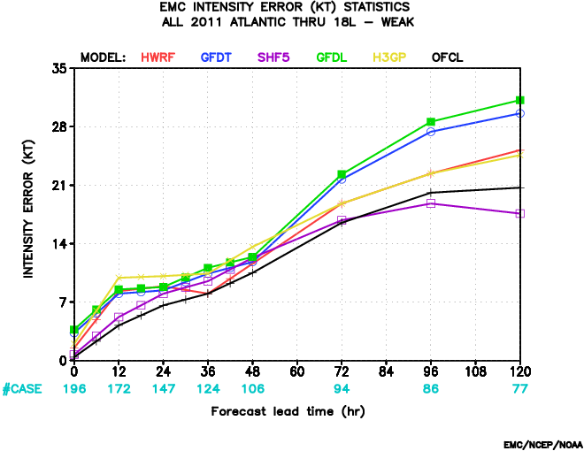
Verification intensity (all/strong/weak)

Slide 10
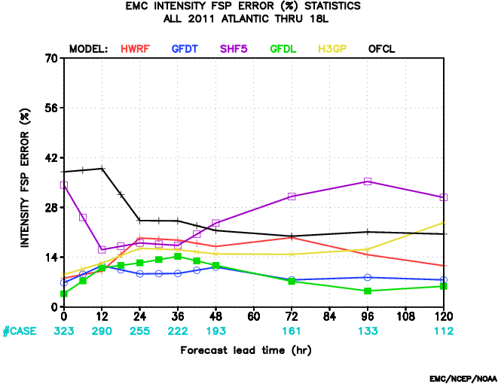
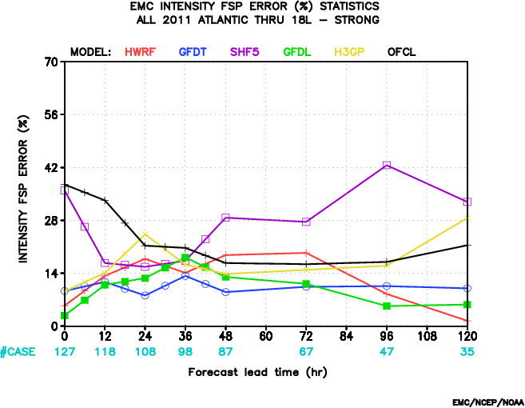
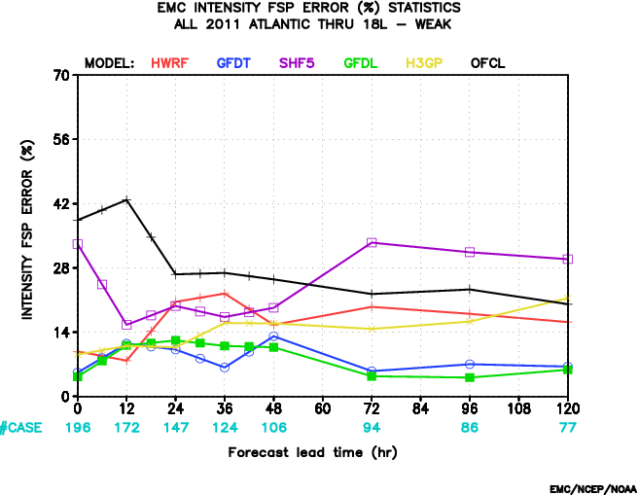
Verification FSP intensity (all/strong/weak)

Slide 11
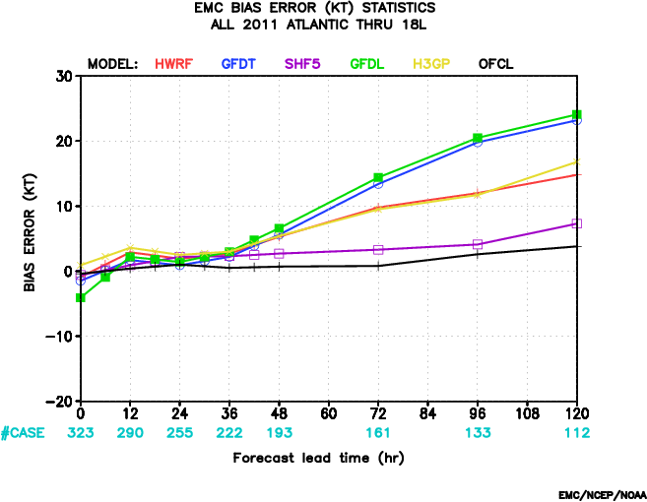
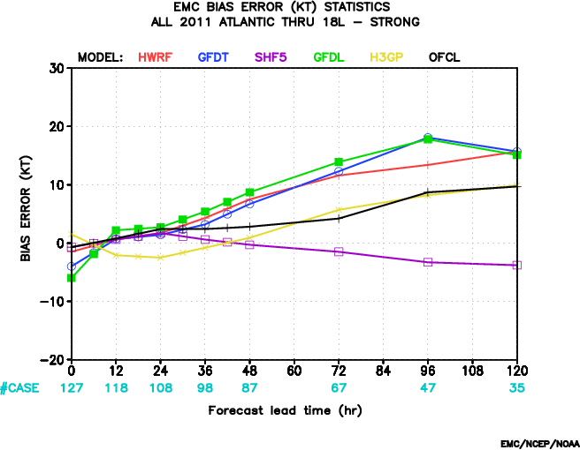
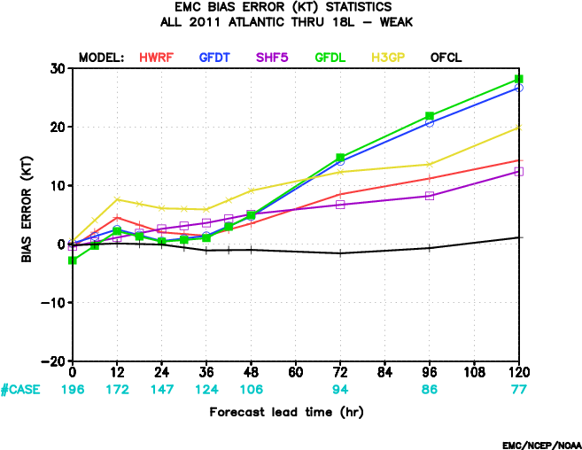
Verification intensity bias (all/strong/weak)

Slide 12
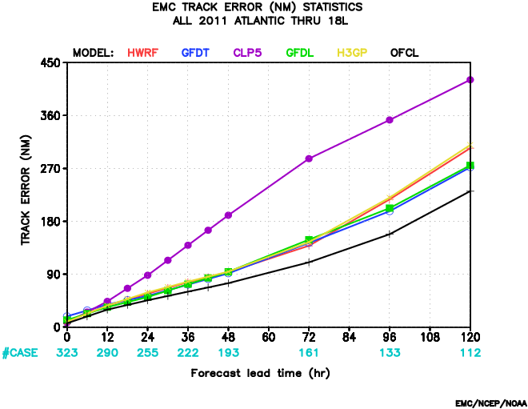
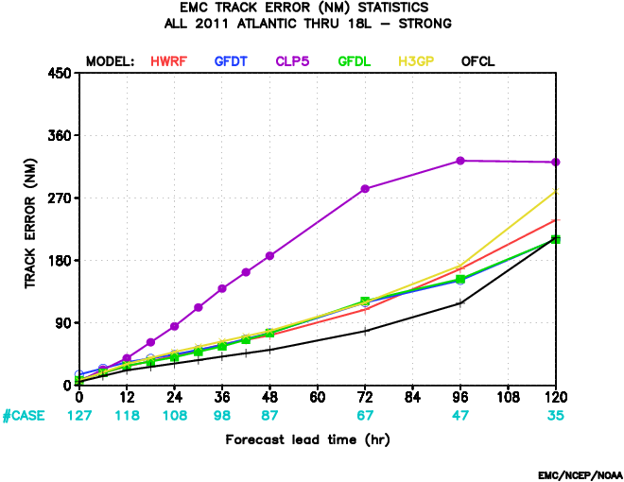
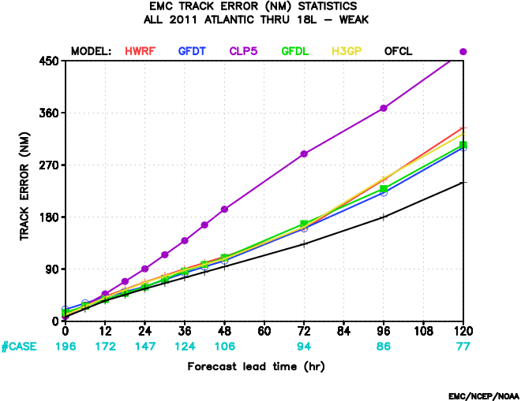
Verification track (all/strong/weak)

Slide 13
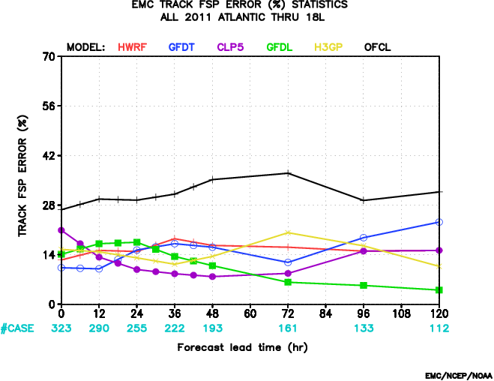
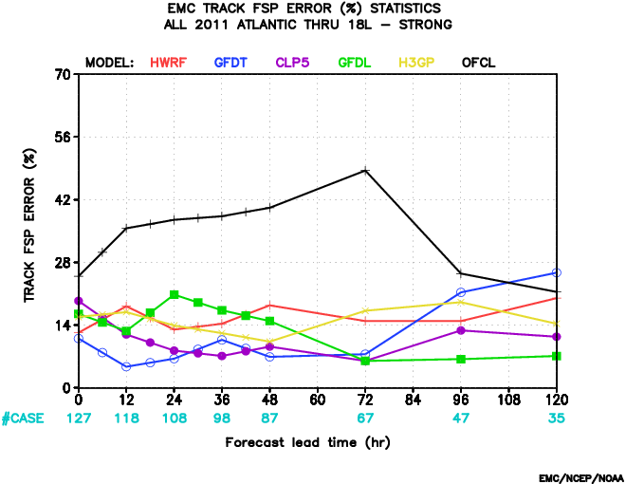
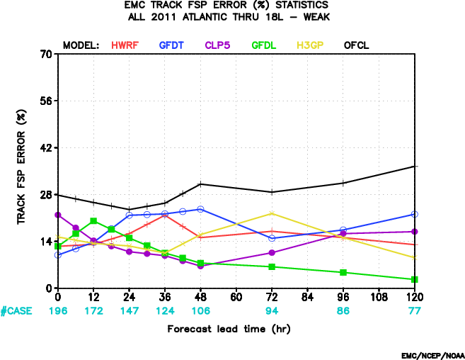
Verification FSP track (all/strong/weak)

Slide 14
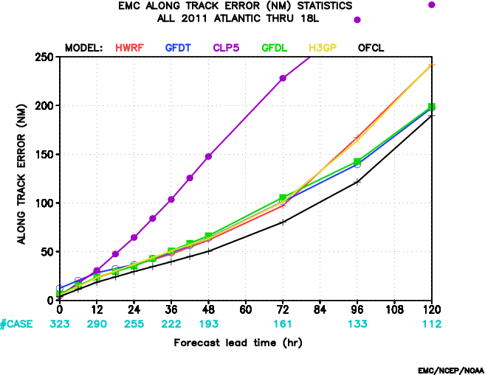
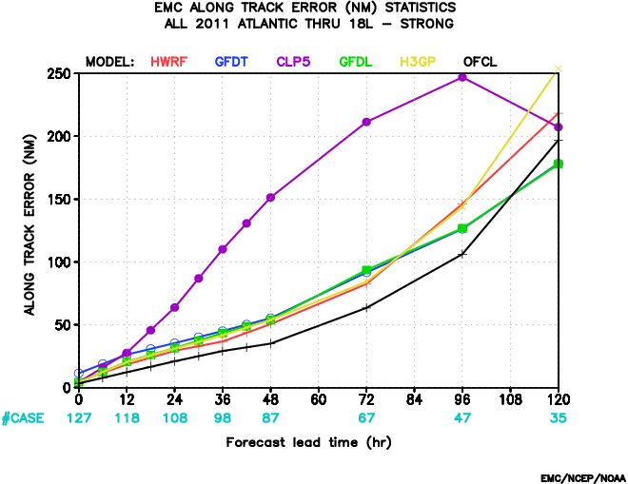
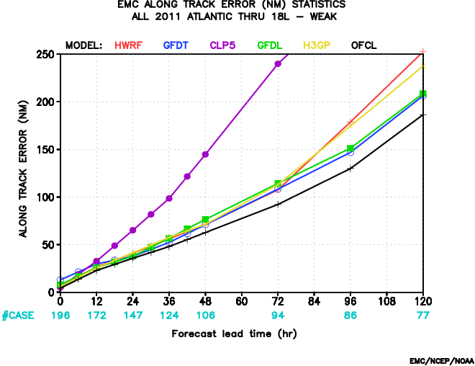
Verification along track (all/strong/weak)

Slide 15
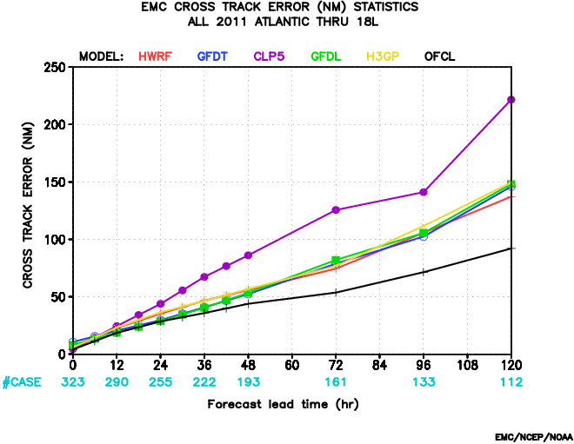
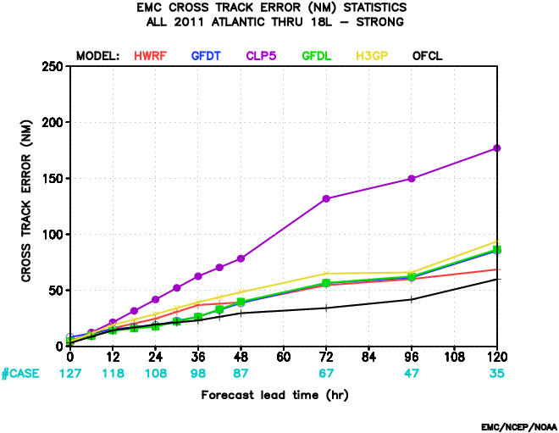
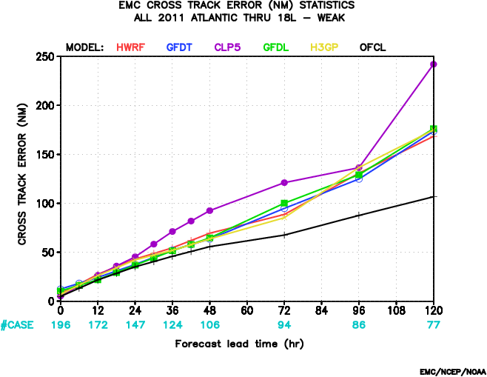
Verification cross track (all/strong/weak)

Slide 16
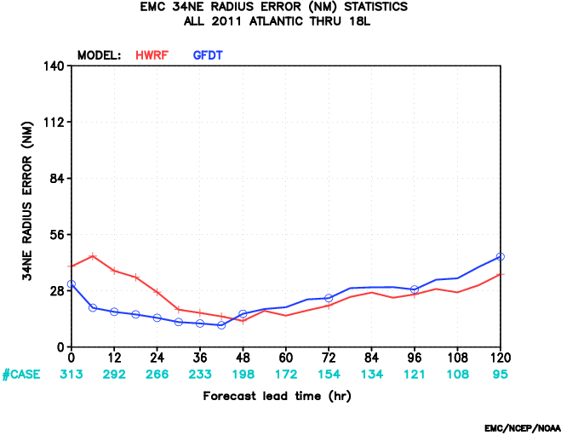
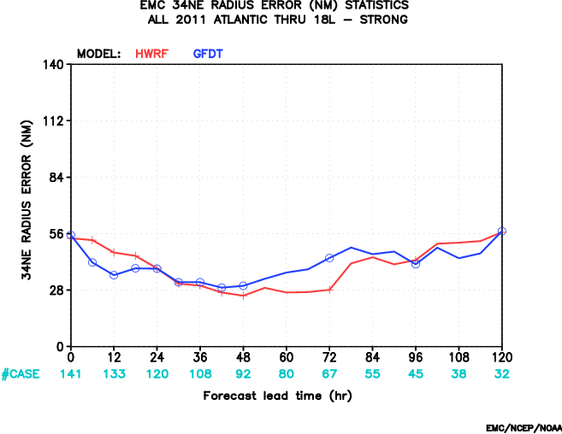
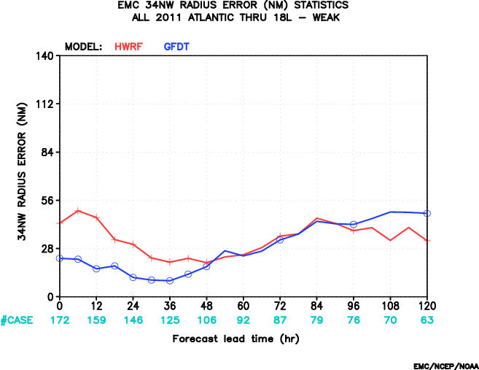
Verification 34NE radii (all/strong/weak)

Slide 17
Further verifications
2D verifications (i.e., field verification) of some basic variables at each level or vertical cross sections w.r.t. radar or satellite?
Grid points verifications w.r.t. GDAS?

