Slide 1
Operational HWRF – Current Status, Ongoing Development and Future Plans
Vijay Tallapragada
Hurricane Team Leader. Environmental Modeling Center, NCEP/NOAA/NWS/DOC, NCWCP, College Park, MD 20740.
National Hurricane Center, Miami, August 21, 2012
Notes:
1
1

Slide 2
Outline
Overview and Performance of the 2012 operational coupled HWRF System
Special projects
ECMWF driven HWRF
Basin-Scale (hemispheric) HWRF
New Initialization for HWRF
TDR DA Parallel Runs and EnKF-Var Hybrid DA for Basin-Scale HWRF
HWRF-HYCOM
HWRF in Western Pacific and North Indian Ocean Basins
HWRF O&M Task Matrix
Ongoing Developments
Future plans

Slide 3
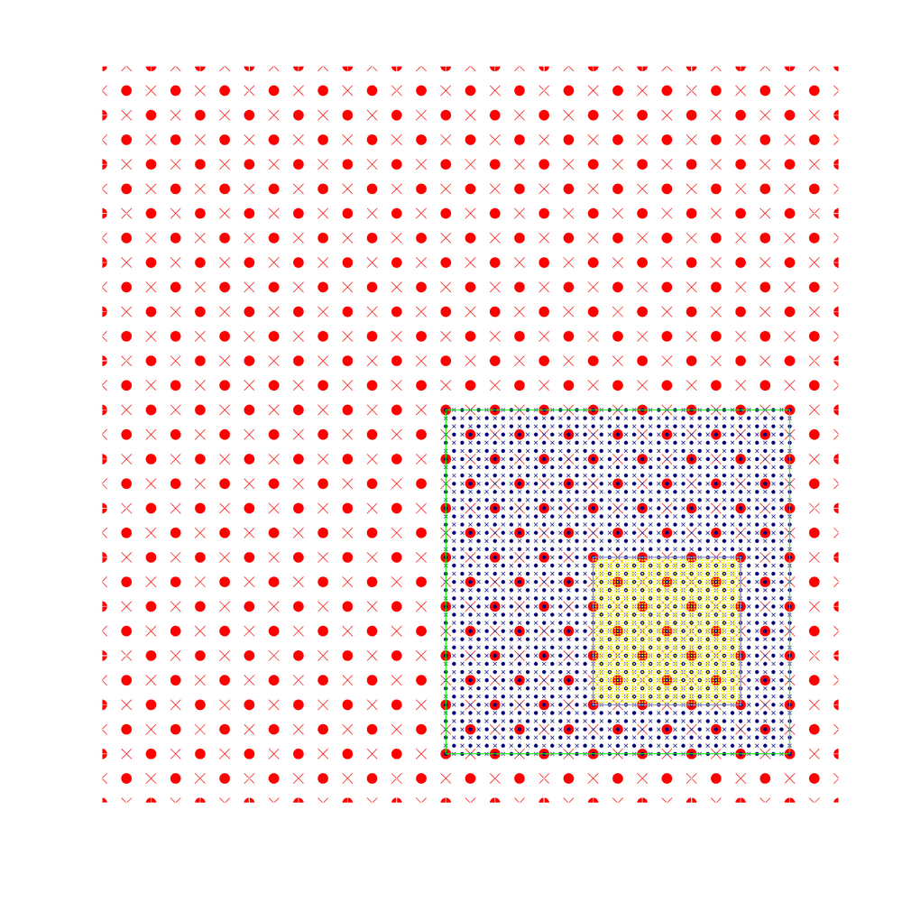
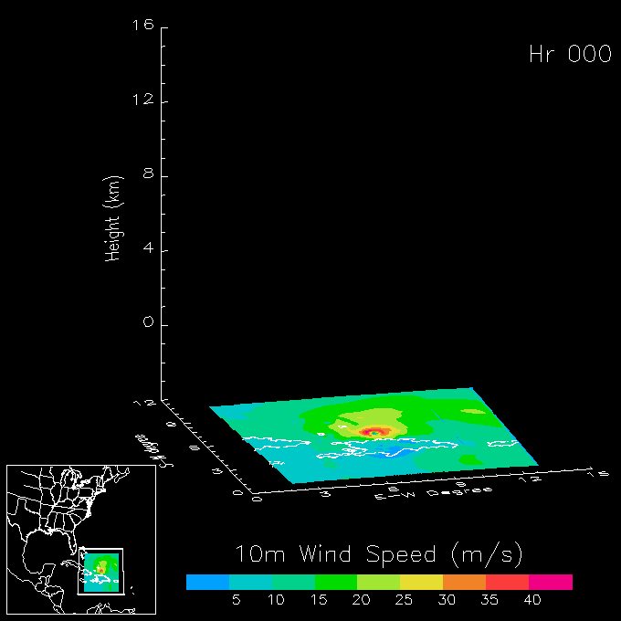
Highlights of the 2012 HWRF upgrades
For the first time, a high-resolution hurricane model operating at cloud-permitting 3km resolution implemented into NCEP operational system
This upgrade is a result of multi-agency efforts supported by HFIP
EMC: Computational efficiency, nest motion algorithm, physics improvements, 3km initialization and pre-implementation T&E
HRD/AOML: nest motion algorithm, multiple moving nests, PBL upgrades, interpolation for initialization, DTC/NCAR: code management and repository, MPI profiling
ESRL: Physics sensitivity tests and idealized capability
URI: 1D ocean coupling in East Pac GFDL: Knowledge sharing, joint T&E
NHC: Diagnostics and evaluation of the HWRF pre-implementation tests
Three telescoping domains:
27km: 75x75º; 9km ~11x10º 3km inner-most nest ~6x6º
Notes:
3

Slide 4
NCEP Operational HWRF (2.0) 2007
AOML/HRD HWRFX (V3.0.1) 2008 (HFIP Stream 2)
HWRF Vortex
Assimilation & GSI
WRF pre-processing system
Flexibility for testing initial
Conditions for research
NMM dynamics with
one moving nest
NMM dynamics with
multiple moving nests
Operating resolution 27:9
Operating resolution
27:9, 9:3 and 27:9:3
Hurricane EnKF Data
Assimilation System (HEDAS)
Ocean Coupled
GFDL/GFS Physics/
Slab LSM
GFDL/GFS Physics/
NOAH LSM
Consistent w/ 3 km res.
Framework also
Includes Idealized
Cases/ 1-D HYCOM
HWRF post-processor
& HPLOT
Diapost: High Res. Hurricane Post-Processing system
Release Version HWRF V3.2
2010
Tropical Prediction System
(HWRF-GEN)
Basin-Scale &
Multiple-Movable Nests
HWRF V3.4 2012 Implementation
27:9:3 REAL-TIME HFIP STREAM 1.5 SYSTEM (2011)

Slide 5
Highlights of 2012 HWRF implementation
Dynamics
modified several components of the model codes and add I/O servers and redirect the standard output through log-buffering to speedup model run time in order to fit within the operational time window (speedup factor of 3.2 in run time from ~265 min. to ~82 min.) and using 4 nodes (oper. HWRF uses 3 nodes)
Reduced Time step of model integration 45, 15, 5 sec
Fix a bug in mask inside the leading edge of a nest domain
Initialization and GSI
Build the vortex initialization at 3km resolution with more accurate interpolation algorithms and composite storm structure consistent with 3km
Upgrade GSI to version 3.5 which is the latest community version. Optimize the impact of prepbufr data in a storm environment.
Ocean
Add one dimensional ocean coupling in Eastern Pacific basin
Bug fixes in ocean initialization for Atlantic basin
Physics
Add GFS shallow convection scheme with slight tuning (no precip. from SC when cloud is less than 50mbs thick and SC top is below PBL top)
Modify several microphysical parameters to more realistic values (NLImax, NCW and snow fall speed)
PBL: Change critical Richardson number from 0.5 to 0.25, and alpha=0.5
Use the constant Ch profile with wind speed consistent with observations
Notes:
5

Slide 6
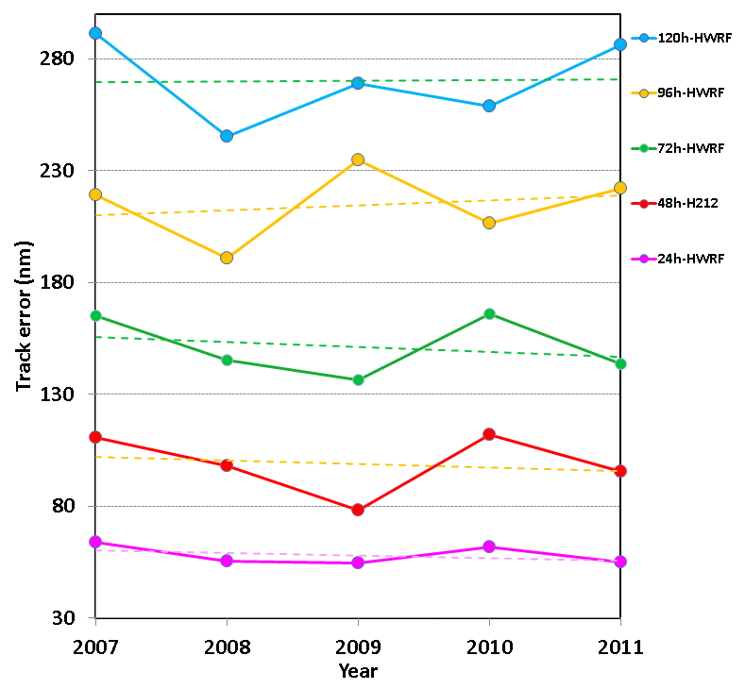
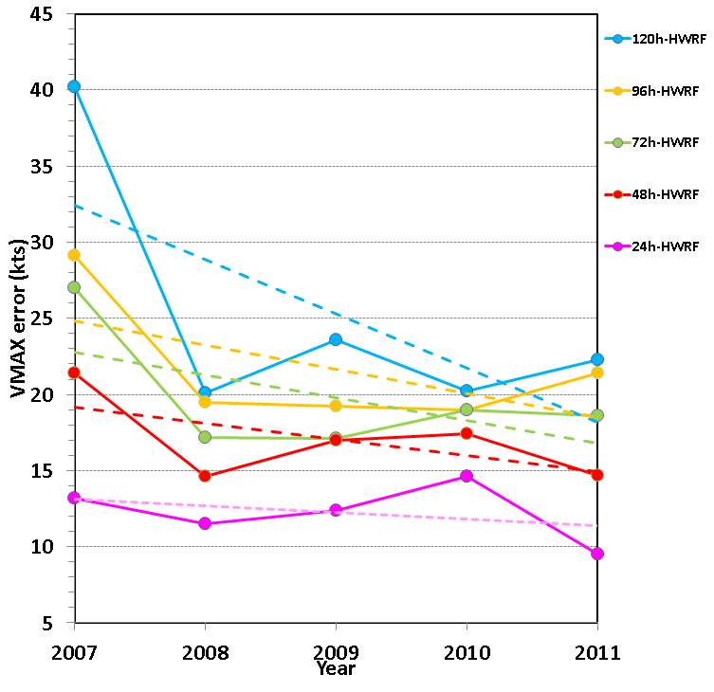
Atlantic basin 2007-2011: HWRF
Track
Intensity

Slide 7
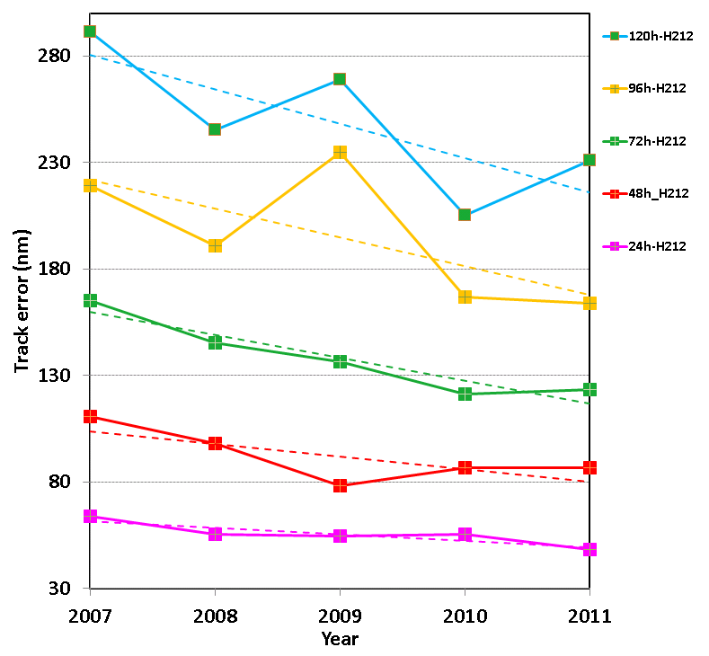
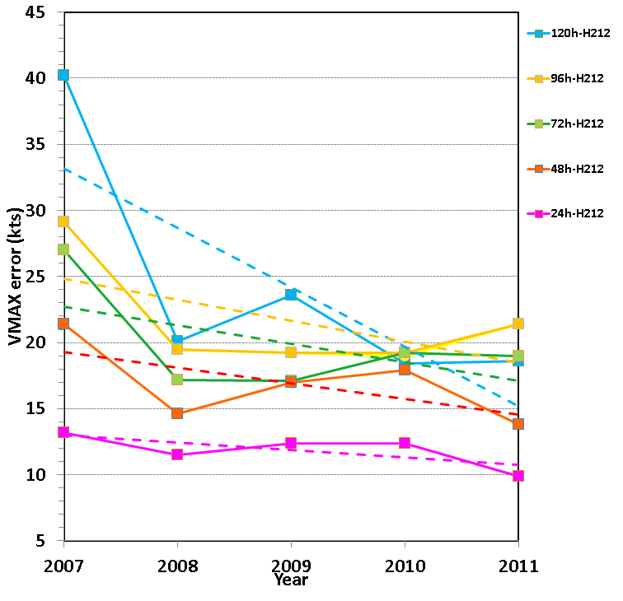
Atlantic basin 2007-2011: H212
Track
Intensity

Slide 8
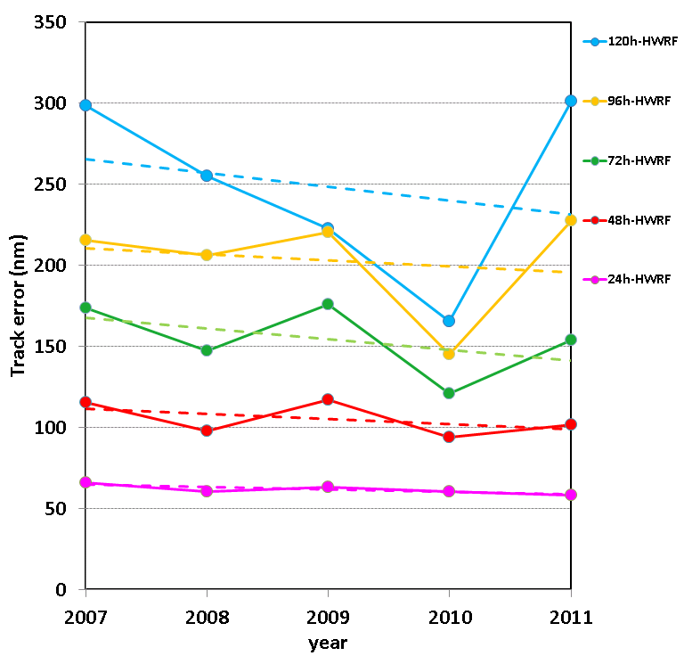
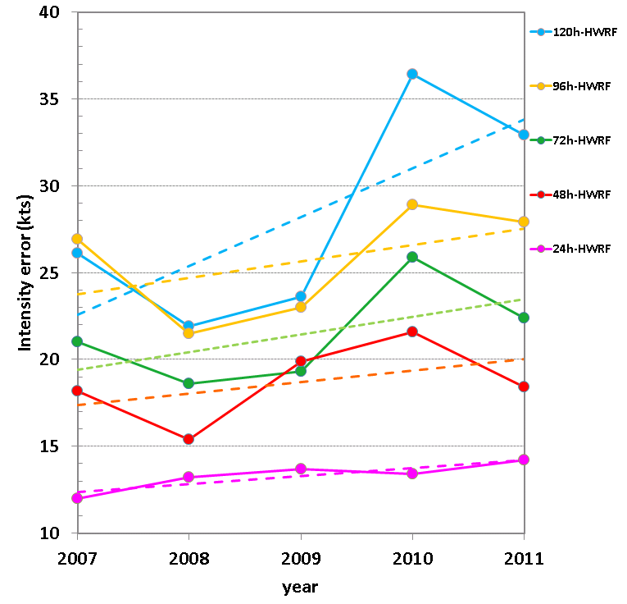
EPAC basin 2007-2011: HWRF
Track
Intensity

Slide 9
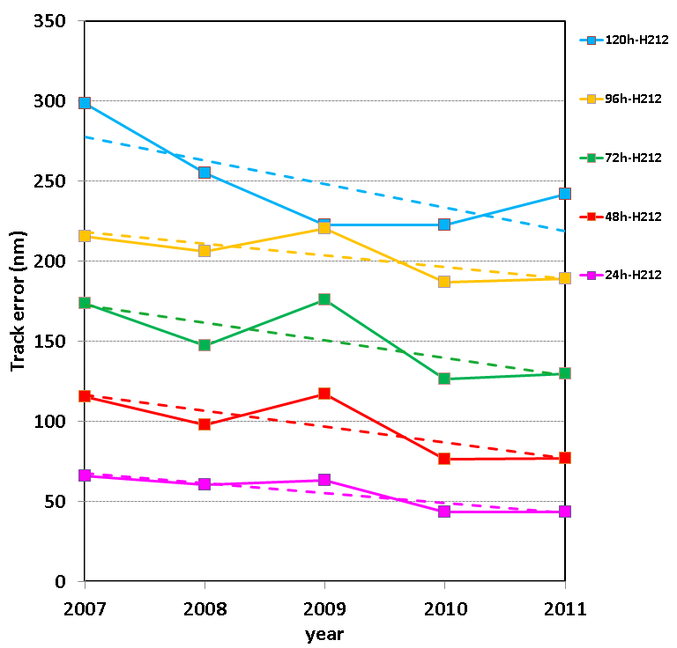
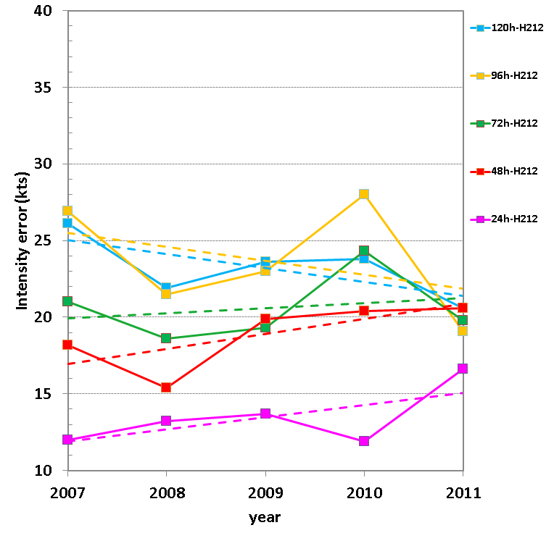
EPAC basin 2007-2011: H212
Track
Intensity

Slide 10
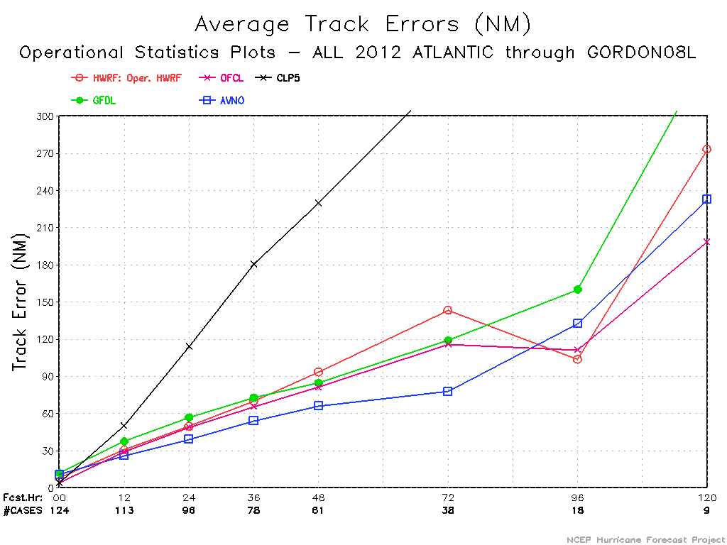
Real-Time Performance Update – ATL
Few cases from TS Debby contaminated the Atlantic Stats

Slide 11
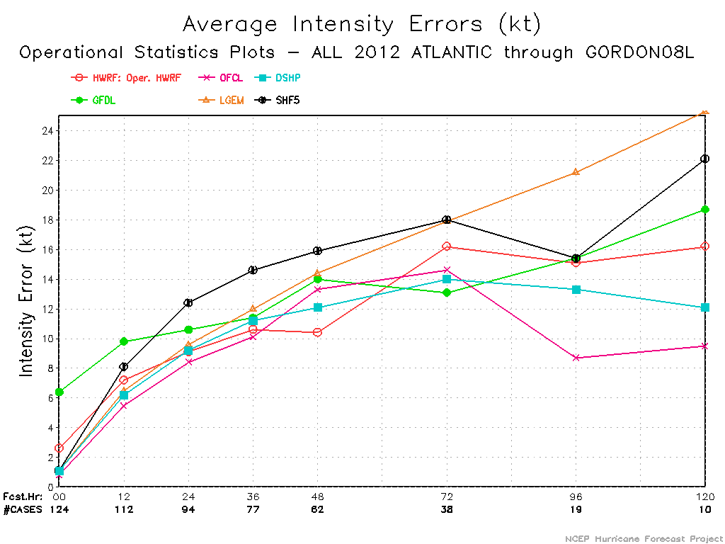
Real-Time Performance Update – ATL
Improvements in Atlantic intensity forecasts in 12-48hr period

Slide 12
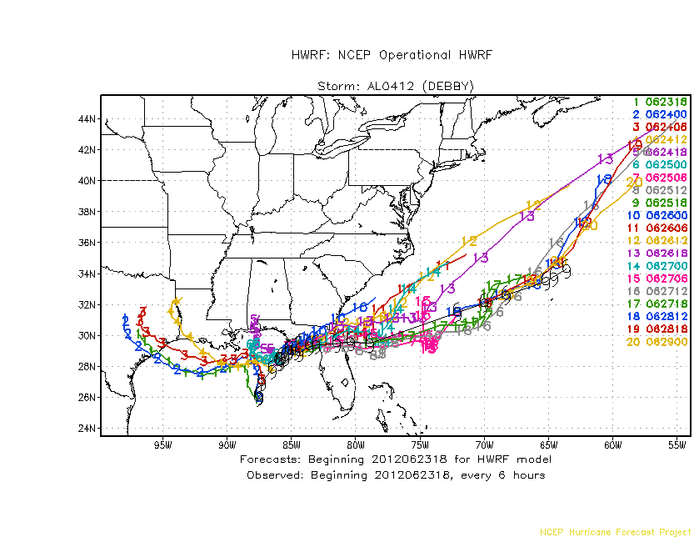
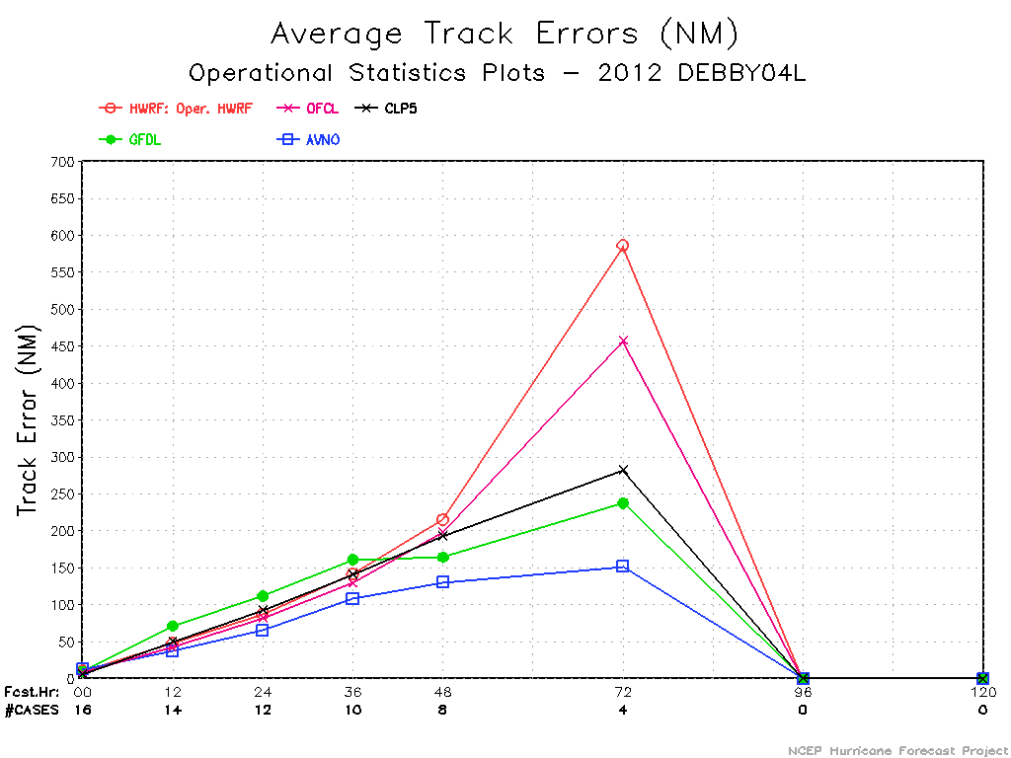
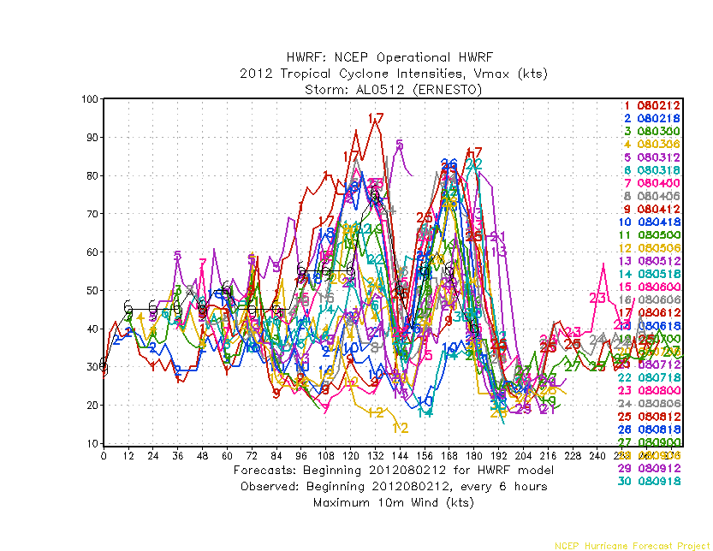
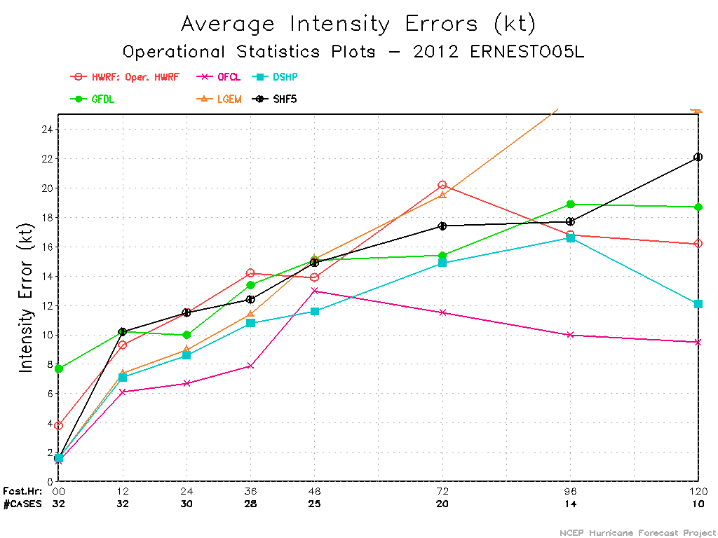

Slide 13
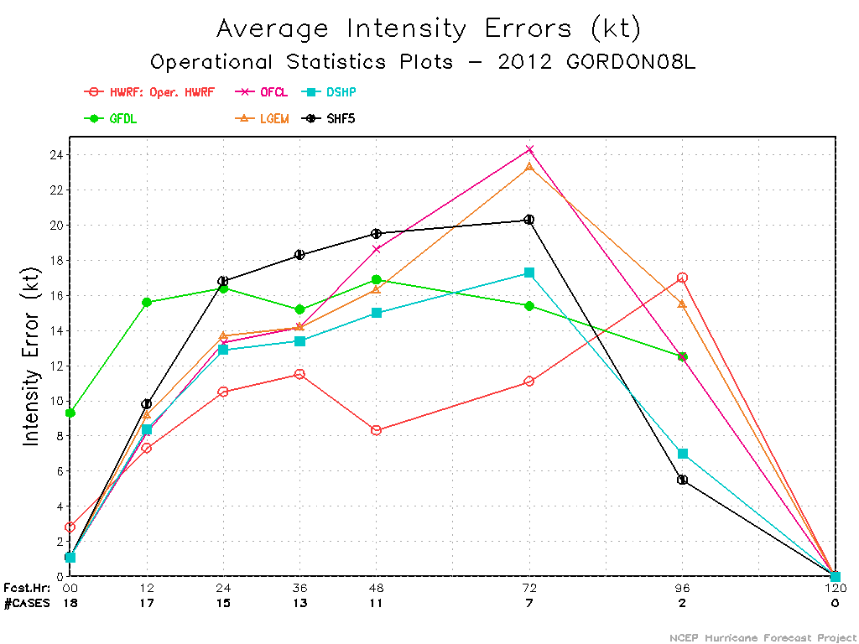
Impressive intensity forecasts for Hurricane Gordon

Slide 14
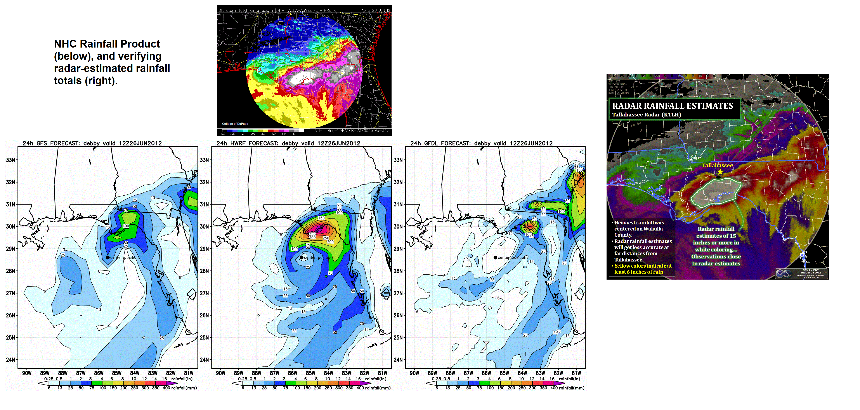
Experimental Real-Time products from HWRF
Supplemental HWRF products than simple track and intensity.
Synthetic Satellite Imagery, High Frequency output and Rainfall products to aid forecast guidance.

Slide 15
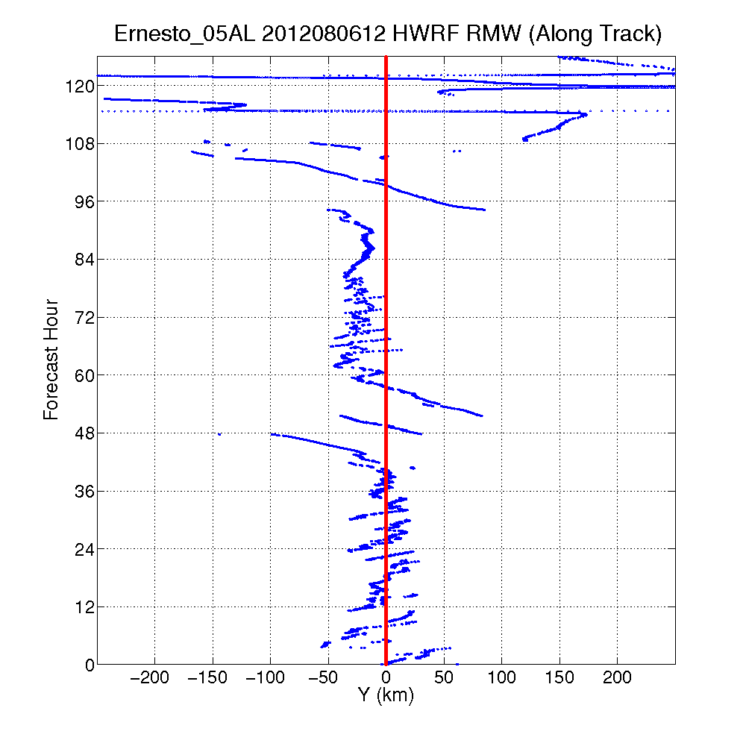
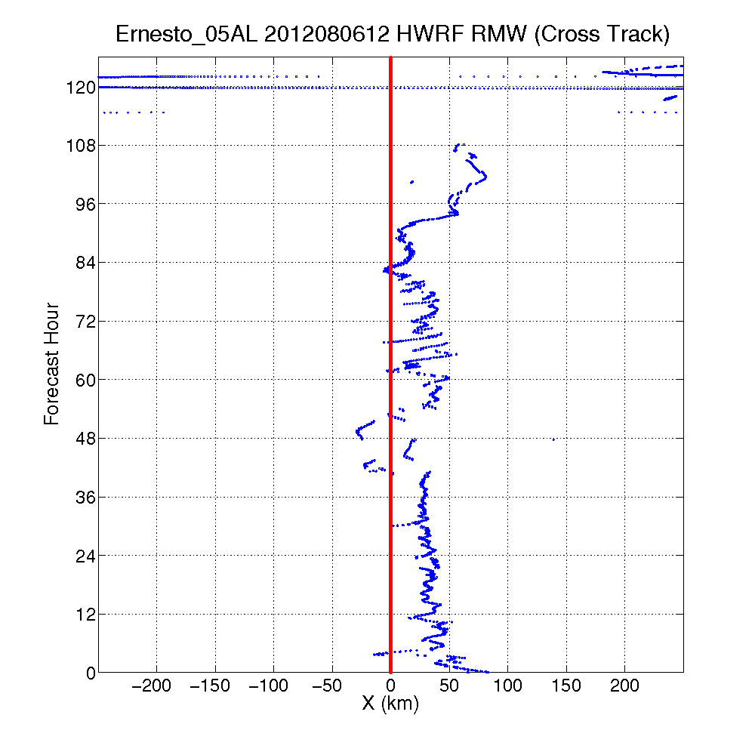
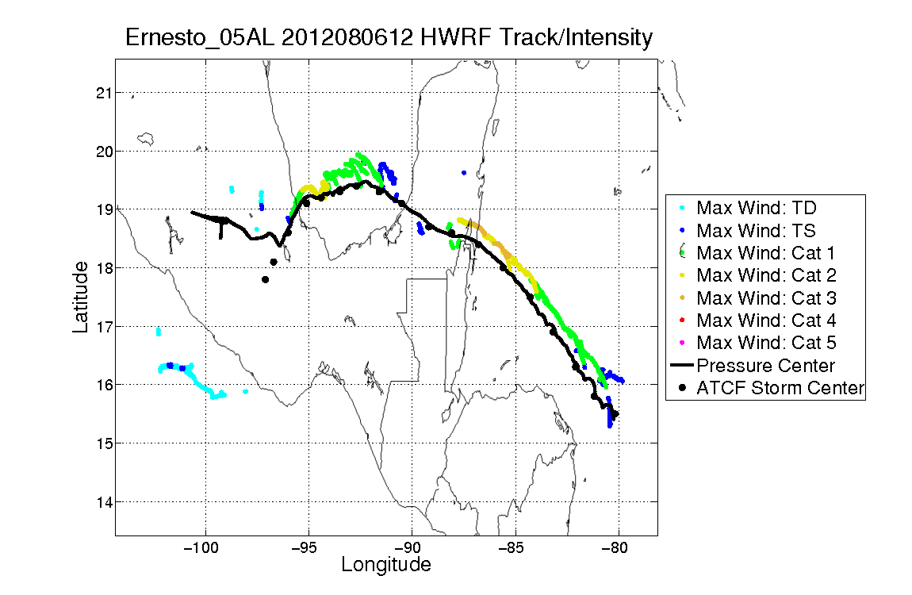
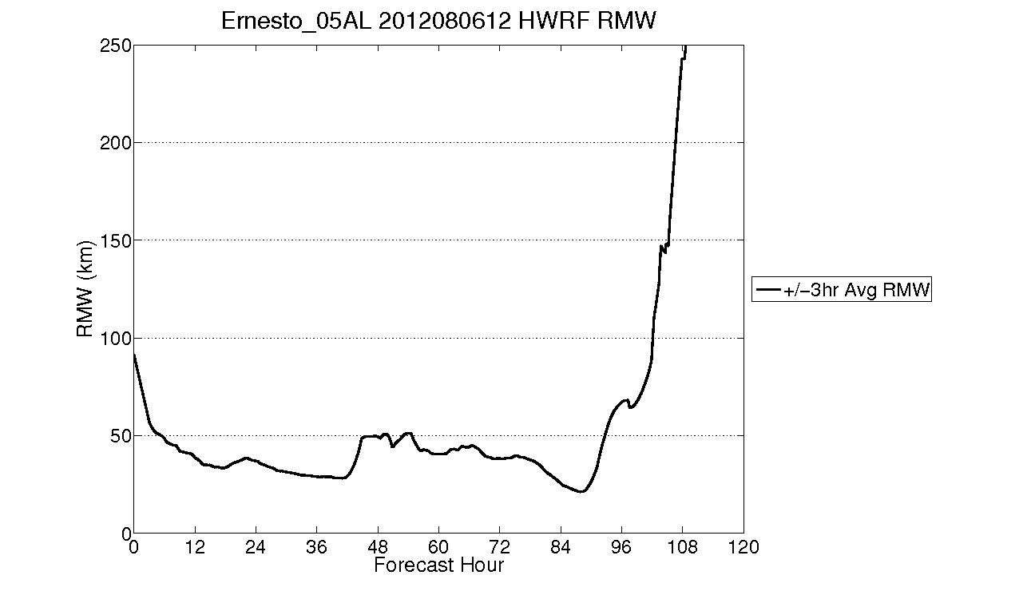
Good

Slide 16
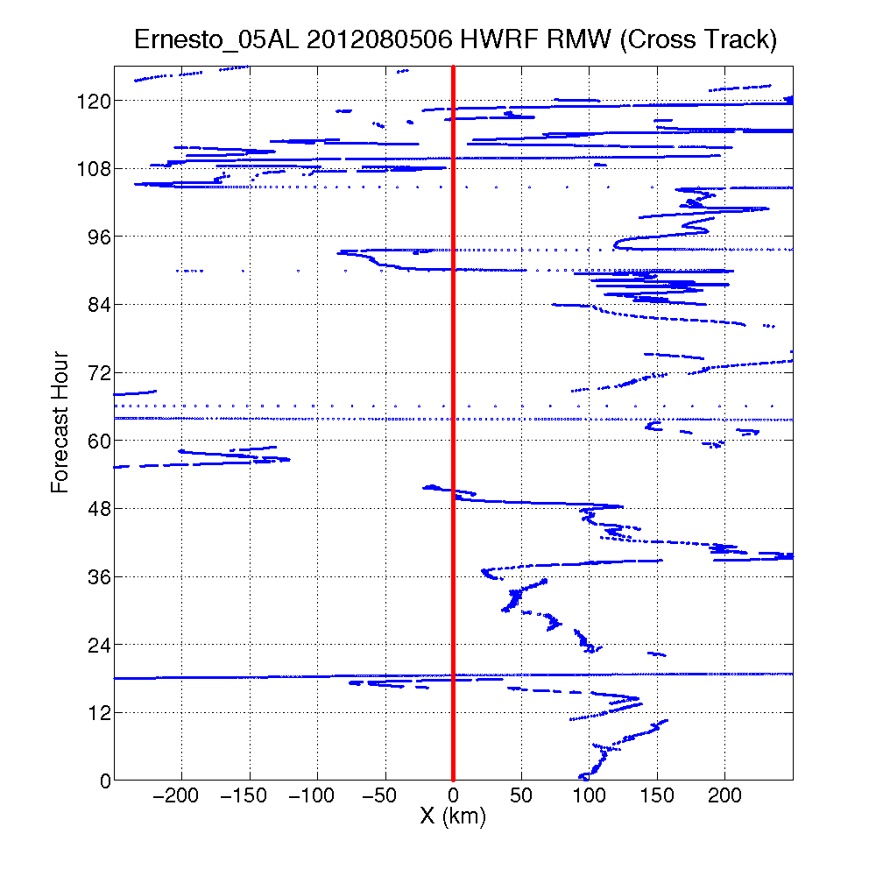
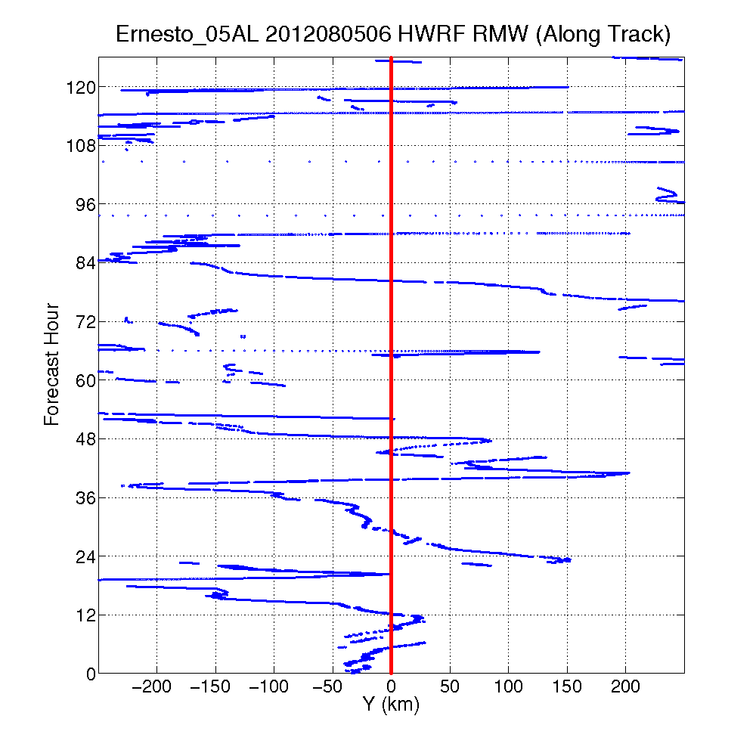
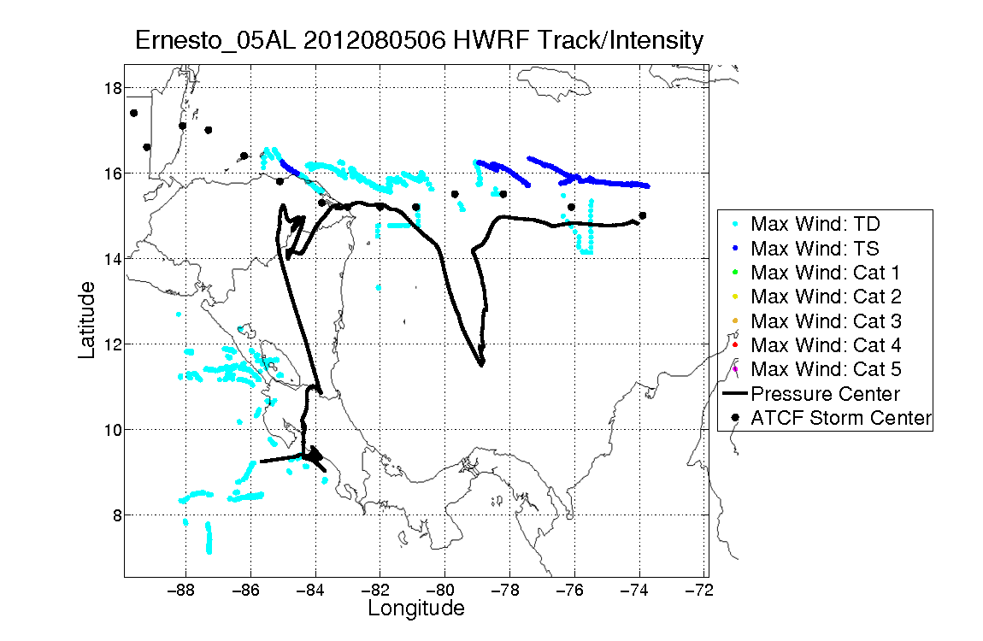
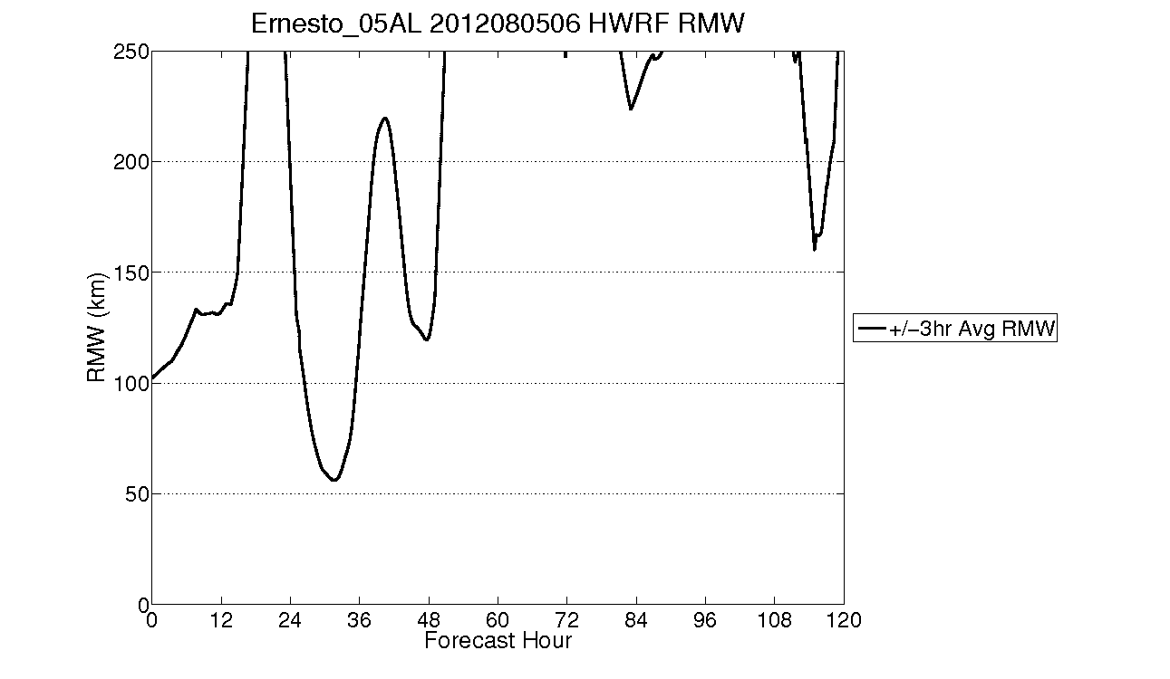
Bad

Slide 17
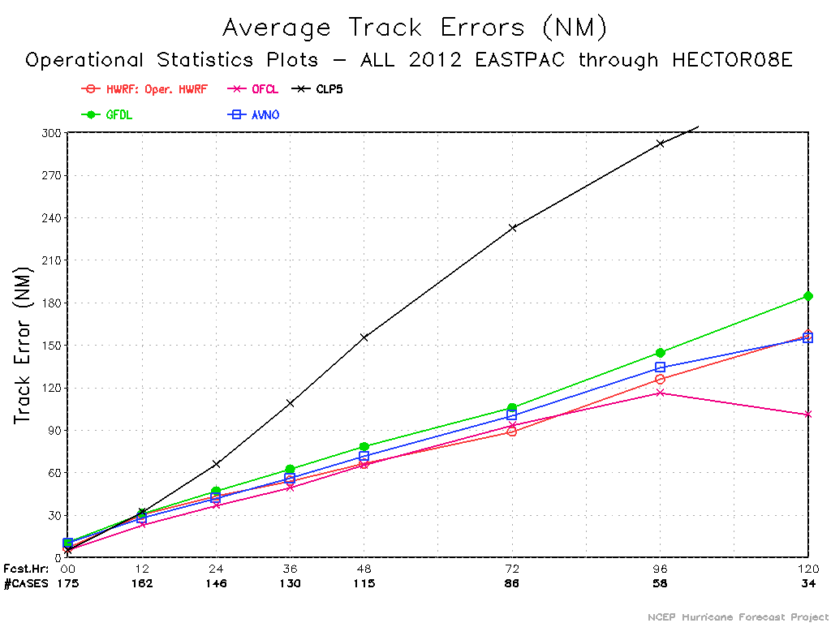
Real-Time Performance Update – E-PAC
AVERAGE ERRORS RELATIVE TO HWRF (%)
00 12 24 36 48 72 96 120
HWRF .0 .0 .0 .0 .0 .0 .0 .0
GFDL 51.7 3.6 8.2 15.8 18.1 19.4 15.0 17.6
AVNO 46.0 -7.1 -3.6 3.6 8.1 13.1 6.6 -1.4
OFCL -28.4 -23.2 -15.0 -9.0 -1.5 5.3 -7.4 -35.7
CLP5 -26.8 7.3 50.9 101.2 133.9 161.7 132.1 115.4
#CASES 175 162 146 130 115 86 58 34

Slide 18
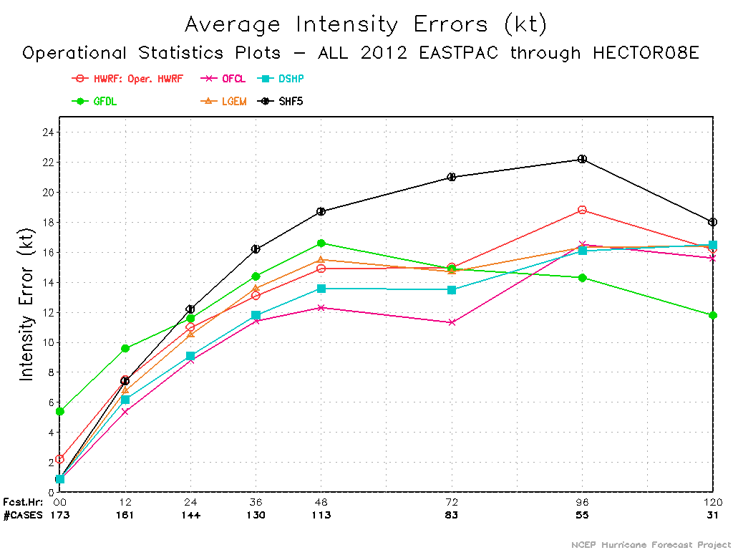
Real-Time Performance Update – E-PAC
Intensity performance still not good. HWRF suffers from negative bias.

Slide 19
Special Real-Time Projects
ECMWF driven HWRF
Basin-Scale (hemispheric) HWRF
New Initialization
TDR DA
HWRF-HYCOM
HWRF for Western Pacific and North Indian Ocean Basins

Slide 20
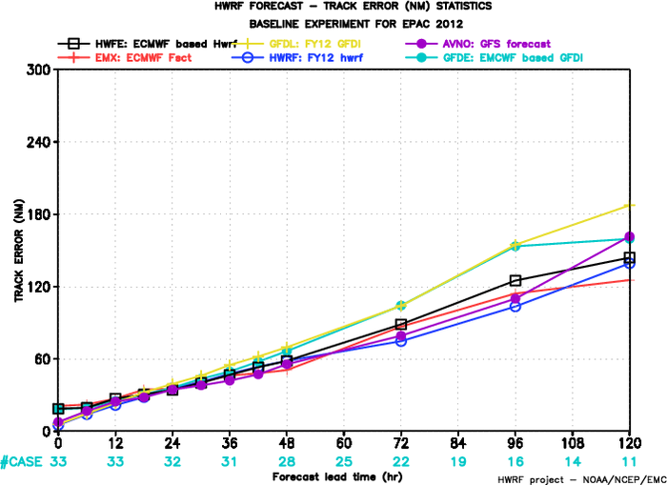
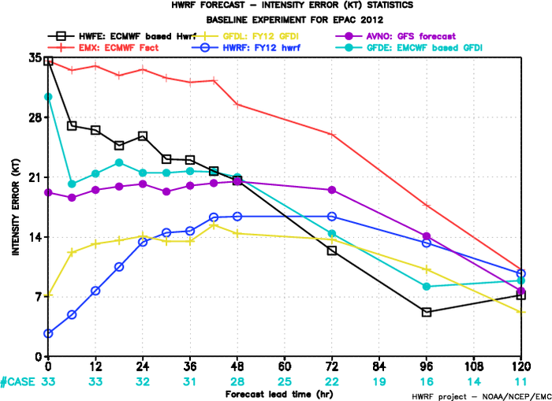
HWRF w/High-Resolution ECMWF IC/BC
Guidance from HWFE received special attention by NHC, especially for intensity forecasts

Slide 21
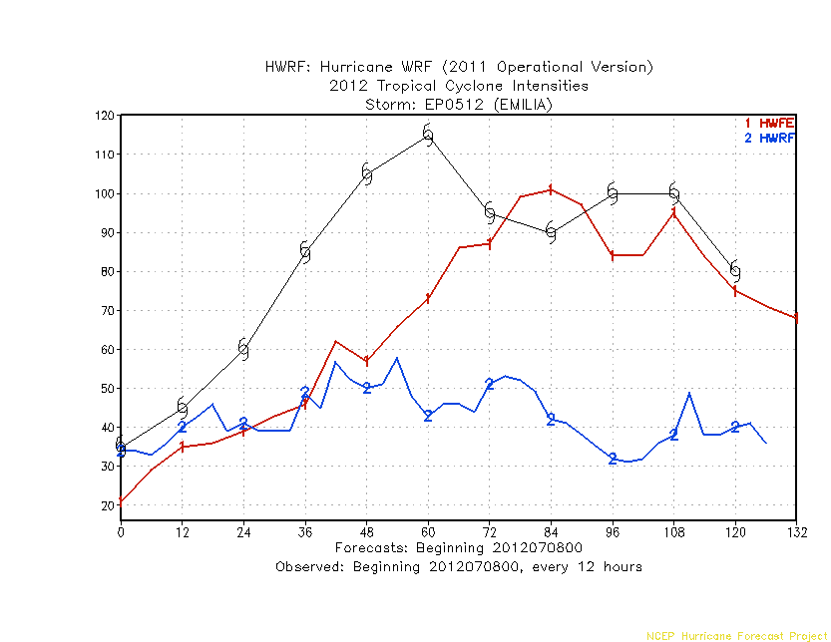
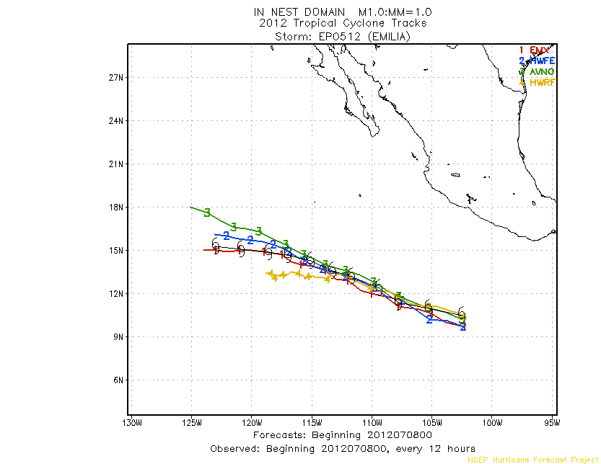
Comparison of intensity forecast:
HWFE vs. HWRF
Forecast beginning: 2012070800

Slide 22
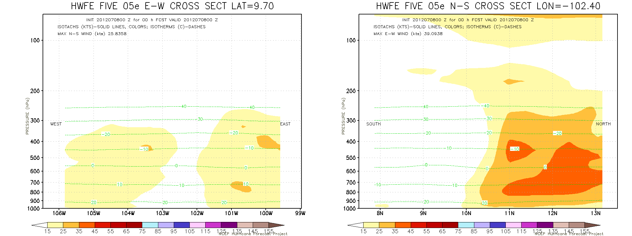
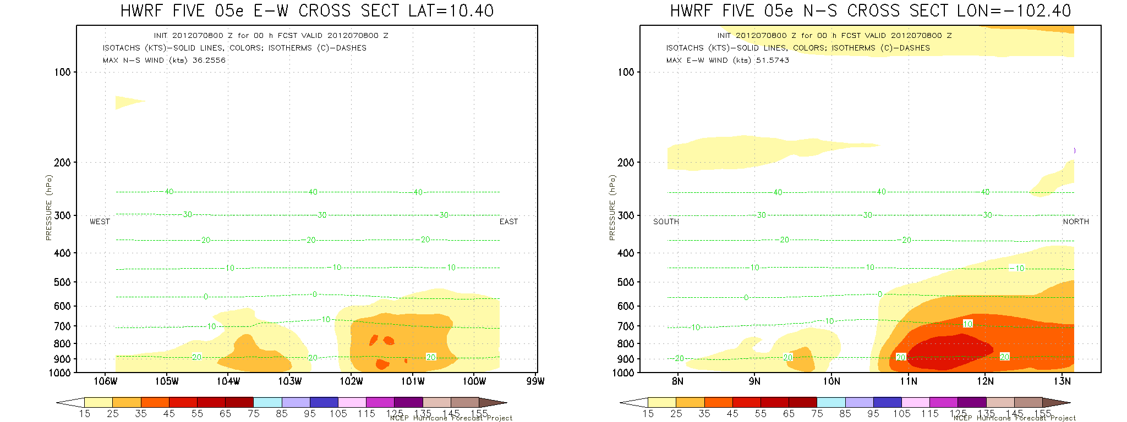
ECMWF based 0h
Deep init Storm
GFS Based 0h
Shallow init Storm

Slide 23
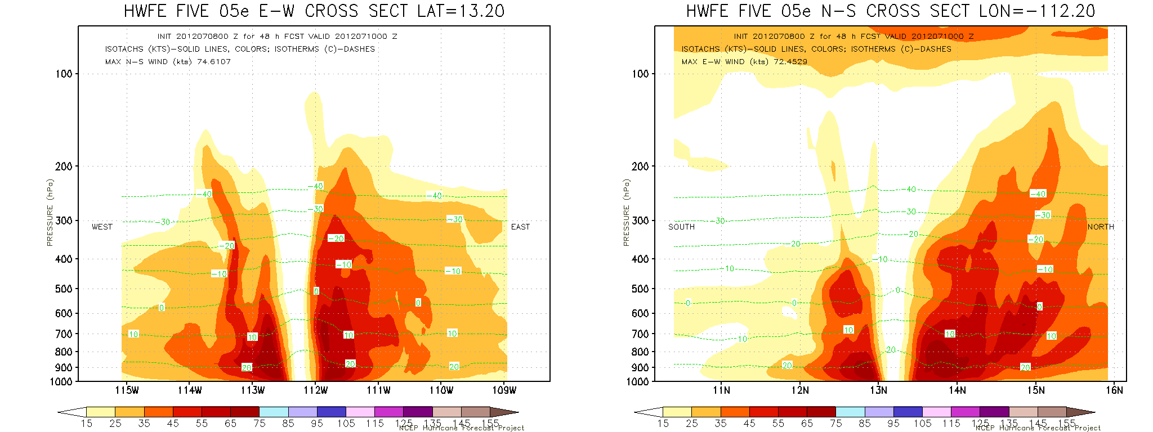
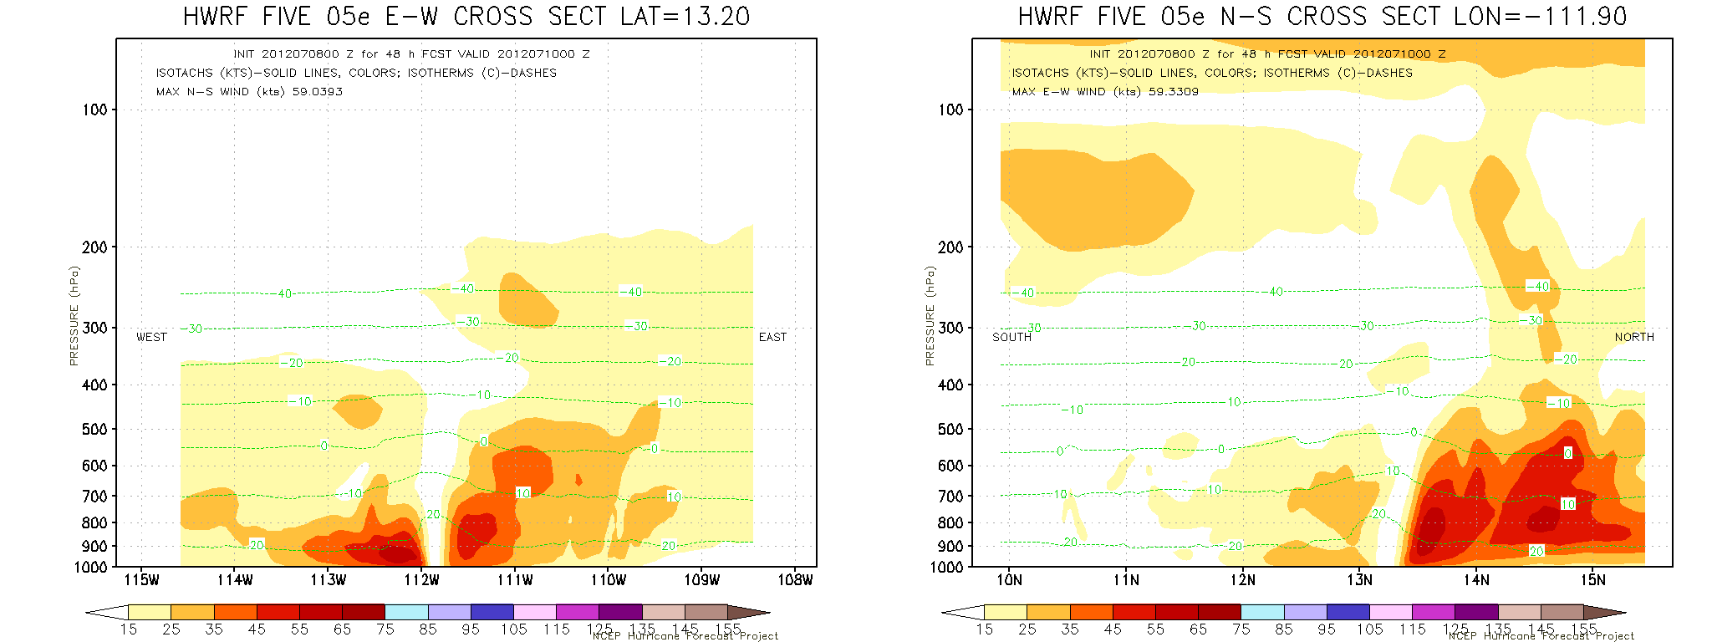
ECMWF based 48h
Strong storm
Weak Storm
GFS Based 48h

Slide 24
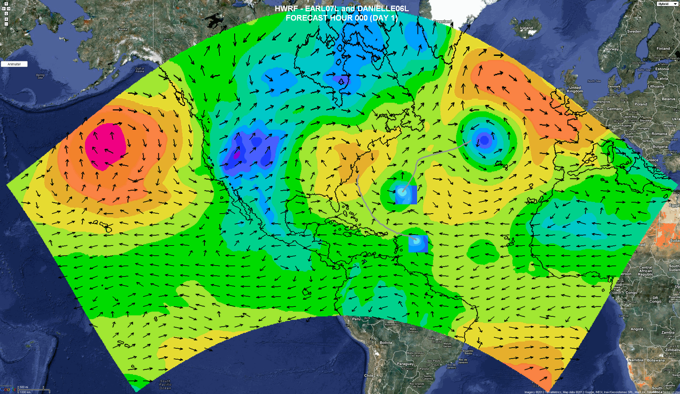
HWRF With Multiple Moving Nests (EMC-HRD)
Regional ensembles/products
Daily Tropical Outlook/genesis
Computational Efficiency
Auto-detection of genesis (configure high-resolution nests during model integration)
Basin scale domain
7 days forecast
SDA and cycling

Slide 25
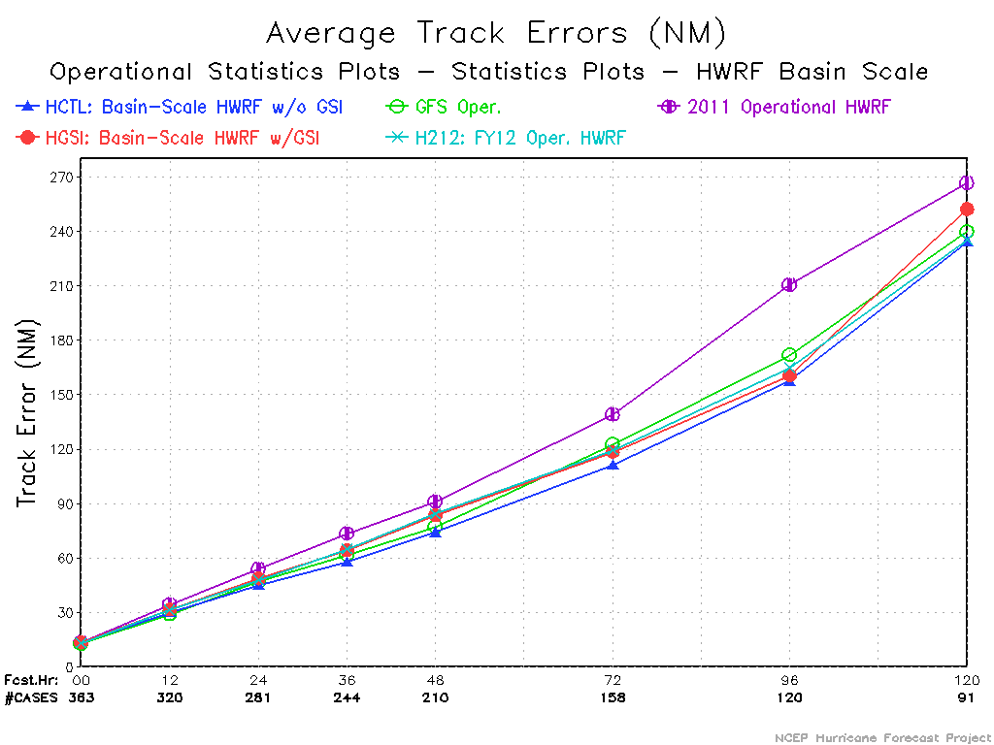
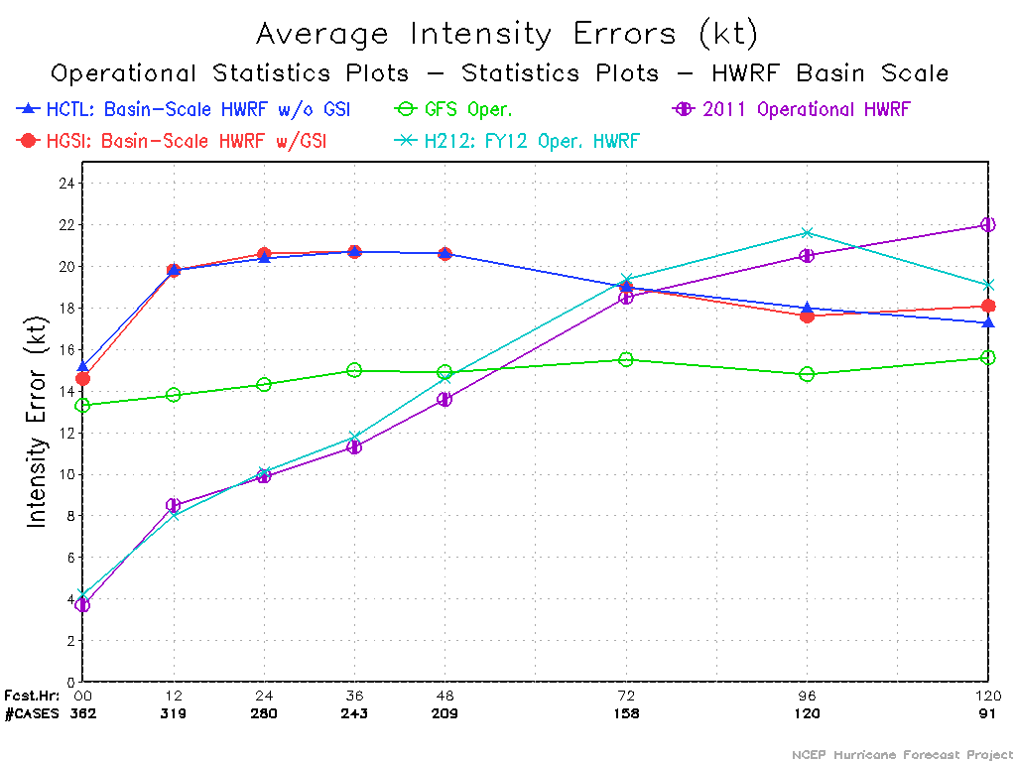
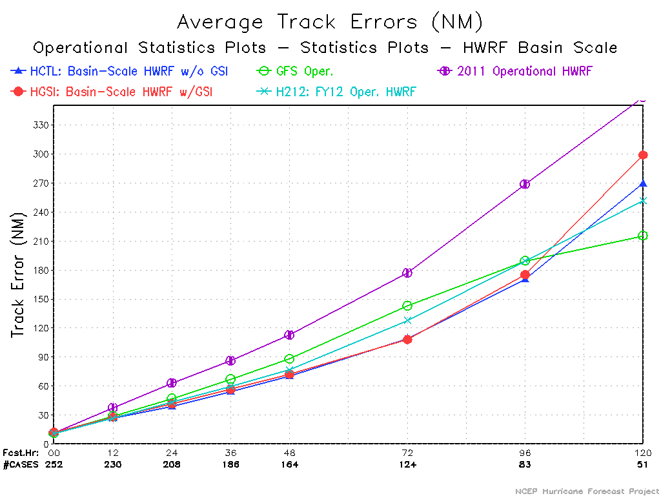
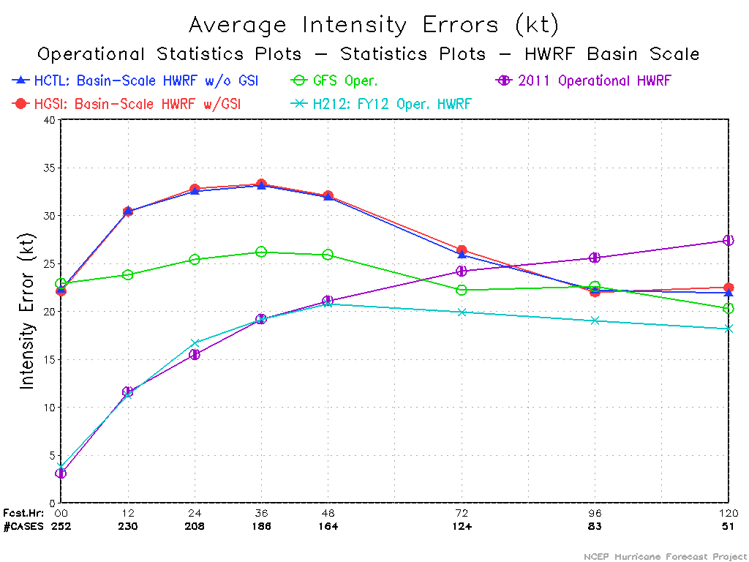
Basin-Scale HWRF – Superior track performance in both ATL and E-PAC basins

Slide 26
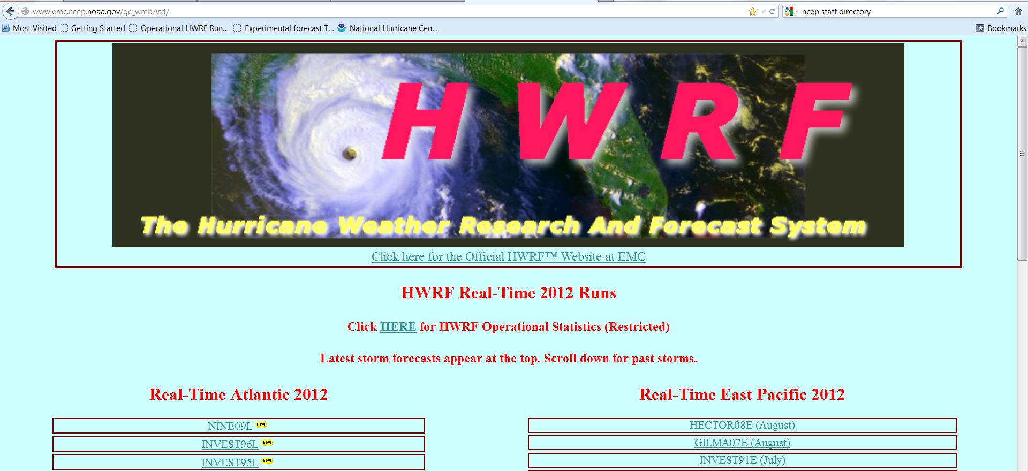
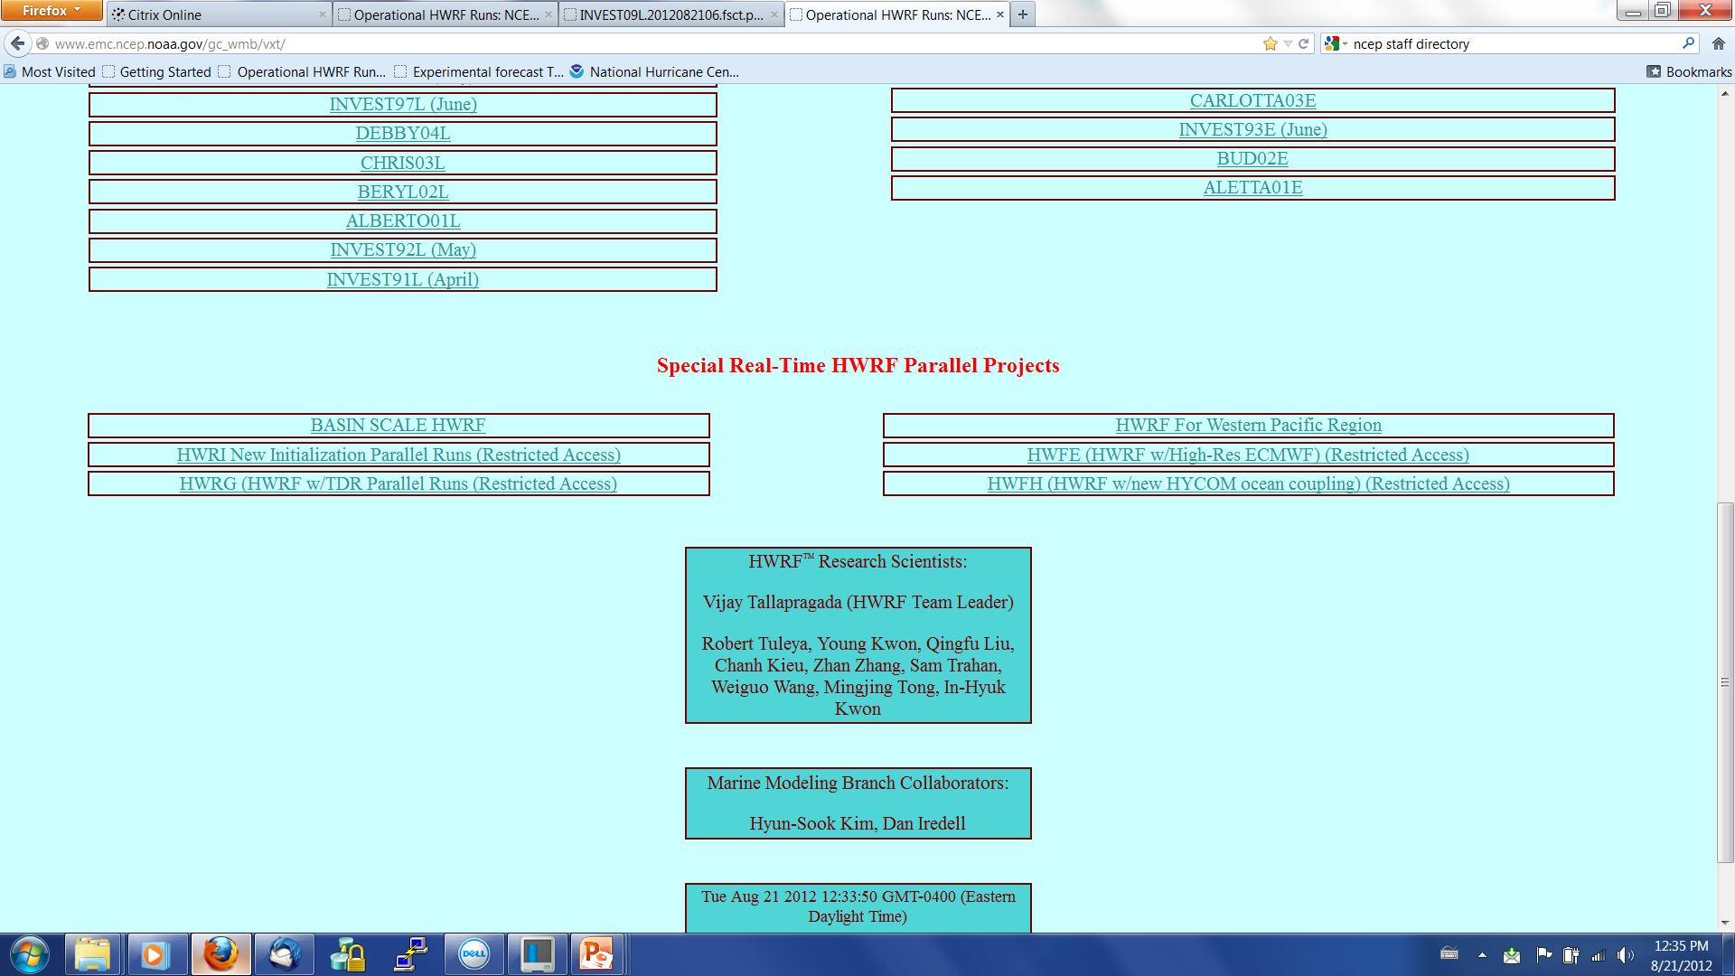

Slide 27
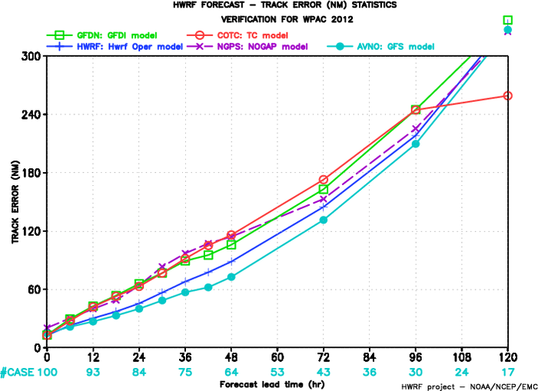
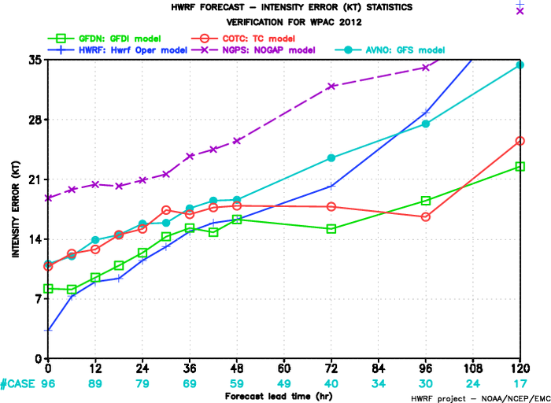
HWRF in Western Pacific
Provided better track skill than the FNMOC models. Intensity skill good through 60hrs, suffered from pre-mature landfalls and lack of ability to capture RI events.
This basin provides a proving ground for HWRF - more complex terrain interactions and monsoonal environment.

Slide 28
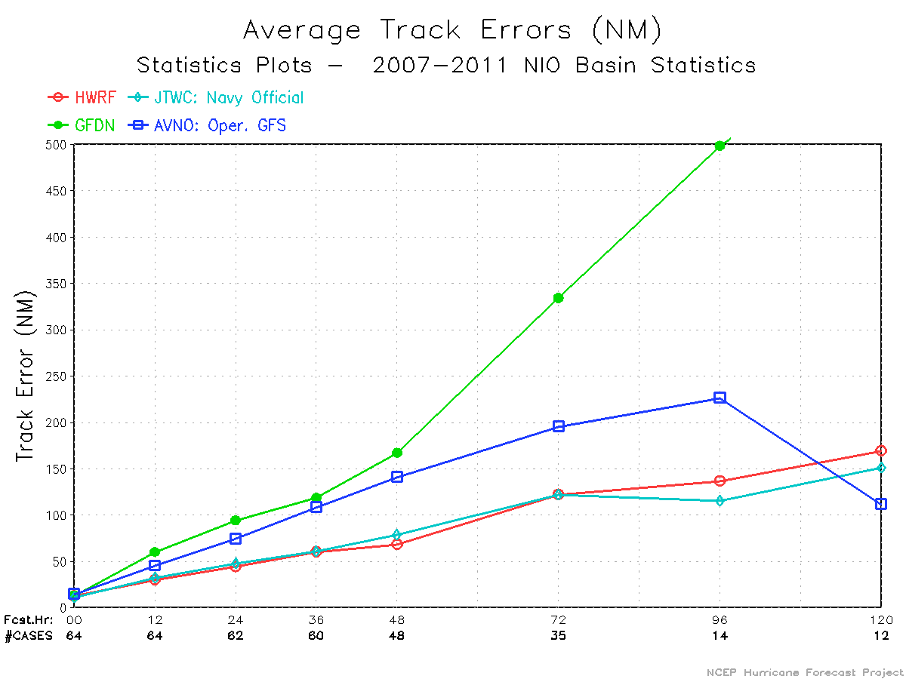
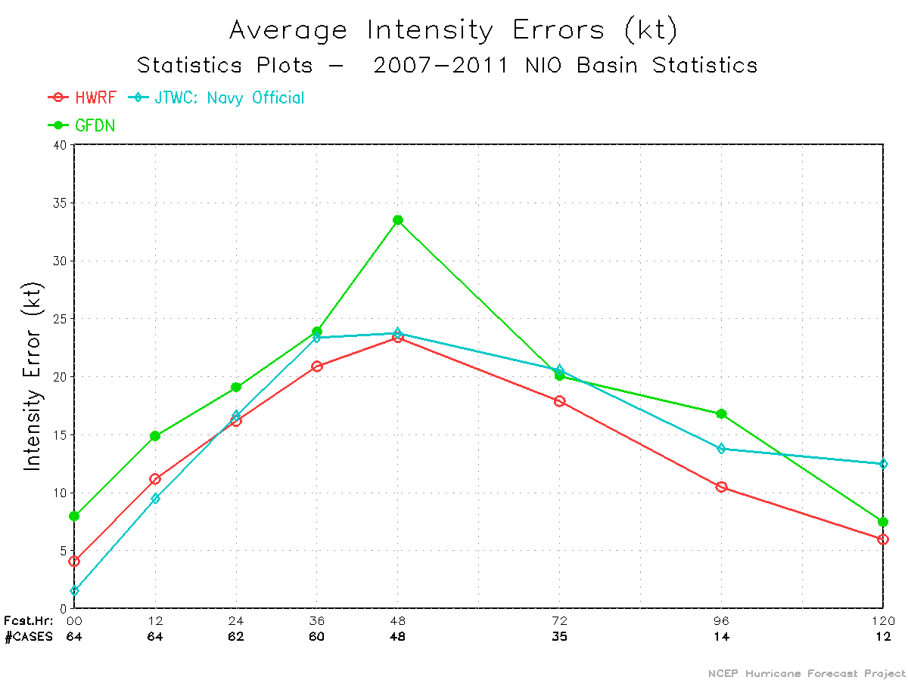
HWRF for Tropical Cyclones in the North Indian Ocean region
2007: Gonu (AS), Sidr (BB)
2008: Nargis (BB)
2011: Thane (BB)
Significantly superior performance for track and intensity from HWRF noted for these storms in Bay of Bengal and Arabian Sea.

Slide 29
HWRF Task Matrix – O&M
Pre-Implementation T&E | Code Optimization and IT Testing, RFCs
Scripting for Operational and Parallel Runs | Porting activities
Troubleshooting Operational and Parallel Runs | Automation of runs, archives, products and graphics
Product Display and Website maintenance | Real-time Statistics and Diagnostics
Code management and subversion maintenance | Support to NHC, JTWC and other partners
Real-time tasking of P-3 and G-IV | HWRF Weekly and Monthly meetings

Slide 30
HWRF Development – Ongoing Work – Real-Time Parallels (Potential candidates for 2013 HWRF implementation)
Vortex Initialization | Improved methods for storm size, vertical structure and intensity correction, revised composite storm consistent with model physics
PBL | TKE based local PBL as an alternative to deeper non-local GFS PBL, Modified GFS PBL with revised computation of Critical Ri and PBL depth
Microphysics | Advection of hydrometeors across boundaries, treatment of individual species, improved nest-parent interpolations
Radiation | RRTM-G as a replacement candidate for GFDL radiation
Convection | SAS Scheme for high-resolution grids
Horizontal Diffusion | Sensitivity experiments for horizontal diffusion, divergence damping, dissipative heating and cloud momentum mixing
HWRF-HYCOM | Operational HWRF coupled to RTOFS-Global (Hyun-Sook)

Slide 31
Experiments in support of long-term developmental tasks
TDR DA | Assimilation of real-time aircraft TDR (P-3 and G-IV), SFMR and flight level data in GSI framework (Mingjing)
Basin-scale HWRF | Control runs for Hybrid DA, no initialization, no coupling, 27km 61L (Weiguo)
Hybrid DA | Minimal hybrid system for basin-scale HWRF driven by global ensembles (Mingjing), starting on August 1
Hybrid DA | Minimal hybrid system for basin-scale HWRF driven by HWRF ensembles (Jeff Whitaker), starting on August 1
Basin-scale HWRF | Control experiments with multiple moveable nests (HRD), starting on August 1
Miscellaneous | HFIP funded PIs working on various projects: Rob Fovell, UCLA; Da-Lin Zhang, UMD; Xuguang Wang, OU and DTC

Slide 32
Ongoing Developments - Infrastructure
HWRF in ESMF framework:
Align with long-term strategies for unified modeling framework (NEMS)
Take advantage of other components in the ESMF framework for ocean (HYCOM) and wave (WWIII) models for coupling through ESMF coupler
Follow the procedure adopted by NMM-B to develop the ESMF wrapper for HWRF
0.5 FTE effort (with additional help from DTC)
Projected completion in one year
Need a work-around for MPMD execution in ESMF framework

Slide 33
Ongoing Developments – Infrastructure
NMM-B for hurricanes:
Align with long-term strategies for unified modeling framework (NEMS)
Take advantage of developments in NMM-B
Ongoing work includes:
Two-way feedback
Multiple nest support
Outstanding issues:
Vortex relocation and initialization
Ocean coupling
Porting HWRF physics
Training for HWRF team members and collaborators
Extensive T&E
3-5 year effort
Significant spin-up time for HWRF community to transition to NEMS

Slide 34
Ongoing developments - Infrastructure
Multiple moveable nests in basin-scale HWRF:
Eliminates need for separate runs for each storm
Better representation of storm-storm interactions
Could be run in genesis mode
Seven-day regional model forecasts in support of NHC’s request
Advantageous for large-scale data assimilation (including hybrid) and cycling (constant outer domain)
WRF does not support concurrent integration of different domains
Adds about 50% of run time with each additional domain
Requires changes to WRF infrastructure, IO, and RSL libraries
0.5 FTE effort proposed by John Michalaces
Could impact operational pathway for ongoing Hybrid DA project
Digital Filter in WRF-NMM does not work for HWRF
No foreseeable solution. Essential for EnKF.
No provision to update boundary conditions during DA phase
Work-around designed by Jeff and Henry

Slide 35
Focus Areas–Dynamics and Physics
Several of the physics options in WRF framework do not work with HWRF:
Constraints posed by moving nests and the coupler
DTC’s efforts are not helping to resolve these issues
Issues with centroid method:
Can’t function accurately in presence of high terrain
“Julia-Jumping Syndrome”
About 27% of the cases have nest center deviating from model storm center
High priority development effort for 2013 implementation
Issues with high-terrain
Model crash over mountains in the Indo-China region
Erroneous PGF computation due to high terrain
Temporary fix in place for Western Pacific HWRF runs
More accurate solution being worked out
Issues with initialization
Computation of R34 and ROCI impacted by nest domain size
Model consistent pressure deviates from w-p relationship
Issues with coupler
Coupler assumes more than one domain present in HWRF
Can’t work with single-domain basin-scale HWRF
Not tested for highest resolution third nest

Slide 36
Coupling to HYCOM
New paradigm proposed by MMAB:
First assure that you have the most realistic ocean possible in a coupled HYCOM-HWRF system.
Use frozen HWRF and frozen RTOFS-Global (IC/BC).
Develop best possible coupled RTOFS nest.
Then tune / modify HWRF for use with this ocean representation (optimizing track and intensity). Adjust fluxes / HYCOM tuning as needed while incrementally working on HWRF.
Assuming that HWRF may fill present resources with third nest, no room for HYCOM in ops until 2014/15.
2012: MMAB sets up best possible RTOFS-HWRF.
2013/2014:
Optimize HWRF for HYCOM.
Possible addition of wave model to test system.
2015: Tentative implementation.

Slide 37
Ocean Heat Content
SST & sfc Currents
SST & Z26

Slide 38
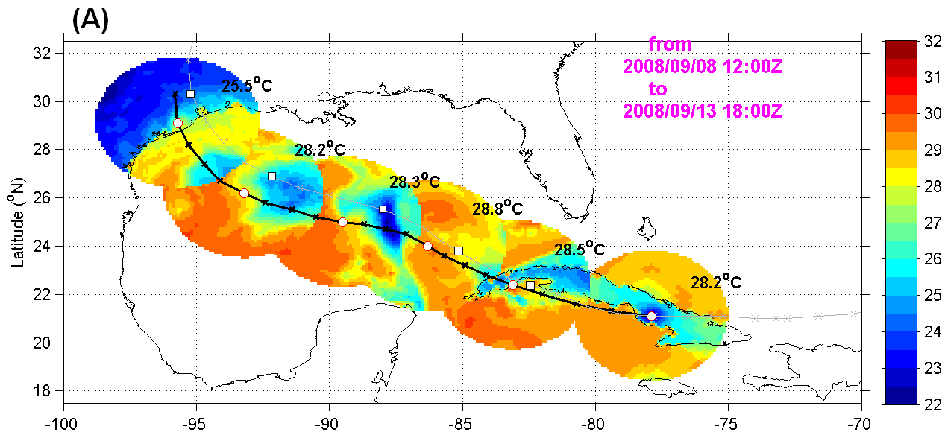
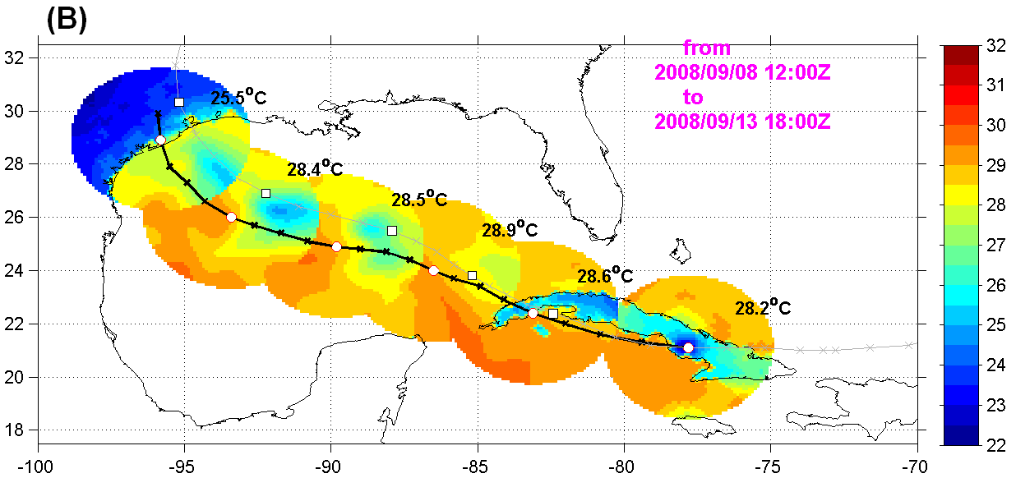
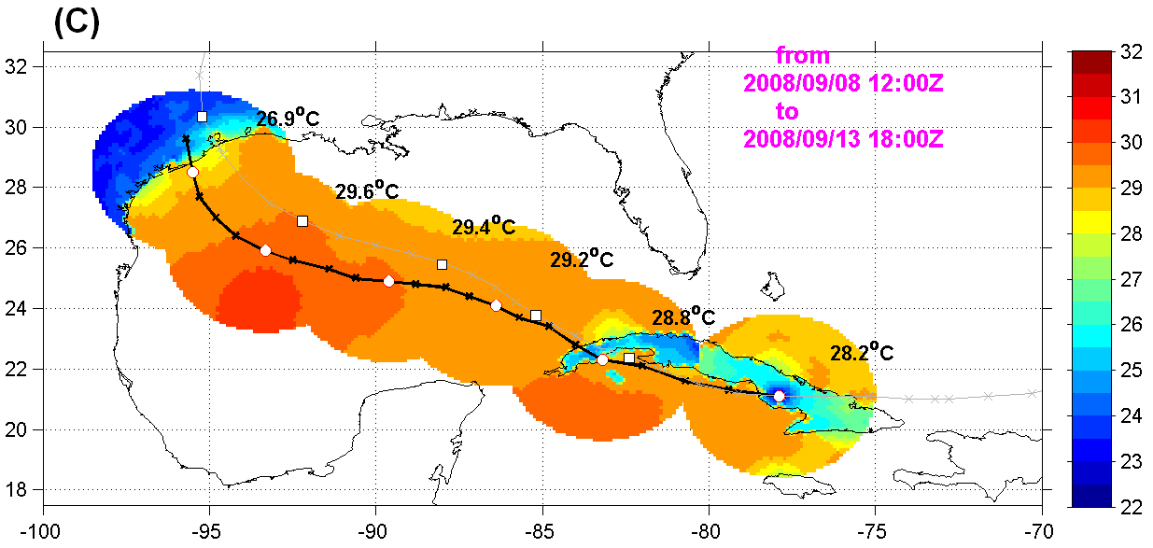
Example: Simuled SST vs TMI SST
IKE (09L) valid 1800Z 2008/09/11
HyHWRF
Op HWRF
HWRF alone
Note: SST cooling as hurricane Ike transit the LC
TMI – SST

Slide 39
Coupling to Wave-Watch III
NOAA/NCEP in-house wave model, based on WAM.
Operational global and (nested) regional model.
Specialized Atlantic and Pacific hurricane wave models with blended winds from GFS and GFDL model.
WAVEWATCH III will be coupled to HWRF
Deep ocean model resolution dictated by GFS model
Higher coastal model resolution dictated by model economy
Highest model resolution in areas of special interest
Which coupler to use?
How to proceed with 3-way coupling?
Hurricane nests moving with storm(s) like GFDL and HWRF

Slide 40
Coupling to Land Surface Model
LSM
Routing Model
Most of the work was completed by Bob Tuleya
Requires about 3-month effort to fine-tune the system and update the scripts
T&E for down-stream applications

Slide 41
HWRF ensembles
Mainly focused on better estimation of hurricane intensity forecasts from EPS.
Single model, multi-initial condition ensembles.
GEFS-based HWRF ensembles with three cumulus convection schemes: Simplified Arakawa-Schubert (SAS), Kain-Fritsh (KF), and Batts-Miller (BM); Each includes 21 members.
Error distribution-based model bias correction method was developed.
Intensity forecast skills are greatly improved by the bias correction method, compared to simple ensemble average method
Multi-model, multi-physics ensembles.
Ensemble members include GFDL, high resolution (27-9-3) HWRF, HWRF with various cumulus convection schemes, PBL schemes;
Mode analysis was developed using PDF kernel density estimation method
Results showed that the intensity forecast skills are further improved by using mode analysis, compared to the arithmetic ensemble mean.
Down-scaled perturbations from High-Res Global ensembles:
HFIP supported project (Brian Etherton and Zhan Zhang)

Slide 42
Focus areas – IMPROVE THE INTENSITY FORECAST SKILL
Vortex Relocation, Initialization and DA
Should become part of DA system
Hybrid DA is currently geared towards environment. Inner core DA will be confined to experimental mode in the next few years
Potential for improvement within the vortex initialization procedure - requires continuous development and maintenance
Physics
Advanced physics applicable for high-resolution and hurricane conditions
Focus on improved PBL, Microphysics, Cloud-Radiative interactions and air-sea interface
Ocean and Wave Coupling
HWRF-HYCOM project needs more resources from MMAB. Currently only one person is working on this project. Ocean modeling efforts should closely follow atmospheric model improvements.
Wave coupling within existing system is possible in the short term. Move to ESMF based system when the wrapper is built.
There are lot of scientific questions that need to be addressed (cost-benefit aspects – how important is sea-spray for intensity forecast problem?)
Downstream applications
Modeling Post-landfall impacts
HWRF driven wind, wave and surge and inundation models

Slide 43
Observed Hurricane PBL
Current HWRF PBL
EARL, INIT-2011 09 02 00, 24-hour forecast
Inflow depth
Max wind height
PBL height
PBL
Mixed layer
Inflow/max wind
PBL is below or ~ inflow depth
PBL >> inflow/max wind H ??
Zhang MWR 2011

Slide 44
Different PBLH & K
Z
Current HWRF
Critical R_{bc} = 0.25
R_{b} = f(h,surface)
K =0.5 x ku*z(1-z/h)²
New try
Critical R_{bc}= 0.3
R_{b}=f(h, mixed layer, first layer)
K = ku*z(1-z/h)².
PBL top
Cal Ri #
0
Z
PBL top
ML top
Cal Ri #
1st level
0

Slide 45
HWRF-OPERATION
NEW PBL-H&K
Ideal
PBLH
Max Wind H
Real
EARL
F24
PBL
Inflow H
Inflow H
PBL

Slide 46
RRTMG Idealized run
Radiation forcing - HWRF
Radiation forcing - RRTMG
.
Potential Temp perturbation - HWRF
Potential Temp perturbation - RRTMG

Slide 47
Collaborations with external agencies
Collaboration with NHC
Model development geared towards meeting NHC’s needs
Constant communication and exchange of information during pre-implementation T&E and operational support
Advanced products tailored for NHC’s applications
Collaboration with HRD
Focus areas are Model development, physics, diagnostics and DA
Need to re-assess their potential contributions due to lack of required skillsets
Collaboration with DTC
Focus areas are code management, community support and T&E
Lagging behind the development at EMC – DTC can’t help with model development
R2O tasks need be aligned with operational priorities
Collaboration with HFIP partners
Focus areas are physics, diagnostics and DA
Support to HFIP PIs sometimes could be draining our resources – need more manpower to effectively utilize these collaborations
Collaboration with international partners
Started making progress with India. HWRF operational at IMD
Will have two visitors from Korea to work with us on specific problems of mutual interest
New collaborations with Vietnam and Shanghai in the making (support for Western Pacific region)
One senior scientist from STI to work on HWRF for Western Pacific basin

Slide 48
Advancing the HWRF System FY2012 & Beyond
 | 2012 | 2013* | 2014* |  | 2015* |  | 2016*
Resolution/ Infrastructure | Triple nested HWRF (27/9/3 km) | Increased vertical resolution, higher model top | community R2O efforts (HFIP) |  | Upgrades to WRF infrastructure, Multiple moving domains, NEMS/ESMF/NMM-B, Other oceanic basins
Physics | PBL, Shallow Convection & Microphysics | Microphysics, Radiation, Surface Physics, Coupling to Waves and Land Surface, Physics for high-resolution
DA/ Vortex Initialization | Storm size correction, dynamic mass-wind consistency | Inner core DA (Doppler Radar, satellite) |  | Hybrid-EnKF DA, advanced vortex relocation procedure, improved GSI w/cloudy radiance assimilation
Ocean | 1-D Ocean coupling and improved initialization | HWRF-HYCOM; Improved ocean DA, physics and resolution, unified coupled system for ATL & EPAC
Waves | One-way Wave Coupling |  | Two-way wave coupling, multi-grid surf zone physics, effects of sea spray
Products & Downstream applications | High-Frequency output, synthetic satellite imagery | HWRF Ensembles, diagnostics, product development |  |  |  | Coupling to Hydrological/ Surge/ Inundation models,
.
2012 upgrades
Ongoing Work
Planned developments
*Computer upgrade

Slide 49
Future Outlook 5 to 25 years??????
 | 5-10 years | 2020+
Resolution/ Infrastructure | Basin-Scale HWRF with multiple moveable nests (at cloud resolving resolutions) Downstream applications (including landfall related storm surge, waves, flooding and inundation) | Global to Local Scale Modeling to capture multi-scale interactions High-Resolution Ensembles for events of interest
Physics | Observations based physics Incorporate effects of sea-spray, aerosols, waves, boundary layer rolls – explicit representation of inner core processes | Ensemble based physics approach
DA/ Vortex Initialization | Hybrid/EnKF with 4-D VAR Vortex initialization will become part of the DA, Maximum utilization of all available observations (all-weather radiances, aircraft and other) | Part of the data assimilation for global system
Ocean/Wave/Land | Fully coupled ocean-wave-land-atmosphere system
Products & Downstream applications | Meeting the next-generation needs of Hurricane Specialists at NHC and JTWC
.

Slide 50
Concluding remarks
There has been lot of progress advancing the hurricane modeling capabilities at EMC, thanks to active collaboration between research and operations.
Improving intensity/structure forecasts are orders of magnitude more difficult than was for track forecasts.
Requires substantial effort between research and operational hurricane communities
With improved track, intensity and structure, it is possible to provide improved guidance on rainfall, storm surge, flooding and inundation.
Model development closely tied with model diagnostics. Comprehensive evaluation making use of all available observations (aircraft, satellite, upper-air, surface, and ocean)
Process studies (including idealized simulations) need more attention
Continued interaction with NHC forecasters at every step of model development and evaluation is key for success!
We are making progress!!!

