Slide 1
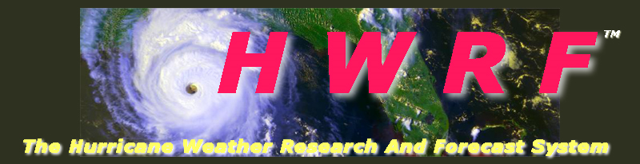
Advancements to NCEP Operational HWRF -towards addressing the intensity forecast issues
Vijay Tallapragada
Hurricane Team Leader. Environmental Modeling Center, NCEP/NOAA/NWS/DOC, NCWCP, College Park, MD 20740.
Seminar at HRD/AOML, Miami, August 23, 2012
Notes:
1
1

Slide 2
Outline
Performance of Operational HWRF
Ongoing activities
  Real-Time Parallels; Model development and Physics; Vortex initialization and Data Assimilation
Addressing the intensity forecast problem
Diagnostic efforts

Slide 3
HWRF Task Matrix – O&M
Pre-Implementation T&E | Code Optimization and IT Testing, RFCs
Scripting for Operational and Parallel Runs | Porting activities
Troubleshooting Operational and Parallel Runs | Automation of runs, archives, products and graphics
Product Display and Website maintenance | Real-time Statistics and Diagnostics
Code management and subversion maintenance | Support to NHC, JTWC and other partners
Real-time tasking of P-3 and G-IV | HWRF Weekly and Monthly meetings
HWRF Team: Robert Tuleya, Young Kwon, Qingfu Liu, Chanh Kieu, Zhan Zhang, Sam Trahan, Weiguo Wang, Mingjing Tong, In-Hyuk Kwon
Marine Modeling Branch Collaborators: Hyun-Sook Kim, Dan Iredell

Slide 4
HWRF Development – Ongoing Work – Real-Time Parallels (Potential candidates for 2013 HWRF implementation)
Vortex Initialization | Improved methods for storm size, vertical structure and intensity correction, revised composite storm consistent with model physics
PBL | TKE based local PBL as an alternative to deeper non-local GFS PBL, Modified GFS PBL with revised computation of Critical Ri and PBL depth
Microphysics | Advection of hydrometeors across boundaries, treatment of individual species, improved nest-parent interpolations
Radiation | RRTM-G as a replacement candidate for GFDL radiation
Convection | SAS Scheme for high-resolution grids
Horizontal Diffusion | Sensitivity experiments for horizontal diffusion, divergence damping, dissipative heating and cloud momentum mixing
HWRF-HYCOM | Operational HWRF coupled to RTOFS-Global (Hyun-Sook)

Slide 5
Experiments in support of long-term developmental tasks
TDR DA | Assimilation of real-time aircraft TDR (P-3 and G-IV), SFMR and flight level data in GSI framework (Mingjing)
Basin-scale HWRF | Control runs for Hybrid DA, no initialization, no coupling, 27km 61L (Weiguo)
Hybrid DA | Minimal hybrid system for basin-scale HWRF driven by global ensembles (Mingjing), starting on August 1
Hybrid DA | Minimal hybrid system for basin-scale HWRF driven by HWRF ensembles (Jeff Whitaker), starting on August 1
Basin-scale HWRF | Control experiments with multiple moveable nests (HRD), starting on August 1
Miscellaneous | HFIP funded PIs working on various projects: Rob Fovell, UCLA; Da-Lin Zhang, UMD; Xuguang Wang, OU and DTC

Slide 6
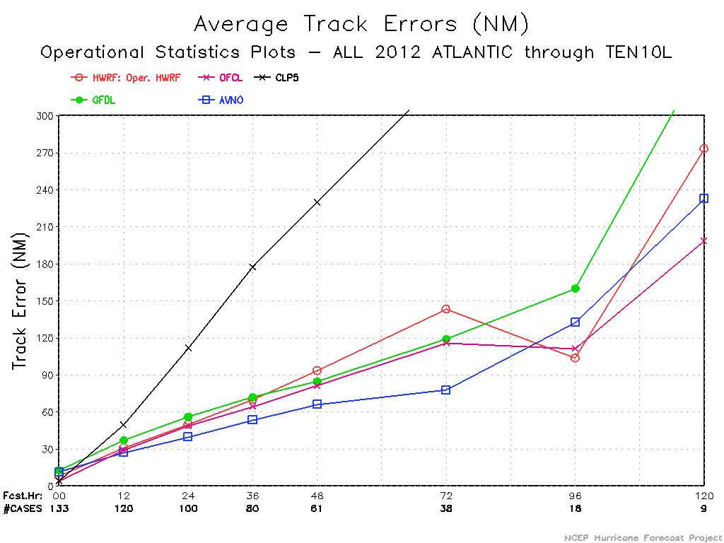
Real-Time Performance Update – ATL
Few cases from TS Debby contaminated the Atlantic Stats

Slide 7
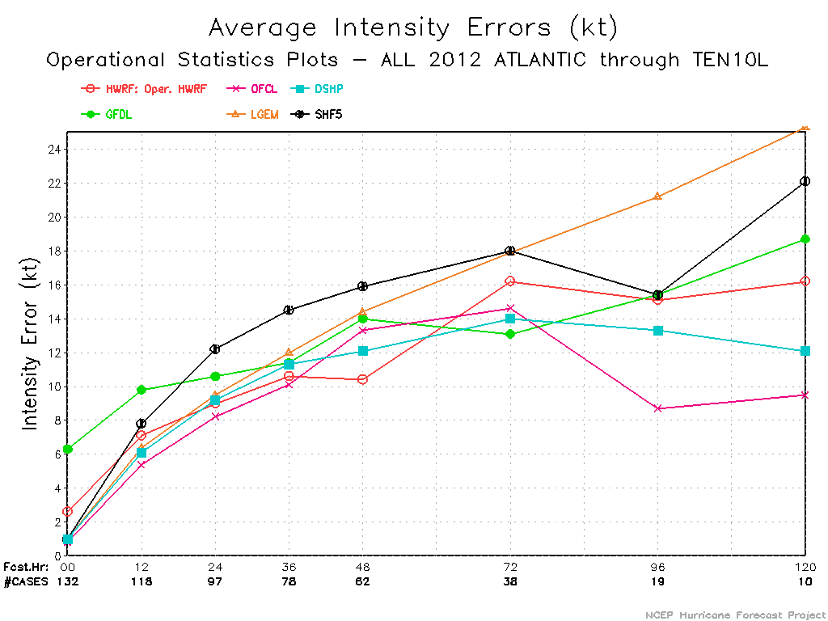
Real-Time Performance Update – ATL
Improvements in Atlantic intensity forecasts in 12-60hr period

Slide 8
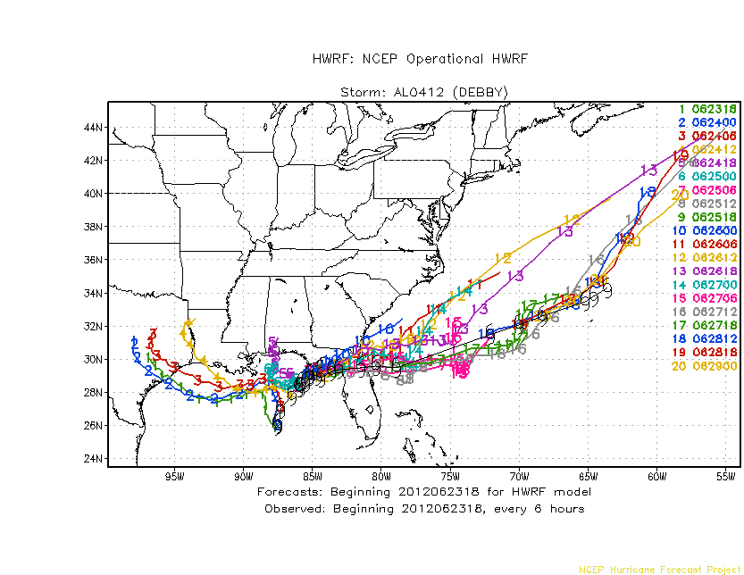
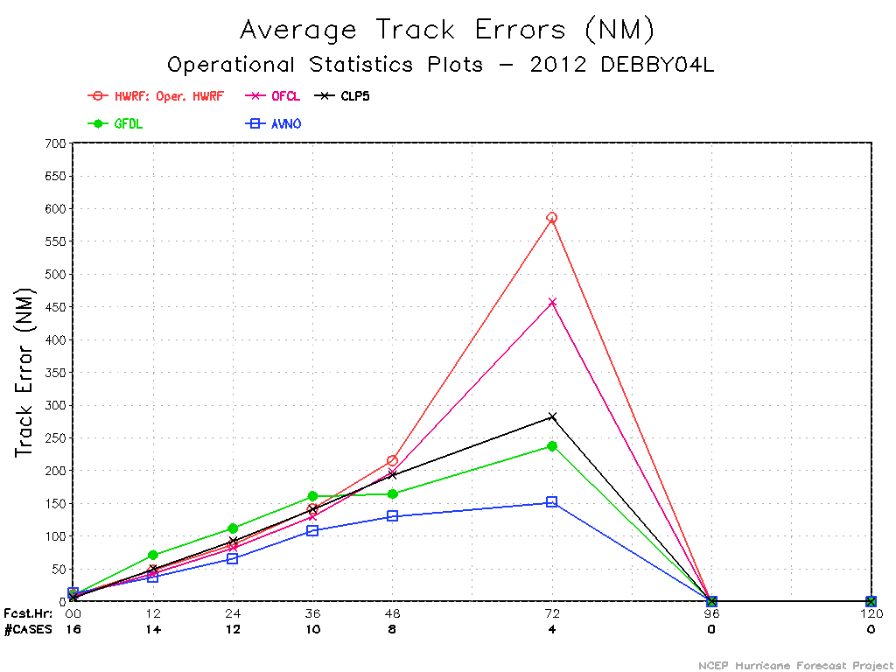
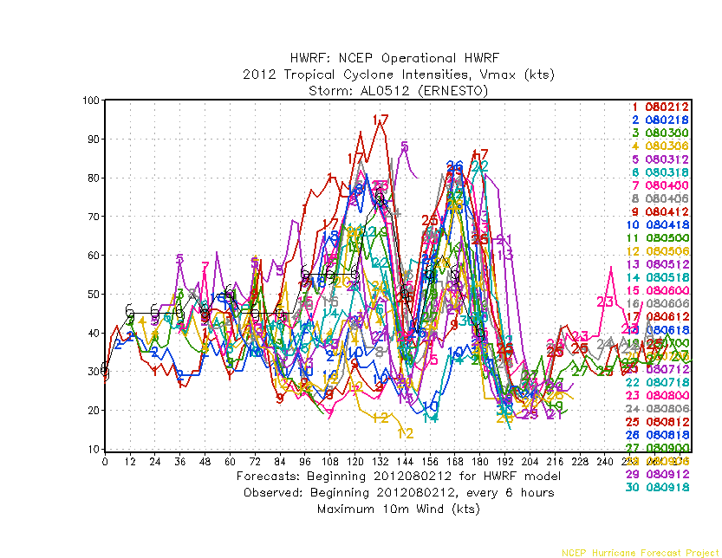
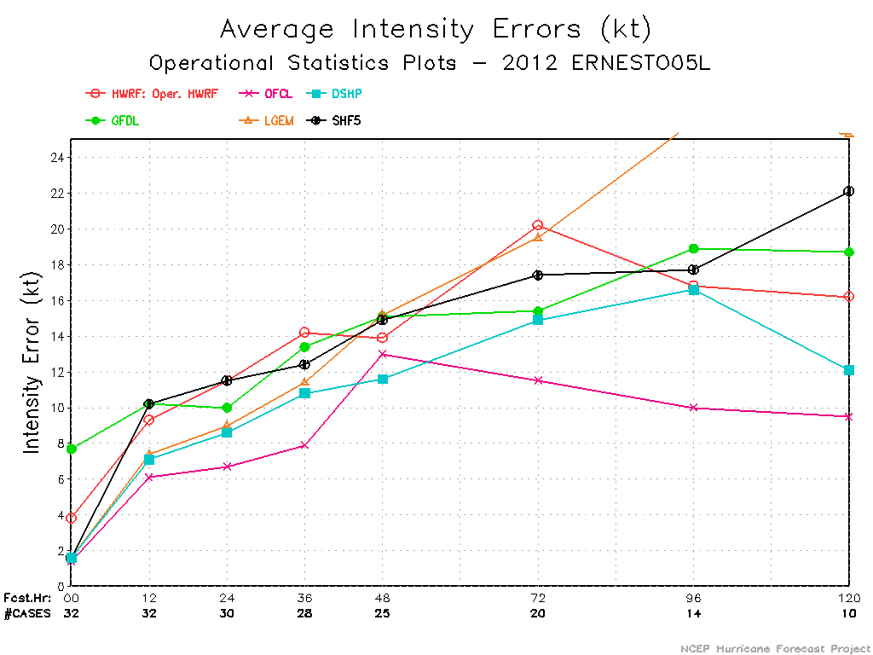

Slide 9
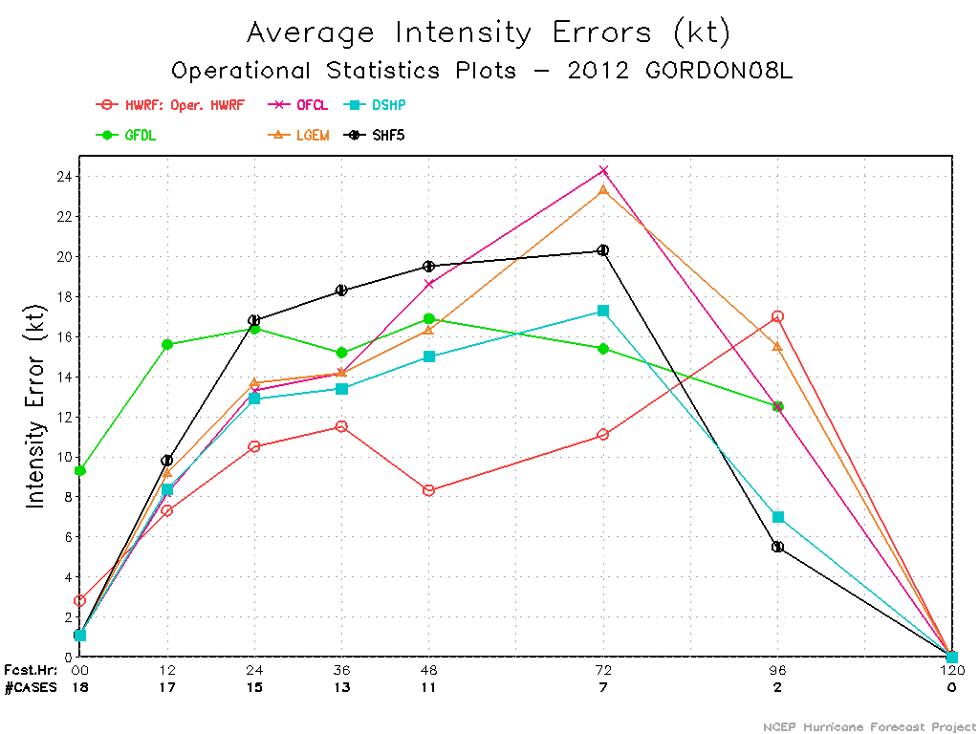
Impressive intensity forecasts for Hurricane Gordon

Slide 10
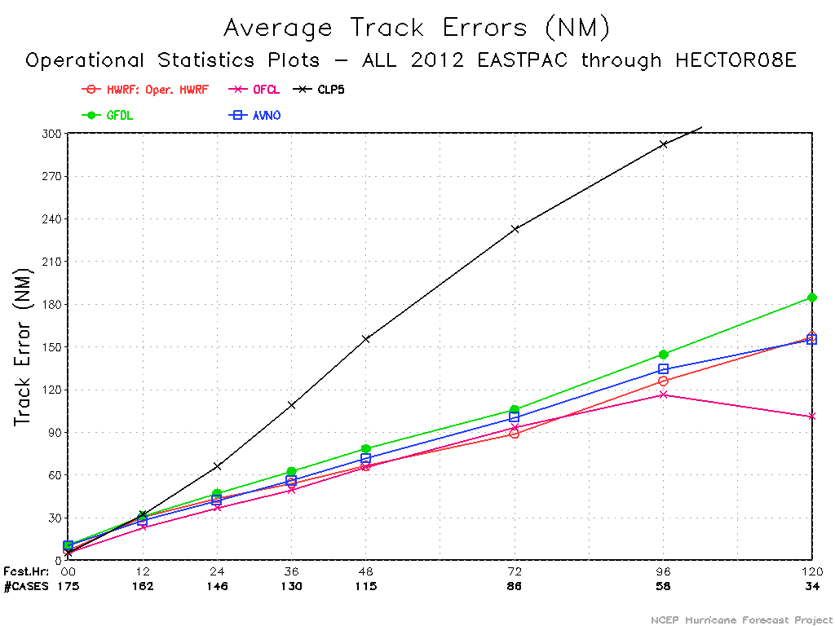
Real-Time Performance Update – E-PAC
AVERAGE ERRORS RELATIVE TO HWRF (%)
00 12 24 36 48 72 96 120
HWRF .0 .0 .0 .0 .0 .0 .0 .0
GFDL 51.7 3.6 8.2 15.8 18.1 19.4 15.0 17.6
AVNO 46.0 -7.1 -3.6 3.6 8.1 13.1 6.6 -1.4
OFCL -28.4 -23.2 -15.0 -9.0 -1.5 5.3 -7.4 -35.7
CLP5 -26.8 7.3 50.9 101.2 133.9 161.7 132.1 115.4
#CASES 175 162 146 130 115 86 58 34

Slide 11
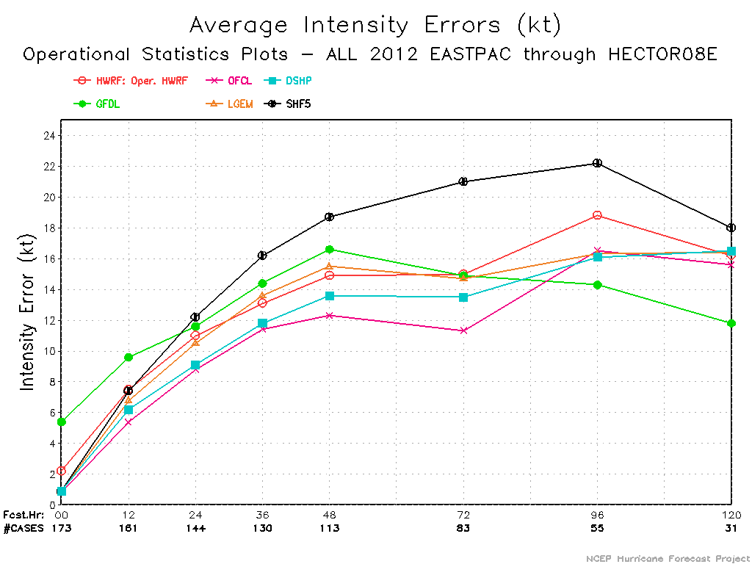
Real-Time Performance Update – E-PAC
Intensity performance still not good. HWRF suffers from negative bias.

Slide 12
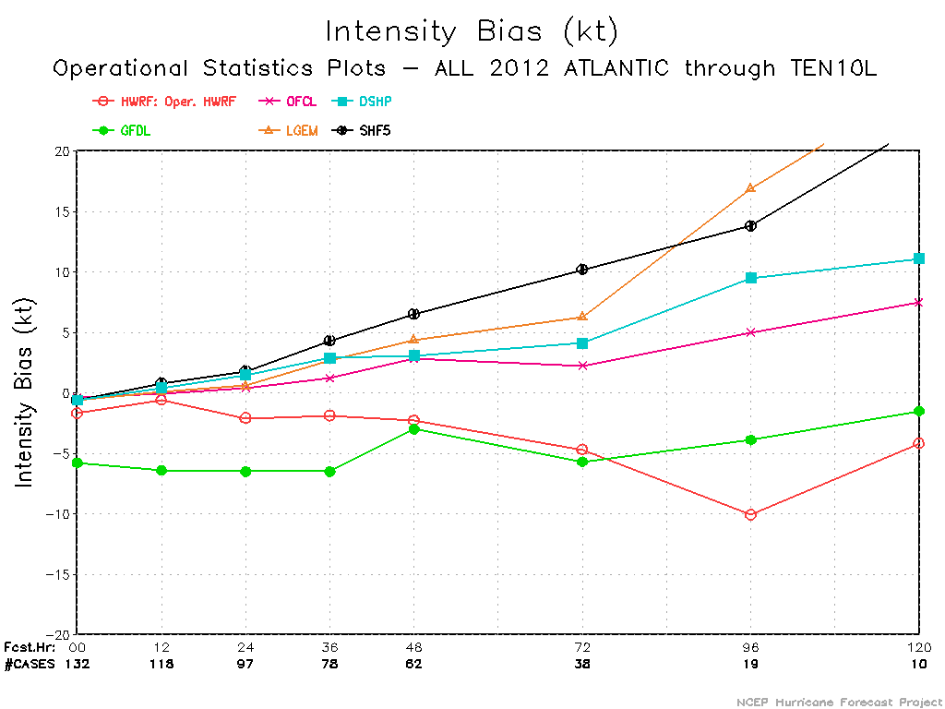
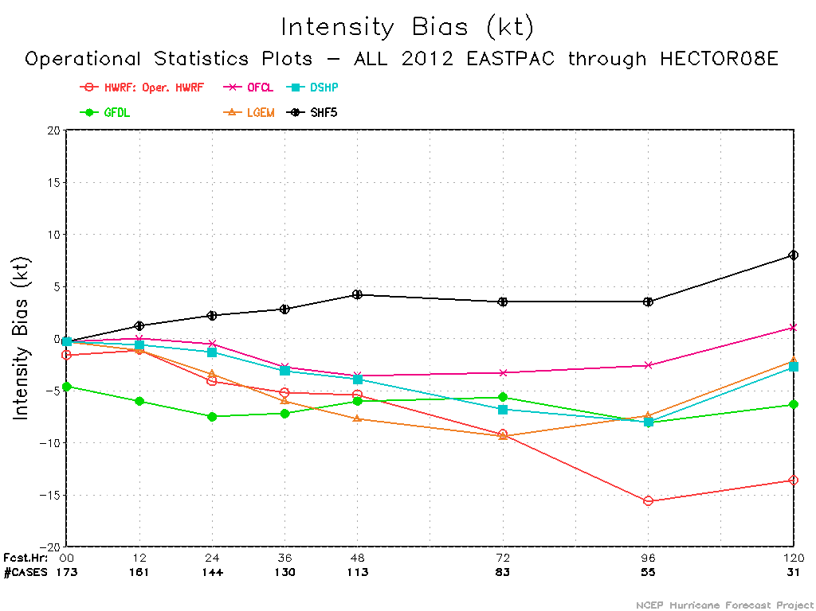
Negative Bias …. 3km Physics???

Slide 13
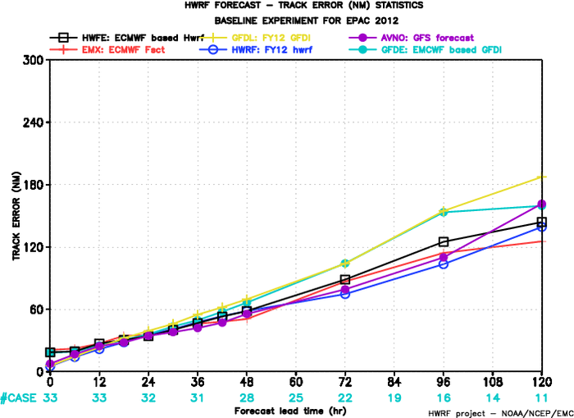
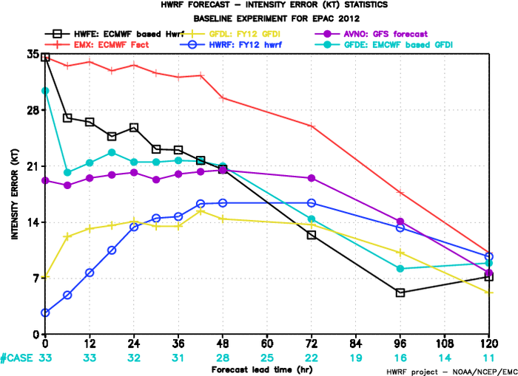
HWRF w/High-Resolution ECMWF IC/BC
Guidance from HWFE received special attention by NHC, especially for intensity forecasts

Slide 14
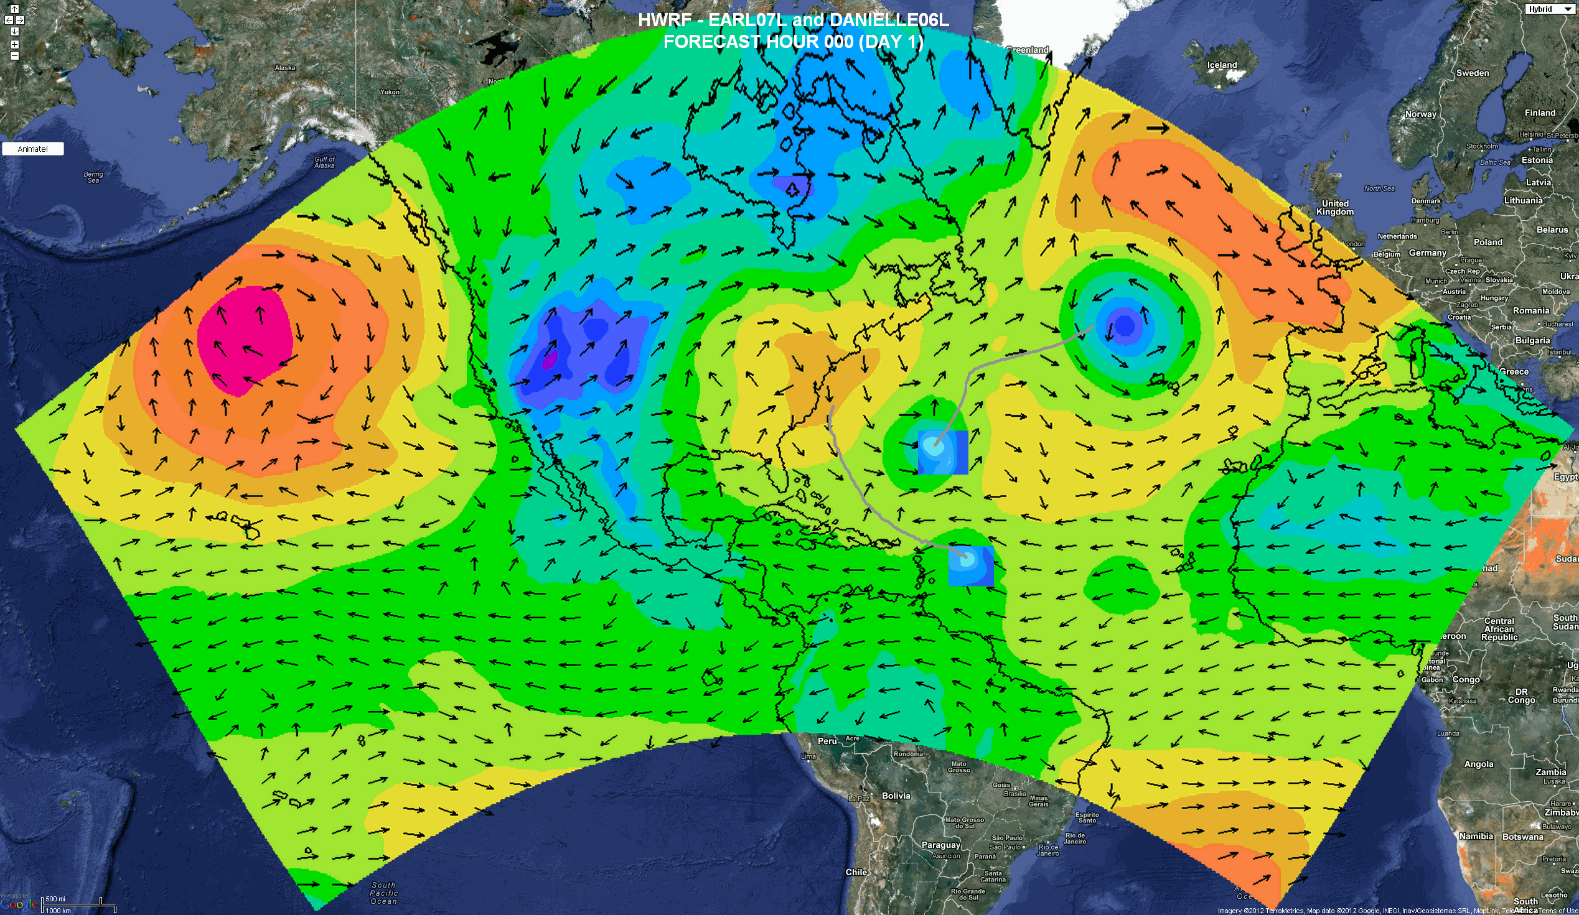
HWRF With Multiple Moving Nests (EMC-HRD-ESRL)
Projected as next generation hurricane modeling system
Requires major developmental effort
Basin scale domain
Active Hybrid DA efforts
13.5km analysis/forecasts

Slide 15
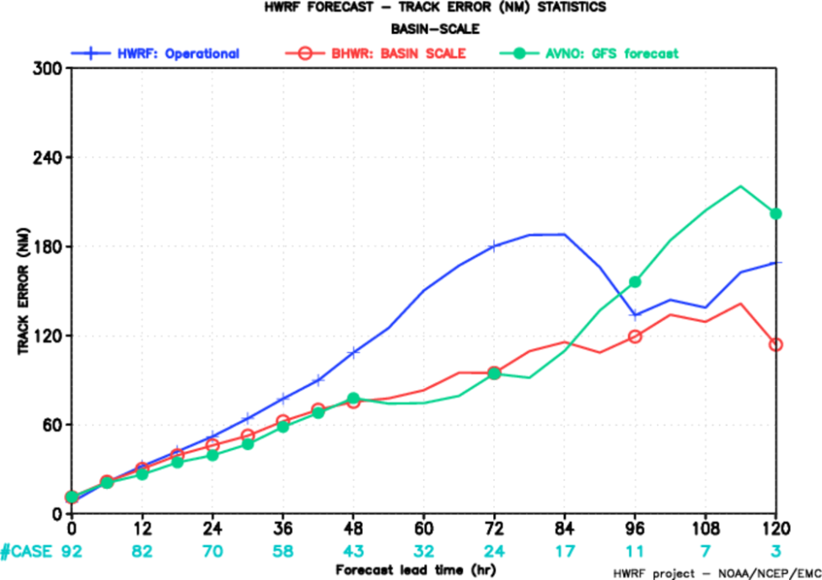
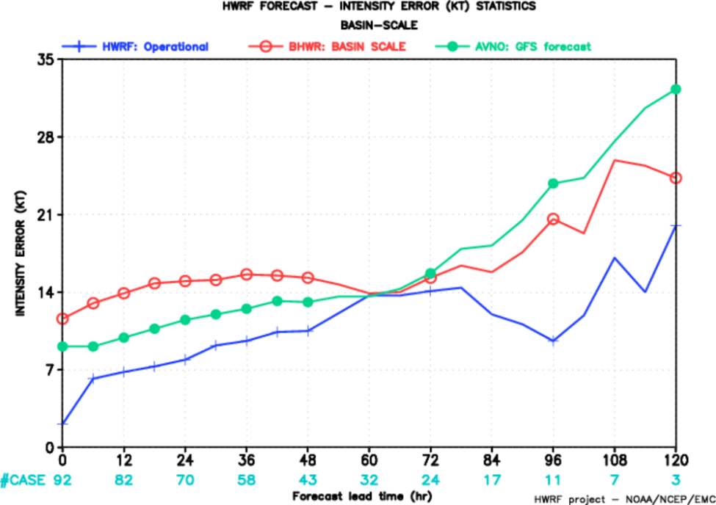
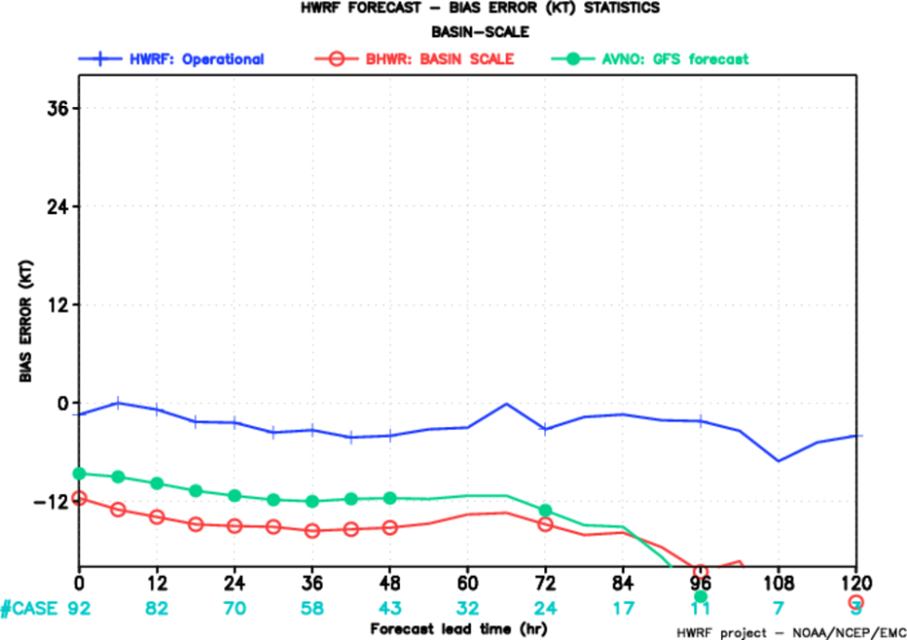
Basin scale (BHWR) verification for Atlantic 2012
Track
Intensity
No westward turn for Debby
Bias
Intensity errors worse than global models
Higher negative bias – physics not suitable for coarser domain at 27 km???

Slide 16
Basin Scale Requirements
Initialization issues
Better nesting algorithms
Multi-scale physics
Computational efficiency
Integration of DA and model development efforts
Ocean/wave/land coupling
Downstream applications & product development

Slide 17
How to address the intensity forecast problem? (how to connect the dots…….)
Identify (and quantify) issues:
  Stratification of results
  Establish relationship between structure and intensity
  Verification of intensity change
  Diagnose vortex-environment interactions
  New verification metrics based on wave number decomposition of intensity
Relate the above information to physical/dynamical processes in the model
Formulate methods to systematically address the above

Slide 18
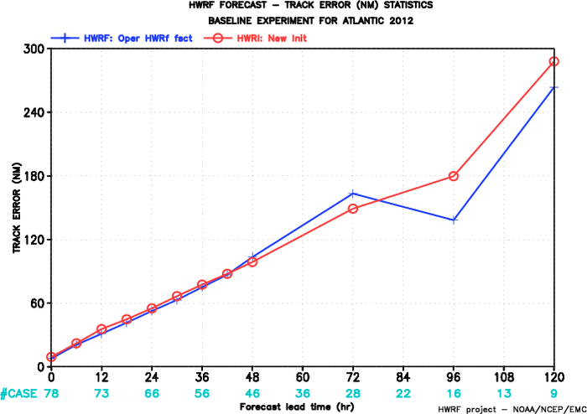
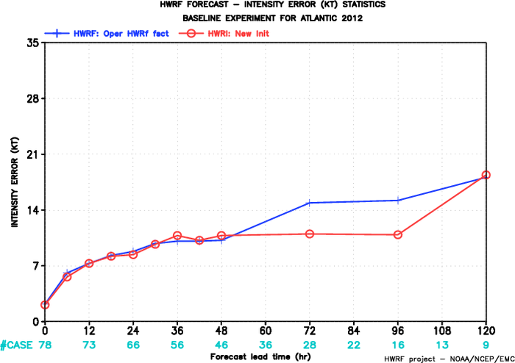
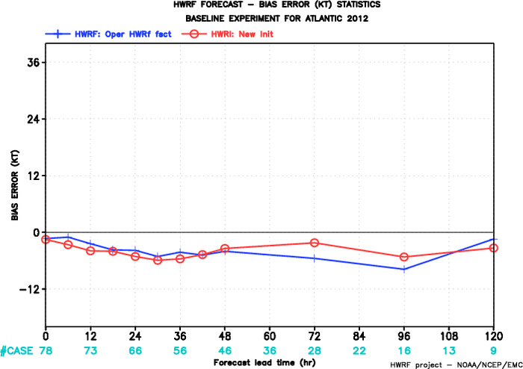
New Initialization experiment (HWRI) – Atlantic 2012
Track
Intensity
Bias
Similar performance compared to operational HWRF

Slide 19
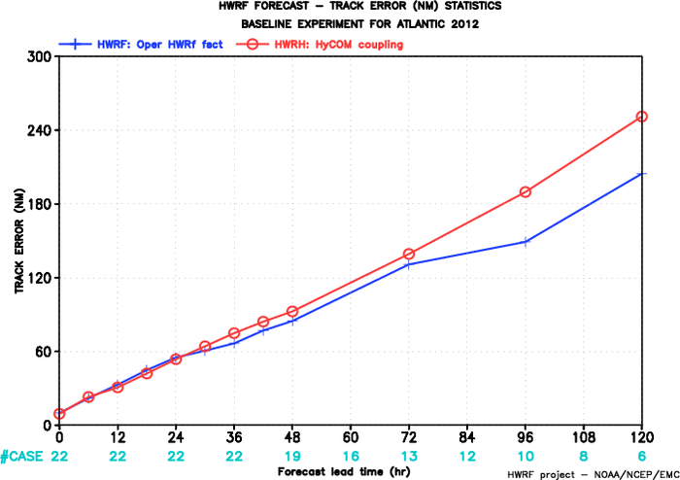
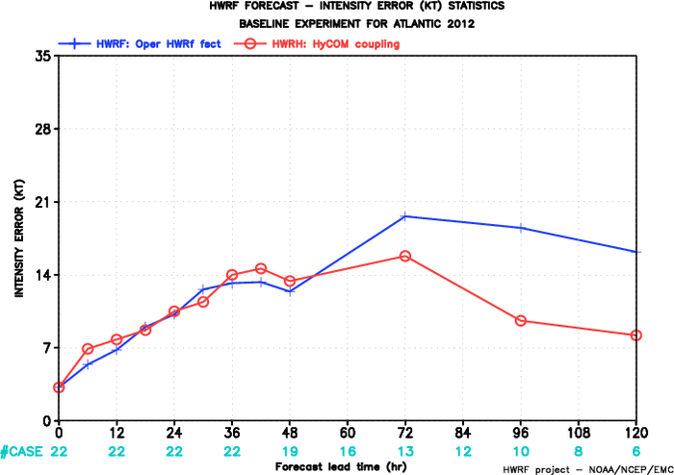
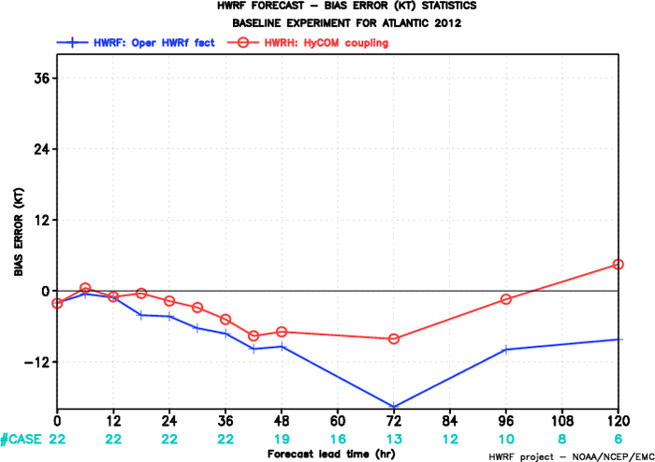
HYCOM coupling experiment (HWRH)- Atlantic 2012
Track
Intensity
Bias
Coupling to HYCOM showed improvements in intensity
Smaller sample size

Slide 20
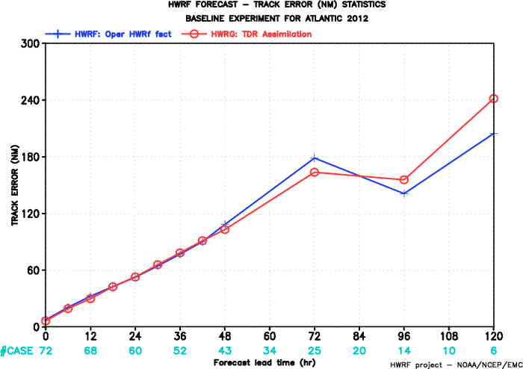
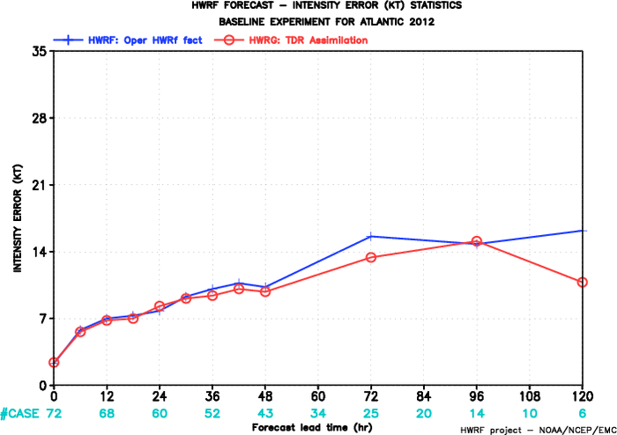
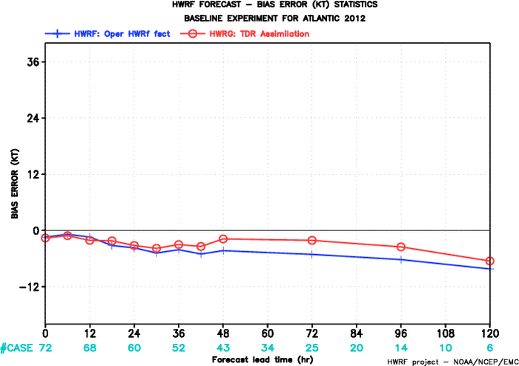
TDR assimilation experiment (HWRG)- Atlantic 2012
Track
Intensity
Bias
No real-time aircraft data available yet.

Slide 21
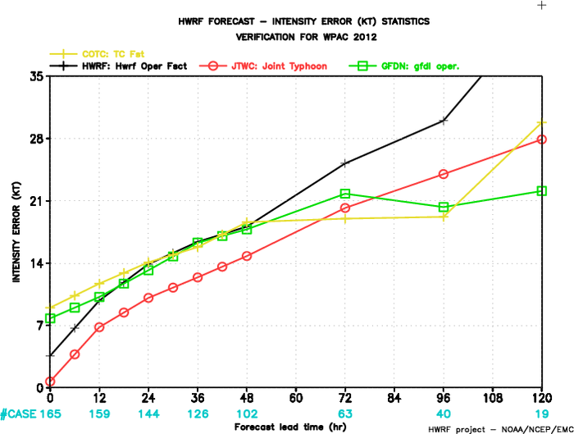
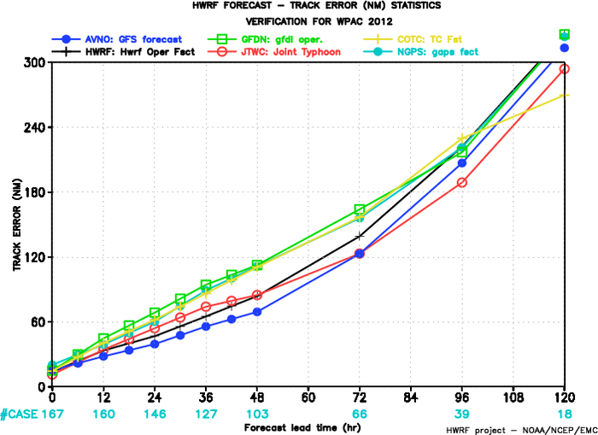
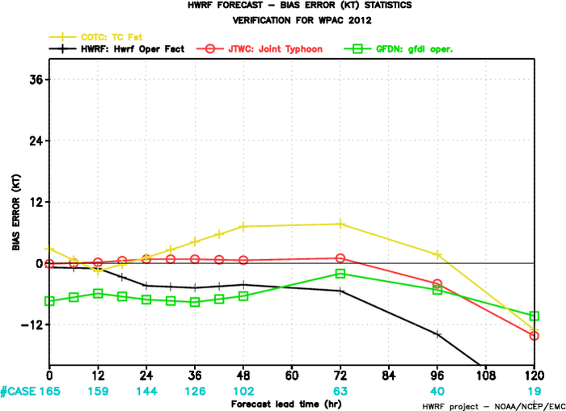
West Pacific experiment 2012
Intensity
Track
Bias
HWRF track errors comparable to GFS and OFCL
No skill in intensity beyond 48hrs (topographic interactions??)
Significant negative bias

Slide 22
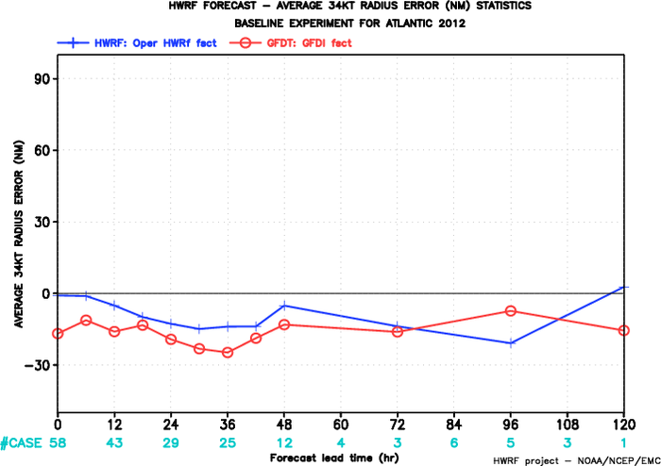
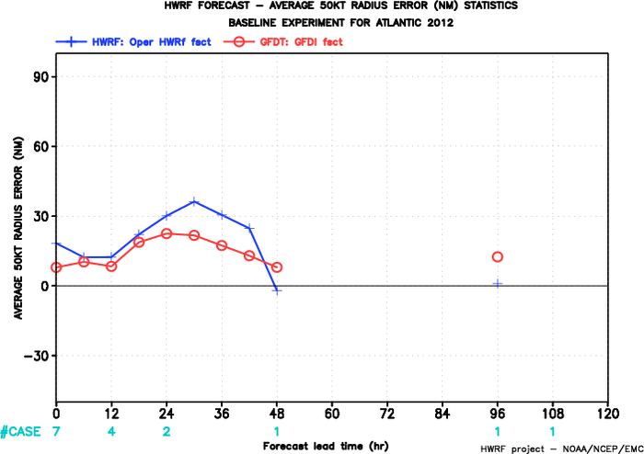
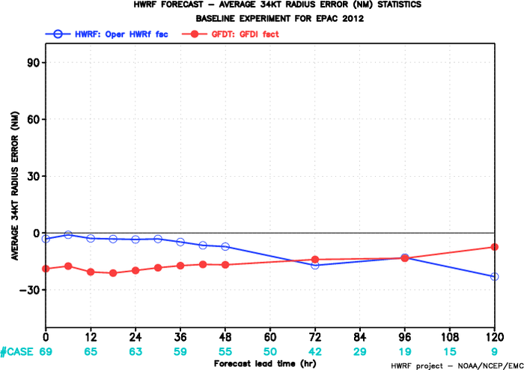
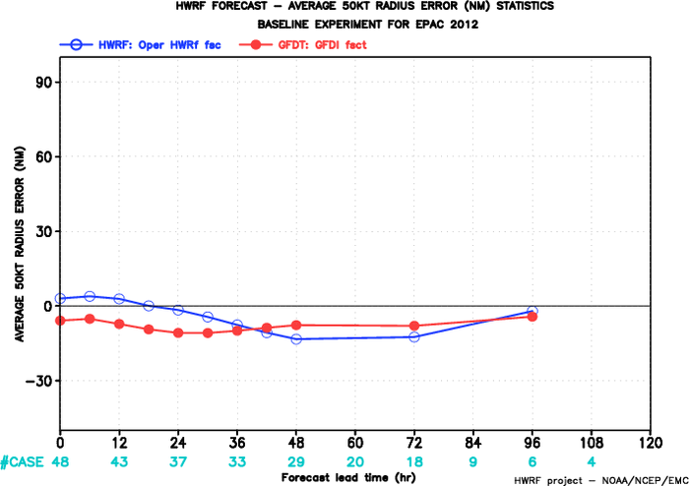
Radii verification for 2012
Mean 34 kt
Atlantic
Mean 50 kt
Mean 34 kt
E-Pac
Mean 50 kt

Slide 23
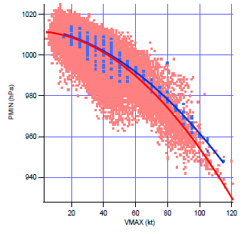
Pressure-wind relationship (Atlantic+EPAC combined 2012)

Slide 24
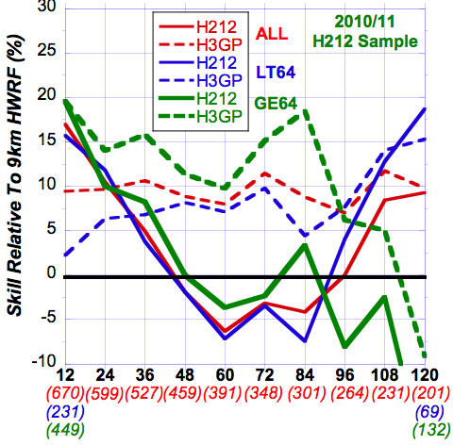
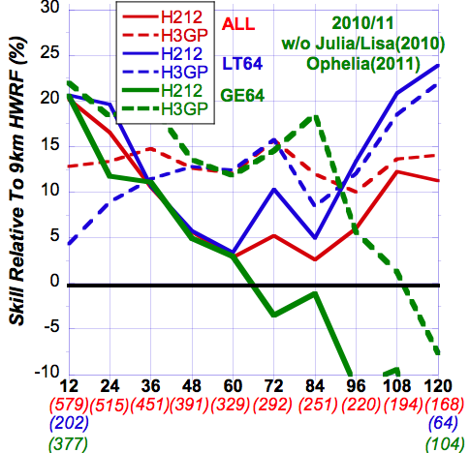
Stratified Intensity Forecast Skill
2010-2011 Seasons Retrospective Runs
H212/H3GP (27:9:3 km) relative to HWRF (27:9 km)
All Cases/Initially <Hurricane/Initially Hurricane
All Storms
w/o Julia, Lisa (2010), Ophelia (2011)
H212: Improved over HWRF (esp. thru 36h*)
& except from 48-96h
BUT H3GP better than H212 & HWRF
H212: Improved over HWRF at all times
(esp. thru 24h*) esp. for <H
Has problem with HR after 84h
BUT H3GP better than H212 & HWRF
(*) Much better initialization?
Notes:
Same rules as NHC verification -- tropical or subtropical --- at initial and verification
Wish I had looked at EPAC
Interpolation -- Early vs Late models -- Not just showing operational performance -- want to show model comparison and improvement

Slide 25
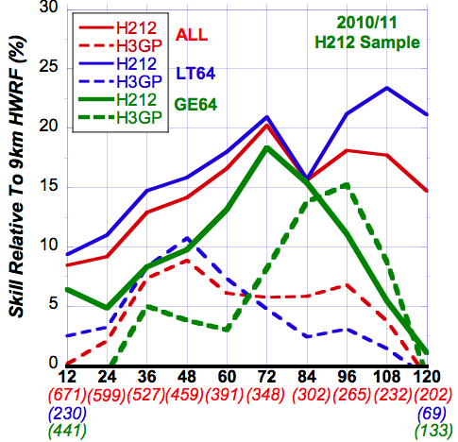
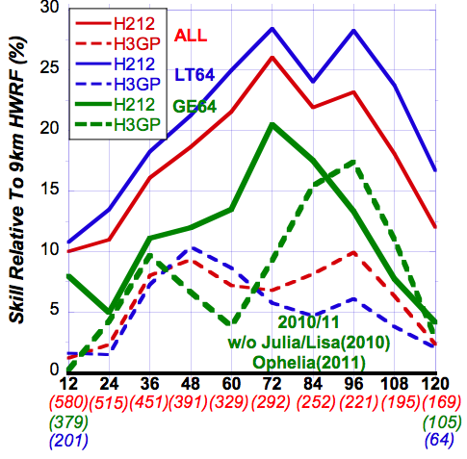
Stratified Track Forecast Skill
2010-2011 Seasons Retrospective Runs
H212/H3GP (27:9:3 km) relative to HWRF (27:9 km)
All Cases/Initially <Hurricane/Initially Hurricane
All Storms
w/o Julia, Lisa (2010), Ophelia (2011)
H212: Large improvement over HWRF & H3GP
(More improvement for <H)
H212: Even Larger improvement
(More improvement for <H)
H212: Much better Track Forecasts than HWRF & even H3GP
(better initialization--less contamination of Large-Scale field?)
Notes:
Same rules as NHC verification -- tropical or subtropical --- at initial and verification
Wish I had looked at EPAC
Interpolation -- Early vs Late models -- Not just showing operational performance -- want to show model comparison and improvement

Slide 26
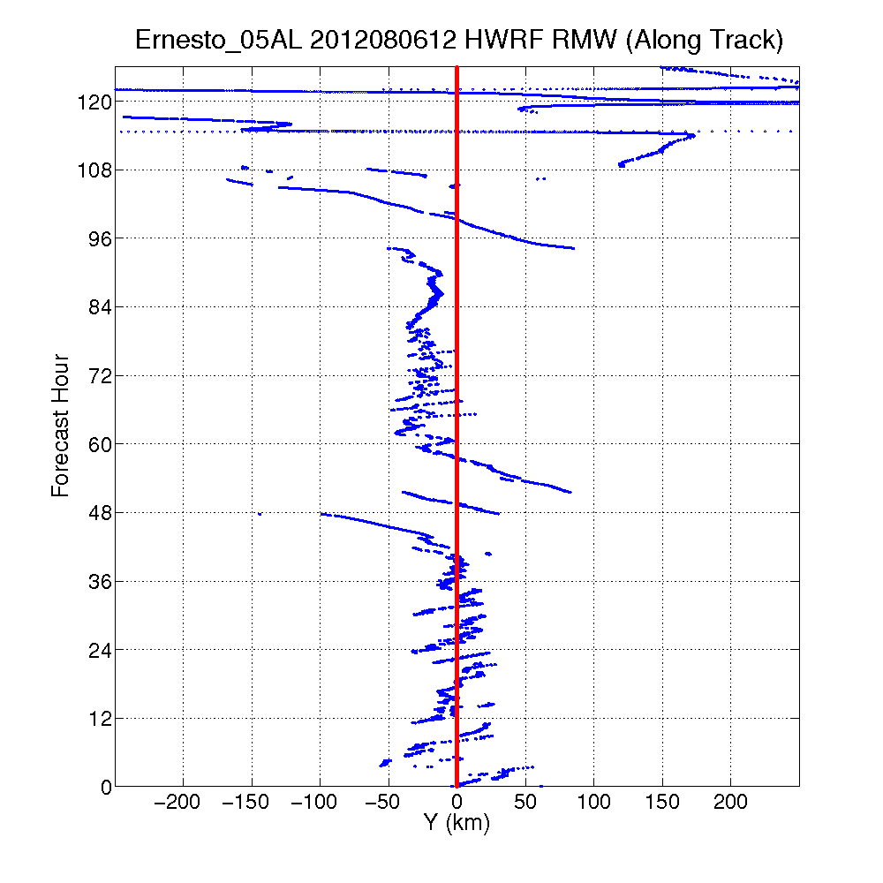
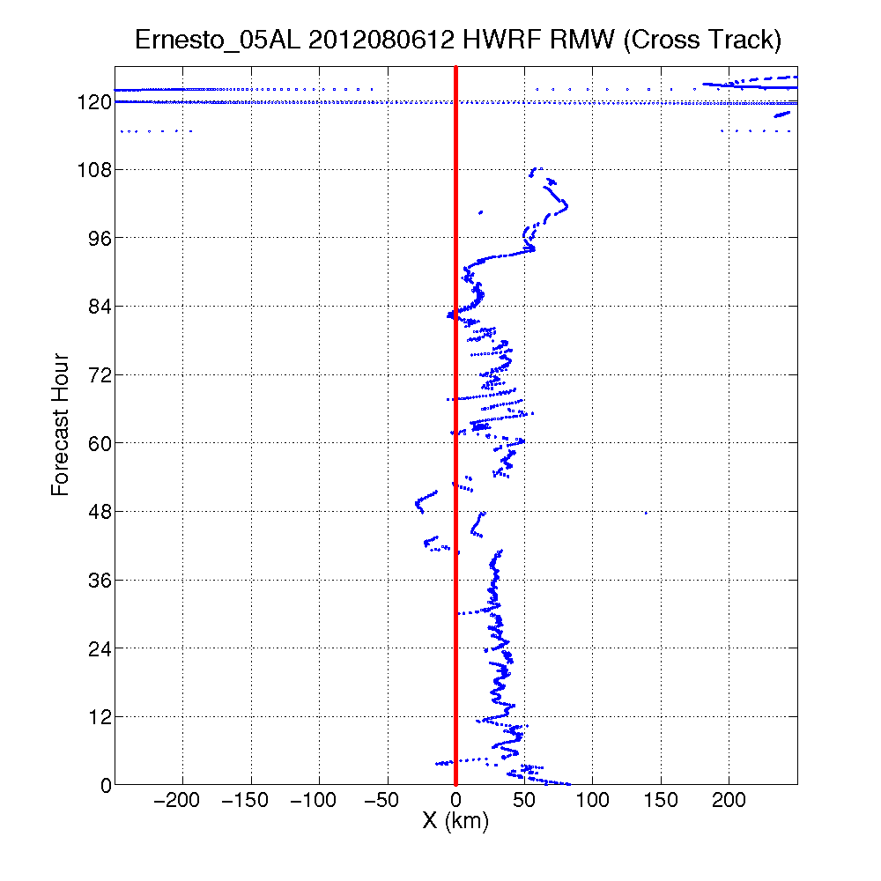
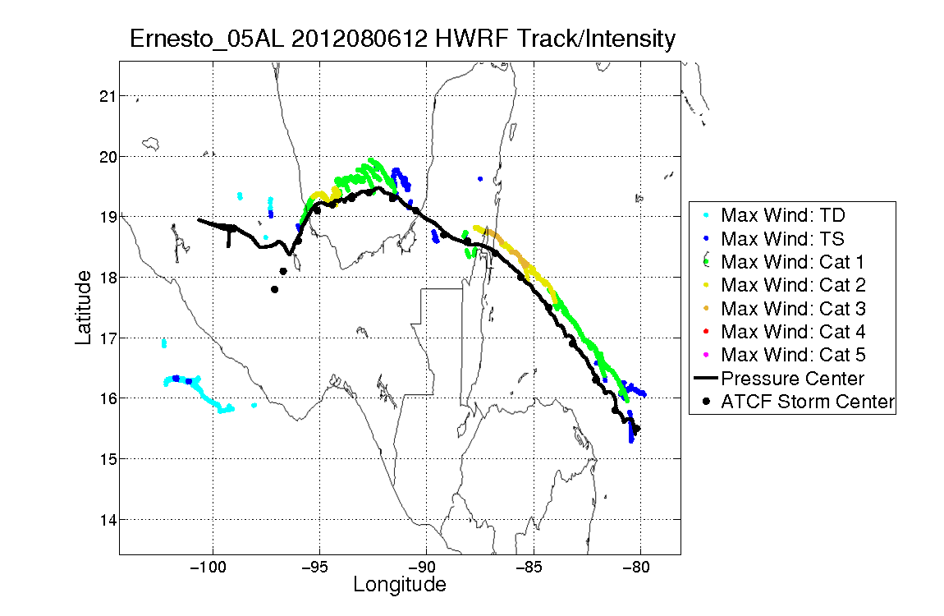
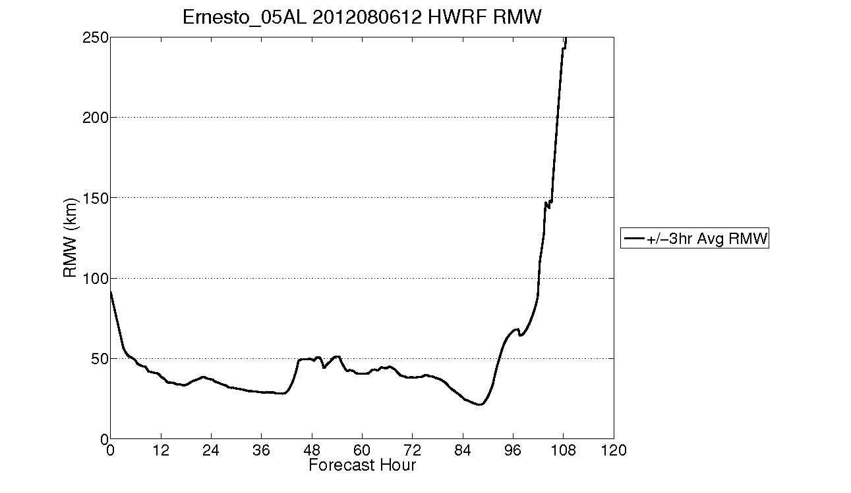
Use of HTCF data
Good

Slide 27
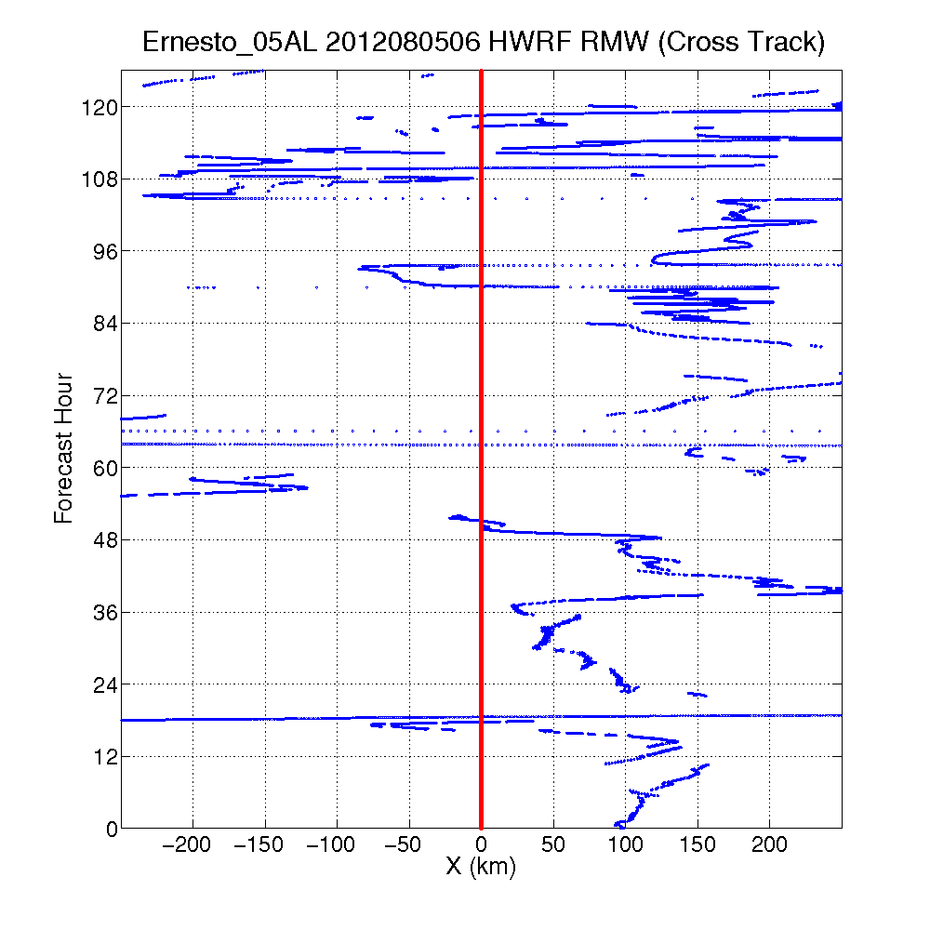
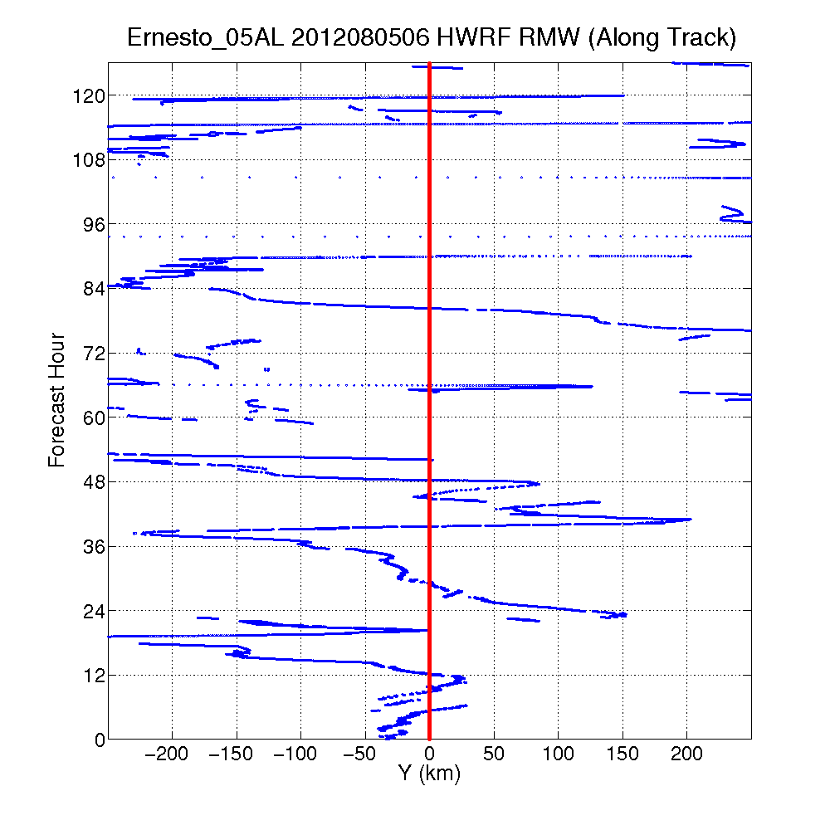
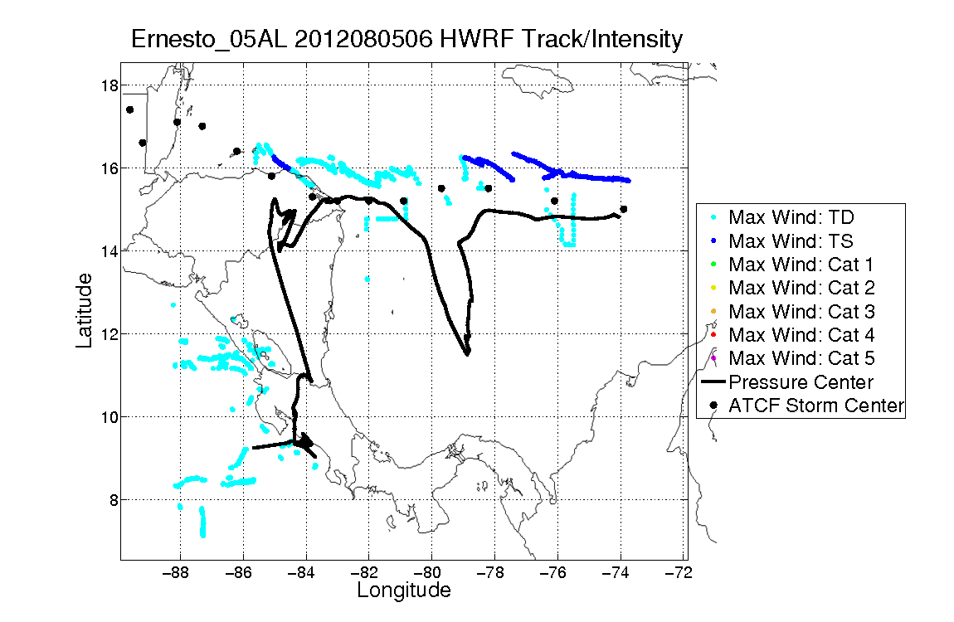
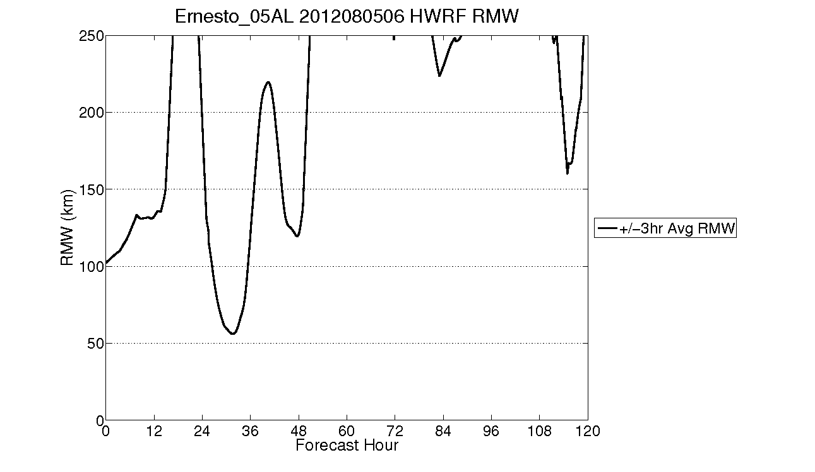
Use of HTCF data
Bad

Slide 28
H212 Nest movement statistics for storms
(total 848 cases)
maximum HTCF-ATCF distance | with intensity >35 kts | with intensity >20 kts
>100 km | 245 (29%) | 671 (54%)
>200 km | 63 (7%) | 282 (23%)
>300 km | 36 (4%) | 201 (16%)
>400 km | 24 (3%) | 158 (13%)
>700 km | 4 (0.5%) | 69 (5.5%)
With strong storms, we rarely lose the 3km domain entirely and virtually never lose the 9km domain
With weak storms we frequently (23% vs. 7%) lose the 3km, and sometimes even lose the 9km domain (13% vs 3%)

Slide 29
Need a Better Storm Tracking Algorithm
Current 3km algorithms: mass centroid methods
Follow the center of the mass displaced by the storm.
Two algorithms: HWRF-X and Revised Centroid
HWRF-X algorithm works well for strong textbook storms, not well for others.
Most cycles are non-textbook cases:
  Genesis cases
  Strongly sheared storms
  A weak storm near a stronger one
  Nearby high pressure systems pushing center off-track.
Revised Centroid Method: a compromise that does decently well for “textbook” cases while improving “non-textbook” cases (6000 simulations for tuning)

Slide 30
New Nest Motion Algorithms
Neither centroid method works with 100% reliability. Examining four possibilities:
  HTCF-based temporal curve fit through extrapolation for next movement time
  Instantaneous large-scale averaging of pressure and use of dynamic pressure to eliminate terrain issues
  Feature tracking
  “Consensus” – combine multiple trackers

Slide 31
Potential Issues (focus areas):
Large-Scale:
  Systematic evaluation of large-scale synoptic features
  Evaluation of basin-scale HWRF runs
  Influence of lateral boundary conditions
  Vortex influence on large-scale circulation
  Impact of DA on large-scale
  Impact of vertical levels (and their distribution)
  Evaluation of tropical rainfall forecasts
Define metrics and tools for large-scale evaluation
Construct HWRF model climatology
Generate high-resolution HWRF analysis

Slide 32

Motivating Questions
What are the error characteristics of the basin-scale HWRF’s large scale climatology?
Are there systematic errors in model physics that aren't
obvious near the hurricane, but which affect the model's forecast?
Are there any issues at the lateral boundaries?
Can regional biases be tied to certain physical processes that highlight model deficiencies?

Slide 33
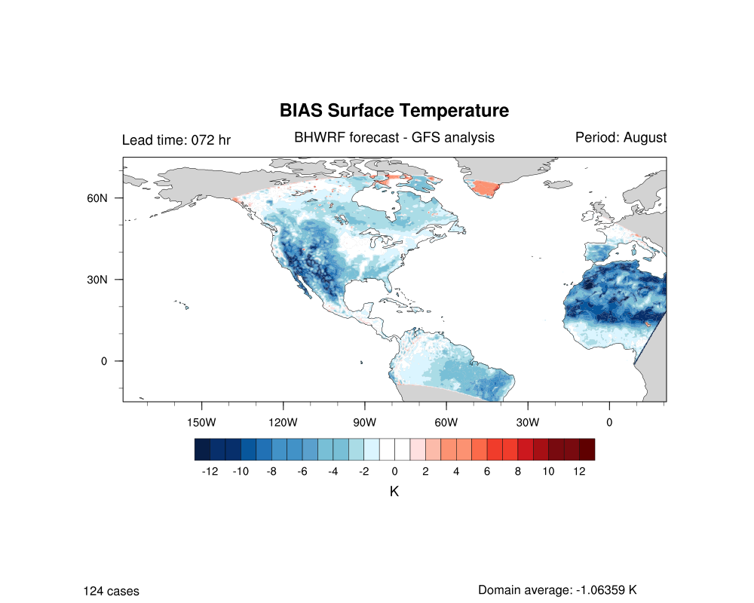
Vertical Bias Structure at 72-hr Lead Time During month of August

Slide 34
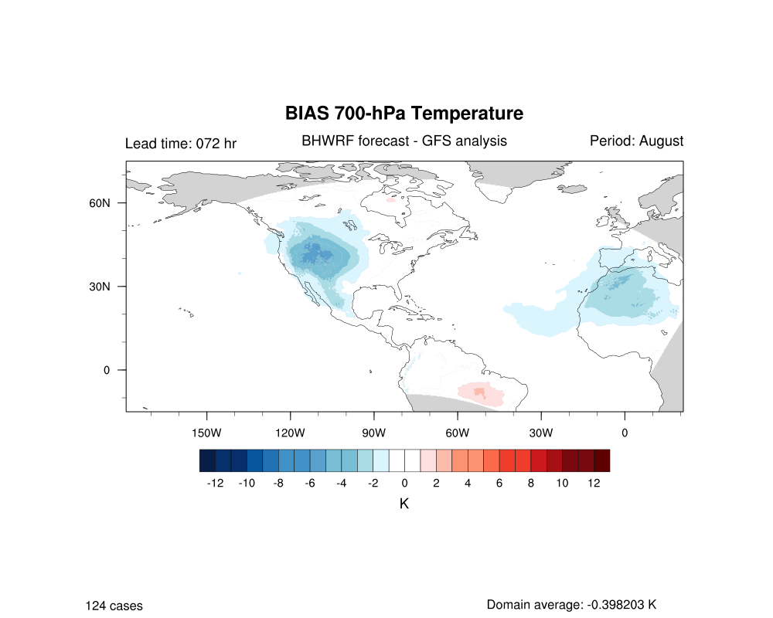
. . . switches to a warm bias (issues with shallow convection?)

Slide 35
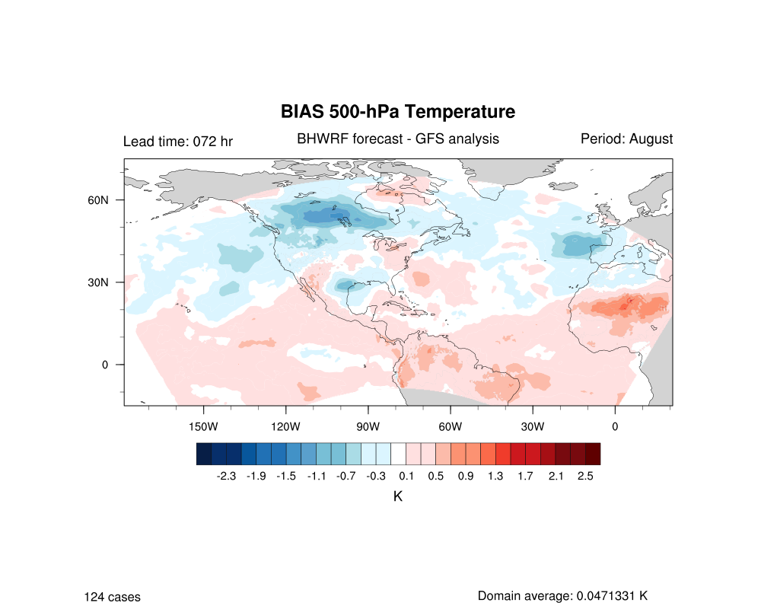
Broad warm bias develops in tropics above 500 hPa

Slide 36

Warm bias switches back to a cold bias

Slide 37

Notable dryness

Slide 38
Potential Issues (focus areas):
Vortex initialization:
  small weak storm is hard to intensify
  initial storm structure may have problem in strong shear environment
  bogus storms (cold start) have problem when defined as shallow or medium
  current operational initialization only uses the max wind speed for intensity correction
How to quantify the relationship between initial vortex specification and intensity errors?
Ensemble based sensitivity analysis of initial vortex structure
Moisture perturbations in the initial vortex analysis

Slide 39




HWRF-OPERATION
NEW PBL-H&K
Ideal
PBLH
Max Wind H
Real
EARL
F24
PBL
Inflow H
Inflow H
PBL

Slide 40




RRTMG Idealized run
Radiation forcing - HWRF
Radiation forcing - RRTMG
.
Potential Temp perturbation - HWRF
Potential Temp perturbation - RRTMG

Slide 41
Potential Issues (focus areas):
Ocean in HWRF:
  Very limited evaluation done so far (only a few case studies)
  Relevance and importance of SSTs on storm intensity in various situations (fast moving, slow moving, shallow waters, loop current, warm/cold eddies etc.)
  Ocean initialization
  Differences in atmospheric SSTs and oceanic SSTs
  Ocean coupling frequency
  Reduction of fluxes from atmosphere to ocean (as in current operational HWRF)
  POM vs. HYCOM
  Wave coupling and sey-spray effects
How to analyze and quantify these issues to help physics development? (use of observations)

Slide 42



Ocean Heat Content
SST & sfc Currents
SST & Z26

Slide 43




Example: Simuled SST vs TMI SST
IKE (09L) valid 1800Z 2008/09/11
HyHWRF
Op HWRF
HWRF alone
Note: SST cooling as hurricane Ike transit the LC
TMI – SST

Slide 44
Potential Issues (focus areas):
Intensity issues:
  Peak wind is in the tail of the distribution. Need to define alternate metrics for model intensity forecast verification
  Wave number zero – can it explain the variance? Axi-symmetric mean may not help for weak storms
  Relationship between storm structure (horizontal and vertical) and intensity
  How good are regional models in capturing the intensity change?
  Vortex interactions with large-scale (use of SHIPS predictors)
  Metrics for rapid intensity change verification
Construct intensity change climatology at different forecast intervals
Develop tools to understand vortex-shear interactions

Slide 45
Intensity change verification
H212 vs HOPS

Slide 46
Definition
False alarm ratio (FAR) index: indicating the how frequent the model fails to capture the actual change as compared to observation (the closer to 0, the better)
Probability of detection (POD) index: indicating the how the model can capture the correct change as compared to observation (the closer to 1, the better)
The frequency bias index (FBI) index: indicating the how the model bias is as compared to observation (overestimation > 1, underestimation < 1)

Slide 47

Intensity change verification: FAR index
H212 has smaller false ratio of the intensity change at the longer time interval in both Atlantic and EPAC basin;
The false alarm ratio is smaller in the Atlantic basin as compared to the EPAC;
HOPS has a smaller FAR index for all range of intensity change from 6 to 72 h in the Atlantic;
H212 has consistently smaller FAR index for the intensity change between 36 to 96 h

Slide 48

Intensity change verification: POD index
Both HOPS and H212 in general have higher POD index the Atlantic than in the EPAC basin;
In the Atlantic basin, H212’s POD index is consistently higher than that of HOPS, indicating the that H212 is better in the Atlantic basin;
In the EPAC basin, HOPS has higher POD for 6 to 36 h intensity change, whereas H212 has higher POD index for 48 to 96 h intensity change.

Slide 49

Intensity change verification: FBI index
Both H212 and HOPS tend to underestimate the intensity change for all range of time intervals from 6 to 96 h;
Overall, H212 tends to have increasing underestimation of the intensity change for time interval longer than 48h in the EPAC basin, whereas it has less underestimation in the Atlantic basin for all range of time interval;
Both H212 and HOPS have their maximum negative bias for 24-48h intensity change in the Atlantic basin, but they have minimum bias in the EPAC basin for the same time intervals

Slide 50
Concluding remarks
Model development closely tied with model diagnostics
Comprehensive evaluation making use of all available observations (aircraft, satellite, upper-air, surface, and ocean)
Process studies (including idealized simulations) need more attention
Coordination among all collaborators is critical

