Slide 1
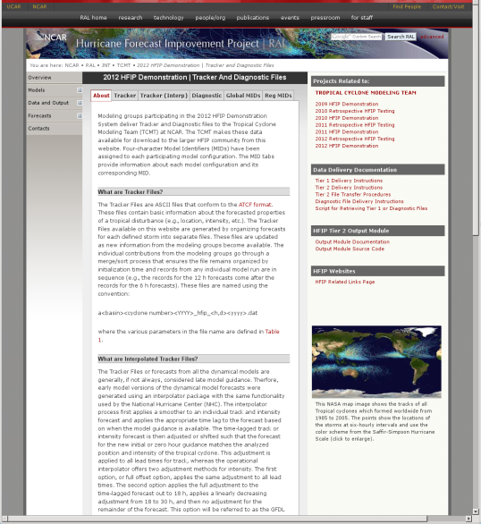
HFIP Diagnostic Activities and Plans TCMT
Collect and make available Tier 1, Tier 2, and Diagnostic Files
Provide definition and delivery guidance regarding Tier 1 and Tier 2 datasets to be archived by TCMT
Collect Tier 1 data, process and post merged files
Available on the TCMT/HFIP website (http://www.ral.ucar.edu/projects/hfip/d2012/data_output/)
Collect and archive Tier 2 data
JNT RAMADDA Data Repository
https://verif.rap.ucar.edu/repository/
Convenient tar and wget data retrieval options
IDV (implement visualization tools for model fields and model/analyzed tracks)
In development

Slide 2
HFIP Diagnostic Activities and Plans TCMT
2012 Retrospective Planning, Testing, and Evaluation
Coordinated with NHC and prospective Stream 1.5 modeling groups
Activities coordinated with NHC
Baselines (top-flight models and impact on consensus)
Early model conversion (interpolator)
Groups provided input on flexible intensity adjustment settings
Evaluated configurations from eight modeling groups
Model types included regional, global, deterministic, ensemble, early, late, statistical, dynamical, correlation-based consensus
All but one candidate were selected by NHC as having some Stream 1.5 application for 2012
Organization | Model
MMM/SUNY-Albany | AHW
UW-Madison | UW-NMS
NRL | COAMPS-TC
PSU | ARW
GFDL | GFDL
ESRL | FIM
CIRA | SPICE
FSU | Multi-Model Ensemble
Notes:
- TCMT tools for consensus mirror NHC types (fixed and variable)
- Access to ECMWF data – impacts consensus and top-flight analysis
Impact of multiple stream 1.5 models on consensus
Intensity options available in NHC’s interpolator/determination of optimal configuration for stream 1.5 candidates

Slide 3
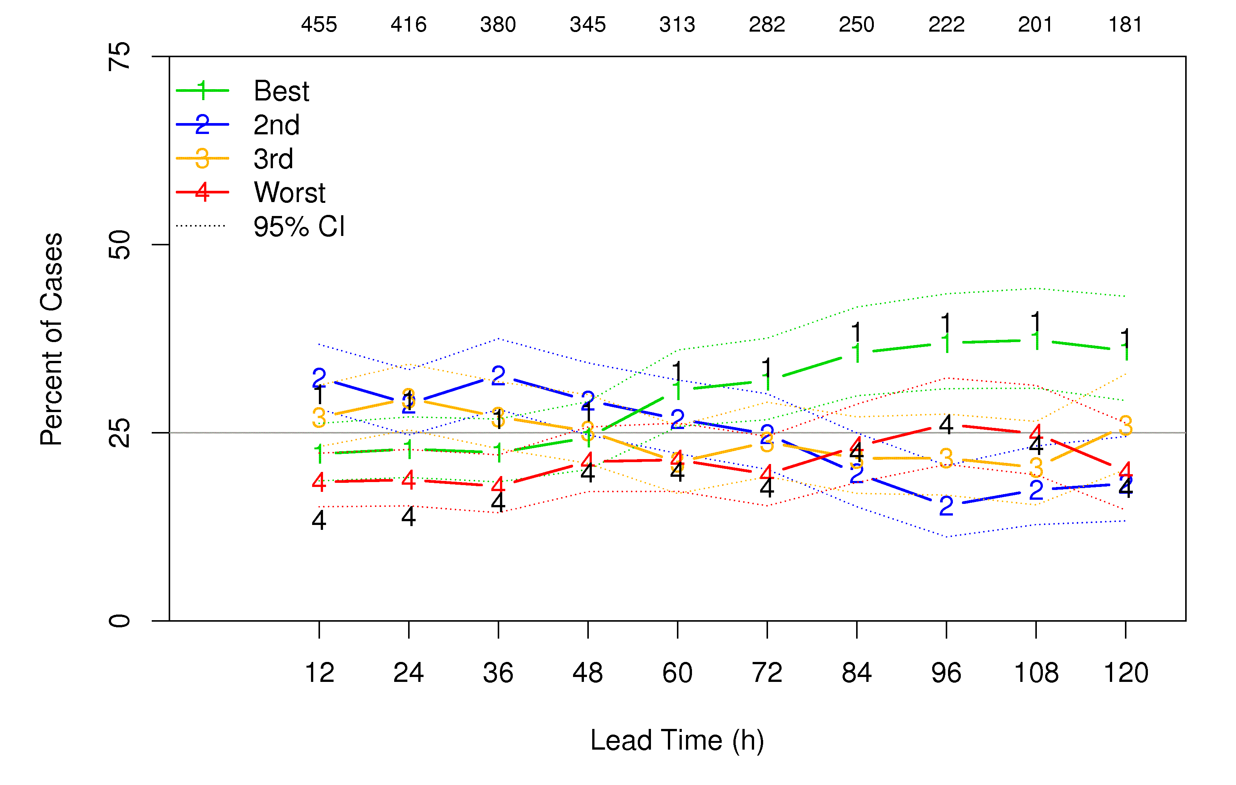
HFIP Diagnostic Activities and Plans TCMT
2012 Retrospective Testing: Methods for Displaying Results
Mean errors with confidence intervals
Percent of cases for which error differences exceed a specified threshold
Boxplots
Summary tables
Rankings line plots
Track - ECMWF, GFS, GFDL
Intensity - LGEM, DSHP, GFDL
http://www.ral.ucar.edu/projects/hfip/h2012/verify/

Slide 4
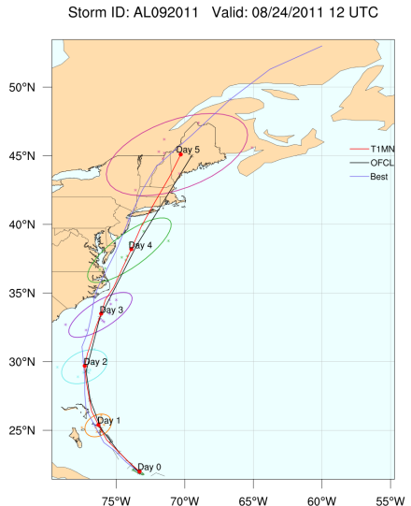
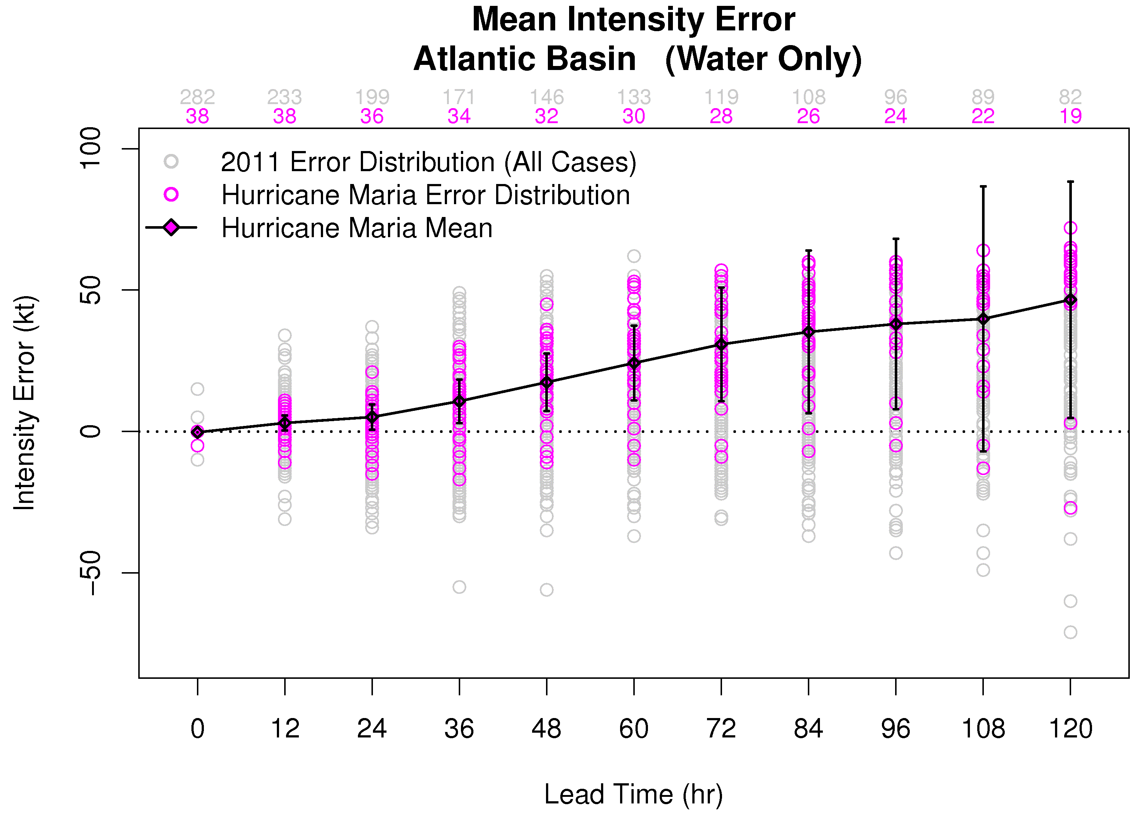
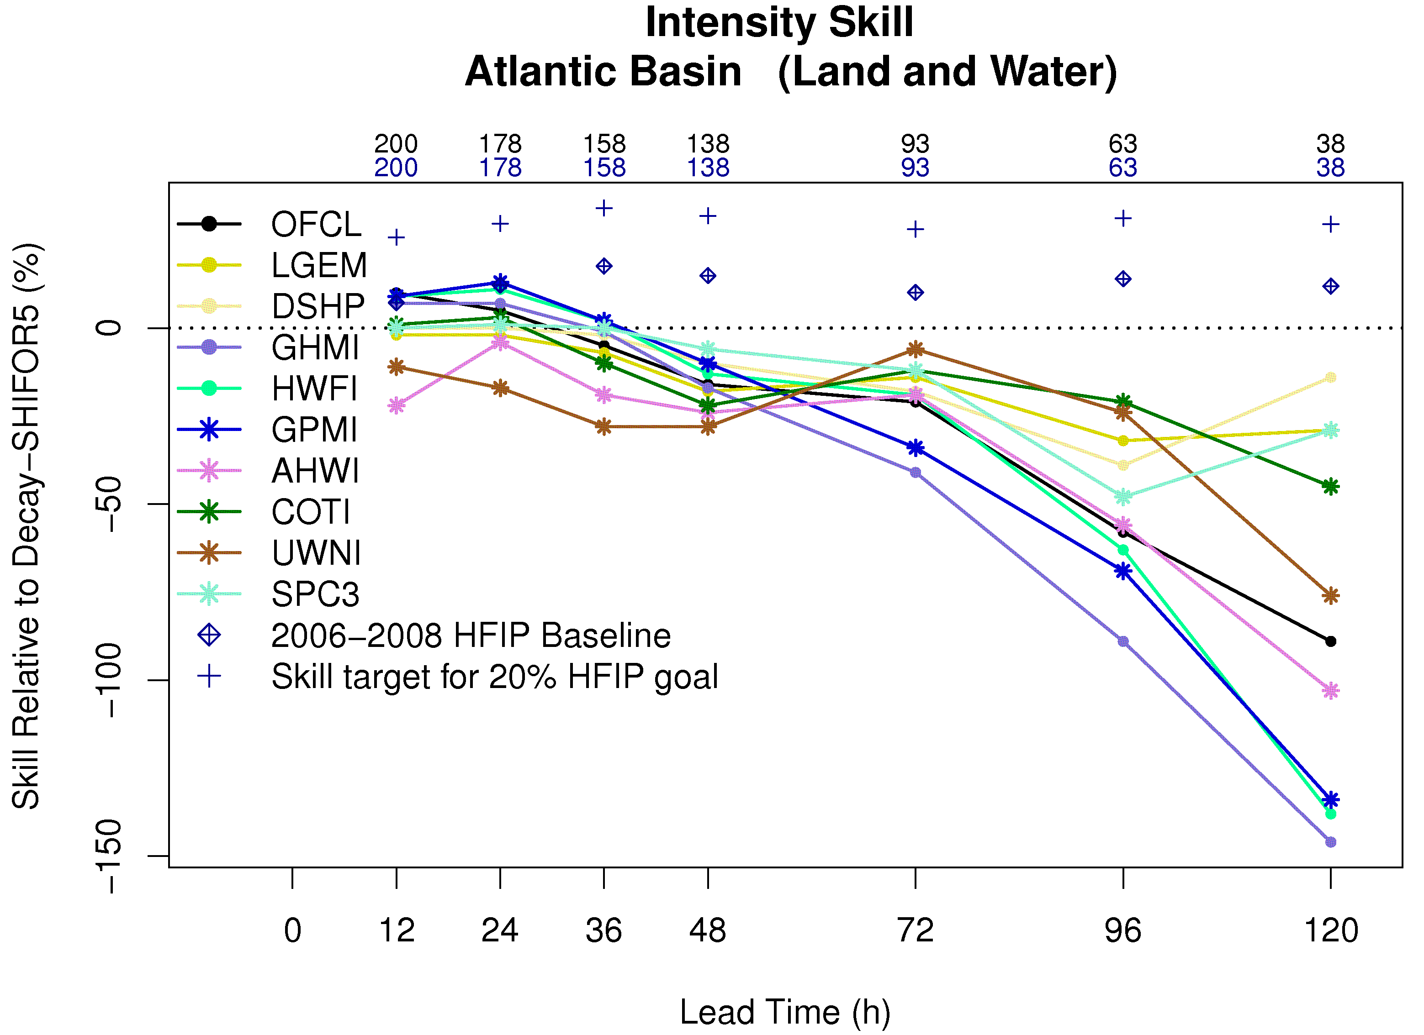
HFIP Diagnostic Activities and Plans TCMT
2012 HFIP Demonstration
Real-time track and intensity plots
Track: basin and storm-scale domains, 90th percentile ellipse plots
Case study and full sample evaluations
Stream 1, 1.5, 2, plus combinations
Development of storm and up-to-date season model performance verification
Development of diagnostic evaluation tools to compare model errors as a function of environmental conditions
Development of ensemble evaluation methods

