Slide 1
Impact of cumulus parameterization on motion, structure, intensity: preliminary results
Robert Fovell and Yizhe Peggy Bu
University of California, Los Angeles
Collaborators: Ligia Bernardet and Mrinal Kanti Biswas, DTC
9 August 2012
rfovell@ucla.edu

Slide 2
Background
Different model physics appears to encourage distinct symmetric and asymmetric structures that can influence storm motion and may provide means of validating, modifying model physics
Demonstrated in high-resolution, semi-idealized WRF-ARW simulations, varying MP and radiation schemes
HWRF 2011 radiation (based on old GFDL code) scheme has virtually no cloud-radiative interaction
http://www.hfip.org/documents/minutes/Track%20sensitivity%20to%20microphysics%20and%20radiation.pdf

Slide 3
Goals and technique
Goal #1: To determine if systematic biases exist in various cumulus parameterization (CP) schemes
Goal #2: To assess how well CP schemes work with microphysics (MP) and radiation assumptions
Technique: construct vortex-following composite fields and analyze differences among physics-based ensemble members, including PV analysis
Reminder: The PV equation diabatic heating (DH) term is based on gradients of diabatic heating (Q) and absolute vorticity (q), not Q or vertical velocity itself
Notes:
How and why different model physics results in different structures, motions, intensities

Slide 4
Experimental design
HWRF 2012 with additional cumulus parameterizations enabled (Ligia & Biswas, DTC)
  3 domains, ~27/9/3 km
CPs active in D1 and D2:
  SAS (HWRF default = HPHY)
  NSAS (cu_physics = 14)
  KF (cu_physics = 1)
  TIEDTKE (cu_physics = 6)
Radiation parameterizations:
  HWRF default (“old GFDL”)
  RRTM LW + Dudhia SW (RRTM)
Example case: Eugene (05E, 2011)
Notes:
No MP variation

Slide 5
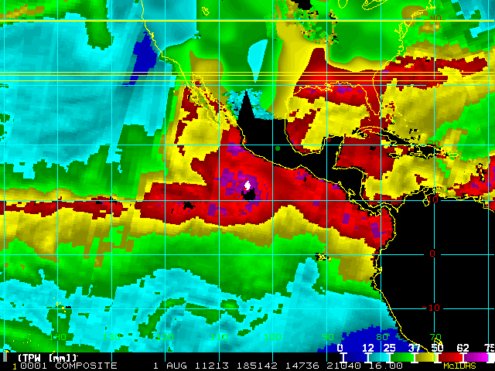
Eugene (05E, 2011) total precipitable water
http://rammb.cira.colostate.edu

Slide 6
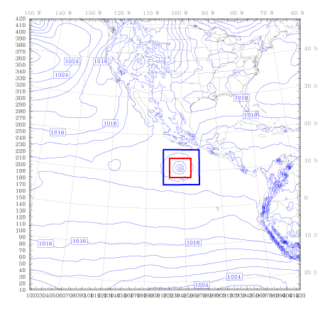
Initial grid arrangement
Initial SLP field: 2011073118
All of D1 shown

Slide 7
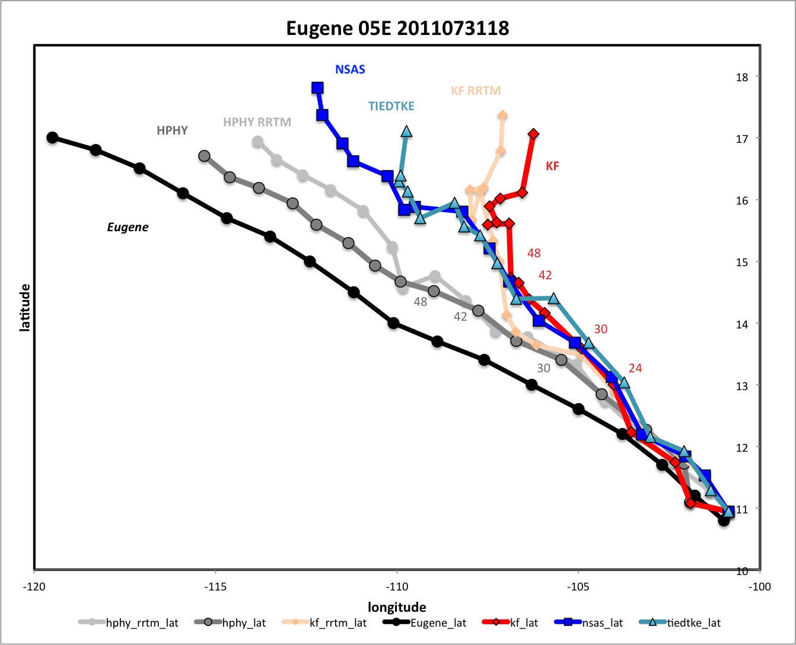
Notes:
All go to right
All are too slow
RRTM makes HPHY worse

Slide 8
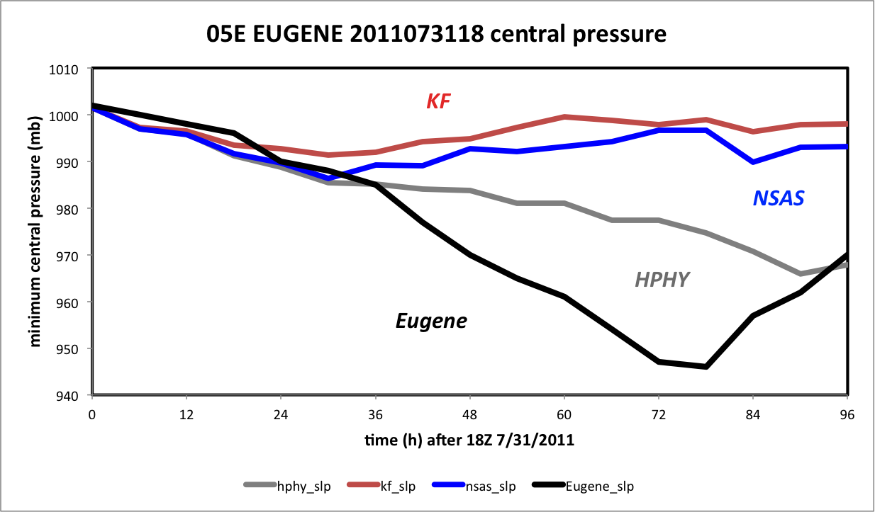
Minimum central pressure
(HWRF radiation runs)
Notes:
After 36 h, all fail to replicate observed deepening

Slide 9
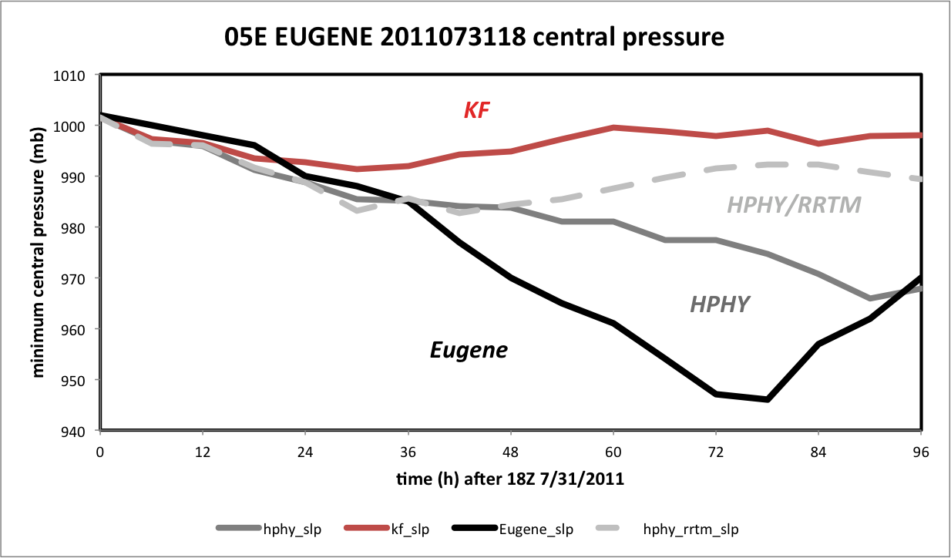
Minimum central pressure
(HPHY vs. HPHY/RRTM)
How much of the intensity error reflects position error?
Notes:
After 36 h, all fail to replicate observed deepening

Slide 10
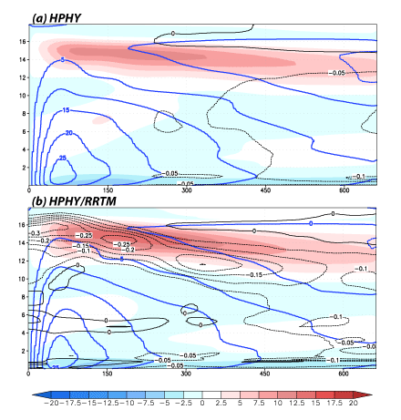
HPHY vs. HPHY/RRTM: 24-30h
colored: symmetric radial wind
contours (blue): symmetric tangential wind (5 m/s)
contours (black): LW radiative forcing (0.05 K/h)
18 km
• confirms radiative impact
of deep clouds still absent
in HWRF 2012 in default
radiation scheme
• caveat: storm is highly
asymmetric
661 km x 18 km

Slide 11
Questions
Why do differences with respect to CP scheme emerge so quickly when no CP is employed in the 3 km nest, D3?
Why does HPHY develop the hurricane (albeit too slowly) while the other schemes do not?
Why does KF, in particular, perform so poorly?
Why does RRTM radiation throttle development with HPHY?
Is RRTM handling Ferrier scheme condensed water mass correctly?
Preliminary answers to a few of these questions…
Notes:
Track diffs after 18h. Will show material differences emerge before that

Slide 12
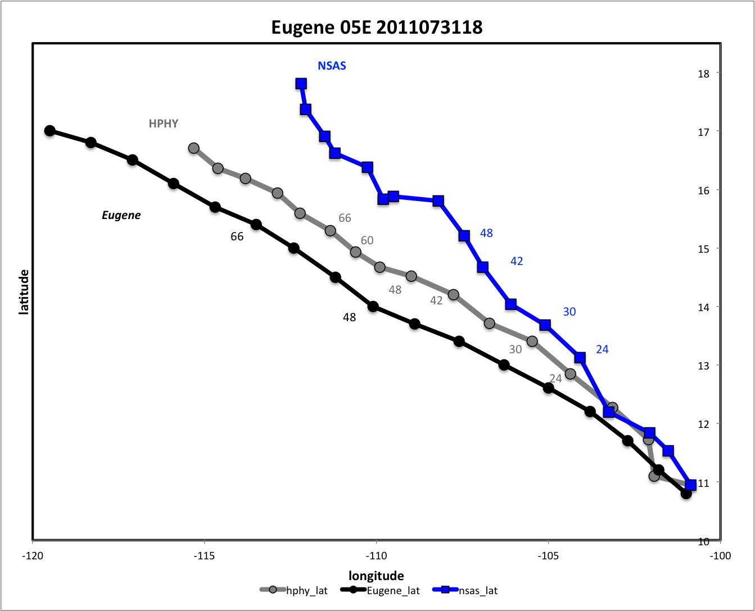
HPHY vs. NSAS

Slide 13
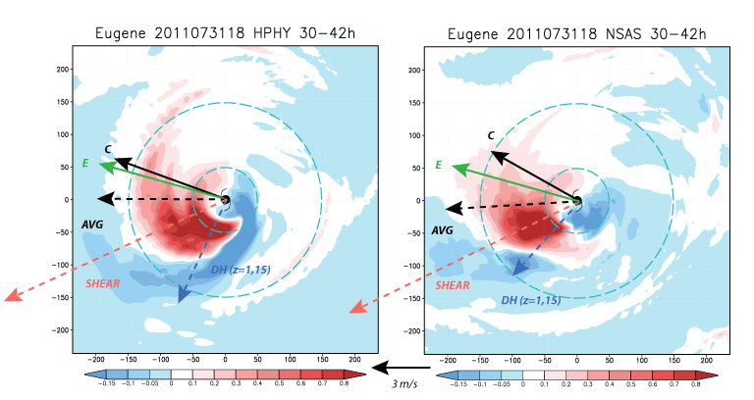
HPHY vs. NSAS: 30-42h colored: avg. vertical velocity sfc-5.4 km AGL storm motion vector C; actual storm motion E; low-level DH (sfc-2.8 km) average wind (0-600 km, 850-200mb) AVG vertical shear (300-500 km, 850-200 mb) SHEAR (~ 12.5 m/s or 24 kt)
480 km square portion of D3 shown
Shear is fairly large. Storms asymmetric w/ maximum convective activity downshear
Notes:
DH 90 degrees to left of storm motion in both cases. HPHY rotated cyclonically relative to NSAS

Slide 14
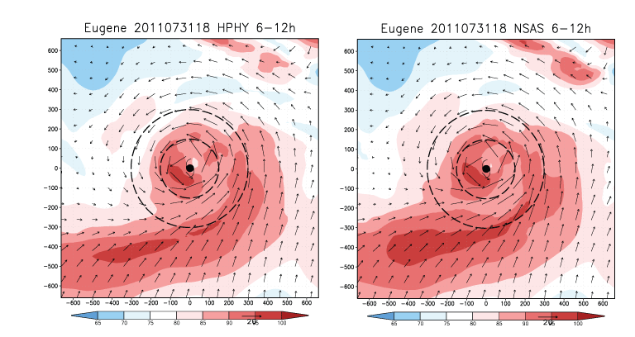
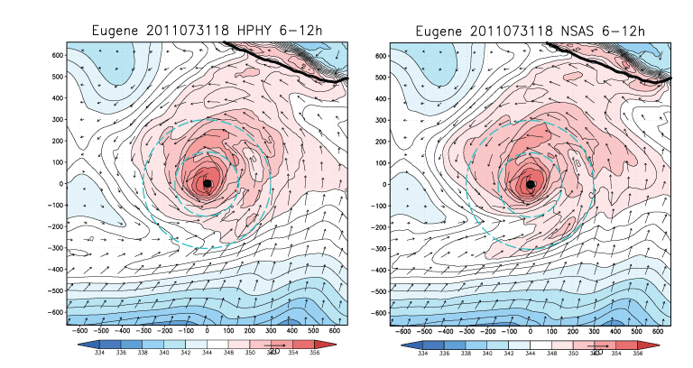
HPHY vs. NSAS: 6-12h colored: low-level avg. θ_{e} sfc-1.2 km AGL vectors: ground-relative avg. sfc-1.2 km AGL
Land
(Mexico)
1322 km square portion of D1 shown
Notes:
About 870 mb or so

Slide 15
HPHY vs. NSAS: 6-12h colored: low-level avg. RH sfc-1.2 km vectors: ground-relative avg. sfc-1.2 km
1322 km square portion of D1 shown

Slide 16
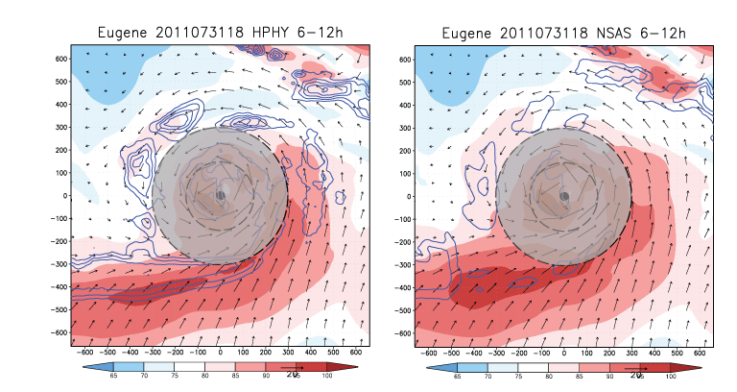
HPHY vs. NSAS: 6-12h colored: low-level avg. RH sfc-1.2 km vectors: ground-relative avg. sfc-1.2 km contours: column sum instantaneous cumulus heating (7.5 K/h)
~D3
~D3
Extra cumulus heating
Nest boundary physics transition issue apparent
Ignore grey area – nest communication issue

Slide 17
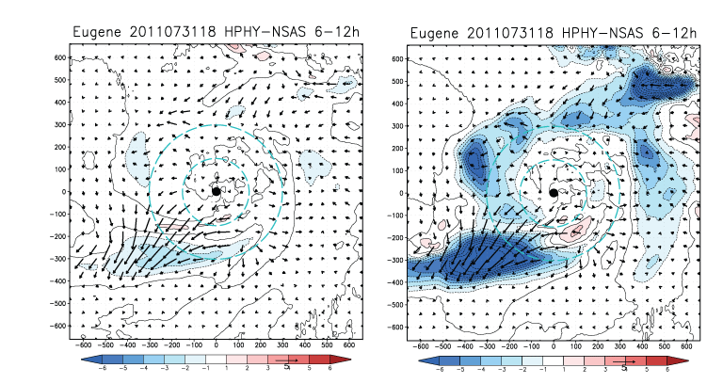
HPHY-NSAS differences: 6-12h colored: low-level avg. ∆θ_{e} (left), ∆RH (right) sfc-1.2 km vectors: ground-relative avg. vector wind difference sfc-1.2 km
5 m/s
Nest boundary physics transition issue apparent
Notes:
Note RH diffs appear to surround a nest boundary

Slide 18
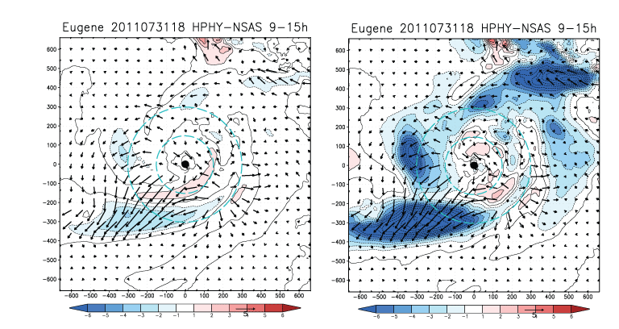
HPHY-NSAS differences: 9-15h colored: low-level avg. ∆θ_{e} (left), ∆RH (right) sfc-1.2 km vectors: ground-relative avg. vector wind difference sfc-1.2 km
5 m/s
1322 km square portion of D1 shown
Notes:
Note RH diffs appear to surround a nest boundary

Slide 19
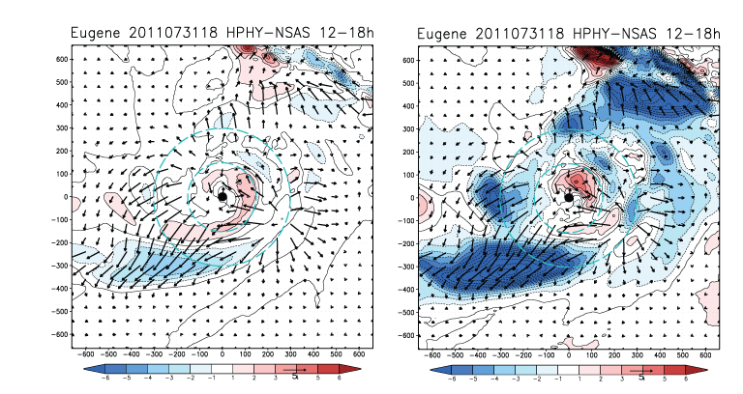
HPHY-NSAS differences: 12-18h colored: low-level avg. ∆θ_{e} (left), ∆RH (right) sfc-1.2 km vectors: ground-relative avg. vector wind difference sfc-1.2 km
5 m/s
Easterly wind differences west and east of TC
Notes:
Note RH diffs appear to surround a nest boundary

Slide 20
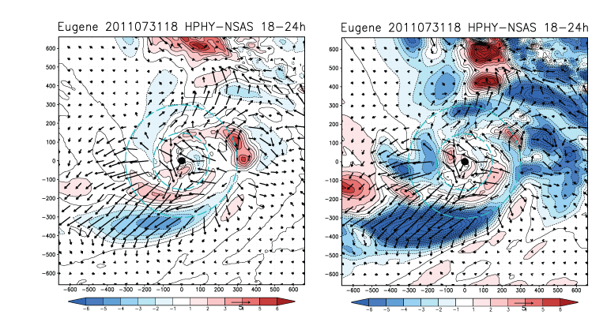
HPHY-NSAS differences: 18-24h colored: low-level avg. ∆θ_{e} (left), ∆RH (right) sfc-1.2 km vectors: ground-relative avg. vector wind difference sfc-1.2 km
5 m/s
HPHY has low-level easterly anomaly across vortex relative to NSAS
Systematic track variation apparent after this time
Notes:
Note RH diffs appear to surround a nest boundary

Slide 21
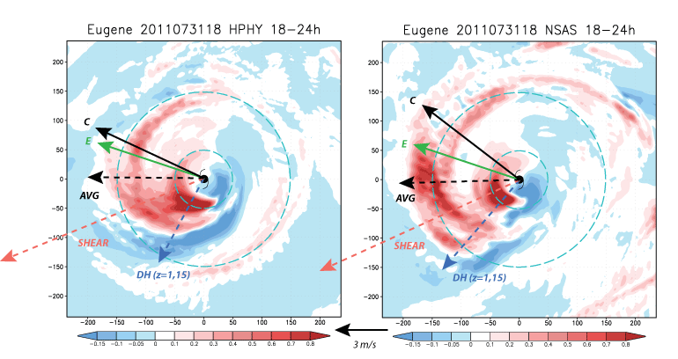
HPHY vs. NSAS: 18-24h colored: avg. vertical velocity sfc-5.4 km storm motion vector C; actual storm motion E; low-level DH average wind (0-600 km, 850-200mb) AVG vertical shear (300-500 km, 850-200 mb) SHEAR
Little impact on average wind or shear
Direct, indirect or no influence?
Notes:
Direct impact – give vortex larger westward component
Indirect impact – influence convergence, location & mag of convective activity

Slide 22
HPHY vs. NSAS

Slide 23
Minimum central pressure
Does NSAS, KF development failure represent position error, and/or something else?
Notes:
After 24h, direction divergence AND divergence wrt min SLP

Slide 24
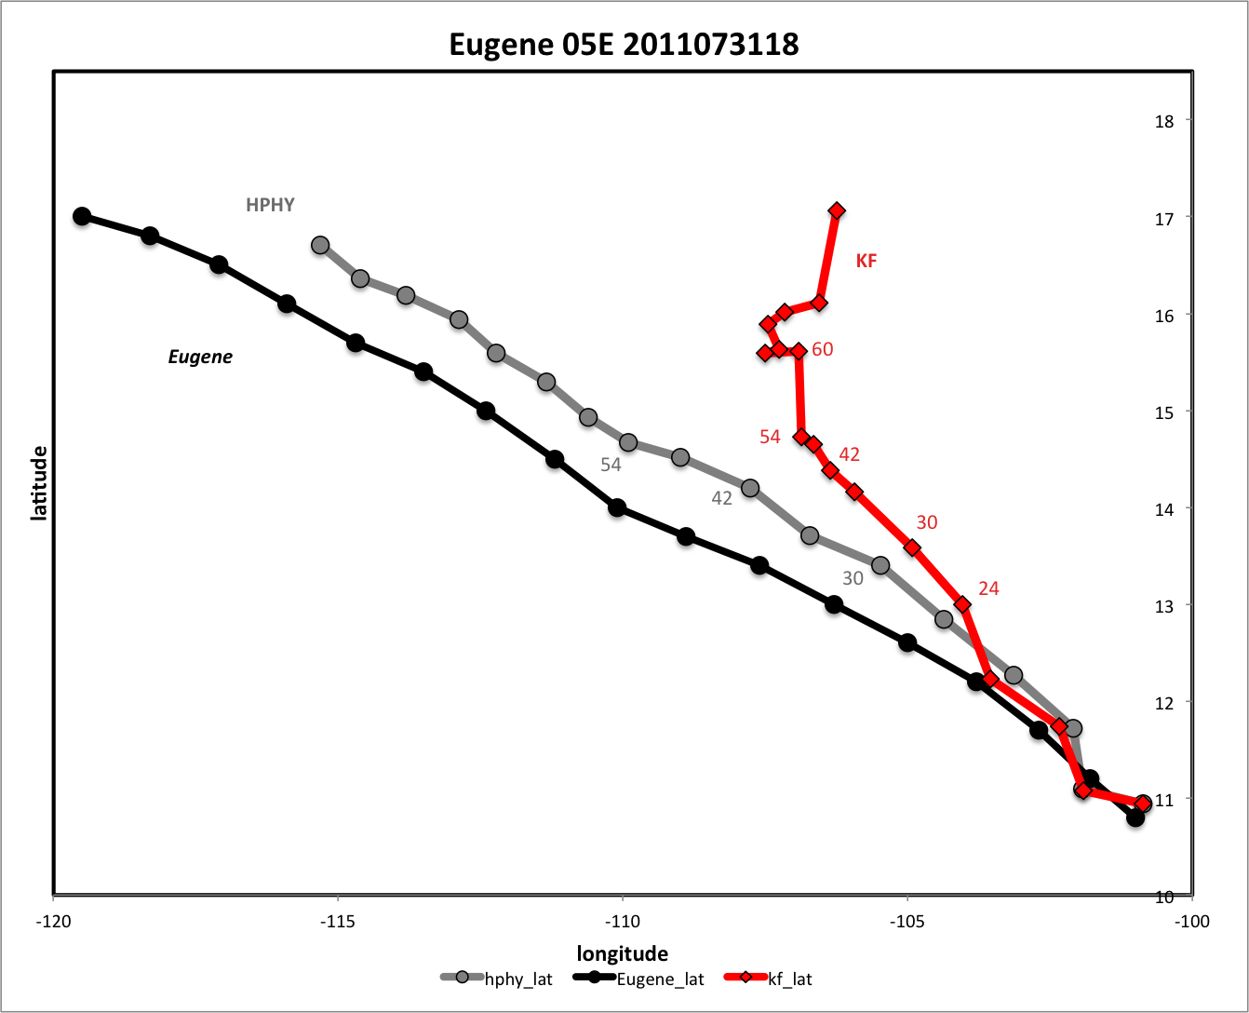
KF slows after 36h
…stalls at 48h
…turns at 54h
HPHY vs. KF

Slide 25
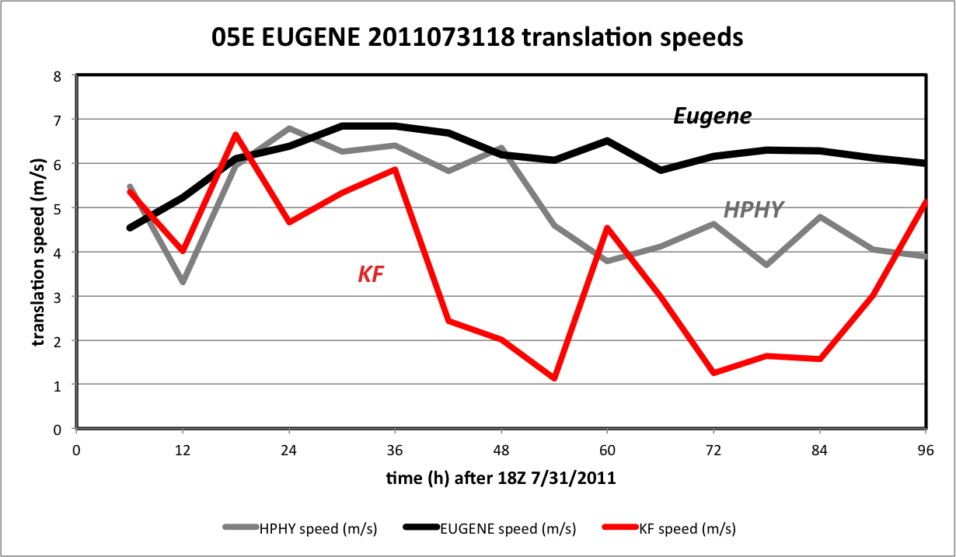
Translation speeds
Eugene
HPHY
KF

Slide 26
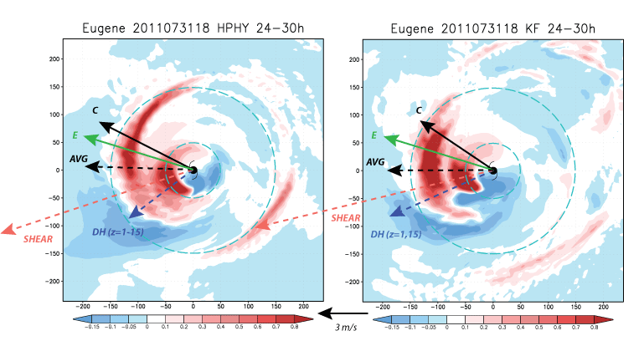
HPHY vs. KF: 24-30h
colored: avg. vertical velocity sfc-5.4 km
storm motion vector C; actual storm motion E; low-level DH
average wind (0-600 km, 850-200mb) AVG
vertical shear (300-500 km, 850-200 mb) SHEAR
480 km square portion of D3 shown

Slide 27
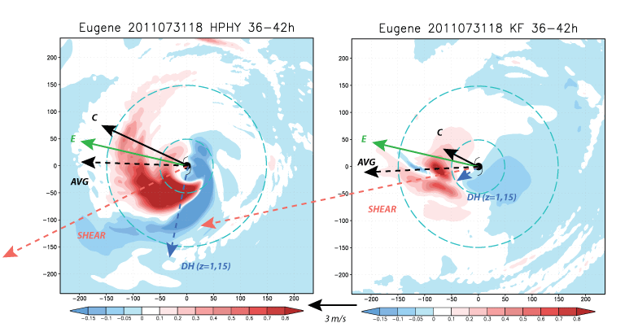
HPHY vs. KF: 36-42h
colored: avg. vertical velocity sfc-5.4 km
storm motion vector C; actual storm motion E; low-level DH
average wind (0-600 km, 850-200mb) AVG
vertical shear (300-500 km, 850-200 mb) SHEAR
Downshear tilt of KF vortex complicates shear calculation

Slide 28
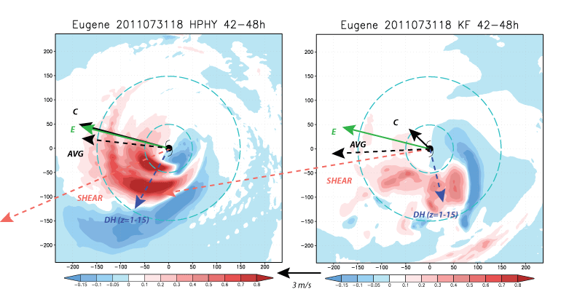
HPHY vs. KF: 42-48h
colored: avg. vertical velocity sfc-5.4 km
storm motion vector C; actual storm motion E; low-level DH
average wind (0-600 km, 850-200mb) AVG
vertical shear (300-500 km, 850-200 mb) SHEAR
Downshear tilt of KF vortex complicates shear calculation

Slide 29
ARW version
WRF-ARW v. 3.3, 3.4
  27/9/3 km (but C-grid, Mercator, 51 levels)
  Stock model (no TC-specific physics)
  D2, D3 are moving nests
  D2, D3 sized as in HWRF 2012 (but D1 smaller)
  KF with Lin (mp = 2) and Ferrier (mp = 5) microphysics
Caveats
  GFS initialization w/o modification in ARW
  Ferrier (ARW) ≠ tropical Ferrier (HWRF)
  RRTM radiation (ARW) vs. HWRF radiation (“old GFDL”)
  Other ARW-HWRF physics differences

Slide 30
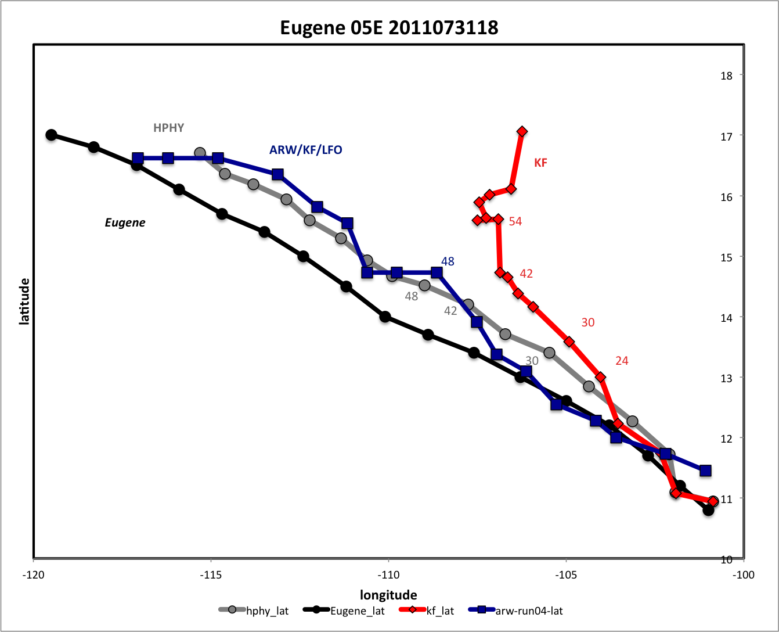

KF slows after 36h
…stalls at 48h
…turns at 54h
HPHY vs. KF
with ARW/KF/LFO

Slide 31
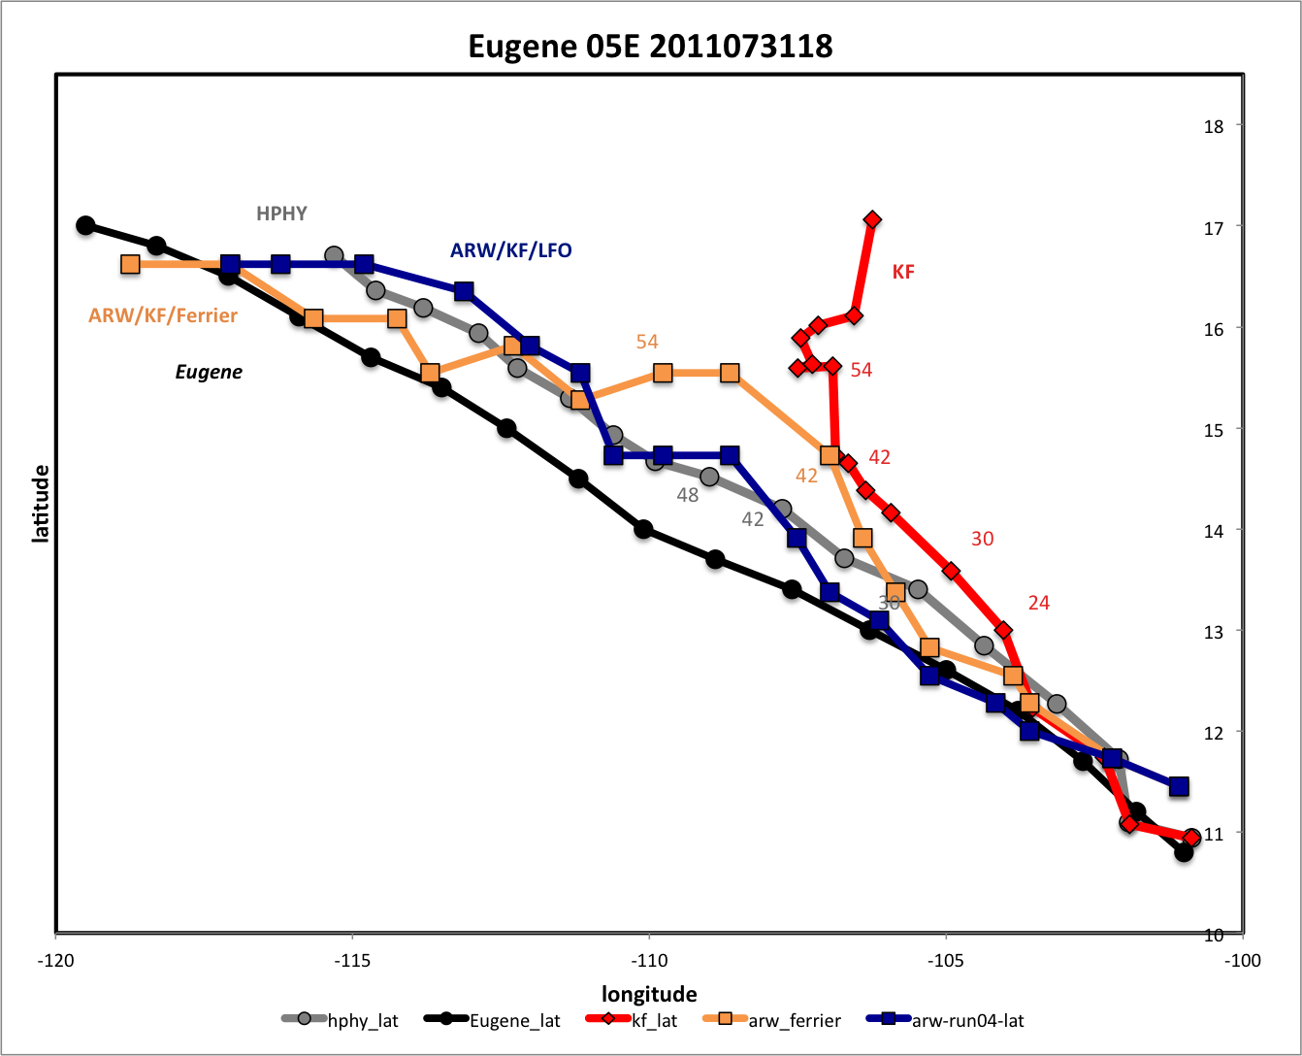
KF slows after 36h
…stalls at 48h
…turns at 54h
HPHY vs. KF
…and ARW/KF/Ferrier

Slide 32
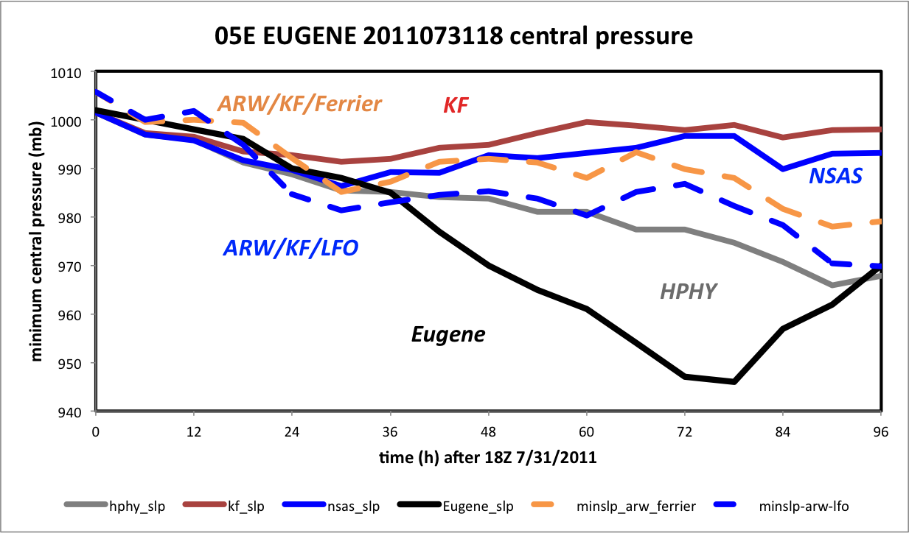
Minimum central pressure
(with ARW runs added)

Slide 33
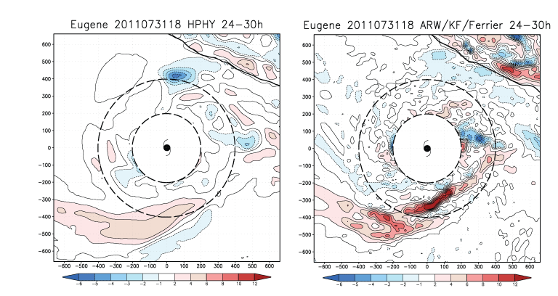
HPHY vs. ARW/KF/Ferrier: 24-30h colored: low-level avg. vertical velocity, sfc-1.2 km AGL (cm/s)
[Region inside radius = 200 km masked out]
Land
(Mexico)
cm/s
1322 km square portion of D1 shown
HWRF/HPHY fields are much smoother, and vertical velocities much weaker
Notes:
Note RH diffs appear to surround a nest boundary

Slide 34
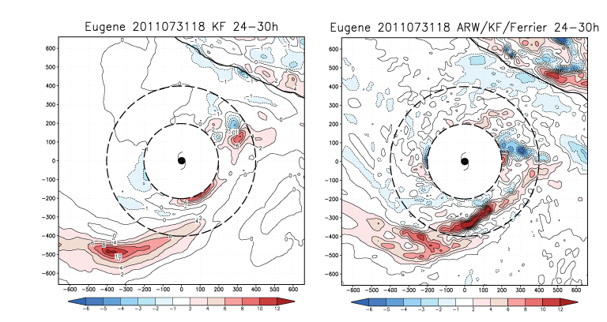
KW vs. ARW/KF/Ferrier: 24-30h colored: low-level avg. vertical velocity, sfc-1.2 km
[Region inside radius = 200 km masked out]
Land
(Mexico)
1322 km square portion of D1 shown
Part of HWRF’s smoothness reflects its convective scheme
Notes:
Note RH diffs appear to surround a nest boundary

Slide 35
Future plans
Expand analysis to other storms and additional start times
Create alternate versions of the Ferrier MP scheme?

