Slide 1
HWRF Model Diagnostics: Priorities, Activities and Needs
Vijay Tallapragada & HWRF Team
Environmental Modeling Center, NCEP/NOAA/NWS,
Camp Springs, MD 20746.
Acknowledgements:
Chanh Kieu, Young Kwon, Zhan Zhang, Weiguo Wang, Qingfu Liu, In-Hyuk Kwon, Mingjing Tong, Hyun-Sook Kim and Stanley Goldenberg (HRD)
HFIP Diagnostics Workshop,
August 10, 2012
Notes:
1
1

Slide 2
Outline
Performance of Operational HWRF
Ongoing activities
Real-Time Parallels; Model development and Physics; Vortex initialization and Data Assimilation
Diagnostic efforts at EMC:
Evaluation of operational and ongoing experimental HWRF runs - Vijay and Chanh
Structure diagnostics and relationship to intensity change - In-Hyuk
Large-Scale diagnostics and radiation– Chanh
PBL diagnostics – Weiguo
Ocean diagnostics - Hyun-Sook
Basin-scale diagnostics - Zhan and Weiguo
Initialization diagnostics - Qingfu and In-Hyuk
Model output diagnostics and troubleshooting – Young
Collaborative efforts
FY2013 Priorities and Needs

Slide 3
Status of FY12 Diagnostics Tasks Supported by HFIP
Task | Status | Remarks
Provide real-time HWRF model-derived satellite imagery products | Completed, Implemented in FY12 | SSM/I-S , GOES-E, GOES-W and MTSAT
Provide real-time high temporal resolution HWRF track/ intensity/ structure diagnostic products | Completed, Implemented in FY12 | NHC taking lead role in utilizing HTCF products
Evaluation of synthetic imagery using observed satellite products | Ongoing | Collaboration with CIRA/NESDIS and HRD
Development of diagnostic code and verification for pre-implementation T&E and for operational HWRF | Completed, produced in real-time for FY12 HWRF | Collaboration with CIRA/NESDIS
Verification of Environmental Parameters from diagnostic files | Ongoing | Collaboration with DTC and SUNY
Ensemble-based sensitivity analysis for initialization diagnostics | Ongoing | Collaboration with SUNY
Diagnostic post-processing in storm relative framework (tangential, radial, R-Z mean) and area averaged quantities. | Completed, produced in real-time for FY12 HWRF | Collaboration with HRD

Slide 4
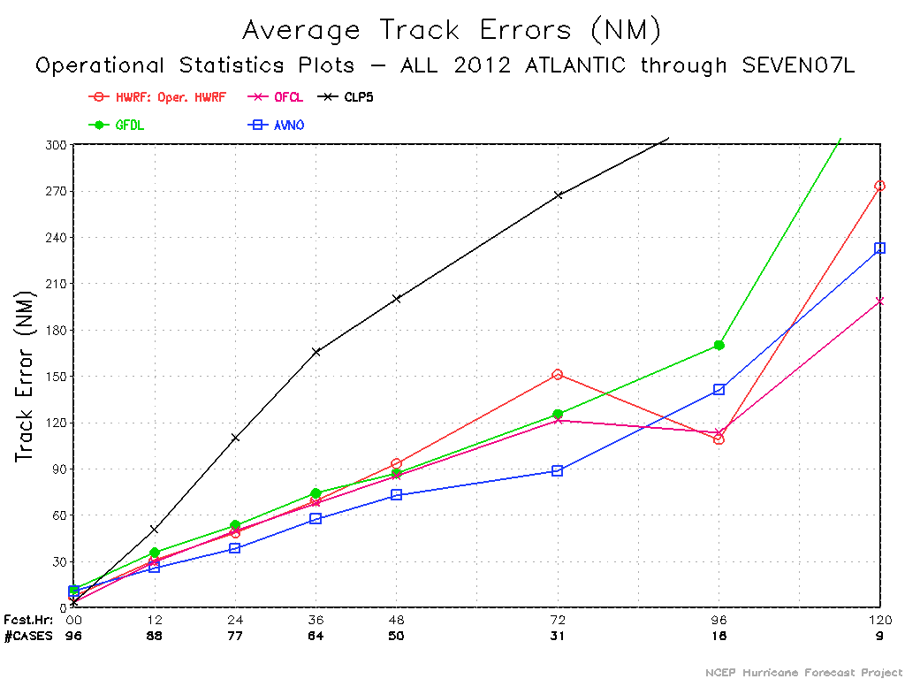
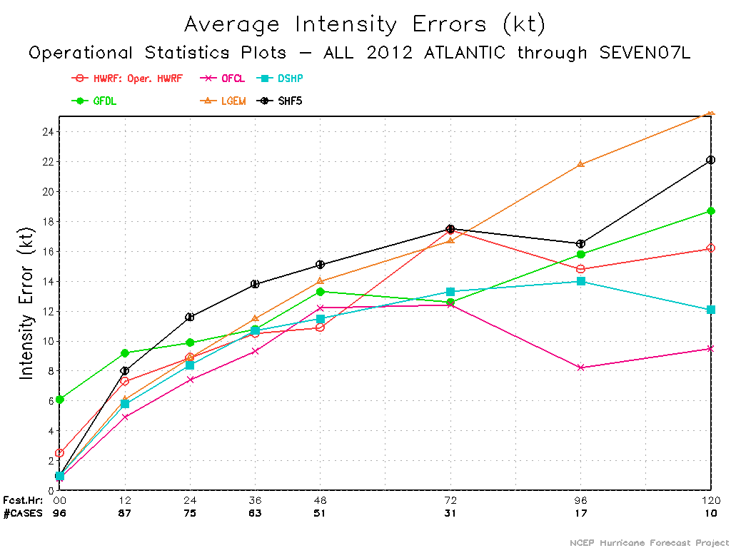
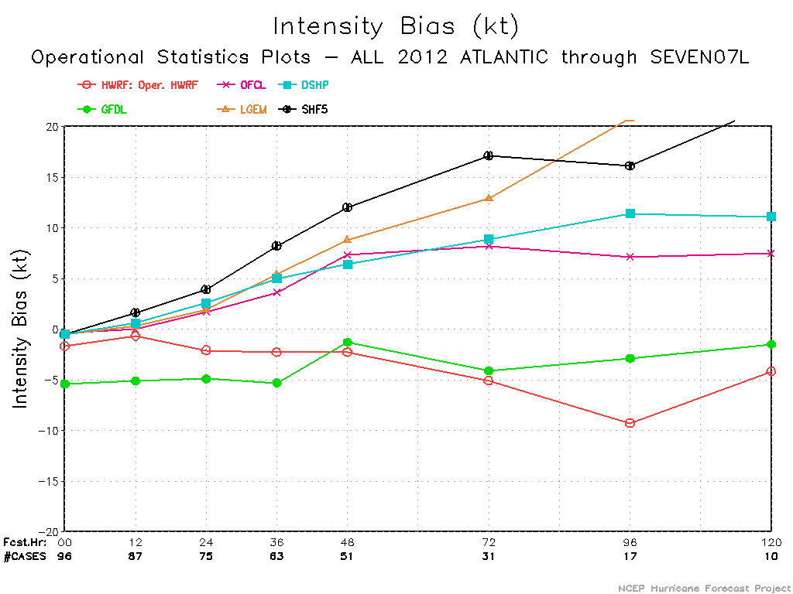
Performance of Operational HWRF – 2012 ATL

Slide 5
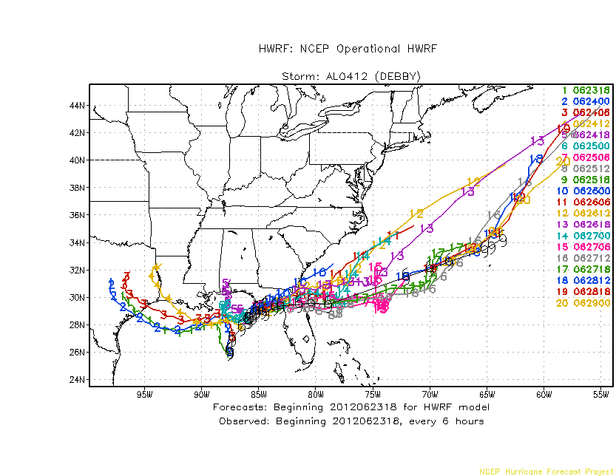
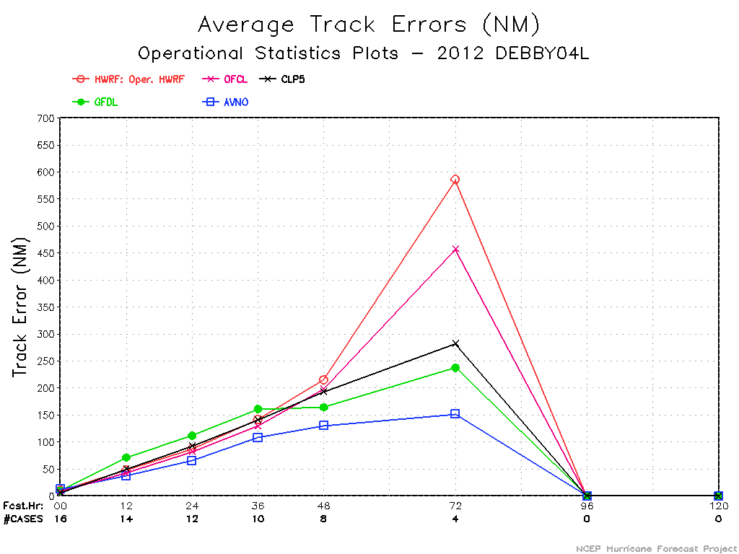
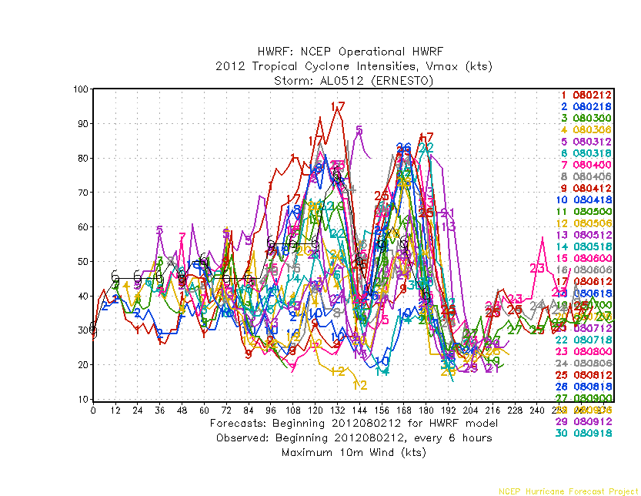
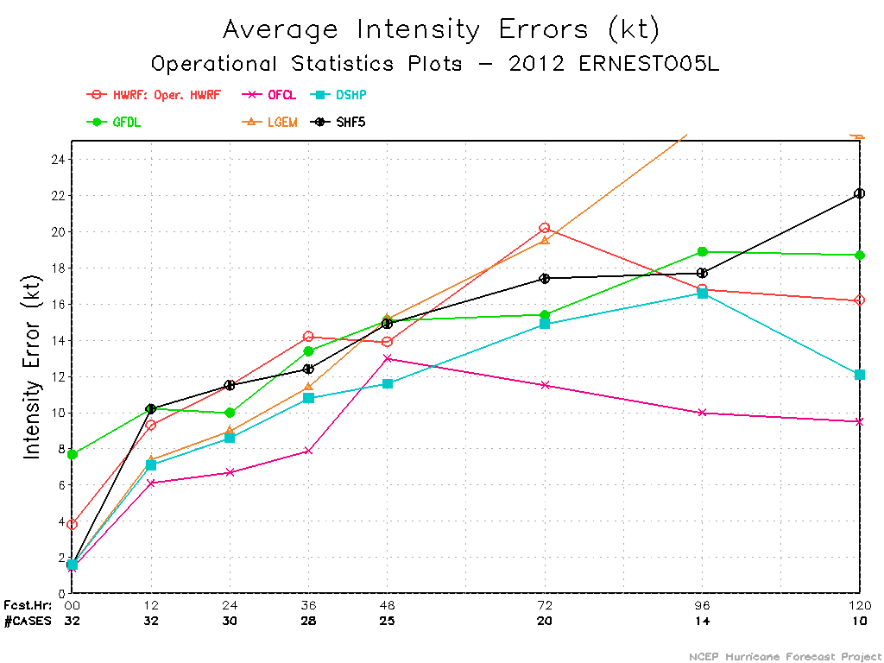

Slide 6
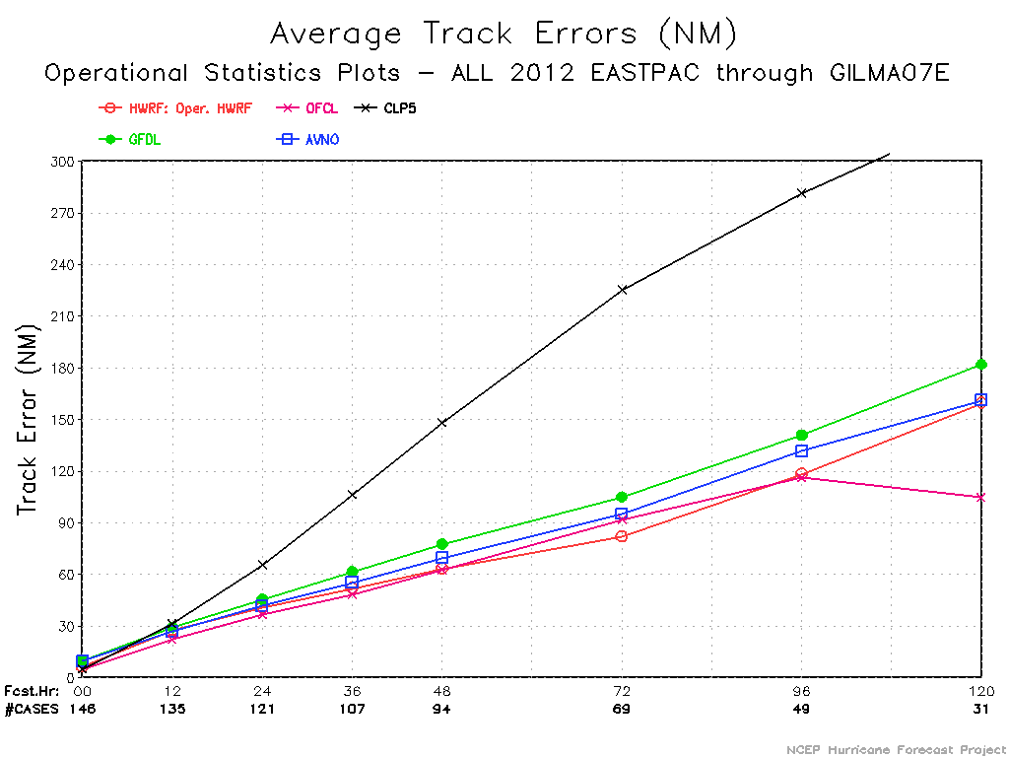
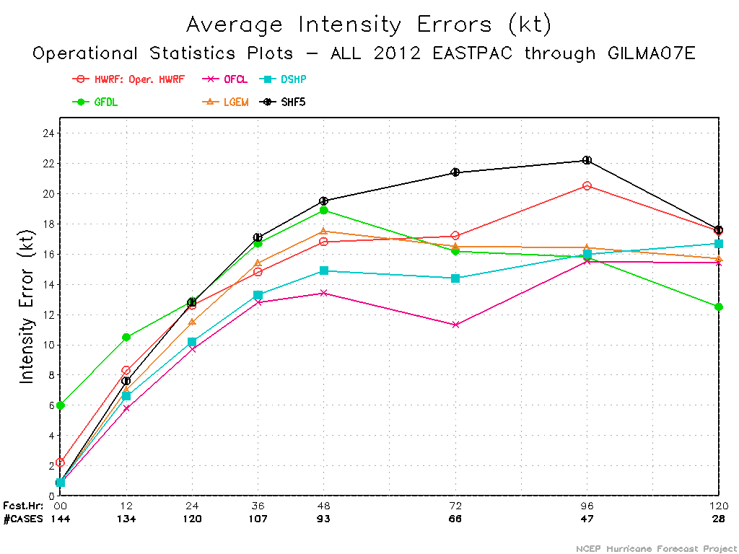
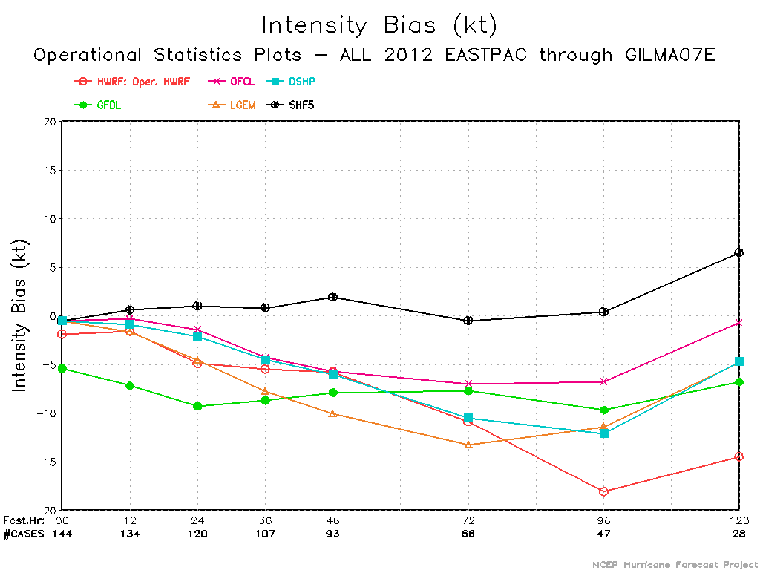
Performance of Operational HWRF – 2012 E-PAC
Reasonable track performance in both ATL and EPAC
Intensity Errors and Negative Bias are major issues.

Slide 7
Verification of the operational HWRF vs various Real-Time parallel experiments for Atlantic/E-Pac

Slide 8
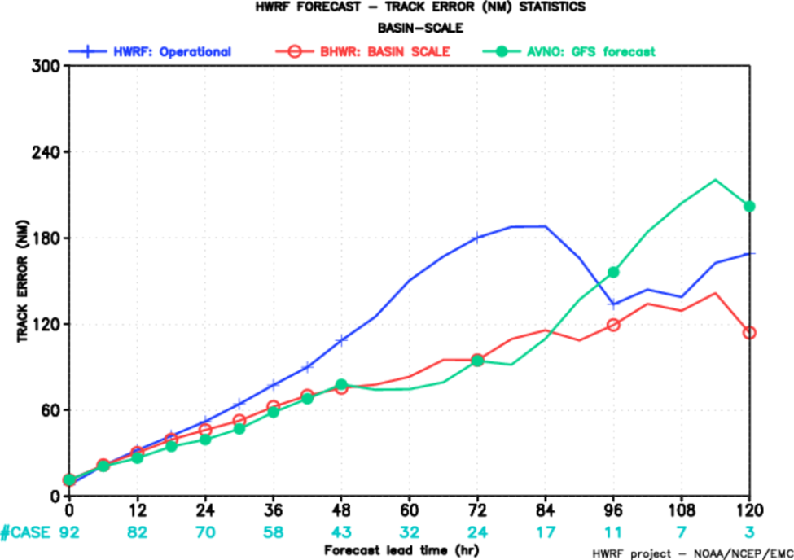
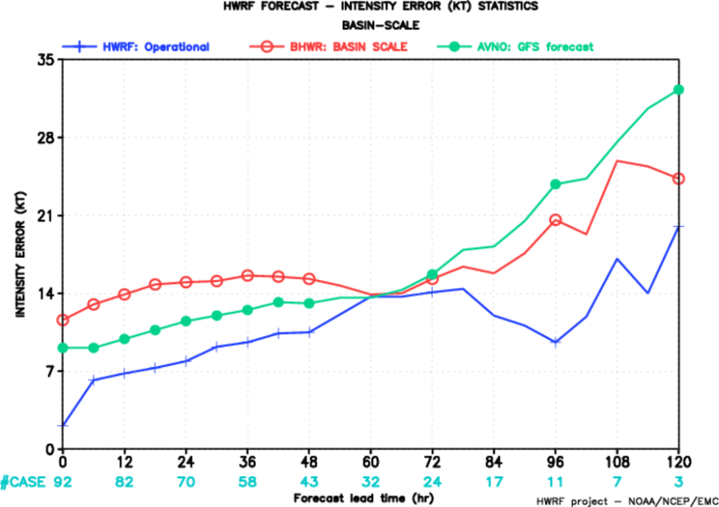
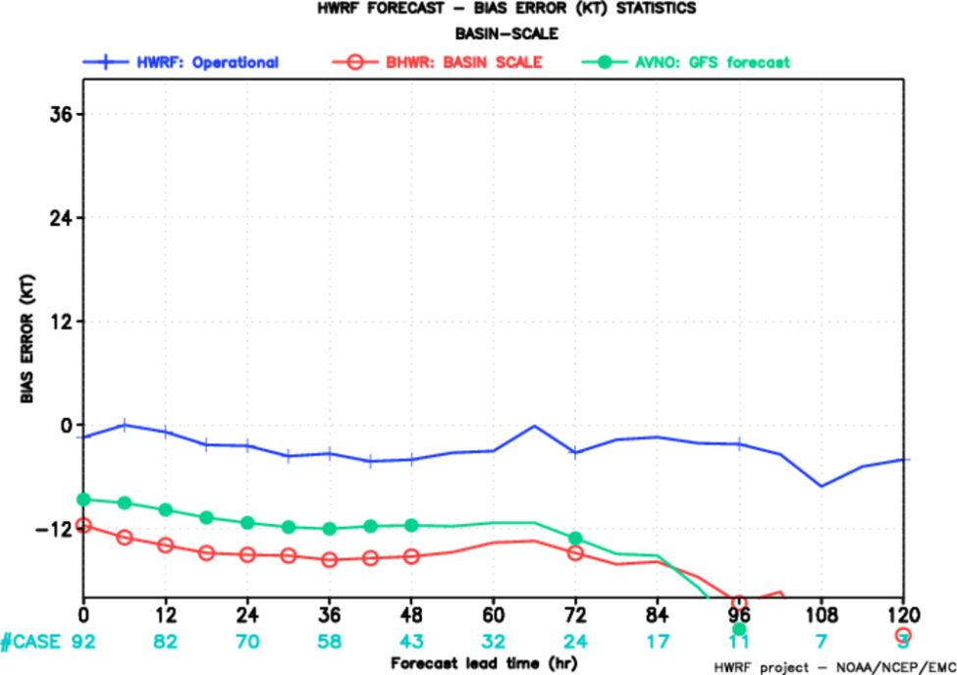
Basin scale (BHWR) verification for Atlantic 2012
Track
Intensity
No westward turn for Debby
Bias
Intensity errors worse than global models
Higher negative bias – physics not suitable for coarser domain at 27 km???

Slide 9
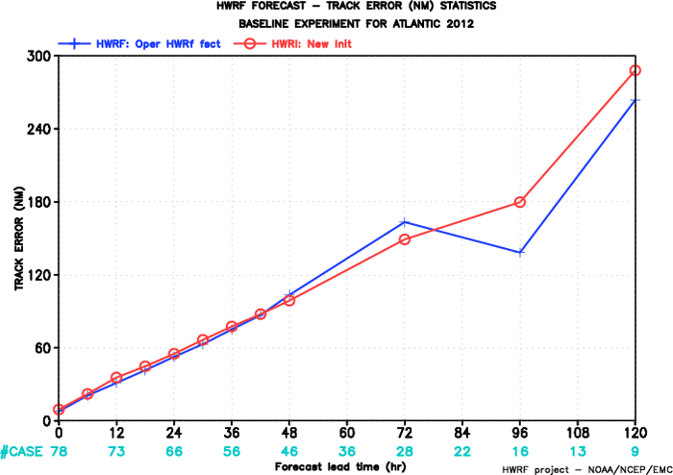
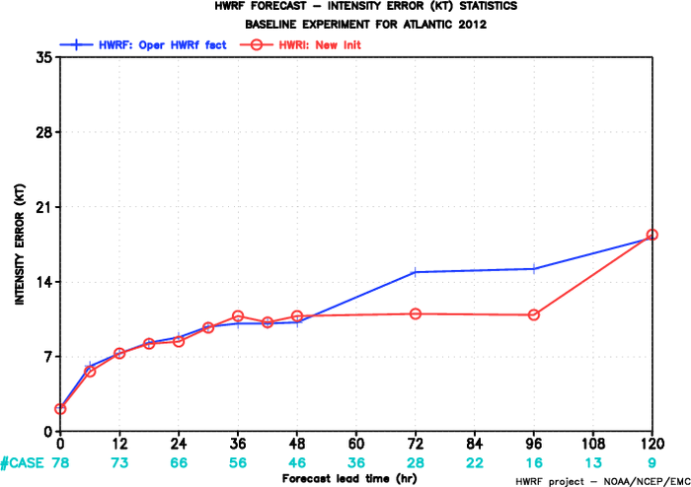
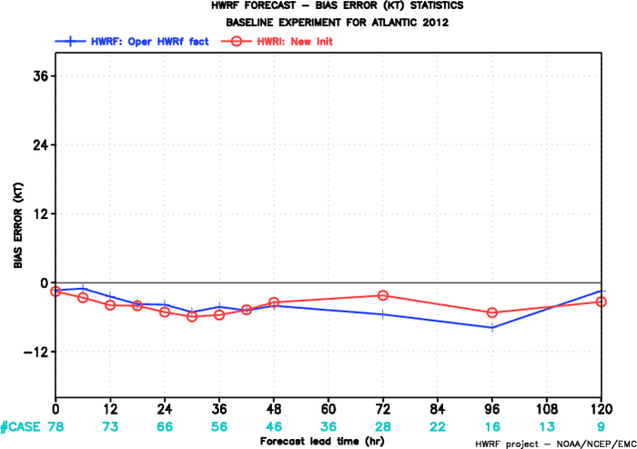
New Initialization experiment (HWRI) – Atlantic 2012
Track
Intensity
Bias
Similar performance compared to operational HWRF

Slide 10
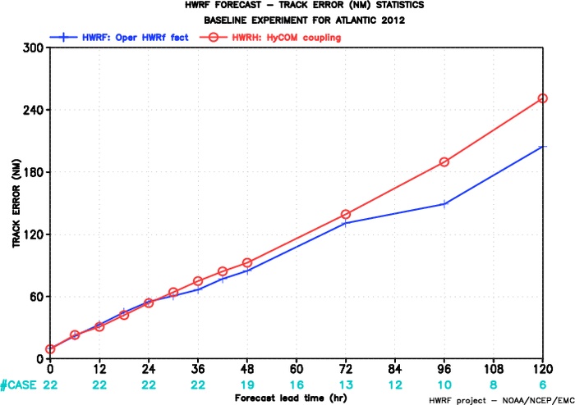
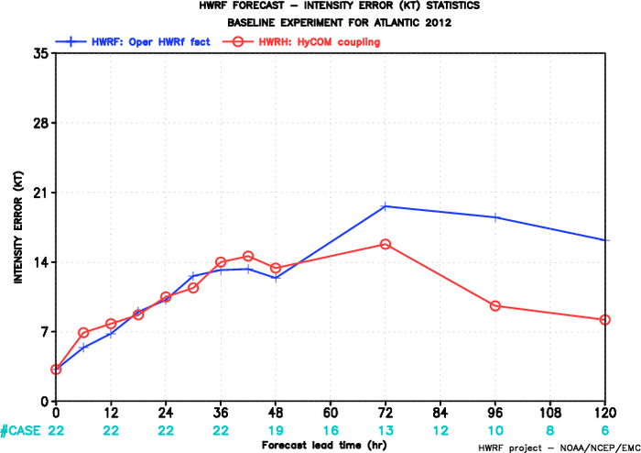
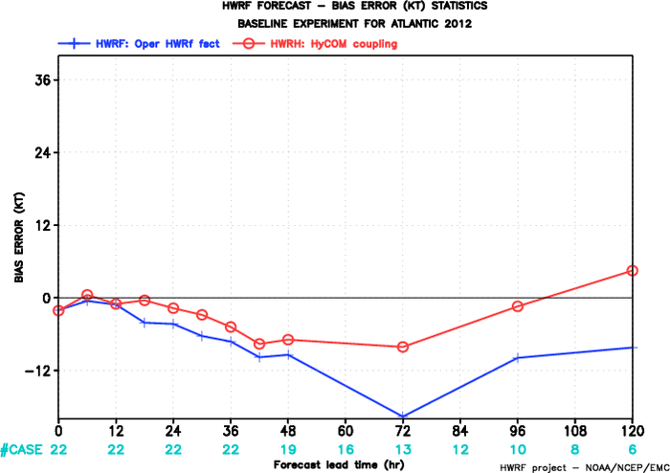
HYCOM coupling experiment (HWRH)- Atlantic 2012
Track
Intensity
Bias
Coupling to HYCOM showed improvements in intensity
Smaller sample size

Slide 11
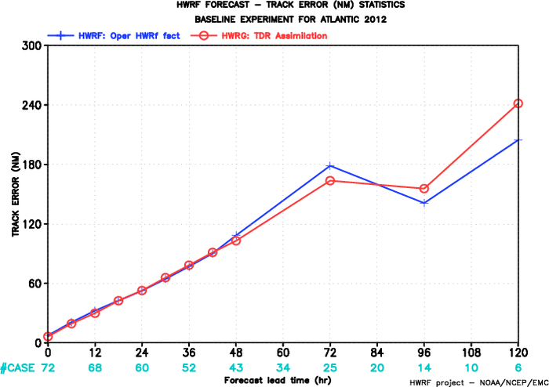
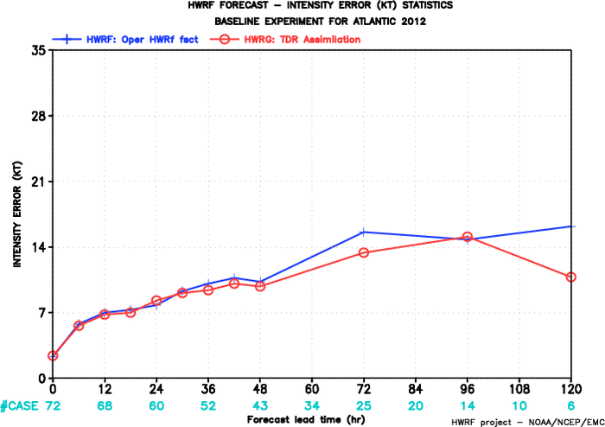
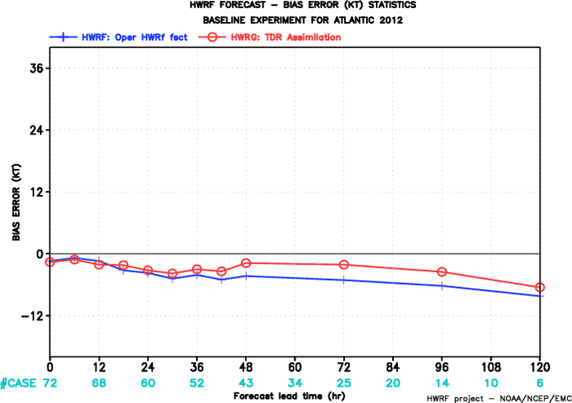
TDR assimilation experiment (HWRG)- Atlantic 2012
Track
Intensity
Bias
No real-time aircraft data available yet.

Slide 12
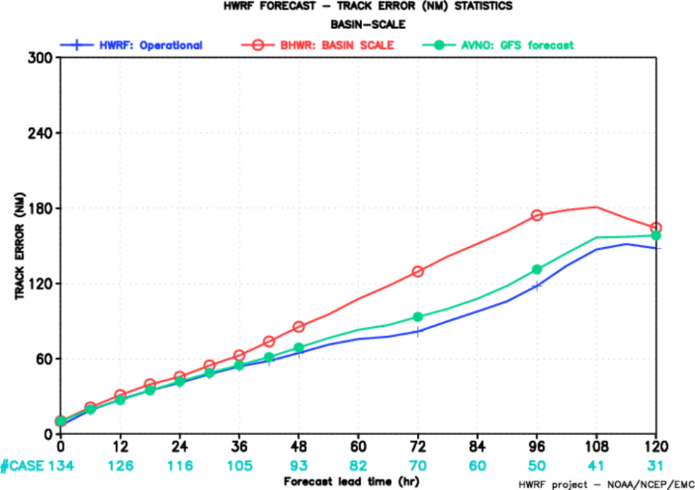
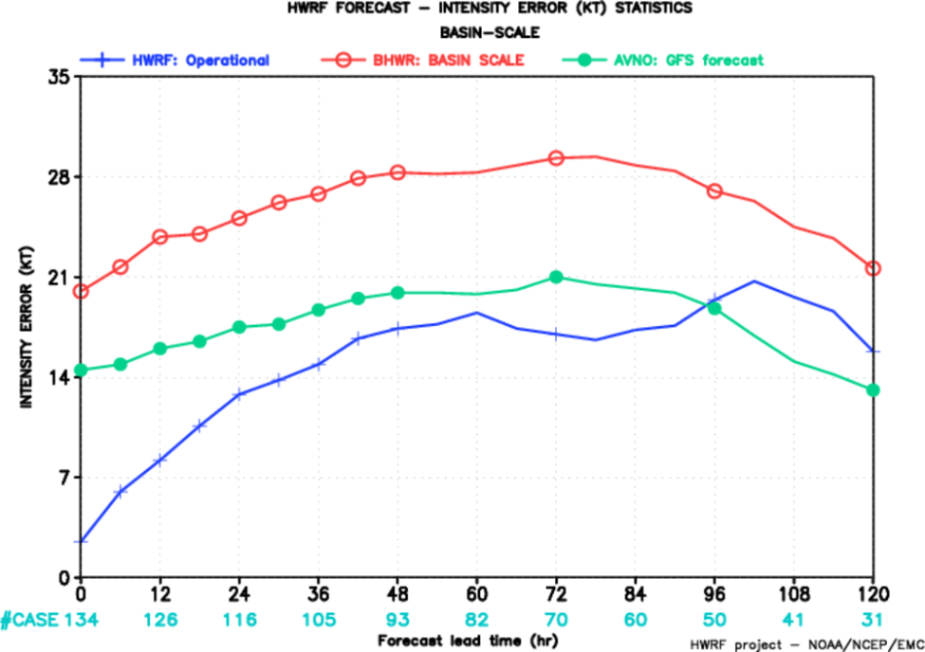
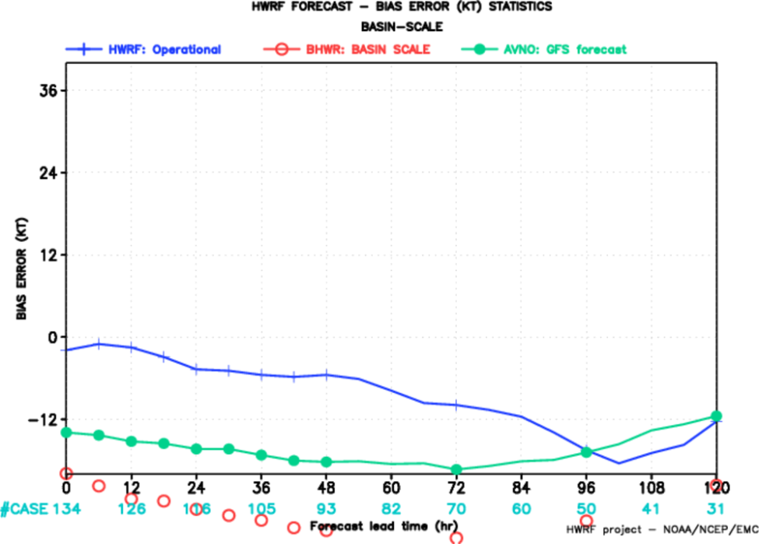
Basin scale (BHWR) verification for EPAC 2012
Track
Intensity
Bias
Intensity errors worse than global models
Track skill not as good
Huge negative bias

Slide 13
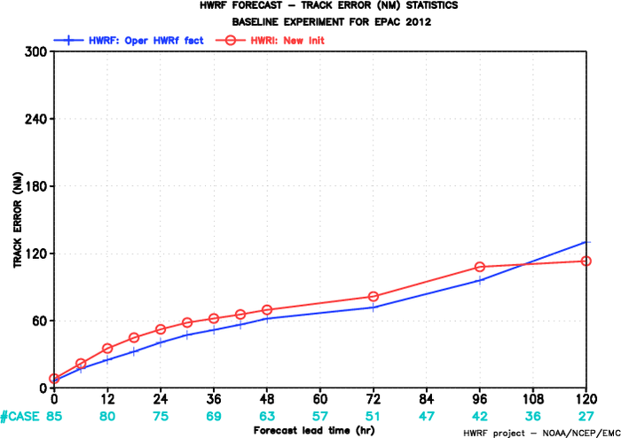
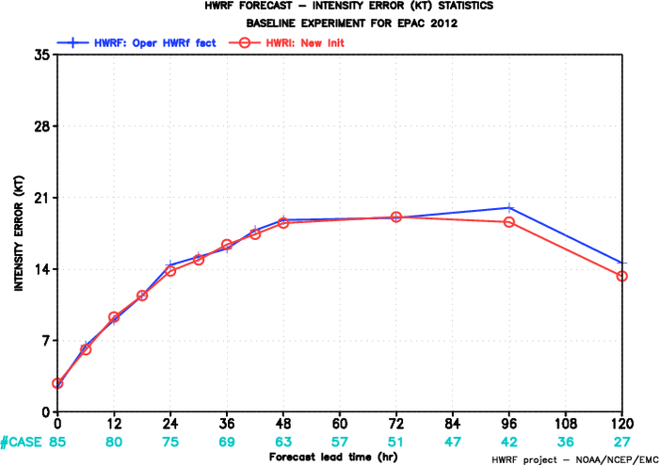
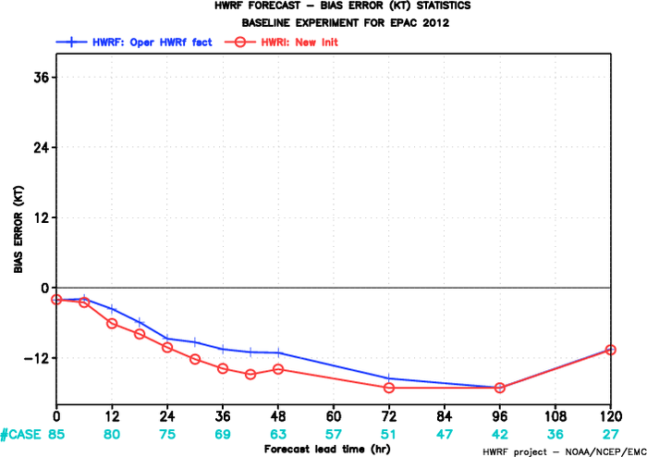
New Initialization experiment (HWRI) – E-Pac 2012
Track
Intensity
Bias
Similar performance compared to operational HWRF

Slide 14
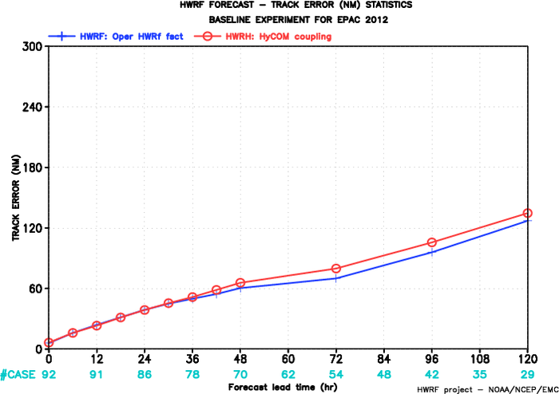
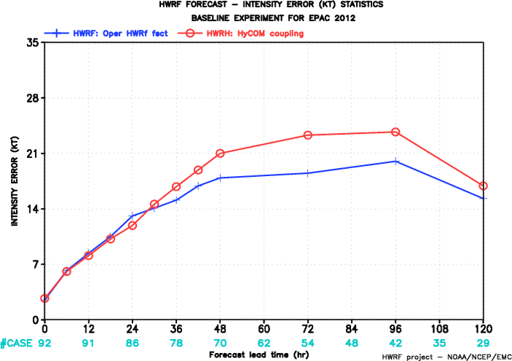
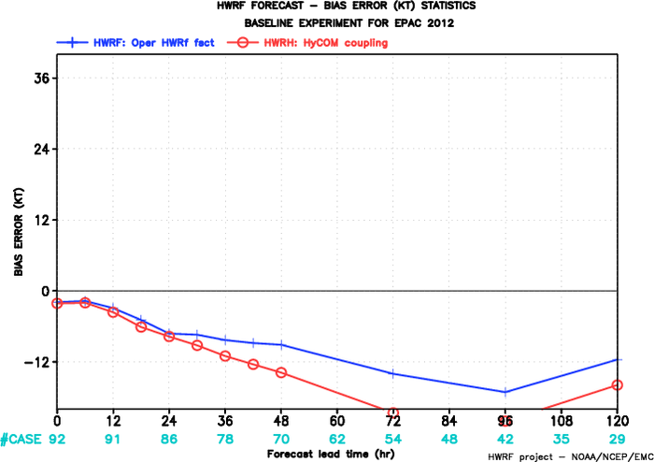
HYCOM coupling experiment (HWRH)- E-Pac 2012
Track
Intensity
Bias
No real gains from HYCOM coupling in E-Pac
Increased negative bias

Slide 15
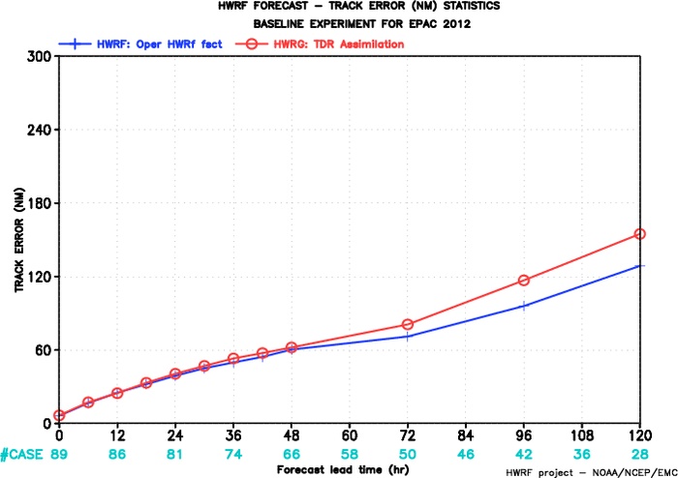
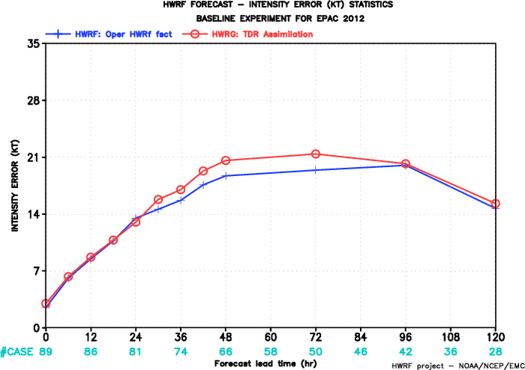
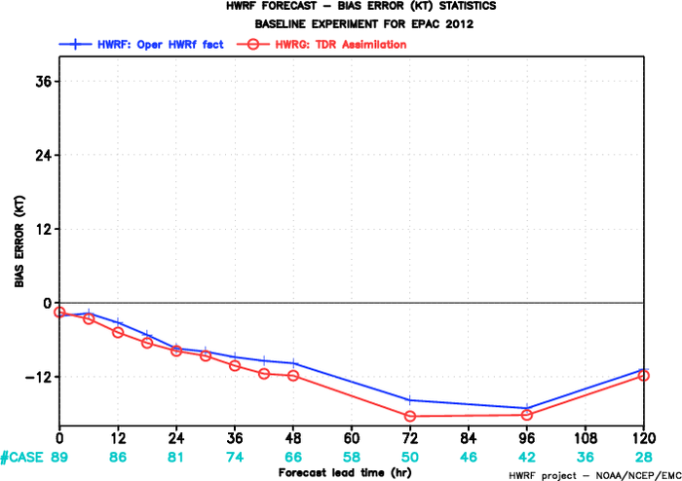
TDR assimilation experiment (HWRG)- E-Pac2012
Intensity
Track
Bias
No real-time aircraft data

Slide 16
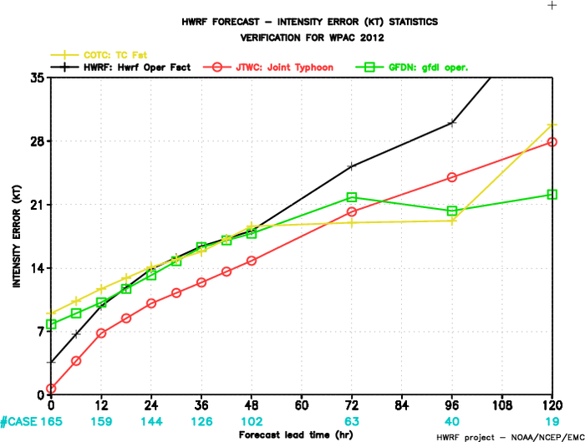
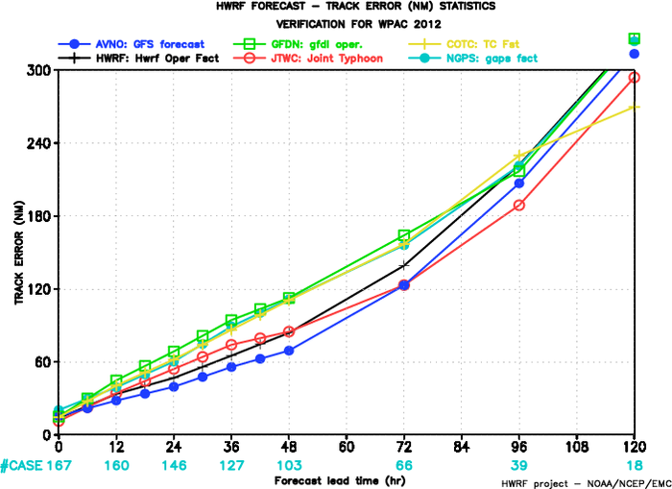
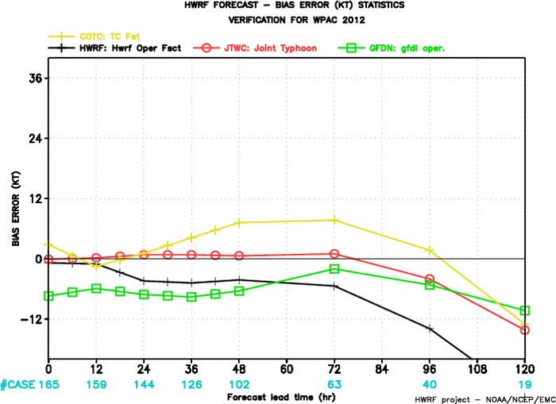
West Pacific experiment 2012
Intensity
Track
Bias
HWRF track errors comparable to GFS and OFCL
No skill in intensity beyond 48hrs (topographic interactions??)
Significant negative bias

Slide 17
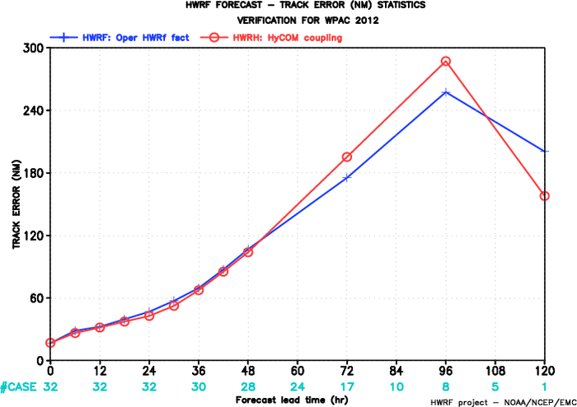
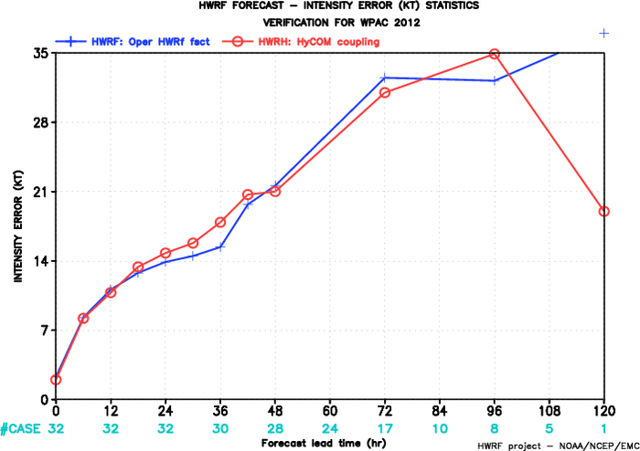
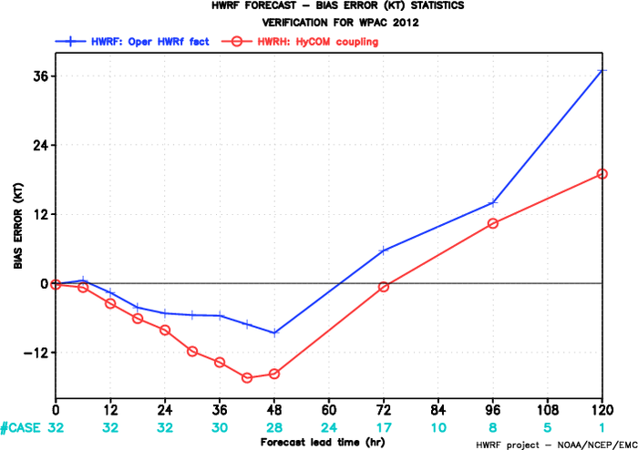
West Pacific with HYCOM experiment 2012
Track
Intensity
Bias
Ocean coupling in Western Pacific, surprisingly, not showing any impact.
Much smaller sample size.

Slide 18
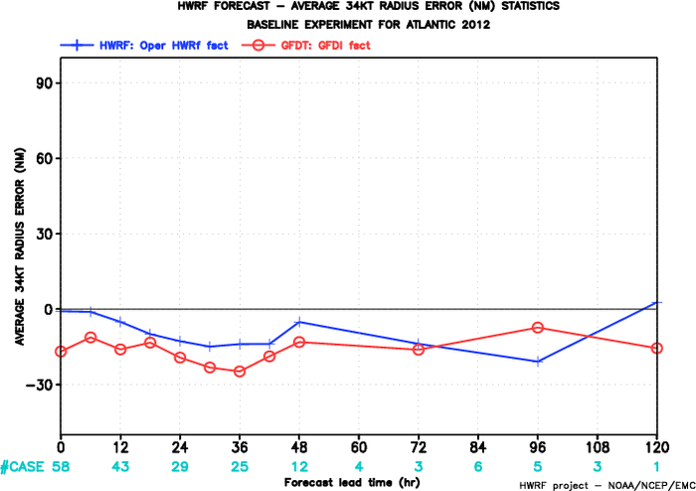
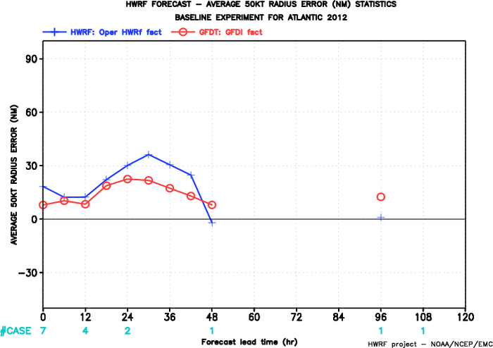
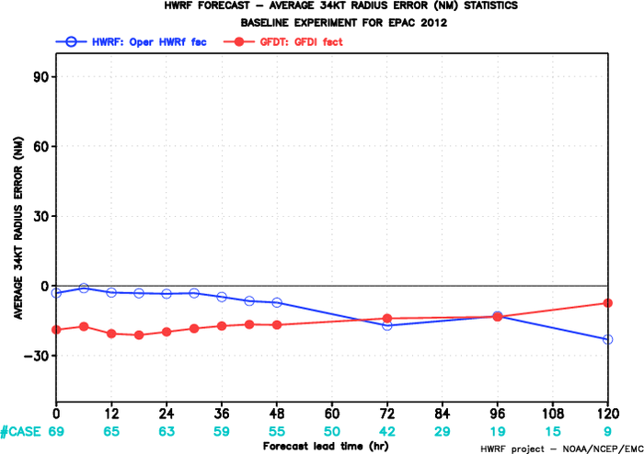
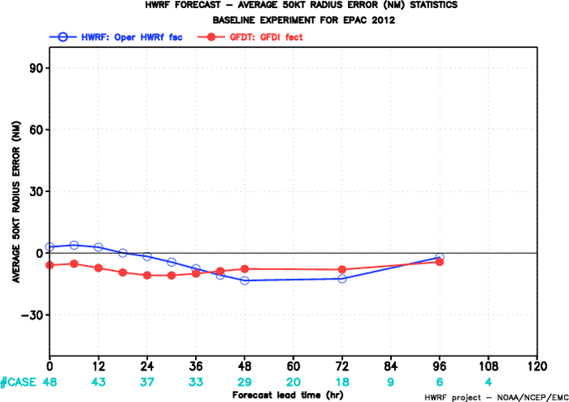
Radii verification for 2012
Mean 34 kt
Atlantic
Mean 50 kt
Mean 34 kt
E-Pac
Mean 50 kt

Slide 19
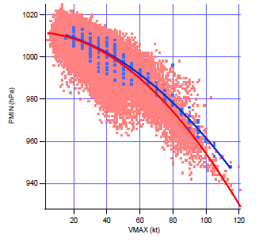
Pressure-wind relationship (Atlantic+EPAC combined 2012)

Slide 20
Potential Issues (focus areas):
Large-Scale:
Systematic evaluation of large-scale synoptic features
Evaluation of basin-scale HWRF runs
Influence of lateral boundary conditions
Vortex influence on large-scale circulation
Impact of DA on large-scale
Impact of vertical levels (and their distribution)
Evaluation of tropical rainfall forecasts
Define metrics and tools for large-scale evaluation
Construct HWRF model climatology
Generate high-resolution HWRF analysis

Slide 21
Potential Issues (focus areas):
Vortex initialization:
small weak storm is hard to intensify
initial storm structure may have problem in strong shear environment
bogus storms (cold start) have problem when defined as shallow or medium
current operational initialization only uses the max wind speed for intensity correction
How to quantify the relationship between initial vortex specification and intensity errors?
Ensemble based sensitivity analysis of initial vortex structure
Moisture perturbations in the initial vortex analysis

Slide 22
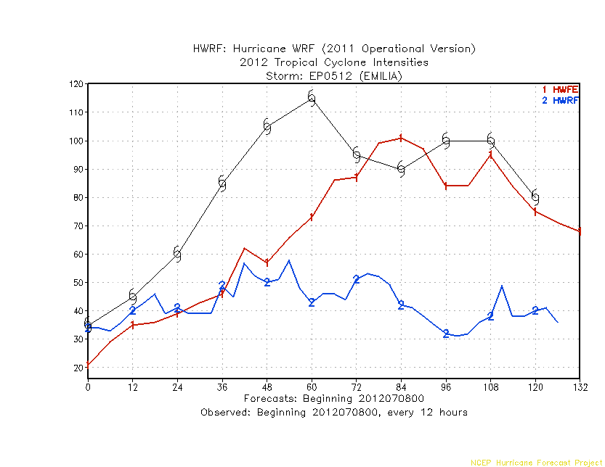
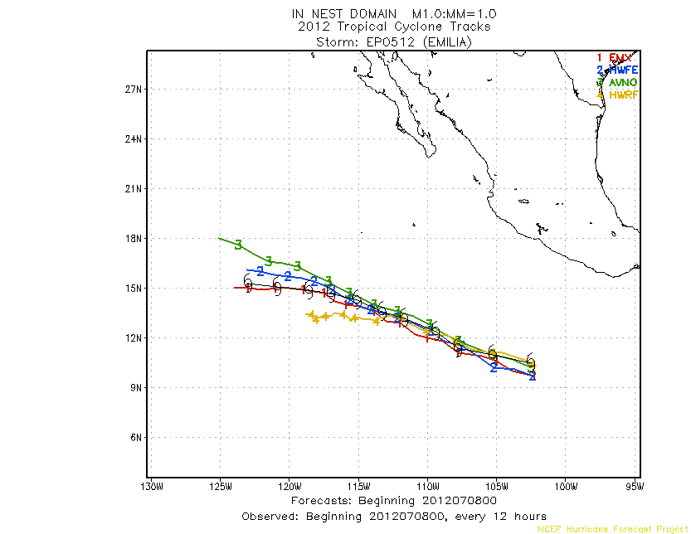
Comparison of intensity forecast:
HWFE vs. HWRF
Forecast begining: 2012070800

Slide 23
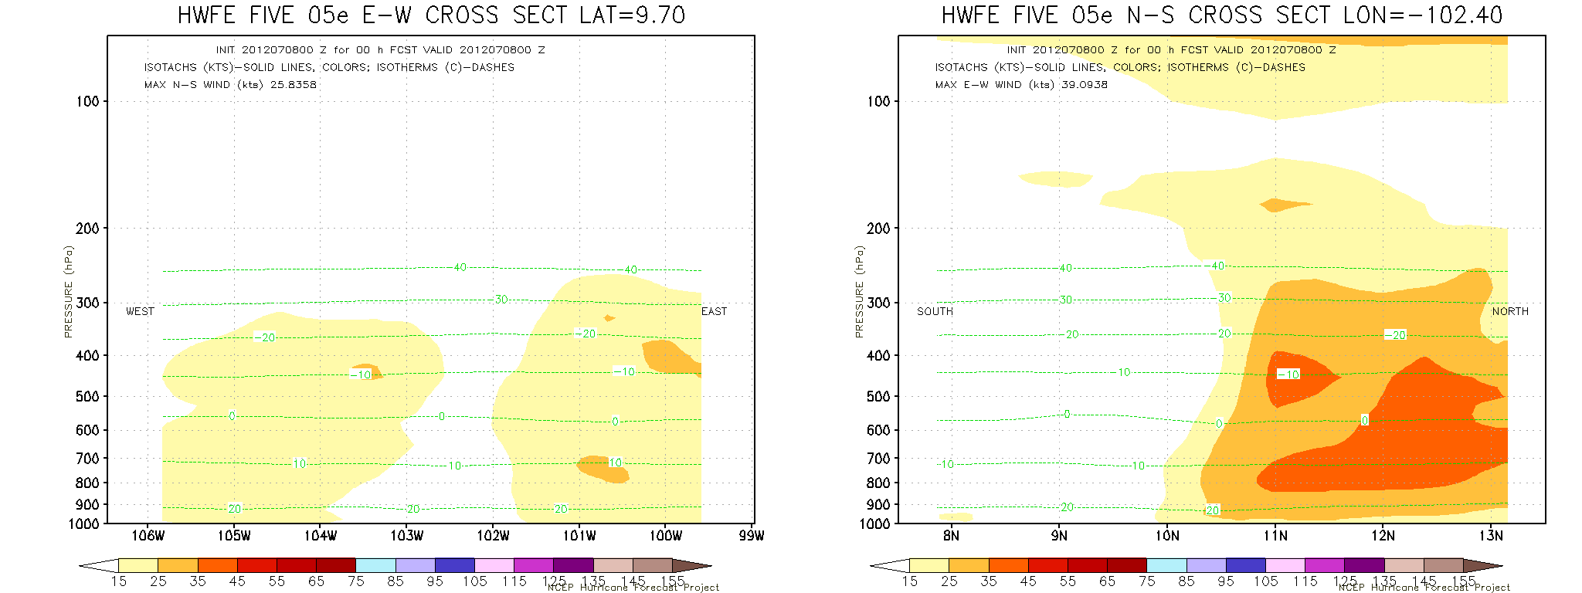
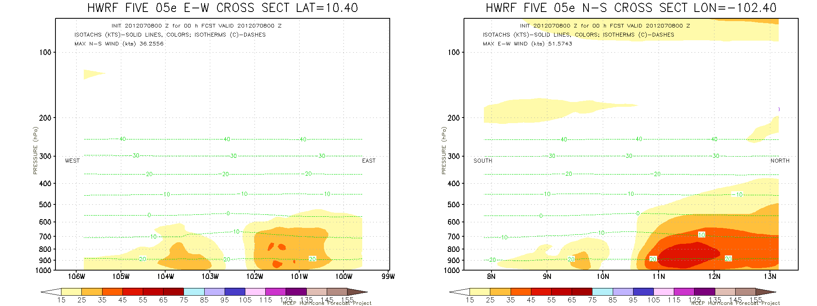
ECMWF based 0h
Deep init Storm
GFS Based 0h
Shallow init Storm

Slide 24
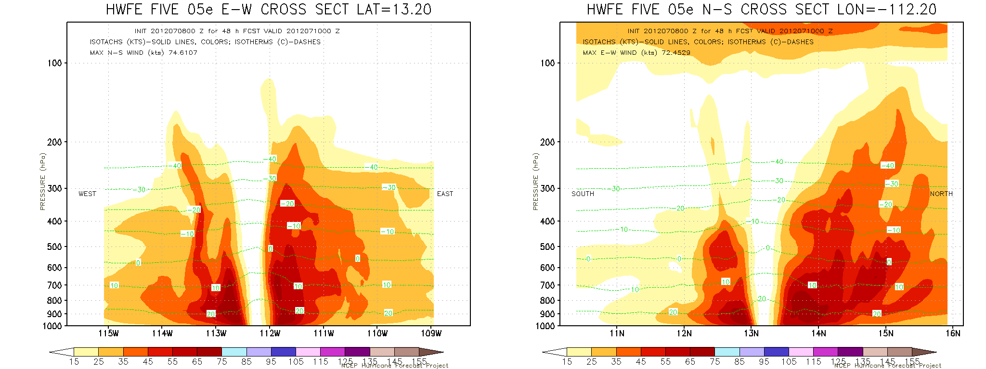
ECMWF based 48h
Strong storm
Weak Storm
GFS Based 48h

Slide 25
Potential Issues (focus areas):
Nesting in HWRF:
Often, nest loses the storm (or nest center significantly deviates from storm center)
Centroid method appears to be problematic in presence of another storm or another low/high presssure system near the storm, and when over high-terrain
3 minute physics time step for the third domain
Nest-parent interpolations
Nest-parent feedback – currently set to 50%
Terrain differences between parent and nest
Shocks due to nest movement
How to analyze and quantify these issues to help model development?

Slide 26
Good

Slide 27
Bad

Slide 28
Potential Issues (focus areas):
Physics in HWRF:
PBL issues –made significant improvements in the PBL parameterization – still need more work in evaluating horizontal and vertical structures. PBL height computation, TKE based schemes, Rolls…..
Convection (deep and shallow) –parameterized convection for 3km domain, discontinuity in evolution of convective processes between 9km and 3km
Microphysics – advection of individual species, multi-moment schemes, interaction with convection
Radiation – treatment of clouds, interaction with convection and microphysics (optical depth)
Surface physics and air-sea interaction
How to analyze and quantify these issues to help physics development? (use of observations)

Slide 29
Observed Hurricane PBL
Current HWRF PBL
EARL, INIT-2011 09 02 00, 24-hour forecast
Inflow depth
Max wind height
PBL height
PBL
Mixed layer
Inflow/max wind
PBL is below or ~ inflow depth
PBL >> inflow/max wind H ??
Zhang MWR 2011

Slide 30
Different PBLH & K
Z
Current HWRF
Critical R_{bc} = 0.25
R_{b} = f(h,surface)
K =0.5 x ku*z(1-z/h)²
New try
Critical R_{bc}= 0.3
R_{b}=f(h, mixed layer, first layer)
K = ku*z(1-z/h)².
PBL top
Cal Ri #
0
Z
PBL top
ML top
Cal Ri #
1st level
0

Slide 31
HWRF-OPERATION
NEW PBL-H&K
Ideal
PBLH
Max Wind H
Real
EARL
F24
PBL
Inflow H
Inflow H
PBL

Slide 32
RRTMG Idealized run
PMIN
VMAX

Slide 33
RRTMG Idealized run
Radiation forcing - HWRF
Radiation forcing - RRTMG
.
Potential Temp perturbation - HWRF
Potential Temp perturbation - RRTMG

Slide 34
Potential Issues (focus areas):
Ocean in HWRF:
Very limited evaluation done so far (only a few case studies)
Relevance and importance of SSTs on storm intensity in various situations (fast moving, slow moving, shallow waters, loop current, warm/cold eddies etc.)
Ocean initialization
Differences in atmospheric SSTs and oceanic SSTs
Ocean coupling frequency
Reduction of fluxes from atmosphere to ocean (as in current operational HWRF)
POM vs. HYCOM
Wave coupling and sey-spray effects
How to analyze and quantify these issues to help physics development? (use of observations)

Slide 35
Ocean Heat Content
SST & sfc Currents
SST & Z26

Slide 36
Example: Simuled SST vs TMI SST
IKE (09L) valid 1800Z 2008/09/11
HyHWRF
Op HWRF
HWRF alone
Note: SST cooling as hurricane Ike transit the LC
TMI – SST

Slide 37
Potential Issues (focus areas):
Intensity issues:
Peak wind is in the tail of the distribution. Need to define alternate metrics for model intensity forecast verification
Wave number zero – can it explain the variance? Axi-symmetric mean may not help for weak storms
Relationship between storm structure (horizontal and vertical) and intensity
How good are regional models in capturing the intensity change?
Vortex interactions with large-scale (use of SHIPS predictors)
Metrics for rapid intensity change verification
Construct intensity change climatology at different forecast intervals
Develop tools to understand vortex-shear interactions

Slide 38
Stratified Intensity Forecast Skill 2010-2011 Seasons Retrospective Runs H212/H3GP (27:9:3 km) relative to HWRF (27:9 km) All Cases/Initially <Hurricane/Initially Hurricane
All Storms
w/o Julia, Lisa (2010), Ophelia (2011)
H212: Improved over HWRF (esp. thru 36h*)
& except from 48-96h
BUT H3GP better than H212 & HWRF
H212: Improved over HWRF at all times
(esp. thru 24h*) esp. for <H
Has problem with HR after 84h
BUT H3GP better than H212 & HWRF
(*) Much better initialization?
Notes:
Same rules as NHC verification -- tropical or subtropical --- at initial and verification
Wish I had looked at EPAC
Interpolation -- Early vs Late models -- Not just showing operational performance -- want to show model comparison and improvement

Slide 39
Stratified Track Forecast Skill 2010-2011 Seasons Retrospective Runs H212/H3GP (27:9:3 km) relative to HWRF (27:9 km) All Cases/Initially <Hurricane/Initially Hurricane
All Storms
w/o Julia, Lisa (2010), Ophelia (2011)
H212: Large improvement over HWRF & H3GP
(More improvement for <H)
H212: Even Larger improvement
(More improvement for <H)
H212: Much better Track Forecasts than HWRF & even H3GP
(better initialization--less contamination of Large-Scale field?)
Notes:
Same rules as NHC verification -- tropical or subtropical --- at initial and verification
Wish I had looked at EPAC
Interpolation -- Early vs Late models -- Not just showing operational performance -- want to show model comparison and improvement

Slide 40
1. Wind Structure Animation (ERNESTO 05L 2012080612)

Slide 41
2. Thermal Structure Animation (ERNESTO 05L 2012080612)

Slide 42
Relationship to Intensity Change
(ERNESTO 05L 2012080512)
Not Developing
Storms for both cases
: located at similar location
Storm 0512 keeps its intensity
Storm 0612 developed rapidly
Investigation of the storm intensity change related to the storm structure
(ERNESTO 05L 2012080612)
Developing

Slide 43
Storm 0512
Storm 0612
Storm 0612 has a stronger tangential wind structure
: RMWs are similar
Storm 0612
: Distinct secondary
: Stronger inflow and outflow
Surface temperatures are similar

Slide 44
Storm 0512
Storm 0612
Initial angular momentum distributions are similar
Storm 0612 has stronger angular momentum advection
:because of the stronger radial wind

Slide 45
Storm 0512
Storm 0612
Initial humidity distributions are similar
Storm 0612 has stronger moisture convergence
:because of the stronger radial wind
Much bigger latent heat flux
:because of the stronger surface wind speed

Slide 47
Concluding remarks
Model development closely tied with model diagnostics
Comprehensive evaluation making use of all available observations (aircraft, satellite, upper-air, surface, and ocean)
Process studies (including idealized simulations) need more attention
Coordination among all HFIP teams is critical
We are making progress!!!

Slide 48
Sigma-pressure hybrid vertical coordinate of HWRF model
PT
Model top (50mb)
Pressure range (19 levels)
PDtop
PT+PDtop
Top of sigma levels
Currently ptsgm=420mb
sigma range (22 levels)
PD
PT+Pdtop+PD
surface

Slide 49
In case of high mountain regions (e.g. Tibetan plateau ~6000m), there are too many sigma levels (22 in HWRF) to fit in very shallow depth (~1km). This may lead numerical instability and cause the HWRF model failure
Top of sigma levels=420mb
~7000m
Depth of sigma level ~1km
Top of plateau
~ 6000m
Tibetan Plateau

Slide 50
To prevent this failure, increase the top of the sigma level to 250mb
Top of sigma levels=250mb
~10km
Depth of sigma level ~4km
Top of plateau
~ 6000m
Tibetan Plateau

Slide 51
Example of Sanvue (03W, 2012052506UTC cycle)
The standard deviation of topo inside a grid box (HSTDV)
HSTDV=1.E+20 at one point

Slide 52
Intensity change verification H212 vs HOPS

Slide 53
Definition
False alarm ratio (FAR) index: indicating the how frequent the model fails to capture the actual change as compared to observation (the closer to 0, the better)
Probability of detection (POD) index: indicating the how the model can capture the correct change as compared to observation (the closer to 1, the better)
The frequency bias index (FBI) index: indicating the how the model bias is as compared to observation (overestimation > 1, underestimation < 1)

Slide 54
Intensity change verification: FAR index
H212 has smaller false ratio of the intensity change at the longer time interval in both Atlantic and EPAC basin;
The false alarm ratio is smaller in the Atlantic basin as compared to the EPAC;
HOPS has a smaller FAR index for all range of intensity change from 6 to 72 h in the Atlantic;
H212 has consistently smaller FAR index for the intensity change between 36 to 96 h

Slide 55
Intensity change verification: POD index
Both HOPS and H212 in general have higher POD index the Atlantic than in the EPAC basin;
In the Atlantic basin, H212’s POD index is consistently higher than that of HOPS, indicating the that H212 is better in the Atlantic basin;
In the EPAC basin, HOPS has higher POD for 6 to 36 h intensity change, whereas H212 has higher POD index for 48 to 96 h intensity change.;

Slide 56
Intensity change verification: FBI index
Both H212 and HOPS tend to underestimate the intensity change for all range of time intervals from 6 to 96 h;
Overall, H212 tends to have increasing underestimation of the intensity change for time interval longer than 48h in the EPAC basin, whereas it has less underestimation in the Atlantic basin for all range of time interval;
Both H212 and HOPS have their maximum negative bias for 24-48h intensity change in the Atlantic basin, but they have minimum bias in the EPAC basin for the same time intervals

